Slide 1
Next-Generation Polymer Aerogel Insulation for Cryogenic Applications
Sadeq Malakooti, Stephanie Vivod, Wes Johnson, Vadim Lvovich
NASA Glenn Research Center
Jonathan Demko and Gitogo Churu
LeTourneau University, Longview, TX
AIAA - The 51st Dayton-Cincinnati Aerospace Sciences Symposium (DCASS), Dayton, OH
March 10, 2026

Slide 2

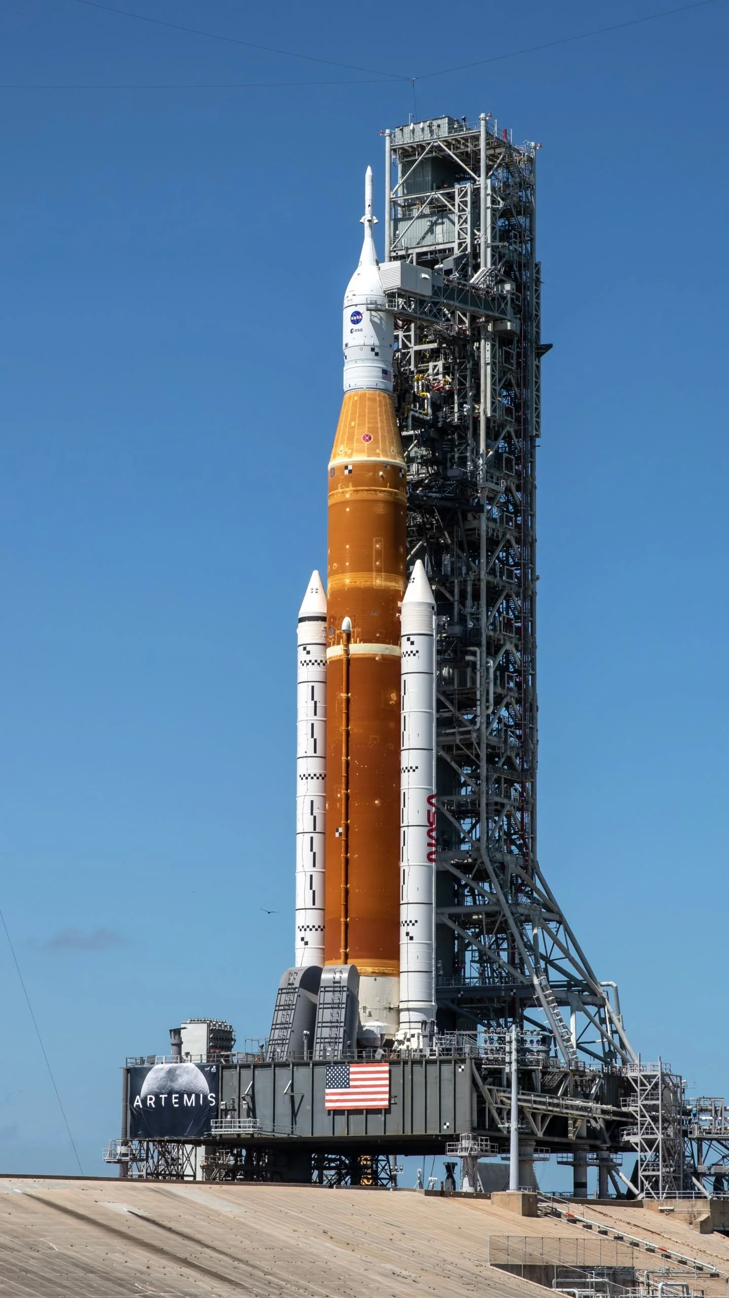

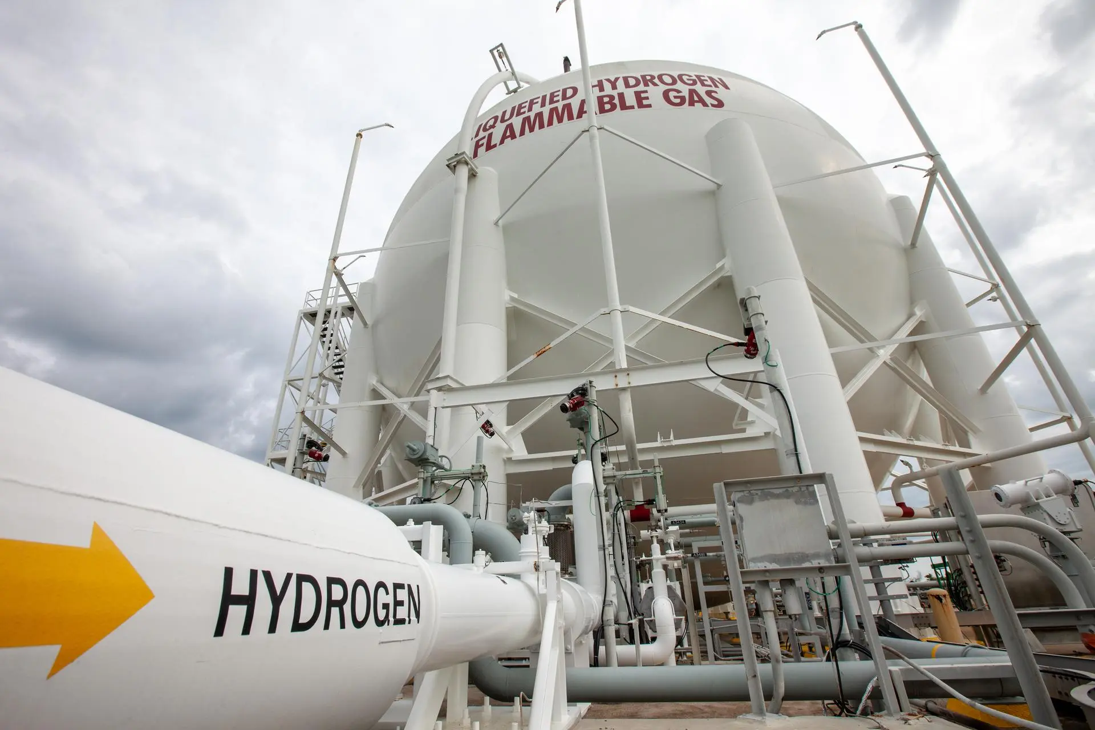
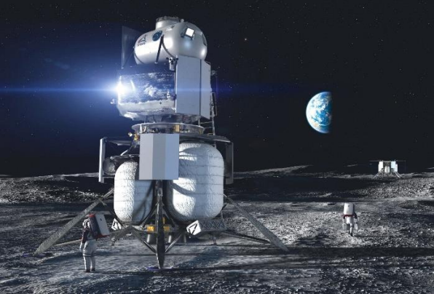
Cryogenic Systems and Applications
Next-generation aviation with on board cryo-fuel. Image Credit: NASA
Lunar Night Survivability (50-100 K). Image Credit: NASA
Cryogenic Insulation for Liquid Hydrogen Tank. Image Credit: NASA
Space Launch System Cryogenic Propulsion. Image Credit: NASA
Blue Origin Lunar Lander Baselined Fuel Cell Power as a primary power source

Slide 3
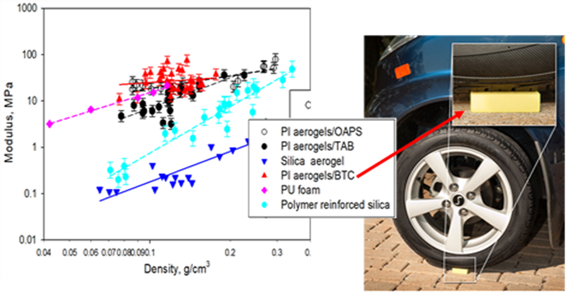
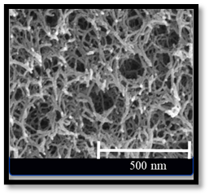
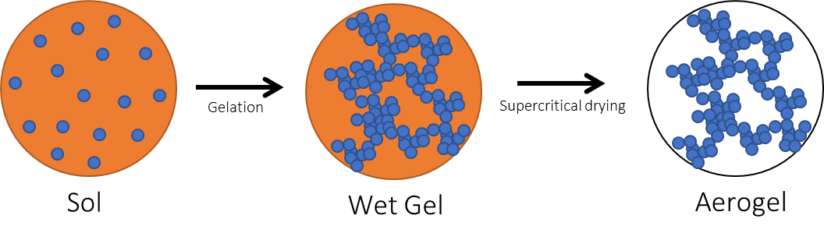
Polyimide Aerogels at NASA GRC
Typical properties
High porosity (>85%)
Pore size 10-40 nm
High specific surface area
Open-cell fibrillar architecture
High thermal stability
Tunable hydrophobicity
Tunable mechanical properties
Can be cast into flexible thin films
SEM image of aerogel structure
Meador et al., Aerogels from engineering polymers: polyimide and polyamide aerogels, in Springer Handbook of Aerogels (2023)

Slide 4
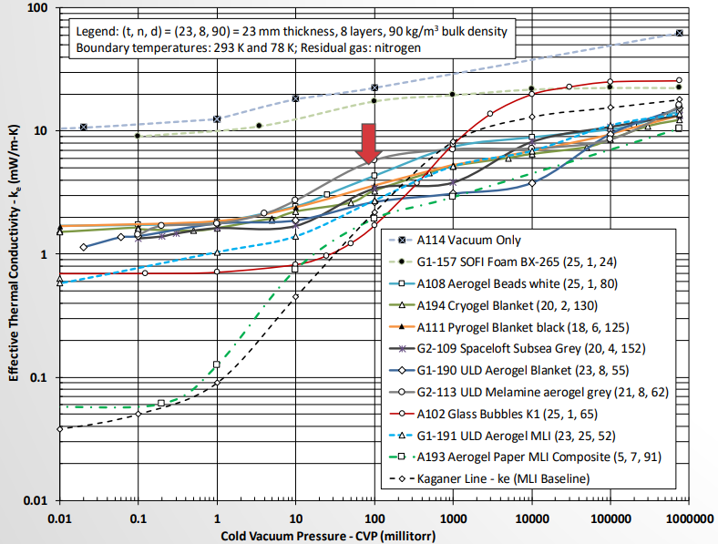
Limited Thermo-physical Data on Aerogels
Credit: NASA KSC (J. Fesmire, NTRS 20180006720)

Slide 5
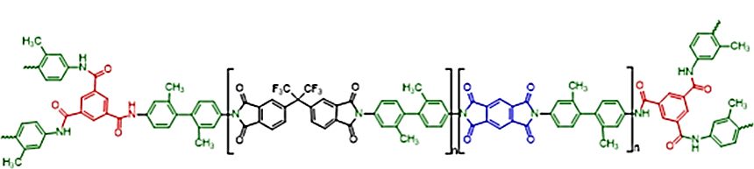
Molecular Engineering of Polyimide Aerogels
2,2'-Dimethyl-4,4'-diaminobiphenyl
(DMBZ)
Pyromellitic dianhydride (PMDA)
2,2'-Bis-(3,4-Dicarboxyphenyl) hexafluoropropane dianhydride
(6FDA)
Run | Weight % | Chain length (n) | % 6FDA (remaining % PMDA) | Run | Weight % | Chain length (n) | % 6FDA (remaining % PMDA)
1 | 7 | 45 | 50 | 11 | 10 | 30 | 25
2 | 7 | 30 | 0 | 12 | 8.5 | 45 | 50
3 | 8.5 | 60 | 50 | 13 | 10 | 30 | 0
4 | 8.5 | 45 | 0 | 14 | 8.5 | 45 | 50
5 | 7 | 60 | 25 | 15 | 7 | 30 | 25
6 | 10 | 60 | 25 | 16 | 7 | 60 | 0
7 | 8.5 | 30 | 50 | 17 | 8.5 | 45 | 50
8 | 10 | 45 | 50 | 18 | 8.5 | 45 | 25
9 | 8.5 | 45 | 50 | 19 | 8.5 | 45 | 50
10 | 8.5 | 45 | 50 | 20 | 10 | 60 | 0

Slide 6
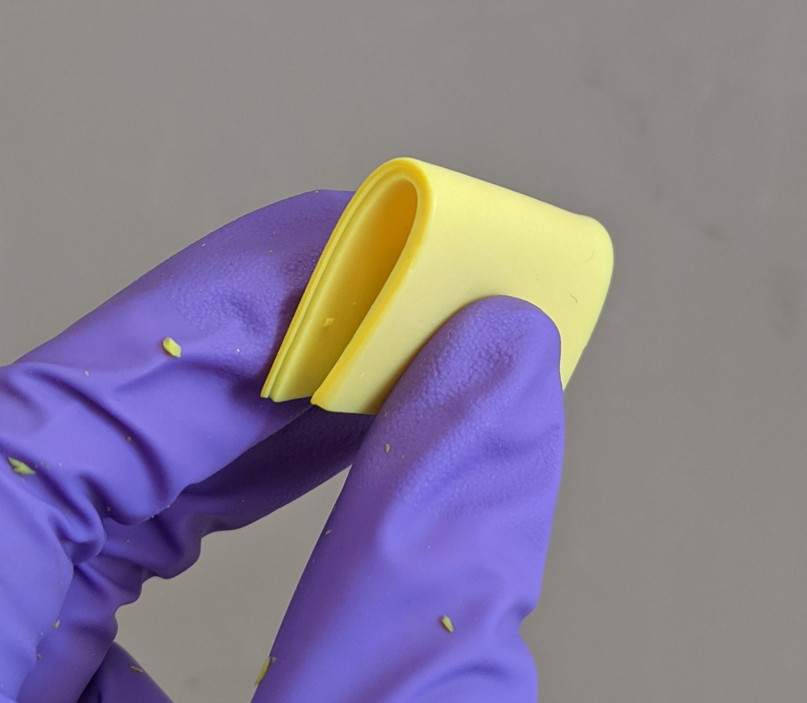
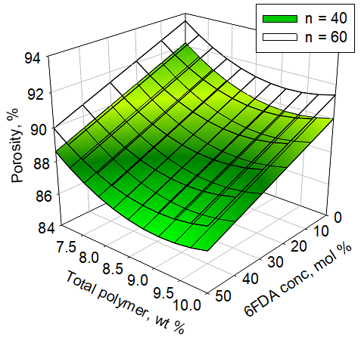
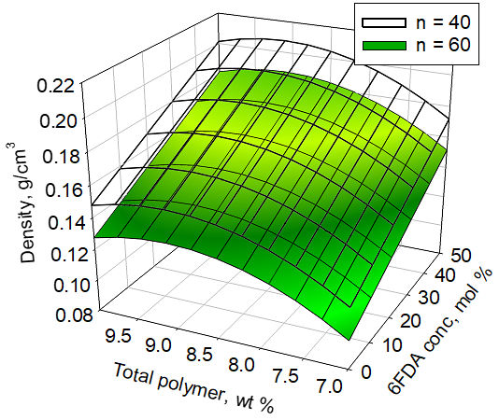
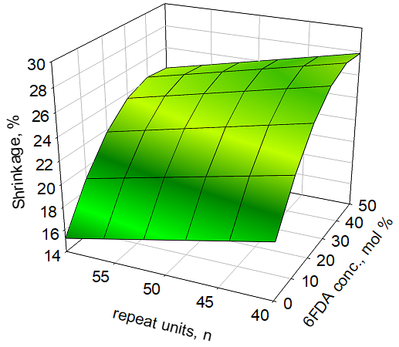
Molecular Engineering of Polyimide Aerogels
Properties tailored for:
enhanced flexibility
high porosity
low density
low shrinkage

Slide 7
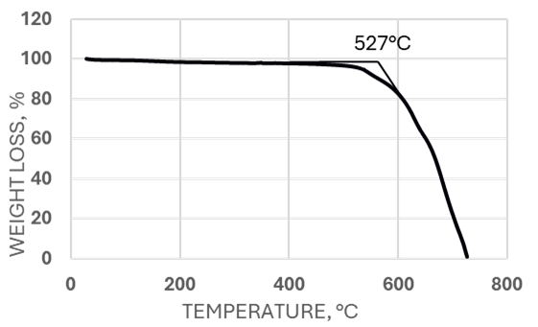
Thermal Conductivity / Thermogravimetric Analysis
Thermogravimetric Analysis (TGA) to determine
onset of decomposition
Modified Transient Plane Source (ASTM D7984-16)
C-Therm Trident thermal conductivity instrument (C-Therm Technologies Ltd., Fredericton, Canada)

Slide 8
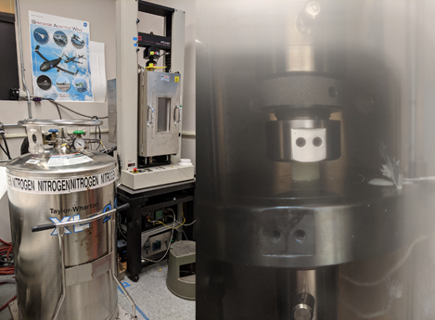
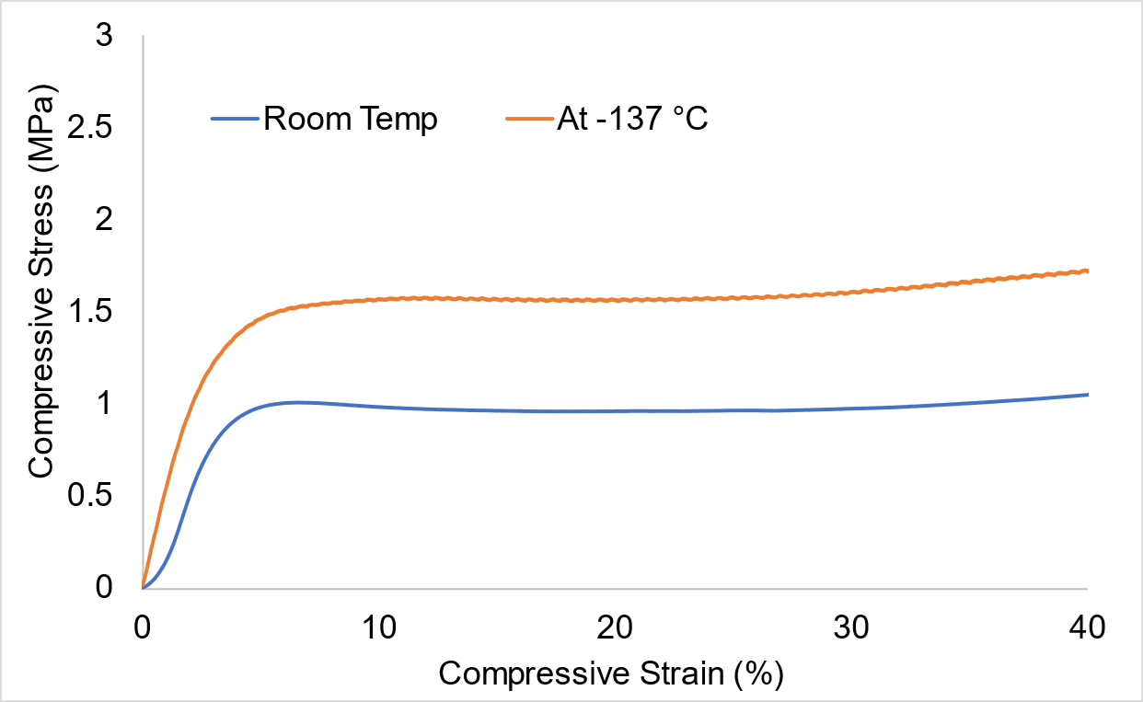
Cryogenic Quasi-static Compression Experiment at -137 °C

Slide 9

NASA Cryostat-400
LeTourneau University –NASA contract for building a boil-off calorimeter and testing aerogels at a liquid N2 boundary condition

Slide 10
NASA Cryostat-400
Comparative, flat plate, boil-off calorimeter
Cold boundary is the pot full of LN2
Warm boundary at room temperature
Run to steady state
Measure flow rate of LN2 boil off
Effective Thermal Conductivity Calculated from Boil-off

Slide 11
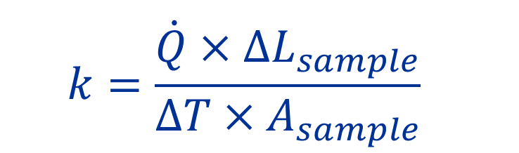
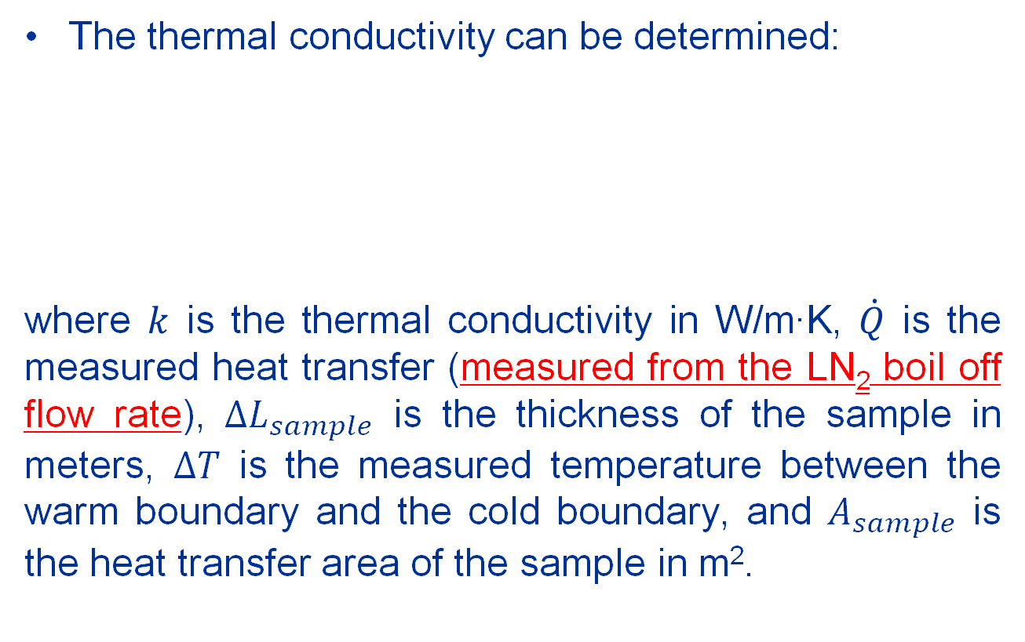
One-dimensional heat conduction
The thermal conductivity can be determined:
where $k$ is the thermal conductivity in W/m∙K, $\dot{Q}$ is the measured heat transfer (measured from the LN₂ boil off flow rate), ${∆L}_{sample}$ is the thickness of the sample in meters, $∆T$ is the measured temperature between the warm boundary and the cold boundary, and $A_{sample}$ is the heat transfer area of the sample in m².
$$k=\frac{\dot{Q}×{∆L}_{sample}}{∆T×A_{sample}}$$

Slide 12
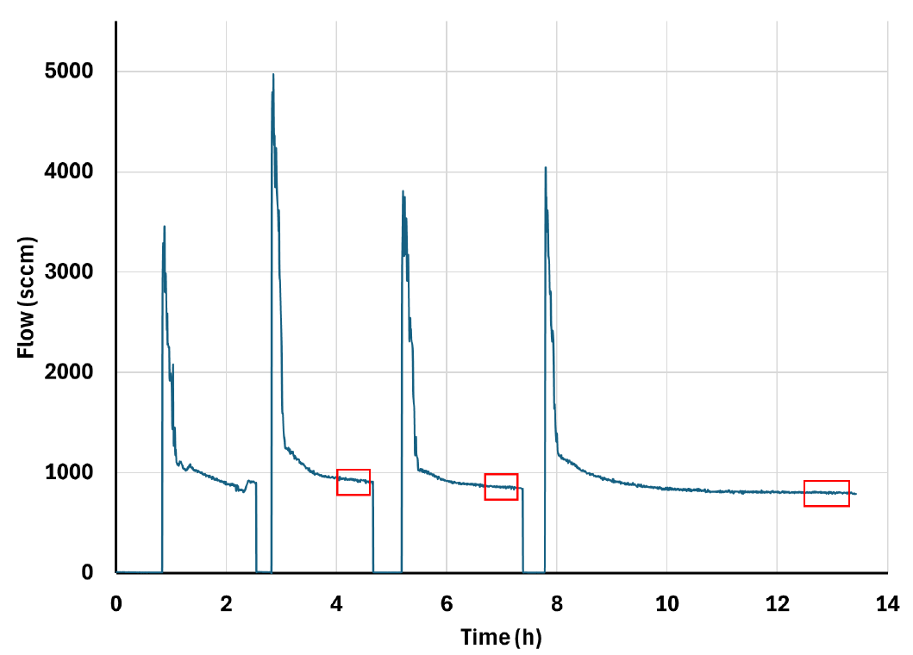
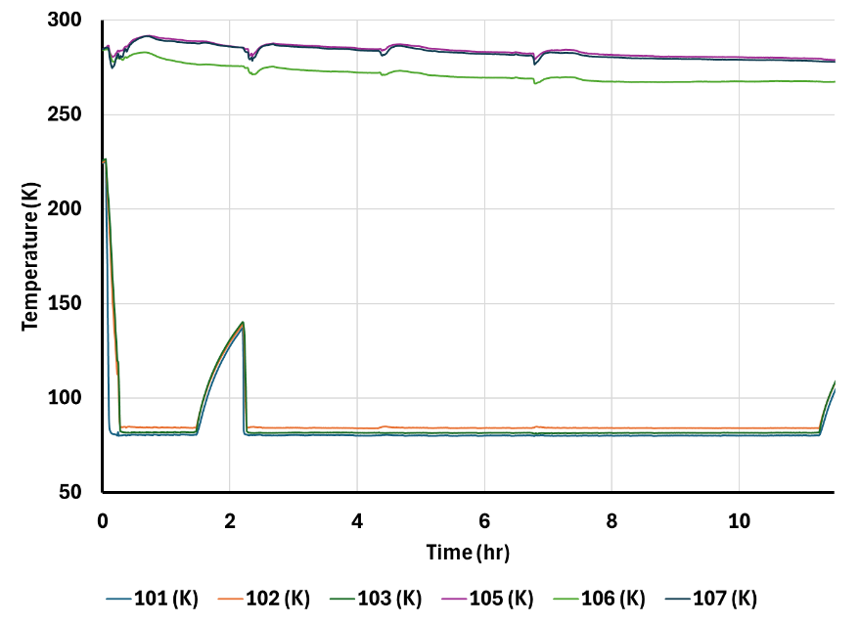
Typical measurements
No vacuum
With vacuum
Measured warm and cold boundary temperatures for FoamGlass (calibration sample) run at atmospheric pressure.

Slide 13
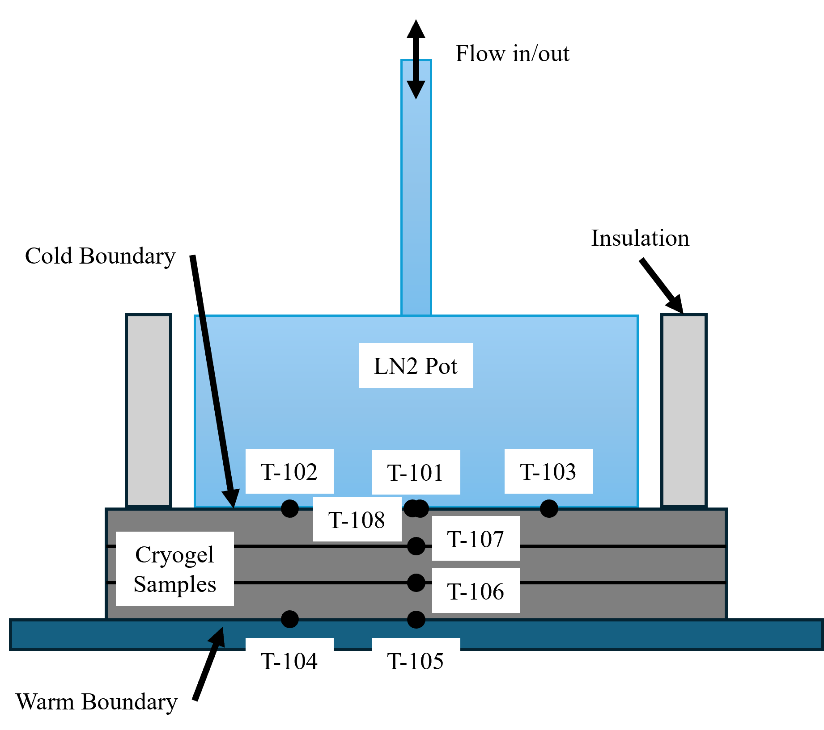
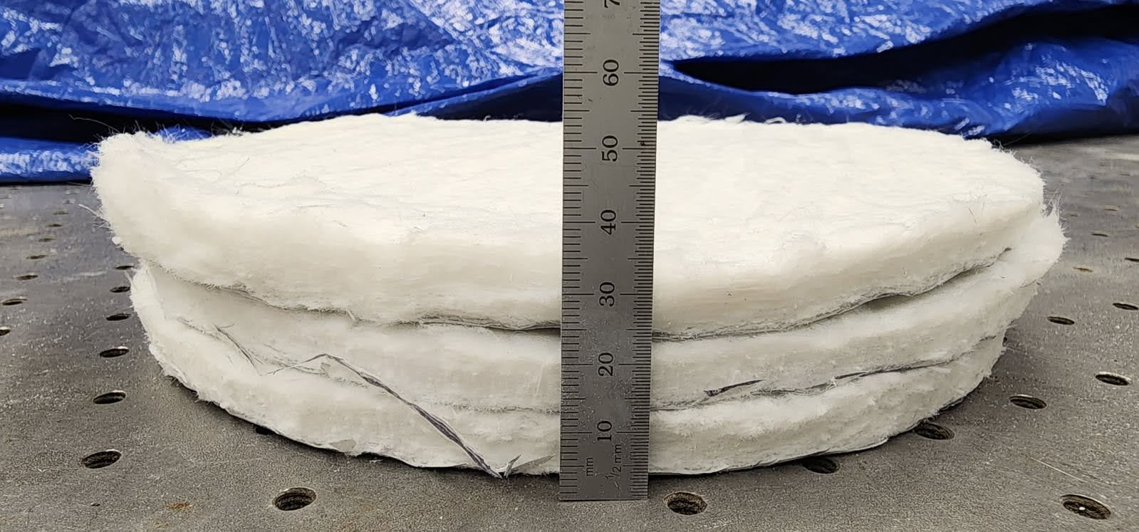
Aspen Cryogel
Aspen Cryogel
  A commercially available blanket
  Silica aerogel imbedded into a fibrous blanket
  An aluminum backing layer
Nominal dimensions
  Three layers used.
  Density = 0.16 g/cm³
  Diameter: 205 mm
  The total thickness before installing in the cryostat: 31.8 mm
  Compressed to 25.4 mm inside the cryostat during testing

Slide 14
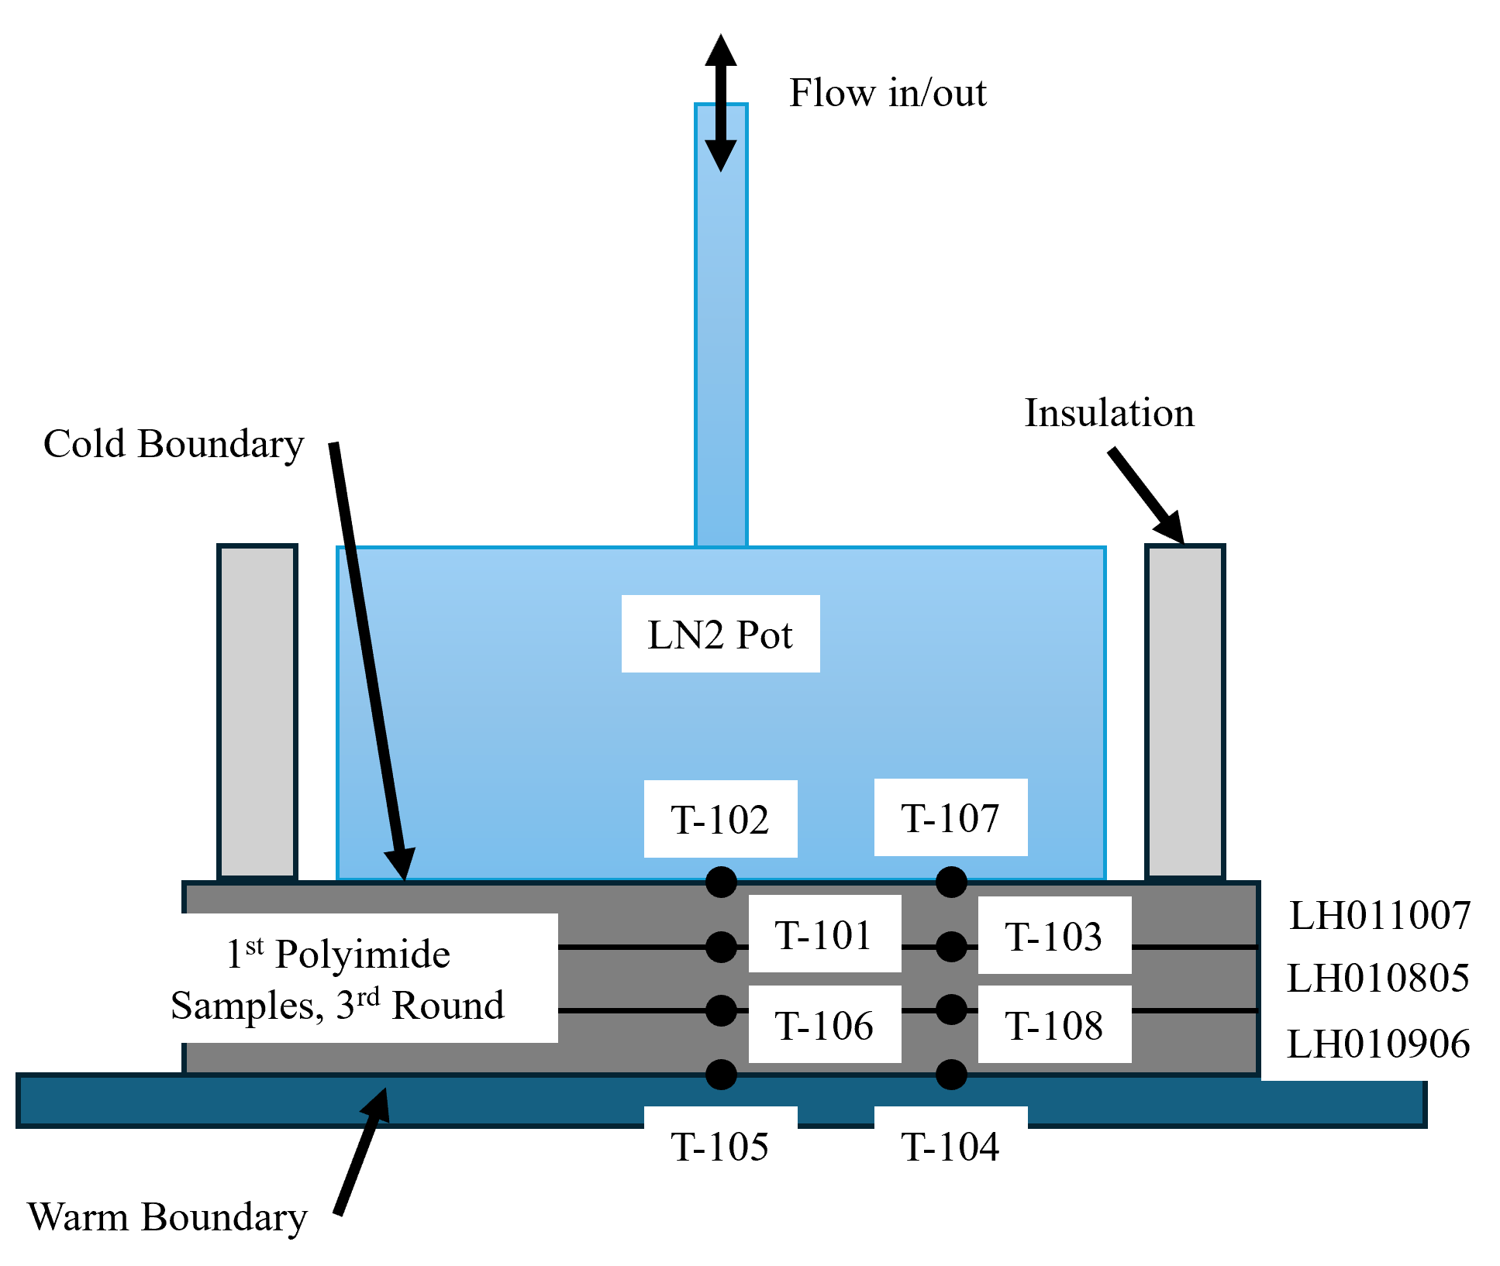
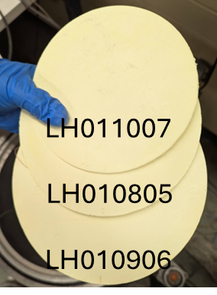
NASA GRC Polyimide Aerogel
Formulation 1:
  DMBZ & BAPB / BPDA / TAB
  Solid wt% = 10%, n = 45
  DMBZ fraction = 37%
Average density = 0.12 g/cm³
Porosity = 92.05%
Total stack-up thickness: 12.18 mm

Slide 15
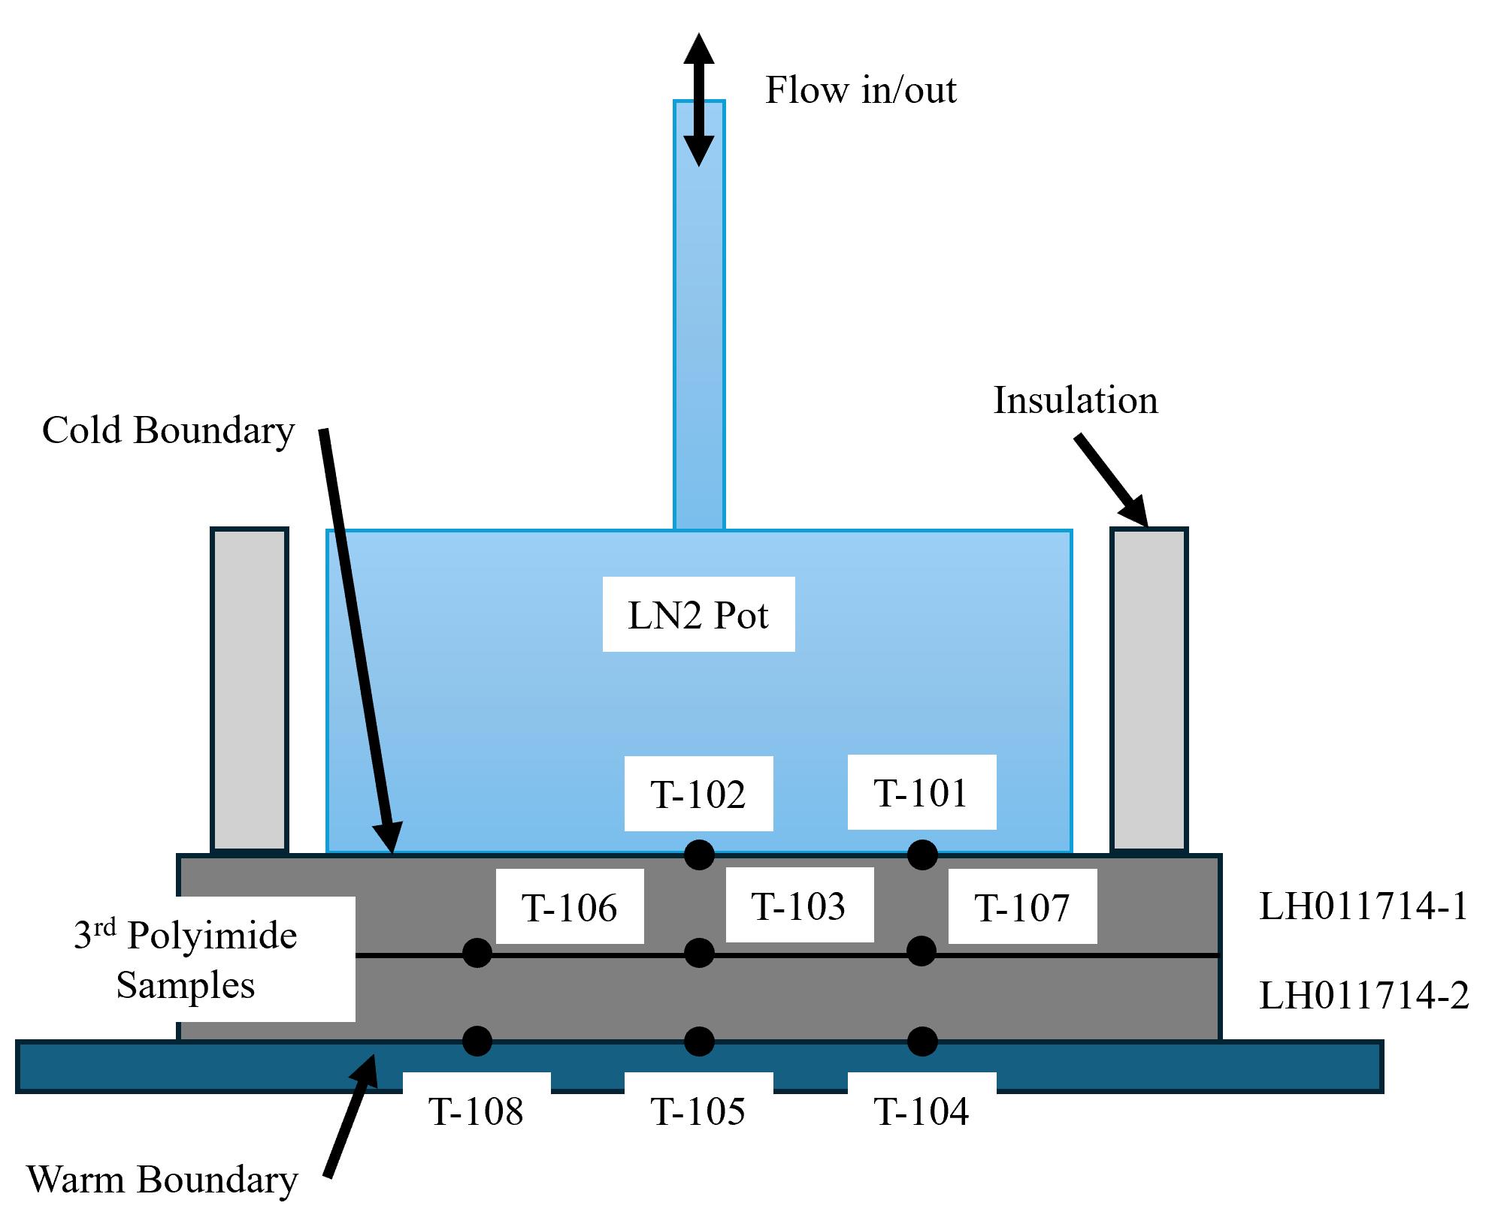
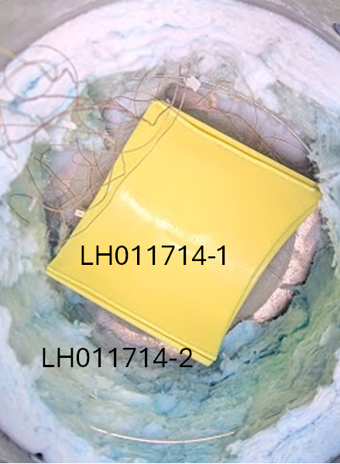
NASA GRC Polyimide Aerogel
Formulation 2:
  DMBZ/PMDA & 6FDA/TAB
  Solid wt% = 8.5%, n = 53
  6FDA fraction = 49%
Average density = 0.16 g/cm³
Porosity = 89.3%
Total stack-up thickness: 7.63 mm
Note: An aluminum disk, equal to the diameter of the nitrogen pot was placed at the warm boundary under the sample.

Slide 16
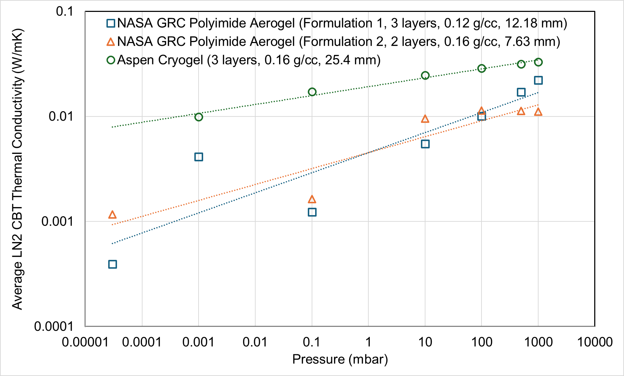
Effective Thermal Conductivity with LN2 CBT
An order of magnitude lower cryogenic TC than the state of practice
More than 50% mass and volume saving
Formulation 1: DMBZ & BAPB / BPDA / TAB, Solid wt% = 10%, n = 45, DMBZ fraction = 37%
Formulation 2: DMBZ / PMDA & 6FDA / TAB, Solid wt% = 8.5%, n = 53, 6FDA fraction = 49%

Slide 17


Acknowledgments
NASA GRC Aerogel Team
  Dr. Stephanie L. Vivod
  Dr. Michael Chauby
  Trevor Hagen (Intern)
  Luke Hohman (Intern)
NASA Glenn Research Center
  Dr. Vadim Lvovich
  Wesley Johnson
LeTourneau University
  Dr. Jonathan Demko
  Dr. Gitogo Churu
Funding:
NASA Aeronautics Research Mission Directorate (ARMD)
Subsonic Vehicle Technology and Tools (SVTT) Project

