Slide 1
Spacecraft Thermal Control Operations
Anthony Vareha/NASA
John Paul Yabraian/KBR
Johnson Space Center

Slide 2

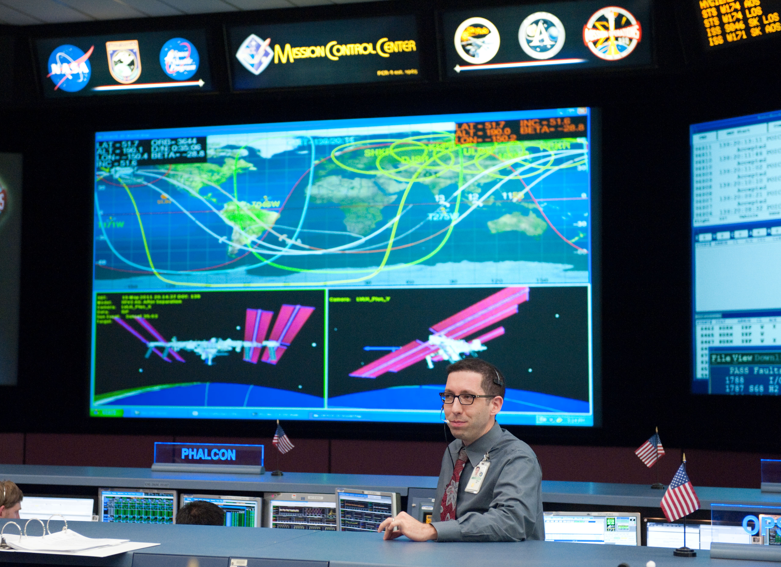

Notes:
background and bio.

Slide 3
Outline
1. The Spacecraft Thermal Environment
2. Thermal Components
3. Operations
4. System Interactions
5. Failure Modes and Redundancy
6. Example Systems
7. Tales of the TCS

Slide 4
The Temperature of Space
Notes:
What’s the temperature of space?

Slide 5
Space has no temperature!
Heat Generated
SPACE
THING
Heat Out
Heat In
Notes:
[Space has no temperature, but anything that you put into space has one. If your job is to manage something’s temperature in the space environment, you must consider how heat travels. Not only are you going to see heat entering and leaving your space thing, but that thing will generate its own heat that needs to be dealt with. And how, exactly, does this heat travel? Let’s remind our selves of the three main methods.]
Temperature is a quality of all matter and is the measurement of the kinetic energy of a substance’s molecules. The coldest theoretical temperature is absolute zero, at which the thermal motion of atoms and molecules reach a state of being motionless. Because there must be matter to have a temperature, the vacuum of space has no temp. However, as soon as you put something into space, that something has a measurable temperature.
Temperature is determined by:
Heat radiated into the spacecraft from the sun and nearby planets
Heat radiated out from the spacecraft
Heat created by the spacecraft itself (or any humans inside it)
The job of a spacecraft thermal control operator is to make sure heat is being transferred away from things that could become too hot and make sure heat is being added to things that could become too cold. Much of this is decided during the design phase, but when things go wrong in the thermal control system, the thermal control operators (and other members of the flight control team) have to think outside the box to find solutions to maintain the necessary thermal equilibrium.

Slide 6
Space has no temperature!
Convection
Conduction
Radiation
Radiation
Radiation
SPACE
THING
Notes:
[Convection, Conduction and Radiation. *briefly explain if necessary*
Because of the space environment, the only way you’ll get heat coming in is via radiation. Inside the habitable environment, you’ll deal with all three methods. Of special note is convection: It won’t happen unless you have a motive force like a fan to circulate the air. Take away that fan and you can no longer rely on that transfer happening. Finally, the ultimate destination for all this heat is space, only via radiation]
Conduction is the transfer of heat by microscopic collisions of particles and movement of electrons within a body. Faster atoms and molecules collide with neighboring slower ones, transferring some of their kinetic energy to them. This is heat transfer within a material without physical motion of that material.
The classic example of conduction is the metal spoon sitting in the hot soup. Eventually, as heat is transferred via conduction, the spoon will warm and the handle will warm as energy is transferred along the handle.
The amount of heat transferred via conduction is proportional to the area of contact between the two materials and the temperature difference.
T(hot) and T(cold) are the temperatures on either side of the wall in Kelvin
d is the thickness of the wall (m)
Thermal conductivity at 25C:
Copper 401
Vacuum 0
Water 0.58
Air 0.02
Wool blanket 0.04
Convection is the transfer of internal energy into or out of an object by the physical movement of a surrounding fluid that transfers the internal energy along with its mass. There are two types of convection: natural and forced
Natural convection is driven by the fluid density differences which result from temperature gradients. The updrafts which are utilized by glider pilots to gain altitude is a good example of natural convection. Fluid (air) in proximity to a heat source (the sun-warmed ground) becomes warmer and less dense, so the fluid rises. The air surrounding the updraft is cooler, and moves in to replace the risen warm air. This is what allows glider pilots to stay aloft.
So, why doesn’t that work in space?
Natural convection requires force to sort the less dense air from the cooler air. That force is gravity, on Earth. In space, natural convection does not occur.
Forced convection is a tool that can be used by a spacecraft operator. In this method of heat transfer, the force comes from unnatural means, such as a fan or a pump. Heat transfer is a function of the fluid flowrate and the temperature difference between the fluids.
Thermal radiation is electromagnetic radiation generated by the thermal motion of charged particles in matter. All matter with a temperature greater than absolute zero emits thermal radiation.
This method of heat transfer is of particular interest to a spacecraft operator, while in orbit, it is the ultimate method by which heat exits (or enters) a vehicle.
When you step out on a sunny day, and you hold your face to the sun, the warmth you feel is a prime example of radiative heating. That heat has travelled 93 million miles. That’s amazing! And even more amazing is what we feel at sea level is just a fraction of what first encounters the top of the atmosphere.
29% of the sun’s radiation is reflected away from the Earth by clouds, atmosphere, surface
23% of the sun’s radiation is absorbed by the atmosphere
Without any atmosphere, the sun is much harsher on orbit.
Radiation is the ultimate method of heat rejection from a spacecraft. Radiation is also the only method by which a spacecraft can be heated from externally.
Equation for radiation:
Emissivity for a perfect radiator would = 1
A is the area of the radiating body
T(rad) is temperature of the radiator
T(cold) = temperature of surroundings
“Blackbody equivalent temperature” is the temperature a perfect blackbody would need to be at to emit the same radiant flux density (amount of radiant flux crossing a unit of area). A perfect blackbody is one that absorbs all incoming light and does not reflect any.
Deep space is 2.7K, basically the background temperature of the universe. Very good place to point your radiators. If you point at Earth, the T(cold) would be the Earth’s planetary equilibrium (which is 255K).
One form of heat transfer rarely exists without another. Convection and conduction often go hand in hand. For spacecraft operations, often all that you need to know is how much heat has been transferred in and out of the system.
Temperature is determined by:
Heat in
Heat out
Heat from

Slide 7
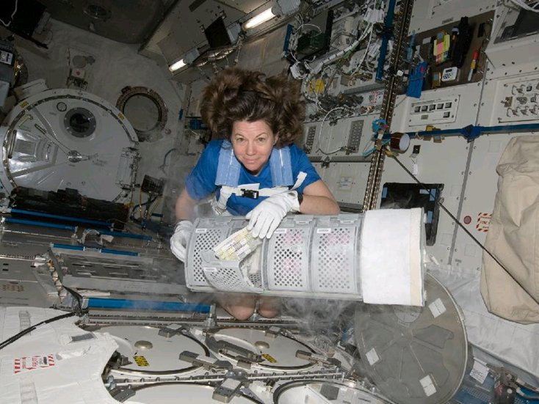
The Goal
Notes:
The goal of the TCS operator is to ensure that the specifications delivered from the design engineers are met in the operation of the spacecraft.
Different Components have different temperature ranges for operation. Batteries have extremely tight ranges. Solar panels have large ranges. And certain components have different ranges based on whether or not they are being used or they’re just sitting there dormant.
In low earth orbit, you’re bouncing between day and night once an orbit. Without TCS, an exposed block of metal would vary by hundreds of degrees.
Additionally, for manned vehicles, crew comfort has to be kept in mind.

Slide 8
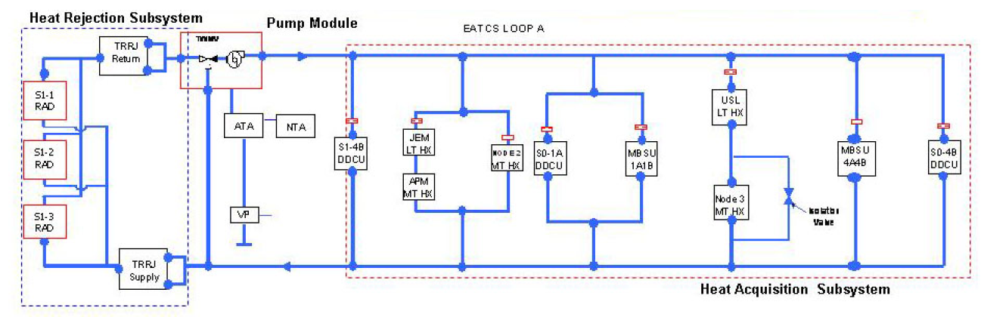
ISS External Thermal Control System
Notes:
Here’s one way that we manage heat on the ISS; the ETCS. It looks complicated, it takes on heat from 5 different modules. Through this system, the entirety of the US orbital segment is cooled (explain USOS). We’ll talk about this more later. But first, we need to touch on the components that do the work.

Slide 9
Spacecraft Thermal Components
Active Thermal Control
Notes:
[Here are some things that make up active thermal systems.]
This isn’t every single doo-dad that can be part of a spacecraft TCS. But it includes many of the most common devices.

Slide 10
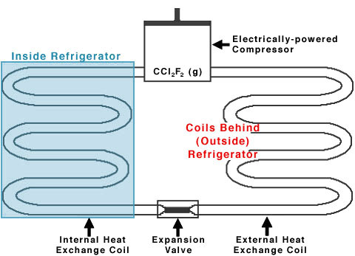
Pumped Fluid Loops
FLOW →
FLOW →
Notes:
This is a refrigerator. Or an air conditioner. Or a water fountain.
Compressor compresses the fluid making it increase in temperature. Radiates outside and then comes back in and expands to get cold and then cools the load. Load could be a refrigerator or an air conditioner or a water fountain. Compressor acts as a pump giving the fluid motion. Fluid loops can collect, transport, and reject heat.

Slide 11
Pumped Fluid Loops
Transport
Reject
Collect
Notes:
The cooling loop is the best method to move a large amount of heat efficiently from point A to point B. Collect, transport, reject – either to space via a radiator or into a different cooling system via a heat exchanger. Fluid loops require a pump to move the fluid, tubing between various components, and a number of valves to control flow.

Slide 12
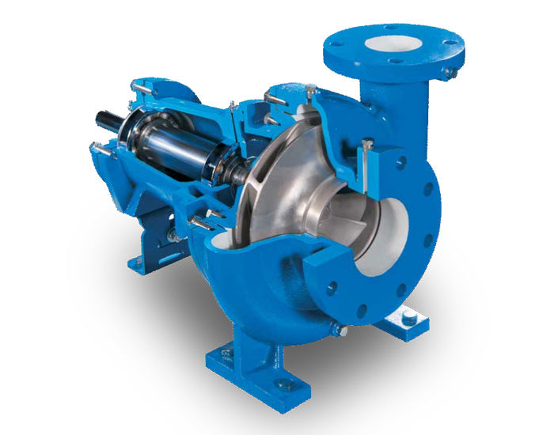
Pumped Fluid Loops - Pumps
Active Thermal Control
Vulnerabilities: Wear and tear on moving parts, cavitation, power loss, deadheading, foreign object debris
Notes:
Pumps are the heart of the cooling loop. They force fluids to flow by imparting energy into the fluid, thereby raising fluid pressure at the pump outlet. The dP (known as the pump head or pressure head) between the inlet and outlet of a pump is analogous to the voltage of an electrical circuit. The more dP, the greater the flow (current) for a given layout of conduit (resistors).
A pump curve provides information on how well a pump operates in a given system configuration. As a spacecraft operator, engineering will typically provide constraints in which pump operations is allowed based on the pump curve. If you operate the pump on an undesirable portions of the pump curve, it can lead to extensive pump wear and cavitation. For example, the external thermal control system pump onboard the ISS can only operate if at least two radiator flowpaths are integrated into the loop.
Vulnerabilities for pumps include wear and tear on the moving parts, cavitation, power loss, deadheading, and foreign object debris.
Pump creates dP (voltage for EEs)
More dP, more flow (current) for a given layout of conduit (resistors)

Slide 13
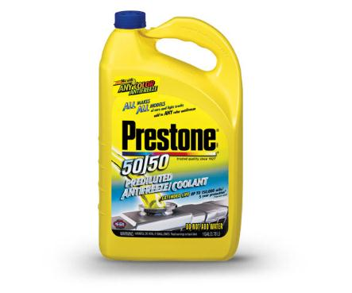
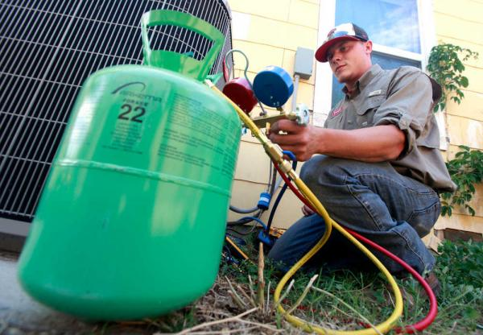
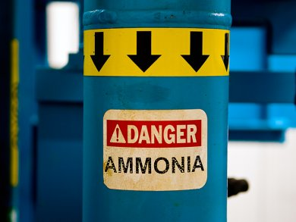
Pumped Fluid Loops - Fluid
Active Thermal Control
Vulnerabilities: Leaks
Notes:
[Spend a little more time on this topic. As you design spacecraft, think about the operators. Small choices can lead to big problems. Talk about ammonia.]
A great variety of fluids are available for use in spacecraft TCS and extensive trade studies are performed before a given mission to select the proper one.
With STS docked, between the ISS and the orbital, there were 5 cooling fluids in use.
Anhydrous NH3 – ISS ETCS and PVTCS
Water – USOS ITCS
Flourinert – JAXA ITCS
Triol (water with 30% solution of glycerin) – RS TCS
Freon-21 – Orbiter cooling system
Lots of things are taken into account when choosing a fluid. Boiling point, freezing point, vapor pressure, density, specific heat, thermal conductivity…and for crewed areas, toxicity. Watch out for toxicity!
NH3 has a slightly lower specific heat than water but is used in the external thermal control system because it has a much colder freezing point.
Specific heats:
Water: 4.184J/gK
Ammonia: ~4J/gK
Freon: 1J/gK
Ethylene Glycol: 2.36J/gK

Slide 14
Pumped Fluid Loops - Accumulators
Active Thermal Control
Vulnerabilities: Bellows sticking, bellows rupture allowing the two sides to mix
Notes:
Allows for expansion & contraction, maintains a minimum static charge on a cooling system, serves as the tank to carry the fluid that will fill the coolant loops sometimes.
Makes up for leaks
Issues include bellows sticking and no longer providing fluid expansion and contraction, bellows rupturing and allowing two fluids to mix.

Slide 15
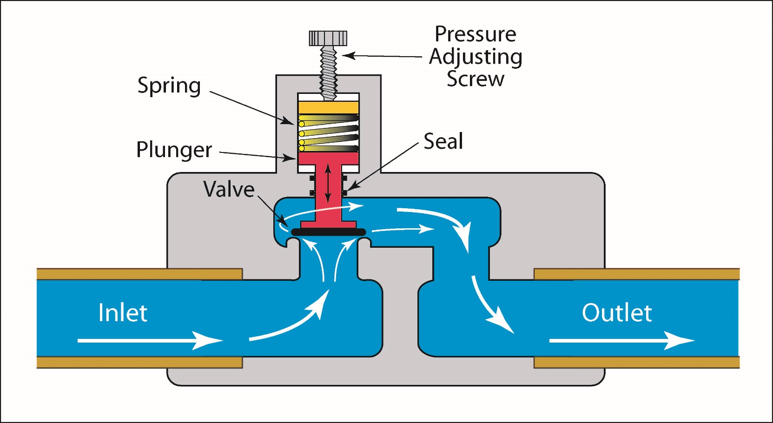
Pumped Fluid Loops – Relief Valves
Active Thermal Control
Vulnerabilities: Failure to reseat properly, thus becoming a permanent leak site
Notes:
Each component of thermal control system has some maximum design pressure. Above this pressure, the system is at risk for damage or even explosion. Often, mechanical relief valves are placed into the system to ensure pressures don’t get too high. They are often used as the last means for overpressurization protection due to the risk that they may not reseat properly. These valves have a crack pressure, above which fluid is allowed to escape and a reseat pressure, below which the valve returns to its normal sealed state.
The above picture shows a spring-loaded pressure relief valve.

Slide 16
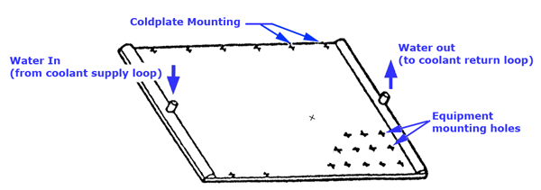
Pumped Fluid Loops – Coldplates
Active Thermal Control
Vulnerabilities: Leaks
Notes:
Placing a heat-producing component adjacent to a coolant loop is not enough to provide cooling in space applications. It is usually necessary to use a coldplate. A coldplate is a thermally conductive metal housing containing coolant tubes. Heat-producing components are designed to have strong conductive paths from the warm components to the surface adjacent to the coldplate. Heat transfers from the component to the coldplate via conduction (when mounted flush) or radiation.
The biggest vulnerability with cold plates is the potential for leakage. No moving parts so pretty reliable.

Slide 17
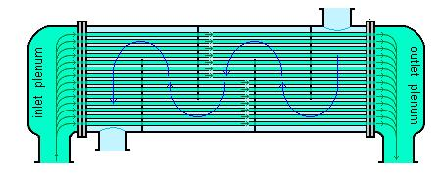
Pumped Fluid Loops – Heat Exchangers
Active Thermal Control
Vulnerabilities: Rupture
Notes:
[Spend a little more time on these. Because they provide an interface between two systems, they represent a little more risk than systems in isolation. Explain water freezing on ISS.]
Heat exchangers are similar in function to coldplates, but provide a fluid-to-fluid transfer of heat. Composed of alternating layers of thin fluid passages which allow heat collected by one fluid to be transferred to another. (Can also be used to dump heat from one section of a coolant loop into another section).
If you want to move heat from one independent loop to another, a thinner wall is better. But if you want to prevent leaks, you want a thick wall.
The thin membranes of a heat exchanger are vulnerable to leakage and rupture. The International Space Station utilizes heat exchangers to transfer heat from the internal water cooling loops to the external ammonia cooling loops. The risk of the ammonia flowing too cold and freezing the water, thereby rupturing the heat exchanger due to the expansion of the ice, requires a number of software and operational protections to be put in place.

Slide 18
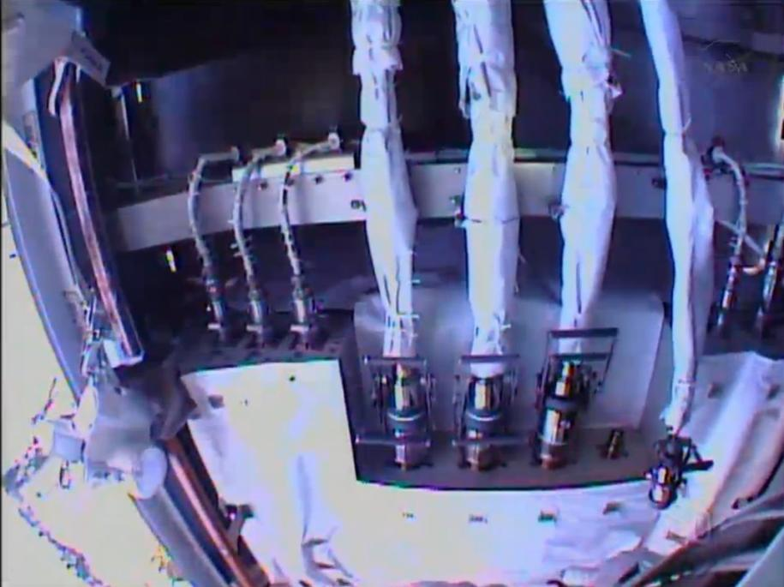
Pumped Fluid Loops – Pipes & Connectors
Active Thermal Control
Vulnerabilities: Leakage at connection points (especially after a disconnection/reconnection cycle), tube blockage due to foreign object debris
Notes:
The welded metal tubing typically used for the pipes and connectors is extremely robust and reliable. For spacecrafts where in-flight maintenance is possible (and required), the ability to connect and disconnect coolant lines from hardware is a necessity. Sometimes this requires system shutdown and depressurization (especially if it’s a simple threaded connector) or the use of self-sealing quick disconnects.
QDs onboard the ISS are fairly complex and also, externally, fairly prone to leakage.

Slide 19
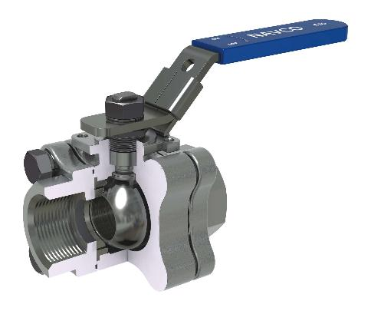
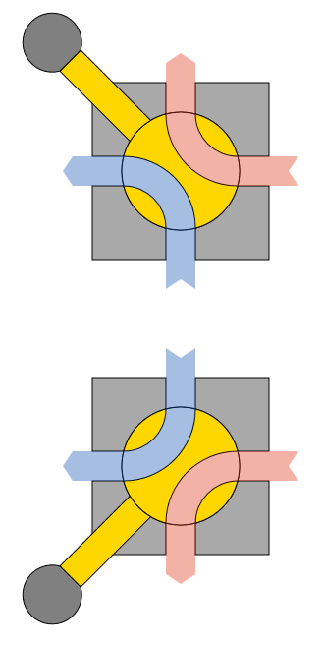
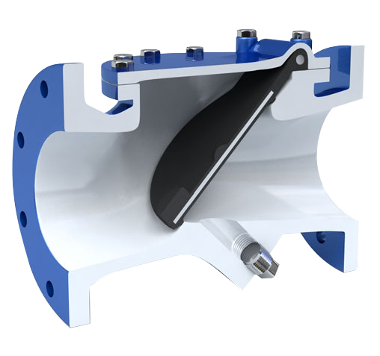
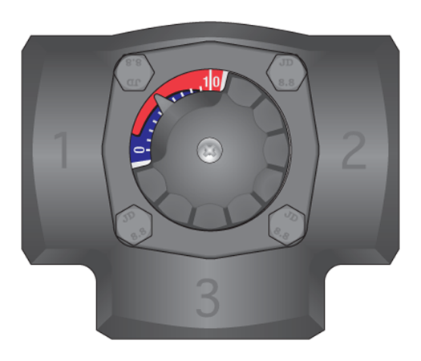
Pumped Fluid Loops – Valves
Active Thermal Control
Vulnerabilities: Valve motor failures, internal valve leakage (fluid bypassing a seal but staying within the cooling system), external valve leakage
Notes:
Multiple types of valves:
Shutoff valves – used to terminate or hydraulically isolate flow through a portion of the system
Metering valves – regulate massflow (supplying water to a garden hose)
TWMV – varies flow from two inlets, one warm and one cold, to output flow of a desired temperature
Check valves – Only allow flow in one direction, usually can’t be controlled by an operator
Focus on TWMVs; bang bang versus spectrum
Valves can be motorized or manual, in human spaceflight applications, motorized valves are given a manual override. Talk differences between valves to system racks (pre-set on the ground) vs valves to payload racks (controllable from mission control).
Vulnerabilities are valve motor failure, internal valve leakage (fluid bypassing a seal), external valve leakage.

Slide 20
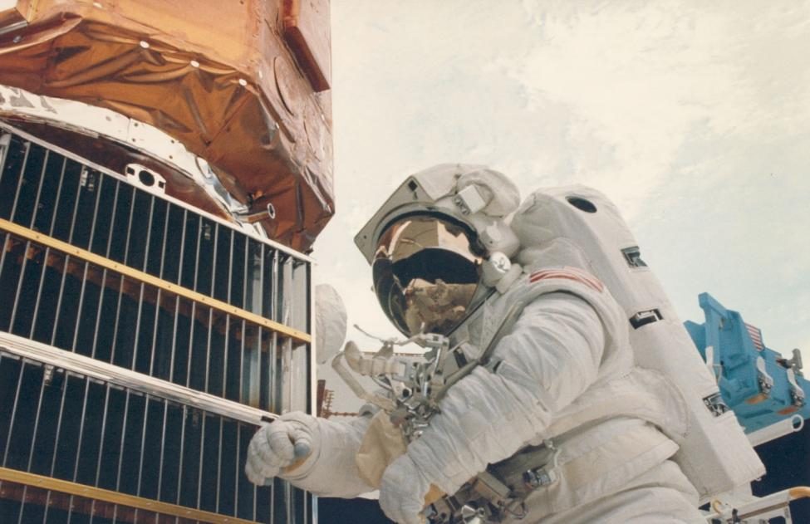
Louvers
Active Thermal Control
Vulnerabilities: Mechanical failure
Notes:
Automated Venetian blinds which usually stand between a radiator and the point in space that radiator faces. Generally utilize a bimetallic mechanism (like an old household thermostat) which will torque the louver more closed or more open based on whether or not the bimetallic actuator is becoming colder or warmer. In order to provide accurate control, the bimetallic actuator must be in as close proximity to the radiator’s thermal environment as possible.
Picture shown above is from the SolarMax satellite that was serviced during a space shuttle mission.
Biggest vulnerability is the louver stops moving due to a mechanical failure.

Slide 21
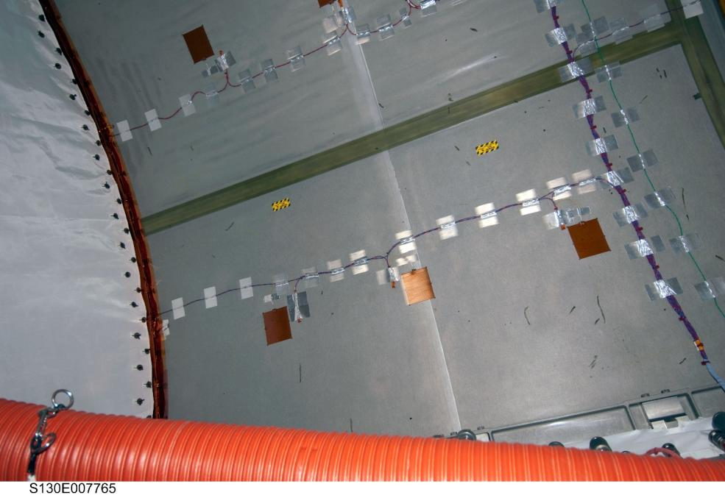
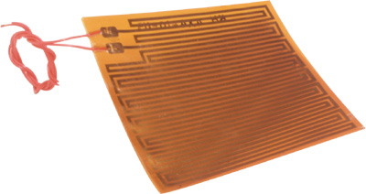
Heaters
Active Thermal Control
Vulnerabilities: Electrical short circuits, excessive electrical load, delamination
Notes:
When MLI and paint isn’t enough, heaters are used. For space applications, usually a heater patch, sometimes with multiple circuits through each patch for redundancy. Resistor sandwiched between electric insulation.
Can be used to heat a component or to prevent condensation – prevents electrical circuitry or to prevent corrosion and mold growth…Apollo 13 scene
Used to keep components above their lowest acceptable operational or non-operational limits, limits determined through the design process. Good to put heater on opposite string of power of ORU itself.
Often utilized in closed loop control fashion, with software setpoints. Can also use bimetallic thermostat to turn on and off. In general, there will be an upper setpoint at which the heater turns off and a lower setpoint at which the heater turns on. Can get more complex, like boosting setpoints when batteries are full.

Slide 22
Spacecraft Thermal Components
PASSIVE Thermal Control
Notes:
[Here are some things that provide passive thermal control.]
This isn’t every single doo-dad that can be part of a spacecraft TCS. But it includes many of the most common devices.

Slide 23
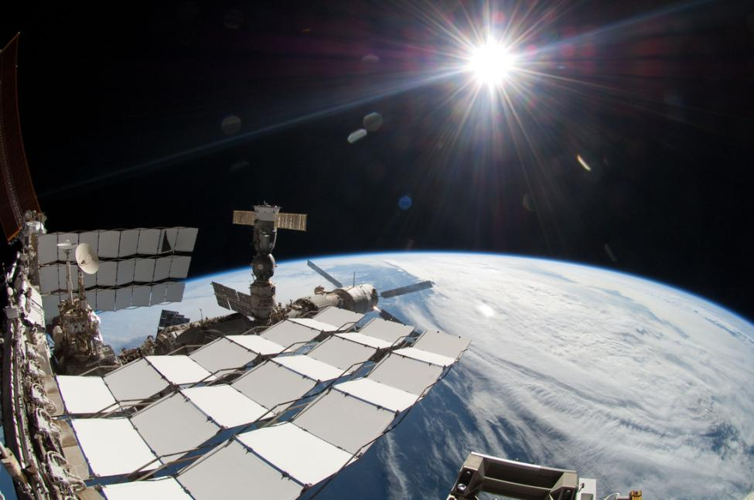
Radiators
Passive Thermal Control
Vulnerabilities: MMOD puncture, freezing, optical property degradation
Notes:
Radiators themselves are a passive system, although they may be implemented as part of an active system if the design calls for the cooling fluid to flow beneath the faces of a given radiator.
Usually body-mounted. Each radiator is about 11’ wide. Space shuttle radiators were on the inside of the PLB doors.
In the vacuum of space, this is the best method of heat transfer by which the spacecraft as a whole is cooled. The radiator is optimized by the radiator’s surface finish (emissivity and solar absorptance), its position adjacent to heat loads, and the orientation of the radiator in terms of its view of the sun and space.
Pointing radiators can greatly aid their heat rejection.
Can be used as a passive application by mounting them directly to the heat-generating component or heat pipes can be used to connect components to a nearby radiator. For active TCS, they often provide the final link in the chain of how excess heat is removed from the spacecraft.
Tiny tubes in the radiator panels
Risks are MMOD puncture, freezing, and optical property degradation

Slide 24
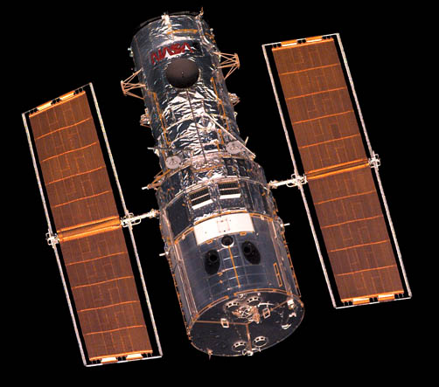
Radiators
Passive Thermal Control
Vulnerabilities: MMOD puncture, freezing, optical property degradation
Notes:
Example of body mounted.
Pointing radiators can greatly aid their heat rejection.
Tiny tubes in the radiator panels

Slide 25
Radiators
Notes:
Each radiator is about 11’ wide.

Slide 26
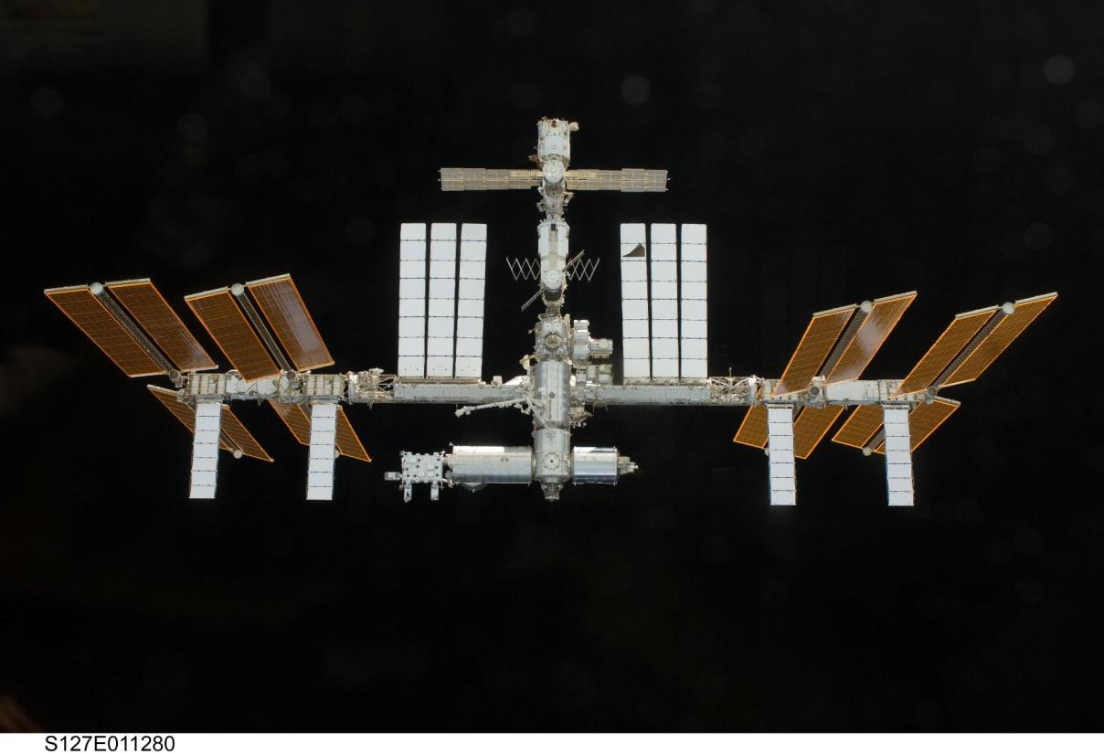
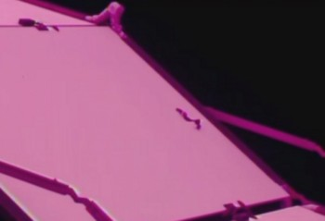
The “Lived In” Look
Notes:
Note the significance of the puncture wound

Slide 27
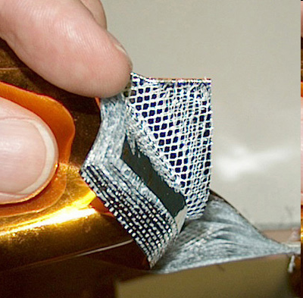
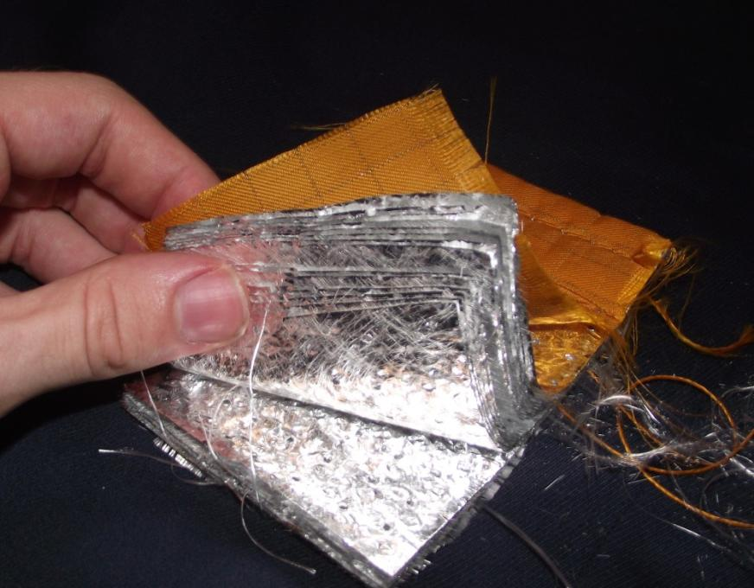
Multi-Layer Insulation
Passive Thermal Control
Vulnerabilities: Optical Degradation, ripping, tearing
Notes:
Aided by the presence of a vacuum between the layers, MLI greatly reduces heat transfer by nearly eliminating convection and conduction between layers, and forcing all heat to be transferred radiatively. Spacecraft MLI on Earth would not work nearly as well, as the atmosphere provides an augmented path for heat to travel between layers.
In instances where temperature constraints cannot be maintained using insulation and coatings alone, heaters are often used to meet minimum temperature requirements.
It can also protect the spacecraft from atomic oxygen and MMOD.

Slide 28
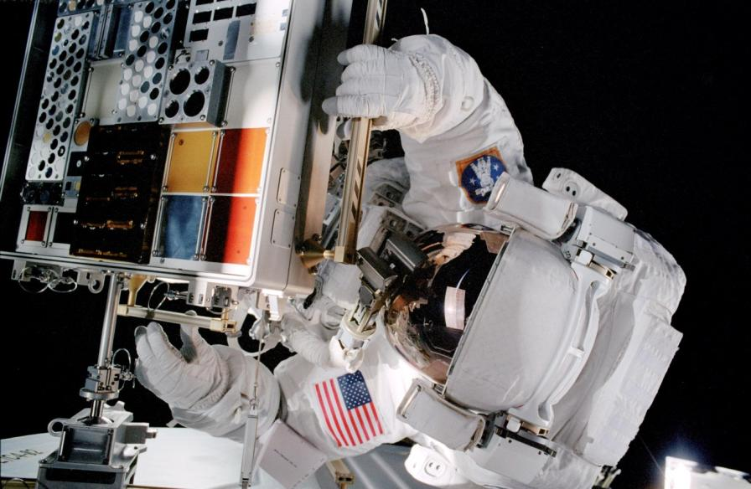
Coatings
Passive Thermal Control
Vulnerabilities: Optical property degradation, flaking
Notes:
Coatings, often in the form of paint, are surface treatments that change the thermal and optical properties of a surface. Selection of a particular coating during the design process is driven by concerns of longevity, BOL and EOL properties, and degradation effects due to contamination.
Have to survive vacuum, MMOD pelting, atomic oxygen, thruster firings
Above is MISSE, an experiment that tested coatings in the space environment.

Slide 29
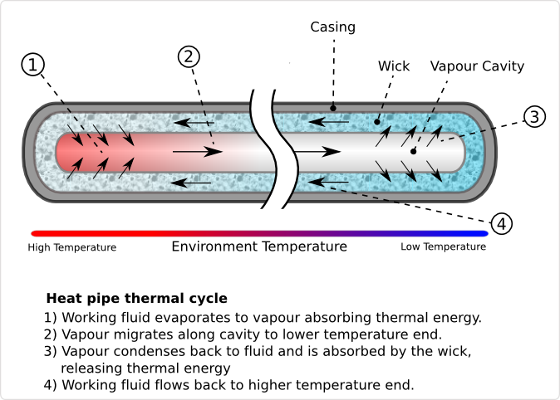
Heat Pipes
Passive Thermal Control
Vulnerabilities: MMOD Puncture, high acceleration
Notes:
A heat pipe can transport relatively large quantities of heat from one location to another without needing any electrical power to do so. The primary principle behind the heat pipe is capillary flow, utilizing a single fluid which transitions between two phases in order to transfer heat from one place to another.
heat-producing component is placed at one end of the heat pipe, called the evaporator section. Heat is absorbed into the pipe and the working fluid becomes a gas. The gaseous fluid expands through the length of the pipe and reaches its dewpoint somewhere near the other end of the heat pipe, called the condenser section. The condenser section will usually be attached to a radiator or other heat-removal device to facilitate the cooling of this end of the heat pipe. The transport creates a suction effect which pulls liquid fluid into the evaporator section to make up for the travelling gas.
Talk about heat pipe DDCUs and how we’ve looked at running station off the two of them if both ETCS loops fail.
High acceleration along the heat pipe axis can degrade/disrupt the fluid cycle.

Slide 30
Operations
Notes:
Now that we’ve talked about some of our tools, what do we do with them?

Slide 31
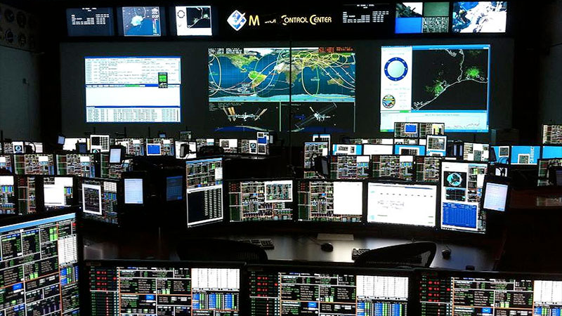
Notes:
We get a lot of data in MCC. What is it that we’re doing when we’re sitting in mission control and watching monitors? The answer varies for each discipline.
CDH/EPS = 1’s and 0’s, on and off
TCS = trends, ebb and flow
Pattern recognition is the key. Signal from noise.
Talk about external thermal control data vs internal thermal control data. Now let’s look at what environmental factors affect these systems. What are the steady “heartbeats” of these systems?

Slide 32
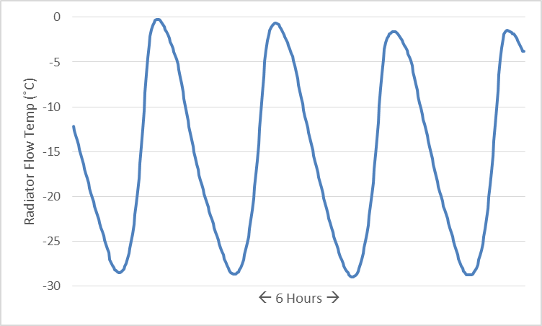
Orbital Patterns
Notes:
Starting with the ETCS, orbital patterns have a regular effect. Warming and cooling effects are obvious for spacecrafts in low earth orbit as they go through insolation and eclipse. As you can see, it’s not quite so simple as the coldest point being during eclipse. Eclipse cooling may start before sundown and insolation warming may start after sunrise, due to vehicle shadowing or the sun being out of the field of view of some equipment.

Slide 33
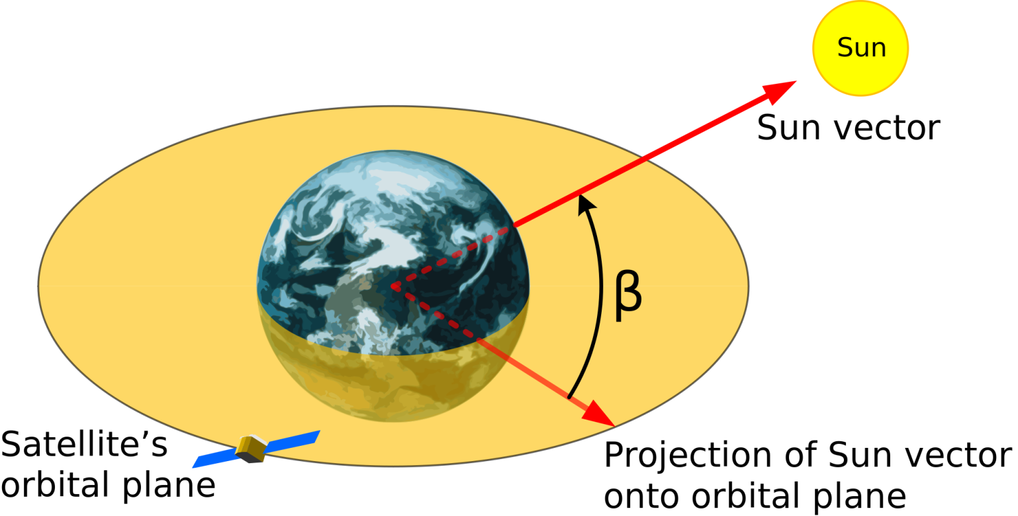
Beta Angle
Notes:
Beta has a huge thermal effect; orbital is short term, beta is long term.
Beta is the minimum angle between the orbital plan and the solar vector. For any vehicle in a planetary orbit, solar beta varies continuously with orbital precession and the movement of the sun’s relative position to a planet over the course of the year.
Station was originally designed for a <30 degree inclination.

Slide 34
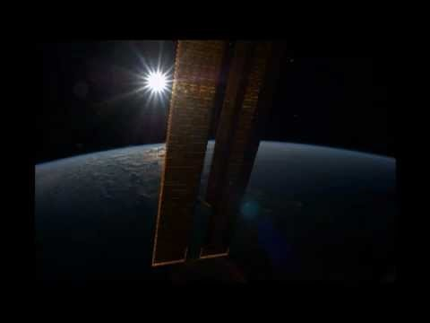
Perpetual Sun
Notes:
High beta can be beneficial or detrimental depending on spacecraft design.

Slide 35
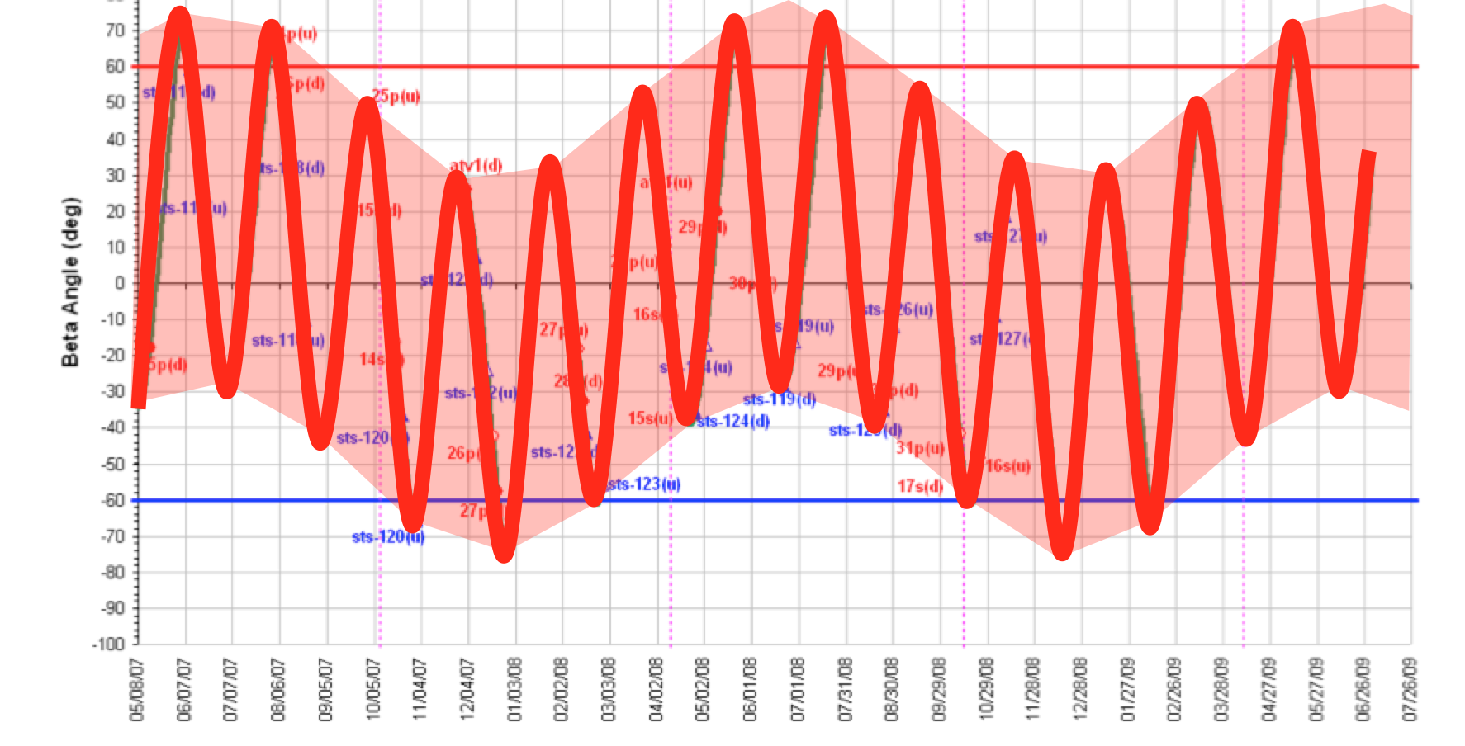
Beta Angle
Notes:
ISS Beta angle. Beta can vary from 0 to a value equal to the orbital inclination plus the axial tilt of the planet.

Slide 36
Beta Angle
Notes:
Beta angle has a dramatic effect on amount of time in insolation. For example, for the ISS at an altitude of 400 km, eclipse times exceed 30 minutes at a beta of 0 deg, but at a Beta of 70 degrees, the ISS remains in insolation throughout the entire orbit.

Slide 37
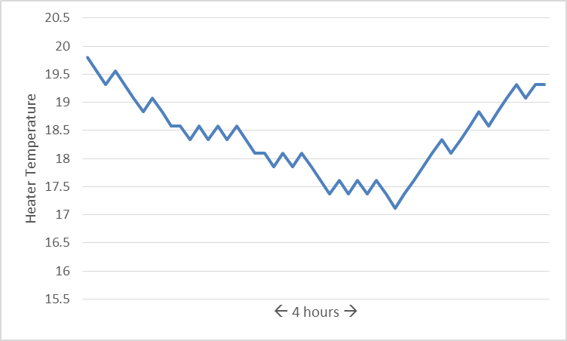
Heater Closed-Loop-Control
Heater Activation
Notes:
Talking more along the lines of operational effect and what you’d expect to see in telemetry, here’s a plot of a temperature trend on an ORU. At a certain point, the temperature sensor falls below the on setpoint, and the heater is either turned on by software if software controlled, or the thermostat switch closes to apply power to the heater if thermostatically controlled.

Slide 38
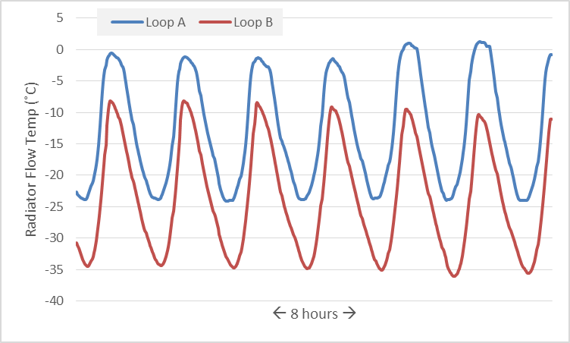
Attitude Maneuvers
Radiator A
Reposition
Notes:
Effect on radiator flow temperature of an ISS ETCS radiator reposition from 45 degrees to 60 degrees. Note the increase in Loop A's peak temperature, signifying reduced heat rejection.
Sometimes, when there is a lot of heat being put out by systems, we put the radiators into an automated tracking mode.

Slide 39
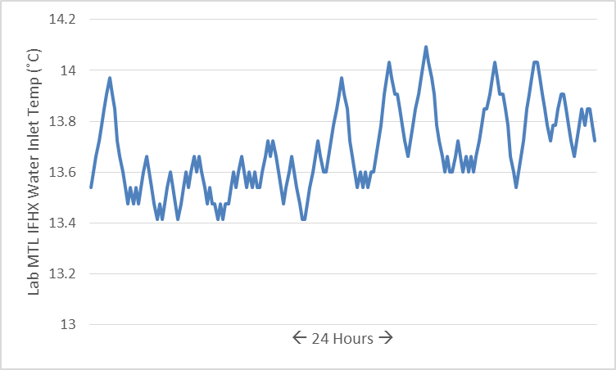
Crew
Heat signature of ISS crew on an off-duty day.
Notes:
Internal thermal systems are affected by crew activity. Notice how this cooling system temperature varies throughout the day. Crewmembers produce metabolic heat (60W-250W per person); they also use equipment and perform experiments. Grey is asleep. White is awake.

Slide 40
What are we watching for?
Leaks
Pressure
Quantity
Temperature
Component Failure
Electrical Current
dP (pumps)
Speed (pumps)
Notes:
As we take all those constants into account, what types of things are thermal operators looking for? The two biggest things are leaks in the system and signs of pump instability. Pressure and quantity provide good insight into a leak. Combining that data with temperature can help separate a leak from just a cooling thermal environment.
Constant speed pump should operate within a deadband for pump speed and electrical current.
We’ll talk about specific failures later.

Slide 41

Thermal Analysis
Attempts to answer questions like:
  If component X is unpowered, removed from its current location and held out on the end of the robotic arm, how cold will it get?
  How long can these shell heaters go unpowered before the walls of the habitable module cool down to the dewpoint?
  If the radiator is pointed in Y direction, how long until the coolant freezes?
Notes:
[It’s wise to prepare for thermal operations. To that end, we rely on analysis. While the predictions aren’t perfect, they can give us an idea of what to expect and help us set boundaries.]
Predicting the spacecraft thermal environment is extremely difficult given the number of variables involved. Small changes in attitude, beta, system power consumption, and even the optical properties of the paint mean that any predetermination of the temperatures which will be experienced by a certain component will likely be presented with a wide tolerance band. What is presented to the TCS controller will likely be the result of the worst of all cases for conservatism.
In reality, due to the worst-case assumptions discussed above, this will likely represent the period before a component could possibly reach a limit on the very worst day given the very worst conditions. Unfortunately, it is probably the best information you will be armed with.

Slide 42
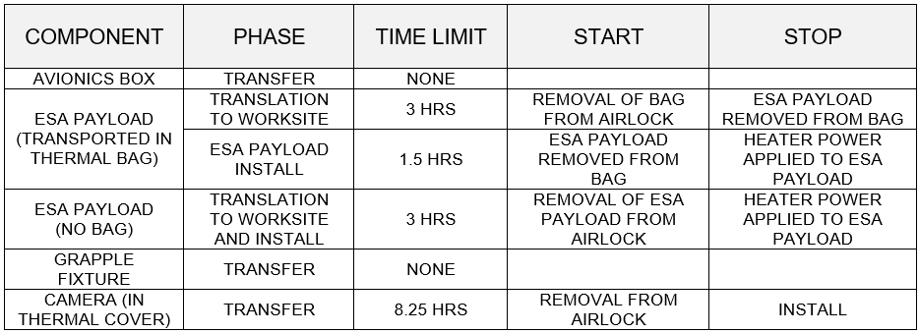
Thermal Clocks
Notes:
[Here’s an example of the boundaries that thermal analysis might produce.] Much of Flight Control is about taking complex constraints and converting it into useful “if/thens”
Data will often be supplied in graphs showing when a temperature falls below the red line with various models using different variables. That has to be converted into something useful. The example above resembles flight rules used by the flight control team to set thermal clocks for various equipment being moved during an EVA.

Slide 43
Nominal TCS Maintenance Activities
System Repressurization
Powerdowns & Preheats
Radiator Repositioning
Temperature Setpoint Changes
Coolant Samples
Filter Changeout
Notes:
[Once we have a sense of our thermal environment, what are the normal things a thermal operator might expect to perform?]
Repressurization – after adding a new ORU, due to spec leakage
Left Column (External heat rejection system)
- Powerdowns – done if arrays are being feathered, due to a failure, high Beta
- Preheats – done to carry the spacecraft through the powerdown time period
- Radiator repositioning – If the radiators are not statically mounted, and can be controlled, would rotate the radiators for better heat rejection at different attitudes, beta, etc. If statically mounted, you would have to change the orientation of the spacecraft to achieve better radiator pointing.
Right Column (Internal heat collection system)
- Coolant Samples – Ensure that coolant chemistry is well balanced and won’t encourage microbial growth or lead to plumbing degradation
- Filter Changeout – If coolant chemistry ISN’T well balanced and sludge grows.
Temperature setpoint changes – Used for controlling the needs of a particular payload or crew member

Slide 44
System Interactions
Notes:
What other systems do you think the thermal control system is reliant on?

Slide 45
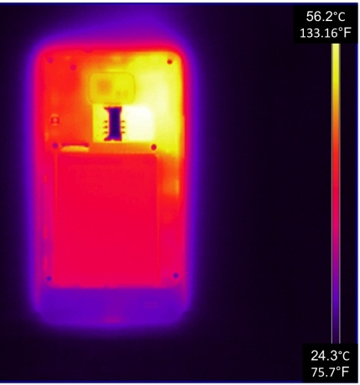
Power
Power Loss = Instant TCS Loss
TCS Loss = Eventual Power Loss
Notes:
Power and TCS are closely linked. SPARTAN console manages both.
Pumps and heaters require power to run. But most electrical components require specific thermal conditions to operate properly.
If cooling is recovered quickly, impacts of the temporary loss will be negligible.
Longer-term losses of cooling may be more difficult to recover from, as the restoration of cooling will require power, and power systems may be offline due to lack of cooling. In this catch-22 situation, power components will likely be brought online to provide just enough electrical output to restore cooling systems. Speed will be of the essence in these situations so as to not damage the electronics.

Slide 46
Data/Software
Closed Loop Control
Fault Detection, Isolation, and Response
Ground/Crew Manipulation
Redundant System Activation
Thermal Load Shed
Automated Leak Isolation
Notes:
TCS operation requires insight into the functioning of the system. Software commands must be decoded and routed to the TCS components to ensure proper operation, and telemetry must be returned not only to provide information to TCS operators, but also to onboard software algorithms.
Closed loop control – very good for temperature control. This can be as straightforward as software looking at a coldplate temperature sensor and commanding a valve to provide more coolant, or a heater turning on because temperature sensor X fell below value T. It can also be as complex as using a certain temperature, combined with information about solar beta, vehicle attitude, and orbital period to determine the optimal position at which a moving radiator can be pointed. A requirement for any system that has a tight operational range and encounters loss of signal with operators on the ground.
FDIR: Usually thermal system FDIR operates on human timescales. Operator sometimes can take action to beat the FDIR, but this shouldn’t be done without thinking first. Pump failure – fail over to the redundant pump. Loss of heat rejection - thermal load shed. Leak – automated leak isolation and safing (turn off pump before cavitation) Talk about how ETCS leak FDIR evolved.
Ground/Crew manipulation – either uploading new software, or changing a single parameter within the software, to change how the system works. Software revision takes time (or it doesn’t if it’s important enough)

Slide 47
Failure Modes & Redundancy
Notes:
The first question with any failure is – “What’d you do?!”
Random failures do occur, but they’re much more likely to result from some change in the operation of the vehicle. No matter the failure, ask “What have we done to the system recently, and how might it have caused this?”
The next question to ask is “What if something else fails?” Redundancy is a part of any spacecraft, but being in this section of the presentation means you’ve used up some of that redundancy.

Slide 48
Leaks - Causes
MMOD →→→→
Crew
Design Faults & Degradation
Notes:
A fast leak is the #1 fear of any active thermal loop operator.
The photo on this slide was taken after STS-118 (Endeavour). This was on the port side payload bay door-mounted radiator. Notice proximity to flow tube. Particle was determined to be 1.75mm in diameter.
Crew can cause leaks by their actions. (See video). Also reference 2013 “stepped on” leak.
Radiators are especially vulnerable to leaks, although designed such that the coolant flow only takes up a fraction of the radiator.
Degradation in the space environment – harsh operating conditions. Also design flaws-imperfect welds, degraded seals

Slide 49


Slide 50
Leaks - Signature
Notes:
I said they could be MMOD, Crew, Design Faults – this is a design fault.
Pattern recognition. Need to separate signal from noise!

Slide 51
Leaks - Response
Characterize
Isolate
Workaround
Fast or slow?
Toxic for crew?
What fluid?
Use Press & Qty Sensors
Remain hydraulically compliant
Shut down loop and affected systems
Activate redundant systems
Notes:
What do you do when you have a leak?
Note pressure/qty trending due to isolation.

Slide 52
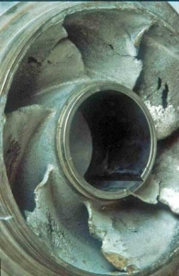
Pump Failure
Deadheading
Manufacturing Defects
FOD
Cavitation →→→→
Response: Switch to redundant pump; otherwise, shut down loads
Notes:
All described with centrifugal pumps in mind.
Deadheading – operating a pump with no flow through it. Shutoff valve closed upstream or downstream. Can cause damage as the pump continues to churn the same coolant. Friction will cause the fluid to increase in temperature and possible flash to vapor. If the pump depends on the coolant for its own mechanisms (bearings), you might be in trouble.
Cavitation – Caused when pressures fall low enough that they flash into vapor at the eye of the pump. The vapor bubbles are carried along the vanes of the pump until they reach a point where the local pressure increases enough to collapse the bubbles. This causes high temperatures and emission of shock waves in very small spots. This can cause extensive damage. Therefore, loop pressures must be kept high enough that none of the fluid can flash to vapor at the low point in the system (eye of the pump). The minimum acceptable pressure is called the Net Positive Suction Head Required (NPSHR). This value is define by the pump manufacturer.
Many pump failures are completely out of the operator’s control. Manufacturing defects, design faults, and installation issues have all claimed their share of pumps as casualties. For instance, investigation following a 2010 failure of an ISS external thermal pump module showed that the pump motor’s rear journal bearing was improperly sized for the application. As a result, the ammonia coolant was not properly lubricating the bearing. This was detected in telemetry as a series of sharp electrical current spikes (likely the signature of friction as the rotor rubbed directly against the housing) culminating in the ISS equivalent of a blown fuse.
Foreign object debris is another concern, and is also likely outside of the purview of the operator. Most pumps are designed with filters to prevent FOD from entering the pump itself, some pumps even have coarse filters at the pump outlet to prevent the large pieces of a catastrophically disassembled pump from sneaking into other critical components. Enough FOD in a filter can choke off flow and potentially lead to a deadhead condition.
Response – switch pump or shutdown loads.

Slide 53
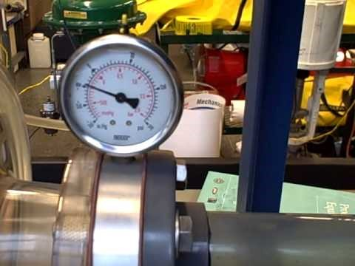
Pump Cavitation
Notes:
Example of cavitation

Slide 54
Other Failures
Heat Exchanger Rupture
Radiator Freeze & Rupture
Cause
Lack of Relief Valves
Improper pressure manipulation
Response
Cooling loop loss
Replacement
Cause
Cold!
Improper orientation
Fluid stagnation
Response
Cooling loop loss
Notes:
Heat exchanger design walks a fine line between efficiency and robustness. Thinner material between the two different fluids allows for more efficient heat transfer but at the expense of a greater chance of rupture. A rupture between the two “sides” of a heat exchanger will, in the most benign instances, degrade the efficiency of the heat exchanger due to changed hydraulics. In more extreme cases, a heat exchanger rupture may cause the total loss of the involved fluid loop(s). In human spacecraft, a heat exchanger rupture involving a toxic coolant such as anhydrous ammonia can be an immediate risk to life as the ammonia enters an internal habitable-volume cooling system.
Overpressurization can be caused by failures elsewhere in the system causing a pressure rise, such as in the case of a regulator valve failure or the improper operation of a pump at perhaps too high of a speed.
Overpressurization might also be caused by physical changes in the working fluid. For example, on the International Space Station, Interface Heat Exchangers (IFHXs) are utilized as the method of heat transfer out of the internal habitable volumes and into the external thermal control system for eventual radiation into space. The internal loops utilize water cooled to just a few degrees Celsius above 0, while the external loops utilize pressurized ammonia. As ammonia under pressure can stay in a liquid state at temperatures well below 0 deg C, there is risk that a low temperature excursion could cause the water to freeze and therefore expand, thereby rupturing the heat exchanger. Upon a later thaw of the heat exchanger, the ice dam holding back the ammonia will melt away and allow ammonia to enter the habitable volume’s cooling system.
The radiator of an active thermal system is designed to expend heat; however, there are instances where there can be too much of a good thing. Radiator freezing can lead to the temporary cessation of cooling, or the permanent destruction of a radiator due to tube leakage.
Possible mitigation methods for radiator freezing include:
Utilization of radiator heaters
Retraction of the radiators, or closure of radiator louvers, for planned cold events
Spacecraft attitude changes to point the radiator at a warmer environment (such as a nearby planet or the Sun)
Pump redundancy to increase the likelihood of non-stagnant coolant at all times
A temporarily frozen radiator can be thawed using some of the same methods described above to prevent freezing in the first place. The greatest operational difficulty in these cases will be in knowing that the radiator is frozen. If a radiator contains multiple parallel flowpaths, the presence of a frozen flowpath might have a negligible effect on the system hydraulics.
If thawing occurs in a style that causes a localized pressure buildup and tube rupture, the radiator in question will likely be out of service due to the presence of an overboard leak path.

Slide 55
Redundancy
Parallel
Availability
=
1-(1-Component Availability)^{n}
“N+1 Shoddy Things is better than N Shoddy Things.”
Notes:
[Redundancy is a fundamental tool to counter failures. Sometimes the best choice is to simply have a backup. But how many backups do you need? It depends on how much availability you require and how often you expect that thing to fail.]
Often we talk about MTBF, and readjust those numbers as time goes on
In several of the examples listed in 6.1, the “response” section is unfortunately limited. A cruelly large number of TCS contingencies put the operator in a position where that service simply is not available anymore. The troubleshooting of an electrically shorted heater patch is likely to be of limited benefit – that patch is simply unusable. A ruptured radiator is useless. For this reason, designers must have an eye towards fault tolerance.

Slide 56
Redundancy
Parallel
Availability
=
1-(1-Component Availability)^{n}
Given a pump of 80% availability, how many pumps would be needed to ensure 99% availability?
0.99 = 1-(1-.8)^{n}
0.99 = 1-(.2)^{n}
n = 2.86, therefore, 3 pumps
Notes:
Fault tolerance is a way of building robust systems out of less-than-robust components. A pump with 50% availability over a 1-year mission (that is, a pump that can be expected to work for 6 months) is a fairly lousy pump. However, if you put “n” of these pumps into the same loop, in parallel, your overall availability is affected per the following equation:
Parallel Availability = 1-(1-(Component Availability))^{n}
Two lousy 50% pumps in parallel makes for a 75% available system: you could nominally expect to have a working pump 9 months out of the year. Three pumps provide 87.5% availability. Four provide 93.75% availability. Five parallel pumps provide enough availability to expect operation for all but less than 3 days a year. All of this assumes, however, that the pumps are completely independent of each other. Rarely is this totally achievable: if part of the pump’s low availability is its susceptibility to cosmic radiation, the same model pump sitting a meter away is going to be subjected to the same cosmic radiation. Similarly, two parallel pumps sharing the same power source are not independent – any failures downstream of the electrical source are independent, though, so there is some benefit (one rotor seizing and stopping won’t necessarily ruin a parallel rotor in this case).

Slide 57
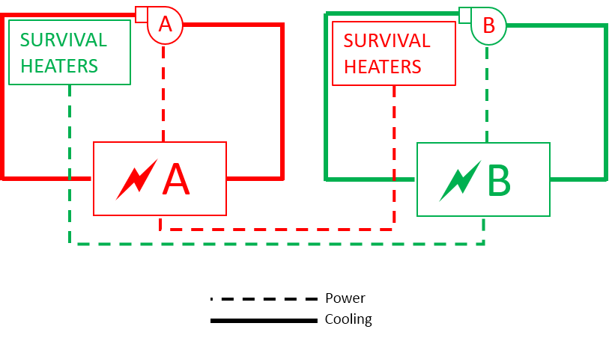
Channelization
Notes:
[Smart channelization is another design choice to help limit the impact of failures.]
The International Space Station’s habitable modules and main computers are all cooled by two External Thermal Control System (ETCS) loops, A and B. Each ETCS loop cools the electrical transformers which provide power to itself. Loss of ETCS pump A therefore stops cooling to ETCS A’s own electrical supply but does not affect the components that ETCS B needs to operate.
However, active operation is different than survival. Some functions are necessary for “keep alive” purposes, so that a dormant ETCS loop does not get so cold as to become unable to be restarted. While it makes sense to keep equipment necessary for active operation powered by electrical boxes cooled by the operating loop, survival functions are generally kept independent from any electrical or thermal dependency on the operation of the loop and instead might rely on the opposite. For this reason, the survival heaters of Loop A are powered by electrical components which rely on Loop B (ref Figure 26).

Slide 58
Duplication
Notes:
Some complex TCS components, such as centrifugal pumps, are more likely to fail than less intricate components, such as coldplates. It is for this reason that the more complex components are often duplicated. When one fails, the other takes over.
This duplication was present in the TCS of the Mars Pathfinder mission of the late 1990s, shown schematically in Figure 24. In this example, there were two centrifugal pumps – one primary, one secondary. Only one pump was on at a time, and four check valves prevented flow from being forced backwards through the dormant pump.
Similarly, many spacecraft feature heater patches situated next to each other but powered by different power sources, or shutoff valves in parallel with each other.

Slide 59
TCS Examples
Notes:
Let’s talk a little more about the two main active thermal systems on the ISS.

Slide 60
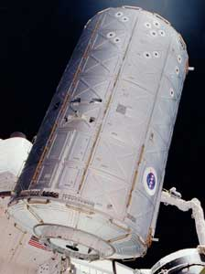
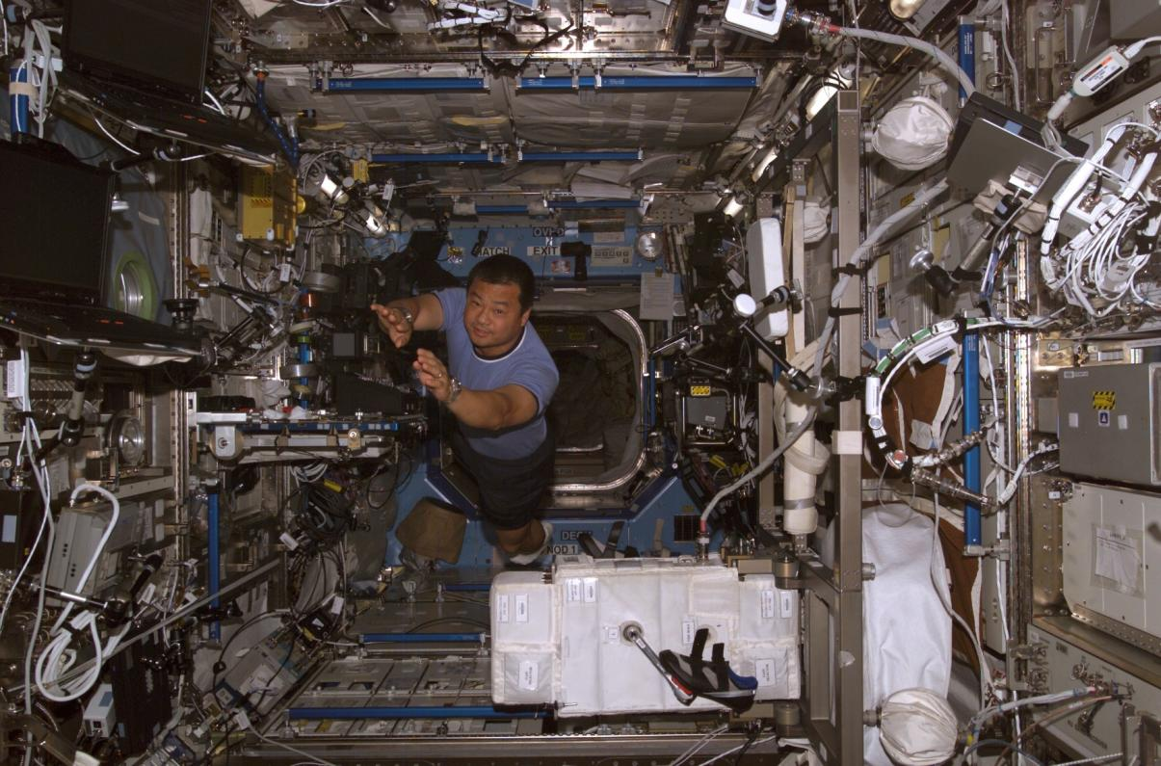
ISS US Lab Internal TCS
Notes:
Here’s a photo of the Lab module being installed, with a photo of Leroy inside the module a while later. It’s one example of the many modules that need their heat collected and rejected out to space.

Slide 61















ISS US Lab ITCS
Heat
Rejection
Heat
Transportation
Heat
Collection
LTL
Three-Way Mix Valve
Interface
Heat Exchanger
Pump
Package
Heat Loads
Loop Crossover
Assembly
System Flow
Control Assembly
MTL
Three-Way Mix Valve
Regenerative
Heat Exchanger
Interface
Heat Exchanger
Pump
Package
Heat Loads
System Flow
Control Assembly
Regenerative
Three-Way Mix Valve
Notes:
Here are some of the components that we talked about earlier. Follow a drop of water, explaining different components as you go.
As I mentioned, there are two loops here. What happens if one of them goes down? We go to Single Loop Mode. The LCA allows that to happen.

Slide 62
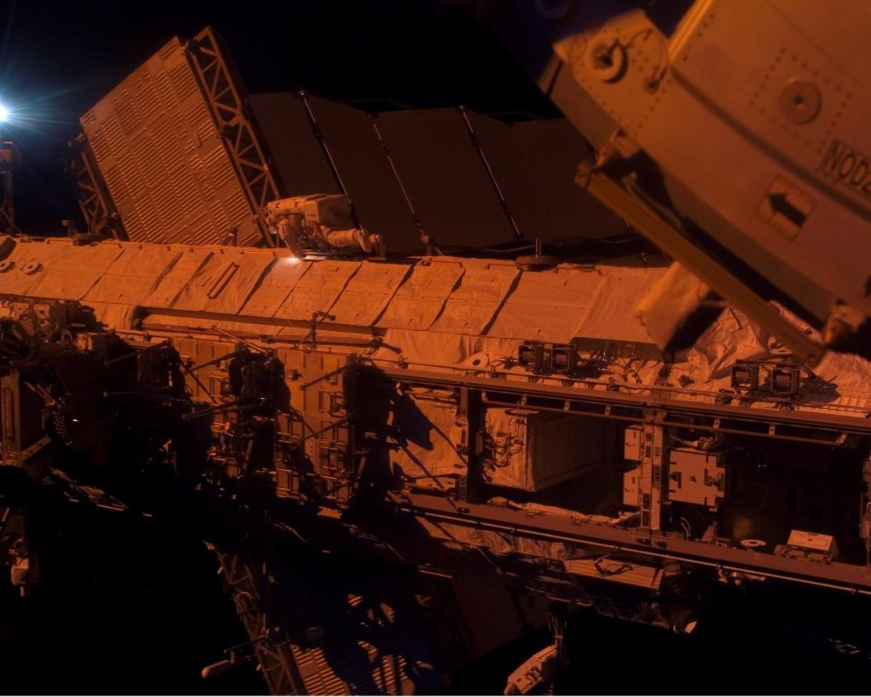
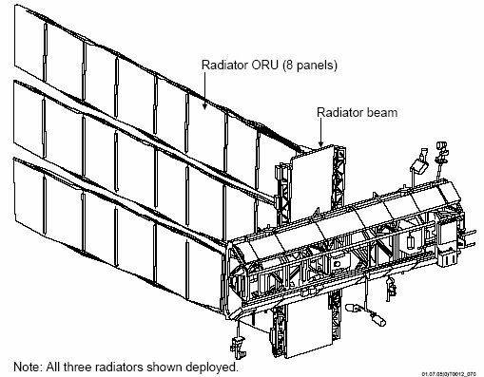
ISS External Thermal Control System
Notes:
Moving outside, we rely on the ETCS loops to reject all the internal heat out to space. On the left is a schematic of some of the radiator panels we use for this purpose and on the right is a photo of those panels. Note the astronaut for scale.

Slide 63
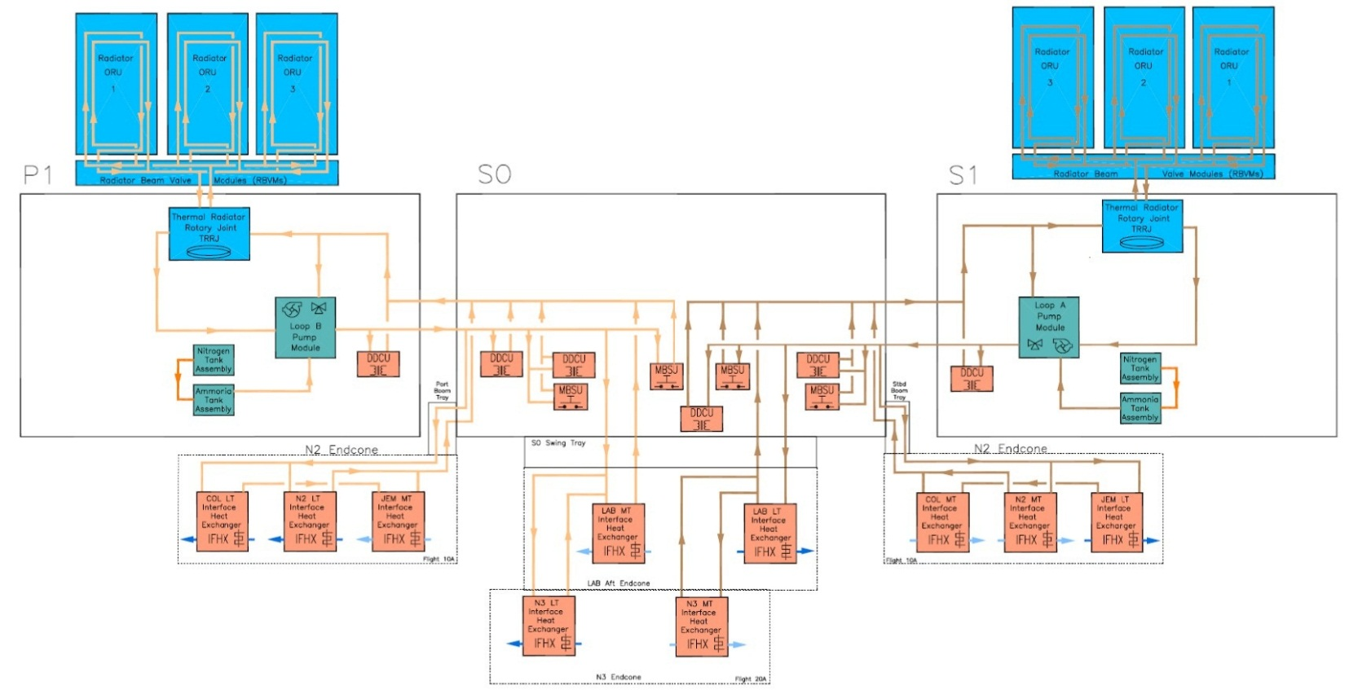
ISS External Thermal Control System

Slide 64

Tales of the TCS

Slide 65
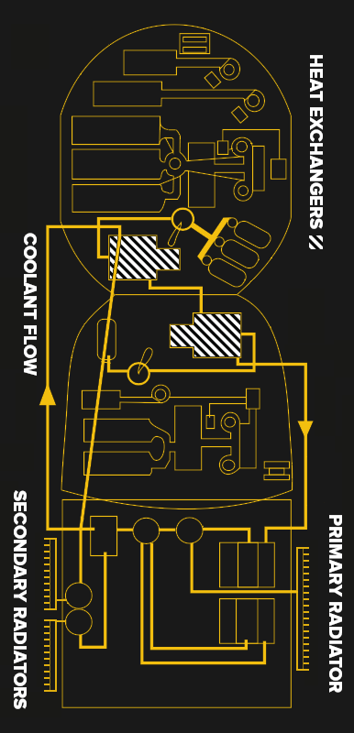
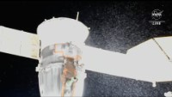
Soyuz Leak – December 14th, 2022
Notes:
Crew config: Three crew via Soyuz (including Astronaut Frank Rubio) and four crew via Crew Dragon
An external Soyuz coolant leak started spontaneously (later attributed to a 1 mm debris impact)
All the coolant leaked out, leaving the internal cooling loops without means to reject heat.
What’s the big deal with this? The Soyuz, when docked, is a lifeboat for its crew in case of an emergency and their nominal ride home. Without cooling, it was estimated air temps could reach over 40 degC (105-110 degF), endangering crew and flight computers.
Work was done to allow one or more Soyuz crew to come home on Crew Dragon in an emergency.
Roscosmos flew an uncrewed replacement Soyuz on Feb 23rd and commanded the damaged Soyuz to re-enter autonomously.
This Soyuz swap forced a delay in the next crew’s arrival, leading Frank and his crew to stay onboard for a full year.

Slide 66
The ISS 2013 Flow Control Valve (FCV) Failure
Notes:
Significant failures can arise from small sensor issues. In this case, it was a sensor bias on the valve that controls the target temperature of one of the two external heat rejection loops. Part of the solution involved using hardware as it was never intended to be used!

Slide 67
2013 ETCS Pump Module FCV Failure
FCV
Notes:
We’ve seen this schematic of the ETCS before. This is one of two external ammonia loops, with the heat rejection equipment (radiators) on the left and heat load equipment (IFHXs and power boxes) on the right. In the middle is the pump module providing all the motive force. [CLICK] The FCV is part of the pump module and modulates flow to the radiators to control the coolant temperature going to the heat loads. It can move between 5 positional degrees (warm, mostly radiator bypass) and 90 positional degrees (cold, full radiator flow).
As we learned before, we want to keep the water-side of the IFHXs from freezing to prevent creating a flow path for ammonia to enter the cabin, so software will shut down the loops if it detects the ammonia is getting too cold. Normally, the FCV does a good job of maintaining the target temperature, but in mid-December 2013, one of the loops unexpectedly shut down due to an undertemp condition.,
This shut down half of the heat rejection on the US segment, leading to powerdowns to keep equipment from overheating. The FCT reactivated the loop (with the IFHXs bypassed and isolated from flow) to troubleshoot and soon found that the FCV was biased 30 positional degrees in the cold direction. This meant that, even though the software was trying to warm up the ammonia by moving to radiator bypass, it wasn’t actually reaching that position, resulting in an ammonia mix too cold to allow flow to the IFHXs. (Analysis showed that the valve had been biasing for a month until it finally could no longer compensate.)
What could we do?
Put in more heat? The IFHXs are the biggest source of heat, but they were off limits.

Slide 68
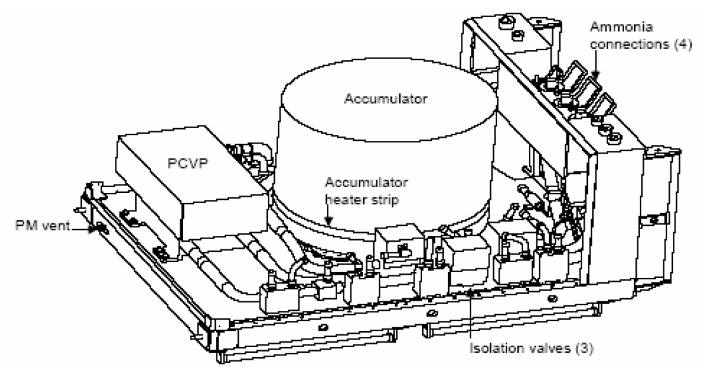
2013 ETCS Pump Module FCV Failure
Pump Module
Notes:
Here’s a drawing of the pump module. The FCV is contained within the PCVP (Pump Control Valve Package). Also part of this Valve Package are flow isolation valves for ammonia bypassing and returning from the radiators, as we’ll see on the next slide.

Slide 69
2013 ETCS Pump Module FCV Failure
TO ACCUMULATOR
FCV
TO LOADS
COLD FROM
RADIATOR
WARM RADIATOR BYPASS
Notes:
Looking at these valves, how could you give the heat loads warmer ammonia?
Close Radiator Isolation valve? Sure, but when you open it to start rejecting heat again, the inrush of cold ammonia will shut down the loop again.
The isolation valve can only be commanded open or closed, BUT, it takes 5-10 seconds to travel.
What if you commanded it and then cut power in an intermediate position?
This is what we did [click], but it was hard to get the valve in a precise position. (Talk about commanding limitations, smartphone metronome commanding, the Quasnytron, and 48 hr software turnaround.) The software worked and allowed us to reintegrate the IFHXs.
Talk about
Quick turnaround EVAs to replace pump module and keep the old one as a last-ditch spare (since we proved we could allow the biased FCV to control)
NWF team for loss of other ETCS loop
Maybe COL IFHX freeze close call?

Slide 70
The ISS 2B PVTCS Leak

Slide 71
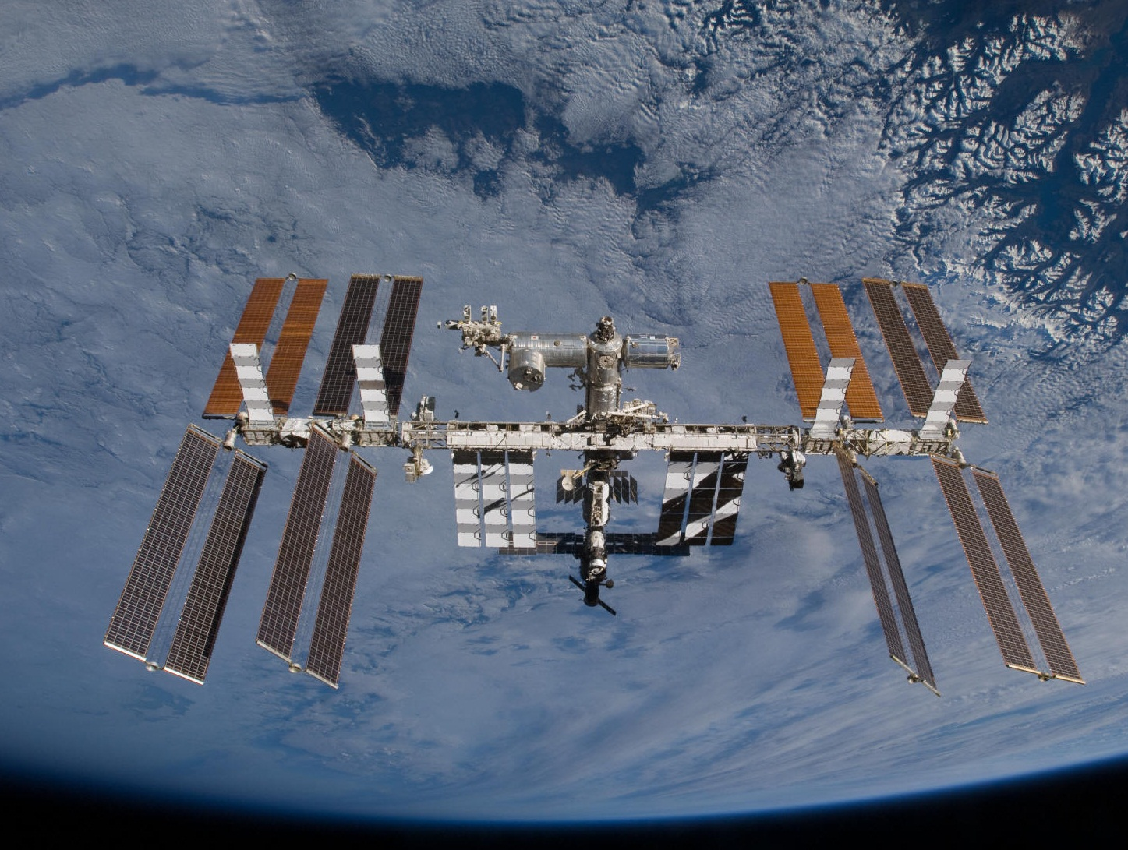
4B
2A
3A
1B
2B
4A
1A
3B
Electrical Power Channels
Notes:
Eight power channels, each with their own batteries.
Battery heat is carried away by means of an ammonia cooling system, the PVTCS.
Each channel has its own PVTCS, two per radiator.
Of all of these channels, the 2B channel is the most critical due to what loads are assigned to it.
2B and 4B are on P6, which is the oldest…

Slide 72
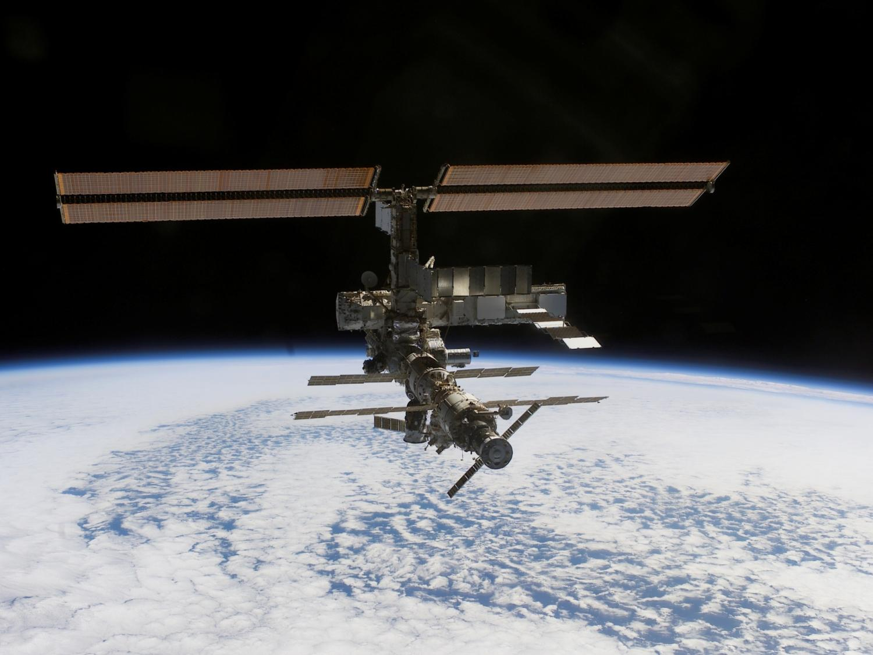
4B
2B
2002 Configuration
Notes:
…launched in 2000.
Note the EETCS and PV radiators. PV radiator cools batteries, the other two radiators cooled the module avionics themselves.
This EETCS was a stopgap thermal control system on the “long spacer”, until the ETCS was fully built (shown in its early stages of construction here in 2002)
EETCS is basically the same guts as a PVTCS, whereas the ETCS is comparatively much larger and more robust than either.

Slide 73
(
2B Pump
(
(
(
(
(
(
(
Battery
Battery
Battery
Battery
Battery
Battery
PV Radiator
Battery
Battery
Battery
Battery
Battery
Battery
(
4B Pump
(
(
(
(
(
(
(
Orbit-Replaceable Unit
Notes:
This is what a PVTCS looks like, on the P6 truss. Note that the pump and radiator can be replaced via an EVA (Extravehicular activity = spacewalk)
System contains ~ 50 pounds of anhydrous ammonia.
2B and 4B are independent.
Radiator flowpaths are independent, too, though.
The system worked flawlessly until…

Slide 74

1.5 lbm/yr
Notes:
This is a plot of the ammonia mass of the 2B PVTCS over time, from 2001 to 2011.
0 is shutdown, meaning the accumulator is empty and the system will cavitate, so the y axis is “above bare minimum”
Note the 1.5lbm leak rate starting in the 2006 timeframe.
4B was fine.

Slide 75
(
2B Pump
(
(
(
(
(
(
(
Battery
Battery
Battery
Battery
Battery
Battery
PV Radiator
Battery
Battery
Battery
Battery
Battery
Battery
(
4B Pump
(
(
(
(
(
(
(
Orbit-Replaceable Unit
Notes:
The leak can be anywhere in the 2B system. We hope it is in one of the replaceable parts (Pump or radiator).
1.5 lbm/year is too small to detect source.
The only hope is to feed the leak.

Slide 76

EVA #1:
REFILL
22 MAY 2011
Notes:
This leak mandated our first spacewalk I’m going to talk about today, what I’ll call EVA #1 in 2011.
Part of the STS-134 mission
Planned over the course of 2 years to refill the PVTCS. But how?
Good design is how.

Slide 77
4B
2B

Slide 78


4B
2B

Slide 79

PVTCS
EETCS
ETCS
PVTCS Refill Capability
Notes:
Each truss segment launched on a separate shuttle flight, some jumpers in place by the time STS-134 refill came around.
The key is that you need to cross the normally-rotating Solar Alpha Rotary Joint.

Slide 80


1.5 lbm/yr

Slide 81
5 lbm/yr
Notes:
Exponential decay?

Slide 82

EVA #2:
RECONFIGURE
1 NOV 2012
Notes:
Refilling was no longer an option –
we had to troubleshoot and attempt to isolate this leak.
Due to leak rate and the possibility of it being exponential, this EVA needed to be done by the end of 2012.
Six weeks to plan versus 2 years for the refill.

Slide 83
(
2B Pump
(
(
(
(
(
(
(
Battery
Battery
Battery
Battery
Battery
Battery
PV Radiator
Battery
Battery
Battery
Battery
Battery
Battery
(
4B Pump
(
(
(
(
(
(
(
Orbit-Replaceable Unit
Notes:
Leak was still to slow to be able to determine quickly where it was – any attempt to isolate, you’d have to leave isolated for months.
You can’t isolate the pump – the system will shut down.
You can’t simply isolate the radiator, again, too hot. But if you can route 2B around the radiator (the most likely leak source)…
<PRESS>
This is where another fortunate design aspect comes in – the fact that the PVTCS is right next to the abandoned EETCS.

Slide 84
PV Radiator
EETCS Pump A
EETCS Pump B
Battery
(
(
Battery
(
(
(
(
(
(
(
(
(
(
(
(
(
(
2B Pump
Battery
Battery
(
(
(
Battery
(
Battery
(
(
(
(
Notes:
Operations personnel during the late stages of ISS manufacture saw it as possible that a leak may occur that could drive folks to want to bypass the radiator.
Adding the EETCS into the system would not only allow for Radiator troubleshooting, but also add to our leak reserve. And we could do it by means of some clever fluid jumpers.
So we see here, the EETCS. Those lines to and from the bottom of the slide, those are dead ends which used to go to the Lab module back in the day.
Doesn’t matter, we only care about a path to a radiator!

Slide 85
PV Radiator
X
Battery
Battery
2B Pump
Battery
Battery
(
(
(
Battery
(
Battery
(
(
(
(
Notes:
So the goal of this EVA would be…Radiator bypassed
Jumpers installed…and

Slide 86
PV Radiator
X
Battery
Battery
2B Pump
Battery
TTCR*
Battery
(
(
(
Battery
(
Battery
(
(
(
(
*Trailing Thermal Control Radiator
Notes:
EETCS Radiator deployed

Slide 87


Slide 88

Port Truss After EVA 20
Notes:
Left with a stagnant flowpath in the P6 PVR. We watched it for months
While the isolated radiator didn’t leak, the system quantities overall kept falling
We knew the leak was either in the pump or the irreplaceable hardlines.
The Leak continued until may 9th, 2013.

Slide 90



Slide 91


EVA #3:
REPLACE
11 MAY 2013
Notes:
Stage EVA 21, May 11th. The fault must be the pump. From “I see the leak” to new pump up installed by crew and up and running: 48 hrs 49 min

Slide 92
Notes:
Crews had a familiarity with the worksite.
The persistent leak led to the P6 worksite being a standard part of EVA training.
Suits were already prepped for summer EVAs.
The EVA was basic – swap the pump out with a spare – an EETCS pump!

Slide 93
PV Radiator
X
EETCS Pump A
EETCS Pump B
Battery
(
(
Battery
(
(
(
(
(
(
(
(
(
(
(
(
(
(
2B Pump
Battery
TTCR
Battery
(
(
(
Battery
(
Battery
(
(
(
(
Notes:
Starting config.

Slide 94
PV Radiator
X
EETCS Pump B
Battery
(
Battery
(
(
(
(
(
(
(
2B Pump
Battery
TTCR
Battery
(
(
(
Battery
(
Battery
(
(
(
(

Slide 95
PV Radiator
X
Mr. Leaky
Battery
(
Battery
(
(
(
(
(
(
(
New 2B Pump
Battery
TTCR
Battery
(
(
(
Battery
(
Battery
(
(
(
(

Slide 96
Leak Status:
  The 2B PVTCS leak was isolated to “Mr. Leaky”
  Since May 2013, system mass has not appreciably changed
  An EVA occurred in late 2015 to return 2B PVTCS to design configuration
Conclusion:
  ISS PVTCS leak mitigation capabilities were crucial to continuing successful operation
  An operations mindset during the design process is a necessity

Slide 97
TCS Lessons Learned

Slide 98
Lessons Learned
Design for the full life cycle, including ops
Never lose the big picture
Core engineering knowledge is critical to ops
Understand the hardware and everything it can do
Notes:
Flight control is all about data organization, and taking a thousand constraints and using them to build tools to help automate the monitoring, and CONVERT THAT DATA TO THE MOST USEFUL FORMAT (be empathetic!) – but still there’s no replacement for training.
PVTCS Lessons
Procedures are great but understand the whys!

