Slide 1
NASA BPS Reduced Gravity Integrated Computational Materials Engineering (ICME) Study
Dr. Louise Littles, NASA/MSFC
TMS 2026: 155th Annual Meeting & Exhibition
March 15-19, 2026, San Diego, CA
Materials Research in Reduced Gravity Symposium
- In-Situ Resource Utilization

Slide 2
Abstract: The Biological and Physical Sciences (BPS) Division of NASA’s Science Mission Directorate (SMD), and its predecessors, has sponsored extensive flight and ground experiments yielding benchmark datasets in many materials science research areas including thermophysical properties and solidification microstructure formation and evolution. The subject study sought to motivate and focus BPS’s engagement within the broader Integrated ICME community to understand the phenomena underlying material processing, structure, and properties in the microgravity environment of space and to support future space exploration efforts.
BPS-relevant physical phenomena including solidification kinetics, coupled solidification-fluids, and solidification microstructures up to the grain length scale (mesoscale) are critically needed to benchmark computational models that can enable rapid advances in materials for both terrestrial and space use – for example, through better predictions of in-space joining, welding, and additive manufacturing. Leveraging the wealth of experimental data obtained to anchor incipient advances in Artificial Intelligence and Machine Learning (AI/ML) is a vital link towards efficient attainment of exploration goals. The computational means are finally becoming available to accurately model the complex (and inherently multi-discipline) phenomena involved in solidification. Making the most of the current and potential validation datasets available has never been more important.
NASA Biological and Physical Sciences (BPS) Reduced Gravity and Microgravity Integrated Computational Materials Engineering (ICME) Study Final Report
Andrew O’Connor and Louise Littles
  NASA Marshall Space Flight Center, Huntsville, AL
Brodan Richter and Edward Glaessgen
  NASA Langley Research Center, Hampton, VA
Alain Karma
  Northeastern University, Boston, MA
Douglas Matson
  Tufts University, Medford, MA
Peter Voorhees
  Northwestern University, Evanston, IL
Fredrick Michael, Benjamin Rupp, Michael SanSoucie, Jeffrey Sowards, and Jeffrey West
  NASA Marshall Space Flight Center, Huntsville, AL
George R. Weber
  NASA Langley Research Center, Hampton, VA
Joshua D. Pribe and Vesselin Yamakov
  Analytical Mechanics Associates, Hampton, VA
Saikumar R. Yeratapally
  Science and Technology Corporation, Hampton, VA
Vernon Cole and Rae Waxman
  CFD Research Corporation, Huntsville, AL
This final report was published as a NASA TM available at:
  https://ntrs.nasa.gov/citations/20250000717
Permission for 3rd party images in this presentation was granted for report publication and dissemination

Slide 3
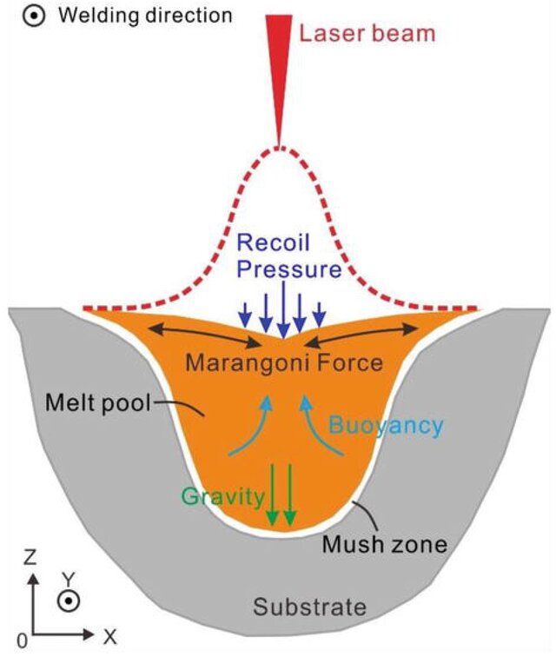
Motivation
To focus NASA Biological and Physical Sciences (BPS) Division’s engagement within the broader Integrated Computational Materials Engineering (ICME) community to understand the phenomena underlying material processing, structure, and properties in the microgravity environment of space and to thereby support future space exploration efforts.
ICME-relevant disciplines covered
  Thermophysical properties, solidification kinetics, coupled solidification-fluids, and structures up to the grain length scale (mesoscale).
Approach
  Survey the heritage & current flight experiments, current ICME engagement, and future opportunities concentrating on the BPS-relevant fields of thermophysical properties, solidification kinetics, coupled solidification-fluids, and structures up to the grain length scale (mesoscale).
Emphasis
  The emergence of additive and in-space manufacturing gives emphasis to studies of rapid solidification in metal alloys.
Uncertainty reduction via validation datasets is one of the foundational pathways towards the fundamental understanding of process-structure-properties relationships has been one of the primary aims of microgravity materials science since its inception. BPS and its predecessors and partners have conducted benchmark experiments for decades in the unique environment of microgravity, advancing the development and validation of both analytical and computational models.
These models are useful for understanding materials behavior on Earth and are even more critical towards predicting performance in exploration relevant reduced gravity environments.
Figure from O. Dumitrescu et al.., “Additive Manufacturing in Space: Process Physics, Qualification, and Future Directions,” licensed under CC BY 4.0.

Slide 4
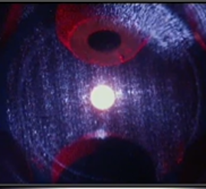
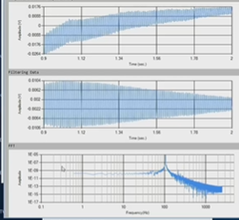
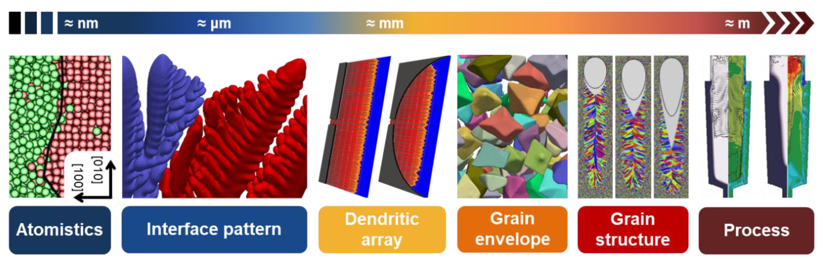
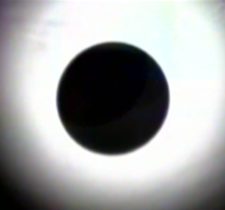
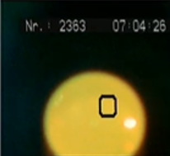
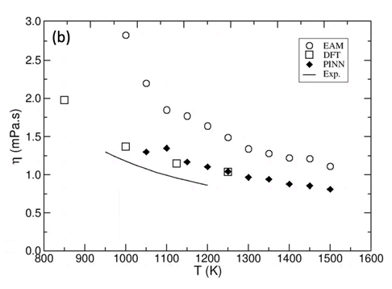
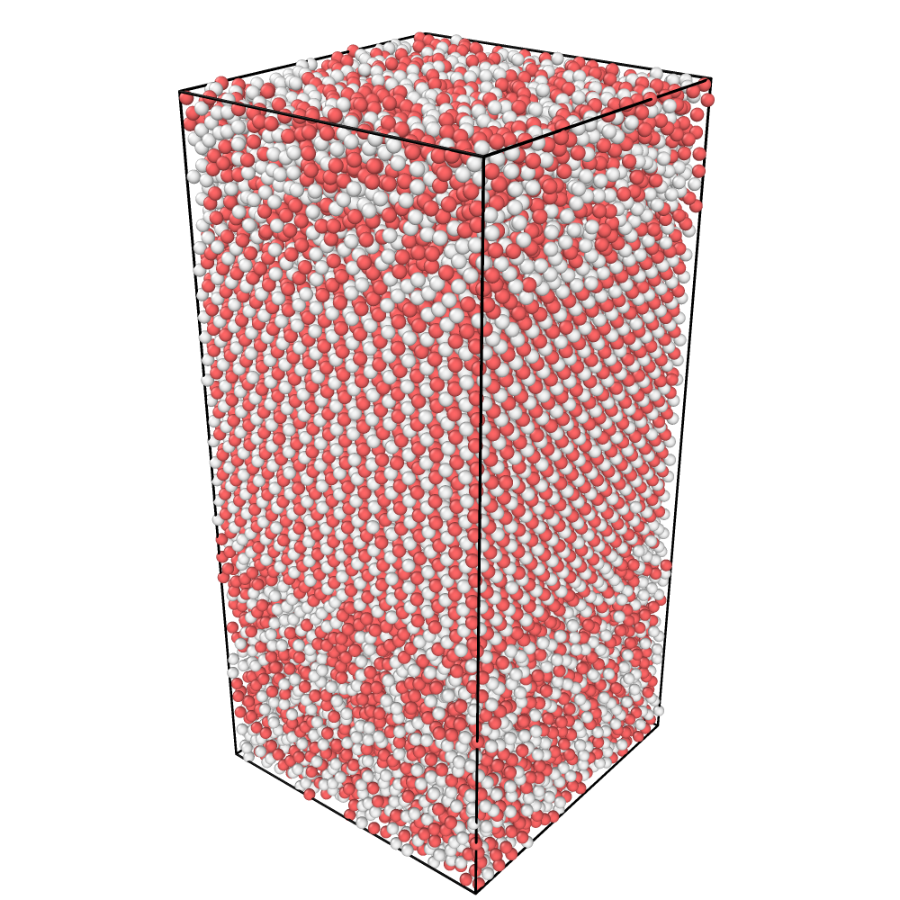
Thermophysical Properties
The continuum of computational material modeling organized by length scale. Figure used with permission.
Examples of sample processing in the JAXA Electrostatic Levitation Furnace.
Example of thermophysical properties determined in the ESA ISS-EML Facility.
Figure from M. Mohr et al., “Electromagnetic levitation containerless processing of metallic materials in microgravity: thermophysical properties,” licensed under CC BY 4.0.
Predictions of thermophysical & interfacial properties
The physically informed neural network (PINN) derived potential allowed the calculation of the energy of the liquid-solid interface, which has never been measured experimentally or calculated through the DFT method.
Figure used with permission.
The complementary nature of ground-based (e.g. MSFC-ESL) and space-based levitation experiments were also described in the report.

Slide 5
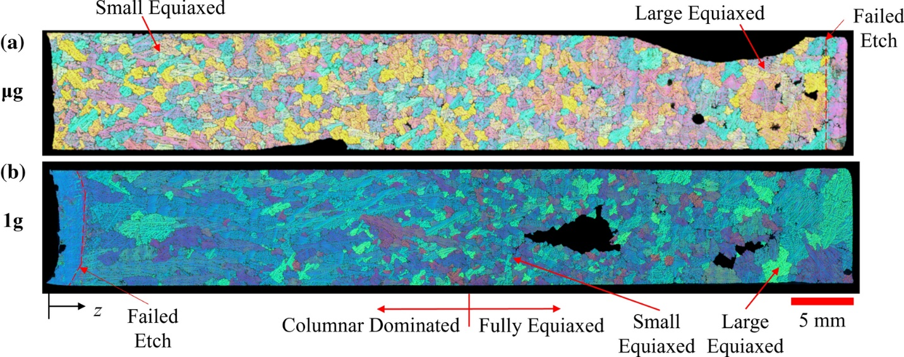
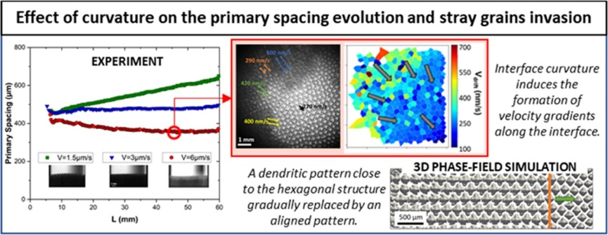
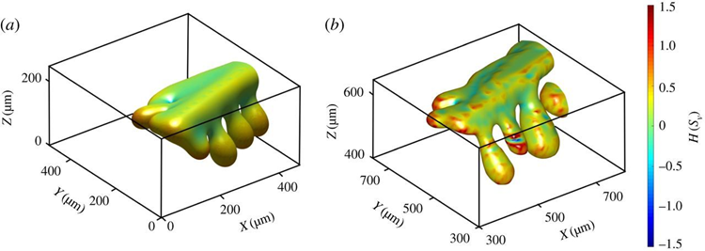
Validating models by experimental flight datasets
“The ongoing international NASA-ESA collaboration in the framework of CETSOL project has produced several benchmark datasets for modeling the ubiquitous transition from columnar to equiaxed grain structures, which is of well-recognized practical importance for controlling the mechanical behavior of structural alloys produced by a wide range of solidification processes.” – BPS ICME Final Report, Modern Benchmark Cases
Figure used with permission.
Optical micrographs of etched aluminum-4wt%Cu specimens solidified under a) microgravity and b) 1 g in SUBSA-CETSOL.
Used with permission from T. J. Williams and C. Beckermann, “Benchmark Al-Cu Solidification Experiments in Microgravity and on Earth,” Metall Mater Trans A, vol. 54, no. 2, pp. 405–422, Feb. 2023, Springer Nature, doi: 10.1007/s11661-022-06909-6.
Lacking appreciable gravitational forcing and therefore buoyancy and sedimentation within a liquid or solid-liquid mixture, flight experiments provide a clearer view of fluid-solidification coupling.
Figure from F. L. Mota, K. Ji, L. S. Littles, R. Trivedi, A. Karma, and N. Bergeon, “Influence of macroscopic interface curvature on dendritic patterns during directional solidification of bulk samples: Experimental and phase-field studies,” licensed under CC BY-NC-ND 4.0.
Dendritic structure after 1.6 hours of coarsening seen a) as simulated and b) as measured experimentally
Notes:
PRedictive Integrated Structural Materials Science (PRISMS)
Multiphysics Object-Oriented Simulation Environment (MOOSE)

Slide 6
Achievements of the BPS ICME Study Team (as of report delivery 12/2024)
Accomplishments to Date:
Convened experts from academia, Agency, & industry; across all length scales from atomistic to macroscale; computational and experimental backgrounds
Produced survey report describing flight experiments and BPS unique capabilities & role in broader ICME context
Exercised BPS-supported academic research codes validated with BPS flight datasets and benchmarked against open-source or commercial codes widely used in ICME community
Interacted with developers of open-source codes (PRISMS-PF, MOOSE); yielded extensions of codes – alternate formulations that support validation datasets, treadmill simulation, and 3-dimensional capability
Implemented 2-dimensional & 3-dimensional PRISMS-PF (CPU-bound) and GPU-PF (GPU-bound) on NAS
Findings to Date:
BPS datasets are foundational anchoring/benchmark datasets used to validate modeling efforts
Interaction with code developers using BPS/microgravity datasets for validation is critical for continued progress
Generation of useful meso/macro-scale property models via scale bridging requires accurate, precise thermophysical properties and solidification- & fluids-coupled models
Computational infrastructure is rapidly evolving from CPU-bound to GPU, increasing throughput and enabling increasingly useful modeling efforts.
  Moving from multi-GPU on single CPU node to multi-GPU on multiple CPU nodes for massively parallel computing that enables simulating entire sample volumes
Models can be made relevant to industry by reducing uncertainty
  Uncertainty quantification requires knowledge of relevant model inputs and parameters; the identification of which requires flight experimental data

Slide 7
BPS ICME Report Conclusions: Recommendations to BPS management
Recommendations:
Accelerate flight experiments to collect critical validation datasets to:
  Quantify and drive down uncertainty in inputs and models for engineering-relevant data to:
    Validate materials property and processing computational and theoretical models
    Conduct materials property and processing experiments unique to microgravity
    Enable progression of experiments from ground to parabolic to suborbital to on-orbit
  Champion “Can Do” science with existing ground and flight facilities and hardware
  Investigate rapid solidification, concentrated alloys, multicomponent engineering alloys, etc. to close science gaps and reduce uncertainty via anchoring datasets
  Engage with STMD and ESDMD to identify "experiments of opportunity” such as welding flight experiments that involve rapid solidification
  Identify facilities requirements for future experimental platforms (i.e. CLDs)
Invest in human capital and computational resources via:
  Contribute to and leverage open-source codes
  Become a visible and trusted partner in the ICME community
    Continue engagement with MOOSE and PRISMS-PF developers
    Continue simulation comparison using flight datasets and BPS-supported research codes
  Support the transition of legacy codes to modern architectures with enhanced capabilities and ease-of-maintenance (e.g. CPU-bound to GPU-bound, multi-GPU multi-node)
  Explore opportunities to employ cognitive (i.e. AI/ML) computing rather than traditional algorithmic (von Neumann) computing
  Support/mentor research teams across multiple academic partners and NASA Centers

Slide 8
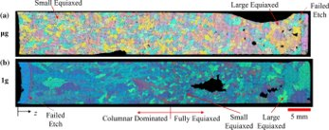
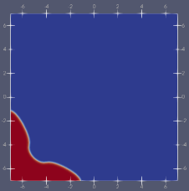
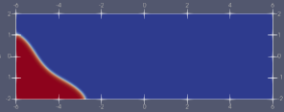

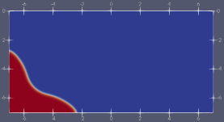
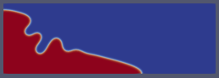
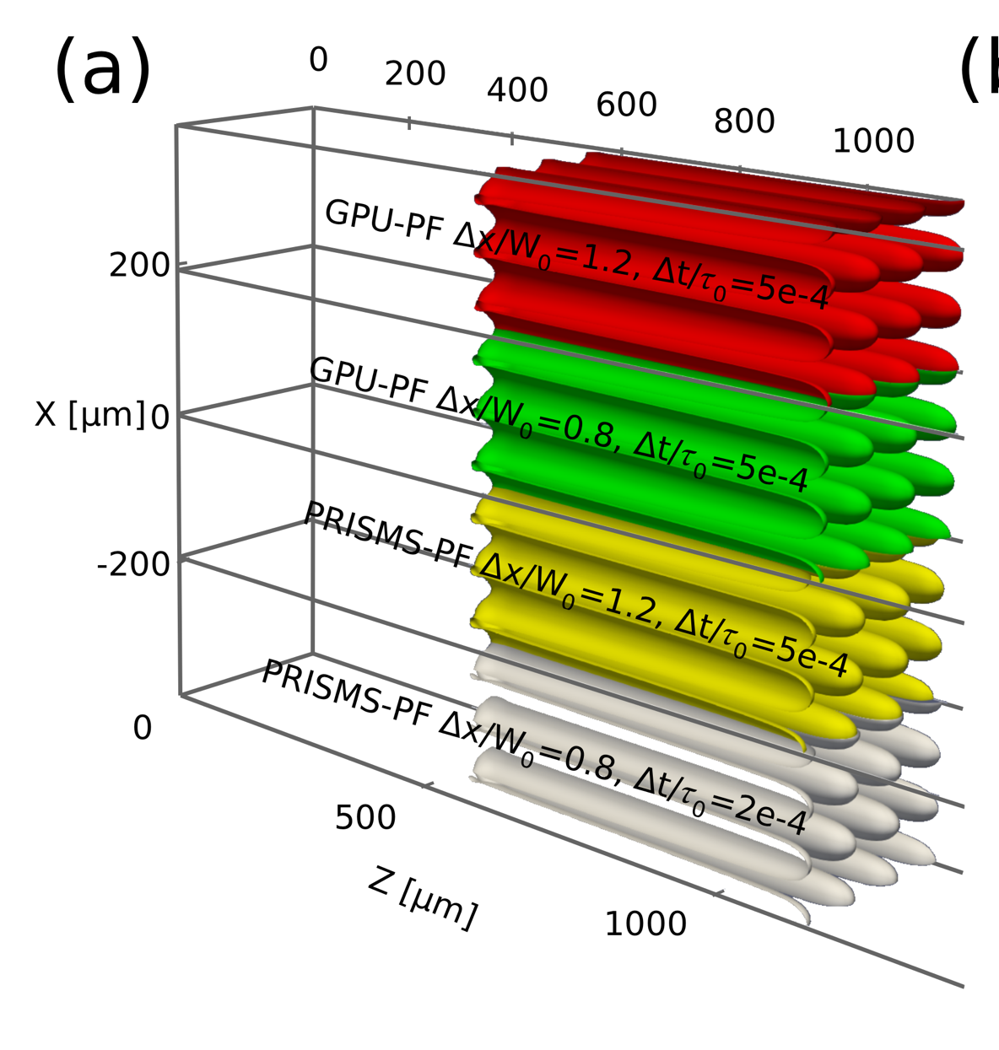
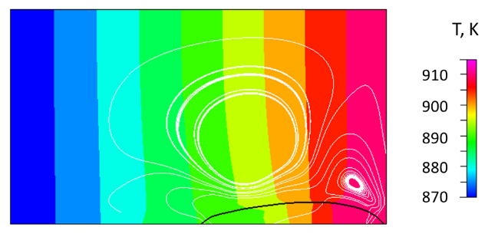
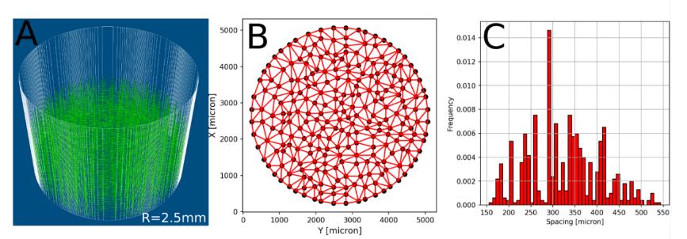
2025/2026 Focus: Validating models/codes using experimental flight/ground datasets
SUBSA-CETSOL
SUBSA-DFM
DECLIC-DSIR
PFMI - update
ISSI - update
MSL-MICAST
Comparison of MOOSE (top) and PRISMS-PF (bottom)
Benchmarking state-of-the art
PF solidification codes
Solidification-fluid flow coupling
Image from ICME Report, CFD-ACE+ Simulation
Comparison of PRISMS-PF and GPU-based research codes
for DECLIC-DSIR experiments
https://arxiv.org/abs/2602.10316
  Support the transition of legacy codes to modern architectures with enhanced capabilities and ease-of-maintenance (e.g. CPU-bound to GPU-bound, multi-GPU multi-node)
Dendrite Needle Network model evolution supports scale bridging and fluid flow coupling
Connection to Applied Exploration Projects:
ESI24: CME for Lunar Metals Welding
  Weld-ASSIST Weldability Assessment for In-Space Conditions using a Digital Twin
  P-S-P Linkage of Lunar Metal Welding with Internal Defects
SBIR Ignite! PY25 ICME Subtopic
NASA/MSFC/EM31 In-House Modeling Status:
Phase Field & 2D DNN models on NAS: simulations & post-processing
Flow 3D Cast Module + Flow 3D AM Module validation studies imminent (funding dependent) – tied to ongoing and proposed work in weld, cast, AM
2D-DNN – flow model (research code) being provided through SME

Slide 9
Validation Dataset Updates: Progress and Near-Term Plans
2026 Focus: Given limited resources and significant uncertainty the focus has been review of existing BPS datasets (both in and in queue for PSI) towards identifying key benchmark datasets for Reduced Gravity Joining (Welding/Brazing) or Additive Manufacturing model validation
Metallic alloy microstructure formation dynamics in a positive temperature gradient
  Transient dynamics, effects of curvature, grain boundary migration
  Dynamics of porosity during melting and solidification
PFMI Update
Flight upgrade of the PFMI hardware and associated ground-based testing as well as periodic reviews of the PSI-available dataset have yielded additional higher-quality images and previously unpublished data files. This imagery and data is of significant interest towards Reduced Gravity Joining applications. 15 samples of Succinonitrile-Water (~25 experiment sequences). Correlated ground-based benchmark thin sample data not yet published.
ISSI (2003-2004 Flight Investigation) Update
PSI-181 “Structure and Properties of Pb-Sn and Pb-free Sn-Ag-Cu Solders Produced in Terrestrial vs. Microgravity Environments under Extremes of Elevated and Cryo Temperatures” – publication in work. (Migration of voids and Pb-rich dendrites during/after solidification). Upcoming ISSI-NEXT (Nano-mechanical Evaluation under eXtreme Temperatures) –
DECLIC-DSIR PSI-48 “Dataset 2” augmentation
DSI-R Paper Published in Acta Materialia June 2025 - “Benchmark microgravity experiments and computations for 3D dendritic-array stability in directional solidification” – Published, open access doi.org/10.1016/j.actamat.2025.120954
* Transient dynamics in metallic alloy solidification including dynamics of pore migration in reduced gravity is highest priority data.

Slide 10
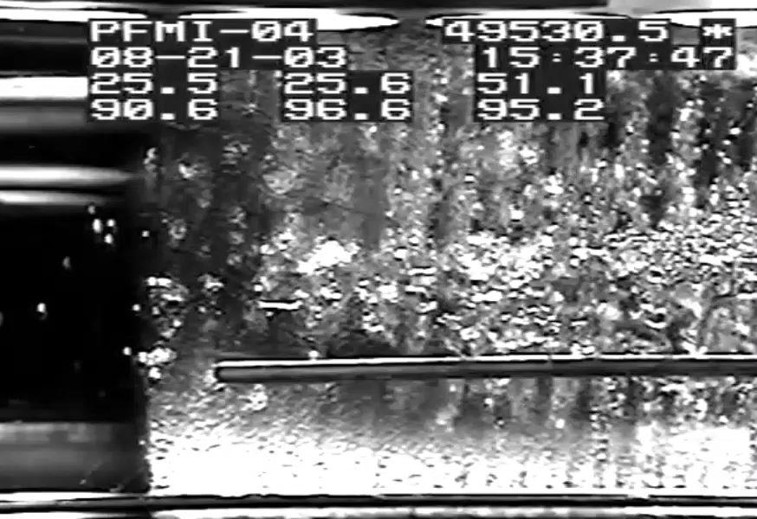
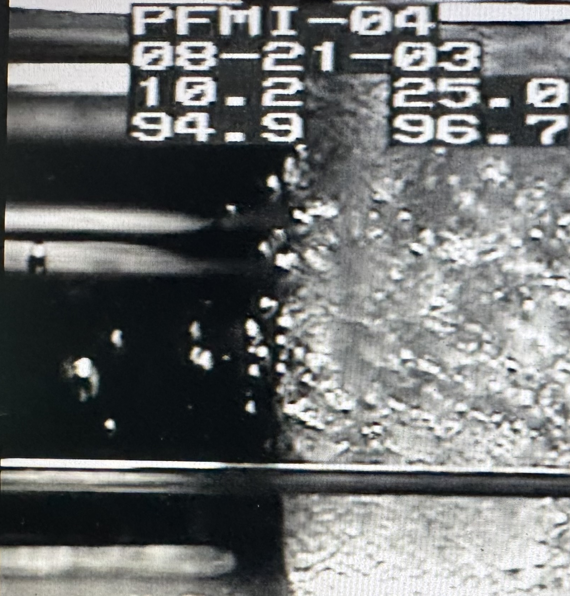
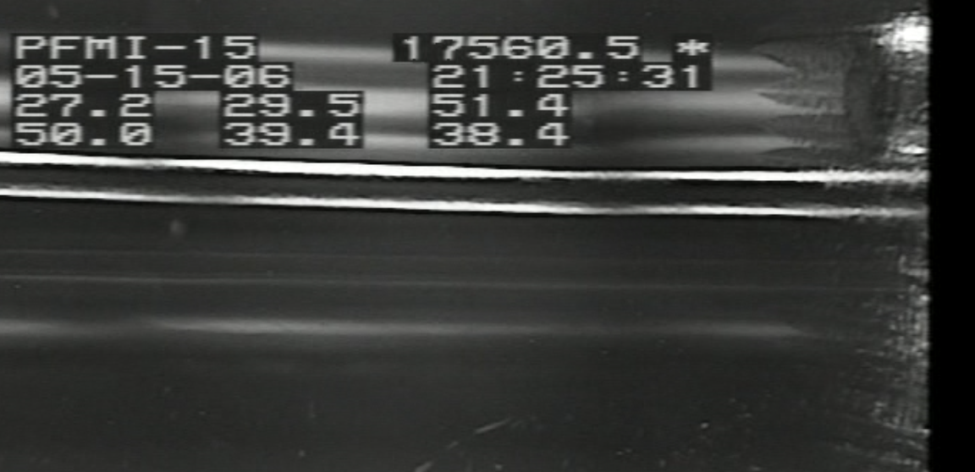
PFMI Dataset Updates/Augmentations
Higher Resolution Conversions of Flight Hi-8 Tapes
Evaluation of Melt as well as Solidification segments for key dynamics of pore dynamics: interaction with Marangoni flow, thermocapillary motion and pressure effects in gradient
Flight datasets on PSI did not include associated raw data logs (command or data) or analyzed data such as gradients and velocities. Found some “lost” data files.
Ground-based SCN-water thin samples

Slide 11
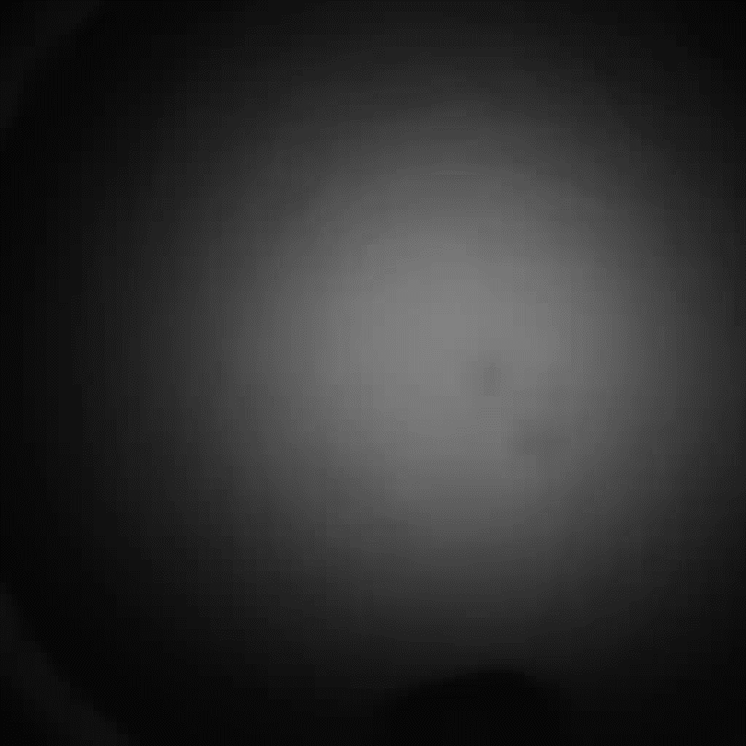
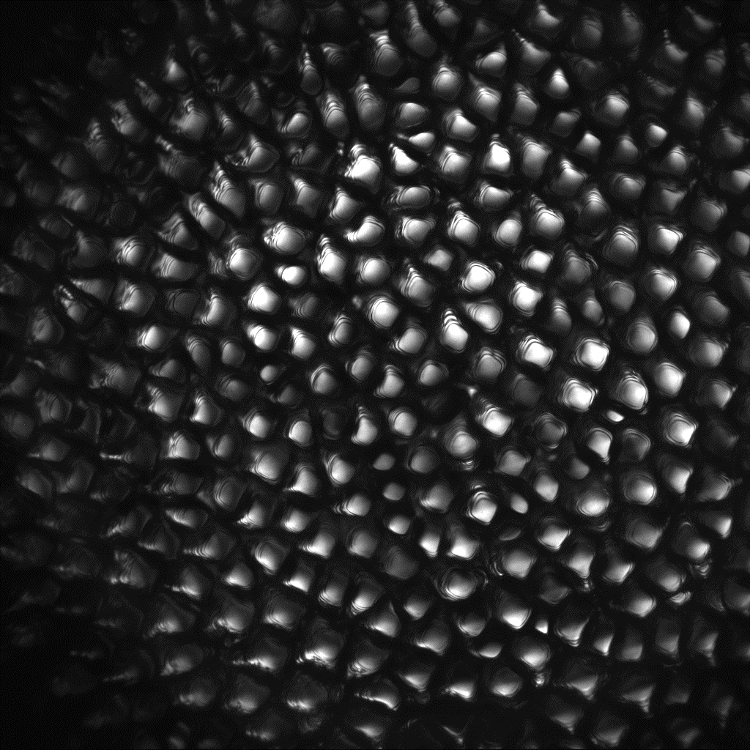
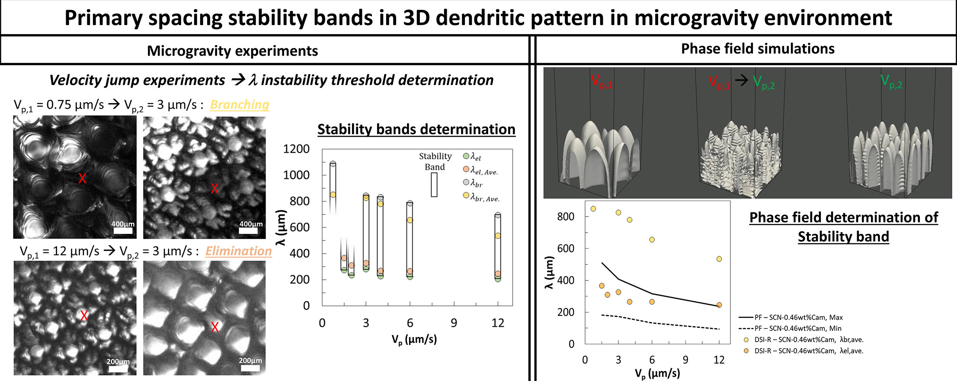
vp1 | vp2
0.75 | 3
1.5 | 3
6 | 3
12 | 3
1.5
3
6
12
4 | 2
2 | 4
6 | 1.5
1.5 | 6
12 | 1.5
1.5 | 12
12 | 6
PSI-48 Dataset 2 includes the 15 sequences analyzed in the paper. All of these sequences were performed with the DSI-R sample (SCN-0.46wt% camphor), and all with G of 12 K/cm. Either with a constant pulling velocity vp (microns/sec) or with a step velocity (up or down) vp1 ->vp2
Videos provided are not temporally accurate, but illustrative of the dynamics being described. The full dataset provides high resolution images with timing, allowing accurate benchmarking of various dynamics captured during the sequence (~7000-8000 images)
Typical
v1.5
thumbnail
• Video 2: Pulling rate jump 0.75 → 3 µm/s (Experiment A); real duration = 13.9 h, video duration = 32.46 s, jump at 11.1 h (real), 14.71 s (video), Ljump = 30 mm, video sec/image = 0.04 sec/image, acquisition frequency before jump = 10.87 sec/image, after jump = 2.27 sec/image.
Graphical Abstract from M. Medjkoune, T. Lyons, F. Mota, J. Tian, K. Ji, L. S. Littles, R. Trivedi, A. Karma, and N. Bergeon, “Benchmark microgravity experiments and computations for 3D dendritic-array stability in directional solidification,” licensed under CC BY 4.0.

Slide 12
vp1 | vp2
0.75 | 3
1.5 | 3
6 | 3
12 | 3
1.5
3
6
12
4 | 2
2 | 4
6 | 1.5
1.5 | 6
12 | 1.5
1.5 | 12
12 | 6
PSI-48 Dataset 2 includes the 15 sequences analyzed in the paper. All of these sequences were performed with the DSI-R sample (SCN-0.46wt% camphor), and all with G of 12 K/cm. Either with a constant pulling velocity vp (microns/sec) or with a step velocity (up or down) vp1 ->vp2
Videos provided are not temporally accurate, but illustrative of the dynamics being described. The full dataset provides high resolution images with timing, allowing accurate benchmarking of various dynamics captured during the sequence (~7000-8000 images)
• Video 2: Pulling rate jump 0.75 → 3 µm/s (Experiment A); real duration = 13.9 h, video duration = 32.46 s, jump at 11.1 h (real), 14.71 s (video), Ljump = 30 mm, video sec/image = 0.04 sec/image, acquisition frequency before jump = 10.87 sec/image, after jump = 2.27 sec/image.
Graphical Abstract from M. Medjkoune, T. Lyons, F. Mota, J. Tian, K. Ji, L. S. Littles, R. Trivedi, A. Karma, and N. Bergeon, “Benchmark microgravity experiments and computations for 3D dendritic-array stability in directional solidification,” licensed under CC BY 4.0.

Slide 13
vp1 | vp2
0.75 | 3
1.5 | 3
6 | 3
12 | 3
1.5
3
6
12
4 | 2
2 | 4
6 | 1.5
1.5 | 6
12 | 1.5
1.5 | 12
12 | 6
PSI-48 Dataset 2 includes the 15 sequences analyzed in the paper. All of these sequences were performed with the DSI-R sample (SCN-0.46wt% camphor), and all with G of 12 K/cm. Either with a constant pulling velocity vp (microns/sec) or with a step velocity (up or down) vp1 ->vp2
Videos provided are not temporally accurate, but illustrative of the dynamics being described. The full dataset provides high resolution images with timing, allowing accurate benchmarking of various dynamics captured during the sequence (~7000-8000 images)
• Video 2: Pulling rate jump 0.75 → 3 µm/s (Experiment A); real duration = 13.9 h, video duration = 32.46 s, jump at 11.1 h (real), 14.71 s (video), Ljump = 30 mm, video sec/image = 0.04 sec/image, acquisition frequency before jump = 10.87 sec/image, after jump = 2.27 sec/image.
Graphical Abstract from M. Medjkoune, T. Lyons, F. Mota, J. Tian, K. Ji, L. S. Littles, R. Trivedi, A. Karma, and N. Bergeon, “Benchmark microgravity experiments and computations for 3D dendritic-array stability in directional solidification,” licensed under CC BY 4.0.

Slide 14
vp1 | vp2
0.75 | 3
1.5 | 3
6 | 3
12 | 3
1.5
3
6
12
4 | 2
2 | 4
6 | 1.5
1.5 | 6
12 | 1.5
1.5 | 12
12 | 6
PSI-48 Dataset 2 includes the 15 sequences analyzed in the paper. All of these sequences were performed with the DSI-R sample (SCN-0.46wt% camphor), and all with G of 12 K/cm. Either with a constant pulling velocity vp (microns/sec) or with a step velocity (up or down) vp1 ->vp2
Videos provided are not temporally accurate, but illustrative of the dynamics being described. The full dataset provides high resolution images with timing, allowing accurate benchmarking of various dynamics captured during the sequence (~7000-8000 images)
• Video 2: Pulling rate jump 0.75 → 3 µm/s (Experiment A); real duration = 13.9 h, video duration = 32.46 s, jump at 11.1 h (real), 14.71 s (video), Ljump = 30 mm, video sec/image = 0.04 sec/image, acquisition frequency before jump = 10.87 sec/image, after jump = 2.27 sec/image.
Graphical Abstract from M. Medjkoune, T. Lyons, F. Mota, J. Tian, K. Ji, L. S. Littles, R. Trivedi, A. Karma, and N. Bergeon, “Benchmark microgravity experiments and computations for 3D dendritic-array stability in directional solidification,” licensed under CC BY 4.0.

Slide 15
2025 Dissemination/ 2026 Plans
TMS ICME 2025:
  Overview of “NASA Biological and Physical Sciences (BPS) Reduced Gravity and Microgravity Integrated Computational Materials Engineering (ICME) Study Final Report” (presented by Peter Voorhees)
  “Benchmarking Massively Parallel Phase-Field Codes for Alloy Solidification” – J. Tian and A. Karma: Northeastern University (co-authors D. Montiel, J. Landini, K. Thornton: PRISMS-PF group Univ. Michigan)
7th International Conference on Advances in Solidification Processes (ICASP-7)
  Plenary lecture “ Phase-field modeling of far-from equilibrium solidification processes: from additive manufacturing to ice templating” – A. Karma
  Microgravity Solidification, faceted interfaces and intermetallics, fluid flow sessions
2025 MRS Fall Meeting: (topical cluster) MATERIALS THEORY, COMPUTATION AND DATA SCIENCE (MT)
  Symposium Sessions | 2025 MRS Fall Meeting & Exhibit | Boston, Massachusetts
  Nov 30 – Dec 5, 2025
American Society for Gravitational and Space Research (ASGSR) 2025
  NASA BPS Reduced Gravity Integrated Computational Materials Engineering (ICME) Study Results and Path Forward – L. Littles
  Ad hoc group discussed path forward (Exploration focus, leverage collaborations, incremental capability development)
2026 TMS Annual Meeting
  Materials Research in Reduced Gravity Symposium
    Laser Beam Welding Benchmark Experiments Performed in Reduced Gravity and Vacuum – O’Connor & al.
    Computational Modeling of Dendritic Microstructures in Transparent NPG-DC Alloys Solidified in Microgravity – Karma & al.
Continue to expand and meet with ad hoc group to catalyze collaboration and leverage proposal opportunities – responding in a timely manner to the opportunities that arise quickly in the present dynamic environment.
Leverage nascent PSI Analysis Working Group structure to the maximum extent possible.

Slide 16
Thank you!

