Slide 1
Passive Capture Tool Dock (PCTD) Challenge
March Team Tech Update
Micro-g NeXT 2026
Michael Sanchez
EVA Tools – EC7
Trade names and trademarks and company names are used in this report for identification only. Their usage does not constitute an official endorsement, either expressed or implied, by the National Aeronautics and Space Administration.

Slide 2
PDR Recap
Congratulations to all teams for successfully making it through PDR! The JSC Micro-g team was very impressed with the work you guys have done, and we are excited to see some EVA tools in action in only a few months. We’ll check back in for TEDP’s and TRR’s soon!
Please review these slides carefully as they contain key clarifications and updates that may affect design details.
These charts include:
  Details on the Tool Belt that will be used by the test subject diver during NBL testing.
  Details on the Mock Pistol Grip Tool (PGT) that will be used by the test subject diver during NBL testing.
As always, if there are any questions or concerns, please reach out!

Slide 3
Utility Belt Assembly Drawing
TOP VIEW
RIGHT VIEW
3
4
6 in
5
4.5 in
5 in
6 in
4 in
6
1
1 in
2
16 in
The purpose of the Swingarm Spacer is to adapt the 1”x1” bolt pattern to the existing Swingarm. The spacer gives teams the option to:
Use clearance holes on their tool dock and interface with threads within the Swingarm Spacer.
OR
Include threads/inserts on their tool dock and interface with counterbored clearance holes on the Swingarm Spacer.
General Assumptions
Left & right Swingarms are mirrors (left not shown).
Test subject is wearing the Weight Belt, just above hip level.
Weight Belt is rigidly mounted to Weight Belt Base Plate.
The purpose of the Weight Belt Base Plate is to provide a mounting interface for the existing Tool Belt.
Swingarm rotates about its mounted axis under no less than 10 lbf applied at the end of the Swingarm.
Volume between Item 2 and Item 3 should be treated as a keep out zone.
Passive Capture Tool Dock |  | 6
Swingarm Spacer | Tough PLA | 5
Swingarm (Right) | Aluminum 6061 | 4
Tool Belt |  | 3
Weight Belt Base Plate |  | 2
RitFit Large Weight Belt | Nylon, Stainless | 1
Part Name | Material | Item

Slide 4
Swingarm Sub-Assembly Drawing
TOP VIEW
RIGHT VIEW
(PCTD NOT SHOWN)
Ø1.5 in
4.5 in
1 in
1.75 in
1 in
1.75 in
1.75 in
7.5 in
Due to export control related justification, we are unable to share the dimensions of the bolt-hole pattern on the Swingarm. Additionally, the middle row of holes on the Swingarm Spacer allow mounting to the Swingarm. As a result, the provided CAD model of the Swingarm Spacer will EXCLUDE the middle row of holes. Please feel free to modify the provided CAD model to include whatever hole spacing you’d like to accommodate at-home testing prior to test week.
NASA will provide each team with a Swingarm Spacer at the beginning of the test week. This NASA provided Swingarm Spacer will include the middle row of holes that allow mounting to the Swingarm. Teams are responsible for providing their own mounting hardware.
.6 in
.375 in
.2 in
.375 in

Slide 5
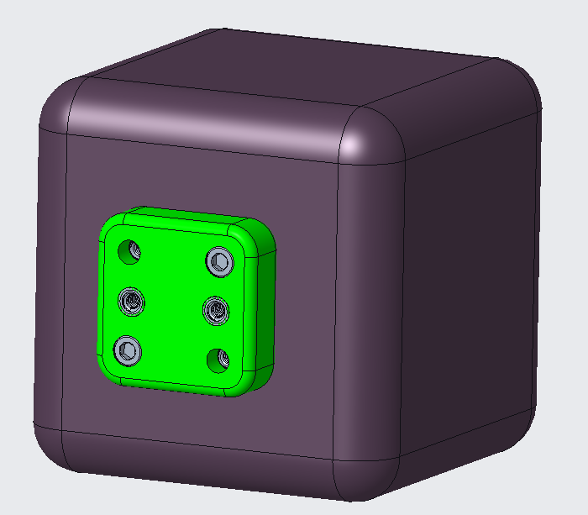
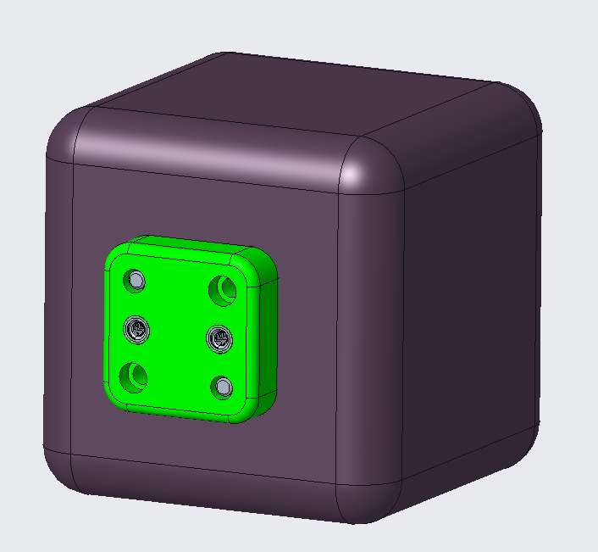
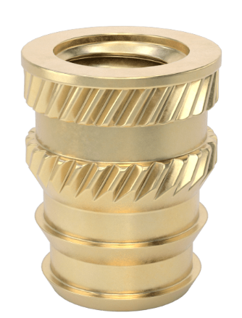
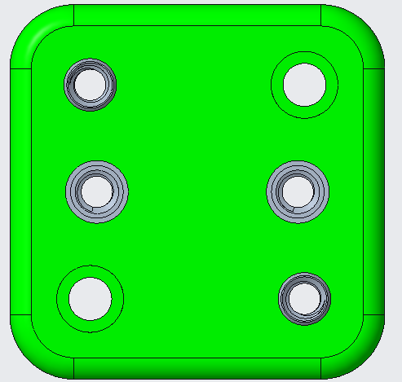
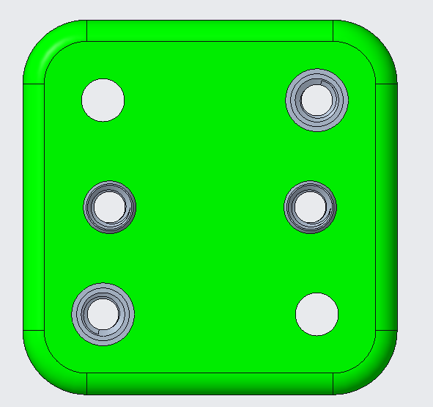
Swingarm Spacer Drawing
Front View
Rear View
Bolt through front of spacer and interface with threads on tool dock. Be sure to size bolt length correctly to ensure sufficient thread engagement.
Bolt through back of spacer and interface with threads on spacer. Be sure to size bolt length correctly to ensure that threads do not protrude past spacer.
Brass heat-set insert installed
10-32 thread size
Total insert length: .375” deep
McMaster-Carr P/N: 93365A156
Counterbore geometry for #10 socket head bolt
(Ø.314”, .195” deep)
(Ø.201” THRU)
OR
Middle row inserts installed from and flush with front surface
Top right and bottom left inserts installed from and flush with rear surface
In both options, bolts entering from the swingarm rear will interface with threads in the middle row on the front of the spacer. Spacers will be mounted to each team's tool dock prior to underwater testing. Between tests, support divers will swap out the two bolts that fasten the spacer to the Swingarm. Prior to testing all teams will mount a spacer to their tool dock, where it will remain throughout the full underwater test duration.
Detailed dimensions of the Swingarm Spacer can be found in the CAD model. Teams are responsible for providing their own mounting hardware.

Slide 6
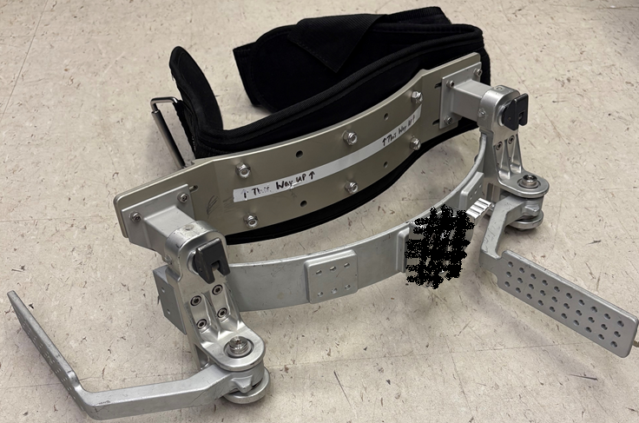
Utility Belt Assembly Drawing
REFERENCE VIEW
1
NOTES
Swingarm Spacer not shown
Swingarm rotation axis shown
2
4
Passive Capture Tool Dock |  | 6
Swingarm Spacer | Tough PLA | 5
Swingarm (Right) | Aluminum 6061 | 4
Tool Belt |  | 3
Weight Belt Base Plate |  | 2
RitFit Large Weight Belt | Nylon, Stainless | 1
Part Name | Material | Item
3

Slide 7
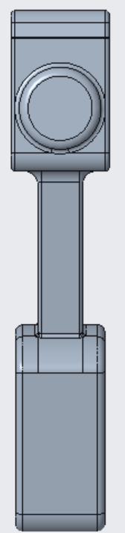
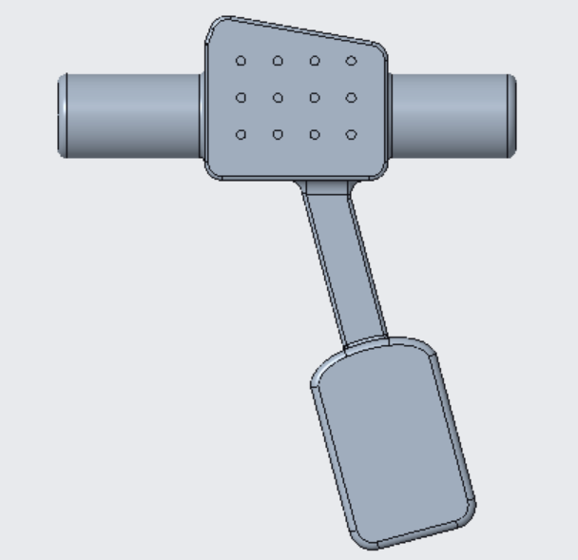
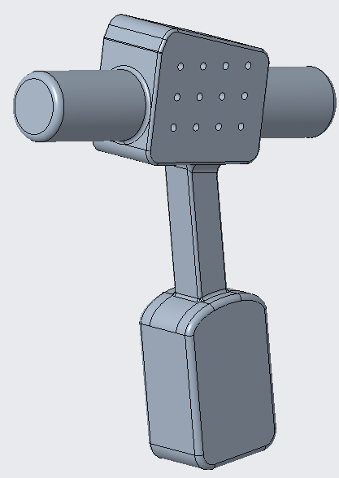
PGT Mockup Dimensions
2.75 in
12.5 in
5 in
1 in
4.5 in
2.3 in
1.25 in
14.6 in
1.25 in
1.25 in
1” x 1” hole pattern, mirrored on both sides
5.5 in
2.5 in
3.5 in

Slide 8
PGT Mockup
Each hole will have a brass heat-set insert installed
#10-32 bolt size
Total insert length: .375” deep, sitting flush
Total hole depth: .6” deep
McMaster-Carr P/N: 93365A156
If your teams’ tool probe cannot accommodate this test hardware change, let us know ASAP. Modifications can be made to the PGT to allow bolts to thread into the tool probe.
1” x 1” hole pattern, mirrored on both sides

