Slide 1
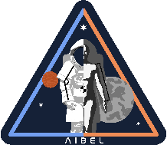
CREW POPULATION CHARACTERISTICS – PERSPECTIVES FOR SPACESUIT FIT
Cassandra Vining (Aegis/NASA JSC)
Han Kim (Leidos/NASA JSC)
Chris Miller (KBR/NASA JSC)
Nate Newby (KBR/NASA JSC)

Slide 2
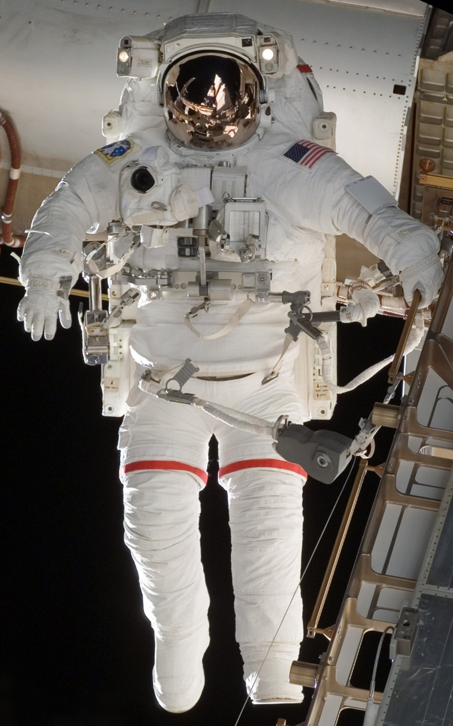
Background & Aim
Introduction
NASA has operated Shuttle Extravehicular Mobility Unit (EMU) for over 40 years
    The Hard Upper Torso (HUT) is a critical component for crew protection and suit functionalities
    The EMU HUT accommodates 40th percentile female to 95th percentile male
    Inadequate HUT fit has impacts to EVA objectives and crew health
There is a demonstrated need for more robust sizing schema
This study aims to develop a framework for designing custom‑fit HUTs for future spacesuit development
    A custom fit model was developed using historical NASA spacesuit‑operations data
    The framework was projected onto the crew population to identify key anthropometric characteristics from the perspective of spacesuit fit

Slide 3
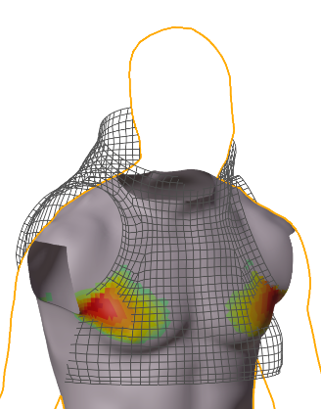
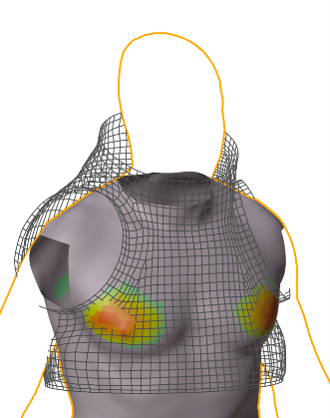
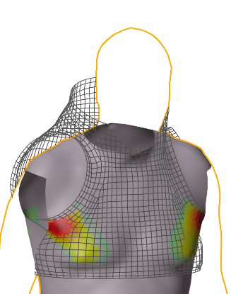
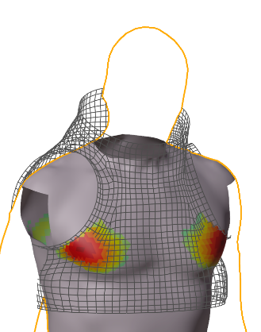
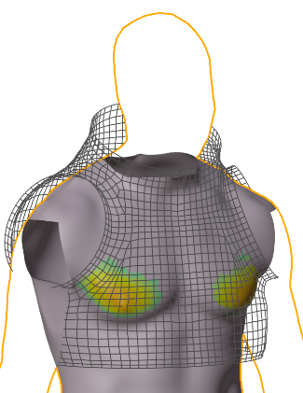
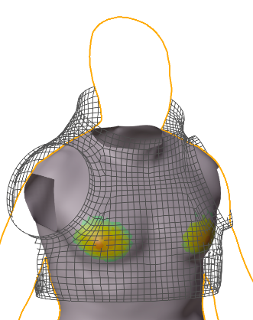
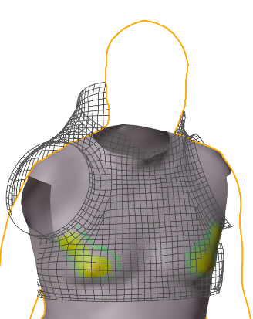
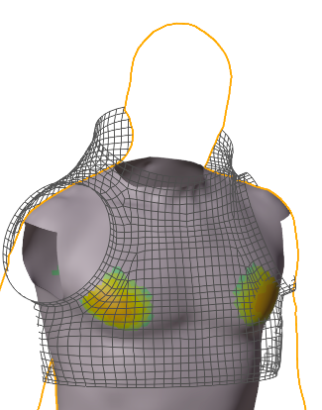
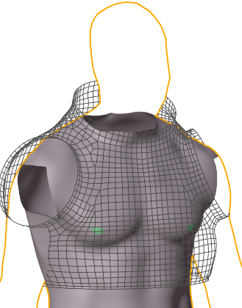
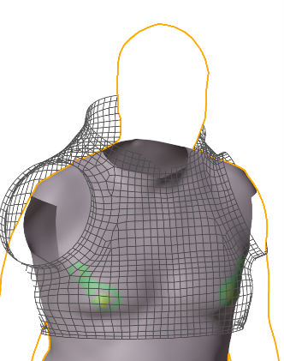
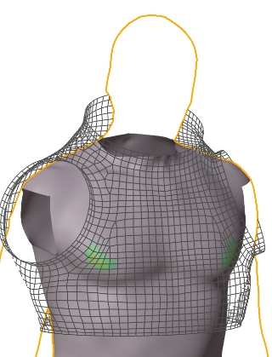
Premise & Aim
Introduction
When a person wears their preferred HUT size, the HUT‑to‑body contact shows a distinct pattern compared to wearing one size larger or smaller
Hypothesis: Selecting an optimal HUT size is driven by achieving optimal HUT‑to‑body contact
Wearing a HUT one size smaller than preferred
Wearing the preferred size HUT
Wearing one size larger than preferred

Slide 4
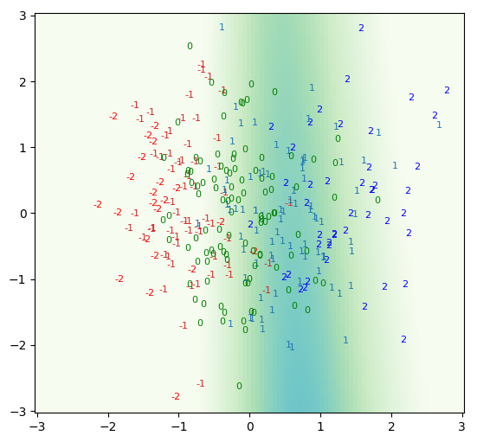
Underlying Data
Methods
HUT size preferences were obtained from historical Shuttle EMU fit‑check data (N = 105, Medium 44%, Large 35%, XL 21%)
Body scan was overlaid with shuttle EMU internal surface geometry; Suit-to-body contact patterns were computed and reduced using partial least squares regression based on the HUT size delta
    EMU internal surface geometry was obtained via scanning; for HUTs that were not developed (such as Small size), geometry was extrapolated from existing HUTs
This demonstrates that HUT size deltas can be categorized using contact pattern
    This capability enables adjusting the HUT shape to achieve the desired level of fit
Original
Contact
Pattern
Principal Component 2
Desired
Contact Pattern
Principal Component 1
Reduced contact pattern data. Points are labeled with how many sizes the HUT is from nominal. For instance, “0” represents an optimal size HUT, and “-2” represents a HUT two sizes smaller than optimal. Distinct clusters appear corresponding to each HUT size offset.

Slide 5
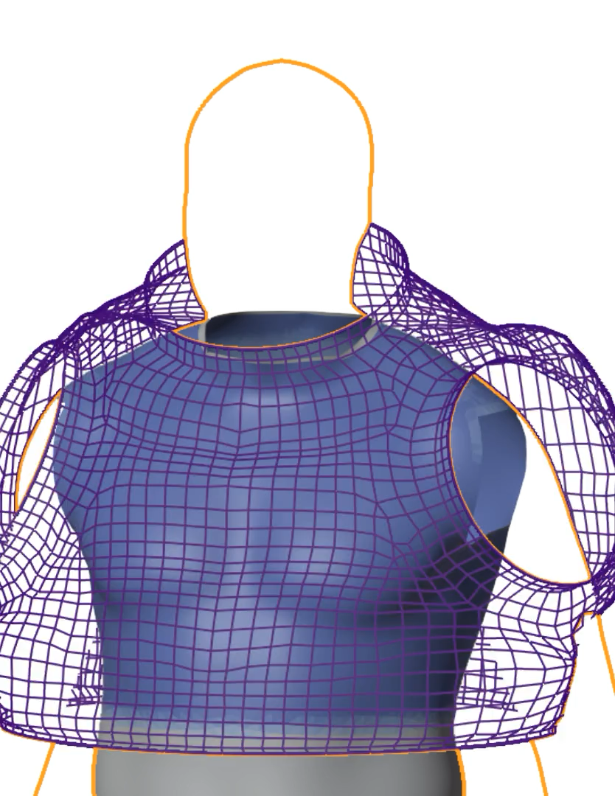
Statistical Models
Methods
Contact patterns are a function of a person’s body shape and suit geometry
Therefore, a person’s “optimal” HUT geometry can be generated by adjusting the suit shape to create the “optimal” HUT-to-body contact pattern
An optimization model was built to parametrically adjust suit shape to achieve a contact pattern associated with a targeted fit and size condition for a given person

Slide 6
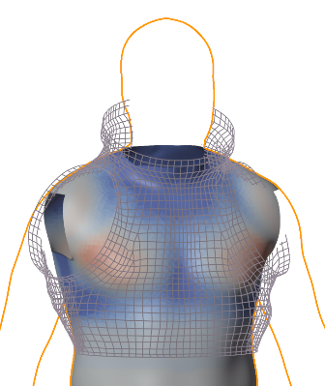
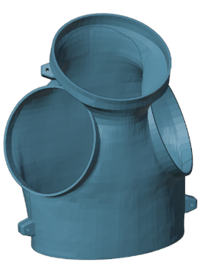
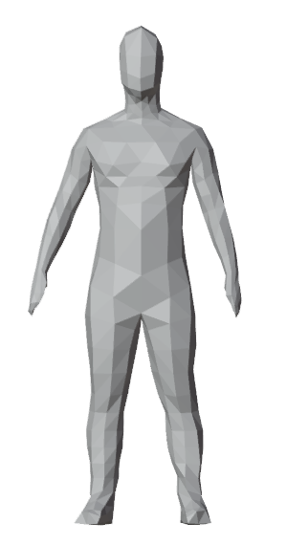
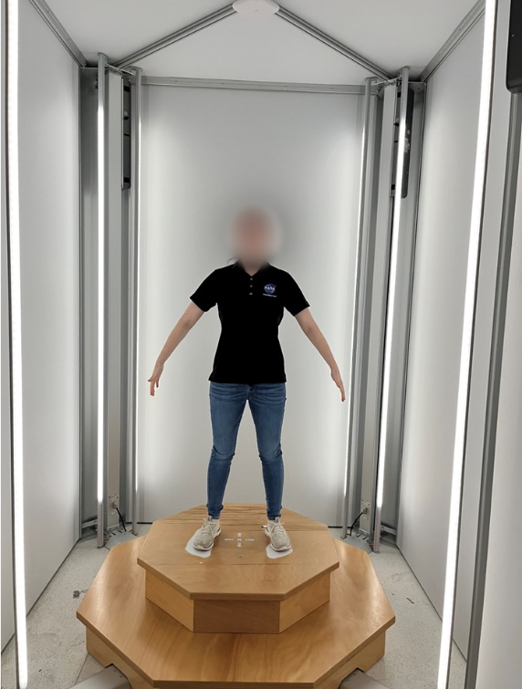
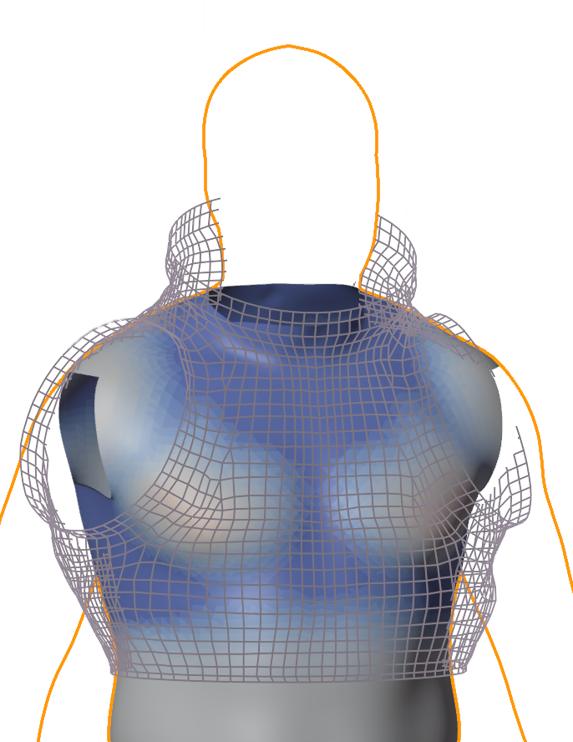
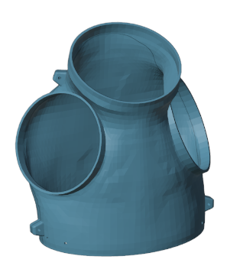
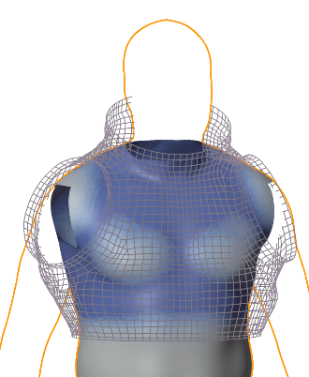
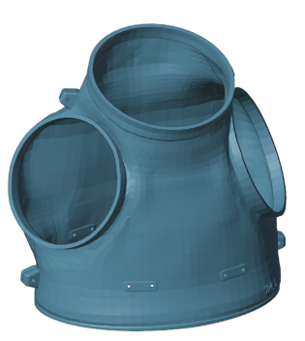
Human in the Loop Testing
Model Validation
Subject body scan data are used to generate the contact pattern associated with wearing the predicted “Optimal”, “Optimal + 1”, and “Optimal – 1” sized HUTs
Each subject evaluates all three of their customized HUTs during a Human-In-The-Loop (HITL) test series
Statistical HUT
Generation
Mockup
Fabrication for
HITL
3D Body Scan
Optimal - 1 Size
Optimal Size
Optimal + 1 Size

Slide 7
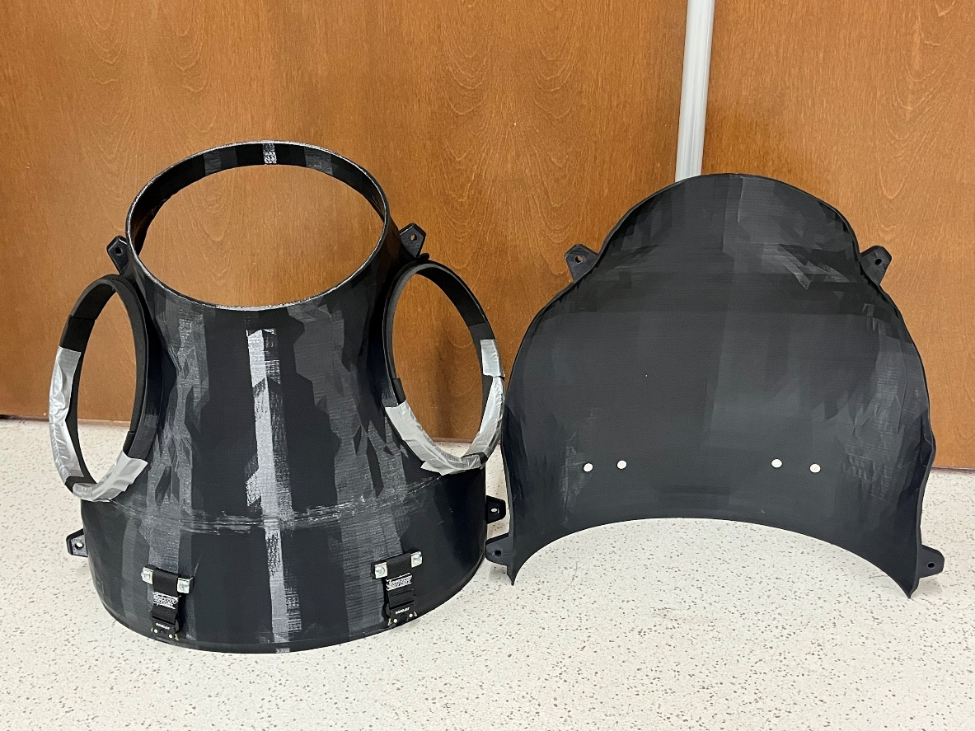
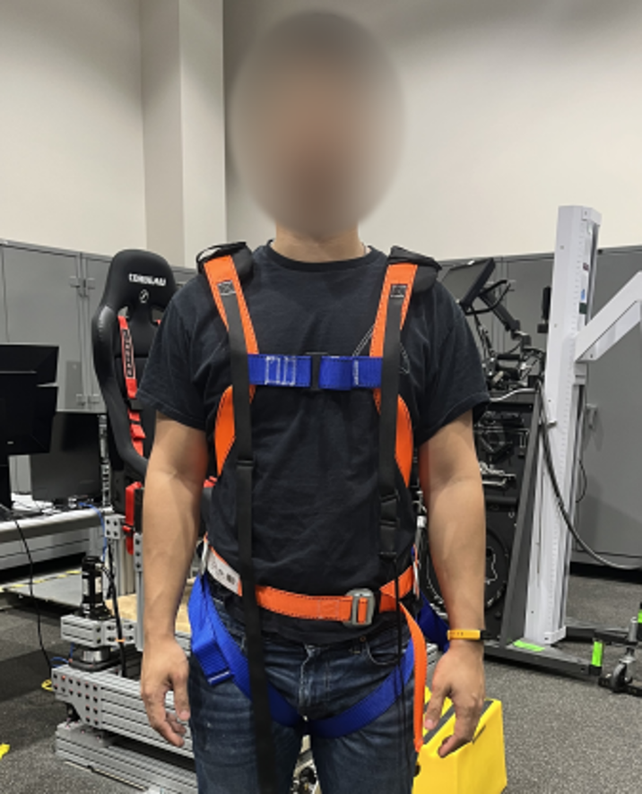
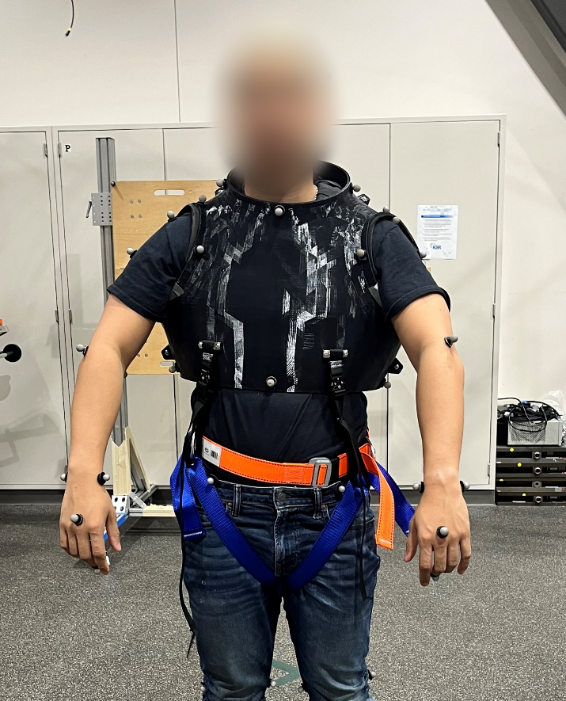
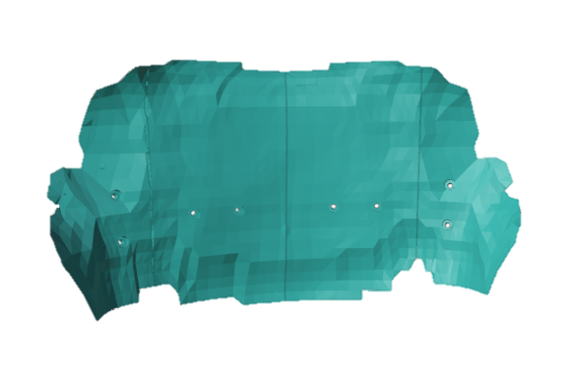
HITL Hardware
Model Validation
HUT is 3D printed based on generated internal geometry
  Harness and internal hardware are used to hold HUT in a realistic position
  Sizing inserts eliminate need to fully print each HUT
Sizing Inserts

Slide 8
Evaluation Metrics
Model Validation
Indexing
Reach
Functional Mobility
Subjective Experience
How the HUT sits on the body
Maximal and comfortable reach capacity
Ability to complete EVA-analogous tasks
Perceived body-to-HUT contact pattern
Discomfort or pain

Slide 9
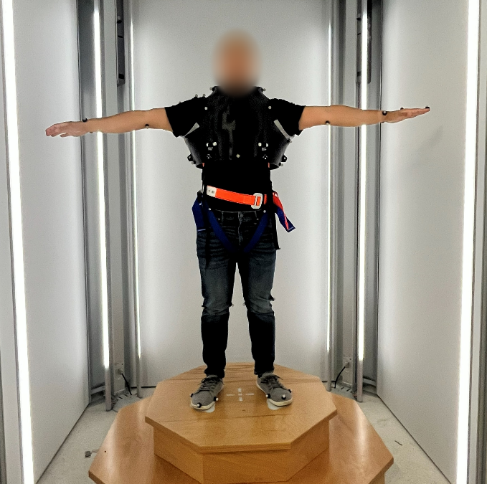
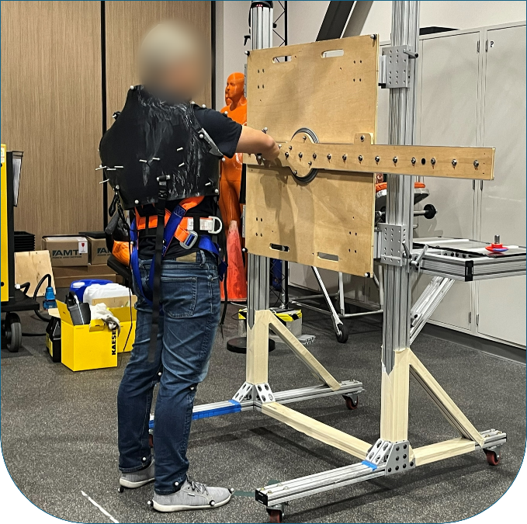
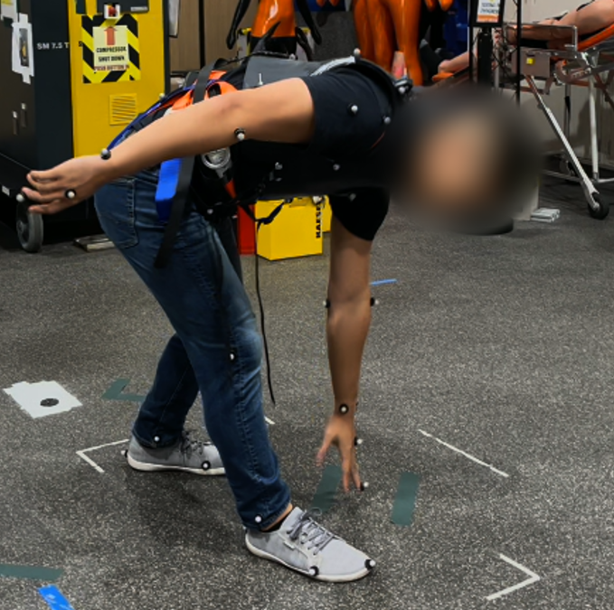
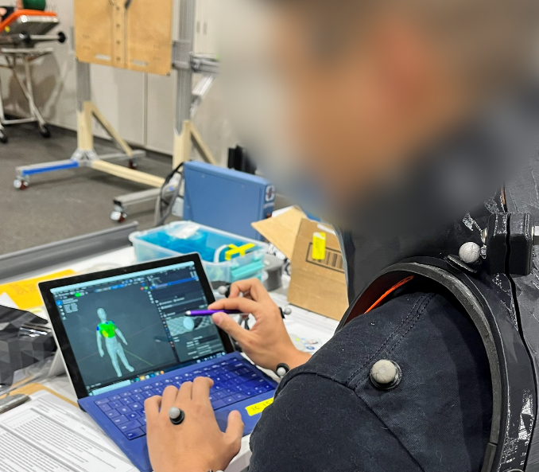
Data Collection
Model Validation
Indexing
Reach
Functional Mobility
Subjective Experience
Laser scanning
Motion capture-
Reach envelope and tasks
Motion capture-
Mobility tasks
Subject feedback
Questionnaires
Subjective contact
pattern mapping

Slide 10
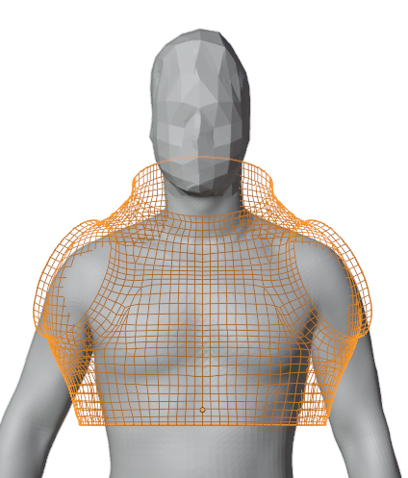
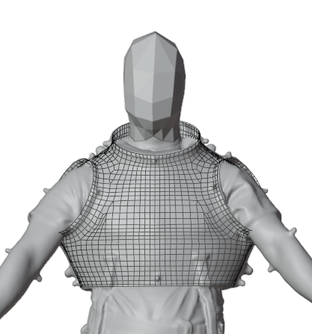
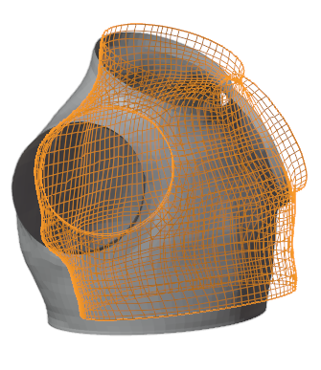
Data and Analysis
Indexing
Model predicted indexing
HUT geometry overlaid with scan of subject wearing HUT
Comparison of model prediction vs. actual HUT placement

Slide 11
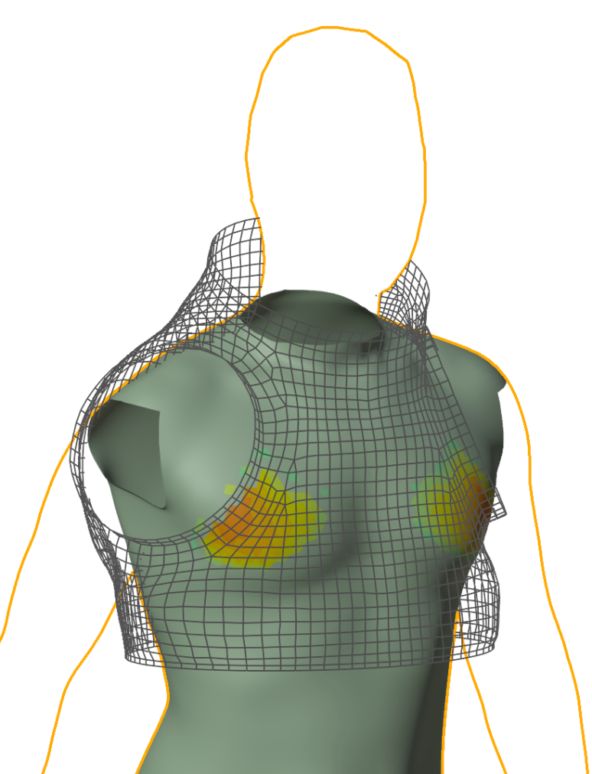
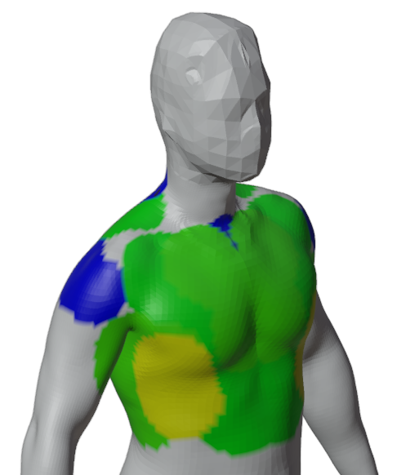
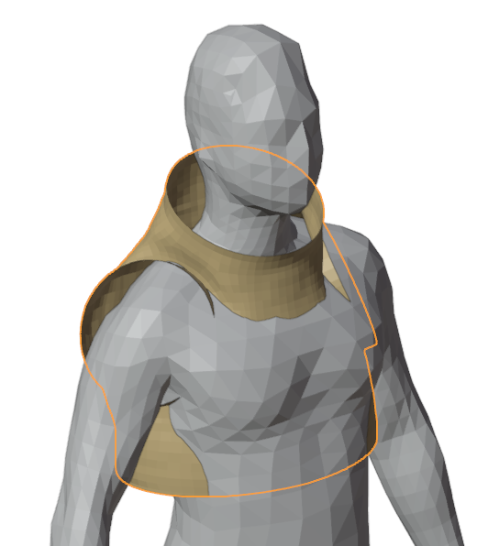
Data and Analysis
Contact Patterns
Model predicted contact pattern
Subject perceived contact pattern
HUT geometry overlaid with body scan geometry

Slide 12
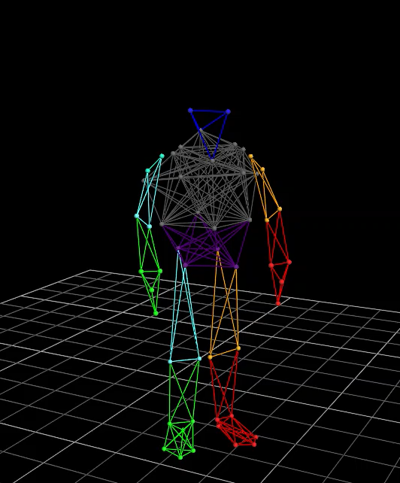
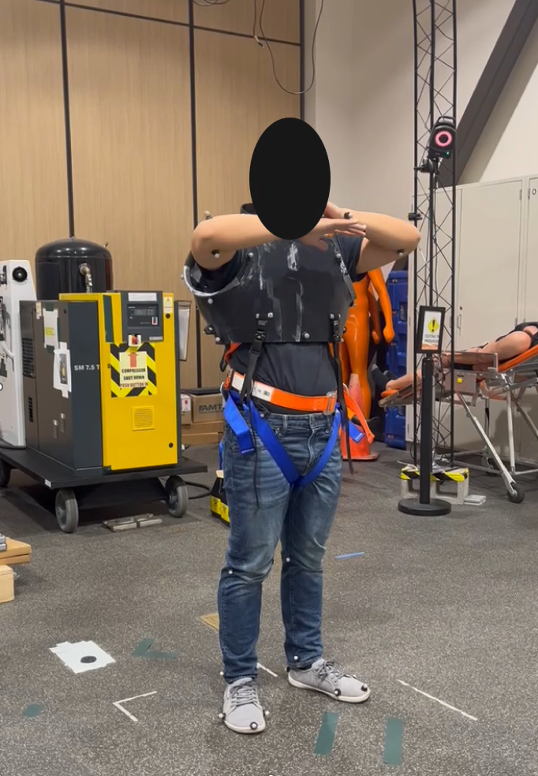
Data and Analysis
Functional Mobility + Reach
Subject completed various tasks to evaluate full-body mobility and reach
Measured maximum arm reach envelopes (sweeping extreme-to-extreme locations) and “comfortable” range of motion

Slide 13
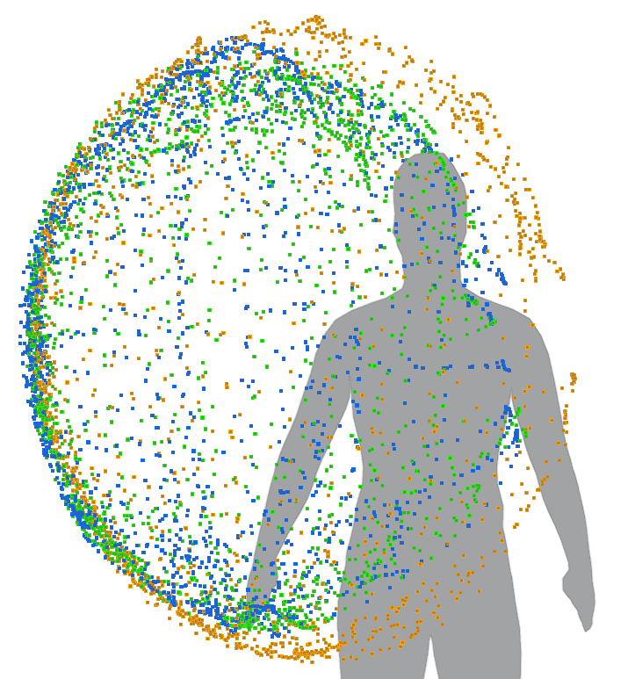
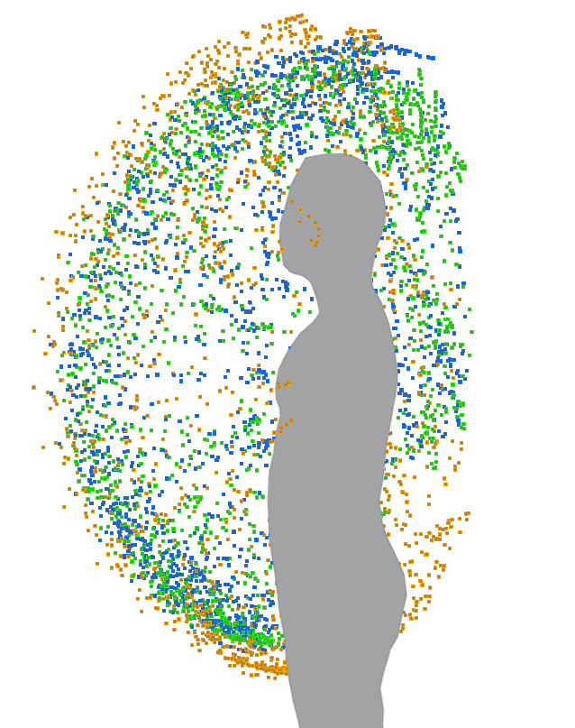
Data and Analysis
Reach Envelopes
“Optimal + 1” HUT size reduced reach envelope dimensions, potentially due to arm-to-scye bearing interference
In the “Optimal - 1” size, the subject showed larger maximal range of motion and larger comfortable range of motion than with the other sizes.
Comparison of “Optimal”, “Optimal + 1”, and “Optimal - 1” size conditions

Slide 14
Data and Analysis
Subjective Evaluation
All three HUTs were considered comfortable as tested
    “Optimal + 1” was comfortable, but the subject noted that it would not feel secure in a simulated reduced gravity condition (e.g., Neutral Buoyancy Laboratory)
    “Optimal – 1” was tight but very comfortable; subject noted that there was no clearance to add other suit components such as the LCVG
Scye ring was a consistent source of discomfort, particularly for larger HUT sizes
Subjective contact pattern mapping was evaluated for static and dynamic postures. The difference between static and dynamic contact patterns was smaller for larger HUT sizes (e.g., there was no difference in mapped contact pattern for “Optimal + 1” static and dynamic conditions)

Slide 15
Conclusion
Discussion
This is the first study to apply quantifiable metrics from historical fit check data to future HUT architecture development
Provides potential framework updates for Mars suits
  Historically, it was not feasible to implement multiple sizes that could match critical interfaces (e.g., body seal closure diameter) due to cost and logistical challenges
  Producing a discrete set of critical interface sizes could now be practical
This work characterized the crew population not by standalone anthropometry, but by how the crew interacted with the spacesuit, yielding more meaningful insights for suit design and crew performance
Limitations
  Architecture specific (EMU)
  No HUT fixtures (e.g., LCVG, drink bag, etc.) nor supplemental hardware included in the model and HITL tests

Slide 16
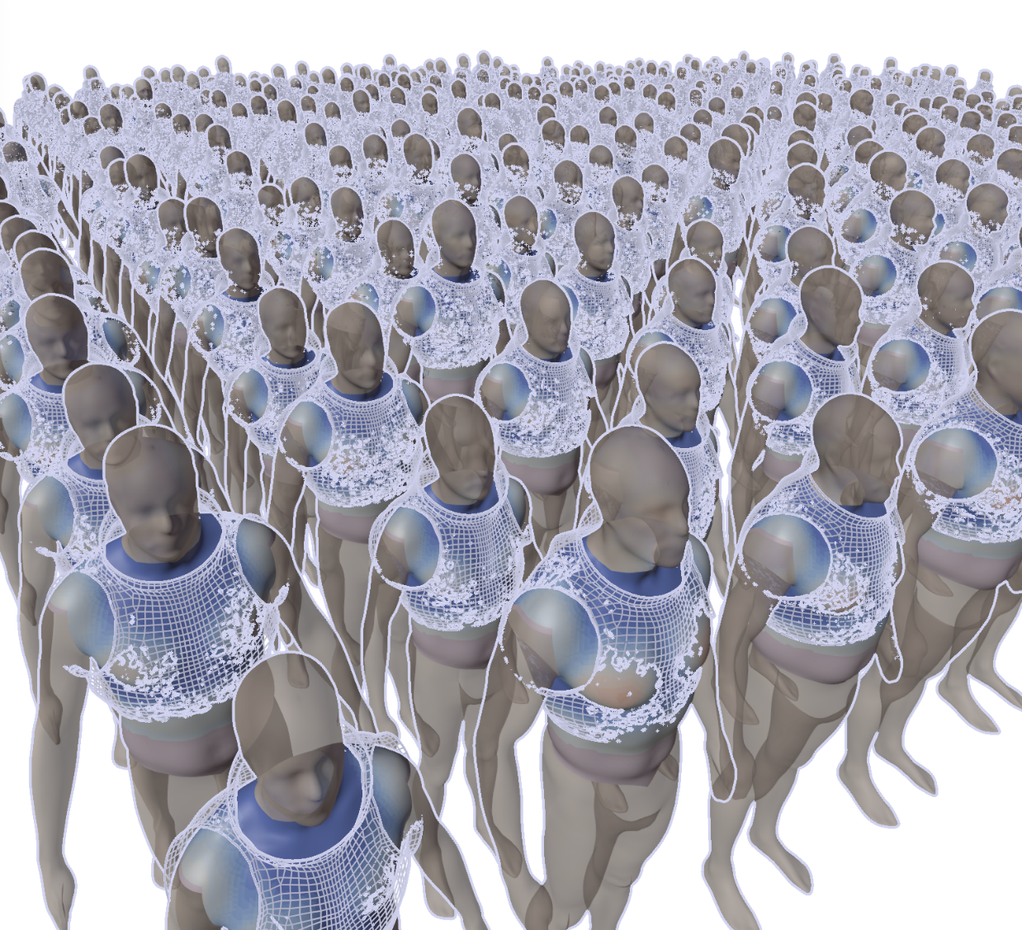
Conclusion
Future Work
Collect and assess data for remaining HITL subjects
Estimate optimal suit shape for individual cases across entire crew population
Group the optimal suit shapes by clustering analysis; Identify the population segments that are associated with non-common suit shapes or dimensions

Slide 17
CREW POPULATION CHARACTERISTICS – PERSPECTIVES FOR SPACESUIT FIT
Cassandra Vining (Aegis/NASA JSC)
Han Kim (Leidos/NASA JSC)
Chris Miller (KBR/NASA JSC)
Nate Newby (KBR/NASA JSC)
This study is funded by NASA HRP Human Factors and Behavioral Performance Element Directed Study.

