Slide 1
Space Radiation Countermeasure Research Plan
Janice Zawaski, PhD,
Space Radiation Element Scientist
Human Research Program (HRP)
Janapriya Saha, PhD
Space Radiation Deputy Element Scientist
Human Research Program (HRP)
January 13, 2025

Slide 2
Overview
Space radiation background overview
Current Evidence of Space Radiation-induced Effects
  Cancer
  Cardiovascular (CV)
  Central Nervous System (CNS)
  Past Drug Experiments
Overall Research Strategy
  Research Emphases
    Research, Techniques, and Tools
    Sequence of Tasks
  Deliverables & Risk Buy Down
Collaborations, Stakeholders and Customers Integration

Slide 3
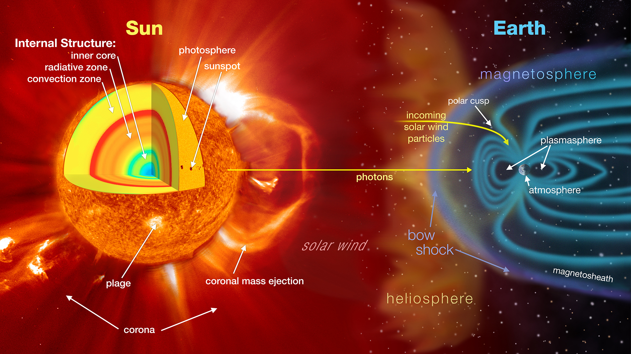
Low Earth Orbit Environment
Notes:
The chart shows the number of sunspots from 1975 to 2030, represented as a green line that goes up and down, like a wave. The original prediction is at the right side of the chart as a blue line. A red line, the McIntosh Et al study is layered with it but at many points higher than the blue line

Slide 4
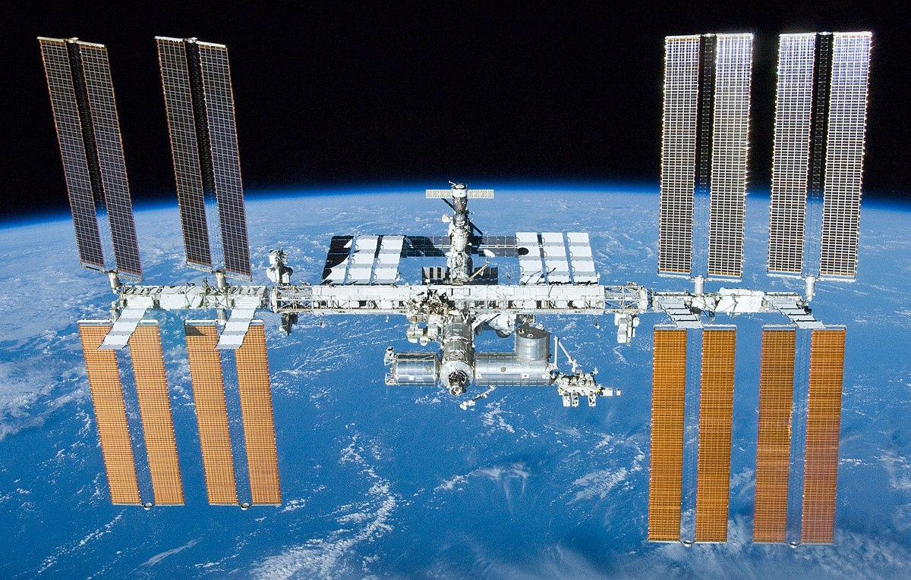
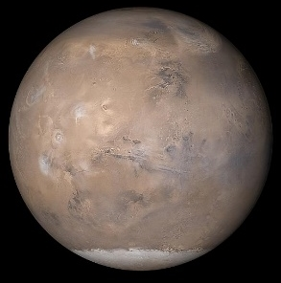
What's out there? The Space Radiation Environment
Exposure Type | ISS (51.6⁰ inclination) | Beyond Low Earth Orbit (LEO)
Galactic Cosmic Rays (GCR) | Limited to polar regions Fractionated low dose-rate ~ 87% protons, 12% Helium, 1% High charge and Energy (HZE) | Continuous Chronic low dose-rate ~ 87% protons, 12% Helium, 1% HZE
Trapped Radiation | South Atlantic Anomaly (SAA) Fractionated low dose-rate Protons | Transit through Van Allen Belts Quasi-acute Protons
Solar Particle Events (SPEs) | Limited to polar regions Fractionated low dose-rate Protons | Full Event Quasi-acute Protons
Neutrons, Secondary Radiation | Shielding affects Secondary Radiation Chronic low dose-rate | Shielding affects Secondary Radiation Planetary (albedo) Chronic low dose-rate
Notes:
Space radiation is composed of mainly high energy particles from 3 primary sources. Galactic Cosmic Rays which are theorized to be the result of stellar explosions accelerating every known element on the periodic table across the universe. Then there are the protons and electrons that get trapped in Earth’s magnetic field – commonly referred to as the Van Allen Belts. These are responsible for the South Atlantic Anomaly – a region where the offset of Earth’s geomagnetic and rotational axes create an area where the inner radiation belts impinges into the atmosphere. And then finally, probably the most well known are the Solar Particle Events. These occur when localize magnetic fields on the Sun get so tangled that they reconnect and the energy released accelerates particles out into the solar system. Additionally Neutrons and Secondary radiation can be created inside a spacecraft, habitat, or on a planetary or lunar surface.
But of course the, contribution of each of these sources to a person’s dose is dependent on a number of factors, including where you are in space. For example….
However, on a per day dose rate basis, ISS and Beyond LEO exposures are roughly similar – but it is the composition of the radiation that is different and the fact that there is no geomagnetic protection from solar particle events beyond LEO.

Slide 5
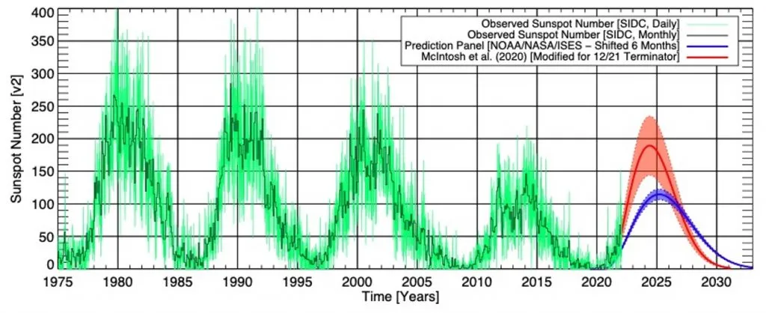
Space Weather
From the Space Weather Archive
Notes:
The chart shows the number of sunspots from 1975 to 2030, represented as a green line that goes up and down, like a wave. The original prediction is at the right side of the chart as a blue line. A red line, the McIntosh Et al study is layered with it but at many points higher than the blue line

Slide 6
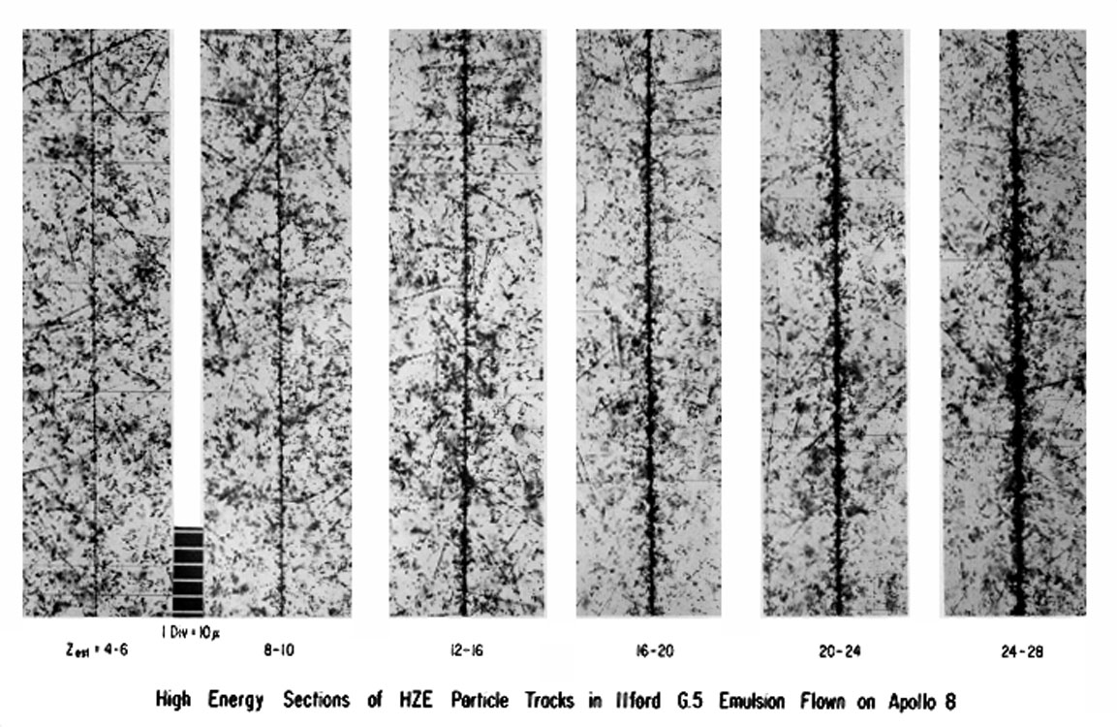
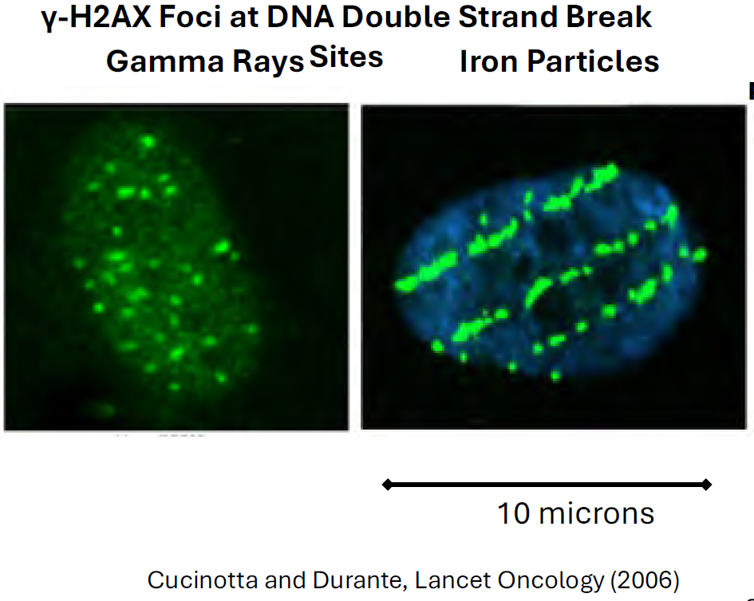
Beyond Low Earth Orbit (BLEO) Exposure
Space radiation is complex and unlike terrestrial radiation
  High energy, fully ionized particles
    Deposit energy along tracks quantified by linear energy transfer (LET)
    Ionization density depends on LET and charge (Z)
  GCR composition
    87% protons
    12% helium
    1% High charge & energy (HZE) ions Z > 2
Schaefer & Sullivan, 1976
Cucinotta and Durante, Lancet Oncology, 1976

Slide 7
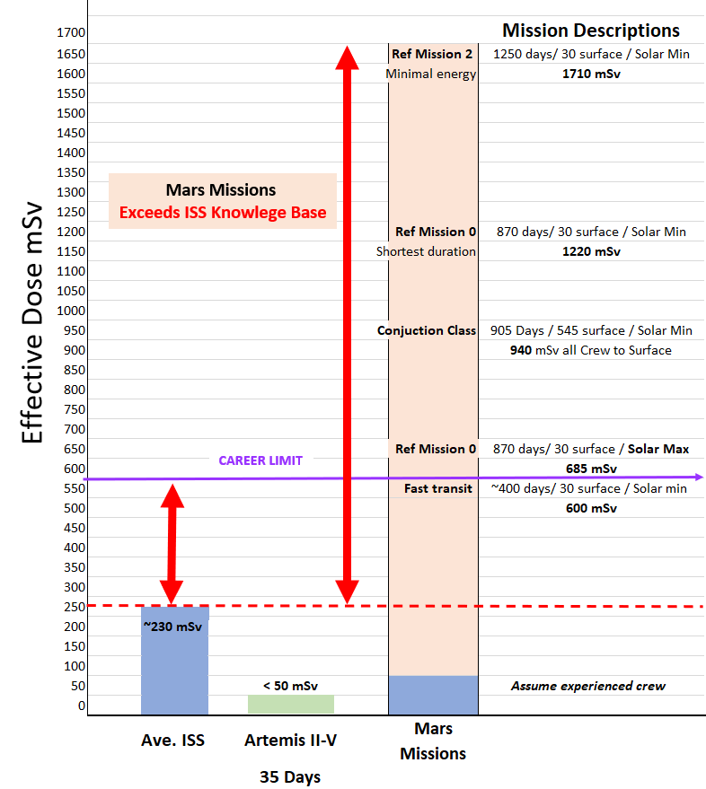
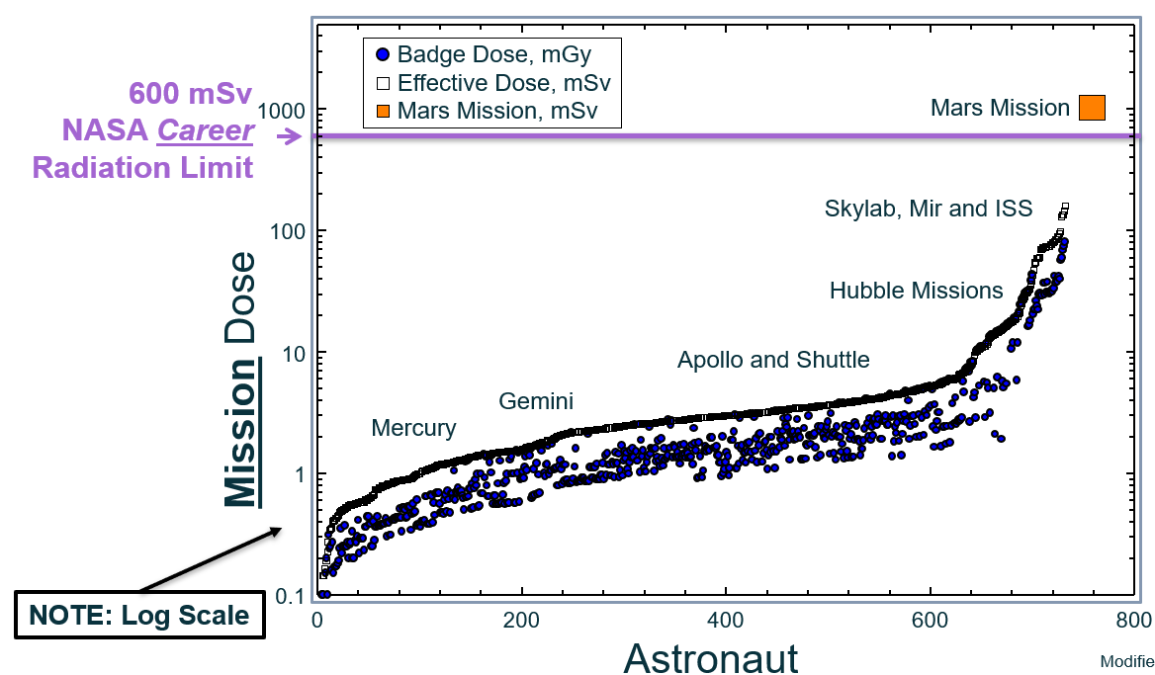
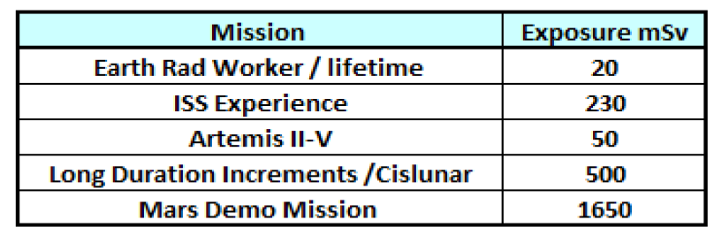
Historical and Future NASA Crew Mission Doses
Notes:
NASA Radiation Standards – Crew Health
NASA STD 3001 Vol. I
4.8.2 Career Space Permissible Exposure Limit for Spaceflight Radiation
An individual crewmember’s total career effective radiation dose due to spaceflight radiation exposure shall be less than 600 mSv. This limit is universal for all ages and sexes.
Conservative approach 3% mean REID of a 35 year old female

Slide 8

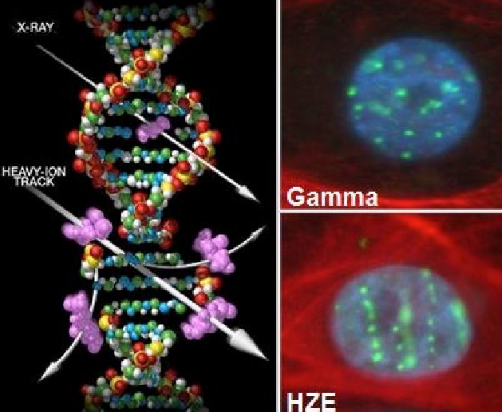
Space Radiation Health Risks
Major Risks:
Radiation Carcinogenesis (long-term health)
Central Nervous System Effects – in-flight and post mission
Degenerative Diseases – cardiac and vascular (Long-term health), cataracts
Acute Radiation Syndrome
Gamma Rays
  GCR composition
    87% protons
    12% helium
    1% High charge & energy (HZE) ions Z>2
Iron Particles
DNA Damage in Cells: Space radiation (HZE) dense ionizing particle track
Life 2014, 4, 491-510

Slide 9
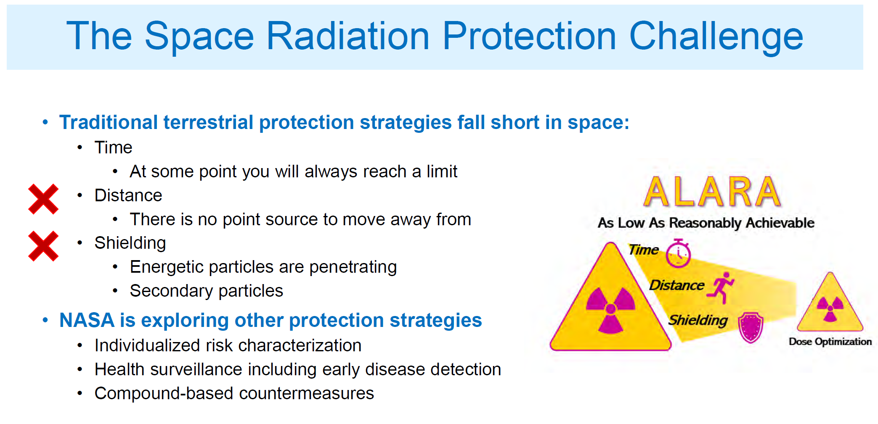
The Space Radiation Protection Challenge
Traditional terrestrial protection strategies fall short in space:
  Time
    At some point you will always reach a limit
  Distance
    There is no point source to move away from
  Shielding
    Energetic particles are penetrating
    Secondary particles
NASA is exploring other protection strategies:
  Individualized risk characterization
  Health surveillance including early disease detection
  Compound-based countermeasures
    Biomarkers
Each crew member is badged
Active radiation area monitoring

Slide 10
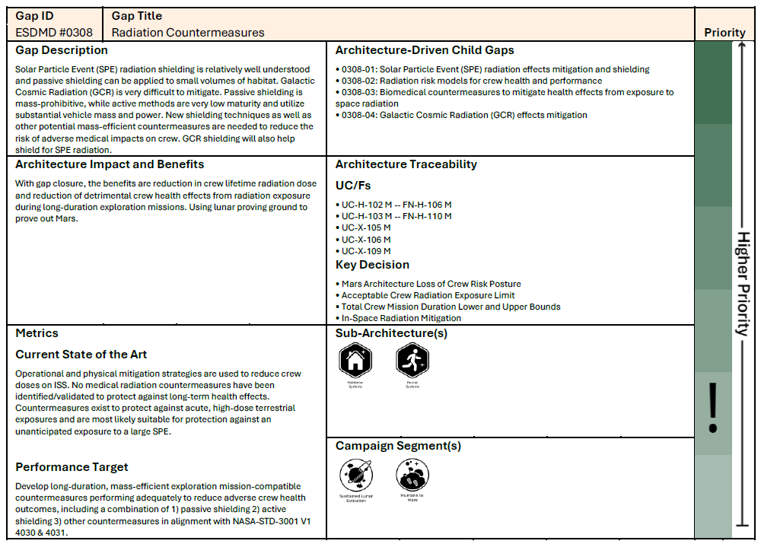
Background and Justification – NASA Requirements Document
NASA STD 3001 Vol. I
4.8.1 As Low as Reasonably Achievable (ALARA) Principle
All crewmember radiation exposures shall be minimized using the ALARA principle.
4.8.2 Career Space Permissible Exposure Limit for Spaceflight Radiation
An individual crewmember’s total career effective radiation dose due to spaceflight radiation exposure shall be less than 600 mSv. This limit is universal for all ages and sexes
Radiation Countermeasures Gap – ESDMD #0308
0308-02: Radiation risk models for crew health and performance
0308-03: Biomedical countermeasures to mitigate health effects from exposure to space radiation
0308-04: Galactic Cosmic Radiation (GCR) effects mitigation
GOAL: Utilize countermeasures (CM) to mitigate the radiation health risk to crew and potentially increase the permissible mission duration.

Slide 11
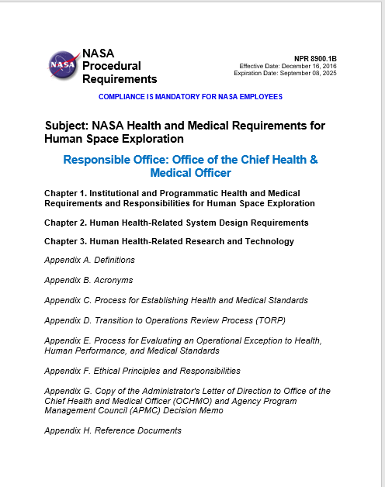
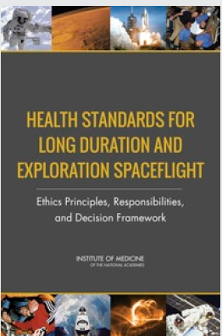
NASA Responsibility - Operational Exception to Health Standards
Procedures in place to consider exception to standards following an ethics-based framework – for missions or individuals (NPR-8900-1B)
Ethics Principles:
  Avoid Harm
  Beneficence
  Favorable Risk-Benefit Balance
  Respect for Autonomy
  Fairness
  Fidelity
  Responsibilities:
  Fully inform astronauts
  Continuous updating knowledge base
  Ensure transparency
NASA Procedural Requirements 8900
  OCHMO provides determination of risk and mitigation
  NASA Administrator has final decisional authority
Institutes of Medicine, 2014
Notes:
NPR 8900-1b
2014 – Health Standards for Long Duration and Exploration Spaceflight: Ethics Principles, Responsibilities, and Decision Framework. Washington, DC: The National Academies Press. doi: 10.17226/18576. Institute of Medicine. 2014.
2016 - NASA Administrator Letter to CHMO –
- Decision framework of 8900-1B
Ensure all feasible means are taken to reduce astronaut risks to the lowest achievable levels and demonstrate that standards cannot be met despite having done so,
Examine all approaches to minimizing risk, including alternate approaches to meeting the mission's objectives.
Thoroughly monitor and conduct research on health impacts during and after space flight to inform current and future missions,
Have a rigorous process to assure that astronauts are fully informed about risks and unknowns,
Ensure that a crewmember's decision to participate in a mission meets standards of informed decision making and that they are making a voluntary decision, and
Commit to the future health of current and future astronauts by ensuring access to long-term health care, longitudinal followup, and preventive screenings.
All relevant organizations and offices are responsible for ensuring these actions are taken.

Slide 12
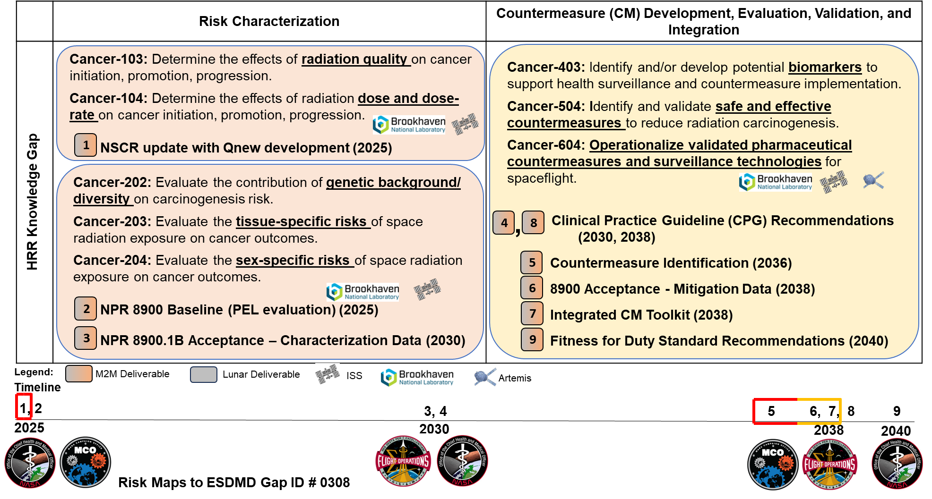
Cancer Risk Approach Plan

Slide 13
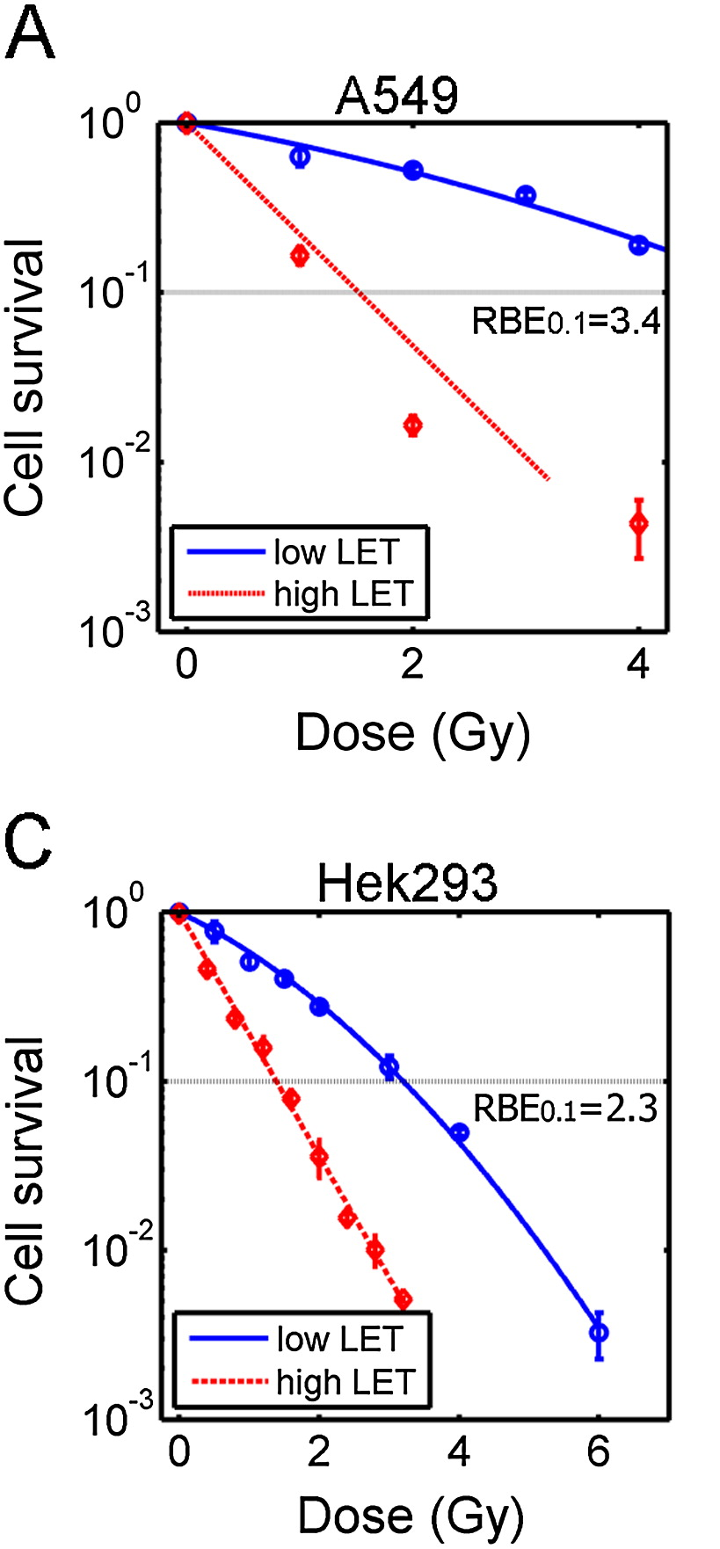
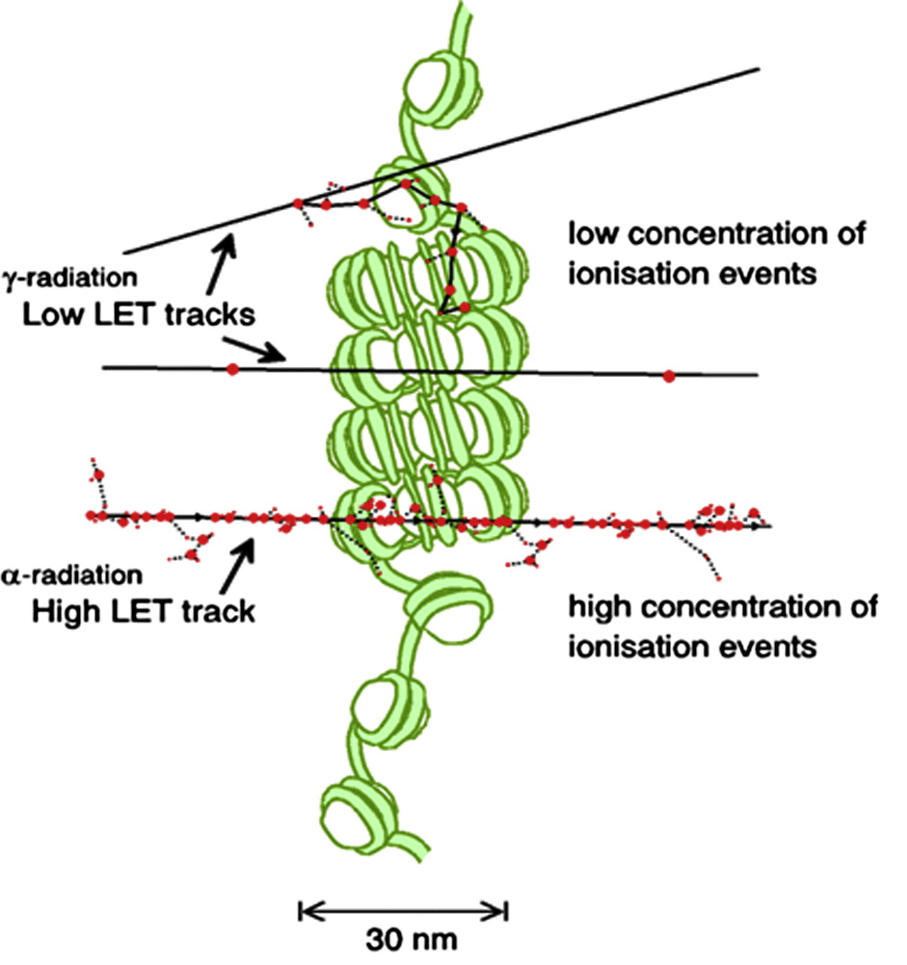
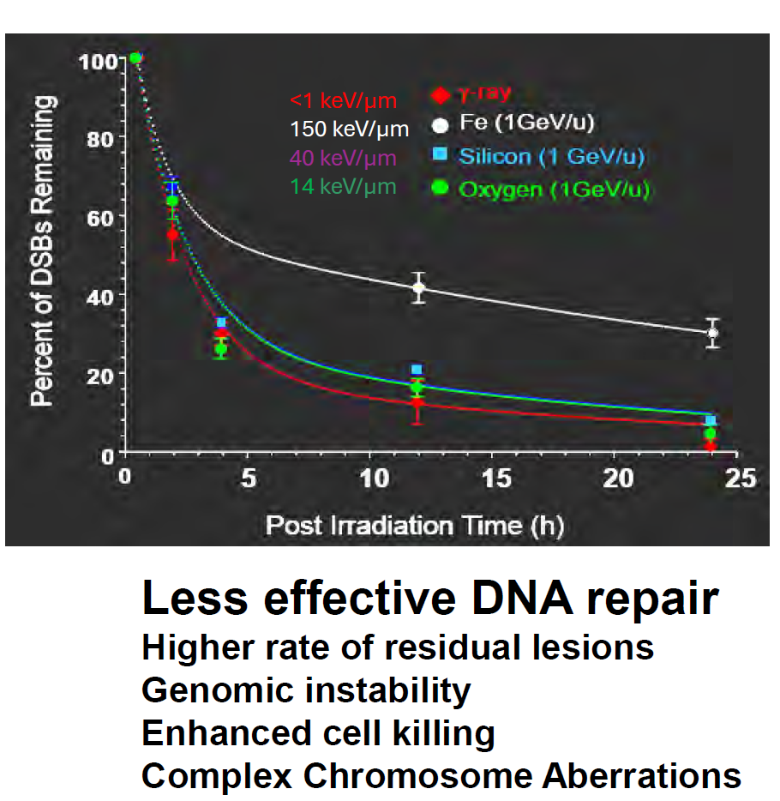
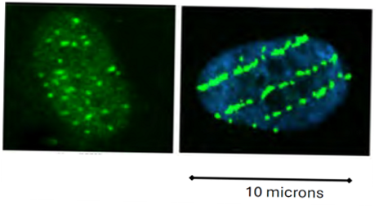
DNA Damage Complexity Increases with Increasing LET
Lomax et al. Clinical Oncology. Clinical Oncology 25 (2013) 578e585
Int J Radiation Oncol Biol Phys, Vol. 83, No. 4, pp. 1291e1297, 2012
Notes:
Schematic of the types of DNA damage, ranging from single and clustered damage sites through to simple and complex double-strand breaks (DSB), formed by passage of a single radiation track. Low linear energy transfer radiation induces lower concentrations of ionization events and consequently less complex DNA damage sites than high linear energy transfer.
Colony-forming (survival) assay of A549 cells, irradiated with indicated doses of photons (cesium source [blue]) or with carbon ions (red).
A549 = Lung Epithelial cells
HEK293 = Embryonic Kidney cells

Slide 14
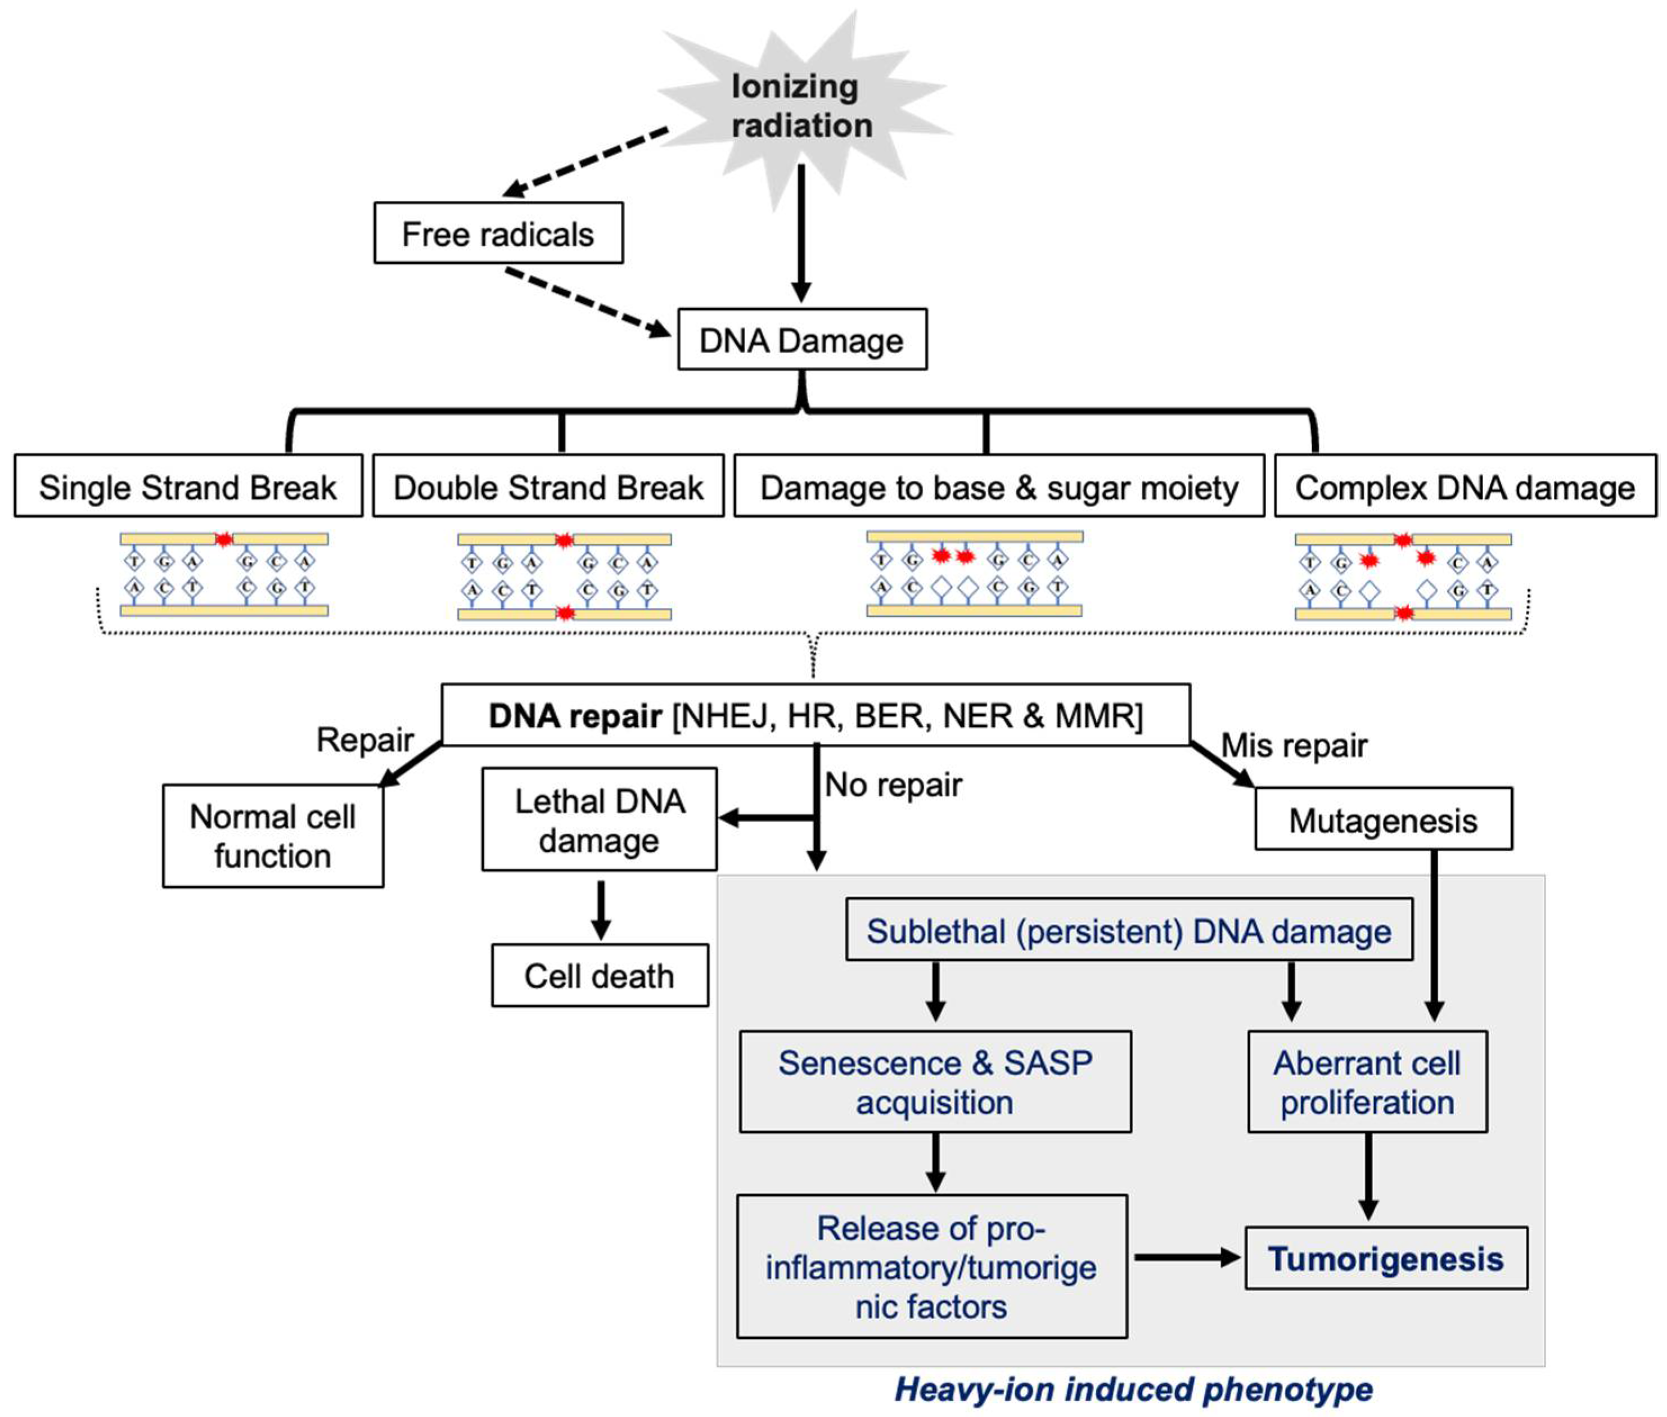
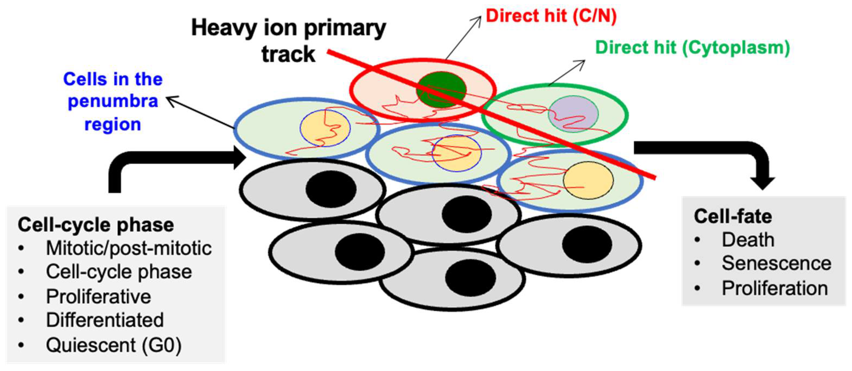
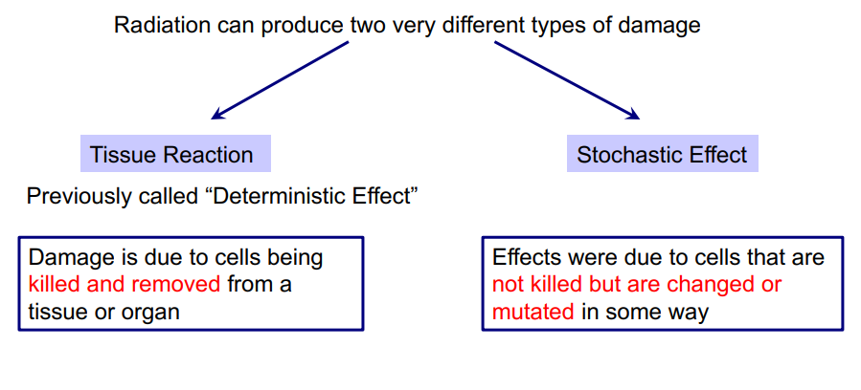
Types of DNA Damage and Repair Pathways
Curr. Oncol. 2023, 30(6), 5497-5514; https://doi.org/10.3390/curroncol30060416
Notes:
Fig A: The central role of DDR in heavy-ion-radiation-induced persistent DNA damage, senescence/SASP, and GI carcinogenesis.
Fig B: Comparison of track structures from different particles. Panel A: Simulated high-LET particle track projections of the indicated species in the XY plane calculated with RITRACKS software (35). Conditions for simulation are liquid water at 258C with particle origination at the Y axis.
Fig c: Variability in radiation response (cell fate) due to cell cycle phase at the time of irradiation and heterogeneous damage caused by heavy ions in the cells located in the core and penumbra regions The heavy-ion track is divided into “core” and “penumbra” regions based on the deposited energy density. The penumbra is the area near the edge of an ion beam track where the deposited energy density changes according to the distance from the primary ion track.

Slide 15
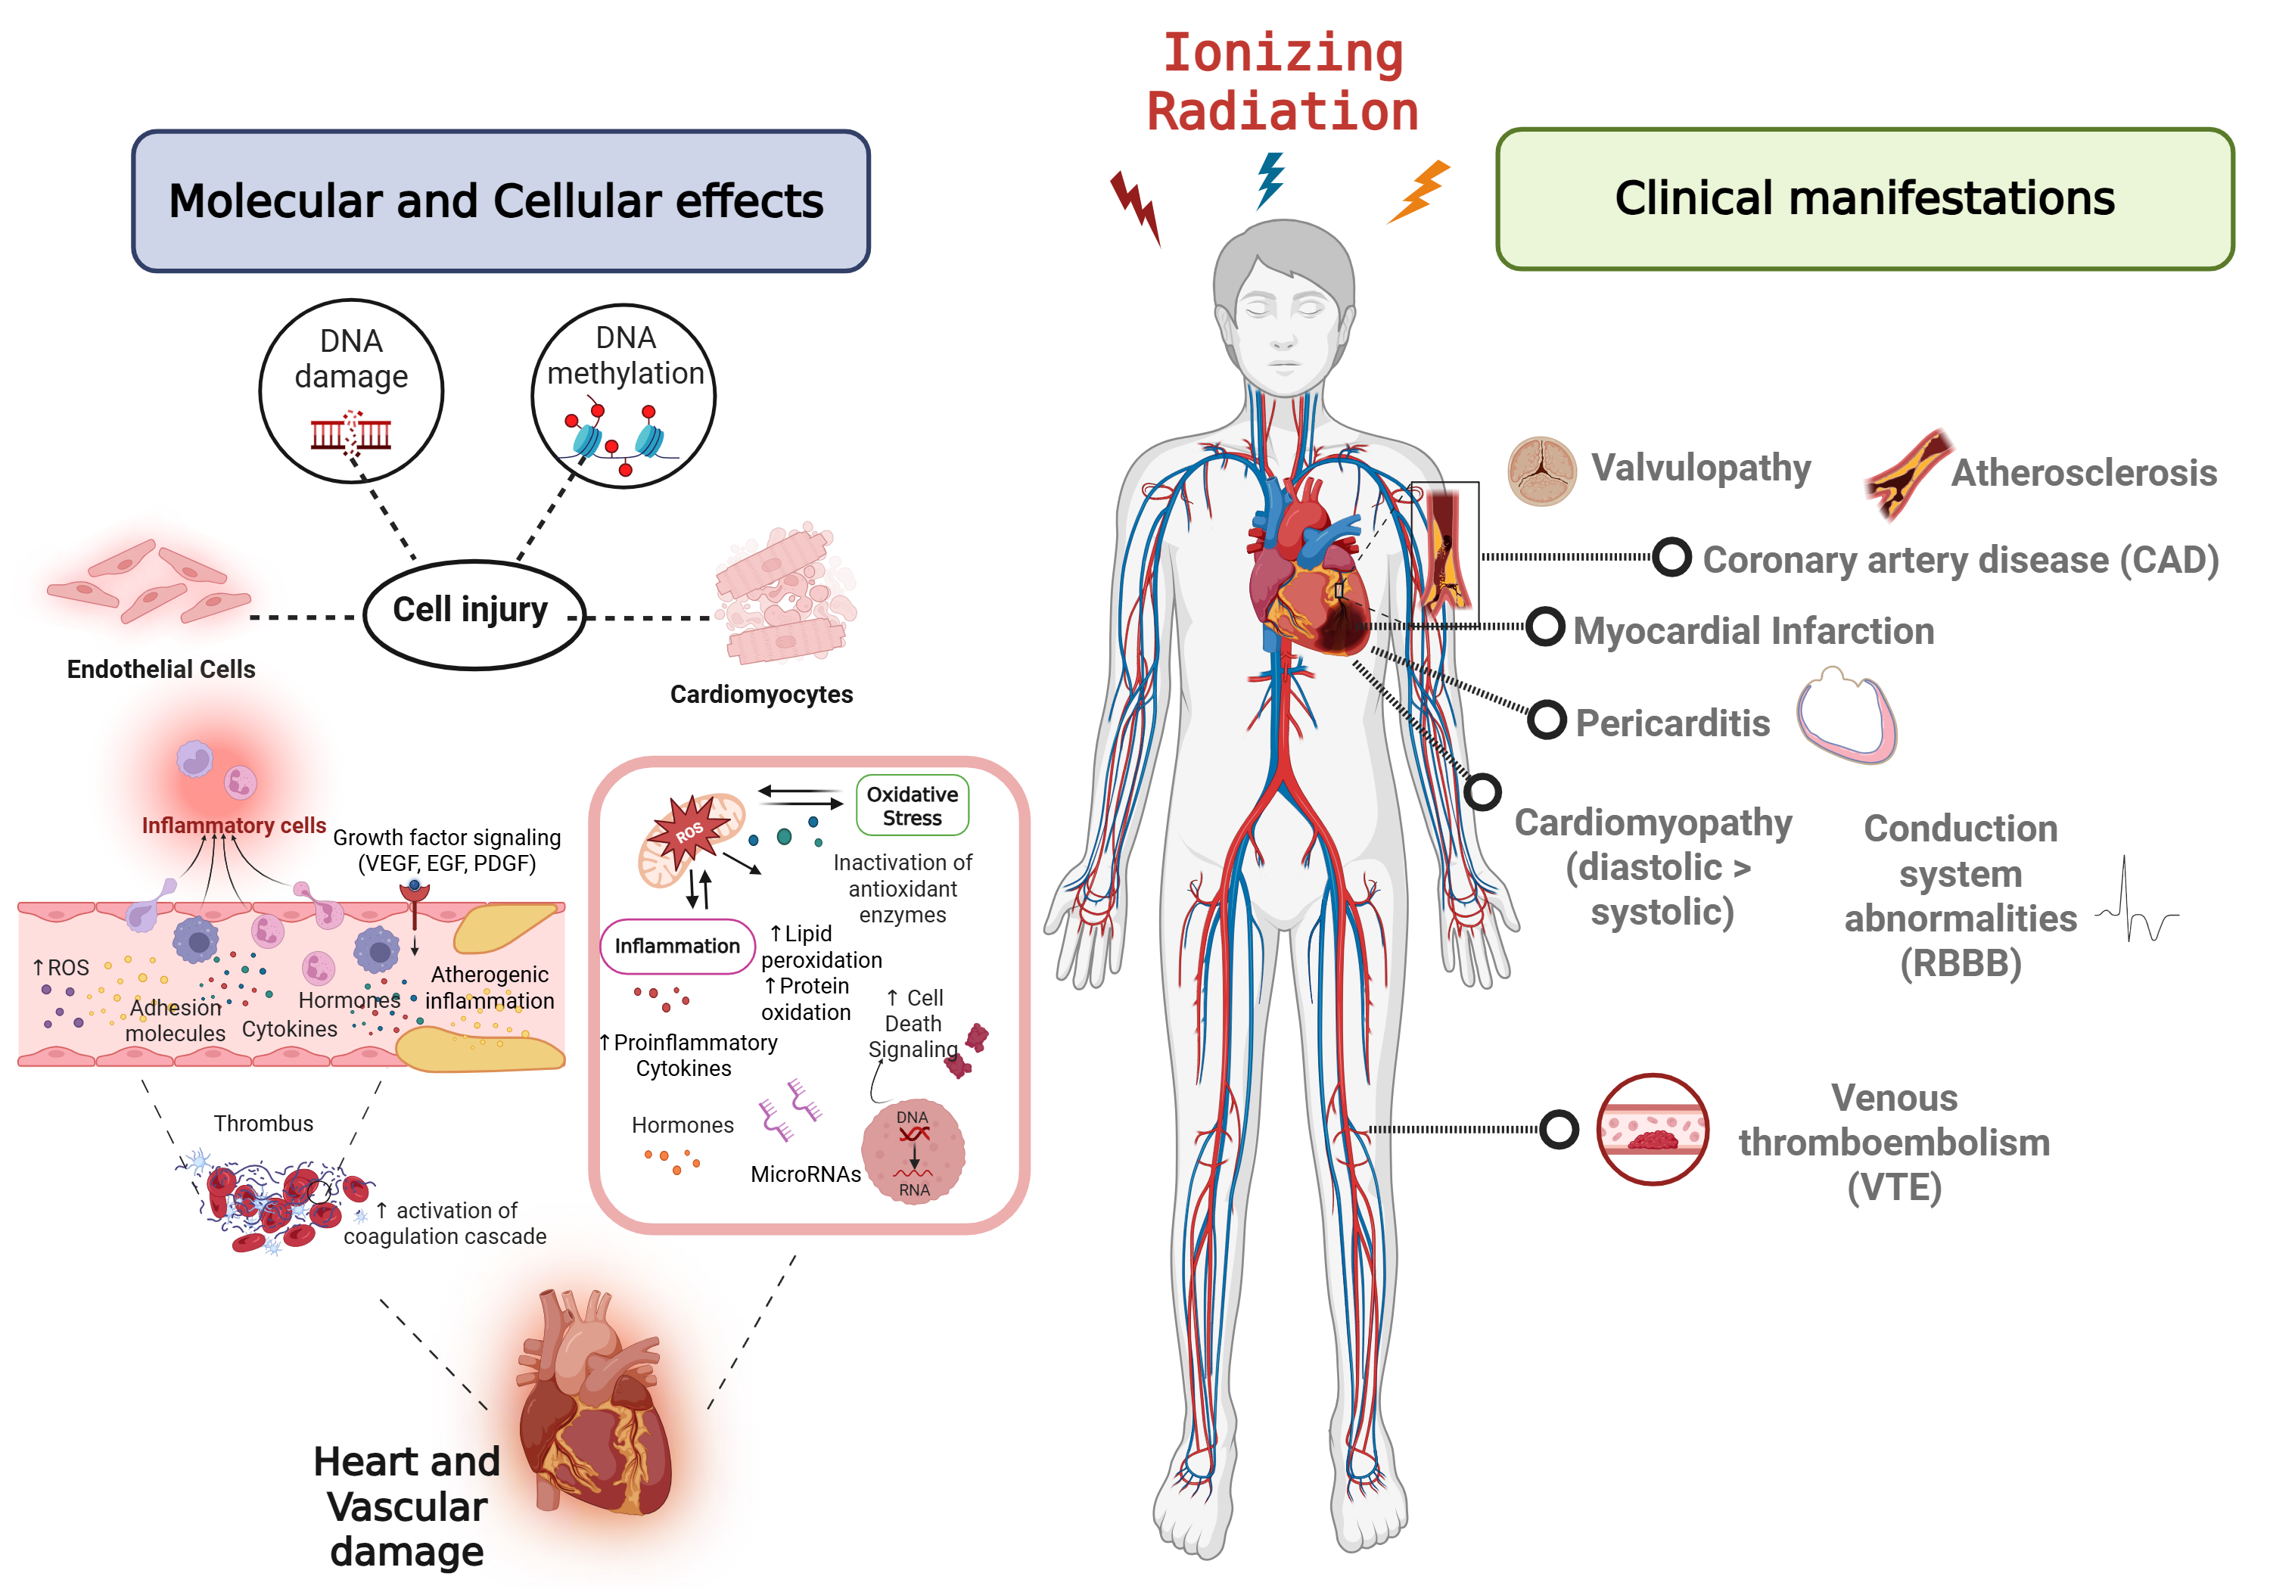
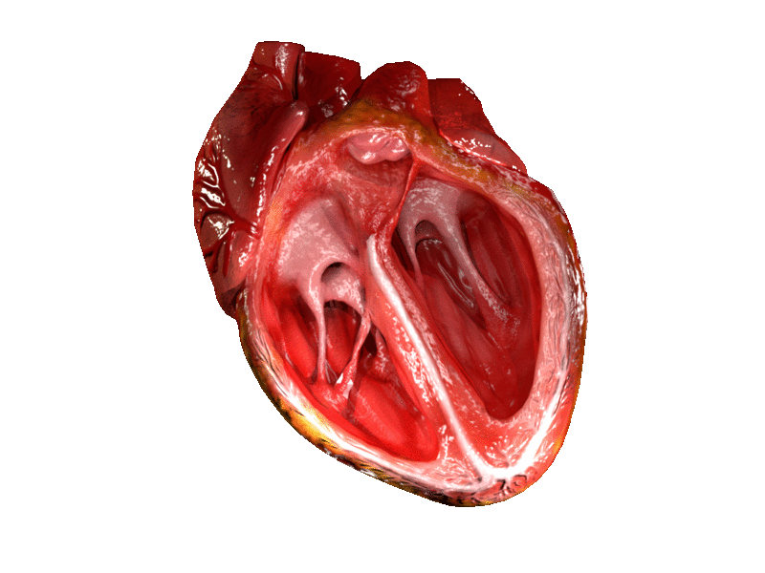
Putative Mechanisms of Radiation-induced CVD
Knowledge gaps exist in the mechanistic understanding of low-dose radiation-induced CVD.
Possible mechanisms of disease: endothelial and cardiomyocyte dysfunction, atherosclerosis, inflammation, inflammasomes
Cruz-Topete D, and Nelson G.A. et al. Unpublished 2025
Notes:
Molecular and clinical manifestations of ionizing radiation (IR) exposure. IR can lead to cell injury and death of endothelial cells and cardiomyocytes through different mechanisms. These include direct DNA damage through single-strand-breaks, double-strand breaks (illustrated in the figure) and changes in DNA methylation patterns, which result in changes in gene expression. In endothelial cells, this damage triggers a cascade of inflammatory responses that leads to a disruption in vascular permeability and integrity, affecting vascular function. This inflammatory cascade involves excessive extravasation of inflammatory cells and increased expression of growth factors, adhesion molecules, hormones, and proinflammatory cytokines. These changes promote increases in reactive oxygen species (ROS) production and leads to further DNA and mitochondrial damage. Atherosclerotic plaque lesions are accelerated by IR, which predisposes to plaque inflammation and rupture. Increased tissue injury and plaque rupture results in bleeding and thrombus formation (increased activation of coagulation factors). As the thrombus grows, it can block blood flow, leading to ischemia. Similar mechanisms contribute to cardiomyocyte injury. Increased oxidative stress (inactivation of antioxidant enzymes, increased lipid, and protein oxidation) due to mitochondrial dysfunction, endoplasmic reticulum (ER) stress, an increased expression of cytokines and cell death modulators, and changes in the levels of hormones and in the expression of microRNAs lead to heart disease and failure. These changes at the cellular level are associated with different clinical manifestations, including valvopathy (valvular disease), coronary artery disease (CAD), myocardial infarction (MI), cardiomyopathy, pericarditis, and conduction system abnormalities (right bundle branch block [RBBB]). Venous thromboembolism results from endothelial and vascular damage.
Ionizing radiation at high doses as used for radiotherapy produces direct damage to the heart and major arteries and increases the risk of cardiovascular diseases (CVD).
In contrast, the evidence for a causal relationship between long-term risk of cardiovascular diseases after moderate doses (0.5–5 Gy) is suggestive; weak after low doses (<0.5 Gy).
The most informative study is the Japanese atomic-bomb survivor Life Span Study (LSS).
Statistically significant linear dose–response for mortality from stroke (excess relative risk (ERR)/Gy = 0.09; 95% confidence interval (CI): 0.01; 0.17) and heart diseases (ERR/Gy = 0.14; 95% CI: 0.06; 0.23) in 1950–2003.
Latency approximately 10 years.
The excess risks are only above colon-equivalent doses of about 0.5 Gy.
No confounding by smoking, alcohol consumption, education, occupation and obesity was observed.
Cardiovascular disease (heart disease)Ischaemic(coronary) heart disease (mainly MI)
Hypertensive heart disease
Valvularheart disease
▪Cerebrovascular disease (stroke)
▪Peripheral vascular disease

Slide 16
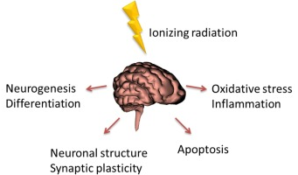
Central Nervous System Changes after Space-Like Radiation Exposure
Changes in neurochemicals, synaptic and neuroinflammatory proteins
Increased activation of microglia (signaling neuroinflammation)
Deficits in neurocognitive performance for several mouse and rat behavioral paradigms
High-LET nuclei at low doses (<10 cGy) significantly reduced production of new neurons in brain (data not shown)
Reduction in neuron arborization and synapse number (dendritic spines)
  Persistent reductions for > 1 year after doses of high Linear Energy Transfer (LET) nuclei below 5 cGy (data not shown)
Performance deficits following exposure to high-LET nuclei depends on
  Physical particle characteristics, strain, sex, age at exposure, evaluation time after exposure and measure used
  Male mice appear to be more radiosensitive than female mice
Notes:
Reduction in neuron arborization and synapse number (dendritic spines)
Persistent reductions for > 1 year after doses of high- Linear Energy Transfer (LET) nuclei below 5 cGy
Significantly reduced production of new neurons in brain
Increased activation of microglia (signaling neuroinflammation)
Deficits in neurocognitive performance for several mouse and rat behavioral paradigms
High-LET nuclei at low doses (<10 cGy, with 1 cGy sensitivity reported in one study)
Dose threshold for performance deficits following exposure to high-LET nuclei depends on
The physical characteristics of the particles, strain, sex, age at exposure, and evaluation time after exposure
Male mice appear to be more radiosensitive than female mice in several studies.

Slide 17
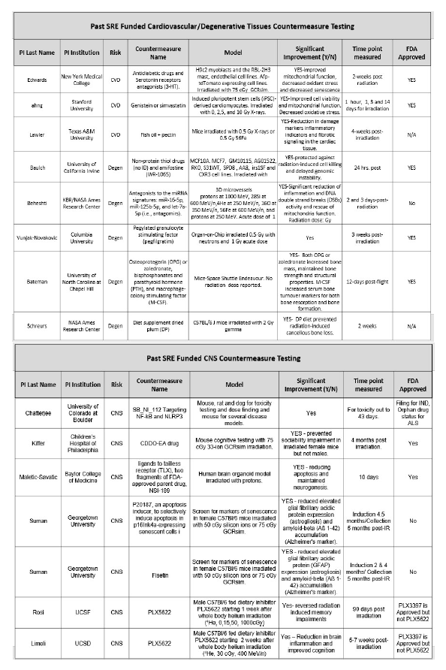
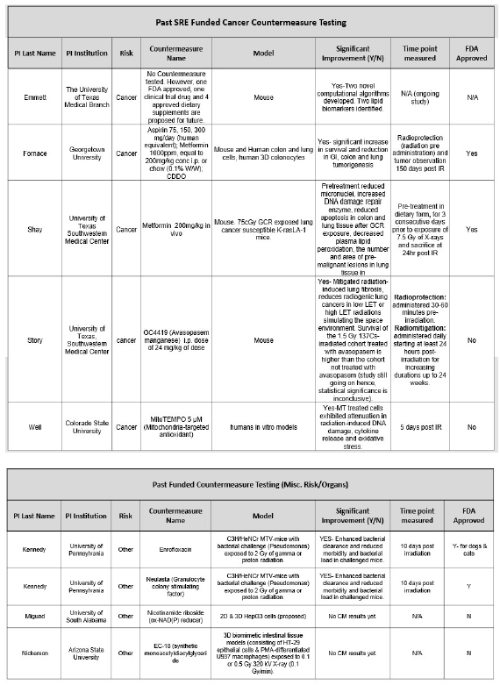
Overview of SR-Funded Cancer Countermeasures
Past Research
~23 studies using drugs
In vitro and rodent models used to assess efficacy
91% of studies had significant results
43% of drugs were FDA approved
Aspirin, Metformin, Avasopasem Manganese, MitoTEMPO, Enrofloxacin, Neutasta, Nicotinamide Riboside, EC-18 (synthetic monoacetyldiacylglyceride), Antidiabetic, Serotonin Receptors Antagonists, Fish Oil, Pectin, Genistein, Simvastatin, Non-Protein Thiol, Amifostine , Antagonists to the miRNA signatures (miR-16-5p,mir-12b-5p, and let-7a-5p, pegfilgrastim, Osteoprotegerin (OPG), Zoledronate, Bisphosphonates, Parathyroid Hormone, Macrophage-Colony Stimulating Factor, Diet Supplement Dried Plum, SB_NI_112 Targeting NF-kB and NLRP3, CDDO-EA, Ligands to Tailless Receptor, NSI-189, P20187 Apoptosis Inducer, Fisetin, PLX5622.
Notes:
Drug delivery mode-
Aspirin: dietary- 75, 150, 300 mg/day-treatment continued until study end (150 days post-IR)
Metformin: 200 mg/kg; 2-3 days prior to IR and kept on this diet for extended periods up to 100 days. 0.1% w/w in diet-continuous from 4 weeks of age
CDDO: 200mg/kg, incorporated into lab chow (dietary delivery) 2-3 days prior to IR and kept on this diet for extended periods up to 100 days.

Slide 18
Overview of SR-Funded Cancer Countermeasures
Drug | FDA status | Model | Radiation | Cancer
Aspirin | Approved | APC1638N/+ male mice | 28Si-ions (10, and 50 cGy) | GI-intestinal, colonic
Metformin | Approved | APC1638N/+ mice, WT 129/Sv mice | 28Si-ions (10 cGy), X-ray (10 Gy), 33-ion GCRsim (75 cGy) | GI-colon, Lung,
CDDO | Approved | CDX2PApcflox/+ mice, WT 129/Sv mice; LA-1 mice, CPC;APC mice | Proton (2 Gy), Fe-ions (1 Gy: 0.2 Gy x 5), X-ray (10 Gy), 33-ion GCRsim (75 cGy) | Lung, Colon
Suman et al.,2021 Life Sci. Space Res.; Suman & Fornace, 2022 Life Sci. Space Res.; Siteni S et al., 2024 PLoS ONE
Notes:
Drug delivery mode-
Aspirin: dietary- 75, 150, 300 mg/day-treatment continued until study end (150 days post-IR)
Metformin: 200 mg/kg; 2-3 days prior to IR and kept on this diet for extended periods up to 100 days. 0.1% w/w in diet-continuous from 4 weeks of age
CDDO: 200mg/kg, incorporated into lab chow (dietary delivery) 2-3 days prior to IR and kept on this diet for extended periods up to 100 days.

Slide 19
Overview of SR-Funded Cancer Countermeasures
Drug | FDA status | Model | Radiation | Cancer | Outcome
Aspirin | Approved | APC1638N/+ male mice | 28Si-ions (10, and 50 cGy) | GI-intestinal, colonic | radiation-induced genomic instability ↓ PGE2 Does not protect against space radiation-associated tumorigenesis
Metformin | Approved | APC1638N/+ mice, WT 129/Sv mice | 28Si-ions (10 cGy), X-ray (10 Gy), 33-ion GCRsim (75 cGy) | GI-colon, Lung, | ↓ x-rays, protons, and GCR ions-induced genomic instability, inflammation ↓ heavy ions-induced GI tumorigenesis
CDDO | Approved | CDX2PApcflox/+ mice, WT 129/Sv mice; LA-1 mice, CPC;APC mice | Proton (2 Gy), Fe-ions (1 Gy: 0.2 Gy x 5), X-ray (10 Gy), 33-ion GCRsim (75 cGy) | Lung, Colon | ↓ x-rays, protons, and GCR ions-induced DNA damage, inflammation and potential anti-senescence proton-induced colon tumorigenesis, reduced invasive carcinomas in both lung and colon models Prevents GCR cognitive changes in GCR irradiated female mice
Future directions •Post-exposure testing •Testing with full GCR • Dose response studies
Implications: Metformin and CDDO as potential radioprotectant, particularly in astronauts, cancer patients undergoing radiotherapy, or populations affected by nuclear accidents
Suman et al.,2021 Life Sci. Space Res.; Suman & Fornace, 2022 Life Sci. Space Res.; Siteni S et al., 2024 PLoS ONE
Notes:
Drug delivery mode-
Aspirin: dietary- 75, 150, 300 mg/day-treatment continued until study end (150 days post-IR)
Metformin: 200 mg/kg; 2-3 days prior to IR and kept on this diet for extended periods up to 100 days. 0.1% w/w in diet-continuous from 4 weeks of age
CDDO: 200mg/kg, incorporated into lab chow (dietary delivery) 2-3 days prior to IR and kept on this diet for extended periods up to 100 days.

Slide 20



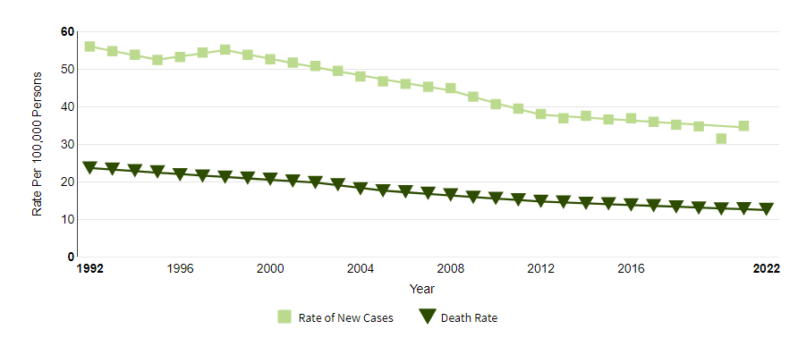
Space Radiation Countermeasure Research Plan
TWO-PRONGED STRATEGY approach to reduce the risk of space radiation induced carcinogenesis and other organ/tissue effects.
Compound Countermeasures
Focus on off label use of already FDA approved drugs and/or Investigational New Drugs that have well known safety profiles.
Accelerates discovery
Reduced budget
Known terrestrial toxicity profiles
Surveillance Countermeasure (FDA Approved):
Surveillance
Countermeasures
Compound Countermeasures
Personalized Medicine
Imaging
  Colonoscopy
  Mammography
  PET
Cells/biopsy
  Pap smear
  Tissue
  Fecal sample
    Hemoglobin
    Methylated DNA
Blood test
  PSA
  cfDNA
    Methylation
    mRNA
Notes:
Mammo 40
45 colon
21 and above pap

Slide 21
Space Radiation Countermeasure Research Plan
TWO-PRONGED STRATEGY approach to reduce the risk of space radiation induced carcinogenesis and other organ/tissue effects.
Compound Countermeasures
Focus on off label use of already FDA approved drugs and/or Investigational New Drugs that have well known safety profiles.
Accelerates discovery
Reduced budget
Known terrestrial toxicity profiles
Surveillance Countermeasure (FDA Approved):
Surveillance
Countermeasures
Compound Countermeasures
Personalized Medicine
Imaging
  Colonoscopy
  Mammography
  PET
Cells/biopsy
  Pap smear
  Tissue
  Fecal sample
    Hemoglobin
    Methylated DNA
Blood test
  PSA
  cfDNA
    Methylation
    mRNA
Notes:
Mammo 40
45 colon
21 and above pap

Slide 22
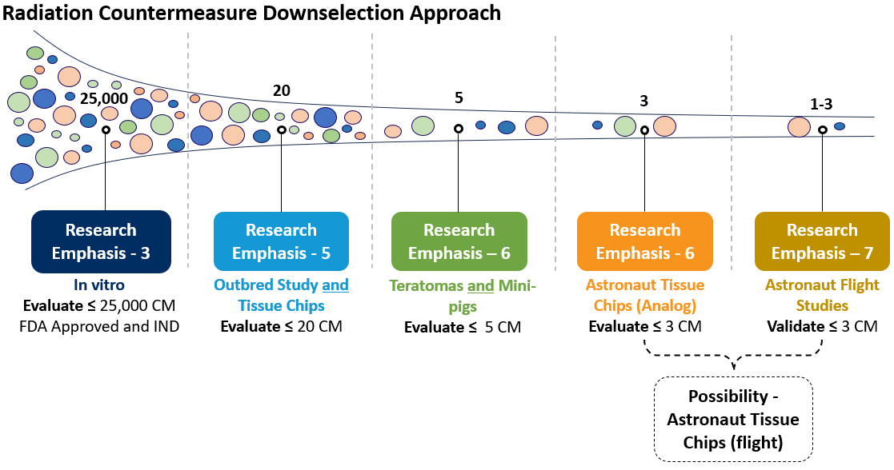
Space Radiation Countermeasures Research Plan
Pharmaceutical Down Selection Approach
Research Emphasis - 5
*
*
*
* Drug down selection will be a concerted and informed effort with stakeholders and customers (OCHMO, SMOD, ESDMD)

Slide 23

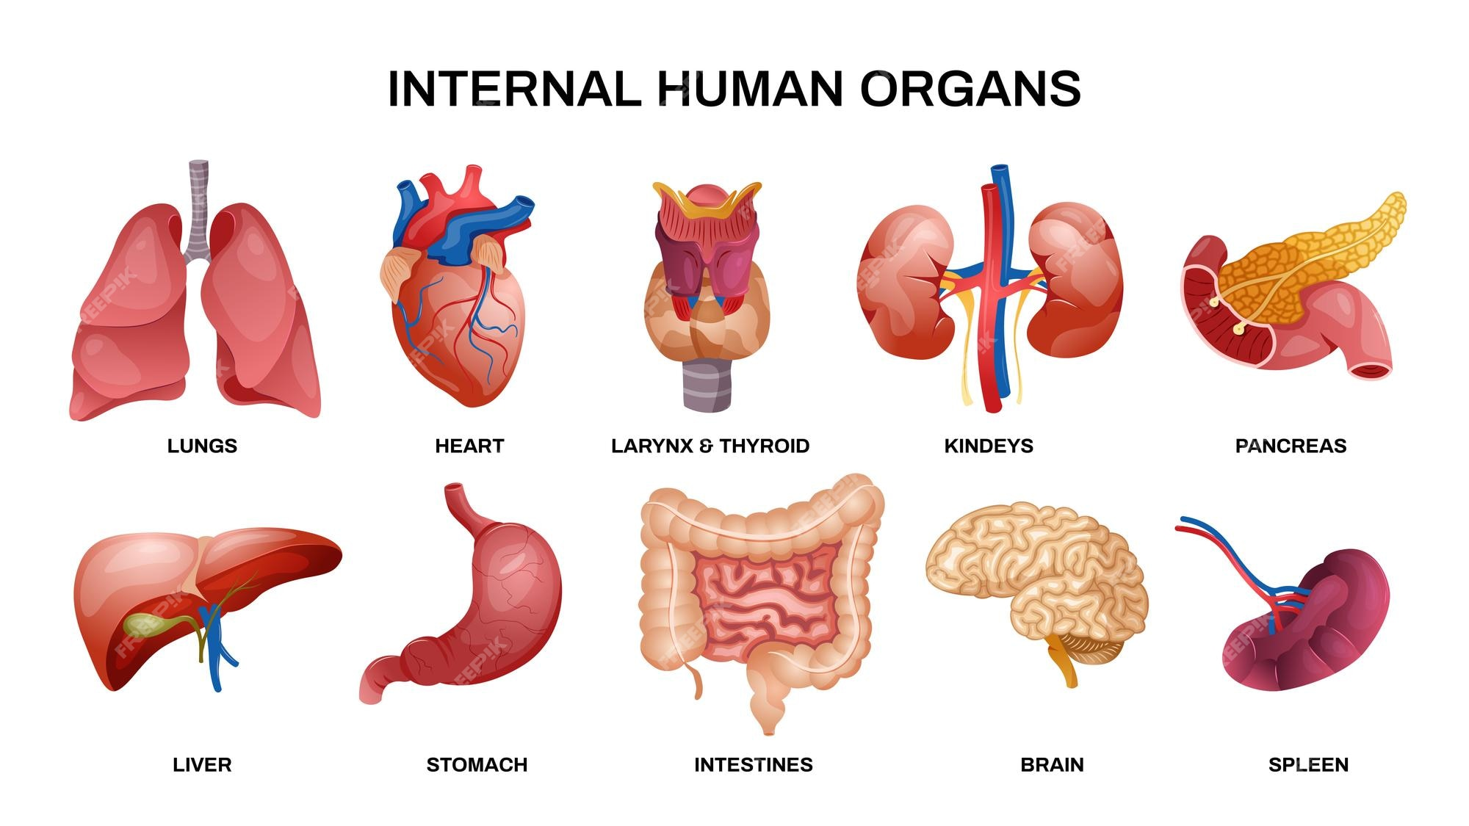



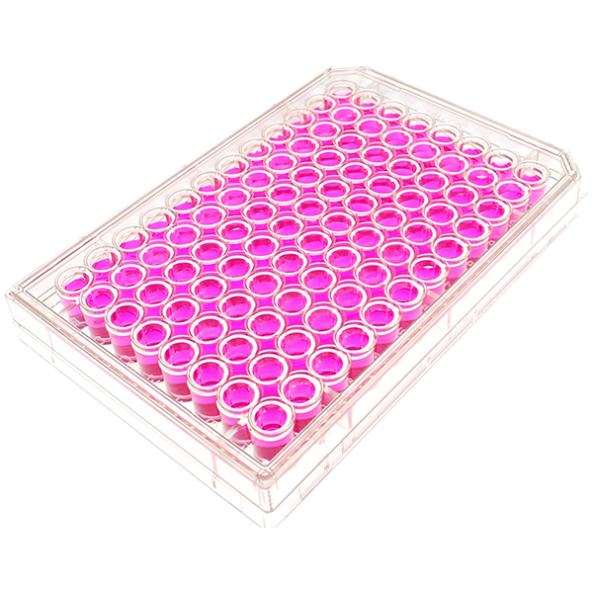
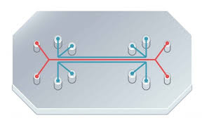
Space Radiation Countermeasures Research Plan
Pharmaceutical Down Selection Approach
Research Emphasis - 5

Slide 24
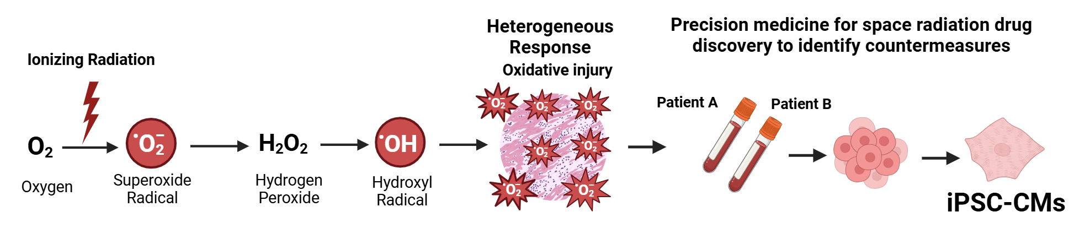
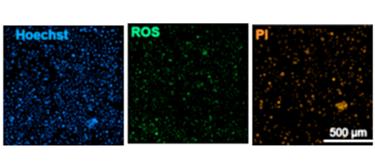
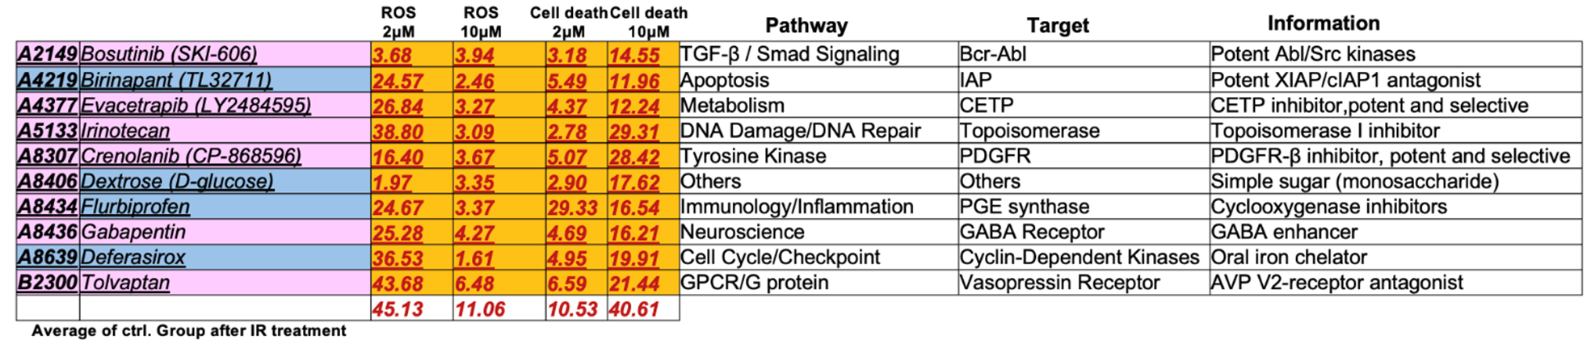
In vitro down selects of FDA-approved drugs – Planned work for cancer countermeasure and Greenstone Biosciences Directed Task
Aim 1:
hiPSCs-derived cardiomyocytes (iPSC-CMs) were used to study X-ray-induced damage and screen for protective drugs.
Screening process:
10 Gy radiation dose was used. 2,320 compounds were screened (post 4 hrs of exposure) .
1st screening → 44 drug candidates.
2nd screening (2 and 10 μM concentration) → 23 drug candidates
Final selection (low dose) → 10 reproducible and effective drug candidates.
Ideal drug candidate
↑ cell count (↑ Hoechst)
↓ ROS (↓ CellRox)
↑ cell viability (↓ PI)
Future studies will utilize Fibroblasts, DSB Measurements, and simGCR exposure
Notes:
the FDA-approved drug library by APExBIO: https://www.apexbt.com/discoveryprobetm-fda-approved-drug-library.html
We used this library to focus on FDA-approved drugs or drugs in late-stage clinical trials (Phase 3) that have demonstrated favorable drug safety profiles that can be quickly repurposed.
A more detailed and curated list with chemical data is attached.

Slide 25
Greenstone Screening Downselects
Compound | Company | Pathway | Target | Advantages & Disadvantages
Atovaquone | GlaxoSmithKline | Mitochondrial electron transport chain inhibitor Potential effects on metabolism | Binds ubiquinone binding site on cytochrome bc1 | Extensive characterization in parasitic diseases. Good tolerance and safety in humans Long half-life Its effects on mitochondria maybe deleterious for cells like cardiomyocytes that are high-energy demanding Too suppressive of ROS signaling GI irritation, possible hepatotoxicity
Evacetrapib | Eli Lilly | Lipid Metabolism/cardiovascular | Inhibits cholesterylester transfer protein (CETP) | Oral bioavailability Improves lipid profiles Failed in phase III for CV outcomes (ACCELERATE trial) ↑ aldosterone and ↑blood pressure
Flurbiprofen | Generic | Nonsteroidal anti-inflammatory drugs (NSAIDs) | COX-1 and COX-2 | Oral bioavailability and anti-inflammatory Reduces ROS GI irritation, ↑ risk for heart attack or stroke in chronic use, kidney damage
Deferasirox | Generic | Iron homeostasis/oxidative stress | Iron chelation | Oral bioavailability Reduces free iron GI irritation, ↑ risk for kidney and liver toxicity with long-term treatment
Methylcobalamin (vitamin B12) | Generic | One-carbon metabolism, DNA-methylation, nucleotide synthesis | Coenzyme for methionine synthase. Converts homocysteine to methionine | Excellent safety profile, few adverse effects Vitamin Maintain DNA methylation, DNA repair, antioxidant Low cost Neuroprotective effects
Geniposide | Natural Product | GLP-1R receptor activator or sensitizer | GLP-1R activator (not fully established. Involved in AMPK, Nrf2, PI3K/Akt, and NF-kB signaling | Positive effects in cardiomyocytes Protects in myocardial infarction and prevents fibrosis Bioactive natural compound Liver and kidney toxicity Clinical studies are limited No FDA approved
Irsogladine |  | PDE inhibitor | Increased intracellular cAMP | Antioxidant, anti-inflammatory, cytoprotective, antiapoptotic effects No evidence of cardioprotection No FDA approved

Slide 26
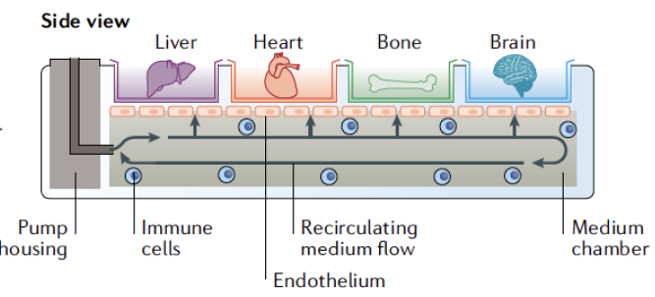
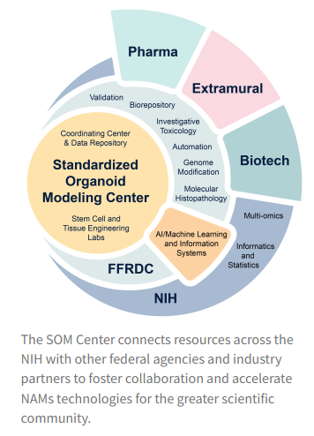
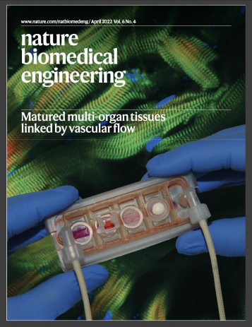
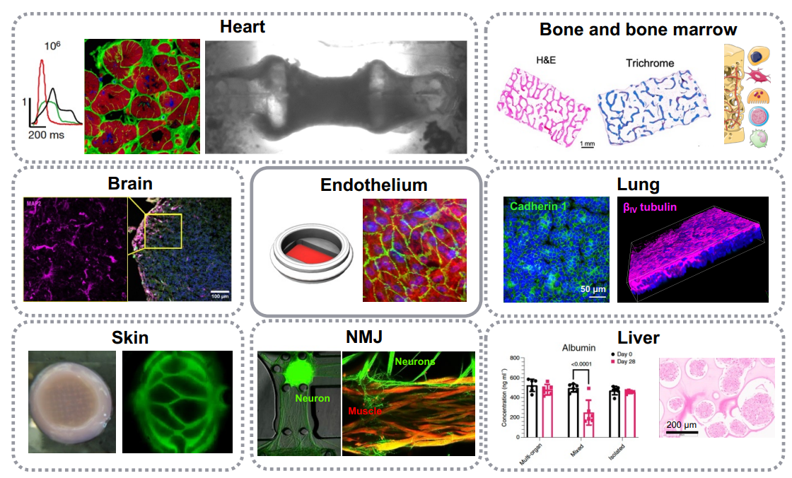
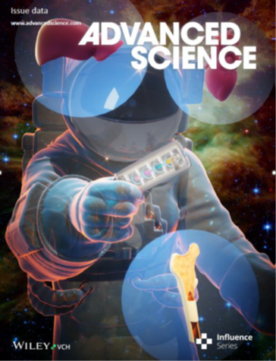
Advance biological systems/tissue chip radiation dose response
Drs. Sharon Gerecht and Gordana Vunjak-Novakovik - TRISH Funded
Notes:
Standardized Organoid Modeling Center (SOM) to reduce reliance on animal modeling
Vunyak Novakovich
The SOM Center aims to serve as a neutral scientific hub for standardization, developing organoids that are reproducible, reliable, and easily accessible for medicinal and biological research.

Slide 27
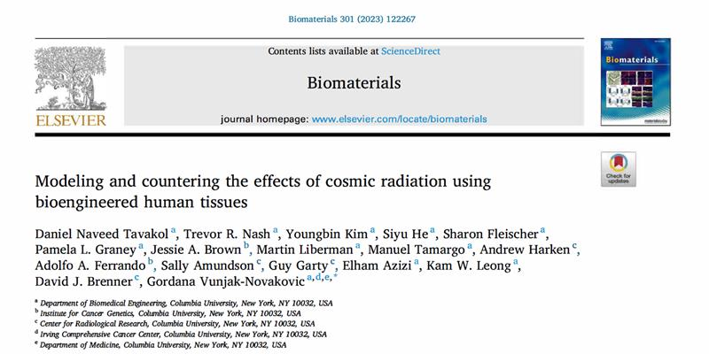
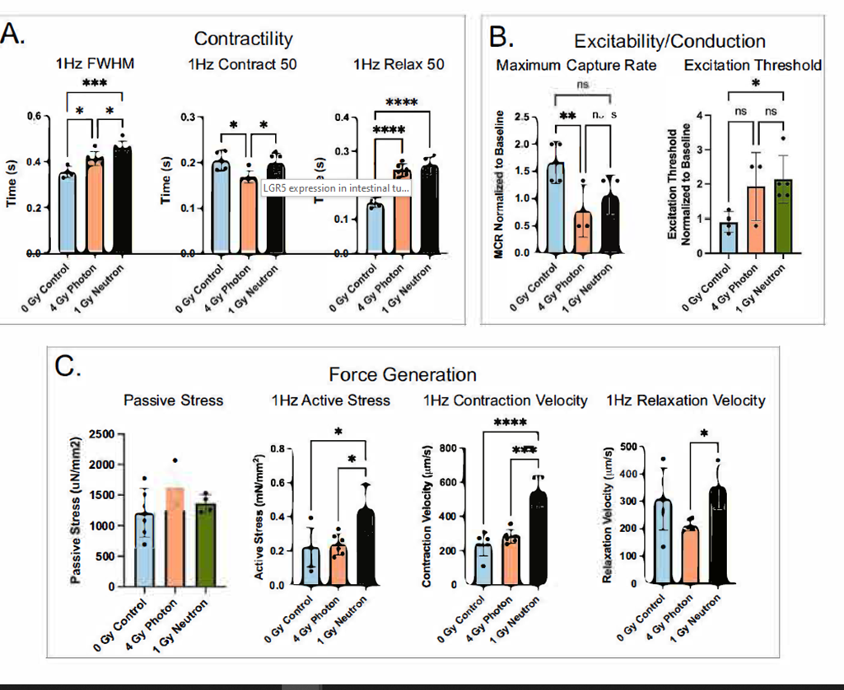
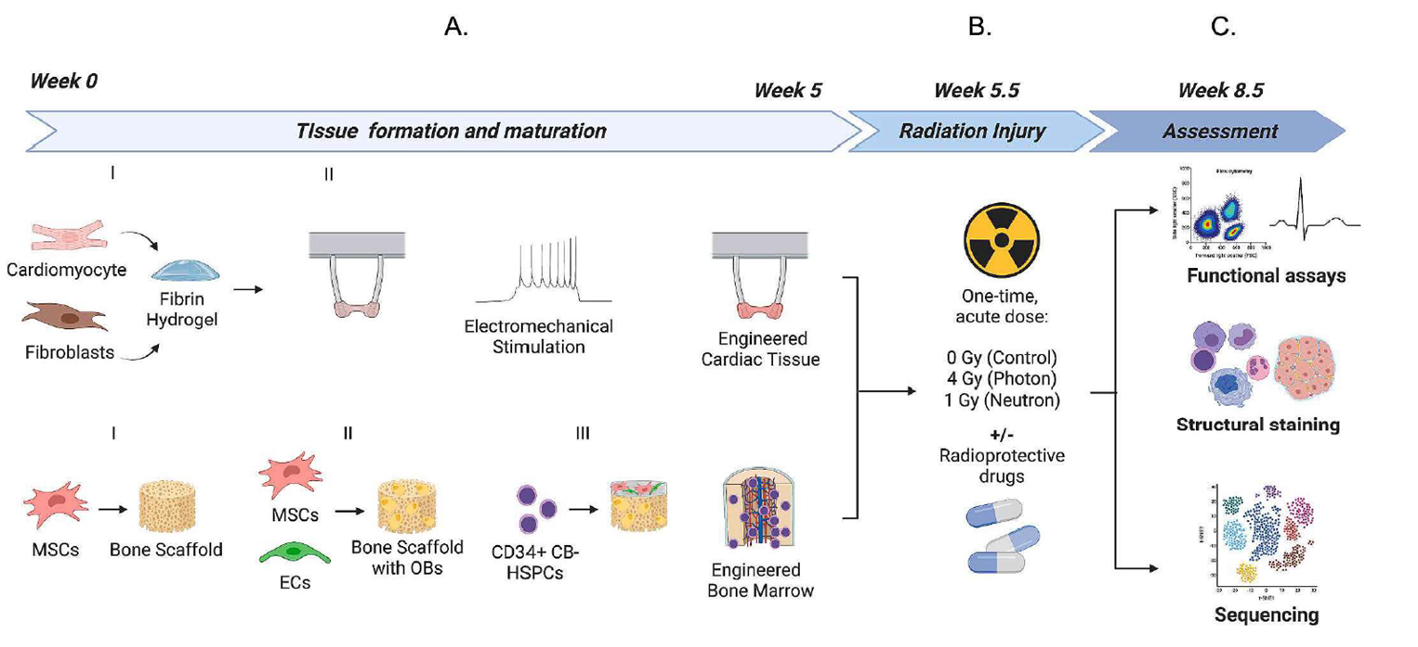
Advance biological systems/tissue chip radiation dose response
Functional analysis was performed for all eCT tissues before radiation and after 3 weeks post-irradiation, using a combination of bright field and fluorescent calcium imaging (based on the endogenous GCaMP reporter) to reveal tissue contractility, excitability, and force generation by measuring muscle movement and pillar displacement.
Simplified GCRsim dose curve in Spring 2027
Notes:
ig. 1. Experimental design for engineered human tissue models for assessing the effects of galactic cosmic rays. (A) Breakdown of engineered human cardiac muscle tissue and engineered human bone marrow tissue models and timeline for formation/maturation. (B) Exposure of engineered tissues to acute doses of photons or neutron irradiation and (C) endpoint assays to assess tissue health 3-weeks post-irradiation. Figure created with Biorender.com
Functional analysis was performed for all eCT tissues before radiation and after 3 weeks post-irradiation, using a combination of bright field and fluorescent calcium imaging (based on the endogenous GCaMP reporter) to reveal tissue contractility, excitability, and force generation by measuring muscle movement and pillar displacement.
Contractility analysis showed differences in both contraction and relaxation (Fig. 3A).
Irradiated tissues had a greater full width half maximum (FWHM) than control tissues (p < 0.001) and required longer times for relaxation (p < 0.0001, Fig. 3A).
There was a significant change in contraction and relaxation lengths between tissues irradiated by photon and neutron sources (p < 0.05) (Fig. 3A).
Irradiation also caused significant changes in excitability and conduction metrics, including the decreased maximum capture rate and increased excitation thresholds (Fig. 3B).
Notably, both the active stress and contraction velocity of neutron-irradiated tissues increased, indicating greater force generation (Fig. 3C).

Slide 28
Space Radiation Countermeasure Research Plan
TWO-PRONGED STRATEGY approach to reduce the risk of space radiation induced carcinogenesis and other organ/tissue effects.
Compound Countermeasures
Focus on off label use of already FDA approved drugs and/or Investigational New Drugs that have well known safety profiles.
Accelerates discovery
Reduced budget
Known terrestrial toxicity profiles
Surveillance Countermeasure (FDA Approved):
Surveillance
Countermeasures
Compound Countermeasures
Personalized Medicine
Imaging
  Colonoscopy
  Mammography
  PET
Cells/biopsy
  Pap smear
  Tissue
  Fecal sample
    Hemoglobin
    Methylated DNA
Blood test
  PSA
  cfDNA
    Methylation
    mRNA
Notes:
Mammo 40
45 colon
21 and above pap

Slide 29
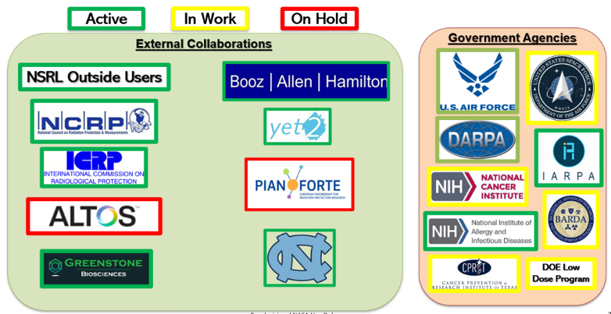
Screening and Surveillance Research Strategy
Surveillance/Screening Multi-prong Strategy:
1. Collaborations
3. Meetings
NASEM Workshop I: Enabling 21st Century Applications for Cancer Surveillance through Enhanced Registries and Beyond. July 29 & 30, 2024.
NASEM Workshop II: Opportunities and Challenges for the Development and Adoption of Multi-cancer Detection Tests: Oct 28 & 29, 2024
Occupational Flight Exposure and Cancer Risk Symposium (March 2025, Annual), Houston, TX.
Early Detection of Cancer Conference (Annual), Portland, OR.
American Association for Cancer Research (annual meeting in April 2026).
Precision Medicine World Conference (March 4-6, 2026)
2. Tech/Lit. Searches
Yet2 (Results in Research Emphasis 2)

Slide 30
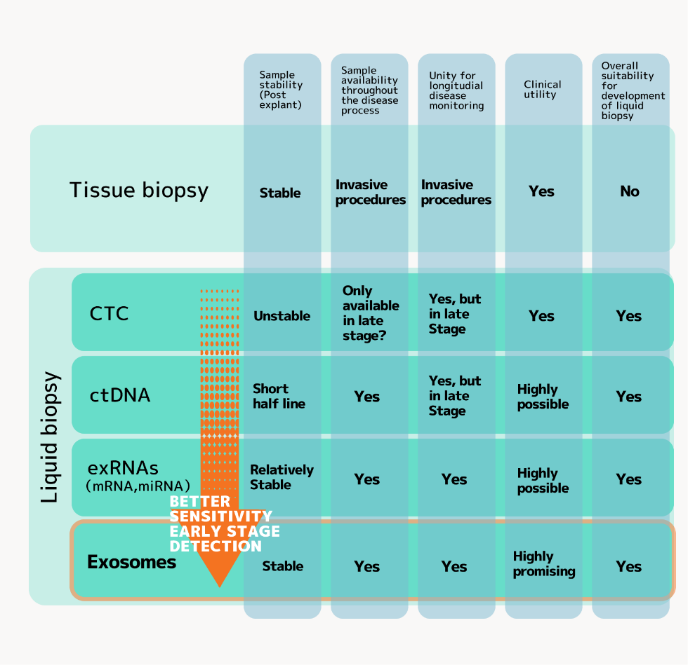
Identify early surrogate biomarkers that correlate with cancer, pre-malignancy, or the hallmarks of cancer
Task 2: Landscaping of Cancer Advances (Multi-Cancer Early Detection [MCED], Biomarker etc.)
POP: 2021, 2026, 2031, 2035
Aim 1: Technology watch(es) will be used to assess current and upcoming technologies with high technology readiness levels, and techniques to help identify and develop actionable cancer, CVD, and CNS biomarkers
Deliverables:
Valid, actionable, and robust biomarkers of cancer, CVD, and/or CNS decrements
Recommendations and incorporation of MCED into SRE-initiated clinical studies on long-term health
Recommendations to clinical practice guidelines
Notes:
There are many different biomarkers being assessed for liquid biopsy cancer detection, but there does not appear to be one clear leader yet.
One of the leading technologies for liquid biopsy analysis, Next Generation Sequencing (NGS), seems to have major issues with cfDNA samples, including low cfDNA concentration and high fragmentation, hence it may have an impact on the assay’s sensitivity.
While ctDNA, CTC, exRNAs, and Exosomes appear to be the most widely used biomarkers for current technologies, other unique approaches such as microbiota (Micronoma), volatile organic compounds (Canary Health & Hirotsu Bio Science), and metabolites (Elypta) may also prove promising with more research and testing.

Slide 31

Research Emphasis 2, Task 2:
YET2 Insights and Observations
Yet-2: SolutionScape - 2021
Liquid Biopsy
Blood
Saliva
Urine
Breath
Imaging
StageZero Life Sciences
Summit Biolabs
Canary Health Technologies
Entopsis
Ezra
Freenome
Lucence
Bluestar Genomics
GRAIL
Multiple Sample Types
Owlstone Medical
NuView Life Sciences
Ceres Nanosciences
Nucliex
Ultrasonic Med. Mapping
BioFluidica
Elypta
Micronoma
Singlera Genomics
Guardant Health
Other
Skin DNA
Hirotsu Bio Science
NIB Biotech
Skin Vision
DermaVision
Cyrcadia Health
Datar Cancer Genetics
Hummingbird Diagnostics
Mercy Bioanalytics
Thrive
Delfi Diagnostics
Nanostics
New
Highly Interesting “A”
Interesting “B”
On Hold/ Rejected “C”
Harbinger MSK
Notes:
Yet2 is a technology scouting organization, also Booz Allen Hamilton

Slide 32
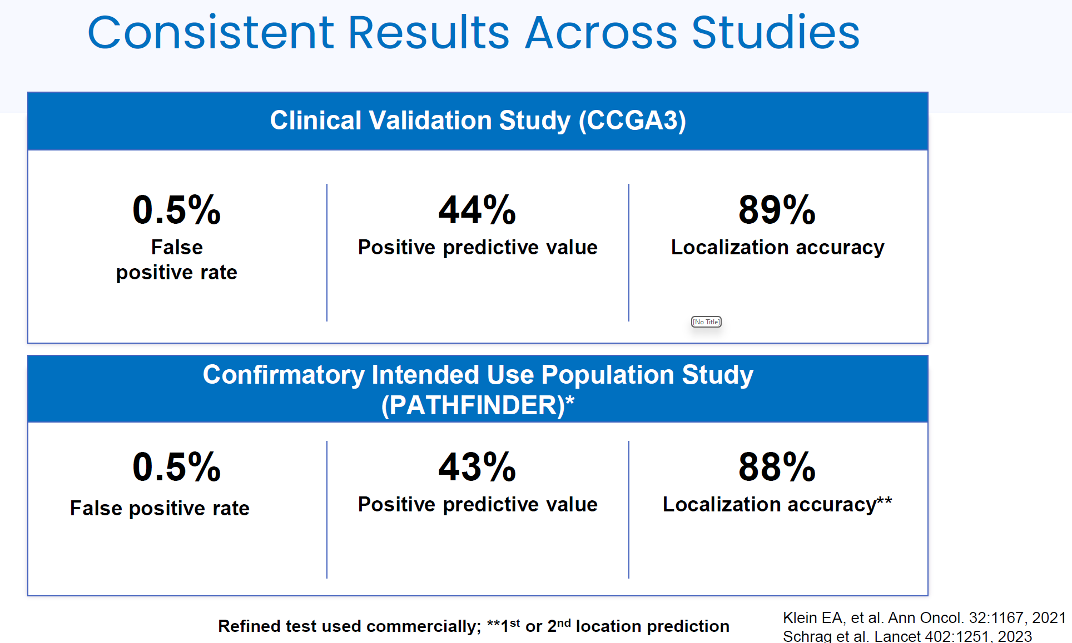
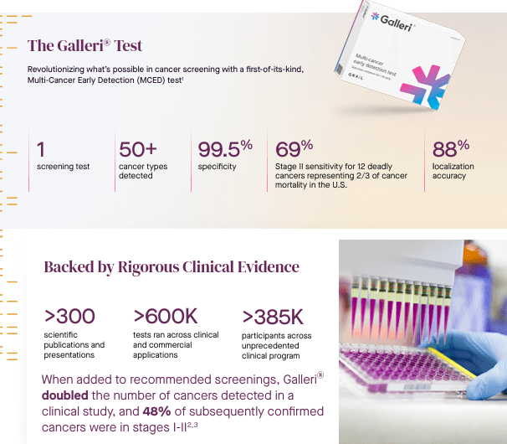
Research Emphasis 4, Task 1:
Identify and/or develop monitoring tools to support spaceflight research, long-term health surveillance, and countermeasure implementation
Multi-Cancer Early Detection – GRAIL Galleri Test
Purpose of Study:
  Captures measures of anxiety, acceptance/satisfaction with test
  Process testbed for incorporation into the astronaut corps
  Socialize test
Chen et al., Clin Cancer Res 27:4221, 2021

Slide 33
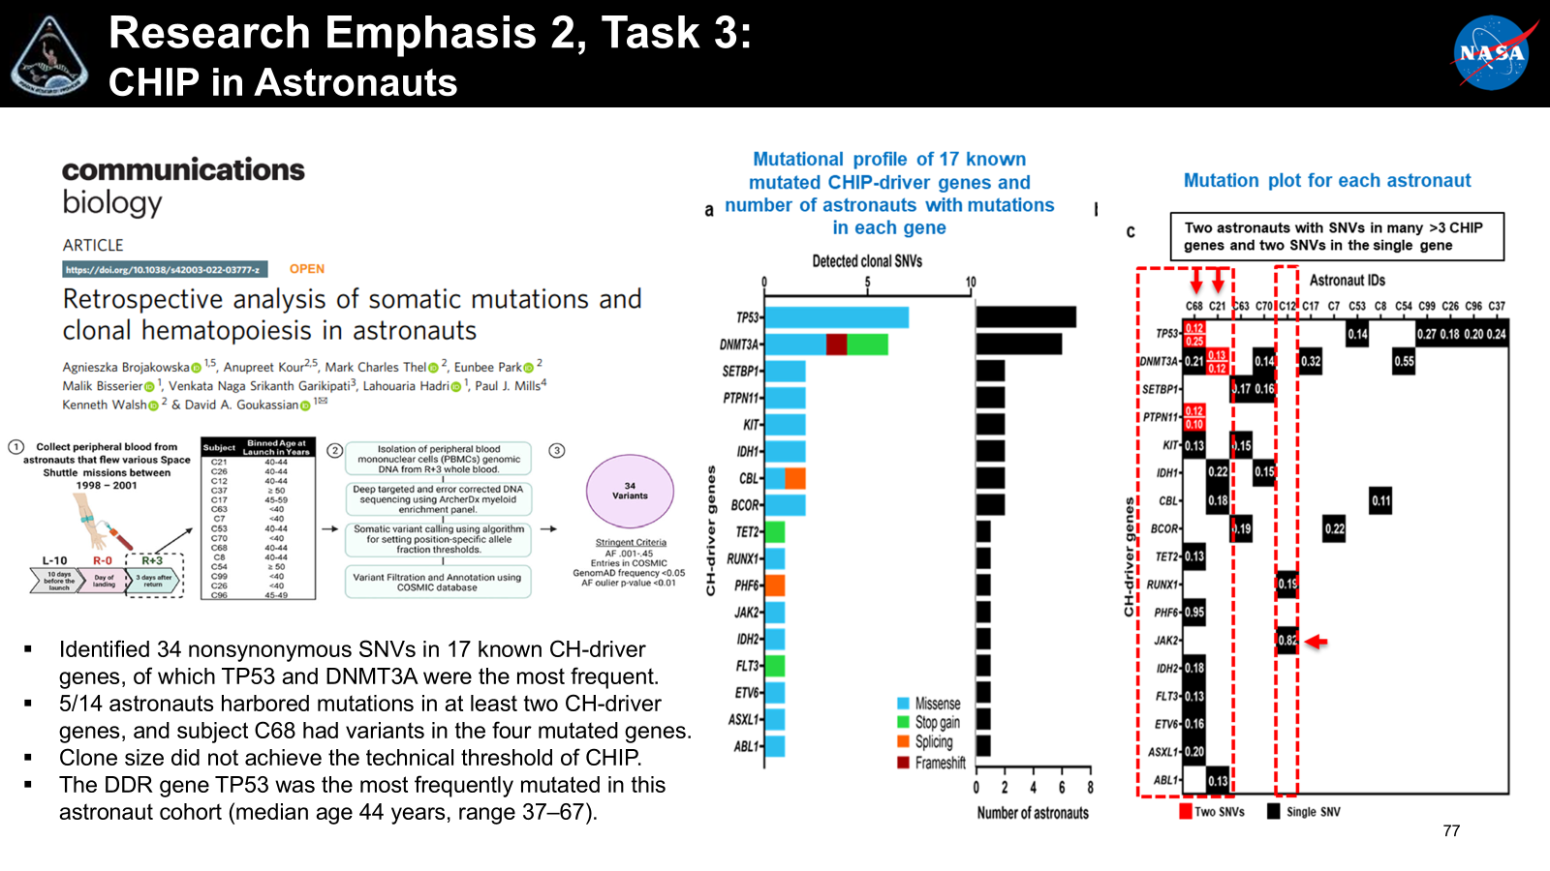
Research Emphasis 2, Task 3:
Identify early surrogate biomarkers that correlate with cancer, pre-malignancy, or the hallmarks of cancer
Task 3: Space radiation exposure and risk mediated by clonal hematopoiesis
POP: 2020 – 2027
A novel murine adoptive bone marrow transfer approach, will be developed in the applicants’ labs, to model clonal hematopoiesis induced by somatic mutations in TET2, DNMT3A, TP53 and PPM1D. Experiments will examine the consequences of simulated GCR and SPE on:
Aim 1: the rates of hematologic clone expansion.
Aim 2: cardiovascular function endpoints.
Aim 3: leukemogenic/cancer endpoints. DNMT3A, TET2 TP53 and PPM1D genes were selected for analysis because they represent the most prevalent driver mutations that contribute to “age-associated clonal hematopoiesis” (DNMT3A and TET2) and “therapy-associated clonal hematopoiesis” (TP53 and PPM1D)
Deliverables:
Evidence regarding whether space radiation exposure can promote clonal hematopoiesis and thereby impact CVD and leukemogenesis in a radiation- and gene-specific manner: These findings will lead to improved health surveillance and better/early detection of CVD and malignancy risks in astronauts who may be clonal hematopoiesis carriers.

Slide 34
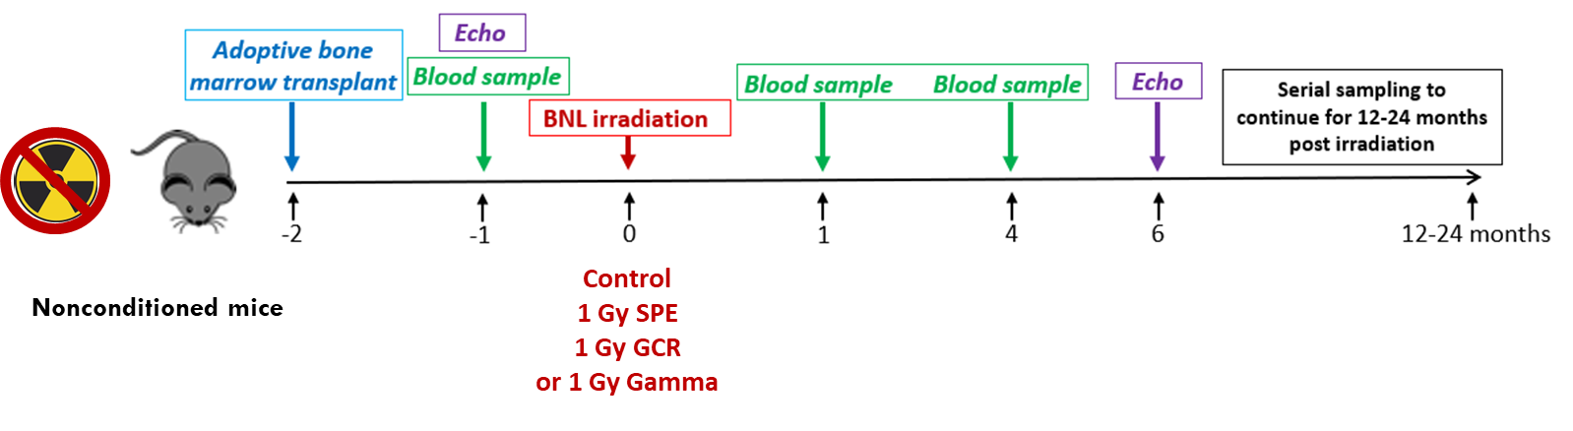
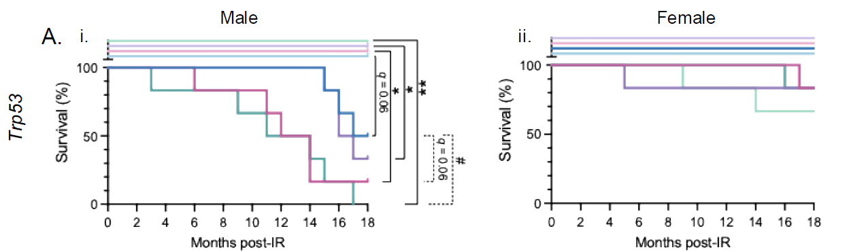

Research Emphasis 2, Task 3:
Understanding the sex-specific consequences of ionizing radiation on clonal hematopoiesis. PI: Kenneth Walsh, IWS Student Augmentation: Megan Evans
Relevance:
Studying the effect of radiation on driving clonal hematopoiesis (CHIP), specifically TP53, PPM1D, TET2, and DNMT3A driver genes due to their association with CVD and cancer.
Easily measurable and could inform risk estimates but also post-mission surveillance for both cancer and cardiac.
Observations:
Some forms of clonal hematopoiesis are promoted by space radiation, with striking effects on morbidly and mortality (e.g. TP53)
Notes:
Space radiation accelerates mortality in mice engrafted with Trp53-mutant cells in a sex-dependent manner
Assessment of survival across the experimental time course showed radiation and mutation-specific effects across the cohorts. In the Trp53 cohorts it was revealed that there was strong male specific effect among mice transplanted with mutant cells that was further exacerbated by exposure to radiation (Figure 3A). More specifically, compared to WT controls, male mice transplanted with Trp53 mutant cells tended to have worse survival, which reached statistical significance in all radiation groups (Figure 3A part i). Male mice with Trp53 mutant cells that were exposed to sim-GCR-sim radiation showed significantly worse survival compared to those that received no radiation (Figure 3A part i). A similar trend was observed for gamma radiation, although this did not reach statistical significance (Figure 3A part i). In contrast, the effect of the mutation and radiation on survival was absent in females (Figure 3 A part ii). For Ppm1d, there was no detectable effect of the mutation or radiation on survival in either male or female mice (Figure 3B).
Some forms of CHIP are promoted by space radiation, but have no detectable effect on survival (e.g. PPM1D)
Some forms of CHIP are unaffected by space radiation, and the radiation does not affect the mortality associated with CHIP on survival( TET2)
Radiation: 1Gy SPE, GCR and Gamma rays
Adaptive bone marrow transplant 2 months prior to radiation
Blood Sampling and Echo 1 month prior to IR
Specific aims: To evaluate the effects of gamma, simulated GCR and SPE on the following parameters
Hematologic mLOY cell expansion
CVD development
Leukemogenic/cancer endpoints in mice.

Slide 35




Research Emphasis 2, Task 4:
Mosaic Loss of Y (mLOY)
Notes:
Cf-mtDNA fractions increased by 2 and 355- fold when compared to preflight levels. Mt-DNA levels were increased only in plamsa as cf-mtDNA rather than EV-mtDNA. DNA/RNA oxidative damage was increased in PBMCs at both timepoints post-landing.
Then he is going to perfrom invitro validation of transciptome and proteome findings in sEV in human cells

Slide 36


Research Emphasis 2, Task 4:
Mosaic Loss of Y (mLOY)
M. A. Evans and K. Walsh Physiological Reviews 103:649-716 (2023)
Notes:
The medical relevance of mLOY is not fully understood, but is correlated with cardiovascular disease, increased cancer risk, some cognitive disorder, and may partially explain the 5-year difference in lifespan between men and women in the United States. We hypothesize that radiation exposure may accelerate mLOY.

Slide 37




Research Emphasis 2, Task 4:
Understanding the sex-specific consequences of ionizing radiation on clonal hematopoiesis. PI: Kenneth Walsh, IWS Student Augmentation: Megan Evans
Relevance:
Studying the effect of radiation on driving clonal hematopoiesis (CHIP), specifically TP53, PPM1D, TET2, and DNMT3A driver genes due to their association with CVD and cancer.
Studying how the loss of the Y chromosome (LOY), only in male animals, may affect mortality in combination with CHIP and radiation.
Easily measurable and could inform risk estimates but also post-mission surveillance for both cancer and cardiac.
Observations:
Some forms of clonal hematopoiesis are promoted by space radiation, with striking effects on morbidly and mortality (e.g. TP53)
Strong male-dependence of space radiation on survival in the TP53 condition may be partly explained by the tumorigenic effects of LOY.
Notes:
Space radiation accelerates mortality in mice engrafted with Trp53-mutant cells in a sex-dependent manner
Assessment of survival across the experimental time course showed radiation and mutation-specific effects across the cohorts. In the Trp53 cohorts it was revealed that there was strong male specific effect among mice transplanted with mutant cells that was further exacerbated by exposure to radiation (Figure 3A). More specifically, compared to WT controls, male mice transplanted with Trp53 mutant cells tended to have worse survival, which reached statistical significance in all radiation groups (Figure 3A part i). Male mice with Trp53 mutant cells that were exposed to sim-GCR-sim radiation showed significantly worse survival compared to those that received no radiation (Figure 3A part i). A similar trend was observed for gamma radiation, although this did not reach statistical significance (Figure 3A part i). In contrast, the effect of the mutation and radiation on survival was absent in females (Figure 3 A part ii). For Ppm1d, there was no detectable effect of the mutation or radiation on survival in either male or female mice (Figure 3B).
Radiation: 1Gy SPE, GCR and Gamma rays
Adaptive bone marrow transplant 2 months prior to radiation
Blood Sampling and Echo 1 month prior to IR

Slide 38



Research Emphasis 4, Task 2:
Long-Term Health Standard Measures Baseline
CHIP and mLOY
MCED
Disease Surveillance
Parkinson's Disease
detection assays:
Mito DNA_{DX}
α-Synuclein
Timeline for LTH measures
Pre-flight Baseline/ASCAN
One-Year Post Mission
Every 5 Years
End of Active Career
Post Retirement –
Dependent on Crew Participation
David P. Steensma et al. Blood 2015;126:9-16
Panagiotis Baliakas Lars A. Forsberg. Haematologica Vol. 106 No. 2 (2021): February, 2021

Slide 39
Cancer Risk Approach Plan

Slide 40
Space Radiation Countermeasures Research Plan
Pharmaceutical Down Selection Approach
Research Emphasis - 5
BIOMARKERS
Assessment of drug efficacy in tissue chips, animals and/or in astronauts
Threshold of damage for delivery of the drug
Personalized medicine approaches, determination of who is administered the drugs

Slide 41
Research Emphasis 4, Task 3:
Identification of Transcriptomic and Proteomic Biomarkers in Plasma and Urine Samples of Astronauts in CardioOx Study
PI: David Goukassian / Icahn School of Medicine at Mount Sinai
Experimental Design
Utilizing CardioOx Study samples
PRE-FLIGHT
IN-FLIGHT
POST-FLIGHT
180 days
45 days
15 days
60 days
160 days
5 days
Baseline detection expression -
Determination of
interpersonal variability
In-flight space hazard-associated alterations in biomarkers and the kinetics of changes over time – Novel biomarker identification and the assessment of validity with published plasma biomarkers and clinical data in this cohort of astronauts
Recovery or progression
n = 8 subjects
PLASMA
PLASMA and URINE
Cell Free Mitochondrial DNA (cf-mtDNA)
Cell Free DNA (cf-DNA
Cell Free RNA (cf-RNA)
In small extracellular vesicles (sEV)
RNA and Protein Biomarkers:
Messenger – mRNA
Small non-coding – miRNA, snRNA, snoRNA, tRNA
Long non-coding – lncRNA
Proteins

Slide 42


Research Emphasis 4, Task 3:
Identification of Transcriptomic and Proteomic Biomarkers in Plasma and Urine Samples of Astronauts in CardioOx Study
Top 3 upregulated proteins in URINE L-180 vs. Fs and R
Heatmap – Supervised Clustering URINE Proteins
FD15
ARTN
263-fold
PSMA1
256
NPR3
36
FD60
IQGAP1
167
RPL7A
34
PTPRO
15
FD180
AHNAK
174
RPL7A
9
PEPD
3
R+5
PSMA1
100
IQGAP1
85
MFGE8
28
L-180
L-45
FD15
FD60
FD180
R+5
The PSMA1 is a critical component of the 20S proteasome, a multi-protein complex responsible for
degrading unneeded or damaged proteins inside a cell. Gastric cancer: High PSMA1 expression
is linked to poor prognosis, promotes the proliferation, migration, and invasion of cancer cells. Lung cancer: Overexpression of PSMA1 is associated with poor prognosis and increased tumor
growth in lung squamous cell carcinoma. Triple-negative breast cancer (TNBC): a circular RNA derived from PSMA1 (circPSMA1) promotes tumorigenesis, metastasis, and migration. Colon
cancer: High expression of PSMA1 may be a biomarker for early-stage colon cancer. RPL7A - encodes ribosomal protein L7a, a component of the large 60S ribosomal subunit essential for
protein synthesis. Clinical Relevance - up-regulation by ethanol in breast cancer, may influence translational regulation and contribute to tumor progression and metastasis.
Notes:
The IQGAP1 protein is a large, ubiquitously expressed protein that functions as a molecular hub, integrating various cell signaling pathways, including B-RAF, MEK1/2, ERK1/2, WNT/beta-catenin, RAC1, CDC42 and Rho GPTases.
Clinical significance
Overexpression and mislocalization of the IQGAP1 protein are associated with the progression of many cancers, and it is a promising therapeutic target for metastatic disease.
Role in Cancer: High levels of IQGAP1 are observed in various cancers, including gastric, breast, colorectal, and thyroid cancer. It promotes malignancy by enhancing cell proliferation, migration, invasion, and suppressing apoptosis. In certain cancers, increased IQGAP1 levels correlate with poor prognosis.
Metastasis: IQGAP1 is crucial for metastasis by influencing the ability of cancer cells to extravasate from blood vessels and invade new tissues. In mouse models of melanoma and breast cancer, knocking out the IQGAP1 gene significantly reduced the formation of metastases.
Diabetes and Glucose Homeostasis: Studies in mice lacking IQGAP1 have shown impaired glucose tolerance and insulin signaling, suggesting a role in regulating glucose metabolism.
B-cell Development: IQGAP1 is an essential scaffold in B-cell development and function, orchestrating the activation of key signaling pathways and playing a role in the maturation of B-cells in the bone marrow and spleen.

Slide 43
Space Radiation Countermeasures Research Plan
Pharmaceutical Down Selection Approach
Research Emphasis - 5
BIOMARKERS
Assessment of drug efficacy in tissue chips, animals and/or in astronauts
Threshold of damage for delivery of the drug
Personalized medicine approaches, determination of who is administered the drugs

Slide 44
Radiation Working Group
Initiative 2
Janice Zawaski “JZ”, NASA HRP Space Radiation Element Scientist
Rodrigo Coutinho de Almeida, ESA HRE-SU Biology Science Support
Janapriya Saha “JP”, NASA HRP Space Radiation Deputy Element Scientist
April 13, 2026

Slide 45
OVERVIEW OF PAST RADIATION WORKING GROUP
Objectives:
Identify spaceflight-relevant gaps in radiation and omics research domains.
Recognize opportunities for collaborations between agencies where these research gaps may be more efficiently addressed through international cooperation.
Identify strategic (e.g. research roadmaps/strategy) and/or tactical (e.g. individual studies) level opportunities.
Determine whether and where it may make sense for agencies to standardize research methodology and data standards.
Length:
Initially 8 Agencies represented but afterwards only ESA, NASA, CSA, ASI and JAXA were actively participating.
Notes:
Radiation and Omics Splinter Working Group

Slide 46
LESSONS LEARNED
Focused objective
Appropriate meeting cadence with time commitment from POC
Appropriate POC (knowledgeable/doers)
Inclusion of agencies with active work
Semiannual reporting out

Slide 47

BIOMARKERS
Definition: Biomarkers (biological markers) are objectively measured, quantifiable characteristics—such as proteins, genes, or imaging findings—that indicate normal or abnormal biological processes, disease states, or pharmacological responses to treatment. They function as biological clues to diagnose diseases early, predict risks, or determine if a therapy is working.
https://www.als.org/research/als-research-topics/biomarkers

Slide 48
BIOMARKERS
Definition: Biomarkers (biological markers) are objectively measured, quantifiable characteristics—such as proteins, genes, or imaging findings—that indicate normal or abnormal biological processes, disease states, or pharmacological responses to treatment. They function as biological clues to diagnose diseases early, predict risks, or determine if a therapy is working.
Health
Countermeasure
https://www.als.org/research/als-research-topics/biomarkers

Slide 49
BIOMARKERS
Health (Cancer, CVD, CNS, Accelerated Aging)
Informs Countermeasure Administration
https://www.als.org/research/als-research-topics/biomarkers

Slide 50
SCHEDULE AND AGENCY INCLUSION
Meetings schedule: Monthly for the first 6 months and then we will reevaluate
Inclusion: Agencies with active biomarker work or techniques to identify potential biomarkers
    Knowledgeable in biomarker area
    Time availability
    Well connected with others

Slide 51
REPORTING
Meetings will be recorded
  For awareness videos can be dispersed regardless of inclusion of a POC
Actions documented
Results will be presented semi annually
  ISLSWG

Slide 52
Thank you for your attention!
Questions?

