Slide 1
HWO TMPO Instrument Study
Initial Information Document
HWO TMPO Systems Engineering Team
May 4, 2026
Alice Liu, Goddard Space Flight Center
Matthew Bolcar, Goddard Space Flight Center
Josh Abel, Goddard Space Flight Center
Marie Levine, Jet Propulsion Laboratory
Charley Noecker, Jet Propulsion Laboratory
Maxime Rizzo, AKAT Corporation
Paul Scowen, Goddard Space Flight Center
Breann Sitarski, Goddard Space Flight Center
Feng Zhao, Jet Propulsion Laboratory
Jon Lawrence, Goddard Space Flight Center
Charles Wang, Jet Propulsion Laboratory
Joseph Howard, Goddard Space Flight Center
Hong Tang, Jet Propulsion Laboratory
Jordan Effron, Goddard Space Flight Center
Brad Moore, Jet Propulsion Laboratory
Greg Walsh, Goddard Space Flight Center
Harry Culver, Bay Engineering Innovations

Slide 2
Document Outline
Introduction
Mission and Observatory Overview
EAC5 Observatory Design Guidelines and Concept
Instrument Mass, Power, and Volume Allocations
Preliminary Interface Assumptions: Mechanical, Structural, Thermal, and Electrical
Telescope and Instruments
  EAC-5 Telescope Optical Design
  Instrument Design Guidelines (Government Team Response to EAC-5 Instrument Capabilities)
    Coronagraph Instrument (CI) NIR Channel
    High Resolution Imager (HRI)
      Guiding Design Guidelines
      HRI-S WFS Design Guidelines
    Ultraviolet Multi-Object Spectrograph (UV MOS)
    Ultraviolet Integral Field Unit (UV IFU)

Slide 3
Introduction
The Initial Information Document provides top-level information on the HWO mission, Exploratory Analytic Case-5 (EAC-5), instrument resource allocations, and instrument interfaces to support instrument study proposals.
Current Design Basis
  Derived from the HWO Technology Maturation Project Office (TMPO) EAC-5 design
  Large aperture: 8.2 m inscribed diameter / 10.0 m circumscribed diameter
Guiding Principles
  Serves as a guide, not a set of strict requirements
  While compliance with resource allocations (mass, power, volume) and interface constraints is encouraged, please note that this information is preliminary and some exceedances may be considered
HWO TMPO encourages instrument proposers to identify:
  Guidelines that are challenging or easily met with margin
  Missing guidelines that may impact the design
  Opportunities and breakpoints in allocations and interface assumptions
  Trades against allowable resources and interface assumptions are encouraged

Slide 4
HITS Solicitation: Instrument Capabilities
The candidate instrument capabilities listed below are within the scope of this solicitation. Other instrument capabilities not listed here may be within the scope, if the proposal convincingly demonstrates sufficient traceability to HWO science goals.
Coronagraphy (*see note below):
  Near-IR coronagraphic imaging and spectroscopy
  Near-UV coronagraphic imaging
Spectroscopy:
  UV / visible integral field spectroscopy
  UV / visible multi-object spectroscopy
Imaging:
  High-resolution near-UV / visible / near-IR imaging
  Visible wavelength high-precision astrometry
  Observatory guiding and wavefront sensing
Note that visible coronagraphic imaging and spectroscopy are excluded from this solicitation, as the visible coronagraph is being studied as directed work within HTMPO. Proposals may address near-IR coronagraphy as a stand-alone instrument or as an additional channel within the visible coronagraph.

Slide 5
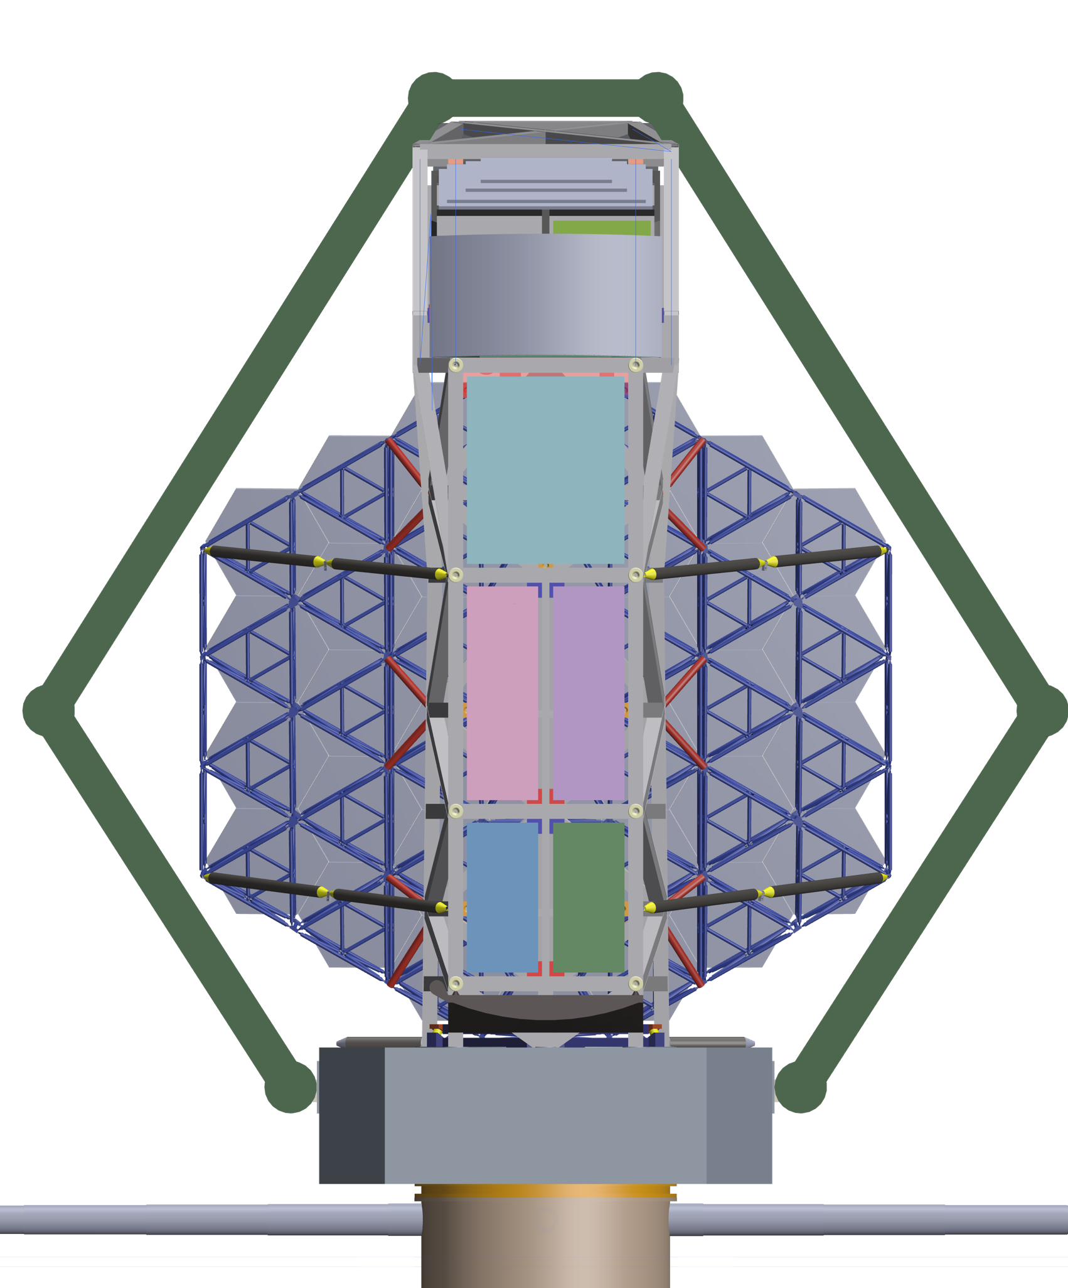
EAC-5 Instrument & Guider Assembly Overview
CI (including NIR channel)
The observatory accommodates a total of six instrument bays for science instruments and guiders.
Instrument Location Guidelines
  CI NIR Channel: Positioned on the cold side of the observatory to enable passive cooling of detectors
  Instrument A (w/ far UV): Located under CI bay to minimize number of reflections
  All Other Instruments and Guiders: May be located in any of the remaining instrument bays (B–E) or across multiple bays
Instrument A (far UV)
Instrument B
Instrument C
Instrument D
Instrument E

Slide 6
Acknowledgement
Name | Systems Team
Alice Liu | Project Systems Engineer
Matt Bolcar | Chief Technologist
Josh Abel | Observatory Systems Engineer
Marie Levine | Systems Analysis Lead
Charley Noecker | Coronagraph Coordination Lead
Maxime Rizzo | HRI Working Group Lead
Paul Scowen | UVI Working Group Lead
Breann Sitarski | Deputy Architect and Testbed Lead
Feng Zhao | Deputy Chief Technologist
With inputs from CI, HWI, and UVI Working Group teams
Name | Discipline Engineering
Jon Lawrence | Mechanical Lead
Charles Wang | Coronagraph Mechanical Lead
Joe Howard | Optical Lead
Hong Tang | Coronagraph Optical Lead
Jordan Effron | Thermal Lead
Brad Moore | Coronagraph Thermal Lead
Greg Walsh | Structures Lead
Harry Culver | Electrical Lead
With inputs from government systems design team

Slide 7
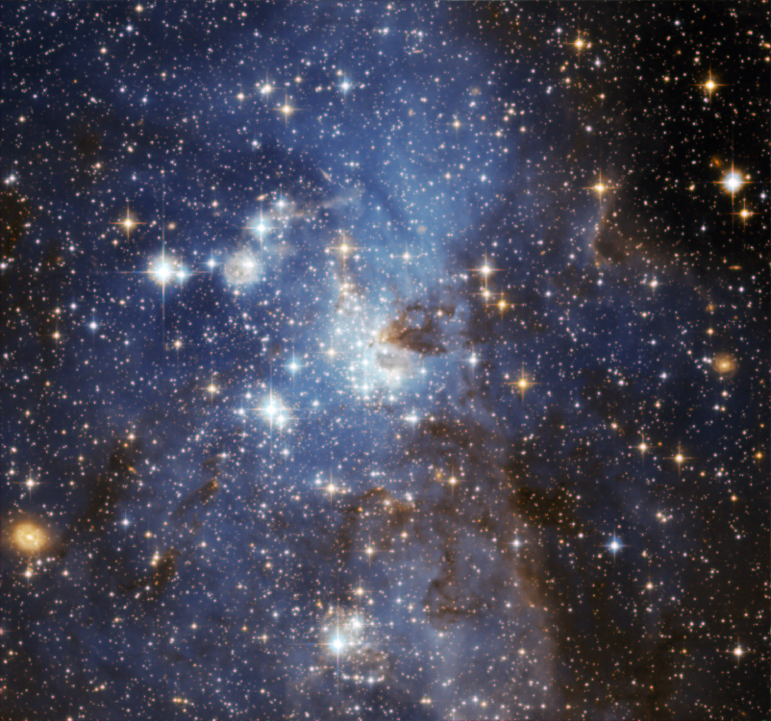
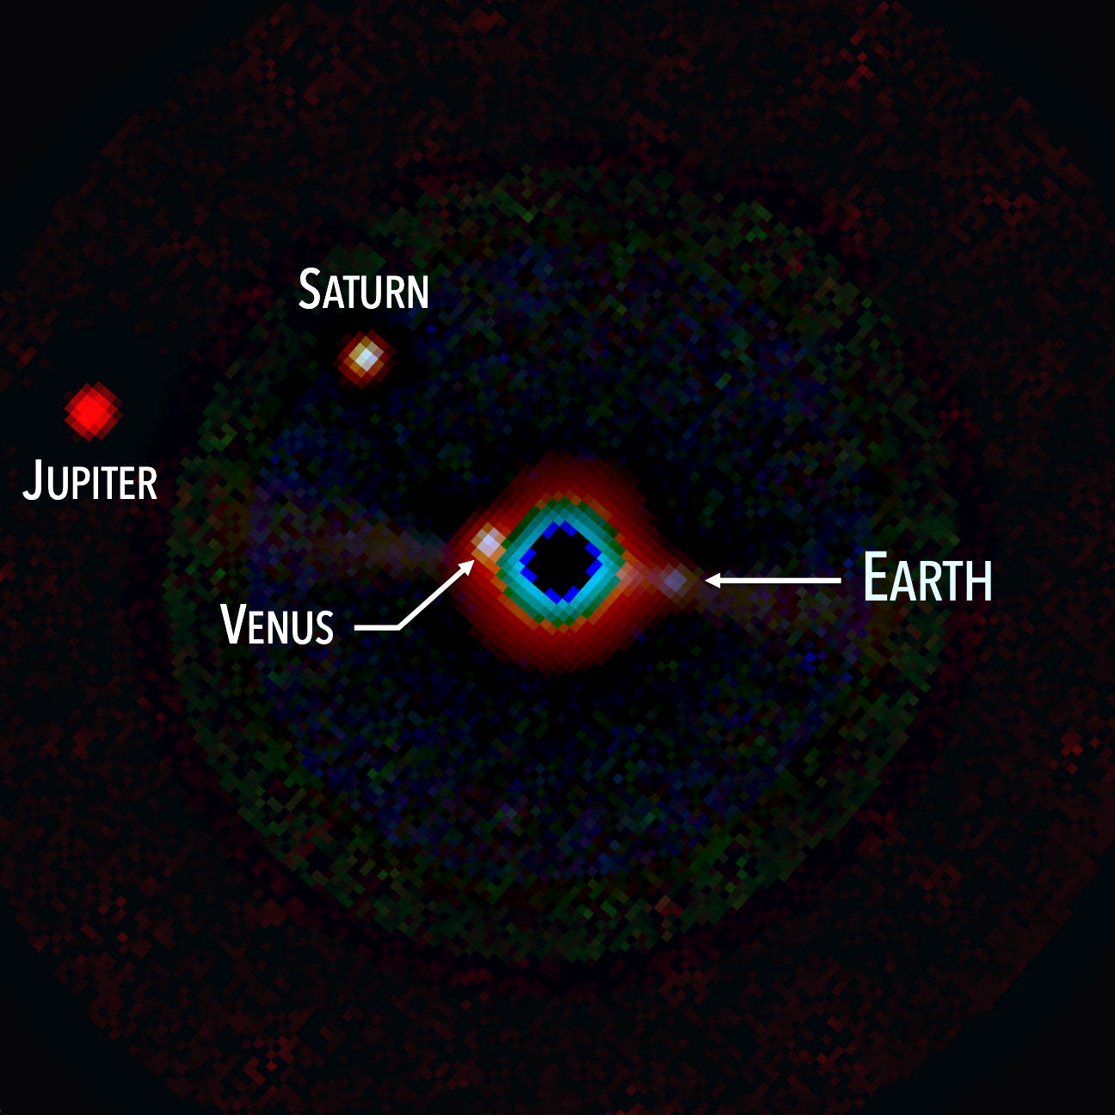
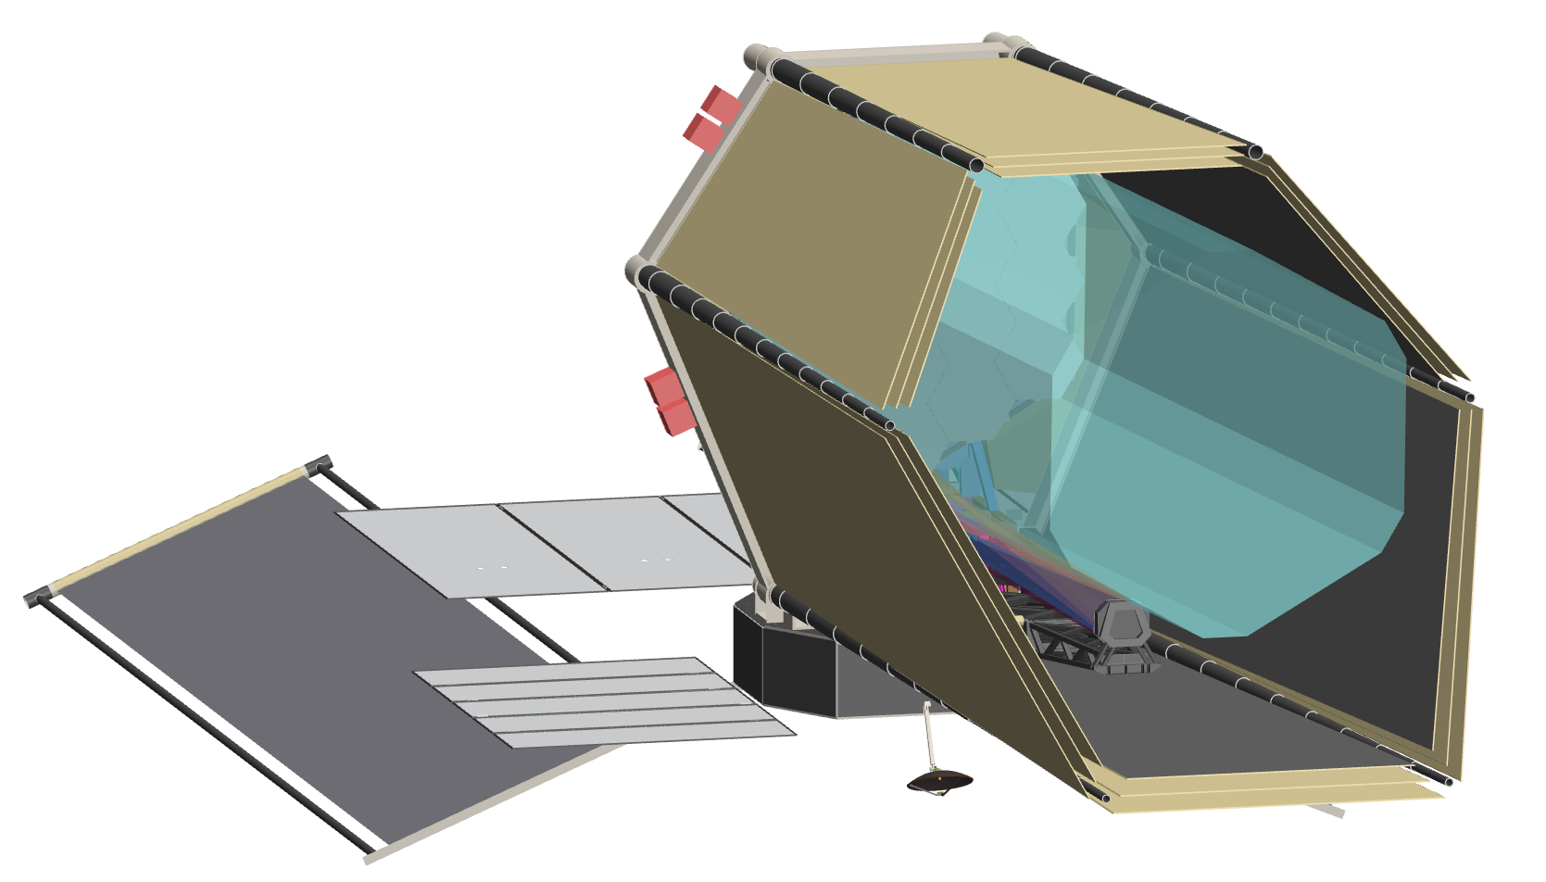
Habitable Worlds Observatory (HWO) Mission Overview
NASA's next flagship mission, recommended by the Astro2020 Decadal Survey
  Large-aperture UV/Optical/NIR observatory performing transformative astrophysics across cosmic time
  First telescope designed to directly image and characterize Earth-like exoplanets, including search for signs of life
HWO includes a segmented primary mirror and coronagraph instrument
Operational orbit at Sun-Earth L2
Serviceable at L2

Slide 8
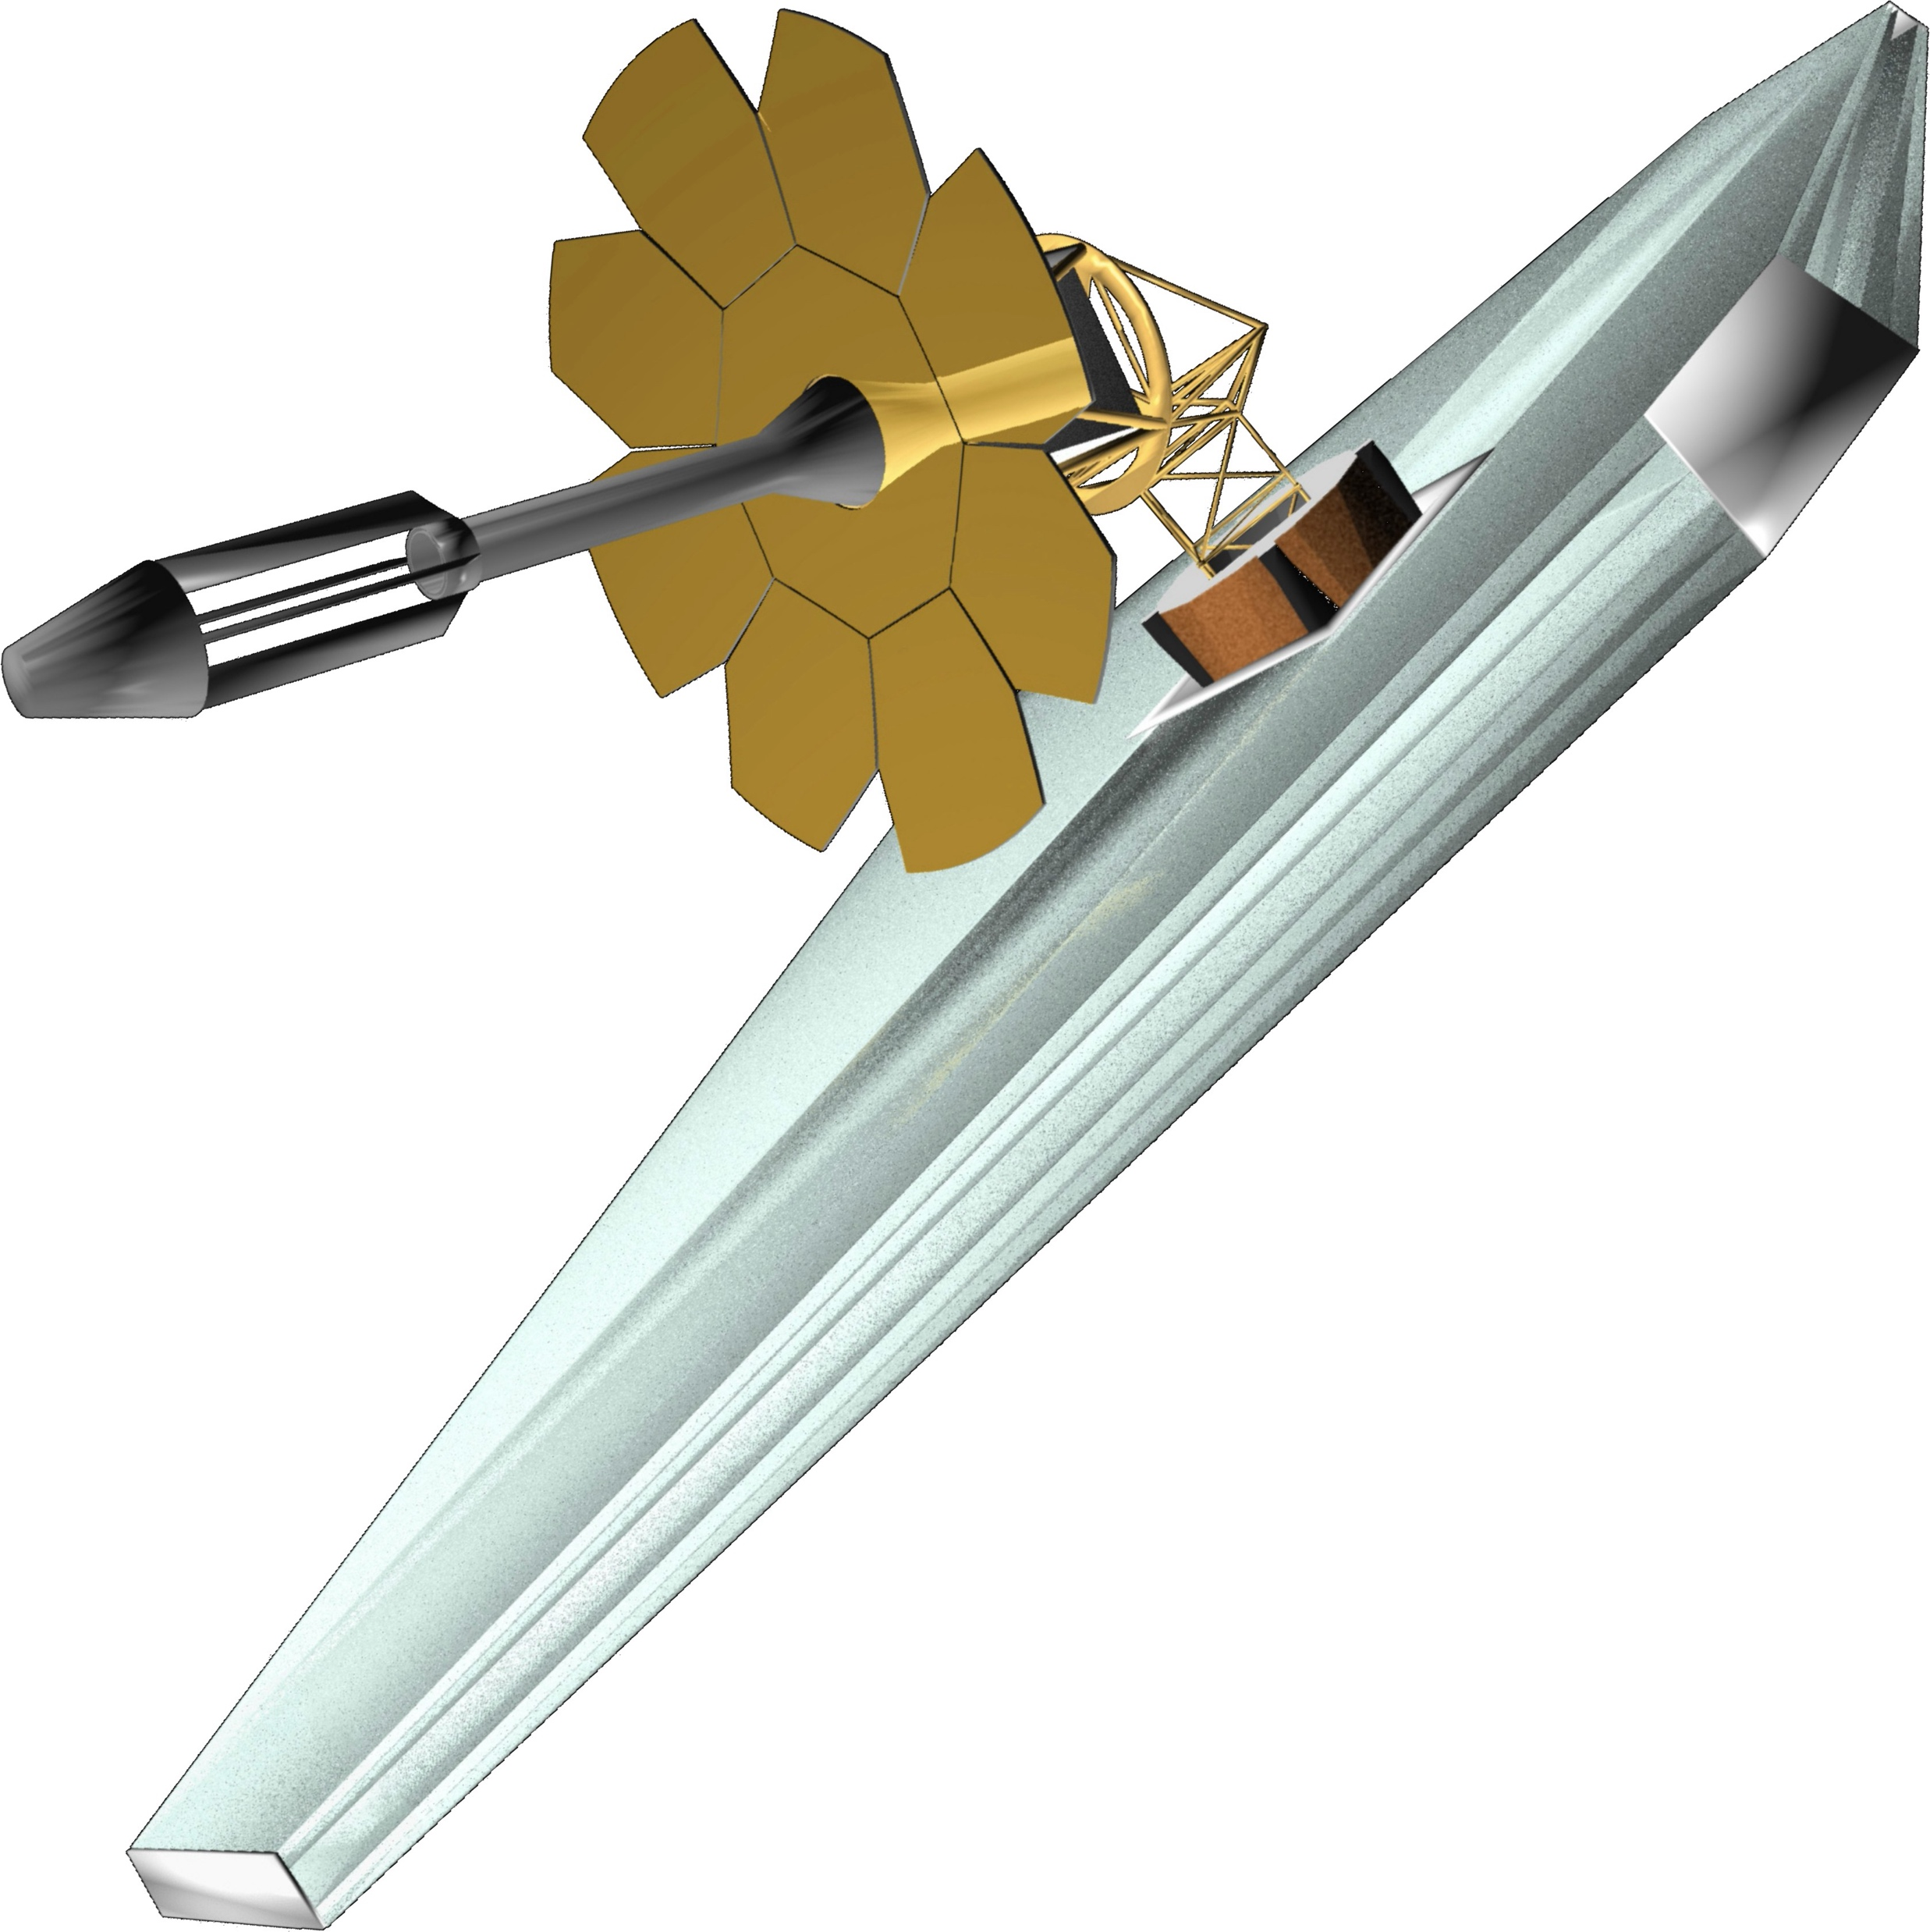
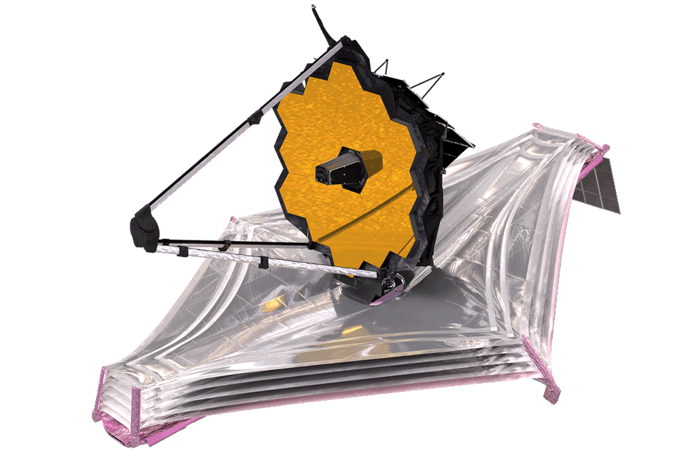
Exploratory Analytic Cases (EACs)
Mission architectures developed to explore the HWO trade space:
  Explore key architectural options and breakpoints to guide future point design decisions
  Develop end-to-end models and tools to understand modeling capabilities and needs
  Identify technology gaps and guide maturation of potential solutions
  Provide early feedback to launch vehicle vendors to help influence their direction
  We don’t expect any of the cases studied will become a baseline design going forward.
  These are only intended to explore and practice.
Final JWST
CML 9+
Early JWST

Slide 9
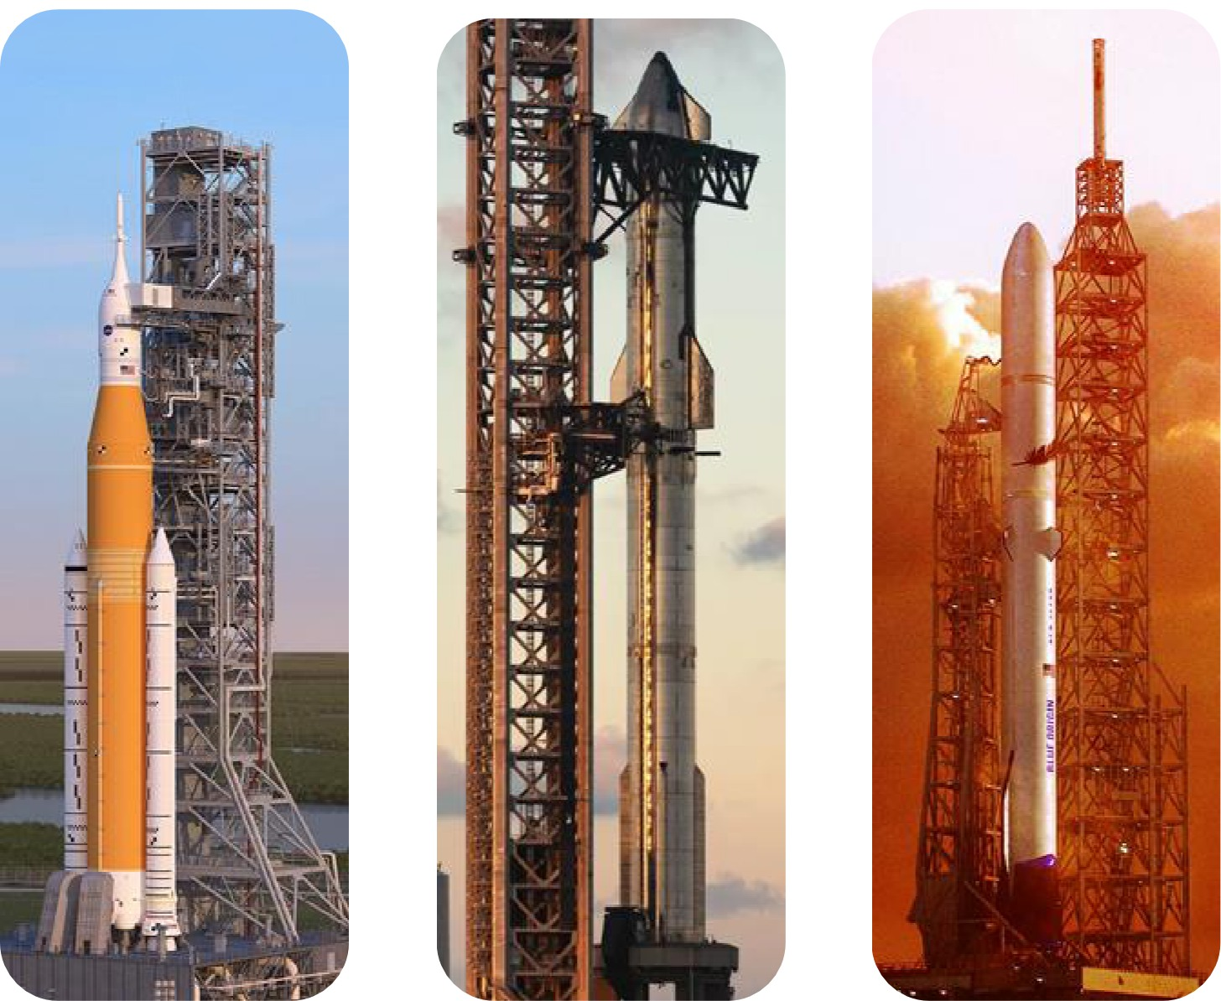
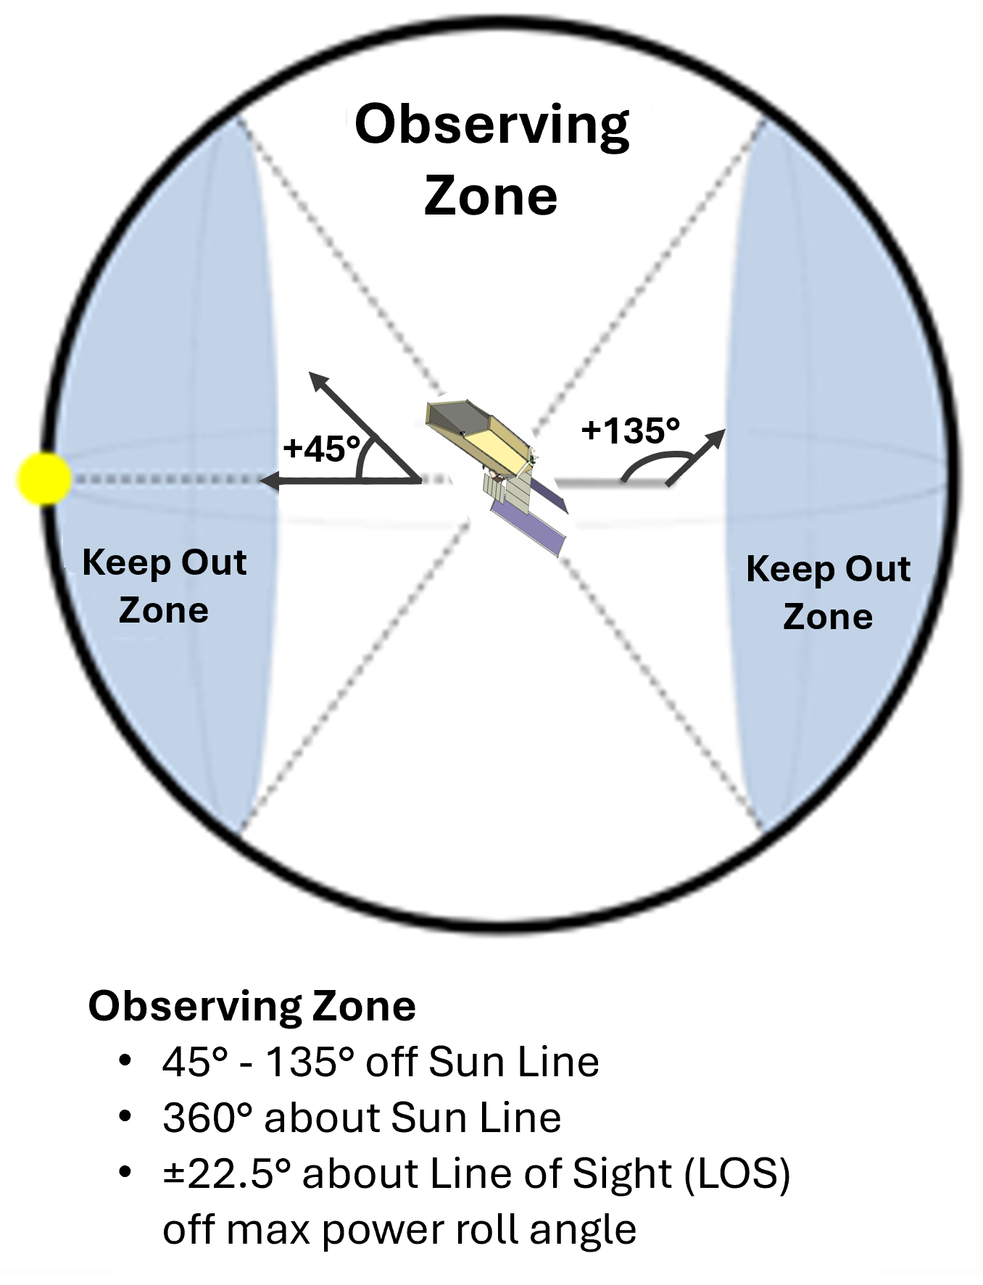
EACs Design Guidelines
Baffle/barrel protection for optics against micrometeoroid impacts
Compatible with at least two future launchers
Serviceable architecture
ULE glass mirrors (primary/secondary) at room temperature for simplified I&T
Field-of-Regard: ±45° pitch, ±22.5° roll, 360° yaw
Slew/Settle: 90° in 60 min
Observatory LOS stability: 4 mas
Passive cooling for NIR detectors
NASA
Space Launch System
SpaceX
Starship
Blue Origin
New Glenn
(7x2 shown, 9x4 considered)

Slide 10
HWO Observatory Schematic
PM Backplane
Assembly (PMBA)
Deployable Baffle
DBS Containment Box
Optical Telescope Element
Instrument and Guider Element
Instrument 1
Instrument & Detector Radiator Assy’s (Multiple radiators)
Primary Mirror (PM) Segments
Instrument 2
Spacecraft Element
Instrument 3
SC-to-Payload Vibration Mitigation System (SPVM)
●
Instrument Module Structure
Secondary Mirror Assembly (SMA)
●
●
Extra Instrument (XI)
Deployable Baffle System
Sun-Shade or Instrument Radiator Shields
Secondary Mirror Support Structure
Spacecraft Bus
ACS Hardware, Propulsion
Avionics, Comm, C&DH, Power System
Solar Arrays
SC-to-Payload Vibration Mitigation System (SPVM)

Slide 11
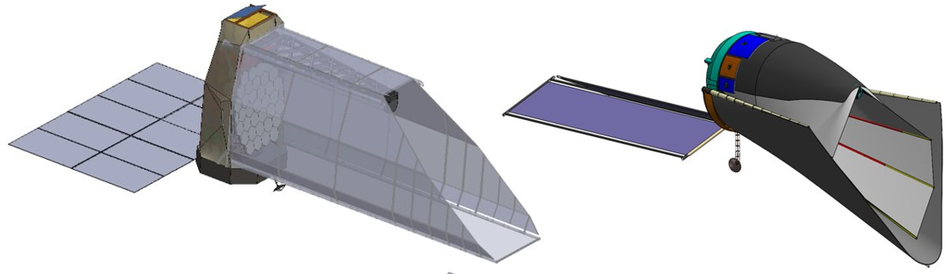
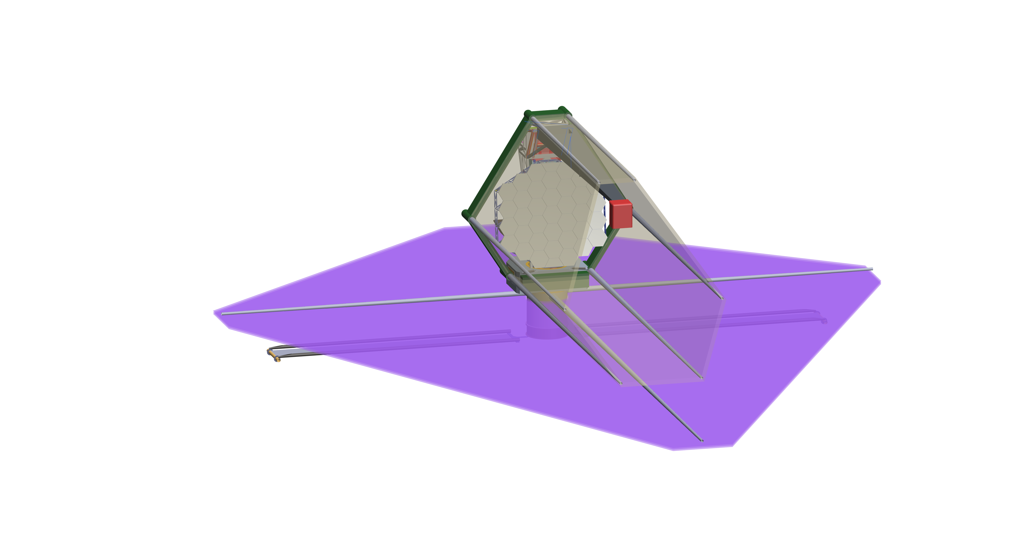
Overall Approach to EAC 4 and 5
EAC-4 Objectives:
  Balances cost, schedule, and science performance
  Mitigate baffle-related engineering risks
EAC-5 Objectives:
  Driven by science goals with minimum 8-m inscribed diameter aperture
  Consider large flat sunshade to improve thermal stability
Instrument Suite:
  CI (VIS + NIR)
  UV MOS and UV IFU
  HRI (provides guiding and out-of-field WFS)
  Reserved bay for future servicing mission instrument
EAC-4: To be delivered as part of the HWO Technical Packet at the kick-off meeting
EAC-4 selection pending
EAC-5: Delivered as part of the Pre-Proposal Information Packet

Slide 12
  EAC5 Observatory Overview: Front View

Slide 13
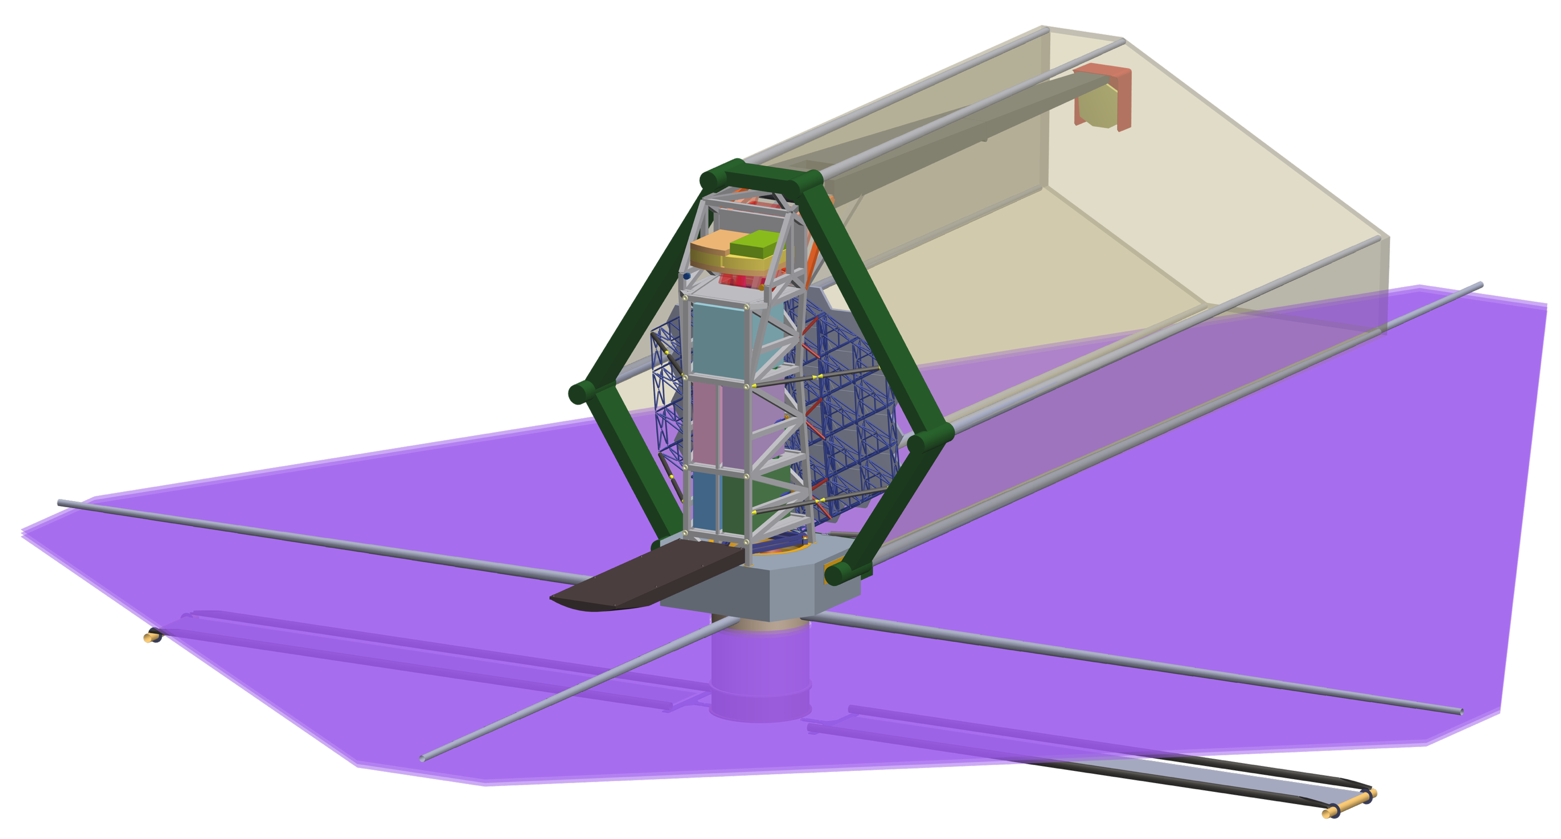
  EAC5 Overview: Rear View (radiators, OTE closeout not shown)

Slide 14
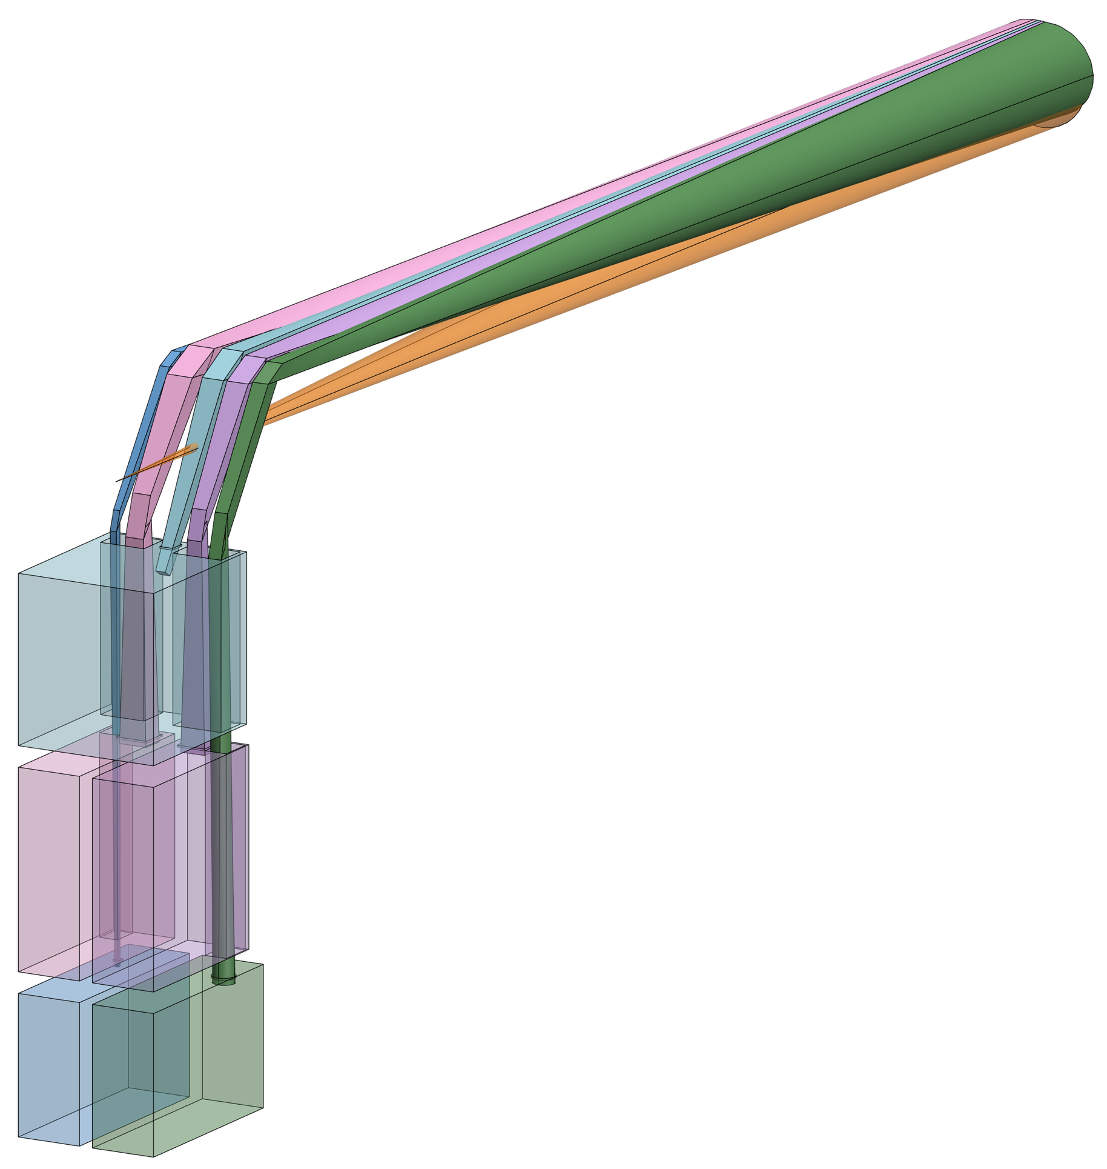
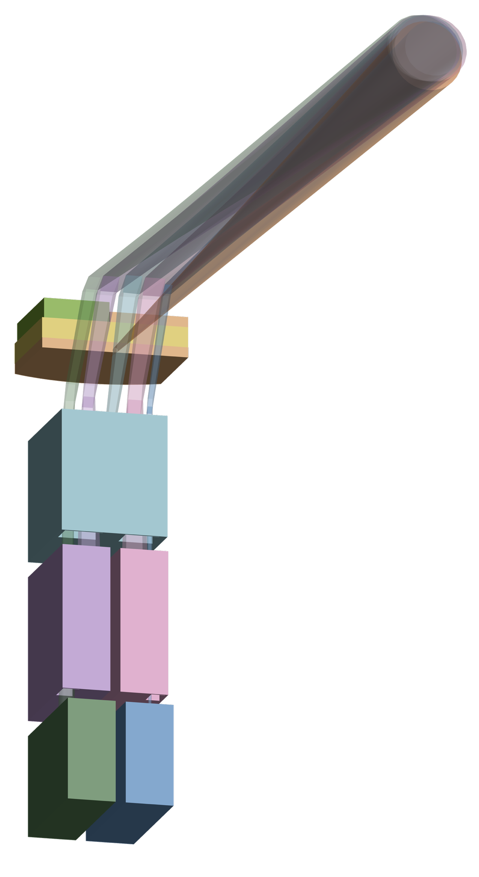
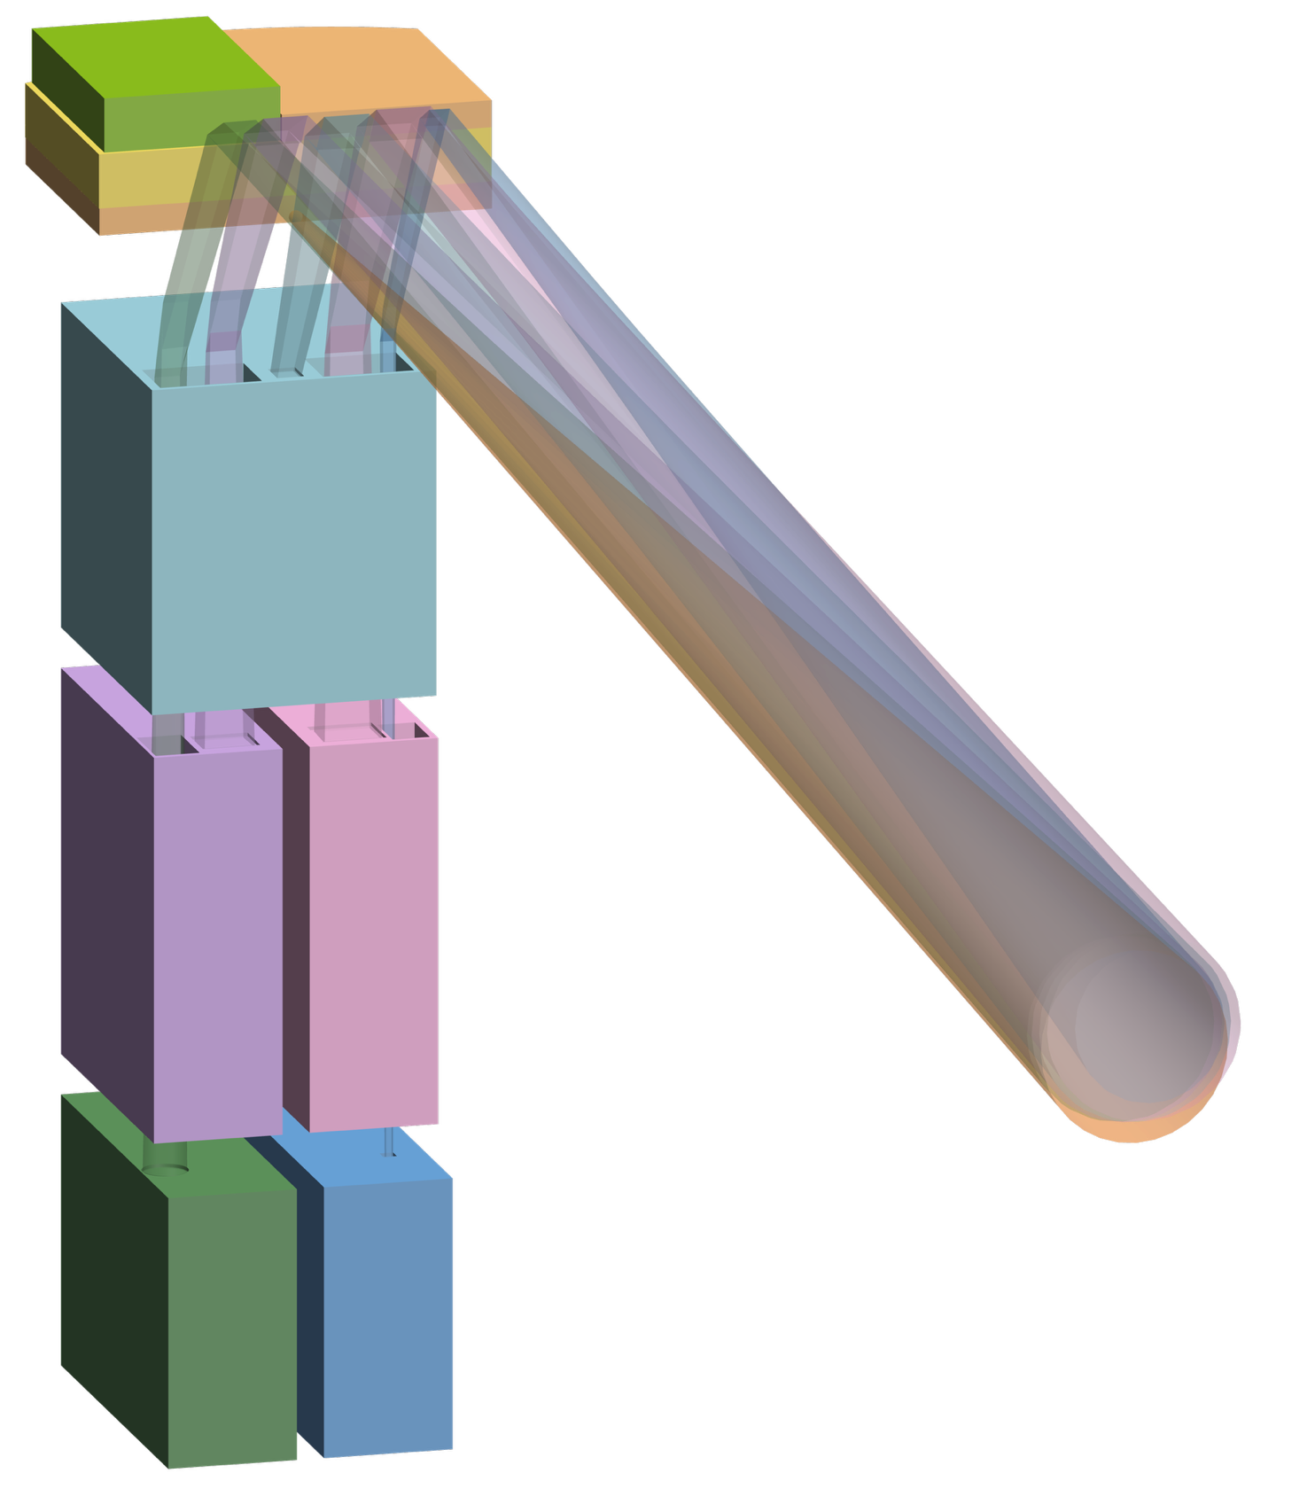
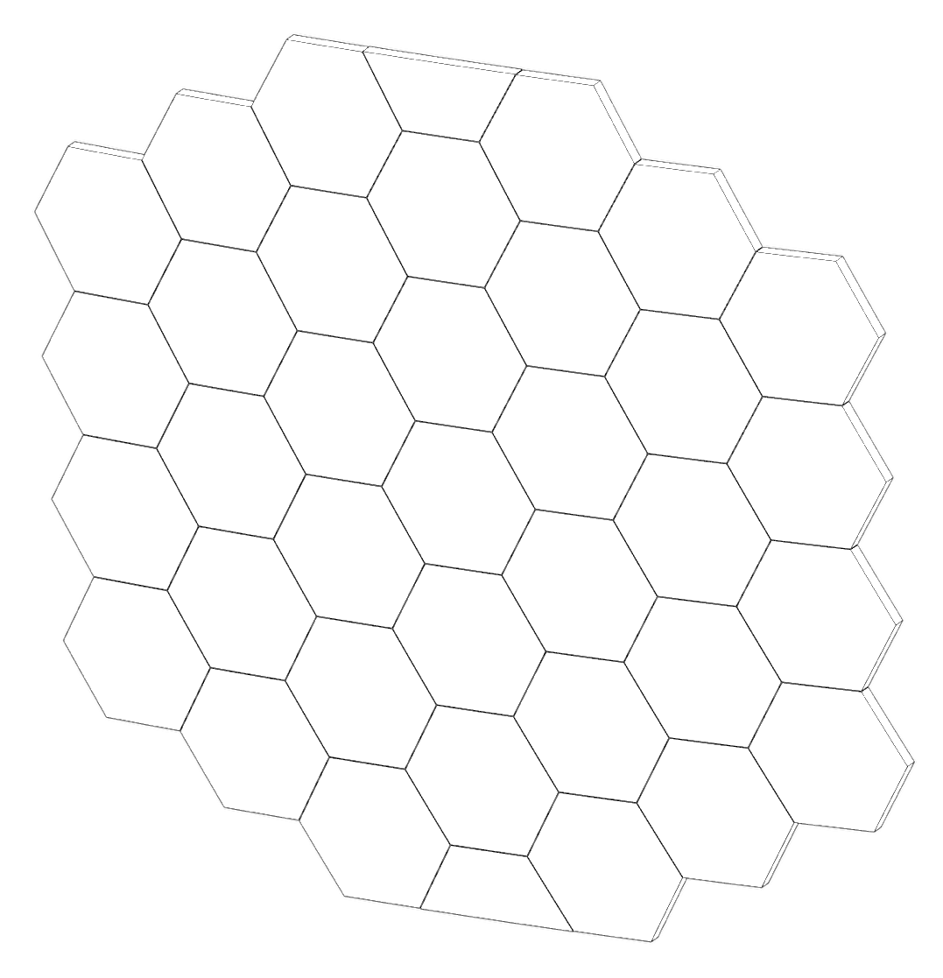
  EAC5 Overview: Telescope to SI light paths

Slide 15
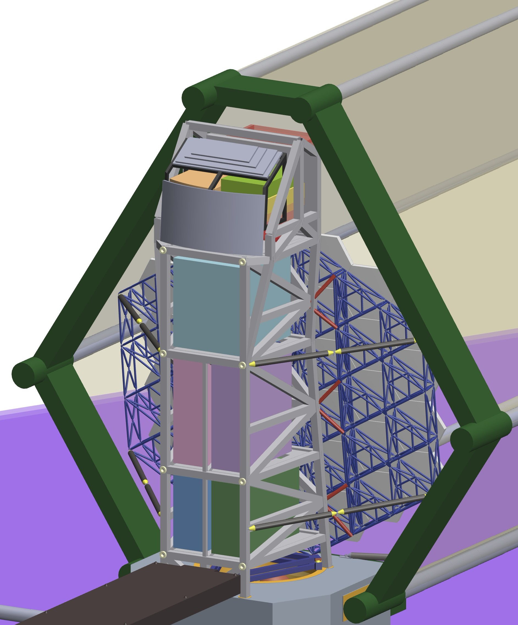
EAC5 Instrument & Guider Assembly Overview (radiators not shown)
OTE Closeout (TBR)
CI
Instrument A
(w/ far UV)
Metering
Plane (PM; SI’s)
Instrument B
Instrument C
Instrument D
Servicing
Plane
Instrument E

Slide 16
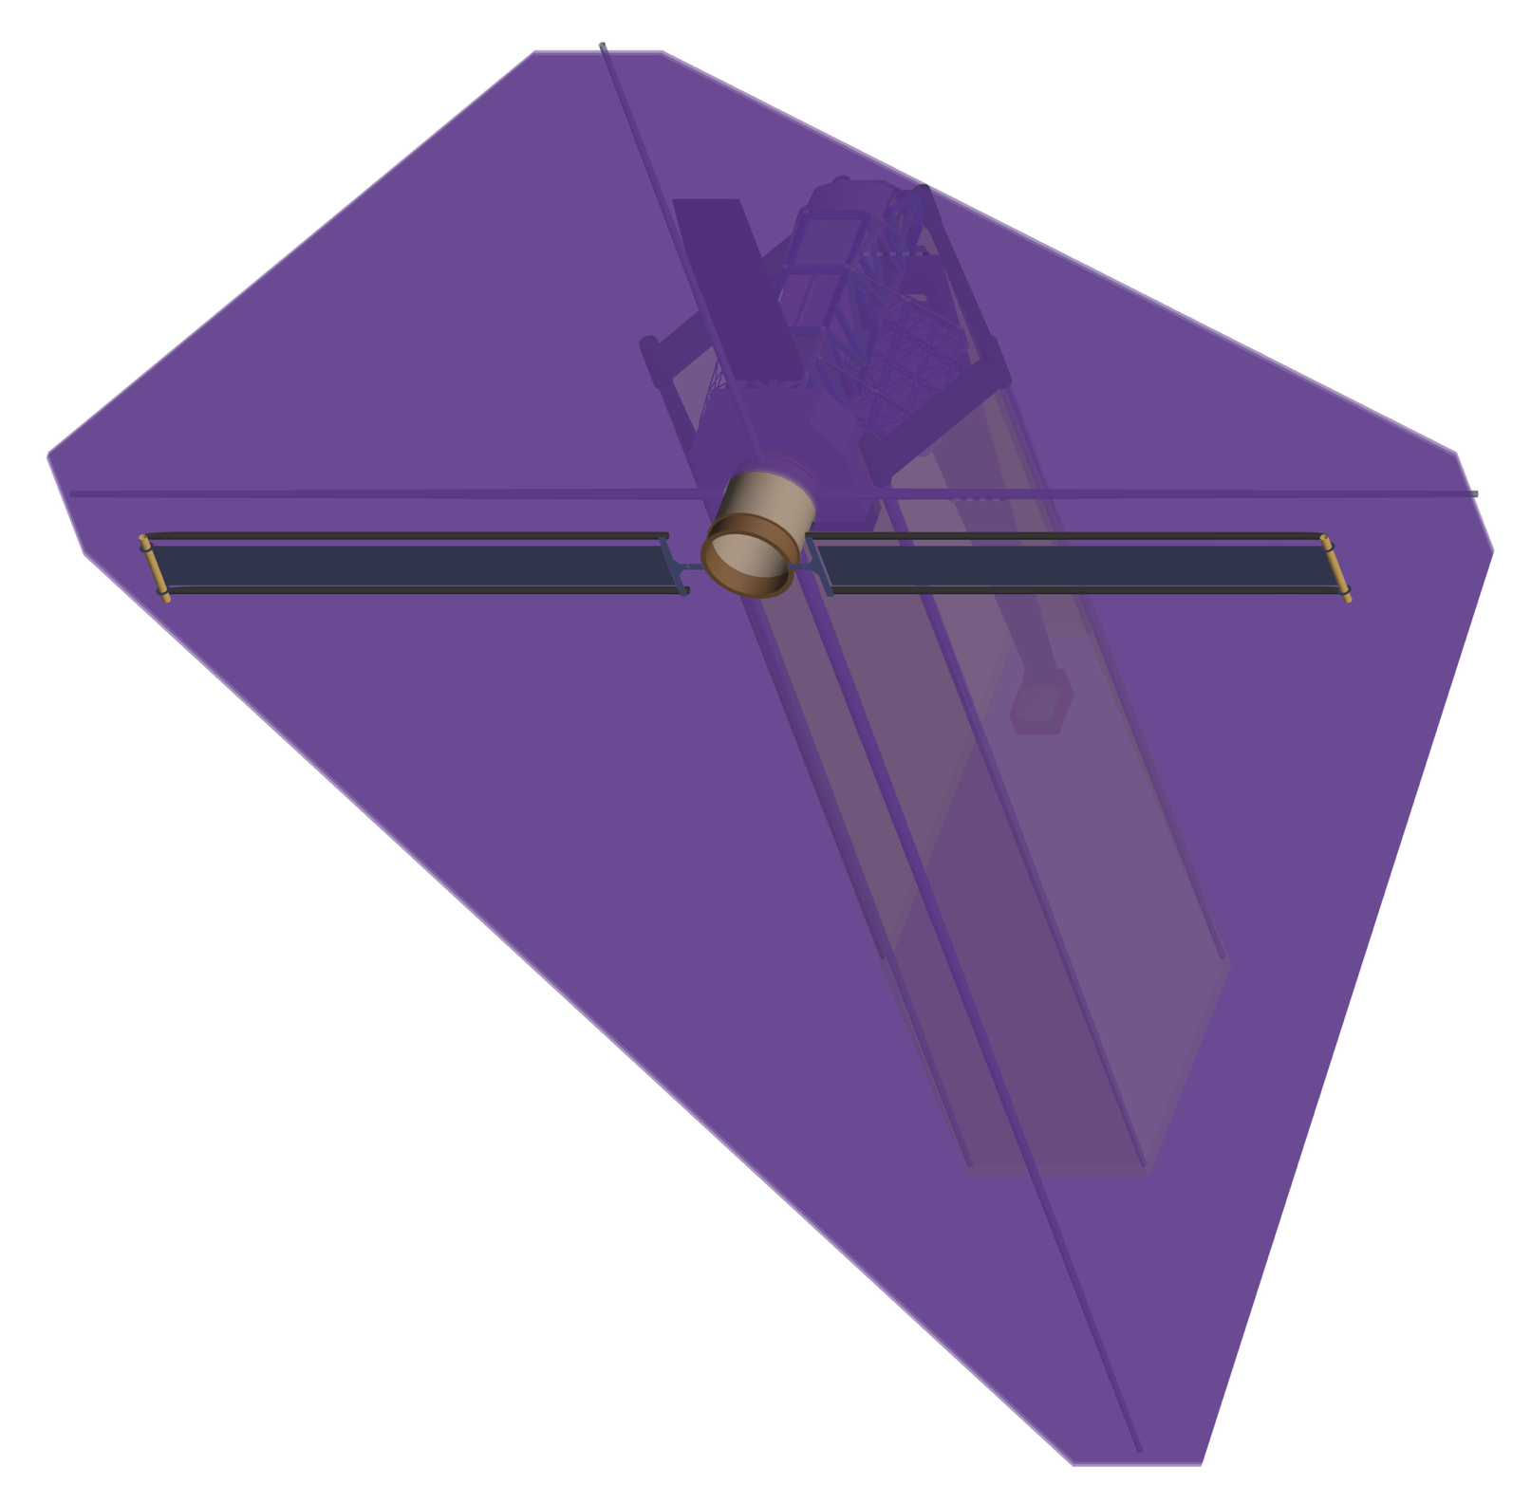
EAC5 Sunshade precludes solar impingement on SI radiators over FOR

Slide 17
Acronyms
Acronym |  | Definition
AOS | - | Aft Optics System
BDA | - | Baffle Deployment Assembly
BG | - | Beyond Gravity
BSF | - | Backplane Support Frame
CAD | - | Computer Aided Design
CFRP | - | Carbon Fiber Reinforced Polymer
CGI | - | CoronaGraph Instrument (Roman)
CI | - | Coronagraph Instrument
CCS | - | Coronagraph Coordinate System
DBS | - | Deployable Baffle Subsystem
DRSA | - | Deployed Radiator Shade Assembly
EAC | - | Exploratory Analytic Case
EGSE | - | Electrical Ground Support Equipment
GI-A | - | Guider Instrument A
GI-B | - | Guider Instrument B
HGAS | - | High Gain Antenna System
HRI | - | High Resolution Imager
HS | - | HardShell (EAC4)
IFS | - | Integral Field Spectrograph
IGA | - | Instrument & Guider Assembly (IGA)
IMS | - | Instrument Module Structure
IRP | - | Instrument Radiator Panels
IRU | - | Inertial Reference Unit
ISS | - | International Space Station
JWST | - | James Webb Space Telescope
LRM | - | Launch Restraint Mechanism
LUVOIR | - | Large UltraViolet Optical InfraRed Telescope
LV | - | Launch Vehicle
Acronym |  | Definition
MBA | - | Main Baffle Assembly
MMOD | - | MicroMeteoroids and Orbital Debris
NG | - | New Glenn
OBS | - | Observatory
OTE | - | Optical Telescope Element
PAC | - | Payload Aft Closeout
PAS | - | Payload Adapter System
PLF | - | Payload Fairing
PM | - | Primary Mirror
PMBA | - | Primary Mirror Backplane Assembly
PMSA | - | Primary Mirror Segment Assemblies
PSS | - | Payload Sunshade
ROSA | - | Roll-Out Solar Array
RSS | - | Radiator Sunshade
SAA | - | Solar Array Assembly
SCB | - | Spacecraft Bus
SCE | - | Spacecraft Element
SLS | - | Space Launch System
SM | - | Secondary Mirror
SMA | - | Secondary Mirror Assembly
SMSS | - | Secondary Mirror Support Structure
SS | - | Sun Shield
ST | - | Star Tracker
ULE | - | UltraLow Expansion
USG | - | US Government
UVI | - | UV Instrument
VPM | - | Vertical Primary Mirror (EAC4)
XI | - | Extra Instrument

Slide 18
Instrument Mass Allocation Guidelines
Not to exceed (NTE)
  Note: based on Observatory “allocation” of 25000kg CBE
Includes:
  All growth and SI project margins
  Internal Harnesses
  Thermal control (passive and active)
    Radiators
    Insulation
    Coolers
    Etc.
  Avionics
    Note: data storage provided by Spacecraft
Does not include:
  GFE latches SI-side (operational and launch restraints)
  GFE servicing grapple fixture
  GFE servicing electrical connectors SI-side
Instrument | NTE Mass (kg)
CI-NIR* | 150
A (w/ far UV) | 500
B | 350
C | 350
D | 200
E | 200
*Optics, mechanisms, and harnesses (see CI section for details)

Slide 19
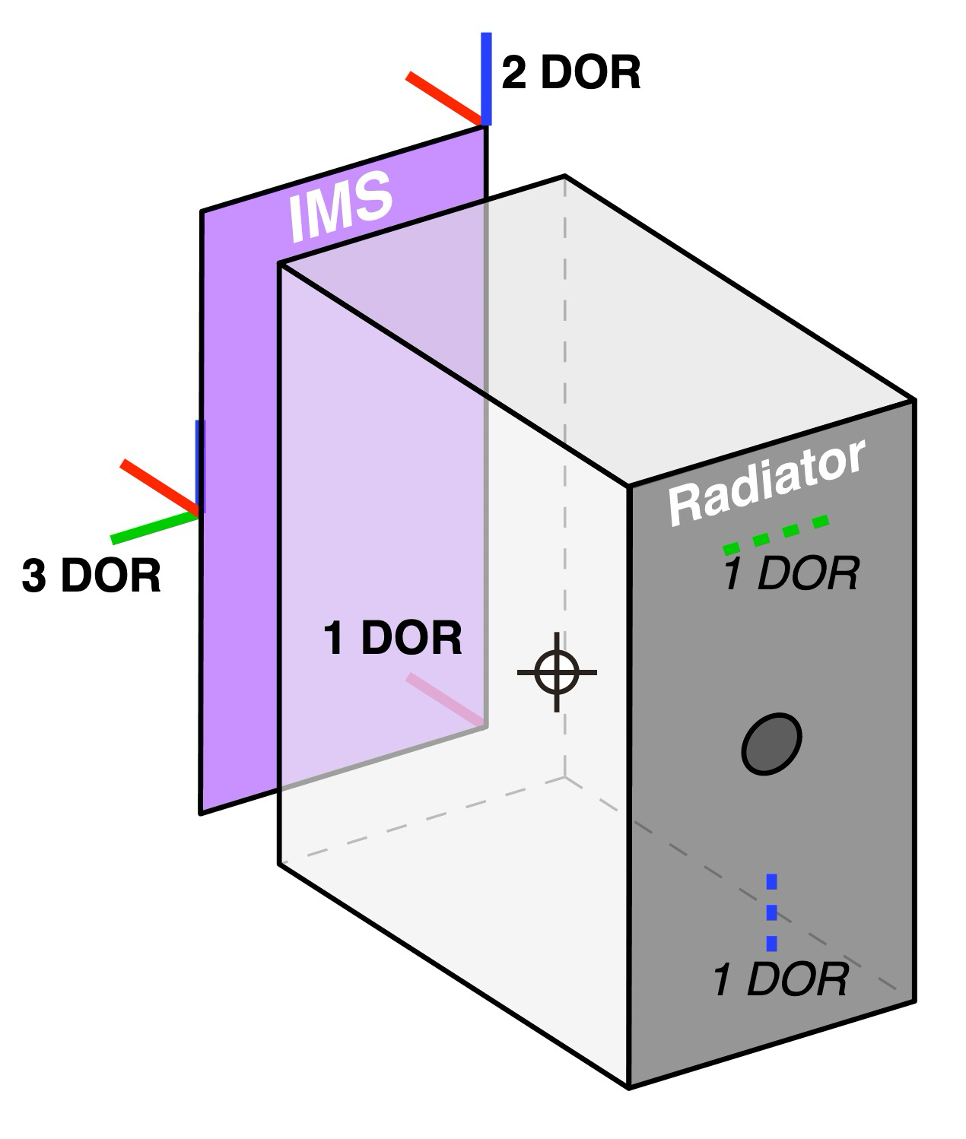
Instrument Volume Allocation Guidelines
Not to exceed (NTE)
  Clearance to surrounding IMS guaranteed if SI stowed frequency ≥40Hz
Includes on SI side:
  Radiator
  MLI
  Carve-outs for light pass-through(s) and avoidances
  Avionics
  Active thermal control/cooler if needed
  Clearance for installation/removal on orbit
  Grapple fixture accommodation
Does not include:
  Bridging structure to latches SI-side (operational)
Note: deploying radiator not permitted
  NASA open to discussion
Instrument | Detailed Volume Descriptions
CI-NIR | Slide 35
A (w/ far UV) | Slide 43
B | Slide 53
C | Slide 55
D | Slide 61
E | Slide 65

Slide 20
Power Budget
Item | Power (W) | Notes
Coronagraph Instrument – NIR Channel | 252 | See CI NIR section for details.
Instrument A | 525 | Top-down estimates; allocations subject to revision based on proposal feedback.
Instrument B | 250
Instrument C | 250
Instrument D | 200
Instrument E | 200
Instrument Total | 1677

Slide 21
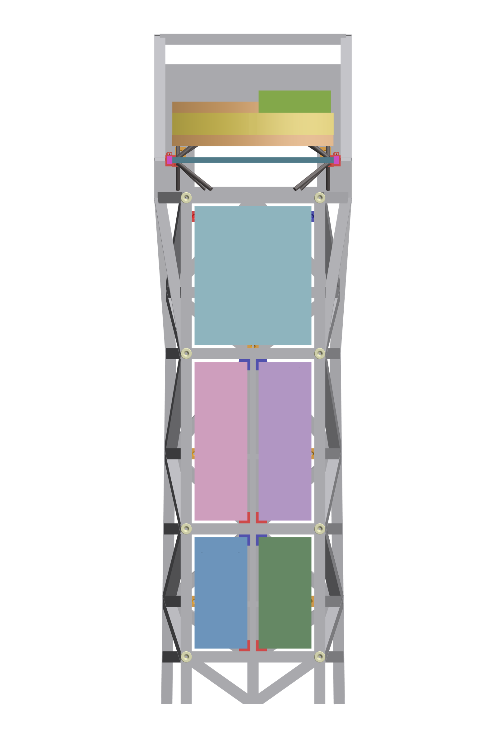
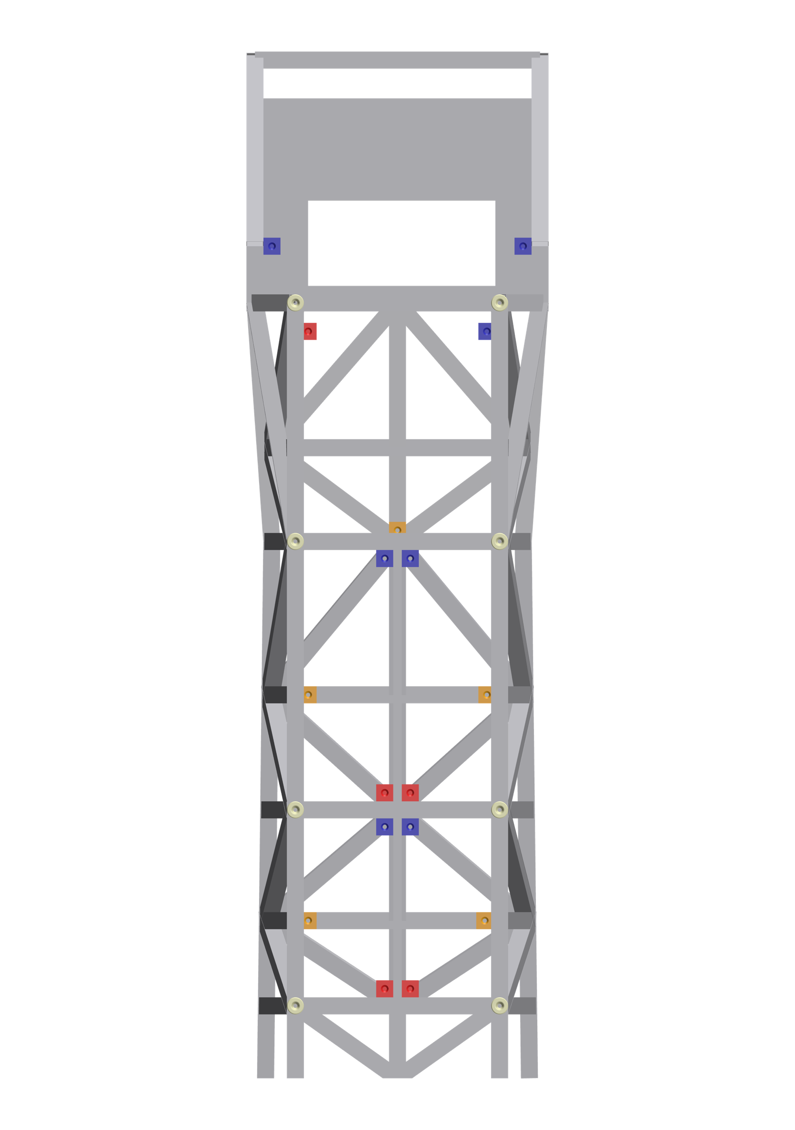
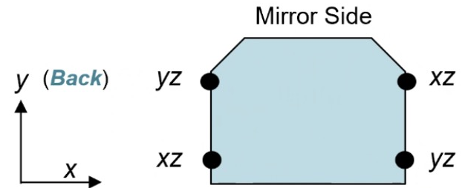
Latch position; degrees of restrain (DOR) details on IMS
CI
CI interfaces:
2 / 2 / 2 / 2 DOR
(pairs in-line)
CI
A
A
B
C
SI’s with kinematic
interfaces: 1 each of
B
C
1 DOR
2 DOR
D
E
3 DOR
D
E

Slide 22
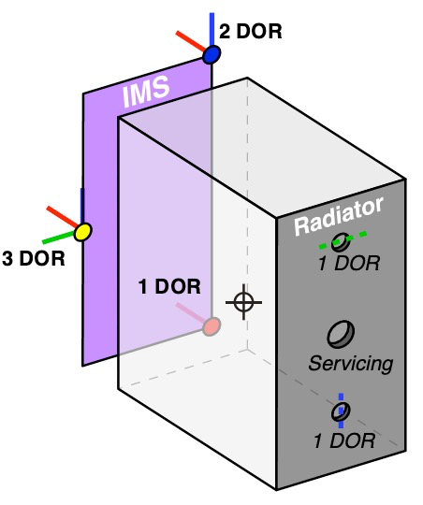
Interfaces to IMS: Mechanical
For SI’s except CI-NIR:
  Operational: kinematic mount to metering plane also used by primary mirror consisting of 3 serviceable interfaces:
    3 degrees of restraint (DOR)
    2 DOR
    1DOR
  Launch supplemental (for SI’s except CI) to relieve cantilever launch loads:
    1 DOR vertical
    1 DOR lateral
  GFE SI-side of interfaces
For CI-NIR (new channel built off main CI provided by NASA/JPL)
  Note: main CI uses four x 2 DOR restraints on side rails (not directly @ metering plane of PM)
  See CI section for details
Assuming kinematic interfaces, SI fundamental modes ≥ 40 Hz
CG Launch load factors ~12g per axis for primary structure
  Evaluate one axis at a time
  Cantilever is relieved for launch by supplemental supports
  Load factors for internal components per MAC (next page)

Slide 23
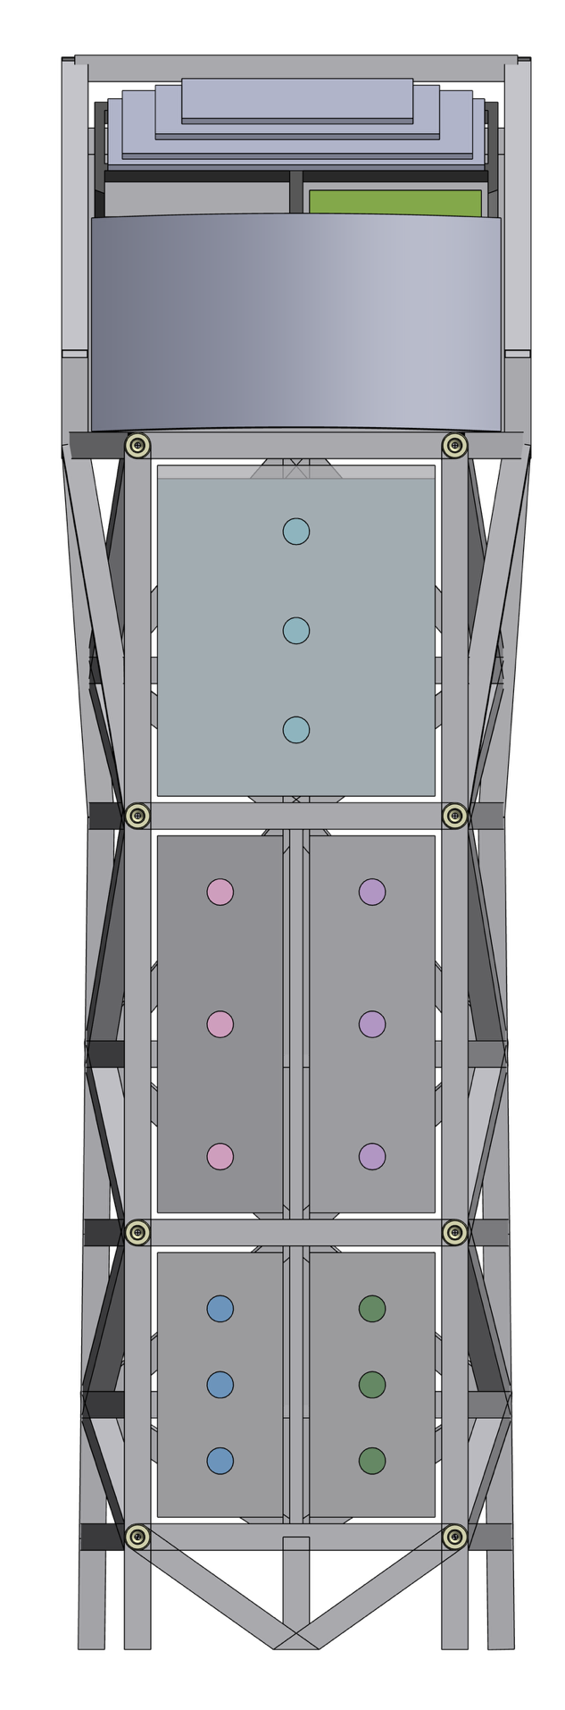
Instrument Thermal Interfaces
Instrument Bays (5 sides of the enclosure)
  Volume: See mechanical
  Temperature: Room temperature
Instrument to IMS:
  IMS will be blanketed (either at the truss or cavity level)
  Minimize heat exchange to IMS
  Conductive Interface: Instrument should assume isolative hardware/flexures
    Estimated conductance: 0.05W/K per latch (similar to HST)
    See mechanical for # of connections/latches
    Consider using Ti hardware
  Radiative Interface: Instrument should radiatively isolate from the IMS
    Will be desirable, especially with low temperature components
CI
Instrument A
Instrument B
Instrument C
Instrument D
Instrument E
Notes:
Thermally, it is best assumed that the instrument has little thermal (conductive and radiative) interaction (isolative) from the instrument enclosure to the IMS.
it should be assumed that the instrument cavity will be low IR emissivity, MLI blanketed. Whether or not the truss members or the gaps between will be blanketed is still up for discussion. Ensuring the outside of the instrument (radiator excepted) is low IR emissivity and possibly blanketed will yield more radiative isolation.
The latches are thermally isolative by design, so its unlikely additional isolation is necessary. Hardware with low thermal conductance is preferred. Adding G10 spacers and/or washers is also an option for situations where additional thermal isolation is desired.

Slide 24
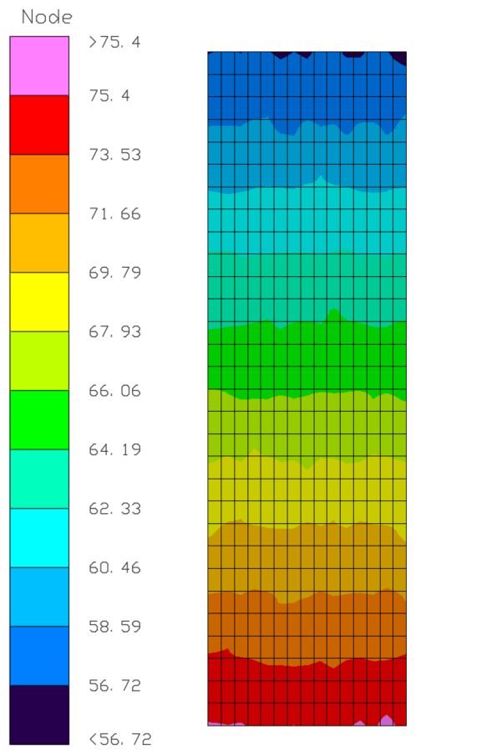
Instrument Radiators
Pitch 0°/Roll 0° Contour
Available Area:
  Ensure servicing grapple feature is accounted for
  Plan to subdivide radiator area into desired temperature zones
Views to Space (EAC5 Specific):
  Estimated blackbody IR sink temperature calculated and provided based on latest EAC5 geometry
  IR backloading from sun shade is accounted for
  No solar loading → can optimize for high ε radiator coatings
Radiators for cold components:
  May have fewer options for heat spreading → limits for heat pipe working fluids → may require high purity metallic spreaders
  Smaller ΔT⁴ to their blackbody sink temperature → more radiator area will be required
NOTE: assumptions and guidelines are consistent with the EAC5 design and are subject to change given the early state of HWO design
Range:
Highest Min Sink – Highest Max Sink
CI
CI
Temperature: 57K-69K
Radiator Area: 7.9 m²
Inst. A
Instrument A Temperature: 60K-72K
Radiator Area: 5.1 m²
Inst.
B
Inst.
C
Instrument B/C: Temperature: 65K-73K
Radiator Area: 2.6 m²
Inst.
D
Inst.
E
Instrument D/E: Temperature: 72K-76K
Radiator Area: 1.8 m²
EAC5 Sink Temp Range Across All Attitudes
Notes:
A sweep of attitudes was performed to determine these preliminary radiative sink temperatures. The first number in the range represents the hottest minimum sink temperature in the attitude sweeps. The second number represents the hottest sink temperature in the radiator area in that attitude sweep. Additional thermal recommendations have been provided in later slides, but thermal architecture approach will depend on desired component temperatures. Also remember, if the component temperature is at or above the radiative sink temperature, expect complications to the instrument thermal design. These sink temperatures represent a NOTIONAL, 3 parallel, separated layer sun shade completely occluding the observatory from direct solar impingement (see mechanical discipline materials for more detail)

Slide 25
Avionics Block Diagram
Efforts are underway to standardize interfaces across all instruments; leading options include:
  SpaceWire — well-established with extensive heritage
  Ethernet — higher overhead but potentially more advantageous for instrument development and EGSE
Interfaces under consideration:
  Command, Telemetry, and Science Data to spacecraft/recorder
  Avionics and heater power
  Analog temperature readings (if required when instrument power is off)

Slide 26
HWO TMPO Optical Telescope Design
Design Assumptions & Guidelines
Optical Design Team:
Joe Howard, Mike Rodgers, Jon Papa, Hong Tang, Guangjun Gao,
Len Seals, James Corsetti, Scott Rohrbach, Breann Sitarski
April 2026

Slide 27
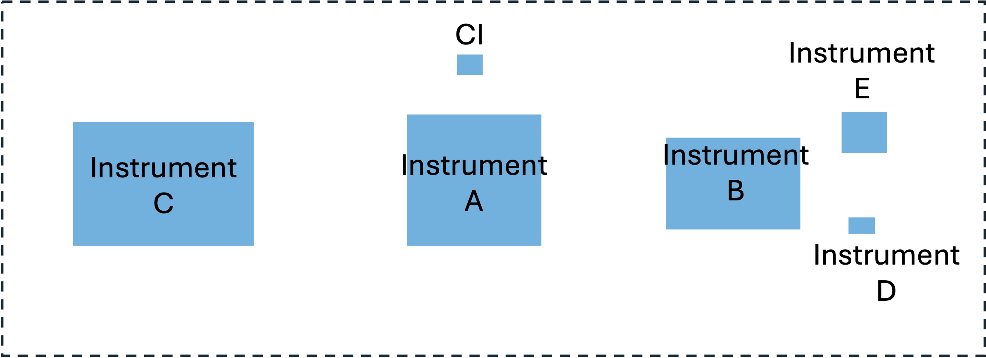
EAC5 Telescope Design Specifications
Telescope Specification | Range | EAC5 | Comment
Pupil obstruction | none | none | CI high contrast imaging performance
Entrance Pupil Diameter (EPD), m | maximize | 10 | Launch vehicle payload volume
Inscribed Circular Pupil Diameter (D), m | >6 | 8.2 | CI minimum required for science
Focal Length, m | - | 171 | UVI MOS MSA hardware and science
F/# | >10 | 19 | UVI MOS MSA hardware structure depth
Maximum delta Angle of Incidence, deg | minimize | 11.1 | CI needs to minimize polarization aberrations
Fields of View
CI, arcmin^2 | - | 0.001 | 2x2 arcsec for acquisition
Instrument A, arcmin^2 | - | 9 | 3x3 arcmin field to MSA for EAC-5
Instrument B, arcmin^2 | - | 6 | 3' x 2'
Instrument C, arcmin^2 | - | 12 | 3' x 4'
Instrument D, arcmin^2 | - | 0.003 | 3 x 3 arcsec
Instrument E, arcmin^2 | - | 1 | 1x1 arcmin
Total Field of View: |  | 58.004
CI = Coronagraph Instrument
Notional Field Layout for EAC 5, (loosely scaled)

Slide 28
Optical Design Summary
The HWO telescope optical design is highly constrained by the instrument requirements of the CI and UVI MOS.
The rocket fairing size also constrains the telescope aperture and secondary mirror distance due to the volumetric limits.
Instrument etendue (specifically the desired field of view) plays a significant role in realizable instrument level packaging for the wider field instruments (i.e. HRI and UVI MOS).
Freeform Optics enables more science for HWO.

Slide 29
Government EAC-5 Instrument Design Overview
Coronagraph Instrument (CI)
  Visible and near-infrared channels
  High-contrast imaging + spectroscopy
  Heritage from Roman's CGI
High-Resolution Imager (HRI)
  Near-ultraviolet/optical/near-infrared high resolution imager
  Low-spectral resolution spectroscopy is possible with prisms + grisms
  Astrometry mode
  Guiding and telescope wavefront sensing + control
Ultraviolet multi-object spectrograph (UVMOS)
  Far-ultraviolet/near-ultraviolet/optical wide-field, multi-object spectrograph
  High spectral resolution point source spectroscopy (FUV/NUV)
Ultraviolet Integral Field Spectrograph (UVIFS)
  Far-ultraviolet/near-ultraviolet spatially resolved spectroscopy

Slide 30
Science Instrument Dimensions
Overall dimensions (orthogonal views)
  Provide STEP file referencing Optics coordinate system upon request
Position of SI w/r to Optics coordinate axes (center of PM)
Proposed local SI coordinate system
Optical input physical location w/r to SI
  Position
  Opening dimensions
  Reference chief ray of optical path into SI
  Reference optical path positions where other SI’s pass through or around
Positions of operational Interfaces to IMS with depiction of DOR (degrees of restraint for each)
Positions of additional conceptual launch Interfaces to IMS door with depiction of DOR (degrees of restraint for each)
Details of radiator dimensions showing “cutouts” for servicing interface and door interfaces, with calculated remaining actual radiative area available

Slide 31
HWO TMPO Coronagraph Instrument (CI)
Near Infrared (NIR) Channel Study
Design Assumptions & Guidelines
HWO TMPO CI Team
April 2026

Slide 32
Assumptions & Guidelines
Configuration Assumptions:
  Proposed NIR channel optics will be mounted on a shared optical bench alongside a USG-provided ‘bridge’ Channel (same side of bench) and a USG-provided VIS Channel on the opposite side of the bench.
  Proposed NIR channel electronics and harness will be mounted on a shared, thermally controlled electronics pallet located approx. 1 m from the optical bench.
  Proposed NIR channel thermal control will be provided by a shared thermal management system using heaters, blankets and/or enclosures, a room-temperature radiator, and a cryogenic-temperature radiator.
Accommodation Guidelines (preliminary):
  Volume
    2.0m x 1.3m x 0.4m; horizontal mounting area is 2.0m x 1.3m; vertical height is 0.4m.
  Mass
    150 kg; includes proposed NIR channel optics, mechanisms, and harnesses (e.g. items on the optical bench)
    Does not include shared optical bench, shared thermal hardware, DM electronics, or shared housekeeping electronics
  Power
    250 W dissipating to shared 293K room temp radiator
    0.85 W dissipating to shared 100K cryogenic radiator
    0.4 W dissipating to shared 65K cryogenic radiator

Slide 33
Assumptions & Guidelines, continued…
Additional notes:
  Optical
    The NIR coronagraph coordinate system (CCS_{NIR}), input beam location, and pupil image are shown in the following figures. The input starlight is a collimated beam with direction (0.8829, 0.4695, 0.0) in the CCS_{NIR}, and forms an image of the telescope entrance pupil centered at (538.8, 273.7, 105.5) in millimeters. The circumscribed diameter of the PM pupil is 10 m, and the diameter of the largest inscribed circle on the primary mirror is 8.2 m. The inscribed diameter at the PM maps to a 40 mm diameter circle at the NIR coronagraph entrance pupil.
  Structural
    The optical bench is a 0.4m thick carbon graphite structure with metallic inserts for mounting optics and proximity electronics. NIR channels share one side of the structure, and a VIS channel is located on the opposite side.
  Thermal
    Both sides of the optical bench (VIS and NIR) will be maintained at 293K via heaters, blankets, and a radiator.
    Cryogenic thermal control to 65K-100K is provided via a separate radiator located within 0.5m of NIR cameras.
  Electronics
    VIS and NIR channel electronics boxes are mounted on the thermally controlled electronics pallet.
    Shared housekeeping/infrastructure electronics (e.g., C&DH, PCD) are also located on the electronics pallet.
  NOTE: assumptions and guidelines are consistent with the EAC5 design and are subject to change given the early state of HWO design.

Slide 34
Initial CI Specifications

Slide 35
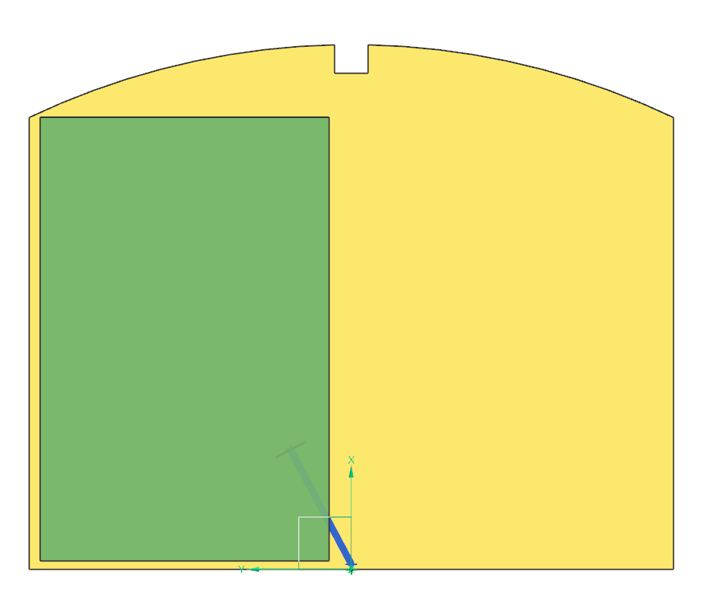
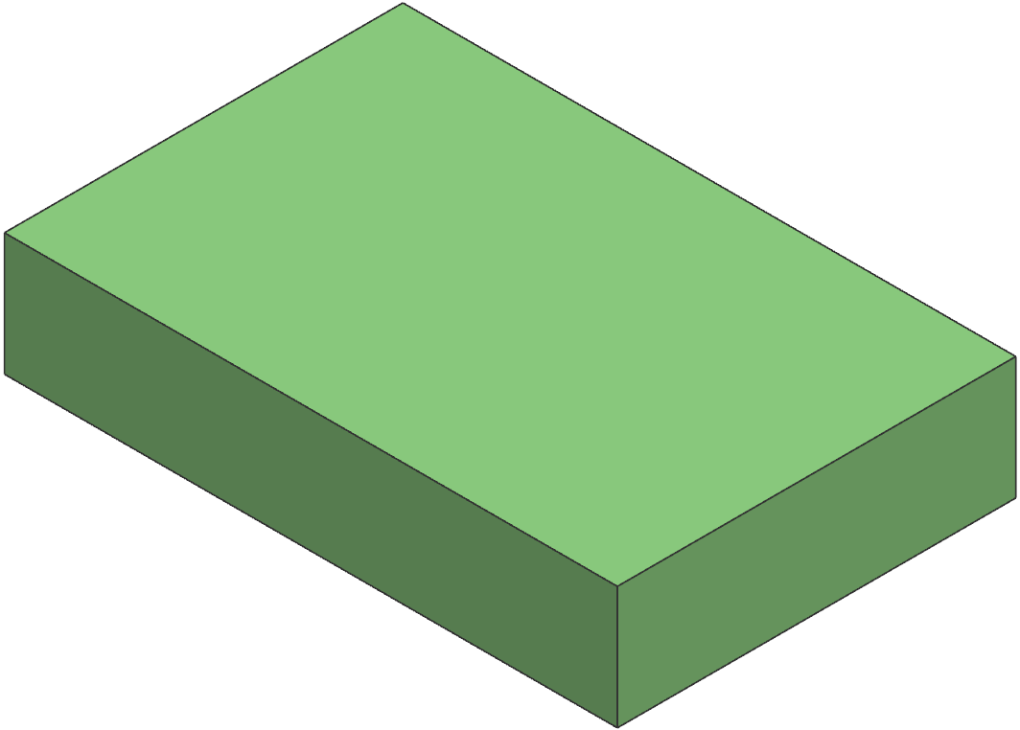
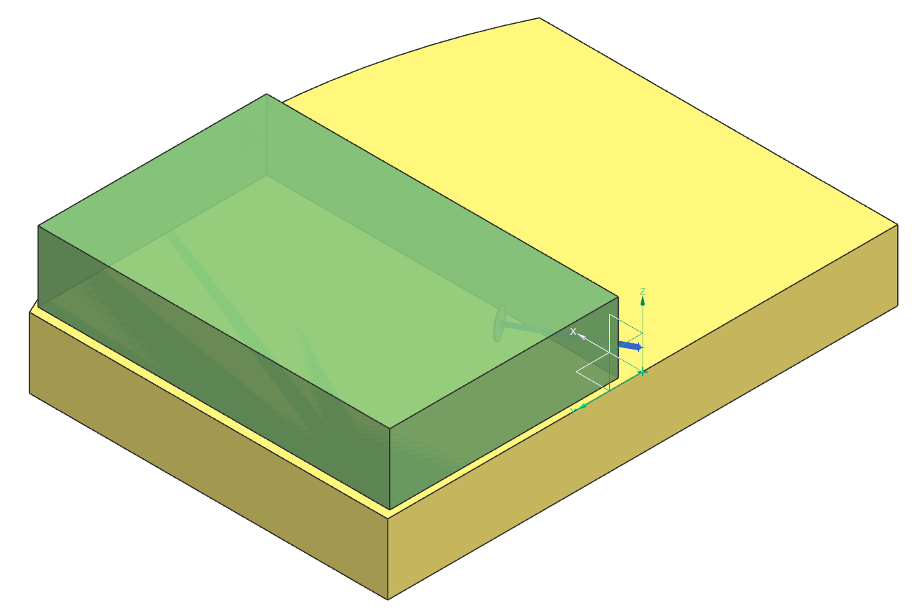
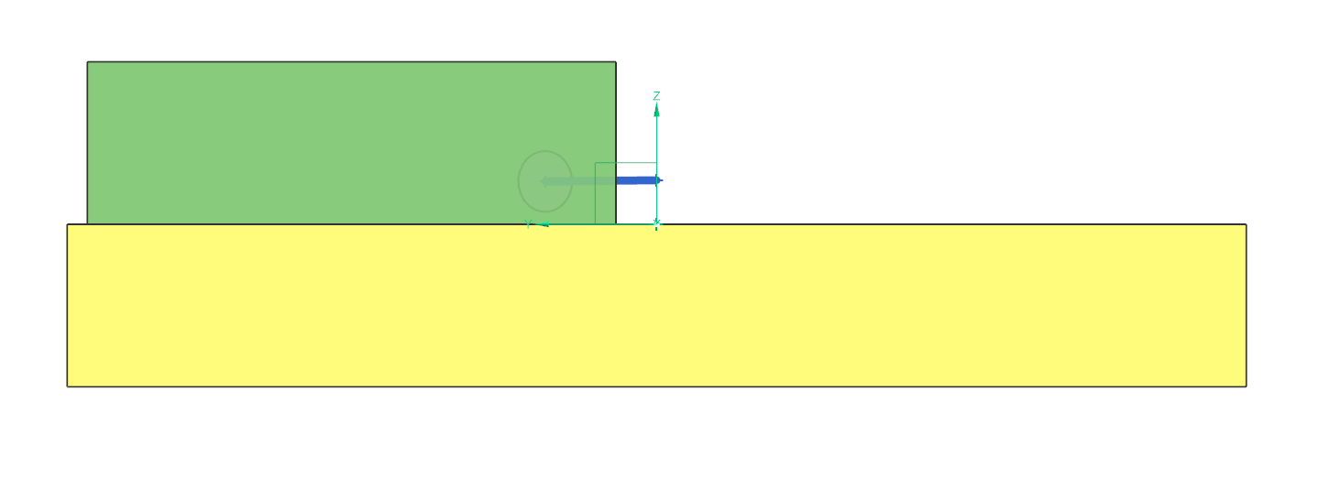
NIR Channel Volume (green) on Optical Bench (yellow) with CCS_{NIR}
1300 mm
2000 mm
400 mm
NIR Channel Volume
Optical
Bench
Optical
Bench
CCS_{NIR}
NIR Channel Volume
NIR Channel Volume
CCS_{NIR}
Optical
Bench
CCS_{NIR}

Slide 36
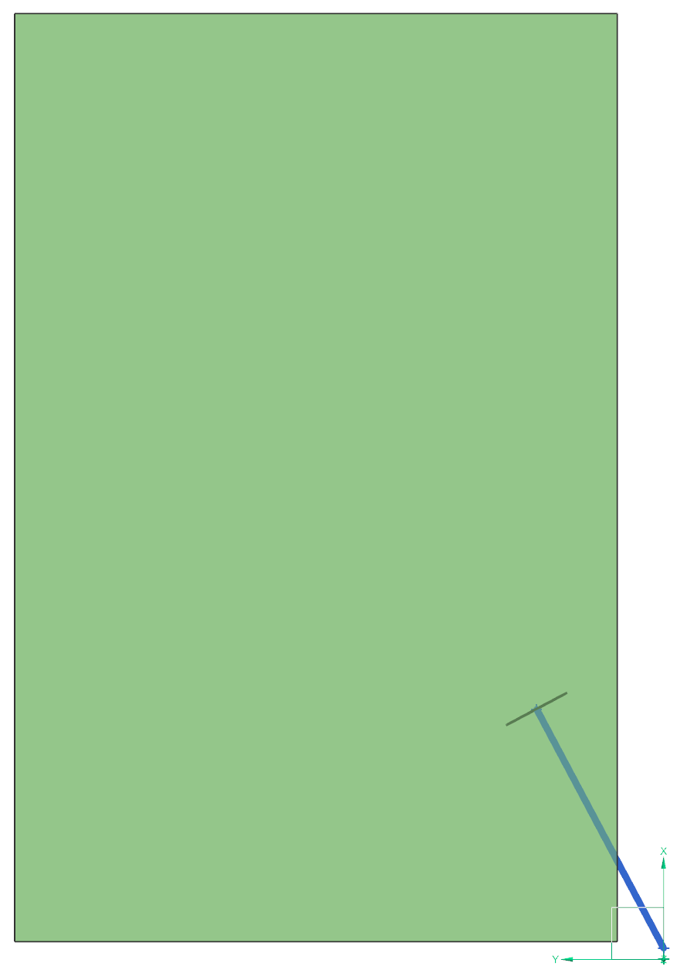

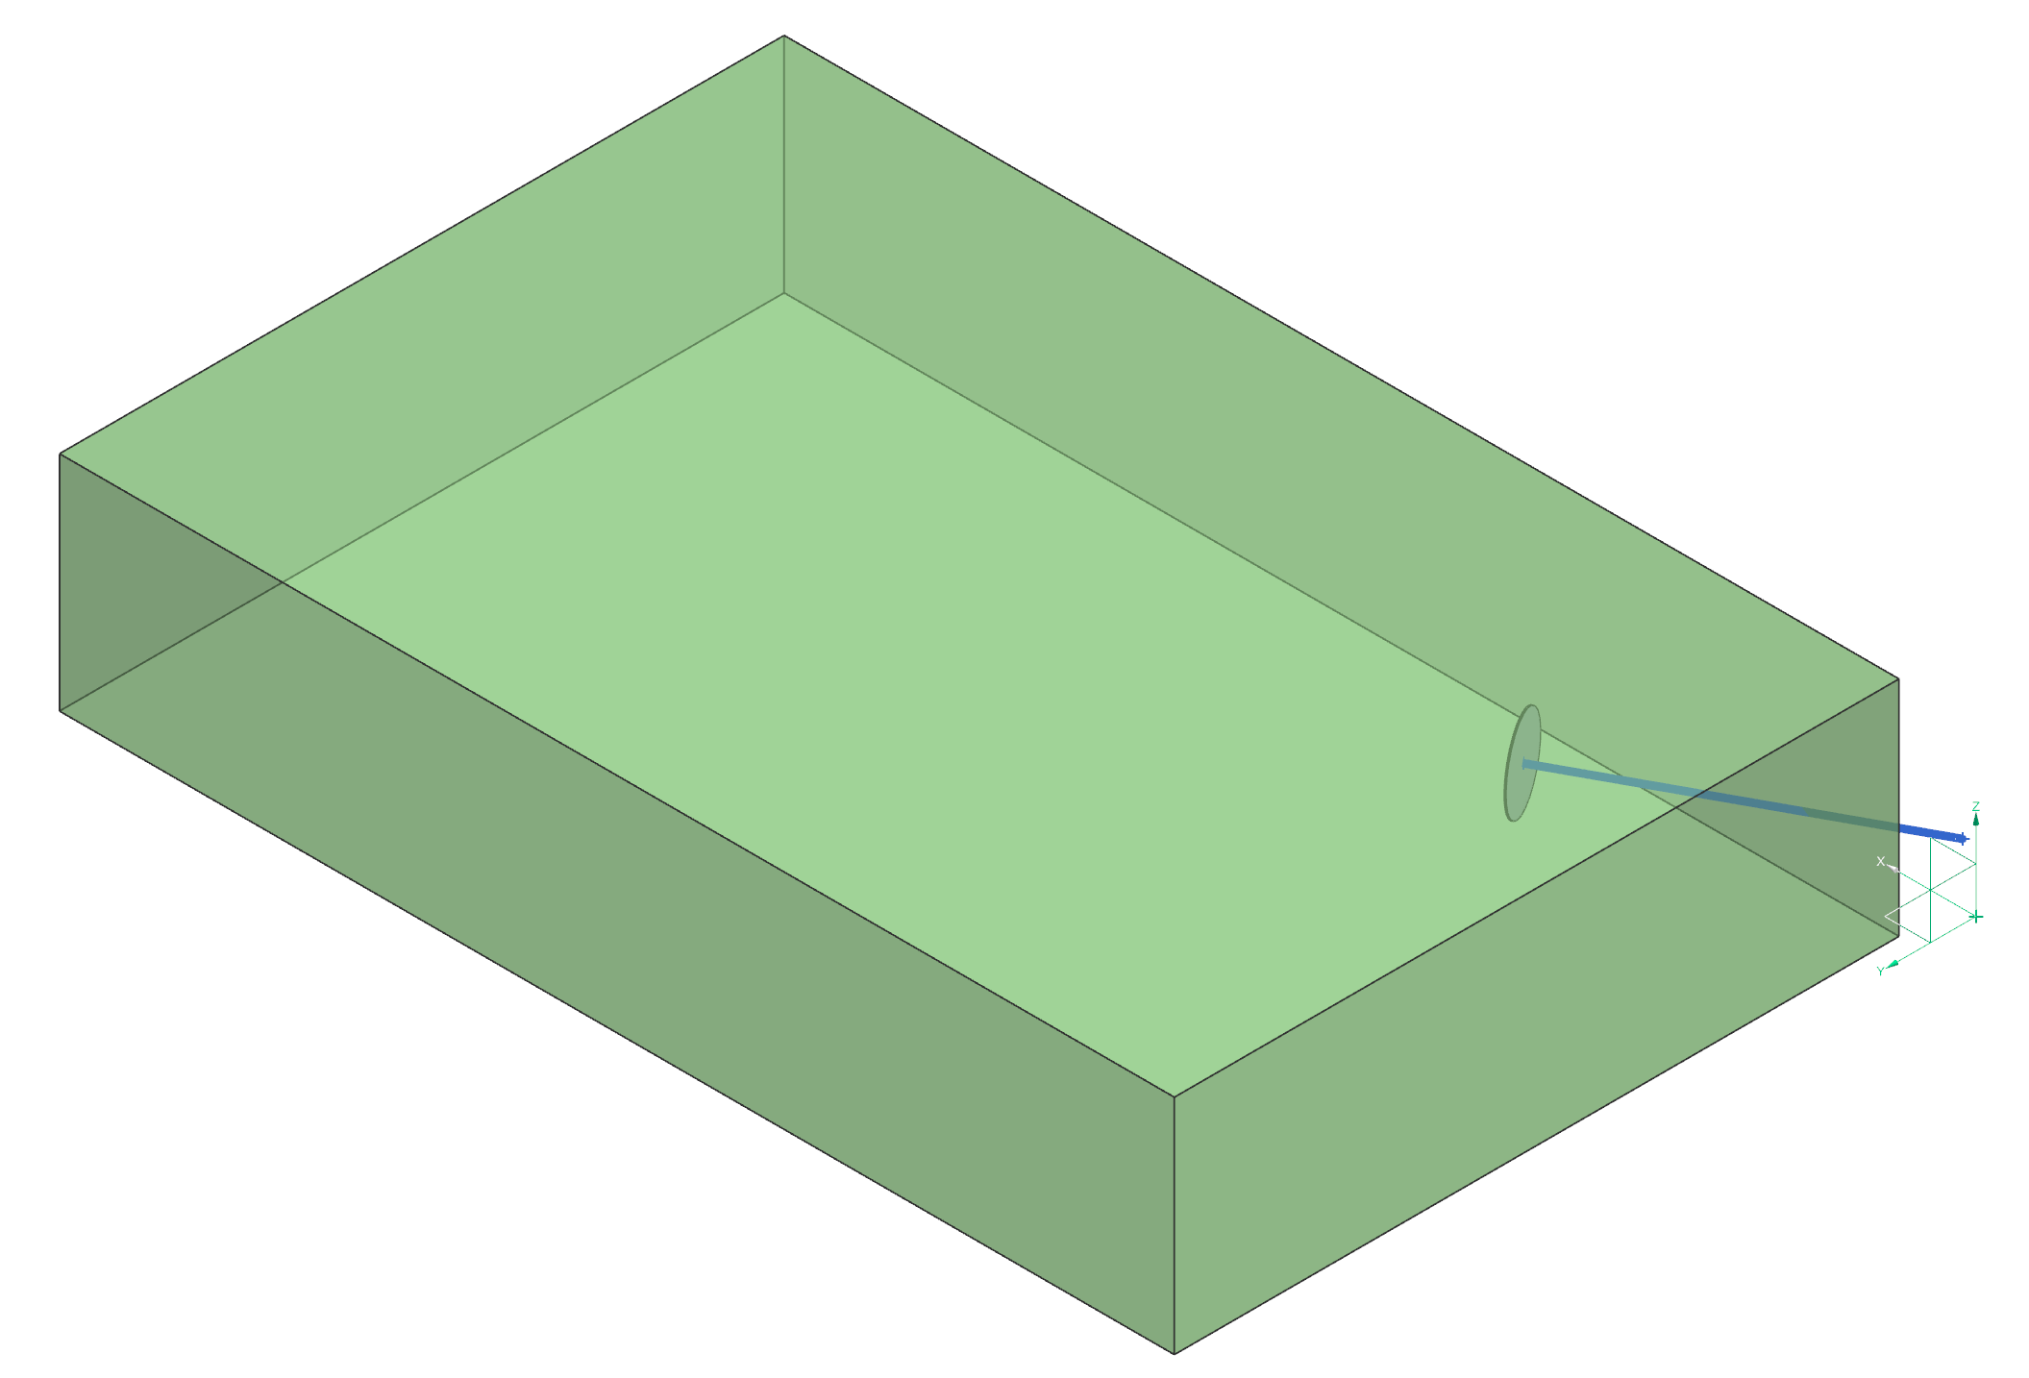
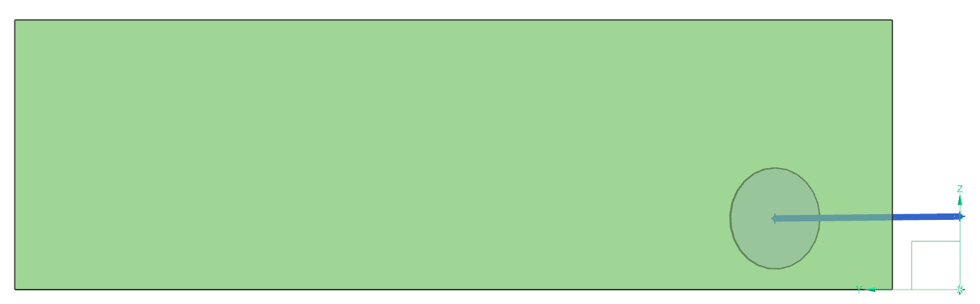

NIR Channel Input Beam Light Path
Input beam vector:
Direction cosines
  [0.8829, 0.4695, 0.0]
Entrance pupil image
  [538.8, 273.7, 105.5] mm
X
38.1 mm
Y
CCS_{NIR}
100 mm
Z
Y
CCS_{NIR}

Slide 37
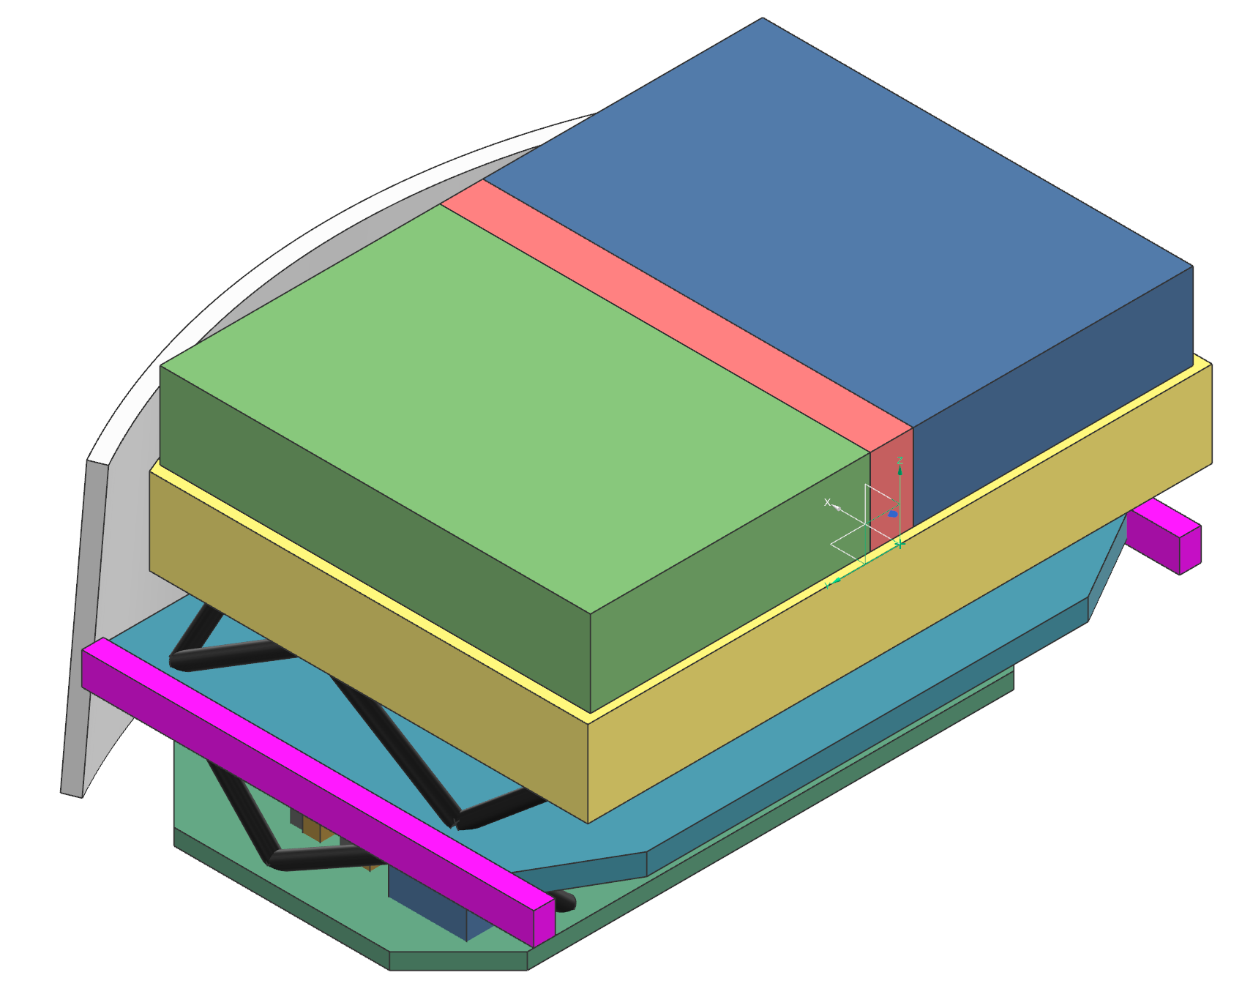
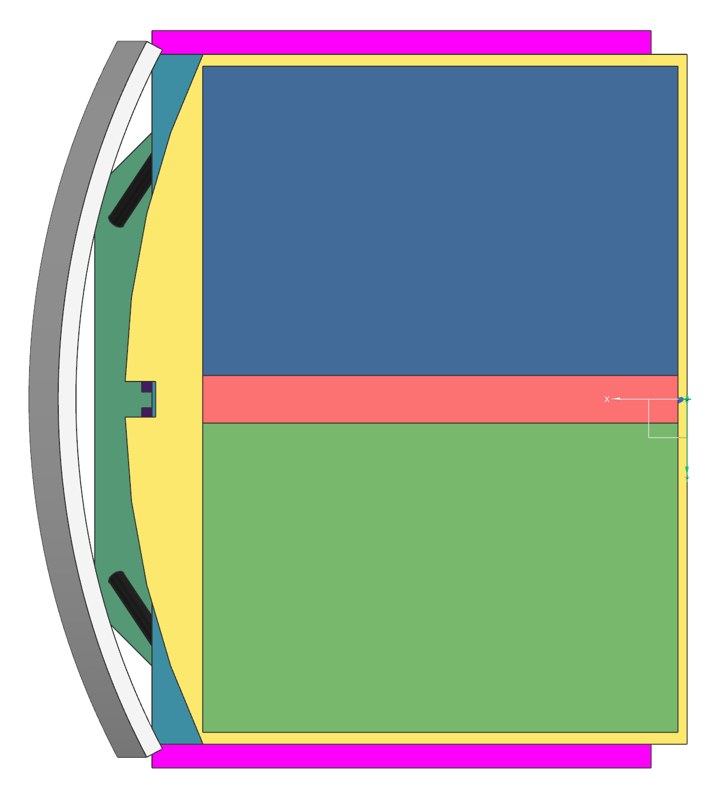
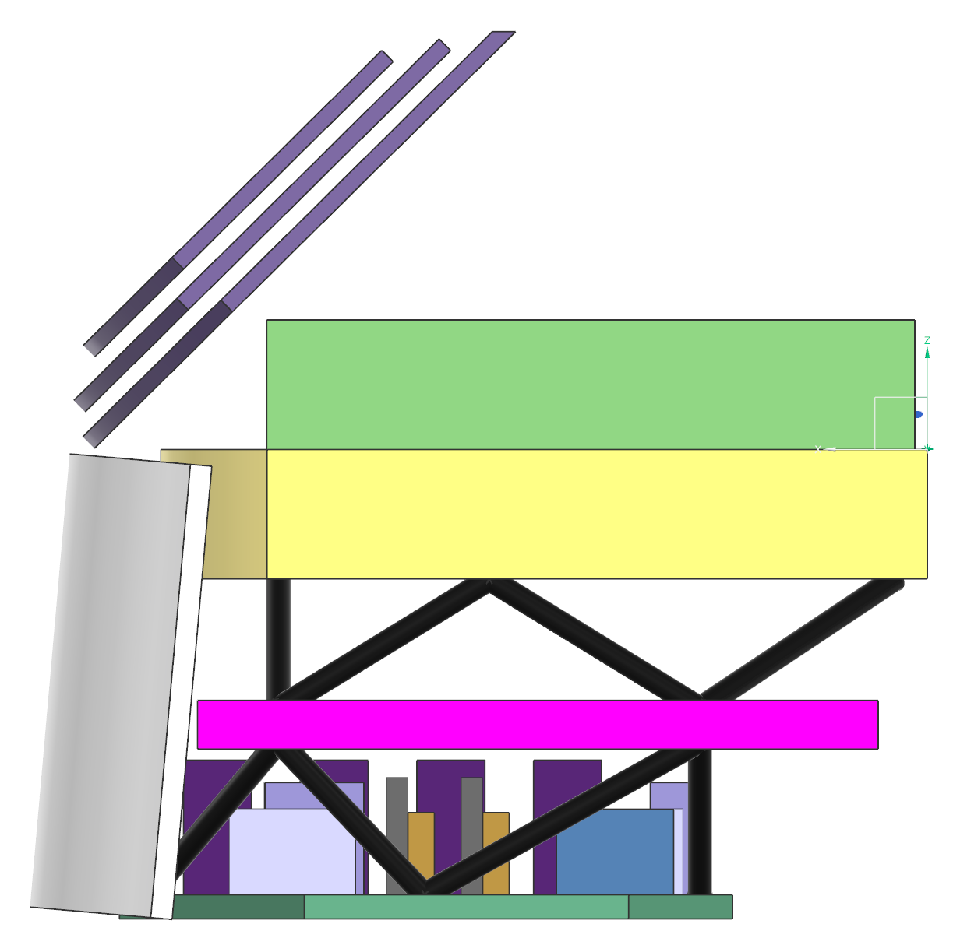
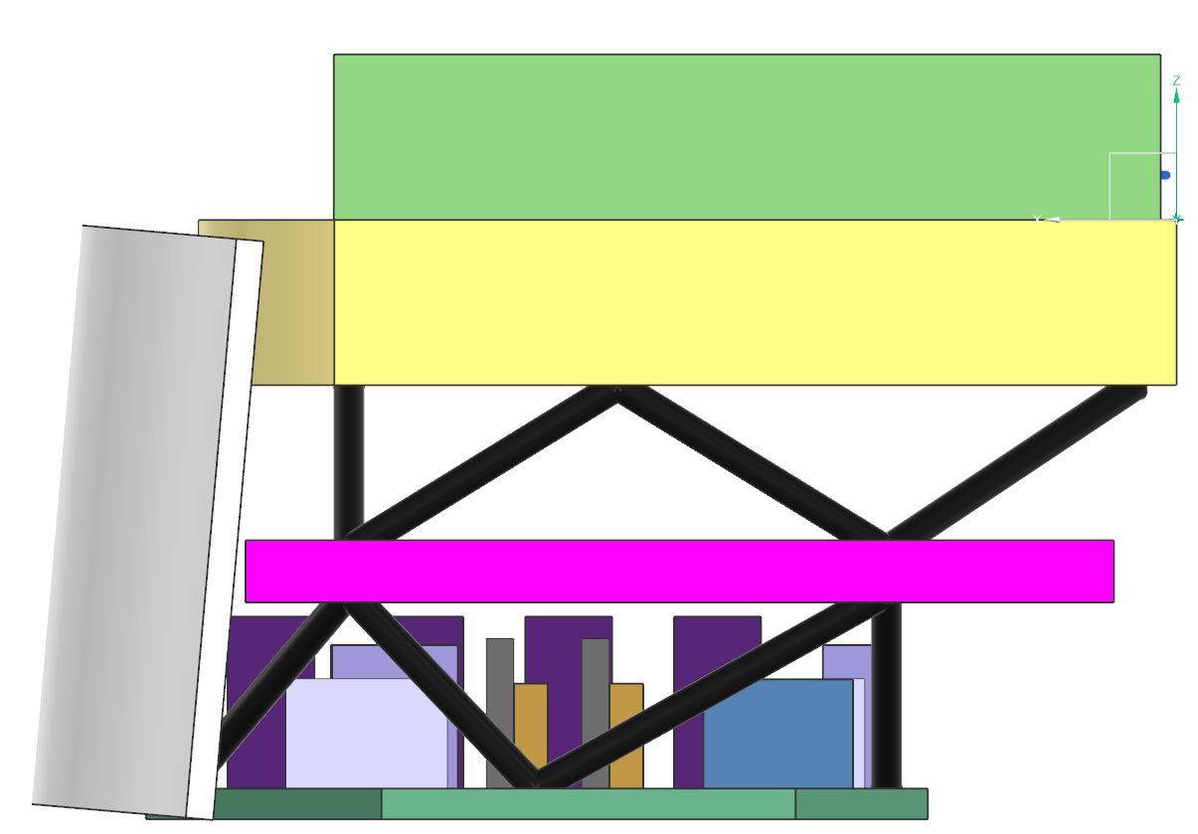
Context Views: EAC-5 Integrated Coronagraph Instrument
Keep out zone
USG ‘Bridge’
Channel Volume
NIR Channel Volume
CCS_{NIR}
Structural Strongback (includes CI interface to observatory)
Cryogenic
Radiator
(not shown in other views for clarity)
CI interface to observatory
NIR Channel Volume
Optical Bench
Room Temp
Radiator
USG VIS Channel Volume (underside of bench)
Electronics
Pallet

Slide 38
HWO TMPO Ultraviolet Multi-Object Spectrograph (UV MOS)
Design Assumptions & Guidelines
HWO TMPO UV MOS Team
April 2026

Slide 39
Assumptions & Guidelines
The UV MOS is intended to be a general-use, multi-object, ultraviolet and visible-light spectrograph with multiple modes:
  FUV Imager (3’ x 3’ field of view)
  FUV/NUV/Visible light MOS (3’ x 3’ field of view; 100 – 700 nm; R~500 – 50K)
  High-resolution point source spectroscopy (100 – 400 nm; R ≤ 100K)
For EAC-5, the government team used Instrument A resources and interfaces for the UV MOS
Initial study used the same gratings/bandpasses as LUMOS-B
Accommodation Guidelines (preliminary):
  Volume
    See slide 42 for details
  Mass Allocation
    500 kg
  Power
    525 W

Slide 40
Initial UVMOS specifications
We used LUMOS-B gratings and bandpasses for initial optical design
Instrument Parameter | Units | G120M | G150M | G180M | G155L | G145LL | G165LL | G300M | G700L | FUV Imager
Optimized Spectral Bandpass | nm | 100-140 | 130-170 | 160-200 | 100-200 | 100-200 | 110-200 | 200-400 | 400-1000 | 100-200
Actual Spectral Bandpass | nm | 93-159 | 111-189 | 141-219 | 93-267 | 93-210 | 110-270 | 193-460 | 340-1000 | 100-200
Spectral Resolving Power (λ/Δλ) [Required] | - | 3.0 x 10⁴ | 3.0 x 10⁴ | 3.0 x 10⁴ | 8000 | 500 | 500 | 2.0 x 10⁴ | 1.5 x 10⁴ | -
 | Parameter | Value | Units
FUV Imager | Bandpass | 100 - 200 | nm
 | Angular resolution | 50 | mas
 | Field of view | 3 x 3 | arcmin x arcmin
 | FUV Detector Temperature | 220 | K
 | Filters | TBD | -
MOS | Bandpass | 100 - 700 | nm
 | Field of view | 3 x 3 | arcmin x arcmin
 | Spectral resolving power | 500 - 50,000 | -
 | Angular resolution | 50 | mas
 | FUV Detector Temperature | 220 | K
 | NUV/Visible Detector Temperature | 170 | K
 | Microshutter Dimensions | 100 x 200 | µm x µm
 | Microshutter Array Format | 384 x 768 | - x -
 | MSA Buttability | 2 x 2 | - x -
Point Source | Spectral resolving power | 100,000 | -
 | Bandpass | 100-400 | nm
 | FUV Detector Temperature | 220 | K
 | NUV/Visible Detector Temperature | 170 | K
For all modes | # preceding reflections | 4 | -

Slide 41
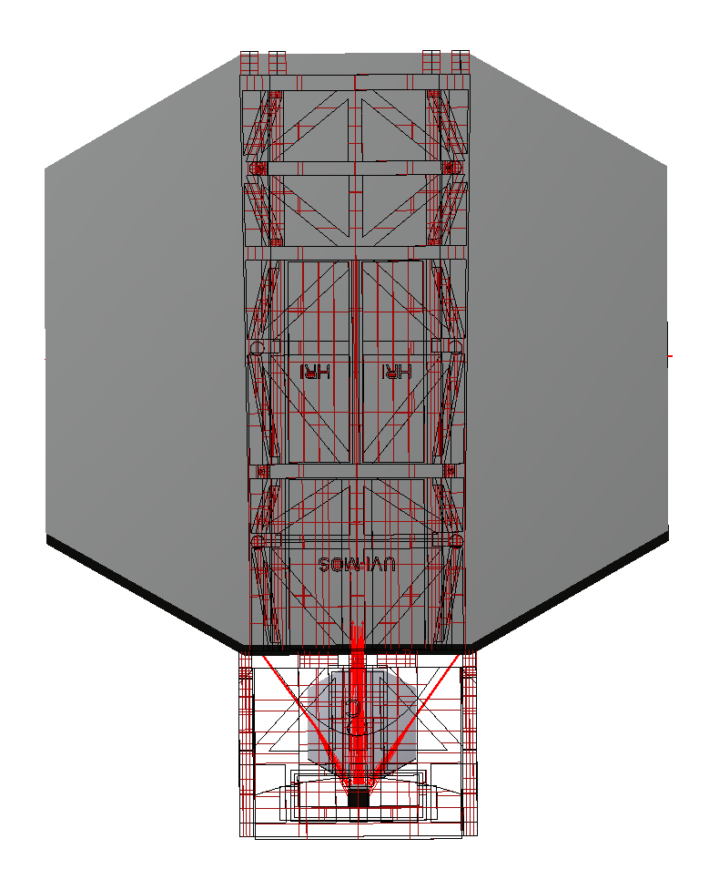
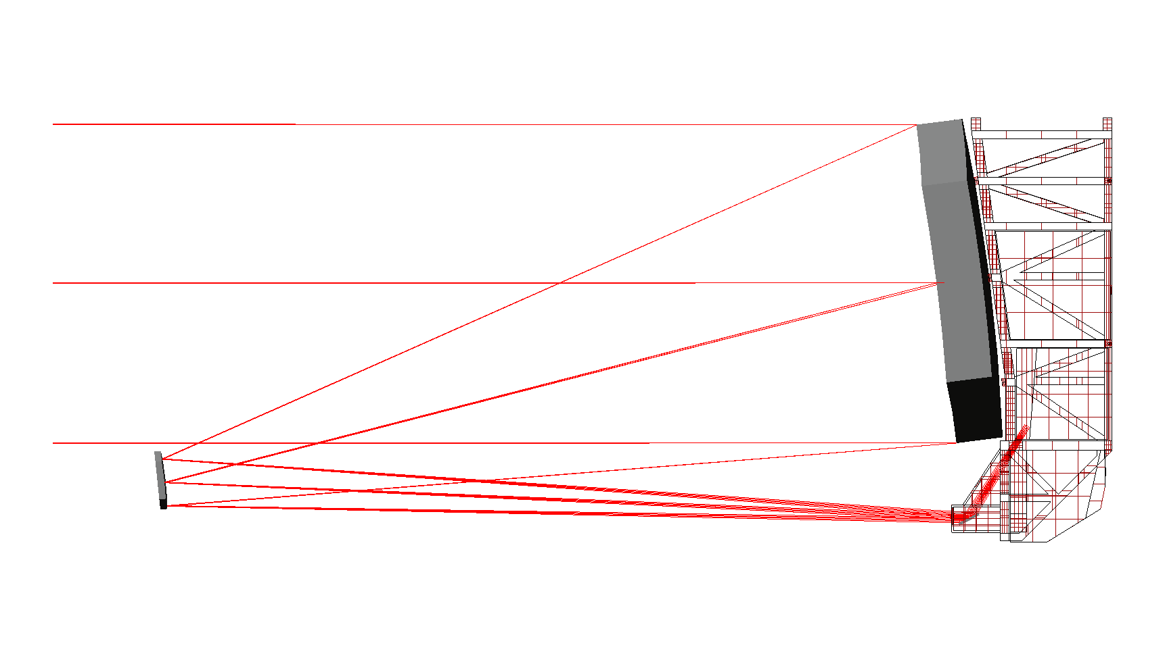
Instrument A (or EAC-5 UV MOS) Optical feed from telescope

Slide 42
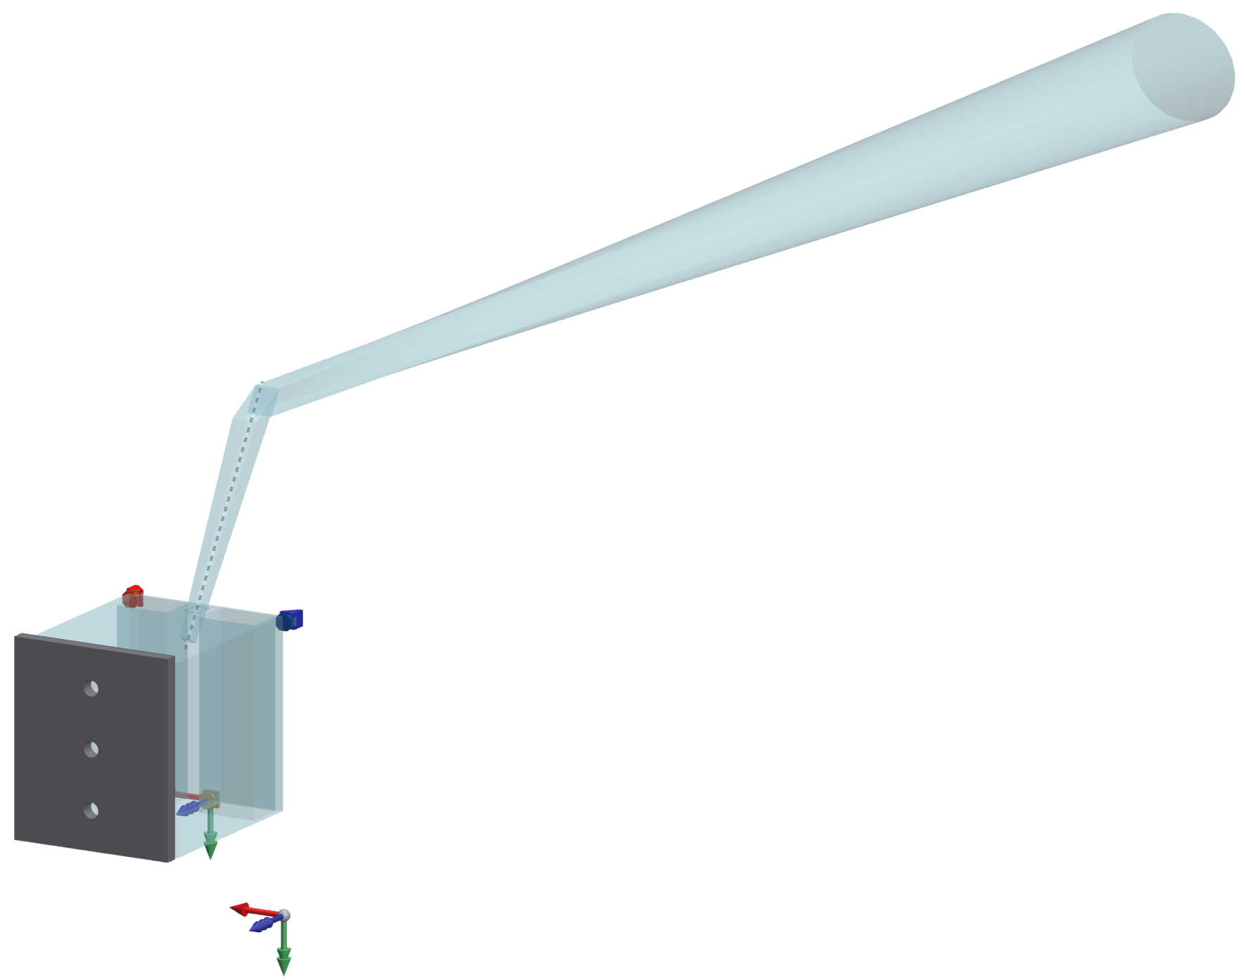
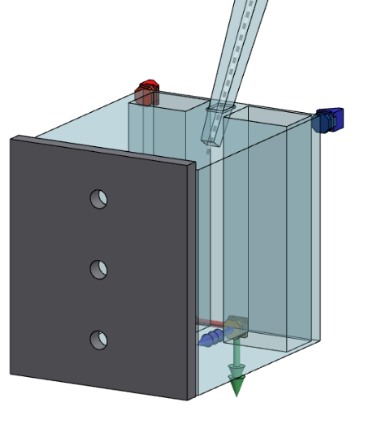
Instrument A (or EAC-5 UV MOS) Overview (dimensions next page)
1DOR
2DOR
3DOR
(A_CS @ center)
A_{X}
V_{X}
A_{Z}
Optics CS
A_CS
V_{Z}
V_{Y}
A_{Y}

Slide 43








Instrument A (or EAC-5 UV MOS) Dimensions

Slide 44
HWO TMPO High Resolution Imager
Government Concept Design Assumptions & Guidelines
HWO TMPO HRI Team
April 2026

Slide 45
Assumptions & Guidelines
HRI is intended to be a general-purposed, high-resolution camera for astrophysics and precision astrometry
Configuration Assumptions made for EAC5 government designs:
  HRI contains two different channels:
    HRI-A: VIS Astrometry camera that also acts as a primary guiding instrument
    HRI-S: Science + wavefront sensing and control channels
      UVIS, including NUV
      NIR
      Enables secondary guiding capability
For EAC-5, the government team used Instrument B resources and interfaces for HRI-S and Instrument C resources and interfaces for HRI-A
Accommodation Guidelines (preliminary):
  Volume
    HRI-A: Slide 54
    HRI-S: Slide 52
  Mass
    HRI-A + HRI-S: 700 kg
  Power
    HRI-A + HRI-S: 500 W

Slide 46
Proof-of-concept for HRI
HRI
Astrometry + Guiding
Science + WFSC
UVIS (400 – 1000 nm)
UVIS (200 – 1000 nm)
Diffraction-limited wavelength: 500 nm
Nyquist sample the core of the PSF
3’ x 4’ FOV (masses of exoplanets)
Diffraction-limited wavelength: 550 nm
Nyquist sample the the spatial resolution element at 550 nm
3’ x 2’ FOV (following HDI heritage)
NIR (1.0 -2.5 µm)
Guider functionality provides roll when combined with guiding in science channel.
NEA (tip/tilt) < 1 mas per axis at 10 Hz.
NEA (roll) < 1000 mas (requires ≥ 2 guide stars)
Diffraction-limited wavelength: 1.2 µm
Nyquist sample the the spatial resolution element at 1.2 µm
3’ x 2’ FOV (following HDI heritage)
Wavefront sensing via defocusing lenses à la JWST

Slide 47
Initial HRI-A specifications
Configuration | Parameter | Value | Units | Comments
HRI-A | Field of View | 3' x 4' | arcmin x arcmin | Note that this is currently shared with the guiding functionality
 | Plate scale | 5.3 | mas/pix | Nyquist sample core at diffraction-limited wavelength
 | Bandpass | 400 - 1000 | nm
 | Detector Temperature | 170 | K
 | # preceding reflections | 4 | - | From telescope
 | f-number | 38.9 | -
 | Astrometric Precision per epoch | 0.3 | µas | Likely necessitates detector calibration
 | Diffraction-Limited wavelength | 500 | nm

Slide 48
Initial HRI-S specifications
Configuration | Parameter | Value | Units | Comments
HRI-S, UVIS | Field of view | 3' x 2' | arcmin x arcmin
 | Diffraction-Limited wavelength | 500 | nm
 | Bandpass | 200 - 1000 | nm
 | Plate scale | 6.9 | mas/pix | Nyquist sample spatial resolution element at diffraction-limited wavelength
 | Detector temperature | 170 | K
 | f-number | 16.4
 | Filters | TBD
 | Allowable wavefront error | ≤ 35 | nm RMS WFE
 | # preceding reflections | 4 | - | From telescope
HRI-S, NIR | Field of view | 3' x 2' | arcmin x arcmin
 | Diffraction-Limited wavelength | 1200 | nm
 | Bandpass | 1000 - 2500 (TBC) | nm
 | Plate scale | 15.1 | mas/pix | Nyquist sample spatial resolution element at diffraction-limited wavelength
 | Detector temperature | 95 | K
 | f-number | 13.7
 | Filters | TBD
 | Allowable wavefront error | ≤ 71 | nm RMS WFE
 | # preceding reflections | 4 | - | From telescope

Slide 49
Initial wavefront sensing specifications
Configuration | Parameter | Value | Units | Comments
Wavefront sensing, in either of the HRI-S channels | Wavefront sensing reference wavelength | 632 or 1550 | nm
 | Wavefront sensing sampling "Q" | ≥ 1.25 at reference wavelength | - | Q = λ*f-number/pixel pitch
 | Wavefront sensing defocus ranges | -8λ, -4λ, 0λ, 4λ, 8λ | -
 | Wavefront sensing spectral bandpass | 20% of reference wavelength
 | Wavefront sensing focus sweep speed | ≤ 10 | minutes
 | Pupil Imaging resolution | ≤ 2 | mm | At telescope entrance pupil
 | Number of pupil wheel element spaces | ≥ 3
Suggest having WFS operational in both channels if possible.

Slide 50
Initial guiding specifications
2 Degrees of freedom measured (tip + tilt) with the goal to include roll
Noise equivalent angle (NEA) < 1 mas, per axis for tip + tilt; < 1000 mas for roll
Guide star availability ≥ 95% (TBC)
Number of stars to be found ≥ 10 (TBC)
Field of view: 3' x 4' (TBC)
Able to acquire guide stars in the presence of ≤ 200 mas (per axis of tip, tilt, and roll) of pointing error
Guider sampling rate of 5 (TBR) - 10 Hz
Wavelength range of 400 – 1000 nm
Wavefront error input to FGS < 35 nm RMS

Slide 51
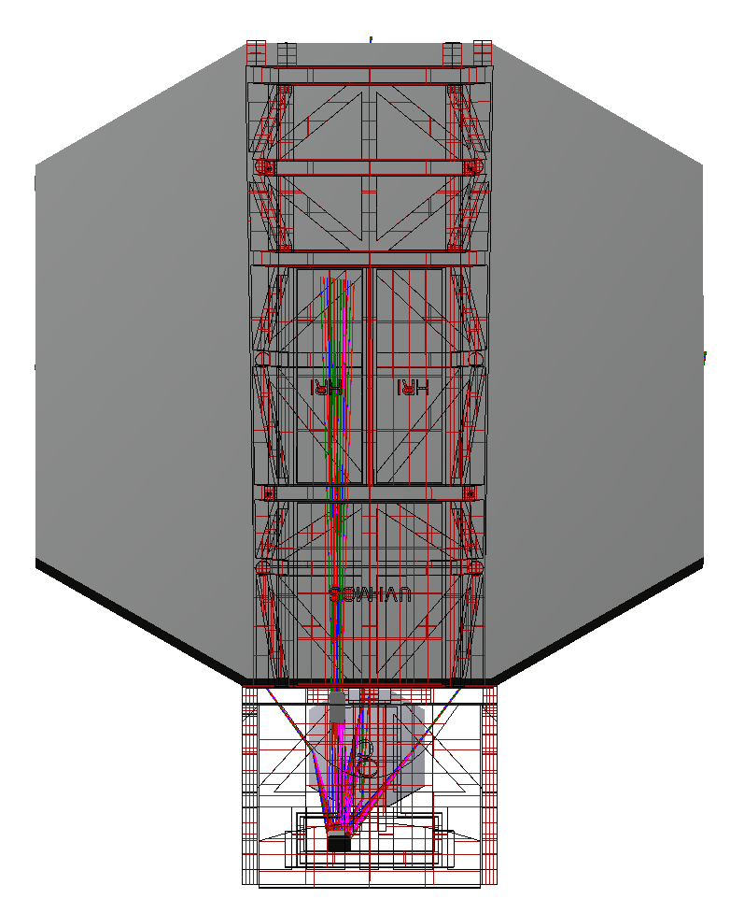
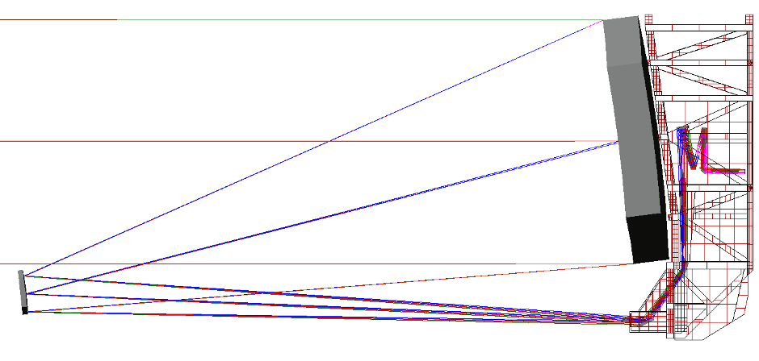
Instrument B (or EAC-5 HRI-S) Optical feed from telescope
M4
M3

Slide 52
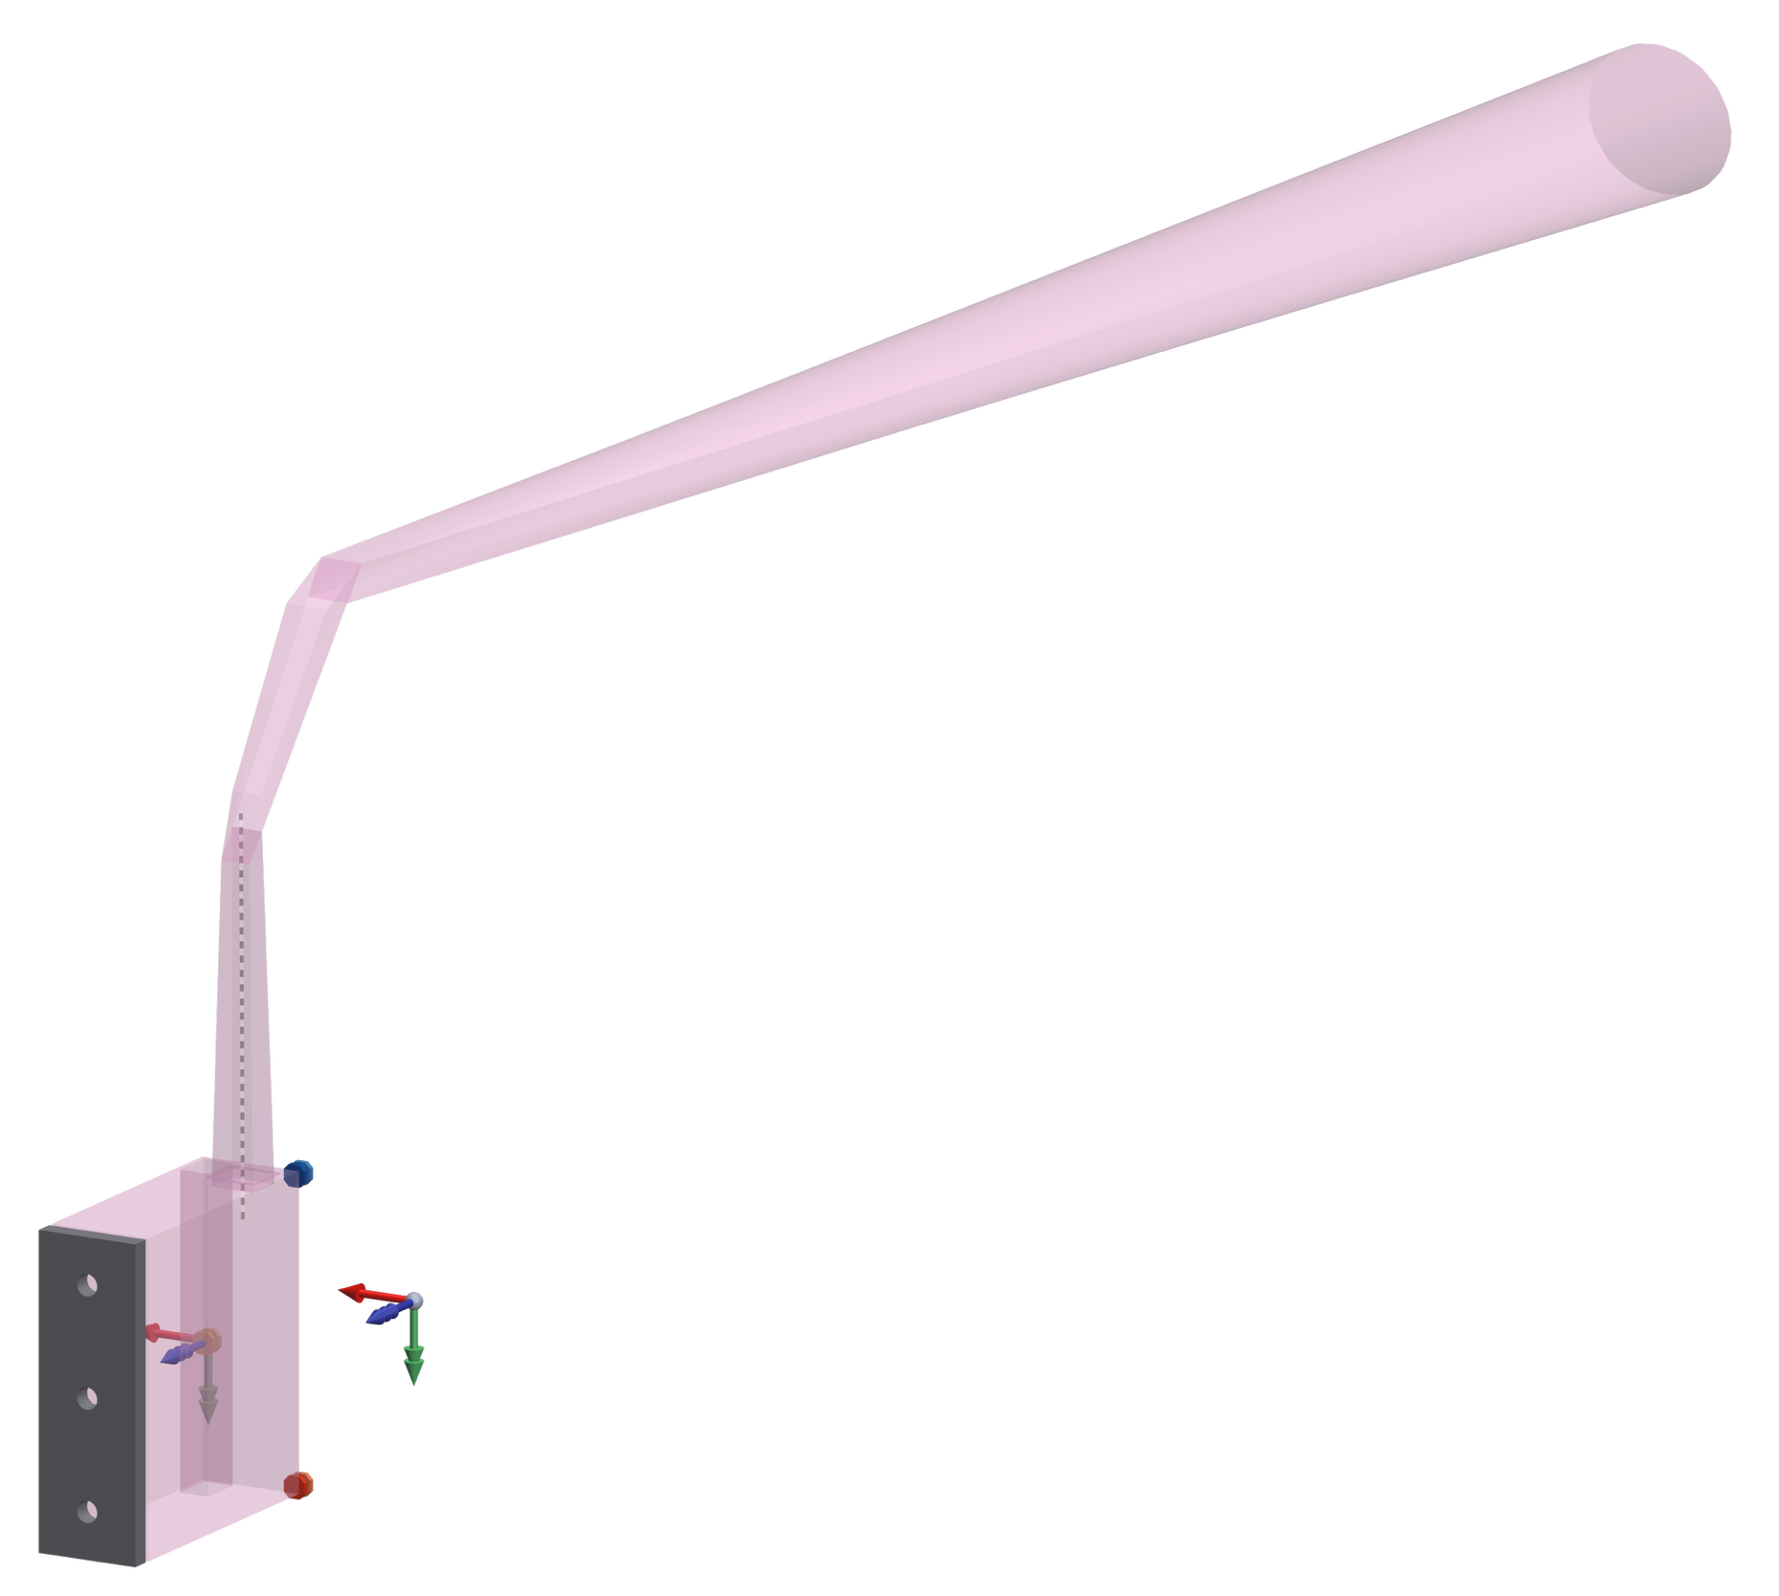

Instrument B (or EAC-5 HRI-S) Overview (dimensions next page)
B_{X}
B_{Z}
B_CS
3DOR
(B_CS @ center)
B_{Y}
2DOR
V_{X}
Optics CS
V_{Z}
V_{Y}
1DOR

Slide 53
Instrument B (or EAC-5 HRI-S) Dimensions

Slide 54
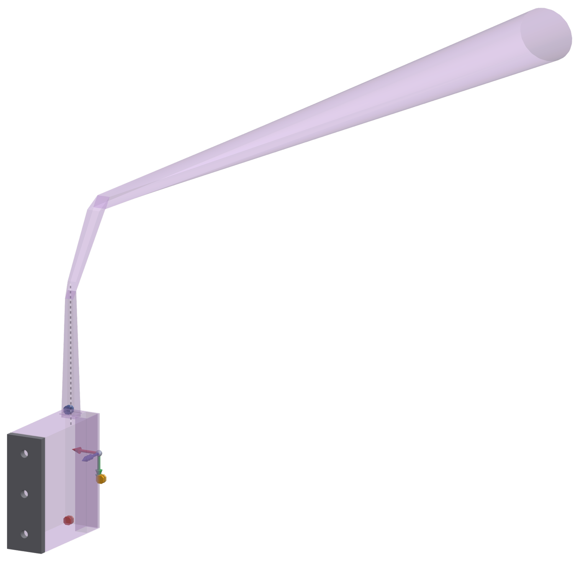
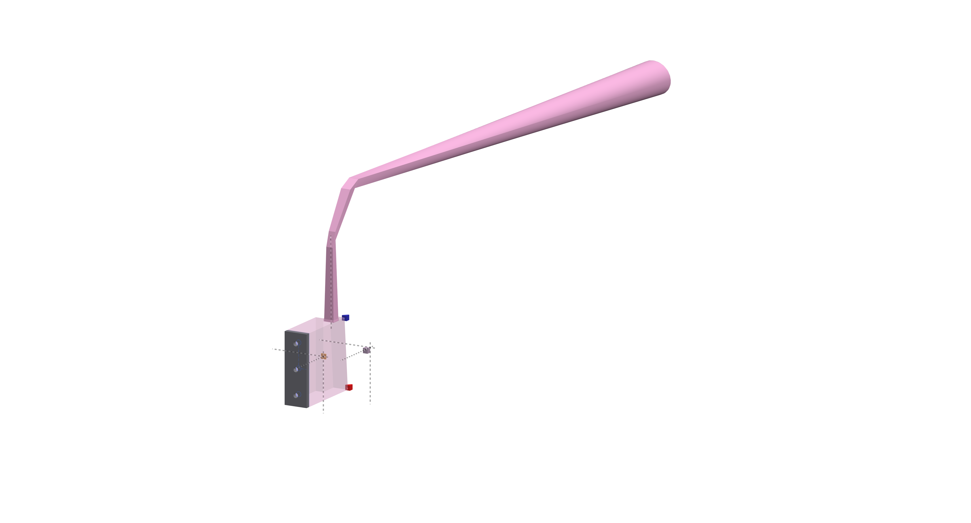

Instrument C (or EAC-5 HRI-A) Overview (dimensions next page)
C_{X}
C_{Z}
C_CS
C_{Y}
2DOR
V_{X}
Optics CS
V_{Z}
V_{Y}
1DOR
3DOR
(C_CS @ center)

Slide 55



Instrument C (or EAC-5 HRI-A) Dimensions

Slide 56
HWO TMPO Ultraviolet Multi-Object Spectrograph (UV IFS)
Design Assumptions & Guidelines
HWO TMPO UV IFS Team
April 2026

Slide 57
Assumptions & Guidelines
The UV-IFS is intended to sample the diffraction limited angular resolution of the telescope + instrument to deliver moderate spectral resolution data cubes (x,y,λ) over an equally modest field of view (~3-5 arcseconds). Science drivers currently target the ultraviolet, but some emerging science cases may drive this into the visible band.
  Ultraviolet (100 – 400 nm) integral field spectrograph with high angular resolution (20 mas) and moderate spectral resolution (R~4000) over a ~3 arcsecond square field of view
For EAC-5, the government team used Instrument D resources and interfaces for the UV-IFS
Accommodation Guidelines (preliminary):
  Volume
    2.0m x 1.3m x 0.4m; horizontal mounting area is 2.0m x 1.3m; vertical height is 0.4m.
  Mass
    150 kg; includes proposed NIR channel optics and associated electronics and harness
    Does not include shared optical bench, shared thermal hardware, or shared housekeeping electronics
  Power
    250 W dissipating to shared 293K room temp radiator
    0.85 W dissipating to shared 100K cryogenic radiator
    0.4 W dissipating to shared 65K cryogenic radiator

Slide 58
Initial UVIFS specifications
Parameter | Value | Units
Bandpass | 100 - 400 | nm
Field of view | 3" x 3" | arcsec x arcsec
Angular Resolution | 20 | mas
Spectral Resolving Power | 4000 | -
FUV Detector Temperature | 220 | K
NUV Detector Temperature | 170 | K
Spot size | 50 | mas

Slide 59
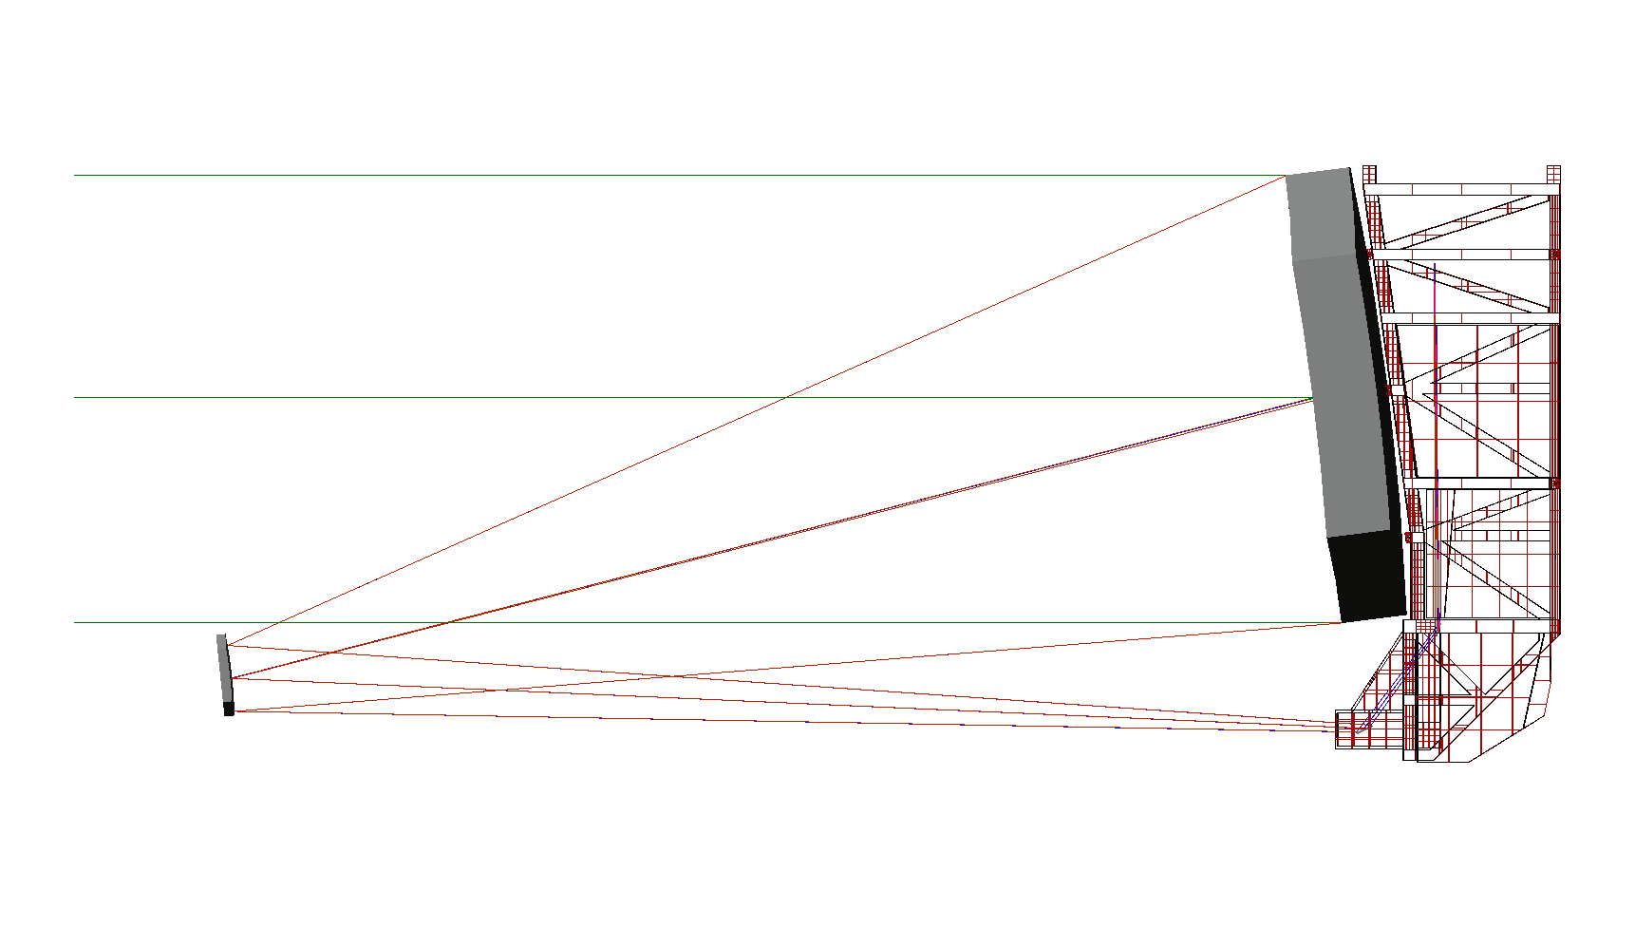
Instrument D (or EAC-5 UVIFS) Optical feed from telescope
M4
M3

Slide 60
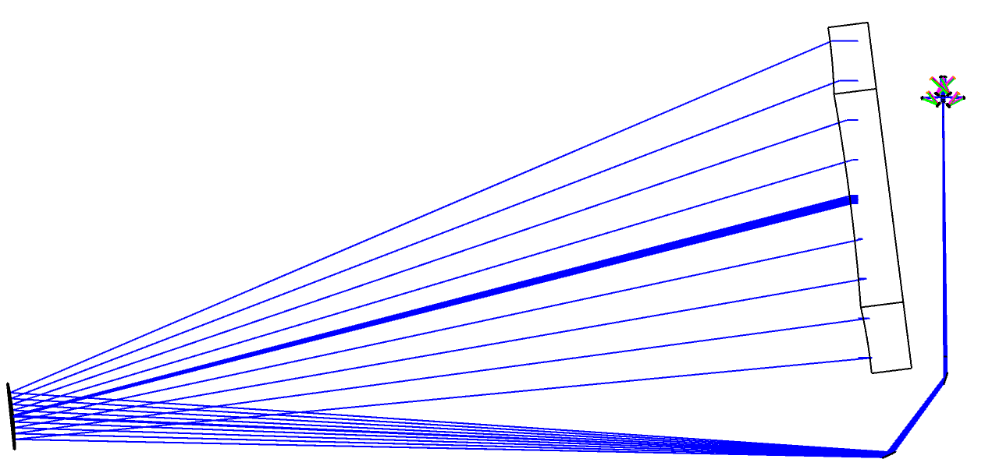
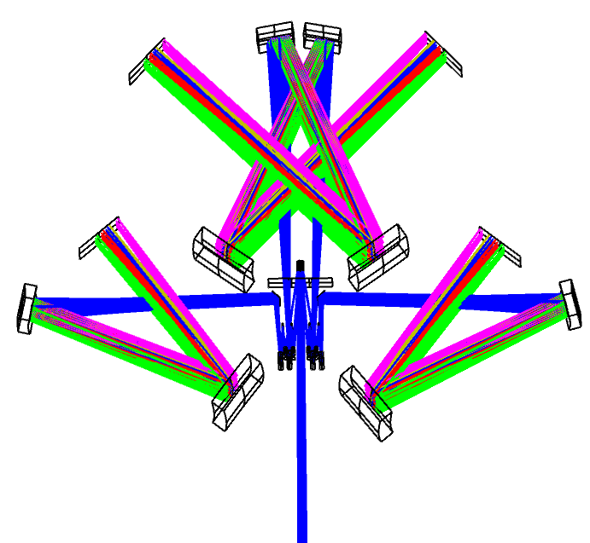
EAC-5 UV IFS Optical Layout
Detector2
Detector3
Detector1
Detector4
M4
M3
For each group, there are three gratings installed on the element wheel/shift stages (100 – 200 nm, 200 – 300 nm, 300 – 400 nm)
Groups 1 and 3: 11 mirrors
Groups 2 and 4: 10 mirrors
Beam from OTA
(Only beams of 100nm-200nm plotted)

Slide 61
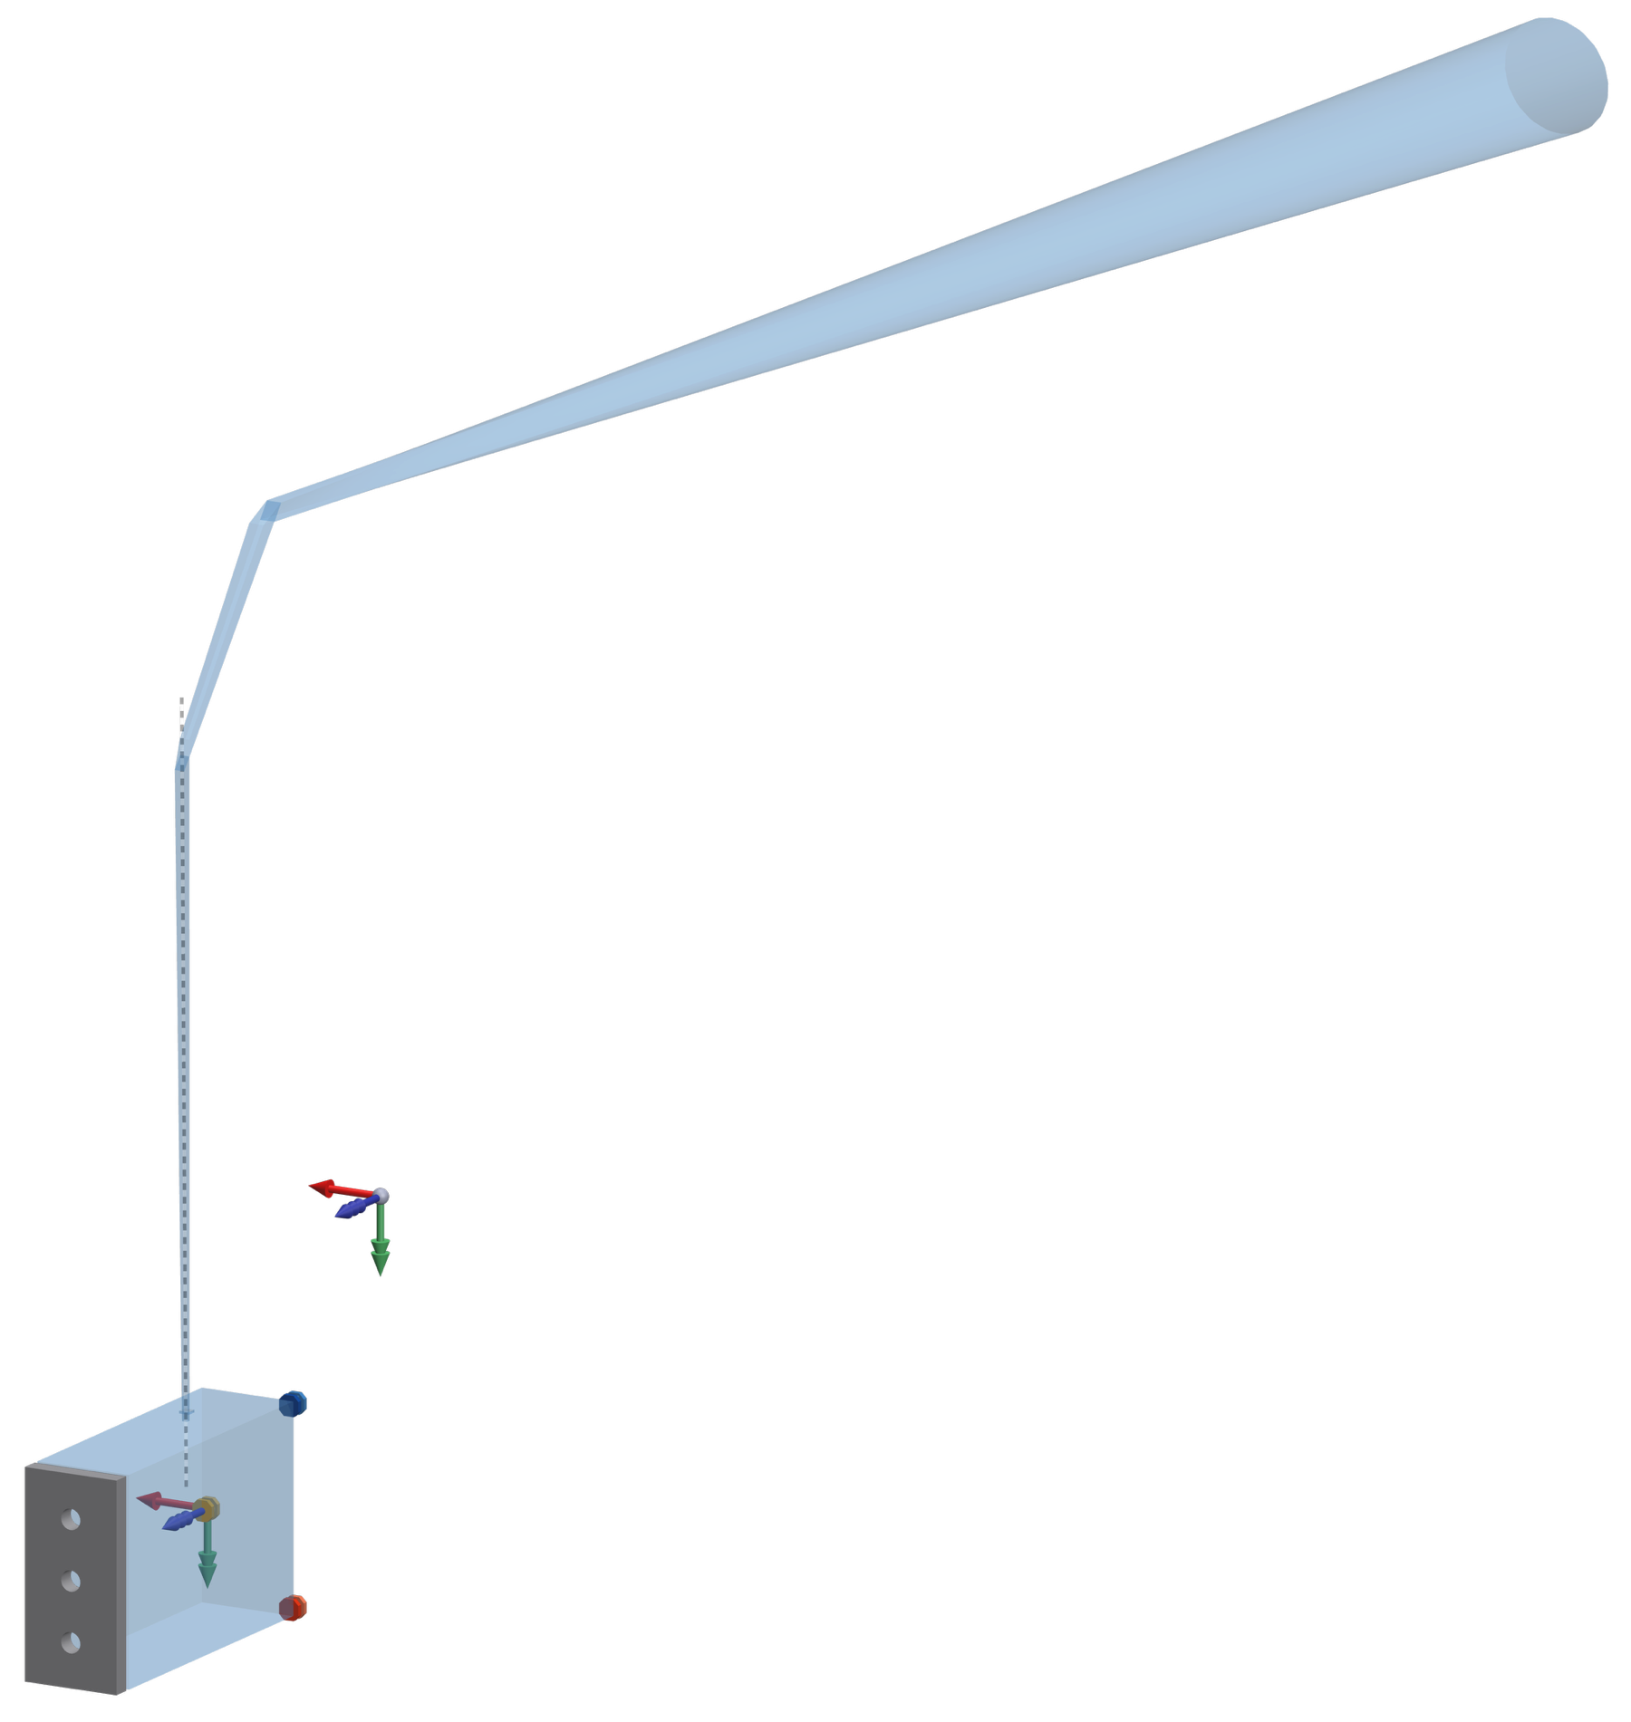

Instrument D (or UV IFS) Overview (dimensions next page)
D_{X}
D_CS
3DOR
(D_CS @ center)
V_{X}
D_{Z}
Optics CS
D_{Y}
V_{Z}
V_{Y}
2DOR
1DOR

Slide 62




Instrument D (or UV-IFS) Dimensions

Slide 63
HWO TMPO Extra Instrument (XI)
Design Assumptions & Guidelines

Slide 64
Assumptions & Guidelines
The Extra Instrument (XI) is reserved for additional instrument candidates, including a NUV Coronagraph, UV Spectropolarimeter, and others
For EAC-5, the government team did not develop a concept for Instrument E but has provided preliminary mass, power, and volume allocations
Accommodation Guidelines (preliminary):
  Volume
    See slide 65
  Mass
    200 kg
  Power
    200 W

Slide 65
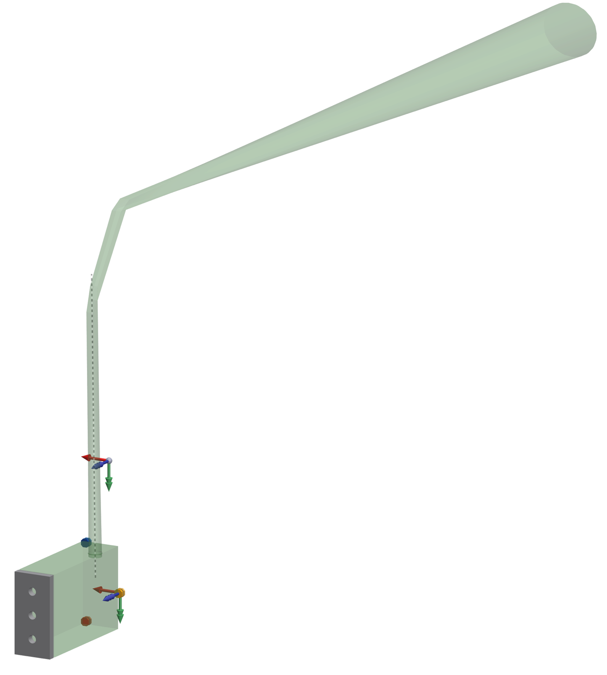

Instrument E Overview (dimensions next page)
E_{X}
V_{X}
E_{Z}
E_CS
Optics CS
E_{Y}
V_{Z}
V_{Y}
2DOR
3DOR
(E_ CS @ center)
1DOR

Slide 66







Instrument E (or XI) Dimensions

Slide 67
Back-up

Slide 68

1. EAC5 Telescope Optical Designs
EAC5 telescope is best described as “Unobstructed Freeform Telescopes”, where the starting configuration was laid out as a Cartesian Reflector system (i.e. Confocal Conics), and then optimized for the UVI MOS MSA field of view.
This design form helps meet the minimum desired reflections to maximize throughput for UV science.
In general, the residual telescope wavefront error is degraded for the other instrument fields, but correction can be applied to the fold mirrors needed for instrument packaging.
EAC5 D_{circ}= 10.0 m
3 Mirrors to MSA
D_{circ} = Circumscribed Diameter, MSA = Micro-Shutter Array

Slide 69

1. Discussion: Unobstructed Freeform Telescopes
Unlike “Off-axis” designs of rotationally symmetric systems, the telescope design for EAC5 is better described as “unobstructed" since the mirrors are defined about the central ray through the system, known as the “base ray,” and tilt with respect to this ray is applied to the mirrors to remove obstruction between reflections, as shown in the drawing below for EAC5.
The telescope is not rotationally symmetric. All mirrors are defined as an XY Polynomial series (to 6th order), and plane symmetry is enforced. For some instruments, dedicated fold mirrors are fully asymmetric and use higher order polynomial coefficients to help correct the telescope image interface at the instrument.
Base Ray

Slide 70
2. Design Driver: Minimize number of reflections for UV instruments
UV science is benefitted by having a minimum # of reflections to detection, which allows maximum throughput and sensitivity.
The ideal placement of UV MOS is separated laterally from the primary mirror, not tucked behind it. Requiring instruments to be behind the Primary necessitates additional fold mirrors.
A better location for both UV MOS and for CI would be between the primary and secondary mirrors, but mechanical packaging prohibits this location.

Slide 71
2. Design Driver: Flat Field required for UVI MOS MSA
The UVI MOS Micro-Shutter Array (MSA) requires a flat image from the telescope, since it currently cannot be fabricated with a spherical shape.
This flat field constraint is similar to that of the Roman Space Telescope wide field channel, where the detector is placed at the telescope focus.
This flat field constraint is fundamentally different than JWST, however, as JWST had a curved image surface with a radius of curvature equal to the exit pupil distance from the Fine Steering Mirror (FSM), which provided observatory level pointing control.
EAC5 requires a 3rd fold mirror to access the instrument location required for UVI MOS due to packaging constraints. Also, the larger MSA can be tiled with small tilts to better tolerate residual field curvature.
Finally, it should be noted that since the UVI MOS drives the design of M1 and M2 to have an optimized image at the MSA, less optimal image quality result at the interfaces to the other instruments, but any additional mirrors in the path can help control degradation by applying freeform surface corrections.

Slide 72
2. Design Driver: Match focal length to UVI MOS needs
The telescope focal length (plate scale) is current set by the physical size of the UV MOS MSA and its desired field of view on the sky.
This is a first-order system constraint that effectively controls the curvature at M1 and M2
EAC5
  MSA Size = 150 x 150 mm, with slit aperture pitch of 100 x 200 microns
  FOV: 3 x 3 arcmin
  Focal Length = 171 meters

Slide 73
2. Design Driver: Angle of Incidence for Polarization Aberrations
Delta AOI
Polarization aberration modeling is required for HWO, to evaluate the impact on the Coronagraph Instrument (CI) yield performance metric.
Currently our design strategy to manage these aberrations is to minimize the “delta-AOI” on the telescope optics that feed the CI
Delta-AOI is defined as the difference in angle of incidence at each mirror (i.e. max – min value).
Minimizing delta-AOI effectively constrains the F/# of the primary mirror to be greater than ~F/2.5 or so, which pushes M2 further away from M1.
The goal is to keep delta-AOI under 15 degrees, but impact requires a full optical analysis.
 | EAC1 | EAC2 | EAC3 | EAC5
M1 | 11.36 | 11.19 | 11.08 | 12.84
M2 | 12.82 | 12.83 | 11.88 | 12.84
 | ΔAOI in degrees

Slide 74







2. Comparison of Driving Specifications with other NASA flagships
(drawings not equal scale)
Spec | Hubble Spitzer | Webb | Roman | EAC1 | EAC2 | EAC3 | EAC5
Unobstructed | No | No | No | Yes | Yes | No | Yes
Number Reflections | 2 | 4 | 5 | 4 | 5 | 4 | 3
Flat field | No | No | Yes | Yes | Yes | Yes | Almost
NOTE: delta-AOI and focal length driving specifications can be adjusted for any of the above telescopes, assuming available packaging, so they are not included in the above table.

Slide 75

Instrument Radiator Max Sink Temp Breakdown
-45°/22.5° Contour
Attitude | Max Radiator Sink Temp [K]
 | CI | UVI-MOS | HRI | UVI-IFU | XI
0°/0° | 60 | 65 | 70 | 72 | 75
0°/22.5° | 62 | 66 | 71 | 73 | 75
0°/-22.5° | 62 | 66 | 71 | 73 | 75
-30°/0° | 67 | 70 | 73 | 75 | 76
-30°/22.5° | 66 | 70 | 73 | 74 | 75
30°/-22.5° | 66 | 70 | 73 | 74 | 75
-45°/0° | 68 | 72 | 73 | 74 | 75
-45°/22.5° | 69 | 71 | 73 | 74 | 75
-45°/-22.5° | 69 | 71 | 73 | 74 | 75
Sink Temp Range Across All Attitudes
CI
CI: 57K-69K
UVI-MOS
UVI-MOS: 60K-72K
HRI
HRI
Attitude | Min Radiator Sink Temp [K]
 | CI | UVI-MOS | HRI | UVI-IFU | XI
0°/0° | 57 | 60 | 65 | 70 | 72
0°/22.5° | 58 | 62 | 65 | 70 | 72
0°/-22.5° | 58 | 62 | 65 | 70 | 72
-30°/0° | 63 | 67 | 69 | 73 | 75
-30°/22.5° | 63 | 66 | 69 | 72 | 73
30°/-22.5° | 63 | 66 | 69 | 72 | 73
-45°/0° | 65 | 68 | 71 | 73 | 73
-45°/22.5° | 65 | 68 | 71 | 72 | 72
-45°/-22.5° | 65 | 68 | 71 | 72 | 72
HRI: 65K-73K
UVI-IFU
UVI-IFU: 70K-74K
XI
XI: 72K-76K
Notes:
Here are the details of the attitude sweep and the resulting blackbody IR sink temperature for each presented radiator area. For more details on location and area of each assigned instrument radiator area, see mechanical discipline materials.
Bear in mind when selecting components that the instrument thermal complexity will be linked to the temperature requirements relative to feasible radiator IR sink temperatures.

Slide 76



Summary
As the observatory is pitched back, min radiator sink temps increase, while max temps remain largely unchanged
  Coldest sink temps occur at the top of the radiator, which has the greatest view to the sunshade. With increased pitch, partial illumination of the middle and upper sunshade layers raises the max sunshade temperature
0°/0°
-30°, 0°
-45°, 0°
Top (anti-sun) layer of sunshade shown
Max Temp = 251K
Max Temp = 302K
Max Temp = 319K
Notes:
The sun shield has a notional design which has 3 separated, parallel layers. As a result of the fact that the shades are the same size and parallel, there is some solar entrapment and impingement between layers at non-zero pitch angles. As a result, some corner cases for worst case IR backloading on the instrument radiators occurs at high pitch angles. Therefore, if the sun shade is further optimized and mechanically feasible, expect radiator sink temperatures to decrease, yielding a more robust thermal design. However, it is not expected that this work will occur prior to instrument kickoffs.

Slide 77

Reducing Radiator Blackbody Sink Temperatures
If radiator sink temperatures are close to an instrument component temperature:
  Reduce the delta temperature from the component to the radiator
  Increase radiator area
  Consider warmer detectors
Use instrument level architecture to reduce sink temperatures (i.e. reduce sunshade IR backloading)
    Baffles can be optimized using parabolic shaped vanes or other similar concepts
    Expect a significant difference between physical radiator area and effective area due to reduced view to space
      For instance, a 4m² radiator may only have a 2m² effective area
    Additional deployable shields may block other instrument radiators views to space and may violate prescribed instrument volumes defined in the mechanical interface guidance
Notional Directional Baffles on Radiator
Notes:
These accommodations can be helpful where passive designs are essential and component temperatures are too close or above radiative sink temperatures. Of course, simpler designs are easier to execute, so warmer components should be considered. Active cooling can also alleviate situations where passive cooling is not feasible, but the vibrations will have to be dealt with. Each instrument will have to tailor their design to their individual needs. More recommendations on next slide.

Slide 78
Recommended Thermal Considerations
The instrument bays will be surrounded on 5 sides with a room temperature environment → may need to create thermal zones for other temperature components
If the radiator blackbody sink temperature isn’t significantly colder than the components rejecting the heat, expect the thermal design to be more complex
  Parasitic heat loads will require close management
  Active cooling may be necessary
Place cold detectors close to radiators
Parasitic heat loads (heat transfer from warmer areas to colder areas) will heavily drive thermal architecture
  Parasitic heat loads in low temperature components can sometimes represent 90%+ of the total rejected heat loads
  To estimate these loads where cryogenic temperatures are concerned, consider using this paper as a reference:
    Ross, R. G. Jr. (2004). Estimation of thermal conduction loads for structural supports of cryogenic spacecraft assemblies. Cryogenics, 44(6–8), 421–424. doi:10.1016/j.cryogenics.2004.02.019
      Describes a nested “shell” configuration that can be used to minimize parasitic heat loads
  Transporting heat at cold temperatures is not the same as near room temperature
    Consider delta temperatures from your cold components to the radiator, as well as potential heat leaks to these transport components (i.e. heat pipes, high purity bars)
    Heat pipes require working fluids in certain temperature regimes. Before assuming heat pipe architecture, ensure there is a working fluid or material that is best suited to your needs
  In pre-phase A, margins are in the 50%-100% range for low temperature components due to parasitic uncertainty
  Consider if active cooling is an option
Warmer detectors will significantly simplify the mechanical and thermal architecture

Slide 79
Pre-Proposal Workshop
Instrument Study Initial Information Document
Appendix: EACs 1-5 Summary

Slide 80
Acknowledgement
Name | Systems & Technology Leads
Alice Liu | Project Systems Engineer
Matt Bolcar | Chief Technologist
Josh Abel | Observatory Systems Engineer
Marie Levine | Systems Analysis Lead
Charley Noecker | Coronagraph Coordination Lead
Maxime Rizzo | HRI Working Group Lead
Paul Scowen | UVI Working Group Lead
Breann Sitarski | Deputy Architect and Testbed Lead
Feng Zhao | Deputy Chief Technologist
With inputs from CI, HWI, and UVI Working Group teams
Name | Engineering Discipline Leads
Jon Lawrence | Mechanical Lead
Charles Wang | Coronagraph Mechanical Lead
Joe Howard | Optical Lead
Hong Tang | Coronagraph Optical Lead
Jordan Effron | Thermal Lead
Brad Moore | Coronagraph Thermal Lead
Greg Walsh | Structures Lead
Harry Culver | Electrical Lead
With inputs from government systems design team

Slide 81
Habitable Worlds Observatory Mission
NASA's next flagship mission, recommended by the Astro2020 Decadal Survey
  Large-aperture UV/Optical/NIR observatory performing transformative astrophysics across cosmic time
  First telescope designed to directly image and characterize Earth-like exoplanets, including the search for signs of life
HWO includes a segmented primary mirror and coronagraph instrument
Operational orbit at Sun-Earth L2
Serviceable at L2

Slide 82

Exploratory Analytic Cases (EACs)
Mission architectures developed to explore the HWO trade space:
  Explore key architectural options and breakpoints to guide future point design decisions
  Develop end-to-end models and tools to understand modeling capabilities and needs
  Identify technology gaps and guide maturation of potential solutions
  Provide early feedback to launch vehicle vendors to help influence their direction
  We don’t expect any of the cases studied will become a baseline design going forward.
  These are only intended to explore and practice.
Final JWST
CML 9+
Early JWST

Slide 83



EACs Design Guidelines
Baffle/barrel protection for optics against micrometeoroid impacts
Compatible with at least two future launchers
Serviceable architecture
ULE glass mirrors (primary/secondary) at room temperature for simplified I&T
Field-of-Regard: ±45° pitch, ±22.5° roll, 360° yaw
Slew/Settle: 90° in 60 min
Observatory LOS stability: 4 mas
Passive cooling for NIR detectors
NASA
Space Launch System
SpaceX
Starship
Blue Origin
New Glenn
(7x2 shown, 9x4 considered)

Slide 84
Observatory Schematic
PM Backplane
Assembly (PMBA)
Deployable Baffle
DBS Containment Box
Instrument & Detector Radiator Assy’s (Multiple radiators)
Optical Telescope Element
Optical Telescope Element (OTE)
Instrument 1
Primary Mirror (PM) Segments
Instrument and Guider Element
Instrument 2
Instrument 3
Spacecraft Element
●
Instrument Module Structure
Secondary Mirror Assembly (SMA)
●
●
SC-to-Payload Vibration Mitigation System (SPVM)
Extra Instrument (XI)
Sun Shade or Instrument Radiator Shields
Deployable Baffle System
Secondary Mirror Support Structure
Spacecraft Bus
ACS Hardware, Propulsion
Avionics, Comm, C&DH, Power System
SC-to-Payload Vibration Mitigation System (SPVM)
Solar Arrays

Slide 85

Exploratory Analytic Cases 1-3
8m, On-Axis
9m Diam Fairing
6m, Off-Axis
9m Diam Fairing
6m ID/7.2m OD, Off-Axis
7m Diam Fairing
Notes:
Here are the EACs we’ve so far studied in detail. They span a range of designs and apertures.

Slide 86






Preliminary specs & candidate instruments
Telescope
Coronagraph
High-Resolution Imager
UV Multi-Object Spectrograph
Diameter | ≳6.0 m
Bandpass | ~100–2500 nm
Diff. Limit @ | ~500 nm
High-contrast imaging and imaging spectroscopy
Bandpass | ~450–1700 nm
Contrast | $$≲1 × {10}^{−10}$$
$$R (λ/{Δλ)}$$ | Vis: ~140 NIR: ~70
UV/Vis and NIR imaging
Bandpass | ~200–2500 nm
Science FoV | ~${2.5}^{′}× 2.5′$
Astrometry FoV | ~12 sq. arcmin
~40 science filters & grism
UV/Vis multi-object spectroscopy and FUV imaging
Bandpass | ~100–700 nm
Field-of-View | ~$2^{′}× 2′$
Apertures | ~$840 × 420$
$$R (λ/{Δλ)}$$ | ~500 & 50,000
Possible Additional Instrument(s)
To be defined
Candidates include
NUV Coronagraph, UV Spectropolarimeter
UV/VIS IFS included in EAC 4 and 5 designs
(specs TBD)
Ceres
International contributions will be considered.
Notes:
The instruments we’ve studied so far

Slide 87









EACs 1-3 Key Design Challenges
Deployable Baffle System
Micrometeorite Protection
Deployment and Test Complexity
Straylight and Other Challenges
EAC-1
EAC-2
Thermal Architecture
Passive Detector Cooling
Radiator Sunshields and Aft Closeouts
Baffle and Large Sunshade Trades
EAC-3
Opto-Mechanical Packaging
Fewer Reflections to Instrument
Off-axis System and Greater PM-SM Separation Preferred
Starting Point (2/2024)
End Point (3/3025)

Slide 88



EAC-5 CI Opto-Mechanical Considerations
EAC-2
Monolithic bench for alignment stability. Large mass and dimensions both challenge structural support.
EAC-3
Two-part bench needs controls for alignment stability
EAC-1
Unable to cool NIR detectors to 65K

Slide 89

HWO IM Pipeline Assesses Performance for Each Thread & Metric
Slew & Settle
Optical Prescription, Coro Design, Static Fabrication Errors …
ACS/LOS/Jitter
Disturbances
RWA
μThrusters
Jitter
FEM
LOM
(Linear Optical Model)
ACS/LOS Control
Diffraction
Analysis
Raw Static Contrast
Observing Scenario OS1
Jitter
Telescope + Compact Coronagraph
(only DMs, masks, occulter, detector)
OPD Maps
Coronagraph WFSC:
LOWFS / HOWFSC
Pipeline tests different observing scenarios, time scales & control systems
TelescopeWFS&C
Rigid Body Control System (RBCS)
(MATLAB/MACOS
Post-processing
(differential)
LOS, WFE, Beam walk, Beam Shear
Residuals post Coro WFSC
Thermal Drift
Static (Raw)
STOP – High Fidelity
Contrast Stability
(nonlinear)
Residuals post RBCS
Stability
Thermal
STOP FEM
SigFit
(conversion)
CodeV
(optical)
w/o RBCS
Speckle Time Histories
Linearized
Analysis Path
LOM
(Linear Optical Model)
Equivalent WFSC Filters
LEM
(Linear E-Field Model)
Coronagraph sensitivities
Contrast Stability
(linear)

Slide 90



STOP Trades & Cases
Performed thermal trades using EAC-1 models to assess sensitivities to various design options:
  Passive thermal barrel with Scarfed vs Unscarfed contour
  Barrel insulation type and emissivity
  Sunshade shape & size
  Field of regard cases & Observing Scenarios OS1- OS5
FOR - Bounding
OS1 Transients

Slide 91



ACS/Jitter Trades & Cases
Evaluate 2 ACS Architectures
  Hybrid: Micro-thruster (observation) + passive RWA (slew)
  RWA only (8) – Combinations of isolation options & frequencies
    All Passive isolation for Payload and Reaction Wheel
    Active hexpapod isolation on Payload
    Active hexapod isolation on Reaction Wheel
Performance dynamics stability trades
  Slew & Settle – investigate error sources and contributions
  ACS pointing stability
  Jitter – LOS & WFE
  Cryo cooler jitter impacts
  Frequency domain and time domain analyses
Defined performance goals in some areas until error budget is finalized

Slide 92
Overall Approach to EAC 4 and 5
EAC-4 Objectives:
  Balances cost, schedule, and science performance
  Mitigate baffle-related engineering risks
EAC-5 Objectives:
  Driven by science goals with minimum 8-m inscribed diameter aperture
  Consider large flat sunshade to improve thermal stability
Instrument Suite:
  CI (VIS + NIR)
  UV MOS and UV IFU
  HRI (provides guiding and out-of-field WFS)
  Reserved bay for future servicing mission instrument
EAC-4: To be delivered as part of the HWO Technical Packet at the kick-off meeting
EAC-4 selection pending
EAC-5: Delivered as part of the Pre-Proposal Information Packet

Slide 93

EAC-5 Government Instrument & Guider Assembly
OTE Closeout (TBR)
CI
UV MOS
Metering
Plane (PM; SI’s)
HRI - A
HRI - S
UVI IFU
Servicing
Plane
XI

Slide 94

Exploratory Analytic Cases (EACs)
Explore → Design → Analyze → Repeat
EAC-1
EAC-4
EAC-6
EAC-2
TBD
Single Baseline for MCR
EAC-5
EAC-3
Starting Point (1/2026)
Starting Point (2/2024)
End Point (3/3025)
Notes:
We’ve now started working on EACs 4 and 5 and we’ll use all of this to inform a baseline design, EAC 6, for MCR

Slide 95
Systems Team Top-Level Schedule
Jan-Mar ‘26
April-Jun ‘26
July-Sept ‘26
Oct-Dec ‘26
Jan-Mar ’27
Mar-Jun ‘27
EAC Schedule
EAC-5 Design
EAC-4 Design
EAC-6 Design Options
Additional Design Studies
Engage and Collaborate with Other Studies
Industry D19 Technology Maturation and Architecture Studies
Instrument Studies
System Engineering Products
Requirements, Resource and Performance Budgets, Risk Management, ConOps and Post-Processing, V&V, I&T, and Model Validation Plans

Slide 96
Summary
Government team has successfully completed preliminary designs for four EACs
EACs support the maturation of science, technology, engineering requirements, and requirement flowdown
Government instrument designs focus primarily on opto-mechanical layout and resource sizing
EACs directly inform instrument resource allocations and interface accommodations
Upcoming instrument studies will further refine design concepts and solidify interface assumptions across all discipline areas
HWO TMPO engineering team is ready to support the Instrument Studies!

Slide 97
Backup section

Slide 98

Deployed Baffle System
EAC-1
EAC-1
  Six “faces” each comprised of three layers of Kapton
  Each “face” is stowed within a containment box and deploys outward via telescoping booms
EAC-2
  “Spreadable” forward petal deployment, followed by,
  Forward sliding of a rigid cylindrical baffle segment over a fixed section in a “camping cup” style design
EAC-3
  Six faces, with each face made up of a nested panel architecture
  During deployment, nested panels slide outward
EAC-2
EAC-3

Slide 99




Thermal Architectures/Features
EAC1
EAC2
EAC3
Sliding Aluminum Panels
Aft, MLI closeouts (deployed)
Deployed Soft Goods (3x layers)
Deployed “Camping Cup”
CI
CI
XI
Aft, MLI closeouts (deployed)
Guiders
Guider
IMS/Bus acts as closeout
UVI
HRI
UVI
CI
Solar/ROSA blockers
Guider
UVI
XI
HRI
Solar/ROSA
blockers
HRI
Guiders
Solar Panels/blockers
CI location thermally unfavorable
CI and HRI detectors do not meet temperature requirements
Membrane baffle closeouts challenging
CI located with a clear, deep space view
Guider radiators in direct sun
“Camping Cups” are already circumferential → fewer closeouts
CI has clear, deep space view
Rigid solar panels serve as aft rad blockers
SLAP panel closeouts more challenging than EAC-2
Instrument radiator position and shielding from solar and IR heat are critical to passive cooling to meet temperature requirements

