Slide 1
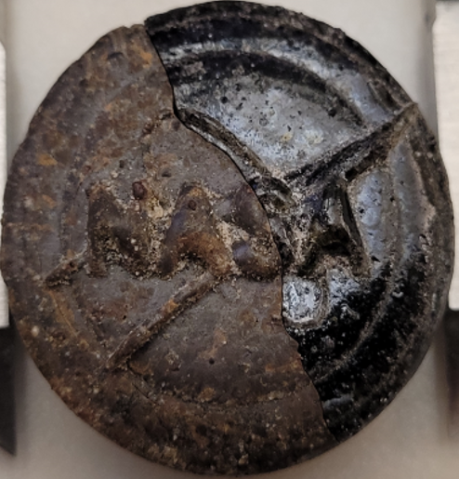
Vacuum Laser Additive Manufacturing of Lunar & Martian Regolith
Parker D. Shake | NASA MSFC | Materials & Processes – Advanced Manufacturing
Worldwide Additive Manufacturing Symposium (WAMS) – June 2026
First Public Showing of NASA’s Patent-Pending Regolith-to-Glass-Ceramic Additive Manufacturing Process
NASA MSFC Tech Transfer Award – First Place – 2024 & 2025
WAMS 2026 | Parker D. Shake | NASA MSFC EM42
Artificial Intelligence (AI) Usage Disclosure
This document was created with assistance from Google Gemini for artistic renditions on slides 9. The content has been reviewed and edited by Parker Shake. More information on the extent and nature of AI usage is included in the Methods or Acknowledgements sections of the document.

Slide 2
Agenda
01
Introduction – The ISRU-AM Challenge
02
The MSFC Patent-Pending Solution – Regolith to Glass-Ceramic Conversion
03
Regolith to Amorphous Vitrified Glass (L-PBF)
04
Regolith to Amorphous Vitrified Glass (2023)
05
Amorphous Vitrified Glass to Glass-Ceramic (2025)
06
TRL 5 Vacuum Testing Campaign – DED System 07
07
Technology Transfer Opportunities
WAMS 2026 | Parker D. Shake | NASA MSFC EM42

Slide 3
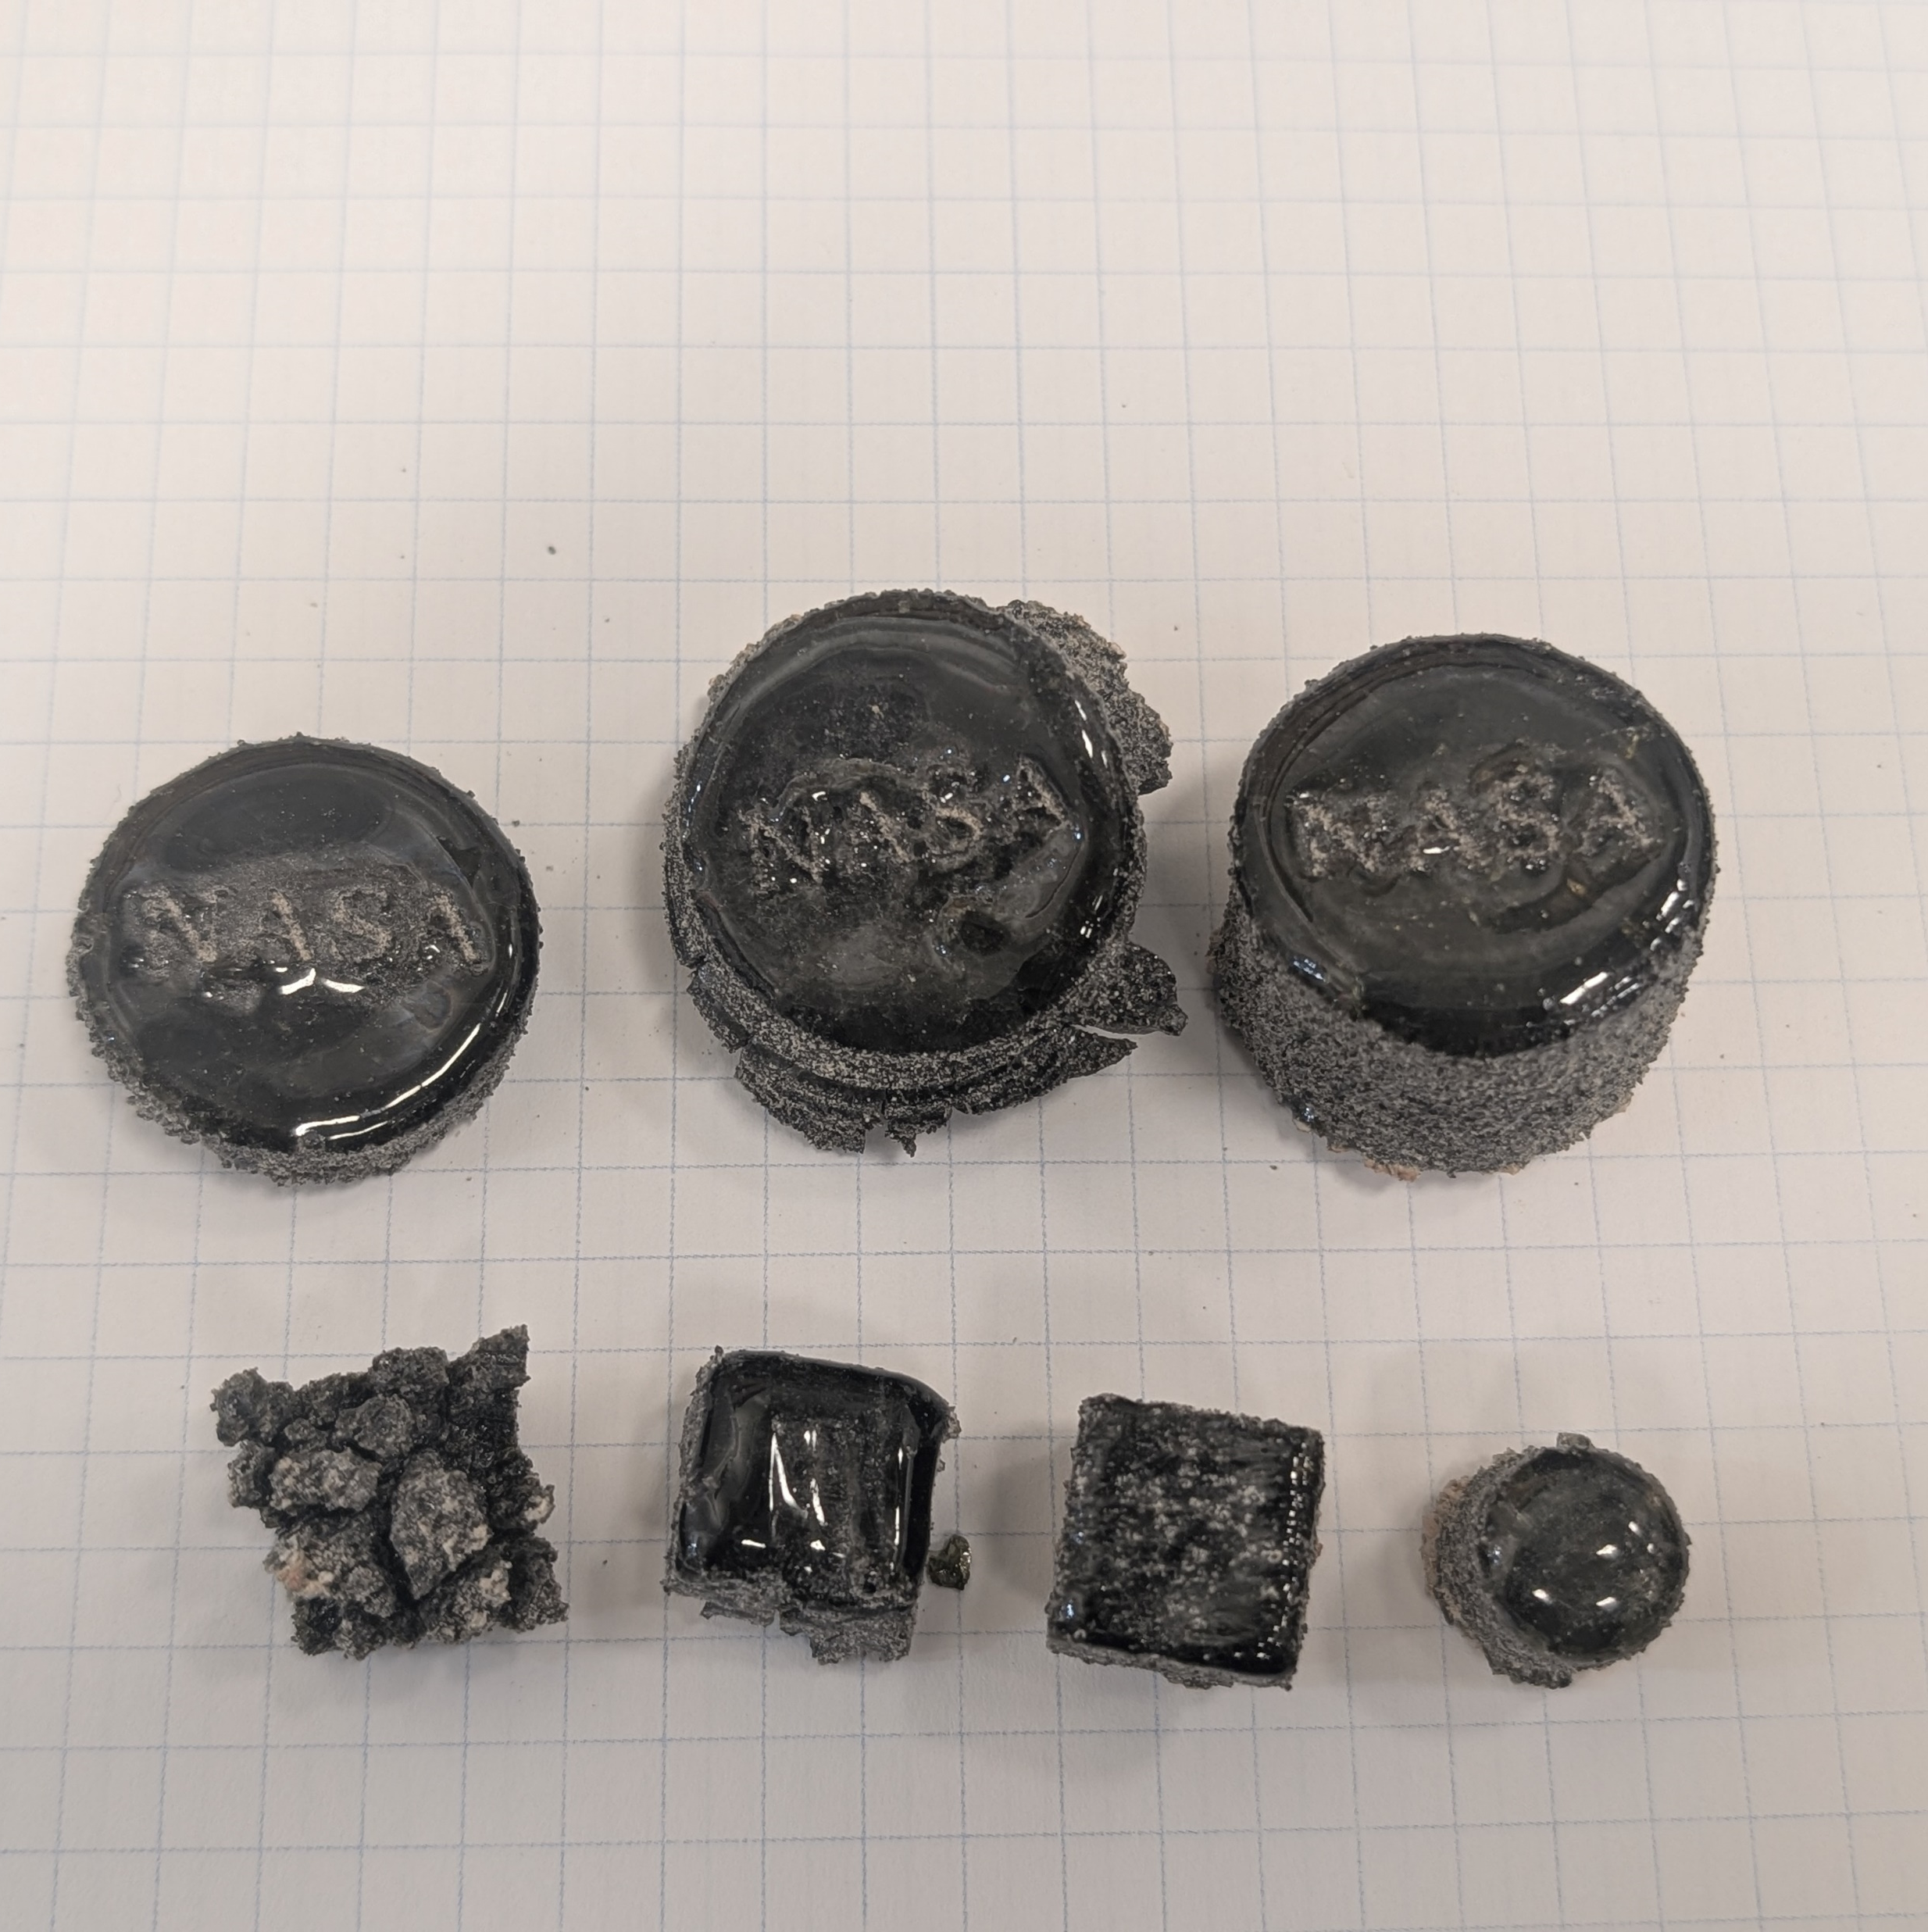
Laser Additive Manufacturing Using Regolith Simulant Feedstocks
Past attempts at laser-based AM of regolith produced parts that were:
Low strength
Brittle
Low resolution
Inconsistent
Anisotropic
Crack-prone
Porous
We hit every one of these failure modes too.
We went back to first principles.
Every root-cause analysis pushed us one step further — until we had a process we knew was fundamentally different.
We refined that process and reached a stable, completely amorphous, vitrified state.
We didn’t stop there.
WAMS 2026 | Parker D. Shake | NASA MSFC EM42

Slide 4
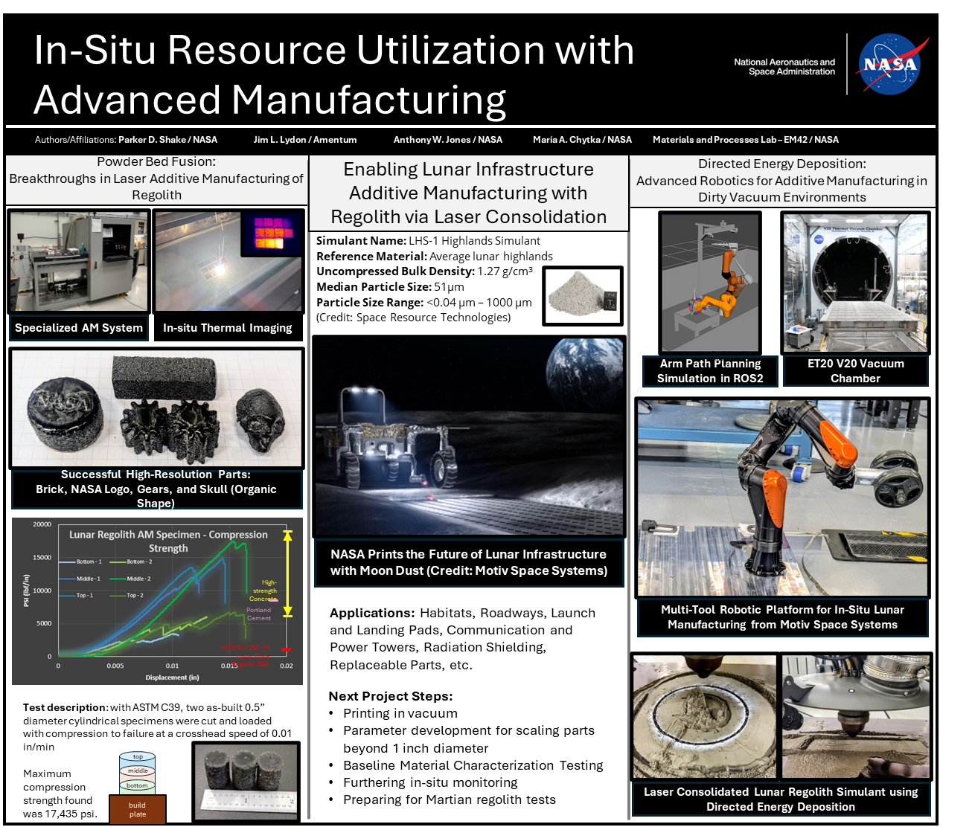
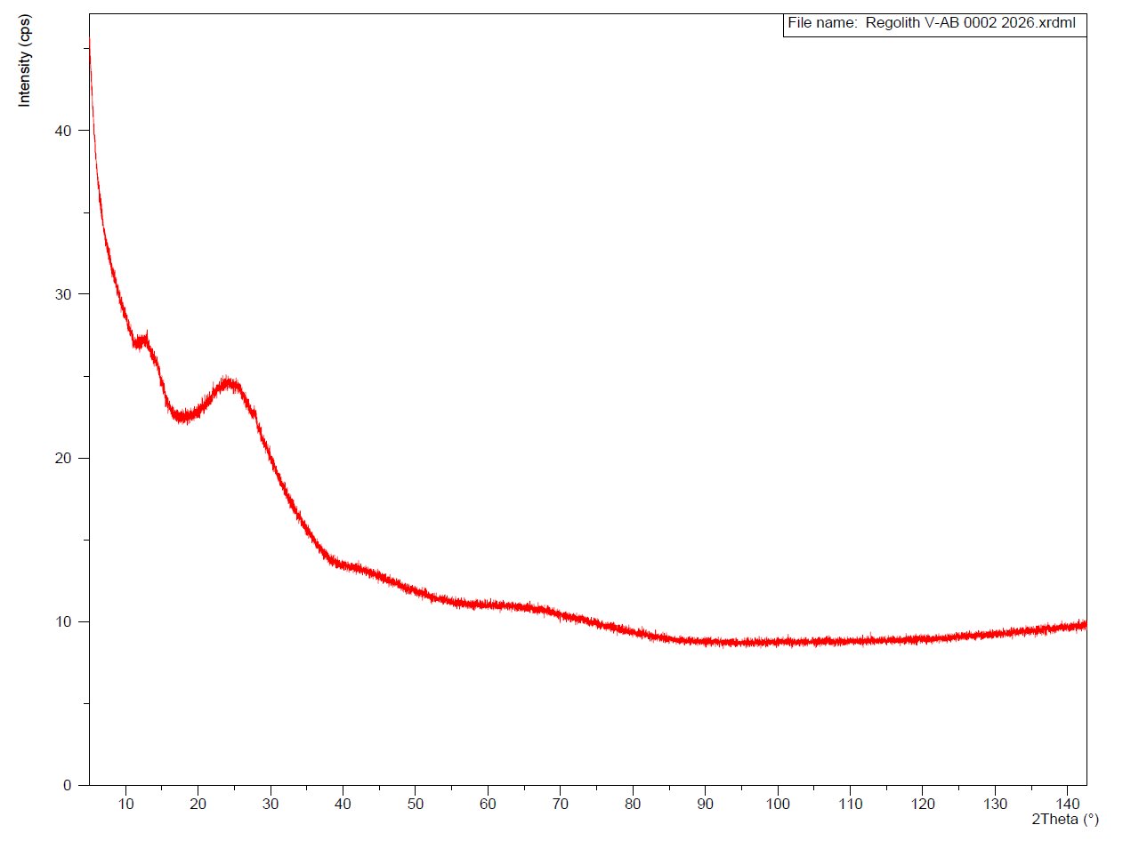
Regolith to Amorphous Vitrified Glass (2023)
Using a customized L-PBF system, built from a decommissioned Concept Laser M1, the team achieved a fully amorphous vitrified specimen with exceptional detail resolution.
Challenges: Regolith’s multi-material composition caused CTE mismatches, making it prone to shattering, cracking, and low tensile strength.
Solution: Precise thermal control created an amorphous vitrified glass, preventing cracks and enhancing material properties.
Verified: The amorphous vitrified glass measured 17 ksi compression strength — exceeding every in-family process, with no pre- or post-processing.
XRD - Vitrified Amorphous Glass
No distinct peaks
WAMS 2026 | Parker D. Shake | NASA MSFC EM42

Slide 5
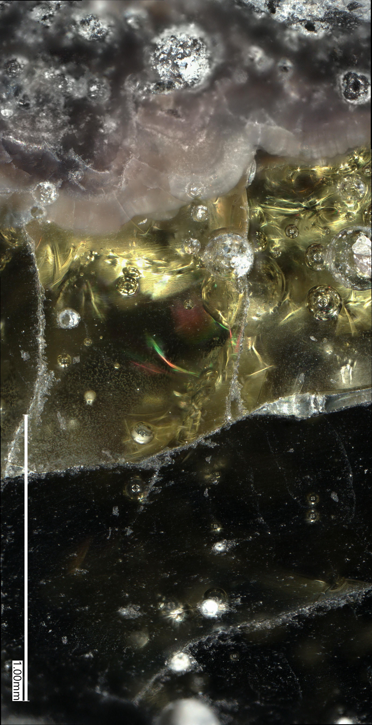
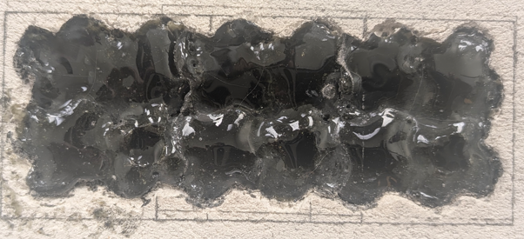
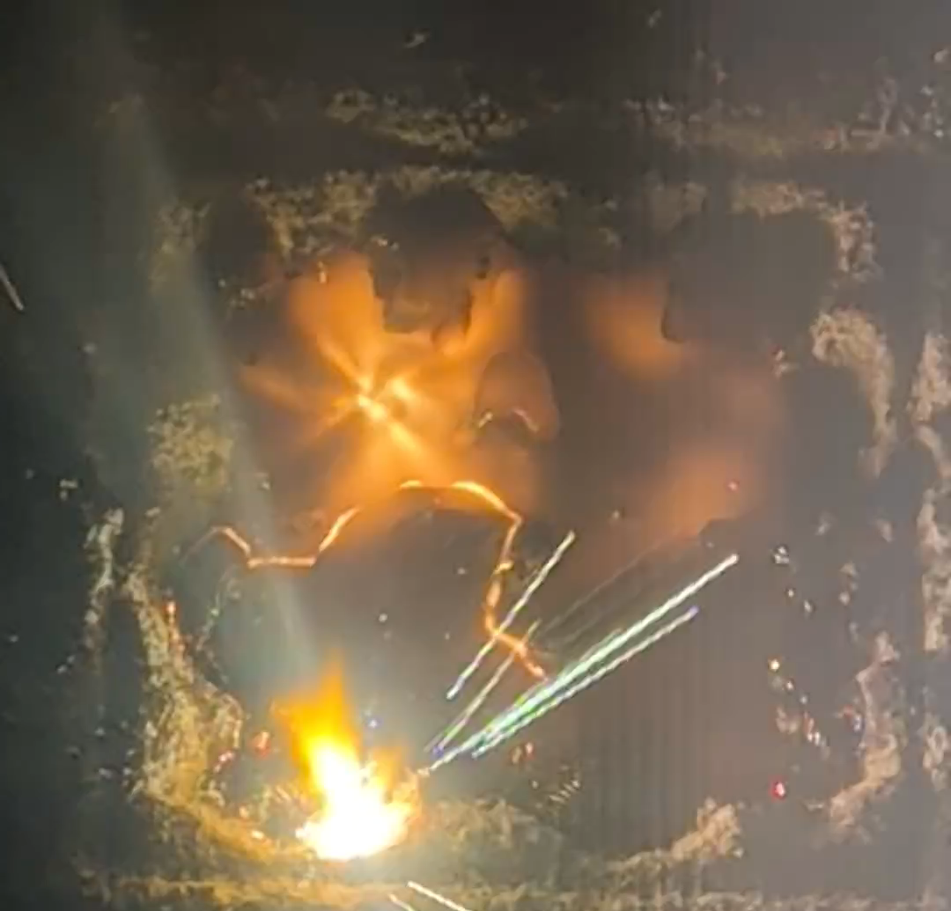
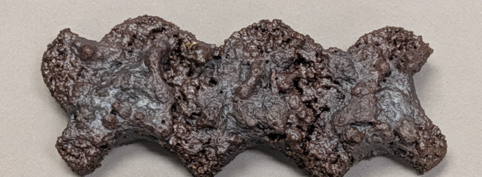
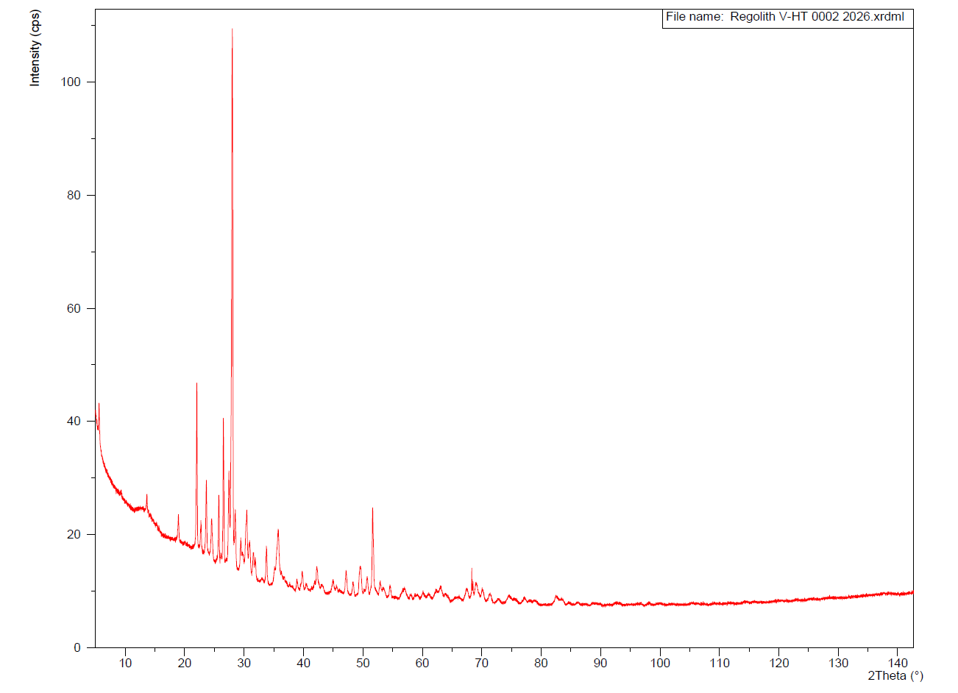
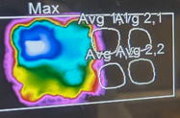
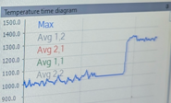
Amorphous Vitrified Glass to Glass-Ceramic (2025)
Using a beam-shaping laser and an advanced custom scan strategy on our L-PBF system, we maintained a 20 mm processing area at ±20 °C mean and ±50 °C min-to-max from target temperature. This meets the ceramming requirements.
Challenges: In-situ conversion to glass-ceramic requires isothermal conditions across the processing area — at specific temperatures, for specific times, in a specific sequence.
Amorphous Vitrified glass — 17 ksi compression, verified. Exceeds every in-family process.
Glass-ceramic — specimens under investigation. We're seeing outstanding strength gains and are confirming them through rigorous testing before formally declaring a value.
New Layer → 2 layers below surface
Melting → Controlled Vitrification
Furnace Ceramming
Left: Glass-Ceramic LHS-1
Right: Amorphous Vitrified LHS-1
Amorphous Vitrified LHS-1 Tiles
Isothermal Ceramming Scan Strategy
Martian Glass-Ceramic
XRD - Glass Ceramic
Distinct Peaks
WAMS 2026 | Parker D. Shake | NASA MSFC EM42
In-Situ Monitoring – Thermal Data

Slide 6
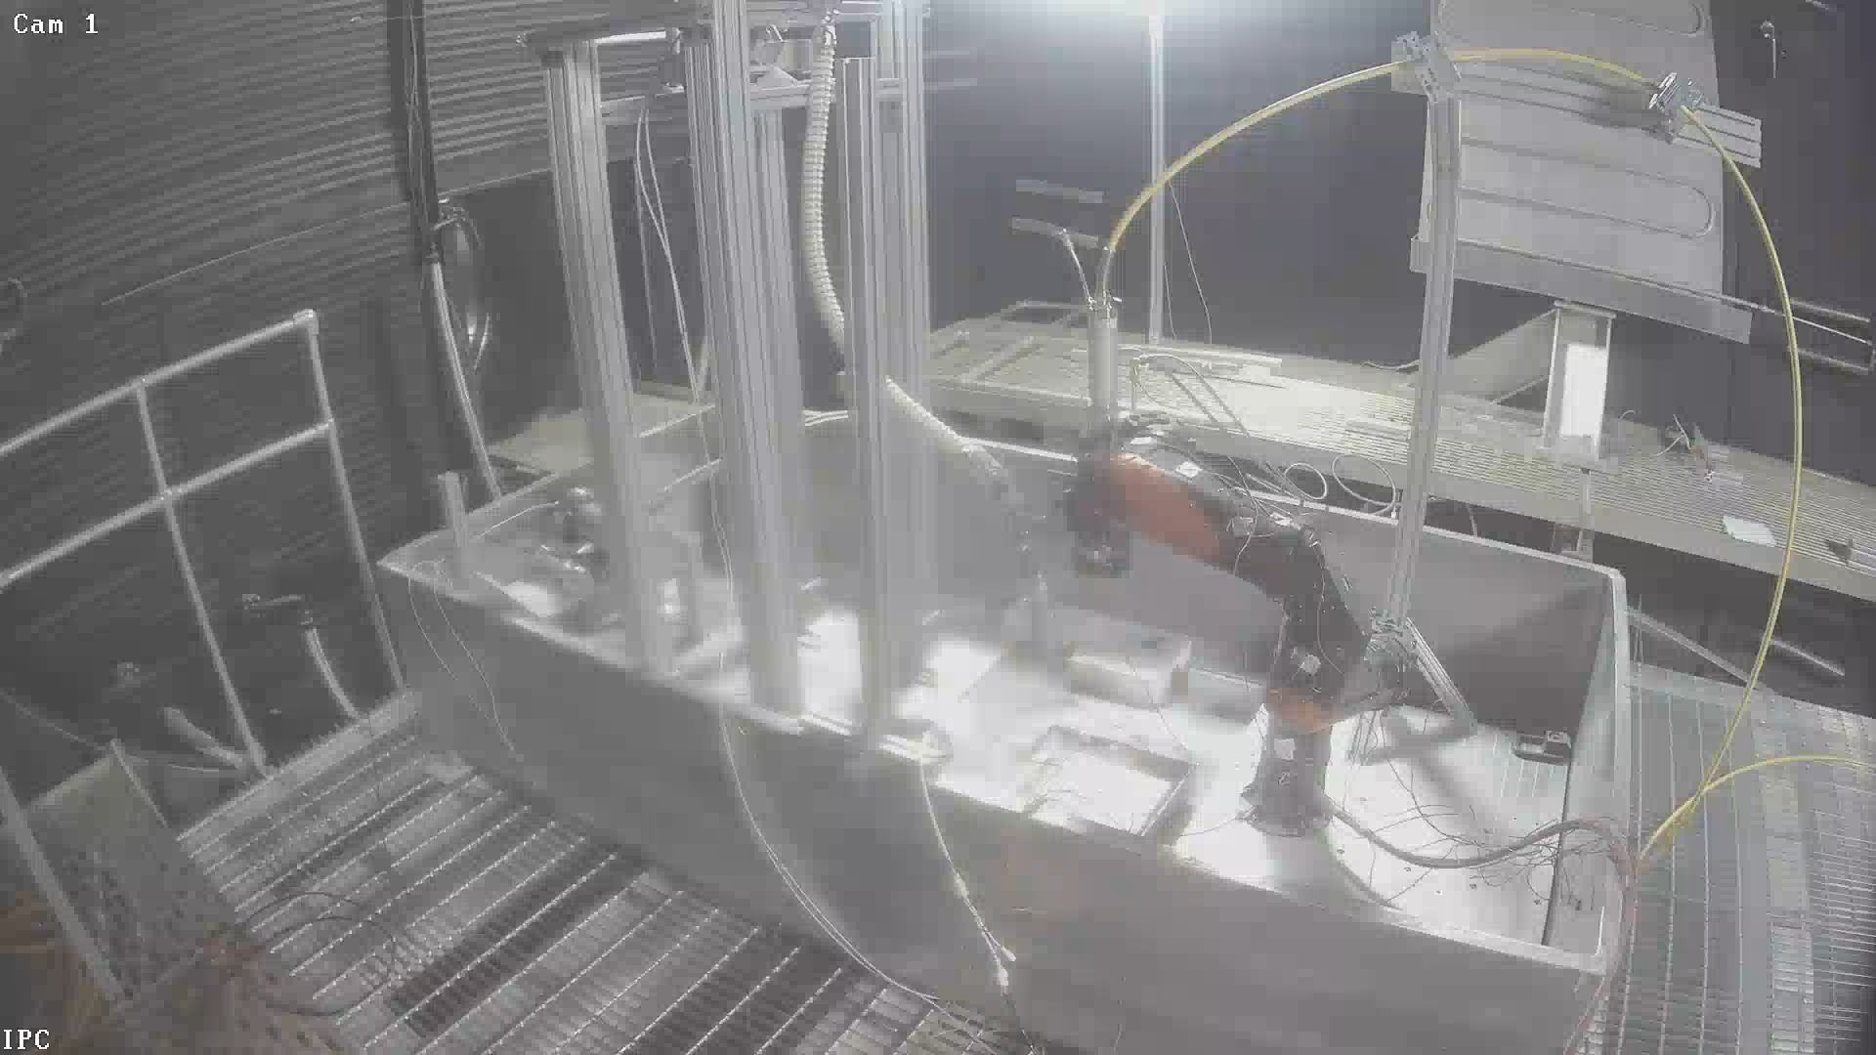
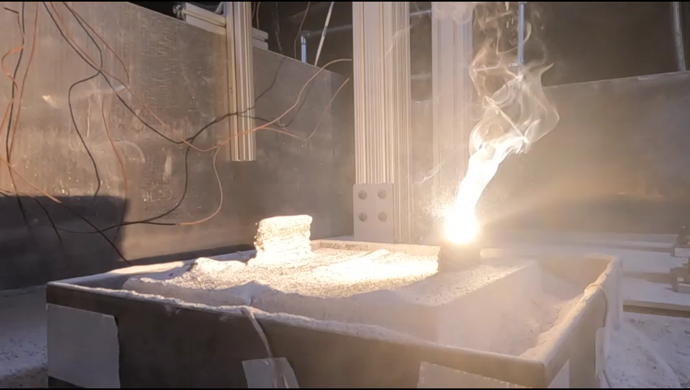
TRL 5 Vacuum Testing - DED System (Setup)
Moon Base construction demands a system built for the environment. No commercial option existed — so we built one in-house and ran it for 60 days at 10⁻⁶ torr in regolith-filled conditions, without interruption.
32 ft diameter vacuum chamber – At NASA MSFC
Motiv Space Systems - space-rated robotic arm
Laserline 1000 W diode laser
Gas-free vibratory fluidizing regolith conveyance system
Build plate (12 in x 12 in)
Bin / enclosure (4 ft x 8 ft)
Thermocouples
Feedstock: LHS-1 or MGS-1 regolith simulant
WAMS 2026 | Parker D. Shake | NASA MSFC EM42

Slide 7
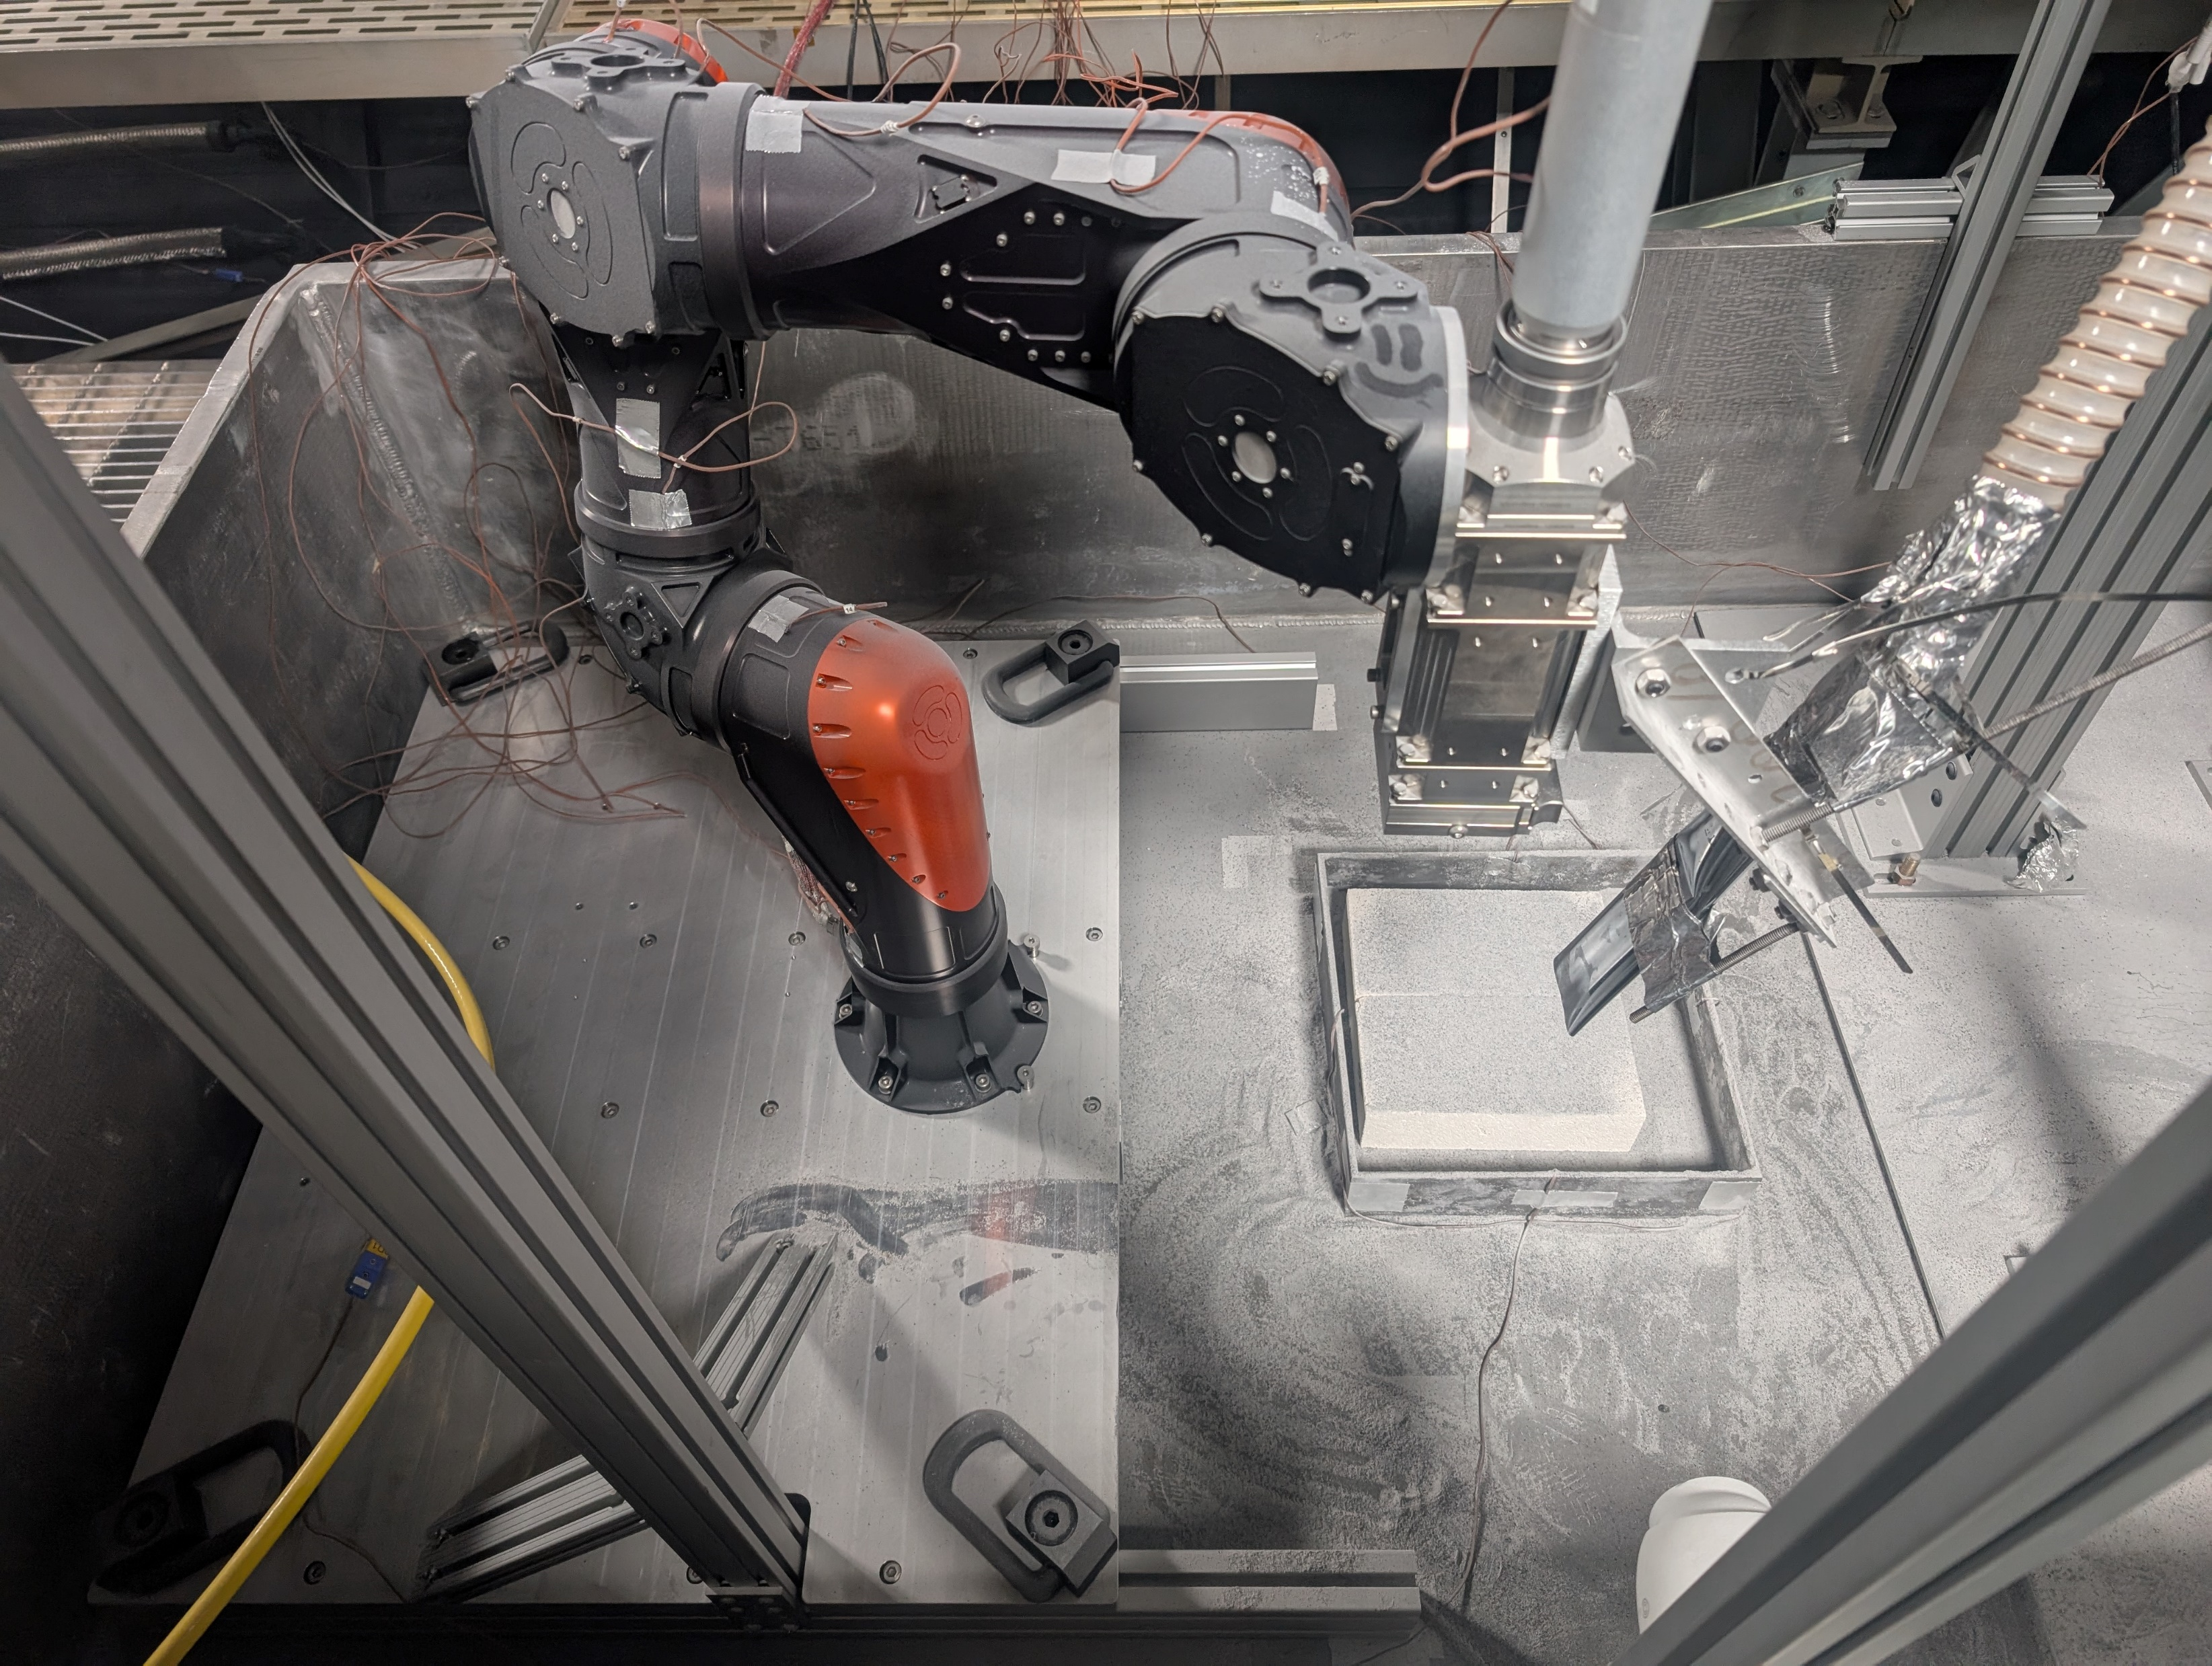
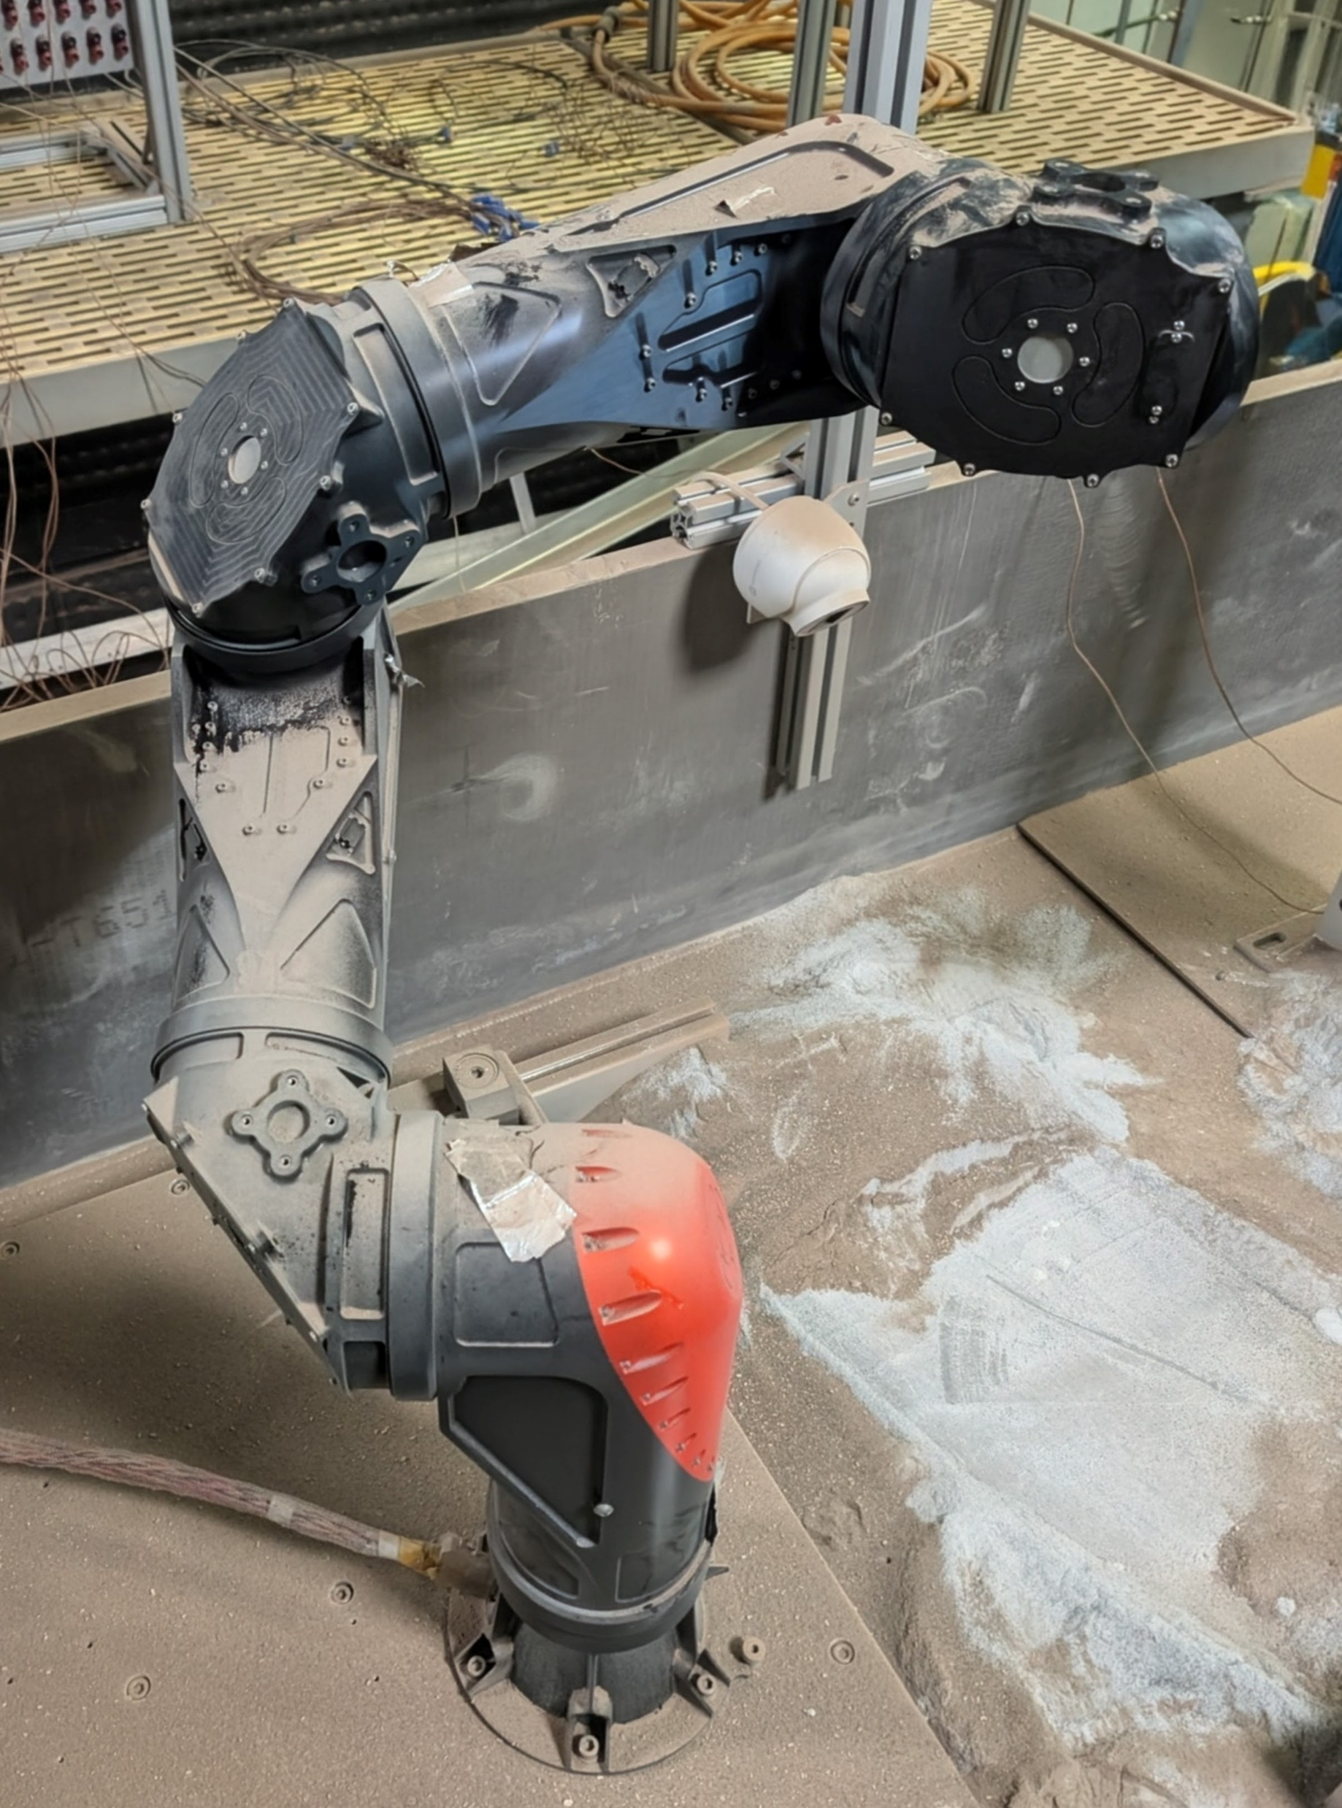
TRL 5 Vacuum Testing - DED System (Results)
60-day test campaign to demonstrate system TRL 5.
The only pause was a tool-head swap to reconfigure for in-space welding — then we swapped back to ISRU-AM, demonstrating multi-mission versatility on a single platform.
No hardware degradation over the full campaign.
The only issue encountered was thermal overload from laser back-reflection in the dusty environment and optics degradation.
Day 0
Day 60
WAMS 2026 | Parker D. Shake | NASA MSFC EM42

Slide 8
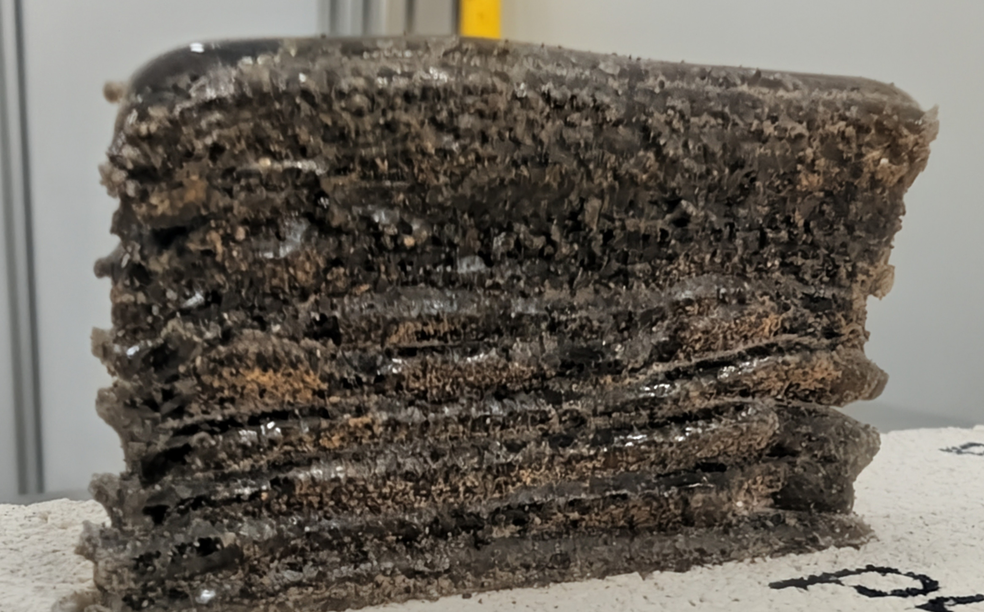
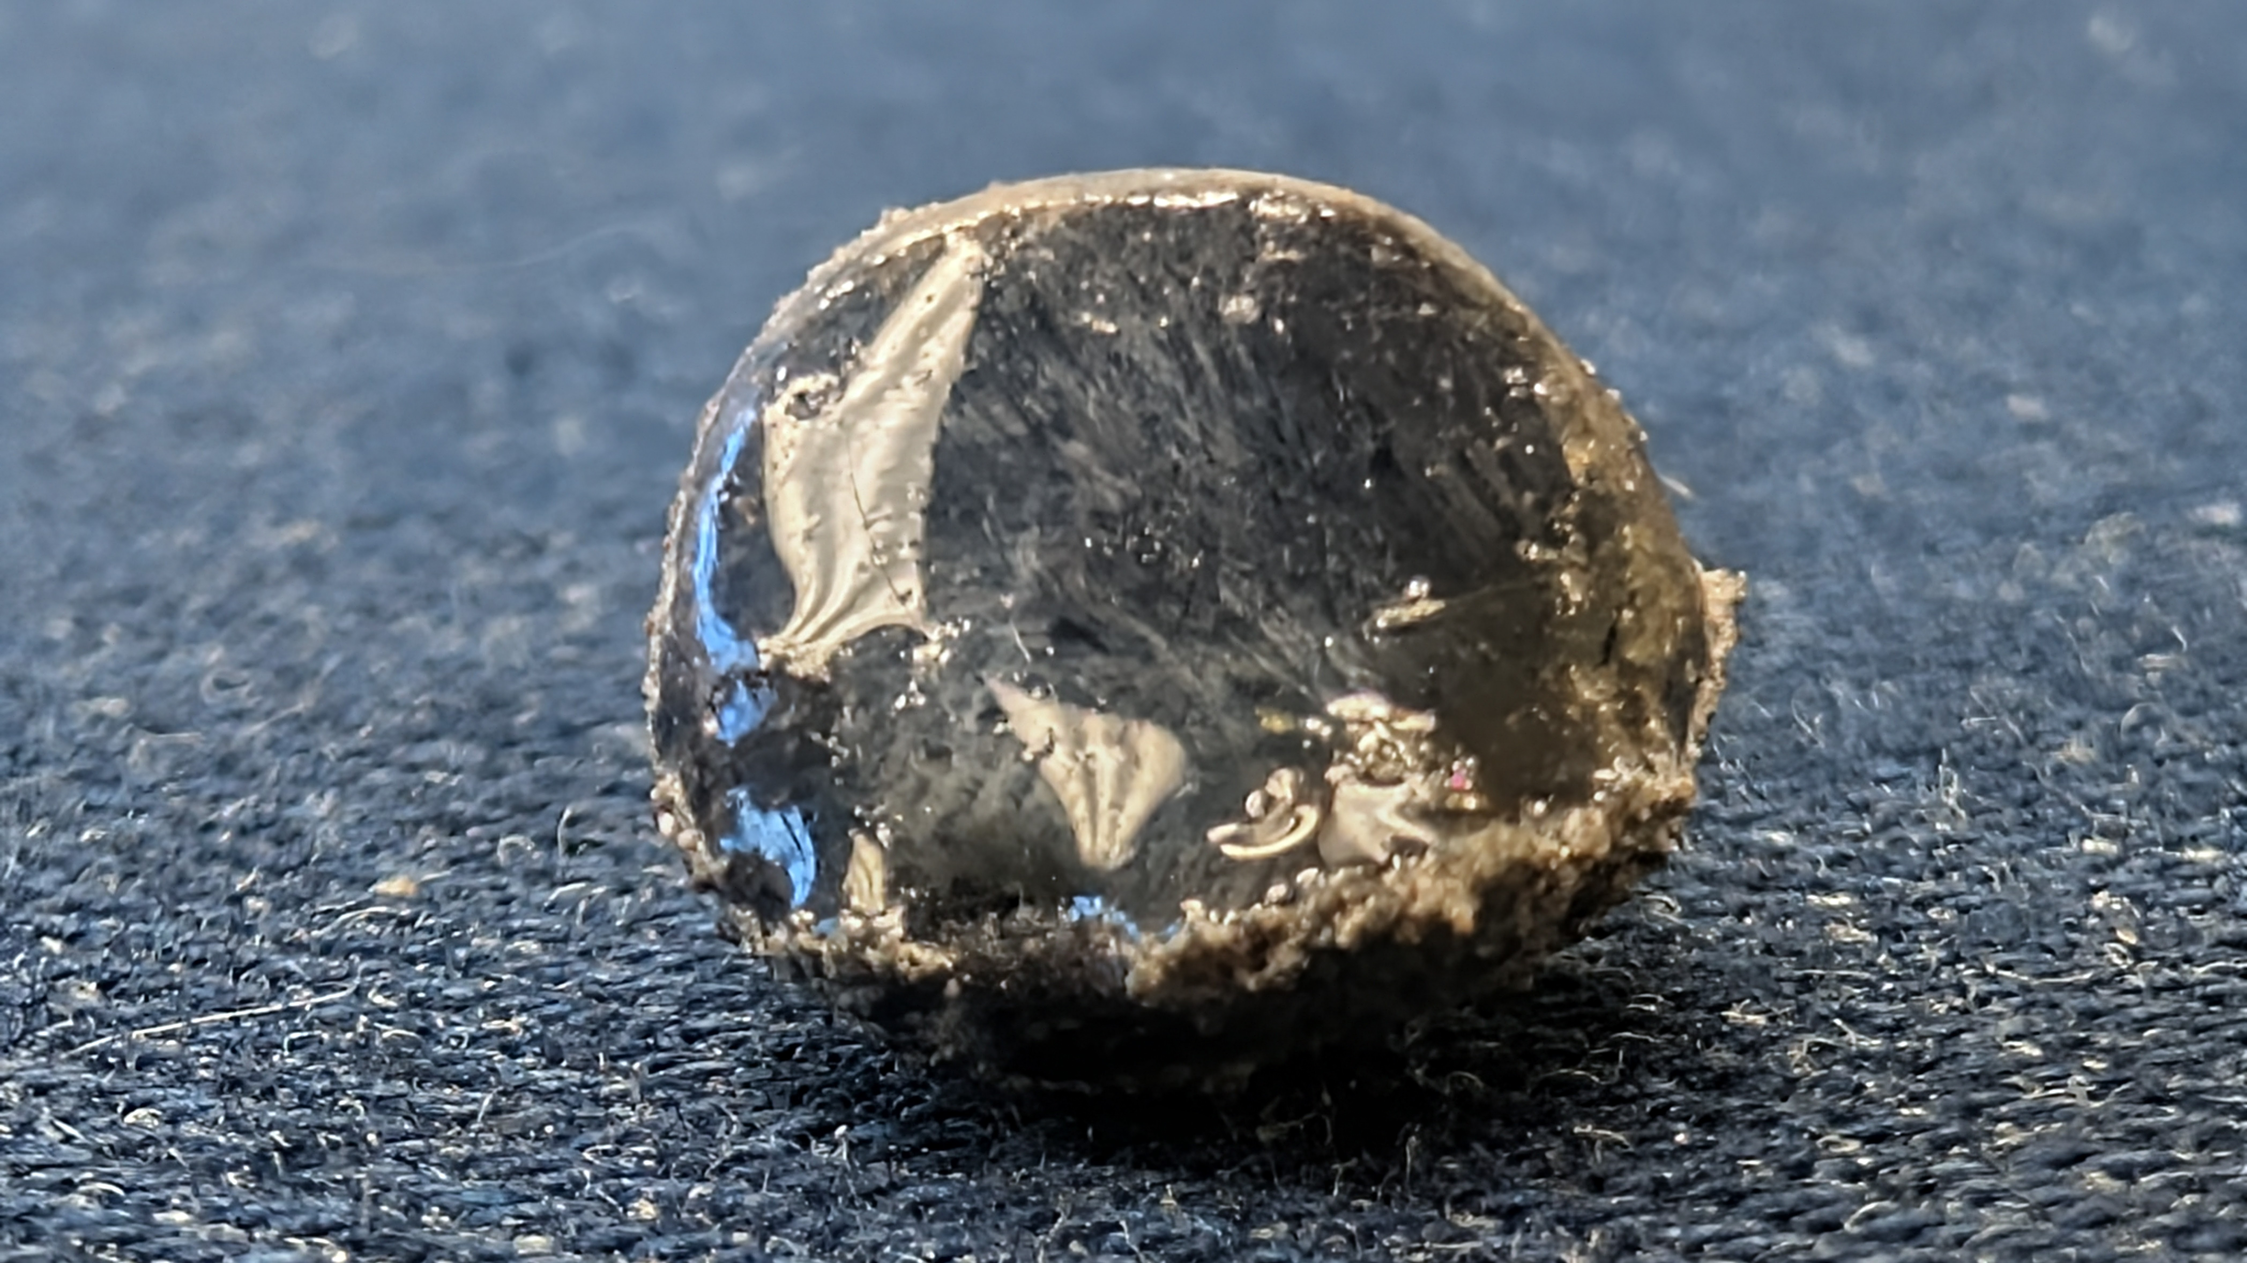
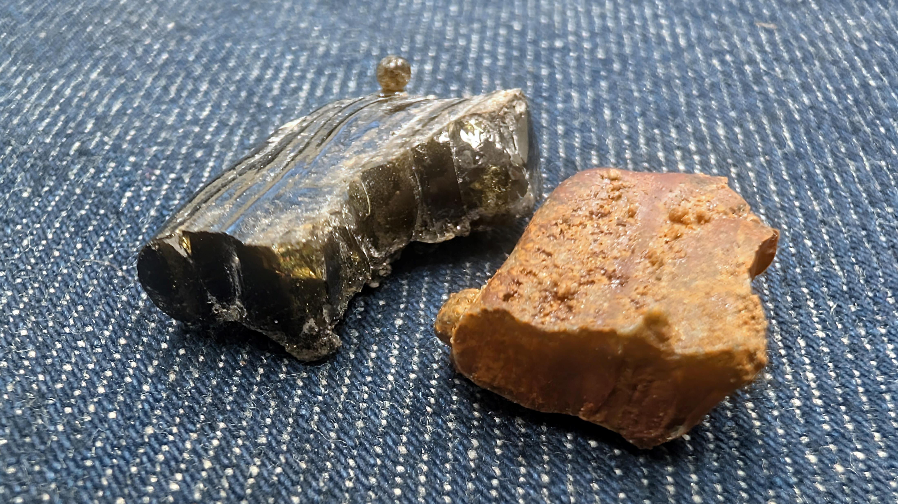
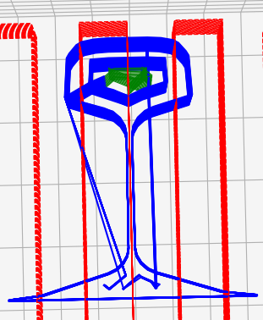
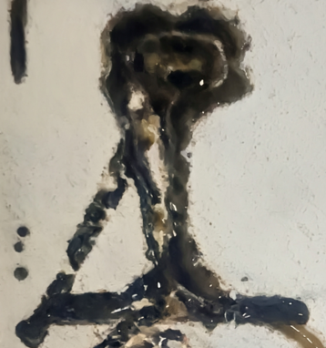
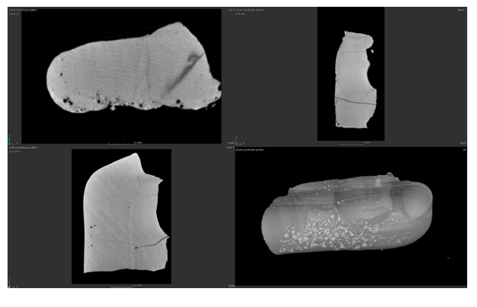
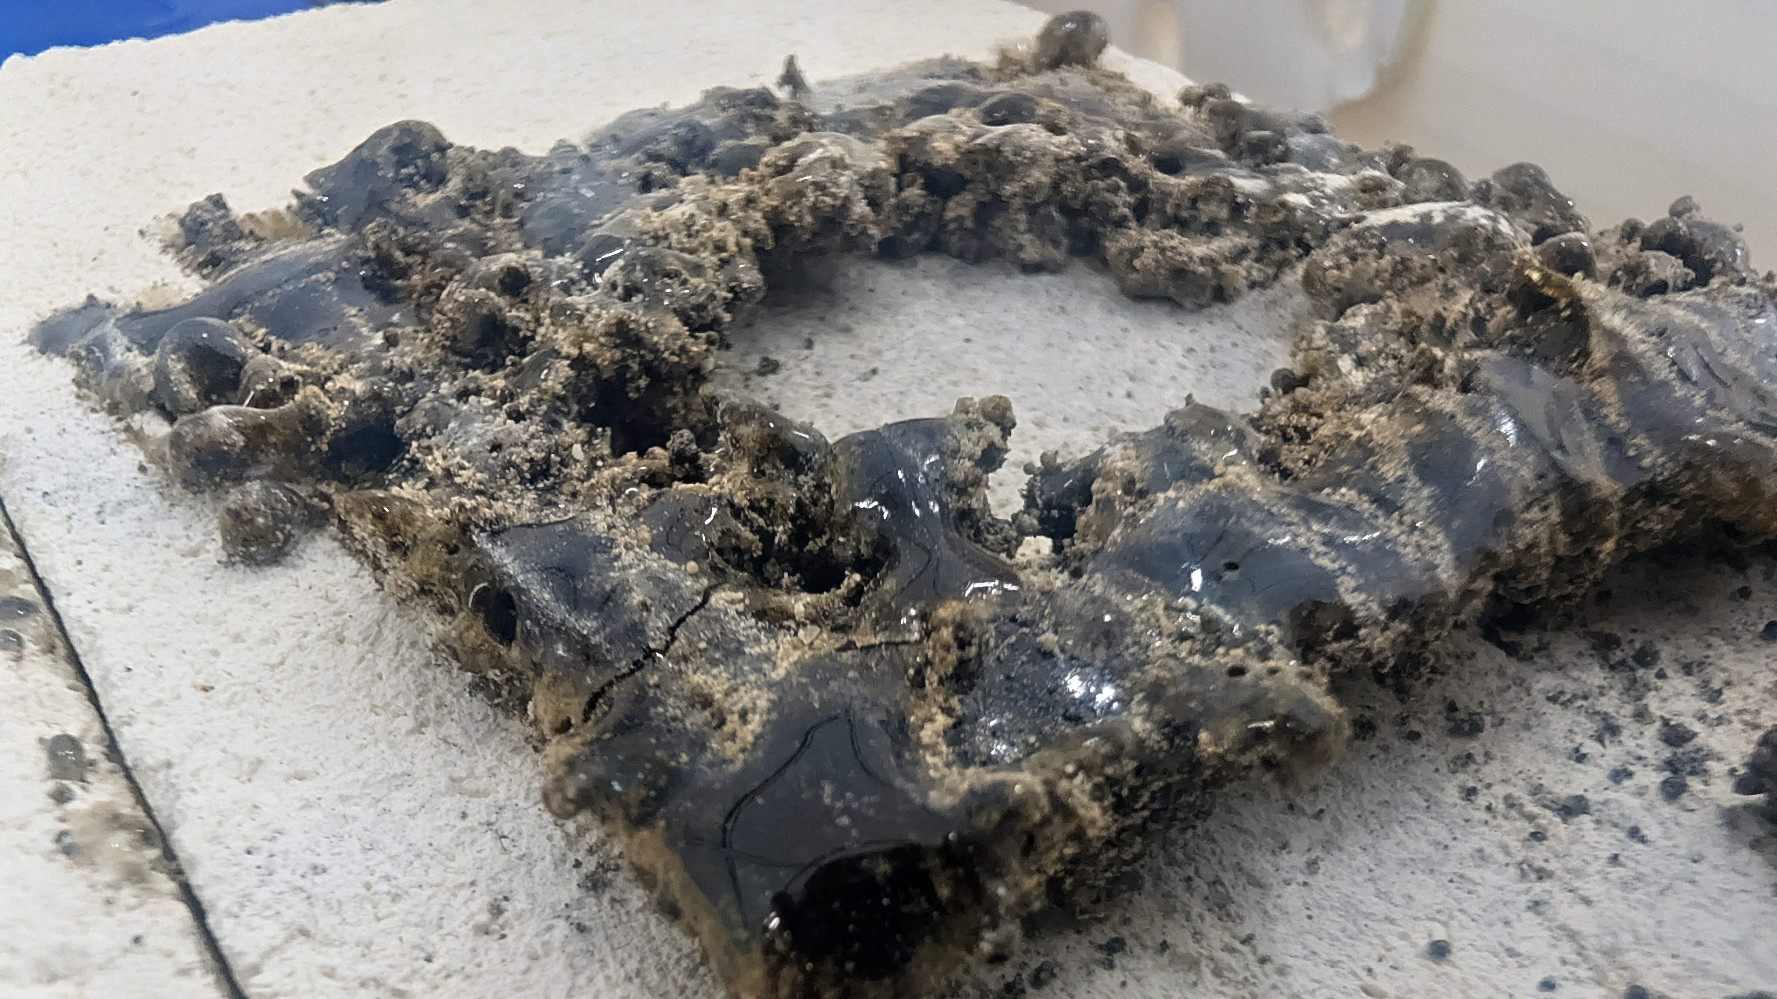
Directed Energy Deposition in Vacuum - Results
Single-pass wall
Bead deposited with a stationary laser and Martian regolith simulant
Both amorphous vitrified glass and glass-ceramic conversion demonstrated
From CAD to toolpath, from data to mass — a printed Railroad Tee
CT scan revealed fully dense parts
Brittle center indicates that complex, coordinated scan strategies are required to build sound monolithic structures.
WAMS 2026 | Parker D. Shake | NASA MSFC EM42

Slide 9
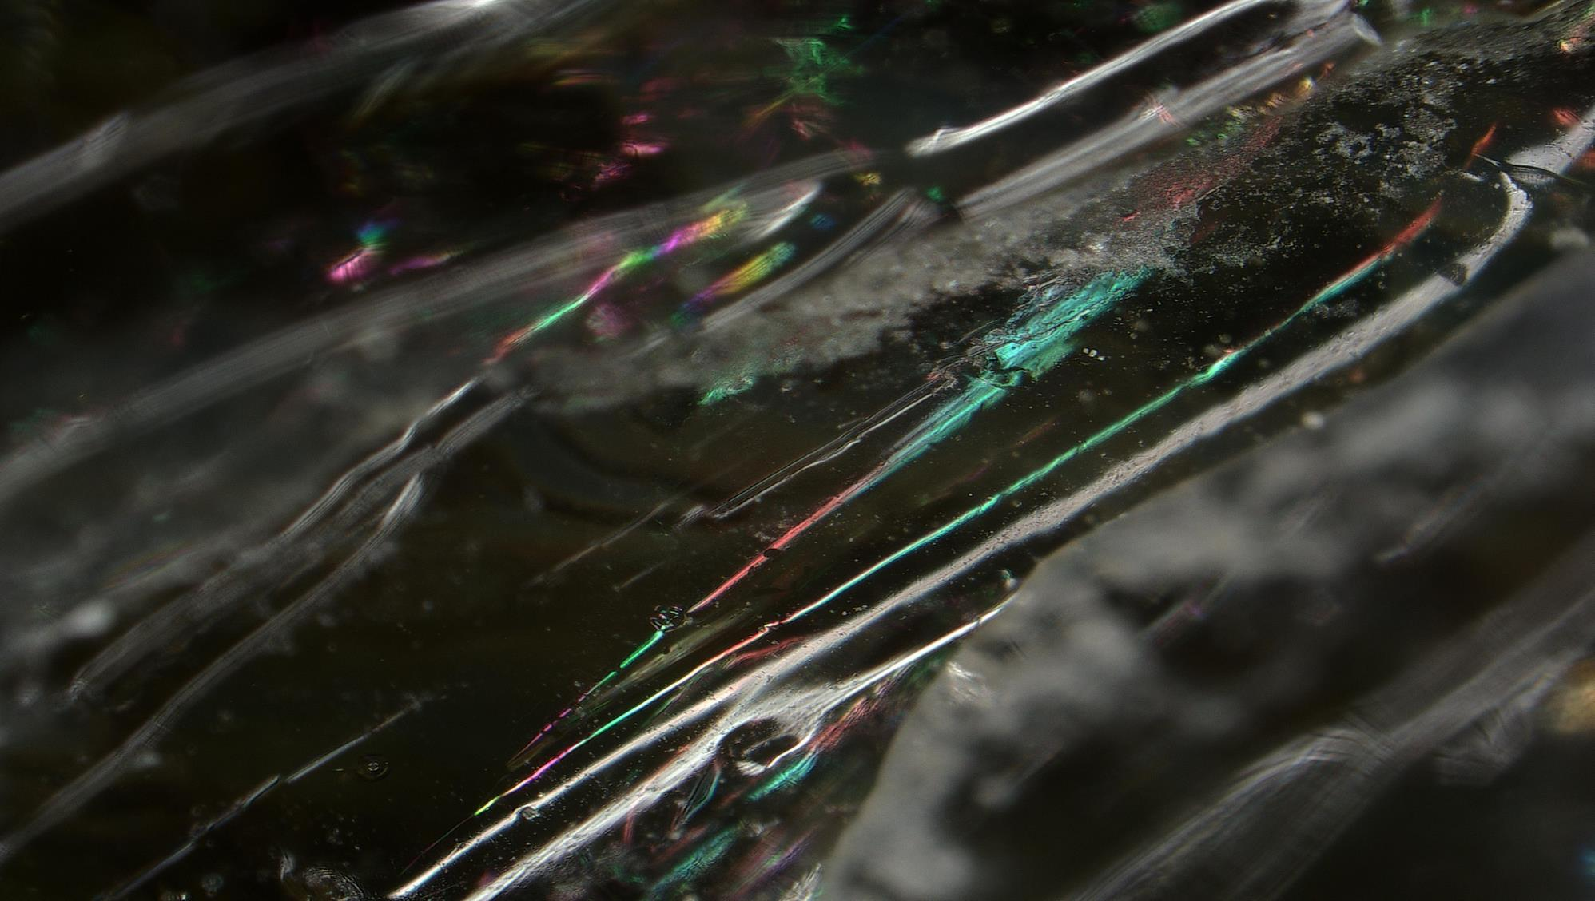
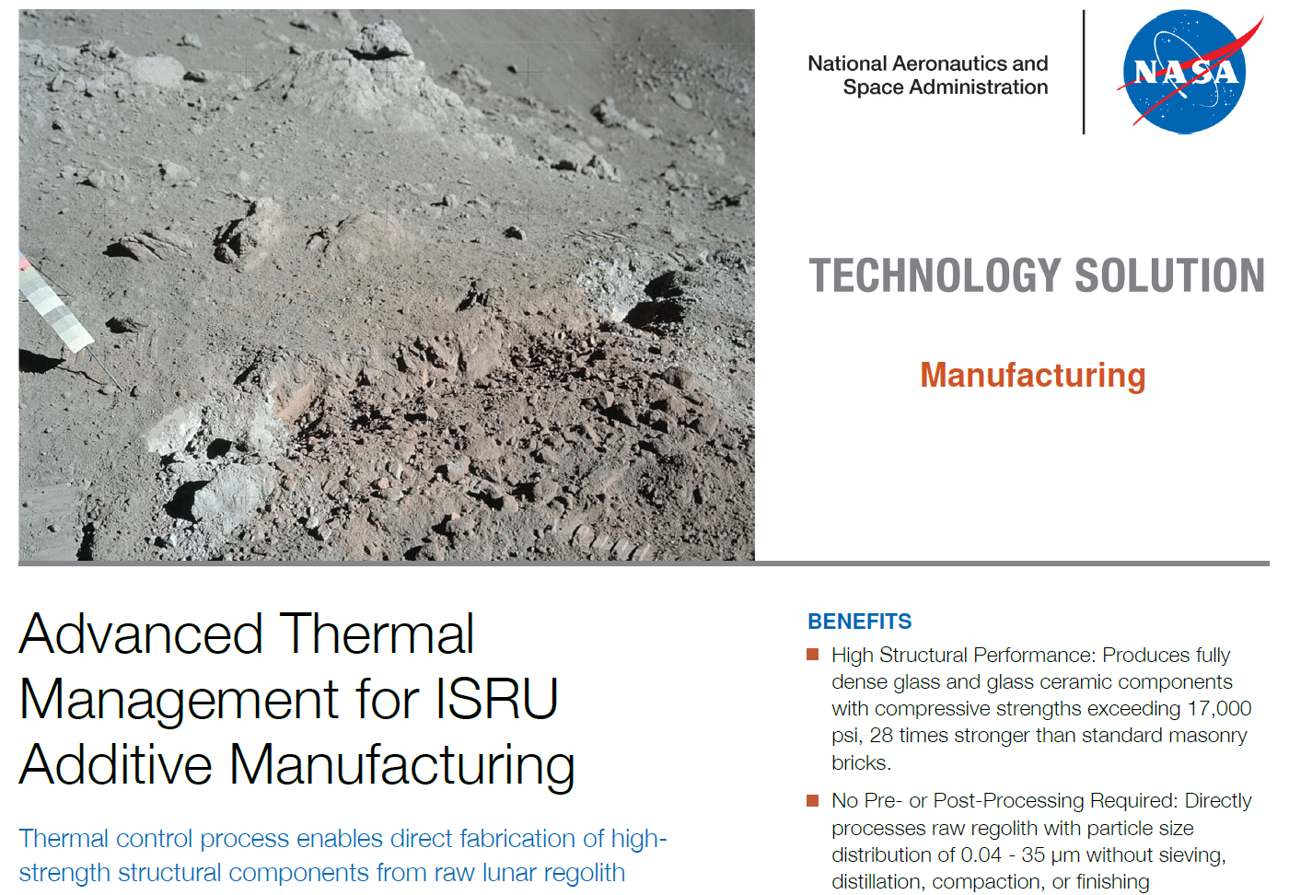
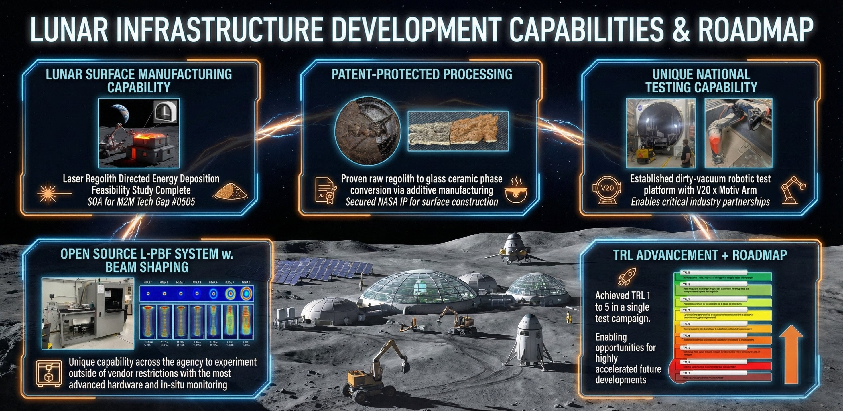

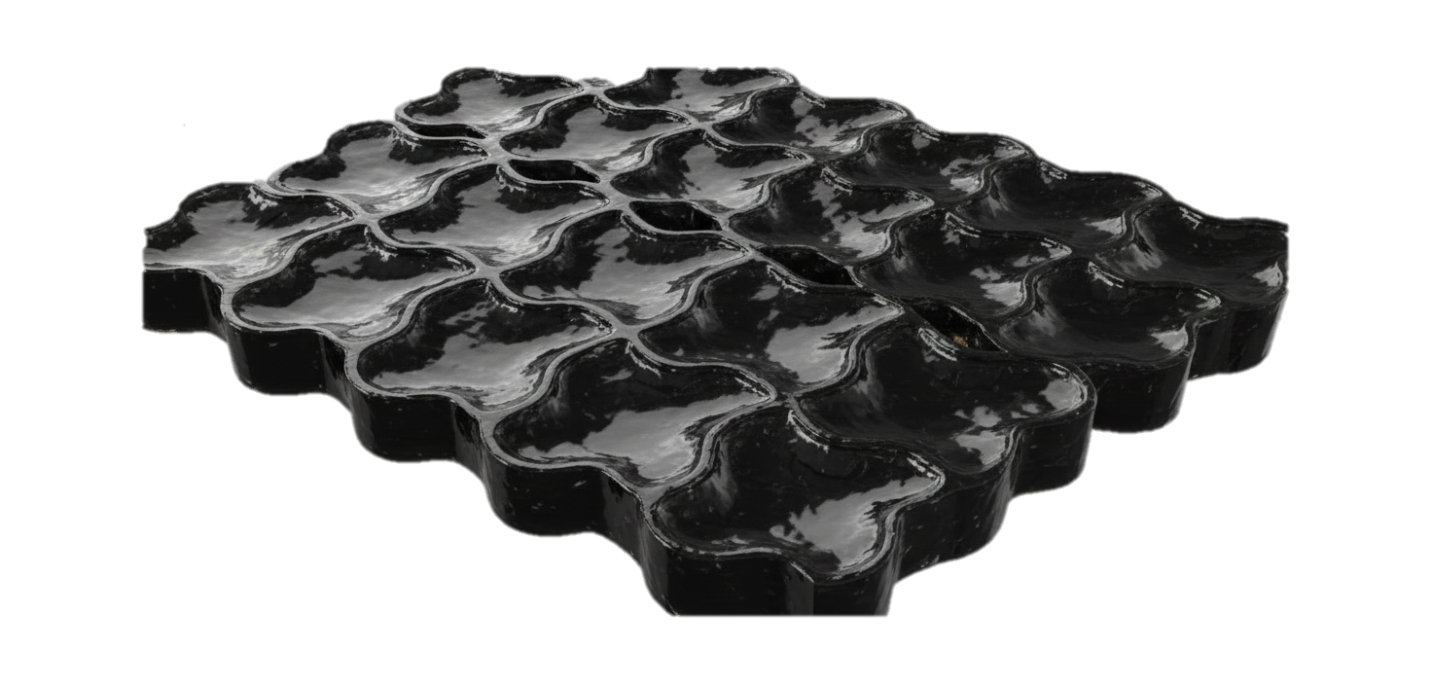
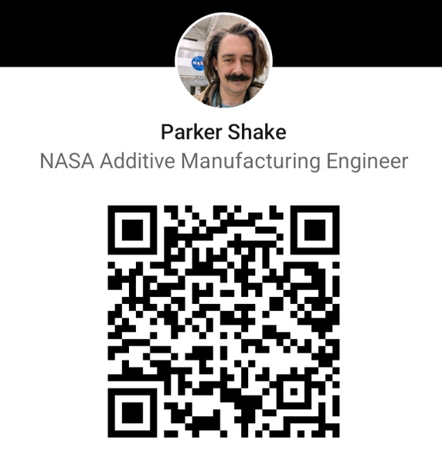
Technology Transfer Opportunities Available
Licensing and Partnership Inquires
https://technology.nasa.gov/patents
Email: Parker.D.Shake@nasa.gov
WAMS 2026 | Parker D. Shake | NASA MSFC EM42

