Slide 1
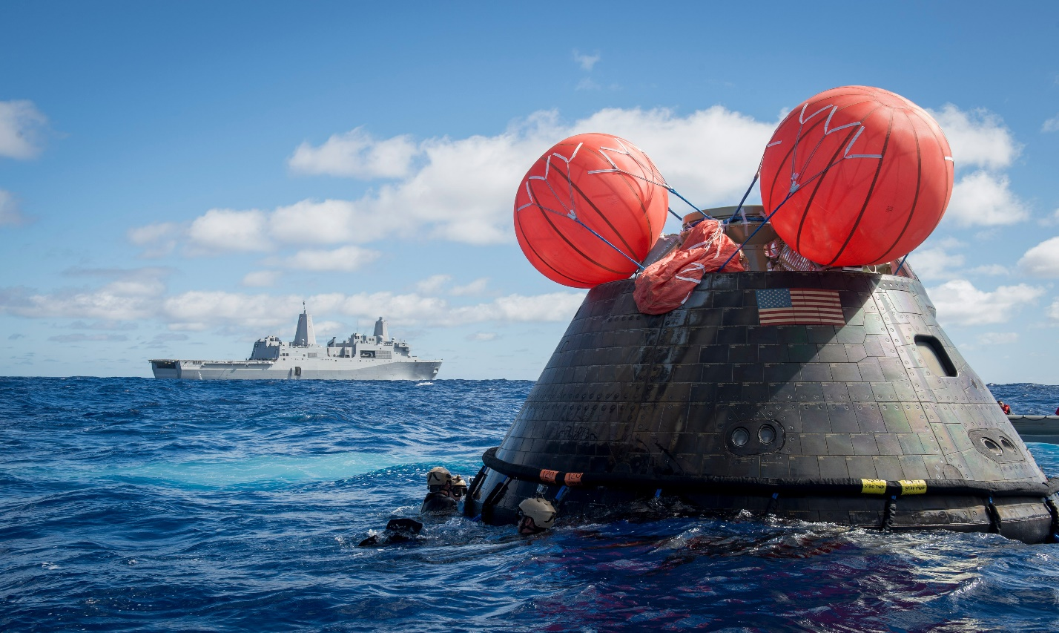
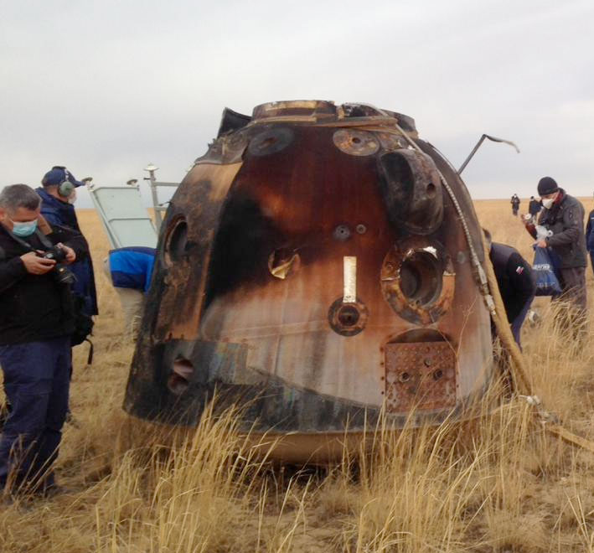


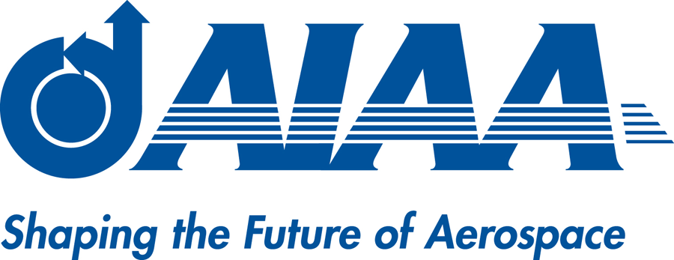
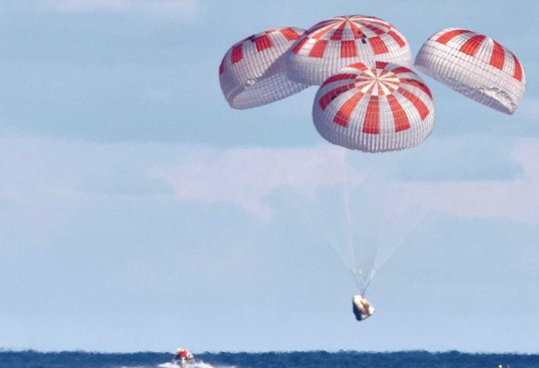
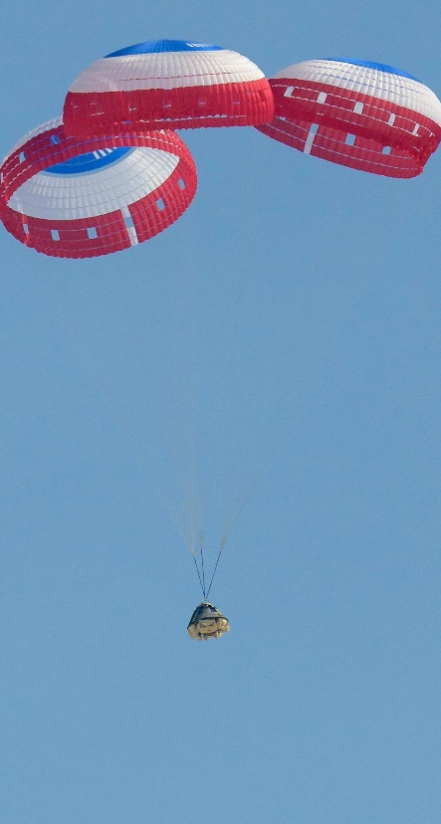
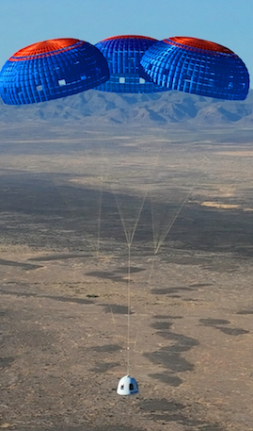
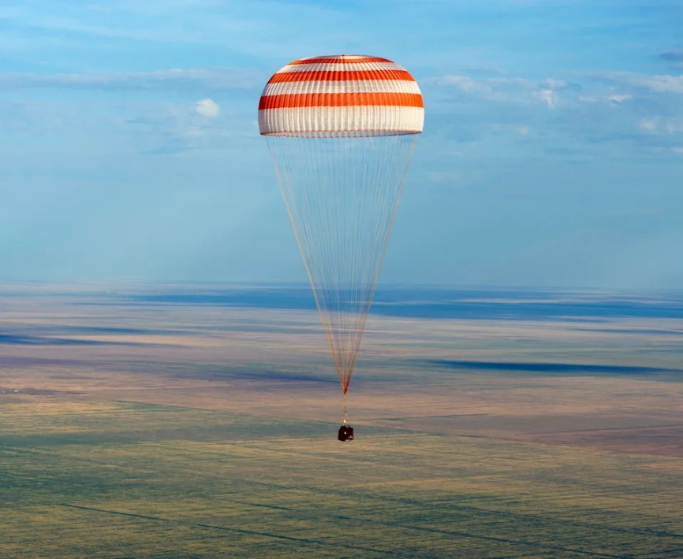
Revisiting the Soyuz-1 Parachute Failure in the Context of Safety in the Modern Era
2026 AIAA ADS Conference, UK
June 1-5
Aaron Morris
Parachute Integration Group Manager
SA-CCP, NASA KSC
Orion Capsule Recovery EFT1 12/15/14
Russian Soyuz MS-16 4/9/20
Image credit 1: NASA
Image credit 2: Roscosmos
Image credit 3: AP
Image credit 4: NASA/Cory Huston
Image credit 5: NASA
Image credit 6: Blue Origin
Soyuz TMA-04M 9/17/20
SpaceX Dragon Demo-1 3/18/19
Boeing OFT-2 5/25/22
Blue Origin NS-22 8/4/22

Slide 2

Video of Soyuz-1 Catastrophe
Soyuz 1 Impact [Russian Documentary]

Slide 3
Introduction and Source Material
Introduction and Purpose
This presentation will revisit the Soyuz-1 accident and parachute failure, including the timeline of events, proximate causes of the accident, and cultural factors. The purpose for revisiting this history is to understand if some of the proximate causes and corrective actions from Soyuz-1 are applicable in maintaining the safety of NASA’s modern spacecraft fleet. Ultimately, we hope to share Lessons Learned from historical parachute failures with various engineering and S&MA stakeholders throughout the Agency to avoid repeating the missteps of history.
Publicly Available Source Material
All material in this presentation is publicly accessible. Please note the sources listed in blue font below each video or photo. While we have deep insights in the parachute industry, this presentation will not share any SBU or proprietary data, or detailed design details of modern spacecraft parachutes. All insights and conclusions drawn here are readily apparent from publicly available internet sources, which will be cited on each page.

Slide 4
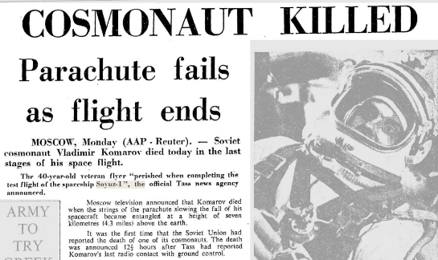
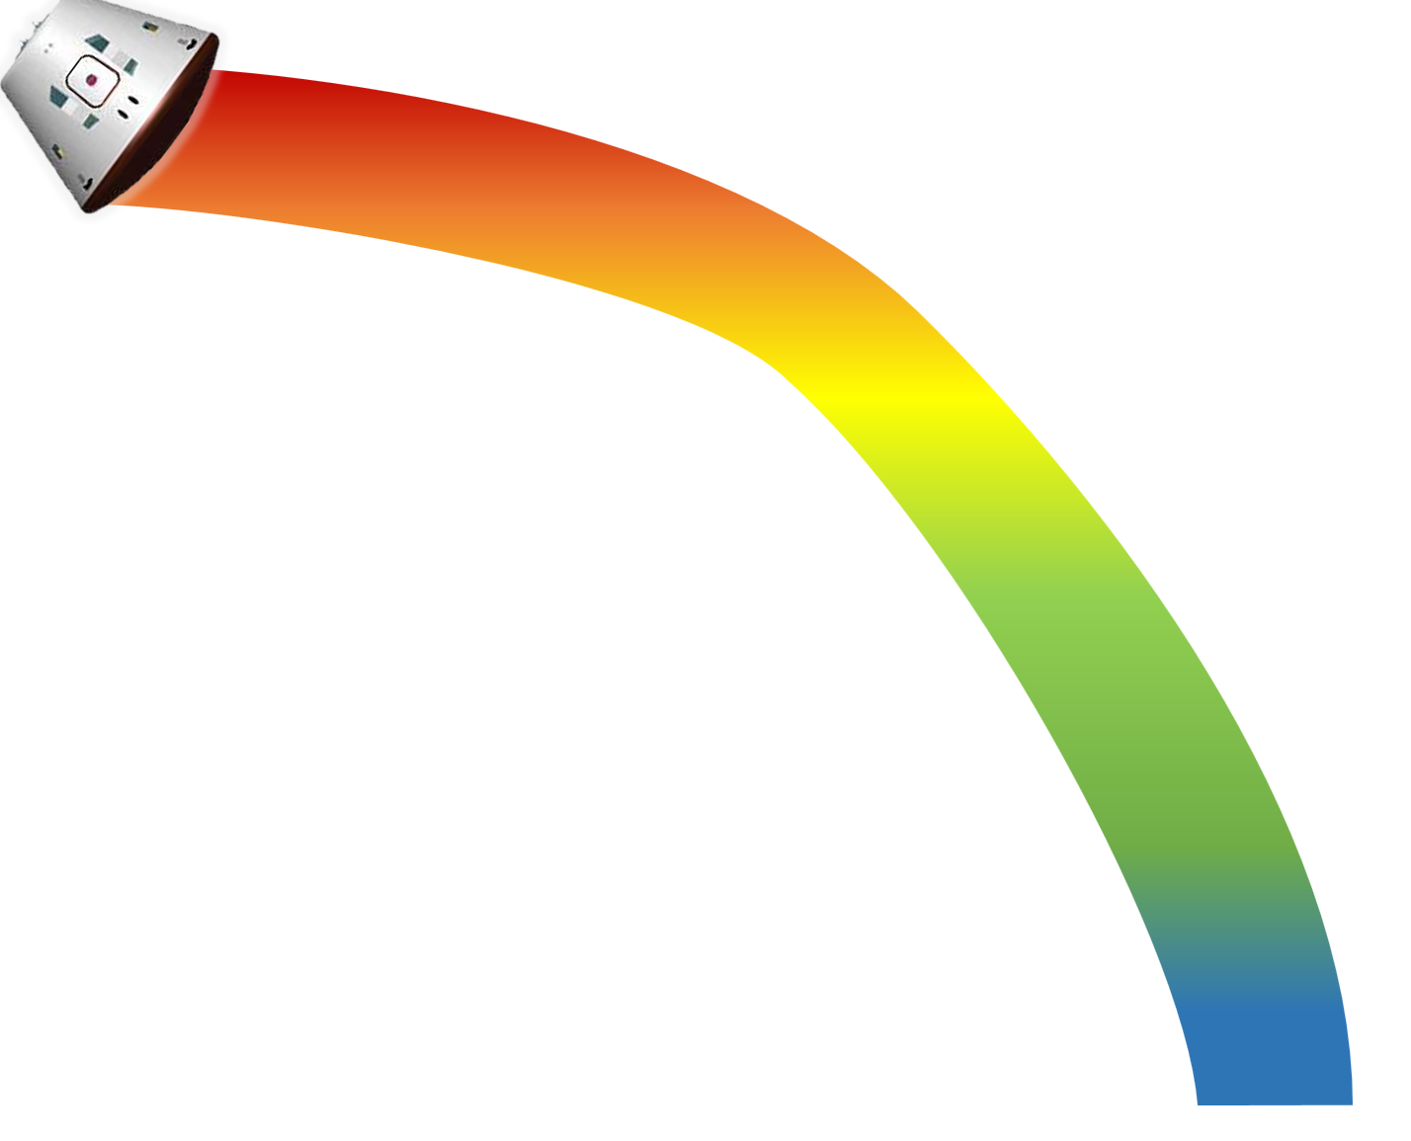
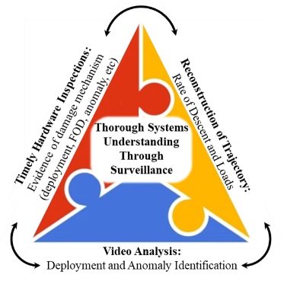
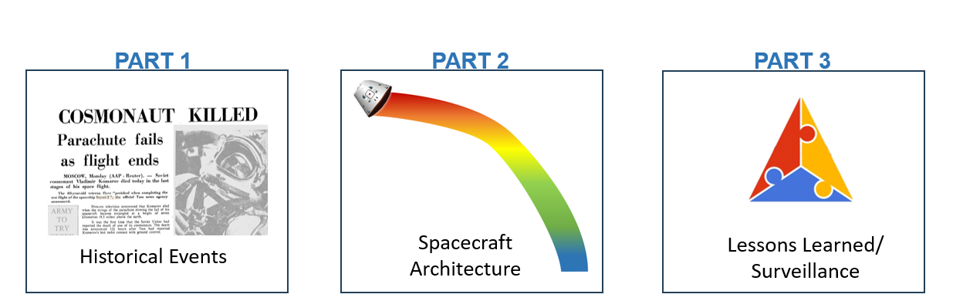

Presentation Structure
PART 1
PART 2
PART 3
[April 26, 1967]
Image credit: The Canberra Times
Spacecraft Architecture
Lessons Learned/ Surveillance
Historical Events
Call outs in Part 1 and 2, Lessons Learned Part 3
Relates to Surveillance in Modern Era

Slide 5
History of the Soyuz-1 Accident
PART 1
[April 26, 1967]
Historical Events
Image credit: Newspaper article from the 25 April edition of The Canberra Times announcing the loss of Soyuz-1

Slide 6
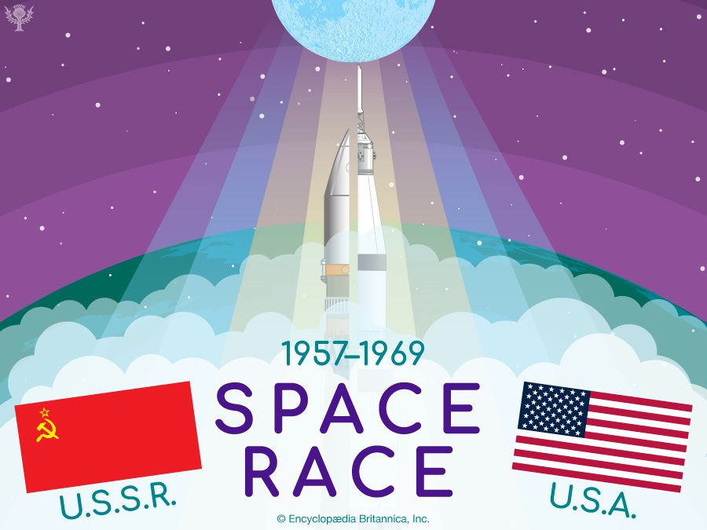
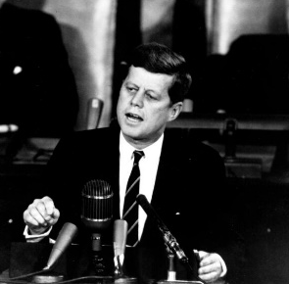
Race for the Moon
1960s
  04/12/61: U.S.S.R. first to orbit (U.S.A. 2/20/62) [Cosmonaut Yuri Gagarin]
  10/12/64: U.S.S.R. first to launch multi-person spacecraft (U.S.A. 3/23/65)
  03/18/65: U.S.S.R. first to perform space walk (U.S.A. 6/3/65)
  01/14/66: Death of Soviet spacecraft designer [Sergei Korolev]
  03/16/66: U.S.A. first to dock spacecraft (Gemini 8) to target vehicle (Agena)
  04/23/67: U.S.S.R. attempted to dock Soyuz-1 and Soyuz-2 with a space walk, cosmonaut Vladimir Komarov became the first spaceflight fatality on Soyuz-1
  07/20/69: U.S.A. first to land humans the Moon [Apollo 11 Neil Armstrong/Buzz Aldrin]
Image credit: Encyclopedia Britannica, Inc.
The United States set its sights on a more ambitious goal: landing a human on the Moon.
I believe that this nation should commit itself to achieving the goal, before this decade is out, of landing a man on the Moon and returning him safely to the Earth. No single space project...will be more exciting, or more impressive to mankind, or more important... and none will be so difficult or expensive to accomplish...."
— President John F. Kennedy, 1961
It took 3+ years after Kennedy's speech for the cash-strapped Soviet government to commit needed resources for the manned expedition on the surface of the Moon. "Do not leave the Moon to the Americans… Anything you need in order to do it, will be provided."
— Nikita Khrushchev, Soviet leading politician
Image credit: NASA
What Was the Space Race? Timeline of the Space Race, 1957–69 Agena target vehicle – Wikipedia Russia's manned lunar program (1949-1980)
The Decision to Go to the Moon: President John F. Kennedy's May 25, 1961 Speech before a Joint Session of Congress - NASA

Slide 7
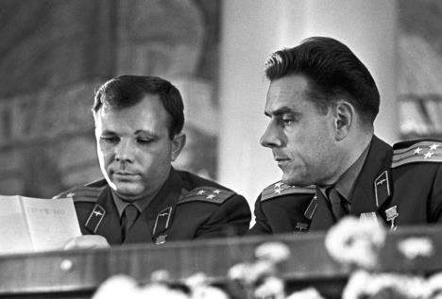
“State of Affairs” Prior to Soyuz-1 Launch
1966-1967
  1966 Lead Spacecraft Designer dies during routine colon surgery (Sergei Korelev)
  Propulsion, battery and parachute issues discovered
    Further testing was neglected.
  Parachutes fail drop tests, and full system test was not performed
    The primary and reserve parachute systems were never tested together.
  Design changes resulted in a tightly compact parachute compartment
    The final design required the use a sledgehammer to install the parachutes due to limited available volume on the spacecraft.
  Explosion on the pad
    Workers killed, parachute deployed, spacecraft is salvaged.
  200+ Soyuz spacecraft technical defects/design flaws
    Gagarin sends 10-page memo up the command chain, viewers were demoted/fired/sent to Siberia.
  Chief Parachute Designer refuses to guarantee the reliability of the system
    4 development drop tests of the parachutes showed design problems (rips, weight increases).
  Political pressures for Soyuz-1 launch to proceed
  A series of space feats to mark the anniversary of Lenin’s birthday.
  Soviet Space Program has systematic management issues
  No Soviet state organization tasked with systematic management of the space program.
Komarov and Gagarin
Image credit: Profimedia
Komarov knew his fate!
Komarov told friends he knew he would probably die. But he wouldn't back out because he didn't want Gagarin, a Soviet hero and friend, to die. Reportedly, the day of launch Gagarin demanded to be put into a spacesuit, though no one was expecting him to fly. Some observers thought Gagarin was trying to muscle onto the flight to save his friend.
“The engineers and cosmonauts knew the Soyuz was doomed!”
Organizational Silence- those that spoke up were fired on the spot!
Kamanin Diaries
The Avoidable Tragedy of Soyuz 1
7

Slide 8
Parachute Design of Soyuz-1
Architecture of Soyuz-1 parachute system
  Soviets very secretive; limited insight 60 years later.
Primary Parachute System
  Primary drogue parachute deploys (2 pilot parachutes lift drogue out)
  Primary main parachute is deployed
Reserve Parachute System
  Activates when sensors detect increased velocity
  Programmed to separate both the primary drogue and primary main parachute before deploying the reserve drogue and reserve main parachute (not tested prior to Soyuz-1)
  Reserve drogue parachute deploys (2 pilot parachutes lift drogue out)
  Reserve main parachute deploys, half the size of the primary main and deploys from a separate compartment
Soyuz-1 Planned Spacecraft Parachute Architecture
Educated guess of Soyuz-1 architecture
Primary System
Reserve System
Resulting Failure
Step 1
Hard Cover
Step 2
Pilots
D-bag
Reserve system pilots & drogue were deployed and cut away.
Reserve main deployed and entangled with the primary drogue.
Step 3
P
Drogue
R
R
D-bag
R
P
R
Step 4
P
Main
Primary drogue was not cut away prior to reserve system deployment.
X
Parachute Compartment
Tragic Tangle – SMA/NSC
8

Slide 9

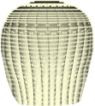
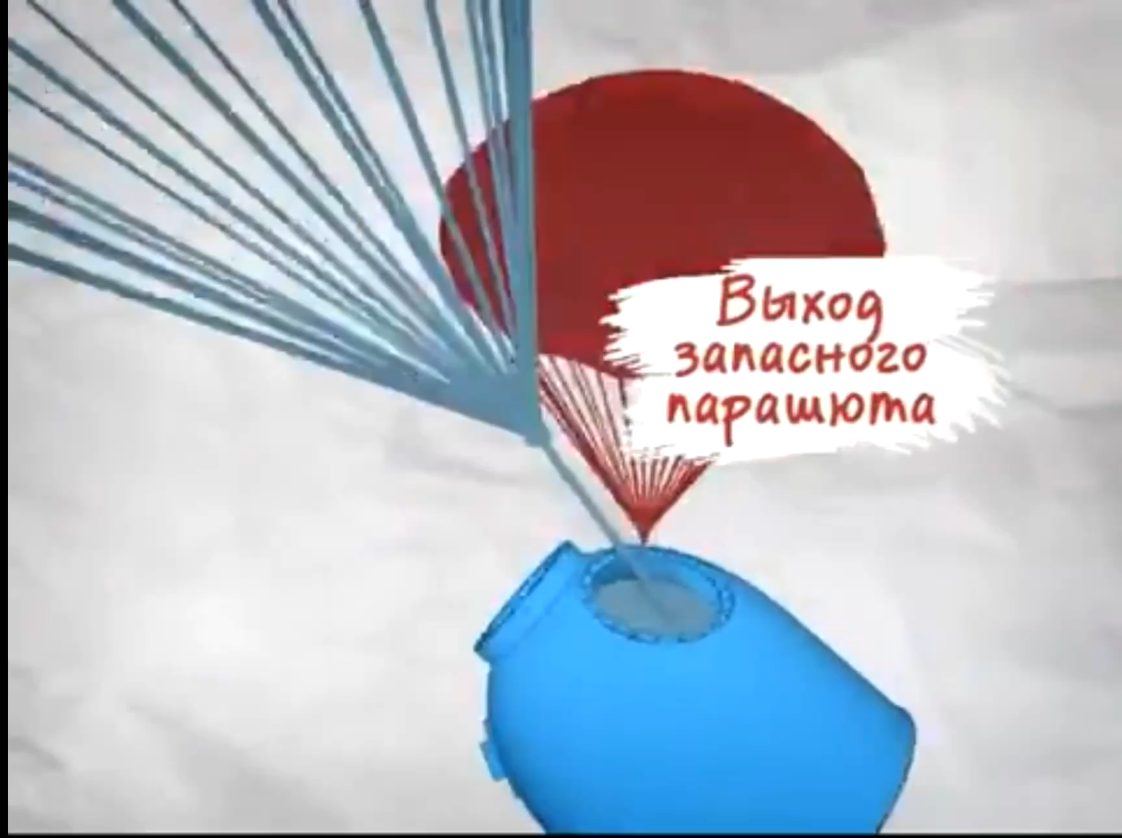
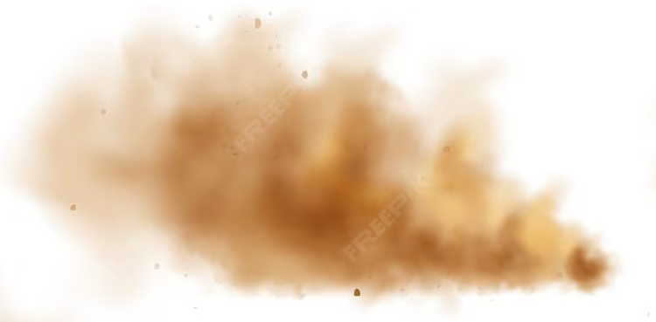
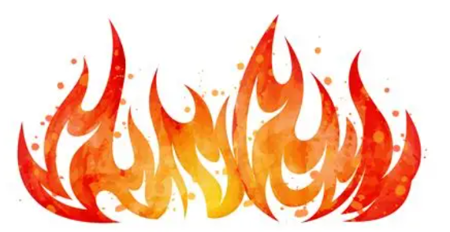

Soyuz-1 Mission Timeline & Crash
4/23/67
Komarov remained calm and worked through several on orbit issues in a professional/trained [test pilot] manner and reentry was successful.
Solar Panel Failure: One solar panel did not deploy, limiting power for the spacecraft's systems
Communications difficulties
Orientation Problems: The spacecraft could not be maneuvered due to failed orientation detectors
Mission Aborted: The mission was aborted after 13 orbits due to the inability to maneuver the spacecraft
Presenters’ interpretation based on video, photograph, and diary review
X
Image credit: YouTube,
“The Death of the Soyuz-1 Crew”
Primary drogue parachute deployed
The primary main parachute was commanded but
did not deploy
Reserve main parachute deployed and entangles with primary drogue parachute
Launch/on-orbit
Reentry / Parachute Deployment
Soyuz-1 Launch April 23, 1967
Cosmonaut: Lieutenant Colonel Vladimir Komarov
The spacecraft reentered the Earth's atmosphere after 18 orbits
Primary drogue parachute remained deployed above the rapidly descending space capsule
Komarov deployed the reserve main parachute, but it became tangled with the primary drogue parachute and did not fully inflate to brake the spacecraft
Soyuz-1 crashed into the ground at a speed of ~90 mph
Soft-landing [retro] rockets fire after the crash causing explosion
Image credit:
Mil.ru
Komarov reported, “the parachute is wrong, heat is rising in the capsule.”
Kamanin Diaries
Tragic Tangle – SMA/NSC

Slide 10
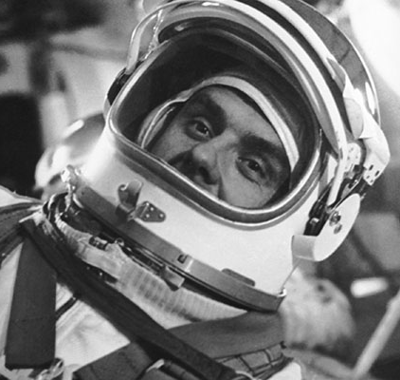
Komarov’s last words
final
seconds
Image credit: TASS
Consummate Professional or Rage? Separating fact from propaganda and urban myth
Russian State Archives reveal that Komarov’s final words were, “I feel excellent, everything’s in order. Thank you for transmitting all of that. [Separation] occurred.”
Komarov was screaming with rage as he died, cursing the people who put him in a "botched ship" knowing well that he would die. "This devil ship! Nothing I lay my hands on works properly,“ (Starman, Doran & Bizony)
Cosmonaut's spine-chilling last words as he fell from space in a faulty parachute
Death of a Cosmonaut - Soyuz 1 - last transmission of Vladimir Komarov @ 1:00

Slide 11
The Aftermath - Politics and Culture
Kamanin’s diary offers a lengthy and detailed account of events: http://www.astronautix.com/k/kamanindiaries.html
More details in backup

Slide 12
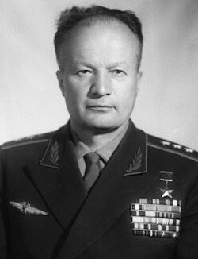

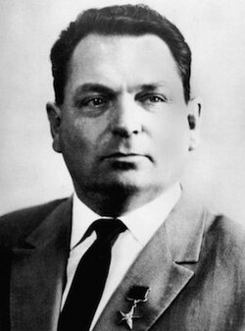
Flawed Engineering Culture
State Commission vs Design Bureau
Key Points from the Diary of Nikolai Kamanin (State Commissioner of Soyuz-1):
Didn’t Test Enough
  Parachute system design, which was delayed, had design flaws and test failures
  Didn’t test enough; failed tests with no root cause
  Due to cost and time constraints, the test planning was poor
Cultural Problems
  In-flighting within the Soviet Space Program
    Mishin refused to work with [rival] design bureaus, blaming others for failures, resulting in lack of coordination and redundant efforts
    Mishin wanted engineers to fly an automated Soyuz mission, Kamanin wanted pilots in command
  Mishin yielded to political/schedule pressure and tested hastily (Mishin Overpromises and Underdelivers)
  Failed Communication
Kamanin cites, “Soyuz is unreliable and incompletely tested.”
Image credit: TACC
Nikolai Kamanin
Soviet Air Force General
Cosmonaut Program Manager
State Commissioner of Soyuz-1
Soviet space failures were due to poor development and testing…, and the unacceptable engineering culture as a result of Mishin’s poor leadership style.
– Paraphrased from Kamanin’s diary
Image credit: unknown
Vasily Mishin
Engineer/Soyuz Designer
Experimental Design Bureau OKB-1
Project Manager of Soyuz-1
The Dark Secrets of Soyuz 1
Kamanin Diaries OKB – Wikipedia
From red star rising to rocket's red glare
Фото
Bad engineering culture = crashes

Slide 13
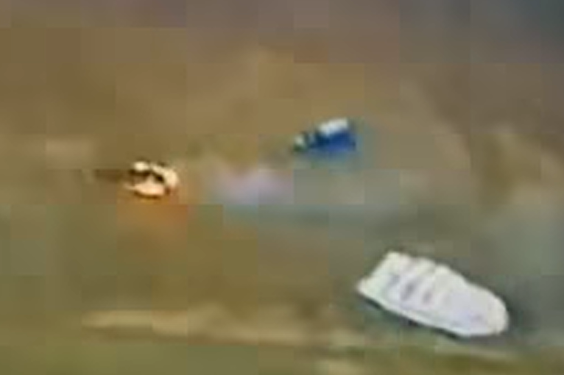
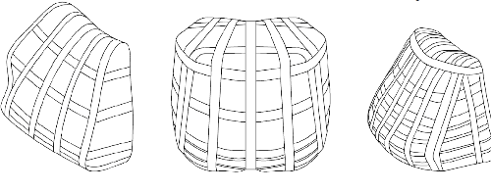
Soyuz-1 Parachute Failure Theories
LII and State Commission (Kamanin)
The official finding is that the drogue (braking) parachute did not apply enough force to pull the main parachute free. The reliable operation of the reserve parachute and the drogue parachute at the same time was never demonstrated in trials. The chance of them getting tangled was actually very likely.
OKB-1 Design Bureau (Mishin)
(Alternative theory emerged after the events of 1967 in memoirs)
During an autoclaving operation, the parachutes may have been contaminated with an adhesive substance. [It would have had the same effect on Soyuz 2]
2nd major malfunction of the Soyuz-1 crash.
Presumed location of Primary Drogue
Soyuz spacecraft
1st major malfunction of the Soyuz-1 crash.
Reserve Main parachute
Image credit: Soyuz 1 Impact
Note: During the design of Soyuz-1, the thickness of the heat shield was increased, which increased weight of the spacecraft, and the size of the main parachute was increased - compartment that it was to be stored in remained the same size and technicians had to hammer it into place with wooden mallets.
  Shockingly, it would have had the same effect on Soyuz 2. “The most chilling implication of this manufacturing oversight,” wrote Siddiqi, “was that both Soyuz spacecraft were doomed to failure. That is, if Komarov had not faced any troubles in orbit and the Soyuz 2 launch had gone on as scheduled, all four cosmonauts would have died on return.
tragic-tangle.pdf
Credit: Airborne Systems
23–24 April 1967 | This Day in Aviation Soyuz 1 Impact
Tragic Flight of Soyuz 1 Pack Density Limitations (NTRS)

Slide 14
Soviets Learn from Mistakes
Evolution
Modern Soyuz Culture
Soyuz-1 Failures
Schedule pressure. Get to the moon at all costs!
Process errors. Changes and not enough oversight – adhesive error. Factories often had poor quality control, undisciplined workforces, and low-quality parts.
Didn’t test enough. No full integrated system tests with reserve, ended development testing early to launch.
A "failure-adverse" culture. The Soviet system, with its rigid five-year plans, disincentivized managers from reporting problems or questioning unrealistic schedules. No one wanted to be the bearer of bad news, so issues were often hidden or ignored.
Lost institutional knowledge. Soyuz designer died, Mishin overworked organization.
Slowed down. Took time to design out 200 design flaws.
Process changes. New regulations required the removal of parachute containers from the reentry capsule, before its installation in the autoclave and introduced step-by-step photo-documentation of the parachute installation.
Test heavy. ~70 drop tests, with full system testing.
Restructuring of the Soviet Space Program. Drastic revisions the implementation of American-style project management and quality assurance techniques.
Mishin was fired. Replaced by a rival, Chief Engineer Designer Valentin Glushko and the space program was restructured and successful under his leadership.
Valentin Glushko – Wikipedia
The Avoidable Tragedy of Soyuz 1 | Drew Ex Machina

Slide 15
Spacecraft Parachute Architecture
PART 2
Spacecraft Architecture

Slide 16
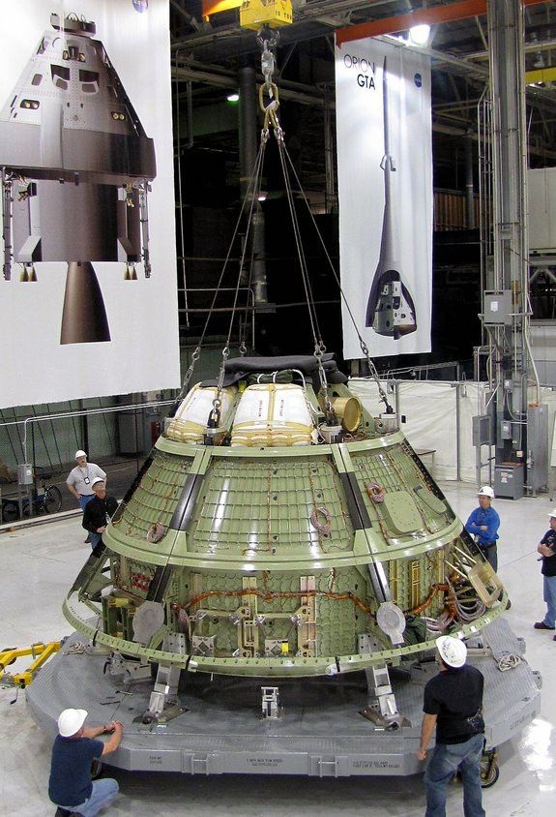


Why are Parachutes Unique? 1/2
Packing:
Like Apollo and today’s modern spacecraft, Soyuz parachutes used machine assisted pressure packing to compress the parachutes to allow for maximum use of the available stowage volume on the spacecraft.
As the density of the parachute packs increase, the amount of damage to the parachutes also increase.
FUN FACT:
Image credit: NASA
Typical spacecraft parachute packing has a density of 40-45 lb/ft³, comparable to oak (37-56 lb/ft³).
Orion
universetoday.com
100s klbs
Image credit: Haraldur Stefansson/Alamy
Orion packing – During the packing of the parachute it accumulates 100klbs of pressure during multiple pack cycles.

Slide 17
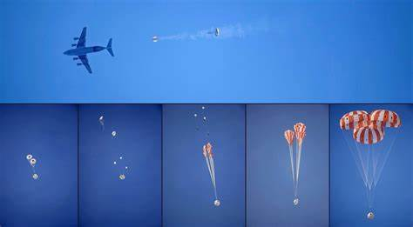
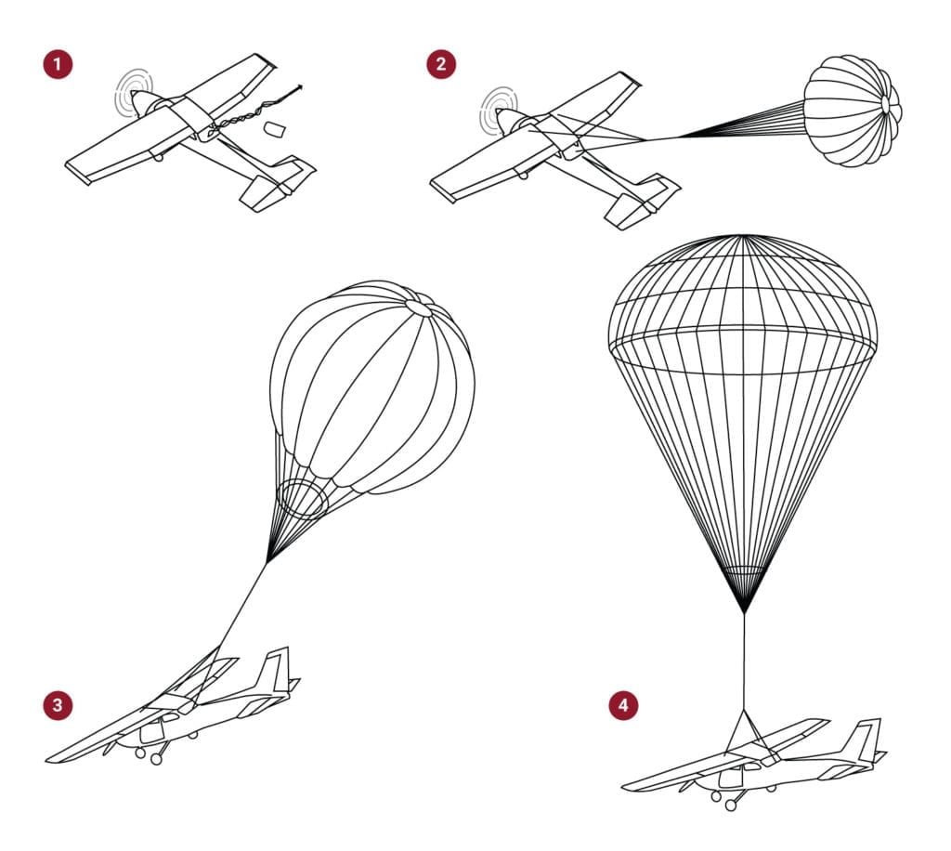
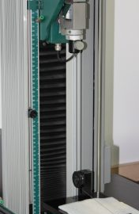
Why are Parachutes Unique? 2/2
Parachutes and other aerodynamic decelerators systems (inflatable heat shields) are a multi-faceted device that must serve dynamic, aerodynamic, and structural functions.
Aerodynamic Decelerator Systems (ADS) must:
Maintain STRUCTURAL INTEGRITY w/TEXTILES. For a clean deployment, quality and processes management needs to be in place to maintain structural integrity for theses ADS stages:
PACK/INSTALL. Preserve material condition during high density packing and integration.
DEPLOY. The densely packed parachutes chaotically deploy and unfurl in flight and become the “wing” the last 5 miles home, in a turbulent environment, with no quantifiable measurements or instrumentation (deployment).
INFLATE. The parachute must ingest air at staged reefing to manage inflation loads on the canopy.
DECELERATE. Slow down the spacecraft from 300mph to a soft landing, with suspension lines attached to the spacecraft.
Why not use the same sorts of established aerospace test techniques as other systems?
We have made great progress during the last 20 years simulating the inflation and deceleration portions of flight. However, no simulation or analytical technique exists to model the chaotic deployment of a flexible structure. It is highly empirical. The structural analysis techniques are not the same for textiles as hard structure. Lots of variability, and strength and stiffness can produce counter-intuitive results in a dynamical system.
Orion Deployment
extremetech.com
We must monitor touch labor processes to ensure proper deployment
Image credit: tiniusolsen.com

Slide 18

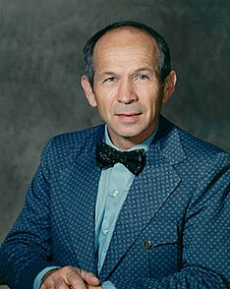
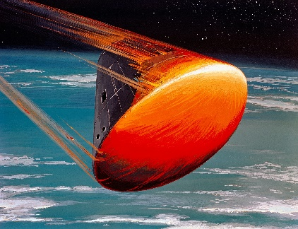
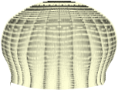
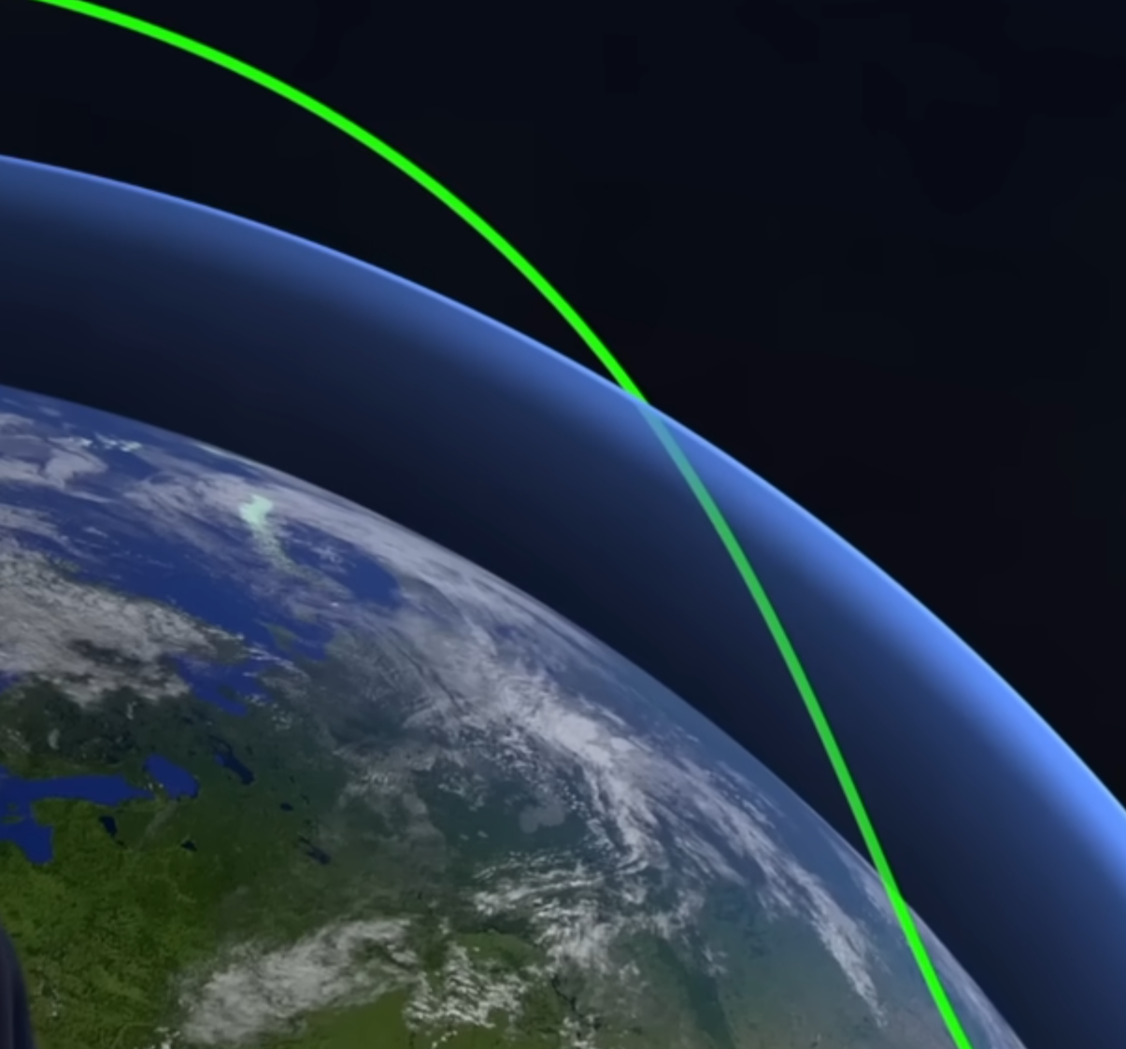
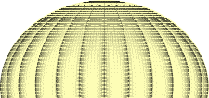
Spacecraft Architecture
Re-entry and Kinetic Energy Management
17k mph / 62 miles
Heatshield
Soyuz architecture used as an example in this illustration
KE =1/2 mV²
307 mph/ 5 miles
Drogue
KE ~74,603 ft/lb
Re-entry heat
Kármán line
130 mph / 9k feet
Main(s)
Tumbling
KE ~24 ft/lb
Image credit: North American Rockwell
Image credit: NASA
MAXIME "MAX" FAGET
One of the 35 engineers who formed the Space Task Group at NACA (which later became NASA), creating the Mercury spacecraft, and was instrumental in selecting the blunt-body shape that won the Mercury competition.
A blunt-body shape creates a shock wave that deflects most of the heat away from the spacecraft, genius understanding physics and the most effective way to enter atmosphere.
A spacecraft moving at orbital velocity has a lot of kinetic energy to dissipate to land safely. (i.e., effective heat management (Aerothermodynamics))
Re-entry heat: Heatshield
Tumbling: Drogues out, Drogue deployment envelope
Motion/Coning: Mains out, Main deployment envelope
Decelerating
Energy Management
KE ~4 ft/lb
Motion
Image credit: European Space Agency
Remaining Energy
Retrorockets/
3-5 feet
KE ~.075 ft/lb
Landing
Maxime Faget - Wikipedia

Slide 19
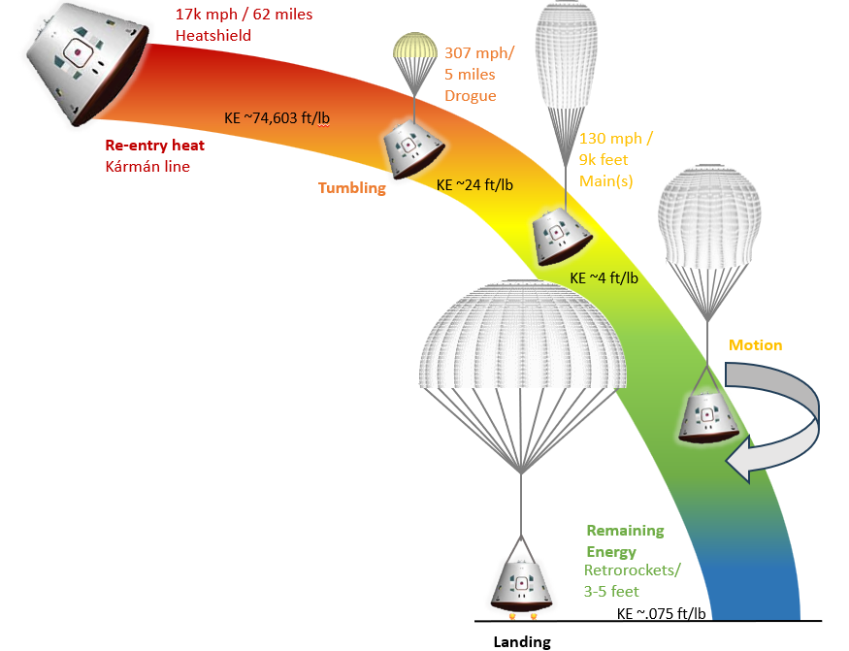
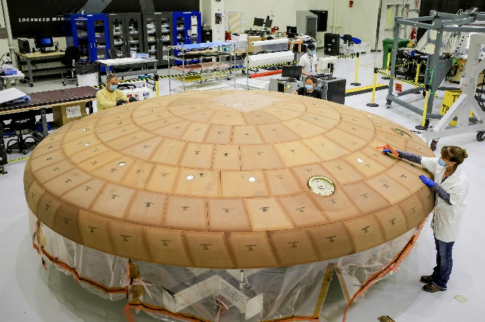
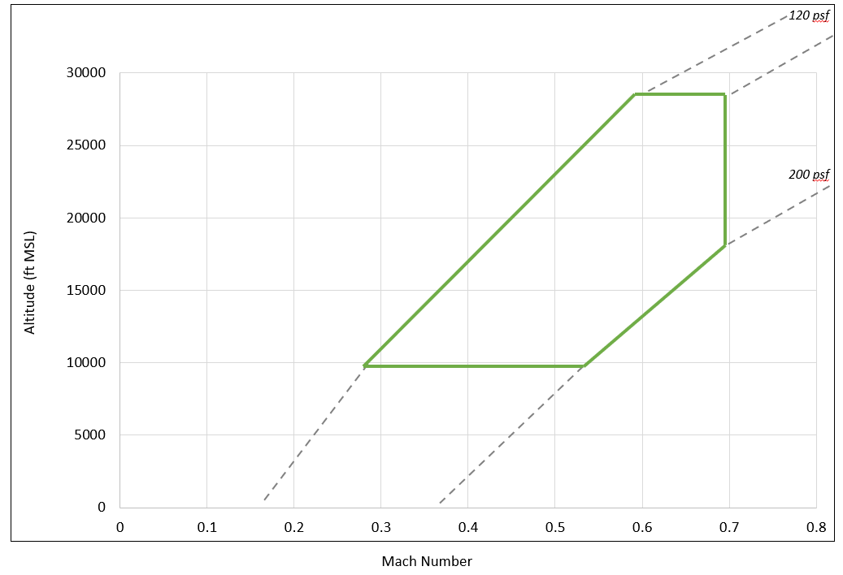
Heat Shield/Drogue
Heat Shield
Slows down the spacecraft from Mach 30 (hypersonic) to
Mach < 1 (subsonic).
Protects from excessive heat
After HS has done its job…
Once the spacecraft slows down, it will start to tumble.
Drogue parachutes are deployed to mitigate this tumbling movement.
Drogue Parachute(s)
Slows down the spacecraft from Mach .7 to .3.
Drogue is not big enough to take the spacecraft all the way to the ground for soft landing.
Need to release drogues and deploy main(s).
Thrusters used to enter atmosphere.
Image credit: Lockheed Martin
Space.com
Goal: Dissipate the kinetic energy as quickly as possible while it is entering the Earth’s atmosphere to land spacecraft safely.
Morris and Hill: Notional and Generic Drogue Deployment Envelope
Astronaut Nick Hague [on Soyuz parachutes]: “…parachutes snapped into place with a bone-jarring crunch…to avoid a deadly collision with the ground.”
ScienceAlert

Slide 20
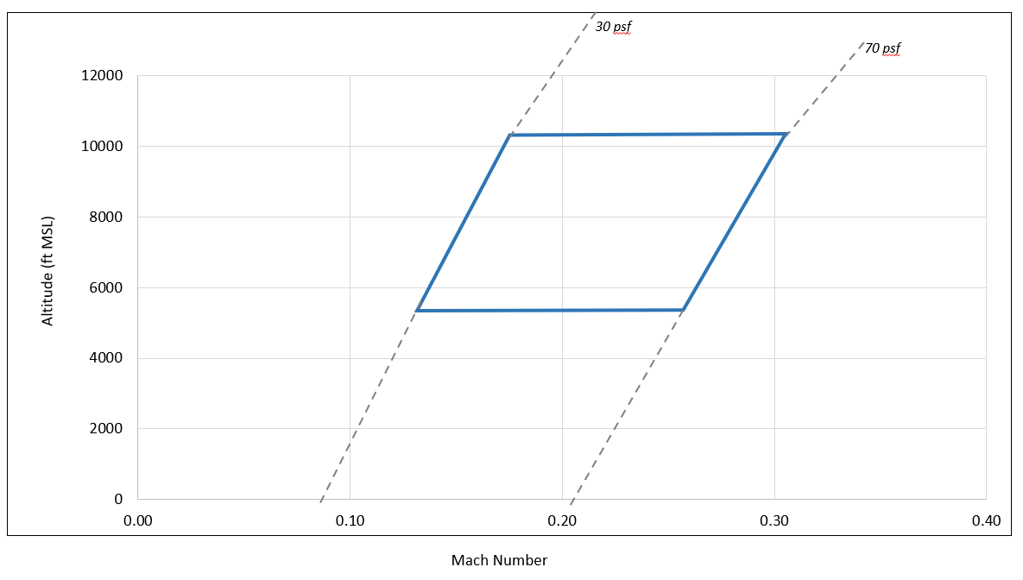
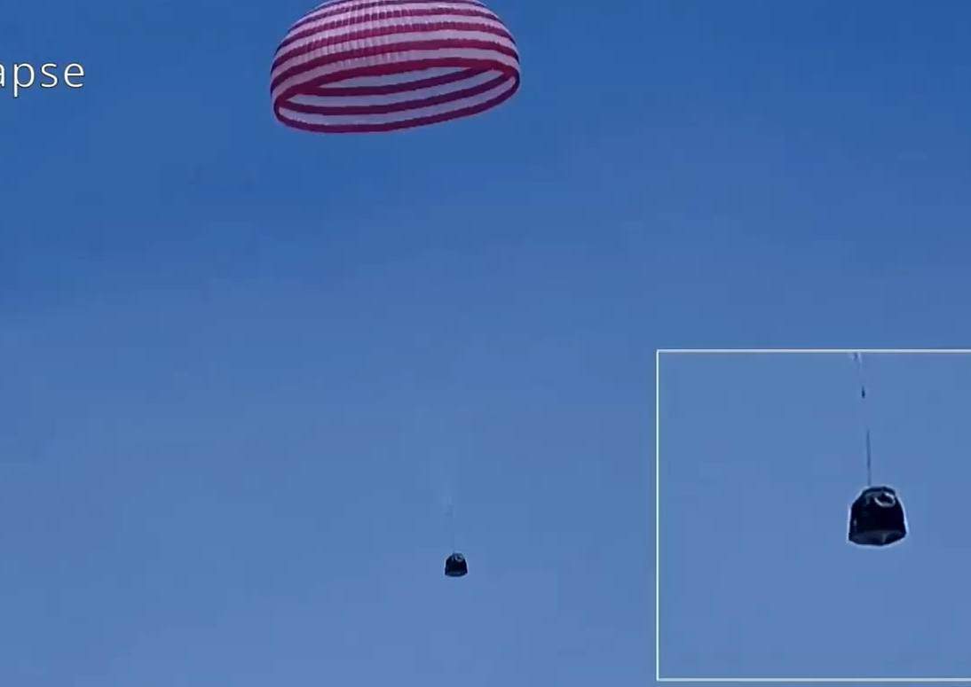
Main Parachute
Main Parachute(s)
Kinetic energy remains before mains deploy, Mach .3 down to 27 fps [18.5 mph].
Kinetic energy is decreasing as the parachute slows down due to air resistance.
All parachute configurations, have excess kinetic energy that needs to be dissipated.
Morris and Hill: Notional and Generic Main Deployment Envelope
Motion
One side effect is excess motion; in which some excess motion patterns are directly related to the parachute configuration:
  1 parachute = coning / yo-yo
  3 parachutes = in/out / breathing
  4 parachutes = various motions (heartbeat, paper fortune teller, etc)
"I didn't look too good because I didn't feel too good." NASA Astronaut Don Pettit and his return on Soyuz
Coning motion Shenzhou-19 (time lapsed video)
Shenzhou-19 landing
Credit: China National Space Administration (CNSA)/
China Central Television (CCTV)

Slide 21
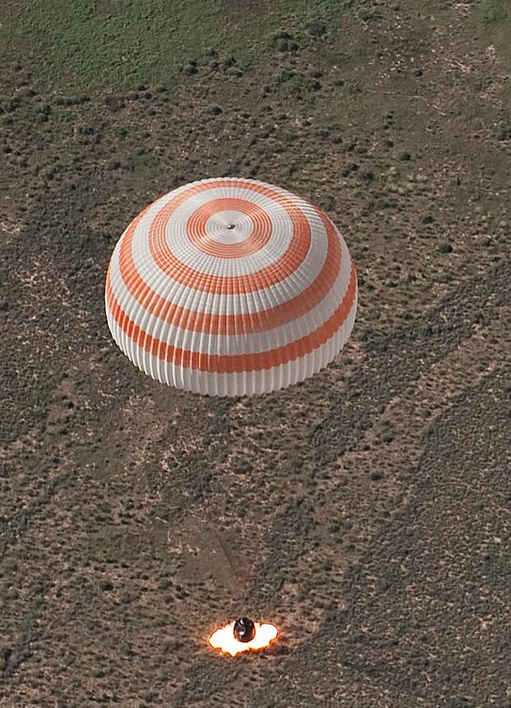
Retrorockets/Touchdown
Retro Rockets
Rocket engine provides thrust, opposing the motion of spacecraft, thereby causing it to decelerate.
RRs are designed to absorb much of the remaining kinetic energy, followed by the crew seats moving down, shock absorbers, and astronaut bodies absorbing the remaining kinetic energy as the vehicle comes to rest.
Land vs Water Trade examples:
Recovery cost and efforts/personnel
Post-landing safety risks
Spacecraft design/loads/weight (landing bags/propellent)
Life cycle/spacecraft cost
Soyuz Retro Rocket
Image credit: NASA/Bill Ingalls
Retrorocket – Wikipedia
ESA Astronaut Paolo Nespoli [on Soyuz landing]: “soft landing” felt like head on collision between a truck and small car!”
ESA, YouTube

Slide 22
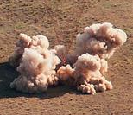
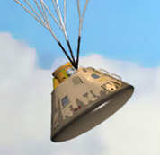
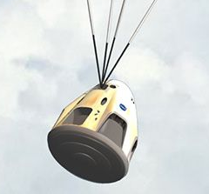
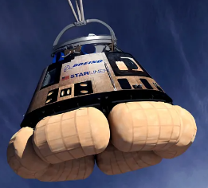
Historical/Modern Day Spacecraft
Commonality in Historical and Modern Spacecraft
  The crew return spacecraft architectures look similar, since they share a common set of physics (kinetic energy must be dissipated)
  Reentry: The heat shield is formed in a rounded shape (blunt body). This forms a shock wave in front of the capsule, so that the heat on the vehicle is minimized.
  Landing: Parachutes are used for the final descent, sometimes augmented by braking rockets and airbags if the capsule is designed to land on ground rather than water.
Since the architectures share commonality, then why are some spacecraft more successful with fewer anomalies? Why have some parachutes failed? How can we apply lessons learned?
The more successful programs share a common element of thorough test programs, continuous surveillance, and a culture hungry for understanding the system, which is the focus of Part 3.
Human Spacecraft | Parachutes | Landing
Russian Soyuz | Single | Land- retrorockets
Chinese Shenzhou | Single | Land- retrorockets
Blue Origin New Shepard | Cluster-3 | Land- retrorockets
Boeing Starliner (demo) | Cluster-3 | Land- airbags
NASA Apollo | Cluster-3 | Water
NASA Orion | Cluster-3 | Water
SpaceX Dragon | Cluster-4 | Water
Nyx (demo) | Single | Water
Soyuz Apollo Dragon Starliner
Image credit: NASA
Infographic credit: Tony Bela
Image credit: NASA

Slide 23
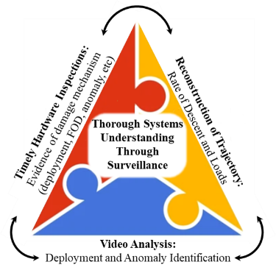
Applying Lessons Learned to Surveillance and
Testing of the Modern Spacecraft Fleet
PART 3
Lessons Learned/ Surveillance

Slide 24
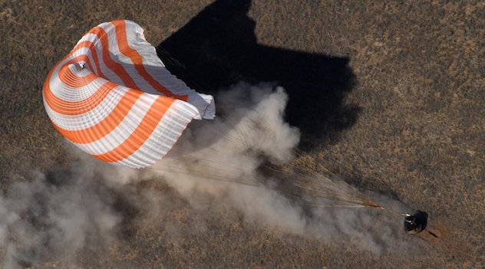
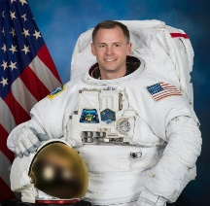
Recovery from Soyuz-1:
Becoming the International Workhorse
Soyuz was constantly improving; Soviets iterated the spacecraft design and has become a reliable workhorse for the modern human spaceflight fleet.
The Soviets learned from the mistakes of 1967, which can be attributed to the Apollo–Soyuz Test Project in 1975. The Soviets implemented the American style program management (cultural shift) and quality assurance; at the time the United States reported that the Soyuz was technically primitive.
Since 1967, Soyuz has had 154 successful crewed missions
and has transported ~70 NASA astronauts to the ISS.
Soyuz MS-02, Roscosmos
Image credit: NASA/Bill Ingalls
Soyuz (1967-1981)
37 crewed mission success / 3 failures – 2 catastrophic, 1 launch abort
Soyuz T (1979–1986)
18 crewed mission success / 1 failure – explosion at pad, crew survived
Soyuz TM (1987–2002)
33 crewed mission success
Soyuz TMA (2002–2012)
22 crewed mission success
Soyuz TMA-M (2010–2016)
20 crewed mission success
Soyuz MS (2016–current)
25 crewed mission success /
1 Pad Abort failure, crew survived
+1 MS-28 currently at ISS
“The Soyuz is an engineering marvel. That thing is reliable, and I'm just glad that there are so many people that have invested so many years of their life making that system as strong as it is.“
– Astronaut Nick Hague
Image credit: NASA
List of Soyuz missions – Wikipedia | Apollo–Soyuz – Wikipedia
NASA Astronaut Nick Hague 'Rolls with Punches' After Harrowing Soyuz Launch Failure

Slide 25
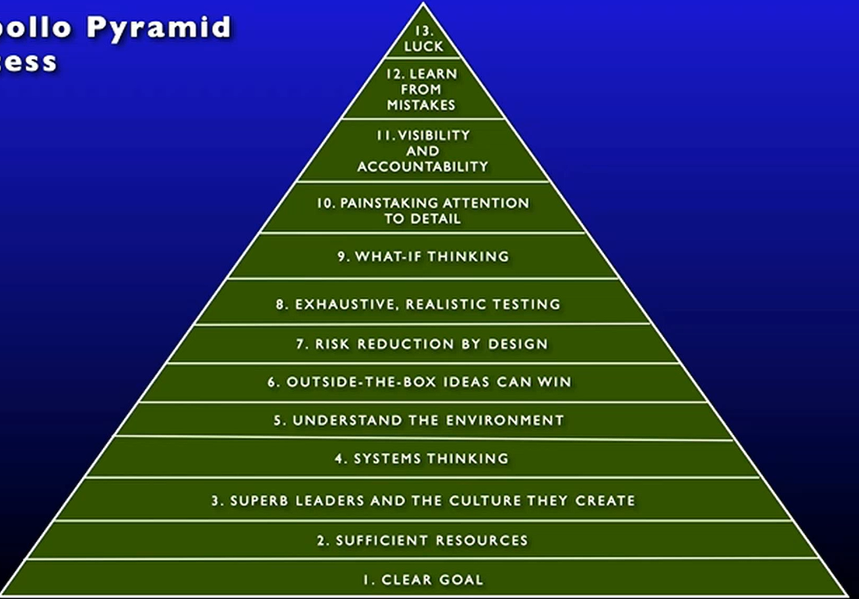
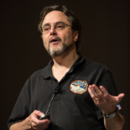
Chaikin Cultural Assessments
Andrew Chaikin’s Pyramid of Success
  Apollo success culture in the early days of spaceflight made it possible to carry out the moon mission. The Apollo program was a near perfect program.
  Prioritize learning from mistakes, Challenger and Columbia accidents were both due to schedule pressures.
Andrew Chaikin thoughts:
Stop the train from barreling down the tracks, spend more on testing, we tend to lean too much on models.
Have we decided to accept that risk and not mitigating risk?
What are stories we are telling ourselves today that we need to pay attention to?
Image credit: NASA
Image credit: NASA NESC
“Learn from mistakes and remember the lessons.” Gene Krantz, Flight Director
Success in Spaceflight: The Human System | NESC Academy Online

Slide 26
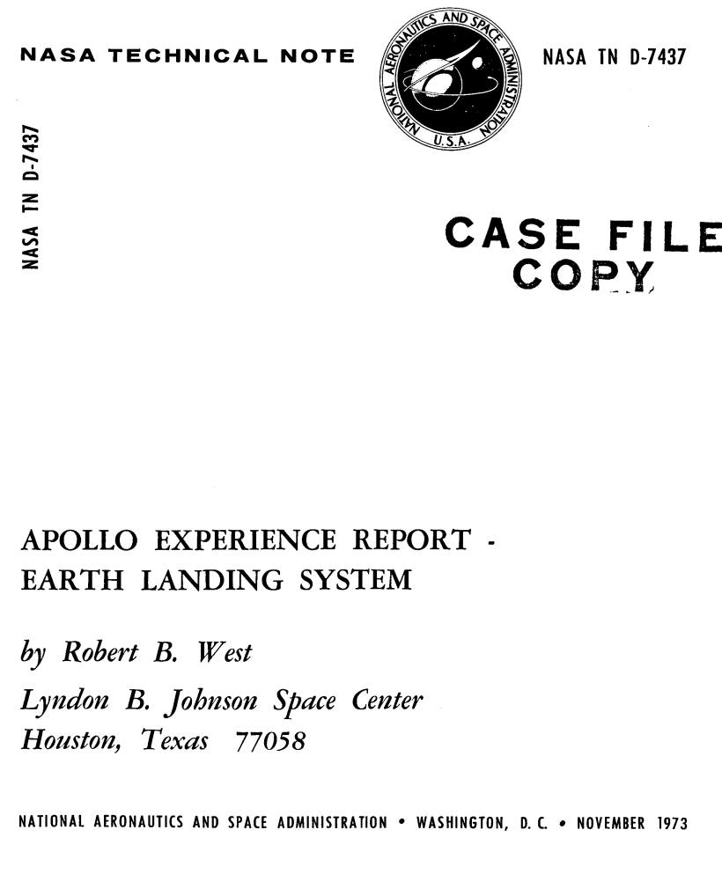

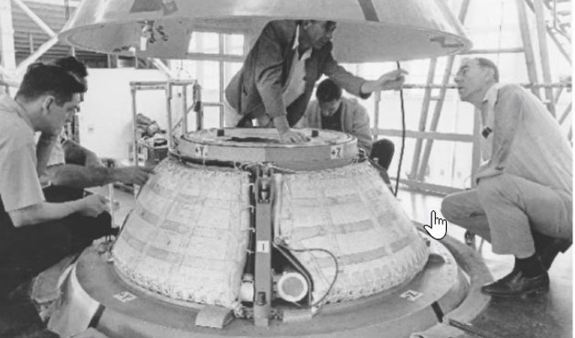
Parachutes Assessments
Keeping astronauts/spacecraft safe in the modern era, and what we encourage in the Commercial Crew Program.
  Surveillance Triangle Process: video, monitor processes, test enough
Listen to what parachute experts taught us from heritage, in particular:
  Full-scale system testing at flight conditions
    Bob West, “Apollo Experience Report – Earth Landing System,” NASA‐TN‐D‐7437, November 1973.
  Final system integrity with 8-12 full-system drop tests
    Chuck Lowry, “Man-Rating the Apollo and Other Earth Landing Systems,” AIAA 2011.
  Spend more money on testing
    Andrew Chaikin, Success in Spaceflight, NESC 2022
Image credit: NASA
BobWestReport Throwback to Apollo Parachute Testing - NASA
Man-Rating the Apollo and Other Earth Landing Systems

Slide 27
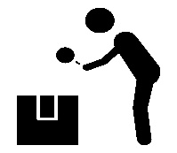


Importance of Surveillance
What makes a parachute system safe?
Good design with proven performance, significant representative testing of full system deployment, capability to operate in the real environment boundaries, known physical limits.
Good Surveillance pre-, during, and post- mission through monitoring of touch labor processes, gathering of in-flight data, and post mission hardware evaluation and flight reconstruction.
A comprehensive surveillance program has been proven to mitigate risk.
Reminder, consistent, key lessons-learned from the Bob West Apollo experience report, AIAA industry lessons learned with Chuck Lowry, and previous NASA flight experience
In an economic environment with limited flights, then surveillance becomes that much more important
There are three types of surveillance: hardware, video, and data.
All three types are necessary, since they work together.
Most parachute failures occur during deployment, which is chaotic and unpredictable.
Since this cannot be modeled, we rely on the following to understand deployment better.
  Monitor touch labor processes
    Packing and installation into the spacecraft can be thought of as a proxy for deployment in reverse
  Closely surveil hardware and soft goods following a flight
    Delta velocity between two components is a key signifier of potential parachute damage or failure. Looking for evidence of abrasion, friction, melted nylon, rubbing against hard surfaces.
Evidence of friction on hardware provides a static interpretation of deployment. An analysis of video is necessary to understand the dynamics of the deployment.
High fidelity data and best estimate trajectories are necessary for improving simulations and verifying key requirements of loads and rate of descent.
Listen to the whispers of the parachute

Slide 28
Surveillance Model Pre-flight
Monitoring touch labor, config control, details of design, correct documentation
Pre-flight model has been documented in a public facing effort as the government standard in surveillance:
AIAA 2022 Paper, Morris et al
IPPW 2023 Paper, Morris et al
Thorough Systems Configuration Understanding Through Surveillance
PACKING | SPACECRAFT INSTALLATION
Eyewitness Observation Parachute Packing | Eyewitness Observation of Spacecraft Installation
Look for approved methodology and procedure adherence Can reveal IFAs or process errors Prevents late findings and unknown risks | Verify consistency of labor and procedural adherence Look for hardware condition, e.g., proper configuration, FOD, sharp edges, bent D-rings Prevents installation errors
Documentation Review | Documentation Review
Review of manufacturing documentation, packing procedures, and installation procedures X-ray review – FOD, bent cutters, bent d-rings and other metallic parts | Review of manufacturing documentation, packing procedures, and installation procedures X-ray review – FOD, bent cutters, bent d-rings and other metallic parts
Image credit: NASA.
Gerstenmeir’s
“Stay Hungry”
Concept
Surveillance in touch labor, results in a measurable reduction in risk

Slide 29











Parachute Post-Flight Surveillance Model
Thorough Systems Understanding
Through Surveillance
Eyewitness
Event
Occurs appx 1-7 days
Trajectory Reconstruction
Occurs appx 30 days
Subjective
understanding
Record Review
Occurs appx 30 days
Quantitative
understanding
Quantitative
understanding
Hypothesis
Hypothesis
Image credit: Russell Lee
Image credit: NASA
TEST
Hypothesis
Hypothesis
Detailed
Video Review
Occurs appx 7 days
Quantify
Occurs 30+ days
TEST
TEST
Visual
Occurs 1-3 days
Hypothesis
Subjective understanding
Camera
Perspective
Subjective
understanding
Photogrammetric
Shape Determination and
Velocity (e.g., whipcrack, FOD)
Hypothesis
Triangle model has been documented in a public facing effort as the government standard in surveillance:
AIAA 2011 Paper, Ray & Morris
AIAA 2019 Paper, Ray
AIAA 2022 Paper, Morris et al
IPPW 2023 Paper, Morris et al
OSMA Forum 2023, Morris
AIAA 2024 Paper, Janssen, Ray & Morris
Aircraft
Uplook
Ground-
to-air
Detailed look for anomalies not seen on visual. Parachute markings, serialization, orientation, etc.
Orderly Deployment
Detailed Timeline of
Deployment Sequence
FOD Damage
Cursory Qualitative observations
Image credit: NASA

Slide 30

Flight Safety and Risk
In the context of flight safety analysis, surveillance helps the parachute engineer characterize risks that have already manifested in past operations, whereas risk forecasting is concerned with predicting the range of credible outcomes on future missions.
Tug of war forces (diagram): Bad (anomalies, damage, performance problems) vs.
Good (demand count on operational missions, ground and flight tests, surveillance)
Comprehensive risk aggregation – We treat parachutes as a system not a part
  NASA engineers evaluate parachute risk using a broad set of considerations that extend well beyond individual component performance. Key data sources include observed risk trends, SME elicitation, mission specific flight demands, and any other inputs that inform the system level risk posture. Major contributors to overall parachute system risk include architecture and heritage, the strength and reliability of load bearing elements, interactions with adjacent structures, analytical capability, process maturity, reliability/demands, and the organizational and safety culture supporting the program.
PARACHUTE SYSTEM AGGREGATE RISK METHODOLOGY
Data Sources
Risk Trends
SME Elicitation
Flight Demands
Observed Flight Performance
Parachute System
Aggregate Risk
Architecture (Heritage) + Load Bearing Elements + Surrounding Structures + Process Maturity + Reliability + Analysis + Culture

Slide 31



Significant Incidents and Close Calls in Human Spaceflight
NASA’s Associate Director, Safety (DRP), Dr. Nigel Packham’s chart:
Image credit: NASA JS-2015-004
Last update was 2015, there have been several parachute related mishaps/close calls/failures addressed on the next page.
Significant Incidents

Slide 32


Crewed Spacecraft Parachute
Anomalies and Malfunctions
Provider | Issue | Potential Root Cause
Nyx | Parachute system failure | Design Flaw/Lack of Testing/Schedule and cost pressure
Blue Origin New Shepard 25 | Crewed, One main parachute did not disreef properly | Cutter malfunction or process error/rigging
Boeing Starliner | Only 2 of 3 main parachutes deployed | Process error/rigging
OSIRIS-Rex | Drogue parachute failed to deploy | Process error
Genesis | Drogue/main parachute failed to deploy | Manufacturing process error
Soyuz-1 | Crewed, Parachute failure | Design flaws/Lack of full system testing/Schedule pressure/ Manufacturing process error
Apollo 15 | Crewed, Landed with 2 of 3 main parachutes | Interaction with contaminants / Lack of full system testing
Primary Lessons Learned
Monitor touch labor processes
Sufficient camera and video views
Direct measurement of loads and vehicle state data
Test sufficiently
Avoid unnecessary schedule pressure
More details in backup on these failures

Slide 33
Conclusion
As an ADS community, let’s continue to document history and lessons learned.
Reach out to Aaron Morris, Aaron.L.Morris@nasa.gov, for more information regarding parachute design and lessons learned.

Slide 34
BACKUP

Slide 35

Failed Communication
Official State Commission Committee
Commissions LII Flight Institute for assessment of Soyuz crash
Soyuz-1 Crash
LII Flight Test Center (Independent Assessment)
LII Assessment
X
Official report didn’t contain all LII recommendations
OKB-1 / TskBEM
(Mishin)
performs failed drop tests
Official Report
X
OKB-1 chute designer reject findings… then got fired
X
X
Factories refused to comply due to lack of centralized authority
Problems emerge due to lack of centralized authority in the Soviet Union: Each flight design bureau, and each flight test center was forced to solve technical problems that arose in the course of work on their own. Instead of combining the efforts of leading specialists into a single bureau, where the most complex tasks could be solved more quickly and efficiently, each structure had to act entirely independently. Mishin’s design bureau was called OKB-1 (aka TskBEM).
~400-500 Organizations
~20 Departments
~ Hundreds of Factories
tragic-tangle.pdf

Slide 36
Mishin Overpromises and Underdelivers
Post Soyuz-1 / Design Bureau
Mishin didn’t wait for the official State Commission Report, within a month he was performing more failed parachute drop tests without root cause of the Soyuz-1 crash
  Three proposed drop test/results: 1.) Reserve parachute didn’t open 2.) Reserve parachute had delayed inflation
  3.) Soyuz mock-up drop was cancelled for fear of losing spacecraft
Mishin “overpromises” 3 more launches in 1967
  Once again, succumbs to political pressure for launch by the Russian Revolution 50th Anniversary in October 1967
State Committee Official Assessment (discussed on next page)
  Cosmonauts (Gagarin and Leonov) meet with Kamanin, urging that Mishin’s inadequacy facts be documented in the Komarov crash commission report
  Chief designer of parachute system (Tkachev) rejects the findings of the Soyuz-1 state commission
  Mishin disagrees with the assessment
Soyuz testing and design changes took 18 months after the crash
  Over 200 recommendations to revise the parachute system
  70 required parachute drops of the Soyuz capsule mass simulator were completed, sometimes dropping 3 per day
  A year after the crash, Soyuz parachute recertification held up all manned programs
    Mishin hastily certifies the Soyuz parachutes
    Parachute designer dissented, stating system was unreliable and overweight and he is fired

Slide 37
Parachute Failure Examples

Slide 38

Nyx - The Exploration Company
Demo Spacecraft Reentry 6/24/25
  Parachute System Failure
    Didn’t Test Enough
      The parachute system wasn’t drop-tested—a risk that “lower costs, shorten development time, and yield a deeper understanding of the vehicle with each flight,” according to TEC..
    Design Flaw
      Deployment Envelope deviated from historical heritage, Nyx deployed at 85k feet
    Schedule/Cost Pressure
Image credit: The Exploration Company
Human remains lost after memorial spaceflight capsule crashes into the sea | Space
160 People Wanted to Be Buried in Space. Their Capsule Slammed Into the Ocean Instead.
After successfully entering Earth’s atmosphere, a European spacecraft is lost - Ars Technica

Slide 39


Blue Origin New Shepard
NS-18 10/13/21
  Canopy Configuration Issue
    One parachute is missing the vent windows in the canopy
NS-25 5/19/24
  Landed with 2 of 3 Parachutes
    One of the parachutes did not disreef properly
YouTube | Blue Origin
Image credits: Blue Origin

Slide 40

Boeing Starliner
Pad Abort Test (uncrewed) 11/4/19
  Landed with only 2 of 3 parachutes.
    Rigging Error during installation
      The malfunction was found to be human error.
Boeing Pad Abort Test - Wikipedia
Image credit: Boeing

Slide 41

OSIRIS-REx
Probe Return to Earth 9/24/23
  Drogue parachute failed to deploy
    Process Error
      NASA found that inconsistent wiring label definitions in the design plans likely caused engineers to wire the parachutes' release triggers such that signals meant to deploy the drogue chute fired out of order
        In the design plans for the system, the word 'main' was used inconsistently between the device that sends the electric signals and the device that receives the signals," they added. "On the signal side, 'main' meant the main parachute. In contrast, on the receiver side, 'main' was used as a reference to a pyrotechnic that fires to release the parachute canister cover and deploy the drogue. Engineers connected the two mains, causing the parachute deployment actions to occur out of order."
Image credit: Keegan Barber/NASA
Crossed wires caused parachute problem during OSIRIS-REx asteroid sample delivery | Space

Slide 42

Genesis
Genesis Sample Return 9/8/04
  Drogue/Main Parachute didn’t deploy
    Manufacturing Error
    Process Error
      Due to a design flaw in a deceleration sensor, parachute deployment was never triggered
        Design Flaw: four gravity-switches aboard the probe's sample return capsule were installed backwards based on flawed spacecraft schematics. That fundamental error, which occurred in both the primary and redundant gravity-switch systems,
Image credit: JPL/NASA
Investigators Find Preliminary Cause of Genesis Crash | Space

Slide 43

Soyuz-1
Soyuz 1 4/24/1967
  Main and reserve parachute failed, loss of Crew (1)
    Not enough testing
    Inadequate design
    Schedule/Leadership pressure
    Factory/Manufacturing process error
    Organizational Silence- those that spoke up were fired on the spot
Image credit: Soviet space program

Slide 44

NASA Apollo 15
Apollo 15 8/7/1971
  Landed with only 2 of 3 parachutes.
    Deviated from the flight test configuration
      All three parachutes inflated properly
      Obscured by clouds and upon emerging, one parachute was deflated
      Post flight analysis would find that two or three of the six shroud lines on the failed parachute were missing. Although no conclusive cause was found, it is thought that the loss of the shroud lines was due to the RCS fuel (highly toxic hydrazine and dinitrogen tetroxide) dump.
sma.nasa.gov/significantincidents/assets/apollo-15-mission-anomaly-report-no.-1-main-parachute-failure.pdf
Return of Apollo 15 to Earth - Wikipedia
Image credit: NASA

