Slide 1

Development of an Additively Manufactured Subscale Secondary Sealed Container for the NASA FROSTE Project
Melissa Forton, Collin Adair, Blake Hyla, Ryan Anderson , & Joseph Sims – Quadrus Corporation
Joe Sanford – NASA FROSTE Project Manager
Distribution Statement A. Approved for public release: distribution is unlimited.

Slide 2
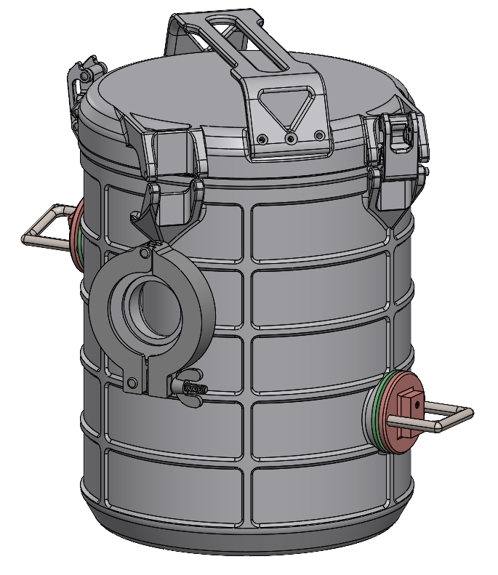
Overview of FROSTE Work
FROSTE Program Overview
Quadrus Corporation’s Role
Secondary Sealed Container Overview
Phase Change Material Tank
  Design Overview
  Internal Lattice Details
  Manufacturing Process
  Powder Removal
Conclusions & Future Work

Slide 3
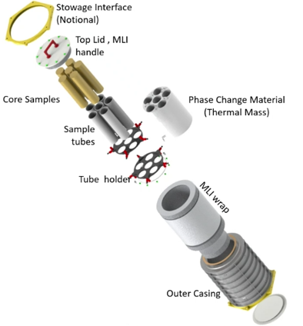

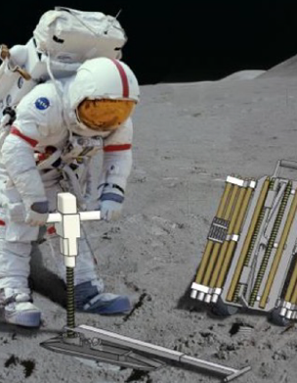
FROSTE Program Overview
Preliminary SSC Design Concept
Frozen Return of Sample to Earth (FROSTE)
  Targeting cryogenic Sample Return from the Permanently Shadowed Regions (PSRs) at the lunar south pole
    Temperatures in PSRs are below 100K
    FROSTE will maintain 100K temperature from sample collection to splashdown on Earth to preserve trapped volatiles in the sample
  Goal is to bring back 50kg of samples
  Return vessel has been designated as the Secondary Sealed Container (SSC)
“THE COOLEST PROJECT AT NASA”

Slide 4
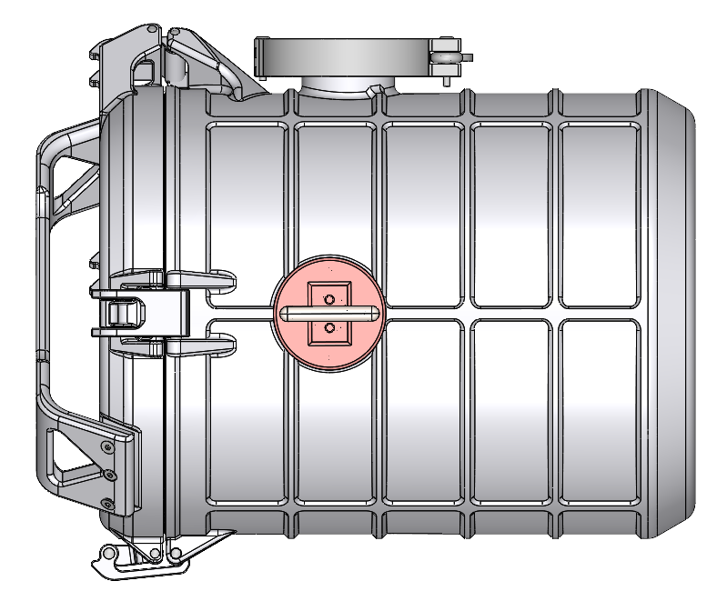
Quadrus Corporation’s Role in FROSTE
Quadrus Corporation’s Role
Design and build a proof-of-concept subscale Secondary Sealed Container (SSC)
Demonstrate the overall capabilities of Additive Manufacturing in for the FROSTE program
Laser Powder Bed Fusion
Colibrium Additive M2 Series 4 Plus
Design Requirements
Temperatures down to 80K
Vacuum to 10⁻⁷ Torr

Slide 5
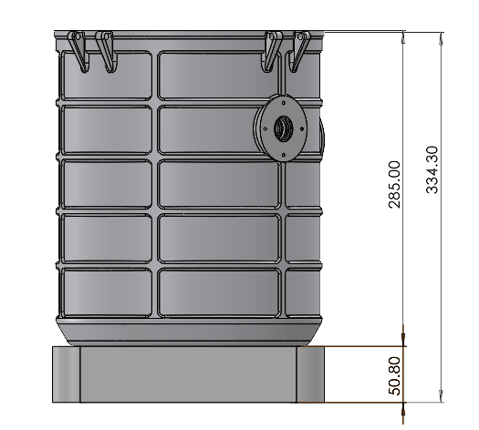
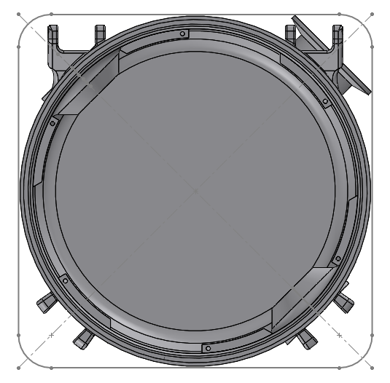
Manufacturing Considerations
Colibrium Additive M2 Series 4 Build Volume: 250mm x 250mm x 378mm
Build Plate Footprint
250mm x 250mm outline
2-inch Build Plate

Slide 6
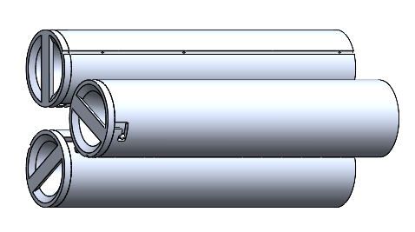
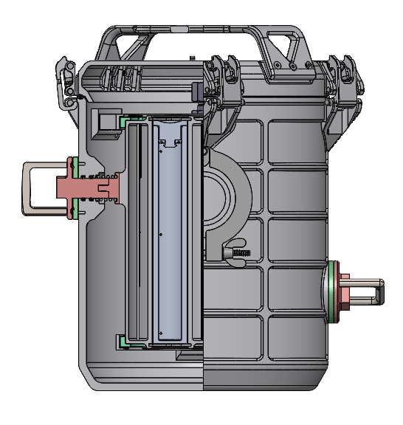
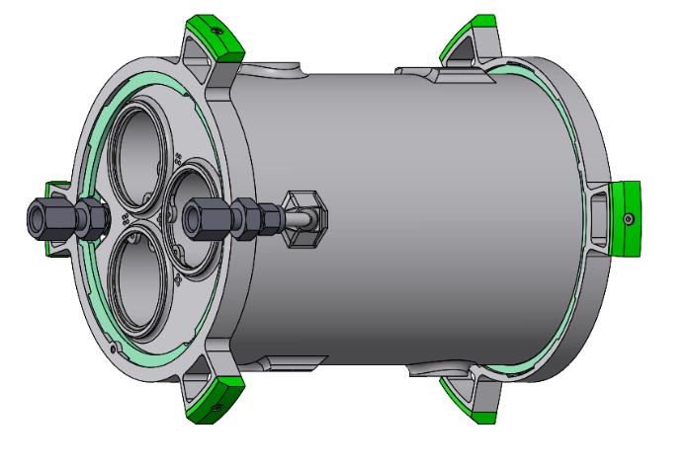
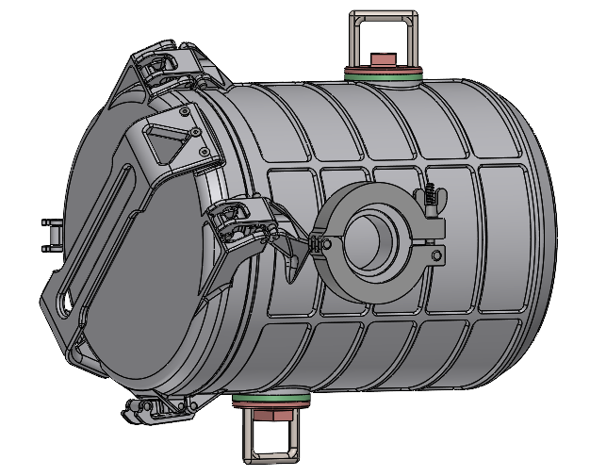
Secondary Sealed Container Terms
Primary Container Assemblies
Phase Change Material Tank Assembly
Outer Container Assembly
*MLI not shown

Slide 7
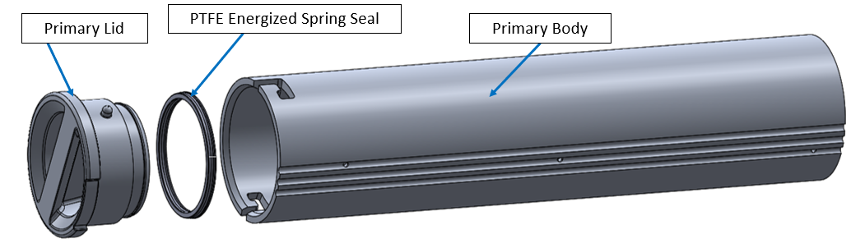
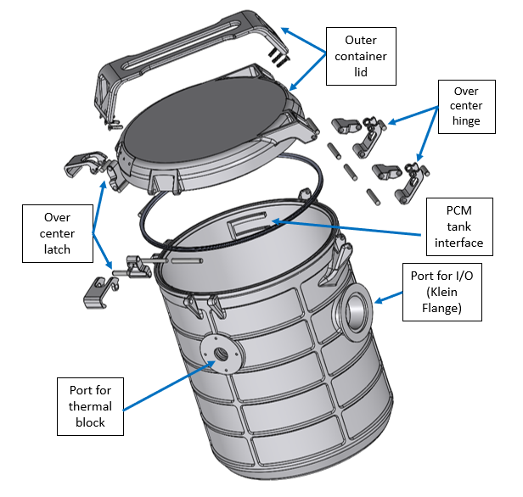
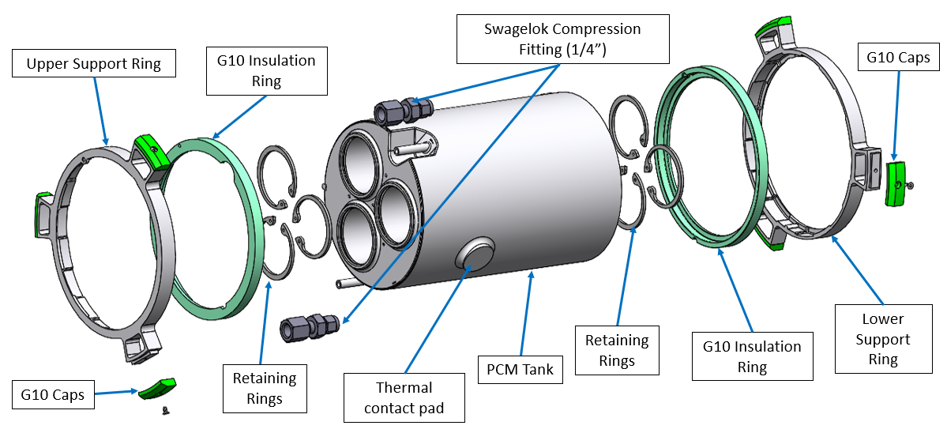
Secondary Sealed Container Overview
Primary Container Assembly
Outer Container Assembly
PCM Tank Assembly

Slide 8
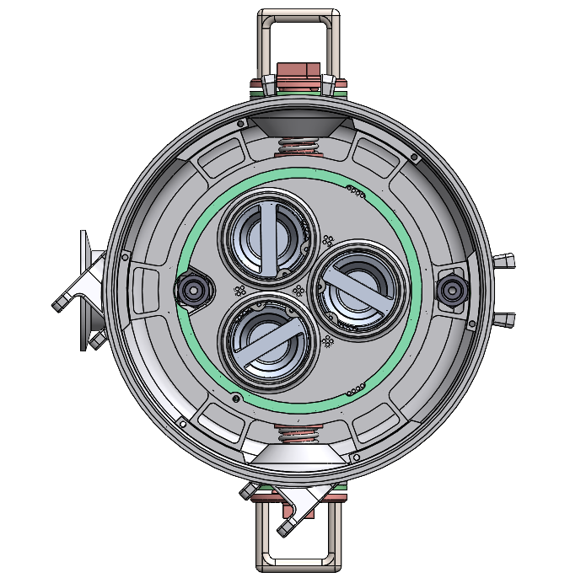
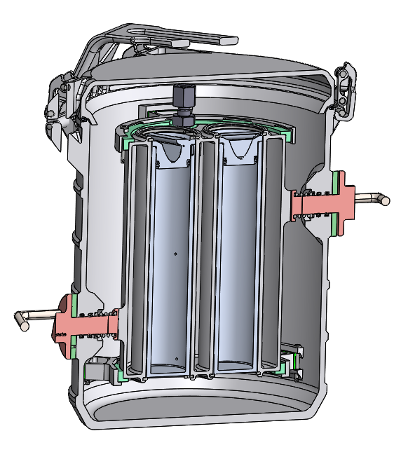
SSC Assembly Details
PCM Tank Assembly rotates into position, and lock pins are inserted

Slide 9
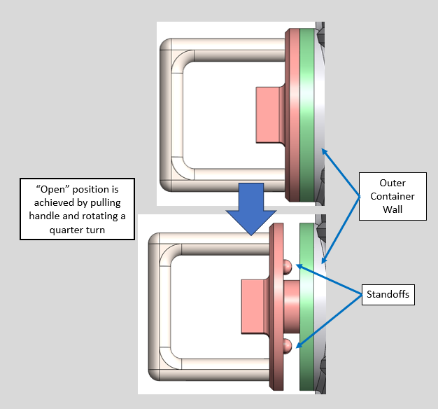
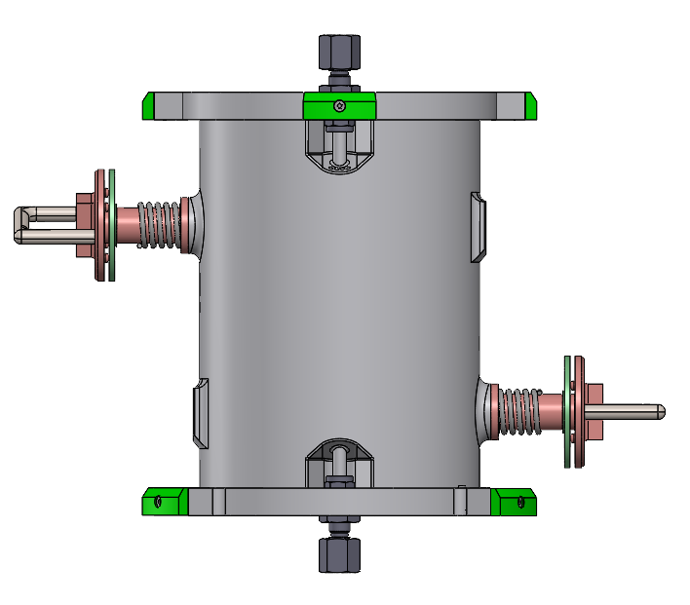
SSC Thermal Disconnect Method from Cryocoolers

Slide 10
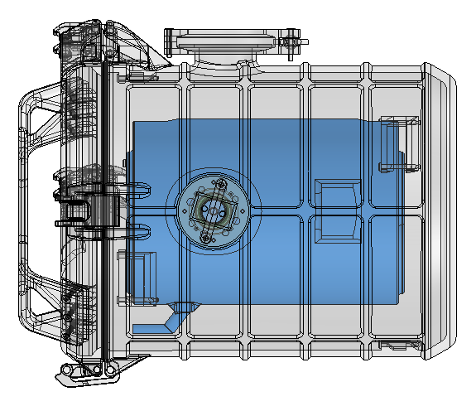
Phase Change Material Tank Design Features
Design Features
Monolithic, One-Piece Component
Phase Change Material: 2-Methylpentane or 2-Methylpentane with Acetone
Internal Lattice Structure to help evenly distribute thermal loads through the PCM
Fill, Drain, and Vent Ports
Integrated Thermocouple Tubes
Design for Solo and Assembled SSC Testing
  Direct Connect Thermal Straps
  Pads for SSC Thermal Plunger Assembly

Slide 11
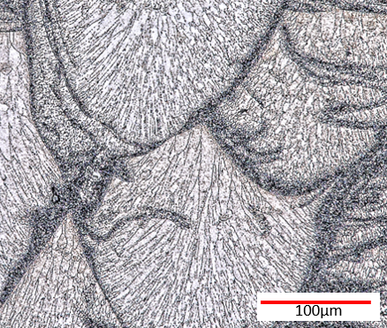
Scalmalloy
Scalmalloy Micrograph
Scalmalloy
Started life as 5000 series
  Aluminum alloy with Magnesium
Added Scandium to make Weldable
Unique Bimodal Microstructure
  Equiaxed and Columnar Grains
Mechanical Properties
Slightly lower strength than 7075-T6
Equivalent Strength-to-Weight Ratio of Ti-6Al-4V
Quadrus AM Scalmalloy Properties
  Yield Strength = 69 ksi
  Ultimate Strength = 73 ksi
Thermal Properties
Thermal Conductivity @ RT = 95 W/m-K

Slide 12
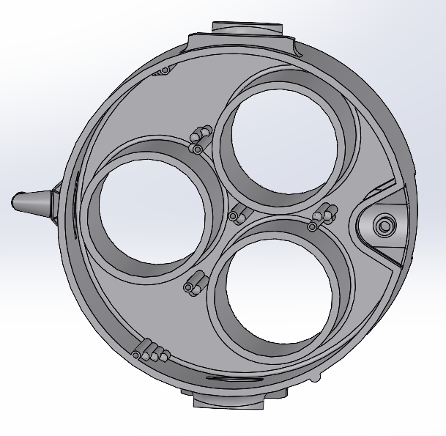
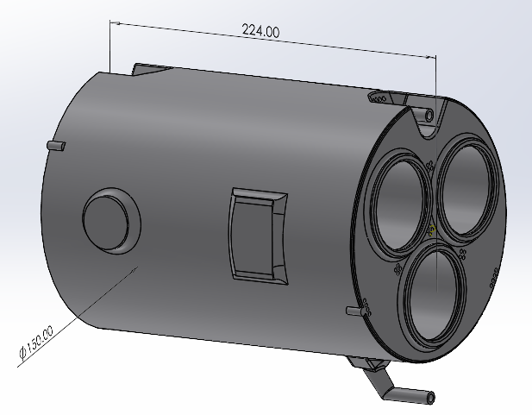
Phase Change Material Tank
Vent Port
Anti-Rotation Feature
Thermocouple Channels (28)
Fill Port
Thermocouples in groups of 4 at quarter, half, three quarter, and full height.
Thermal Contact Surface
(SSC Testing)
Thermal Contact Surface
(PCM Tank Testing)
Retaining Ring Grooves
Internal Volume filled with Lattice
Drain Port

Slide 13
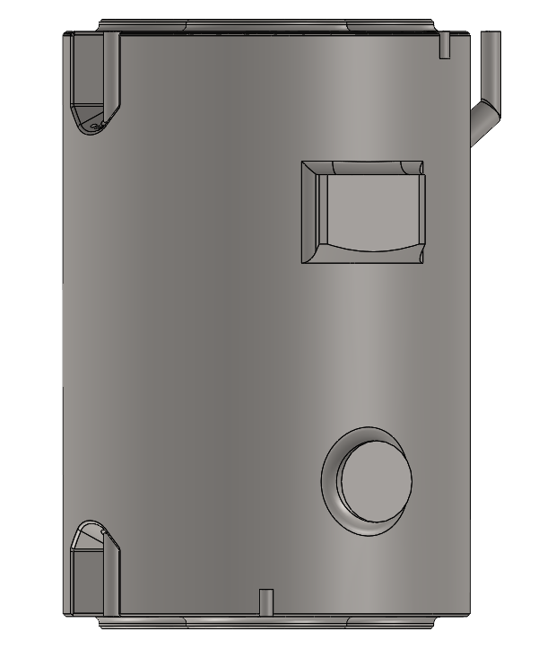
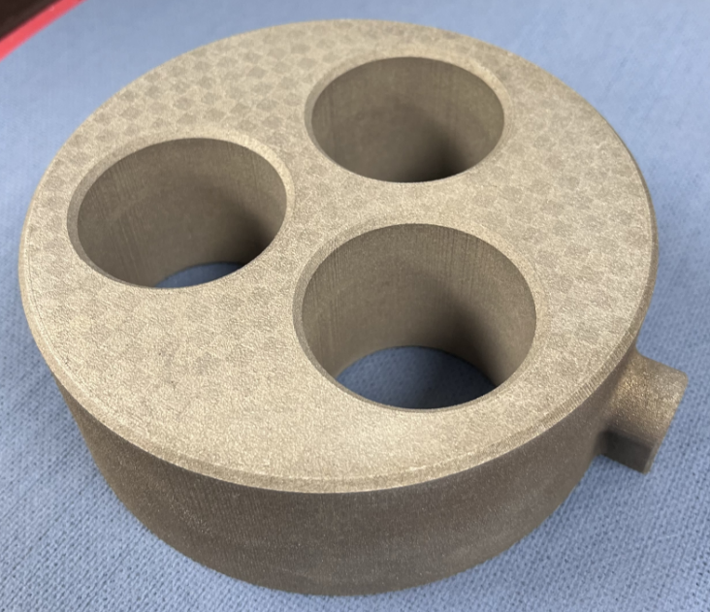
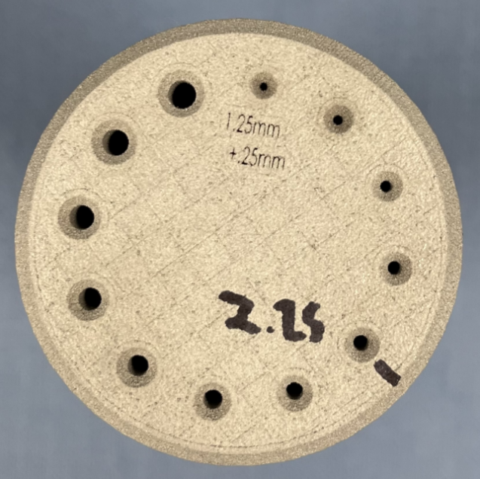
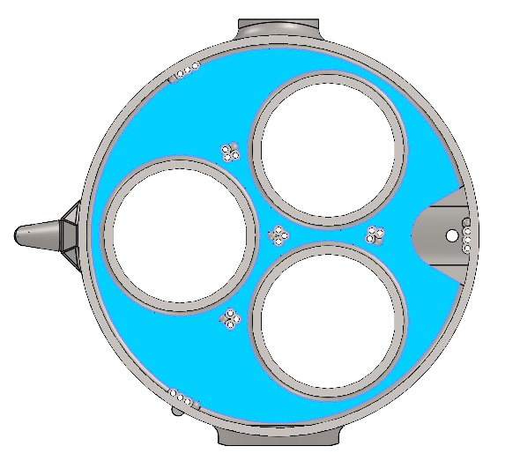
PCM Tank Manufacturing Challenges
Challenges
Large overhang parallel to build plate
Powder removal
Surface finish on thermal pads and primary container slots
Thermocouple sizing
Powder Drainage Pathways (Yellow Arrows)
Thermal Pads
Overhand Surface (Blue)
Thermocouple Sizing
Mini PCM Tank Build
( Pancake Build)

Slide 14
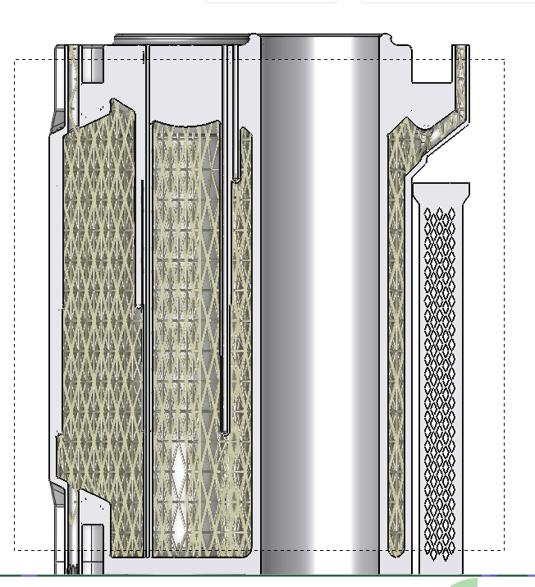
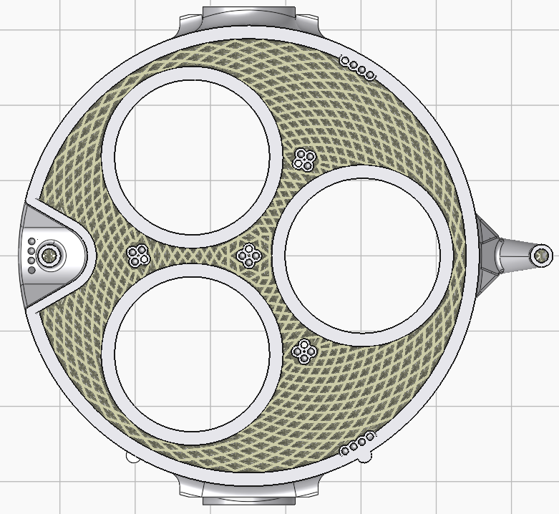
PCM Tank Lattice
Radial Octet Truss Lattice
20% Relative Density

Slide 15
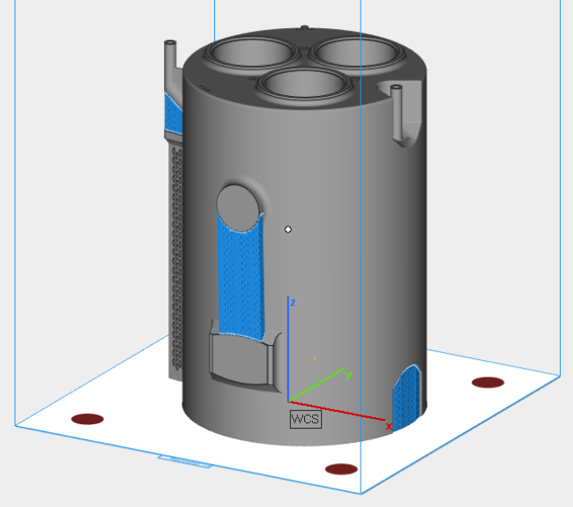
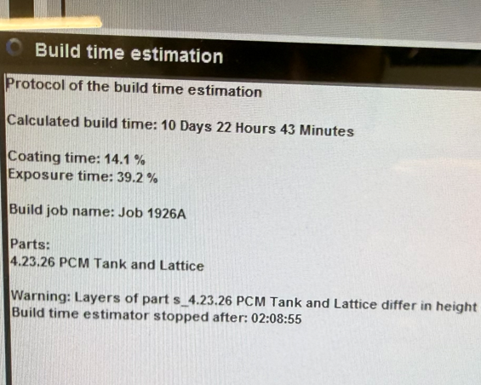
LPB-F Build Setup
STL File - 3DXpert
Slice Files - Materialise Magics 29
Colibrium Additive M2 Series 4 Plus
Dual 400W Lasers
Build Time Estimation – 11 days*
Should equal 100%

Slide 16
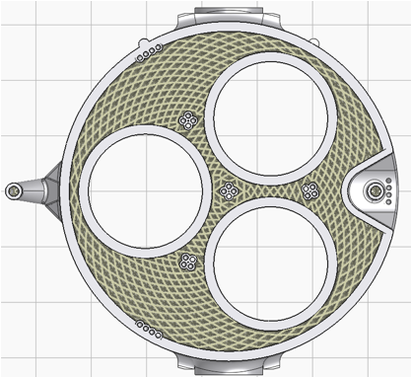
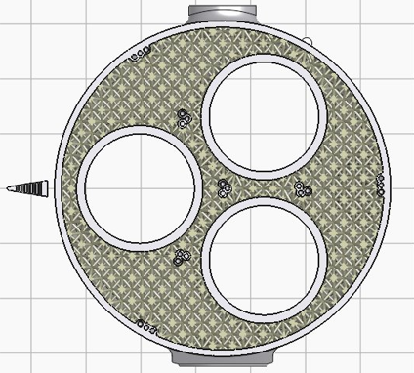
Lattice File Estimation
Largest Part with Lattice Geometry to Date
Slice File Size = 19.1 GB (Typical Part Slice Files Size <300 MB)
Radial Octet Truss Lattice Generation Issue
Sections of lattice randomly missing
New Lattice Geometry - Cubic Octet Truss
20% Relative Density maintained, but cell size increased
Cell size was too small creating too much geometric complexity
Slice File Size 19.1 GB
Slice File Size 3.0 GB

Slide 17
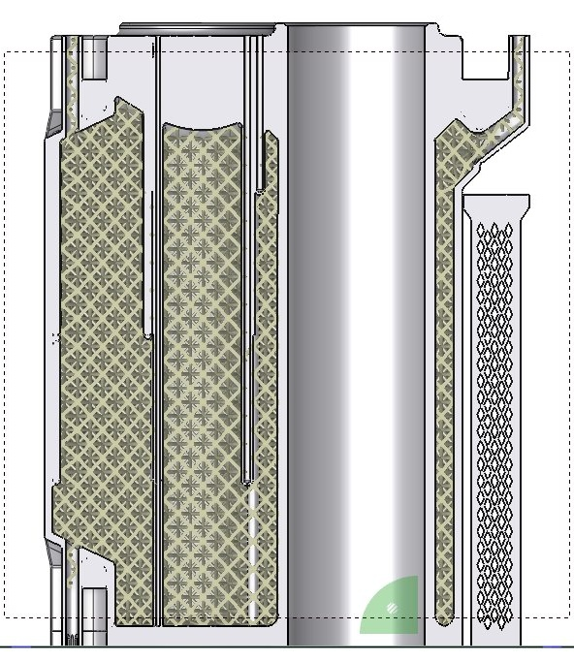
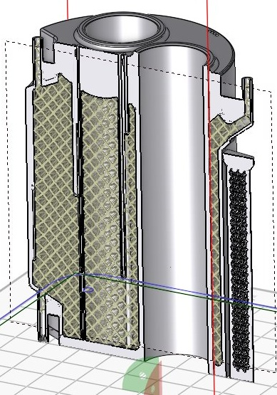
Updated PCM Tank
Colibrium Additive M2 Series 4 Plus
Dual 400W Lasers
Build Time Estimation
4 day 4 hrs

Slide 18
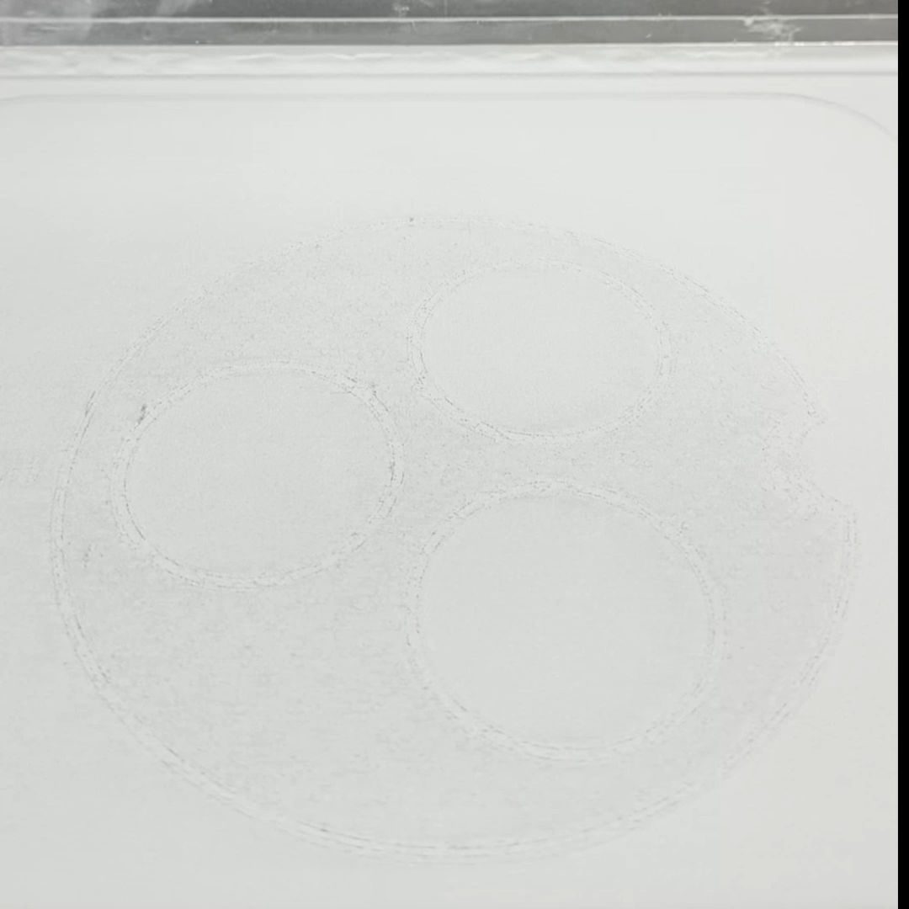
PCM Tank Build Video
Single Layer of Build at 3x Speed
Total Build Time
4 day 19.5 hrs

Slide 19
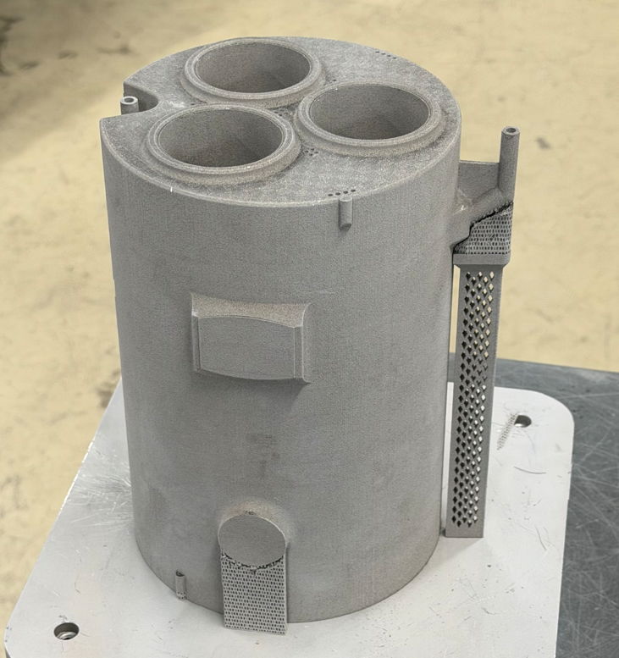
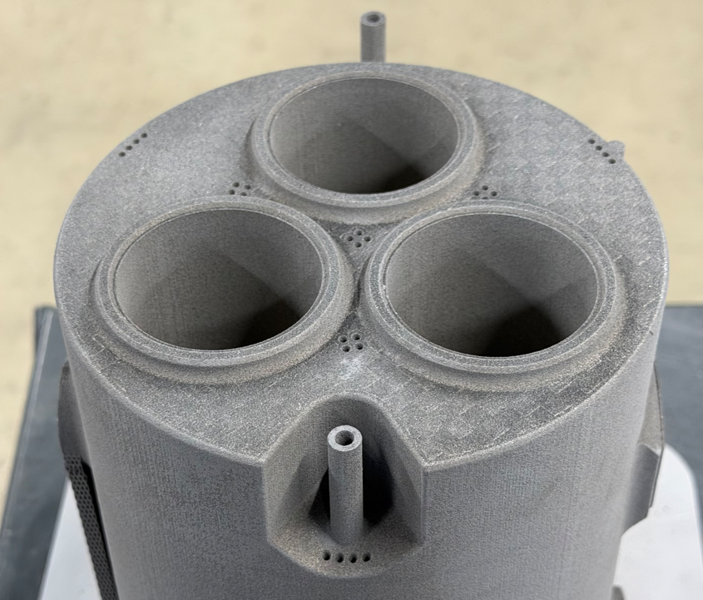
PCM Tank Pictures
Total Build Time
4 day 19.5 hrs

Slide 20
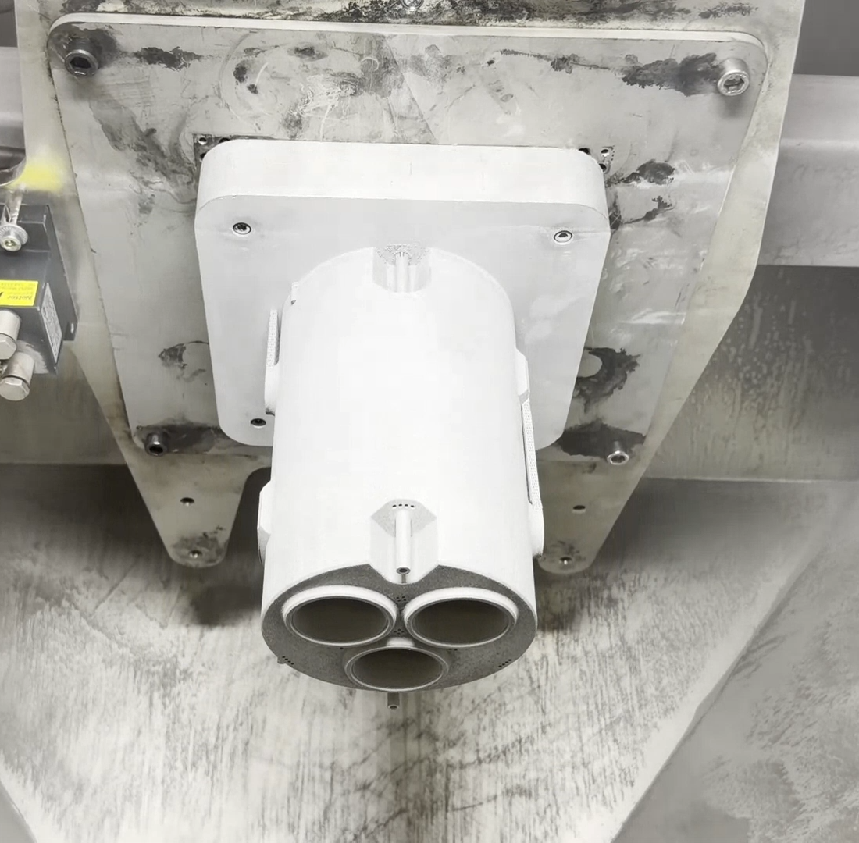
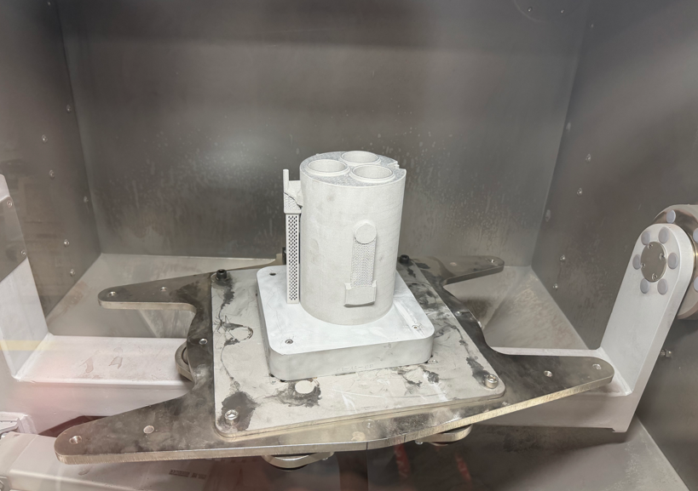
Powder Removal
NASA MSFC
Solukon Shaker Machine
Estimated Time to Remove Powder = 1 week

Slide 21
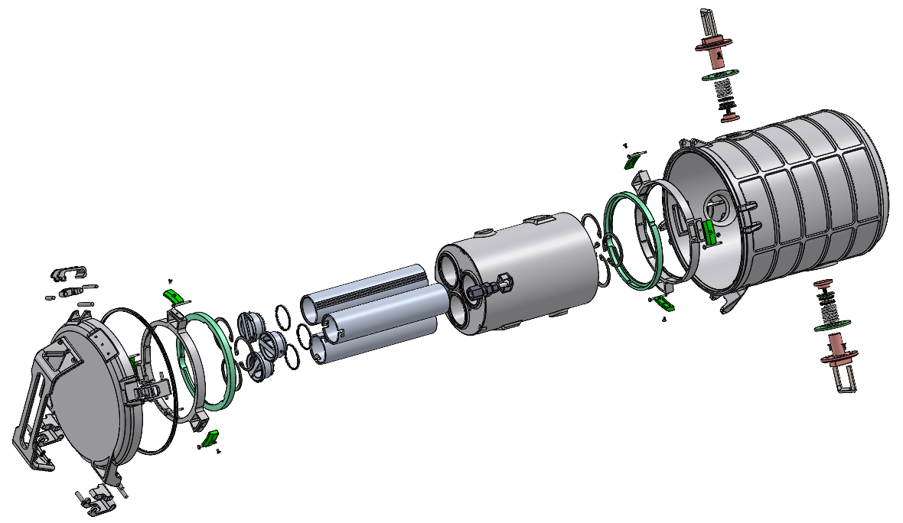
Subscale Secondary Seal Container
Part Type | Quantity
AM Parts | 22
Subtractive Parts | 4
G10 Insulator Parts | 12
Seals | 8
Swagelok Compression Fittings | 3
Fasteners, Pins, Springs, Retaining Rings | 43
Quick-Clamp High-Vaccum Fitting | 1
iMLI Component | 1
TOTAL PART COUNT | 94
iMLI not included

Slide 22
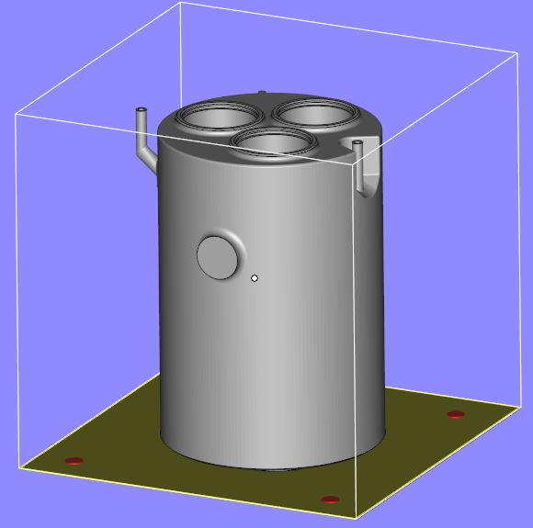
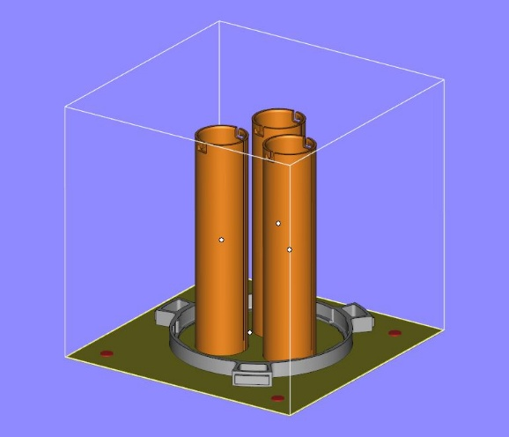
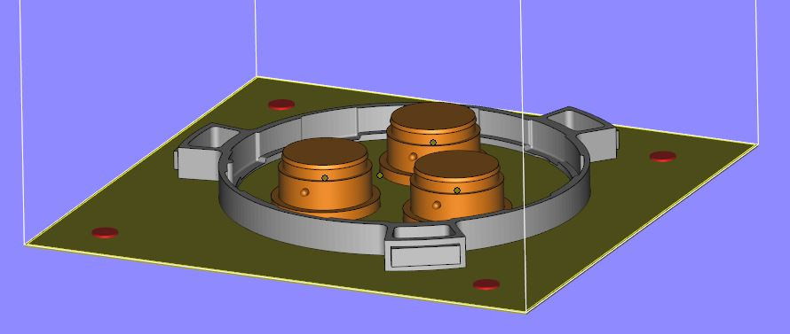
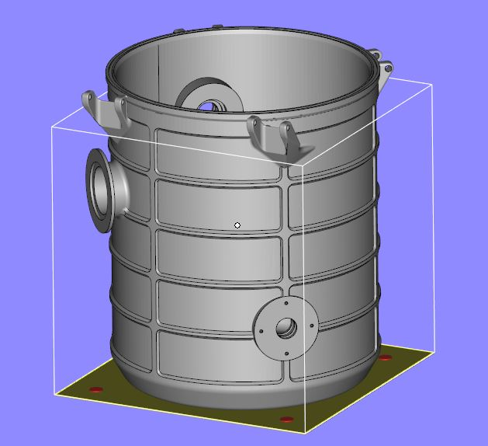
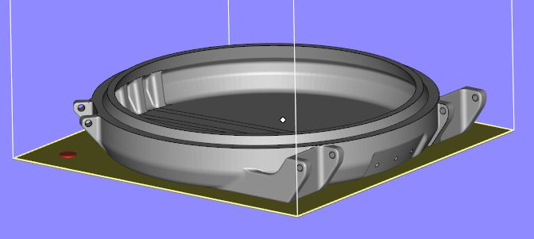
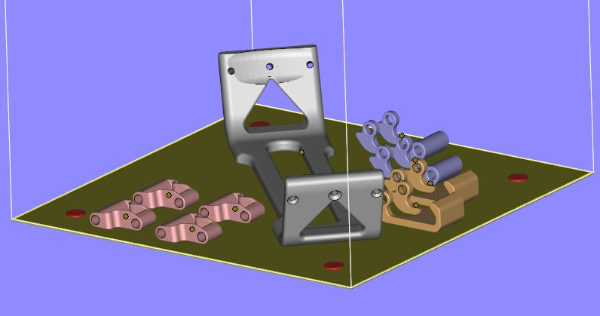
Build Layouts
≈ 4.5 Days
≈ 1.5 Days
≈ 0.5 Day
Build 3
Build 2
Build 1
≈ 2.5 Days
≈ 1 Day
≈ 0.5 Day
Build 4
Build 6
Build 5
22

Slide 23
Conclusions—Future Work
PCM Tank
CTE Scan the PCM Tank to assess how well it built as compared to the CAD
Final Machine PCM Tank
Deliver to NASA MSFC for solo testing
SSC Assembly
5 More LPBF Builds
Final Machine Parts
Assembly
Deliver to NASA MSFC for SSC testing

Slide 24
Acknowledgements
I would like to recognize and give special thanks to:
NASA MSFC for funding this effort
My Quadrus coworkers who helped with effort
iMLI not included

Slide 25




Questions?
690 Discovery Dr NW
Huntsville, AL 35806
256.327.3410 | QuadrusCorp.com
25

Slide 26
Additional Slides

Slide 27
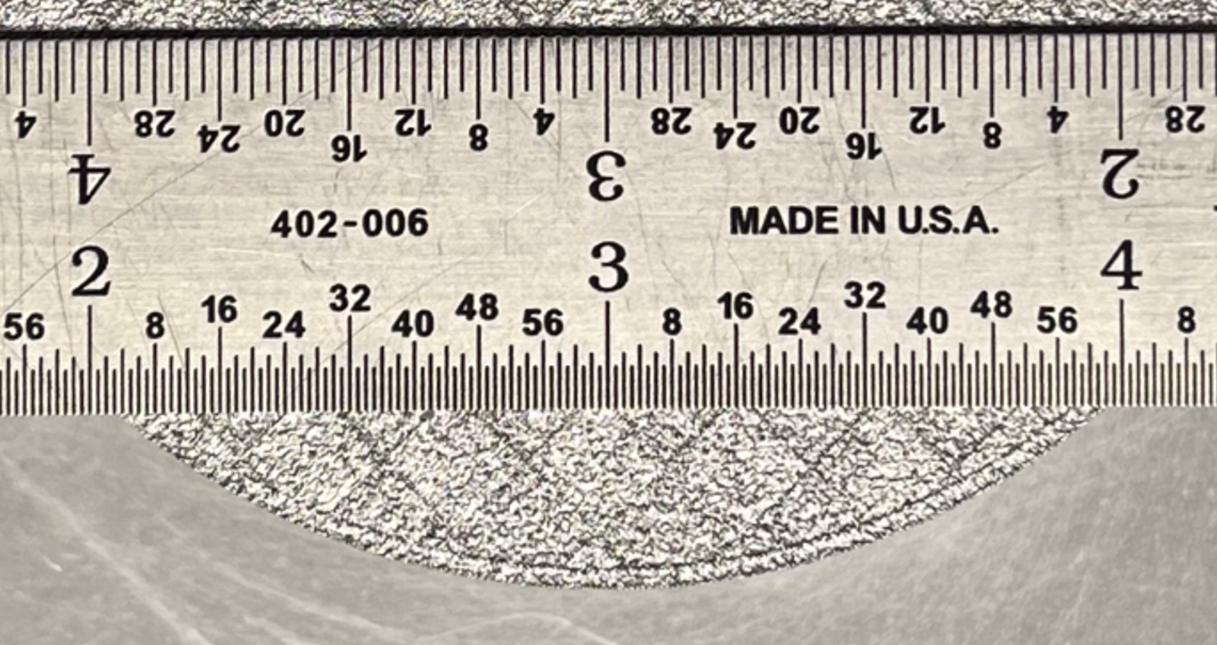
Scalmalloy Skin and Core Scan Strategy
Skin and Core Scan Strategy
  Skin - Continuous Scan Strategy
  with 30-micron layers
    Thickness can be varied
    Scalmalloy uses a thickness of 1.0mm
  Core – Island Scan Strategy
  with 60-micron layers
    Allows core to cool a little bit between laser exposures
  Skin Power = ½ Core Power
  Better control over surface finish
  Faster production times
Core
1.0mm
Skin

