Slide 1




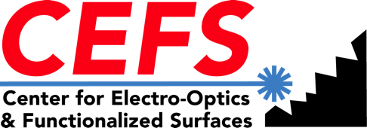
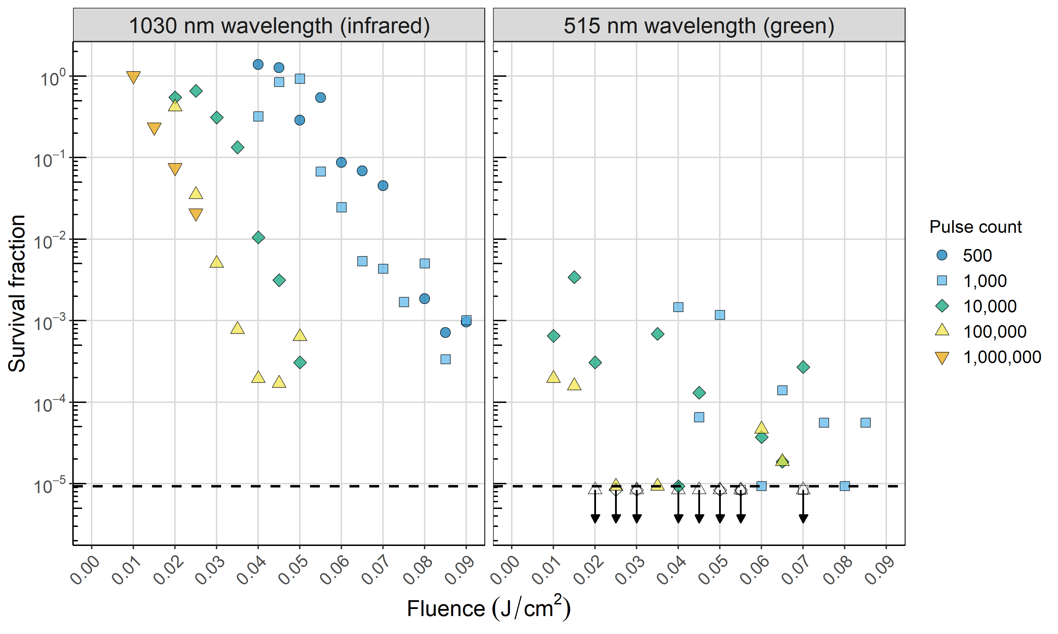
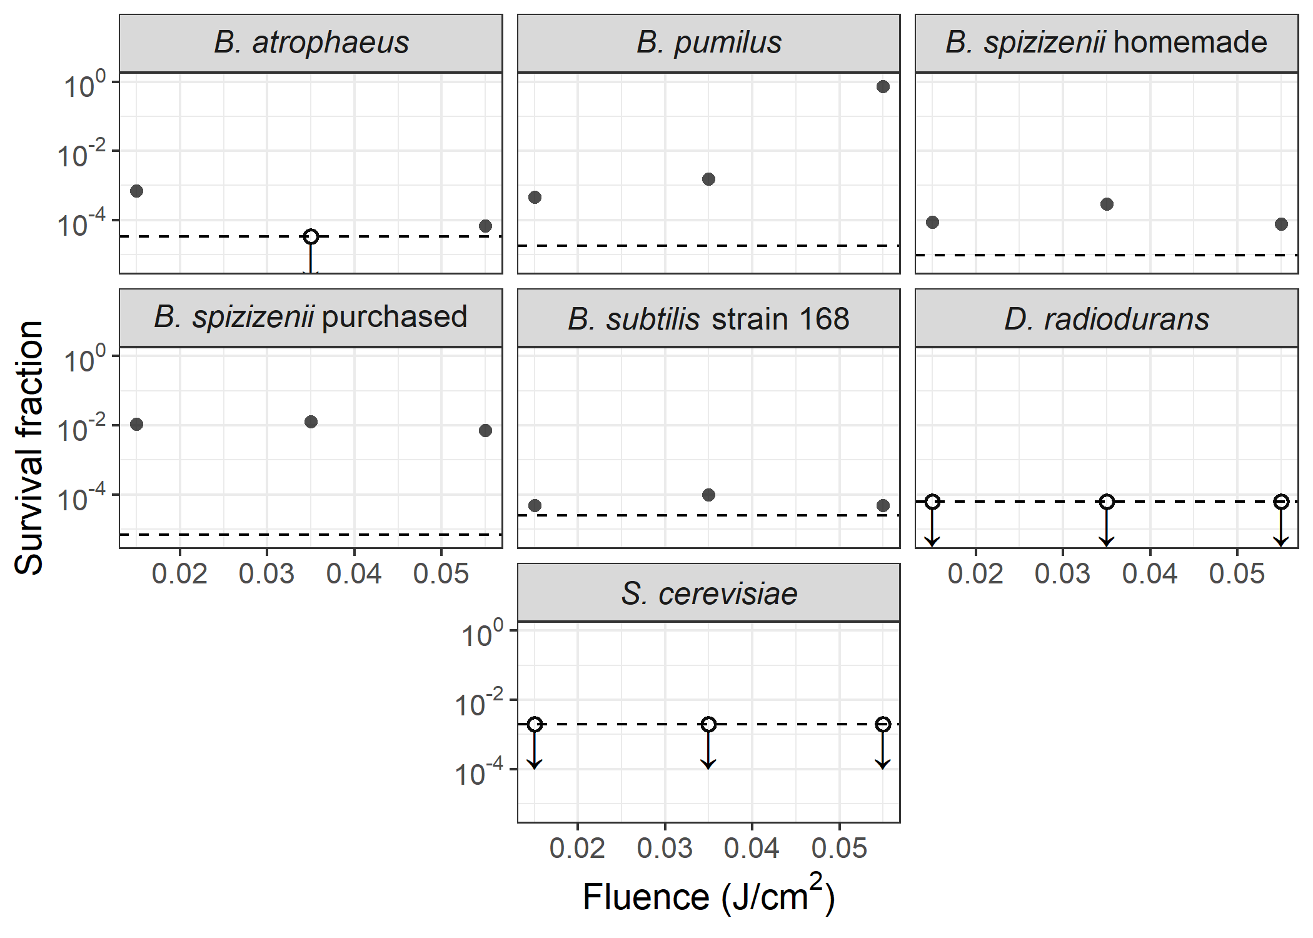
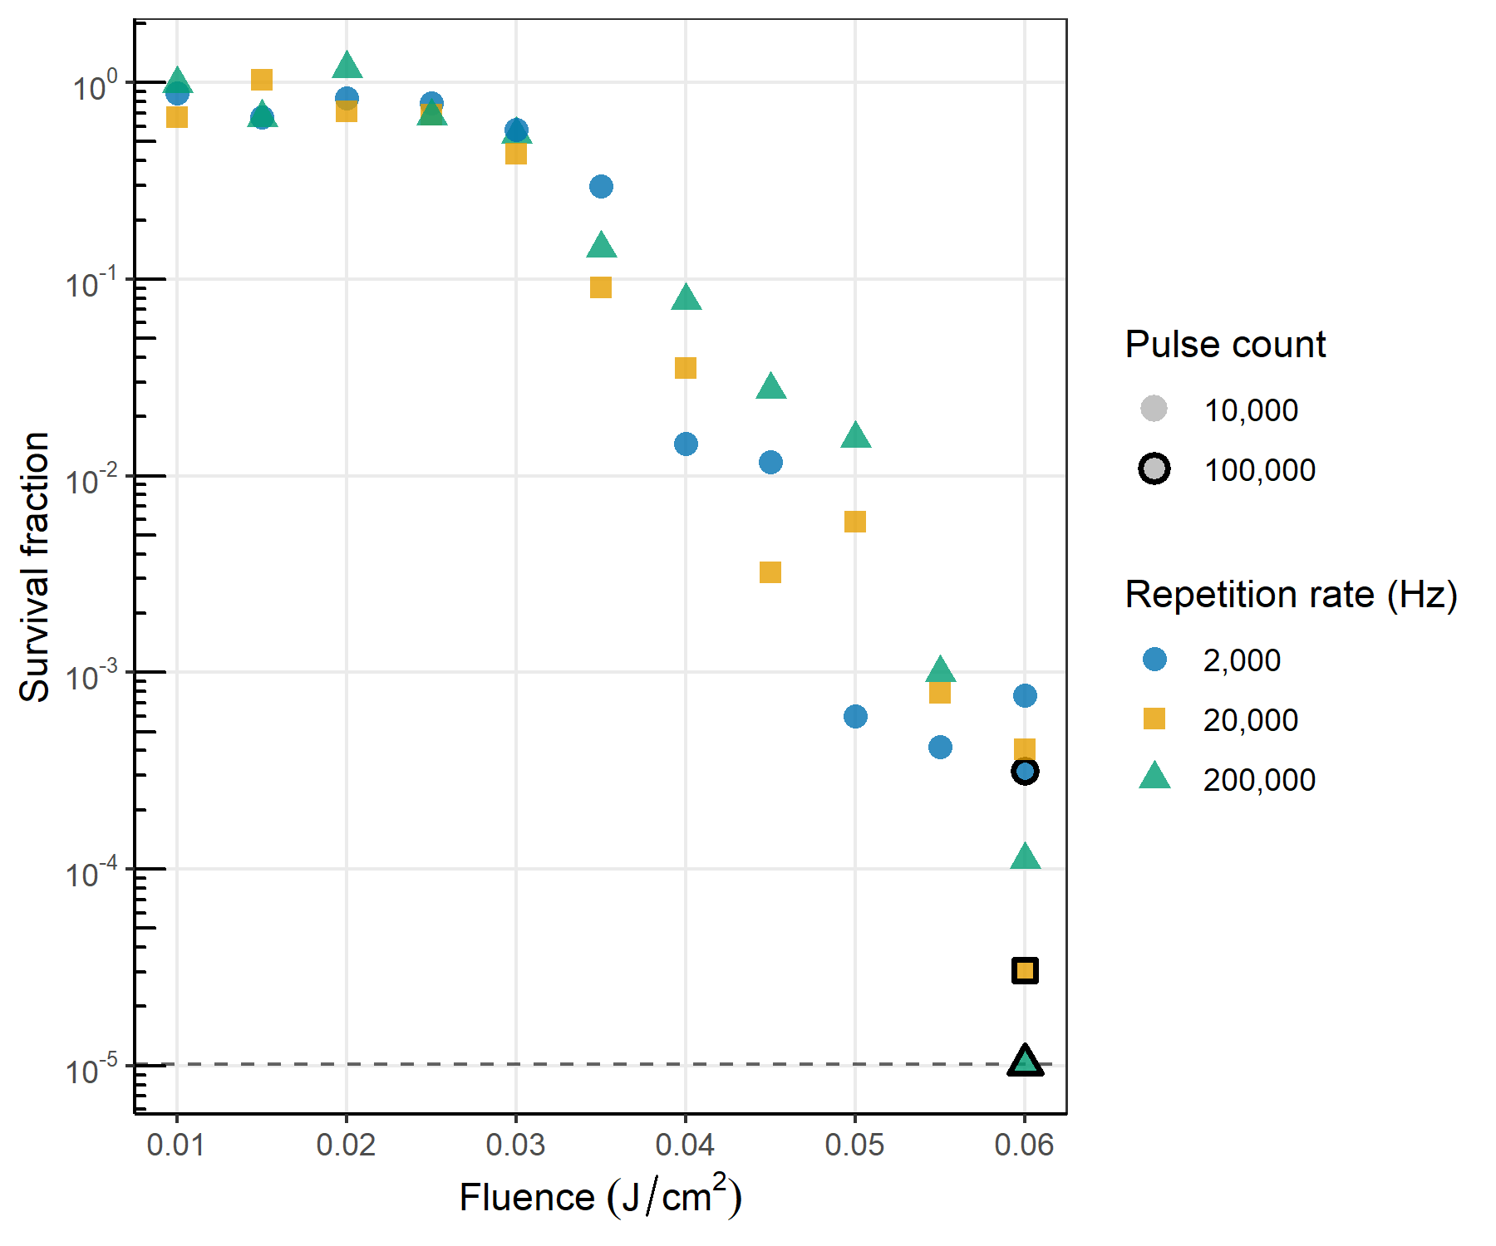
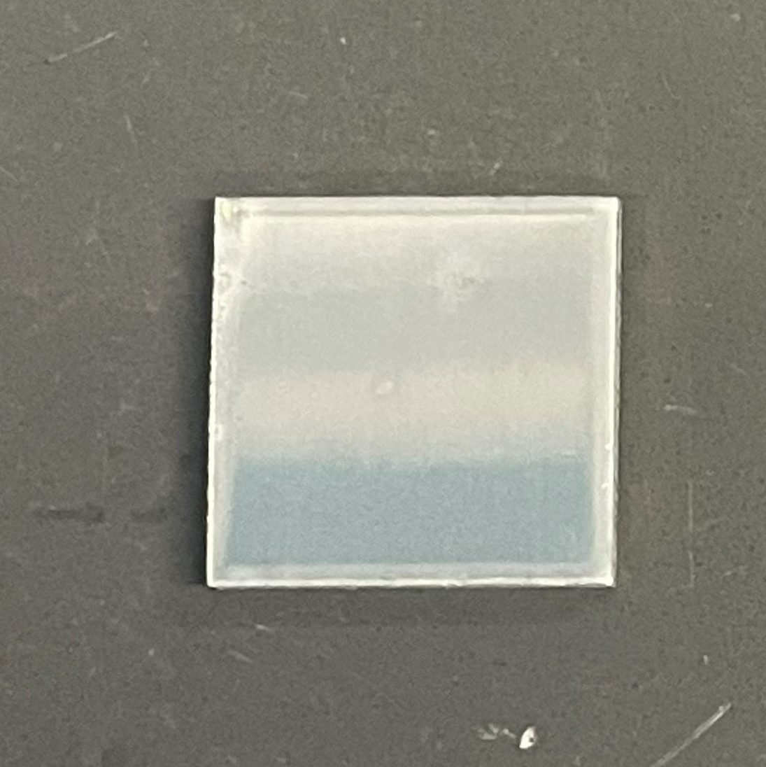
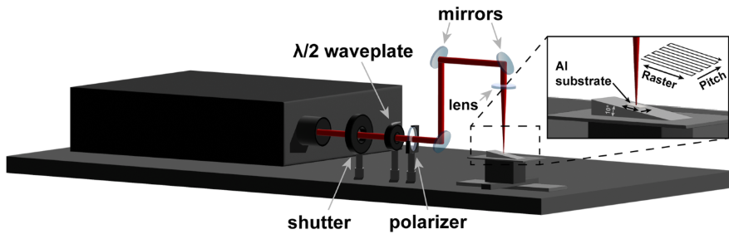
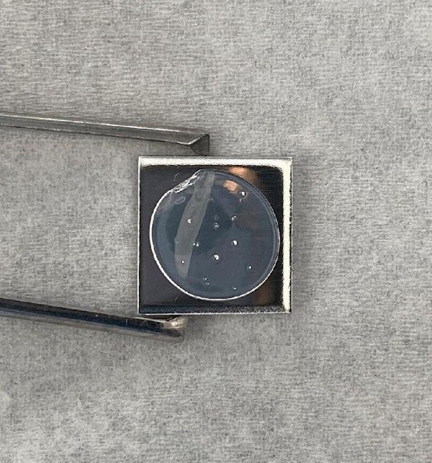
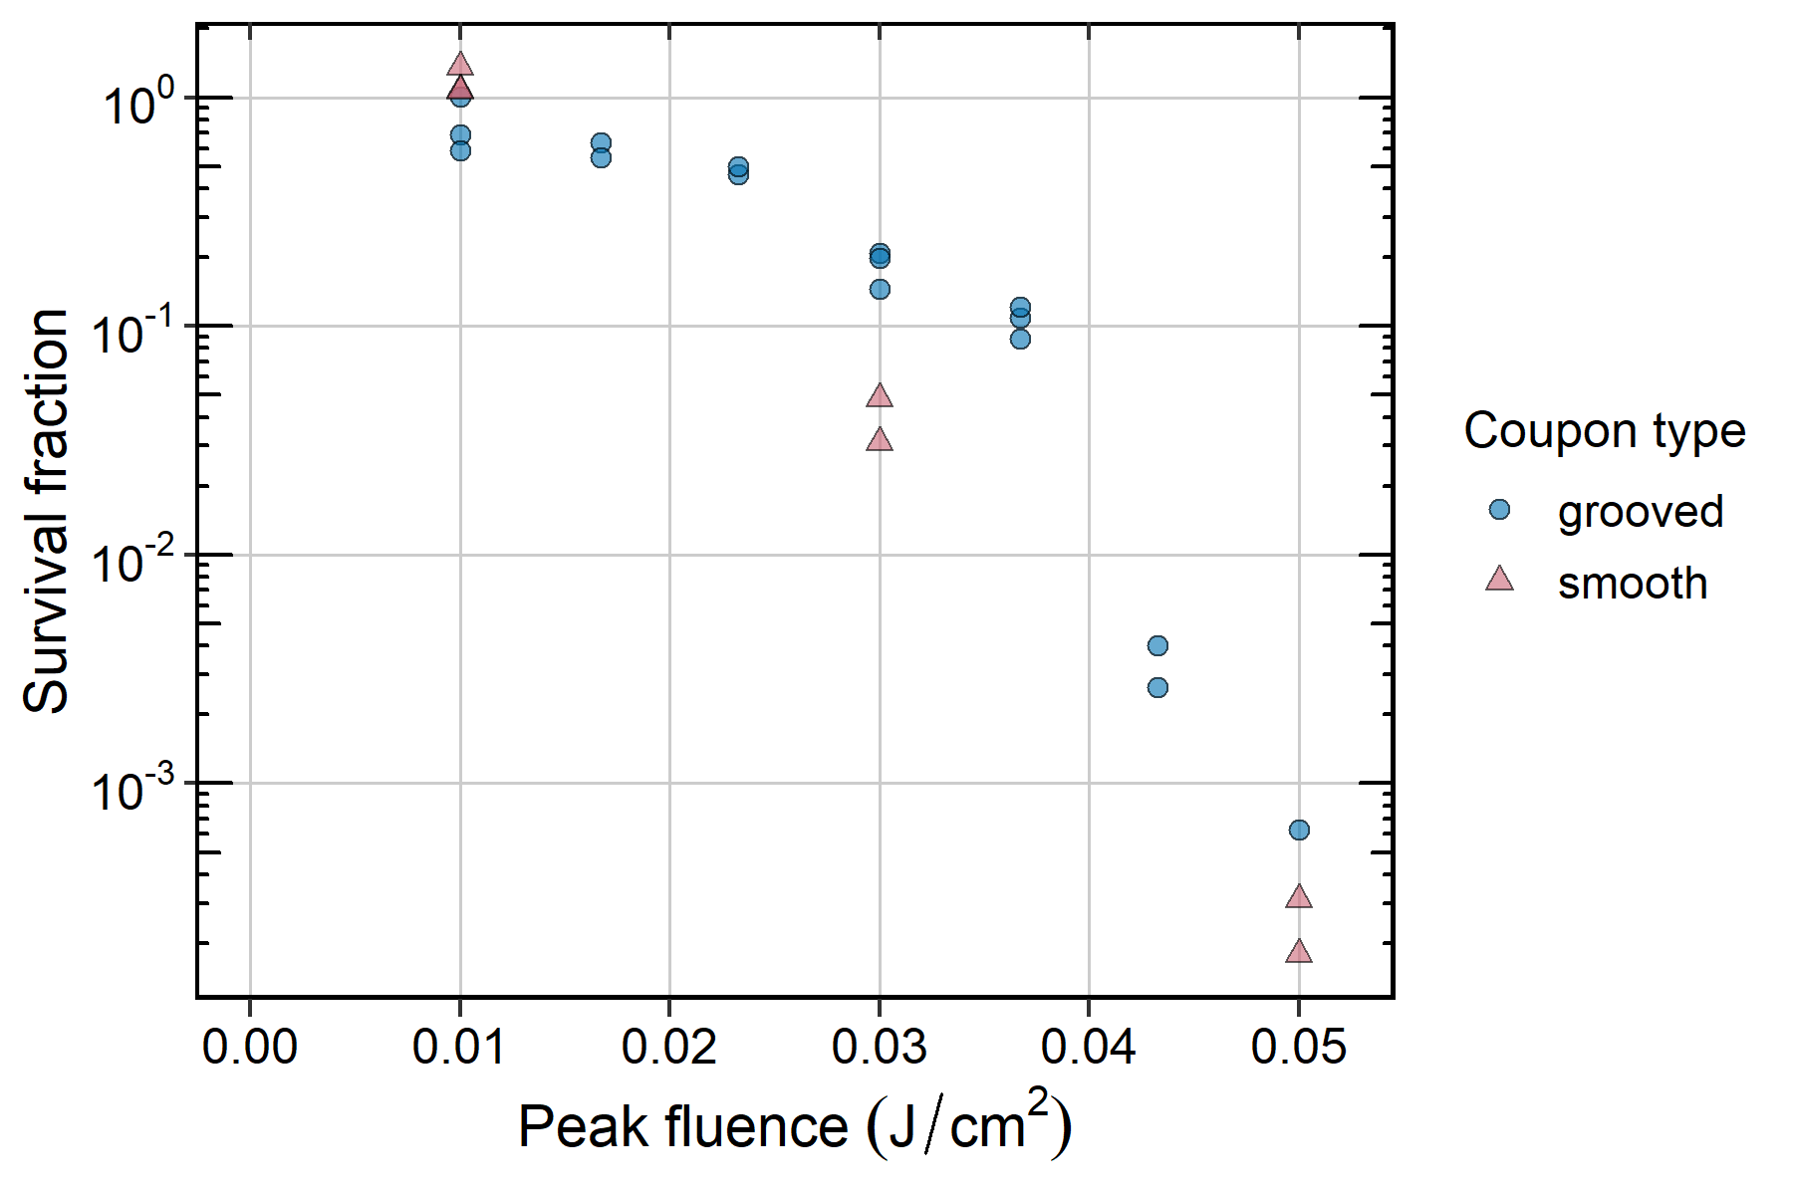
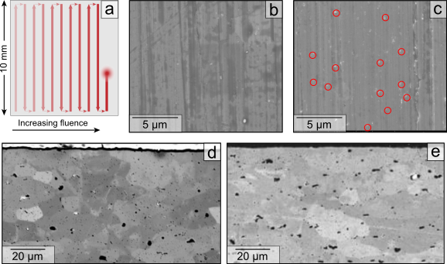
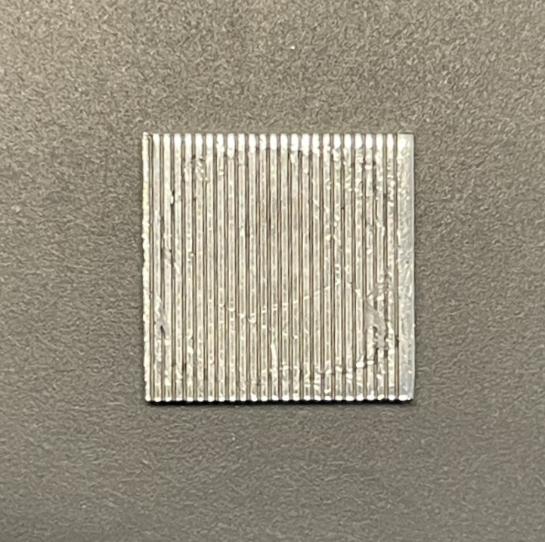
Ultrashort Pulse Lasers for Surface Sterilization
Benjamin Mousseau¹, Graham Kaufman², Andrew Butler², Kaleb McQuillan², Joseph Wright², Andrew Nuss³, Marjorie Potter³, Jessica Lee⁴, Craig Zuhlke²
¹Blue Marble Space; ²University of Nebraska-Lincoln College of Engineering; ³NASA Jet Propulsion Laboratory; ⁴NASA Ames Research Center Space Biosciences Division
Background
Results: Wavelength Dependence
Results: Effectiveness Across Taxa
Spacecraft destined for Mars have maximum allowable spore counts set by the Committee on Space Research (COSPAR), which NASA’s Office of Planetary Protection and other space agencies adhere to, to preserve life detection science.
Femtosecond lasers, a new and rapidly advancing technology for delivering high light intensity in short pulses, are a promising way of reducing bioburden on spacecraft surfaces.
Compared to other bioburden reduction methods, femtosecond lasers are spatially precise and portable and may be compatible with a wider range of materials.
We aim to address these questions: Can femtosecond lasers effectively sterilize a diversity of organisms and surface textures? Which laser parameters achieve the best bioburden reduction while minimizing surface damage?
Survival against fluence at 515 nm wavelength, pulse count of 10,000, and pulse length of 170 fs. Limits of detection are plotted as dashed lines.
Sterilization methods compared
 | Dry Heat Microbial Reduction (DHMR) | Vapor Hydrogen Peroxide (VHP) | Femtosecond lasers
Pros | Reduces both surface and encapsulated bioburden | Sterilizes complex surfaces | Logistical ease of use (in-situ sterilization), spatial precision
Cons | Logistics (transport to and from cleanroom), time, material incompatibilities | Logistics, material incompatibilities | Line-of-sight sterilization only
Best for… | All heat-tolerant spacecraft components² | Equipment with special stringency, e.g. tools for sample return assembly¹ | Targeting contaminated spots of already-assembled hardware, parts incompatible with DHMR and VHP (e.g. electronics, optics)
Laser treatment is effective on several spore-forming Bacillus strains and is at least as effective on Deinococcus radiodurans.
Spore survival plotted against fluence and pulse count at 1030 nm and 515 nm wavelengths. Pulse length is 170 fs. Limit of detection is plotted as a dashed line; hollow points are BDL.
Previous work has shown increased effectiveness at higher fluence, higher pulse count, and shorter pulse length. We also found increased effectiveness at shorter wavelengths.
Results: Repetition Rate
We tested whether the same surface area could eventually be treated more quickly by increasing the repetition rate (the rate at which pulses are repeated).
Methods
We tested several laser parameters to optimize for bioburden reduction:
Fluence – the peak energy per unit area of a single pulse
Pulse count – the number of times that a given point on the surface receives a pulse
Wavelength – the distance between two consecutive peaks of a light wave
Pulse length (not shown) – the time span of a single pulse
Increasing fluence and pulse count inactivated more spores with infrared pulses, but not enough to achieve 4-log reduction. Upon halving wavelength, we saw better than 5-log reduction.
Spore survival plotted against fluence, repetition rate, and pulse count. Pulse length is 170 fs, and wavelength is 1030 nm. Limit of detection is plotted as a dashed line.
Inoculate 1 cm² aluminum coupons with 2.2×10⁵ Bacillus spizizenii spores.
Treat coupons with the femtosecond laser by rastering pulses across the substrate surface.
Deposit polyvinyl alcohol (PVA – it’s like glue) on the coupons, let it dry, then peel it off.
Dissolve the peels in water, serially dilute, plate dilutions to count colony-forming units.
Results: Grooved Surfaces
Aluminum coupon
Laser scanning setup
Dried PVA
We were interested to see whether femtosecond laser treatment is also effective on irregular surfaces, as many spacecraft surfaces are not perfectly smooth.
Repetition rate does not meaningfully affect sterilization efficacy.
Results: Material Compatibility
Future Work
a) Laser raster pattern used for surface damage testing. b) before and c) after treatment at a pulse count of 0.0085 J/cm² and a pulse count of 5,660, SEM images. d) cross-section of control coupon not exposed to laser. e) cross-section of coupon treated at 0.05 J/cm² and a pulse count of 50,000.
Inoculate coupons with 10× more spores to improve limit of detection.
Halve the wavelength again, to 257 nm.
Evaluate surface damage on broader variety of treatments.
Test sterilization and surface damage on different substrates.
Determine and reduce causes of variation between and within sample sets.
A grooved coupon. Grooves are 85 µm deep.
Acknowledgments
Spore survival against fluence on microchanneled (grooved) and smooth surfaces, at a wavelength of 800 nm, pulse length of 35 fs, and pulse count of 100,000.
Thank you to Parag Vaishampayan, Tatyana Sysoeva, and GERMS lab members for helpful discussions. This work is funded by two NASA ROSES Planetary Protection Research Grants to C. Zuhlke (Grant numbers 80NSSC22K0213 and 80NSSC24K0323).
References
Treatment at typical processing parameters causes nano-scale surface modification of aluminum but no subsurface damage.
Treatment on grooved surfaces is still effective, though slightly less than on smooth surfaces.
¹Chen, Fei, et al. “Mars 2020 Mission Biological Return Sample Contamination Control Approach and Verification.” Astrobiology, vol. 23, no. 8, Aug. 2023, pp. 862–79. liebertpub.com (Atypon), https://doi.org/10.1089/ast.2022.0048.
²Benardini, James N., Myron T. La Duc, Robert A. Beaudet, et al. “Implementing Planetary Protection Measures on the Mars Science Laboratory.” Astrobiology, vol. 14, no. 1, Jan. 2014a, pp. 27–32. liebertpub.com (Atypon), https://doi.org/10.1089/ast.2013.0989.

