Slide 1
Quantifying Primary Arc-induced Degradation of Perovskite Solar Cells
Meghan Bush*, Kaitlyn VanSant², Jeremiah Sims¹, Alexis Arroyo¹,
Joey Luther², Boris Vayner³, Timothy J. Peshek¹
¹ NASA Glenn Research Center, Cleveland, OH, 44135, USA
² National Laboratory of the Rockies, Golden, CO, 80401, USA
³ HX5, Cleveland, OH 44135, USA

Slide 2
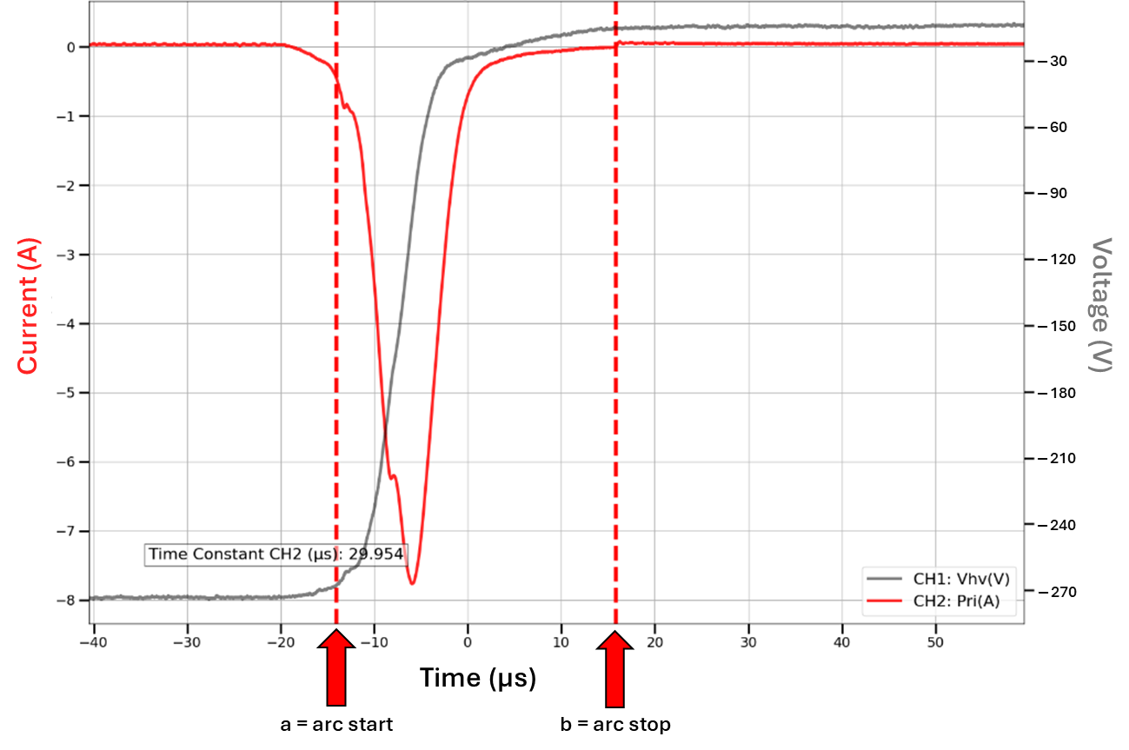
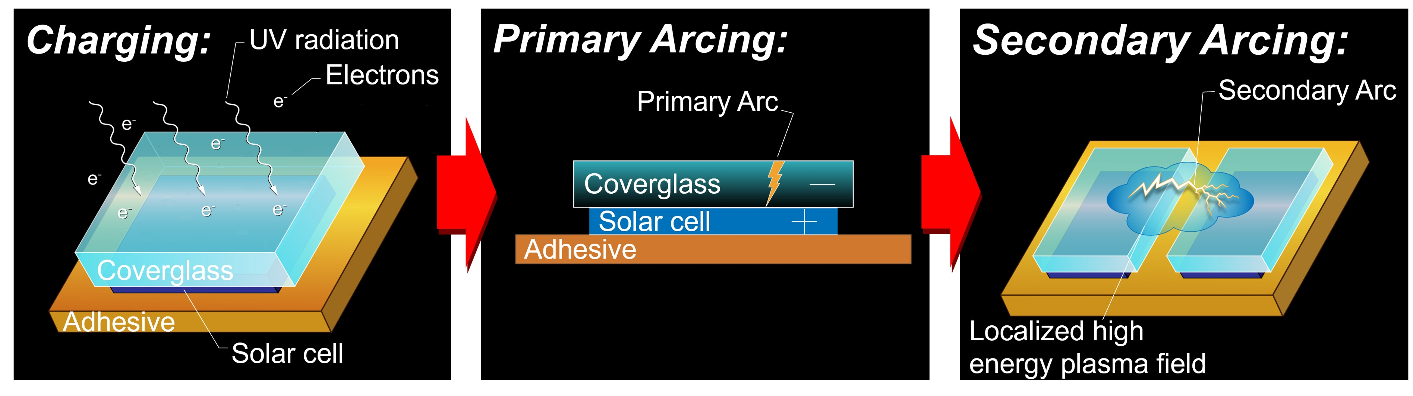
Intro to Spacecraft Charging
Operation in the space environment exposes solar cells to charged particles, which can induce electrostatic discharges on the cell.
Due to their very thin architecture, preliminary research indicates that perovskite solar cells may be especially susceptible to damage via primary arcing.
We aim to characterize perovskites’ vulnerability to primary arcing to best inform protecting them.
Example Primary Arc

Slide 3
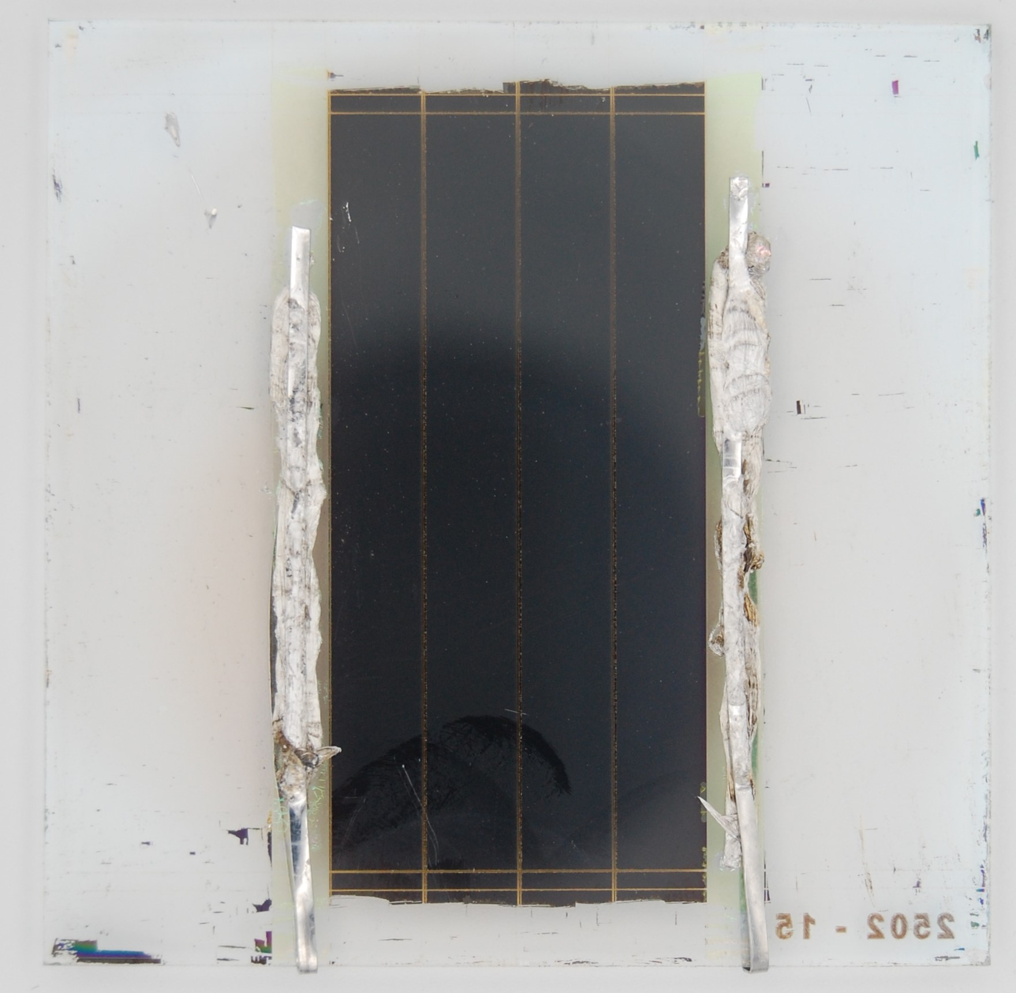
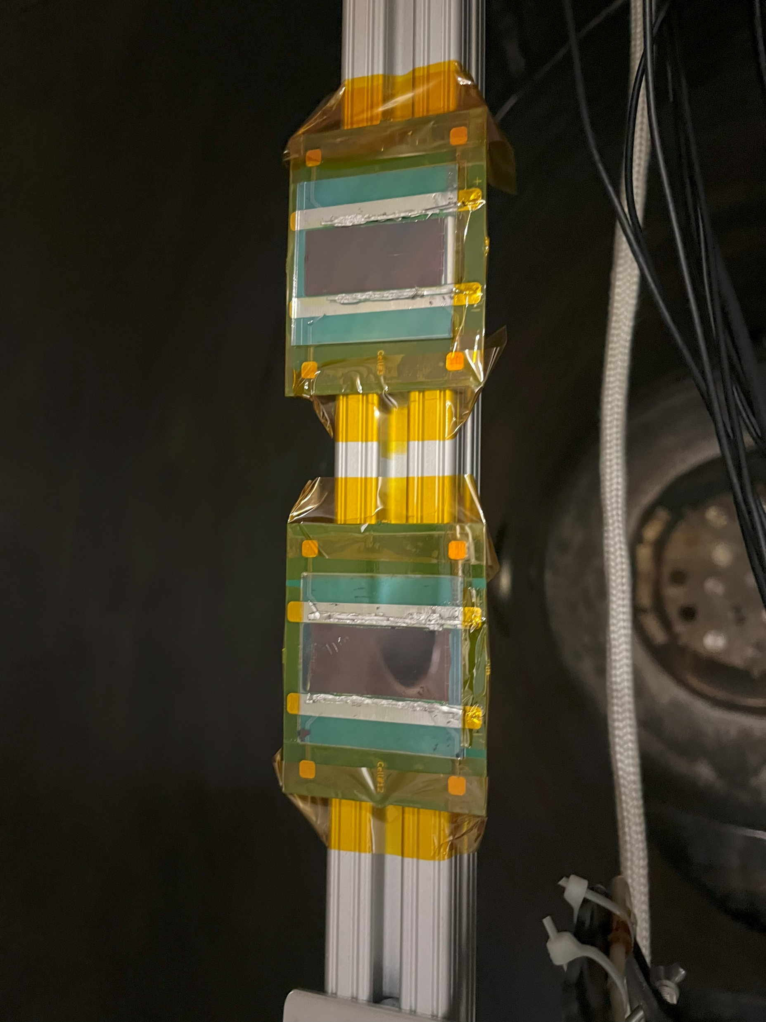
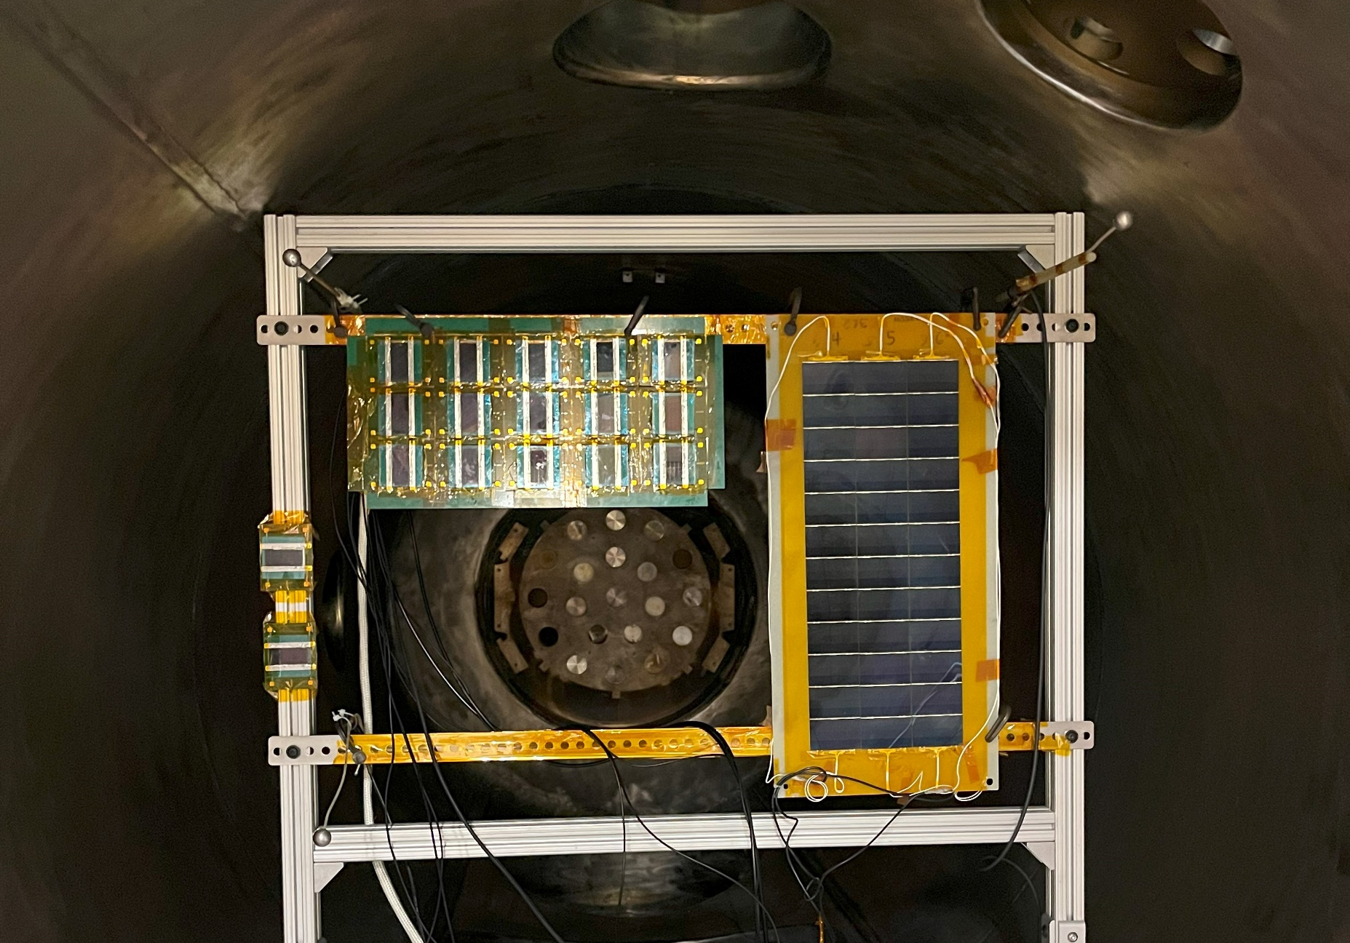
Experimental Setup
“Mini-module” from NLR
Inside the vacuum test facility, cells are divided into three strings of five cells each; two witness cells are included that will undergo high vacuum but no primary arcing.
Perovskites
witness cells
4 individual subcells in series
For clarity, I will be referring to each mini-module as a “cell” throughout this presentation; all 4 subcells are characterized together.

Slide 4
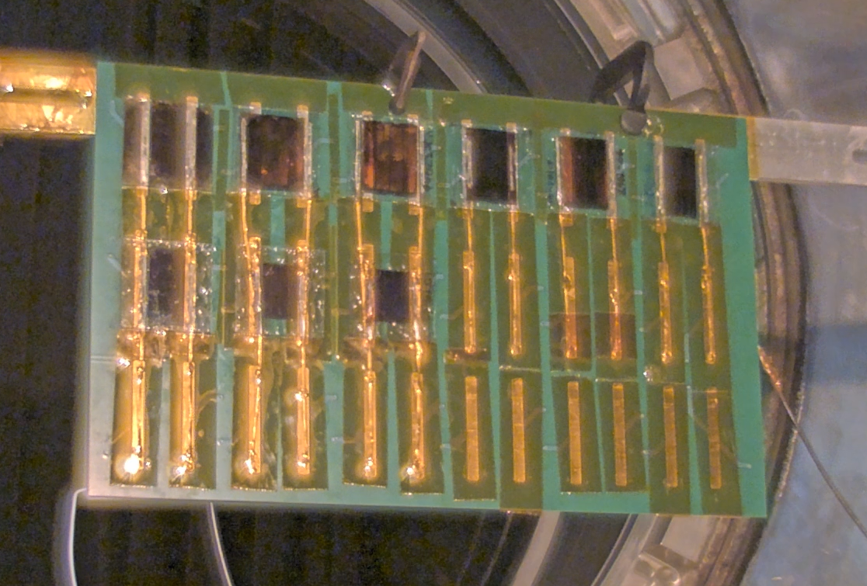
A cycle of damage:
Primary arc
Arc current injects heat into cell
Heating causes damage (material pyrolysis, shunting)
Surface defects can strengthen e-field and increase primary arc probability at that point
Shunts preferentially draw current during next arc, increasing localized heating
Increased primary arc rate and resulting thermal stress cause significant damage to cell

Slide 5
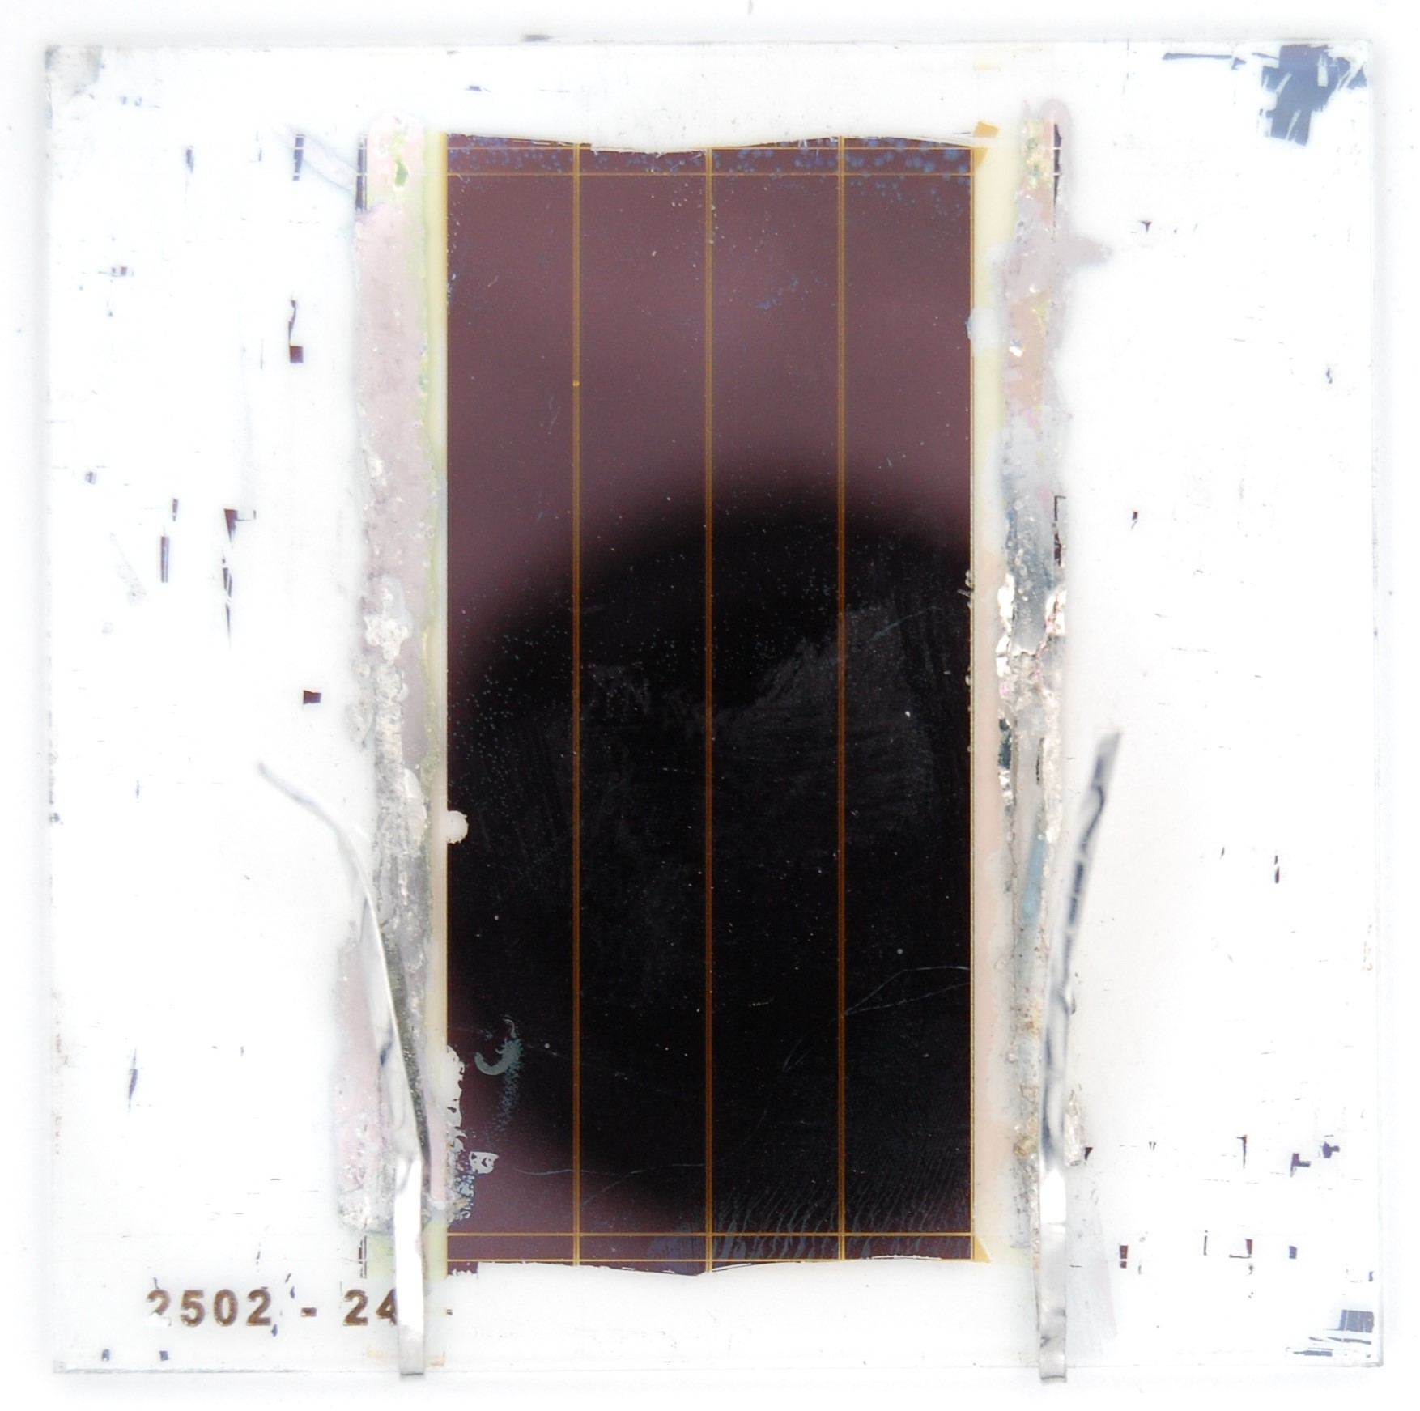
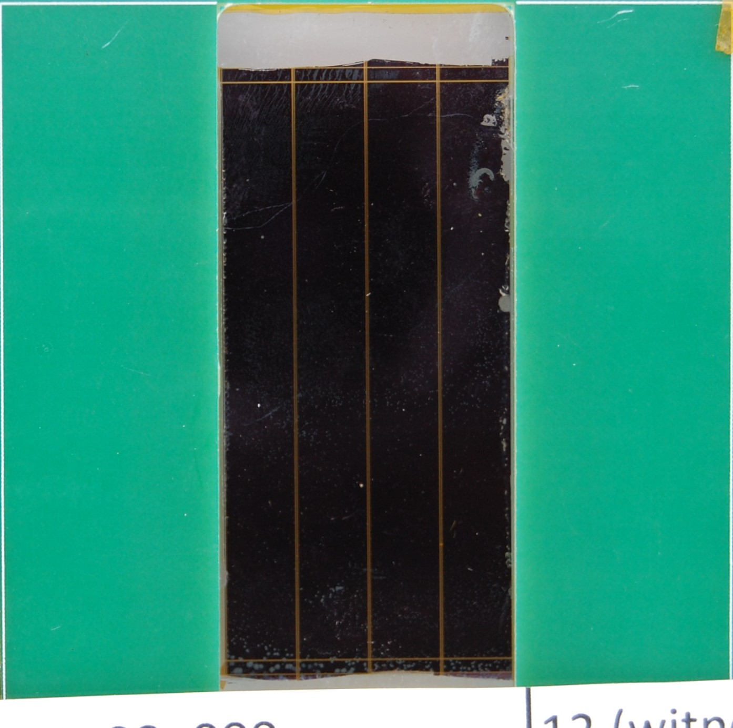
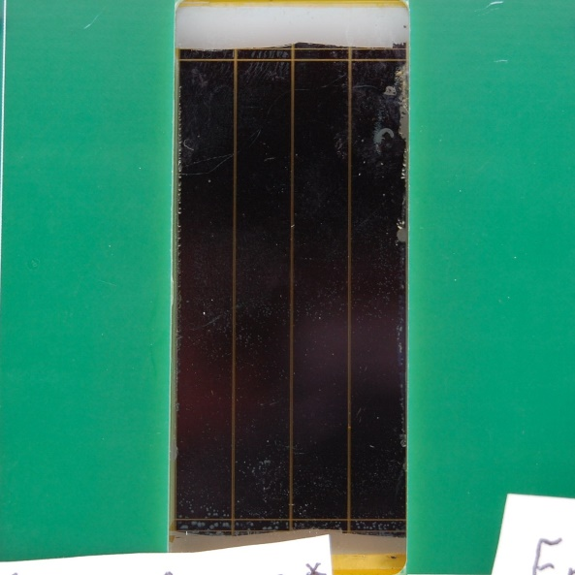
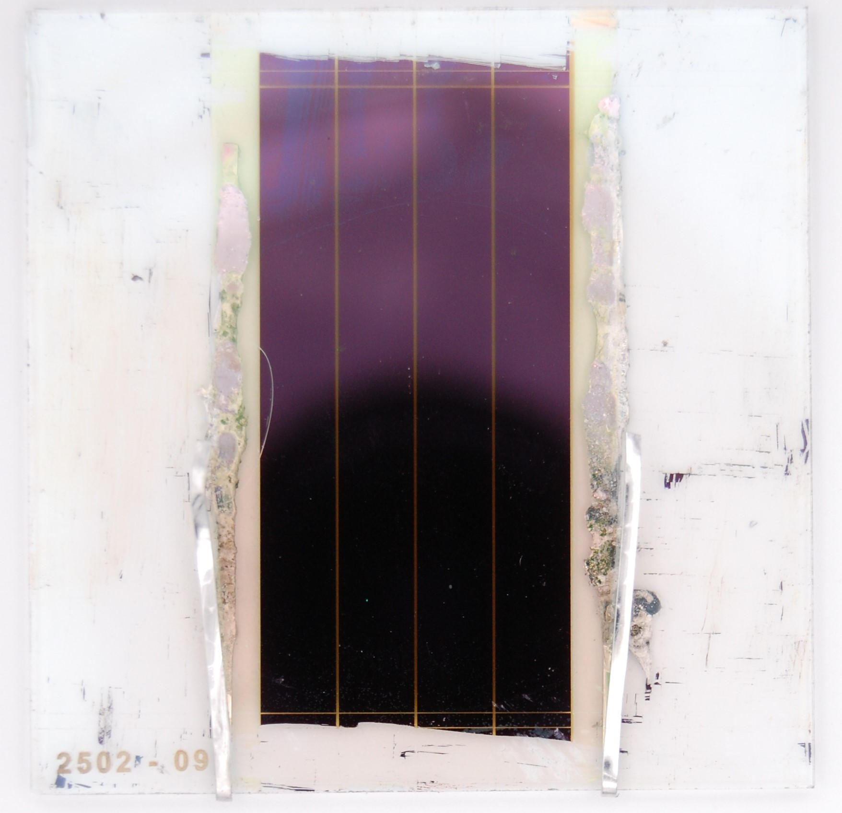
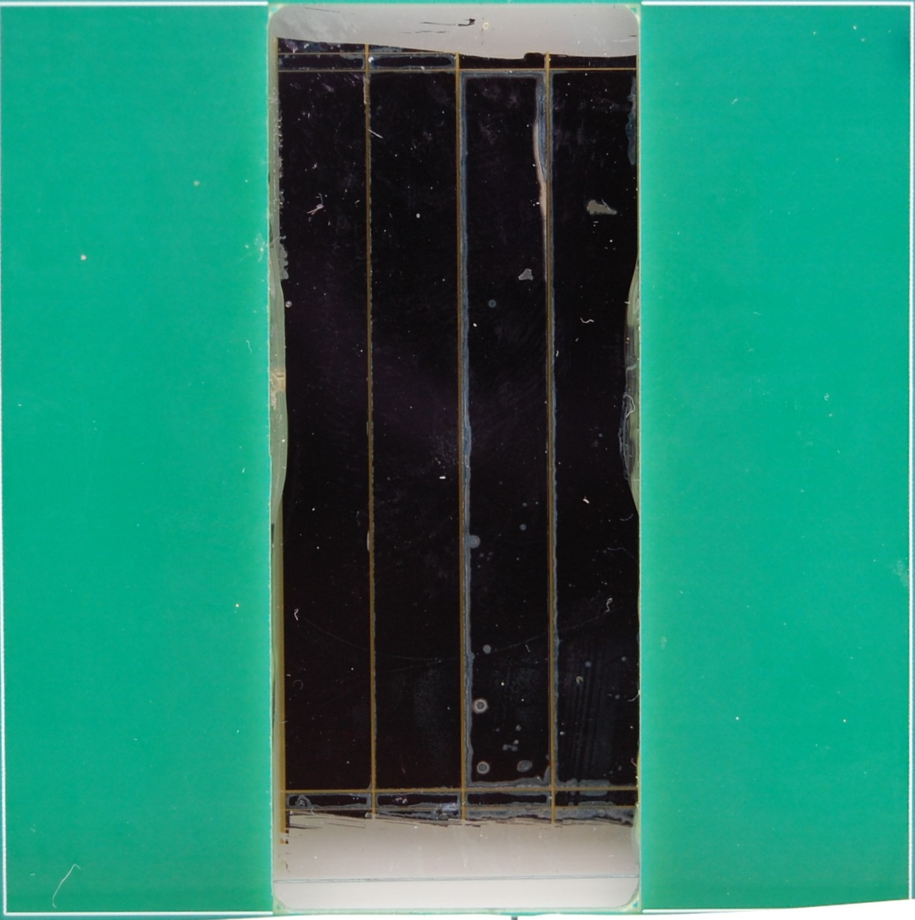
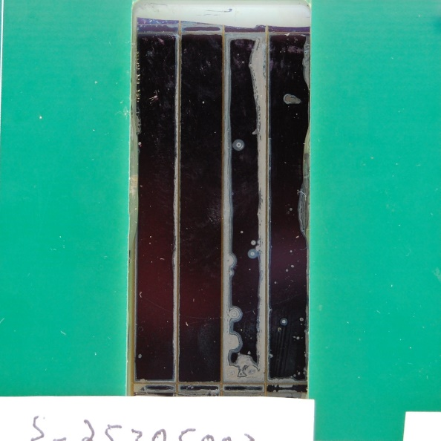
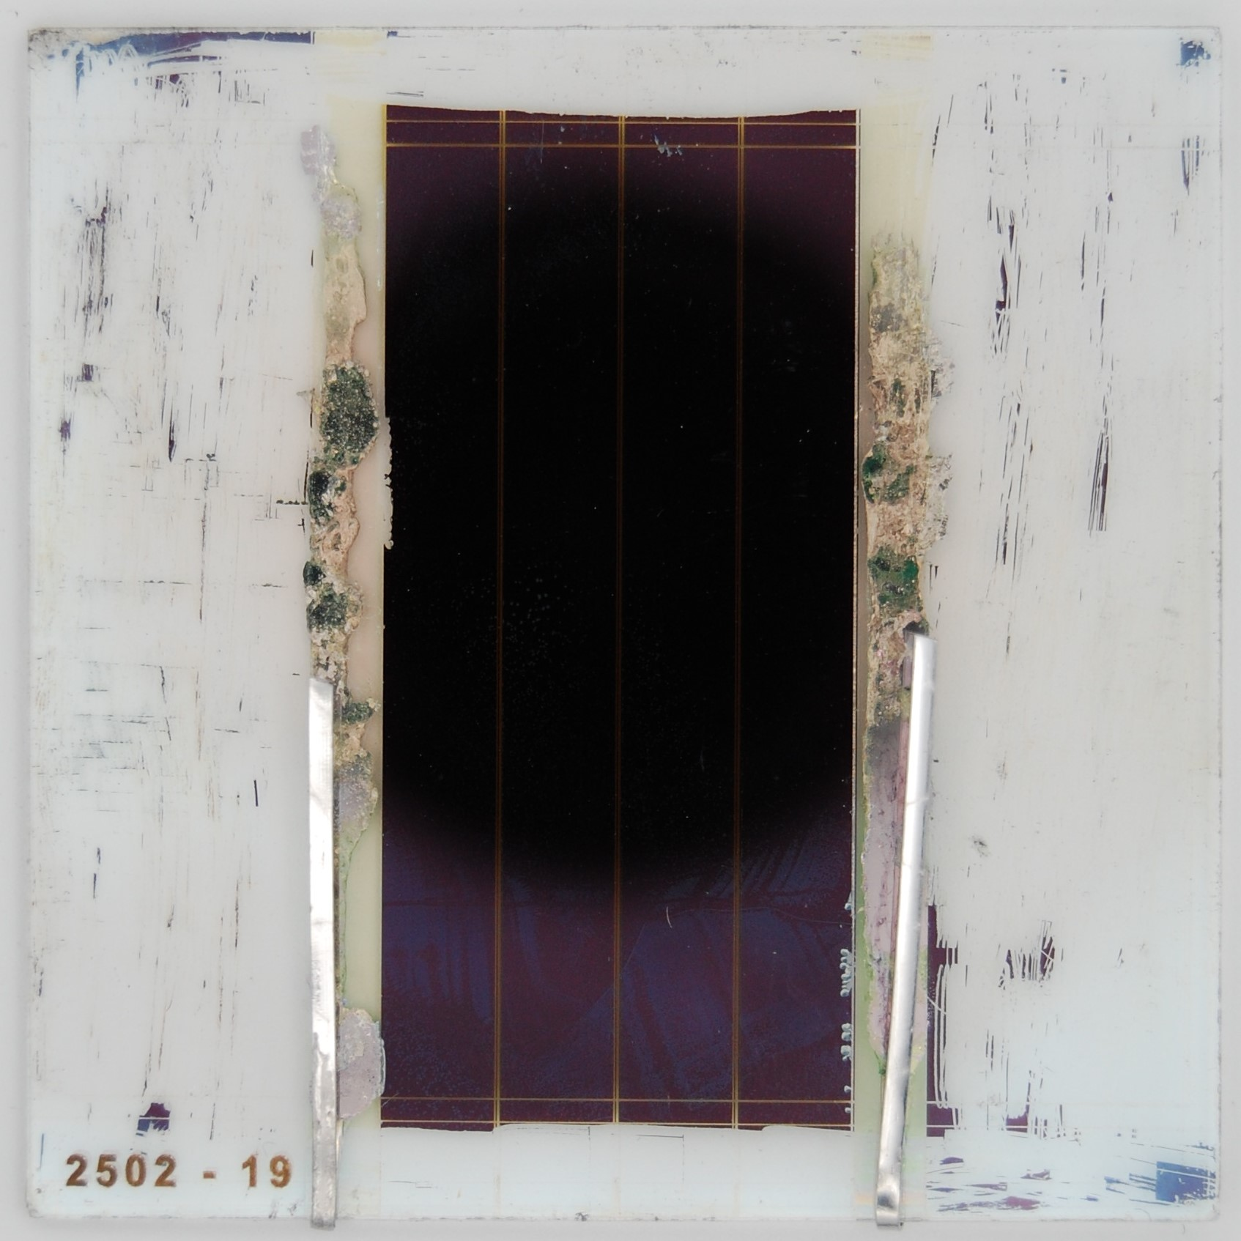
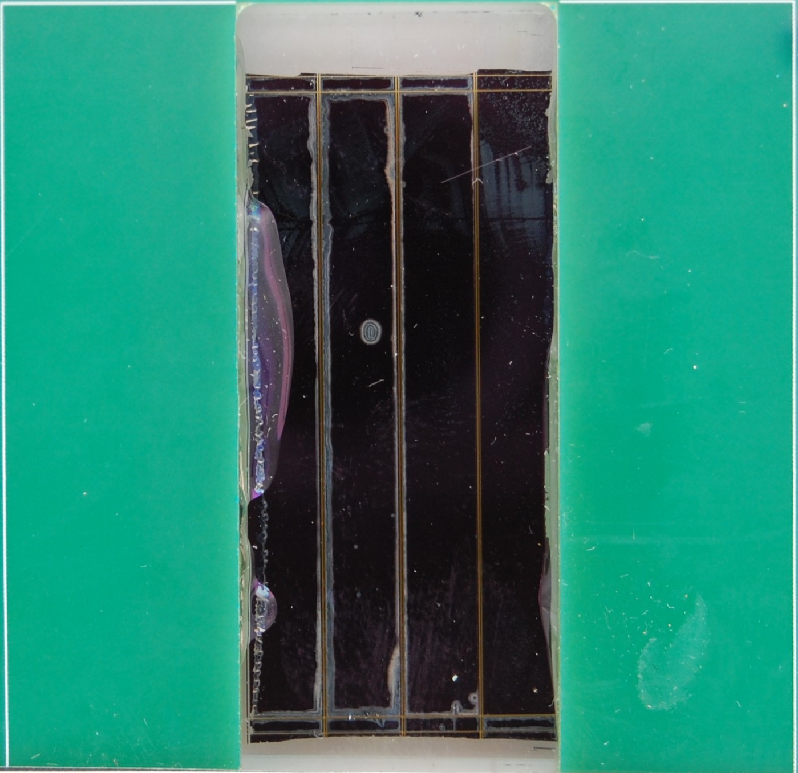
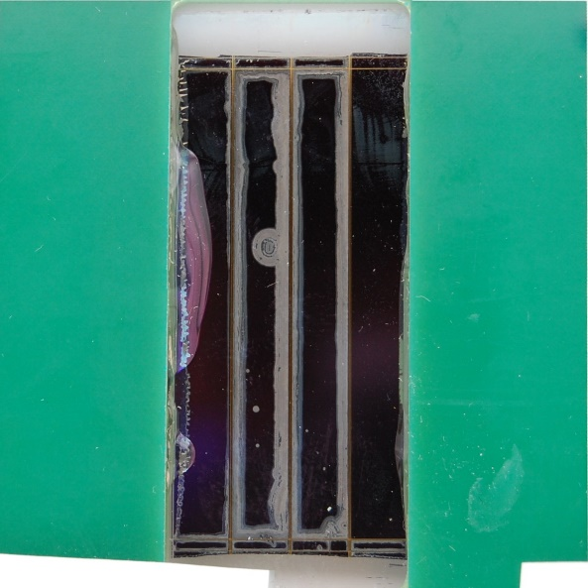
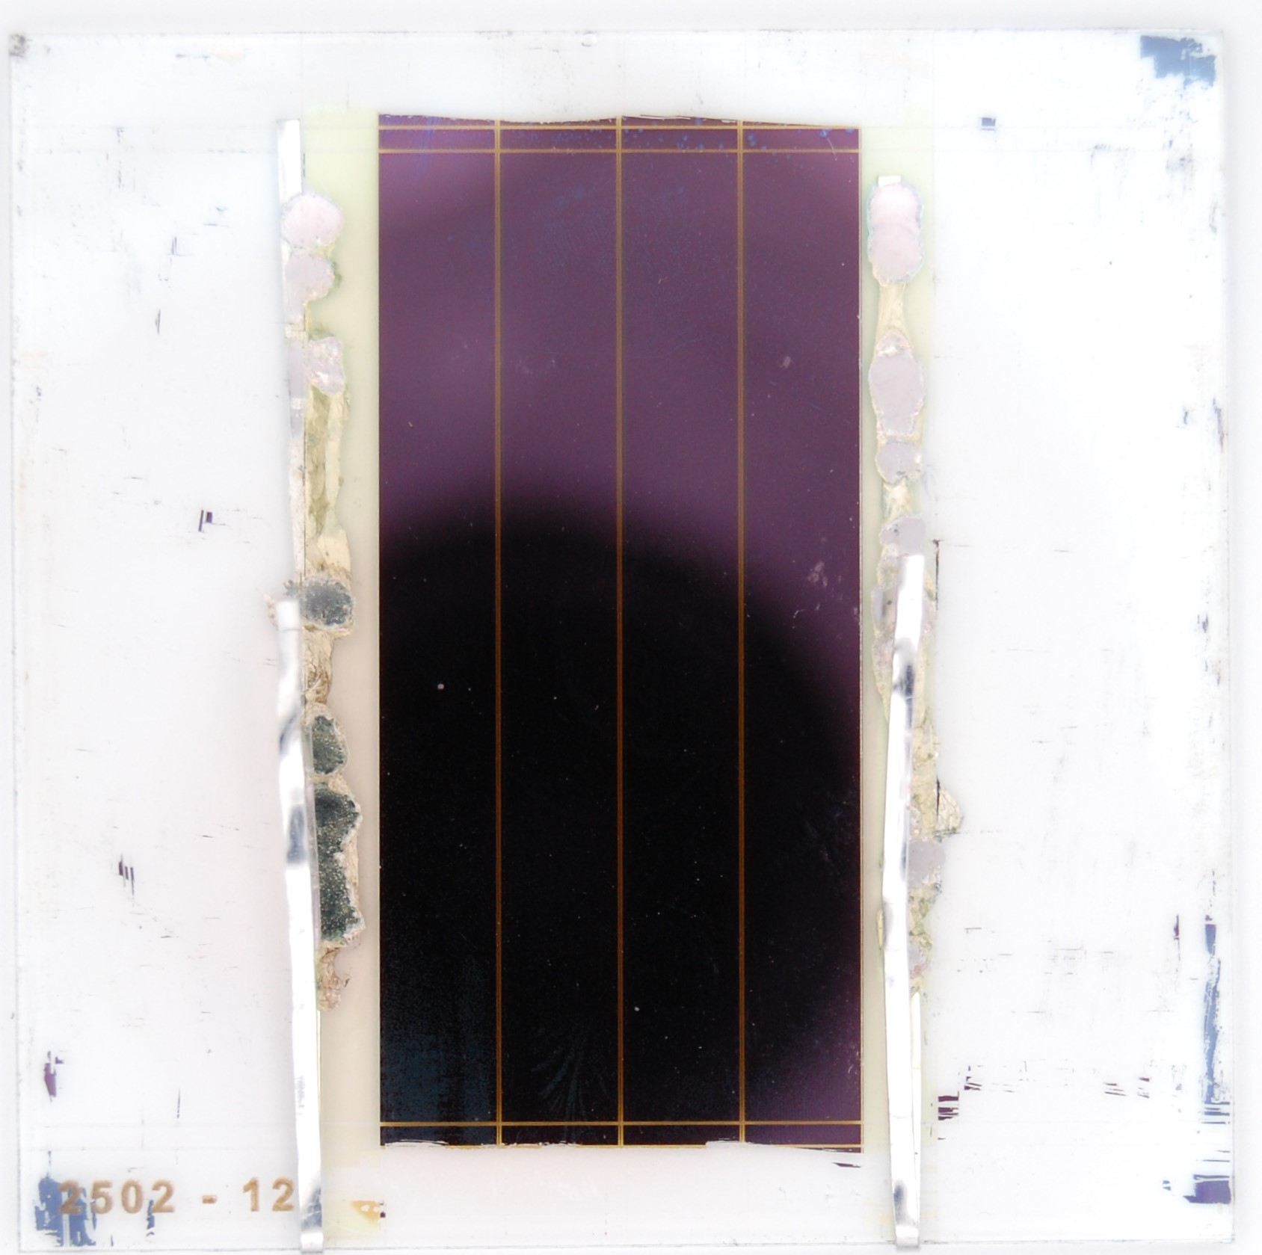
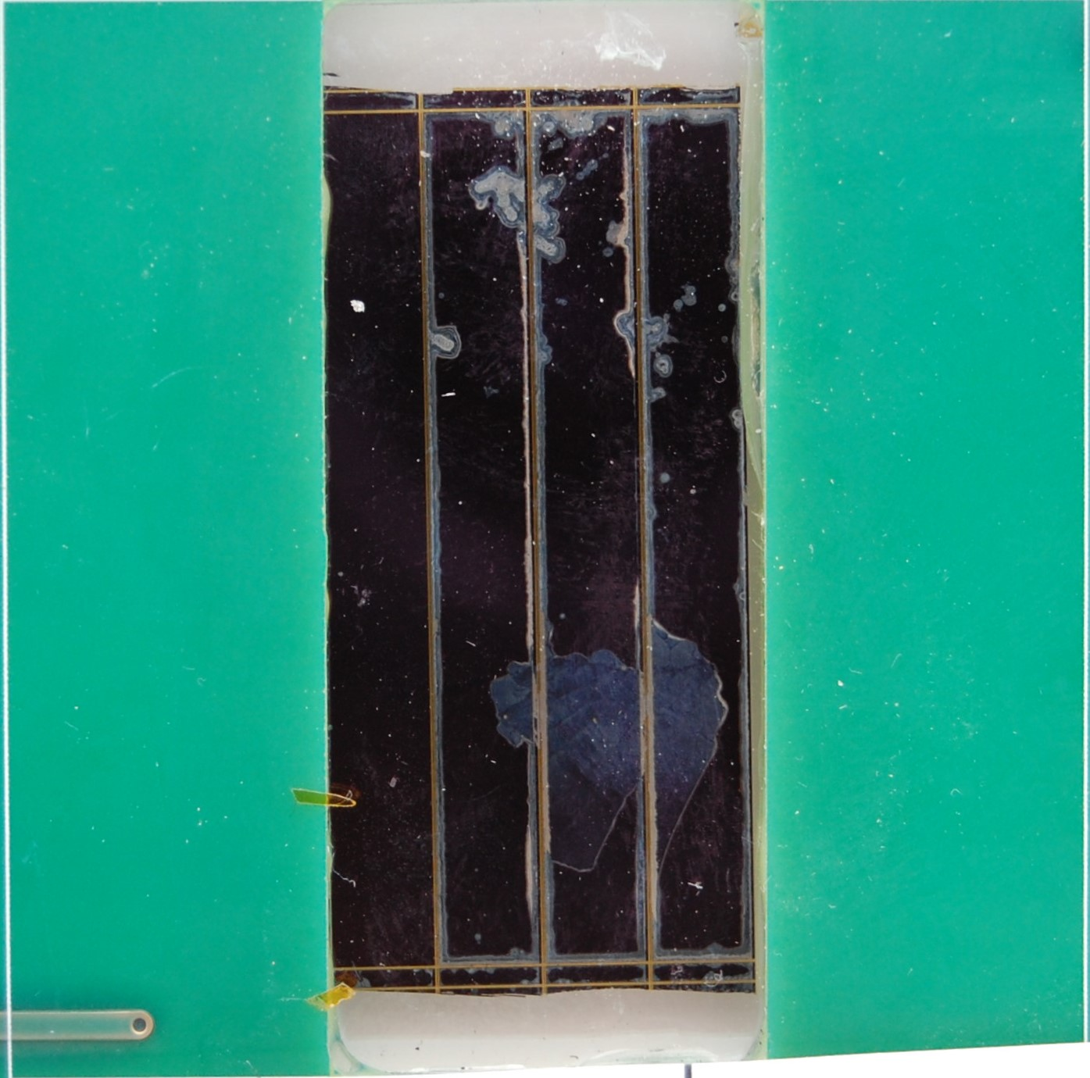
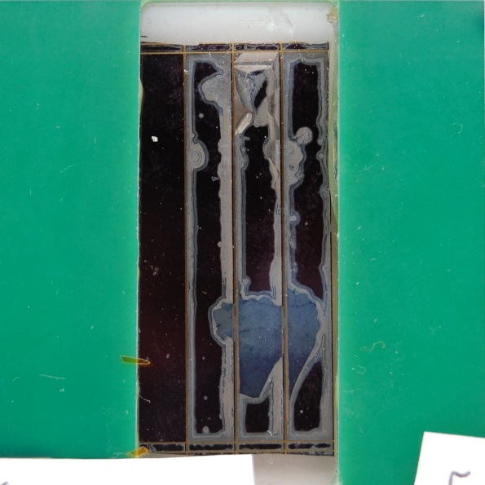
Physical Degradation
Characterization, including LIV and visual inspection, was conducted before testing, after each ESD test run, and again before shipment back to NLR.
When not actively under test or characterization, cells were kept in a nitrogen-purged environment.
We noted that physical degradation of the cells that arced did not halt when returned to safe environment.
Pre-testing
Post-testing
Pre-shipment
Witness
20 arcs
40 arcs
Takeaway: The stress of primary arcing induces a type of autocatalytic degradation of the perovskite cells.
60 arcs

Slide 6
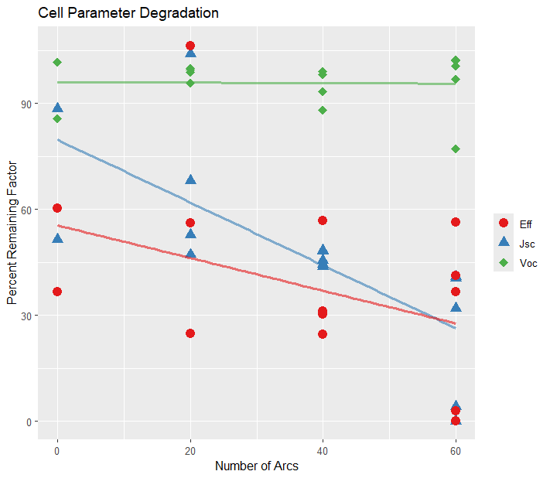
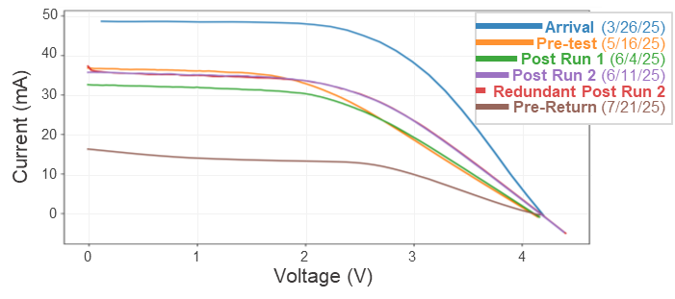
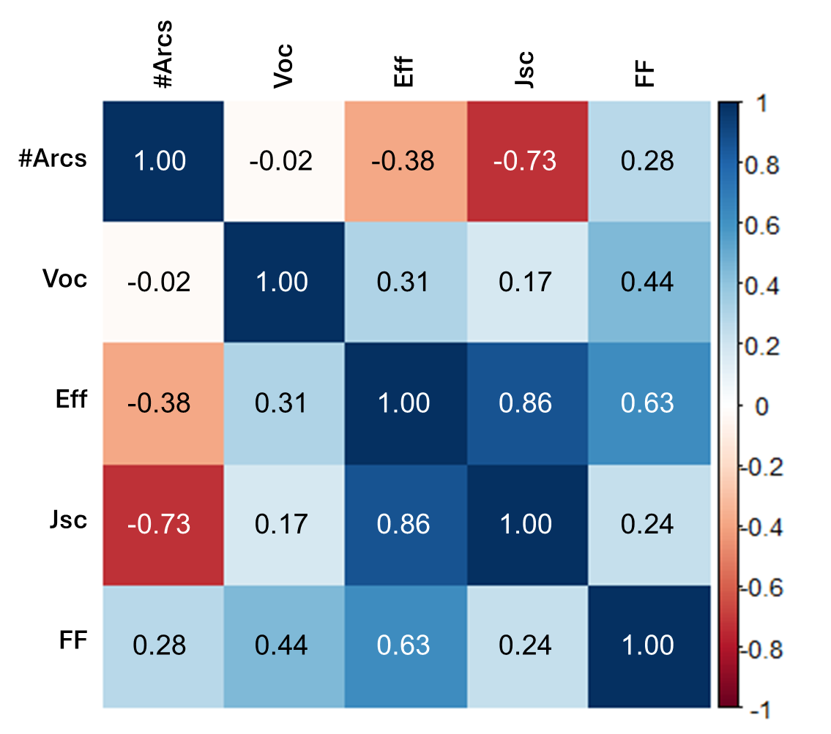
Performance Degradation
Demonstrative LIV Degradation
Takeaway: Isc and efficiency degradation begins after minimal amount of arcing and worsens significantly with increasing number of arcs.

Slide 7
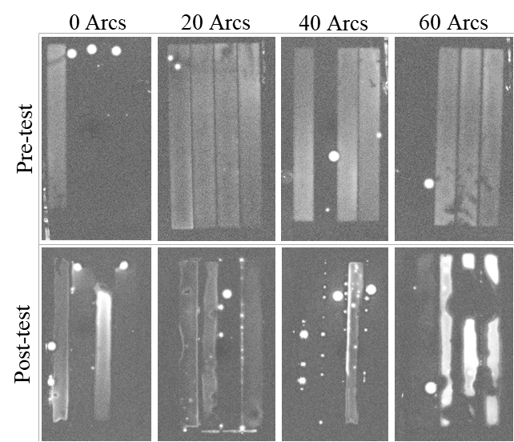
Dark Lock-in Thermography (DLIT)
Since our hypothesis was that primary arcing would create shunts in the perovskite material, we took DLIT images before and after testing.
All cells had at least one shunt upon arrival.
For cells that experienced no arcing, shunts remained.
For cells that did experience arcing, visual degradation of the perovskite material often corresponded with a new or pre-existing shunt.
Takeaway: Shunts present at the start of testing may have served as higher likelihood arc locations, worsening damage in that area.

Slide 8



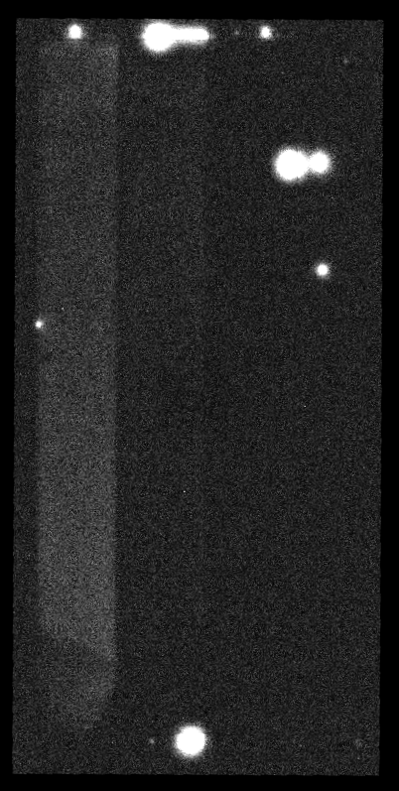
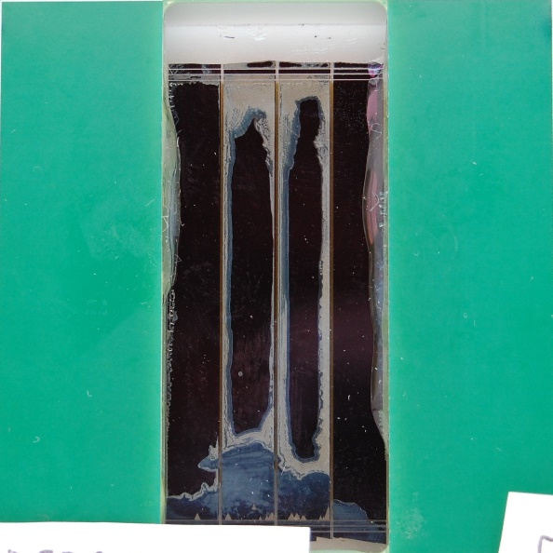
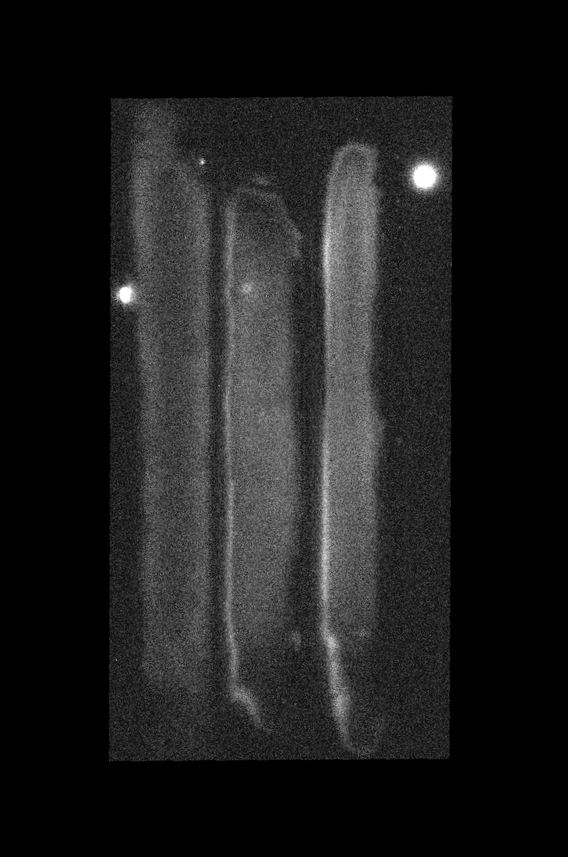
S_5305011: 40 arcs
Cell #7/S2 C2/NREL 17
Pre-DLIT
Post-DLIT
Post-Visual

Slide 9

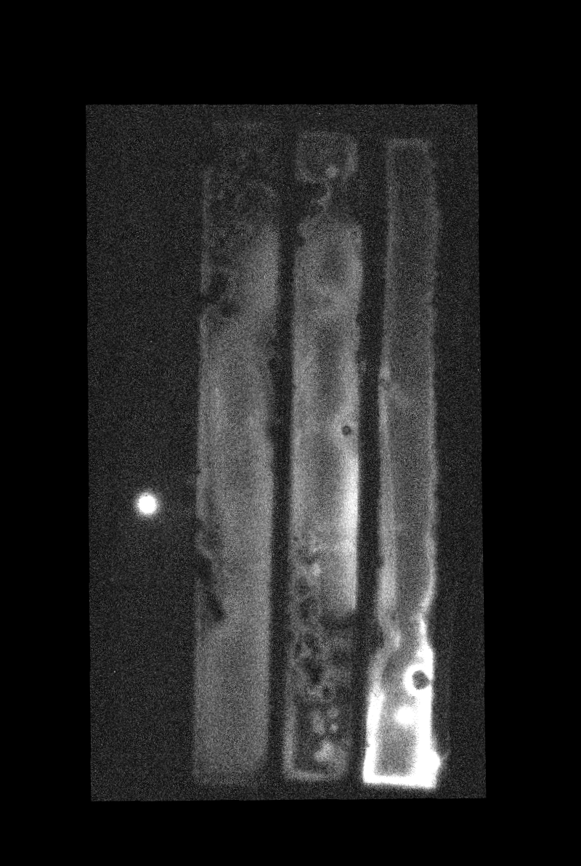
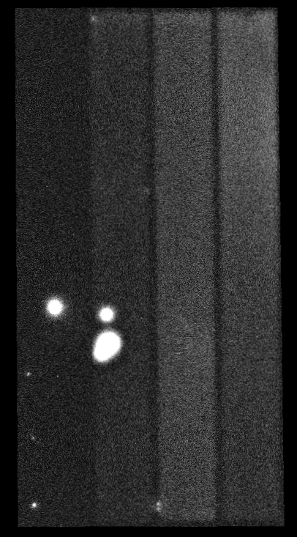
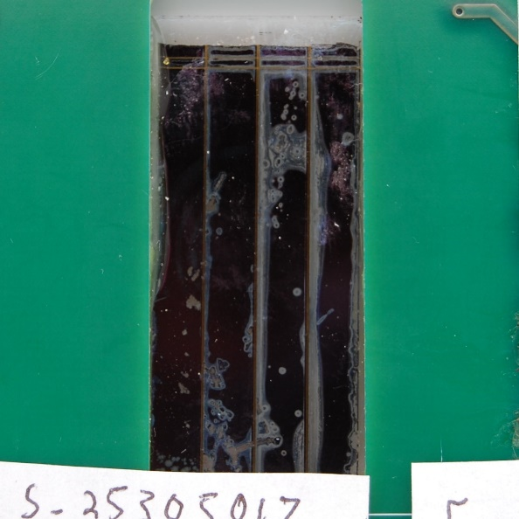
S_5305017: 40 arcs
Cell #6/S2 C1/NREL 23
Pre-test DLIT
Pre-DLIT
Post-DLIT
Post-Visual

Slide 10
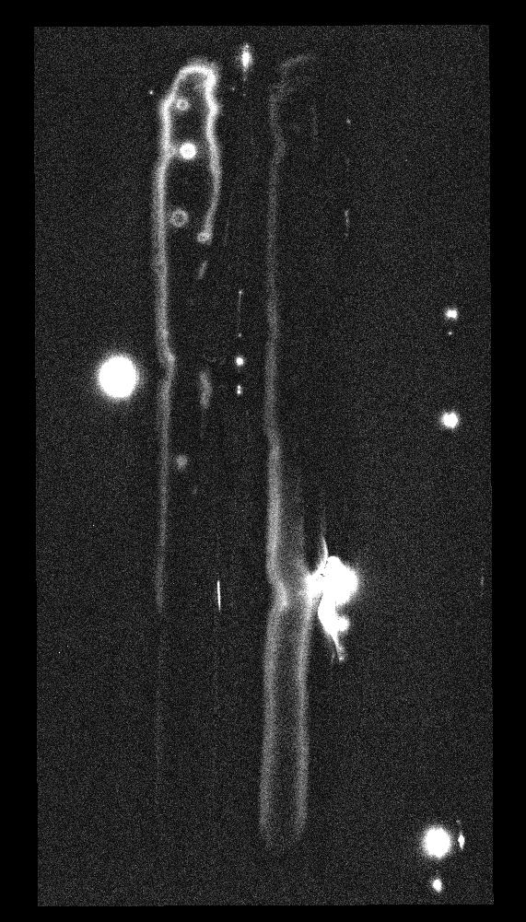
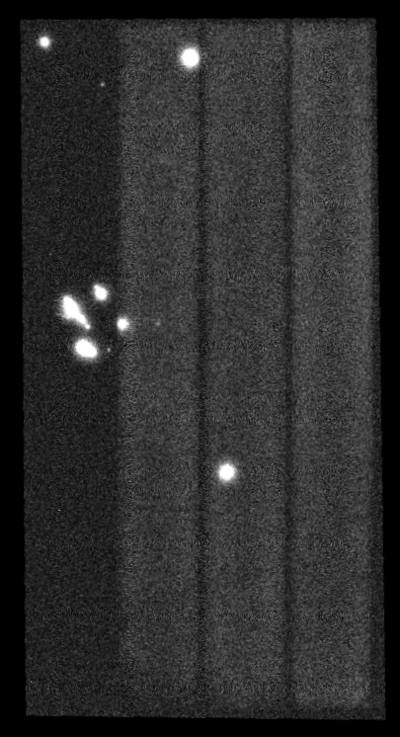
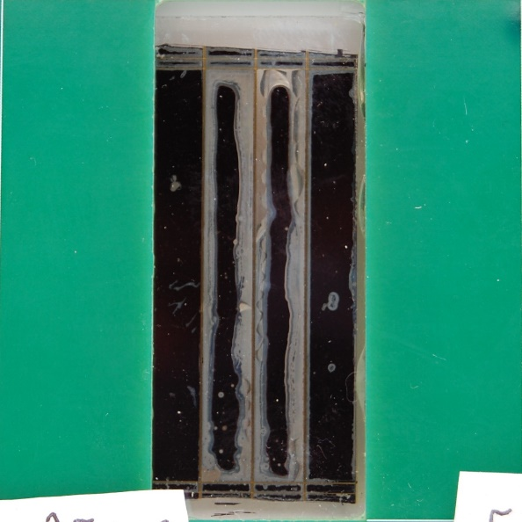
S_5305008: 60 arcs
S_5305008: 60 arcs
c
Cell #14/S3 C4/NREL 14
Pre-DLIT
Post-DLIT
Post-Visual

Slide 11
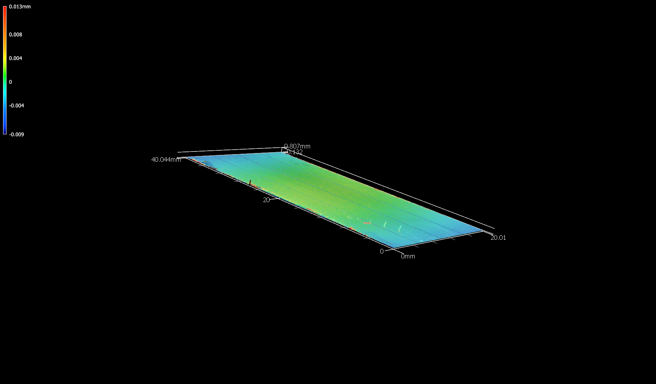
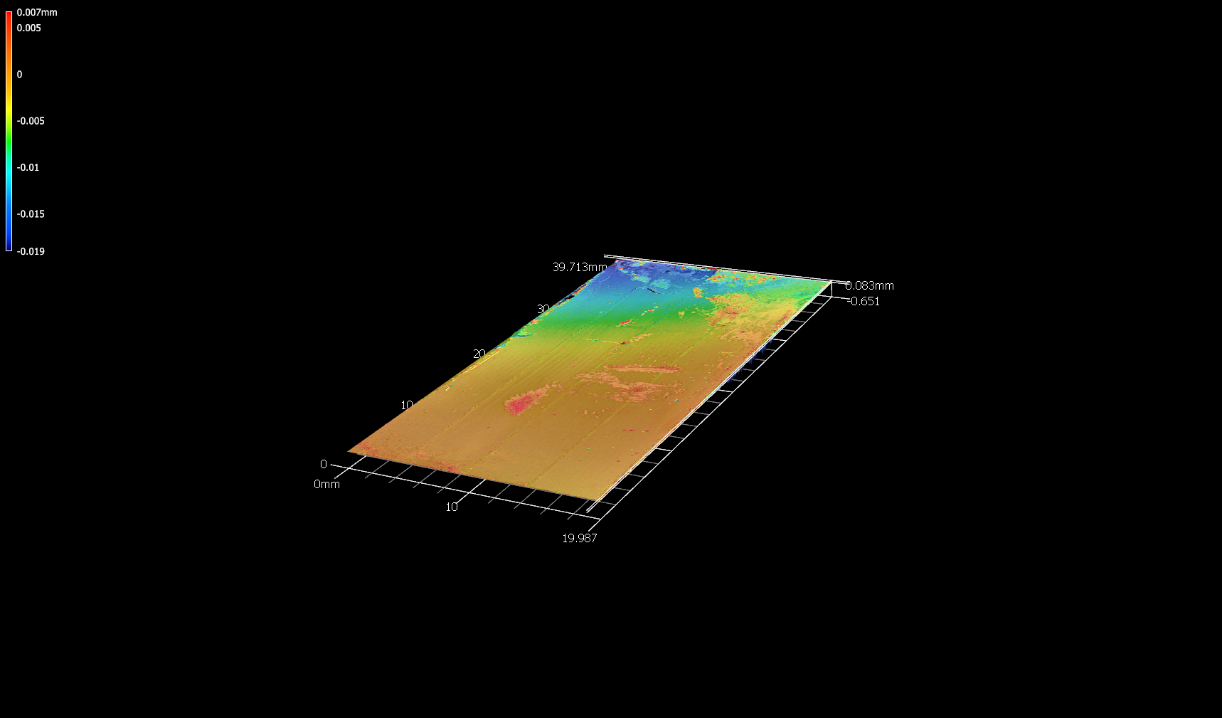
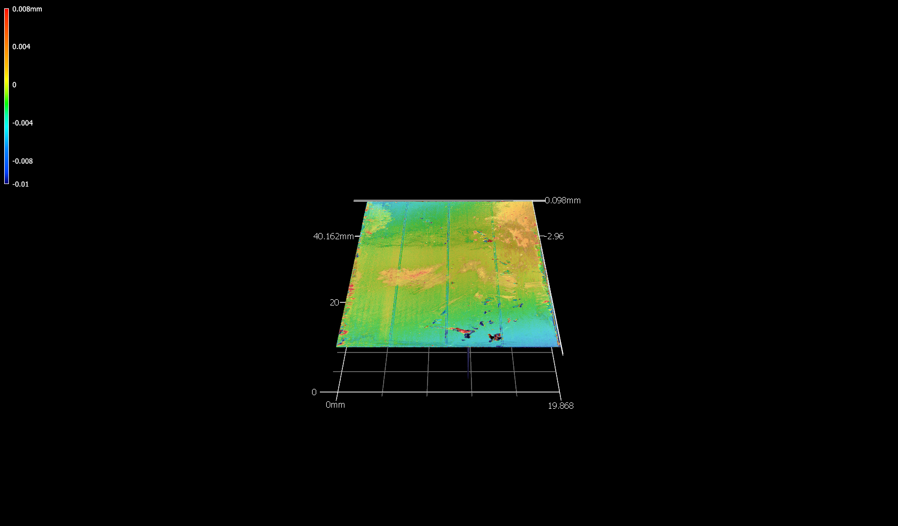
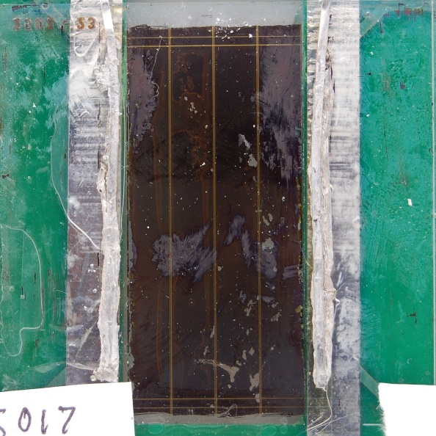
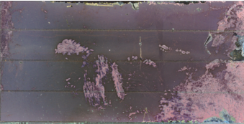
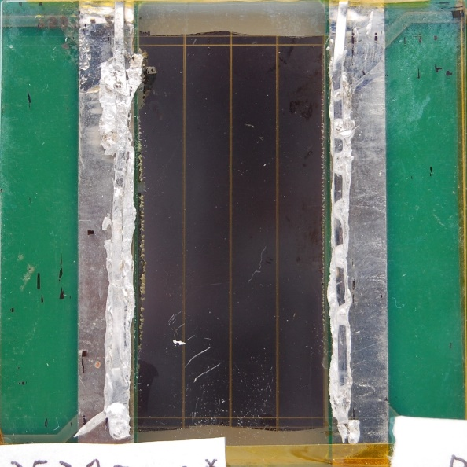
Profilometry – Visual
Witness Sample (#12)
String 2 (40 arcs)
String 3 (60 arcs)
Defects largely constrained to scribe lines.
Defects in the module occurring at scribe lines and across cells.
Notes:
EDS (Energy Dispersive X-ray Spectroscopy) is a characterization technique that identifies the elemental composition of a sample by bombarding it with a high-energy electron beam. This process causes the sample to emit characteristic X-rays, which are then detected. Their energy is measured to determine the elements present. The technique can provide qualitative and quantitative analysis of elements, as well as elemental mapping to show their distribution within a sample.
How the technique works
Electron beam bombardment: An electron beam from a scanning electron microscope (SEM) hits the sample's surface.
Electron ejection: The incident electrons knock out inner-shell electrons from the sample's atoms.
X-ray emission: An electron from a higher energy shell then drops to fill the vacancy, and to balance the energy difference, an X-ray is emitted.
Energy measurement: An X-ray detector, such as a silicon drift detector (SDD), measures the energy of each emitted X-ray.
Spectrum generation: The energy of the X-rays is plotted against the number of counts to create a spectrum. Each peak in the spectrum corresponds to a specific element and its characteristic X-ray energy.

Slide 12
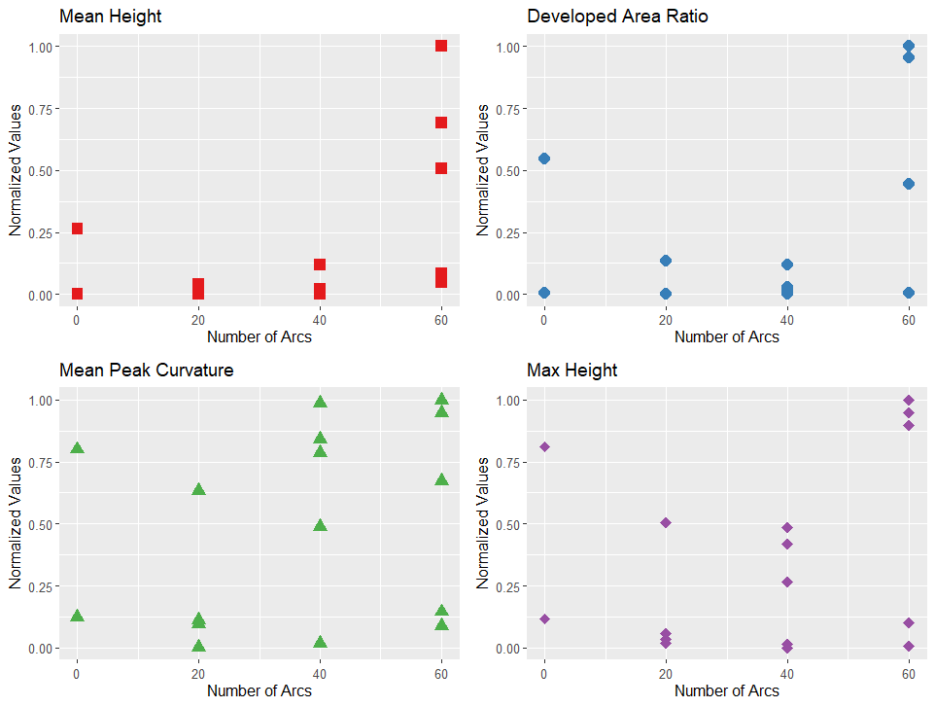
Profilometry – Quantitative
Samples that experiences 60 arcs see an increase in mean height and developed area ratio, both of which indicate an increase in surface roughness and irregularity.
No strong trend in mean peak curvature, indicating that curves are both round and sharp.
Takeaway: Arcing damage on the surface is increasing general surface roughness through material ablation and redeposition.
Notes:
Sa: Arithmetical Mean Height: The average height difference of every point on the surface relative to the average plane. It is the 3D equivalent of the line roughness parameter Ra.
Interpretation: A lower Sa value indicates a smoother surface. This is a common and general parameter for evaluating overall roughness.
Sz: Maximum Height: The sum of the maximum peak height (the highest point above the mean plane) and the maximum valley depth (the deepest point below the mean plane) within the defined measurement area.
Interpretation: This parameter is very sensitive to extreme peaks and valleys caused by scratches, pores, or debris.
Spc: Arithmetic Mean Peak Curvature: The average principal curvature of the peaks on the surface.
Interpretation:
Smaller value: Indicates that the surface's peaks are more rounded.
Larger value: Indicates that the surface's peaks are sharper or more pointed.
This parameter is useful for evaluating surfaces where the nature of contact points is important, such as in sliding or sealing applications.
Sdr: Developed Interfacial Area Ratio: The ratio of the actual (developed) surface area to its projected (flat) area. It is expressed as a percentage.
Interpretation:
Value of 0%: Indicates a perfectly flat, level surface.
Higher value: Indicates a more complex, rough, or irregular surface. The value represents the increase in surface area due to texture.
This parameter is relevant when considering how a surface interacts with fluids, for applications like lubrication, adhesion, and coating.

Slide 13
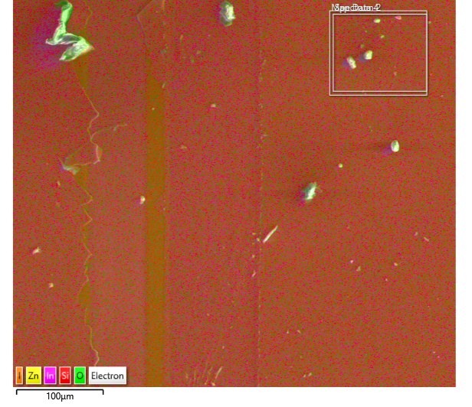
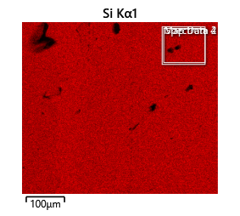
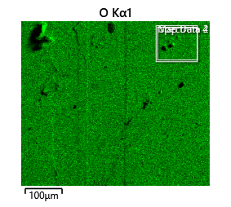
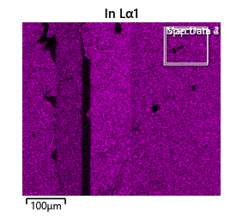
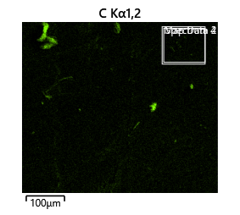
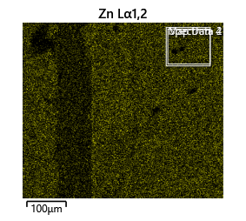
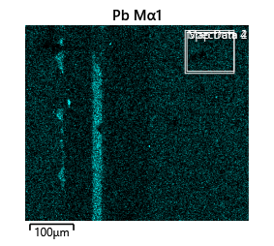
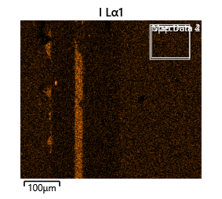
EDS on Arced Sample (60 arcs)
In addition to the expected materials making up perovskite and protective layers, carbon deposits found on the surface of samples that experienced arcing.

Slide 14
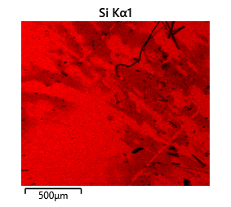
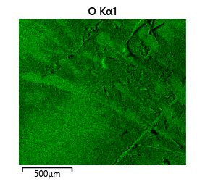
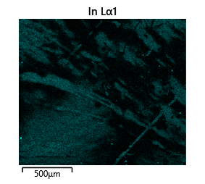
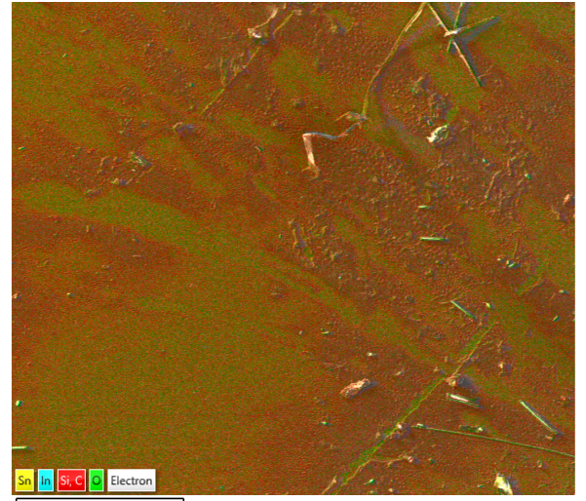



EDS on Arced Sample (40 arcs)
Full scanned image
Takeaway: Cabon depositions on the surface consistent with contamination due to pyrolysis.

Slide 15


Spectrophotometry & Tauc Plots
Spectrophotometry measured on a Lambda 950 UV/VIS.
No significant changes in spectral performance due to primary arcing
Demonstrative Tauc Plot

Slide 16
Conclusion + Forward Work
Unprotected perovskite solar cells degrade readily when exposed to primary arcs, most likely due to the thermal stressors of these ESD events.
Primary arcs are not generally considered a risk to SOA space photovoltaics.
When assessing new solar cells for space, it’s crucial that we thoroughly assess environmental factors and not just what is standard for traditional devices.
Forward Work:
More testing and characterization planned with a larger perovskite dataset (+ more witness and control samples) to improve statistics and deepen understanding.
Test more thin film technologies.
Exploring passive primary arc mitigation strategies to protect thin film cells from this damage mechanism.

Slide 17



Thank you!
Thanks to NLR for letting us destroy your cells in the name of science & working with us on this characterization!
Interested in doing spacecraft charging testing on your solar cells/arrays? Reach out to the NASA GRC PV team!
testing with external partners!
We

Slide 18
Backup

Slide 19







Slide 20






Witness and Controls Visual

Slide 21







EDS on Witness Samples
EDS on witness samples showed largely Si and O, consistent with the SiO top coating
No Pb detected, consistent with intact barrier layers

Slide 22


S_5305003: 20 arcs
Cell #4/S1 C4/NREL 9
Pre-DLIT
Post-DLIT
Post-Visual

