Slide 1


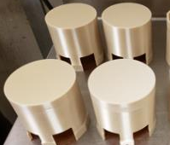
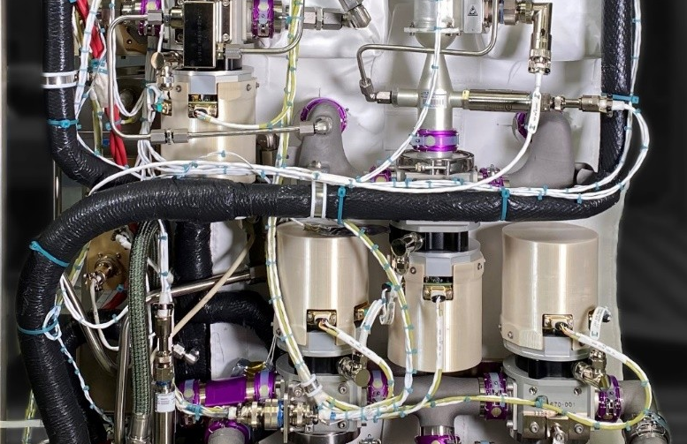
Off‑World Additive Manufacturing – Augmenting NASA‑STD‑6030
Maria Chytka¹, Tim Poe¹, Diana Andreev², Jibrail Muhammad¹, Brady Kimbrel¹
¹NASA Marshall Space Flight Center (MSFC), Huntsville, AL 35812
²Amentum, Huntsville, AL 35806
__________ Need __________
NASA‑STD‑6030 and 6033 assume stable terrestrial environments—not valid off‑world
  Less resources for qualification: time, infrastructure, technician support, etc.
Future missions will require point‑of‑need manufacturing to increase autonomy
  In-space manufacturing becomes a mission subsystem, not a convenience
__________ Challenges __________
New environments: microgravity, radiation, self-contained environmental control, limited operator availability
Post‑processing TRLs: heat‑treat, subtractive machining, electrical discharge machining not yet space‑ready
Verification gaps: limited coupons, limited metallography, no non-destructive evaluation, no destructive testing
Limited failure investigation: limited equipment and crew training in the subject matter
______________ Path Forward ______________
Understand qualification will be tailored to the mission
Select machines and processes for safety, ease-of-use, and resource needs
Design parts with conservative safety margin, as mass and volume allow
Build confidence by strategically increasing hardware classes as material process matures: C → B → A
Use wire-based feedstock. Start with polymers, then move to metals
Develop in-situ monitoring capabilities to increase autonomy
Develop digital twin capabilities to aid in inspection
Consider recycling and in-situ resource utilization where feasible
_ _____ _________ ____ ______The Future _ _____ ________ _ _____ ____
In‑situ process monitoring with active control loops and error handling
Simplified crew operations + remote operator support
Machine health self-monitoring instead of time-bound maintenance cycles
Physics modeling tools using sensor data to reliably predict material state
Automated build summary reports to supplement missing inspection capabilities
Polymer Printed Covers for 4-Bed Carbon Dioxide Scrubber for ECLSS System
This is a work of the U.S. Government and is not subject to copyright protection in the United States. Foreign copyrights may apply.
Artificial Intelligence (AI) Usage Disclosure
This document was created with assistance from Microsoft Copilot with brainstorming ways to summarize the content. The content has been reviewed and edited by Maria Chytka.

