Slide 1
The Future of
Electronics RESHAPED 2026
In-Space Manufacturing of Electronics
Cadré Francis
Electronics Lead
In-Space Manufacturing - Advanced Space Technologies for Resilient Operations
Space Systems Department, NASA Marshall Space Flight Center
June 10, 2026
nasa.gov | Approved for public release.

Slide 2
Agenda
03 / 0:00
Mission Motivation
05 / 2:00
TRL Pathway
05 / 3:00
Key Challenges
07 / 6:00
Additive Electronics in Microgravity
11 / 9:00
Microgravity Demonstrations
12 / 12:00
Program Structure
13 / 14:00
Partnerships
14 / 15:00
Q & A
nasa.gov | Approved for public release.

Slide 3
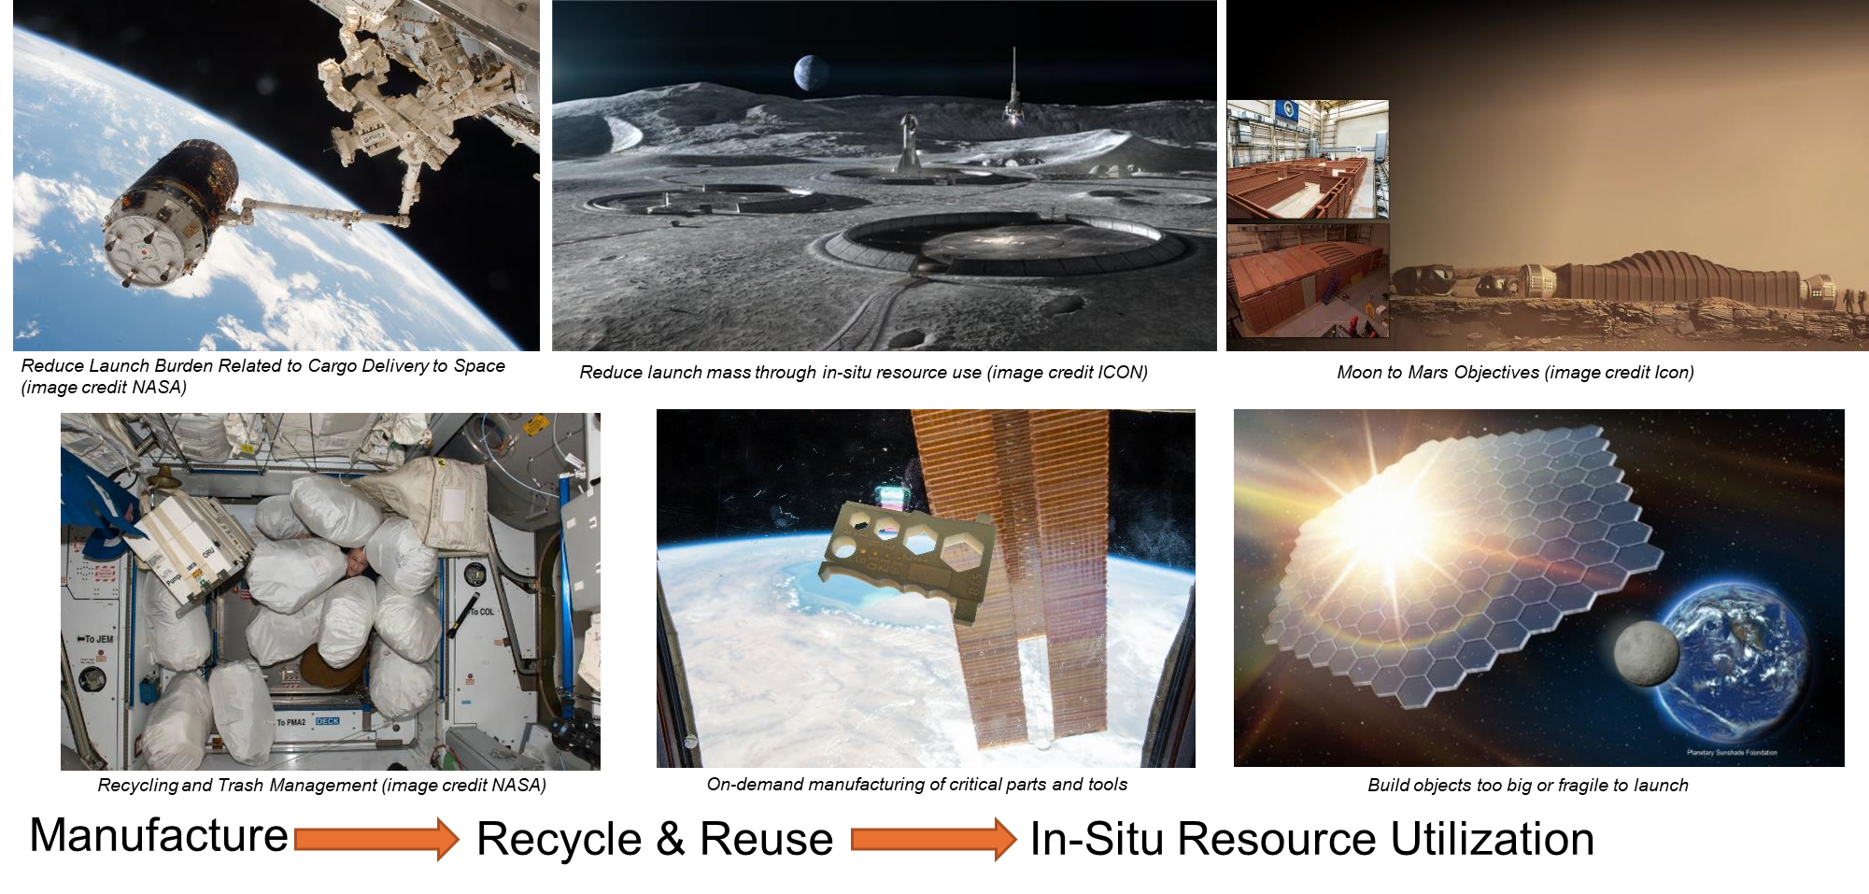
Why In-Space Manufacturing?
nasa.gov | Approved for public release.

Slide 4
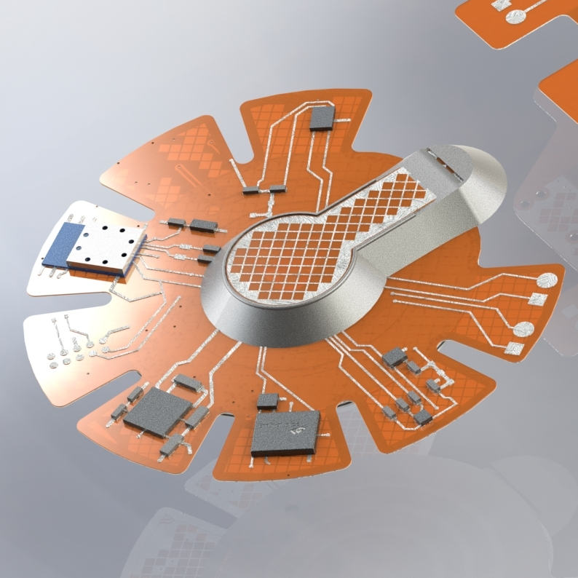
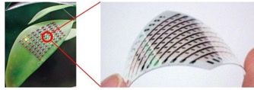
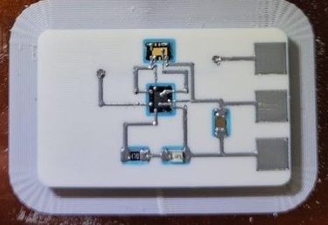
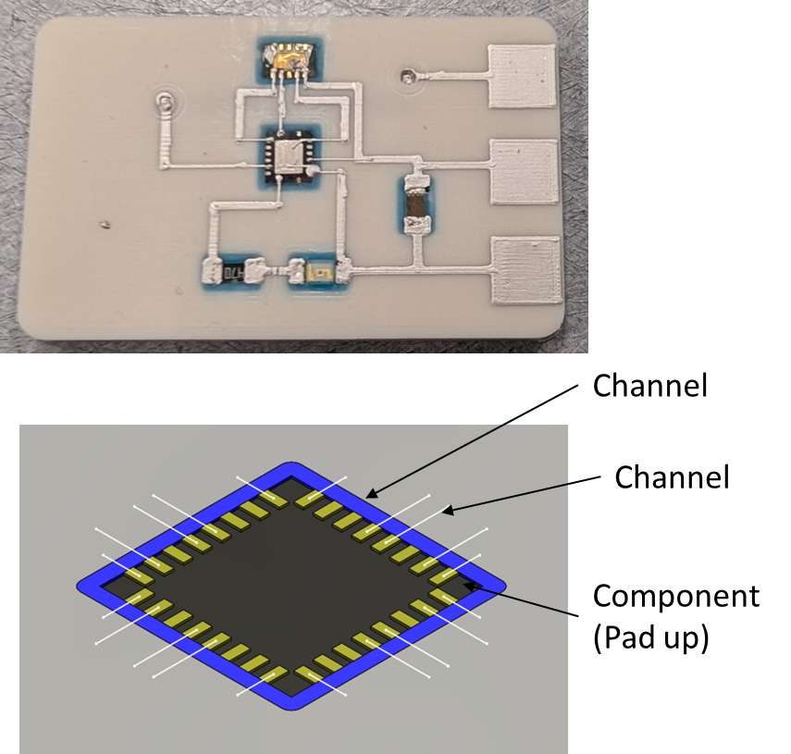
In-Space Manufacturing:
Advanced Space Technologies for Resilient Operations
ISM-ASTRO
Electronics
Additive manufacturing of PCBs
Material properties in space
Electronics printers
Microelectronics and Sensors
Semiconductors
Energy/Power
Why in-space electronics?
Long-duration missions need adaptable, repairable systems
Spares add mass & mission risk
On-demand manufacturing facilitates resilience and autonomy
Plant growth strain sensor
Objective 1
Development of electronics, sensors, and semiconductors for in-space manufacturing
  Primarily for Use in Space
Crew Health Wearable Wireless Sensor
Objective 2
Development of in-space manufacturing of electronics capabilities for microgravity manufacturing of electronics, sensors, and semiconductors
  Primarily for Use on Earth
CO₂ Sensor
nasa.gov | Approved for public release.

Slide 5
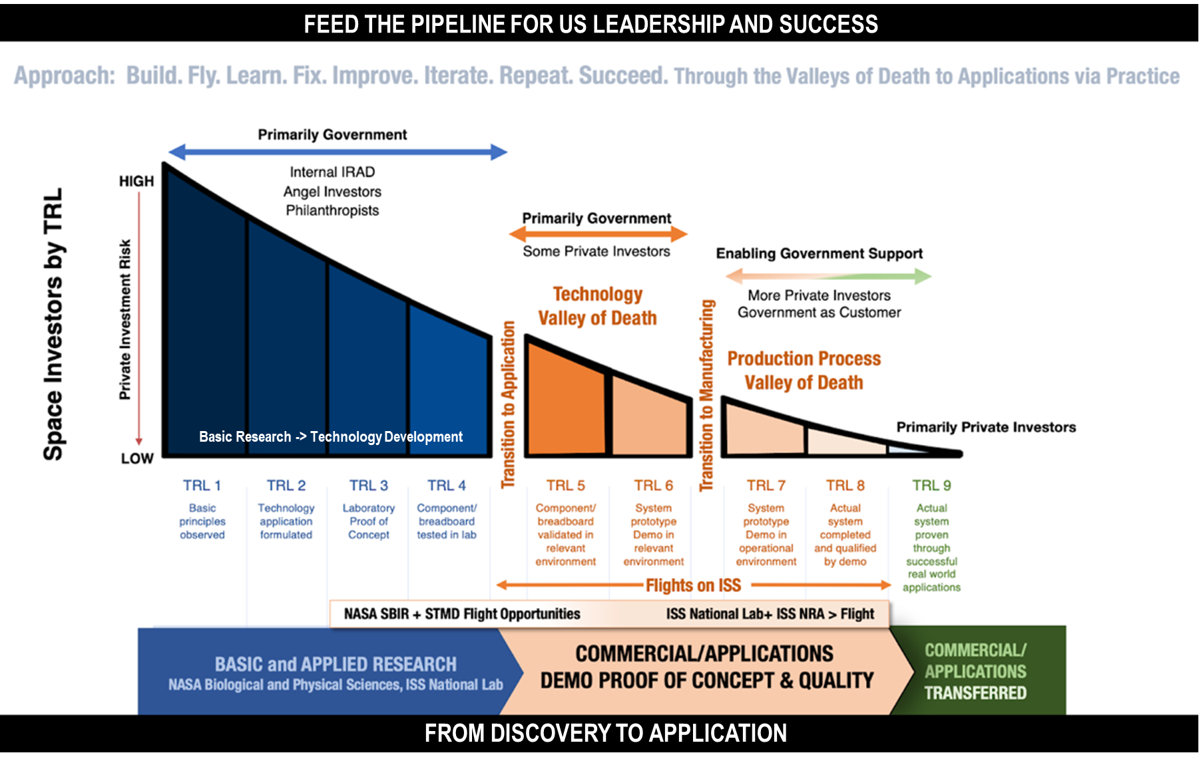

nasa.gov | Approved for public release.

Slide 6
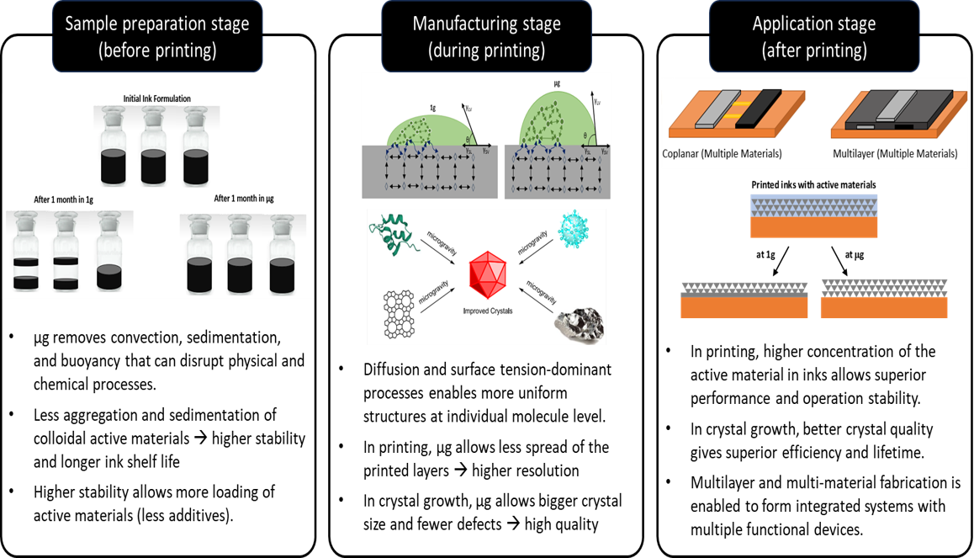
Materials – related µg Impacts
nasa.gov | Approved for public release.

Slide 7



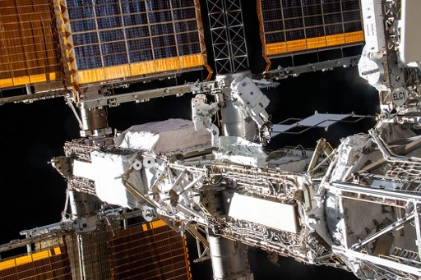

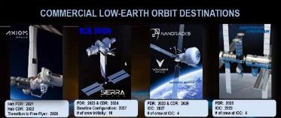
ISM Electronics Technology Development Approach
Ground Development
Parabolic Flights - Test
Microgravity – Demonstrate
Lunar Habitat – Use
Ground-based development and optimization of technologies.
High-throughput experiments for data and validation.
Enabling more infrastructure for experiments and future volume manufacturing.
Parabolic flight campaigns to reduce risk of microgravity manufacturing.
Working with ISS NL and multiple integration partners for microgravity demonstrations of semiconductor technologies.
CLDs – Commercialize
nasa.gov | Approved for public release.
Notes:
Standard approach taken by ODME is risk reduction with parabolic flights followed by an ISS demo to understand microgravity effects since data is limited for parabolic flights. Final Infusion is either surface or commercialize.

Slide 8
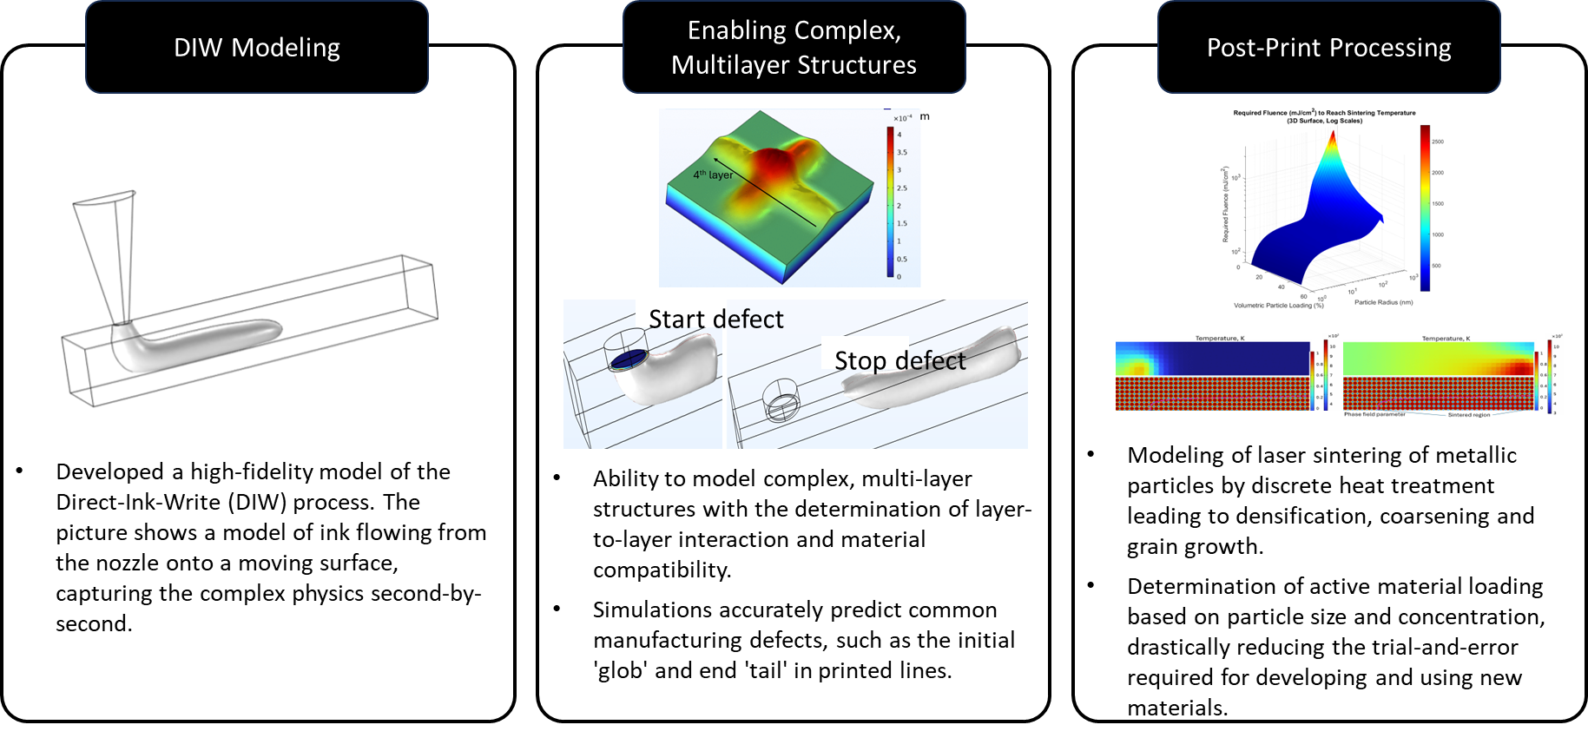
Predictive Modeling
nasa.gov | Approved for public release.

Slide 9
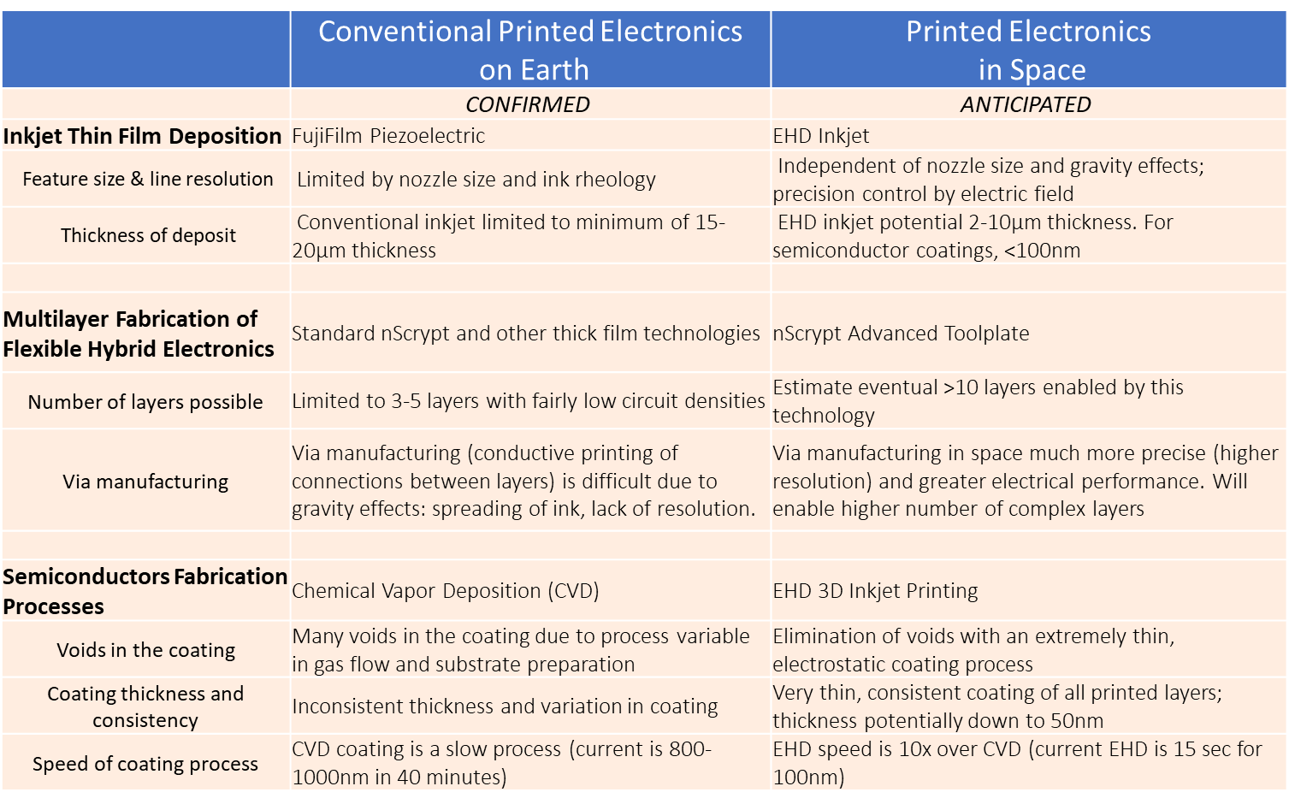
nasa.gov | Approved for public release.

Slide 10
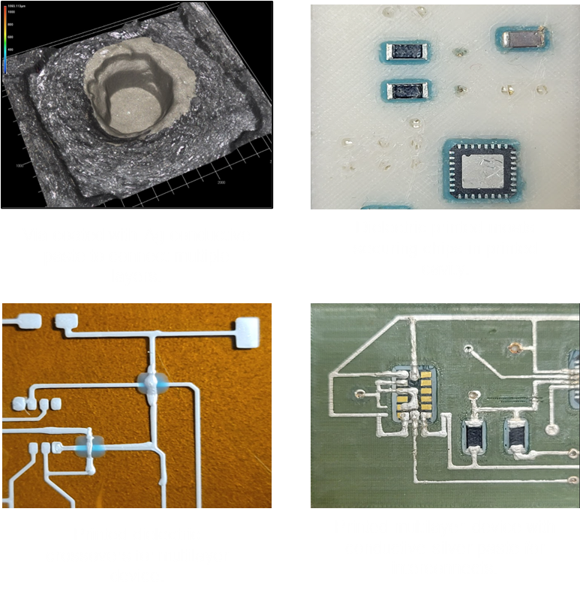
Multi-Layer Printing
  Filling vias between substrate layers to connect circuit layers.
  Printed crossovers using conductive and insulating inks.
Chip Integration
  Printed insulator to hold chips in place and fill moats (printed chambers).
  Printed interconnects over moats to component pads top of chips
  Developing technology to insert a wider range of components.
nasa.gov | Approved for public release.

Slide 11
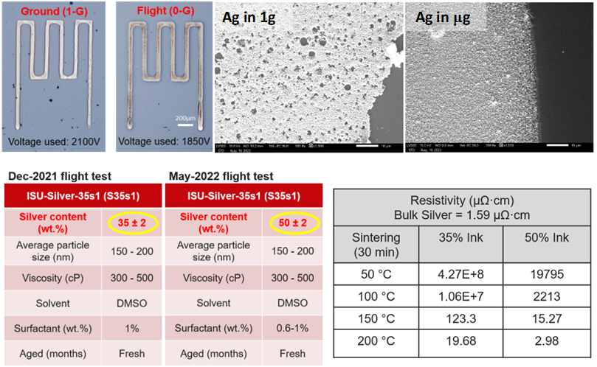
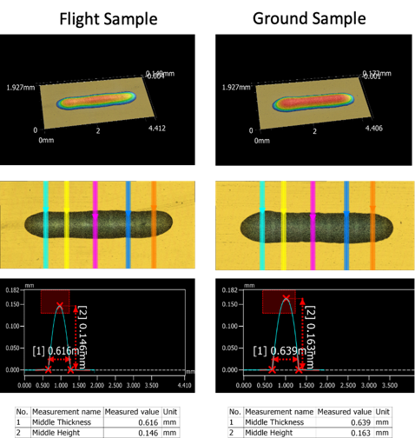
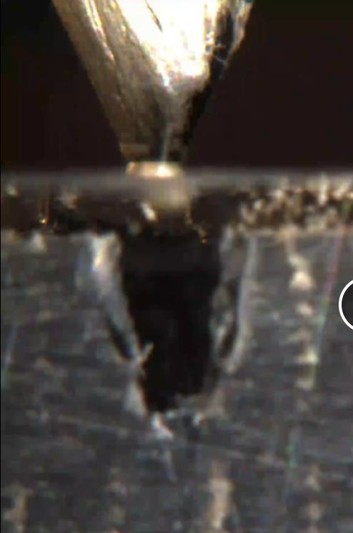
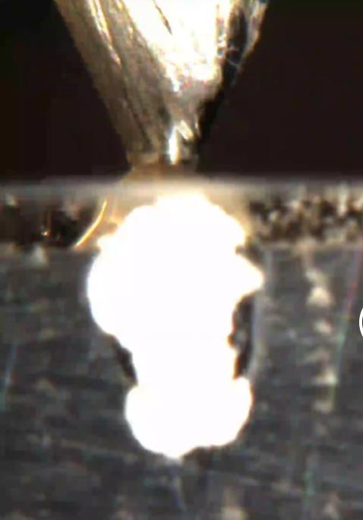
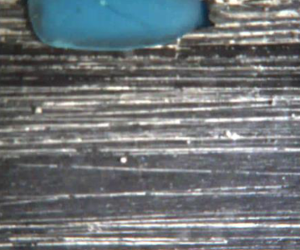
Parabolic Flights : Deposition Phenomena
Thin-Film
Advanced Toolplate System
Via Filling
Moat Filling
A Vertical Interconnect Access (Via) is a small hole used to connect different layers of a circuit.
Via-filling is a pivotal part of fabricating high-performance circuits.
Moat filling involves dispensing dielectric paste around embedded components.
Moat filling is required to evaluate component placing and device manufacturability in microgravity.
SmartPump modification was successful. No clogging or stiction issues were experienced during the flight.
Samples used to inform partner model being developed to better understand DIW-deposition in microgravity.
Formulate and test inks in reduced gravity environments
  Inks include Ag, BaTiO3, ZnO, PDMS
Micro-structures of printed patterns results in denser structure with fewer pores
Silver loading can be increased from 35 % (at 1g) to 50 % (at mg) due to less agglomeration → 8.1 times higher conductivity
nasa.gov | Approved for public release.

Slide 12
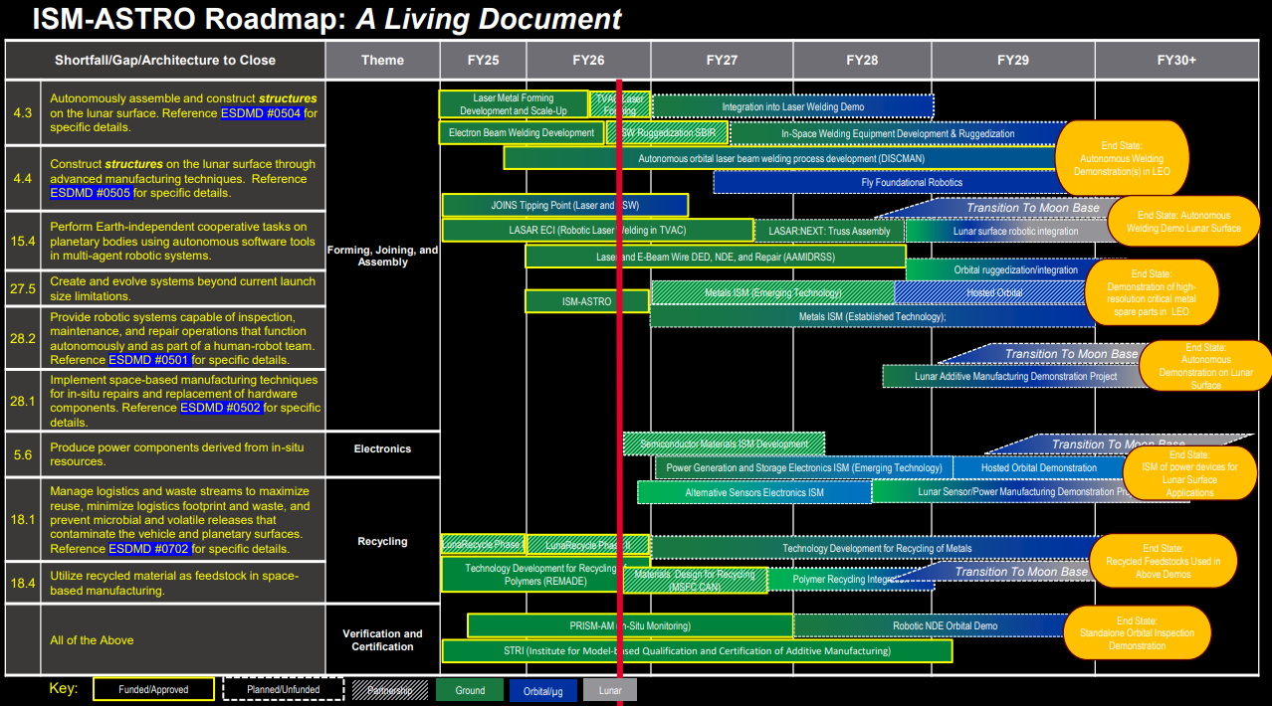
Chapter Breaks
nasa.gov | Approved for public release.

Slide 13
ISM Electronics Collaborations & Partnerships
Academic
University of Louisville
University of Alabama Huntsville
Appalachian State University
Auburn University
Boise State University
Georgia Institute of Technology
California Institute of Technology
Iowa State University
Florida A&M University
Oregon State University
West Virginia University
University of Louisville
University of Alabama Huntsville
Appalachian State University
Auburn University
Boise State University
Georgia Institute of Technology
California Institute of Technology
Iowa State University
Florida A&M University
Oregon State University
West Virginia University
Exploration & Science
NASA Exploration and Support "In Space for Space" development
ECLSS Sensors
Wearable sensors
Printed Power & Energy
Avionics
Logistics – spares and upgrades for missions
Commercialization
Support "In Space for Earth Applications" development
Semiconductors
NASA Centers
Marshall Space Flight Center
Ames Research Center
Johnson Space Center
Kennedy Space Center
Goddard Space Flight Center
Glenn Research Center
Armstrong Flight Research Center
Industry/Government
Redwire Space
Cornerstone Research Group
LambdaVision
Faraday Incorporated
Laboratory for Physical Sciences
Intel
Lockheed Martin
ThinkOrbital
Fujifilm
Axiom Space
ISS National Lab
Goeppert
NextFlex
nScrypt
Sciperio
Multi3D
Astral Materials
nasa.gov | Approved for public release.

