Slide 1
STAR☆FIRE Workshop 2026
­­­Characterization and Mechanical Testing of GRCop-42 Fabricated Using Green Laser-Powder Bed Fusion
Sydney Calhoun
Marshall Space Flight Center
Mentor: Dr. Gabriel Demeneghi
Marshall Space Flight Center

Slide 2
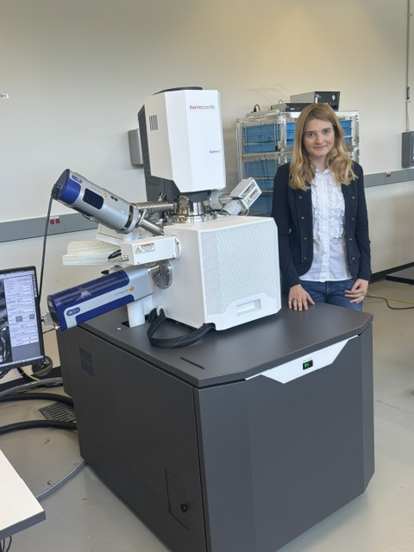
About Me
Recent Chemical engineering grad at the University of Alabama in Huntsville (UAH) with a materials concentration
During college, I did materials science-based research at the University of Tennessee Space Institute, UAH, and NASA Marshall
NASA Marshall is one of the leaders of space nuclear propulsion.

Slide 3
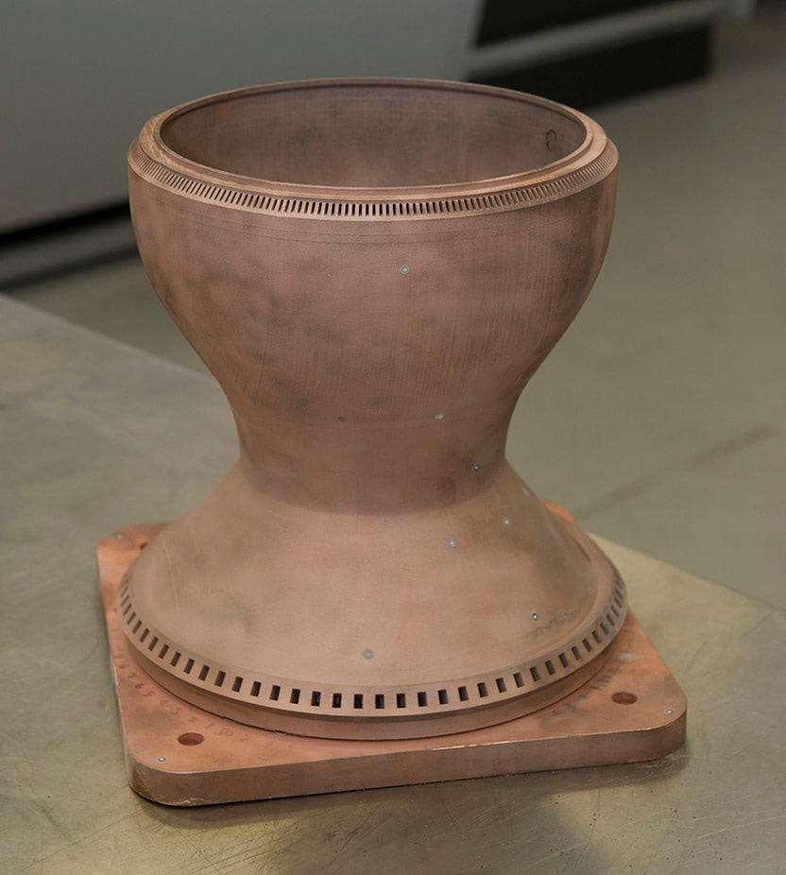
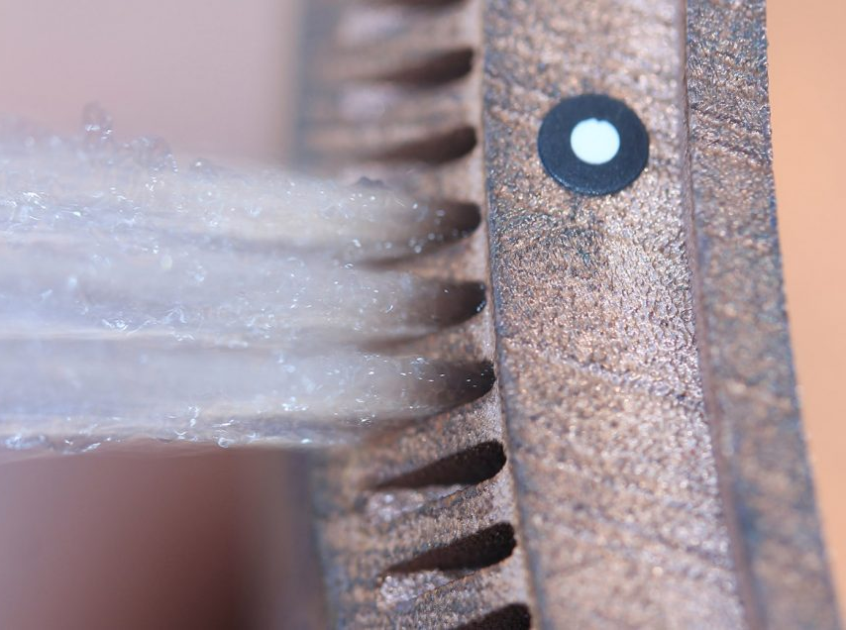
GRCop-42: Background
Glenn Research Copper alloy (Cu – 4 wt% Cr – 2 wt% Nb)
Developed in the 80s for high heat flux satiations
Used in combustion chamber liners (ex. Aeon 1 engine)
High thermal conductivity (copper) and high mechanical strength (Cr2Nb dispersion strengthening)
Internal cooling channels
Combustion Chamber
Gradl, 2021
Notes:
Hall-petch and Orowan mechanism. They do not dissolve back into the matrix at high temperatures
Hotwall 400-700C coolant -200C

Slide 4
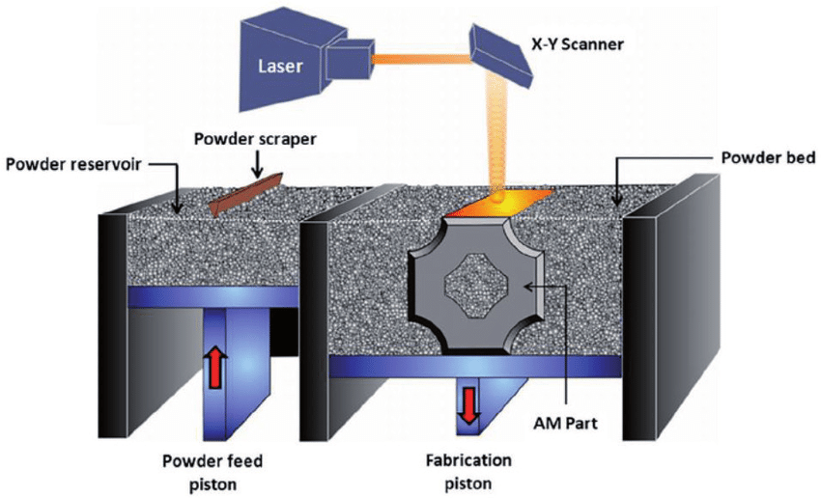
Green Laser Powder Bed Fusion Motivation
Laser Powder Bed Fusion → IR laser
Copper is highly reflective to IR and requires greater power
Can cause inefficient melting and porosity
Green laser has higher adsorption in copper
Larger spot size (200 µm) increases build speeds
Commercially available TruPrint 1000 Green Edition
Mogale, 2021
GOAL: completely characterize the microstructure and mechanical properties of GRCop-42 produced via GLPBF

Slide 5
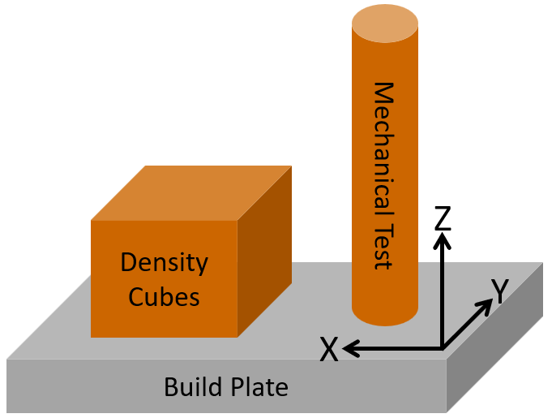
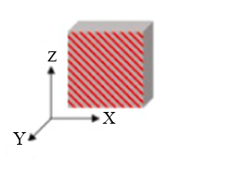
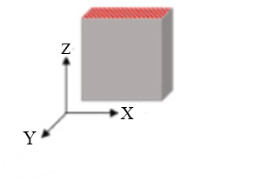
Fabrication, Sample Prep, and Analysis
Fabrication
Power 400-500 W , hatch distance 0.1-0.2 mm, scan speed 600-1200 mm/s, layer thickness 30-60 µm
Produced 12 small cubes
4 As-built (AB), 8 HIP
HIP: 954 ◦C for 3 h at 100 Mpa
Analysis
Surface analysis
Porosity analysis
Microstructural analysis (optical)
Electron Backscatter Diffraction (EBSD)
Energy Dispersive X-ray Spectroscopy (EDS)
Microhardness
Quasi-static tensile testing
Sample Prep
Mounted AB and HIP samples parallel (XZ) and perpendicular (XY) to the build direction (Z)

Slide 6
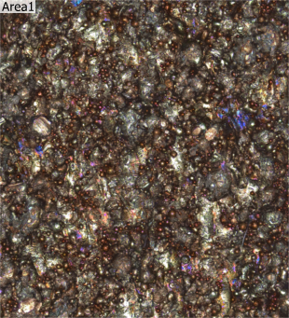
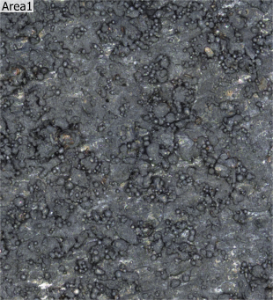

Results: Surface Analysis
Influences fatigue life and strength
Done by laser confocal imaging
Three AB samples and three HIP samples analyzed
Three 1 mm² areas analyzed for each sample
Similar to previous results (HIP 20.3 ±2)
(a) AB XZ
(b) HIP XZ
1 mm² area
1 mm² area
arithmetical mean height (Sa), root mean square height (Sq), maximum peak height (Sp), maximum valley depth (Sv), maximum height (Sz)
Notes:
Surface features could act as stress concentrators and decrease the fatigue life.

Slide 7
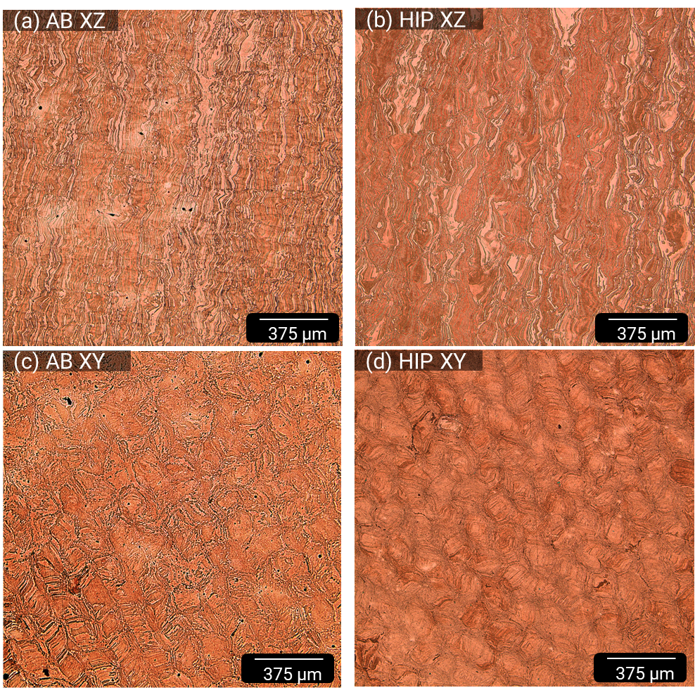
Results: Optical Microscopy
Etchant: Kalling’s
In XZ plane epitaxial growth is evident
Scan strategy and laser scan spots seen in XY plane
HIP did not alter the microstructure
More porosity in AB samples
Notes:
Kalling’s is: 4g CuCl₂, 80mL of HCl, 100mL of ethyl alcohol

Slide 8
Results: Porosity Analysis
Twenty 1.06 mm² areas analyzed for each condition
Processing done in ImageJ
HIP was shown to be effective at reducing the porosity
Values overestimated due to Cr2Nb
HIP causes coarsening of Cr at grain boundaries
Analysis Area Example
100 µm
Removing anything < 1 µm²

Slide 9
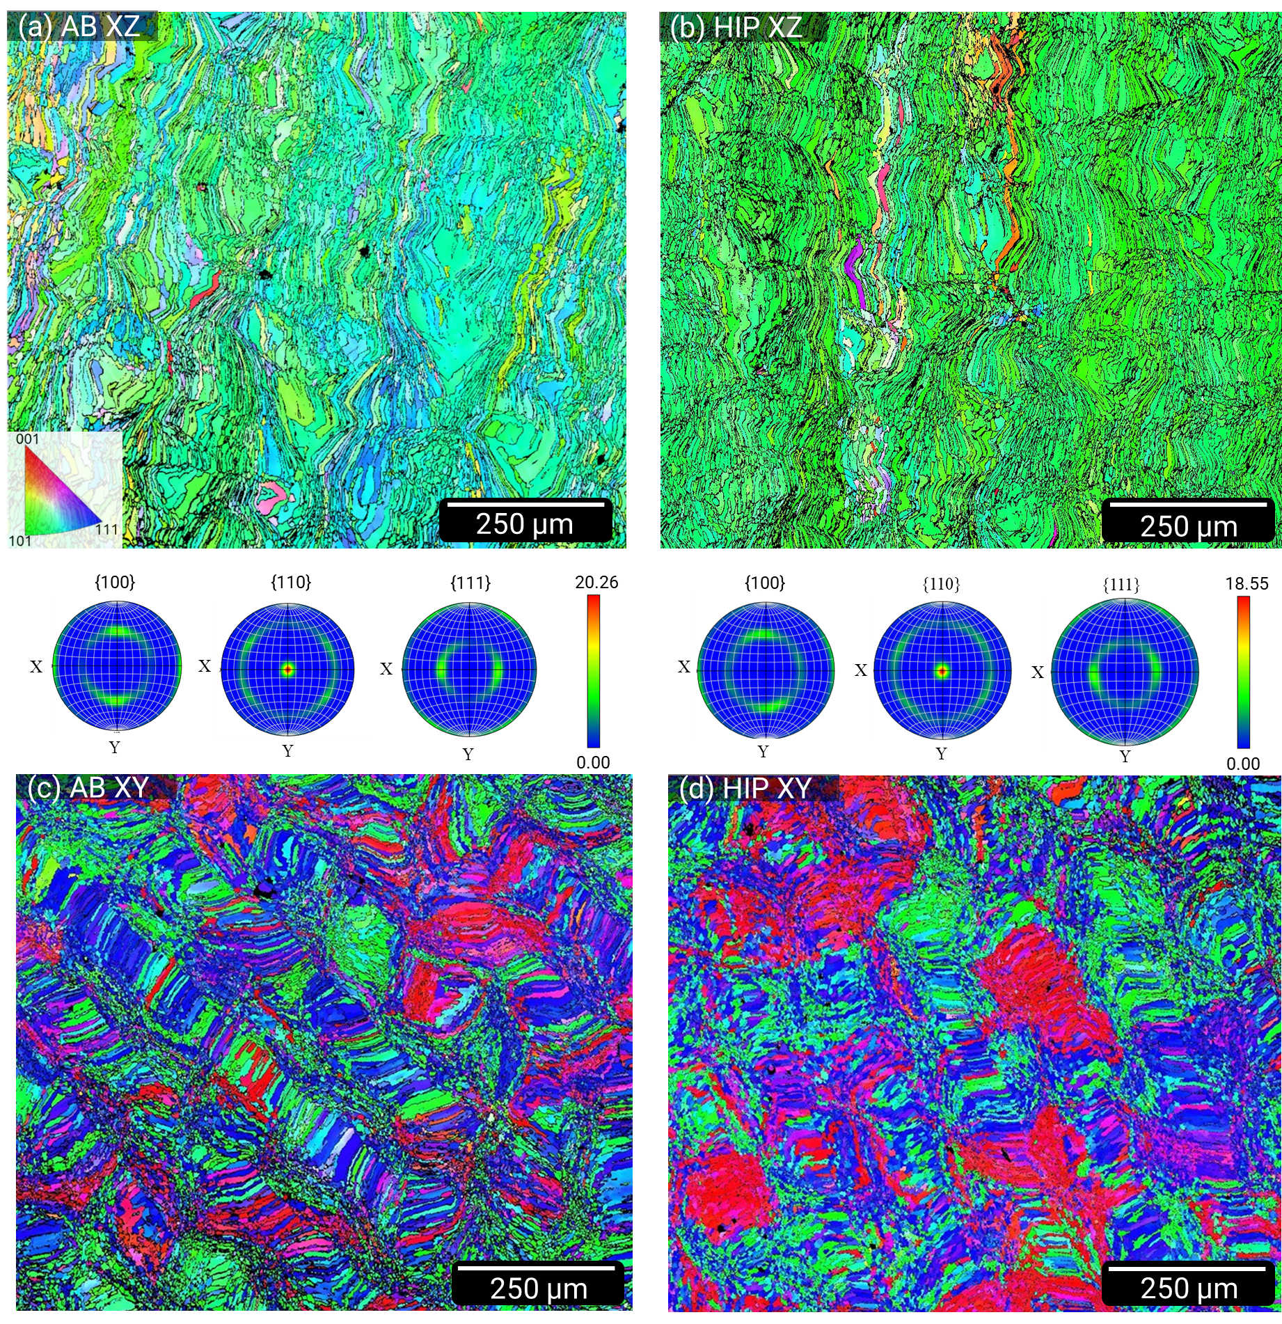
Results: EBSD
Scans at 150x and 1µm step size
MUD number is larger than 18 for all scans
MUD < 1 signifies random texture
These samples are highly textured in <110> direction
Past work shows less texturing
Larger spot size → larger melt pool → slower solidification rate
Notes:
maximum multiples of uniform distribution

Slide 10
Results: Mechanical Testing
The mechanical properties of LPBF GRCop-42 are very comparable to those of traditional LPBF
Although, GLPBF appears to produce more ductile samples

Slide 11
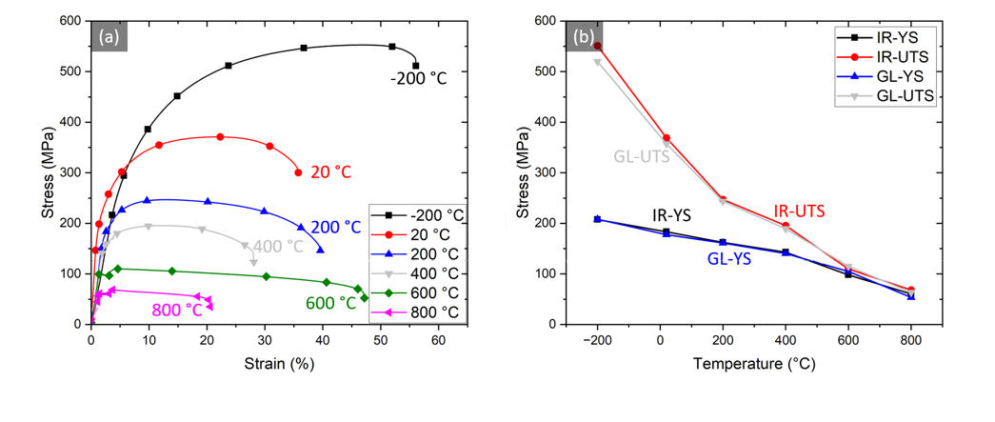
Results: Mechanical Testing

Slide 12
Summary
GRCop is a robust alloy, and its properties were not greatly altered by the green laser process.
Because of the larger spot size of GLPBF, (200 µm compared to 40-80 µm) the production time of a part is reduced.
More market research would need to be done to determine the cost effectiveness of a green laser system.
When published, this research will be the first to report on the surface roughness, texturing, and non-ambient tensile testing of GLPBF GRCop.

