Slide 1
Exploration Extravehicular Mobility Unit 11 Foot Vacuum Chamber upgrades Test Results
55th International Conference on Environmental Systems
12-16 July 2026, Rio Grande, Puerto Rico
ICES-2026-169
Robert Marsch and Michael Lewandowski
Amentum, Houston, TX, 77058
Sean Miller
NASA, Houston, TX
Trade names and trademarks and company names are used in this report for identification only. Their usage does not constitute an official endorsement, either expressed or implied, by the National Aeronautics and Space Administration.

Slide 2
Agenda
Introduction
Testing Objectives
  Extravehicular Activity Testing Days
  Ambient Test Days
Testing/Test Day Overview/Anomalies Overview
Detailed Testing/Anomalies
  EVA Vacuum Loading
  IVA Cooling
  IVA Vacuum Access
  Primary Oxygen Vessel (POV)/Secondary Oxygen Vessel (SOV) Recharge
  FSA Fill and Drain
  Battery Simulators and Vehicle Power
  Suit Telemetry and cOmmunicataions
  SxEMU Performance
  Anomalies
Conclusions
Acknowledgments
References

Slide 3
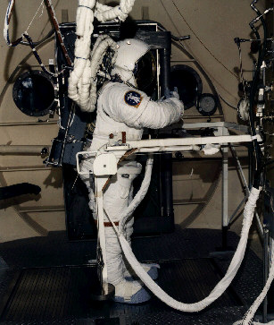
Introduction
Development of spacesuits has evolved significantly since early space flight
  Materials advancements
  Technology advancements
  Mission Requirements
Next generation suits, such as those being developed by our xEVAS partners, must be able to evolve and withstand harsh environments of manned missions
NASA is leveraging their Apollo-Era manned vacuum chambers which are being upgraded for the rigorous testing demands of modern missions.
The NASA 11 Foot Vacuum Chamber, used in Human-in-the-loop (HITL) testing for ISS EMU, is being upgraded for these modern testing requirements
Prior to manned testing all facility checkouts will be done at the unmanned stage

Slide 4
Testing Objectives – Overview
In order to support a full HITL spacesuit test run, the 11ft Chamber must be able to support:
  a single crewed spacesuit starting with suit donning at atmospheric pressure,
  suit consumables (water (H₂O), oxygen, battery) recharge,
  pre-breathe,
  depressurization to vacuum with the suit connected to its servicing umbilical,
  simulated EVA with the umbilical’s disconnected,
  chamber repress with umbilical reconnected,
  vehicle cooling and vehicle power,
  suit doffing.

Slide 5
Testing Objectives – Extravehicular Activity Test Days
EVA Test days purpose was to stress the chamber vacuum system to characterize performance across a range of loads representing EVAs with a nominal metabolic profile, maximum-specification transient metabolic profile, single-purge valve operations, and dual purge valve operations
This sequence of test profiles represented an increasingly challenging gas and water vapor loading for the chamber’s vacuum pumps
IVA cases were tested with each EVA test day which tested
  the capability of suit cooling via the umbilical,
  IVA vacuum access for CO₂ removal swing-beds,
  vehicle power,
  and procedural validity for running an IVA-EVA-IVA series of procedures as a HITL test would

Slide 6
Testing Objectives – Ambient Test Days
Due to the unmanned nature of the SxEMU test, several objectives required engineers to operate the suit and test hardware in the chamber in an ambient environment. The main focus was:
  Consumables Recharge
  Serial Telemetry Output
  Ultra High Frequency (UHF) communication with control room
  UHF telemetry streaming
  Hardline communications
  Execution of a critical lift and installation of the SxEMU into upgraded facility donning stand interfaces
  Integration of Data Acquisition (DAQ) system with the EC4 facility
  Wi-Fi streaming of telemetry and video

Slide 7
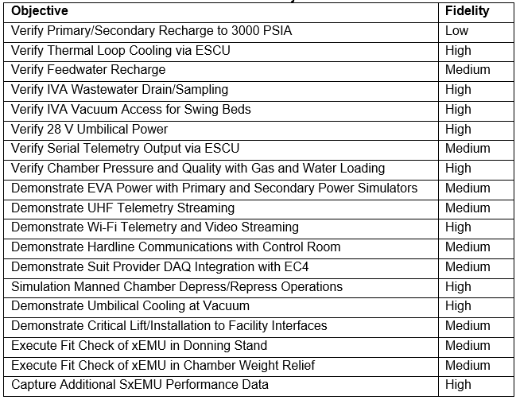
Testing Objectives – Ambient Test Days
Test level of fidelity column represents the level of fidelity with respect to the manned xEVAS vendor HITL test.
High – Test replicated a manned test
Medium – Test realistically demonstrated interface but may not have been perfect
Low – interface was verified, but not in a way that mirrors a manned test
Only one low, and that is due to the xEMU not being O2 rated

Slide 8
Test Day Overview
Test Day 1: Powered Functional
  Test Day Goals:
    Verify the functionality of all systems, integration and procedural flow minus vacuum chamber pump down
    Power on the SxEMU
    Verify Display Control Unit (DCU) simulator (outside the chamber and functional) switch positions
    Verify SxEMU DCU (attached to the suit and not functional) switch positions
    Verify ESCU mating and demating and RCA vacuum access line actuator
    Vehicle cooling capability and SCU to BATT power transitions
  Test Day Anomalies:
    None experienced

Slide 9
Test Day Overview
Test Day 2: EVA 1
  Test Day Goals:
    11 Foot vacuum chamber depress with SxEMU
    Run a full 8hr SxEMU EVA with vacuum chamber at pressure
    RCA vacuum access actuator switching
    ESCU mating and demating actuator
    11 Foot vacuum chamber repress with SxEMU
  Test Day Anomalies:
    RCA vacuum access line leaking.
    ESCU unsuccessfully mated to the DCU at the end of testing
    Vacuum appeared to be struggling more than a nominal depress of the chamber based on previous runs. An inspection was carried out to determine if a leak was present. It was discovered that one of the chamber penetrations was improperly sealed which allowed ambient air leakage into the chamber at a significant rate.

Slide 10
Test Day Overview
Test Day 3: Recharge
  Test Day Goals:
    Recharge consumables
    Fix all anomalies and update procedures as necessary
      Vacuum chamber leaking was due to an improper sized B-nut. This was replaced and a flare saver added
      ESCU was unable to mate with high-pressure O₂ poppets. Procedure change to depress lines prior to mating
      RCA Vacuum access line fittings were replaced with barbed fittings
  Test Day Anomalies:
    None

Slide 11
Test Day Overview
Test Day 4: EVA 2
  Test Day Goals:
    IVA testing at 400 BTU/hr with active vehicle cooling
    11 Foot vacuum chamber depress with SxEMU
    Run a full 8hr maximum transient metabolic rate profile SxEMU EVA with vacuum chamber at pressure. Modified CO2 injection to account for the lack of water injection.
    RCA vacuum access actuator switching
    ESCU mating and demating actuator
    Feedwater Supply Assembly (FSA) depletion and check valve cracking testing
    11 Foot vacuum chamber repress with SxEMU
  Test Day Anomalies:
    SWME (HX-440) back pressure valve (BPV) linear potentiometer went out of sync during valve position changes in the closing direction. No constraint to testing.
    Human Metabolic Simulator (HMS) controlled evaporator mixer (CEM) temperature probes, which measure the temperature of the humidity injection which was not used, read off-scale high. No constraint to testing.

Slide 12
Test Day Overview
Test Day 5: Recharge 2
  Test Day Goals:
    Recharge consumables
    Bypass RCA solenoid valves to pump directly to the IVA vacuum pumps
  Test Day Anomalies:
    None
Test Day 6: EVA 3 and Recharge 3
  Test Day Goals:
    IVA testing at 400 and 600 BTU/hr with active vehicle cooling
    IVA Heat injection testing at 205W
    11 Foot vacuum chamber depress with SxEMU
    Load the vacuum chamber to the maximum extent that the suit could reasonably do under conventional operations. Max CO2, Heat injection and both purge valves opened.
    RCA vacuum access actuator switching
    ESCU mating and demating actuator
    FSA depletion and check valve cracking testing
    11 Foot vacuum chamber repress with SxEMU
  Test Day Anomalies:
    None

Slide 13
Test Day Overview
Test Day 7: IVA Vacuum Access Leak Detection
  Test Day Goals:
    Identify RCA vacuum access line leakage. Source determined to be possible O-ring crushed in the VAC_1003 to VAC_1004 connection
  Test Day Anomalies:
    None
Test Day 8 and 9: Communications, WI-FI, and Radio
  Test Day Goals:
    Verify communications, signal interfaces, and connectivity through EMU radio and the in-suit microphones
  Test Day Anomalies:
    EV-701 communication through EMU radio unsuccessful
    Suit hardline testing no audio detected
    The required Linux laptop and software to access streamed telemetry and video from the suit over Wi-Fi was not present

Slide 14
Test Day Overview
Test Day 10: IVA Vacuum Access Testing and Water Drain and Fill
  Test Day Goals:
    Verify communications, signal interfaces, and connectivity through EMU radio and the in-suit microphones. Focused on hardline communications
    Fill and drain SxEMU water bladders using facility water drain port, recharge and degas
  Test Day Anomalies:
    Facility side hardline audio connection to the chamber intercom system and that the SxEMU test article was the issue.
Test Day 11: IVA Vacuum Access Testing Re-Test
  Test Day Goals:
    Load various profiles on the IVA vacuum pumps using various Ballast Modes on the vacuum pumps
  Test Day Anomalies:
    None

Slide 15
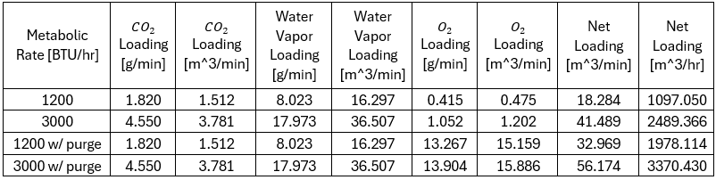
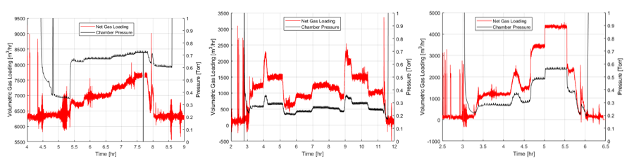
Detailed Testing/Anomalies – EVA Vacuum Loading
3 EVAS, largest vacuum loading on EVA 2 and 3. Total loading seen below
Volumetric gas loading for EVAs 1, 2 and 3. Shows that with high loading the chamber pressure remains around .7 Torr

Slide 16
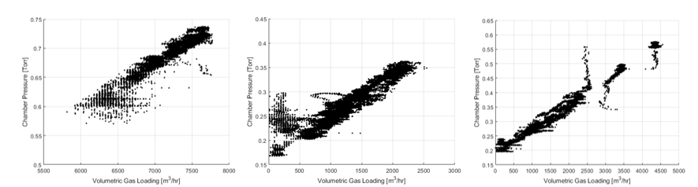
Detailed Testing/Anomalies – EVA Vacuum Loading
Chamber Pressure as a function of volumetric gas loading shows that the gas loading to chamber pressure is linear

Slide 17
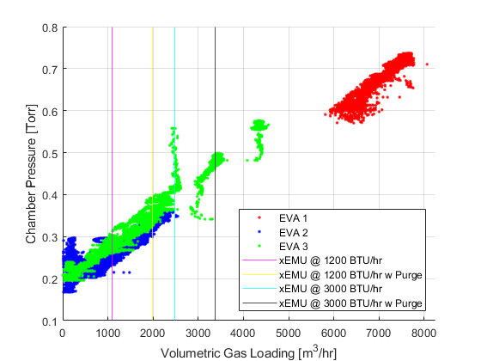
Detailed Testing/Anomalies – EVA Vacuum Loading
Comparison of the xEMU loading with test all tested loads. For maximum RCA and SWME desorbing the vacuum pressure should be as low as possible, ideally less than 1 torr.
For the xEMU, vacuum pressure was sufficient, new providers should be aware of their predicted hardware performance under the now-known 11-ft vacuum environment

Slide 18
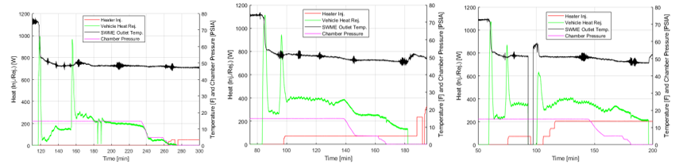
Detailed Testing/Anomalies – IVA Cooling
IVA cooling was tested by injecting controlled heat via the test systems cold plate heaters.
The vehicle chiller cart was set to 45°F (7.22°C) and not adjusted throughout all IVA test days. The outlet temperature was monitored to have the outlet temperature of 50°F +/- 1.5°F

Slide 19
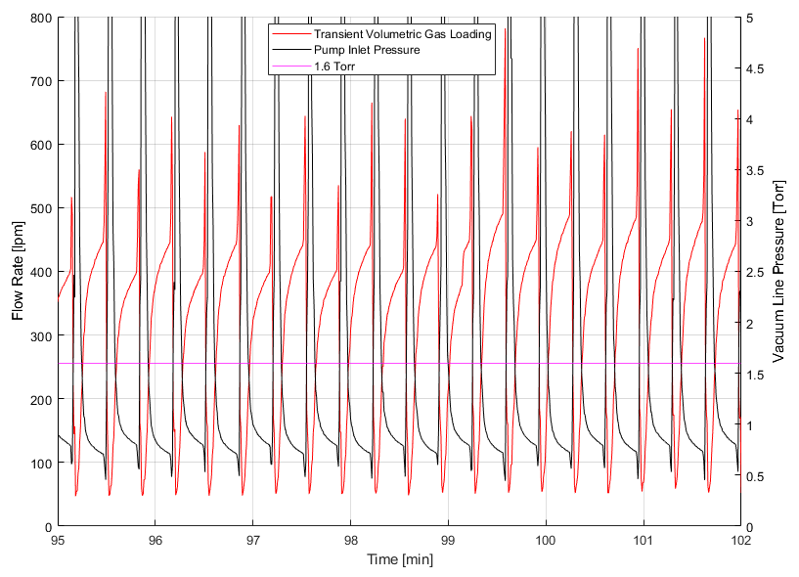
Detailed Testing/Anomalies – IVA Vacuum Access
Vacuum access testing was composed of 2 days testing, the first with the RCA attached directly to the IVA vacuum access system and the second when the pressure transducers were updated and retested.
Figure shows the RCA loading of the IVA vacuum access through the SxEMU and the RCA hit a max of 15s half cycle time.

Slide 20
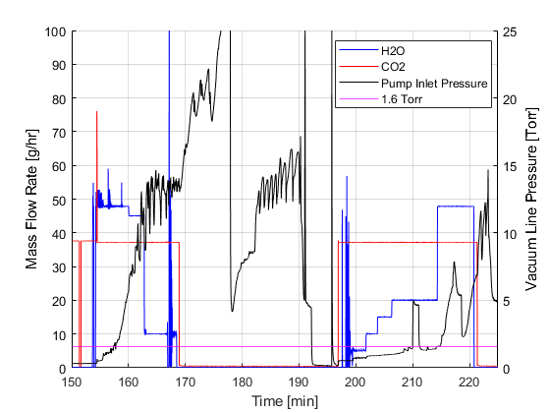
Detailed Testing/Anomalies – IVA Vacuum Access
The second configuration on test day 1 was to inject HMS directly into the IVA vacuum pumps.
An equivalent met rate of 400BTU/hr

Slide 21
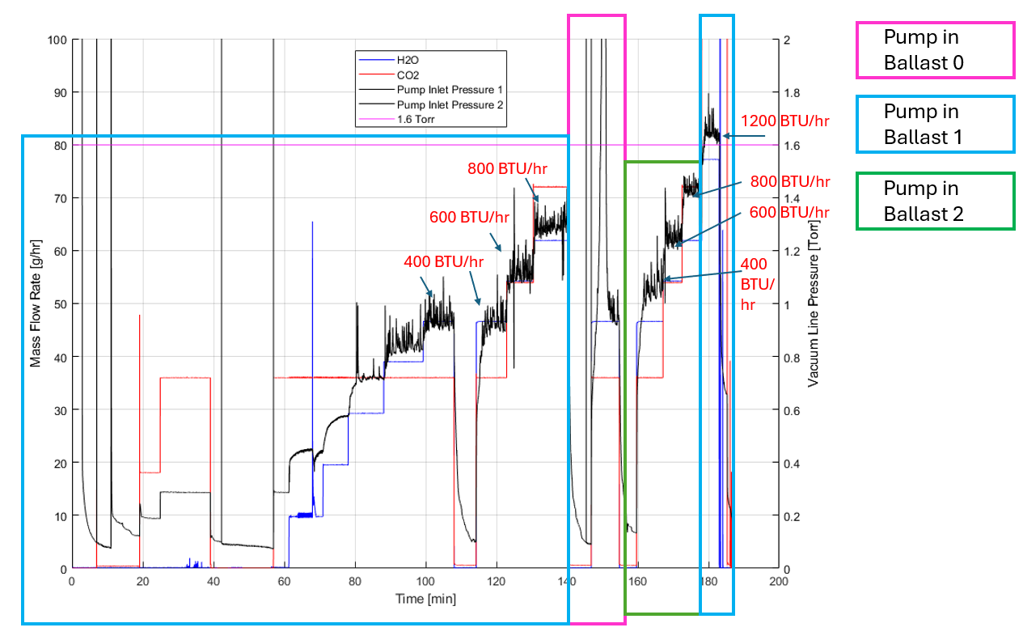
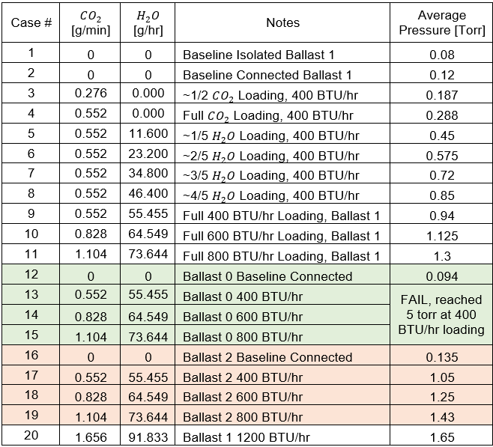
Detailed Testing/Anomalies – IVA Vacuum Access
The second test day was carried out after a faulty pressure sensor was swapped out.
HMS was installed close as possible to the IVA vacuum line
Table below shows the different ballast modes and the figure shows the various pressures at those modes

Slide 22
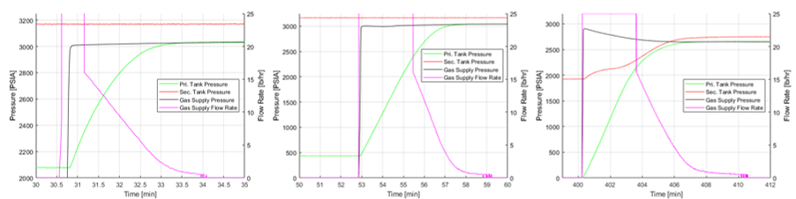
Detailed Testing/Anomalies – Primary Oxygen Vessel (POV) and Secondary Vessel (SOV) Recharge
3 total recharge days with recharge day 3 being a POV full discharge.
All days were successful in charging the POV. Initially read offscale high and then showed 16lbm/hr recharge
Recharge day 1, 2, and 3

Slide 23
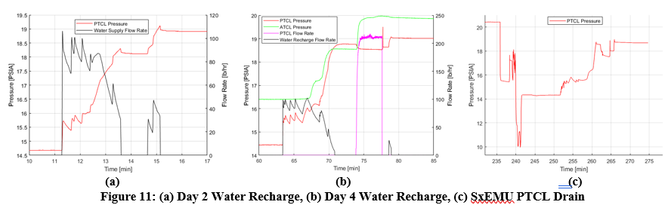
Detailed Testing/Anomalies – FSA Fill and Drain
FSA recharge performed on days 3, 5 and 6
  Day 6 was a fill and drain test day
Testing showed that xEMU can successfully be filled and drained with the updated 11ft chamber water system

Slide 24
Detailed Testing/Anomalies – Battery Simulators and Vehicle Power
Two power supplies, simulated vehicle power and battery simulators, both of which showed good performance.
There was an accidental disable of vehicle power by a technician while the SxEMU was operating off of vehicle power, however once power was restored, the SxEMU recovered from the power loss exactly as intended and gave the expected faults and warning messages
after power was restored to the SxEMU, the suit recovered from the power loss as expected. Other than these two unintentional power resets, the battery simulators and vehicle power supply operated nominally with no other anomalous behavior

Slide 25
Detailed Testing/Anomalies – Suit Telemetry and Communications
Ambient test days were used to verify suit communication and telemetry. Engineers removed the SxEMU helmet and verified radio communications to the control room
While the SxEMU software was not configured for communication over the ESCU hardline, engineers were able to inject audio signals into the ESCU and verify connectivity to the control room. These tests verified the infrastructure for safety-critical communications between a suited test subject and the test team.
WiFi connectivity was confirmed between a test engineer’s laptop and the SxEMU’s informatics box via command terminal. Suit telemetry was successfully transmitted via the serial connection in the ESCU umbilical and via the suit radio.

Slide 26
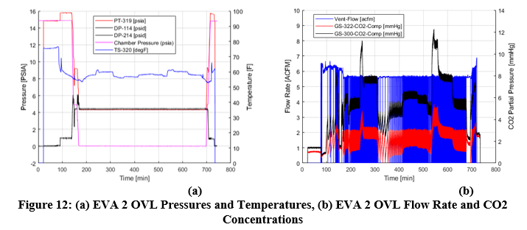
Detailed Testing/Anomalies – SxEMU Performance
Overall the SxEMU performed well during the test series with minimal anomalous behavior.
Figures below are from EVA 2 which is the only 8-hr EVA.
Shows a GS_322 goes high for higher met rates due to RCA degradation

Slide 27
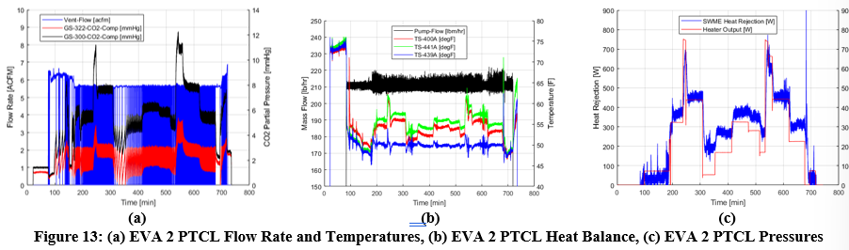
Detailed Testing/Anomalies – SxEMU Performance
The PTCL operated nominally during this test series providing cooling flow to the SxEMU.
Figure below shows the flow rates, temperature, heat injection, heater output, and pressure during EVA 2

Slide 28
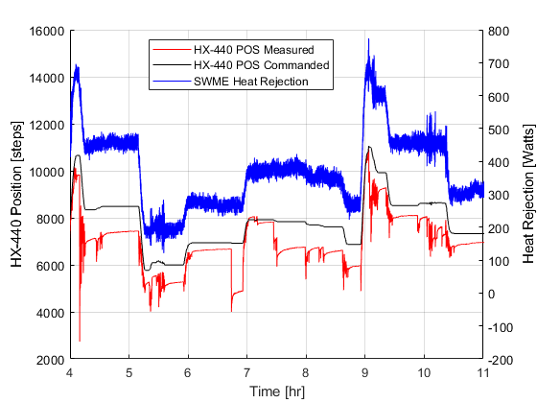
Detailed Testing/Anomalies – Anomalies
SWME BPV anomalous behavior was observed. The measured position and the commanded position became misaligned when adjusting to the CLOSED position.

Slide 29
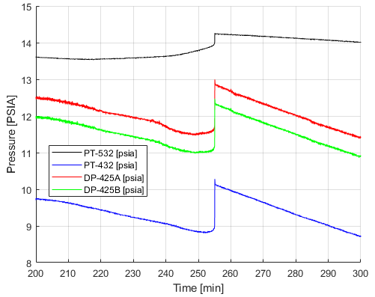
Detailed Testing/Anomalies – Anomalies
During the simulated EVAs there was also anomalous behavior on both water loop pressure sensors
An unexpected spike in pressure on all water loop pressure sensors
additionally the water loop absolute pressure did not follow the suit absolute pressure as expected during depress.
Figures are from EVA 2
the prevailing hypotheses are FSA shifting, or entrained gas or bubble interactions in both water loops

Slide 30
Conclusions
The SxEMU 11-ft Chamber Test was successful, verifying that the chamber is capable of testing an advanced spacesuit in preparation for a planned manned test in 2026.
A key finding of the test was that the IVA vacuum pumps must be operated in Ballast Mode 1 or Ballast Mode 2, preferably Mode 1 as it gives the best performance
Supporting interfaces for high-pressure gas and water fill and drain operations were successfully tested, with only minor anomalies in the flow meters of each system

Slide 31
Acknowledgements by Authors
The authors would like to acknowledge the EC5 test team who designed, built, and upgraded all the test systems required to test spacesuits and performed the test. The authors would also like to acknowledge and thank the EC4 test team who operated all of the vacuum and facility systems. Additionally the authors would like to acknowledge all the EC4 test directors, EC5 test requestors, EC5 test system operators, and many others not mentioned here to allow for a successful unmanned SxEMU chamber checkout test.

