Slide 1

Ceramic Matrix Composite (CMC) Hot Structures for Reusable Hypersonic Vehicles
David E. Glass, Ph.D.
Senior Technologist, Advanced Structural / Thermal Systems
Applied Materials for Space & Hypersonics (AMSH)
NASA Langley Research Center
Hampton, Virginia 23681 USA
27th AIAA International Space Planes and Hypersonic Systems and Technologies Conference
Naples, Italy
July 7-10, 2026
Approved for Public Release

Slide 2

Outline
Ceramic matrix composites (CMCs) are the family of materials that will enable hypersonic vehicles
Introduction
Key technical challenges
Concluding remarks
Leading edges
Acreage
Hot structures
Propulsion system

Slide 3
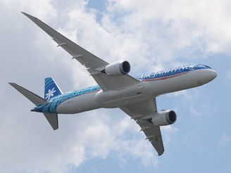
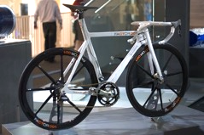
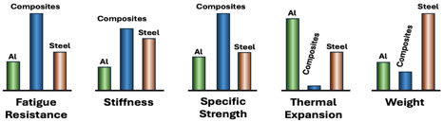

What are Composites?
Two or more constituents combined on macro scale
  Often comprises a matrix (binder) and reinforcement
Types of reinforcement
  Continuous or long fibers
    Unidirectional, woven, braided, or random architecture
  Random or short fibers
  Particulate, flakes, or fillers
Benefits
  Lightweight
  Tailorable to different applications
    Strength / stiffness
    Coefficient of thermal expansion (CTE)
    Hardness, fatigue life, damage tolerance
Common composite examples
  Reinforced concrete and masonry
  Composite wood such as plywood
  Polymer matrix composites (PMC)
  Ceramic matrix composites (CMC)
Boeing Dreamliner 787
PMC composite bicycle
Credit: “Composite Bike (3665606309)" by Paul Hudson licensed under CCA 2.0.
B787 PMC fuselage
Composite plywood
Credit: “N1015X Air Tahiti Nui Boeing 787-9 Dreamliner 26 " by New York-air licensed under CCA 4.0.
PMC versus metallic properties
Credit: “Spruce Plywood" by Bystander licensed under CCA 3.0.

Slide 4
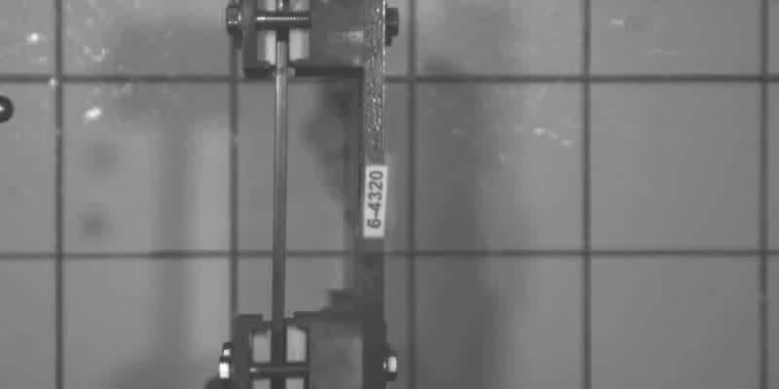
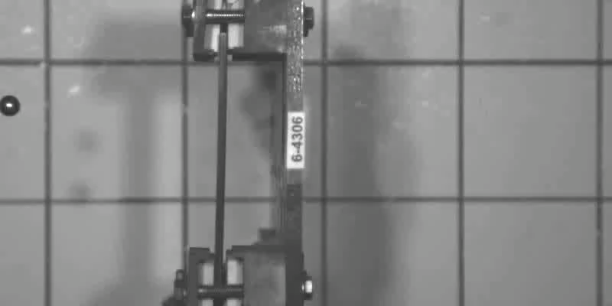
Ceramic Matrix Composites (CMCs)
CMC = Ceramic (or carbon) fiber in a ceramic matrix
  Material nomenclature is “fiber/matrix”
Common examples
  Oxides: Oxide/alumina-silicate, oxide/alumina-mullite
  Carbides: SiC/SiC, C/SiC, C/C-SiC
  Carbon/carbon: C/C
Characteristics
      Moderate density
      High use temperature
      Chemical resilience
      Excellent mechanical capability
“Game changer” for high-temperature applications
180 mph
(290 km/hr)
Environmental barrier coating (EBC) (possible)
Fiber: silicon carbide (SiC), carbon (C), oxide, etc.
Monolithic ceramic
Fiber-matrix interface coating (possible)
Monolithic ceramic panel
Unidirectional fibers shown
Matrix: SiC, C, oxide, etc.
180 mph
(290 km/hr)
CMC
CMC panel
Credit: GE Aerospace, used with permission

Slide 5
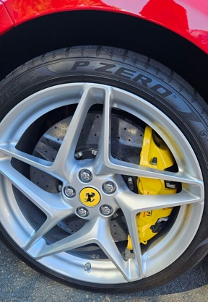
Perception of CMCs
Analogous to that of PMCs in the mid-1980s
Commonly viewed as promising, but…
  Too many problems, unknowns, and risks
  Immature manufacturing techniques
  Immature supply chain
  Exotic
  Complex to analyze and implement
  Too expensive and therefore unrealistic for “real-world structures”
Is this perception valid?
CMC brake discs, calipers, and pads are NOT complex, immature, or risky
Credit: J. Chenenko, used with permission

Slide 6
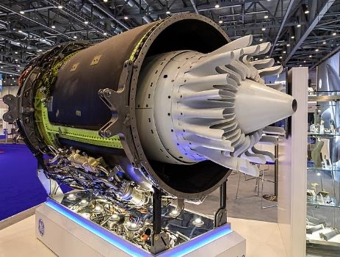
Reality of CMCs
Offer increased efficiency and decreased complexity for elevated-temperature applications
Have reached an inflection point in maturation
  Viable predictive and design capabilities
  Proof of profitability in multiple industries
  An actively developing supply chain
  Technological advances/improvements in manufacturing
    Can be tailored to application
    Decreased costs with increased quality and throughput
Passport engine oxide/oxide mixer and nozzle
Credit: "EBACE 2019, Le Grand-Saconnex (EB190671)" by Matti Blume licensed under CCA 4.0.
  Analogous to PMC composites in the mid-80s – CMCs are poised for explosive growth…

Slide 7
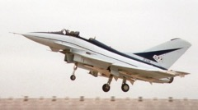

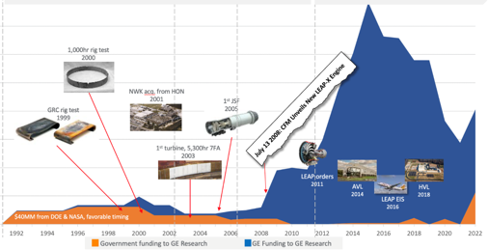
Cost Perceptions and Cost Realities of CMCs
CMCs have a reputation as too expensive
  Acquisition costs can cause hesitation in adoption of CMCs, even if life-cycle costs are reasonable
  Costs must be balanced against the drivers for CMCs
Investment in industrialization for high-pull business cases improves future business cases
PMC Business Case Evolution
1980’s to present
Sector Level of
Industrialization / Capitalization
Credit: “British Aerospace EAP at the Farnborough Air Show, 1986" by Mean as custard licensed under CCA 3.0.
Credit: “Tennis Racket and Balls" by Vladsinger licensed under CCA 3.0.
Low
High
Business case for CMCs in aviation drove GE investment
Demand / Pull for CMC Technology
Performance
Efficiency
Emissions
Environmental
Safety
Business case for industrialization
Cost often competitive
High
Cost may not be competitive
Cost can be competitive
Low
S.J. Lewis, “The use of carbon fibre composites on military aircraft,” Composites Manufacturing, Vol. 5 No. 2, 1994.
Used by permission of GE Aerospace: Approved for external publication (July 2024)

Slide 8
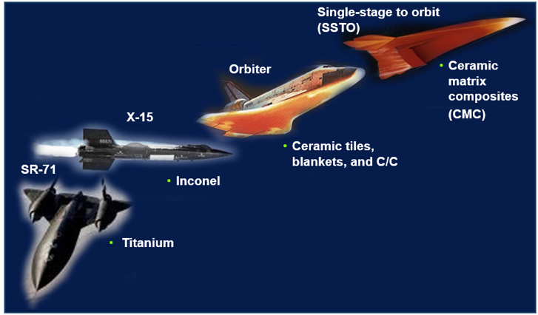
CMCs are Both Enablers and Benefit-Multipliers
CMCs enable new technologies and products
  Spacecraft, aircraft, defense, nuclear, and other power generation components are some currently identified examples
CMC implementation results in system benefits
  CMC components enable a system with lower weight, higher performance, higher efficiency and improved safety while decreasing overall complexity – a benefit-multiplier
Aerospace: new materials enable new vehicles
Credit: NASA
Credit: NASA

Slide 9
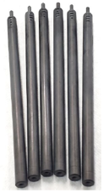
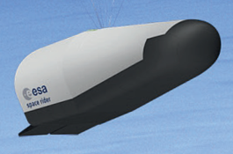
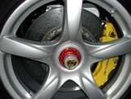
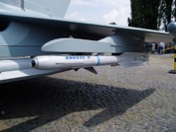
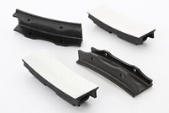
CMC Sectors
CMCs are currently making in-roads in multiple key industrial sectors
Space and Hypersonics
Automotive
Energy
Defense
Aviation
Brakes
Rocket control vanes
Aircraft engine shrouds
ESA Space Rider
Credit: "PCCB Brake Carrera GT" by Nrbelex licensed under CCA 3.0.
Credit: “Space Rider mission” by ESA©ESA, ESA Standard License
Nuclear fuel rods
Credit: General Atomics Electromagnetic Systems (GA-EMS), used with permission
Credit: "IRIS-T air-to-air-missile" by Owly K licensed under CCA 3.0.
Credit: “ORNL History (44684257470)" by ORNL History licensed under CCA 2.0.

Slide 10
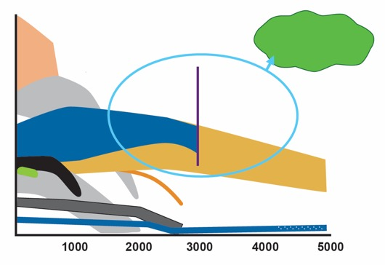
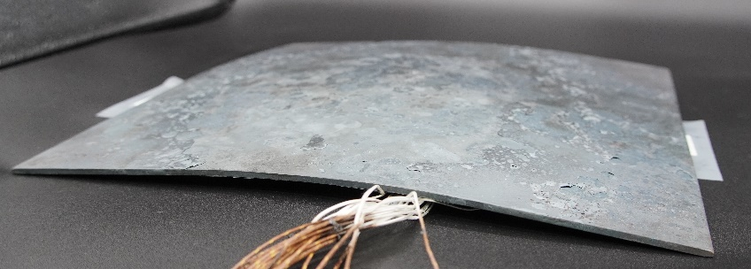
Why CMC Hot Structures?
Hot structures provide ~ 25% weight savings over insulated cold structure
High-performance vehicles utilize high specific strength/stiffness materials
  Aluminum (Al)
  Composites: carbon fiber reinforce polymers (CFRP)
  Titanium (Ti)
  Beyond Ti use temperatures (~Mach 5), often utilize superalloys, refractory metals, and active cooling – not high specific strength/stiffness
  Refractory-composite (C/C, C/SiC, SiC/SiC, etc.) hot structures extend high specific strength/stiffness structures to 3000°F (1650°C) and above
Reduced deflections
MMC: Metal matrix composite
C/SiC: Carbon/silicon carbide
UHT: Ultra high temperature
Goal: High specific strength & high temperature
CFRP
Specific
strength
(strength
/density)
MMC
Multi-Use
Single-Use /Ablator
C/SiC
Al
Ti
C/C
Superalloys
SiC/SiC
Ceramics
UHT Ceramics
Temperature, °F
Steel plate after 2200°F (1200°C) exposure
> 0.5 in. (1.25 cm) residual deformation

Slide 11
Hot Structures for Hypersonic Vehicles
CMCs are the family of materials that will enable hypersonic vehicles
Damage tolerance approach (DTA) is required for reusable hypersonic vehicles
For most reusable hypersonic vehicle structures, there are two key technical challenges
  Environmental durability
  Hot-structure manufacturing
Leading edges
Acreage
Hot structures
Propulsion system

Slide 12
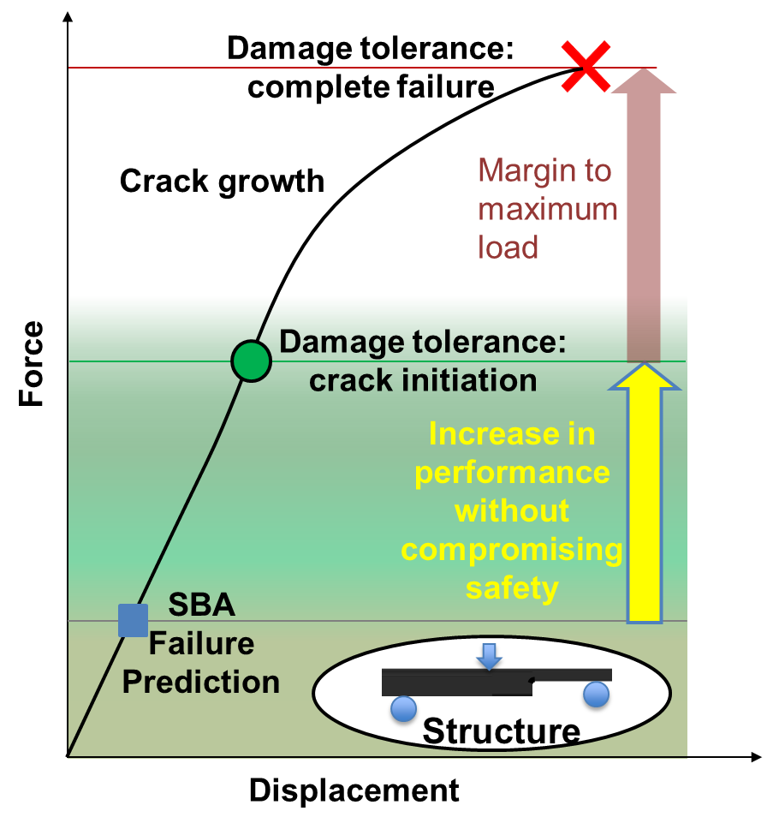
Need for a Damage-Tolerance Approach (DTA)
Strength-based approach (SBA)
  √ Good for initial structural sizing
  X Not applicable around cracks, other defects, or at some stress concentrations
  X Manufactured parts containing defects generally rejected
  X May miss key failure modes
  Needs to be supplemented with a damage-tolerance approach (DTA)
Damage-tolerance approach (DTA)
Emerging approach for C/C and CMCs is to apply at stress concentrations and manufacturing defects
Utilize a no-growth philosophy for C/C and CMCs
Inform part accept/repair/reject decisions
Support safe operational envelope expansion
DTA can increase production yield and confidence in structural integrity and vehicle life

Slide 13
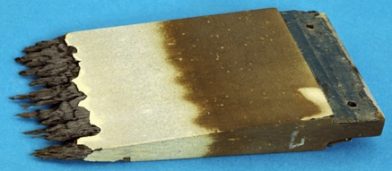
Key Technical Challenge: Environmental Durability
  Oxidation resistance (CMCs containing SiC)
    SiC works very well up to ~ 3000°F (1650°C), depending on temperature and pressure
    Is reusable, but number of cycles limited and must be verified
Passive oxidation (low temperature or high pressure)
    SiC_{(s)} + 2 O_{2(g)} SiO_{2(s)} + CO_{2(g)}
Active oxidation (high temperature or low pressure)
    SiC_{(s)} + 1.5 O_{2(g)} SiO_{(g)} + CO_{2(g)}
  Above ~ 3000°F (1650°C), no reusable solutions exist
  Challenges
Testing in relevant environments
Cycles under combined load
Multi-mechanism-driven failure
Accurate life prediction
Physics-based material limitations
Multiple cycles and increased duration increase challenges

Slide 14
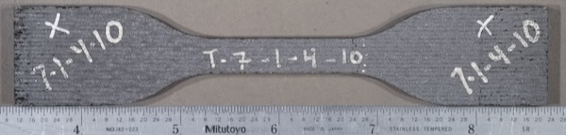
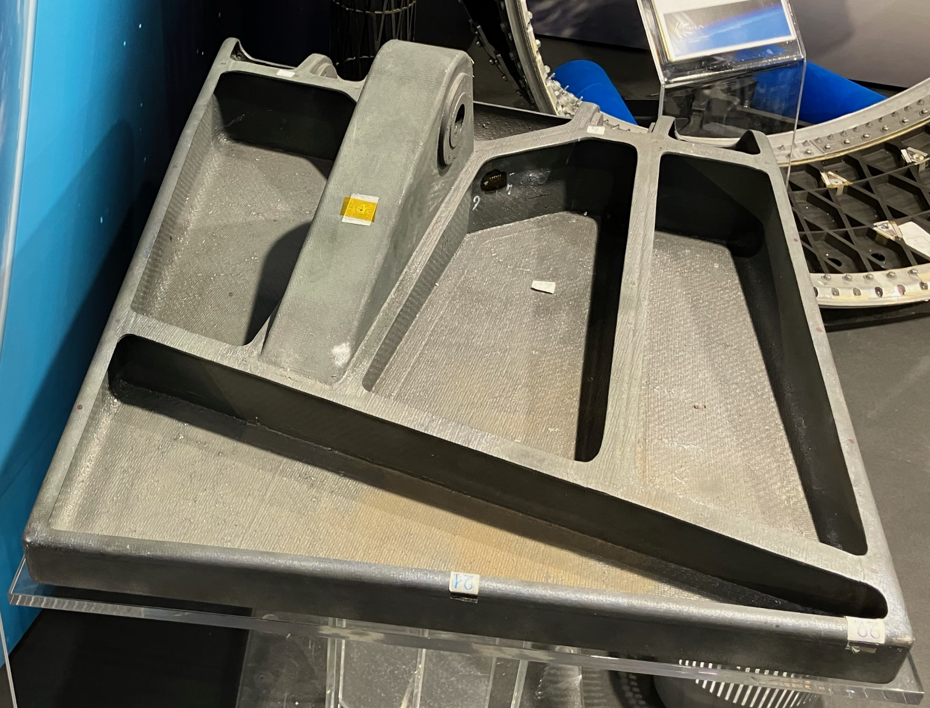
Key Technical Challenge: Hot-Structure Manufacturing
A state-of-the-art material is not the same thing as a state-of-the-art structure – big difference
In almost every program in which I've been involved,
it is manufacturing that comes up and bites us
The manufacturing challenges (MRL) are often under-estimated due to a focus on demonstrating performance (TRL)
Adopting the suggested AMSH Gates for Transitioning CMCs (next chart) will significantly improve cost and schedule for transition to flight
Credit: David Glass
MRL = manufacturing readiness level
TRL = technology readiness level
AMSH = Applied Materials for Space and Hypersonics
If we can manufacture it (well) and analyze it (accurately), it will perform as expected

Slide 15
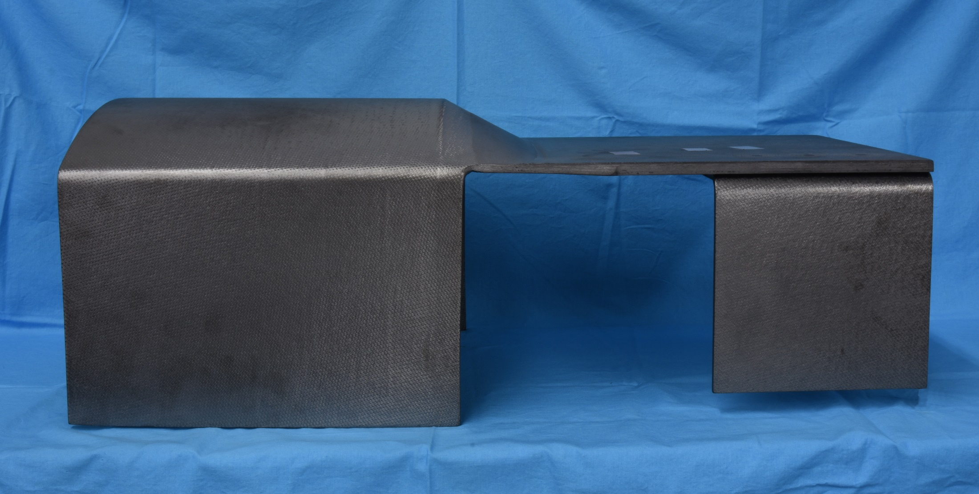
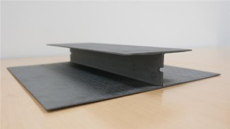
AMSH Gates for Transitioning CMCs
Gate1 (G1): Locked-down manufacturing process – requires iterative process with manufacturing and testing
G2: Material property database utilizing a locked-down manufacturing process
  After database is generated, equivalency testing can be used to gradually transition improved processes
G3: Complex-shaped structure, at appropriate scale, manufactured utilizing the locked-down manufacturing process
  Example manufacturing demonstration: C-channel, saddle, and I-beam
G4: Thermal-structural tests and corresponding analyses of complex structures validating manufacturing and material properties
Can extract sub-elements from these
Saddle
30 in. x 16 in. x 10 in.
Chemical vapor infiltration (CVI) C/SiC I-Beam
24 in. x 16 in. x 8 in.
May do some gates in parallel or different order
61 cm x 41 cm x 20 cm
I-beam
12 in. x 12 in. x 2 in.
C-channel
76 cm x 41 cm x 25 cm
30 cm x 30 cm x 5 cm
Demonstrated manufacturing capability (validated via test and analyses) at desired scale and complexity should be a required gate before consideration in a flight program

Slide 16
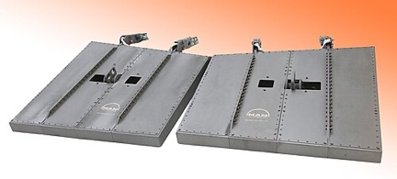
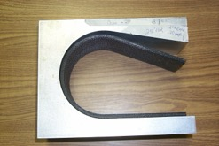
Manufacturing Challenges
Densification of thick parts: properties function of thickness
Complex curvature and closure
Large scale (equipment, power, uniformity, etc.)
Delamination, poor bonds, voids, and defects
Tooling
Machining
Assembly methods, joints, and attachments
Tolerances
Reproducibility / consistency
Fabrication modeling
Design of manufacturable structures
Nondestructive inspection
Repair
Affordable (cost and schedule) manufacturing techniques (often-overlooked and typically addressed late in the development cycle)
X-38 C/SiC body flaps
Manufacturing challenges are process-dependent
Credit: “CMC-X38-Bodyflaps” by MT Aerospace AG, Augsburg, Germany licensed under CCA 3.0.
Credit: C-CAT
Years of manufacturing experience and building-block testing are required before complex structures can be successfully manufactured at scale and flown
C/C closure

Slide 17
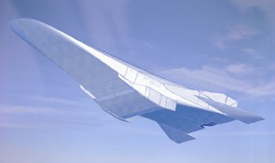
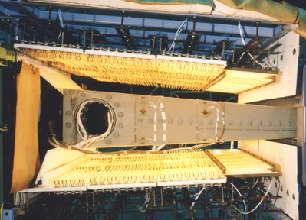
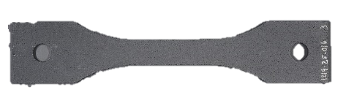
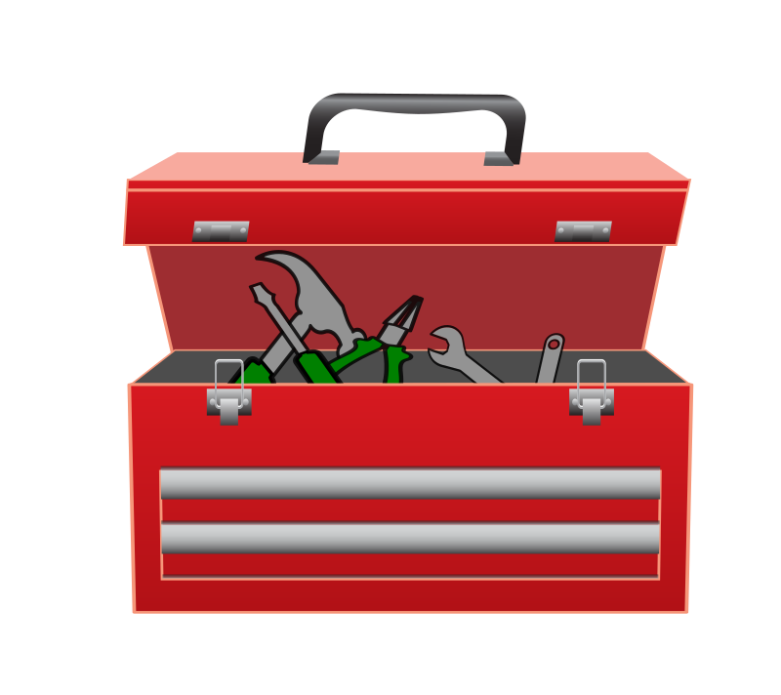

Successfully Transitioning Hot Structures to Flight Vehicles
G1: Locked-down process
G2: Material databases
G3: Fabrication of complex parts at scale
G4: Thermal-structural tests with model correlation
Iterative process
Caution: Jumping straight from a material to flight test can lead to over-estimation of MRL & TRL
Flight hardware
No flight requirements
Components
Subcomponents
Elements
Flight requirements
Coupons
Credit: “CMC-X38-Bodyflaps” by MT Aerospace AG, Augsburg, Germany licensed under CCA 3.0.
May execute some gates in parallel or different order
Transitioning hot structures to flight: Vehicle & flight requirements inform TRL/MRL advancements to fill gaps
Science & technology (S&T) “fill” the toolbox (independent of flight/vehicle requirements)
Toolbox

Slide 18
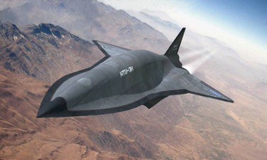
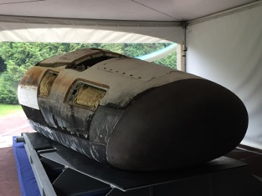
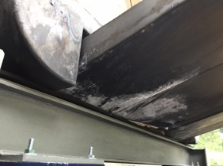
Manufacturing is the Biggest Challenge, Not Performance
Atmospheric reentry
Atmospheric flight
IXV post-flight
IXV body flap post-flight
Credit: David Glass
Credit: David Glass
HTV-3X
Credit: DARPA
Intermediate eXperimental Vehicle (IXV)
Body flaps for different applications are very relevant because manufacturing is the biggest challenge
If we can manufacture it (well) and model it (accurately), it will perform as expected

Slide 19

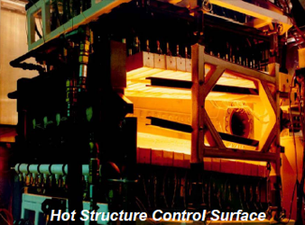
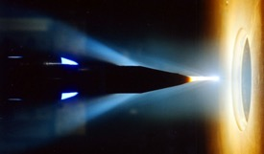
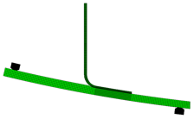
Testing
How do we qualify the vehicle for flight?
We are unable to test many components in relevant, combined loads, environments (even small scale)
  - Thermal, mechanical, plasma, shear, oxygen partial pressure, vibration and acoustic, etc.
  - Apply appropriate boundary conditions over entire structure
  - Thermal gradients (spatial and temporal) from boundary layer transition
Extensive testing is required
- Performance testing and benchmarking for analyses
Building-block approach
We cannot simulate this in ground tests
Component
test
Sub-element test
Arc-jet test of sharp leading edge
Testing at NASA AFRC
Material / coupon test
Test as much as you can, and still include adequate margins for uncertainties

Slide 20
Will Hot Structures Meet Flight Requirements?
Operation has a significant impact on our ability to use these materials as structures on flight vehicles
  Thermal loads
  Thermal gradients
  Mechanical loads
  Acoustic and vibration loads
  Pressure (oxidation)
  Combined loads
  Number of cycles
Testing at NASA Armstrong Flight Research Center (AFRC)

Slide 21
Concluding Remarks
Ceramic matrix composites (CMCs) are the family of materials that will enable reusable hypersonic vehicles
To realize reusable hypersonic vehicles
  Need to validate a damage tolerance approach (DTA) for design, acceptance, and flight
  Solve long term / multiple cycle environmental durability
  Solve manufacturing challenges as demonstrated by the AMSH gates for transitioning CMCs

