Slide 1
Performance Evaluation of Intravehicular Activity Spacesuit without the Use of a Liquid Cooling Garment
July 2026
Monica Mah (NASA JSC)
Nick Machak (NASA Astrion JETS 2)
ICES – 2026 – 170
Trade names and trademarks and company names are used in this report for identification only. Their usage does not constitute an official endorsement, either expressed or implied, by the National Aeronautics and Space Administration.

Slide 2
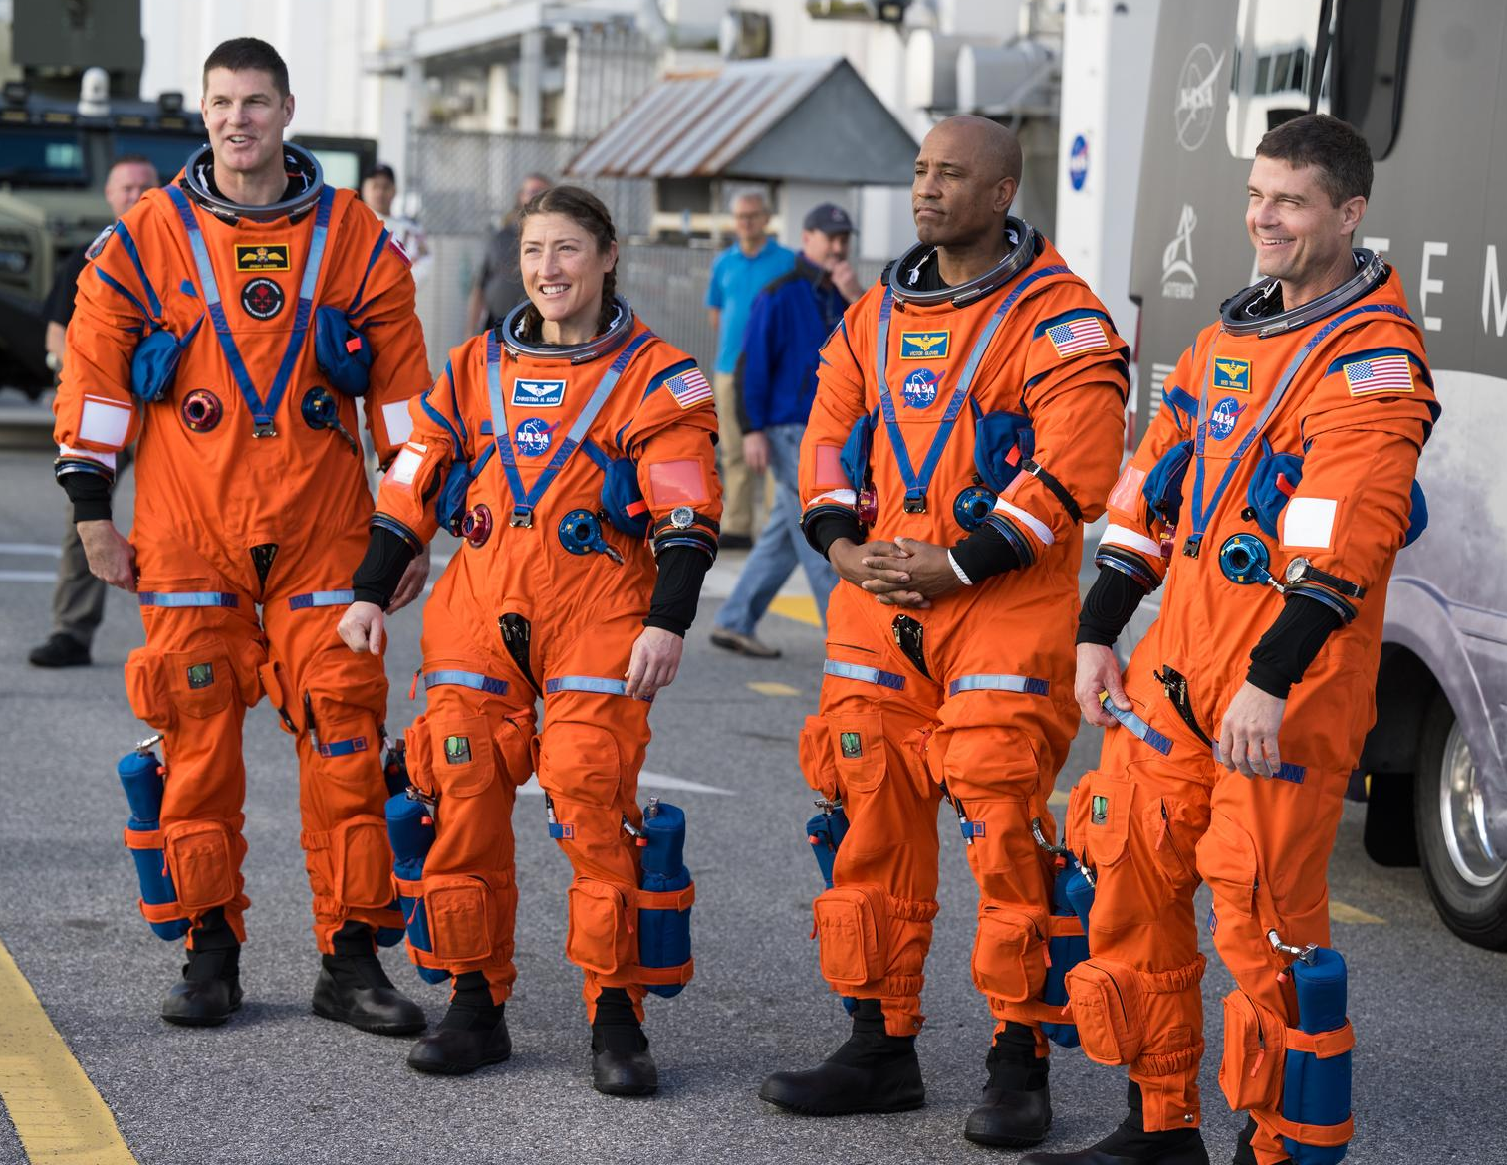
Objective of Study
The Orion Crew Survival Systems (OCSS) suit is equipped with safety technology that protects the crew during launch and re-entry and Intravehicular Activities (IVA).
It was designed to be used with a Liquid Cooling Garment (LCG), an undergarment with tubes that circulate water to remove excess heat from a crewmember.
The exclusion of the LCG from IVA suit architecture and relying solely on air cooling is worth evaluating if those crewmembers are exposed to more benign thermal environments during nominal and contingency operations.
The objective of this study was to determine if the IVA Suit can be used without the LCG to maintain the crew within their heat storage requirements. It was completed in the following phases:
  1.) Execute a test series involving test subjects wearing IVA suits without LCGs in a thermal chamber.
  2.) Correlate the human thermal model to the test data and updating the model’s intrinsic parameters for the use case of the IVA suit without an LCG.
Artemis II Crew Donning OCSS Suits
Notes:
Image Reference: Artemis II Countdown Demonstration Test - NASA

Slide 3
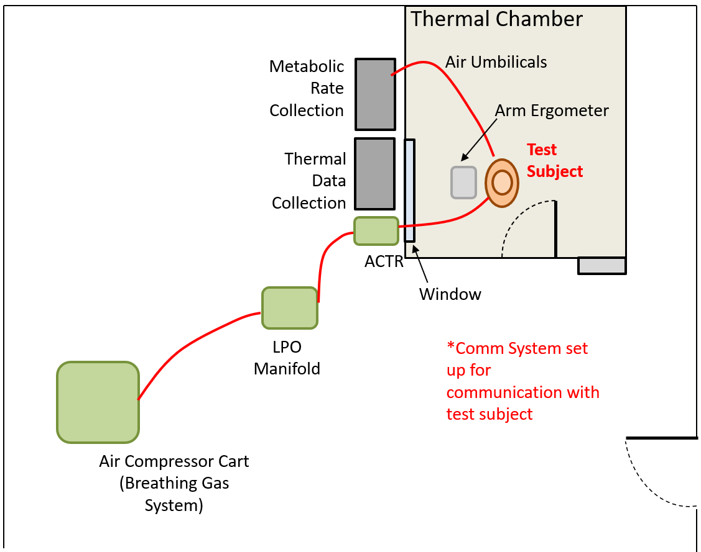
Test Series Overview
To simulate heat loads and human performance within a crewed cabin, test subjects donned IVA Suits and were directed to operate an arm ergometer located in a temperature- and humidity-controlled thermal chamber.
  Body core temperature measurements were transmitted via RF by a sensor-encapsulated pill.
  Skin temperature measurements were logged on iButtonLink, LLC temperature sensors attached to the subject’s body with hypoallergenic tape.
  Air flow rate to suit and CO2 concentrations at the suit outlet allowed for real-time metabolic rates to be estimated.
  Arm ergometer speeds were adjusted to achieve target metabolic rates for various test points.
  Four test subjects were recruited and were referred to with the following identifier: X_Y, where X denotes the suit size of the test subject, and Y is a unique test subject number starting at 1 for each suit size.
  Hence, the four test subjects for this test series are referred to by the following identifiers: XS_1, M_1, L_1, and L_2.
Facility Layout

Slide 4
Test Series Case Matrix
 | Test Point Number | Chamber Temperature [°F] | Chamber Humidity [% rH] | Inlet Breathing Air Temperature [°F] | Inlet Breathing Air Humidity [% rH] | Metabolic Rate [BTU/hr] | Suited Config.
HOT VEHICLE BOUNDARY CONDITIONS | 1 | 86 | 80* | 75 | 80* | 800 | Visors down
 | 2 | 86 | 80* | 75 | 80* | 1200
 | 3 | 86 | 80* | 75 | 80* | 800 | Visors up
 | 4 | 86 | 80* | 75 | 80* | 1200
 | 5 | 86 | 80* | 75 | 80* | 800 | Helmet/gloves off
 | 6 | 86 | 80* | 75 | 80* | 1200
COLD VEHICLE BOUNDARY CONDITIONS | 7 | 59 | 20** | 55 | ≤20 | 600 | Visors down
 | 8 | 59 | 20** | 55 | ≤20 | 800
 | 9 | 59 | 20** | 55 | ≤20 | 600 | Visors up
 | 10 | 59 | 20** | 55 | ≤20 | 800
 | 11 | 59 | 20** | 55 | ≤20 | 600 | Helmet/gloves off
 | 12 | 59 | 20** | 55 | ≤20 | 800
 | 13 | 59 | 20** | 55 | ≤20 | Resting | Visors up
*or as high as can be achieved, granted that the humidity does not go above 80%.
**or as low as can be achieved, granted that the humidity does not fall below 20%.

Slide 5
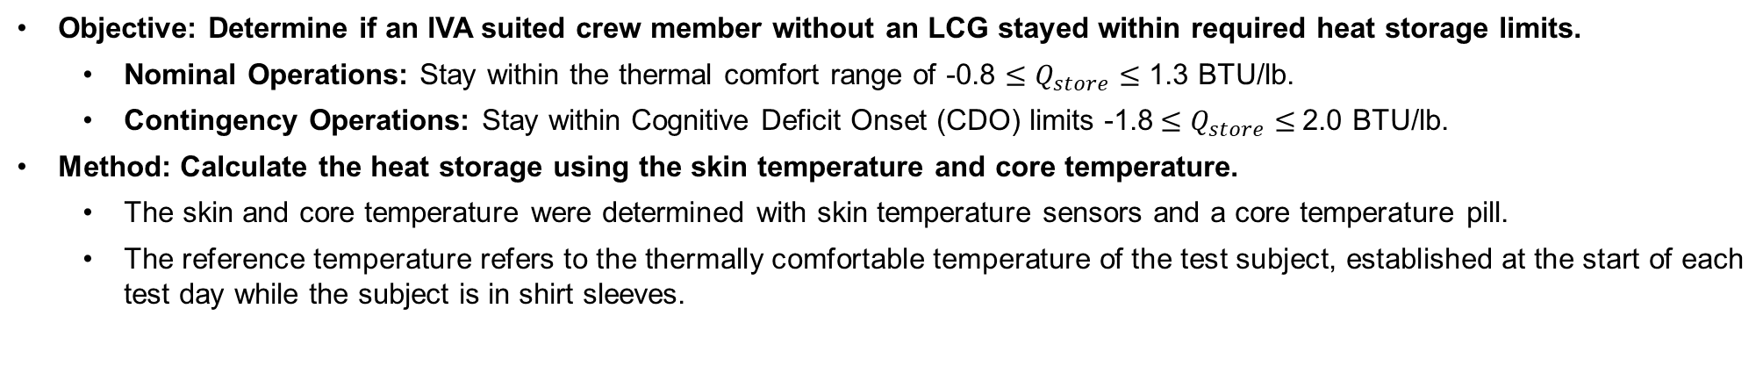
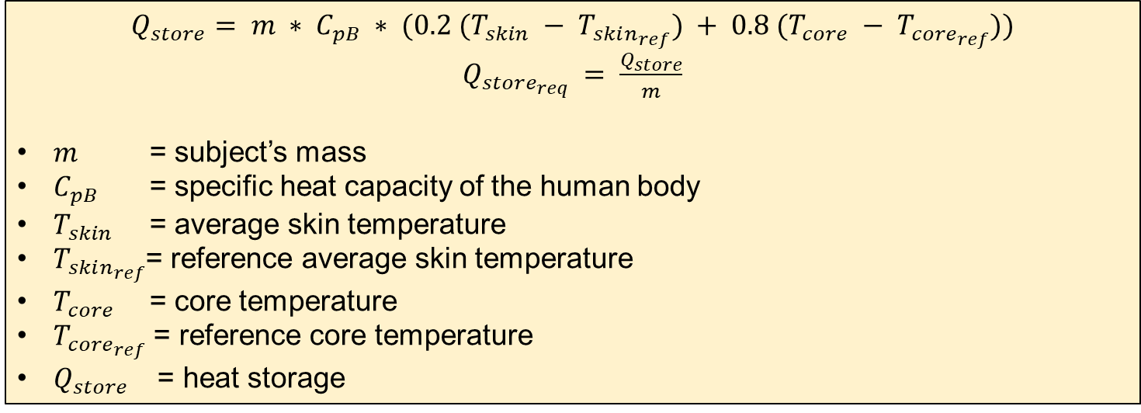
Heat Storage
Objective: Determine if an IVA suited crew member without an LCG stayed within required heat storage limits.
  Nominal Operations: Stay within the thermal comfort range of -0.8 $≤Q_{store}≤$ 1.3 BTU/lb.
  Contingency Operations: Stay within Cognitive Deficit Onset (CDO) limits -1.8$≤Q_{store}≤$2.0 BTU/lb.
Method: Calculate the heat storage using the skin temperature and core temperature.
  The skin and core temperature were determined with skin temperature sensors and a core temperature pill.
  The reference temperature refers to the thermally comfortable temperature of the test subject, established at the start of each test day while the subject is in shirt sleeves.
$Q_{store}= m ∗ C_{pB} ∗ (0.2 (T_{skin} − T_{skin_{ref}}) + 0.8 (T_{core} − T_{{core}_{ref}}))$
$Q_{store_{req}} = \frac{Q_{store}}{m}$
$m$ = subject’s mass
$C_{pB}$ = specific heat capacity of the human body
$T_{skin}$ = average skin temperature
$T_{skin_{ref}}$= reference average skin temperature
$T_{core}$ = core temperature
$T_{{core}_{ref}}$ = reference core temperature
$Q_{store}$ = heat storage
Notes:
The test data aimed to determine if MACES crew members without an LCG stayed within required heat storage limits. For nominal operations, heat storage should remain within the thermal comfort range of - 0.8 to 1.3 BTU/lb (- 1.9 to 3.0 kJ/kg), and for contingency operations, it should be between - 1.8 to 2.0 BTU/lb (- 4.1 to 4.7 kJ/kg), which is the CDO limit. Exceeding these limits can cause discomfort, high body temperatures, CDO, and reduced performance due to overheating. Complex tasks become challenging when heat storage reaches 2.0 BTU/lb (4.7 kJ/kg), which is the upper CDO and contingency operations limit [3].
To determine the heat storage, the mean body temperature is determined with 20% as the skin temperature and 80% as the core temperature, which is historic from previous NASA studies
The skin and core temperature were used with skin temperature sensors and a core temperature pill
The reference temperature refers to the thermally comfortable temperature of the test subject, established at the start of each test day while the subject is in shirt sleeves

Slide 6
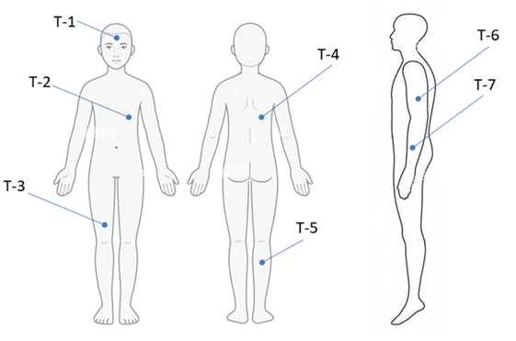
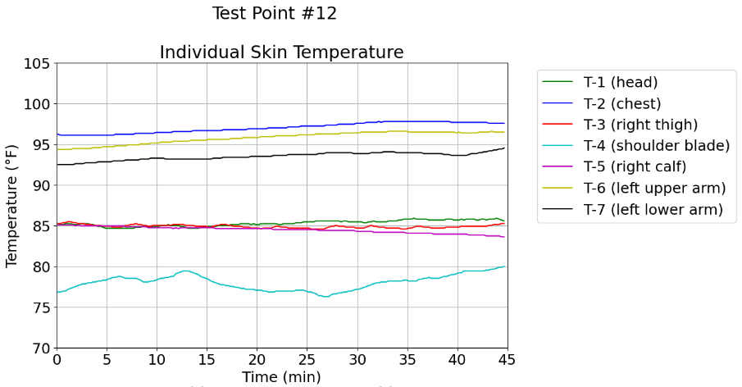
Determining Average Skin Temperature
Objective: Find average skin temperature.
  The average skin temperature was the area-weighted average of the temperatures measured at the head (T1), chest (T2), right thigh (T3), shoulder blade (T4), right calf (T5), left upper arm (T6), and left lower arm (T7).
Modification for test subject L_1 during test point 12: The shoulder temperature sensor may have shifted since it was showing the temperature of ~77 °F while the rest of the sensors were at 85 – 97 °F; the modified equation was used.
$T_{skin} = 0.26∗T1+0.06∗T7+0.1∗T6+0.17∗T3+0.15∗T5+0.26∗(0.45∗T2+0.55∗T4)$
$$T_{skin} = 0.26∗T1+0.06∗T7+0.1∗T6+0.17∗T3+0.15∗T5+0.26∗T2$$
Skin Temperature Sensor Locations [6]
Lower T-7 Temperature for Subject L_1 during Test Point 12.
Notes:
For test subject L_1 during test point 12, the shoulder temperature sensor may have shifted or fallen off since it was showing the temperature of ~77 °F (25 °C) while the rest of the sensors were at 85 – 97 °F (29.4 – 36.1°C).
The shoulder and chest were assumed to be similar temperature due to their proximity and a modified equation, where only the chest sensor is considered.

Slide 7
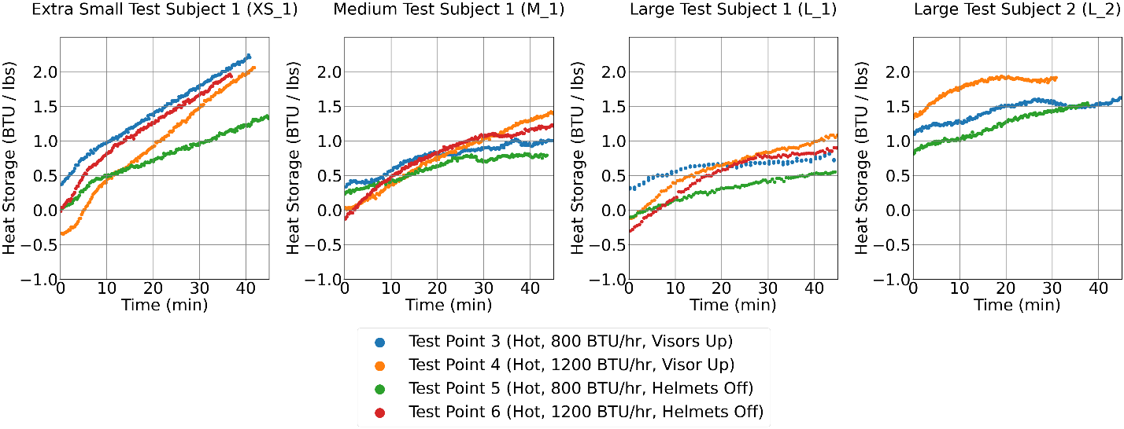
Test Heat Storage Visor-Up and Helmets Off Hot Environment (86 °F) Test Points 3-6
Test Conditions: Each test subject has a subplot with the hot environment (86 °F) visor up configuration (test point 3 and 4) and helmet off configuration (test point 5 and 6); the target metabolic rates are 800 and 1200 BTU/hr.
These represent the most demanding hot scenarios due to elevated metabolic rates in a warm environment.
The XS_1 test subject exhibits the steepest rate of increase.
Subjects with larger size and higher thermal capacitance require more time to heat compared to smaller ones.
Test Subject L_2 did not complete test points 1, 2, 6, 7, 8, 9, 10, and 12 because they were not local to the test facility area.
Notes:
Talk about what is graphed
The slope of increase is highest for the XS_1 test subject
Larger subjects, with greater thermal capacitance, take longer to heat up than smaller subjects
These were the most strenuous hot cases because there were high metabolic rates in a hot environment
Test Subject L_2 did not complete test points 1, 2, 6, 7, 8, 9, 10, and 12 because they were not local to the test facility area

Slide 8
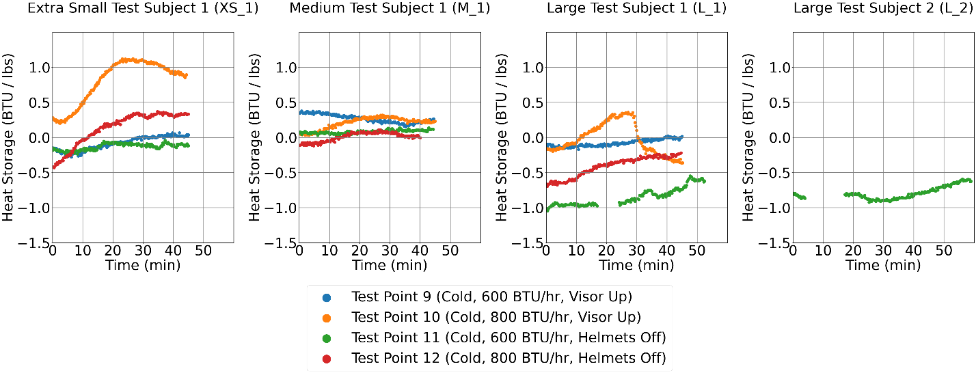
Test Heat Storage Visor-Up and Helmets Off Cold Environment (59 °F) Test Points 9-12
The test subjects were exposed to a cold environment (59 °F) while maintaining moderate metabolic rates (600 and 800 BTU/hr), which provided a reasonably comfortable condition for them.
Throughout most test points, heat storage shows a slight increase over the 45-minute duration of the test.
At test point 11 (green) for both L_1 and L_2, there were data interruptions, but the overall active test time was 45 minutes.
For test subject L_1 at test point 10, the heat storage initially increasing, followed by a sharp decreases could be caused by the subject’s slower digestion of the core temperature pill, as water consumption affects core temperature measurements.
Notes:
At test point 11 for both L_1 and L_2, there were data interruptions: the arm ergometer handle bolt for L_1 became loose, and the breathing gas temperature for L_2 went out of range. As a result, there is a gap in the data, and the cold environment graph extends to 60 minutes, even though the total testing time sums to 45 minutes.
Test subject L_2 did not complete test points 9, 10, and 12 due to their location being distant from the test facility.

Slide 9
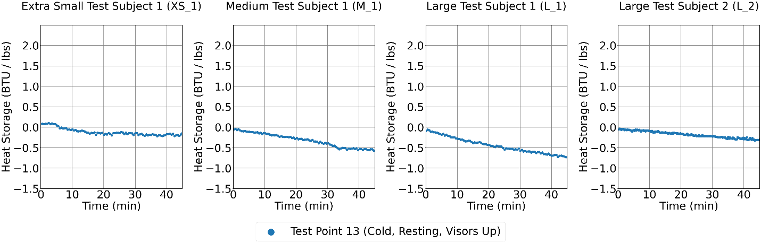
Test Heat Storage Visor-Up, Cold Environment Test Points 13 (59 °F)
This resting metabolic rate case is the most straining cold environment case since test subject are inactive.
Here the metabolic rate ranges between 253 - 332 BTU/hr.
The heat storage decreases slowly over the 45-minute test.
Given that the test subjects are resting with low metabolic rates, their heat storage is understandably negative and decreasing.

Slide 10
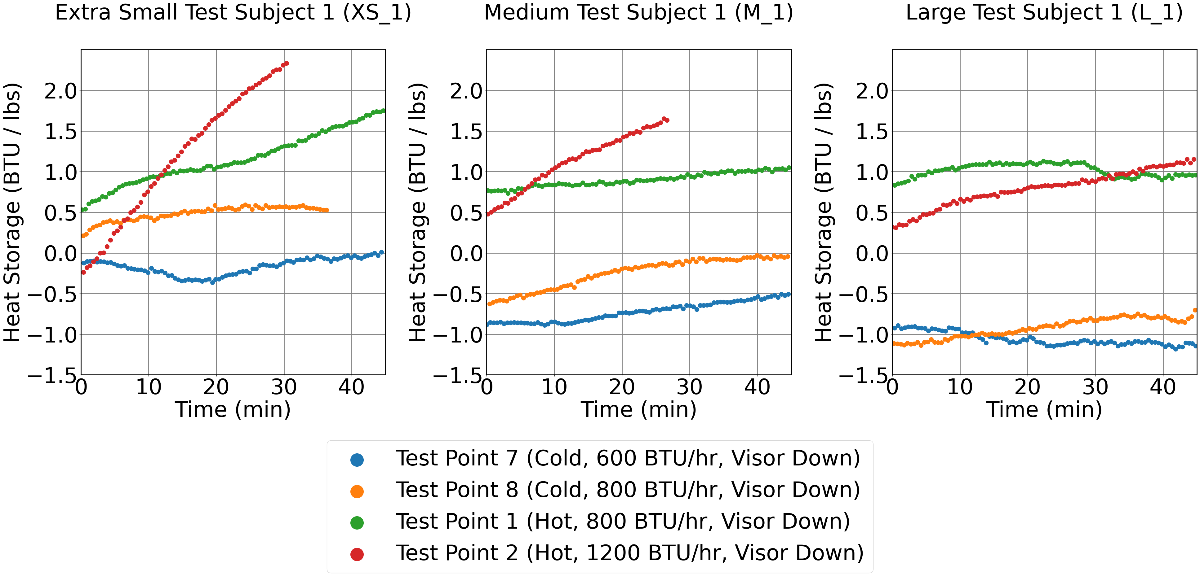
Test Heat Storage Visor-Down Cold and Hot Environment Test Points 1, 2, 7, 8
For the visor-down cases, the hot (86 °F) and cold (59 °F) cases have been plotted together with target metabolic rates at 600, 800, and 1200 BTU/hr.
The largest heat storage increase occurs in test point 2 when the test subjects are at the highest metabolic rate, 1200 BTU/hr.
Most visor-down cold environment cases show a slight increase in heat storage.
The heat storage is less for visor-down cases compared to visor-up/helmet off cases because the cool air is contained to the suit.
The small test subject is more prone to overheating shown in test point 3, 4, 6 and 2 reached or surpassed 2.0 BTU/lb.

Slide 11
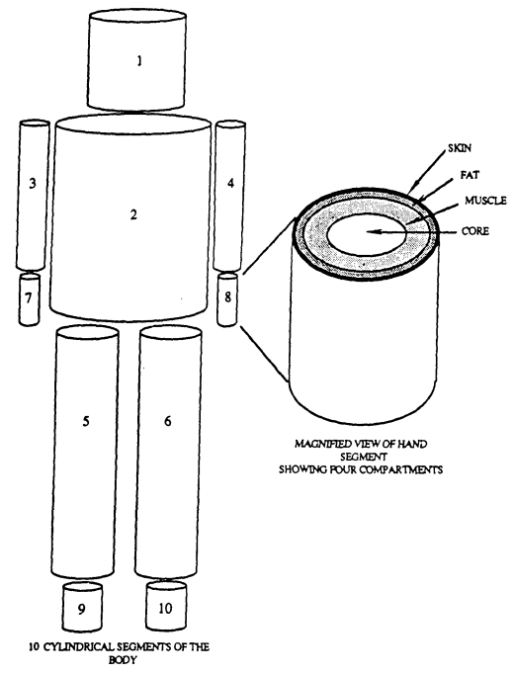
METMAN Model
METMAN is a 41-node Fortran human thermal model that simulates the heat transfer within a crew member’s body and from a crew member to the surrounding environment.
Inputs:
  Since there was no LCG, the undergarment insulation thickness was reduced from 0.0141 ft to 0.00141 ft because effective thickness was previously correlated to similar testing with the LCG present.
  LCG water flowrate was set to 0 to turn the LCG off.
  Adjusted Body Surface Area was used for the METMAN based on subject’s weight.
  Sensor averages of the chamber temperature, chamber dewpoint, suit temperature, suit dewpoint, metabolic rate, and air flow rate were used as inputs.
For Visor-Up and Helmets Off cases:
  Suit inlet airflow: Modified since air from the neck ring would escape to the cabin
  Suit inlet dewpoint: Used the dewpoint corresponding to the average cabin and suit water vapor pressure
  Suit inlet temperature: Used the average cabin and suit inlet temperature.
Test Subjects | Weight (lb) | Body Surface Area (ft²)
M_1, L_2 | ~170-180 | 21.3
L_1 | ~200 | 24.00
XS_1 | ~115 | 15.72
Geometric Representation of METMAN
Notes:
METMAN is a 41-node Fortran human thermal model that simulates the heat transfer within a crew member’s body and from a crew member to the surrounding environment.
This 41-node Fortran model consists of 10 cylinders that represent the arms, hands, legs, feet, torso, and head.
Each of these segments consist of four components: central core, muscle, fat, and skin layer. The last node is the blood node.
Mode 1 – IVA was used for the analysis

Slide 12
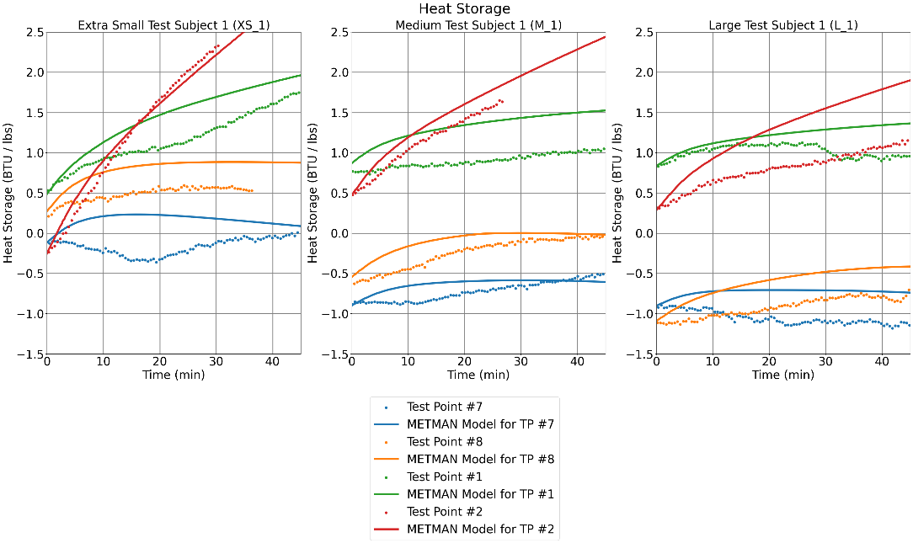
Test Heat Storage Visor-Down Vs. METMAN Model
The transient METMAN heat storage (line) data is graphed with the test data (scatter).
Hot environment (test point 1 and 2): METMAN tends to be conservative, typically predicting that the test subject reach the upper heat storage limit faster than the test data—except at XS_1 test point 1.
Cold environment (test point 7 and 8): Heat storage prediction is sometimes higher and sometimes lower than the test data.
Conclusions:
  The transient METMAN and the test data could differ because the average test values were used as inputs to METMAN.
  Although there were some fluctuations in the test data, the overall heat storage by the end of the test was similar.
Notes:
These visor-down, closed-loop cases are easier to analyze and compare to METMAN because they closely resemble METMAN's current configuration.
This plot graphs the transient METMAN heat storage (line) against the test data (circle).
METMAN predicts higher heat storages than the test data for hot environment points, test point 1 and 2.
For the hot case, METMAN tends to be conservative, typically predicting that the test subject reaches the upper heat storage limit faster than observed in test data—except at XS_1 test point 1.
For the cold environment (test point 7 and 8), there are some instances where the heat storage is higher and some where the heat storage is lower than the test data.
Here, METMAN would be conservative if the METMAN predicted heat storage was lower than the test because it would be expected that the cold environment points would reach the lower bound of the heat storage requirement.
The transient METMAN and the test data differ because the average test values were used as an input to METMAN. For example, the metabolic rate could fluctuate +/-100 BTU/hr
Although there were some fluctuations in the test data, the overall heat storage by the end of the test was similar.

Slide 13
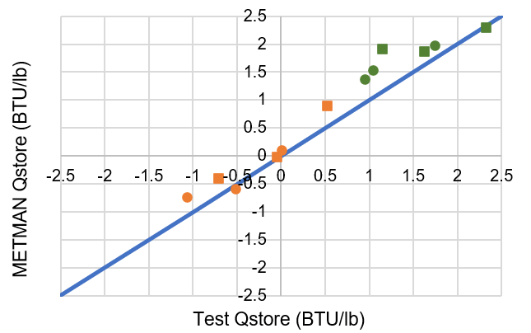
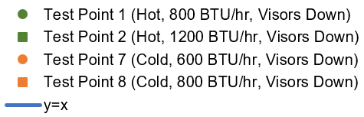
Visor-Down: Q_{store} Test vs. METMAN Model at the End of Test Duration
To examine the heat storage levels from the various test subjects on one graph, the heat storage at the end of the test duration was plotted with the corresponding heat storage from METMAN.
The y=x line would represent a perfect correlation and the R² is 0.8999 for x = y line, which shows good agreement.
The data is plotted so that the same configuration = same color, ● = lower met rate, ■ = higher met rate.
R² = 0.8999

Slide 14
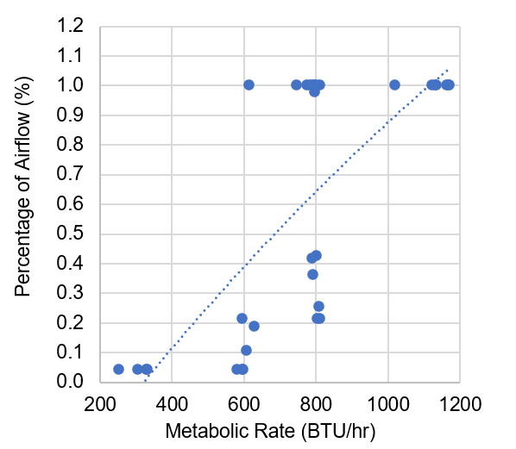
Air Flowrate into Suit Based on Metabolic Rate
Objective: Modify the suit inlet airflow since some air from the neck ring would escape to the cabin.
  Ergometer Arm Movements instigated air flow out of suit into the cabin when the suit was deformed.
  Metabolic rate was a measure of arm movements.
  Higher metabolic rate = more arm movements.
Method: Create a relationship between metabolic rate and flowrate.
  The suit inlet airflow parameter in METMAN was decreased until the model and test data heat storages were similar.
  Reduced suit inlet airflow / total flowrate = percentage of flowrate.
  Scatter Plot: Metabolic rate vs. the percentage of flowrate.
  Second order polynomial curve fit: Generalized the relationship between air flowrate and metabolic rate.
  The visor-up and helmet off cases were re-run using the curve fit percentages multiplied by the measured total flowrate.
$$\% flowrate = −2.58∗{10}^{−7}{\left(MR\right)}^{2} + 1.63 ∗{10}^{−3}(MR) − 4.94∗{10}^{−1}$$
Notes:
The primary factor controlling how much airflow entered the suit for visor up or helmet off cases was the person's metabolic rate.
The air from the neck ring would escape into the chamber and the suit’s movement while using the arm ergometer would cause air exchange between the suit and chamber.
Higher metabolic rates would mean more cycles on the arm ergometer, which would mean more air flow between the chamber and suit.
For the visor-up, resting cases, there was no air flow since air from the neck ring could go out into the chamber, and there would not be anything to motivate flow to enter the suit.
For the high metabolic cases, there is lots of movement and deformations of the suit to maintain the metabolic rate instigating air to travel in and out of the suit.
The relationship between airflow exchange and arm movement is demonstrated by plotting the percentage of air flow expected by the metabolic rate (representing the amount of arm movement).
To get the percentage of expected flowrate, the suit's inlet airflow model parameter was iteratively decreased for each of these test points until the model and test data differences were minimized.
To get the relationship between arm movement and air flow exchange, the percentage of flowrate used for each case was plotted against their corresponding metabolic rate
A second order polynomial curve fit was used to generalize the relationship between air flowrate and metabolic rate
This is needed in situations where test data is not available and only the metabolic rate is known.
The visor-up and helmet off cases were re-ran using the curve fit percentages multiplied by the measured total flowrate.

Slide 15
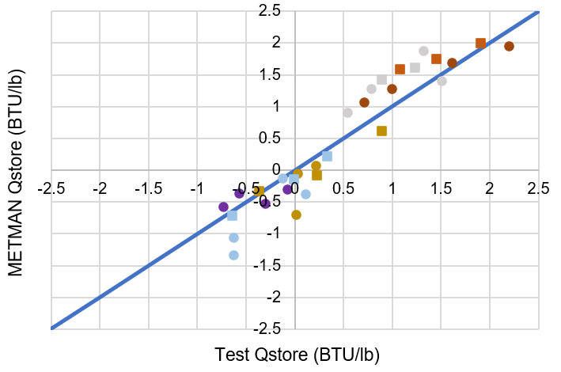
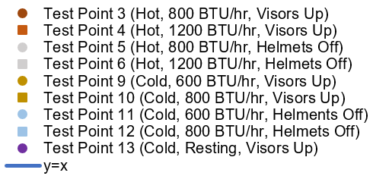
Visor-Up and Helmet Off: Q_{store} Test vs. METMAN Model at the End of Test Duration
The METMAN data is usually conservative, shown with hot cases above the line and cold cases below the line.
The y=x line would represent a perfect correlation and the R² is 0.8902 for x = y line, which shows good agreement.
The data is plotted so that the same configuration = same color, ● = lower met rate, ■ = higher met rate.
R² = 0.8902

Slide 16
Conclusion
The model predictions had good agreement with the test data, further substantiating METMAN in characterizing IVA Suit Pressure Garment Assembly thermal performance.
  R² = 0.8902 for visors-up and helmet-off configurations.
  R² = 0.8999 for visors-down configurations.
  The model is even conservative in its predictions.
The novel approach uncovered in this study will allow the community to assess crewmember heat storage in multiple suited configurations.
Future considerations of this model correlation include conducting more testing to further validate this methodology.

Slide 17
References
[1] Chang, C.-M., B. W. Sauser, G. C. Bue and B. C. Conger, “Space Shuttle Launch Entry Suit Thermal Performance Evaluation,” SAE Transactions, vol. 102, pp. 1646–1659, 1993.
[2] Bue, G. C., M. K. Ewert, C. H. Lin and S. V. Walker, “Launch Entry Suit Individual Cooling Unit Thermal Qualification Test Report,” NASA Johnson Space Center, Houston, TX, 1997.
[3] “MPCV 70024 Orion Multi-Purpose Crew Vehicle Program: Human Systems Integration Requirements (HSIR),” NASA, 4 March 2015.
[4] Sessler, R. L. a. D. I., “Estimation of Mean-body Temperature From Mean-skin and Core Temperature,” Anesthesiology, vol. 105, no. 5, pp. 1117–21, 2006.
[5] Miranda, B., “METMAN Analysis of FY19 OCSS LCG Testing,” NASA, Houston, October 10, 2019.
[6] “Human Body Outline Front And Back Unisex,” [Online]. Available: https://animalia-life.club/qa/pictures/human-bodyoutline-front-and-back-unisex. [Accessed 2 February 2026].
[7] Blue, G. C., “Computer Program Documentation 41-Node Transient Metabolic Man Program,” NASA, Houston, 1989.
[8] Ewert, M., “Human Metabolic Modeling Updates,” NASA, Houston, April 2, 2020.
[9] Vatistas, G. H,.S. Lin and C. K. Kwok, “Reverse Flow Radius in Vortex Chambers,” AIAA Journal, vol. 24, no. 11, pp. 1872–1873, 1986.
[10] Peyret, R., and T. D. Taylor, Computational Methods in Fluid Flow, 2nd ed, Chapters 7, 14., New York: Springer-Verlag, 1983.
[11] Guerrero-Gonzalez, F. J., P. Reiss, M. L. Donten, A. Lovagnini and L. Celiento, “Low-temperature Molten Salt Electrolysis for Lunar Regolith Reduction,” in 54th International Conference on Environmental Systems, Prague, Czechia, ICES-2025- 441, 2025.
[12] Nietubicz, C. J., J. E. Heavey and J. L. J. Steger, “A General Curvilinear Grid Generation Program for Projectile Configurations,” U.S. Army Ballistic Research Lab., Rept. ARBRL-MR03142, Aberdeen Proving Ground, MD, Oct. 1981.
[13] Vickers, A., “10-110 mm/hr Hypodermic Gravity Design A,” Rainfall Simulation Database,” [Online]. Available: http://www.geog.le.ac.uk/bgrg/lab.htm. [Accessed 15 March 1998].
[14] Jacobs, S. E., D. Green, D. B. Tufts and D. Gohmert, “Development of a Custom Space Suit for Orion,” in 49th International Conference on Environmental Systems, Boston, Massachusetts, 2019.
[15] Roza, A. M. a. H. M. S., “The Harris Benedict equation reevaluated: resting energy requirements and the body cell mass.,” The American journal of clinical nutrition, vol. 40, no. 1, pp. 168–82, 1984.
[16] Mifflin, M. D. S. J. S. T. H. L. A. S. B. J. D. S. A. &. K. Y. O. “A new predictive equation for resting energy expenditure in healthy individuals,” The American journal of clinical nutrition, vol. 51, no. 2, pp. 241–247, 1990.

Slide 18
Backup

Slide 19
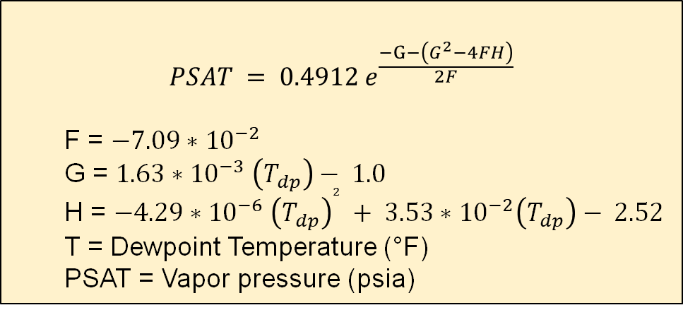
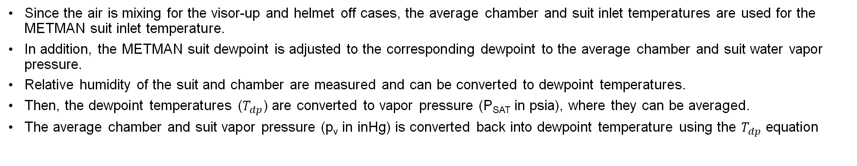
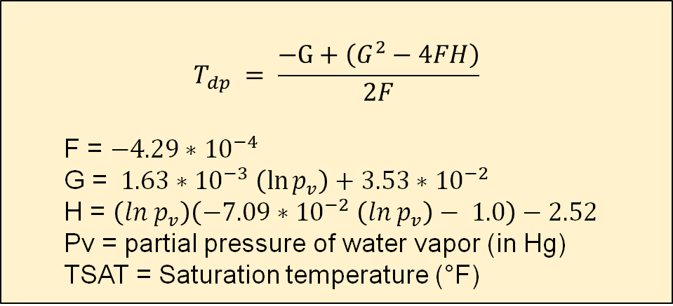
Visor-Up and Helmet Off: METMAN Suit Inputs Converting Average Water Partial Pressure to Dewpoint
Since the air is mixing for the visor-up and helmet off cases, the average chamber and suit inlet temperatures are used for the METMAN suit inlet temperature.
In addition, the METMAN suit dewpoint is adjusted to the corresponding dewpoint to the average chamber and suit water vapor pressure.
Relative humidity of the suit and chamber are measured and can be converted to dewpoint temperatures.
Then, the dewpoint temperatures ($T_{dp}$) are converted to vapor pressure (P_{SAT} in psia), where they can be averaged.
The average chamber and suit vapor pressure (p_{v} in inHg) is converted back into dewpoint temperature using the $T_{dp}$ equation
$$PSAT = 0.4912 e^{\frac{−G−\left(G^{2}−4FH\right)}{2F}}$$
  F = $−7.09∗{10}^{−2}$
  G = $1.63∗{10}^{−3} \left(T_{dp}\right)− 1.0$
  H = $−4.29∗{10}^{−6} {\left(T_{dp}\right)}^{2} + 3.53∗{10}^{−2}\left(T_{dp}\right)− 2.52$
  T = Dewpoint Temperature (°F)
  PSAT = Vapor pressure (psia)
$$T_{dp} = \frac{−G+\left(G^{2}−4FH\right)}{2F}$$
  F = $−4.29∗{10}^{−4}$
  G = $1.63∗{10}^{−3} \left(\ln{p_{v}}\right)+3.53∗{10}^{−2}$
  H = $\left(ln p_{v}\right)\left(−7.09∗{10}^{−2} \left(ln p_{v}\right)− 1.0\right)−2.52$
  Pv = partial pressure of water vapor (in Hg)
  TSAT = Saturation temperature (°F)

Slide 20
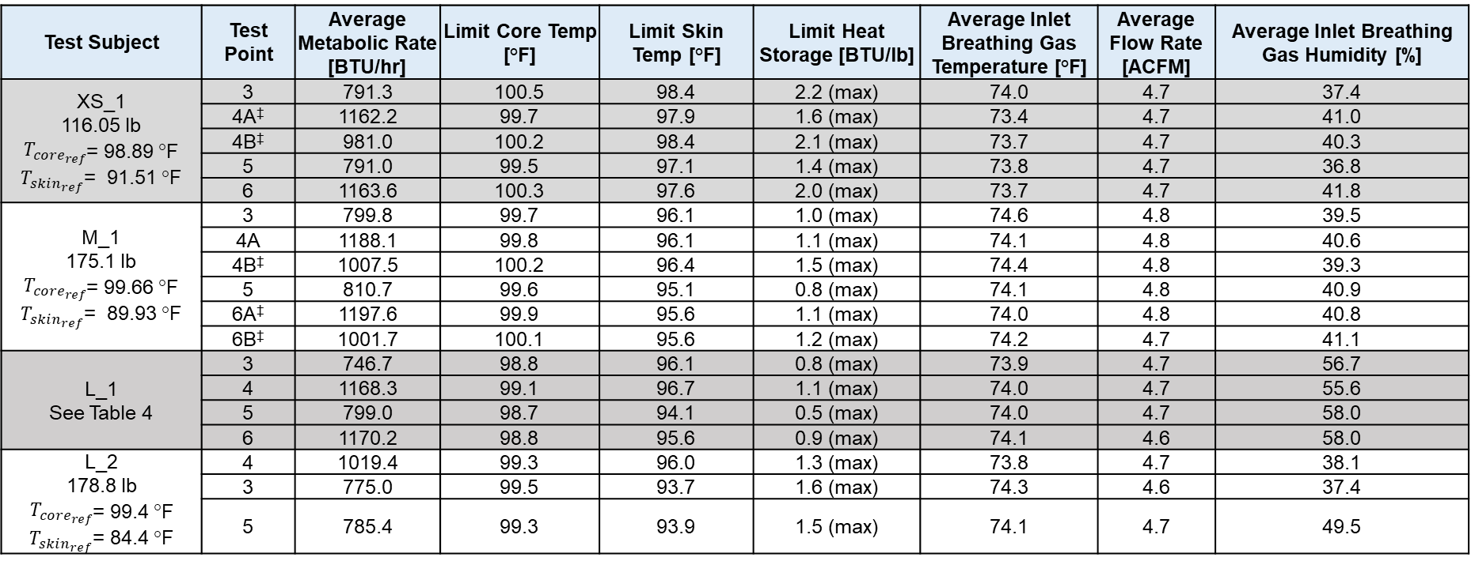
Visor-Up and Helmets Off Test Data for Hot Environments
Test Point 3-6
Test Subject | Test Point | Average Metabolic Rate [BTU/hr] | Limit Core Temp [°F] | Limit Skin Temp [°F] | Limit Heat Storage [BTU/lb] | Average Inlet Breathing Gas Temperature [°F] | Average Flow Rate [ACFM] | Average Inlet Breathing Gas Humidity [%]
XS_1 116.05 lb $T_{{core}_{ref}}$= 98.89 °F $T_{skin_{ref}}$= 91.51 °F | 3 | 791.3 | 100.5 | 98.4 | 2.2 (max) | 74.0 | 4.7 | 37.4
 | 4A‡ | 1162.2 | 99.7 | 97.9 | 1.6 (max) | 73.4 | 4.7 | 41.0
 | 4B‡ | 981.0 | 100.2 | 98.4 | 2.1 (max) | 73.7 | 4.7 | 40.3
 | 5 | 791.0 | 99.5 | 97.1 | 1.4 (max) | 73.8 | 4.7 | 36.8
 | 6 | 1163.6 | 100.3 | 97.6 | 2.0 (max) | 73.7 | 4.7 | 41.8
M_1 175.1 lb $T_{{core}_{ref}}$= 99.66 °F $T_{skin_{ref}}$= 89.93 °F | 3 | 799.8 | 99.7 | 96.1 | 1.0 (max) | 74.6 | 4.8 | 39.5
 | 4A | 1188.1 | 99.8 | 96.1 | 1.1 (max) | 74.1 | 4.8 | 40.6
 | 4B‡ | 1007.5 | 100.2 | 96.4 | 1.5 (max) | 74.4 | 4.8 | 39.3
 | 5 | 810.7 | 99.6 | 95.1 | 0.8 (max) | 74.1 | 4.8 | 40.9
 | 6A‡ | 1197.6 | 99.9 | 95.6 | 1.1 (max) | 74.0 | 4.8 | 40.8
 | 6B‡ | 1001.7 | 100.1 | 95.6 | 1.2 (max) | 74.2 | 4.7 | 41.1
L_1 See Table 4 | 3 | 746.7 | 98.8 | 96.1 | 0.8 (max) | 73.9 | 4.7 | 56.7
 | 4 | 1168.3 | 99.1 | 96.7 | 1.1 (max) | 74.0 | 4.7 | 55.6
 | 5 | 799.0 | 98.7 | 94.1 | 0.5 (max) | 74.0 | 4.7 | 58.0
 | 6 | 1170.2 | 98.8 | 95.6 | 0.9 (max) | 74.1 | 4.6 | 58.0
L_2 178.8 lb $T_{{core}_{ref}}$= 99.4 °F $T_{skin_{ref}}$= 84.4 °F | 4 | 1019.4 | 99.3 | 96.0 | 1.3 (max) | 73.8 | 4.7 | 38.1
 | 3 | 775.0 | 99.5 | 93.7 | 1.6 (max) | 74.3 | 4.6 | 37.4
 | 5 | 785.4 | 99.3 | 93.9 | 1.5 (max) | 74.1 | 4.7 | 49.5
Case | Weight [lbs] | Tref, core [°F] | Tref, skin [°F]
L_1 3&4 | 198.1 | 98.76 | 91.54
L_1 5&6 | 196.7 | 98.55 | 91.38
‡ In these test points, the goal metabolic rate dropped from 1200 BTU/hr (351.7 W) in part A to 1000 BTU/hr (293.1 W) in part B because the subject’s heart rate exceeding 85% of the age-predicted maximum for 2 continuous minutes. Later, the transient metabolic rates for these changes were captured in the METMAN correlation to make a one-to-one comparison between cases.

Slide 21
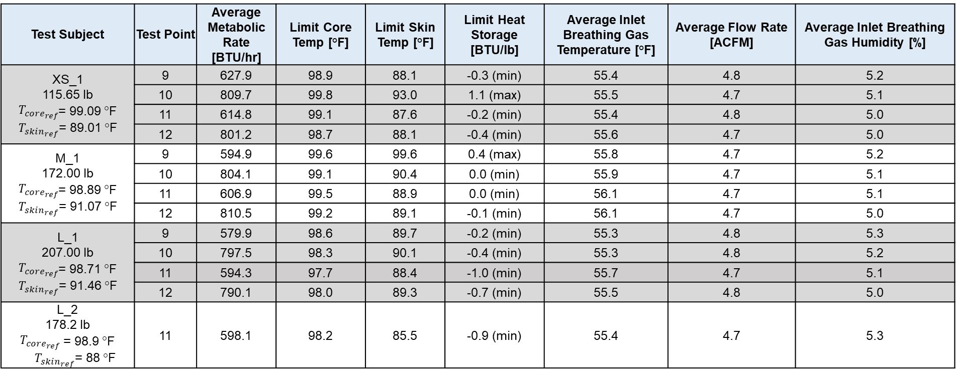
Visor-Up and Helmets Off Test Data for Cold Environments
Test Point 9-12
Test Subject | Test Point | Average Metabolic Rate [BTU/hr] | Limit Core Temp [°F] | Limit Skin Temp [°F] | Limit Heat Storage [BTU/lb] | Average Inlet Breathing Gas Temperature [°F] | Average Flow Rate [ACFM] | Average Inlet Breathing Gas Humidity [%]
XS_1 115.65 lb $T_{{core}_{ref}}$= 99.09 °F $T_{skin_{ref}}$= 89.01 °F | 9 | 627.9 | 98.9 | 88.1 | -0.3 (min) | 55.4 | 4.8 | 5.2
 | 10 | 809.7 | 99.8 | 93.0 | 1.1 (max) | 55.5 | 4.7 | 5.1
 | 11 | 614.8 | 99.1 | 87.6 | -0.2 (min) | 55.4 | 4.8 | 5.0
 | 12 | 801.2 | 98.7 | 88.1 | -0.4 (min) | 55.6 | 4.7 | 5.0
M_1 172.00 lb $T_{{core}_{ref}}$= 98.89 °F $T_{skin_{ref}}$= 91.07 °F | 9 | 594.9 | 99.6 | 99.6 | 0.4 (max) | 55.8 | 4.7 | 5.2
 | 10 | 804.1 | 99.1 | 90.4 | 0.0 (min) | 55.9 | 4.7 | 5.1
 | 11 | 606.9 | 99.5 | 88.9 | 0.0 (min) | 56.1 | 4.7 | 5.1
 | 12 | 810.5 | 99.2 | 89.1 | -0.1 (min) | 56.1 | 4.7 | 5.0
L_1 207.00 lb $T_{{core}_{ref}}$= 98.71 °F $T_{skin_{ref}}$= 91.46 °F | 9 | 579.9 | 98.6 | 89.7 | -0.2 (min) | 55.3 | 4.8 | 5.3
 | 10 | 797.5 | 98.3 | 90.1 | -0.4 (min) | 55.3 | 4.8 | 5.2
 | 11 | 594.3 | 97.7 | 88.4 | -1.0 (min) | 55.7 | 4.7 | 5.1
 | 12 | 790.1 | 98.0 | 89.3 | -0.7 (min) | 55.5 | 4.8 | 5.0
L_2 178.2 lb $T_{{core}_{ref}}$ = 98.9 °F $T_{skin_{ref}}$= 88 °F | 11 | 598.1 | 98.2 | 85.5 | -0.9 (min) | 55.4 | 4.7 | 5.3

Slide 22
Visor-Up, Resting Test Data for Cold Environments
Test Point 13
Test Subject | Test Point | Average Metabolic Rate [BTU/hr] | Limit Core Temp [°F] | Limit Skin Temp [°F] | Limit Heat Storage [BTU/lb] | Average Inlet Breathing Gas Temperature [°F] | Average Flow Rate [ACFM] | Average Inlet Breathing Gas Humidity [%]
XS_1 | 13 | 253.4 | 98.9 | 88.9 | -0.2 (min) | 56.5 | 4.7 | 5.8
M_1 | 13 | 328.3 | 98.7 | 90.4 | -0.6 (min) | 55.9 | 4.6 | 5.9
L_1 | 13 | 332.2* | 97.7 | 89.0 | -0.7 (min) | 55.8 | 4.6 | 5.6
L_2 | 13 | 306.0 | 98.7 | 86.9 | -0.3 (min) | 55.9 | 4.6 | 5.3
* Test subject L1’s metabolic rate, ventilation, and Tidal Volume were averaged to 190.4 BTU/hr, 6.15 L/min, and 0.41 L, respectively. These values were below what was expected and could have resulted in a leak between the mask and test subject’s face. Therefore, an average of the Mifflin-St. Jeor [15] and Harris-Benedict [14] equations were used to calculate expected resting metabolic rate, 332.2 BTU/lb (74.1W). This method was applied to all resting test points. Since there was good agreement with the measured metabolic rate and average of the predicted resting metabolic rate for the other test points, this was deemed an acceptable method for calculating L_1’s resting metabolic rate.

Slide 23
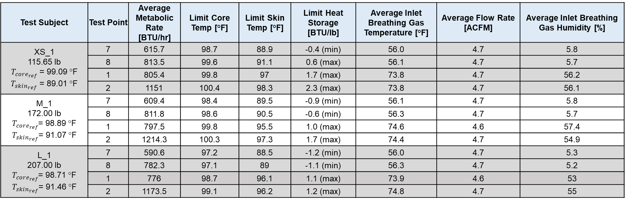
Visor-Down Test Data for Hot and Cold Environments
Test Point 1, 2, 7 and 8
Test Subject | Test Point | Average Metabolic Rate [BTU/hr] | Limit Core Temp [°F] | Limit Skin Temp [°F] | Limit Heat Storage [BTU/lb] | Average Inlet Breathing Gas Temperature [°F] | Average Flow Rate [ACFM] | Average Inlet Breathing Gas Humidity [%]
XS_1 115.65 lb $T_{{core}_{ref}}$ = 99.09 °F $T_{skin_{ref}}$ = 89.01 °F | 7 | 615.7 | 98.7 | 88.9 | -0.4 (min) | 56.0 | 4.7 | 5.8
 | 8 | 813.5 | 99.6 | 91.1 | 0.6 (max) | 56.1 | 4.7 | 5.7
 | 1 | 805.4 | 99.8 | 97 | 1.7 (max) | 73.8 | 4.7 | 56.2
 | 2 | 1151 | 100.4 | 98.3 | 2.3 (max) | 73.8 | 4.7 | 56.1
M_1 172.00 lb $T_{{core}_{ref}}$= 98.89 °F $T_{skin_{ref}}$= 91.07 °F | 7 | 609.4 | 98.4 | 89.5 | -0.9 (min) | 56.1 | 4.7 | 5.8
 | 8 | 811.8 | 98.6 | 90.5 | -0.6 (min) | 56.3 | 4.7 | 5.7
 | 1 | 797.5 | 99.8 | 95.5 | 1.0 (max) | 74.6 | 4.6 | 57.4
 | 2 | 1214.3 | 100.3 | 97.3 | 1.7 (max) | 74.4 | 4.7 | 54.9
L_1 207.00 lb $T_{{core}_{ref}}$= 98.71 °F $T_{skin_{ref}}$= 91.46 °F | 7 | 590.6 | 97.2 | 88.5 | -1.2 (min) | 56.0 | 4.7 | 5.3
 | 8 | 782.3 | 97.1 | 89 | -1.1 (min) | 56.3 | 4.7 | 5.2
 | 1 | 776 | 98.7 | 96.1 | 1.1 (max) | 73.9 | 4.6 | 53
 | 2 | 1173.5 | 99.1 | 96.2 | 1.2 (max) | 74.8 | 4.7 | 55

