Slide 1

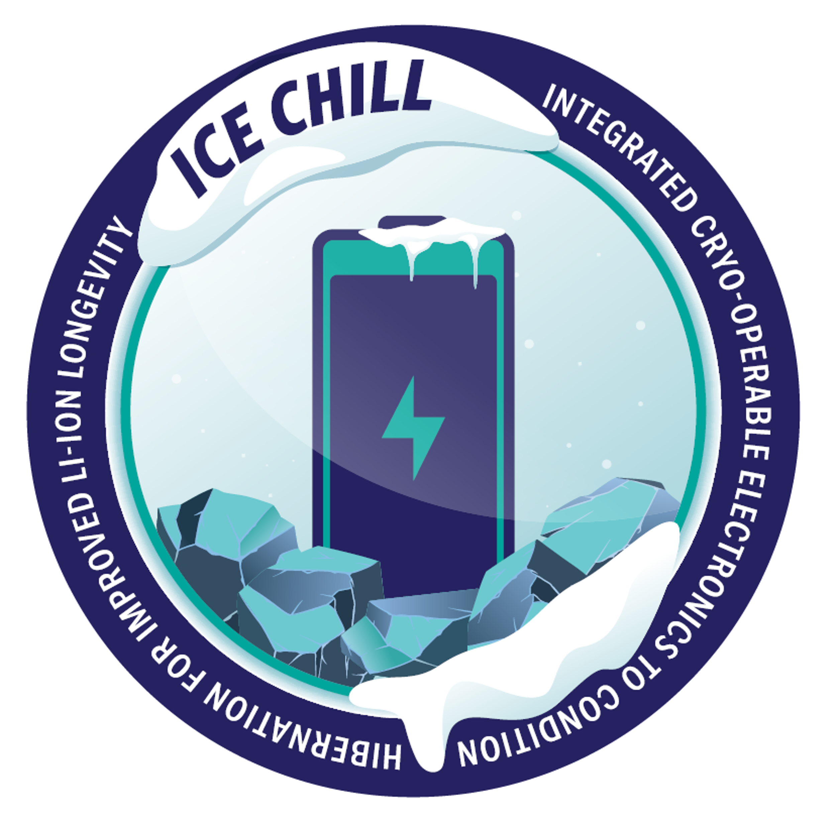
Cryogenic Hibernation Assessment of Commercial Cells for Lunar Surface Applications
PI & Presenter: Dr. Brian Holler, NASA GRC - LEX
LSIC Surface Power Monthly Telecon June 2026
Notes:
We are developing a battery and battery management system that can survive the brutally cold lunar night.

Slide 2
The Extreme Lunar Environment
Thermal model calculations of monthly & annual lunar surface temperature variations at various latitudes
Day: 150-400 K highs based on latitude
Night: 50-100 K lows all latitudes
    Duration (non-polar): ~354 hrs (~14.75 Earth days)
Lunar Polar Winter: Sun is below horizon for ~4.5 months
Li-ion battery approx. freeze temperature
Lunar night is extremely cold at all latitudes
POLAR winter (4.5 months)
Lunar dawn
Image permissions per Dr. N Petro/NASA GSFC, Dr. D Paige/UCLA

Slide 3
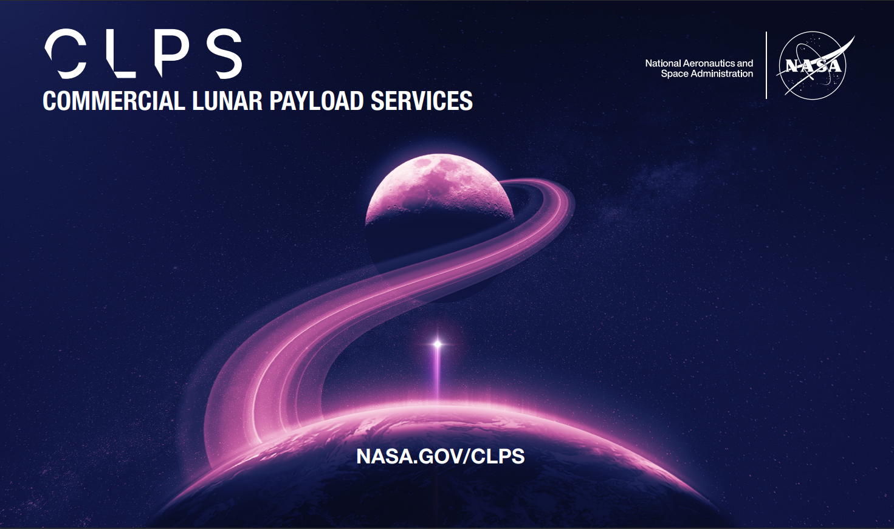


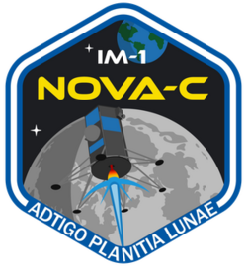
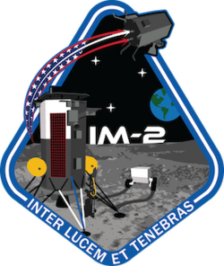
March 2, 2025
Blue Ghost 1
Firefly Aerospace
Landed successfully, operated for the lunar day
Operated ~5 hours into lunar night, then lost power
January 2024
Peregrine Mission One
Astrobotic
Mission Failure before landing
Did not reach lunar surface
February 22, 2024
IM-1 (Odysseus)
Intuitive Machines
Soft-landed (but tilted)
Mission ended at Dusk
Did not survive lunar night
March 6, 2025
IM-2 (Athena)
Intuitive Machines
Landed sideways
Power depleted soon after landing
Did not survive into night
2024
2025
Notes:
Recent testimonies during a 2025 congressional sub-committee hearing revealed the survival strategies of the three primary CLPS providers:
Astrobotic is planning to rely on their LunaGrid vertical solar arrays placed in permanently sunlit regions to provide continuous energy. However, this approach depends on unproven lunar infrastructure and severely limits landing site flexibility.
Intuitive Machines is exploring the use of radioisotope heater units (RHUs) to keep batteries warm. While potentially viable, RHUs come with significant regulatory hurdles and safety concerns, especially in the context of future crewed missions.
Firefly Aerospace has achieved the longest survival time into the lunar night, approximately five hours, by dramatically increasing onboard battery capacity. However, this brute-force method is both mass- and cost-intensive, and scales poorly for long-duration or low-budget missions.

Slide 4
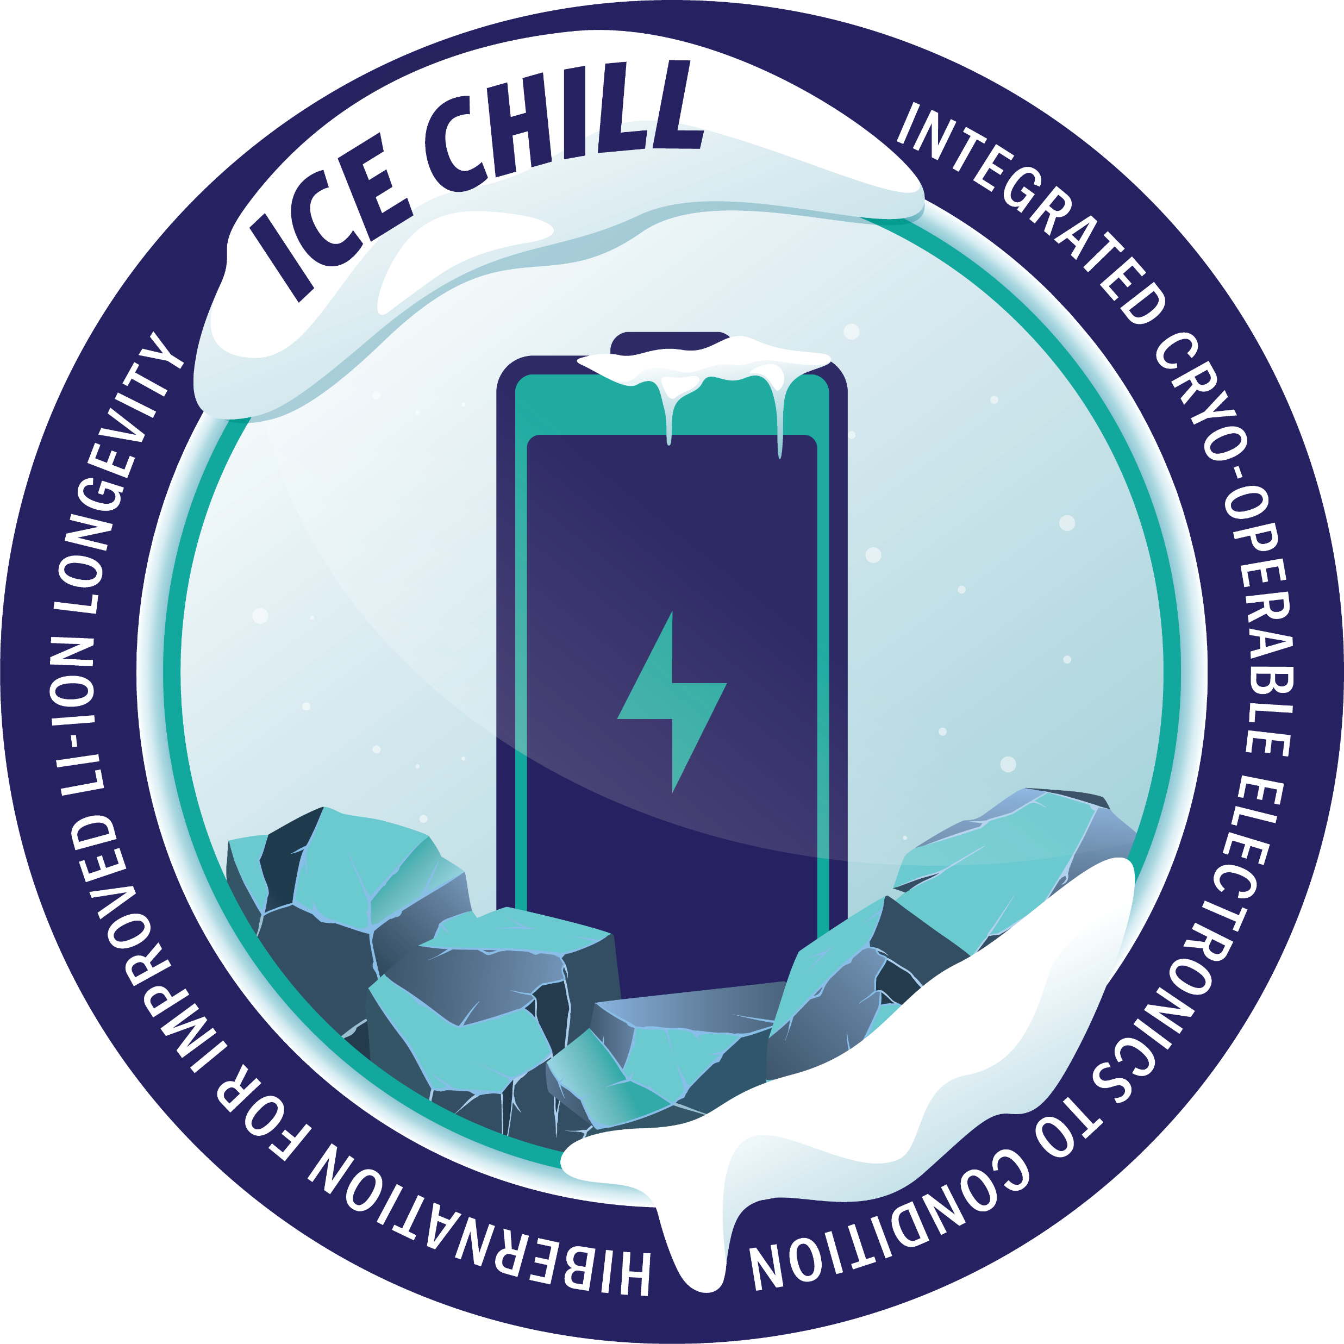
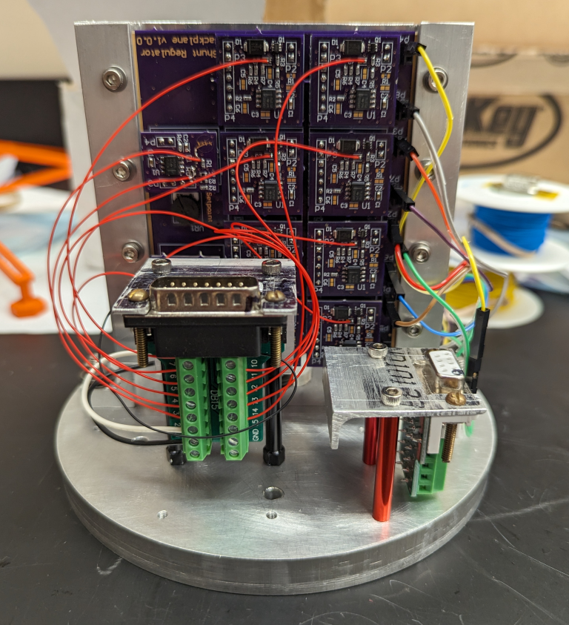
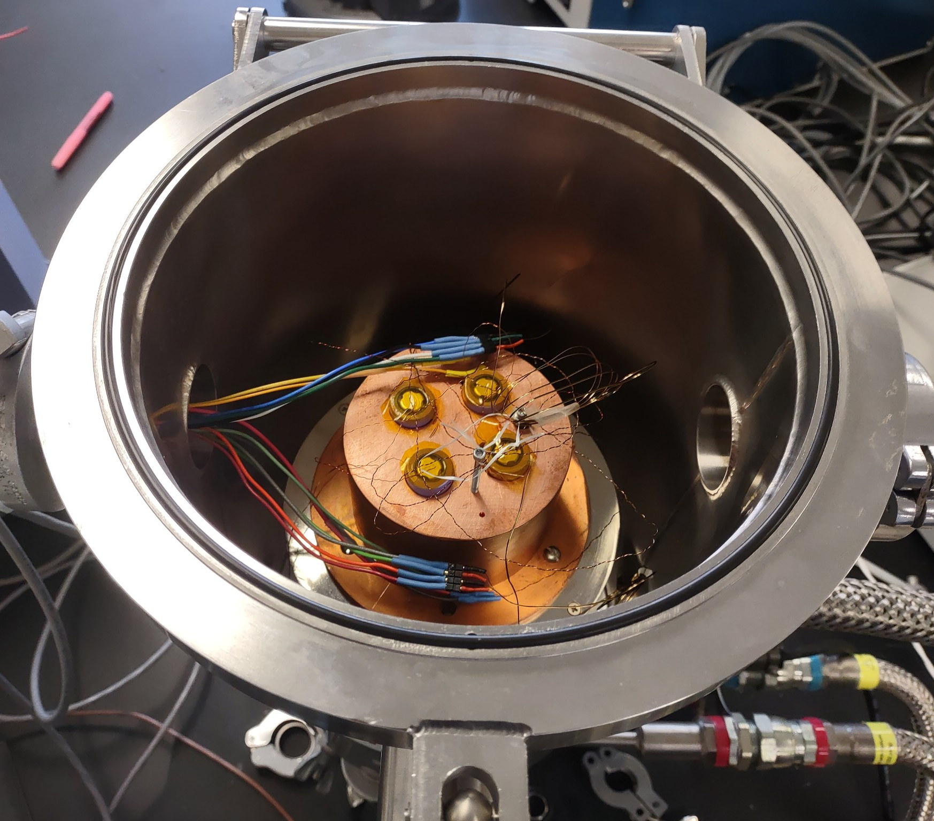
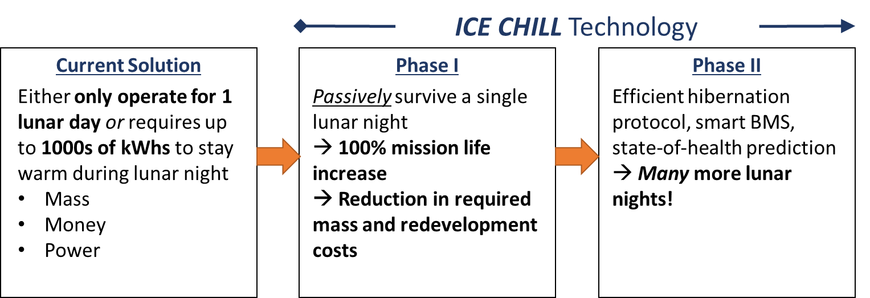
ICE CHILL
Integrated Cryo-operable Electronics to Conditional Hibernation for Li-ion Longevity
NASA Glenn Research Center, contact: brian.a.holler@nasa.gov
Project Overview
Description and Motivation:
Batteries and battery management systems are not designed to survive the extreme cold of the lunar night, which restricts available missions
Develop and demonstrate a novel, easily integrable BMS to enable Li-ion battery hibernation passively through the lunar night with zero excess degradation
Enables longer mission time (>1 lunar day) with minimal impact on system size or payload capacity
Allows for a significant launch cost savings due to the reduced required battery mass when compared to current solutions
a.)
b.)
a.) Cryo-operable Solar Shunt Regulator to enable Lunar Dawn Recover Mode.
b.) Commercial 18650 Li-ion cells in cryochamber for low-temperature hibernation down to 50K.
Primary Project Objectives:
Design and build an integrated battery package/electronics system demonstrating lunar dawn mode to enable Li-ion cell hibernation through the lunar night (Phase 1)
Experimentally determine battery cell survival conditions with a zero-degradation criterion to inform PHM inclusion in microcontroller embedded electronics (Phase 2)
Perform appropriate environmental tests of each design to raise technology readiness level (TRL) from 3 to 5

Slide 5
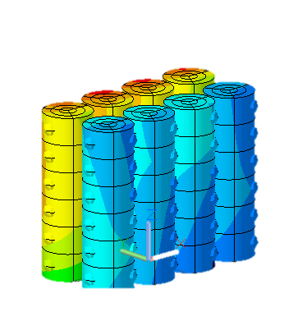
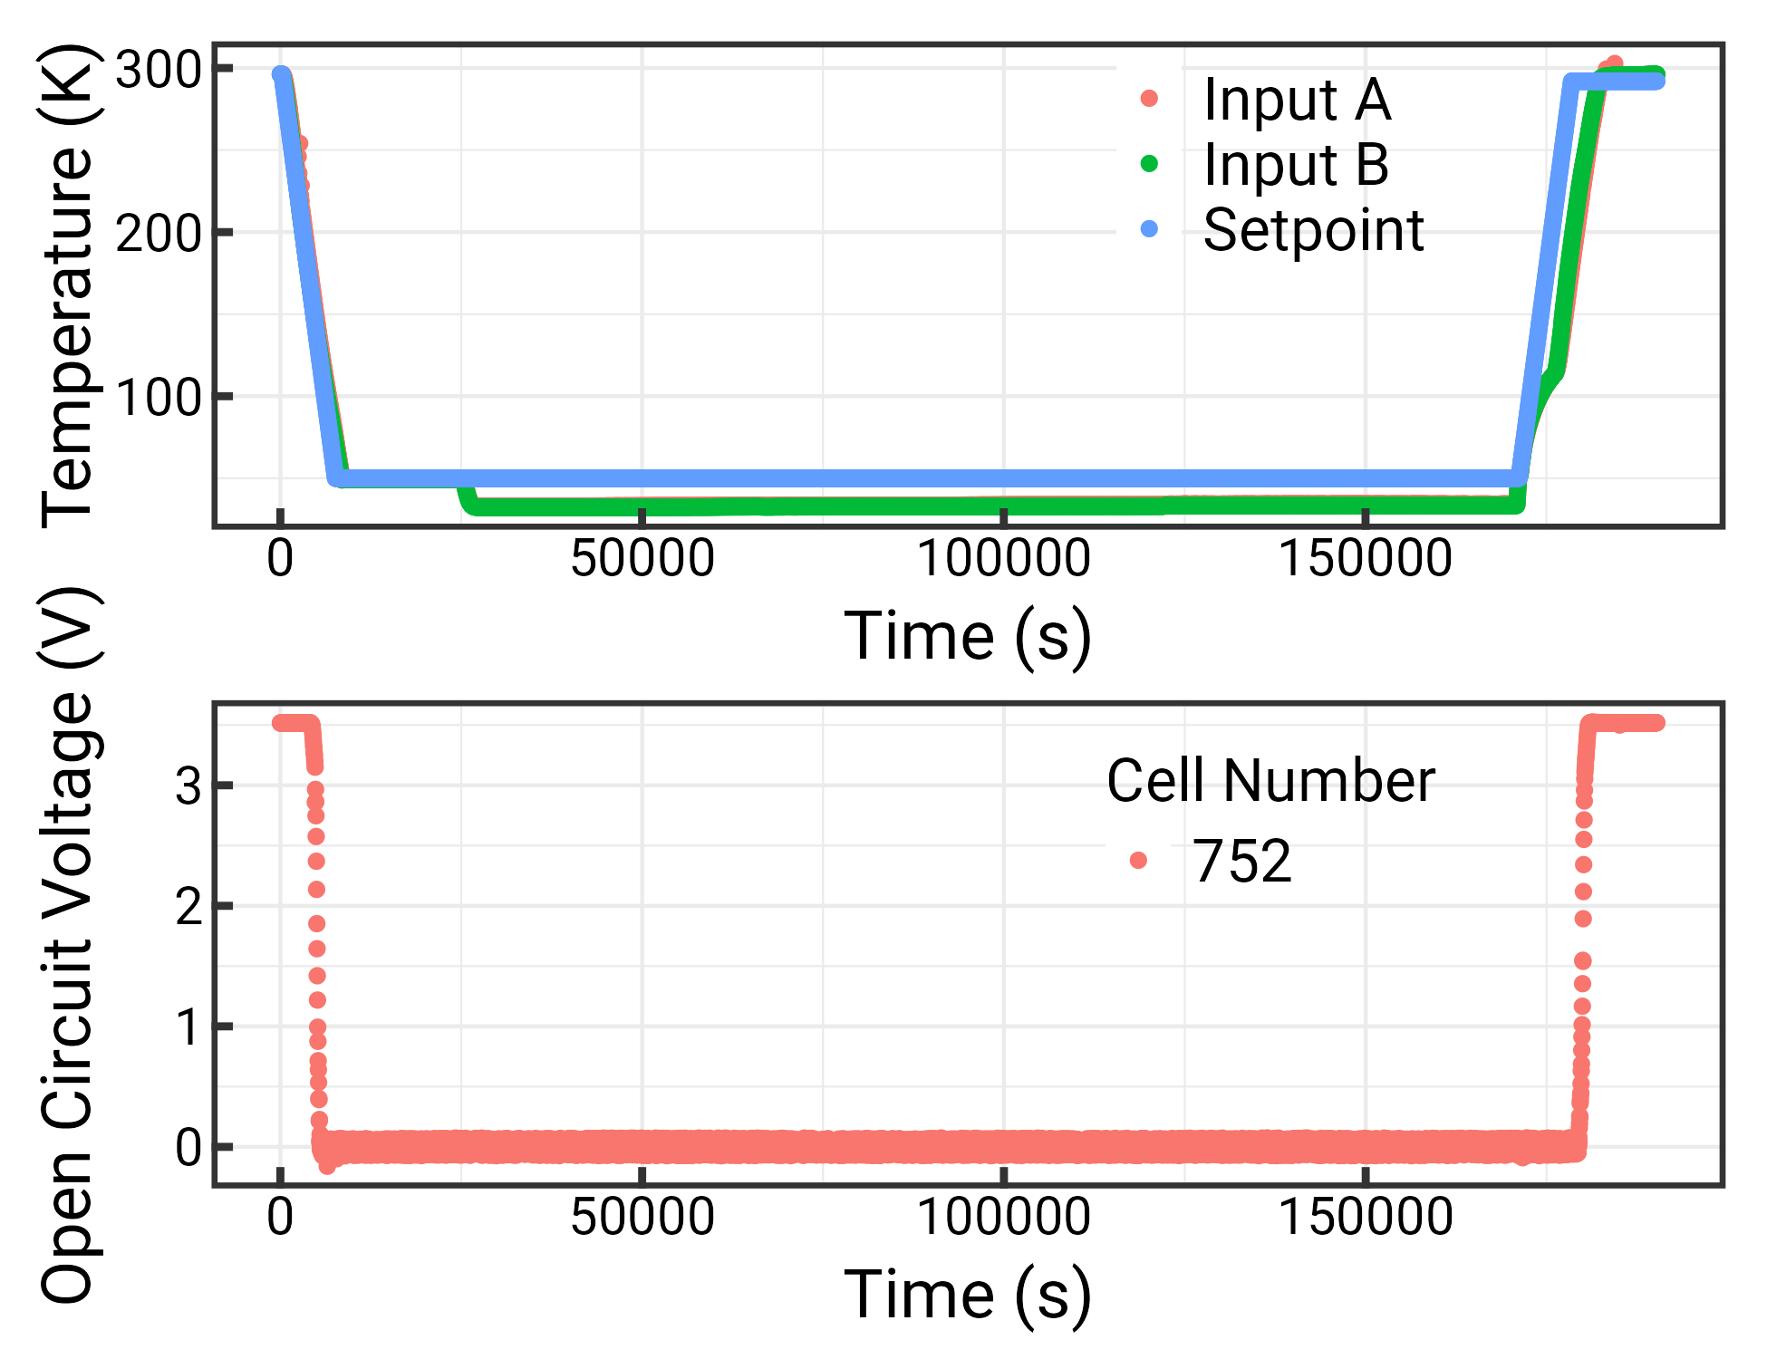
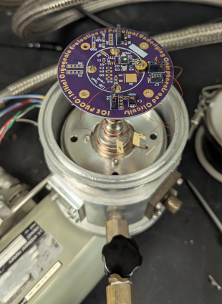
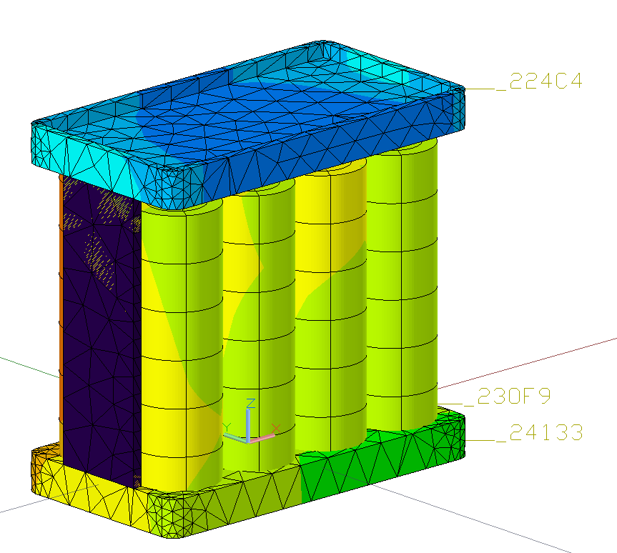
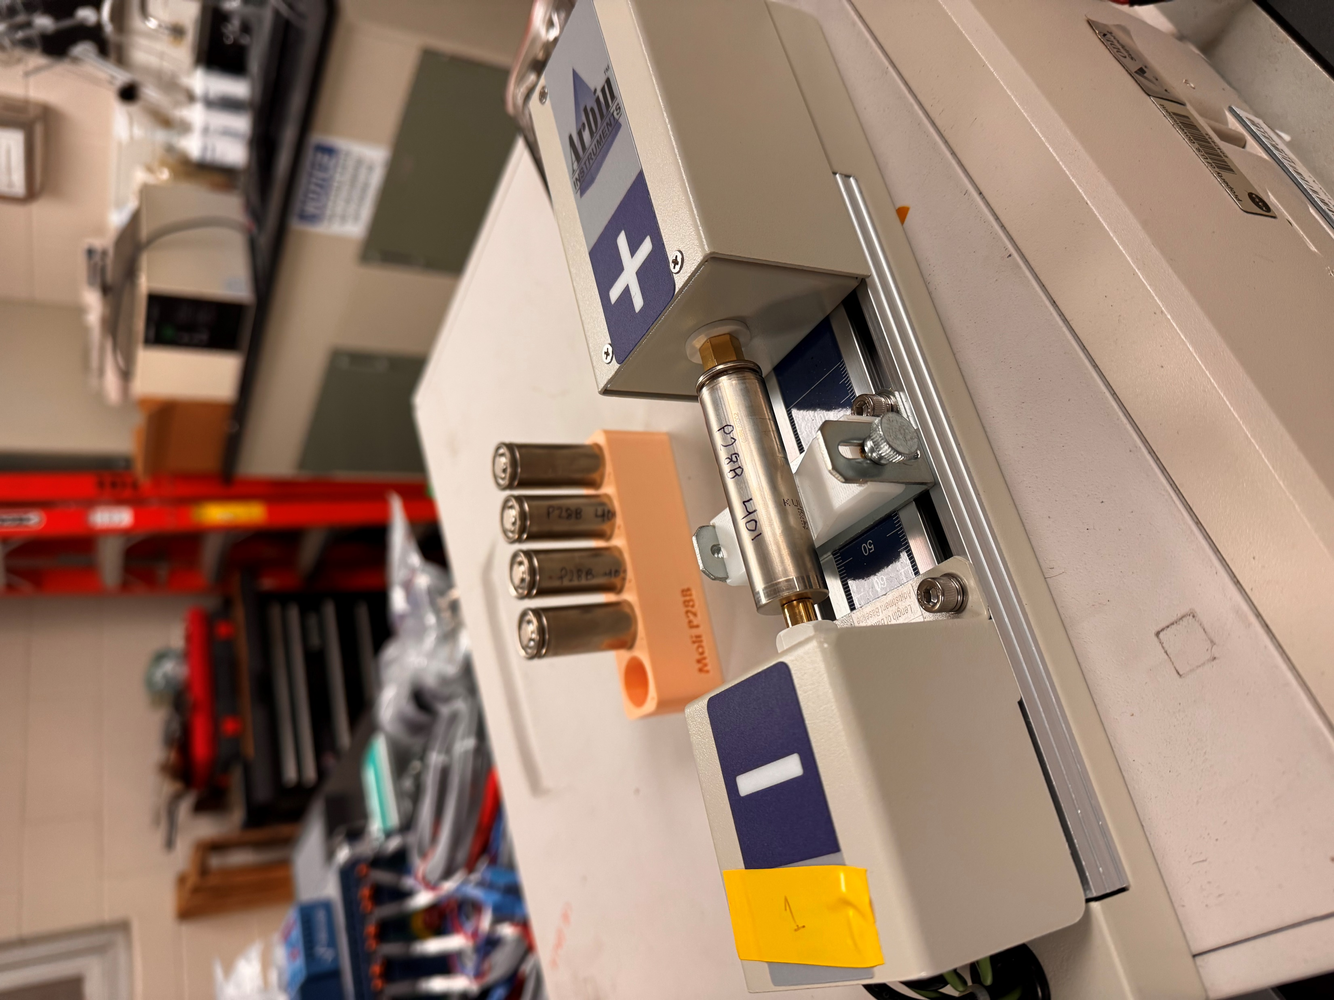
Technical Status Overview
Battery Characterization
Electronics Development
Thermal and Case Design

Slide 6
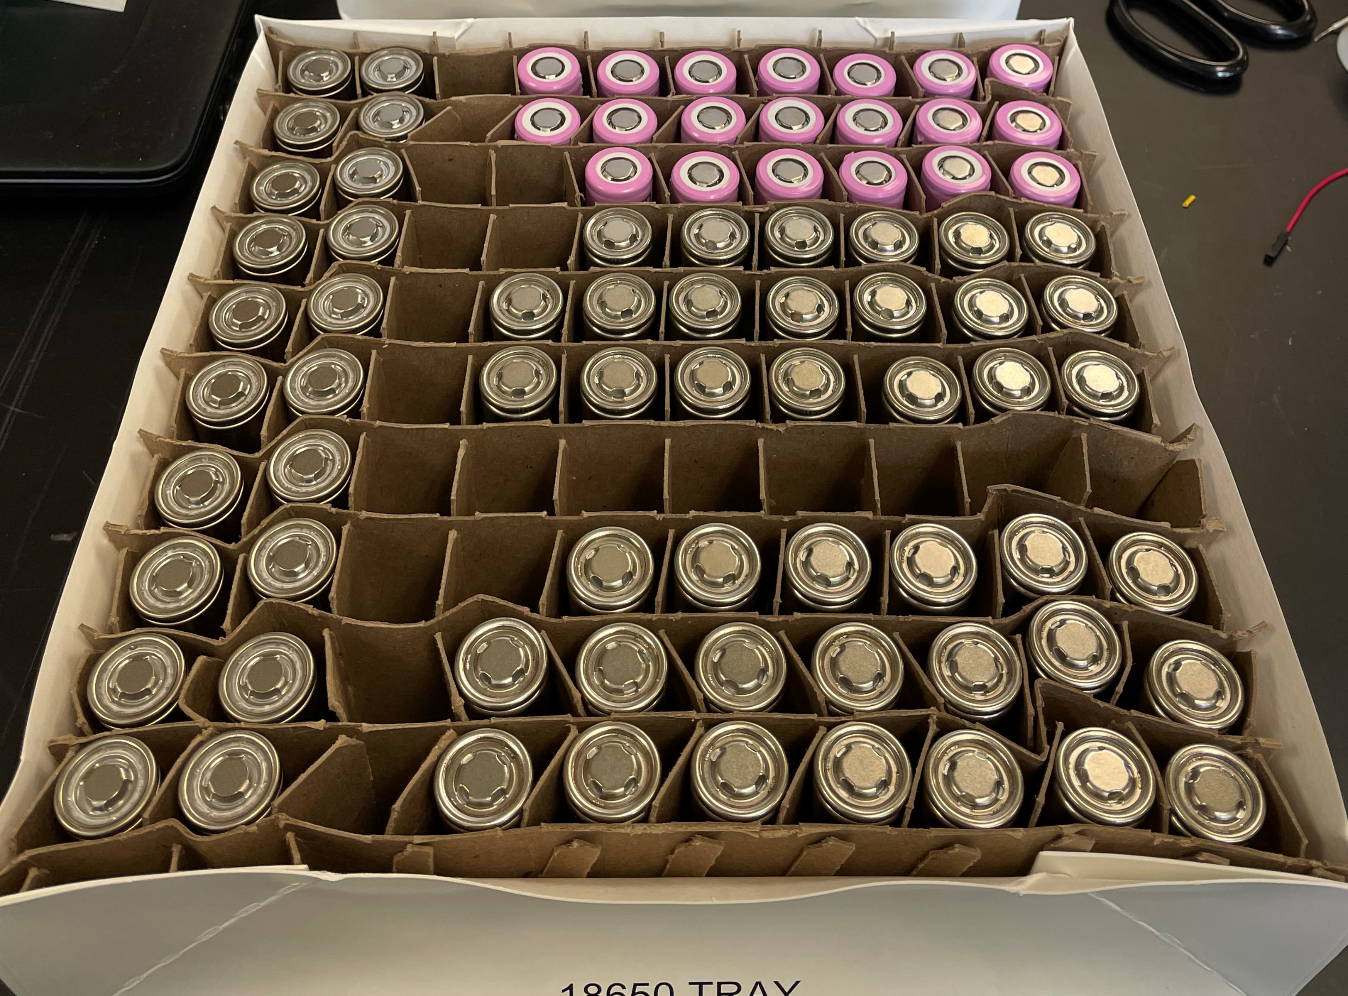
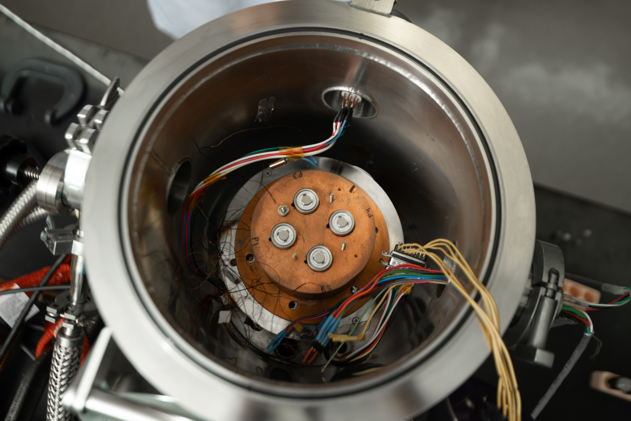
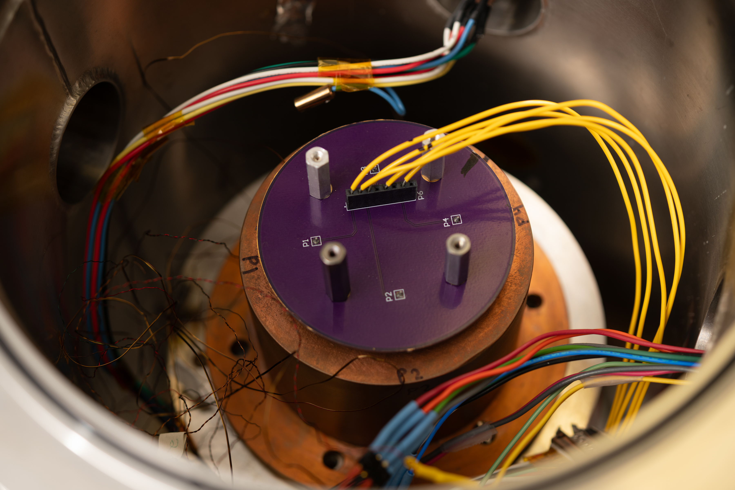
Cell Cryogenic Testing – Strategic Reserve Cells
Manufacturer | Model | Capacity (Ah)
Samsung | Q30 | 3.0
LG | M36 | 3.6
Molicel | P28B | 2.8
Molicel | M35A | 3.6
Preliminary Electrochemical Cycling, establishment of test charge level (0%, 100%)
Preliminary Electrochemical Impedance Spectroscopy (EIS)
Cryo-Hibernation Event
Post Electrochemical Cycling
Post EIS
Notes:
The objective was straightforward: determine whether commercially available Strategic Reserve cells can survive a lunar-night-equivalent hibernation event and identify the operating conditions that minimize degradation.

Slide 7
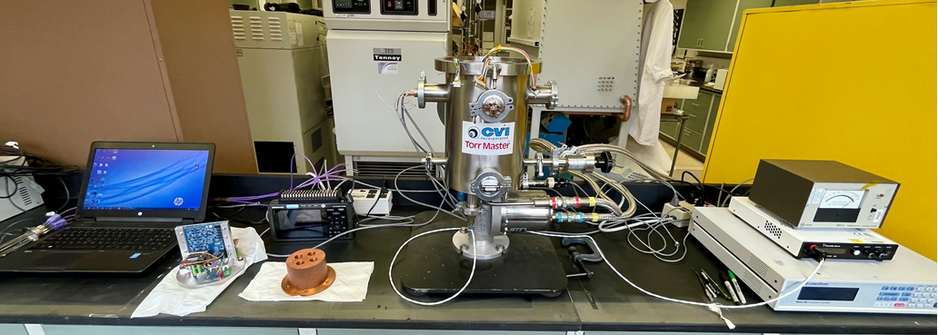
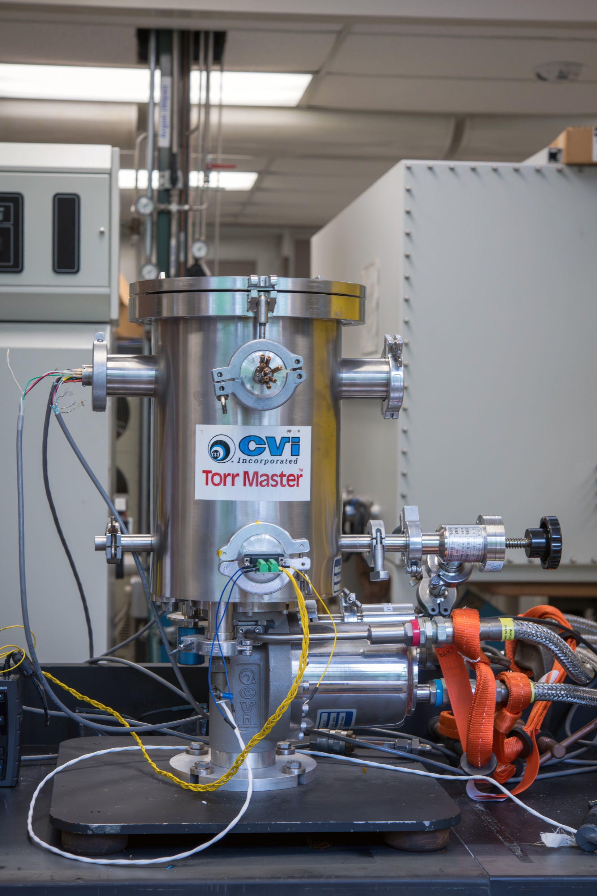
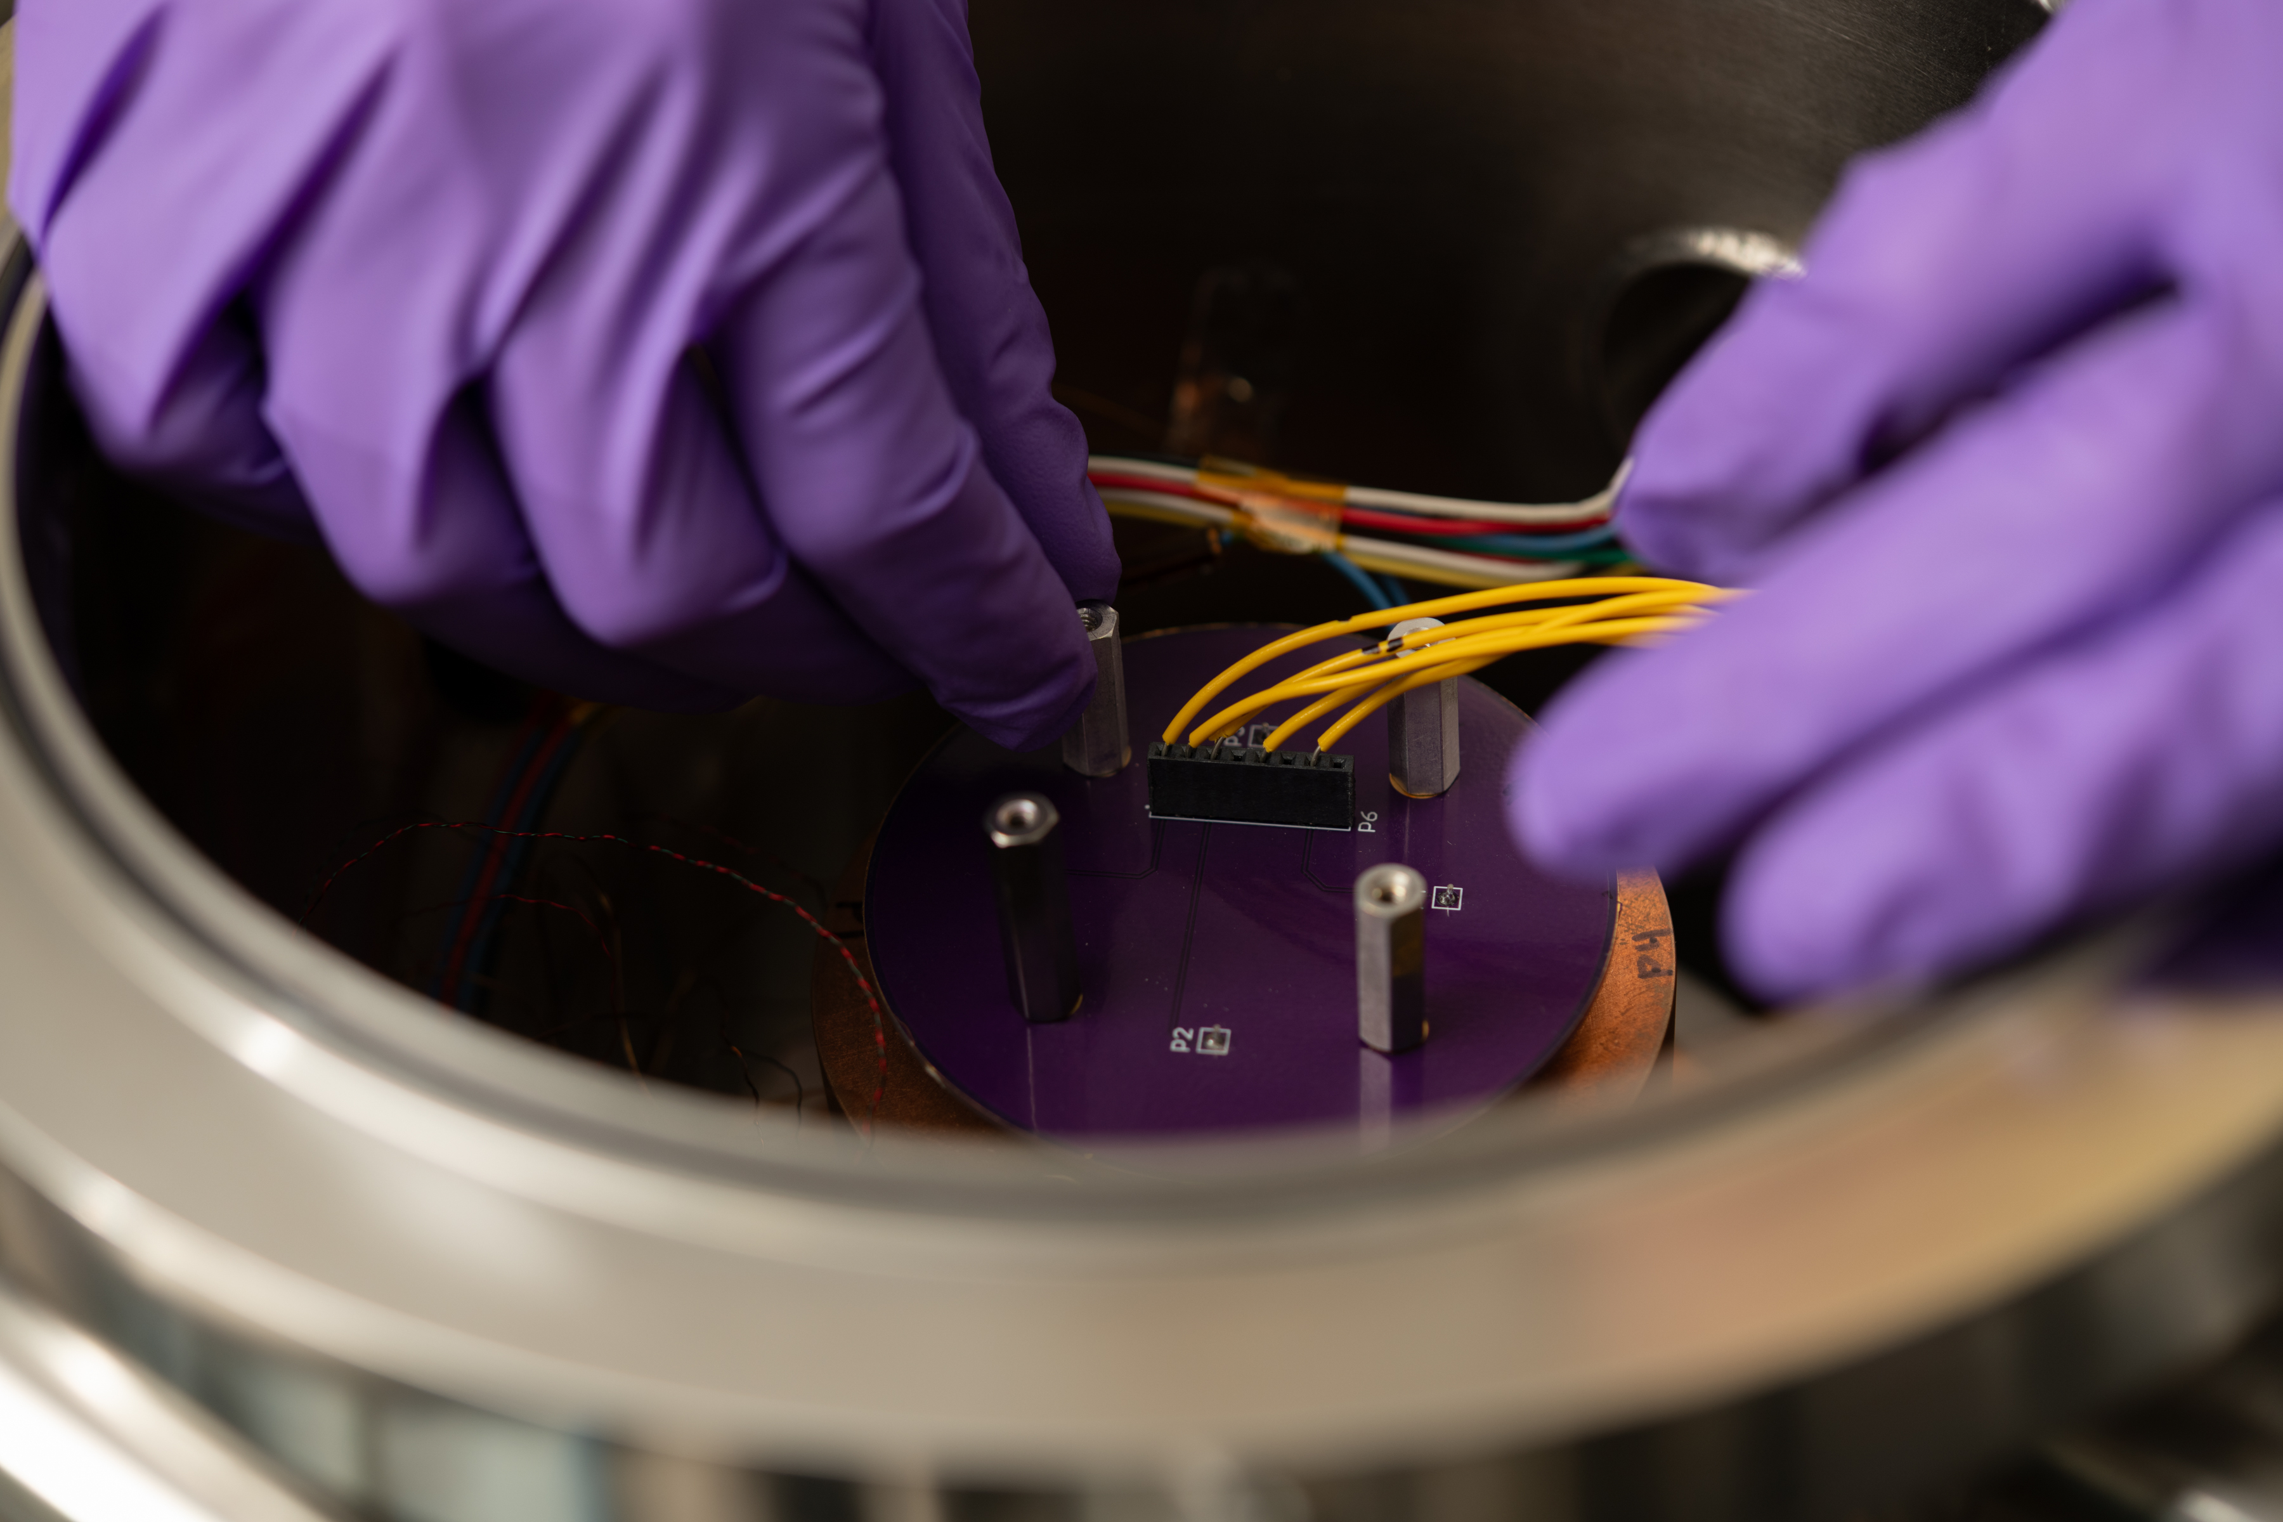
Cryochamber Test Setup

Slide 8
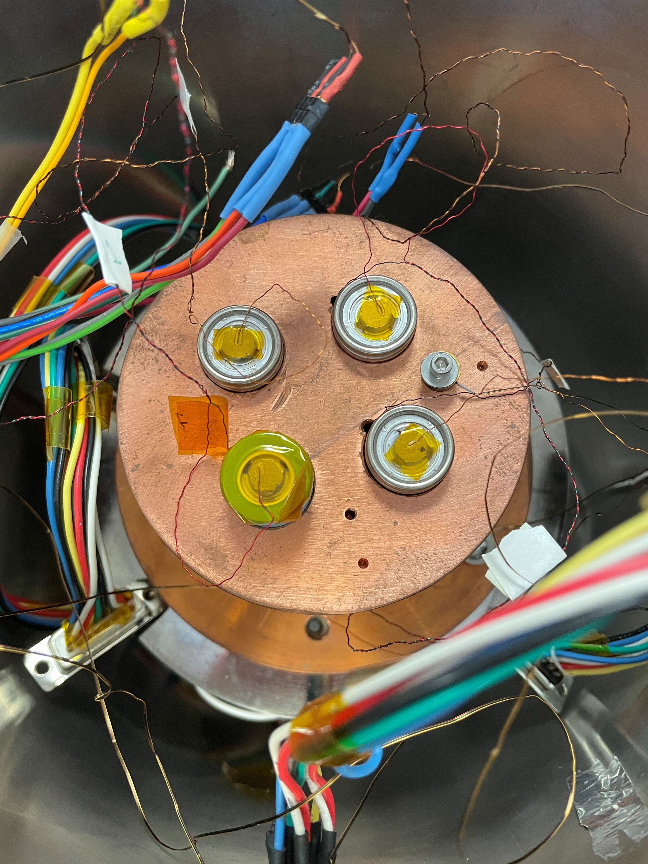
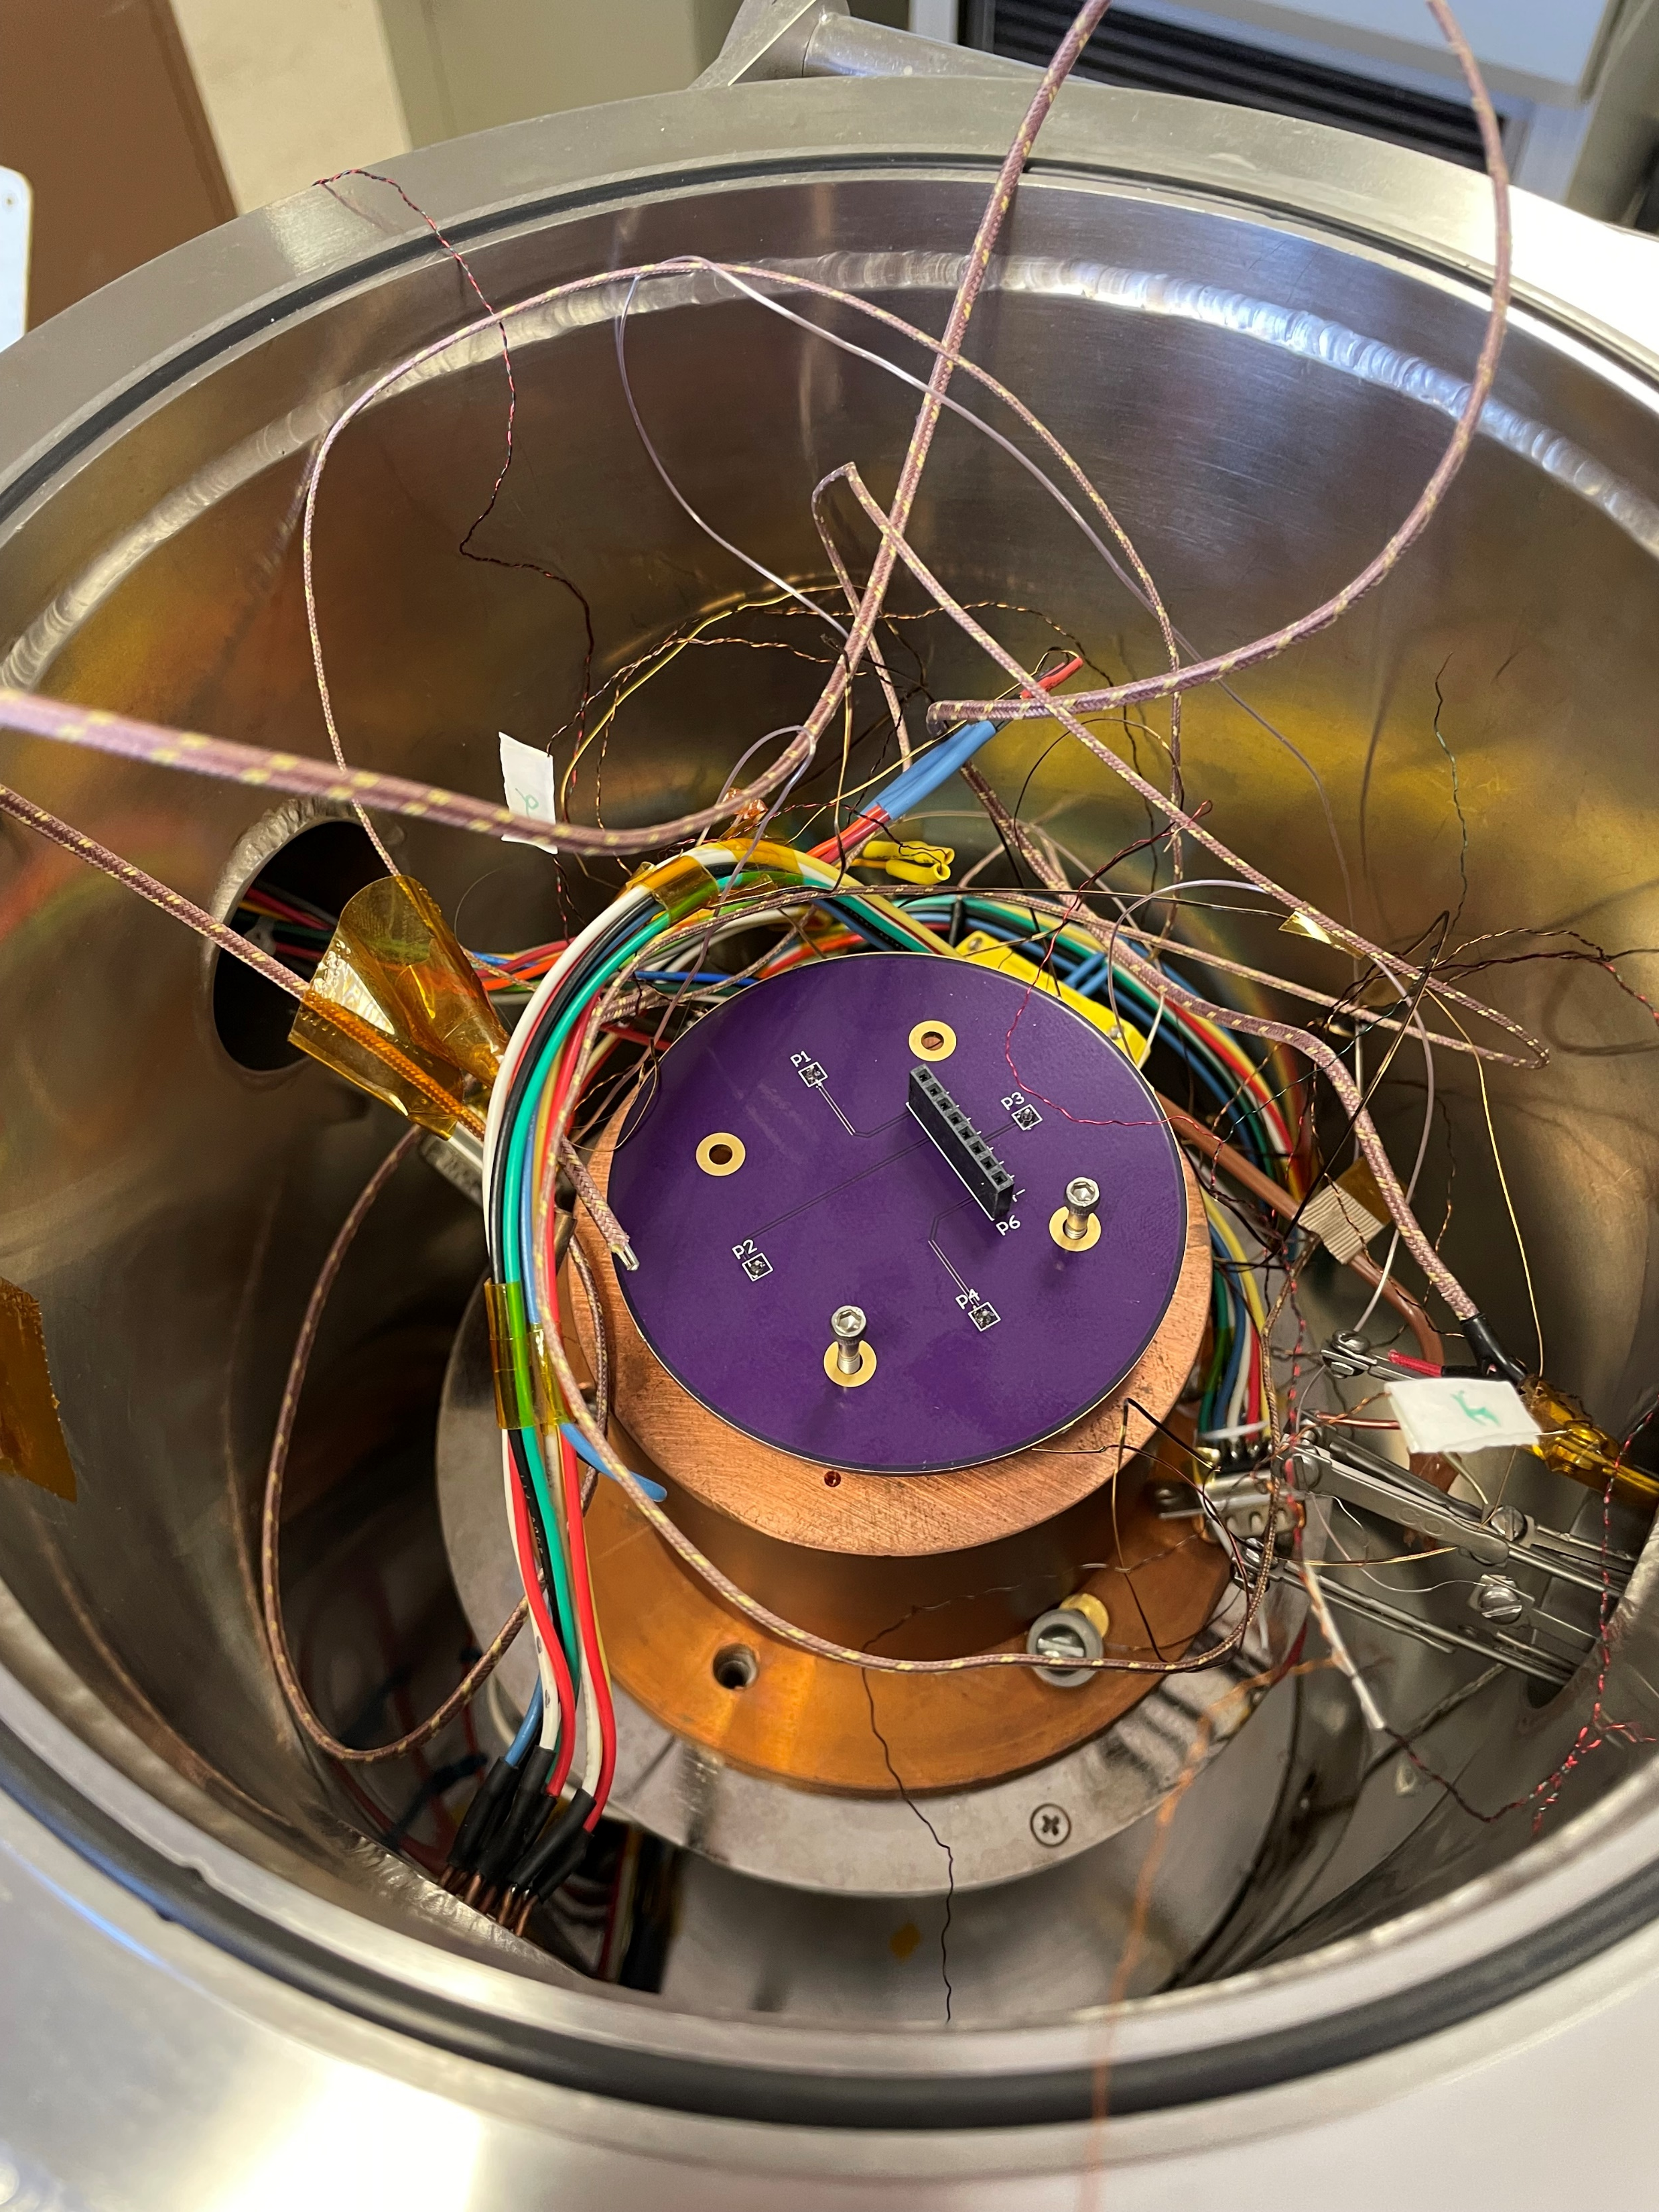
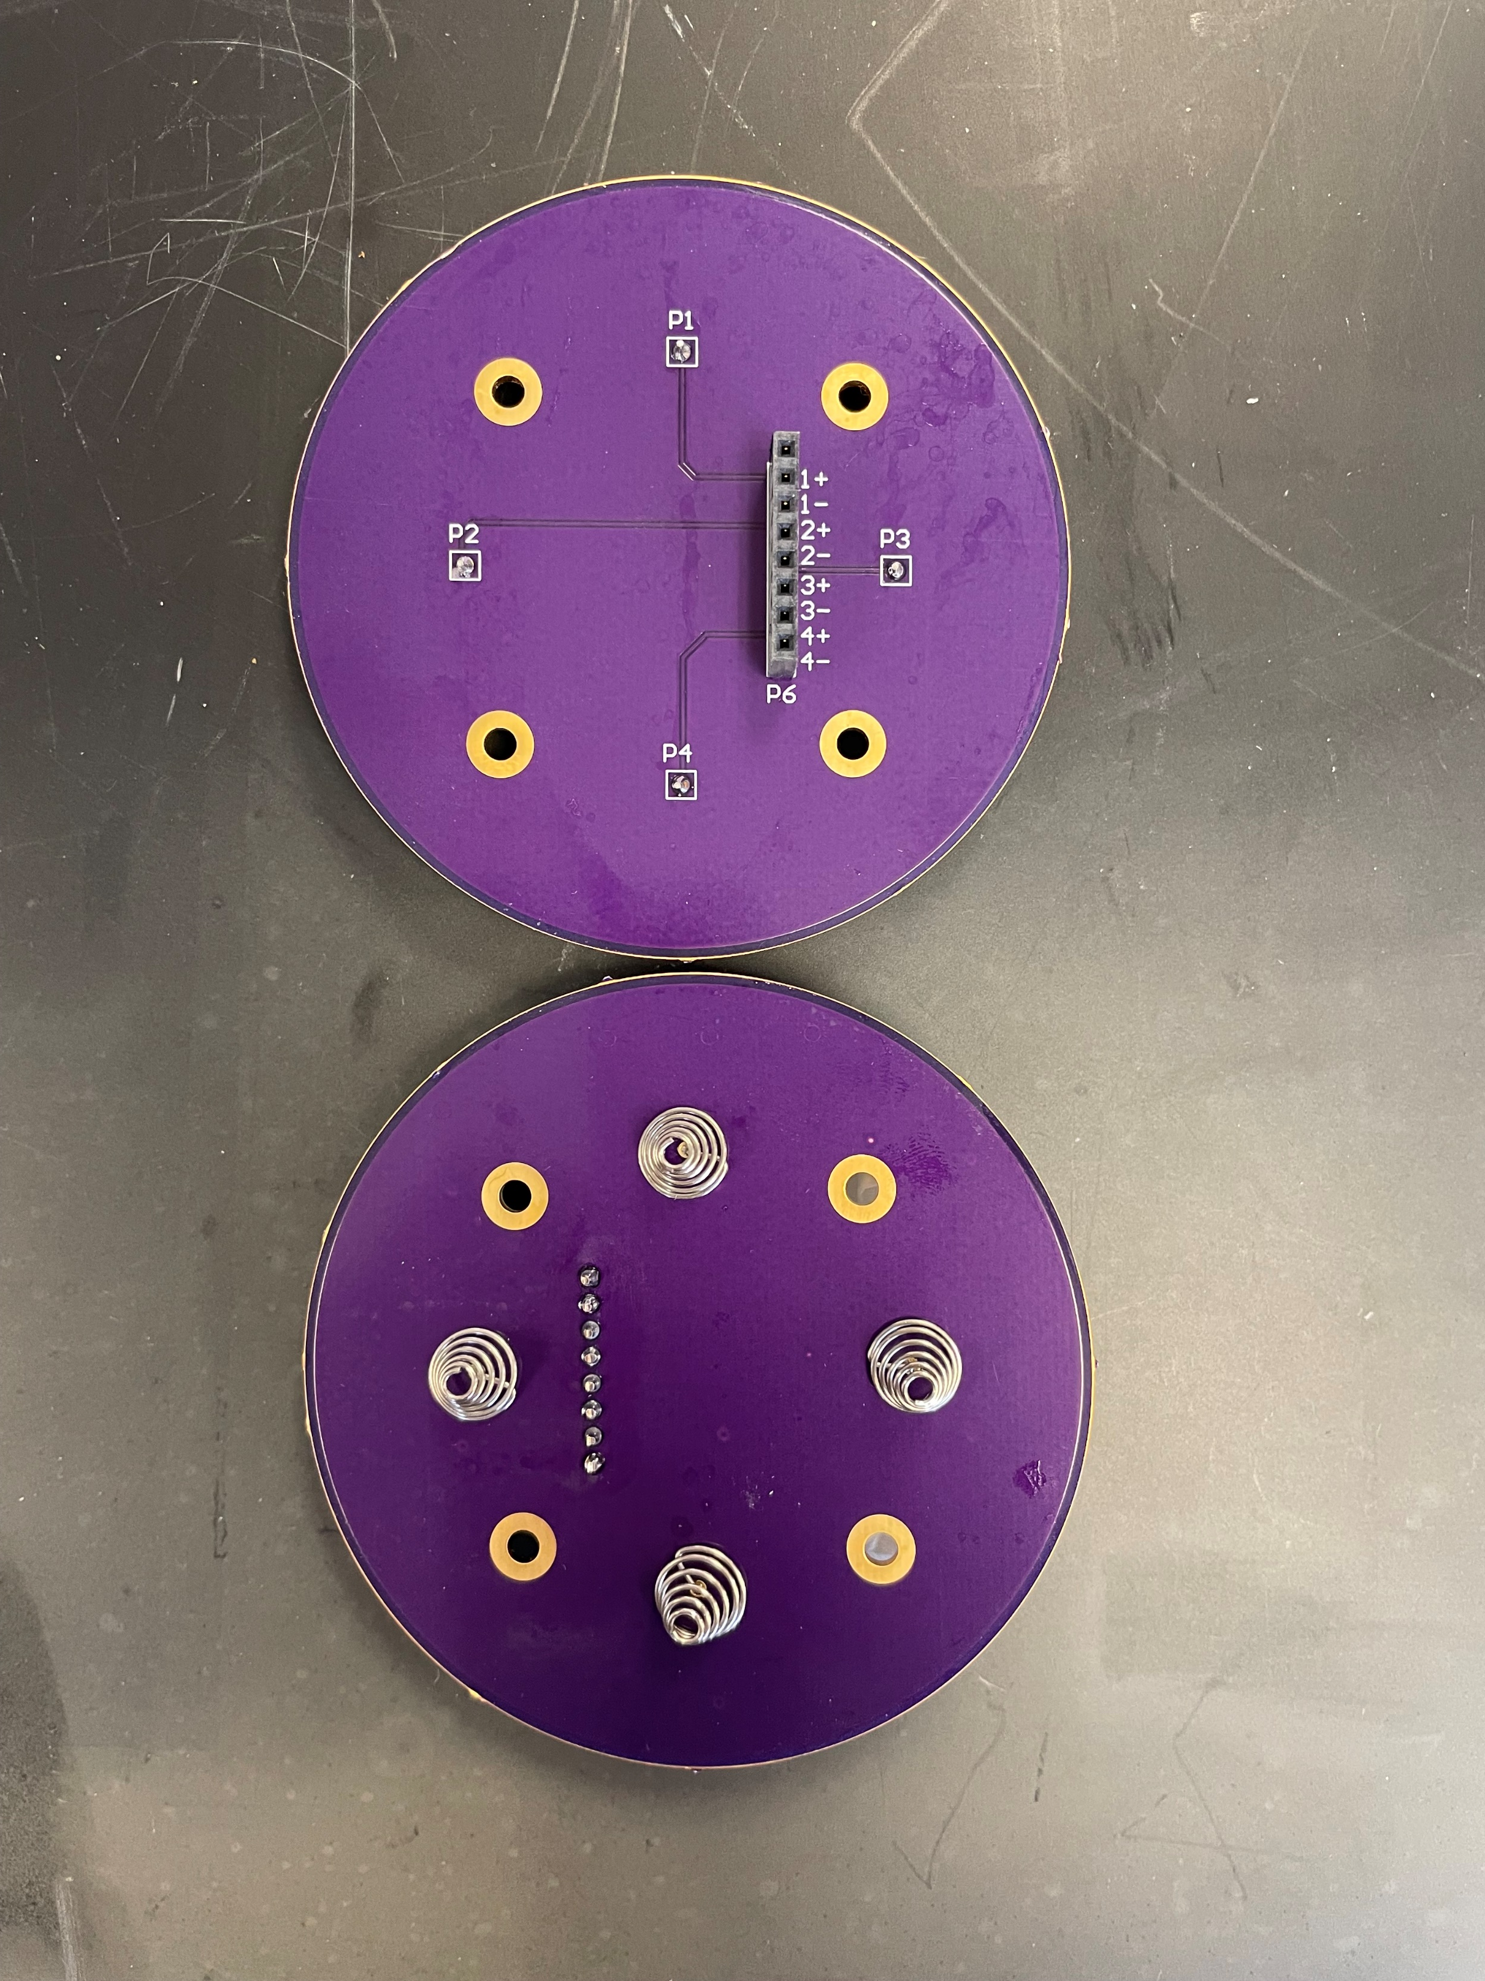
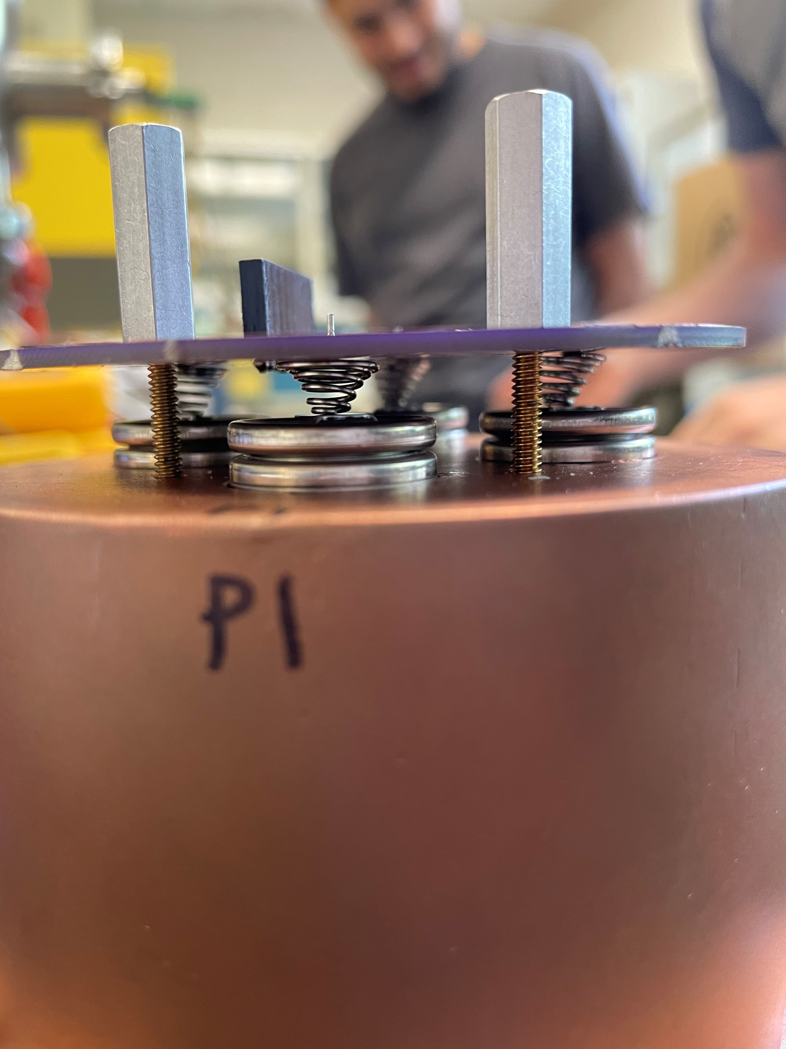
Cryochamber Test Setup

Slide 9
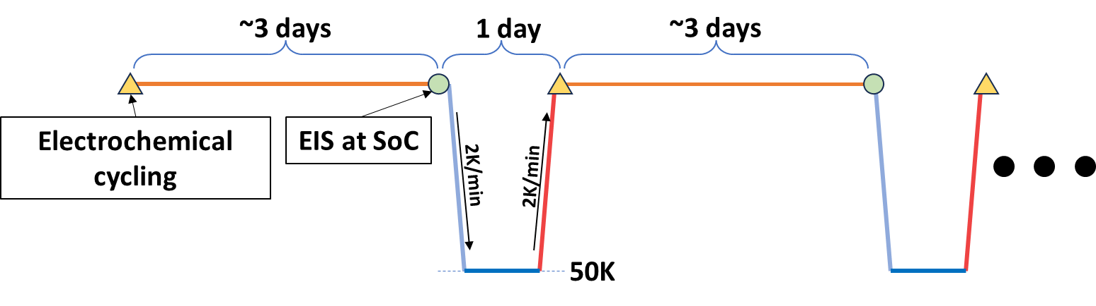
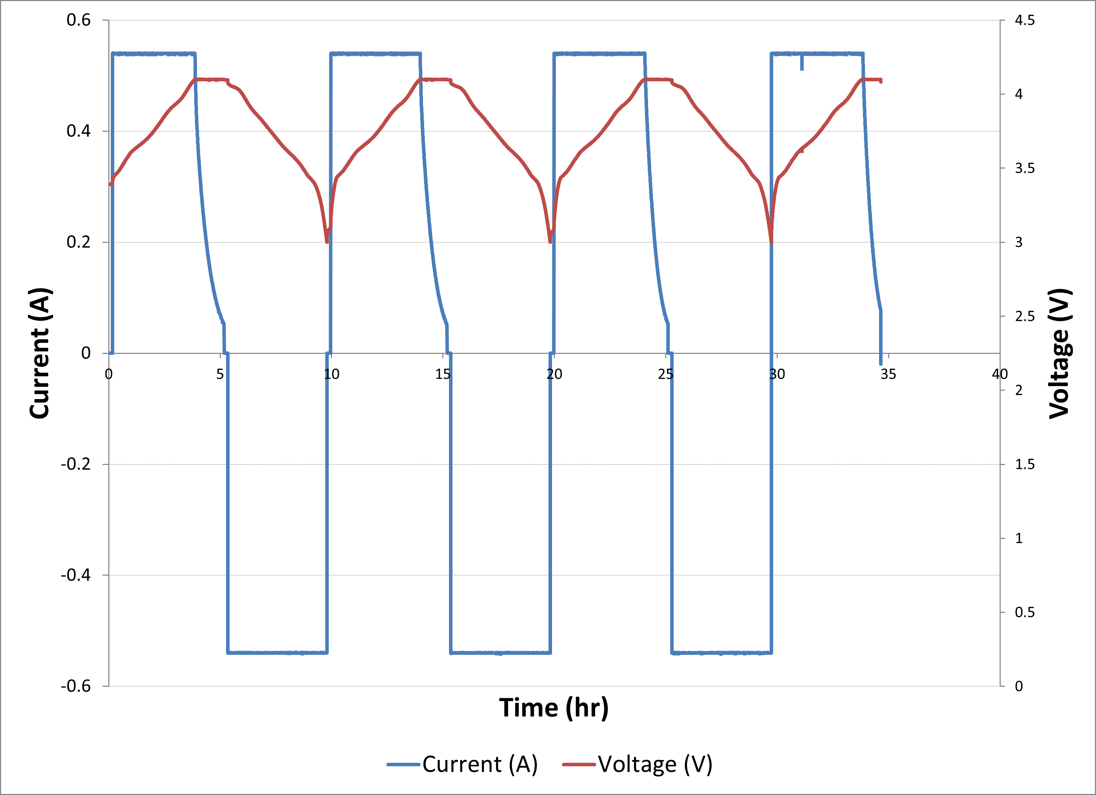
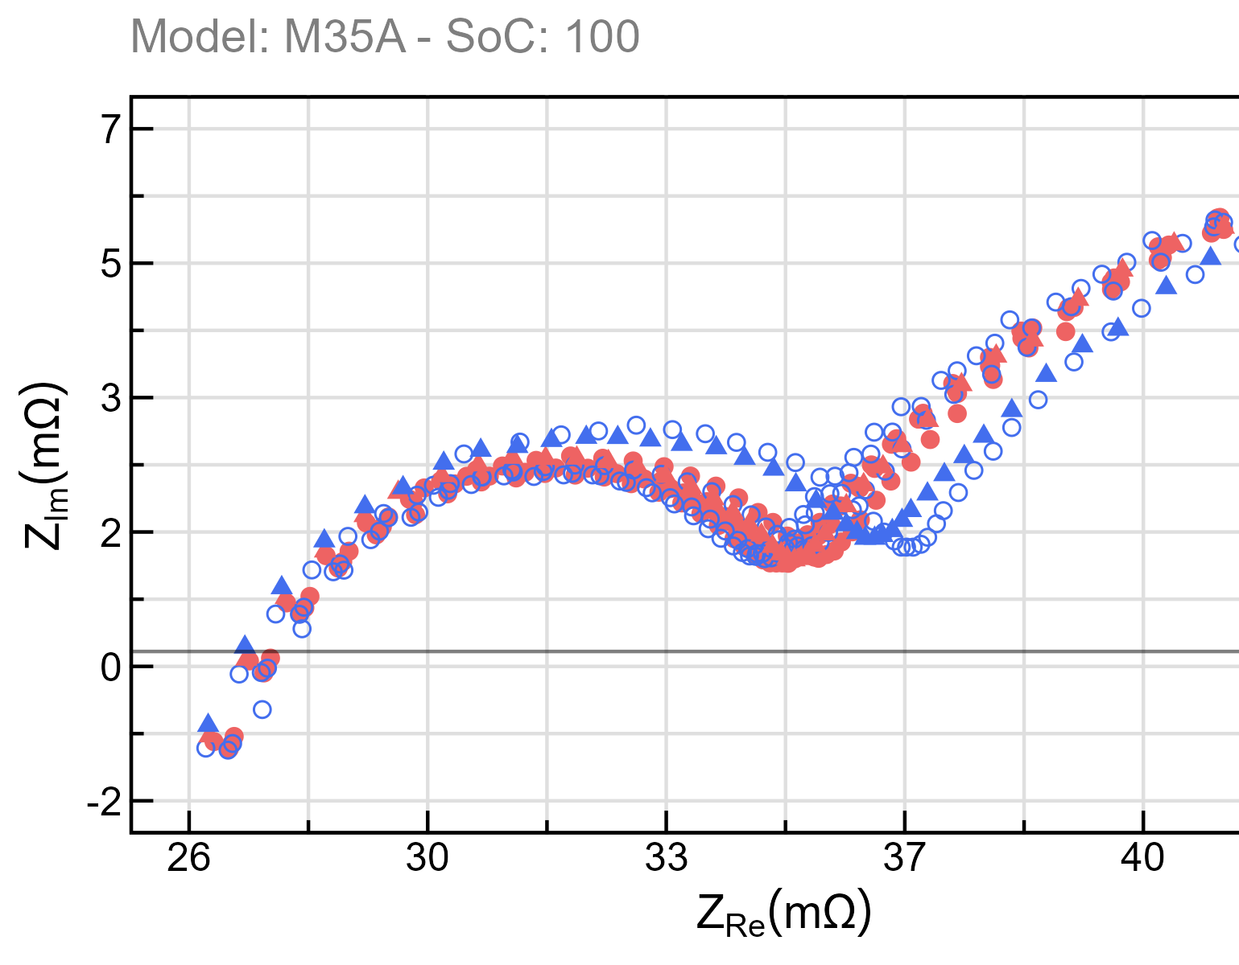
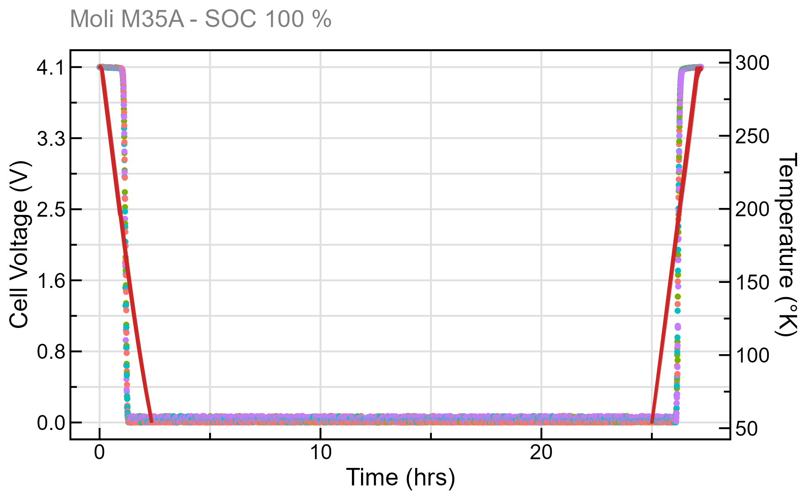
Passive Cell Hibernation Testing
Combinatorial Test Matrix
State of Charge
Temperature Ramp Rate
Dwell Time
Electrochemical Cycling
EIS
Cryo-Hibernation

Slide 10
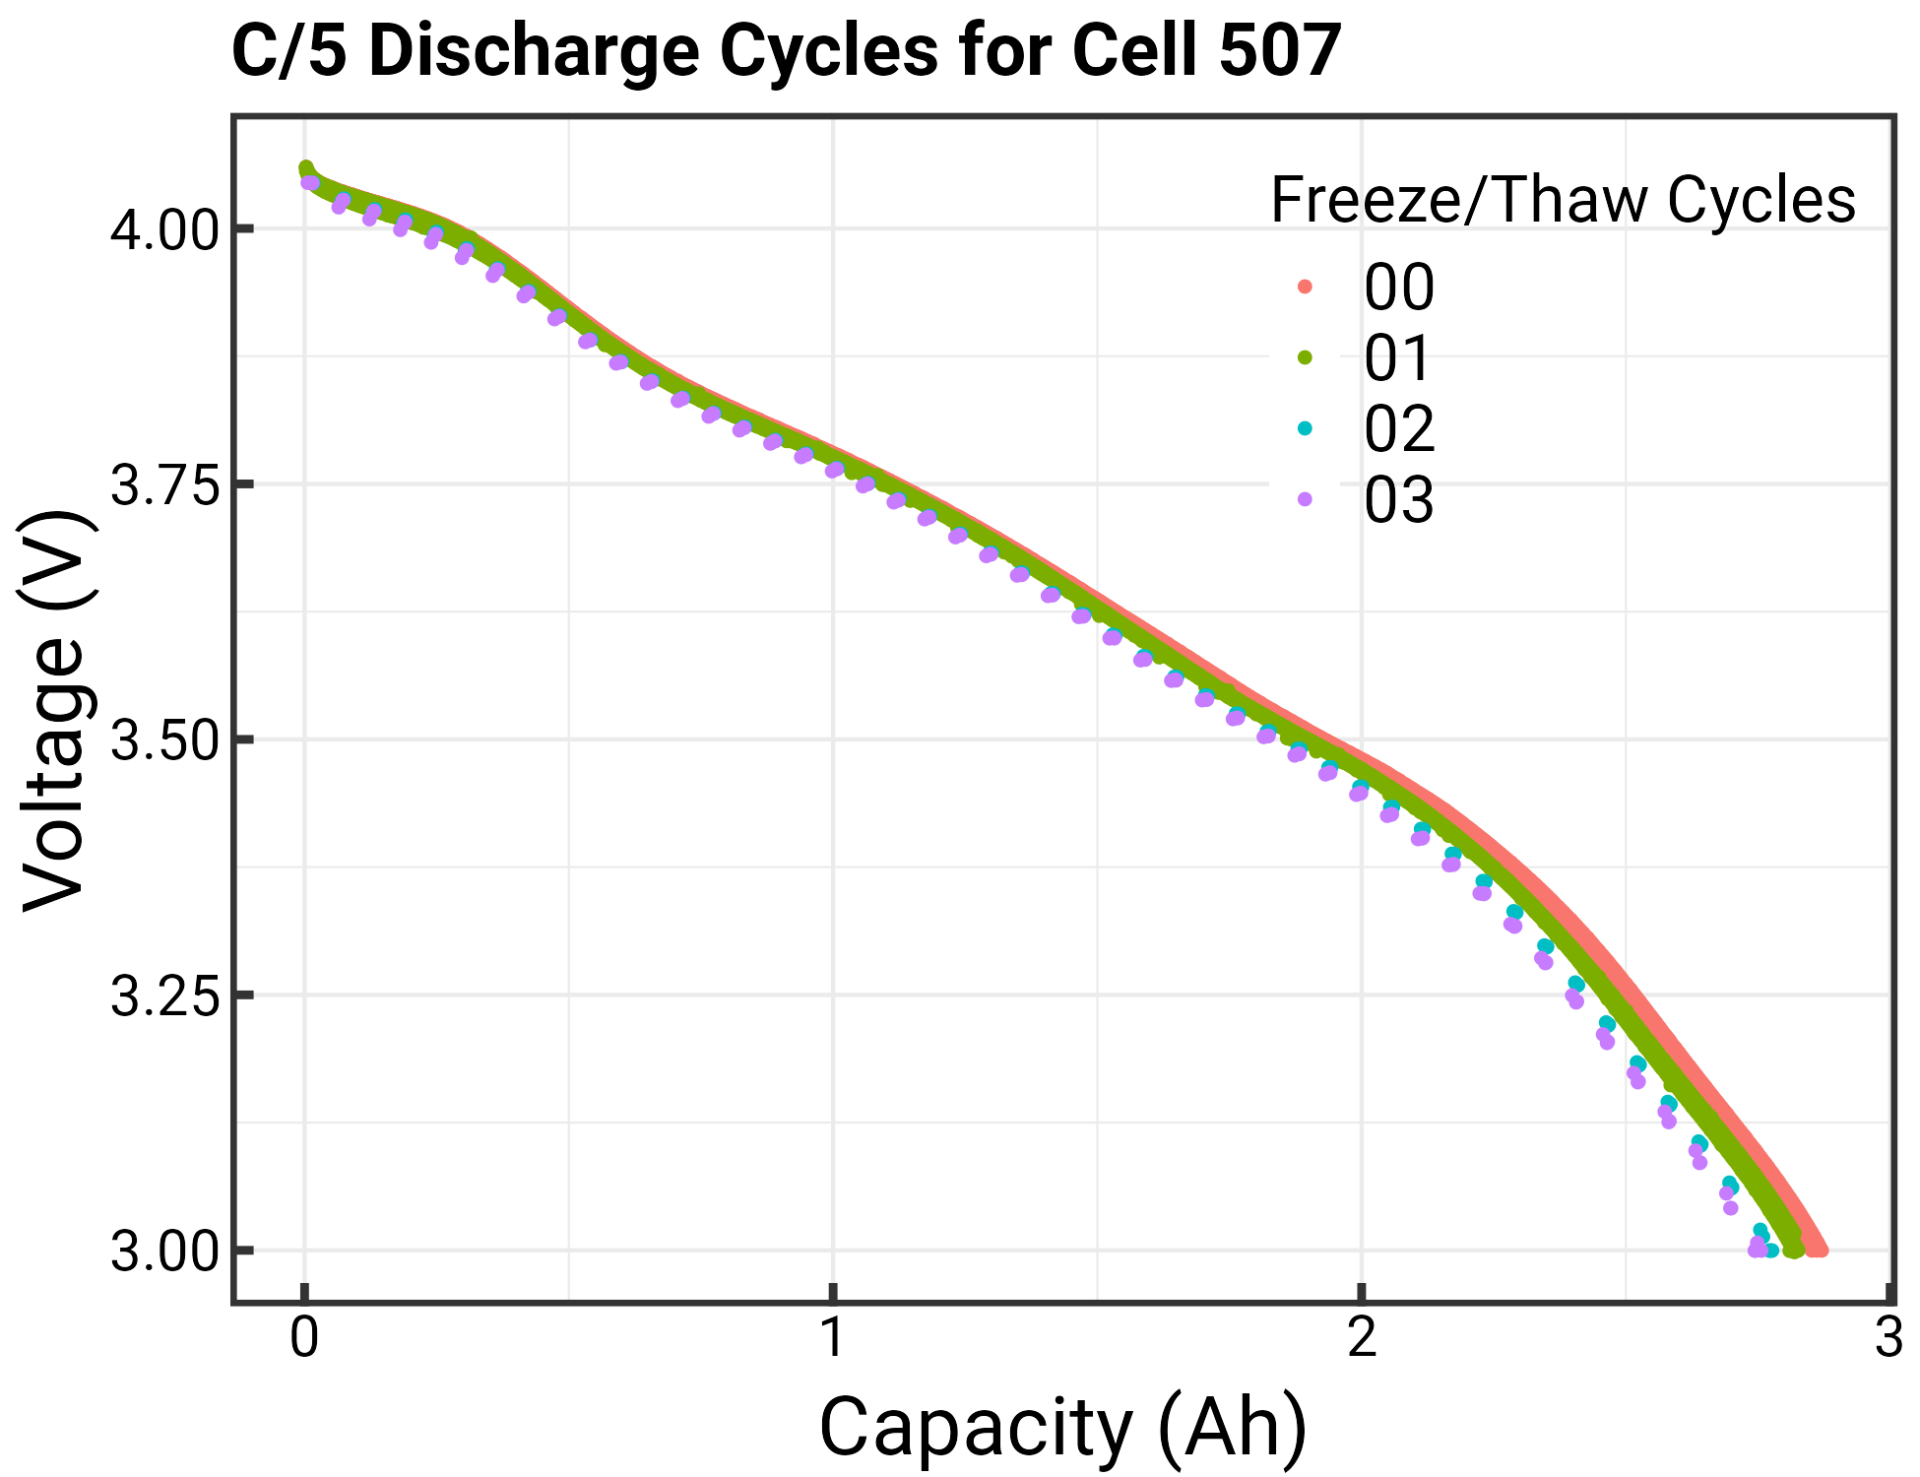
Post-Hibernation Comparison of Cell Behaviors: Cycling
Cell Cycle Testing
Test:
Rest 10 minutes
Variable Reset
C/5 Charge to 4.1V
Taper at 4.1V until 50mA
Rest 10 minutes
Discharge to 3.0V at C/5
Repeat steps 1-6 for a total of 3 cycles
Charge to designated SoC%
This is representative data: All tested cells showed similar behavior

Slide 11
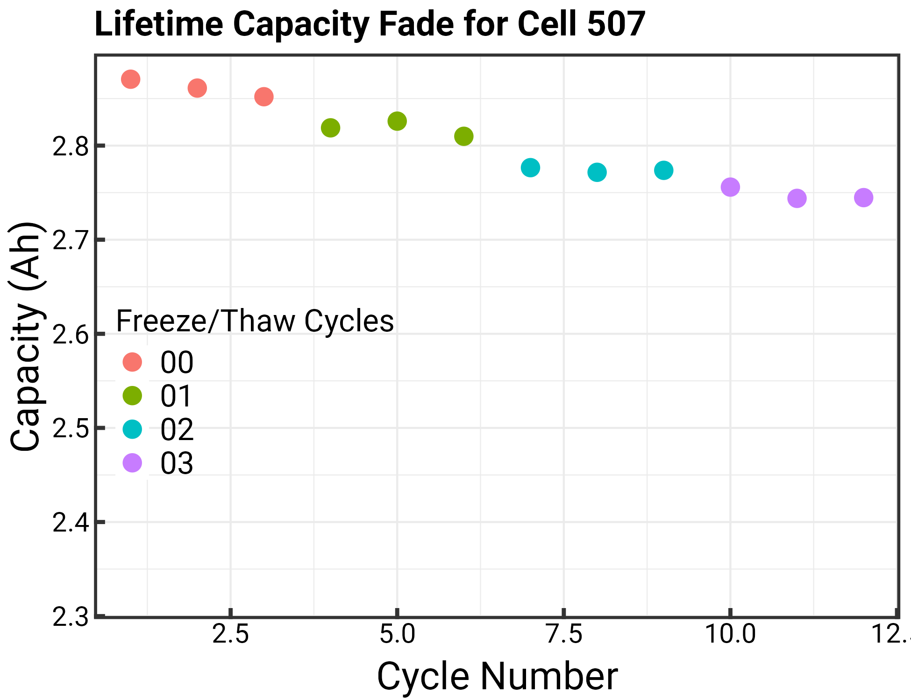
Post-Hibernation Comparison of Cell Behaviors: Cycling
This is representative data: All tested cells showed similar behavior

Slide 12
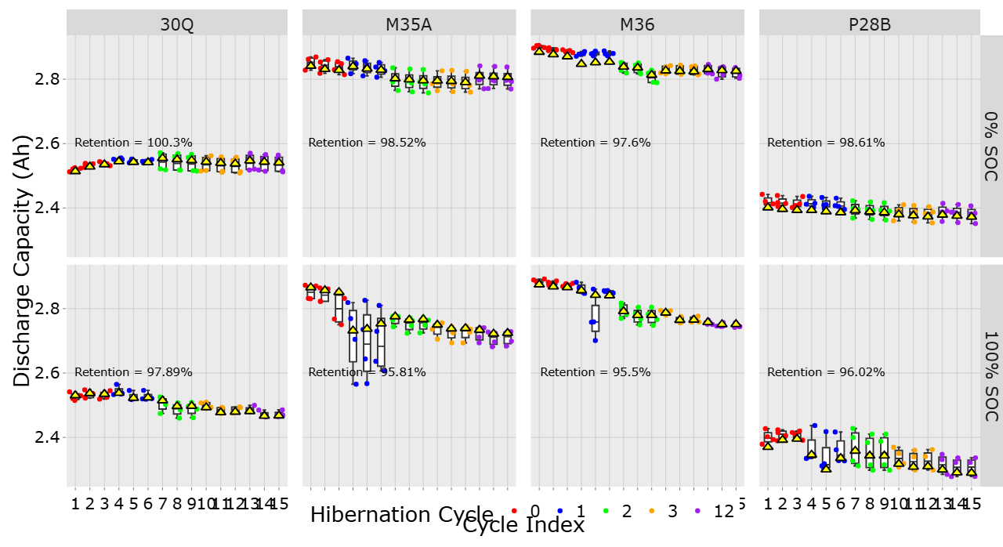
Post-Hibernation Comparison of Cell Behaviors: Cycling

Slide 13
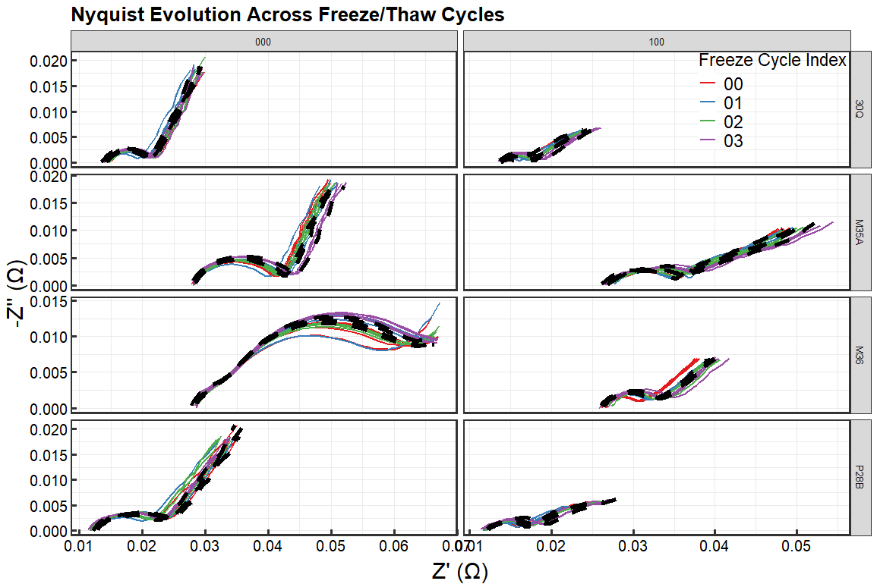
Post-Hibernation Comparison of Cell Behaviors: EIS
Electrochemical Impedance Spectroscopy (EIS) can tell us information about changing interface mechanisms as the cells experience Freeze/Thaw cycles
0% SOC
100% SOC

Slide 14
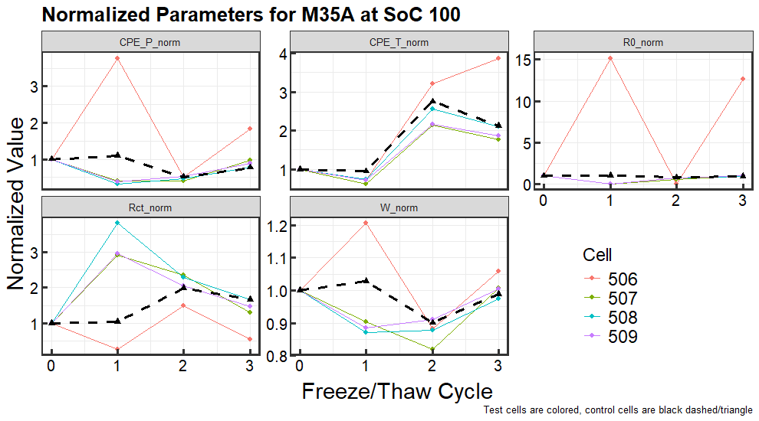
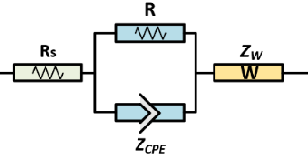
EIS Equivalent Circuit Model Parameter Fitting
Interested in Parameter Trends
Internal Resistance
Charge-transfer resistance
So far no discernable pattern, but will re-evaluate as we complete more F/T cycles

Slide 15
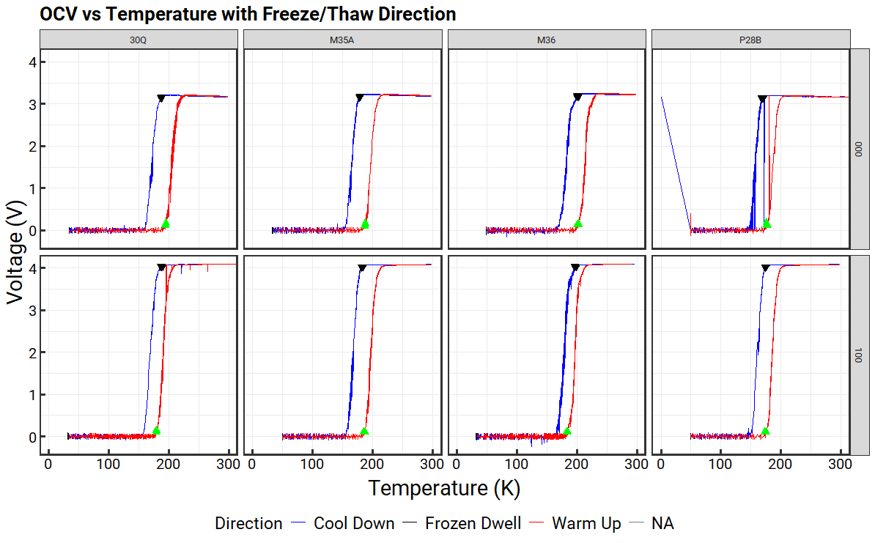
OCV Recovery Hysteresis
0% SOC
100% SOC

Slide 16
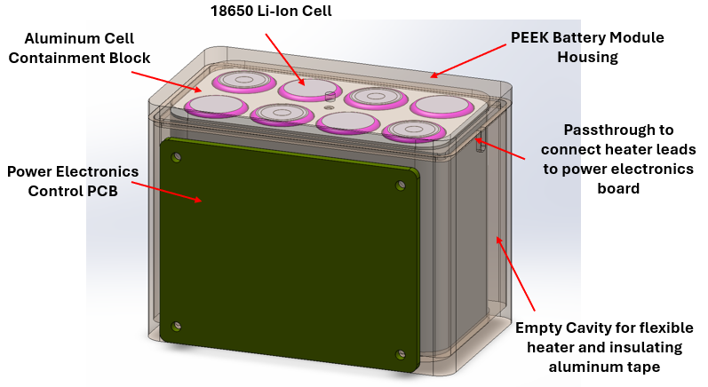
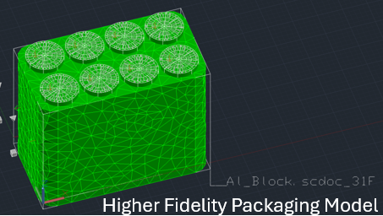
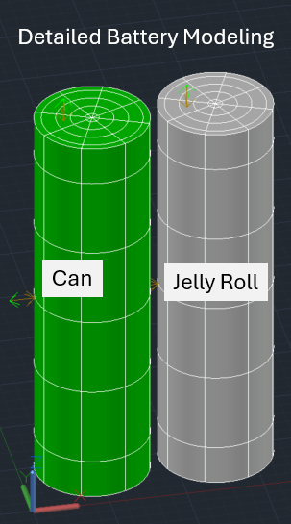
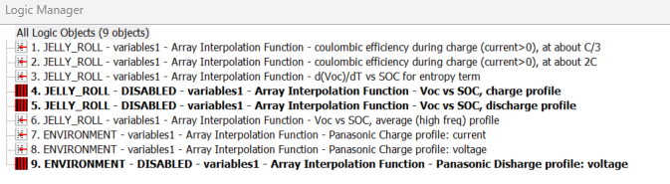
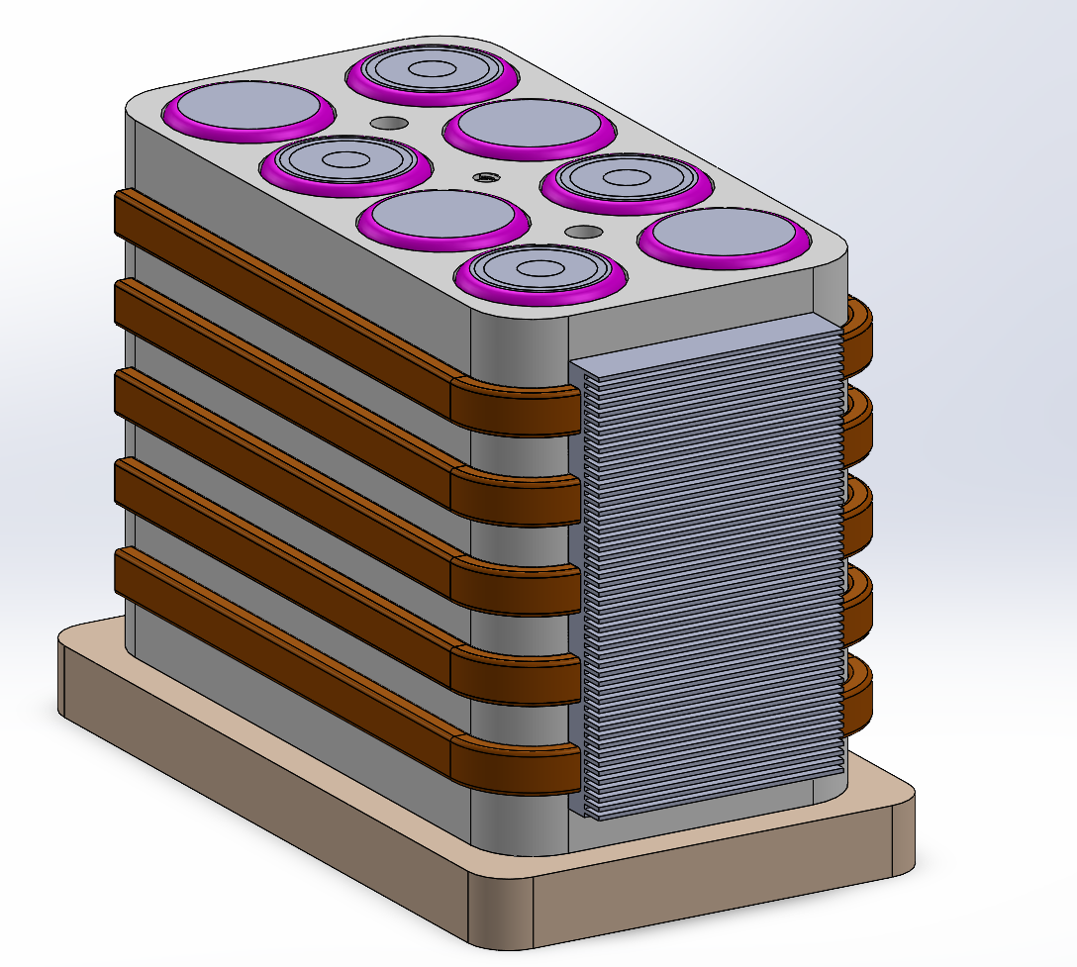
Battery Characterization Informs Case Design Iterations
Thermal Desktop model with NESC-compliant jelly-roll and can representations integrated into the battery housing, including SOC-aware logic and successful execution of a lunar South Pole thermal case.

Slide 17
Cryogenic Testing Current Findings
Big Take-aways (so far)
Completed full test matrix for single-lunar-night assessment across all four Strategic Reserve cell models (working on multiple-night assessment)
Validated thermal ramp rates: No degradation observed when heating ≤ 2 K/min (consistent with lunar maximum rates).
Optimized dwell testing: Demonstrated that extended low-temperature dwell (~14 days) is unnecessary; 1-day dwell sufficient once thermal equilibrium (~8 hr) is reached.
Confirmed hibernation success: All cells recovered OCV and maintained minimal capacity degradation across all tested parameters
Preliminary insight: Depleted cells (0% SoC, lithium stored in cathode) may be more favorable for lunar hibernation.
Notes:
"One preliminary trend we are observing is that depleted cells appear slightly more tolerant of cryogenic hibernation. Our current hypothesis is that storing lithium in the cathode may reduce some of the mechanisms that contribute to freeze-thaw degradation, but we need additional cycling data before drawing firm conclusions."

Slide 18
Upcoming Future Work – Putting it all Together
Battery Future Work
Continue long-term thermal cycling (>= 130 cycles) to assess cell lifespan across multiple lunar days.
Perform non-destructive CT scans to study internal structures.
Use long-term data to advance BMS health and charge estimation models.
Electronics Future Work
Expand cryogenic testing of circuits, components, and evaluation boards.
Assess microcontroller performance at cryo temps; add heaters as needed.
Build and validate a full BMS integrated with cells in vacuum chamber.
System Level Future Work
Begin assembly of 8s1p battery pack (28V, 3Ah, 80W system).
Integrate BMS with battery system.
Conduct environmental testing (radiation, EMI).
Finalize and document operational protocols.

Slide 19
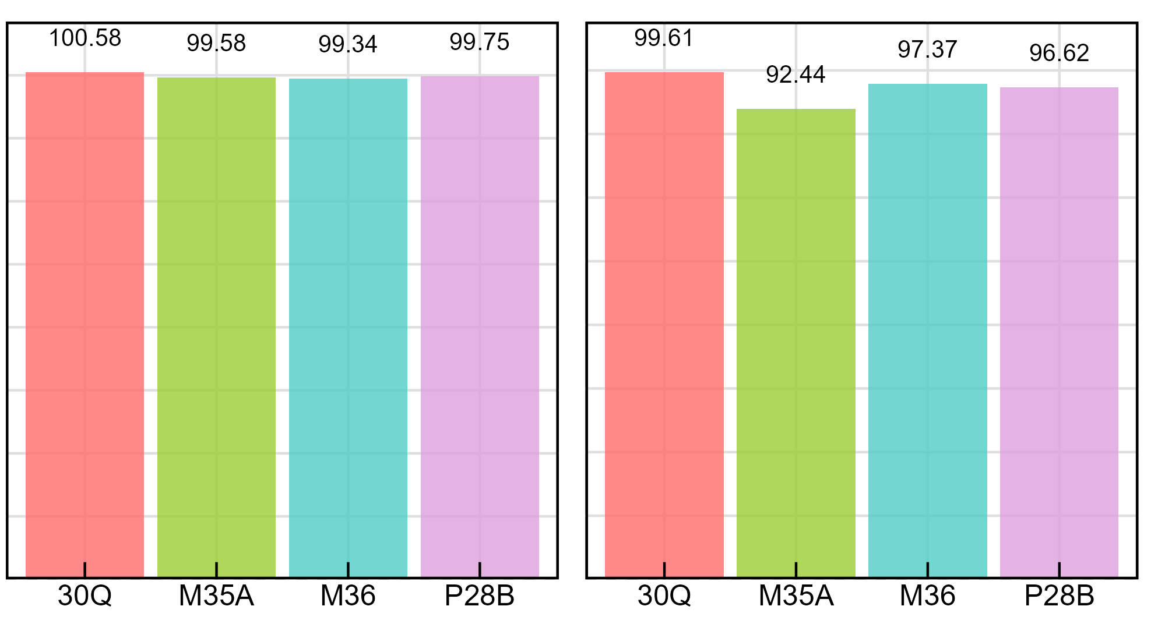
Thank you!
Single Night Cryogenic Hibernation Capacity Retention
Strategic Reserve COTS Li-ion Cells Successfully Survived Lunar Night–Equivalent Cryogenic Hibernation
Four cell models exposed to 50K
Cells survived initial lunar night testing with minimal degradation
Next Steps: Multi-Night & Integration
Wrapping up multi-night evaluations and moving toward full battery + BMS integration
Seeking Technology Infusion and Collaboration Opportunities
Engaging with Moon Base, Artemis, and CLPS programs, including rover teams and lunar infrastructure groups
0% SOC
100% SOC
Capacity Retention (%)
All tested cells recovered with minimal degradation after lunar-night-equivalent exposure
POC:
brian.a.holler@nasa.gov

Slide 20
Appendix A - Back Up Slides
PI & Presenter: Dr. Brian Holler, NASA GRC - LEX
LSIC Surface Power Monthly Telecon June 2026
Notes:
We are developing a battery and battery management system that can survive the brutally cold lunar night.

Slide 21
Concept of Operations
Key
Cryo-tolerant
Cryo-operable (“Dawn Mode”)
(#) – Dawn start-up sequence
Solar Arrays
(1)
→ Power
→ Thermal
→ C&DH
(2)
Main Bus
Spacecraft Avionics & Payloads
Battery Management System (BMS)
Main Bus Controller
Power Distribution
(3)
Monitoring
Pre-heat control
Pre-charging
(3)
Heater Control
Pre-heat as needed
Pre-heat
(4)
Battery
(5)
Isolation Relay
(normally-off)
Closed during nominal ops for battery charge/discharge

Slide 22
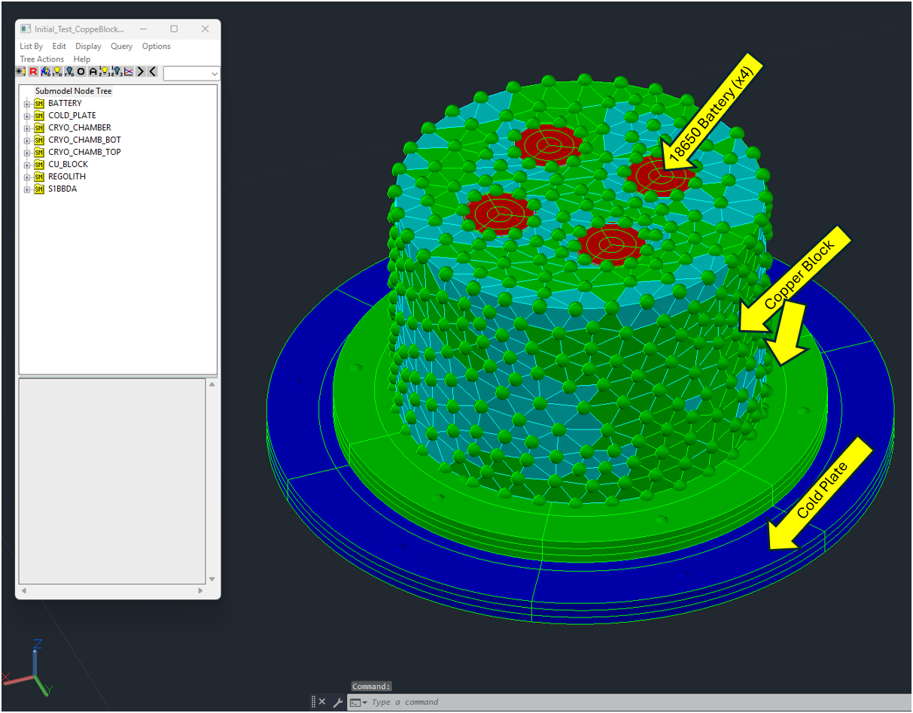
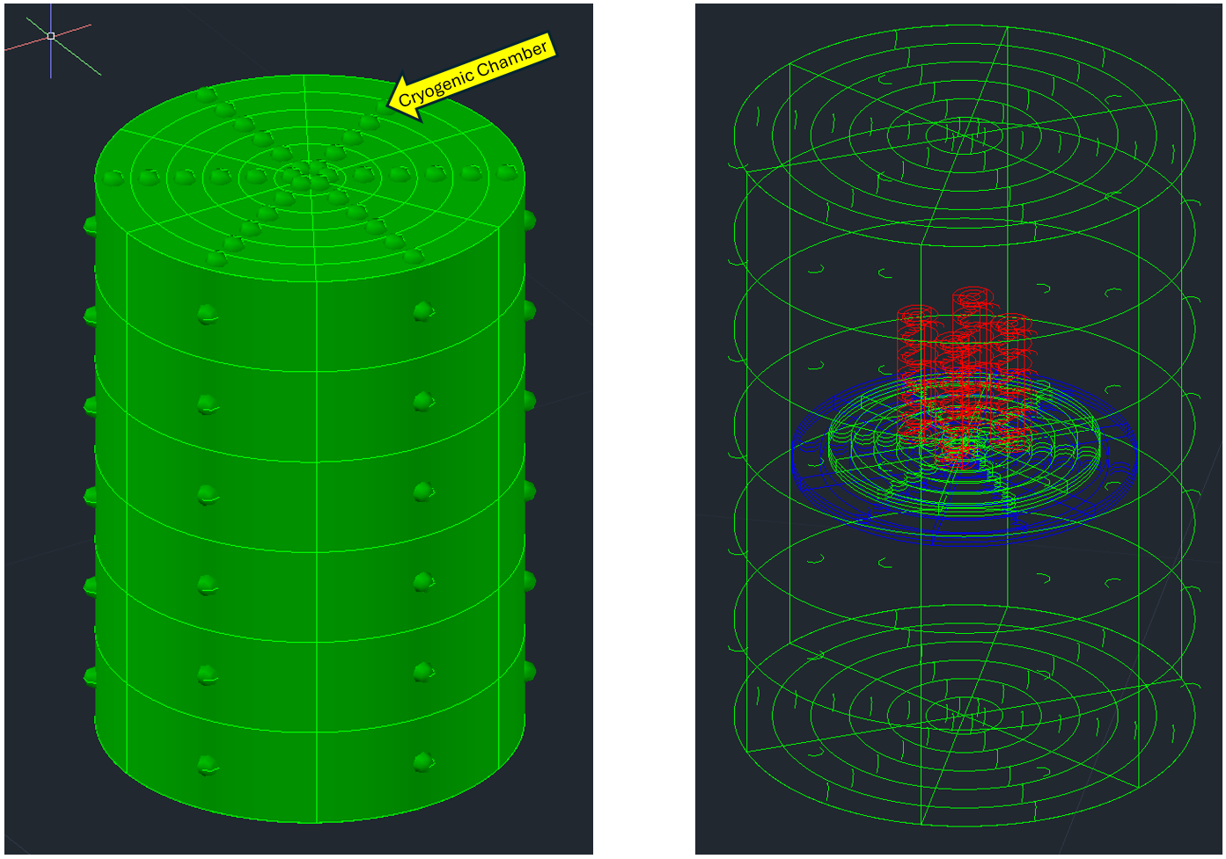
Gen 1 Thermal Model and Thermal Environment
Focused on Cryogenic Chamber environment and its lunar equivalent
Starts at 293.15K, cooldown rate 2K/min till it hits 50K, dwells at 50 K for 8 hours, then warms up in temperature either naturally or at 2 K/min.

Slide 23
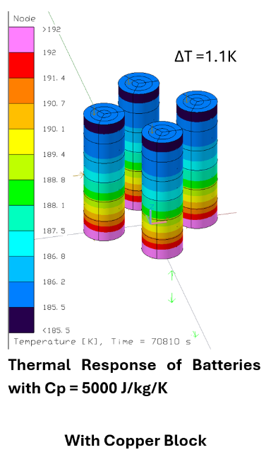
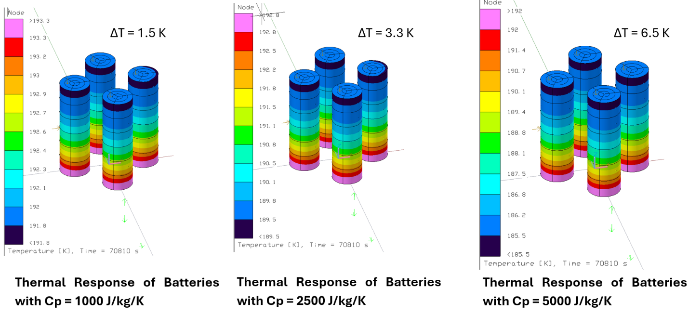
Parametric Studies
Had concerns of degradation via temp gradients across the cell:
In Situ Observation of Thermally Activated and Localized Li Leaching from Lithiated Graphite | ACS Energy Letters - Harrison Szeto, Vijay Kumar, and Yangying Zhu, ACS Energy Letters 2024 9 (9), 4218-4224, DOI: 10.1021/acsenergylett.4c01571
Investigated cell thermal properties and Copper Block contact
Heat Capacity (C_{p})
Parametric sweep: 800–5000 J/kg/K.
With Copper Block: sensitivity at ~2500 J/kg/K (ΔT ≈ 3K); ~6.5K at 5000 J/kg/K.
Without Copper Block: larger ΔT across batteries.
Realization: Copper Block acts as a thermal dampener, masking gradients → ΔT < 1K at high C_{p}.
Thermal Conductivity (κ)
Isotropic sweep: 1–100 W/m/K without Copper Block.
Literature: ~13 W/m/K.
Even extreme values (100 W/m/K) → negligible impact

