Slide 1

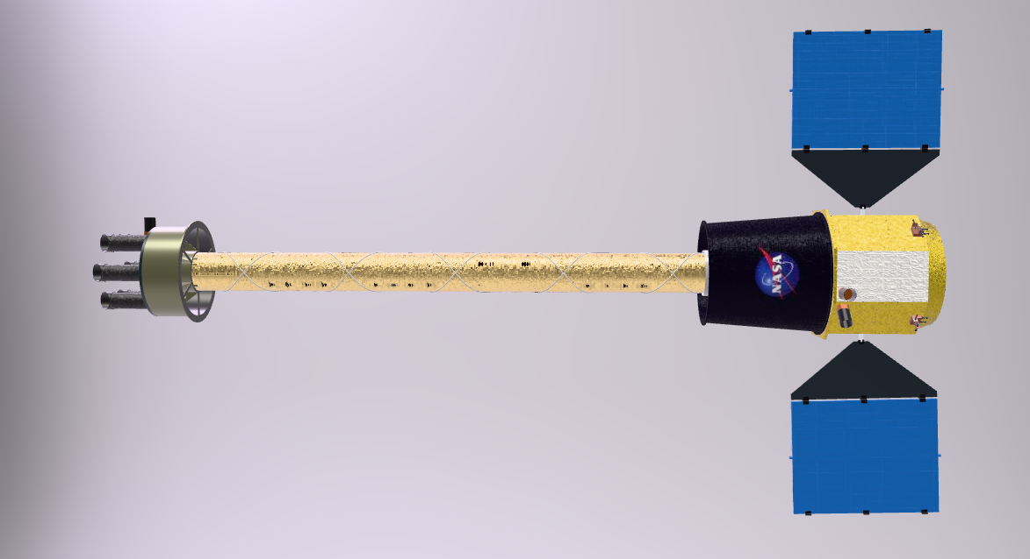
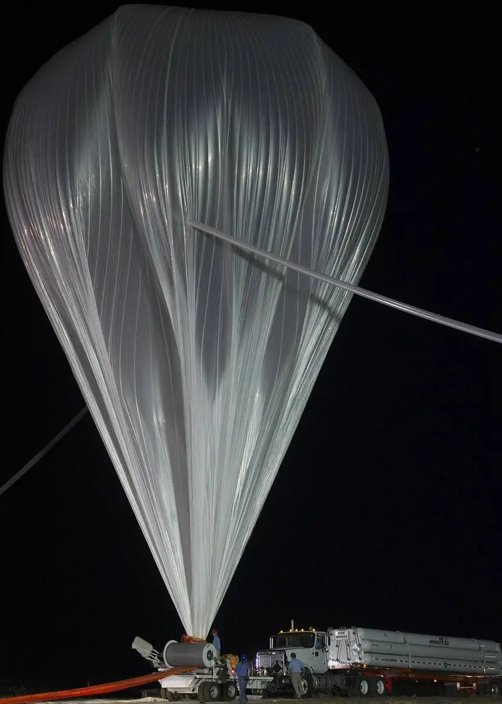
Next-generation hard X-ray missions:
SuperHERO and HEROIX
Chien-Ting Chen¹, Nicholas Thomas²
¹USRA, ²NASA MSFC
on behalf of the SuperHERO and HEROIX teams

Slide 2
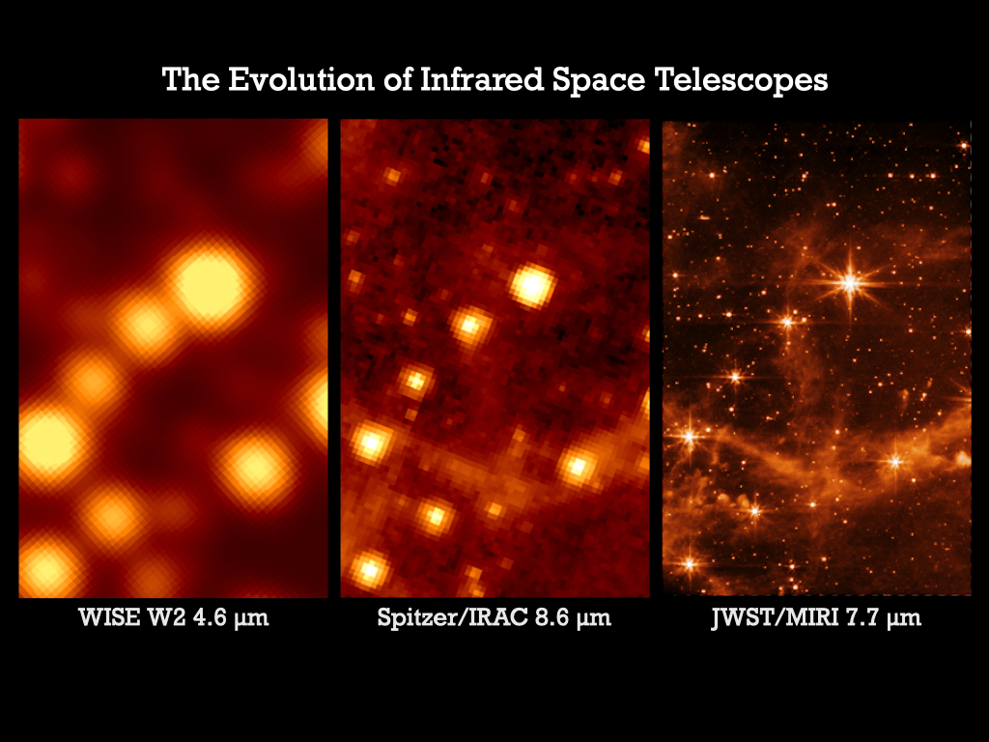
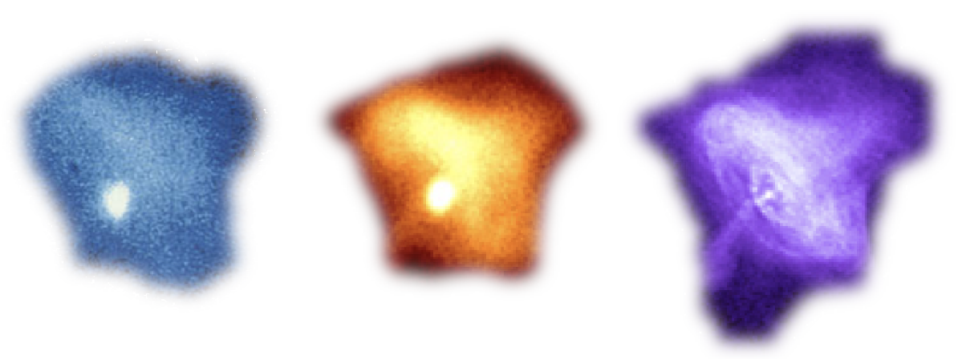
The Hard X-Ray Universe in High-Resolution
Hard X-ray probes photons generated by physical processes in extreme astrophysical environments, from accreting of stellar mass compact objects to shock waves and jets in galaxy clusters
NuSTAR pioneered this field as the first focusing hard X-ray mission in orbit, albeit limited by its ~arcmin half power diameter
An order-of-magnitude improvement in angular resolution will lead to exciting discoveries
Einstein
ROSAT
Chandra

Slide 3

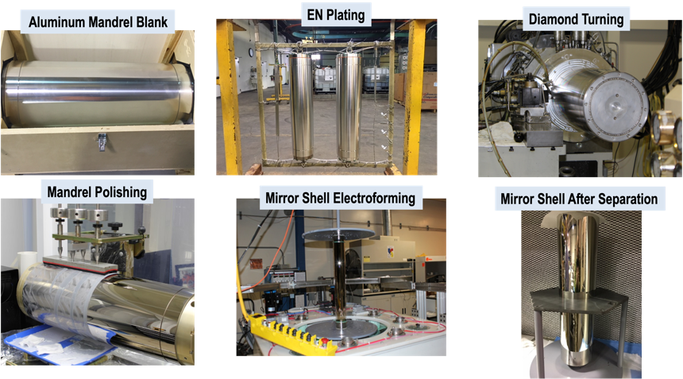

Techonology to achive the goal:
Electroformed Nickel-Cobalt Replicated Optics
Full Shell X-ray Optics
Steve Bongiorno
MSFC
X-ray Group Lead

Slide 4

MSFC X-Ray Mirror Module Performance
MSFC X-Ray Mirror Module Performance
ENR X-Ray Optic Dev at MSFC
First ever focused hard X-ray images of astro sources!
Successful Mass Manufacturing, Coating, Alignment & Mounting
Regularly produce 7 to 8 MMAs and up to 224 mirrors (ART-XC) with predictable flight performance
Mounting & Alignment and mirror fabrication process improvement (ISFM)
Larger diameter MMAs (up to OD 272 mm - IXPE)
Further mirror fabrication process improvement (ISFM)
Larger diam. MMA (OD 444 mm – REDSoX)
HERO Tech Demo & 1st Flight
HERO-2
HERO-4
FOXSI-1
FOXSI-2
SRG ART-XC
HERO-3
HERO-5
HEROES
76”HPD req.
IXPE
REDSoX
FOXSI-3
25” HPD req.
<30” HPD req.
MSFC high-resolution optics are a product of 30 years of mirror development, test, and flight! The HERO Program has been a critical part of this.
FOXSI-4
SuperHERO Balloon
Demo Module
NIF
single small mirror
TBD
Performance GOALS
*All values are for Mirror Module Assemblies (MMAs), with the exception of the NIF optic.
*All values reflect X-ray test measurements or in-flight performance. Not all values are gravity subtracted.

Slide 5
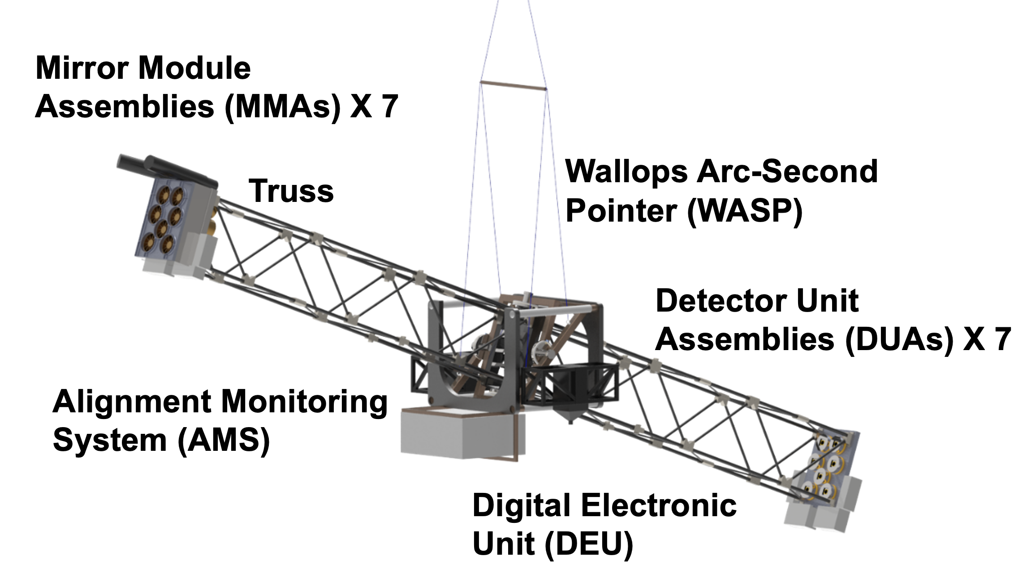
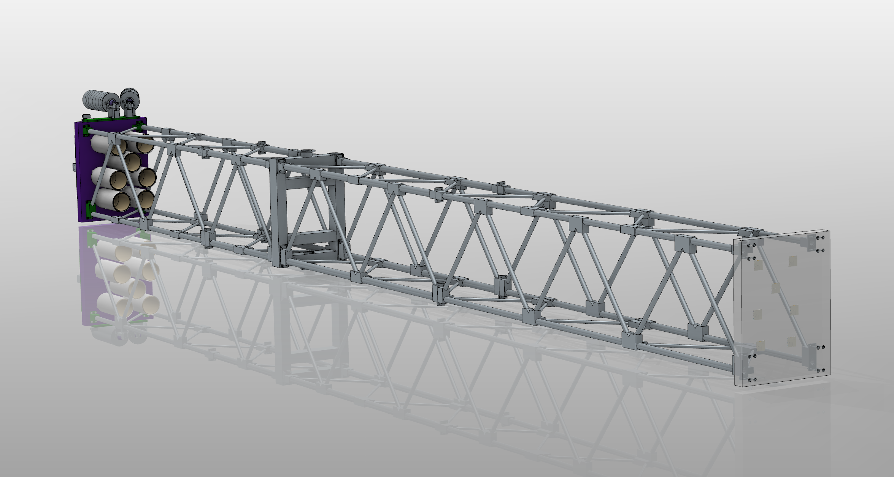
The SuperHERO
Hard X-ray Balloon-
Borne Telescope
Projected by Chien-Ting Chen Chandra Data
Mori et al. 2002, Weisskopf et al. 2012
Successor to the successful HERO/HEROES missions
MSFC NiCo shell X-ray optics with Iridium via RF sputtering with 45 cm² @ 30 keV
Takes advantage of proven technologies from collaborating institutions (WashU, UNH, WFF, Kavli IPMU, & iMAGINE-X)
Mission’s technical goal: 10 arcsec Half Power Diameter (HPD) in the hard X-ray band
The 22nd Meeting of the HEAD AAS 10/13/2025 102.07

Slide 6
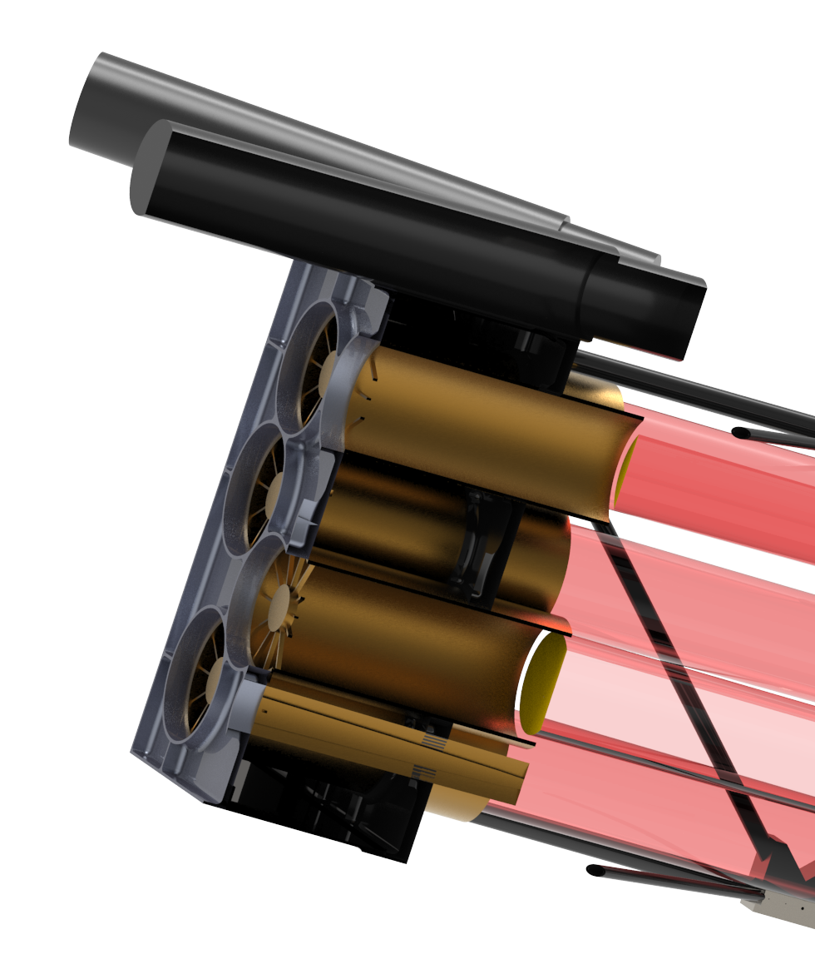
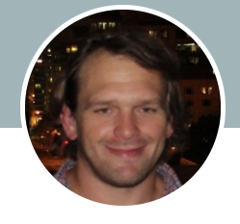
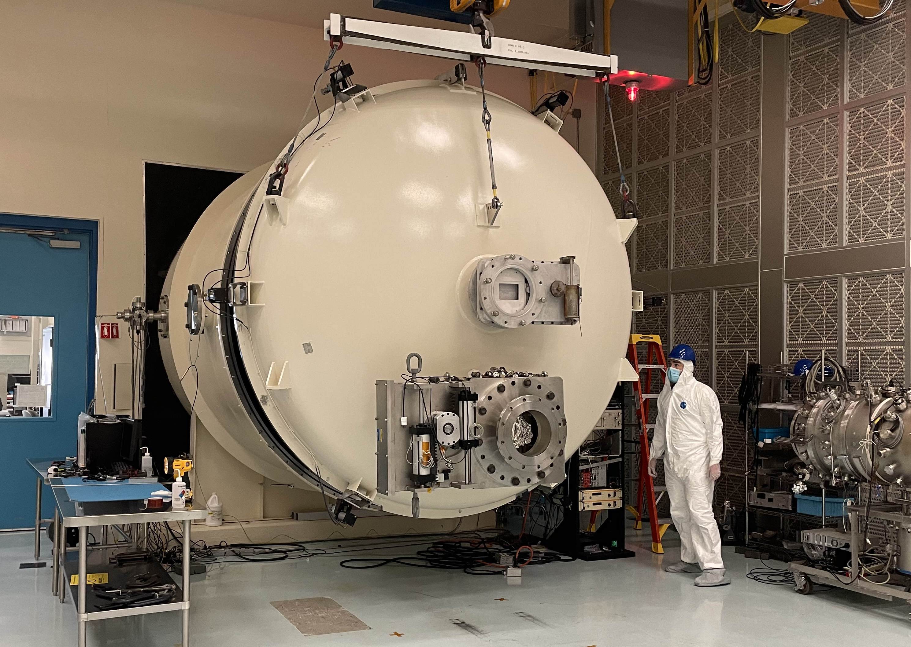
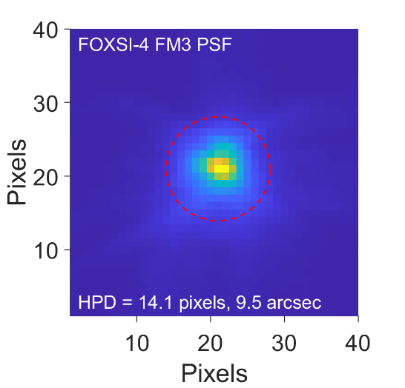
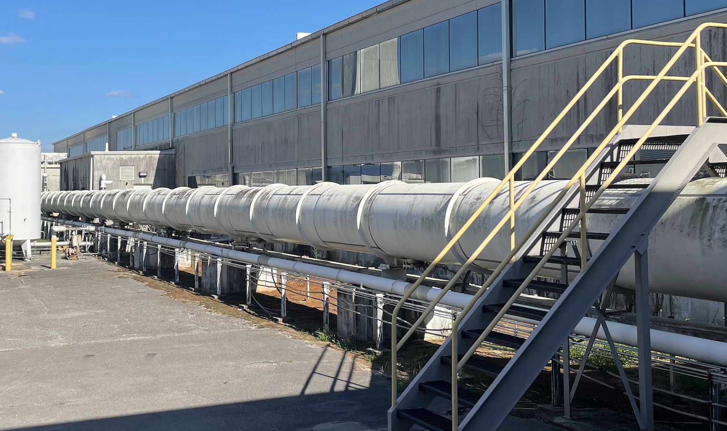
SuperHERO Mirror Module Assembly(MMA)
Seven MMAs, requiring seven replications off of the two super polished mandrels.
MMAs to be enhanced for future missions. Designed to accommodate a total of 5 shells each (100 kg to 200 kg)
Calibration at Marshall 100-meter X-ray Beamline.
Nick Thomas
(PI, SuperHERO/HEROIX)
Marshall 100-m X-ray Beamline
Baumgartner et al. 2023

Slide 7
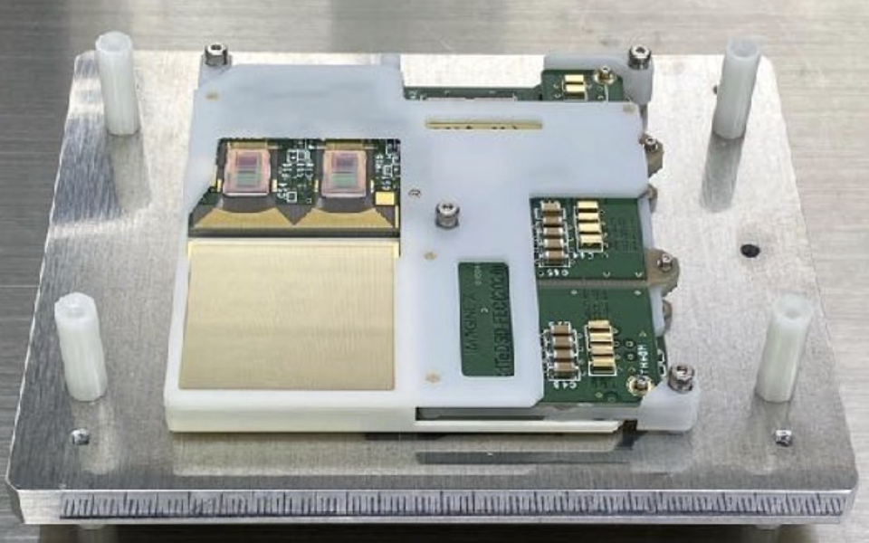
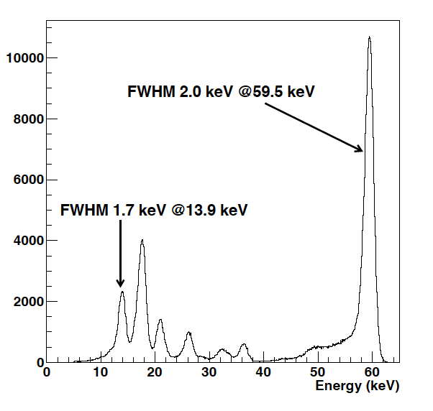
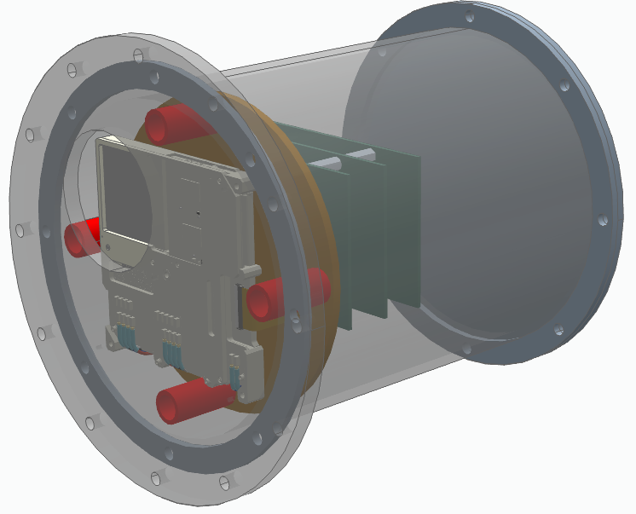
Detector Unit Assemblies
Cadmium-Telluride Double-sided Strip Detectors (CdTe-DSD).
Flown on JAXA/NASA mission Hitomi (Takahashi 2012, Kokubun 2012, Nakazawa 2016, Hagino et al. 2018).
Available commercially through iMAGINE-X Inc. (Takeda 2016).
Optics and detector plate scale well matched
  Eight detectors purchased and delivered.
  1 mm thick, 34 × 34 mm² block of CdTe
  128 platinum cathode and aluminum anode strips applied to the top and bottom of the CdTe block.
  250 μm strip pitch.
  CdTe-DSD operational temperature and bias voltage is –10° (+/- 5 °) C and 250 V.
MSFC designing the Detector Unit Assembly (DUA) to house and provide environmental control during flight.
DUA
Am241
The 22nd Meeting of the HEAD AAS 10/13/2025 102.07

Slide 8
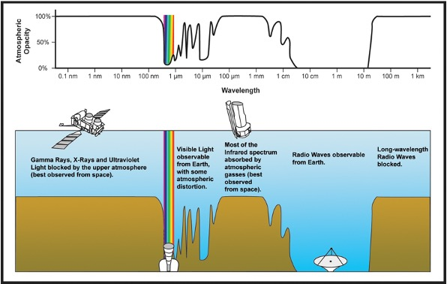
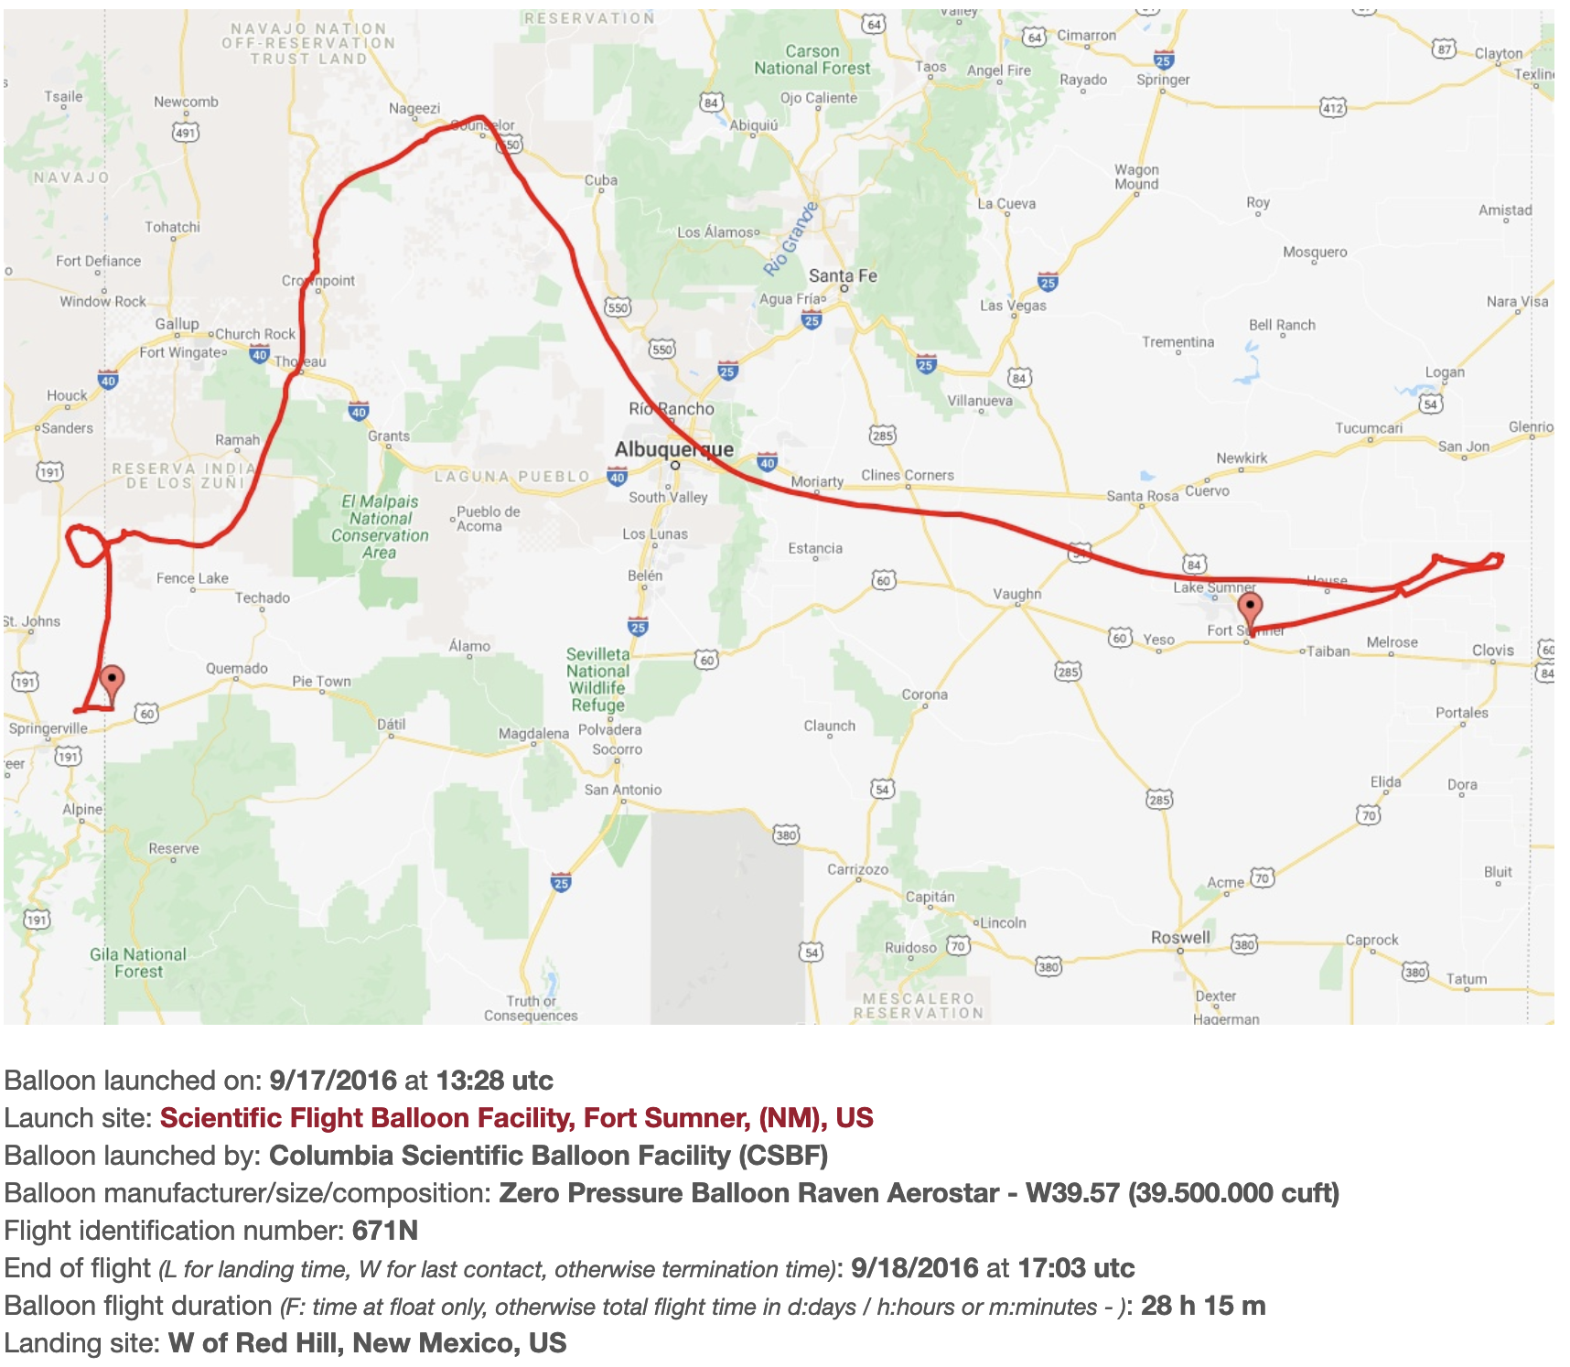
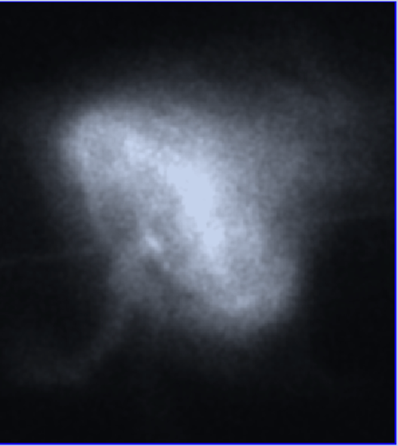
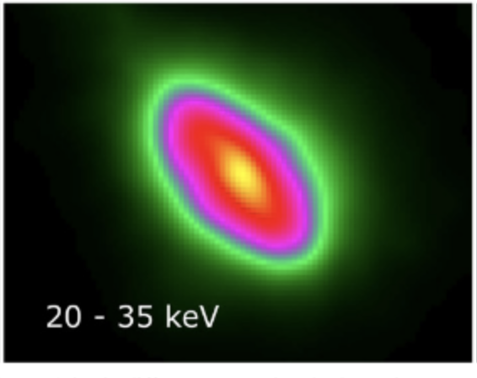
SuperHERO first flight in
September, 2028 or 2029
Turnaround flight, Fort Sumner
Nominally planned for 8 hours.
Crab Nebular — point-source— Crab Nebular — point-source— more Crab or point source observations (weather permitting).
The cost drivers, the mandrels for replicated optics, can be reused for larger-scale missions.
Truss is designed for a future LDB flight with more effective area for enhanced science.
Harrison et al. 2013, Madsen et al. 2015

Slide 9
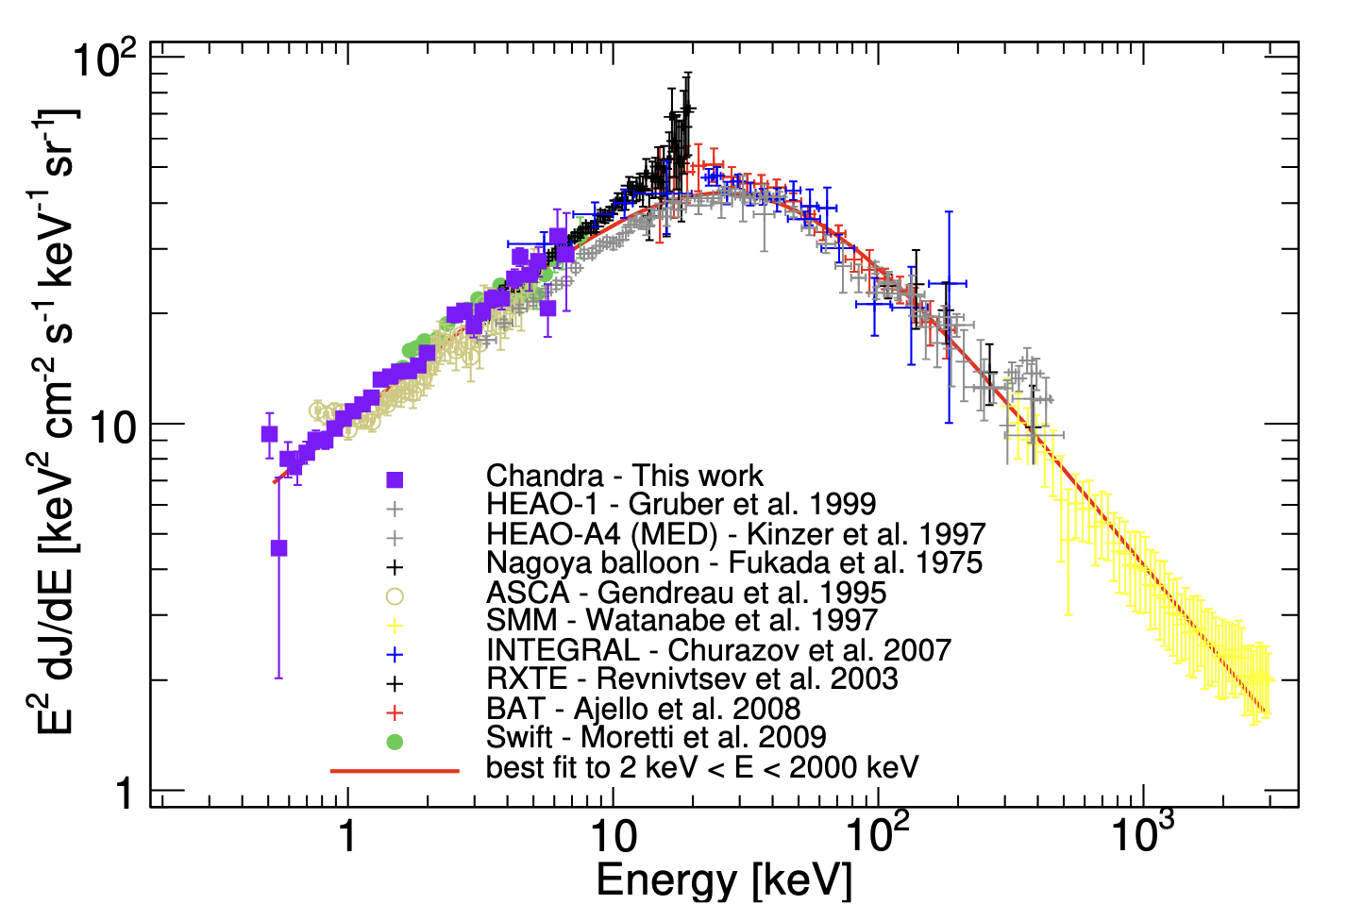
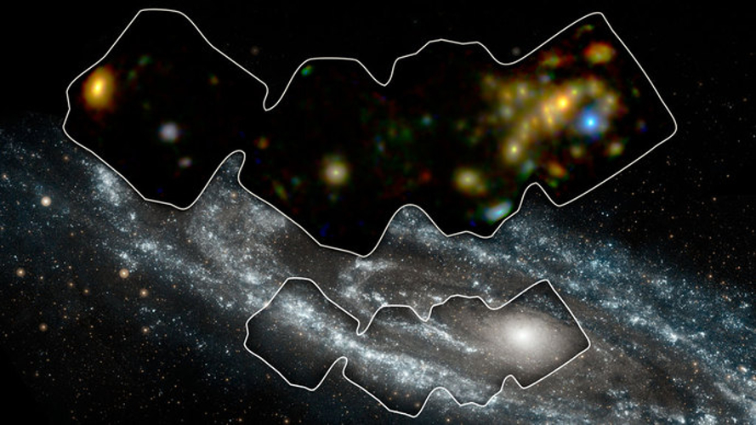
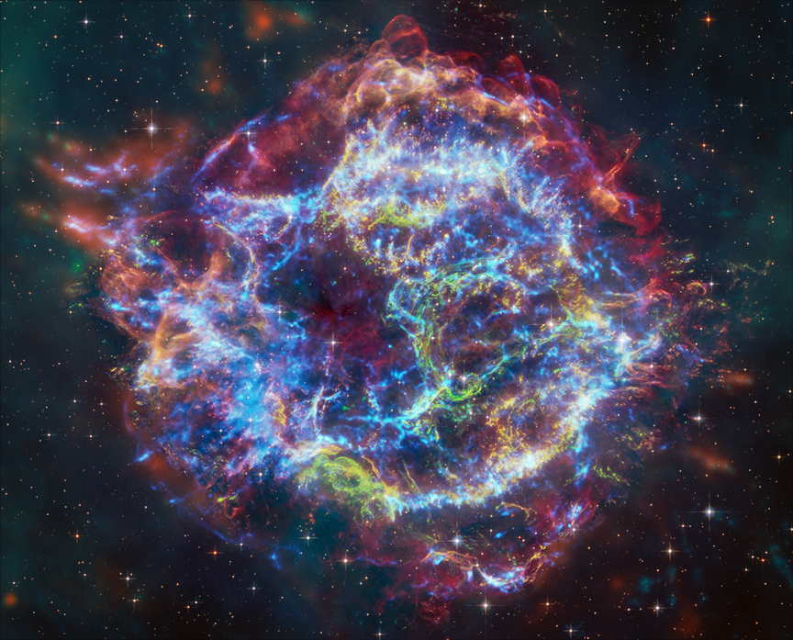
HEROIX MidEx concept
A next-generation hard X-ray observatory with 5 arcsec resolution in ~1-80 keV
  Understanding the dust-enshrouded X-ray population of X-ray binaries and AGN and resolving the Cosmic X-ray Background at its peak of ~30 keV
  Particle acceleration in extreme environments such as shock waves and jets from celestial objects of all sizes
  Accretion physics with broad-band X-ray spectroscopy
  Additional science cases
Capelluti+17
Credit: NASA/JPL-Caltech/GSFC
Astro2020: Drivers of galaxy growth
Astro2020: New windows on the dynamic universe
X-ray: NASA/CXC/SAO; Optical: NASA/ESA/STScI; IR: NASA/ESA/CSA/STScI/Milisavljevic et al., NASA/JPL/CalTech; Image Processing: NASA/CXC/SAO/J. Schmidt and K. Arcand

Slide 10
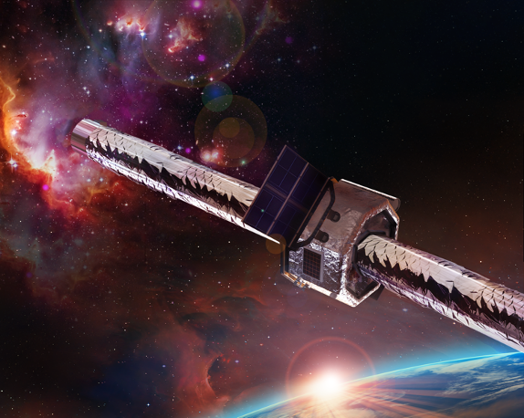
HEROIX baseline mission
5 arcsec half-power-diameter
570 cm² @30keV effective area
12-arcmin FoV
30 shells per mirror module, with 6 mirror modules
~1 to 80 keV bandpass via multilayer coatings
12-meter focal length
SOIPIX + CdTe hybrid detectors — maximizing the effective area for broad-band
Energy resolution 0.8 keV @ 60 keV, comparable with NuSTAR
image credit:
MSFC Advanced Concept Office
See N. Thomas,
2026 SPIE Proceeding

Slide 11
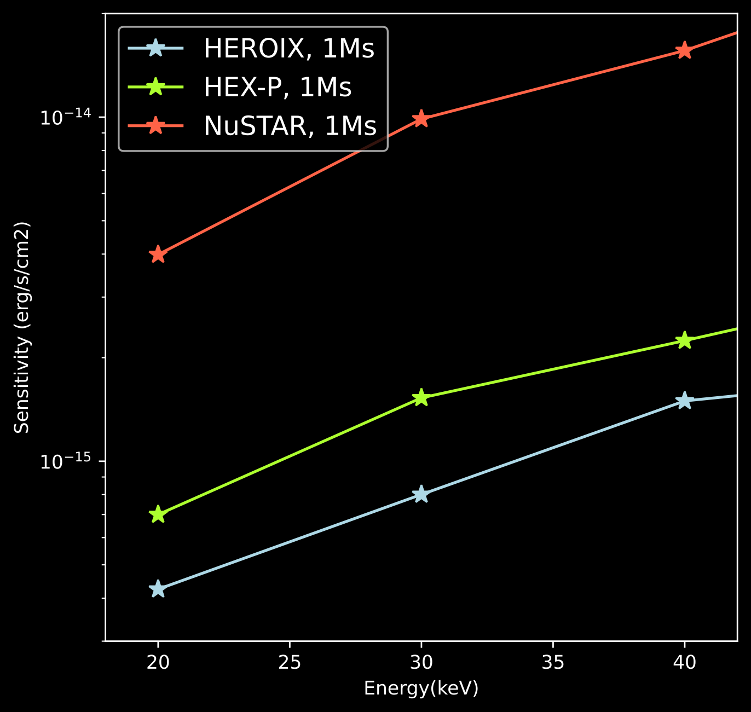
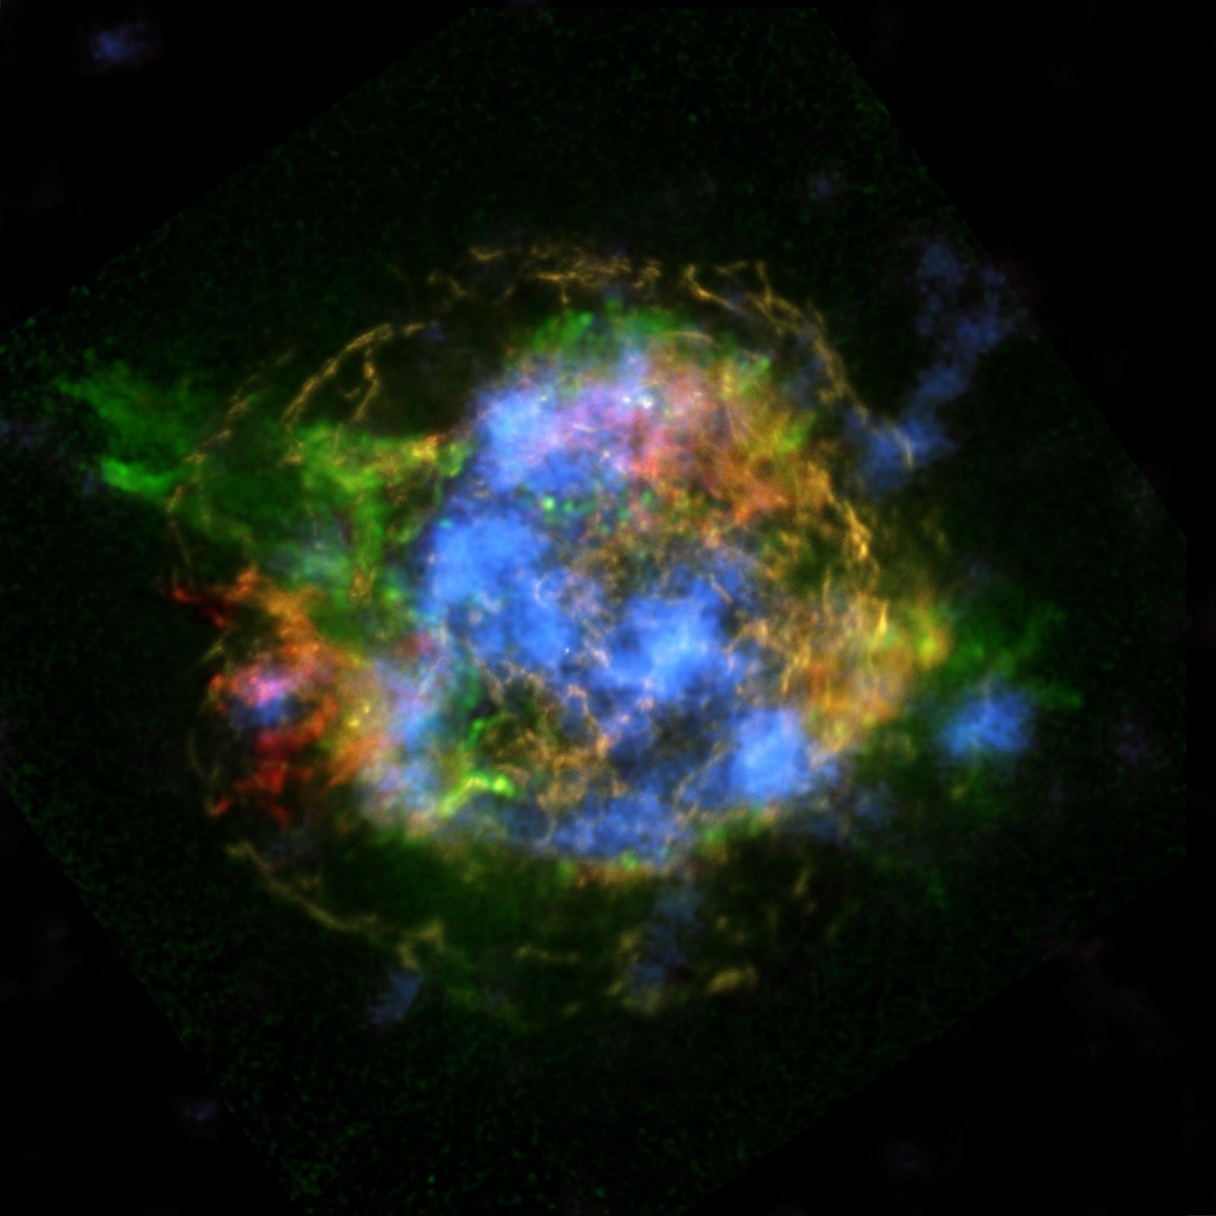
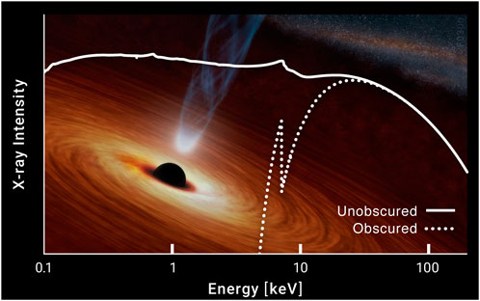
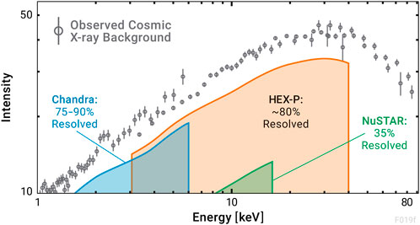


Angular resolution improves sensitivity —
crucial for resolving CXB, studying obscured X-ray sources, and elucidating spatial structures in extended emission
~35% CXB resolved
Grefenstette+16,
NASA/JPL-Caltech/CXC/SAO
>80 % CXB resolved
$$SNR∝\frac{SourceFlux×Time×EA}{\sqrt{BGFlux∗×Time}}$$
Smaller PSF = less background
$→$ better SNR
Garcia+24

Slide 12
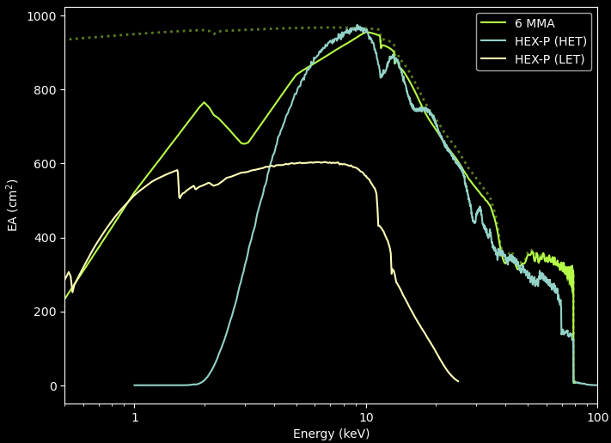
A high angular resolution broad-band observatory for the next decade
Replicated optics technology is efficient for the small-radii shells necessary for hard X-ray photons.
Cost saving from reusing SuperHERO mandrels.
SOIPIX + CdTe hybrid detectors
  Similar to the Hitomi HXI, but replacing Si DSSD with CMOS (Koji Mori et al., 2023).
  < 2 keV quantum efficiency is still in development.
image credit:
MSFC Advanced Concept Office

Slide 13
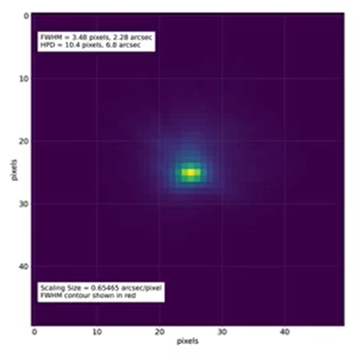
MSFC’s readiness for HEROIX
MSFC's manufactured FOXSI-4 mirror module achieved better than 10 arcsec HPD during beamline calibration.
SuperHERO (APRA, < $10M) technical goal is to demonstrate better than 10 arcsec HPD integrated for the entire observatory during its inaugural flight in the fall of 2028, while mitigating the combined effects of gravity induced error and the thermal environment encountered in stratospheric balloon flight.
In parallel, the MSFC team is developing a dedicated high-resolution optics demonstrator module which aims to achieve 5 arcsec HPD (with gravity subtraction) in a X-ray beamline by late 2027.
HEROIX manufacturing requirements are similar to IXPE and SuperHERO, requiring the use of existing MSFC hardware and capabilities.
MMA 10
FWHM 3.2”
HPD 8.5”
(with gravity)
Wayne H. Baumgartner, Stephen Bongiorno, Jeffery Kolodziejczak, Srikanth Singam, Danielle Gurgew, Chet Speegle, David Banks, Patrick Champey, Nicholas Thomas, C. Grant Davis, "High resolution full shell replicated x-ray optics for FOXSI-4," Proc. SPIE 12679, Optics for EUV, X-Ray, and Gamma-Ray Astronomy XI, 126790C (6 October 2023); https://doi.org/10.1117/12.2680486

Slide 14
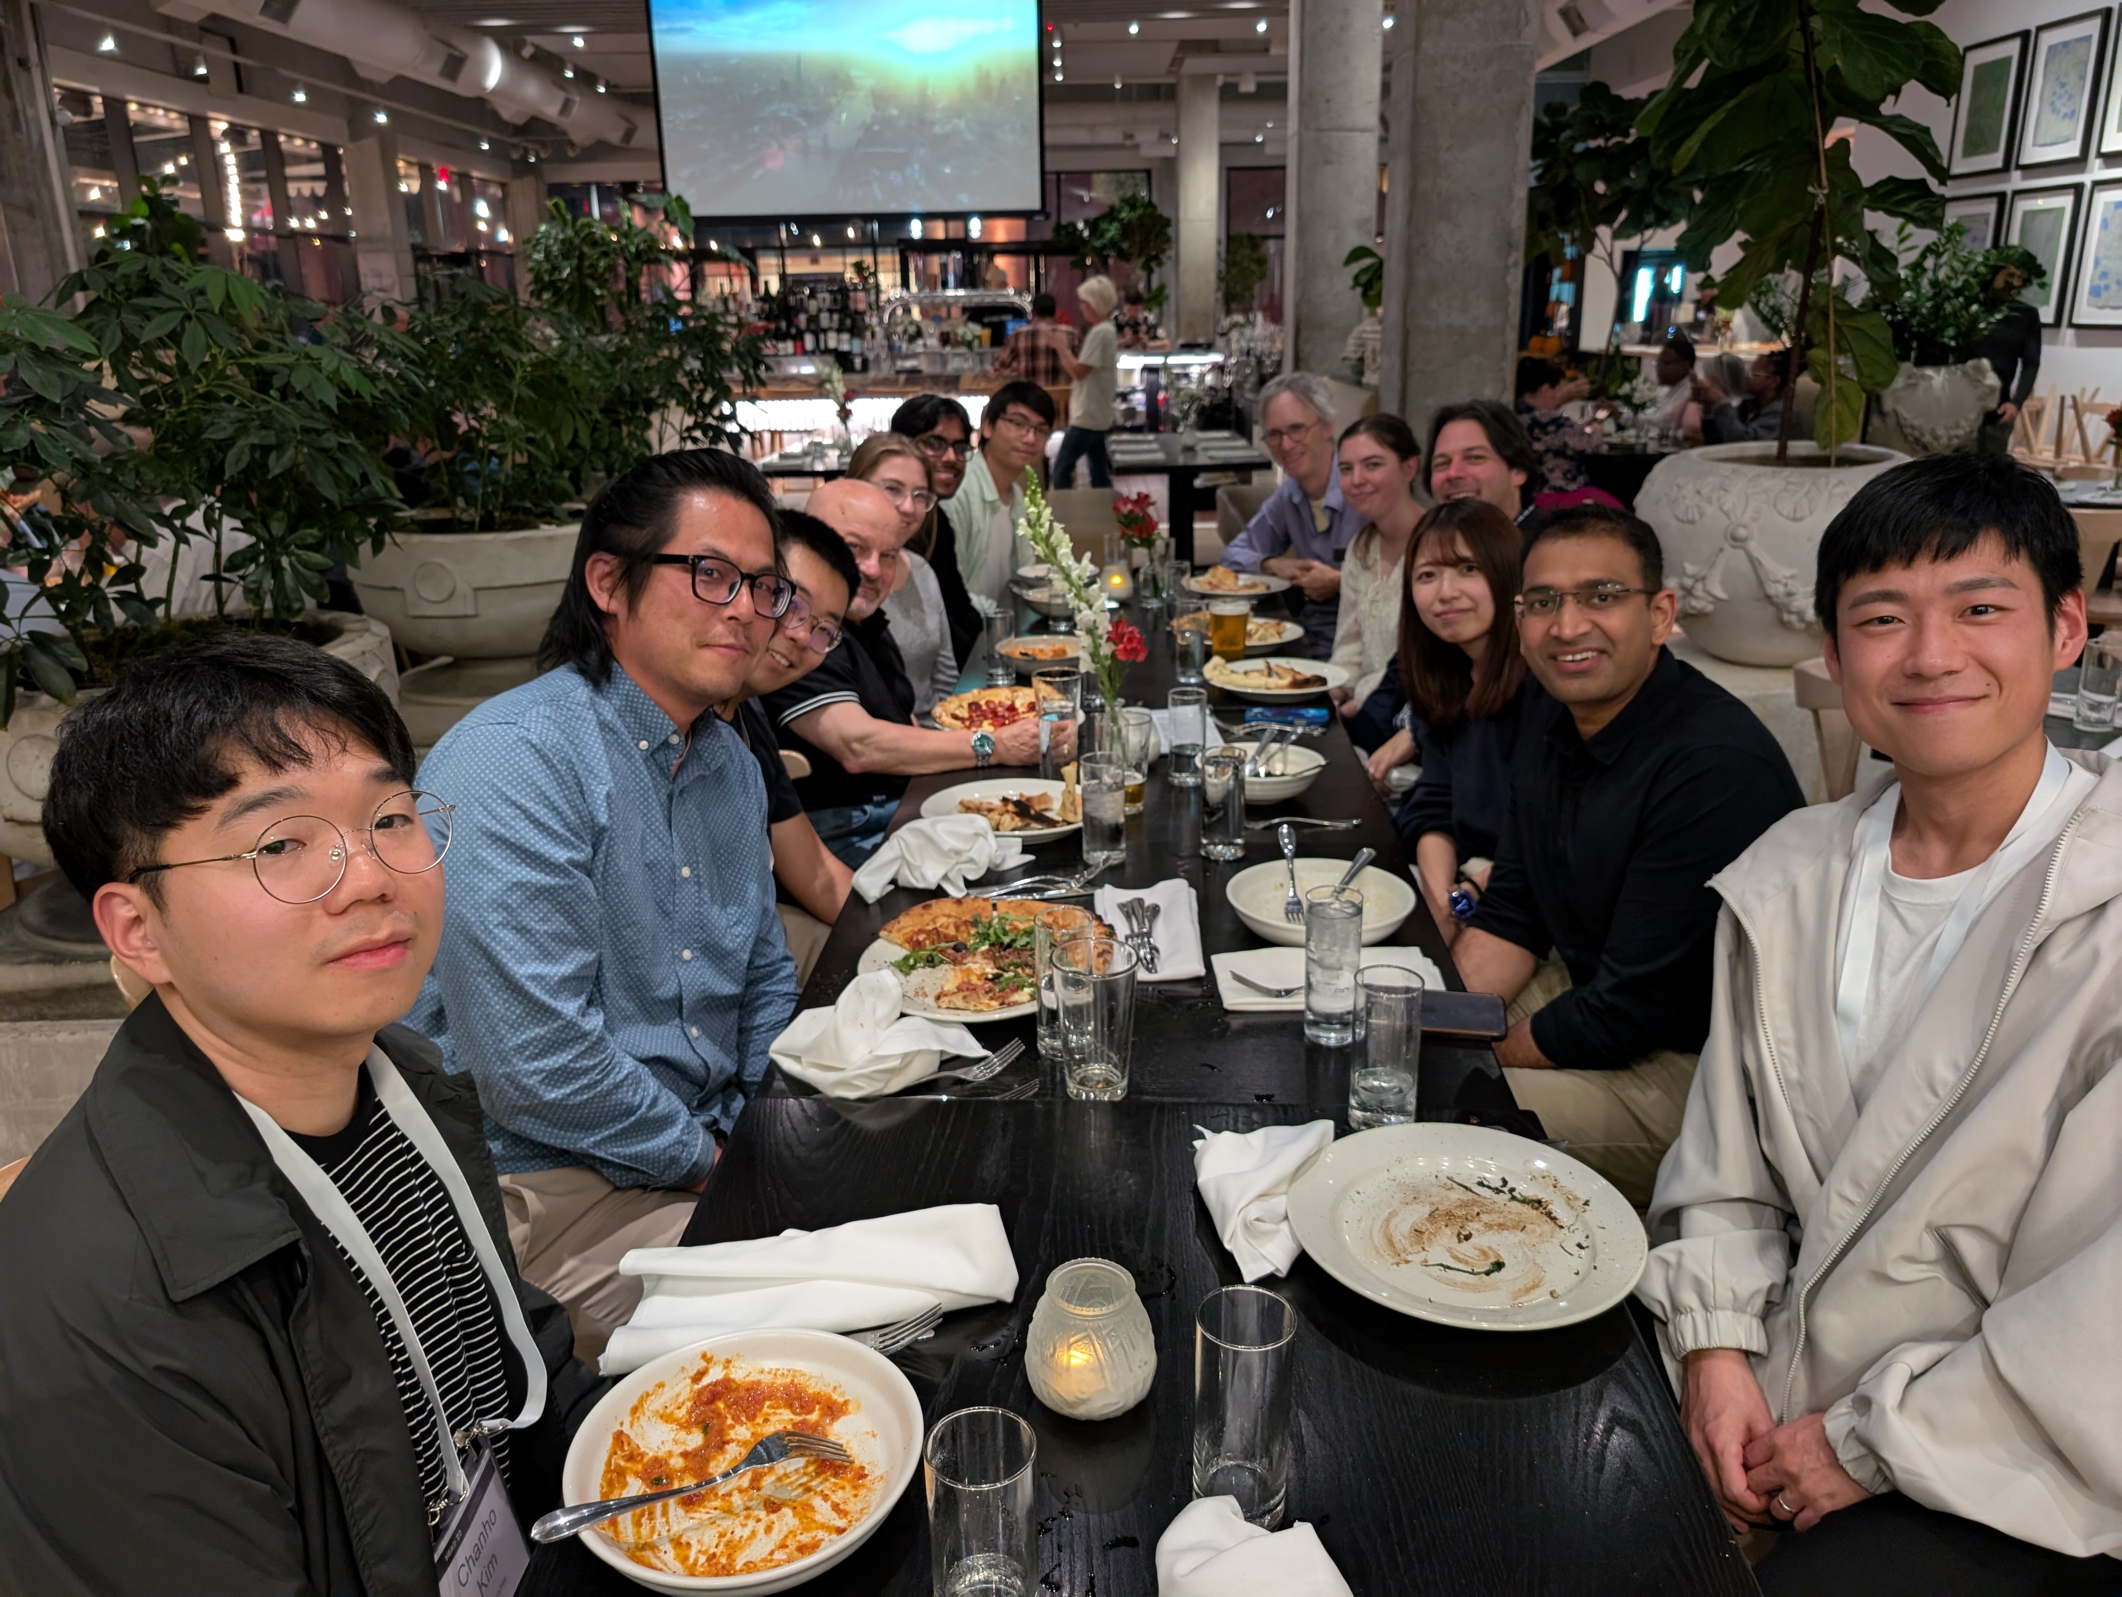
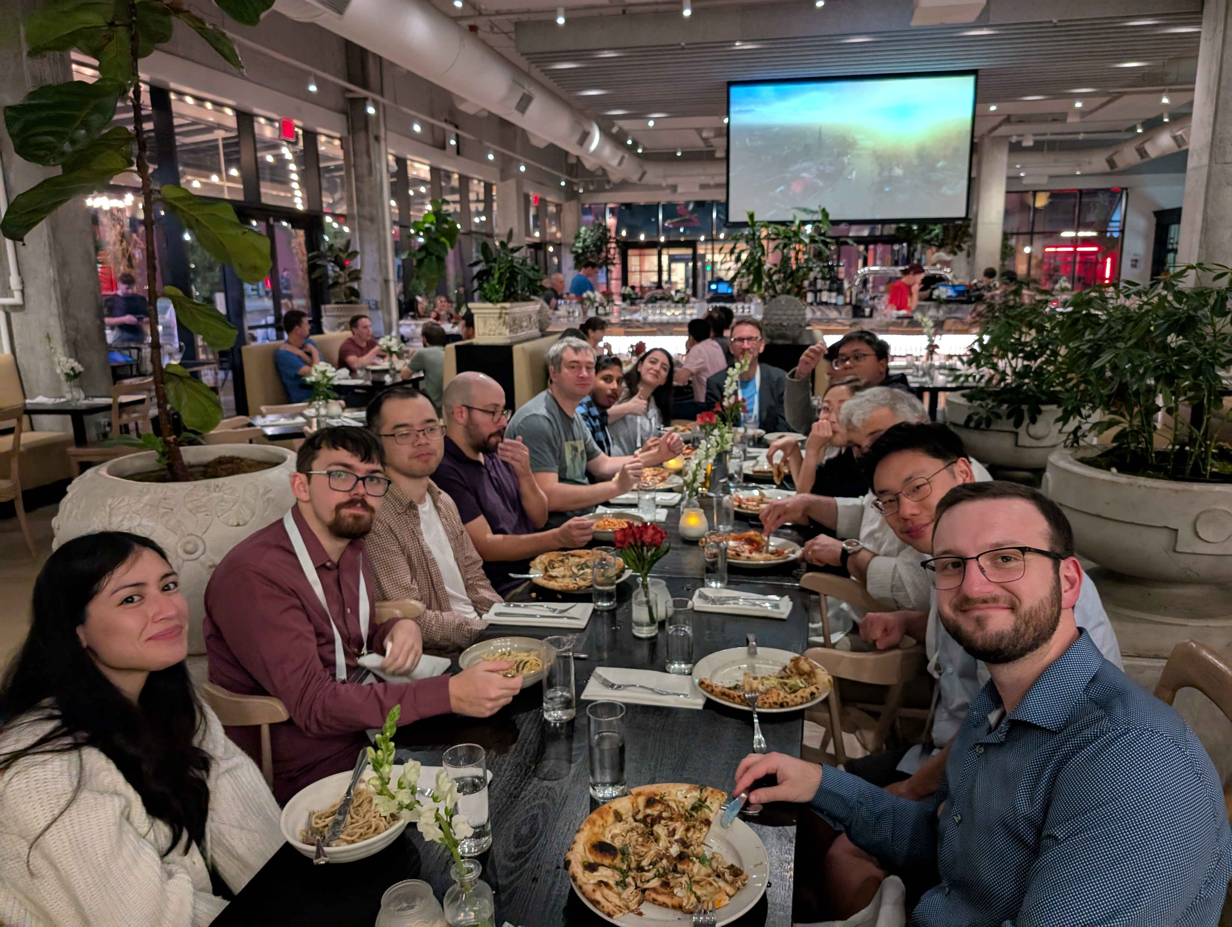

Status updates
PI: Nick Thomas; PS: Chien-Ting Chen
Optics Lead: Steve Bongiorno, Coating: Danielle Gurgew; Optics design: Panini Singham
Science Team:
  Stefano Bianchi, Francesca Civano, Paolo Coppi, Paul Draghis, Steven Ehlert, Ioannis Liodakis, , Lebani Malick, Kaya Mori, Koji Mori, Kazuhiro Nakazawa, Dave Pooley, Fabio Pacucci, Yoshihiro Ueda, Zorawar Wadiasingh, Dan Wilkins
  Approximately > 100 people in the current mailing list, 70 have joined the Slack channel.
  We had a first in-person meeting at the 2025 HEAD, with a mixture of the SuperHERO and HEROIX team members
  ~Bi-weekly science discussions since 2026.
  Working on white papers and science traceability matrix.
Please consider joining the HEROIX science team!

