Slide 1
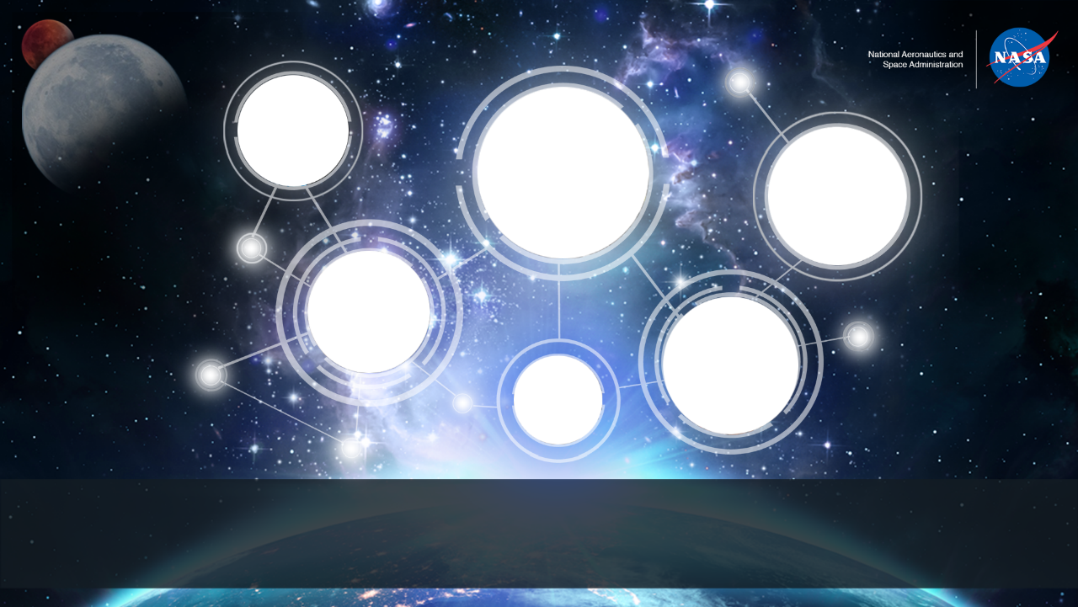
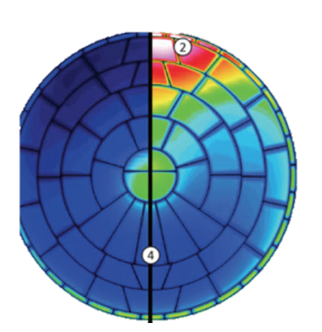
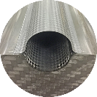
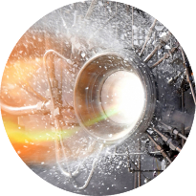
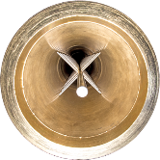
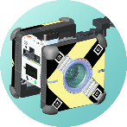
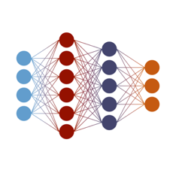
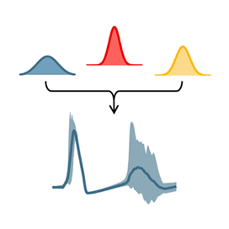
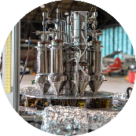

Advances in Design Capabilities for Planetary Missions from the NASA Entry Modeling and Instrumentation Portfolio
Justin Haskins,¹ Aaron Brandis,¹ Tom West,² Monica Hughes²
¹NASA Ames Research Center
²NASA Langley Research Center 23rd International Planetary Probe Workshop | June 23rd, 2026

Slide 2
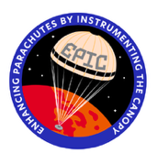
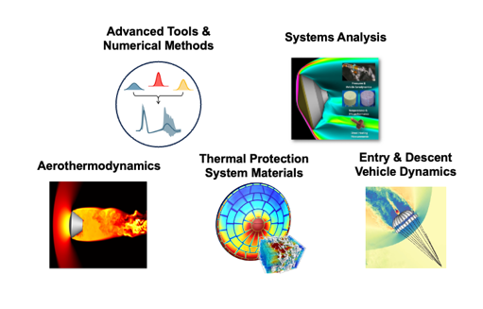
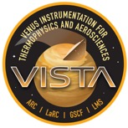
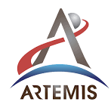
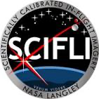
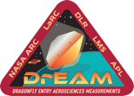


NASA STMD Entry Modeling & Instrumentation Portfolio (EM&I)
EM&I is the only NASA portfolio that builds and validates the cross‑cutting flight technologies, models, and tools needed for EDL across missions
Delivers ground‑to‑flight traceability with quantified uncertainty
Reducing mission risk and facilitating faster design iteration
Enabling new entry and descent system architectures
Flight Test and Instrumentation
Entry Systems Modeling
Entry System Instrumentation
EM&I provides EDL capabilities and expertise resulting from decades of mission-focused development – there is no viable industry counterpart

Slide 3
Capability Outline by Mission
EM&I modeling impacts on Dragonfly (Titan) will be used to highlight modeling capabilities generally useful for EDL missions:
  Aeroheating of Detailed Geometries
  Capsule Dynamics
  Parachute Dynamics
Capability infusion plans for new and emerging missions will also be discussed:
  DAVINCI (Venus)
  Outer Planets (Uranus and Saturn)

Slide 4
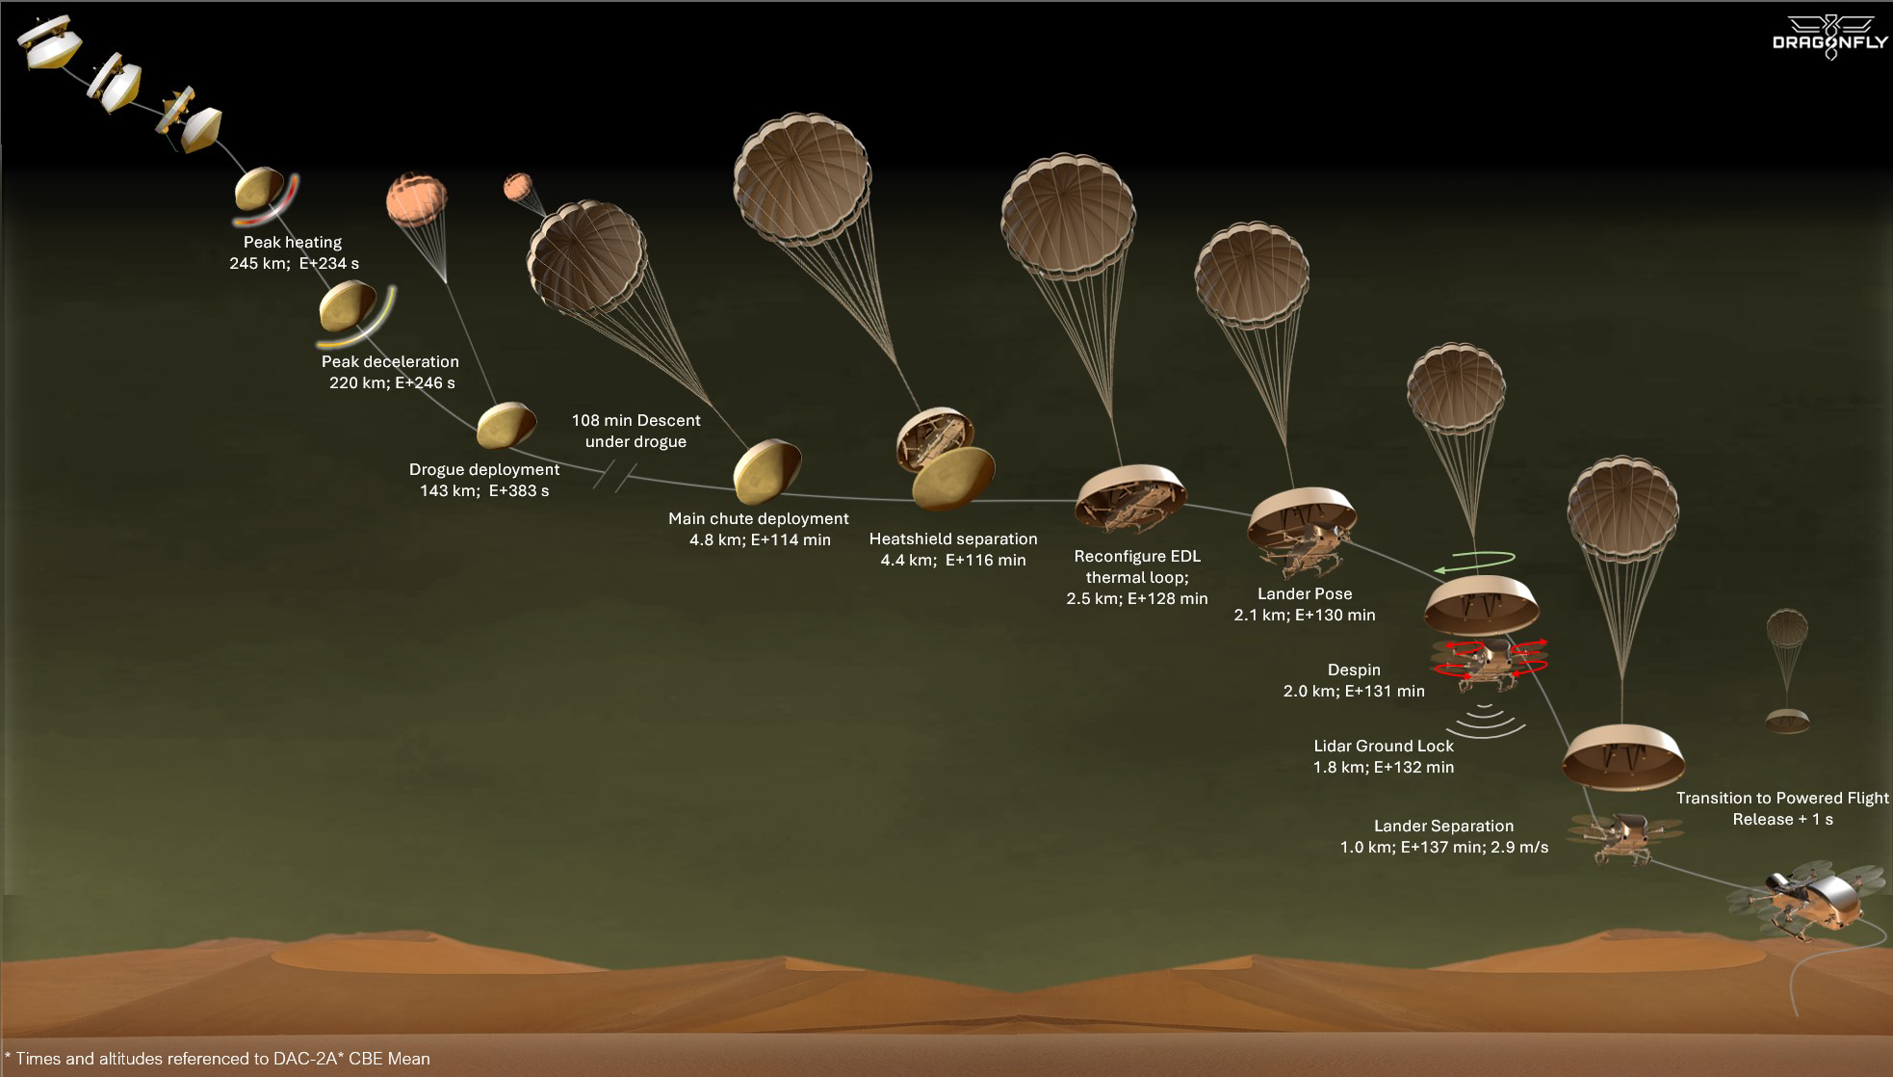
Improved Aeroheating Tools
Highlighting EM&I Capability Infusion for Dragonfly
DrEAM Instrumentation Suite
Dynamic Stability Characterization
Dynamics under Drogue
EM&I partnered with Dragonfly to infuse and demonstrate new capabilities for mission design – mitigation efforts for 5 of 10 major EDL mission risks supported using these developments

Slide 5
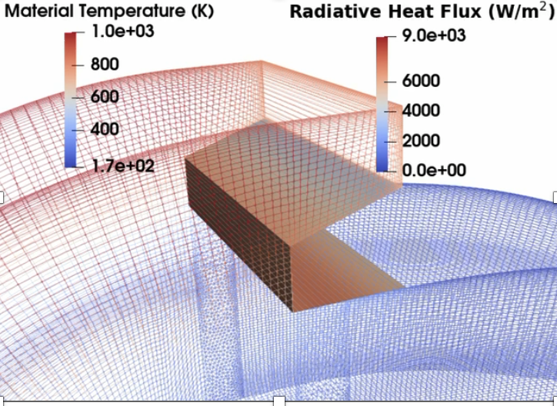
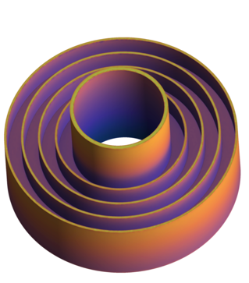
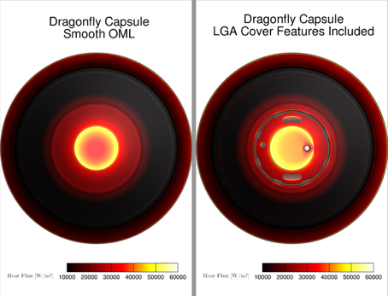
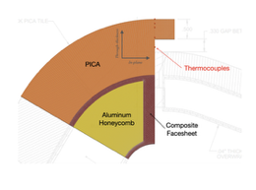
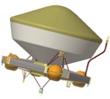
Aeroheating of Detailed Geometries
Dragonfly aeroshell has detailed structural features – capabilities for efficient, multiphysics aeroheating analyses reduced design complexity and mitigated aeroheating risks
Design Impact: Coupled flow-material-radiation analyses mitigated need to protect main seal with complex, protective heatshield ‘tooth’
Risk Mitigation: Improved efficiency radiation and CFD algorithms mitigated aeroheating concerns for backshell low-gain antenna (LGA)
‘PICA-tooth’ Shoulder Heating with Coupled Radiation, Flow, and Material Response (Ares Code)
LGA Heating with Coupled Tools (NERO Radiation Code)
LGA Impact on Heating of Full Aeroshell (HyperSolve CFD Solver)
POC: Olivia Schroeder, Amal Sahai, Joey Schulz, Kyle Thompson, Prakash Shrestha

Slide 6
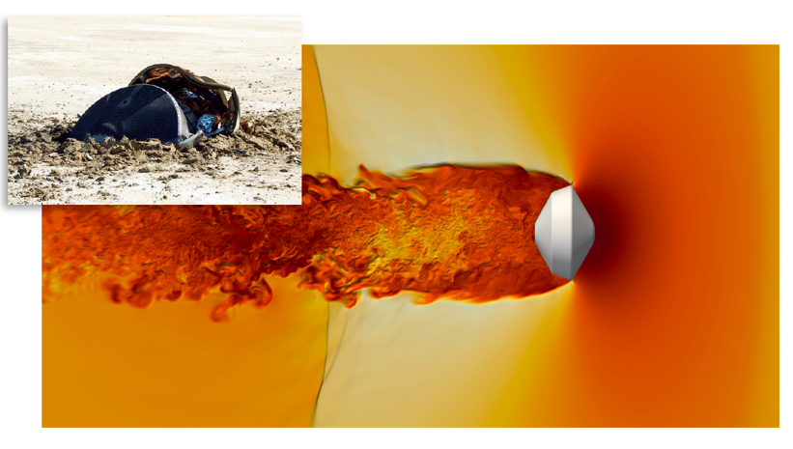
Vehicle Dynamics
Dragonfly poses unique challenges for vehicle dynamics that have not been faced by previous missions – efforts underway to drive down mission risk
Titan atmosphere reaches a higher altitude, is colder, and denser near the surface compared to Mars
Disk-gap-band supersonic drogue parachute 6 minutes after entering the atmosphere at a target Mach number of 1.4 to 1.5
Vehicle will decelerate under drogue for unprecedented > 100 minutes!
Genesis heritage aeroshell (basis for Dragonfly) is known to be dynamically unstable in certain conditions
Genesis Impact and CFD of Dragonfly Capsule

Slide 7
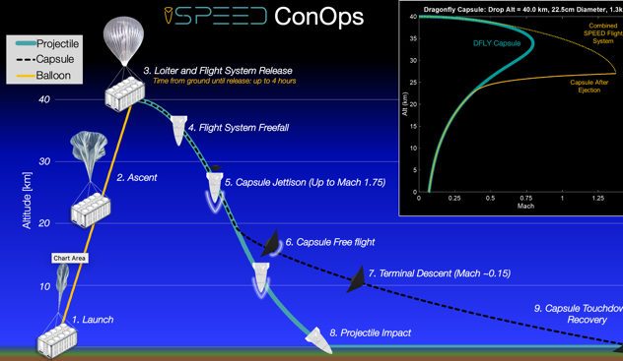
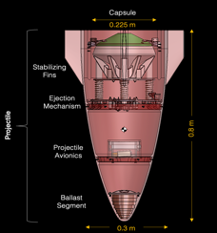
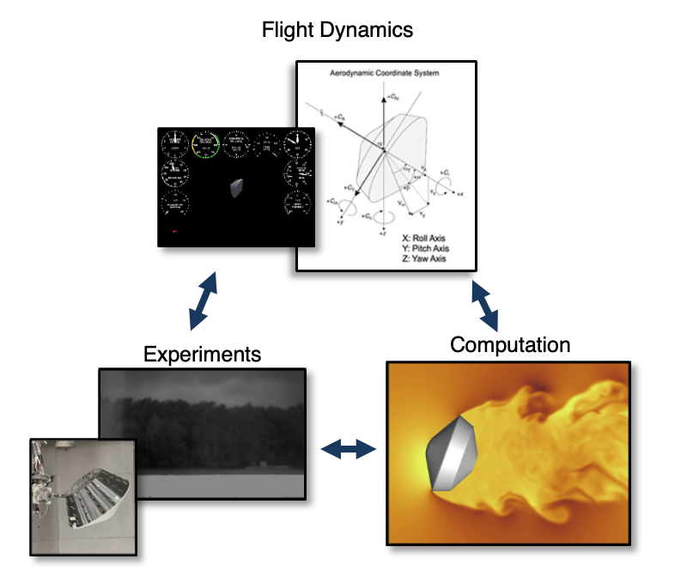
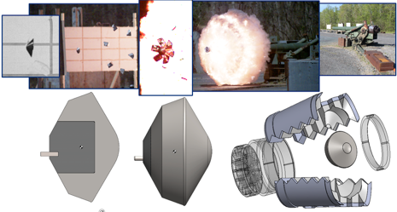

Vehicle Dynamics - DAWG
The Dynamic Analysis Working Group (DAWG) is working to fuse theoretical, computational, and experimental approaches for dynamics to better predict stability
Current work to fill key missing low-supersonic data – LaRC wind tunnels, SPEED drop tests, Aberdeen testing – to reduce into improved model description near drogue deploy
Longer term aim is to reformulate dynamic stability equations for improved accuracy
Three-pronged DAWG Approach to Stability
Collaborative Dragonfly-NESC-DAWG Aberdeen Ballistic Range Testing
SPEED Concept of Operations (Stratospheric Projective Experiment in Entry Dynamics)
POCs: Quincy McKown, Mark Schoenenberger, Ben Libben, Hannah Alpert

Slide 8
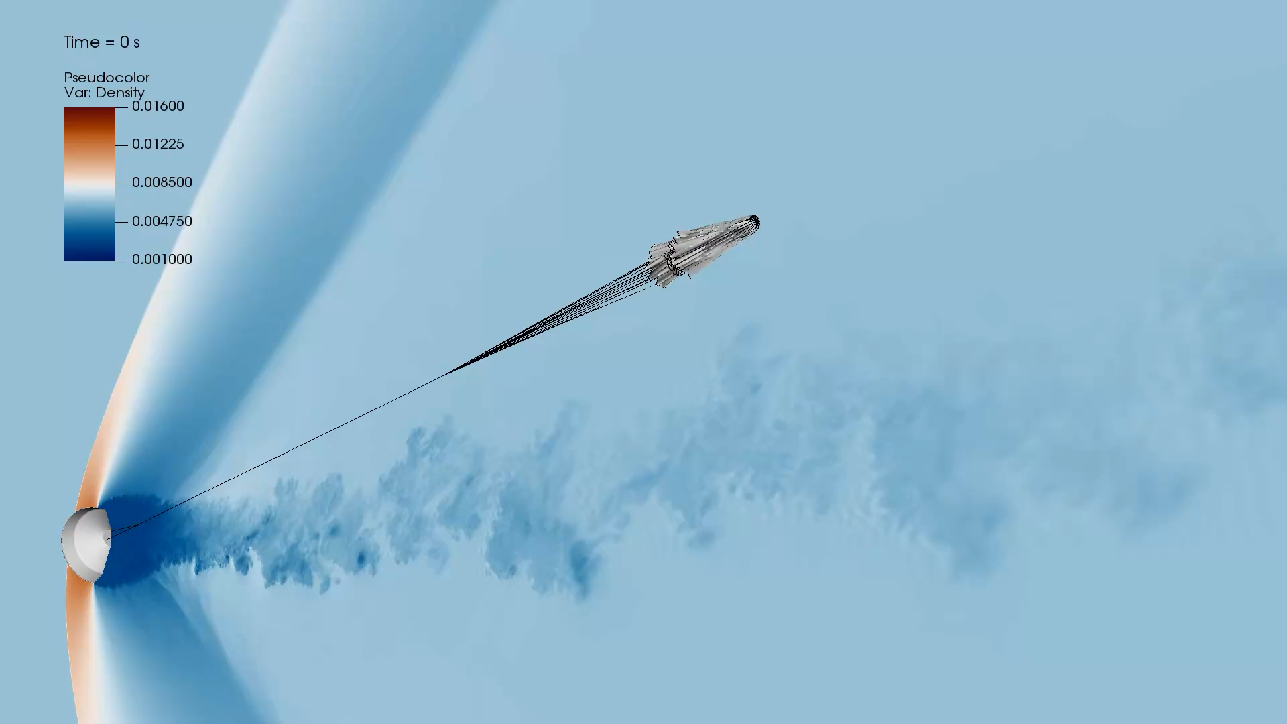
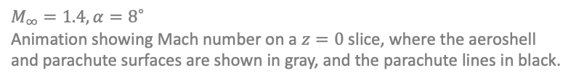
Parachute Dynamics
Capabilities to simulate coupled drogue deploy and aeroshell dynamics in development
Simulation of Dragonfly Drogue Deployment (LAVA solver)
$$M_{∞}=1.4, α=8^{∘}$$
Animation showing Mach number on a $z=0$slice, where the aeroshell and parachute surfaces are shown in gray, and the parachute lines in black.
POCs: Francois Cadieux, Michael Barad

Slide 9
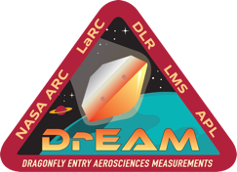
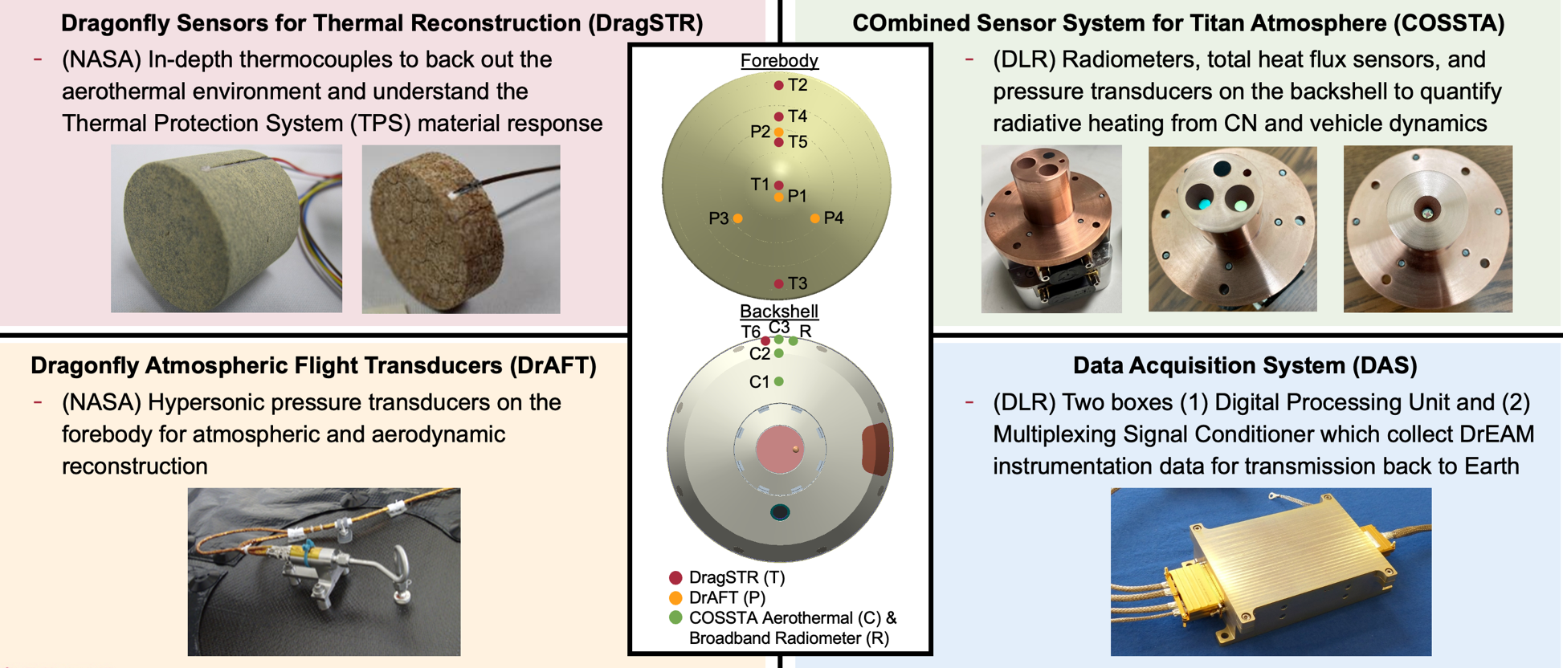
Dragonfly Entry Aerosciences Measurements (DrEAM) Instrumentation Suite
DrEAM Instrumentation Bridges Aeroheating and Dynamics
POCs: Helen Hwang & Aaron Brandis
Notes:
Update figure….

Slide 10
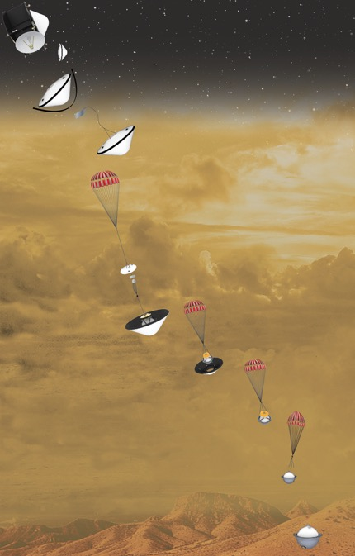
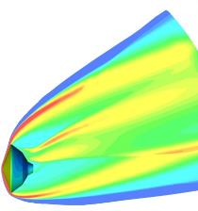

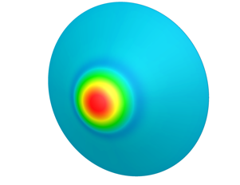
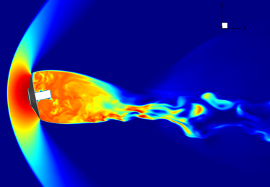
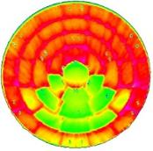
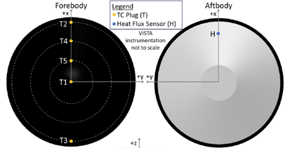






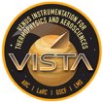
Mission Infusion: DAVINCI (Venus)
Venus offers several challenges for EDL, the entry conditions are extreme, leading to the development of new and novel EDL technologies.
Benchmark Radiative Heating
Radiative heat flux may be dominant for Venus entry. Shock tube data for CO₂ atmospheric entry is being generated for model validation.
Capsule Dynamic Behavior
Free-flight CFD can be used to estimate drag as a function of the trajectory to minimize descent time for Venus descent. (ADEPT shown)
Uncoated
Roughness Heating Augmentation
Models for roughness heating are important for Venus entry and largely empirical. EM&I is developing roughness heating augmentation models for both tiled and monolithic TPS.
Comparison to Flight Data
EM&I will provide entry instrumentation for the DAVINCI capsule through the VISTA project to improve entry modeling in CO₂ environments.
W/cm²
4000
3000
2000

Slide 11
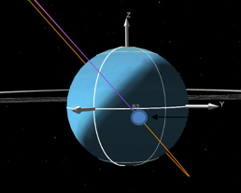
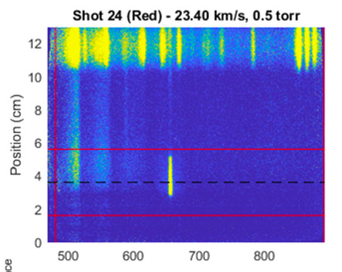
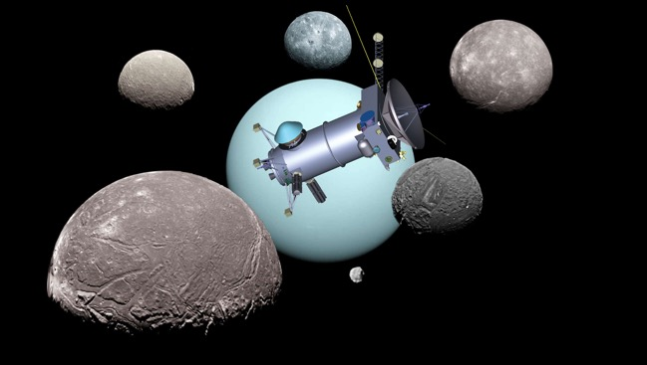
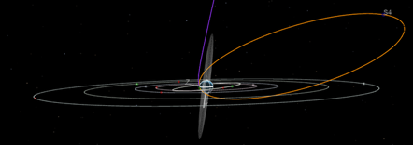
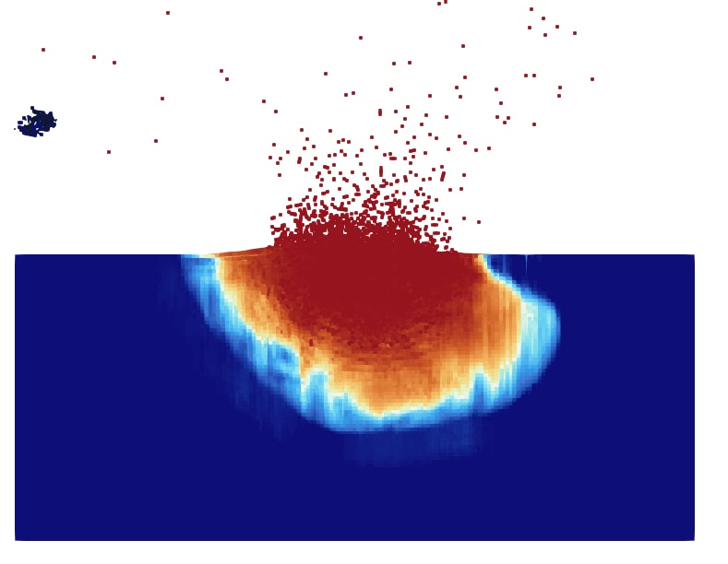
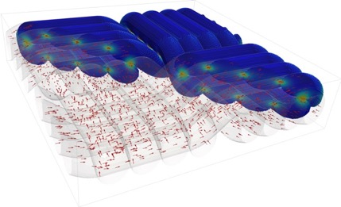
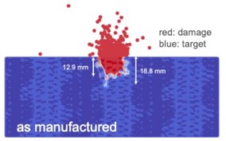
Mission Infusion: Outer Planets (Saturn, Neptune, Uranus)
Missions to outer planets pose several EDL challenges including the largest heat fluxes of our solar system, multi-destinations within one mission, and new TPS materials.
Radiative Heating & Kinetics
Radiative heat flux has large uncertainties for H₂/He atmospheres. Shock tube data for H₂/He atmospheric entry is being generated for model refinement.
Launch to Landing GN&C
Coupled GNC (POST2) and trajectory (MONTE) solver provides insights to multiple mission concepts.
Fracture & Failure of Woven TPS
Developing models for TPS fracture and failure modes to improve reliability prediction and risk reduction for extreme entries.
Advancing Woven TPS Thermal Models
EM&I is developing woven TPS (e.g., HEEET) material models to quantify thermal uncertainties and aid design.
Notes:
Tom

Slide 12
Summary
EM&I seeks to develop new modeling and simulation capabilities for EDL, validated through ground and flight testing
Value of incorporating improved capabilities into missions demonstrated through partnership with Dragonfly
Future activities will be planned as the mission landscape evolves:
  Mars, Outer Planets, Sample Returns, Venus missions

Slide 13
Summary of Tools
Icarus | Material Response | Limited Distribution
Ares | Multi-physics Coupling | US Distribution
PATO | Material Response | Open Source
PuMA | Micro-Material Response | Open Source
arcjetCV | Arc Jet In Situ Analyses | Open Source
SPARTA | Gas-Surface Interactions | Open Source
NEQAIR | Radiation | NASA Software
NERO | Radiation | To Be Released
HARA | Radiation | NASA Software
MPEC | Quantum Chemistry | NASA Software
LAURA | CFD | NASA Software
HyperSolve | CFD | NASA Software
NASA Software: https://software.nasa.gov/
Contact for More Info: justin.b.haskins@nasa.gov, aaron.m.brandis@nasa.gov
Notes:
BEAST… TOMATO… facilities… EAST, ARCTRON,

Slide 15
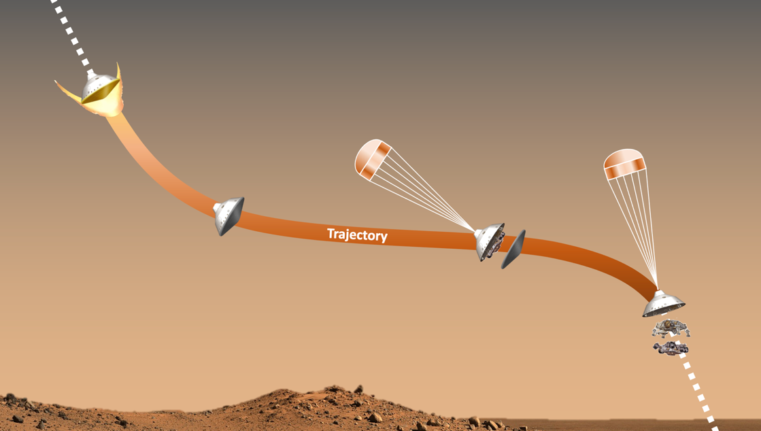
Entry, Descent, and Landing (EDL) Challenges
EDL is small portion of mission timeline but among the largest risks
EDL is a multi-stage process unique to mission and destination
Each stage presents challenges – high velocity, large thermal gradients, and complex maneuvers
Test-as-you-fly is usually not feasible – validated models required for ground-to-flight traceability
Mars2020 Simplified Entry & Descent
Entry Heating
Aerodynamic Heating
Radiative Heating
Thermal Protection System (TPS) Response
Parachute Deployment & Descent
Parachute Stability & Dynamics
Guidance, Navigation & Control
Hypersonic Aero-Maneuvering
Vehicle Dynamics Stability
Guidance, Navigation & Control

Slide 16
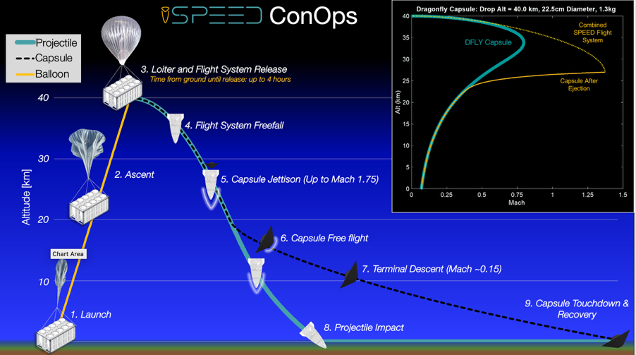
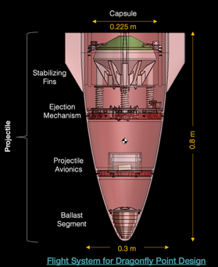
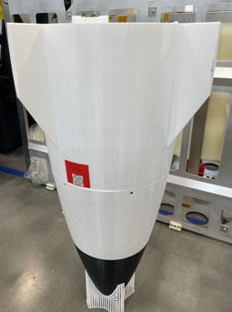
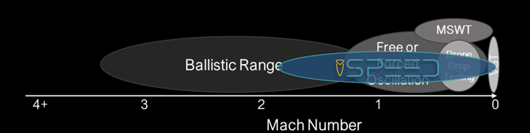
Vehicle Dynamics - SPEED
The Stratospheric Projectile Experiment of Entry Dynamics (SPEED) is low-cost flight test platform to provide free flight dynamics
SPEED allows testing at Transonic Mach where ground facilities have no mutual overlap – verification of ground tests
First flight test with Dragonfly-like capsules is slated for later this summer - data will be leveraged in DAWG activities to complement existing databased
SPEED Projectile and Mach Span
POCs: Ben Libben, Hannah Alpert, Kenny McAfee

Slide 17
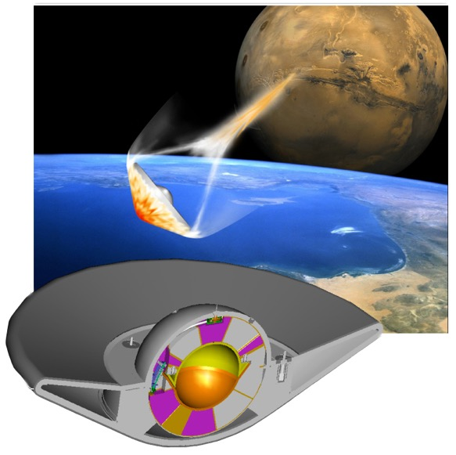



Mission Infusion: Sample Returns (Earth)
Sample returns involve Earth re-entries that require robust TPS materials and understanding of air environments at high-velocity. Weave/GN&C development needs overlap with Outer Planets.
High-Speed Air Radiation
First of their kind databases for backshells and high velocity radiation have been developed. Radiation validated with shock tube data.
Launch to Landing GN&C
Coupled GNC (POST2) and trajectory (MONTE) solver provides insights to multiple mission concepts.
Fracture & Failure of Woven TPS
Developing models for TPS fracture and failure modes to improve reliability prediction and risk reduction for extreme entries.
Advancing Woven TPS Thermal Models
EM&I is developing woven TPS (e.g., HEEET) material models to quantify thermal uncertainties and aid design.
Mars Sample Return – Earth Entry System
Notes:
Tom

Slide 18









EM&I Stakeholder Capability Infusion
EM&I collaborates extensively to accelerate capability development and infusion
External Collaborators
NASA Project and Government Team
Spaceflight Projects and Missions
30+ Major Academic Partners
Multiple NASA Centers and OGAS
Science, human exploration, and commercial space missions
Various International Partners
DLR (German Aerospace Center)
Ecole CentraleSupelec
Von Karman Institute
University of Queensland
Oxford University
Instituto Superior Tecnico
European Space Agency
JAXA (partnered with Orion)

Slide 19






Mission Infusion and Transition
 | Orion/Artemis | ESM: TPS Tools, Models, and Experiments for Char Loss Investigation ESM: Backshell radiative environment models and co-funded spectrometer Artemis I-III FTI: Spectrometer on SciFil for Artemis II imaging
 | Mars Sample Return Earth Entry System (EES) Sample Retrieval Lander (SRL) | ESM: Co-funded TPS material response models for woven TPS and TPS coatings ESM: Vehicle dynamic stability model development ESM: Aerothermal environments and multi-physics design tools FTI: SPEED data on capsule dynamic stability
 | Dragonfly | ESI: DrEAM providing EDL instrumentation for Dragonfly ESM: Multi-physics TPS design tools, Titan aerothermal environments ESM: Vehicle dynamics models development and co-funded ballistic range tests FTI: SPEED data on capsule dynamic stability
 | DAVINCI | ESI: VISTA providing EDL instrumentation for DAVINCI
 | SMD and HEO Futures: Ice Giants and Mars | ESM: Human-Mars will benefit from activities in all capability elements ESM: Uranus-Orbiter Probe aerothermal environments and TPS response
 | Commercial Space | ESM: ULA/Vera HIAD data products through LOFTID Deep Dive ESM: SpaceX and Blue Origin tool infusion for TPS design FTI: SciFli ACO SpaceX Starship Re-entry Observation FTI: SPEED Blue Origin Partnership on testing FTI: OSPREE ARFL Spectrometer Reconstruction from Varda flight
19

Slide 20







Other Capabilities from EM&I Infused into Dragonfly
Benchmark Radiative Heating
The benchmark experimental data for Titan entry, along with validated models performed and developed within ESM
Capabilities have led to reduced radiative aeroheating baselines and margins – changing TPS sizing, mitigating heatshield thermostructural risk, and mitigating internal temperature exceedance risks
Heatshield Coating Behavior
Improved models for behavior of NuSil coated Phenolic Impregnated Carbon Ablator (PICA)
New Radiative Heating
New low density shock tube (LDST) online in the Electric Arc Shock Tube (EAST) at NASA Ames
Convective Cooling
Scale resolved convective cooling conducted to understand temperatures during descent
POCs: Brett Cruden, Aaron Brandis, Brody Bessire, Francois Cadieux

