Slide 1
Overview of Past and Future EVA Suit Testing and Training in Chamber B at NASA JSC
Kaixin Cui
Siddarth Kanoongo
Wesley Bonura
Sam Vengerik
NASA Johnson Space Center/JSC
Crew and Thermal Systems Division/EC
Trade names and trademarks and company names are used in this report for identification only. Their usage does not constitute an official endorsement, either expressed or implied, by the National Aeronautics and Space Administration

Slide 2
Outline
History
Overview
Capabilities
Utilizing CTS for Suit Testing
Safety Considerations for HITL TVAC Testing
SpaceX Suit Testing
xEMU Suit 1 Testing
xEMU Suit 2 Testing
xEVAS Modifications
Artemis Vehicle Airlock Trainer Development

Slide 3
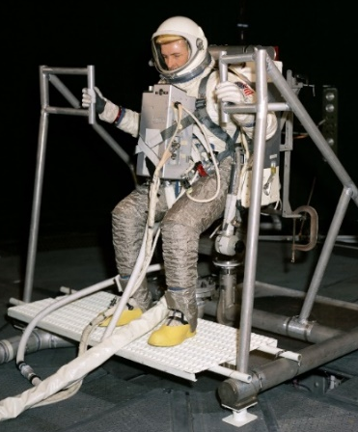
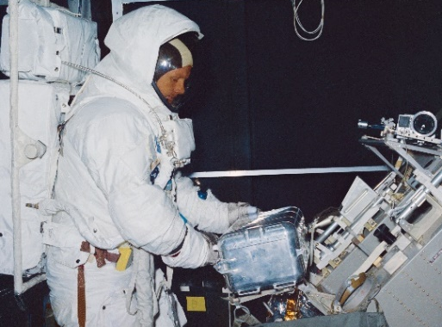
History
Early 1960s: Johnson Space Center’s (JSC) Space Environment Simulation Laboratory (SESL) was built
  Built for spacesuit testing and training astronauts in a thermal vacuum (TVAC) environment for the Gemini and Apollo programs
  Facility contained Chamber A and B, two human-rated TVAC chambers with solar simulation capabilities
1965: Gemini used Chamber B for spacesuit and Extravehicular Activity (EVA) hardware
1966: Apollo Extravehicular Mobility Unit (EMU) spacesuits and Apollo Lunar Module (ALM) were tested Chamber B
  Apollo astronauts found the training in the chamber to be critical for mission success
1970s: EMU was updated for Skylab and a series of human-in-the-loop (HITL) TVAC tests were conducted to verify the redesigned spacesuit
1980s: The chambers were temporarily deactivated
Gemini Testing
Apollo Lunar Testing

Slide 4
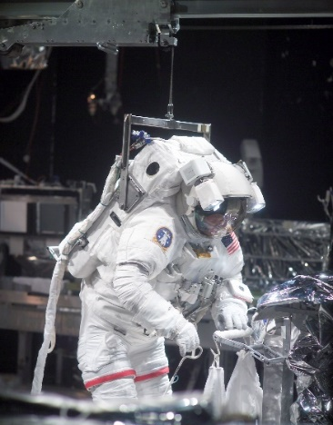
History
1988 through early 2000s: Chamber B was reactivated to support testing of Space Shuttle and International Space Station (ISS) hardware and EMU spacesuits
  During the Shuttle Return to Flight (RTF) after the loss of Columbia, astronauts practiced repairing the shuttle thermal protection systems in the chamber
2010s: The chamber supported multiple ambient tests of future spacesuit designs such as the Z-1 and Z-2 suit
2007-2017: Upgrades to Chamber A to meet the deep space environment requirements of the James Webb Space Telescope (JWST)
  All the human-rated capabilities within Chamber A were deactivated
  Chamber B is now the only facility capable of human-rated TVAC testing
2022 to present: TVAC testing for future generation spacesuits
  SpaceX suit testing (non-HITL and HITL tests)
  xEMU suit testing (non-HITL)
  Upgrades for xEVAs
Shuttle EMU for RTF EVA practice

Slide 5
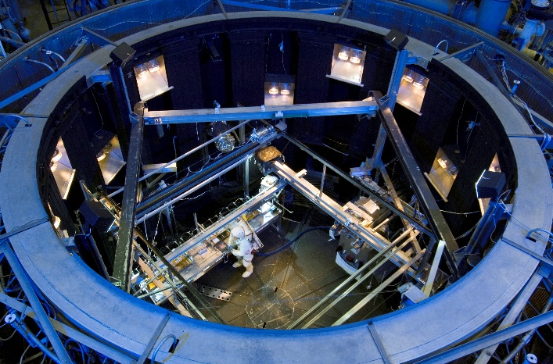
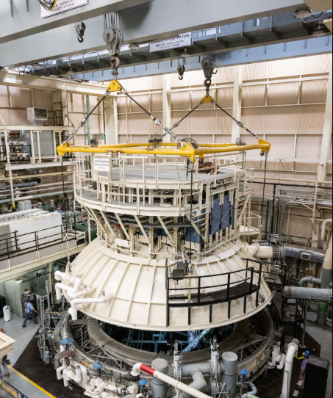
Overview of Chamber
Chamber B has 3 compartments: Main Chamber, Manlock B1 (MLB1), and Manlock B2 (MLB2)
Main Chamber with TVAC capabilities
  25 ft (7.6 m) in diameter and 26 ft (7.9 m) in height
  Load bearing floor of 20 ft (6.1 m) in diameter that can bear up to a concentric load of 37.5 ton (34,019 kg)
Manlocks
  Only ways to ingress the chamber at the ground level
  Act as a dual airlock system with vacuum capability only
  Can be used as independent vacuum chambers
50-ton (45,359 kg) capacity rolling bridge cranes outside of the chamber to take off the chamber head for larger test articles
Subject in ISS EMU with lid removed
Head Lift

Slide 6
Capabilities
Vacuum system with staged roughing pumps
  4 Root blowers and 6 Stokes pumps, 4 valved and trapped oil diffusion pumps, and two –424°F (20 K) cryopumps
  Chamber pressure can reach 1.5 × 10⁻⁴ Torr (19.9 mPa) at ambient temperatures
  Chamber pressure can reach 3.5 × 10⁻⁶ Torr (0.466 mPa) at cryogenic temperatures
Cooling capabilities of the chamber
  Two sets of Liquid nitrogen (LN2) panels that are coated in black paint with a measured emissivity of 0.90
  Sandwiched between LN2 panels, there are 15 gaseous helium cryopumping panels, which help lower the pressure by using their surface area to trap gases
  The floor can be cooled with LN2 to simulate the lunar surface
  Can be cooled to –270.7°F (105 K)
Heating capabilities of the chamber
  Infrared (IR) lamps, self-regulating heater tape, and heater bars to provide heating to test articles
  A thermal enclosure of aluminum framing with steel heater bars (referred to as a heater cage) grouped in zones can be created to provide elevated temperatures (vary the voltage of the heater bars to reach the desired temperatures)

Slide 7
Utilizing CTS for EMU Suit Testing
Crew Transfer System (CTS) can move one suited test subject from MLB1 into the main chamber
  Allows the subject to ingress and egress the main chamber while it is preconditioned and kept at the target TVAC conditions
During the main chamber conditioning, both Manlocks will remain at site pressure
Once the suit and subject are ready, the CTS interfaces with the EMU by latching onto the Portable Life Support System (PLSS) and a weight relief trolley above the CTS offloads a portion of the suit weight
The Manlock doors are then closed and the MLB1 is pumped down and equalized with the main chamber
The door between MLB1 and the main chamber is remotely opened
The CTS will remotely traverse into the main chamber
Subject will unlatch themselves from the CTS and the weight relief trolley will transition onto the traversing monorail
  The monorail provides two degrees of freedom and 200 ft² (18.6 m²) of available working space
After completion of the simulated EVA, the test subject will latch themselves back onto the CTS which will then traverse back into MLB1
The door is then remotely closed and the Manlock is repressurized back to site pressure

Slide 8
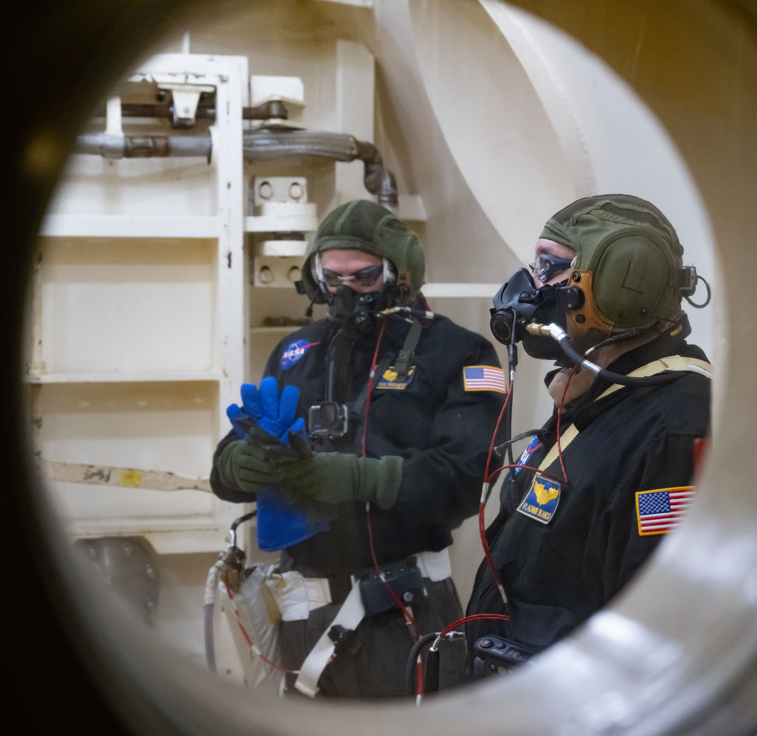
Safety Considerations for HITL TVAC Testing
Cameras with pan-tilt-zoom capability and viewports allow direct line of sight to the test subject
During a HITL test, 2 rescue technicians (RTs) are stationed in MLB2 where they observe the test subject and 2 RTs are outside of the chamber to aid as needed
  RTs are provided with oxygen through masks, communications through a belt pack and cap, and cold weather clothing
  MLB2 is kept at 379.4 Torr (0.05 MPa) throughout the HITL test, and the main chamber can be repressurized to 379.4 Torr (0.05 MPa) with dry air in under 90 seconds
  The RTs will disconnect from facility supplied O2 and utilize their bail-out O2 bottle to retrieve the test subject as soon as possible and extract them to MLB1
  When the chamber is repressed quickly, it will immediately begin fogging
  The door will be remotely closed to the main chamber and the Manlocks can be repressed in less than 30 seconds to bring them to site pressure
In case of smoke or fire, there is a fire suppression system in Manlocks that will provide a water deluge, power kill, and gas isolation capability
Biomedical data such as heart rate can be provided to the medical team
A hyperbaric chamber at JSC is available for decompression sickness treatment
RTs in MLB2

Slide 9
SpaceX Suit Testing
Polaris Dawn launched into low-Earth orbit (LEO) for a nearly five-day mission in September 2024 and completed the first-ever commercial EVA with SpaceX’s new EVA suit
The suit did not have a PLSS and was tethered to the life support system of the SpaceX Dragon vehicle
Throughout 2023 and 2024, SpaceX used Chamber B for a series of tests to prepare their new suit for the EVA
The first series of tests were non-HITL TVAC tests for the suit using a custom heater cage
The next test was HITL TVAC test with the same heater cage, and the test subject walked into the main chamber from MLB1 without the need of the CTS
  A custom-made handrail was created to allow the test subject to stabilize themselves while entering the chamber
After the TVAC test series was completed, SpaceX brought the 4 flight suits and the full crew of the Polaris Dawn for acceptance tests at vacuum only
  The tests were done with two crew and two suits at a time in the MLB1
  The crew had a chance to experience the suits, flight-like leak check seats, a flight-like vehicle hatch, and a simulated metabolic profile for the EVA duration

Slide 10
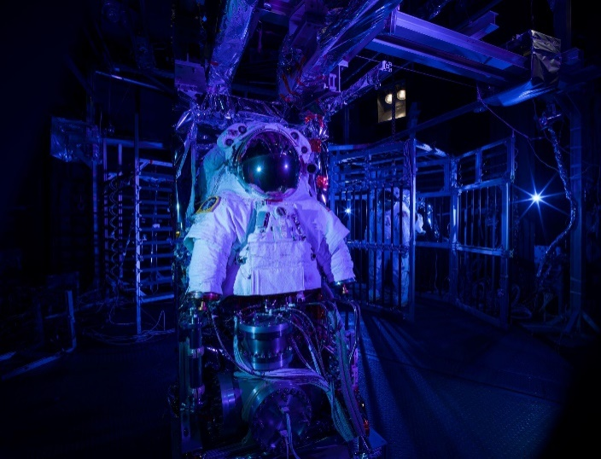
xEMU Suit 1 Testing
xEMU is the government reference design for next generation LEO and lunar spacesuits
Two suit configurations were tested in a non-HITL TVAC test with both the LN₂ cooled lunar plane and shrouds to simulate a lunar environment
Suit 1: A Short-xEMU (SxEMU) is an Exploration Portable Life Support System (xPLSS) connected to a hard upper torso
  The suit rode on Chamber B’s CTS with a human metabolic simulator (HMS) to perform five simulated EVAs by ingressing and egressing the main chamber
  Suit was heated in the heater cage located at the end of the CTS
  High fidelity xPLSS on the SxEMU was the focus during the testing and verified the oxygen systems, thermal loop, batteries, and carbon dioxide removal
  While in MLB1 between EVAs, the oxygen systems were refilled, the suit batteries were recharged, and the HMS water tank was filled
  An Exploration Service and Cooling Umbilical (ESCU) was created to allow the suit to run off facility supplied water and power while bundling the sensor and data wires in a single package
  Nitrogen was supplied to the suit instead of oxygen since the suit has not yet been rated

Slide 11
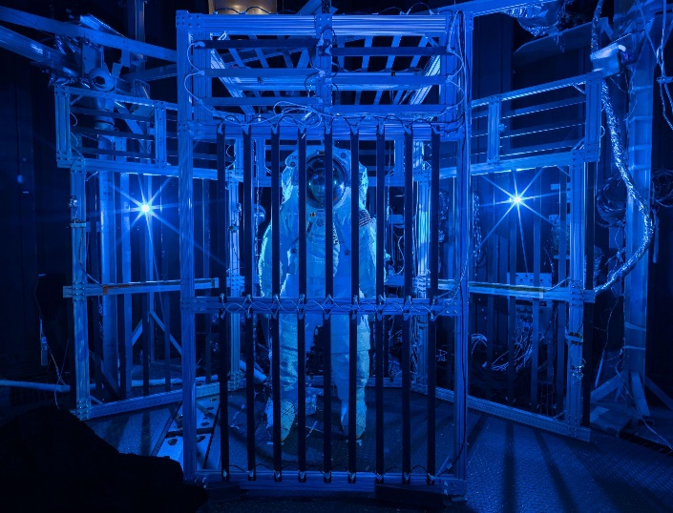
xEMU Suit 2 Testing
Suit 2: A full Exploration Pressure Garment Suit (xPGS) that stood static inside the main chamber
  Suit was conditioned in the heater cage located at the center of the chamber with heating on all four sides and the top of the suit
  Tested the integrated communication system, Exploration Informatics Lighting Band (xInfoBand), and liquid-crystal display screen on the Display and Control Unit (DCU)
  Power, data, air, and TC lines were fed from chamber penetrations into the suit
  11 thermal test points were explored over the course of the test with unique heater bar setup and duration
    The first 7 test points were conducted with LN₂ flowing to the floor to condition the boots which were in contact with the floor
    The final four test points the LN₂ was shut off to allow for the suit to reach its hottest test points

Slide 12
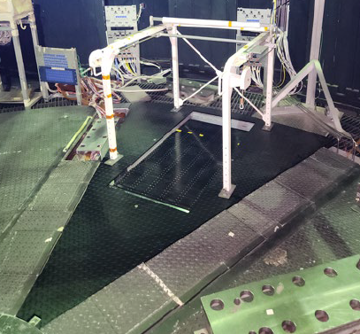
xEVAS Modifications
As part of the Exploration Extravehicular Activity Services (xEVAS) contract, the chamber was upgraded to accommodate the next generation spacesuits
A 3600 psi (24.8 MPa) bulk gas storage tank was built along with a compressor recharge station to store a large quantity O₂
New O₂ control cabinet, cooling water cabinet, feedwater tank, and power supplies were installed to supply MLB1
New ISS umbilical panel was installed into the chamber to provide a flight-like mating interface for umbilicals during prebreathe and recharge operations
MLB1 had a new weight relief trolley for variable offload weights from 350 lbs to 750 lbs (158.7 kg to 340.2 kg)
A new subfloor was incorporated into MLB1 for a rail mounted don/doff stand which allows the donning of rear entry suits
Modifications to the CTS were made to allow a transition from the donning stand, and it included a manual jack system to adjust test subject height to connect the weight relief trolley
A new treadmill (can obtain speeds up to 5 mph) recessed into the chamber floor was needed to accommodate the full anthropometric range of test subjects
Chamber B Treadmill

Slide 13
Artemis Vehicle Airlock Trainer Development
MLB2 is being adapted into the Artemis Vehicle Airlock Trainer (AVAT) for crew and flight operator training for Artemis missions
AVAT supports dual-suited crew training from 1.5 × 10⁻⁴ Torr (13.3 mPa) to 760 Torr (101.3 kPa)
As a generic airlock trainer, facility can be easily reconfigured for multiple Artemis airlock designs with high-fidelity panels and controls, creating a flight-like operational environment
AVAT is also integrated with the JSC’s Mission Control Center (MCC) for joint training of flight controllers and crew
The chamber is engineered for future compatibility with enriched oxygen environments (up to 40% O₂) to support Human Landing System (HLS) vehicle conditions
AVAT includes a suite of utilities and systems to support realistic training. These include:
  Weight Relief System to offload weight and enable crew mobility (Rated to 1,000 lbs per crew member which is 2000 lbs total with );
  Don/doff stands with interfaces for multiple suit types including both rear entry and waist entry suits;
  O2 supply at 3000 ± 50 psig (20.7 ± 0.34 MPa), cooling water rejection capabilities of 2000 BTU/hr (586 Watts), vehicle power at 28 VDC, feedwater supplied at 4–5 psid (27.5–34.5 kPa), and vacuum access pumping speeds exceeding 1,900 L/min at 0.5 Torr (66.6 Pa)
  Adjustable lighting from 500–5,000 lumens to simulate varied conditions

Slide 14
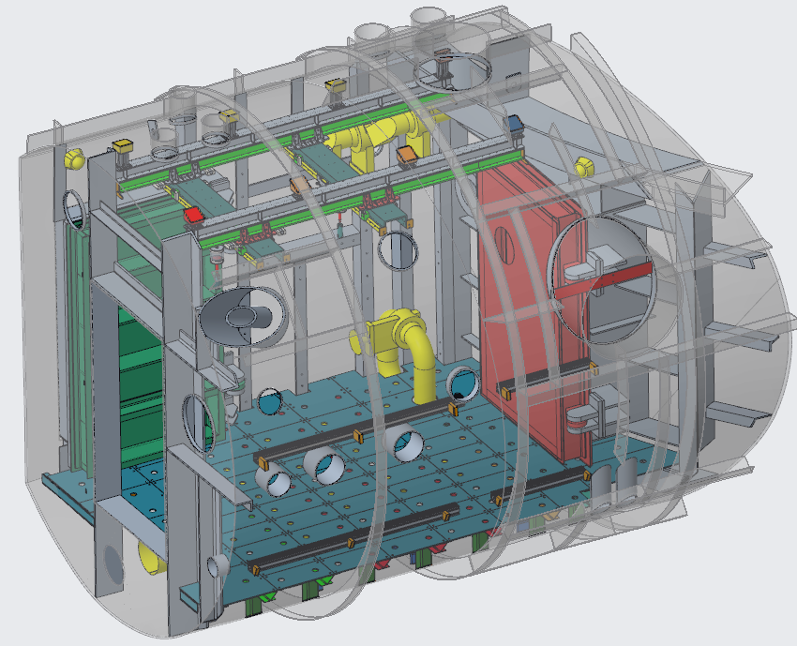
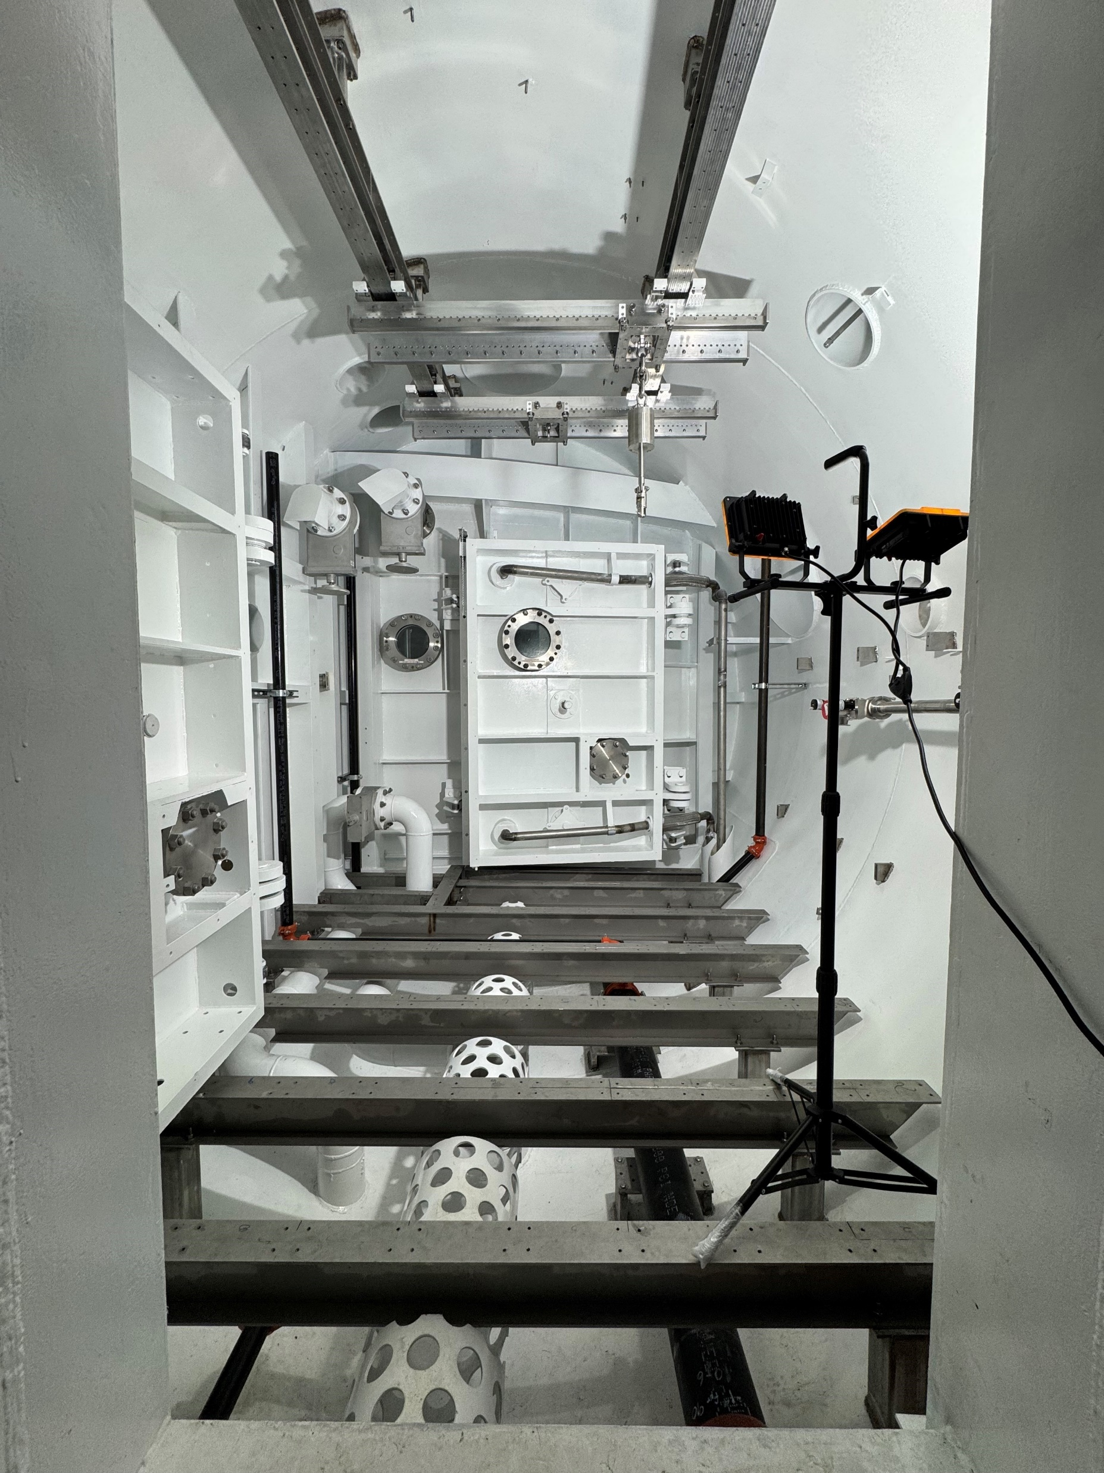
Artemis Vehicle Airlock Trainer Development
The facility is projected for heavy use starting in 2027 to support future Artemis missions
Plays a critical role in preparing astronauts for lunar EVAs
AVAT Facility Model
AVAT Current Modifications

Slide 15
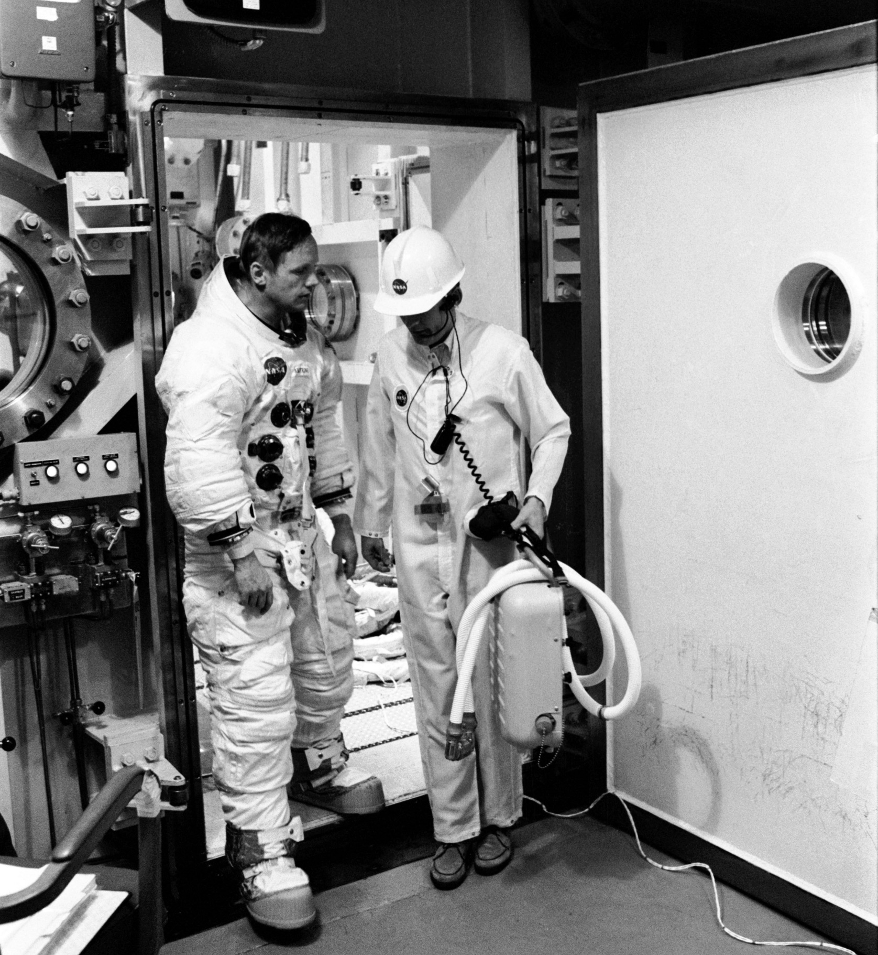
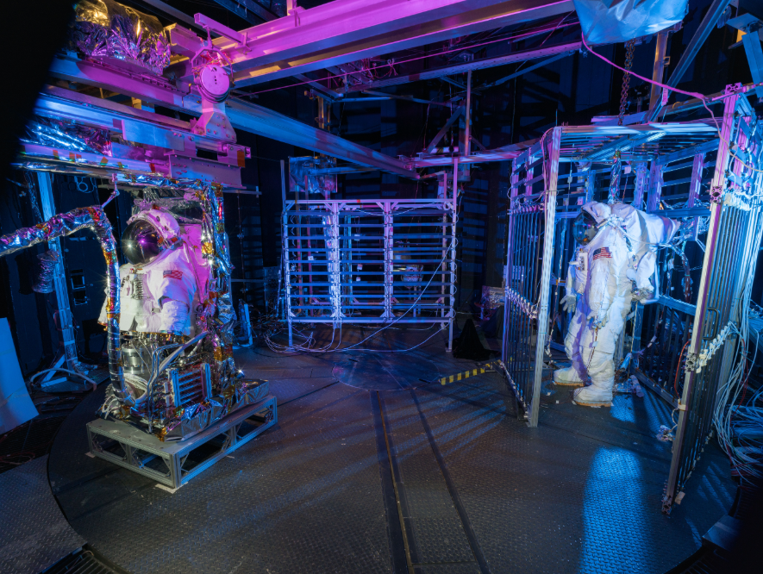
Conclusion
From the Gemini program to ISS and beyond, Chamber B has provided critical TVAC testing capability and training for NASA’s suit development
It will continue to play a pivotal role in the development of next generation spacesuits through unique TVAC capabilities and training for astronauts in a high-fidelity airlock trainer

Slide 16
References
L. C. Walters, "To Create Space on Earth: The Space Environment Simulation Laboratory and Project Apollo," NASA Technical Reports Server (NTRS), 2003.
J. Uri, "Building on a Mission: Spacecraft Environmental Testing," NASA, 2021.
Polaris Program, "Polaris Dawn crew completes final series of EVA spacesuit testing," Polaris Program, 2024.
M. Montz, "Chamber B Thermal/Vacuum Chamber User Test Planning Guide," NASA Technical Reports Server (NTRS), 2012.
B. Swartout and D. Westheimer, "Exploration Extravehicular Mobility Unit (xEMU) Chamber B Thermal Vacuum “Suit 2” Pressure Garment System Hardware and Test Design," in 53rd International Conference on Environmental Systems, Louisville, Kentucky, 2024.
P. D. Whalen, S. P. Gazzara, R. F. Marsch, M. Nasser and A. Moore, "Short Exploration Extravehicular Mobility Unit Testing Setup: Evaluation Under Realistic Pressure and Thermal Conditions," in 53rd International Conference on Environmental Systems, Louisville, Kentucky, 2024.

Slide 17
Acknowledgements
Engineers, technicians, test directors, and management of EC4 Systems Test Branch of CTSD
EC5 Space Suit and Crew Survival Systems Branch
EC Crew and Thermal Systems Division
ES2 Structures Branch
Commercial partners

Slide 18
Questions?

Slide 19
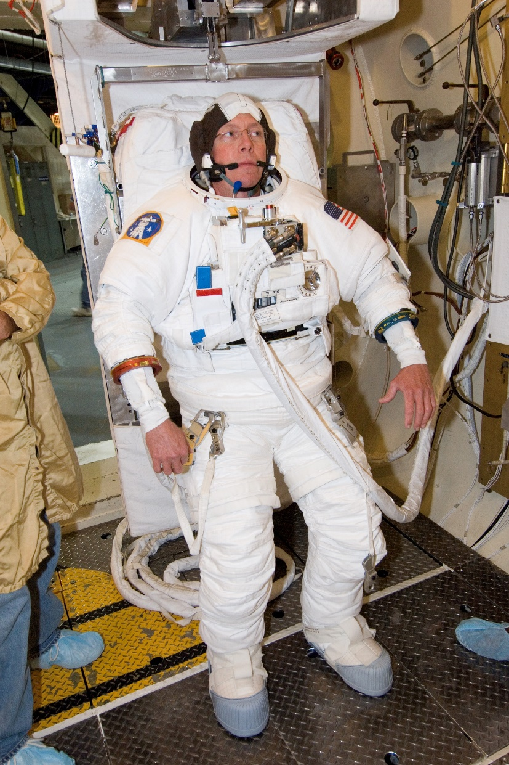
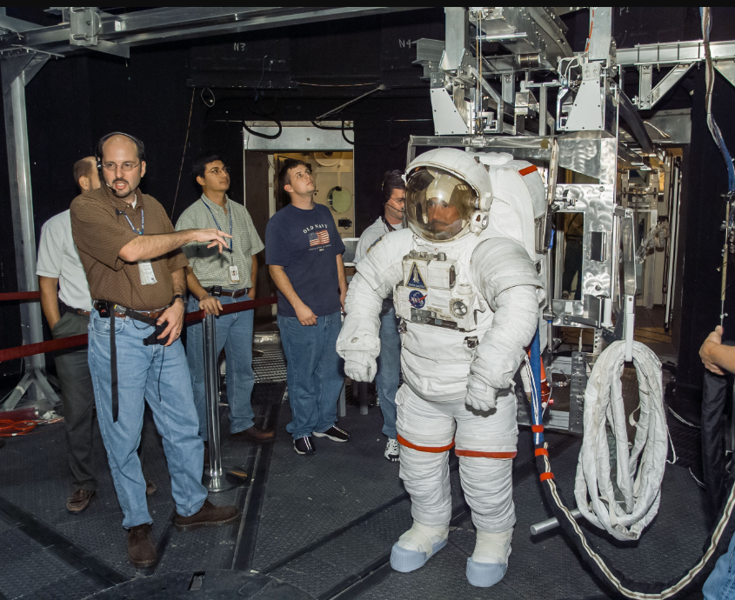
EMU

Slide 20
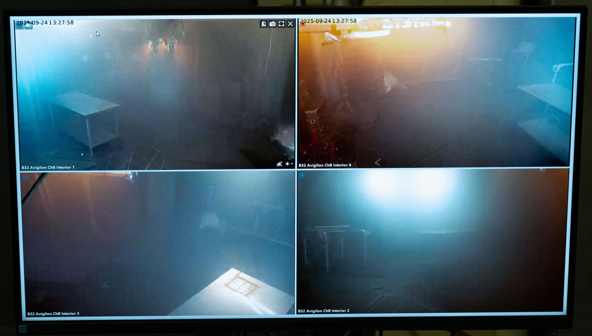
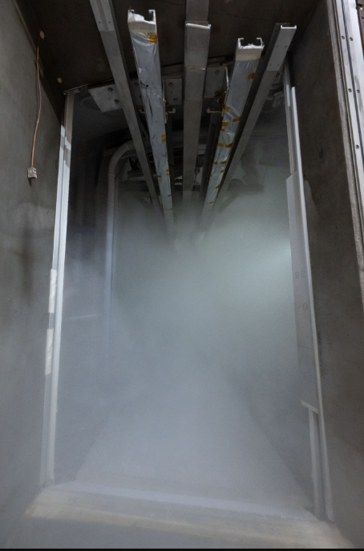
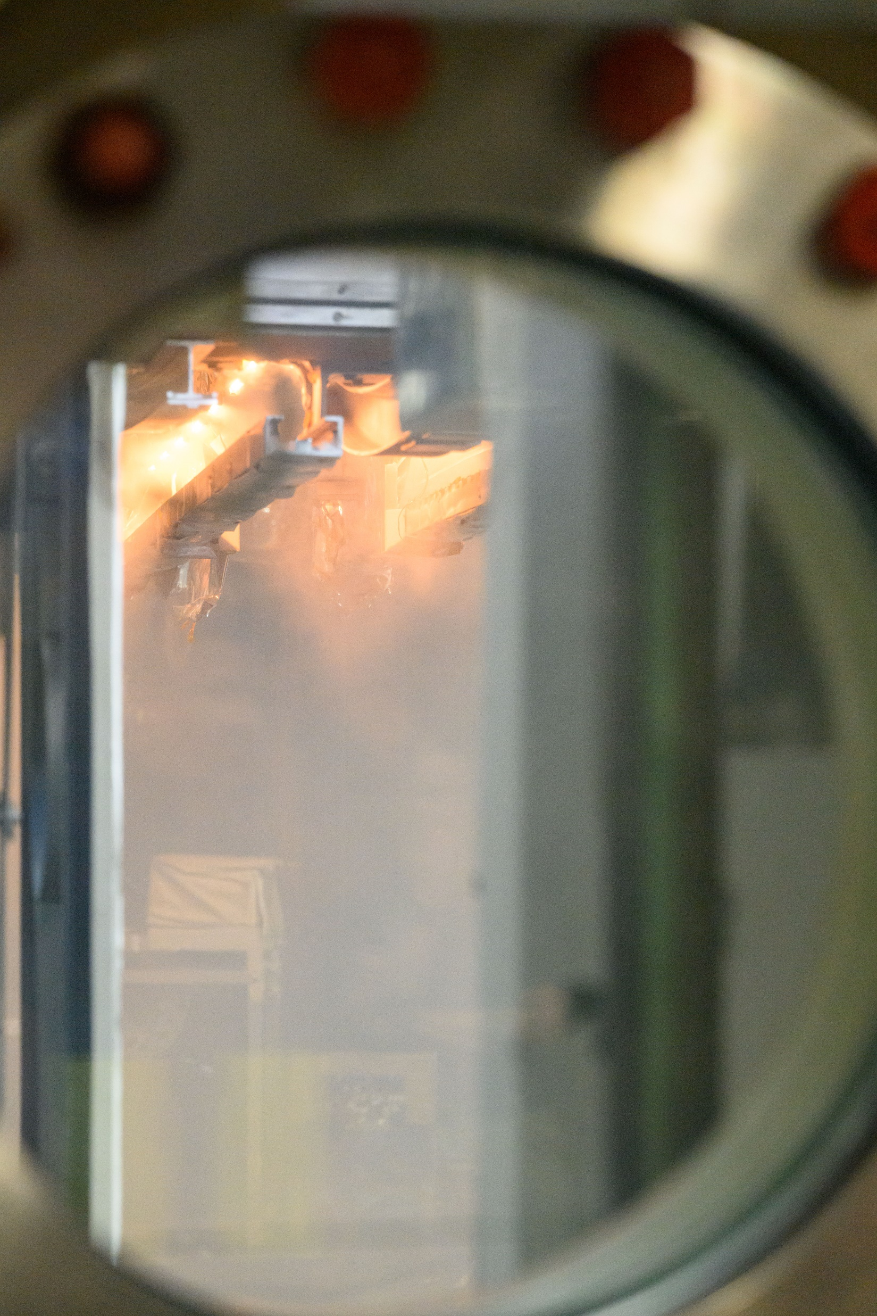
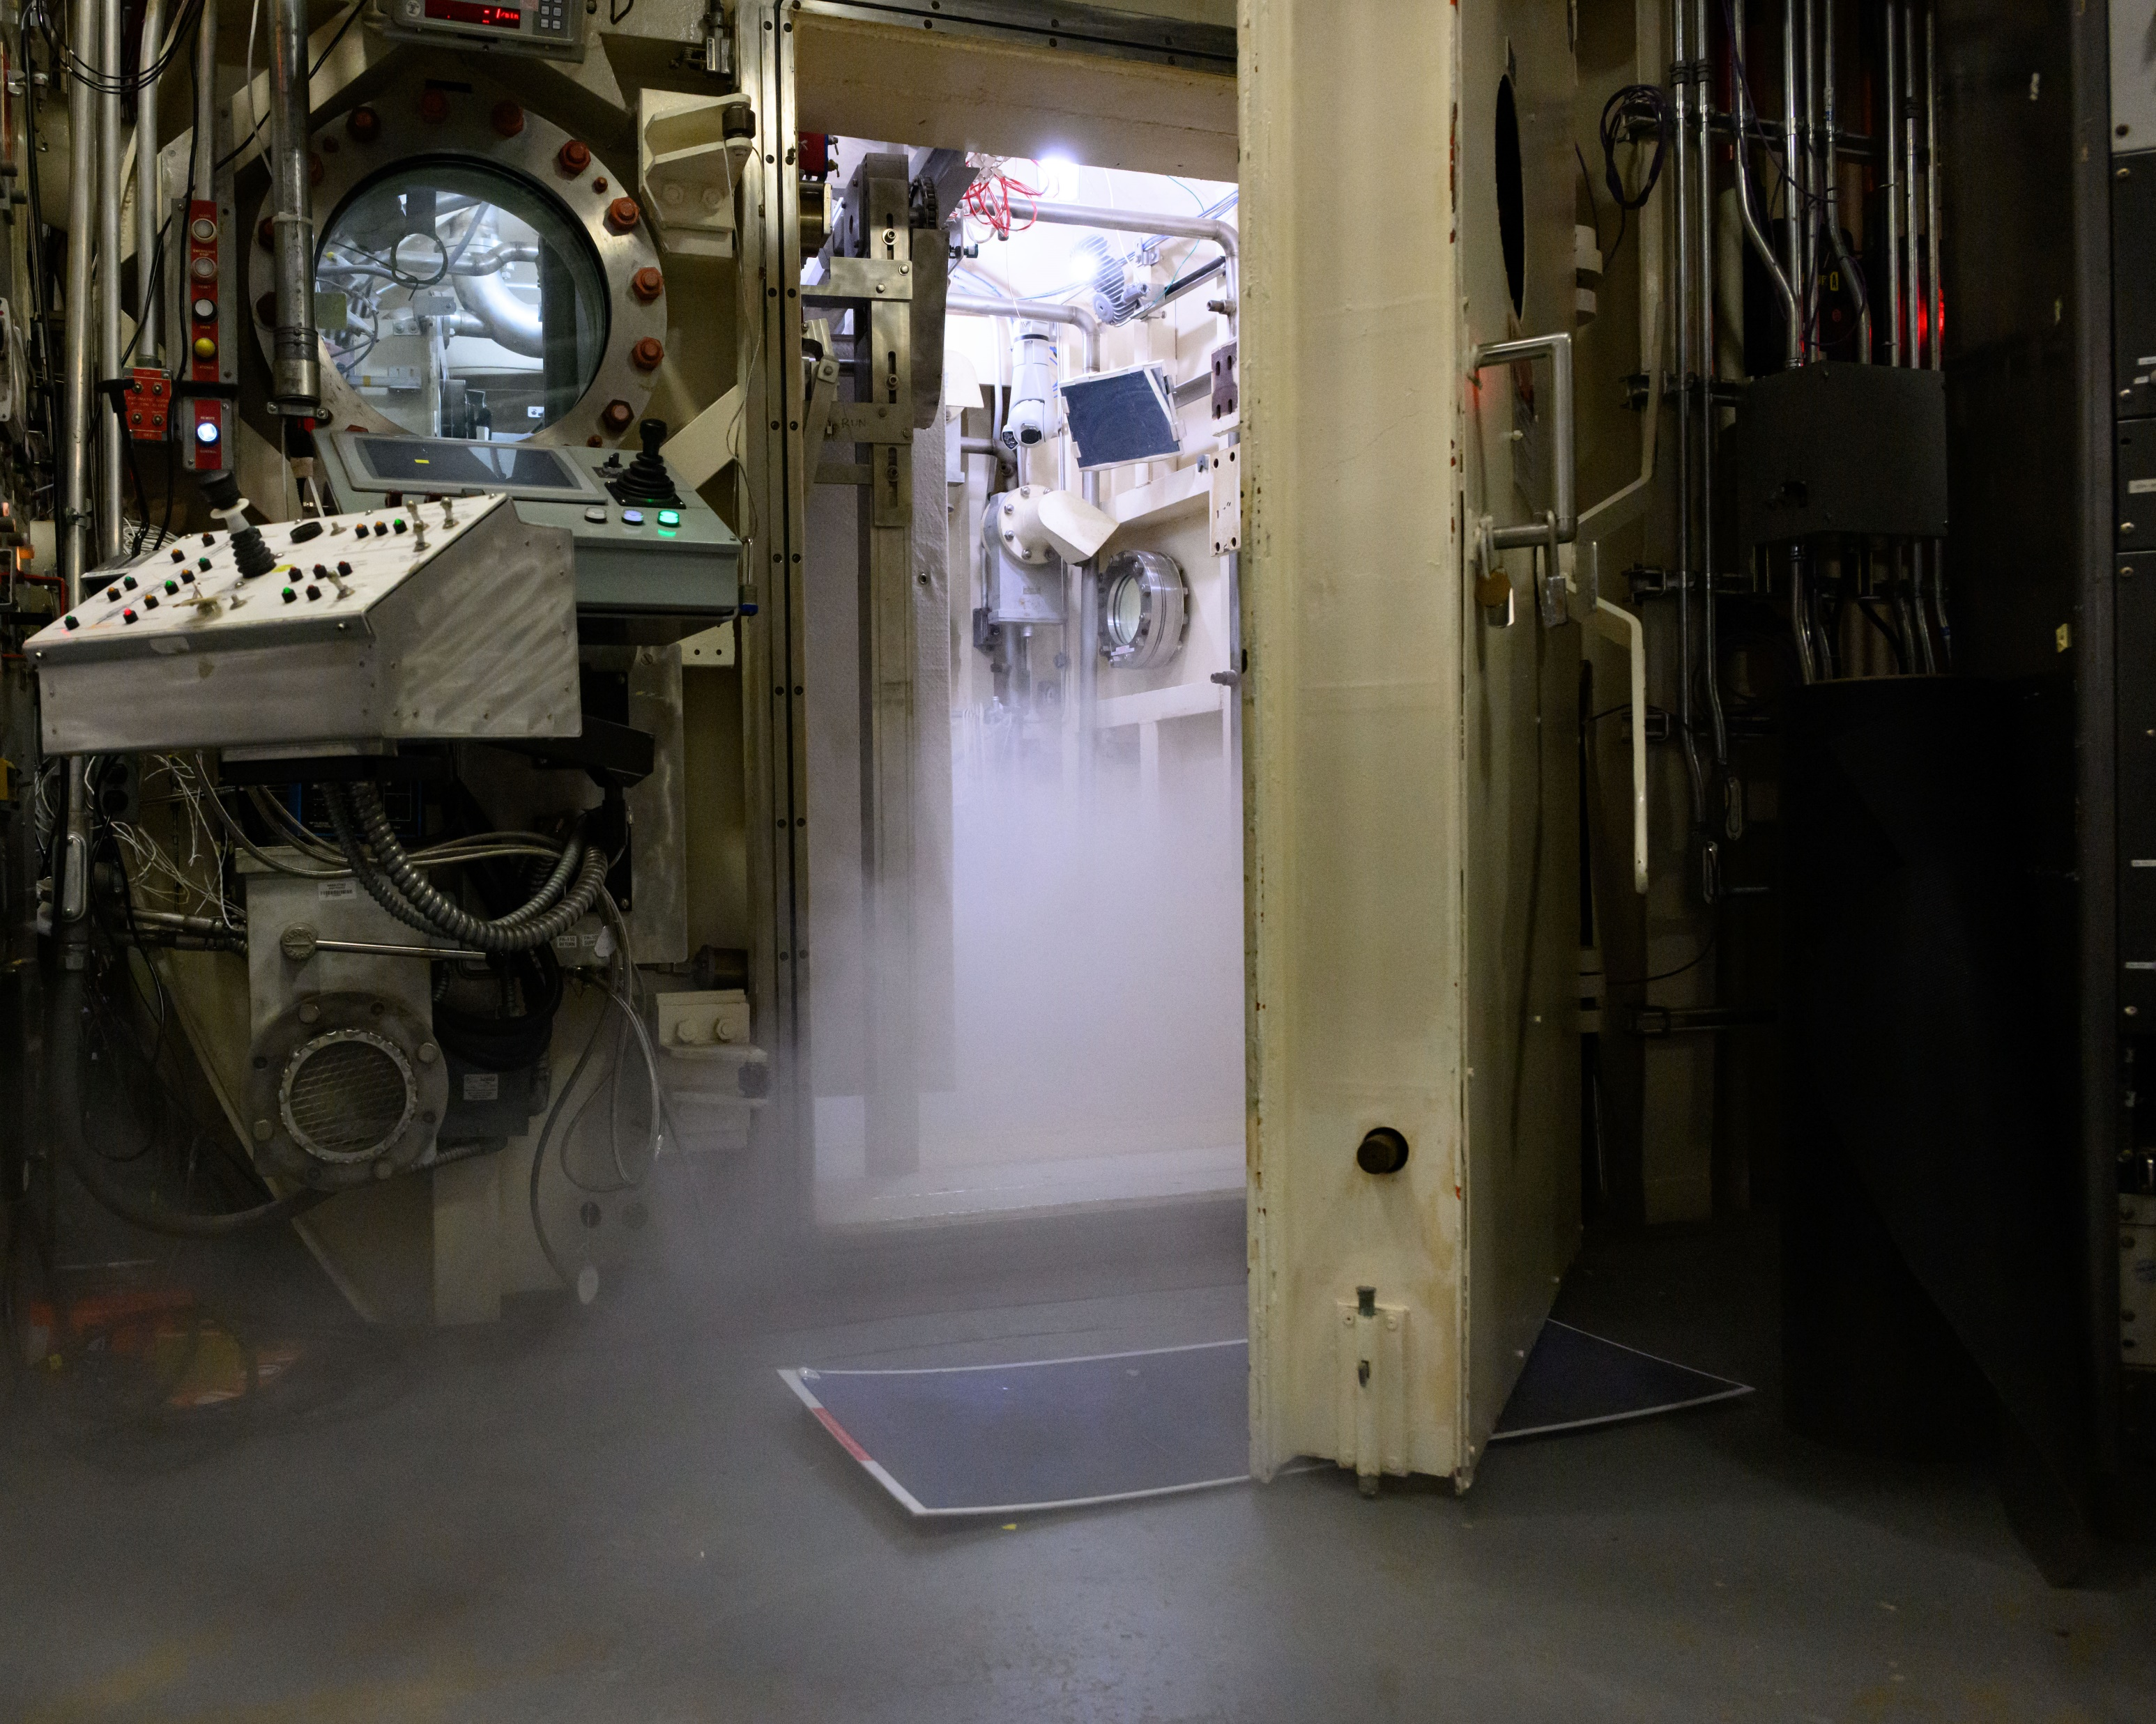
Emergency Repress

Slide 21
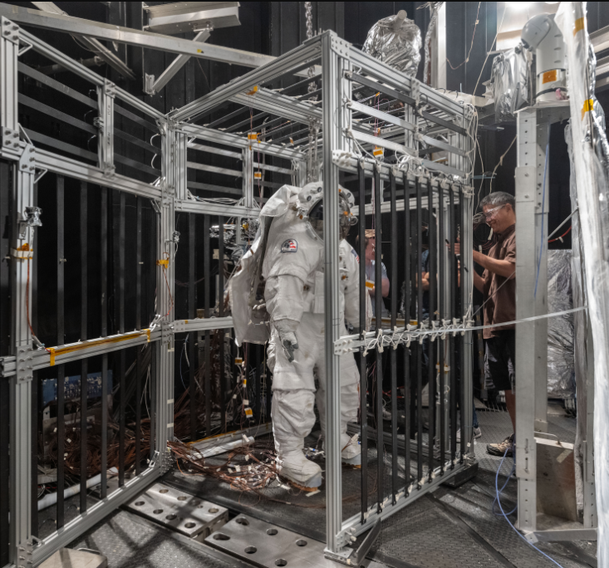
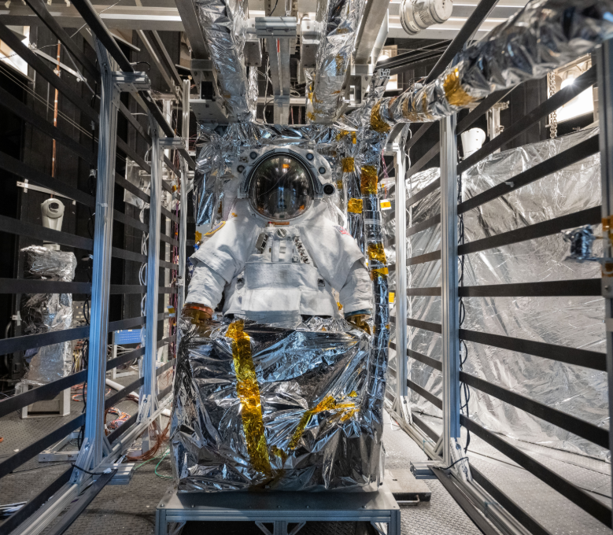
xEMU

