Slide 1
Mars Portable Life Support System Status and Plan
55th International Conference on Environmental Systems
12-16 July 2026, Rio Grande, Puerto Rico
ICES-2026-126
Ryan Ogilvie and Cinda Chullen
NASA Johnson Space Center, Houston, Texas
Lawrence Barrett, Ph.D., Madeleine Oliver, Ph.D., and Bruce Conger
Amentum, Houston, TX
Trade names and trademarks and company names are used in this report for identification only. Their usage does
not constitute an official endorsement, either expressed or implied, by the National Aeronautics and Space Administration.

Slide 2
Introduction
A new development effort for a Mars Exploration Extravehicular Mobility Unit (MxEMU) has started with the Mars Portable Life Support System (PLSS)
The MxEMU will build off the existing government reference design, the Exploration Extravehicular Mobility Unit (xEMU)
The environment on Mars will present a unique challenge:
  Carbon dioxide atmosphere: 0.15psia
  3/8th gravity field (2.2x Lunar gravity)
  Cold atmospheric temperatures: (down to - 143°C (130°K))
  Extended mission profile and long quiescent period for transit
Each environmental consideration presents a new challenge for a Mars suit which will require a testbed and analysis to consider options

Slide 3
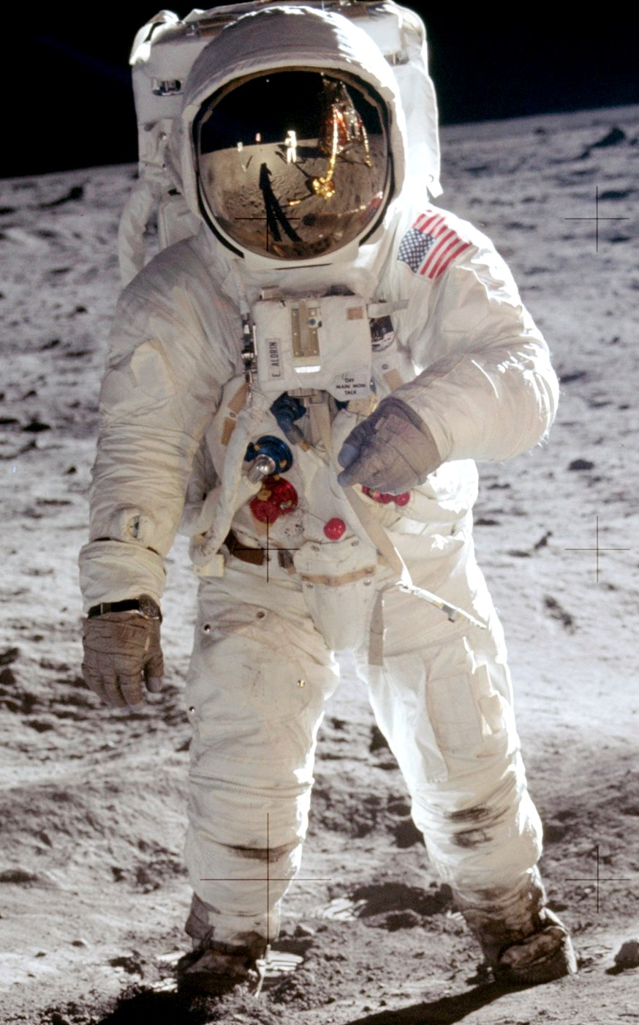
Historical Suit Design - Apollo
The Apollo Suit had a Pressure Garment Assembly (PGA), a Portable Life Support System (PLSS), and a separate Oxygen Purge System (OPS)
  PGA is similar to the modern Pressure Garment System (PGS), the OPS is now included in the PLSS package
  The suit used a Liquid Cooling Garment (LCG) for cooling the crewmember
  The suit doubled as the Intravehicular Activity (IVA) suit
The PGA was made up of a neoprene coated nylon bladder with convoluted joints, a nylon restraint layer, and a Thermal Micrometeoroid Garment (TMG) that included an inner and outer shell of Bata cloth, seven layers of aluminized Kapton film separated by six layers of Beta Marquisette, and a liner of two layers of neoprene-coated nylon ripstop
  The apollo PGA was custom for each crewmember
The PLSS used a passive porous plate sublimator for cooling, Lithium Hydroxide (LiOH) for CO2 removal, and 100% oxygen at 3.6psia during EVA
The OPS provide 30 minutes of emergency oxygen flow in case of failure 3.63 kg/hr
A Buddy Life Support System (BLSS) was used for backup cooling and would connect a failed suits LCG to their “buddy” nearby
Apollo Space Suit

Slide 4

Historical Suit Design - EMU
The EMU was used for the Shuttle and is used on the International Space Station (ISS)
It advanced the suit design from Apollo to be a singular modular architecture
  PLSS and OPS were combined
  Tightly packaged PLSS to be able to fit through the airlock
  The suit provided EVA capability only, not IVA
  A Hard Upper Torso (HUT) was added to improve upper body mobility
  A Display and Control Module (DCM) to display oxygen, power, water, comms was added
  A single Service and Cooling Umbilical (SCU) was added to simplify recharging of all consumables
  Lower body mobility was deemphasized – no lunar walking – to reduce mass
A modular architecture allowed for a variety of astronaut sizes, easier maintainability, safer serviceability, improved caution and warning, less complex emergency O2 systems, and a reusable system
The EMU has been running for 40+ years and has included numerous improvements over its life
  Planar fiberglass HUTs with serviceable ducts
  Orbit Replaceable Units (ORUs)
  Refined Liquid Cooling and Ventilation Garment (LCVG) water/vent networks
  Space-to-Space Extravehicular Mobility Radio (SSER) Ultra High Frequency (UHF) radios,
  DCM controls for fans, water, and communications.
  Used LiOH at the onset and then switched to regenerable MetOx
EMU Space Suit

Slide 5
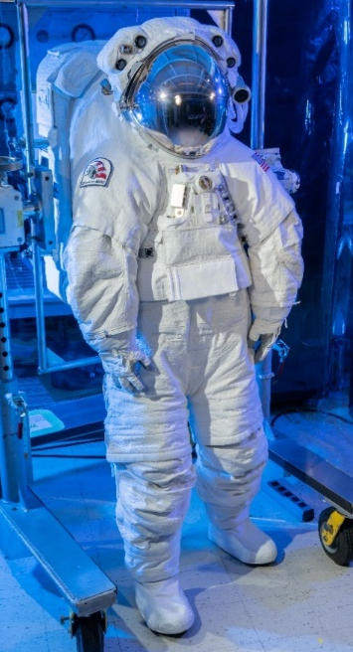
Government Reference Design - xEMU
The xEMU is a significant evolution from the EMU and is being used as a government reference design for commercial vendors such as Axiom Space
xEMU is EVA only and incorporates numerous improvements
  Modular components and increased autonomous control
  Increased 8-hours performance, 100+ EVA per mission
  Regenerable CO2 removal using Rapid Cycle Amine (RCA) swing beds – replaces MetOX and regenerates actively during EVA
  Motor Controlled Variable Pressure Regulators
  Spacesuit Water Membrane Evaporator (SWME) – replaced sublimator for cooling and decouples the ventilation and thermal loops, providing more reliability and contamination tolerance
  Secondary Oxygen reduced to 3000psia to match primary pressure, compared to shuttle/Apollo 6000 psia for safety and simplifying recharge
  Auxiliary thermal control loop for backup cooling
  Lower body mobility
xEMU Space Suit

Slide 6

Umbilical Suit EVA
Umbilical suits represent early and evolving approach to EVA prior to the implementation of a PLSS
Many previous missions used umbilical suits
  Gemini used umbilical to provide oxygen and cooling in an “open loop” – exhaled gas was vented to space
  Skylab used Apollo A7LB suit but used an umbilical instead of a PLSS to provide oxygen, cooling, communications, and monitoring
  SpaceX used umbilical to provide life support during their Polaris Dawn mission
Umbilical suits are not the preferred option for Mars, though represent a “fall back” in case requirements preclude the use of a PLSS due to mass or other constraints
  University of Maryland has concepted a “BioBot” to follow the crew member with an umbilical
Gemini Space Suit

Slide 7
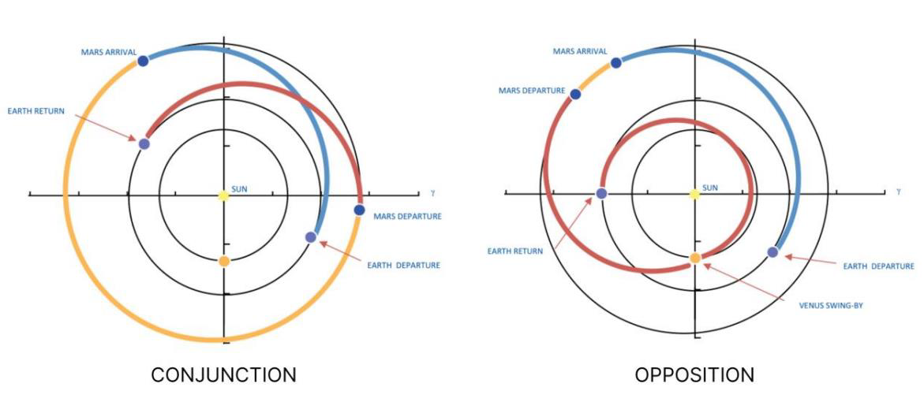
Mars Mission Architecture
Mission profile must be considered to understand the number of EVA’s and Quiescent time in transit
  Conjunction of opposition orbits lead to widely variable parameters
Prior decision memo at NASA favor an opposition mission for the shortest duration mission with the least time on Mars.
  305 days to Mars, 50 days in orbit, 30 days on surface, and 375 days return
  730 days total
For both short duration surface stays; preliminary EVA design requirement: 25 EVAs
 | Transit “To, From” (days) | Orbit (days) | Surface (days) | Total (days) | Mission EVAs (#) | EVAs Design reqt.
Opposition mission #1 | 305, 375 | 50 | 30 | 730 | 20 | 25
Conjunction mission #2 (short stay) | 200, 200 | 500 | 30 | 900 | 20 | 25
Conjunction mission #3 (long stay) | 429, 429 | 365 | 300 | 1223 | 125 | 150+
Mars Reference Missions

Slide 8
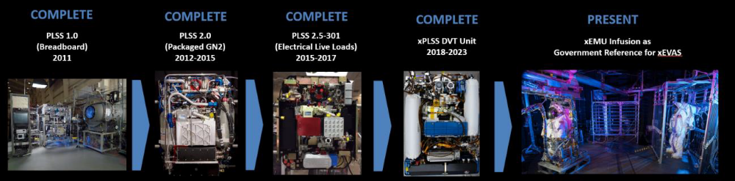
Mars PLSS Planning
Prior government reference design suit, the exploration EMU (xEMU) took ~15 years to develop
A breadboard leading to a DVT mars suit is expected to take a similar amount of time.
Expect to be able to utilize some components from xEMU DVT for Mars
 | 2026 |  |  |  | 2027 |  |  |  | 2028 |  |  |  | 2029 |  |  |  | 2030 |  |  |  | 2031
System Performance Evaluation
Mars Suit Mass Evaluation
Prototype Component Dev.
Mars PLSS Testbed Buildup
Mars PLSS Testbed Testing
DVT Component Dev.
DVT Buildup |  |  |  |  |  |  |  |  |  |  |  |  |  |  |  |  |  |  |  |  | Future >
High Level Schedule for Development of a Mars PLSS

Slide 9
Mars Suit Considerations
Gravity Field
  Mars is at 0.38 g, which is 2.3 times that of lunar gravity (0.17 g)
Atmosphere
  95% carbon dioxide, average 4.6 torr
  Further details following
Temperature
  Ranges from -143°C to 20°C depending on location, season, and time of day
  Further details following
Radiation
  Reduced solar irradiance compared to earth, atmosphere provides limited reduction compared to deep space/lunar, further studies required
Dust and Soil
  Soil is varied depending on landing site
  Dust is airborne and anticipated between 0 to < 10 μm

Slide 10
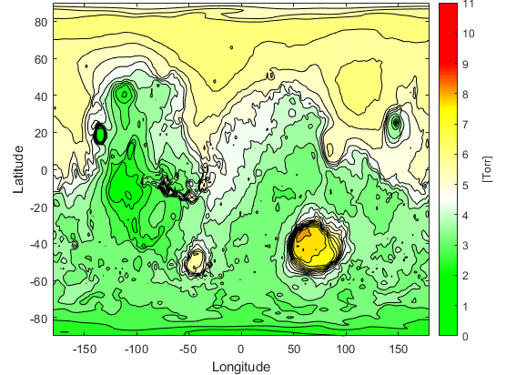
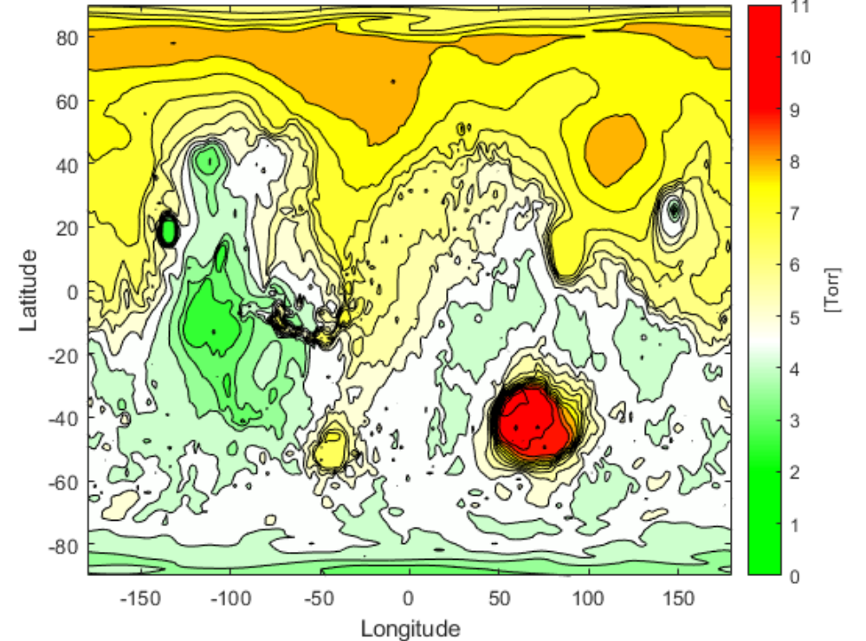
Pressure Environment - Mars
Pressure environments range from 0.2 torr to 9 torr
Pressure maps represent lowest and highest pressures on Mars depending on the time of year (Summer/Winter)
  Pressure is the lowest typically during Northern Summer/Southern Winter and highest typically during Northern Autumn and Winter/Southern Spring and Summer
  CO2 will condensate in the polar caps in the winter and sublimate in the spring, driving the pressure up and down
Pressure environment generally excludes Hellas Planitia crater (in red) (>7torr)
  This pressure boundary is included to assist with having PLSS systems that rely on vacuum to operate on Mars
Mar Lowest Average Global Pressure
Mars Highest Average Global Pressure

Slide 11
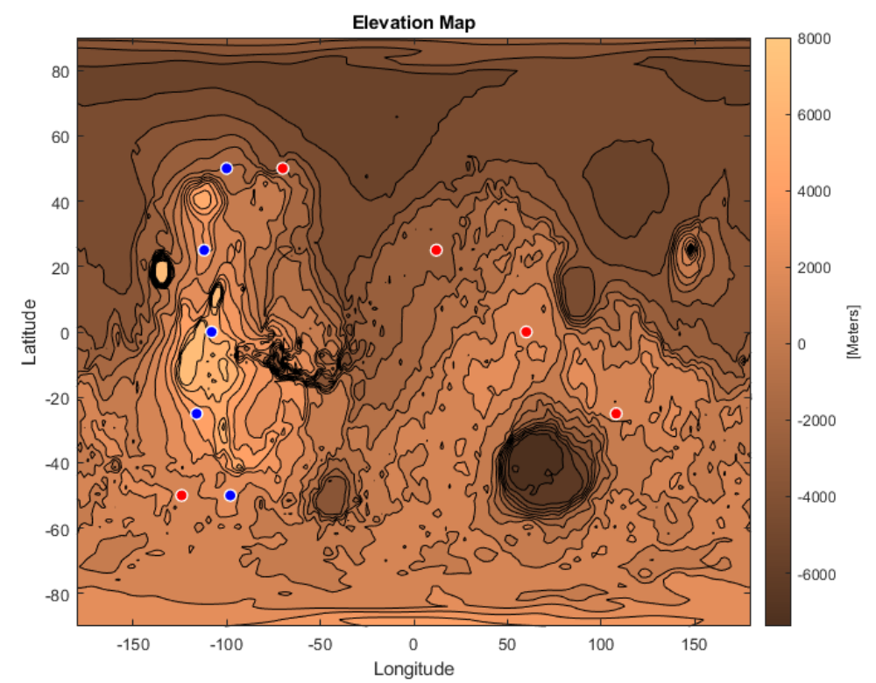

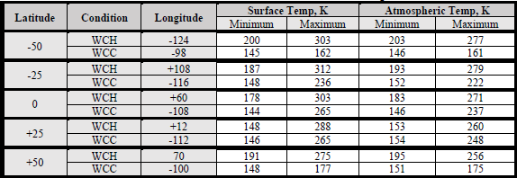
Temperature Environment
Temperature on Mars was evaluated for Worst Case Hot (WCH) and Worst Case Cold (WCC) for certain parameters
  Latitudes of -50, -25, 0, +25, and +50
  Pressure maximum of 7 torr to allow for Spacesuit Water Membrane Evaporator operations
Temperature limited approximately to the frost point of CO2 ~ -143°C
Elevation Map of Mars

Slide 12
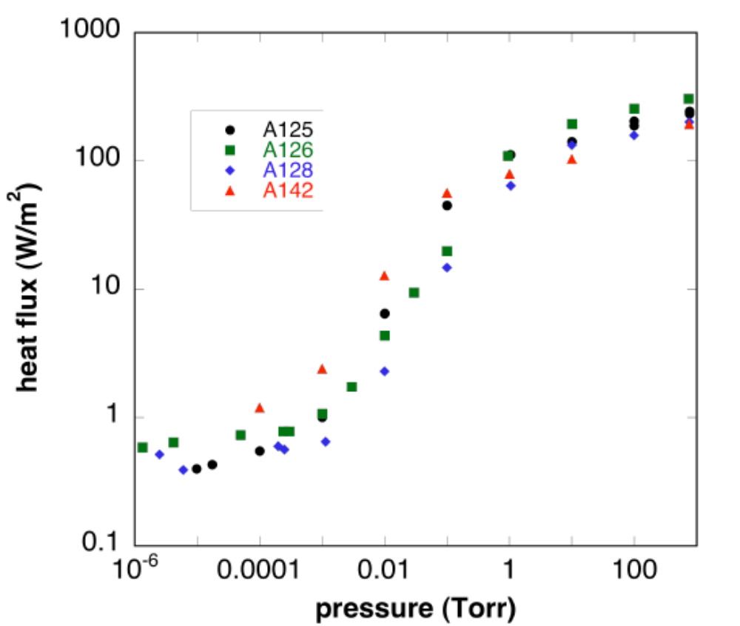
Shift In Design Approach
Suit Mass Prioritization - Options
  Lunar and microgravity have not had as stringent requirement on mass
  Return fault tolerance to single like EMU and Apollo (xEMU has 2 fault tolerance)
  Integrated, custom suit over modular (like Apollo)
  Reduce heavier regenerable systems (i.e. LiOH instead of RCA + sweep gas)
  Return to BLSS and remove auxiliary cooling system (like Apollo)
  Reduce EVA time (i.e. 4 hours instead of 8)
Insulation
  MLI will not provide adequate insulation on Mars due to the atmosphere negating the insulative properties it provides in hard vacuum
    Heat flux transitions around 0.01-1 torr
  Much thicker traditional synthetics or aerogels will need to be tested and used for Mars
    This is expected to effect mobility.
Heat flux versus interstitial gas pressure compared for four different MLI samples

Slide 13
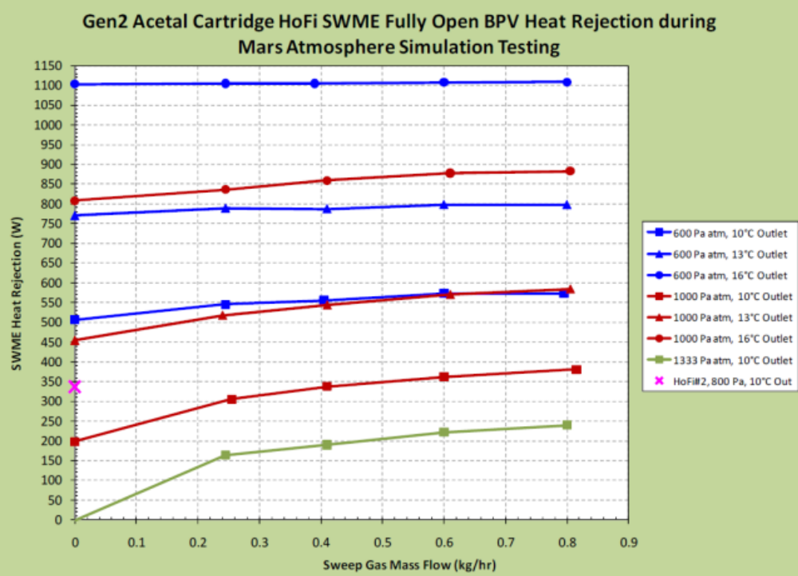
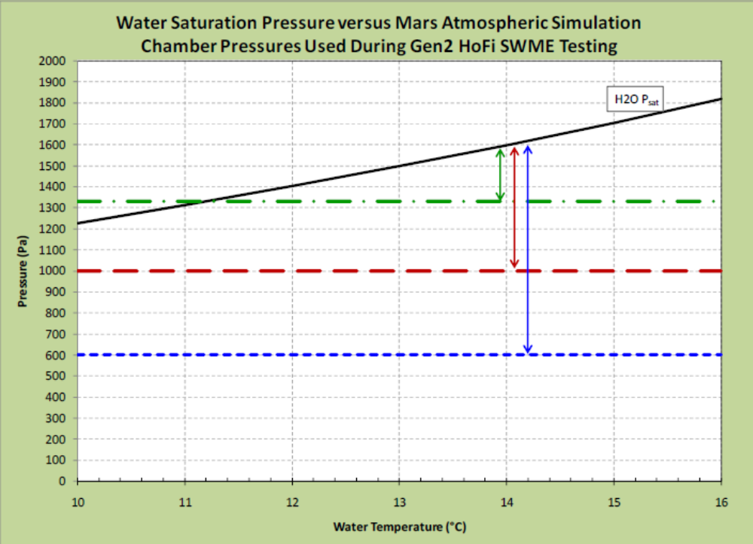
Shift In Design Approach
CO2 removal
  LiOH, MetOX, RCA, and newer technologies are being considered
  RCA will require sweep gas to operate, will not operate as is
  MetOx is expected to be too heavy for Mars
  Carbon Dioxide Removal by Ionic Liquid Sorbent for Mobility (CDRILS‑M) system and Hollow Fiber Membranes (HFM) using liquid sorbents are new technologies being developed
Thermal Control
  SWME is still leading technology for cooling on Mars
  SWME is expected to have degraded performance at Martian pressures up to 10 torr (1333Pa)
  Sweep gas may be required for operation at higher Martian pressures
  SWME normally operates at 50°F (10°C) but may need to operate higher to have a larger saturation pressure difference at higher Martian pressures
Dust Protection
  Filters will be required to avoid dust infiltration in the PLSS while maintaining a flow path for SWME
Mars SWME testing with sweep gas
Mars SWME saturation pressure vs. temperature

Slide 14
Deep Space Operation Contingency
In case of emergency EVA on transit, a space suit may be required
The PLSS may be cross compatible with microgravity and Mars
The PGS is less likely to be cross compatible with microgravity and Mars due to the insulation requirements.
  Deep space requirements may not work well without MLI, which will not work on Mars
  MLI/insulation is an integral part of the PGS that cannot be readily swapped out
Both systems will require assessments following optimal design for Mars
Could consider a hybrid approach
  i.e. you can use one PLSS with two different PGS for Mars/microgravity
Environment Comparison
 | Microgravity/LEO/Deep Space | Lunar | Mars
Gravity | ~0 | 1/6 G | 3/8 G
Temperature | 138 - 337K (sink temperature) | 93 - 377K (sink temperature) | 144 - 279K (atmosphere)
Pressure | ~0 | ~0 | 0.2-9 torr
Dust | No | Yes | Yes - airborne

Slide 15
Mars PLSS Technology Development
A set of new or modified technologies are being developed for Mars
Existing technologies will be reused and are not included here
  Fans, pumps, O2 regulators, tanks, LCVG, pressure sensors, activated carbon for TCC, Thermal Control Ball Valve
Spacesuit Water Membrane Evaporator (SWME)
  SWME will need to be evaluated for Mars and is expected some design changes will be implemented for general improvement, sizing, or potential sweep gas implementation. This is being developed at NASA
Condensing Heat Exchanger (CHX)
  If LiOH is used for Mars, a method to remove humidity will be necessary (currently removed by RCA). Currently, xEMU PLSS heat exchanger does not remove humidity. Multiple vendors are working on a condensing heat exchanger option.
Lithium Hydroxide (LiOH)
  As a lightweight alternative to RCA, a traditional LiOH approach is being explored. Granular and sheet/block LiOH options are being designed for testing by NASA.
Rapid Cycle Amine (RCA) Swing bed
  RCA, while it will not work as is due to the CO2 atmosphere, is being investigated using sweep gas to allow operation on Mars. Multiple vendors have been tasked to explore this option
Carbon Dioxide Removal by Ionic Liquid Sorbent for Mobility (CDRILS-M)
  As an alternative to current CO2 removal methods, Honeywell is exploring and testing an ionic liquid sorbent to trap carbon dioxide. This system may also remove humidity, eliminating the need to a CHX.
Continued on next page

Slide 16
Mars PLSS Technology Development (Cont.)
Hollow Fiber Modules (HFM)
  Reaction Systems is developing a CO2 removal systems using a liquid amine sorbent to remove CO2 using hollow fiber membranes
Phase Change Material (PCM)
  For an auxiliary thermal control loop, a phase change material such as ice is being considered for short term emergency cooling.
Batteries
  Next generation batteries are being evaluated and tested at NASA looking at a monolithic battery design and solid-state battery options
Avionics
  Lighter weight, power, size, and radiation tolerant avionics will be required for the PLSS. New chipsets have become available since xEMU that are being evaluated/tested. Additionally, the Caution and Warning systems will need to be evaluated from a limited mission control support due to comms delay with Mars.
Forced Convection Heat Exchanger
  As an alternative to using a SWME, the cold atmosphere on Mars could be used to help cool the suit without having to consume water for cooling. A vendor is evaluating this potential concept.
Filters
  To protect from dust intrusion into the PLSS while still allowing the SWME to exhaust, filters will need to be added to protect the fine 0-10um size dust
Continued on next page

Slide 17
Mars PLSS Technology Development
Feedwater Supply Volume Sensing
  A volume sensor for a flexible water bladder in microgravity has been tested and developed by a vendor. This would replace the secondary water bladder that cracks open once the primary is used to detect a low water condition.
CO2 and Gas Sensing
  Multiple Vendors are developing new, lighter weight approaches for detecting CO2 in the suit. They are also evaluating options to measure oxygen in addition to CO2.
Advanced Trace Contaminant Control (TCC)
  New regenerable TCC media is being developed by multiple vendors that can regenerate using the vacuum of space. This would replace traditional activated carbon and integrate with RCA beds for simultaneous regeneration when exposed to vacuum.
Check Valve
  Previous xEMU check valves have struggles to meet both back leakage and low delta pressure requirements. New designs will need to be developed to improve this technology.
Flowmeter
  Previous suits have relied on a flow switch for EMU and a flowmeter across the heat exchanger with xEMU. For a CHX, a new flowmeter will need to be developed to measure flow.
Lightweight Materials
  Lightweight advanced materials such as machined PEEK, Ultem, carbon/glass filled versions, and high-performance additive manufactured materials (nylon + carbon fiber) are being tested at NASA to determine feasibility of including them on the suit in critical location in extreme environments.

Slide 18
Conclusion
Mars Environment will present a unique challenge to meet requirements
  Atmosphere presence, higher gravity, and extreme temperatures will drive design
Early suit designs should consider a low number of EVAs (up to 25) for a short stay initial mission on Mars
The suit mass requirements will heavily drive suit design leading to a shift in approach
  Lighter weight components, single fault tolerance, less regenerability, integrated design, and lowered EVA time are in the trade space
Many existing components will not work on Mars and a pivot or redesign may be necessary
  MLI will not work on Mars
  RCA will only work with a sweep gas
  SWME may need a sweep gas
  Many other technologies are being considered as alternative approaches
Mars suits may need to operate in deep space as an operational contingency, so compatibility with microgravity may be necessary, or a separate suit design may be needed

Slide 19
Thank you!
Questions?
Please see associated paper for references
Contact: Ryan Ogilvie
Mars PLSS Project Lead
NASA JSC - Space Suit PLSS Team - EC5
ryan.e.ogilvie@nasa.gov

