Slide 1
Mars Spacesuit Mass Requirements
55th International Conference on Environmental Systems
12-16 July 2026, Rio Grande, Puerto Rico
ICES-2026-127
Ryan Ogilvie and Ben Swartout
NASA Johnson Space Center, Houston, Texas
Bradley Hoffmann
KBR, Houston, TX
Shane Mcfarland and Lauren Hickox
Aegis Aerospace, Houston, TX
Trade names and trademarks and company names are used in this report for identification only. Their usage does
not constitute an official endorsement, either expressed or implied, by the National Aeronautics and Space Administration.

Slide 2
Historical Suit Numbers
Mars Exploration Extravehicular Mobility Unity (MxEMU) is being developed
  Mars gravity is 2.3 times Lunar gravity (3/8th vs 1/6th Earth gravity)
Mass centric design will be critical to support a crewmember on Mars
Table shows historical comparison of relative suit weights across gravity fields
  Historically, 40% of mass has been PGS and 60% has been PLSS (+/- 5%)
  Human weight assumes an average male at 180lbm (82kg)
Regeneration, modularity, and fault tolerance have increased the weight of the xEMU in comparison to previous suits
Suit Relative Weight Comparison
 | Apollo, lbf (N) | EMU, lbf (N) | Orlan, lbf (N) | xEMU, lbf (N) | Avg., lbf (N)
Earth PGS* | 60 (266) | 110 (489) | 88 (391) | 167 (742) | 106 (472)
Earth PLSS | 110 (489) | 141 (627) | 143 (636) | 209 (929) | 150 (670)
Earth Total | 170 (756) | 251 (1116) | 231 (1027) | 376 (1672) | 257 (1143)
Luna equivalent | 28 (126) | 41 (186) | 38 (171) | 62 (278) | 42 (190)
Mars equivalent | 63 (283) | 94 (418) | 86 (385) | 141 (627) | 96 (428)
Luna equivalent (with human) | 58 (259) | 71 (319) | 68 (304) | 92 (412) | 72 (323)
Mars equivalent (with human) | 131 (583) | 161 (718) | 154 (685) | 208 (927) | 163 (728)

Slide 3
PLSS and PGS Mass Breakdown
PLSS components were bucketed below, and a packaging factor (structure, cover, manifolds, fasteners, tubing, and harnesses) is added
  xEMU PLSS mass – 209lbm dry + 16.3lbm consumables + DCU 7.6lbm
For PGS – increased mobility is a large weight driver
  Apollo used the suits for crew survival as well, necessitating minimal mass, but sacrificed mobility
  EMU was optimized for microgravity – minimal/no lower body mobility
  xEMU PGS designed for both upper and lower body mobility
PLSS Suit Mass Breakdown
xPGS Suit Mass Breakdown
 | Apollo (lbm) [5] | EMU (lbm) [5] | xEMU (lbm) | Average (lbm)
Oxygen Loop | 37.1 (58%) | 33.6 (51%) | 47.7 (46%) | 39.5 (51%)
Thermal Loop | 9.6 (15%) | 6.5 (9%) | 14.3 (13%) | 10.1 (13%)
Avionics | 6.7 (10%) | 15 (23%) | 21.6 (21%) | 14.5 (18%)
Power Supply | 9.5 (15%) | 10 (15%) | 19.2 (18%) | 12.9 (16%)
Components | 63.1 | 65.2 | 103.0 | 77.1
Packaging | 47.3 | 75.8 | 105.7 | 76.2
Total | 110.3 | 141.0 | 208.7 | 153.3
Packaging Factor (Total / Components) | 1.7 | 2.2 | 2.0 | 2.0
Volume Packaging Factor | 3.0 | 2.0 | 2.6 | 2.5
Component | Mass (lbm)
Waist brief hip (long) | 36.0
Hard Upper Torso Assembly | 29.0
Hatch Assembly (regular, dry) | 29.0
Environmental Protection Garment (all components) | 22.0
Shoulders (small) | 11.5
Boots | 9.4
Legs | 7.3
Liquid Cooling and Ventilation Garment (LCVG) (wet) | 6.5
Helmet | 6.3
Arms | 4.4
Extra Vehicular Visor Assembly (EVVA) | 4.0
Gloves | 4.3
Total | 169.7

Slide 4
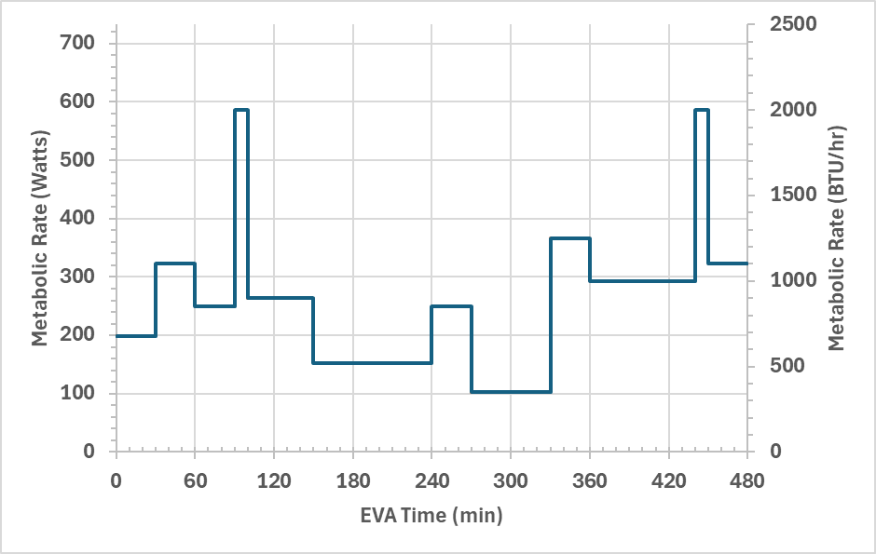
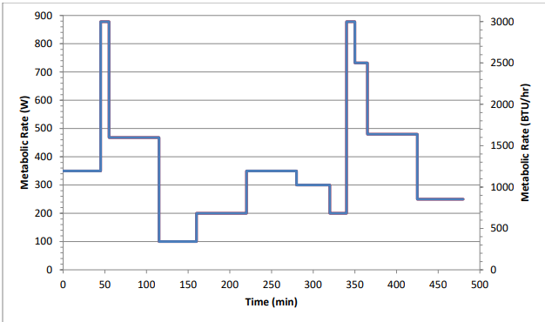
Metabolic Profiles
Maximum mass drivers may include traverse, peak task exertion, and fall recovery
Metabolic rate of the crewmember is estimated based on the below profiles
  ISS/EMU requirements at 1000 BTU/hr average
  EVAs have been increasing beyond 1000 BTU/hr avg. on ISS and future missions will be in a planetary gravity field (either Lunar or Mars) leading to an expected 1200 BTU/hr for future mission sizing
ISS EVA Metabolic Load Profile
xEMU Max Transient Metabolic Profile

Slide 5
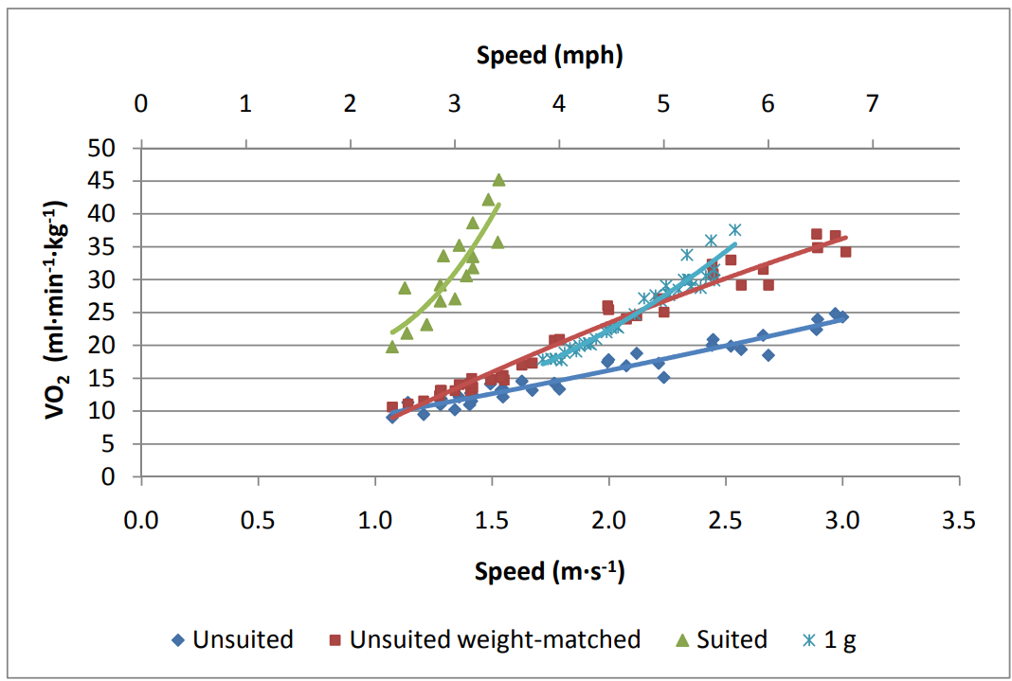
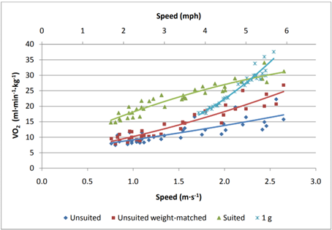
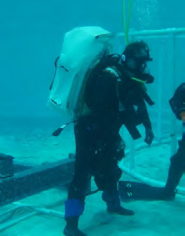
Existing Studies
There are limited suit studies for Mars gravity testing, though they help give an idea of the challenges expected on Mars
10-km Walkback Study
  This NASA study tested suited performance for a 10km walkback at both lunar and Mars gravity offloads for a fixed suit mass
  Did not vary weights
  Did not test at lower walking speeds (2.2mph was considered maximum nominal speed for Apollo)
  Demonstrated a significant effort in operating in Mars gravity
Fall Recovery Testing
  University of Maryland tested fall recovery with a weighted PLSS in their buoyancy lab
  Demonstrated significant mobility challenges with PLSS weights tested (both 70 and 100 kg)
  Was not suited/pressurized (wetsuit only)
10-km Walkback Study
Hits VO2_{max} at 3.5mph on Mars
Martian Offloading
Lunar Offloading
Fall Recovery Testing
10-km Walkback Study Data

Slide 6
Aerobic Modeling for Maximum Suit Mass
To model a maximum suit mass with existing data, aerobic maximums are used as a limiting factor for walk backs
Metabolic rate can be correlated to mass and VO2 rates assuming an average respiratory rate
  Note VO2 is sometimes reported in L/min and other times ml/min/kg and must be converted depending on the application
VO2_{max} (ml/min/kg) has a minimum flight rule set at 36 ml/min/kg for EVA
  Nominal VO2 should not exceed 35% VO2_{max} for an 8-hour workday, or 50% if trained for aerobic, and ~35% for anerobic (lifting)
  Crewmembers may be expected to handle ~43% VO2_{max} for an EVA due to training and mix of aerobic and anerobic work
  For a 5th percentile female, this would be 760 – 1100 BTU/hr (35-50% VO2_{max} )
  Future missions may consider heightened requirements (weight and VO2_{max} minimum) to meet higher exploration requirements (1200 BTU/hr average)
VO2_{max} Ranges (ml/min/kg)
VO2_{max} | 1% | 5% | 25% | 50% | 75% | 95% | 99%
Male age 30–39 | 27 | 31 | 37 | 42 | 48 | 54 | 58
Female age 30–39 | 23 | 26 | 31 | 35 | 40 | 47 | 52
Human Mass Percentile Chart
Mass Percentile | 1% | 5% | 25% | 50% | 75% | 95% | 99%
Male, lbm (kg) | 120 (55) | 138 (63) | 164 (74) | 181 (82) | 199 (90) | 225 (102) | 243 (110)
Female, lbm (kg) | 94 (43) | 108 (49) | 128 (58) | 142 (65) | 156 (71) | 176 (80) | 191 (87)
Metabolic Rate vs. VO2 (ml/min/kg) and Mass
BTU/HR (RER=.85) | VO2 (ml/kg/min)
Mass lbm (kg) | 10 | 15 | 20 | 25 | 30 | 35 | 40
120 (55) | 652 | 978 | 1304 | 1630 | 1955 | 2281 | 2607
140 (64) | 760 | 1141 | 1521 | 1901 | 2281 | 2662 | 3042
160 (73) | 869 | 1304 | 1738 | 2173 | 2607 | 3042 | 3476
180 (82) | 978 | 1467 | 1955 | 2444 | 2933 | 3422 | 3911
200 (91) | 1086 | 1630 | 2173 | 2716 | 3259 | 3802 | 4345
220 (100) | 1195 | 1793 | 2390 | 2988 | 3585 | 4183 | 4780
$MetRate(\frac{kcal}{min}){= }4.039 \left(\frac{kcal}{L}\right) ∗ VO2 \left(\frac{L}{min}\right)+1.157 \left(\frac{kcal}{L}\right)∗VCO2 (\frac{L}{min})$
$MetRate(\frac{BTU}{hr})=\left(0.961+(0.275∗RER)\right)∗VO_{2} \left(\frac{ml}{\min{∗kg}}\right)∗mass(kg)$

Slide 7
Considerations
Crew Physical Characteristics
  For current mission profiles, missions must consider 1st to 99th percentiles in potential crew masses
  Mars may consider more limitations such as 5th – 95th percentile to be in line with previous requirements/Apollo including custom sizing suits
NIOSH Carry Limit
  NIOSH max carry weight limit is 51 lbf for lifting loads
Suit Restricted Mobility
  Based on the 10km walkback study, it is estimated approximately 14 VO2 (ml/min/kg) is added against baseline unsuited walking due to the pressurized suit restrictions
Deconditioning
  Deconditioning is expected to decrease VO2_{max} by approx. 15-25% based on historical evidence
  At the time of EVA, a crewmember is expected to have 36ml/min/kg VO2_{max}. Therefore, at time of launch, a crewmember should have 15-25% higher VO2_{max} (43-49 ml/min/kg)
Pressure Offload
  The pressurized column of the suit provides a net force to offload some of the mass off the shoulder of the astronaut
  During walking this is approximately 48lbf based on testing
Tool/Sample Carry Mass
  A 50 lbm of tool/sample weight is assumed in estimations

Slide 8
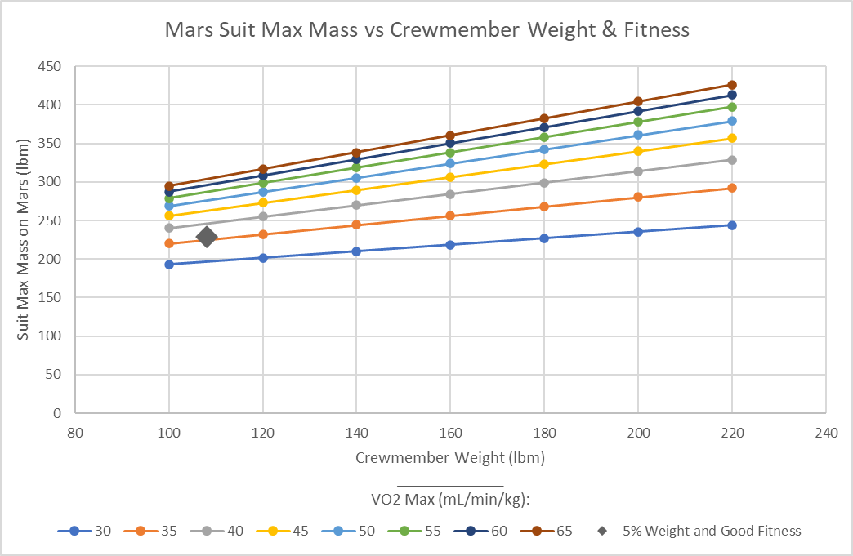
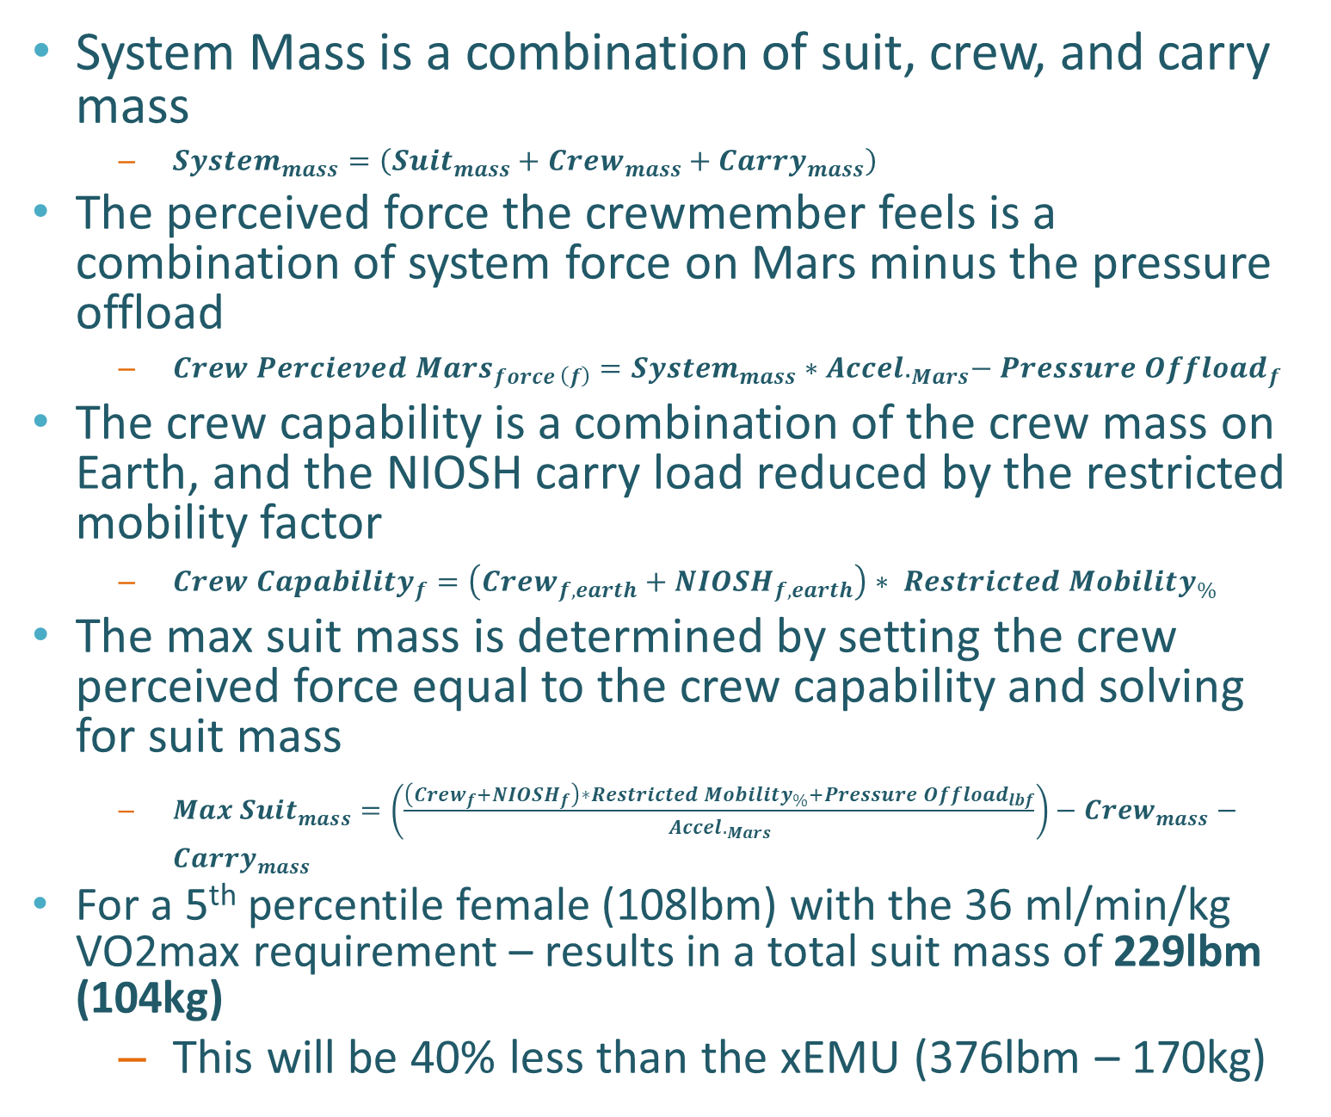
Initial Estimates
System Mass is a combination of suit, crew, and carry mass
  $System_{mass}=\left(Suit_{mass}+Crew_{mass}+Carry_{mass}\right)$
The perceived force the crewmember feels is a combination of system force on Mars minus the pressure offload
  ${Crew Percieved Mars}_{force \left(f\right)}=System_{mass}∗{Accel.}_{Mars}−Pressure Offload_{f }$
The crew capability is a combination of the crew mass on Earth, and the NIOSH carry load reduced by the restricted mobility factor
  ${Crew Capability}_{f}=\left(Crew_{f,earth}+{NIOSH}_{f,earth}\right)∗ Restricted Mobility_{\%}$
The max suit mass is determined by setting the crew perceived force equal to the crew capability and solving for suit mass
  $Max Suit_{mass}=\left(\frac{\left(Crew_{f}+{NIOSH}_{f}\right)∗Restricted Mobility_{\%}+Pressure Offload_{lbf}}{{Accel.}_{Mars}}\right)−Crew_{mass}−Carry_{mass}$
For a 5th percentile female (108lbm) with the 36 ml/min/kg VO2max requirement – results in a total suit mass of 229lbm (104kg)
  This will be 40% less than the xEMU (376lbm – 170kg)
Max Suit Mass vs Crewmember Earth Weight (lbm) and Fitness (VO2 Max, mL/min/kg)
Significant suit mass reduction for Mars will be required

Slide 9
Walking Speed and Walkback
Average walking speed on earth is 3.1 mph
Apollo EVA average walking speed
  Failed rover walkback assumption: 2.2 mph <1hour (1.7mph for >1hour)
  Apollo 15: 0.7-1 mph (first EVA), 1-1.4mph (second EVA)
Walkback after failure
  Walkback from a failure is assumed as limiting case for most EVA backup sizing and maximum distance away from the craft
  Assuming either 30 minute or 1-hour walkback and 2.2mph walkback this is a maximum radius away from the craft of 1.1 miles (30 minute) or 2.2 miles (1 hour)
  With mass constraints, the 30-minute walkback may be preferred so the design will close
Metabolic rates during walkback – assuming RER at 0.85
  Average crewmember would have 1700 BTU/hr
  Large (95th percentile mass) crewmember would be 2300 BTU/hr
  While higher than average of 1200 BTU/hr, traverse tasks are considered above average effort tasks, though the backup systems must be sized with this in mind
Comparison to walkback study
  Assuming a 50% maximum exertion of VO2_{max} for walkback (18ml/min/kg (36ml/min/kg *50%)), at 2.2mph this would be 19ml/min/kg based on the walkback study
  A slightly lighter weight suit compared to the walkback suit (265lbm) could be tenable – though more testing is required.

Slide 10
Validation of Model – Argos Testing
To validate and/or refine the prior model, a suited test using Active Response Gravity Offload System (ARGOS) will be required
  The PLSS mass will be varied for a parameterized test
  The above model will help bound the upper and lower limits of the PLSS mass
  Test will include a pressurized PGS
  Subjects will be varied to cover a wide range of crewmembers
Test will gather gait, task kinematics, metabolic rate, heart rate, workload, and subjective workload ratings
Data from this effort will continue to aid in MxEMU suited requirements by generating crew physiology modeling states based on EVA workload
Prior 10-km Walkback Study

Slide 11
Packaging Factors
Packaging factor is the ratio of total system mass/volume to combined component mass/volume
There is a tradeoff between volume and mass packaging factors
  Apollo had a high low packaging factor, and high volume, while EMU was opposite
  Smaller volume suits - mass will increase
  Larger volume provide more flexibility on structural design allowing for mass savings
EMU was limited in depth/volume to fit in between inter deck hatchways
Apollo used components as structure to save weight rather than a monolithic structure system like the backplate on the xEMU
  This creates a more integrated, less modular suit
A larger volume Mars PLSS with integrated components may be considered to reduce mass
PLSS Suit Mass Breakdown
 | Apollo (lbm) [5] | EMU (lbm) [5] | xEMU (lbm) | Average (lbm)
Oxygen Loop | 37.1 (58%) | 33.6 (51%) | 47.7 (46%) | 39.5 (51%)
Thermal Loop | 9.6 (15%) | 6.5 (9%) | 14.3 (13%) | 10.1 (13%)
Avionics | 6.7 (10%) | 15 (23%) | 21.6 (21%) | 14.5 (18%)
Power Supply | 9.5 (15%) | 10 (15%) | 19.2 (18%) | 12.9 (16%)
Components | 63.1 | 65.2 | 103.0 | 77.1
Packaging | 47.3 | 75.8 | 105.7 | 76.2
Total | 110.3 | 141.0 | 208.7 | 153.3
Mass Packaging Factor (Total / Components) | 1.7 | 2.2 | 2.0 | 2.0
Volume Packaging Factor | 3.0 | 2.0 | 2.6 | 2.5

Slide 12
Suit Mass Budget Strategy Proposed
Based on historical data, the PLSS is typically 60% of the suit mass, and the PGS is 40% of the suit mass
  This is applied here for the 229 lbm (104kg) limit
PLSS Mass Budget Strategy
  Larger volume factor to provide flexibility for lower system mass
  Return to single fault tolerant such as EMU/Apollo
  Reduce modularity, while favoring integration and using components for structure
  Reduce regeneration options
  Reduced EVA time
PGS Mass Budget Strategy
  Emphasis on improved mobility, while balancing mass
  Lighter, waist entry design
  Reduced cycle life
  Custom suit sizing
Both
  Implement lightweight advanced materials
  Increased crew fitness, tightened crew sizing requirements, and exercise countermeasures
Mars Suit Mass Allocation
Subsystem | Mass | %
PLSS Mass | 137 lbm (62kg) | 60%
PGS Mass | 92lbm (42kg) | 40%
Overall Suit Mass | 229lbm (104kg)
Mars PLSS Subsystem Mass Allocation
 | Average Percent | Mars PLSS lbm (kg)
Oxygen Supply | 51% | 41.1 (18.6)
Thermal Loop | 13% | 10.4 (4.7)
Avionics | 18% | 14.5 (6.5)
Power Supply | 16% | 12.8 (5.8)
Packaging | - | 56.4 (25.6)
Components | - | 80.5 (36.6)
Total | - | 137 (62.2)
Packaging Factor | - | 1.7

Slide 13
Conclusion
The current government reference design (xEMU) is 376lbm (170kg)
  Mars suits are estimated to have a maximum of 229lbm (104kg)
  Mars suits will require a 40% mass savings compared to xEMU
ARGOS testing will be required to verify and validate this estimate
Walkback and maximum radius from craft will need to be limited in distance to allow return to cabin in case of failure
Split between PGS (40%) and PLSS (60%) historically
  137 lbm (62kg) for the PLSS and 92lbm (42kg) for the PGS
Mars suit will need to be designed with a mass centered focus to operate
  Lean on Apollo principles to save mass: integrated, custom design, single fault tolerant
  Reduced EVA time
  Implement advanced materials
  Increased crew fitness, tightened crew sizing, and exercise countermeasures

Slide 14
Thank you!
Questions?
For references, please see associated paper
Contact: Ryan Ogilvie
Mars PLSS Project Lead
NASA JSC - Space Suit PLSS Team - EC5
ryan.e.ogilvie@nasa.gov

