Slide 1
Advanced Materials Testing Plan for the Space Suit
Portable Life Support System
55th International Conference on Environmental Systems
12-16 July 2026, Rio Grande, Puerto Rico
ICES-2026-128
Ryan Ogilvie and Sean Miller
NASA Johnson Space Center, Houston, Texas
Jennifer Chavez
Amentum, Houston, TX
Trade names and trademarks and company names are used in this report for identification only. Their usage does
not constitute an official endorsement, either expressed or implied, by the National Aeronautics and Space Administration.

Slide 2
Introduction
Advanced Materials are important to reducing weight and maintaining suit capability for all mission profiles
  Current government reference design, the exploration Extravehicular Mobility Unit (xEMU) suit is 391lbs (177kg)
  Mars suit maximum mass is currently estimated at 229lbs (104kg), requiring a 44% reduction in mass from the xEMU design
Machined thermoplastics and additively manufactured (AM) parts are considered for infusion
  Glass or carbon filled thermoplastics provide some of the highest performing properties on the market after metals
  Augmentation such as plating could be used to improve strength properties
  Inserts may be used to improve bolt pull out strength
A series of testing is required to ensure advanced materials meet all stringent spaceflight requirements

Slide 3
Considerations, Usage, and Safety
Spaceflight has many environmental considerations that materials must meet
  Ultimate tensile strength (UTS) and other mechanical properties
  Galvanic compatibility
  Thermal properties including operation at cryogenic temperatures, heat dissipation
  Electromagnetic interference (EMI) protection and grounding
  Oxygen compatibility
  Off gassing, and vacuum outgassing
Thermoplastics are not new, but usage in criticality 1 space suit life support applications in space is new
  Prior systems have only considered metallics to be mature enough for critical applications
  NASAs AM handbook does not consider thermoplastic AM mature enough for critical applications, but metallic AM can be considered now
  Machined thermoplastics could be used with sufficient testing
  A set of tests to verify advanced materials starting with machined thermoplastics would build confidence to integrate these materials in critical applications

Slide 4
Advanced Material Options
Material | Material Category | Process | UTS/ Density Ratio ksi/(lb/in³) (MPa/(g/cm³)) | Density Average lb/in³ (g/cm³) | UTS ksi (MPa)
Titanium 6Al-4V | Metal | Machine | 969 (241) | 0.16 (4.43) | 155 (1069)
EOS Titanium Ti64 | Metal | PBF (AM) | 956 (238) | 0.16 (4.43) | 153 (1055)
Aluminum 7075-T73 | Metal | Machine | 713 (168) | 0.101 (2.8) | 68 (469)
EOS Aluminum AlSi10Mg | Metal | PBF (AM) | 673 (168) | 0.098 (2.71) | 66 (455)
PEEK 30% CF | Plastic | Machine | 529 (132) | 0.051 (1.41) | 27 (186)
PEI 30% GF (Ultem 2300) | Plastic | Machine | 466 (116) | 0.0545 (1.51) | 25.4 (175)
Aluminum 6061-T651 | Metal | Machine | 429 (107) | 0.098 (2.71) | 42 (290)
PEEK 30% GF | Plastic | Machine | 407 (101) | 0.054 (1.49) | 22 (152)
PEI (Ultem 1000) | Plastic | Machine | 359 (89) | 0.046 (1.27) | 16.5 (114)
PEEK | Plastic | Machine | 340 (85) | 0.047 (1.3) | 16 (110)
Nylon 12 + CF / Windform XT 2.0 | Plastic | SLS (AM) | 307 (76) | 0.0394 (1.09) | 12.1 (83)
Nylon 11 + CF / Windform SP | Plastic | SLS (AM) | 274 (68) | 0.04 (1.11) | 11 (76)
Polycarbonate 20% GF | Plastic | Machine | 268 (67) | 0.0487 (1.35) | 13.1 (90)
Vespel SP-1 | Plastic | Machine | 242 (60) | 0.0517 (1.43) | 12.5 (86)
Ultem 9085 | Plastic | FDM (AM) | 180 (44) | 0.0483 (1.34) | 8.6 (59)
DuraForm PA / Nylon 12 | Plastic | SLS (AM) | 171 (43) | 0.0361 (1) | 6.2 (43)
PerFORM | Plastic | SLA (AM) | 161 (40) | 0.0582 (1.61) | 9.4 (65)

Slide 5
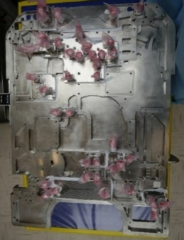
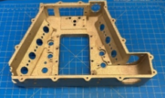
Current Applications
TRL | Source | Description
7 | NASA JSC | SERFE flew to test a next generation thermal loop for the space suit. It included a prototype pump that utilized AM titanium with post process machining. This system was tested at vacuum on the ISS and functioned adequately.
7 | NASA JSC | This backplate was developed by NASA JSC with Langley research center using traditional machining methods but augmented with generative design for mass removal and Electron Beam Welded (EBM) Channels. Generative design has simplified the design iteration process to come to an optimized solution using automated systems and then verified using traditional methods. The EBM channels have helped reduce complexity by creating a single monolithic part. Additionally, a version of this method was also used and flown on the SERFE project in the vacuum of space and functioned without issue.
5 | NASA JSC | Ultem 9085 has been implemented in the Display and Control Unit (DCU) housing for the space suit government reference design. This was tested in the “Suit 2,” a full PGS build, during thermal vacuum testing. It performed without any issues. Another prototype of the DCU housing was explored using Windform SP that was plated with nickel as a proof of concept shown here.
3 | Makel Engineering | A multi-gas sensor primarily intended to measure carbon dioxide is being developed for NASA by Makel Engineering. Makel has explored metal AM as a method to create complex internal geometries for the sensor. They looked at mechanical and electrical polishing the sensor to improve the finish and sealing at first, though they are now looking at machining post processing to improve sealing surfaces.
4 | Hamilton Sundstrand | A prototype AM heat exchanger for the space suit PLSS was fabricated out of titanium and Inconel using PBF. The sealing surfaces were machined before testing and the heat exchanger functioned adequately. It even had a bit higher effectiveness of heat transfer, thought to be due to the increased surface roughness. This demonstration shows the viability of using PBF in the space suit for complex articles such as these.
3 | University of Maryland | An AM elbow assembly from the University of Maryland made from DuraForm PA has been tested at 4.3 psia relative pressure differential. It tested well overall, but there were leaks at the seals. They explored epoxy coating and sanding to improve sealing, but that did not work. Future work is to address some leaks due to surface roughness and to investigate traditional machining for post processing to improve sealing.
Pump Manifold
Backplate
Display and Control Unit Body
Gas Sensor Body
Heat Exchanger
Elbow Assembly

Slide 6
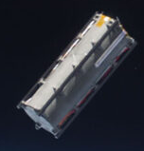
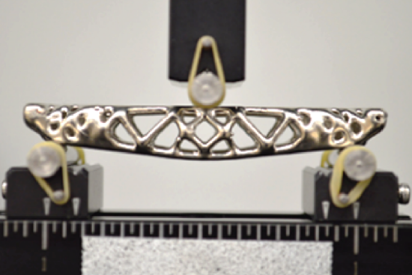
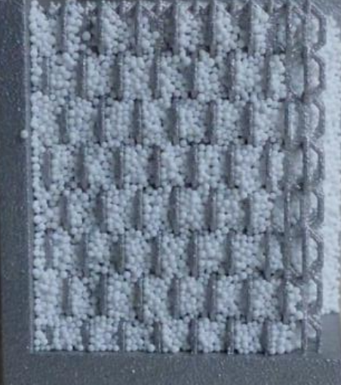
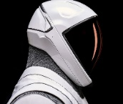
Current Applications
TRL | Source | Description
3 | David Clark | Prototype AM for PGS solid portions has been studied by David Clark Company focusing on boots and helmets. These demonstrations indicate the ability for AM to meet the complex shapes needed for the PGS and can meet basic functional requirements through mechanical testing. The research notes this could be expanded to the large Hard Upper Torso (HUT) assembly, though indicates the need for continued materials testing.
9 | CRP/ Windform, G.A.U.S.S. Srl, Tetonsys, and others | A Tubesat-POD was developed to launch cube satellites from the ISS. It utilized Windform XT 2.0 as the primary external structure. Two Tubesats were launched with this: Tancredo-1 and OSNSAT. While this is not space suit related, this demonstrates the ability of AM thermoplastics to successfully function for critical deployments in space.
4 | Repliform, Pennsylvania State & Formlabs | Repliform in conjunction with Pennsylvania state has been exploring a method of plating AM with a copper/nickel coating to increase the strength of the overall structure. This method uses topology optimization combined with SLA AM to create complex forms, then plated and tested in bending with good results that rival AM PBF aluminum. Future work is needed to develop predictive models using this method and integrate it into hardware.
4 | Reaction Systems | Reaction Systems has been exploring a method to create a lattice for the Rapid Cycle Amine (RCA) swing bed using AM. The figure shows a cross section of the amine beads in the AM lattice.
9 | SpaceX | SpaceX conducted their Polaris Dawn mission with their suits that used polycarbonate AM as the base material for their helmet.
Spacesuit Helmet – David Clark
CubeSat Deployment
Plating AM Thermoplastic
Lattice Sorbent Bed
Spacesuit Helmet – SpaceX

Slide 7
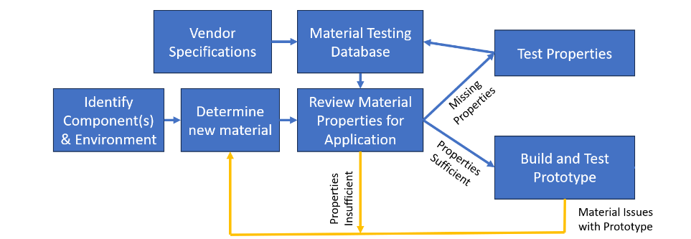
Testing Plan
To raise the TRL of the materials considered, an infusion path is defined
  Identify environment
  Consider new materials for infusion
  Review existing materials properties from material database and vendor specifications
  Identify material testing gaps
  Test materials and update database
  Build and test prototypes
Testing Plan and Infusion Path

Slide 8
Applications
Ventilation System
  Consists of manifolds, fans, CO₂ removal systems and associated housings, and heat exchangers.
  Thermoplastics could be integrated to replace the pressure-holding elements
  Special attention should be paid to the 100% oxygen requirement
Thermal Loop System
  Consists of pumps, housings, water evaporator, heat exchanger, check valves, and associated tubing.
  Thermoplastics could be used to replace any non-active, pressure holding elements in the water loop.
  Special attention and testing should be conducted to verify the iodinated water is compatible with the material chosen and the material does not leach into the water loop
Avionics and Power
  Consists of multiple avionics boxes and battery housings
  Could be replaced with thermoplastics as they do not hold a lot of stress
  Special attention should be paid to EMI, thermal, and bonding requirements
Structure
  Holds all the other components of the PLSS together
  Brackets could be switched to thermoplastics
  Special attention should be paid to galvanic compatibility between the primary structure and the associated brackets

Slide 9
Materials and Standards for Testing
Initial Materials Selected for Testing
  Carbon Filled Thermoplastics
    PEEK CF30 (MIL-P-46183)
  Glass Filled Thermoplastics
    PEEK GF30 (MIL-P-46183) and Ultem (PEI) 2300 (MIL-P-46184)
  General Thermoplastics
    PEEK Natural (per MIL-P-46183) and Ultem (PEI) 1000 (per MIL-P-46184) )
  Additive Manufactured Thermoplastics
    Windform SP (Nylon 11 +CF) (AM) and Windform XT 2.0 (Nylon 12 +CF) (AM)
Recommended supplemental testing for advanced materials in spaceflight
  General Thermoplastic Tests
    ASTM-D4065 – Dynamic Mechanical Analysis (DMA) for temperature performance
    ASTM-D256 – Izod Impact Test
    ASTM-D7332 – Pull out test for fasteners
    ASTM-D3846 – Shear strength of plastic
    ASTM-D570 – Water Absorption Tests
    ASTM-E328 – Creep Test
    ASTM-D2863 - Oxygen Index
    ASTM-E595 – Outgassing
    NASA-STD-6001B – Off gassing/toxicity
  AM Testing
    ASTM-D638 - Tensile test in multiple print orientations (X-Y/ Z)
  Plating Testing
    ASTM-D7127 – Surface Roughness
    ASTM-C177 – Thermal Conductivity
    ASTM-D638 – Tensile Properties
    ASTM-D4935 – EMI Testing

Slide 10
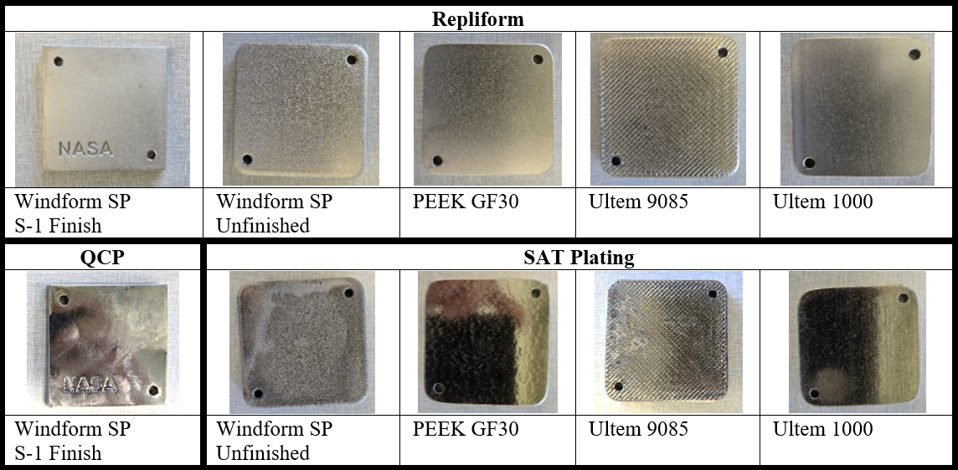
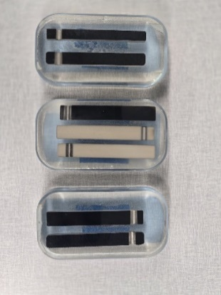
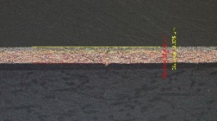
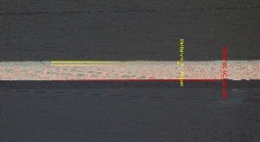
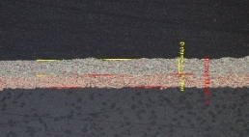
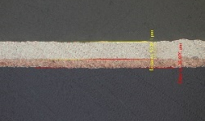
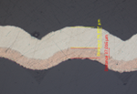
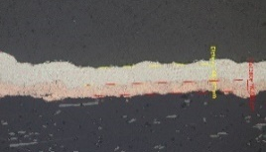
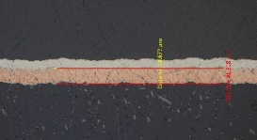
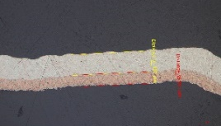
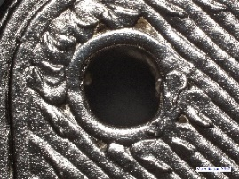
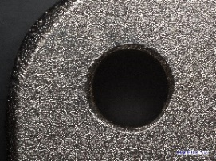
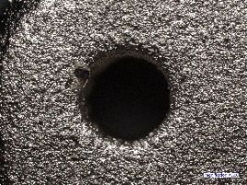
Plating Preliminary Results
Multiple vendors were tested for plating thermoplastics
  Electroless nickel was applied at a 0.003” thickness
  An underlayer of copper is common for electroless nickel plating
  Sanding on 3D printing prior to plating substantially improved results
Samples were mounted to measure plating accuracy
  Finish closely follows original surface finish
  Sat plating – AM – incomplete plating
  SAT plating – Machined – 43-44% diff.
  Repliform – AM – 14-33% diff.
  Repliform – Machined – 7-15% diff.
  Repliform performed most consistently for all materials
Machined Plastics
SAT Plating, Peek 30% GF | SAT Plating, Ultem 1000 | Repliform, Peek 30% GF | Repliform, Ultem 1000
Additive Manufactured (AM)
Repliform, Windform SP Unfinished | Repliform, Windform SP S1 Sanding Finish | Repliform, Ultem 9085 (View 1) | Repliform, Ultem 9085 (View 2)
Cut plated samples
Ultem 9085 | PEEK 30% GF | Windform SP unfinished

Slide 11
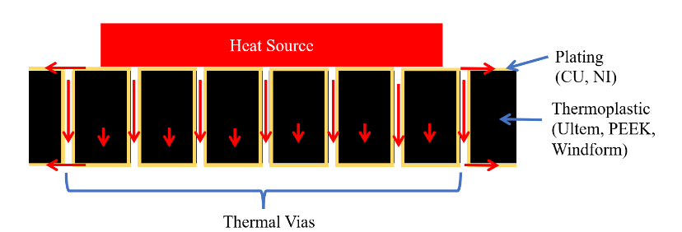
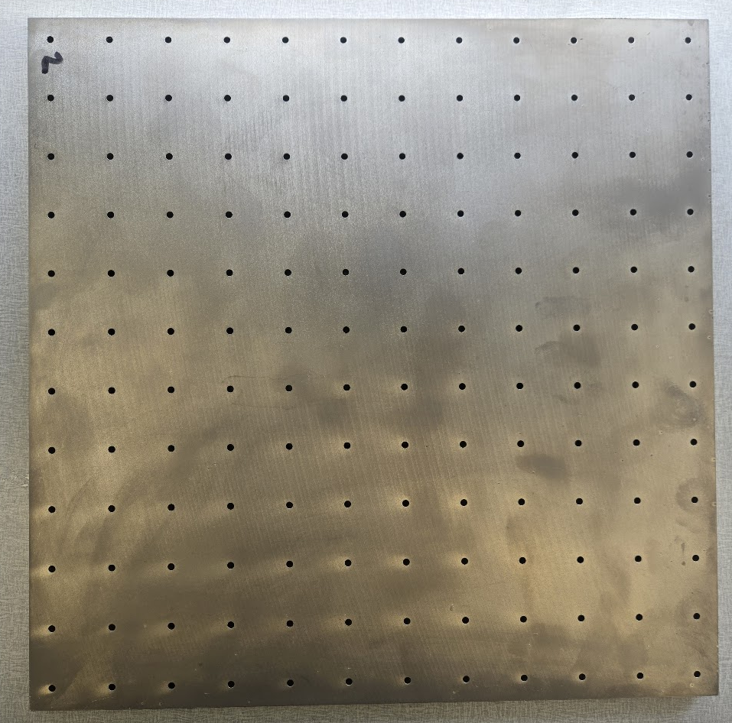
Plating Thermal Testing
Plating improves thermal conductivity by implementing “Thermal Vias”
  Thermal Vias: plated holes through base material to improve thermal conductivity
  Using thermal resistance equations for a steady 1-D system an approximation of heat transfer can be calculated
Ultem 1000 material was machined with holes in a 1 ft x 1 ft panel
  Thermal Conductivity was tested using ASTM C-177
  Number of holes was varied from 0, 25, and 144
Results showed lower performance than estimated
  Plan to verify with a second test
Thermal Vias Diagram
# Holes | Specification | Predicted Thermal Conductivity (W/mK) | Results
- | Ultem Vendor Specification [19] | 0.122 (specification) | N/A
0 | Plated 0.003" | 0.124 | 0.119
25 | Plated 0.003" | 0.164 | 0.122
144 | Plated 0.003" | 0.361 | 0.151
$R_{th}=\frac{Δx}{k A}$ (1) | $R_{th,total}=R_{th,1}+R_{th,2}+R_{th,3}+…+R_{th,N}$
Materials | Tensile Modulus (GPa) | UTS (MPa) | Thermal Conductivity (W/mK)
Structural Copper [16] | 90 | 370 | 401*
Ductile Nickel [16] | 140 | 860 | 90.7*
Hard Nickel [16] | 146 | 1558 | 90.7*
Ultem 2300 [18] | 10.4 | 175 | 0.31
Ultem 1000 [19] | 3.35 | 115 | 0.122
Thermal Vias Plate
Material properties used in plating

Slide 12
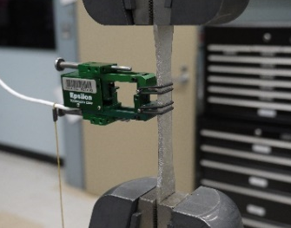
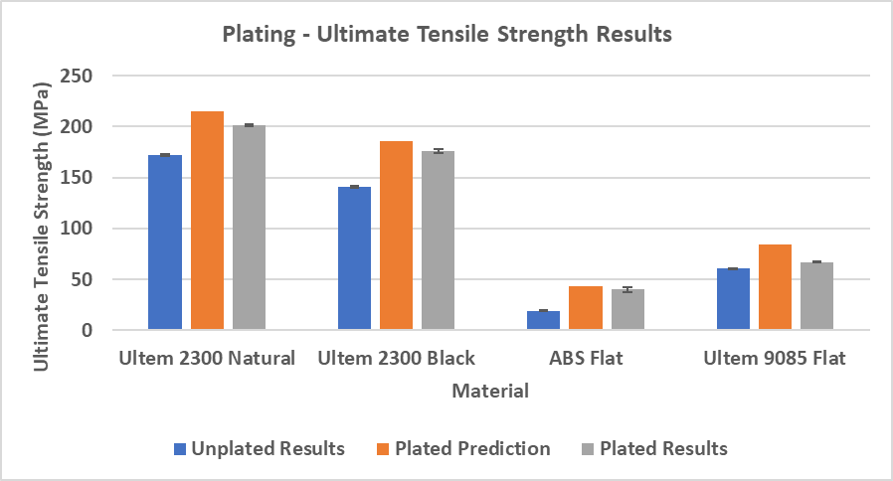
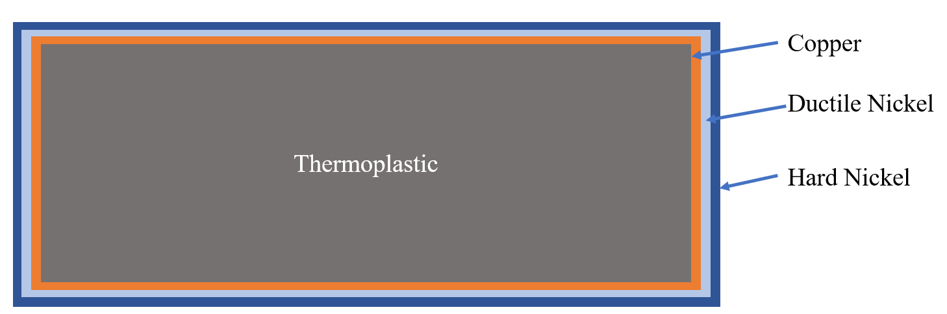

Plating Pull Testing
Plating improves overall tensile properties
  Provides a thin, but strong outer layer of metal on the plastic
  Was evaluated for both tensile and bending performance
Composite material properties could be approximated using the rule of mixtures
  Combines fractions of the different materials
Dog bone samples were procured and plated with different thicknesses from two different test series
  Results matched closely to predicted values – 6%-22% difference overall depending on material
  Ultimate Tensile Strength (UTS):
    17% increase for 2300
    22% increase for Ultem 9085
    108% increase for ABS
  Tensile modulus was a little higher than predicted while UTS was a little lower
Higher plating thicknesses could be used to improve strength more
Plated Dog Bone Sample in Tensile Test
$$E_{C}=f E_{1}+\left(1−f\right)E_{2}$$
Cross section of dog bone (not too scale)

Slide 13
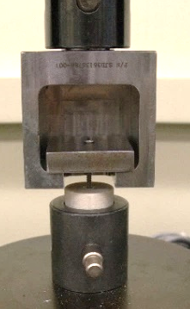
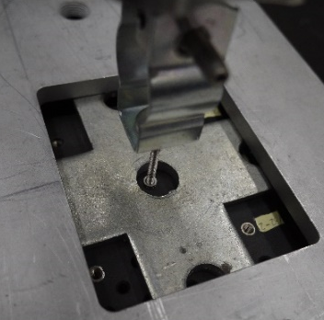
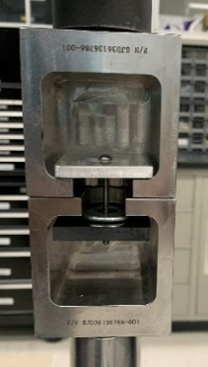
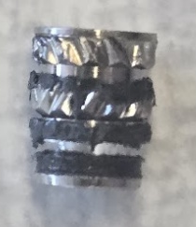
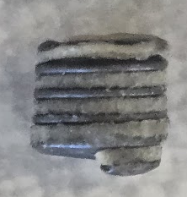
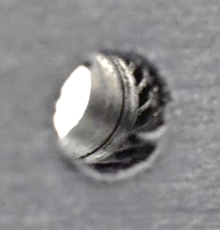
Insert Pullout Testing
Inserts are recommended for usage in thermoplastics to improve pull out strength for bolts
  Heat inserts and helical inserts were tested
  Inserts are installed and bolts are pulled using a tensile test machine
3 different methods were used depending on the test series
Insert typically fails in shear against the material
  This could be used to estimate the pull-out strength; however, shear strength data must be available
Heat inserts may often bead up against the surface during installation
Many Inserts in Plate | Single Insert in Plate | Single Insert in Cylinder
Heat Insert after Pull Out | Helical Insert after Pull Out | Impression Left in Material from Heat Insert Pull Out
$Helical Insert Pull out Strength \left(lbs\right)={\left(\frac{π∗D_{m}(in)}{TPI}∗\%Shear∗N\right)}_{Area}∗Shear Strength$

Slide 14
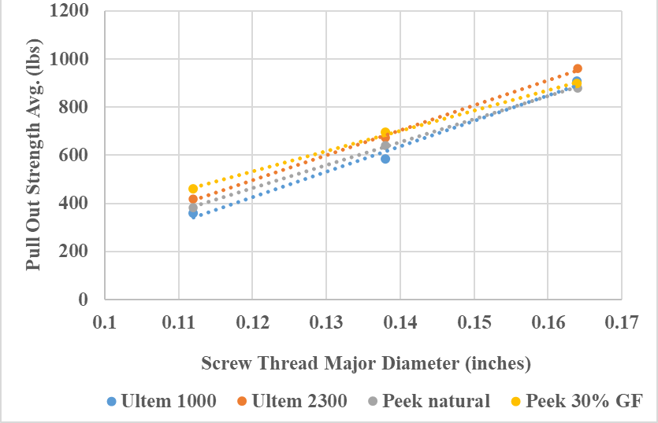
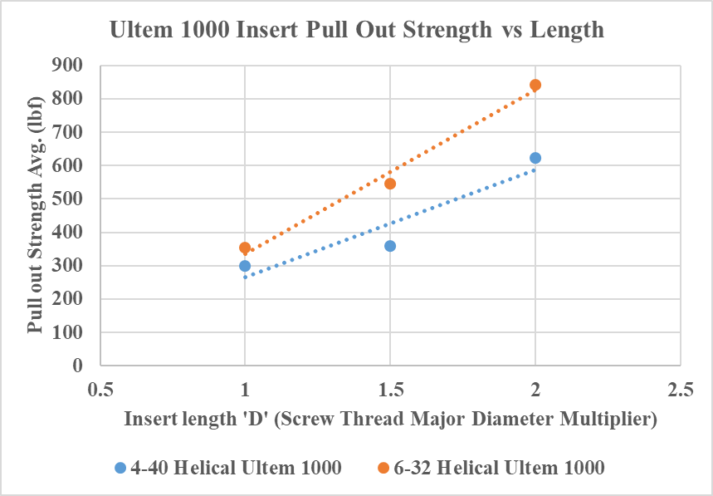
Insert Pullout Results
Heat Insert and Helical Insert data is shown
  Glass filled material did not allow for installation of some heat inserts even at high temperatures
Helical inserts vs Heat inserts do not show a large difference relative to similar lengths and diameter
  Ultem 1000 .219” 4-40 heat insert (634 lbs)
  vs .224” 4-40 helical insert (622 lbs)
  Ultem 1000 .250” 6-32 heat insert (807lbs)
  vs .276” 6-32 helical insert (843lbs)
Quality of insert installation is critical to achieve consistent results
Linear relationship with pull out strength and major diameter and insert length
Helical inserts recommended over implementing heat inserts
  Removes potential for bead up, improved consistency, can be installed in glass filled plastics, and can be replaced
Hole Size | Type | Length/code | Ultem 1000 Black lbs‡ | Ultem 2300 Black lbs‡ | Peek natural lbs‡ | Peek 30% GF lbs‡ | Windform SP lbs‡
4-40 | Heat Set | 0.135" (IUC-440-1) | - | * | - | * | 138 (10)
4-40 | Heat Set | 0.219" (IUC-440-2) | 634 (30) | * | 660 (24) | * | 232 (25)
6-32 | Heat Set | 0.150" (IUC-632-1) | - | * | - | * | 163 (22)
6-32 | Heat Set | 0.250" (IUC-632-2) | 807 (18) | * | 863 (55) | * | 362 (38)
8-32 | Heat Set | 0.185" (IUC-832-1) | 567 (52) | * | 614 (56) | * | 220 (43)
8-32 | Heat Set | 0.312" (IUC-832-2) | - | * | - | * | 347 (20)
4-40 | Helical | 0.112" (1D) | 300 (7) | - | - | - | -
4-40 | Helical | 0.168" (1.5D) | 358 (43) | 420 (38) | 383 (85) | 459 (82) | -
4-40 | Helical | 0.224" (2D) | 622 (37) | - | - | - | -
6-32 | Helical | 0.138" (1D) | 353 (33) | 458 (60) | - | - | -
6-32 | Helical | 0.207" (1.5D) | 582 (33) | 672 (120) | 641 (34) | 694 (84) | 366 (12)
6-32 | Helical | 0.276" (2D) | 843 (49) | - | - | - | -
8-32 | Helical | 0.246" (1.5D) | 908 (129) | 960 (76) | 880 (37) | 897 (119) | -
*Could not gather data or not recommended for installation
‡Data for table above is shown as: Average - lbs (standard deviation- lbs)
1.5D Helical Insert Pull Out Strength vs Diameter
Ultem 1000 Insert Pull Out Strength vs Length

Slide 15
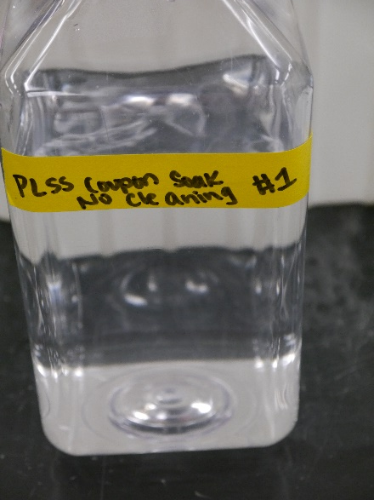
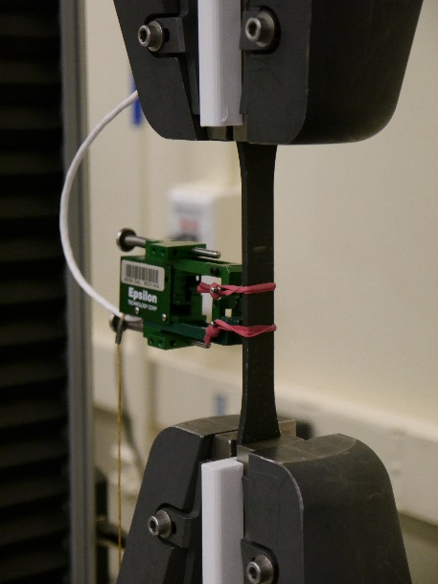
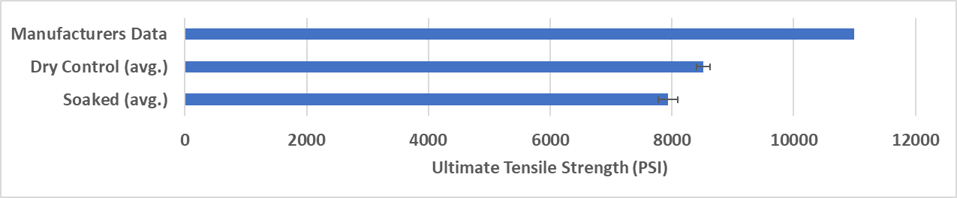
Water Absorption and Pull Tests
For water loop components, materials are subjected to a continuous soak of water
  Evaluated tensile and weight properties for Windform SP
Procedure:
  Type I dog bone samples procured for Windform SP
  Samples were measured prior to soak for weight, and a set of samples was tensile tested to failure
  Samples were soaked in water
  Weight was measured after, and tensile test was run again
Results:
  0.1% change in weight
  7% decrease in tensile strength
Deionized Water Specimen Container
Tensile Test
Water Absorption and Pull Test Data

Slide 16
Forward Work
Materials Testing
  Complete all tests identified to close material gaps for thermoplastics
  If plating is chosen, the same tests and plating evaluation tests will need to be repeated with plated materials
  Complete additional AM tests to improve maturity of AM and allow it in criticality 1 locations
  Material testing should raise TRL level of associated material in spacesuit context to TRL 3/4
Hardware Infusion
  Identify PLSS components in which materials could be replaced for thermoplastics
  Machined thermoplastics should be considered for low complexity parts
  AM components should be considered for complex parts and novel methods which cannot be made with traditional machining methods or reduce cross drills to lower leakage opportunities
  Infusion will help raise TRL to 5/6 of the material in a relevant environment

Slide 17
Conclusion
Advanced materials should be included in future suit designs to lower overall mass of the suit
  PEEK and PEI (Ultem 1000) should be considered as replacements for metallic parts
  Glass Fill and Carbon Fill may be added to improve strength, and improve thermal and electrical properties of the material
  Plating may be added to improve electrical, mechanical, and thermal properties
Material testing is required to quantify critical spaceflight properties for infusion
  Cryogenic temperature mechanical properties, pull out of insert, water absorption, creep, oxygen index, and others
  For infusion and testing, machined thermoplastics should be prioritized first to close the gap of material data
  AM material testing should be conducted in parallel to improve maturity of AM for integration in criticality 1 locations
Initial testing was conducted
  Repliform showed good preliminary results for plating thermoplastics both machined and AM
  Heat inserts and helical inserts performed similarly performance wise
    Helical inserts preferred for installation benefits
  Water absorption tests show only a minor decrease in tensile strength for Windform SP (AM)

Slide 18
Thank you!
Questions?
Please see associated paper for references
Contact: Ryan Ogilvie
Mars PLSS Project Lead
NASA JSC - Space Suit PLSS Team - EC5
ryan.e.ogilvie@nasa.gov

