Slide 1
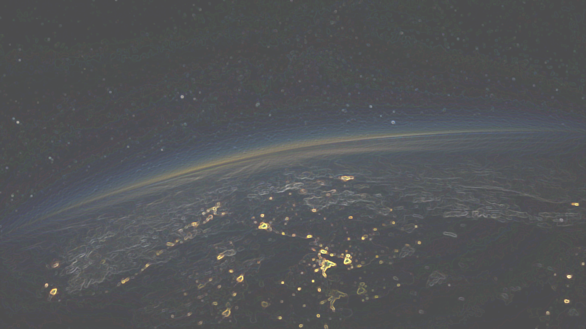



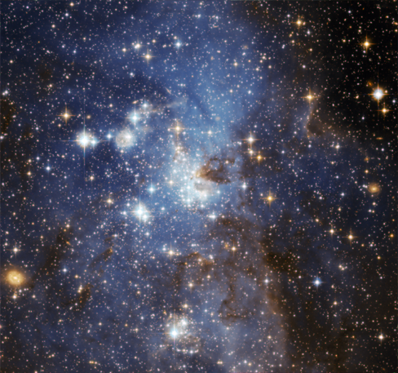
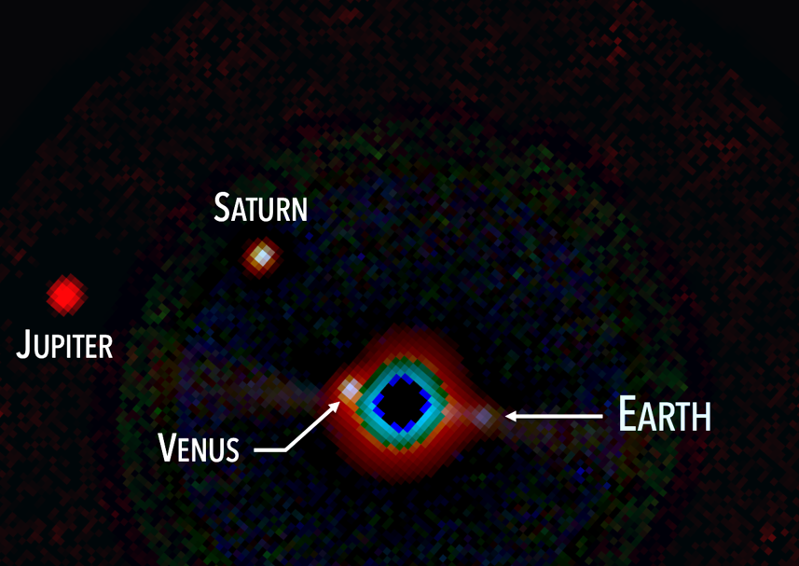
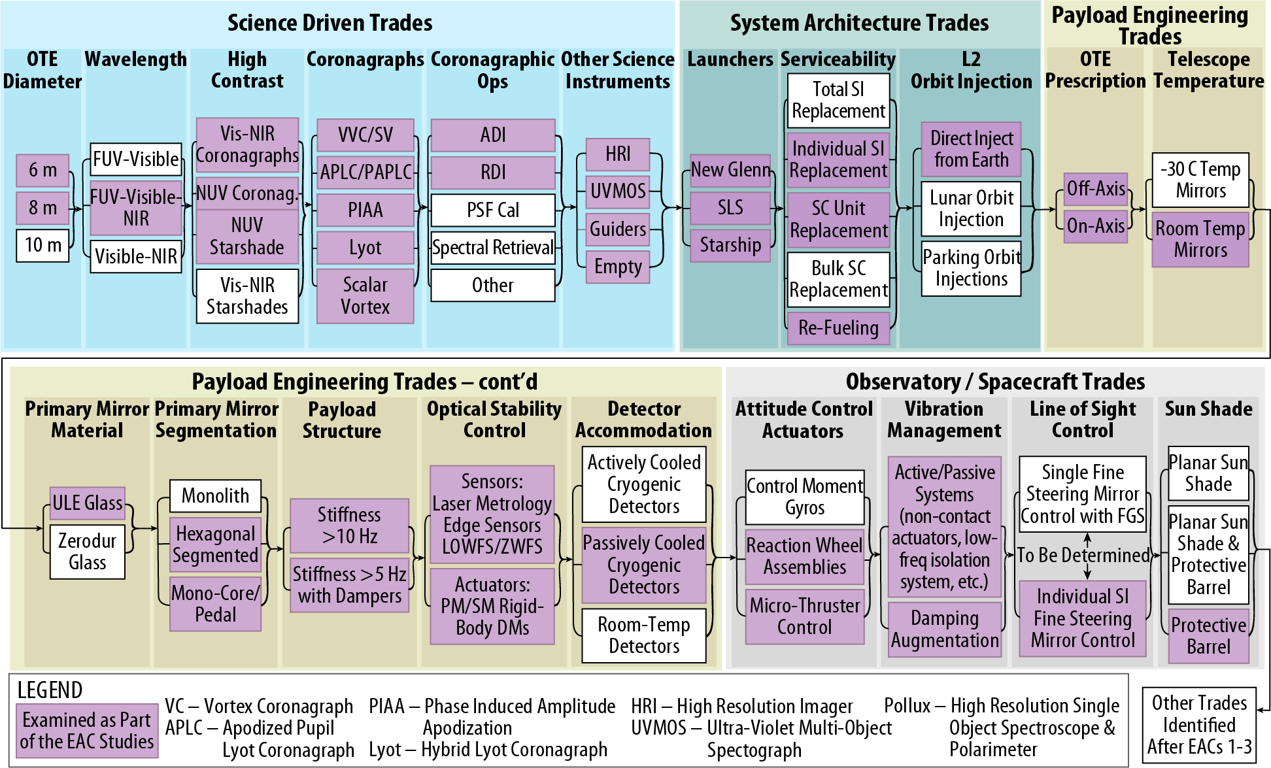
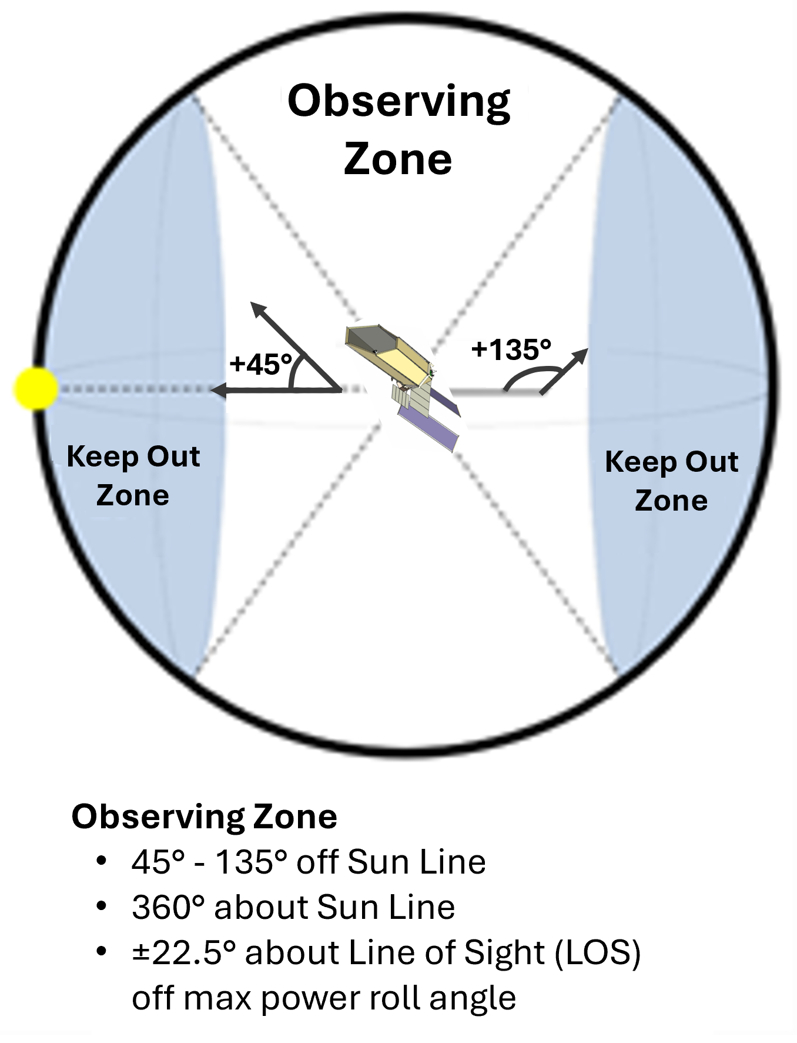
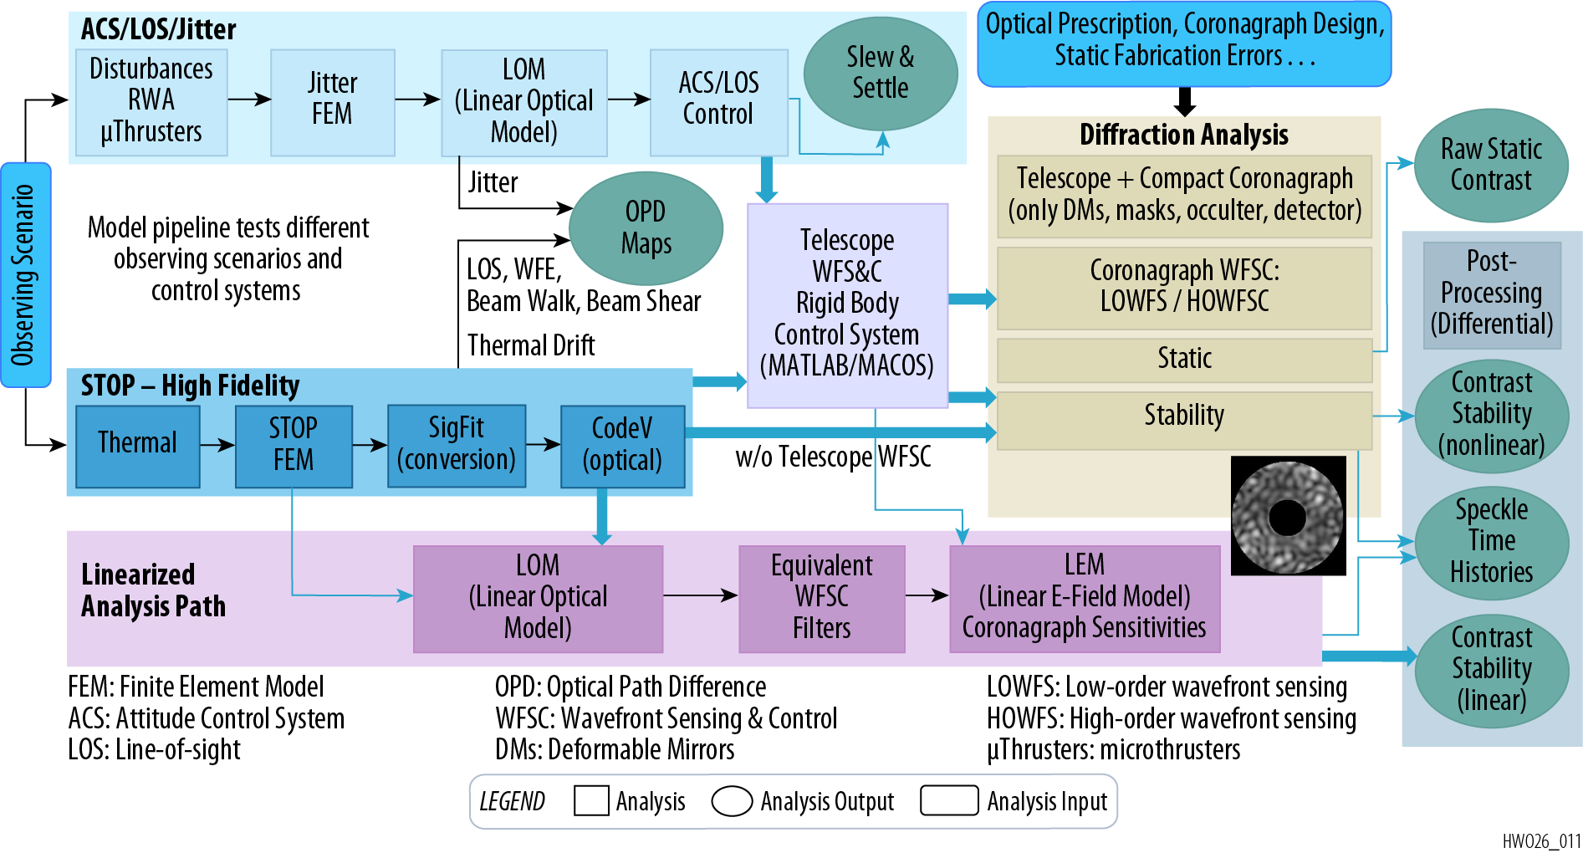
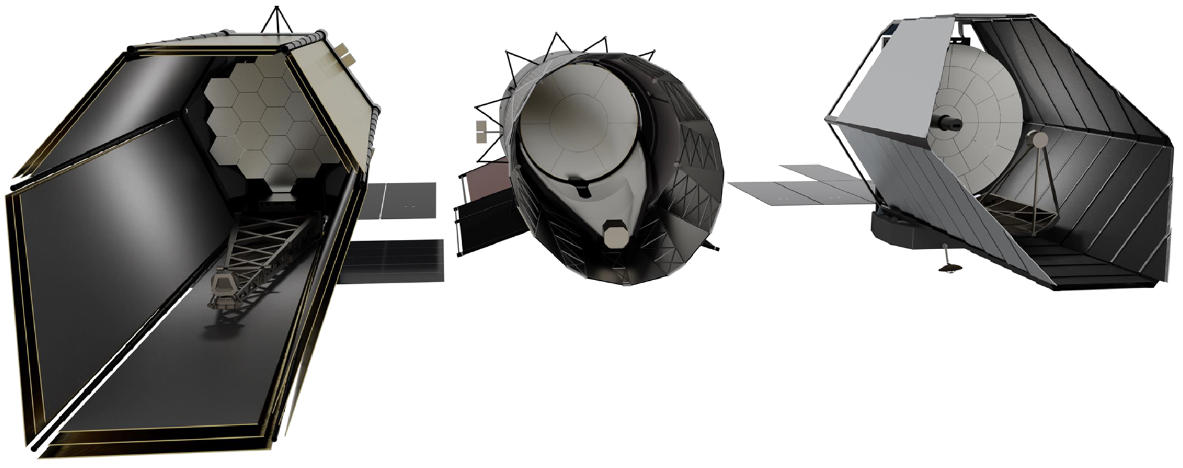
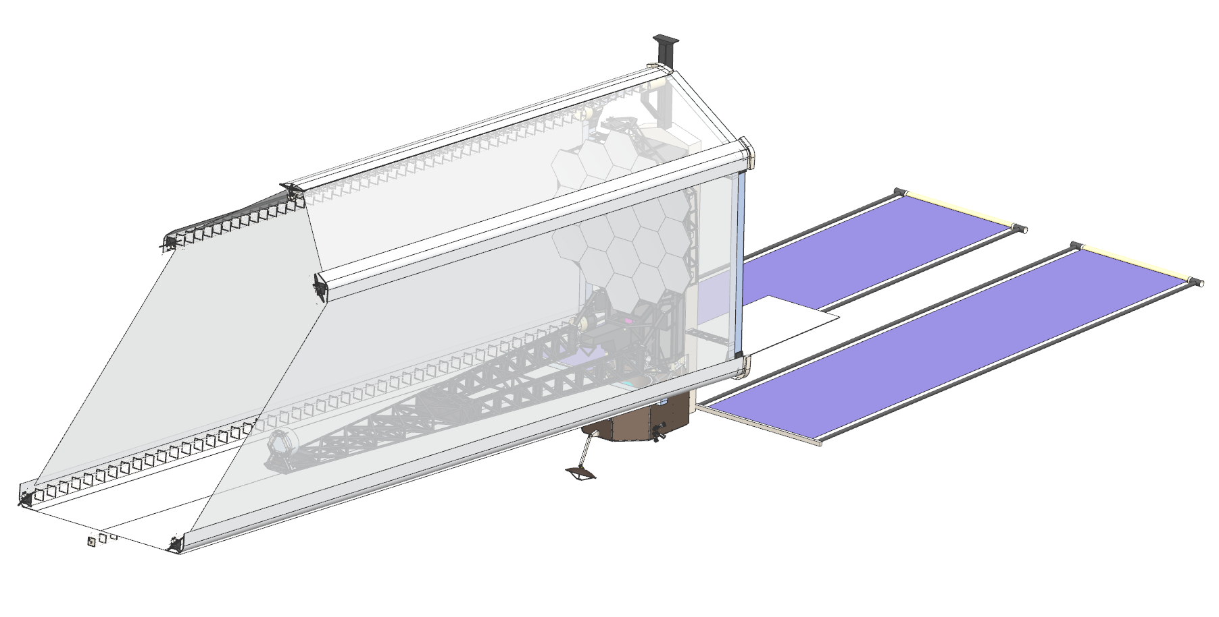
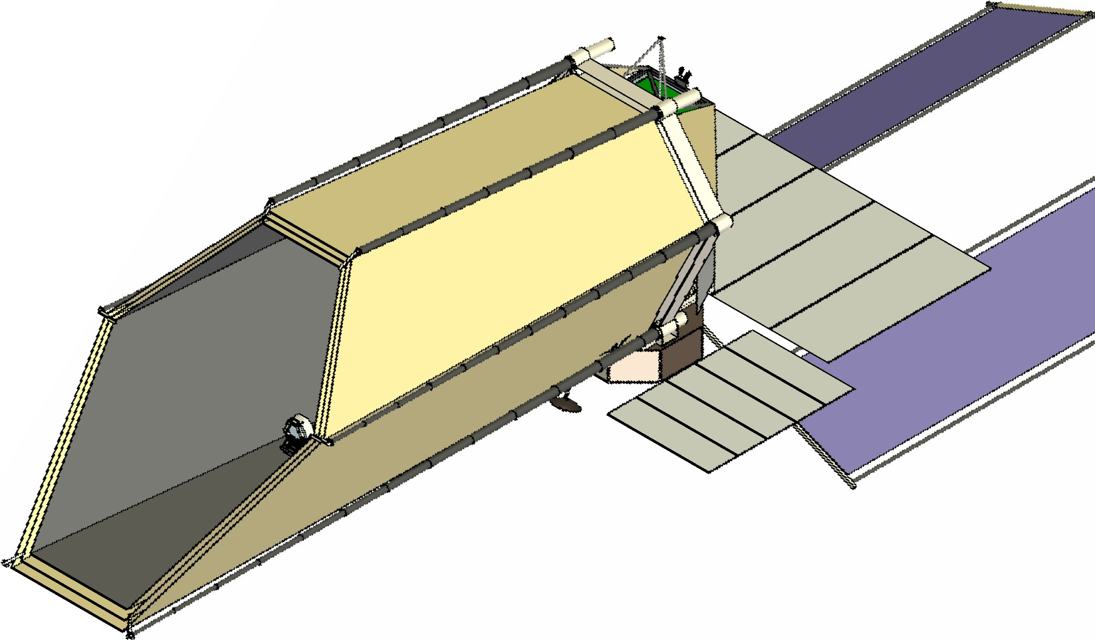
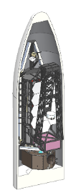
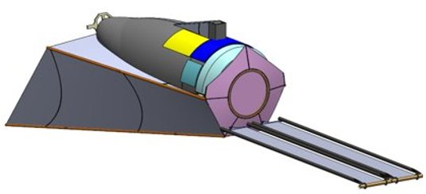
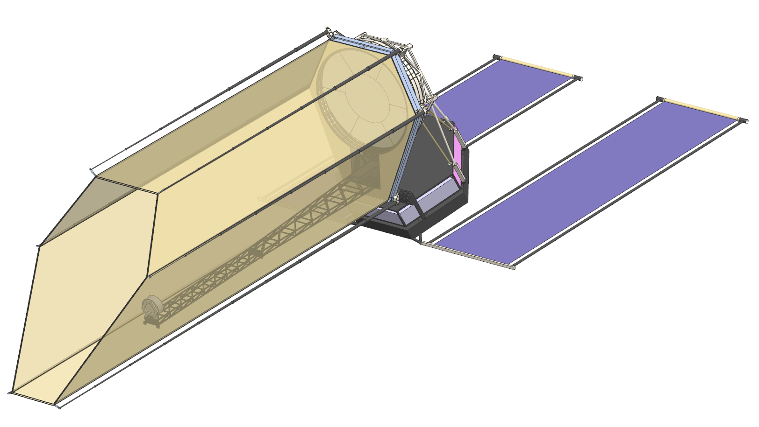
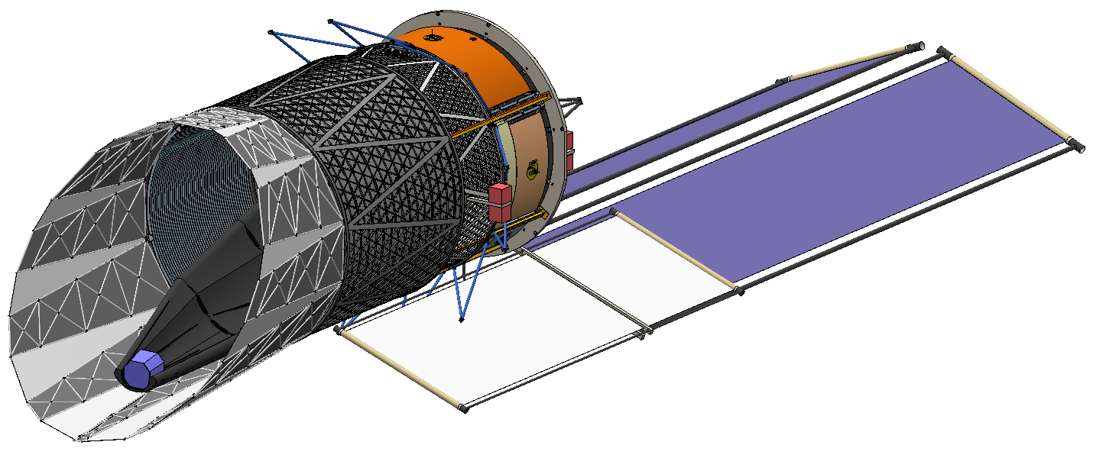
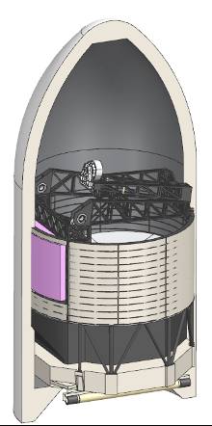
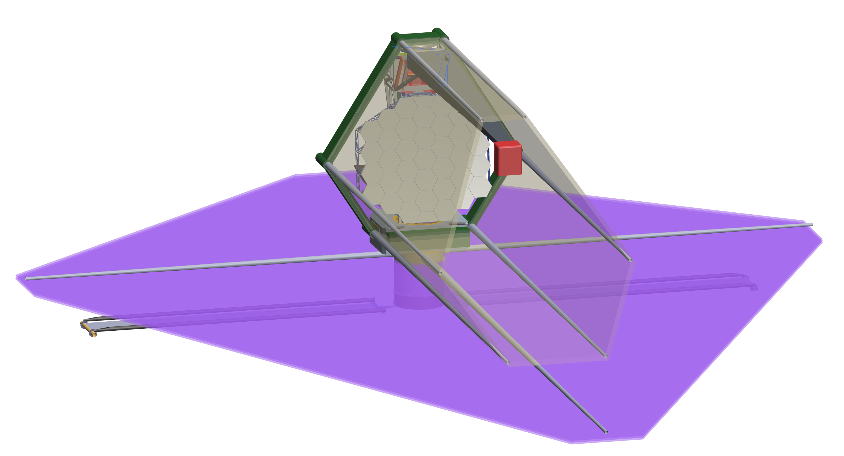
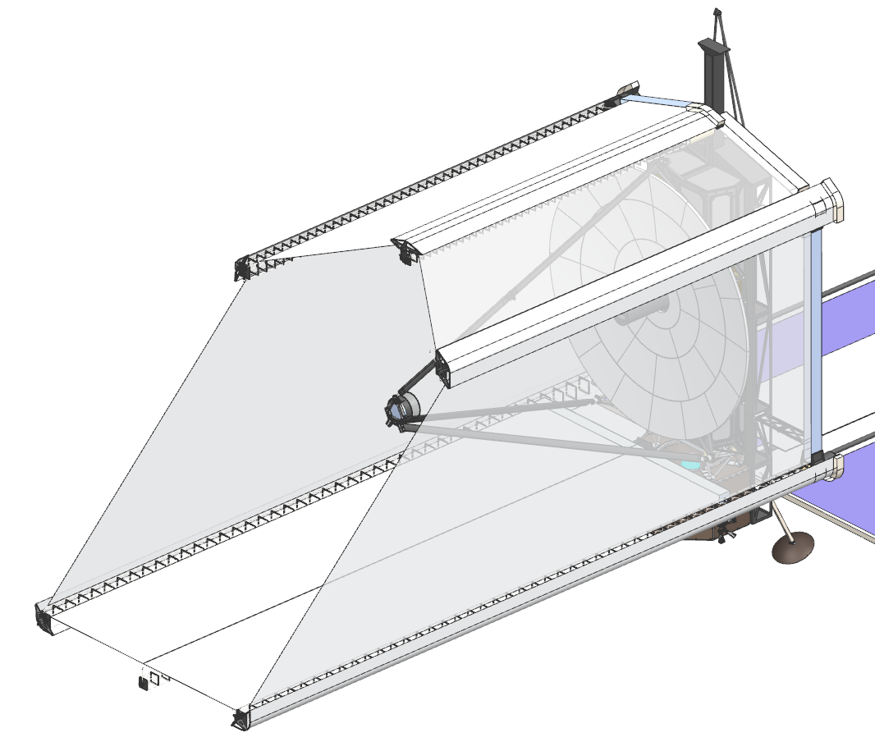
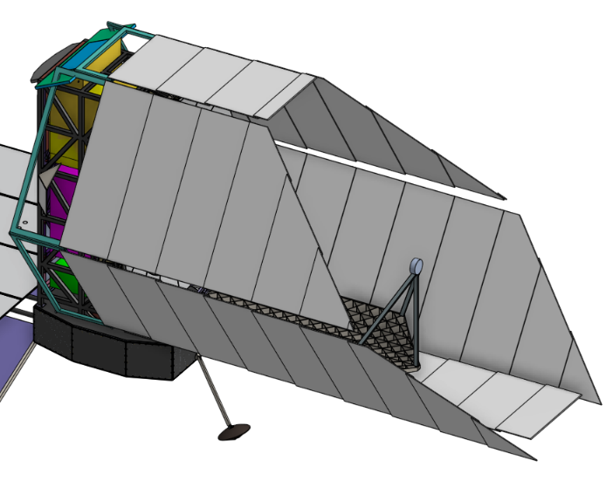
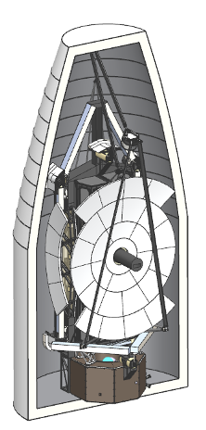
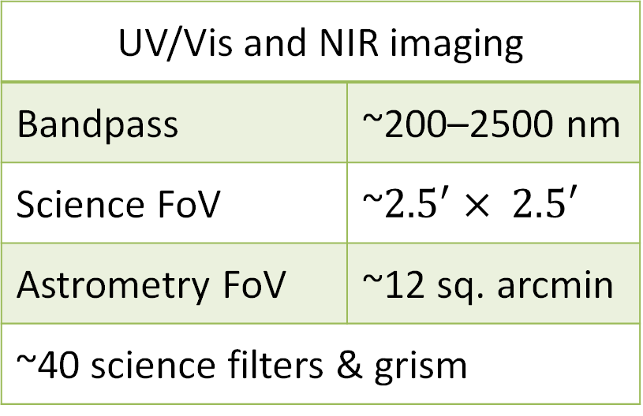
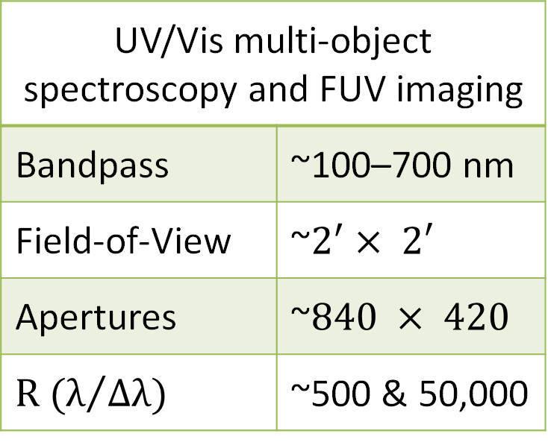
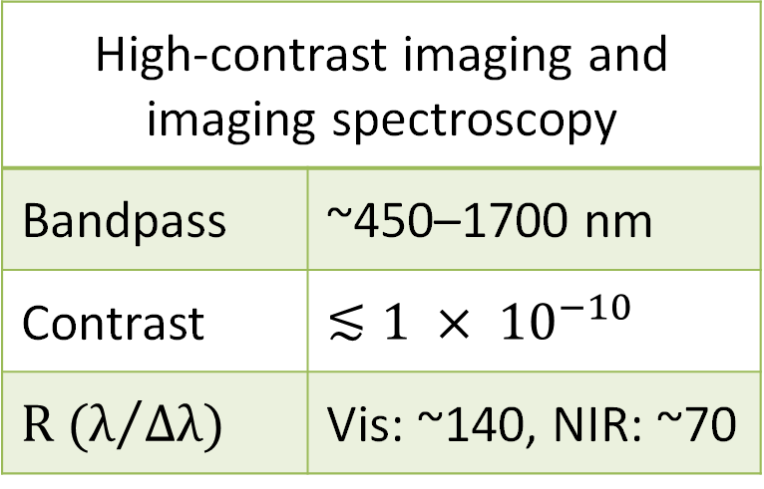
Habitable Worlds Observatory,
Exploratory Analytic Cases Formulation and Analysis
Alice Liuª, James Govern^{b}, Josh Abelª, Jordan Effronª, Jon Lawrenceª, Marie Levine^{c}, Charley Noecker^{c}, Kenneth Dziak^{b}, Gary Kuan^{c}, Alan Gostinª, Joseph Howardª, Cameron Haag^{c}, Connor Mulreninª, Breann Sitarskiª, J. Scott Smithª, Gregory Walshª, John Ziemer^{c}
ªNASA Goddard Space Flight Center, 8800 Greenbelt Rd., Greenbelt, MD, 20771 USA
^{b}Aerodyne Industries, 8910 Astronaut Blvd., Suite 208, Cape Canaveral, FL, 32920 USA
^{c}Jet Propulsion Laboratory, California Institute of Technology, 4800 Oak Grove Dr., La Cañada Flintridge
NASA’s next flagship mission,
recommended by the Astro2020 Decadal Survey
Architecture Trade Options
First telescope designed to directly image and characterize Earth-like exoplanets, including search for signs of life
The first 3 EACs examined a wide range of trade options spanning science, mission system, observatory, payload, and spacecraft, with some trades continuing to future EAC iterations
Large Aperture UV/Optical/NIR observatory performing transformative astrophysics across cosmic time
Exploratory Analytic Cases (EAC)
Mission architectures developed to explore the HWO trade space:
Explore key architectural options and breakpoints to guide future point design decisions
Develop end-to-end models and tools to understand modeling capabilities and needs
Identify technology gaps and guide maturation of potential solutions
Provide early feedback to launch vehicle vendors to help influence their direction
EAC Design Guidelines
HWO IM Analysis Pipeline
Segmented primary mirror and coronagraph instrument
Orbit at Sun-Earth L2 with a serviceable architecture
Baffle/barrel protection against micrometeoroid impacts
Compatible with at least two future launchers
Field-of-Regard: ±45° pitch, ±22.5° roll, 360° yaw
Slew/Settle: 90° in 60 min
Observatory LOS stability: 4 mas
Passive cooling for NIR detectors
ULE glass mirrors (primary/secondary)
at room temperature for simplified I&T
Building on JWST and Roman heritage, HWO is leveraging Integrated Modeling, a multidisciplinary analysis used to predict system performance, to quickly bridge design exploration and end-to-end engineering and science performance metrics
Initial EACs
EAC-1
6m ID / 7.2 m OD off-axis PM
19 hex segments
PM faces horizontal in rocket
JWST-like wing deployment
EAC-3
8m ID (round) off-axis PM
34 keystone segments
PM faces horizontal in rocket
JWST-like wing deployment
EACs 1-3 Key Findings
EAC-2
6m ID (round) off-axis PM
Central 3 m round mirror +6 keystone
PM faces up in rocket
Non-deployed PM
Deployable baffle poses significant engineering challenges, requiring thermal stability, MMOD protection, and solar heat rejection while stowable in fairing volume and deployable on-orbit
Solar arrays limit radiator heat rejection options; The coronagraph requires optimal cold space view factors to achieve passive detector cooling
Primary mirror thermal environment directly drives optical performance and active control system complexity
The large CP-CM offset (>1 m) creates significant attitude control challenges, driving high propellant consumption and complex thruster placement requirements
Key serviceability challenges include maintaining picometer-level latch stability during instrument exchanges, robotic cryogenic heat strap connections, and structural access constraints from the primary launch structure
Telescope
High-Resolution Imager
UV Multi-Object Spectrograph
Diameter | ≳6.0 m
Bandpass | ~100–2500 nm
Diff. Limit | ~500 nm
UV/Vis and NIR imaging
Bandpass | ~200–2500 nm
Science FoV | ~${2.5}^{′}× 2.5′$
Astrometry FoV | ~12 sq. arcmin
~40 science filters & grism
UV/Vis multi-object spectroscopy and FUV imaging
Bandpass | ~100–700 nm
Field-of-View | ~$2^{′}× 2′$
Apertures | ~$840 × 420$
$$R (λ/{Δλ)}$$ | ~500 & 50,000
Coronagraph
EAC-4 Objectives
EAC-5 Objectives
High-contrast imaging and imaging spectroscopy
Bandpass | ~450–1700 nm
Contrast | $$≲1 × {10}^{−10}$$
$$R (λ/{Δλ)}$$ | Vis: ~140, NIR: ~70
Balance cost, schedule, risk and science
Maximize aperture diameter while reducing baffle and PM deployment complexity​
Mitigate baffle-related engineering risks​
Driven by science goals with realistic launch vehicle constraints and technological advances
Minimum 8-m inscribed diameter aperture
Consider large flat sunshade
Includes mass and design margin
Observatory Element Schematic
Explore → Design → Analyze → Repeat
PM Backplane
Assembly (PMBA)
DBS Containment Box
Instrument Radiator Assemblies (Multiple radiators)
Optical Telescope Element
EAC-1
EAC-4
Deployable Baffle
Instrument 1
Instrument and Guider Element
EAC-6
Primary Mirror (PM) Segments
Instrument 2
Spacecraft Element
EAC-2
Single Baseline for MCR
Instrument 3
SC-to-Payload Vibration Mitigation System (SPVM)
EAC-5
●
Instrument Module Structure
IMS Door (Launch Support)
●
Secondary Mirror Assembly (SMA)
●
Extra Instrument (XI)
Sun-Shade or Instrument Radiator Shields
Deployable Baffle System
EAC-3
Secondary Mirror Support Structure
Spacecraft Bus
ACS Hardware, Propulsion
Avionics, Comm, C&DH, FSW, Power System
Additional Designs
(Government and Industry D.19 Studies)
SC-to-Payload Vibration Mitigation System (SPVM)
Solar Arrays
Acknowledgement: The co-authors would like to acknowledge the HWO Technology Maturation Project Systems Engineering Team for their significant contribution to the EACs design, modeling, and analysis work.

