Slide 1



Development of the METMAN Thermal Desktop Human Model for System Integration
Ellie Thurston
NASA Johnson Space Center
Crew and Thermal Systems Division
EC2: Design and Analysis Branch
55th International Conference on Environmental Systems
12-16 July 2026, Rio Grande, Puerto Rico
Human Health and Performance Analysis ICES-513A-465
Trade names and trademarks and company names are used in this report for identification only. Their usage does not constitute an official endorsement, either expressed or implied, by the National Aeronautics and Space Administration.

Slide 2
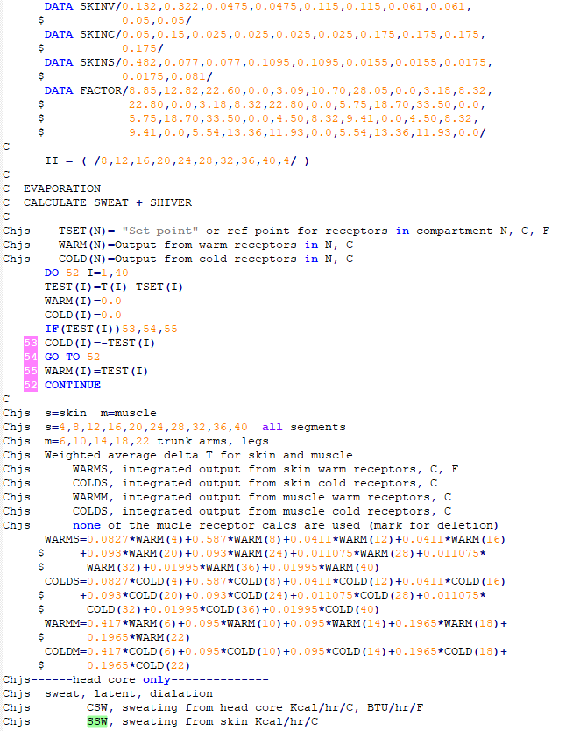
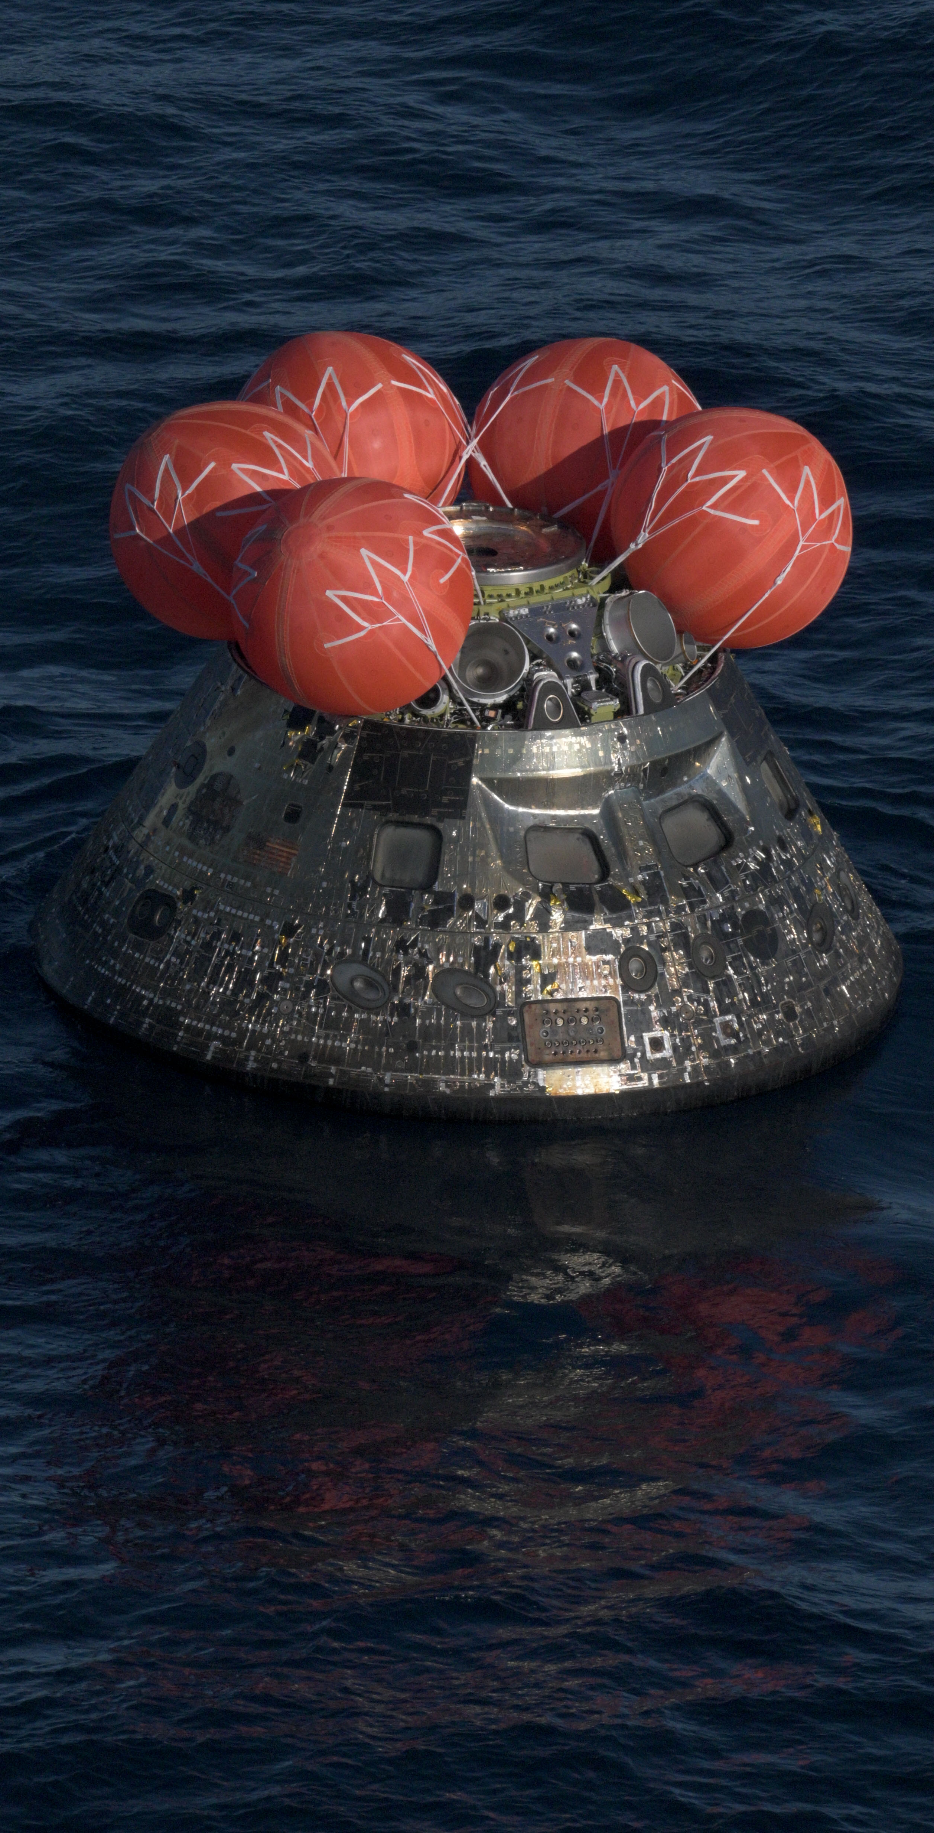
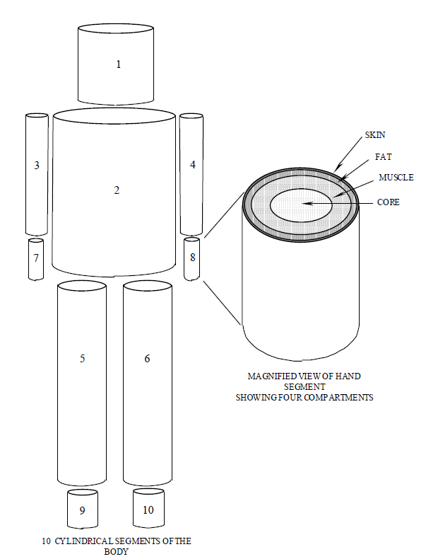
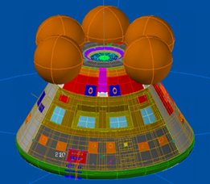
Introduction
Human Thermal Modeling (HTM) and vehicle thermal modeling provide comprehensive simulations of extreme mission environments
Human and environmental/vehicle models have historically been decoupled¹
This presentation describes the development of METMAN TD, an updated format of the NASA METMAN human model for 3D coupling with vehicle/thermal systems
Introduction
Background
Model Overview
Results
Conclusion
Diagram of Thermal Model Information Exchange between METMAN² and Orion Vehicle Model

Slide 3
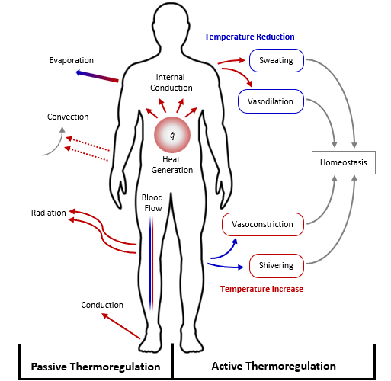
Introduction to Human Thermoregulation
Human Thermal Modeling (HTM) characterizes the heat transfer between a person and the environment
Goal of the thermoregulatory system: maintain homeostasis of the core body temperature
Passive System⁴: fixed parameters
  Anthropometry
  Gender*
  Tissue composition
Active System⁴: thermoregulation
  Sweating
  Shivering
  Blood flow
Introduction
Background
Model Overview
Results
Conclusion
Diagram of Passive and Active Human Thermoregulation³

Slide 4
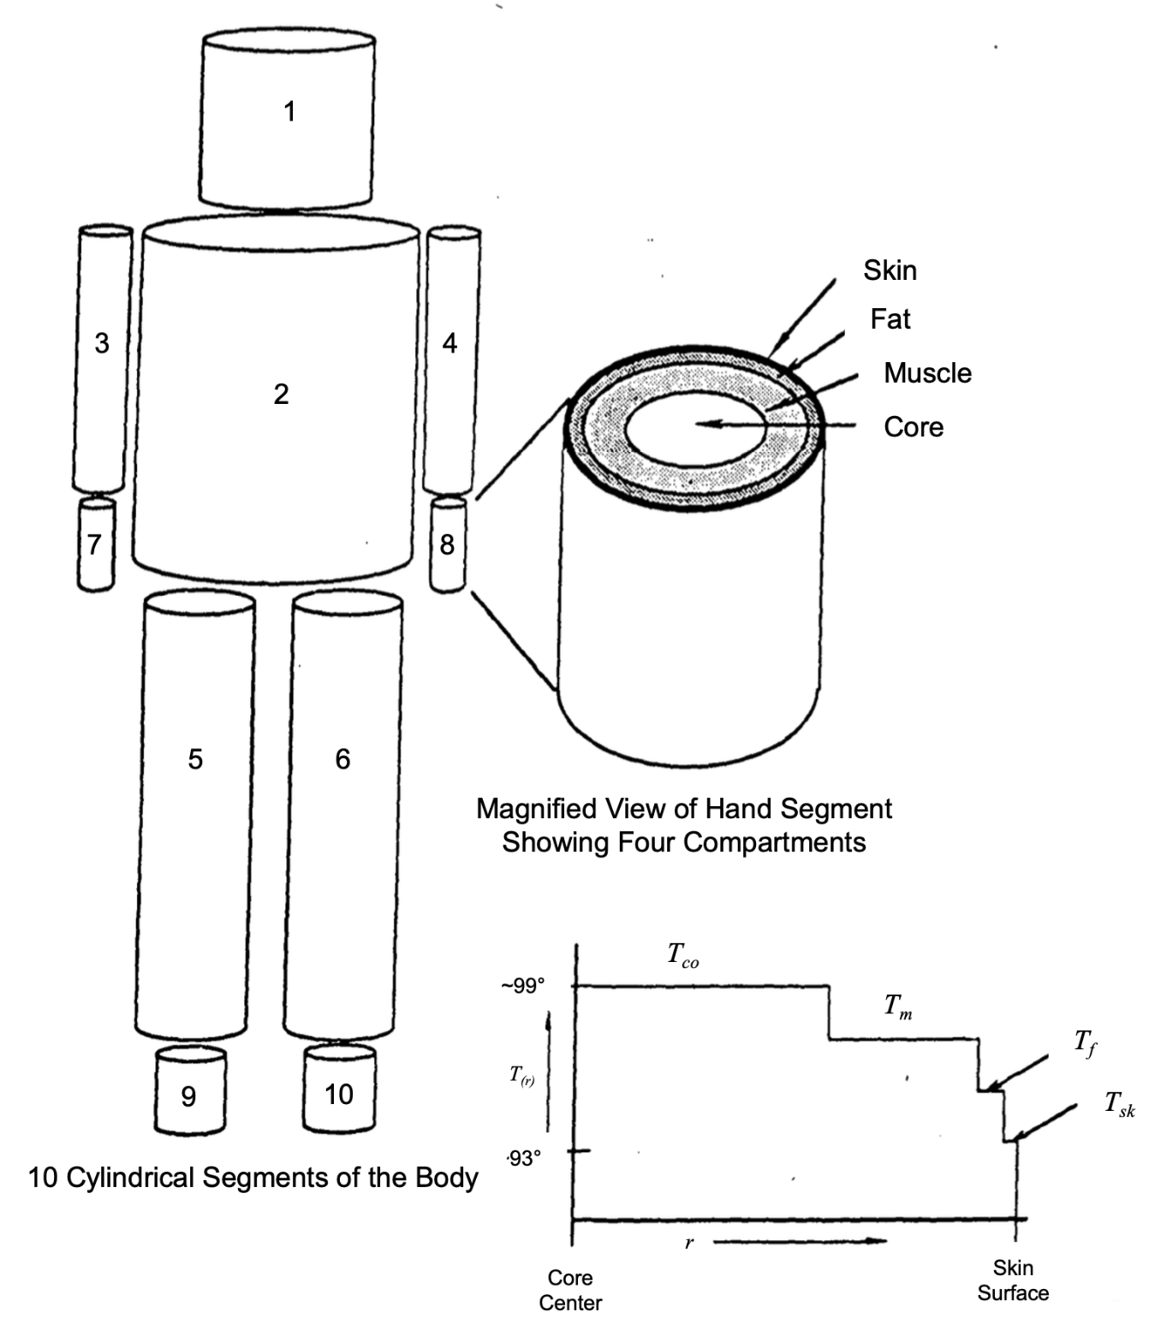
Overview of the METMAN Model
METMAN: the NASA human thermal computational model (Fortran)
  Initially developed in the 1970’s for use on Apollo systems¹
  Current use cases involve EMU, ISS, Orion
Human body segments are represented as layered, concentric cylinders
Model subroutines break down the different functions of thermoregulation
Model is a standalone tool, leading to iterative analysis for dynamic environments
Introduction
Background
Model Overview
Results
Conclusion
Diagram of METMAN Segment and Layer Distribution²

Slide 5

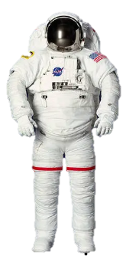


Transition in HTM Utilization
NASA HTM tools were originally developed for specific use-cases; the discipline has evolved to support multiple programs and systems
Human models are “stand-alone” tools; implementation becomes challenging with varied interfaces
As thermal architectures become more complex, there is a growing need to couple the thermal exchange between humans and environmental systems
Thermal Desktop chosen as the model format to facilitate integration within the standard analysis software
Introduction
Background
Model Overview
Results
Designed for Apollo era systems
Conclusion
Needed for versatile use cases

Slide 6
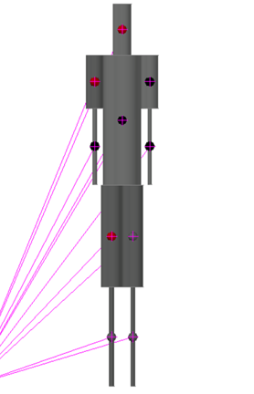
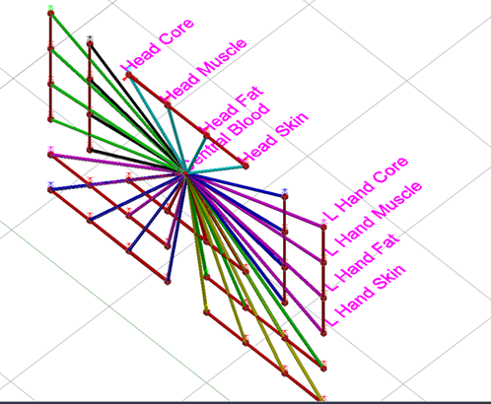
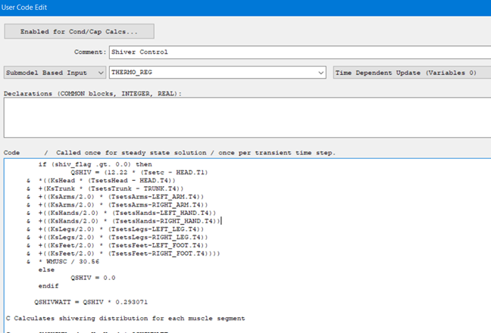
Modeling Process: High Level Structure
Modeling process: break down the METMAN Passive System and Active System into modules.
Create geometry framework for Passive System
Modularize Fortran Code into Submodel Logic Blocks
Connect logic code to graphical nodes and conductors
Introduction
Background
Model Overview
Results
Conclusion
3D cylindrical TD objects
“Skin layer” used for environmental interface
METMAN thermal subroutines contained in TD logic objects
Heat loads stored as SINDA Registers and applied to TD nodes
“Schematic” connects thermal logic to graphical nodes
Skin nodes cloned to passive system

Slide 7
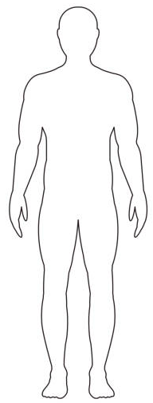
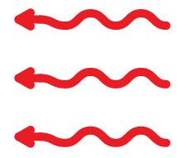
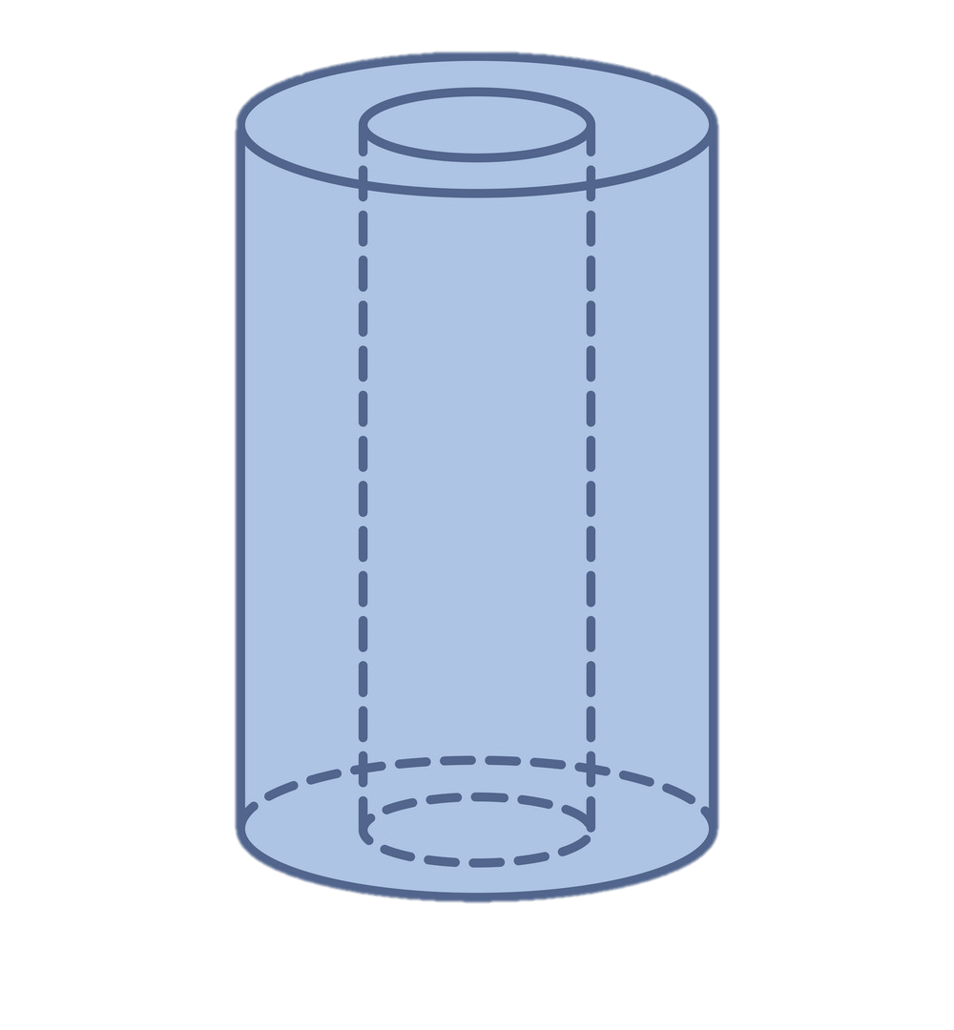


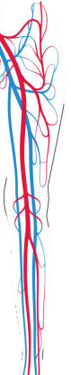

Components of Human Thermoregulation
Heat Storage⁵: heat in – heat out
Modes of Heat Transfer:
  QMET: Metabolic heat production rate (muscle work + shiver)
  QCOND: Cylindrical conduction between layers
  QSENS: Sensible heat transfer to the environment (convection and respiration)
  QRAD: Radiation to environment
  QLAT: Heat rejection from sweating, diffusion, and respiration
  QCONV: Internal convection (blood flow)
Layer Dependent: each layer has its own heat balance that contributes to overall body temperature
-QRAD
Introduction
+QCOND (to layer)
-QCOND (from layer)
Background
-QSENS
-QLAT
Model Overview
Results
-QCONV
+QMET
Conclusion

Slide 8
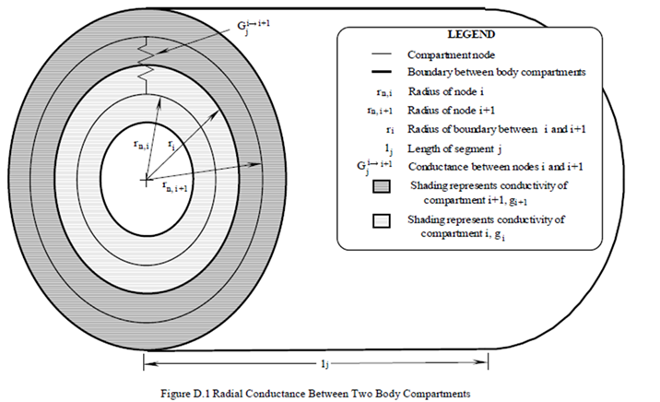
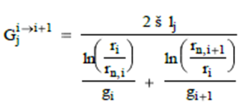
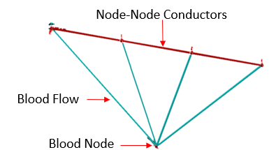
Thermal Control of the Passive System
Internal conduction transfers heat between tissue layers per body segment
Thermal capacitance is the product of body compartment weight and specific heat
  Determines individual node temperature increase/decrease depending on total heat load²
Active system regulates temperatures to mitigate thermal stress
Introduction
Background
²
Model Overview
Results
Conclusion

Slide 9
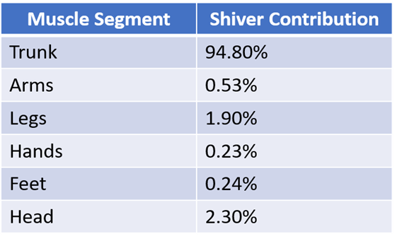
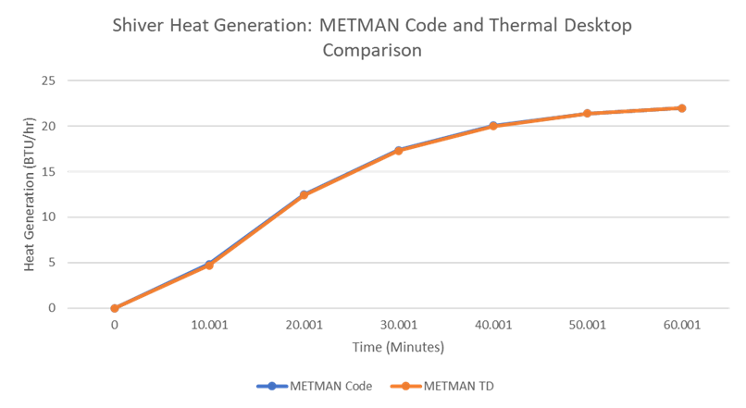
Heat Production in the Body
Basal metabolic rate: baseline rate of metabolic heat generation to maintain essential life functions²
  Biochemical processes + muscle activity produces heat to be dissipated to the environment
Heat generation through shivering:
  Shiver distribution is allocated proportionally²
  Segment shivering is enabled if:
    Full body: Core temperature < setpoint
    Per segment: Skin temperature deviance from setpoint is negative
Introduction
Background
Model Overview
Results
Conclusion

Slide 10
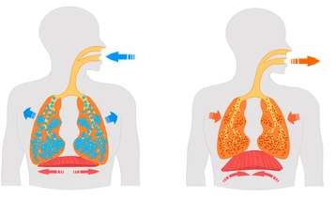
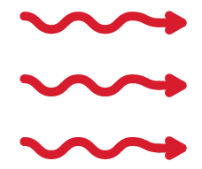
Sensible Heat Transfer
Calculation of both free and forced convection
  Driven by temperature differentials, G, and air flow
Radiation: Heat emitted to surrounding environment
Respiration: Cool air enters the body and warmed by convection
  Driven by respiratory temp and met rate
Inhale
Exhale
Introduction
Convection
Cool air
Warm air
Background
Respiratory Tract Temp
Model Overview
Radiation
Results
Conclusion

Slide 11
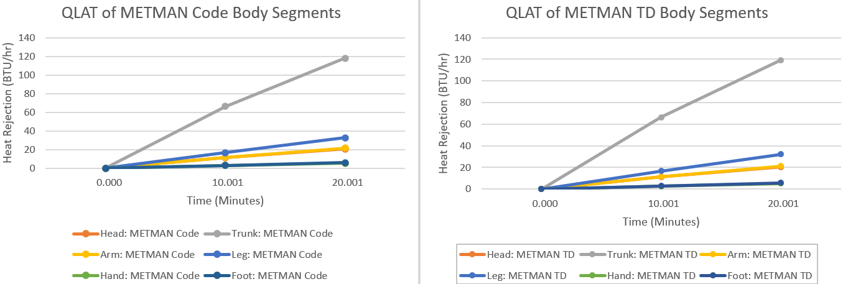
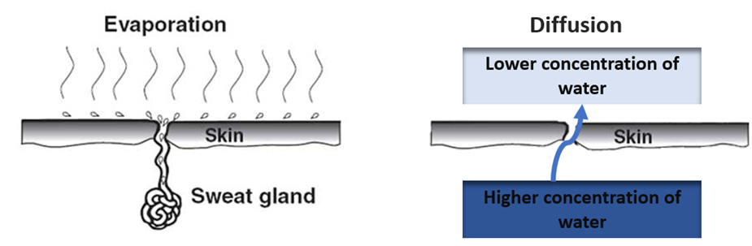
Latent Heat Transfer
Latent heat transfer: dissipation of heat through phase change
Diffusion: vapor pressure differences cause latent heat loss
Respiration: dry gas flow over moist respiratory tract
Sweat: evaporation of sweat cools the skin
Introduction
Background
Model Overview
Results
Conclusion

Slide 12

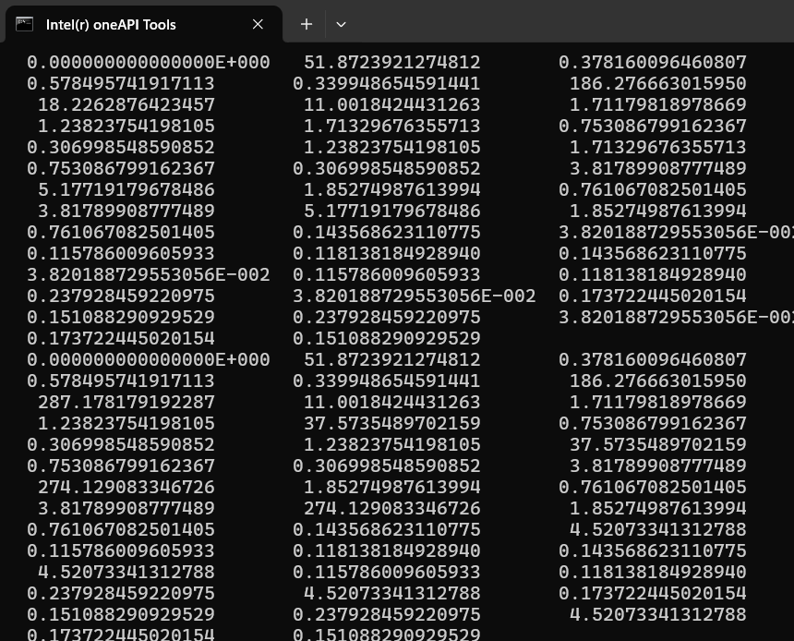
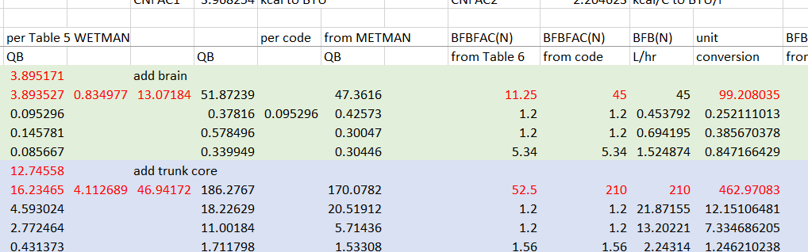
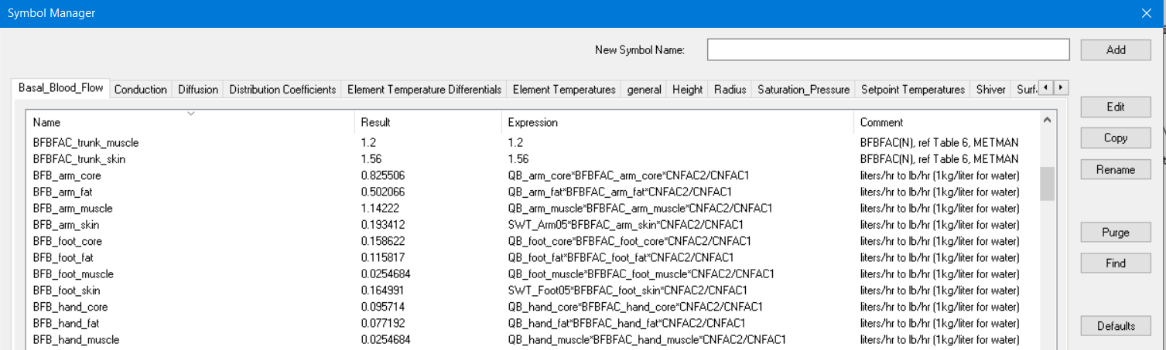
Internal Convection: Blood Flow
Internal Convection: the heat exchange between flowing blood and each respective segment
Basal Blood Flow: flow needed to maintain baseline metabolic requirements
Muscle Work: more blood flow needed during elevated metabolic rates
Vasoconstriction: decreased flow rate to conserve heat
Vasodilation: increased flow rate to reject heat
Introduction
Background
Model Overview
Results
Conclusion

Slide 13

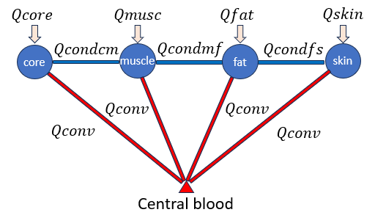
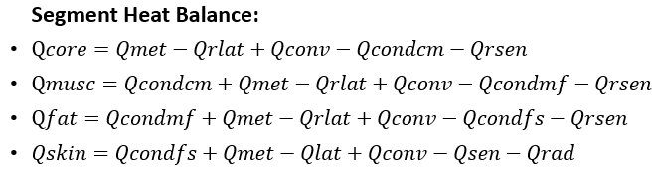
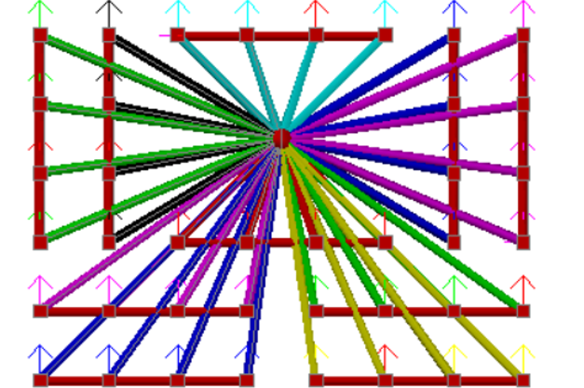
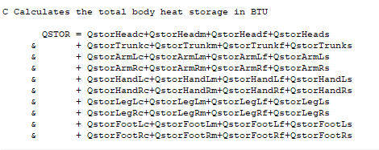
Applying the Total Heat Balance
41
Introduction
Background
Node = 1
R Hand
R Arm
Head
L Arm
L Hand
Model Overview
Results
Conclusion
R Leg
Torso
L Leg
R Foot
L Foot

Slide 14
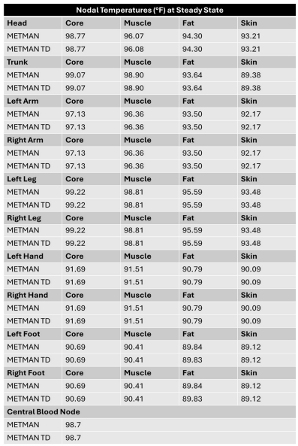
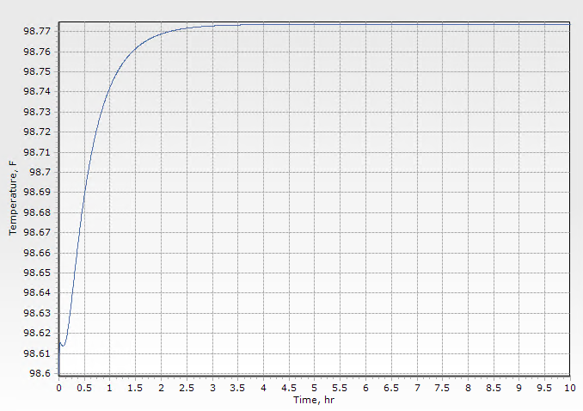
Model Results: Constant Metabolic Rate
Comparison between METMAN code and METMAN TD shows near identical agreement
Steady State example: Metabolic rate held constant at 474 BTU/hr, ambient environment held constant at 85°F
Temperatures at each node match Fortran outputs
Introduction
Background
Model Overview
Results
Conclusion

Slide 15
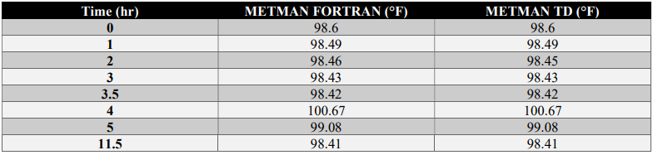
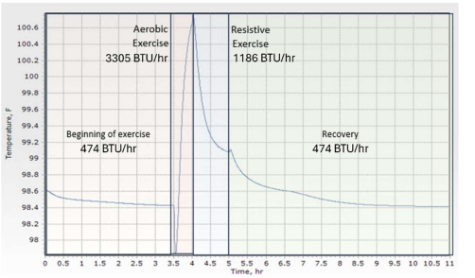
Model Results: Transient Metabolic Profile
Results verification: Model outputs were compared against METMAN analysis of exercise environment: showed almost identical agreement
METMAN is correlated to human test data: METMAN TD provides a firm foundation for human thermal model evolution and can be used for existing systems with embedded METMAN requirements
Introduction
METMAN TD Transient Analysis of Core Temperature at Varied Metabolic Profile
Background
Model Overview
Results
Conclusion

Slide 16
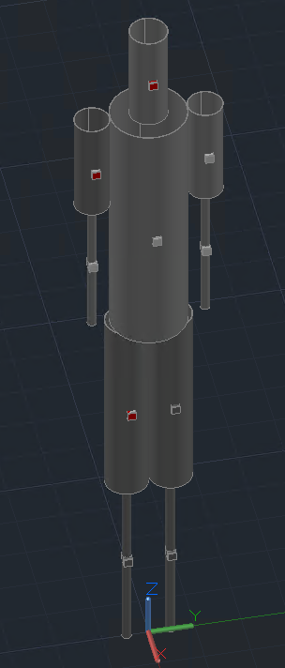
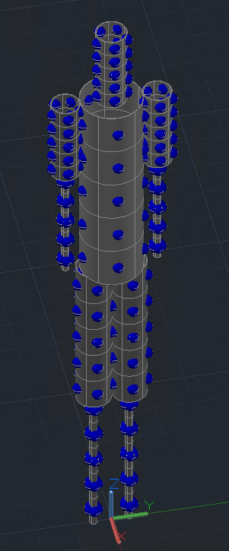
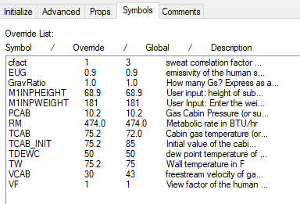
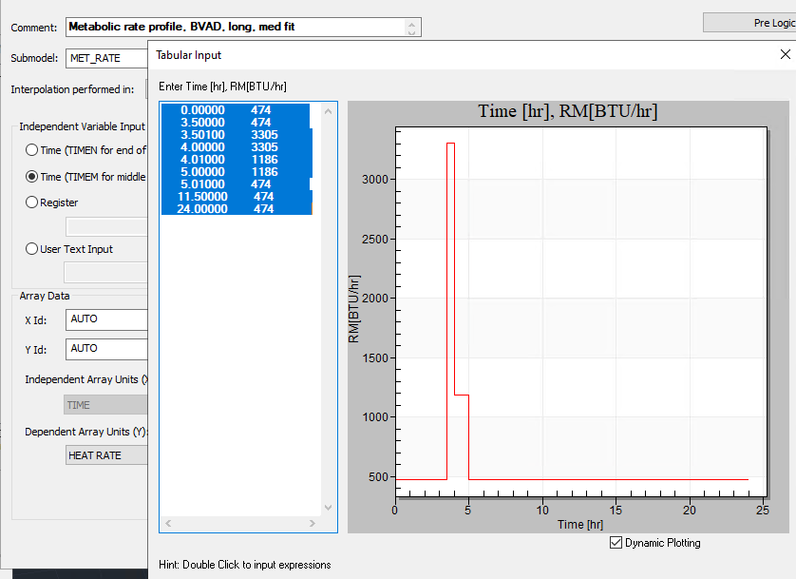
Added Capabilities of a TD Interface
METMAN functionality in a modernized format
Graphical components to interface with vehicle and thermal system models
Modularized structure enables evolution alongside systems and mission contexts
Next steps: Integrate METMAN TD with inline analysis work, such as Artemis II post-flight thermal comfort studies
Can increase fidelity as needed
Introduction
Background
Model Overview
Results
Conclusion
Baseline METMAN: Symbol driven inputs
Customizability for advanced use-cases

Slide 17

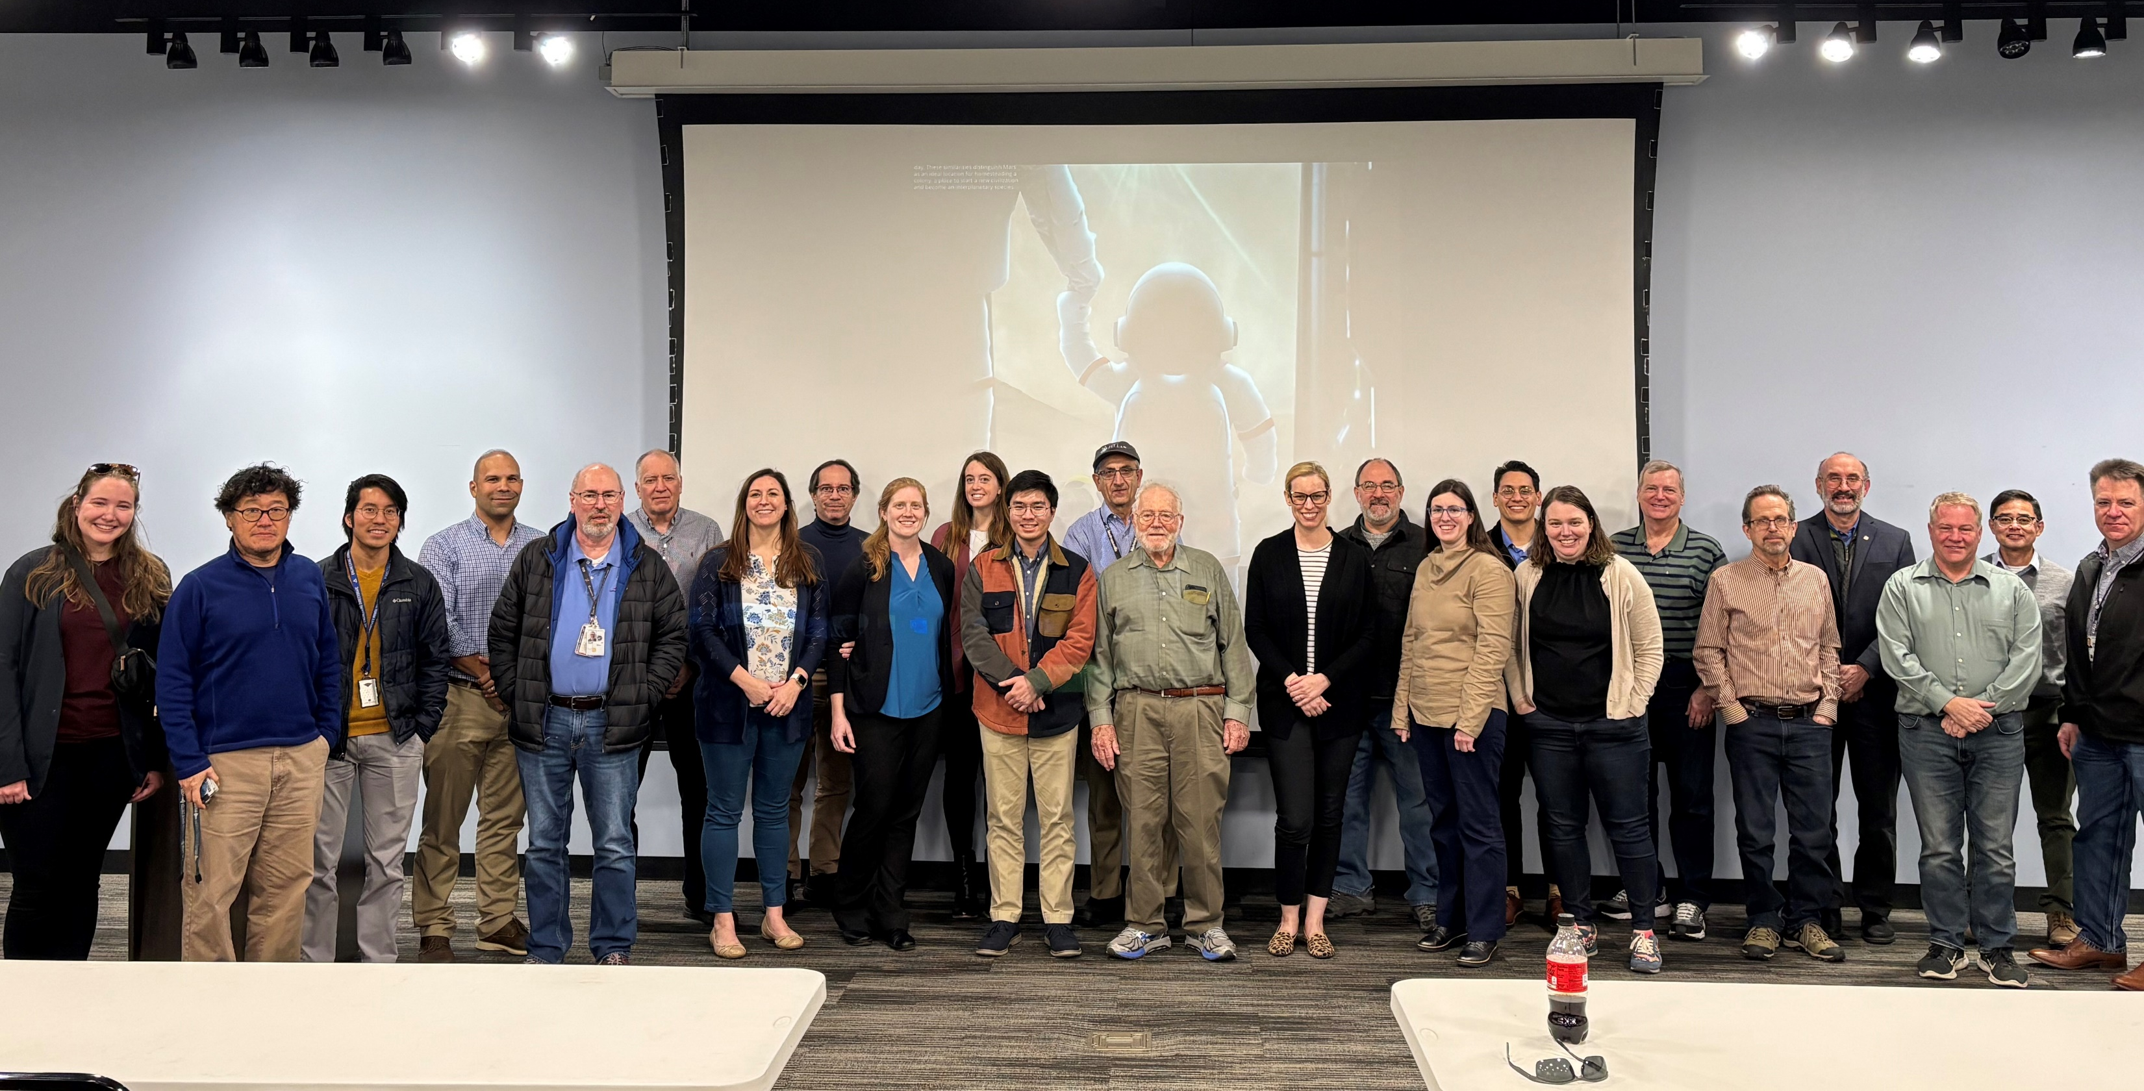
Acknowledgements
This work was supported by the NESC ECLSS Technical Discipline Team (TDT) as a discipline-advancing effort. The human thermal analysis team would like to thank Morgan Abney, Thomas Chen, and the rest of the NESC ECLSS TDT for their support on this model development effort.
Introduction
Background
Model Overview
Results
Conclusion
Thank you!

Slide 18
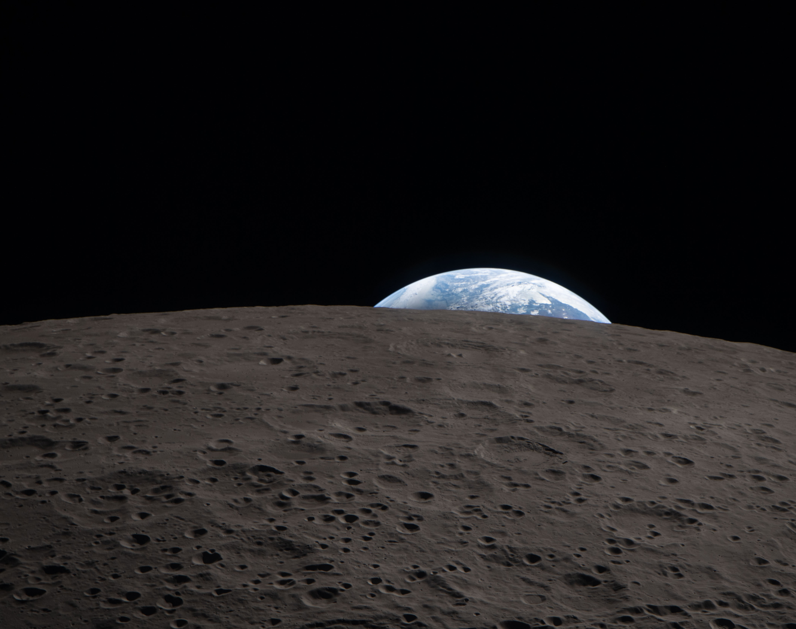
Thank you!
Questions?

Slide 19
References
[1] H. J. Song, Overview of Human Thermal Modeling, Thermoregulation, and Thermal Comfort at NASA, NASA, 2017.
[2] G. C. Bue, "Computer Program Documentation 41-Node Transient Metabolic Man Program," LESC-27578, CTSD-0425, 1989.
[3] M. Haas and D. J. Hartl, "Development of a Three-Dimensional Scripted Human Thermoregulation Model Framework for the Lower Limb," in 53rd International Conference on Environmental Systems, Louisville, Kentucky, ICES-2024.
[4] D. Fiala, K. J. Lomas, M. Stohrer, "A Computer Model of Human Thermoregulation for a Wide Range of Environmental Conditions: the Passive System," Journal of Applied Physiology, vol. 87, no. 5, 1999.
[5] J. A. J. Stolwijk, "A Mathematical Model of Physiological Temperature Regulation in Man," NASA CR-1855, 1971.
Additional references found in accompanying paper:
"Man-Systems Integration Standards," NASA-STD-3000, 1995.
"NASA-STD-3001_VOL_2," NASA, 2025.
"Human Integration Design Handbook (HIDH)," NASA, 2014.
"Constellation Program Human-Systems Integration Requirements," NASA, 2010.
M. Ewert, T. T. Chen, C. D. Powell, "Life Support Baseline Values and Assumptions Document," NASA, 2022.
"Gateway System Requirements," NASA-DSG-RQMT-001, 2019.
M. Ewert, M. E. Downs, J. F. Keener, "Developing a Daily Metabolic Rate Profile for Human Exploration Missions," in 50th International Conference on Environmental Systems, 2021.
T. Golubev, M. Hepokoski, M. Klein, A. Curran, H. J. Song, "Validation of a Human Thermal Model for Assessing Crew-Induced Loads in Spacecraft," in 51st International Converence on Environmental Systems, St. Paul, Minnesota, 2022.
D. DuBois, E. F. DuBois, "The Measurement of Surface Area of Man," Archives of Internal Medicine, vol. 15, pp. 868-888, 1915.
J. A. J. Stolwijk, J. D. Hardy, "Temperature Regulation in Man," Pfluger Archiv ges. Physiologie, vol. 291, pp. 129-162, 1966.
Introduction
Background
Model Overview
Results
Conclusion

