Slide 1
Thermostructural Testing of PICA-D for NASA Planetary Science Missions
23rd International Planetary Probe Workshop
June 22 – 26, 2026
Milad Mahzari, Keith Peterson, Matt Gasch, Suman Muppidi, Michael Wright
NASA Ames Research Center
Derek Shannon, Jack Joyce, Nick Courtney
Lockheed Martin Inc.

Slide 2
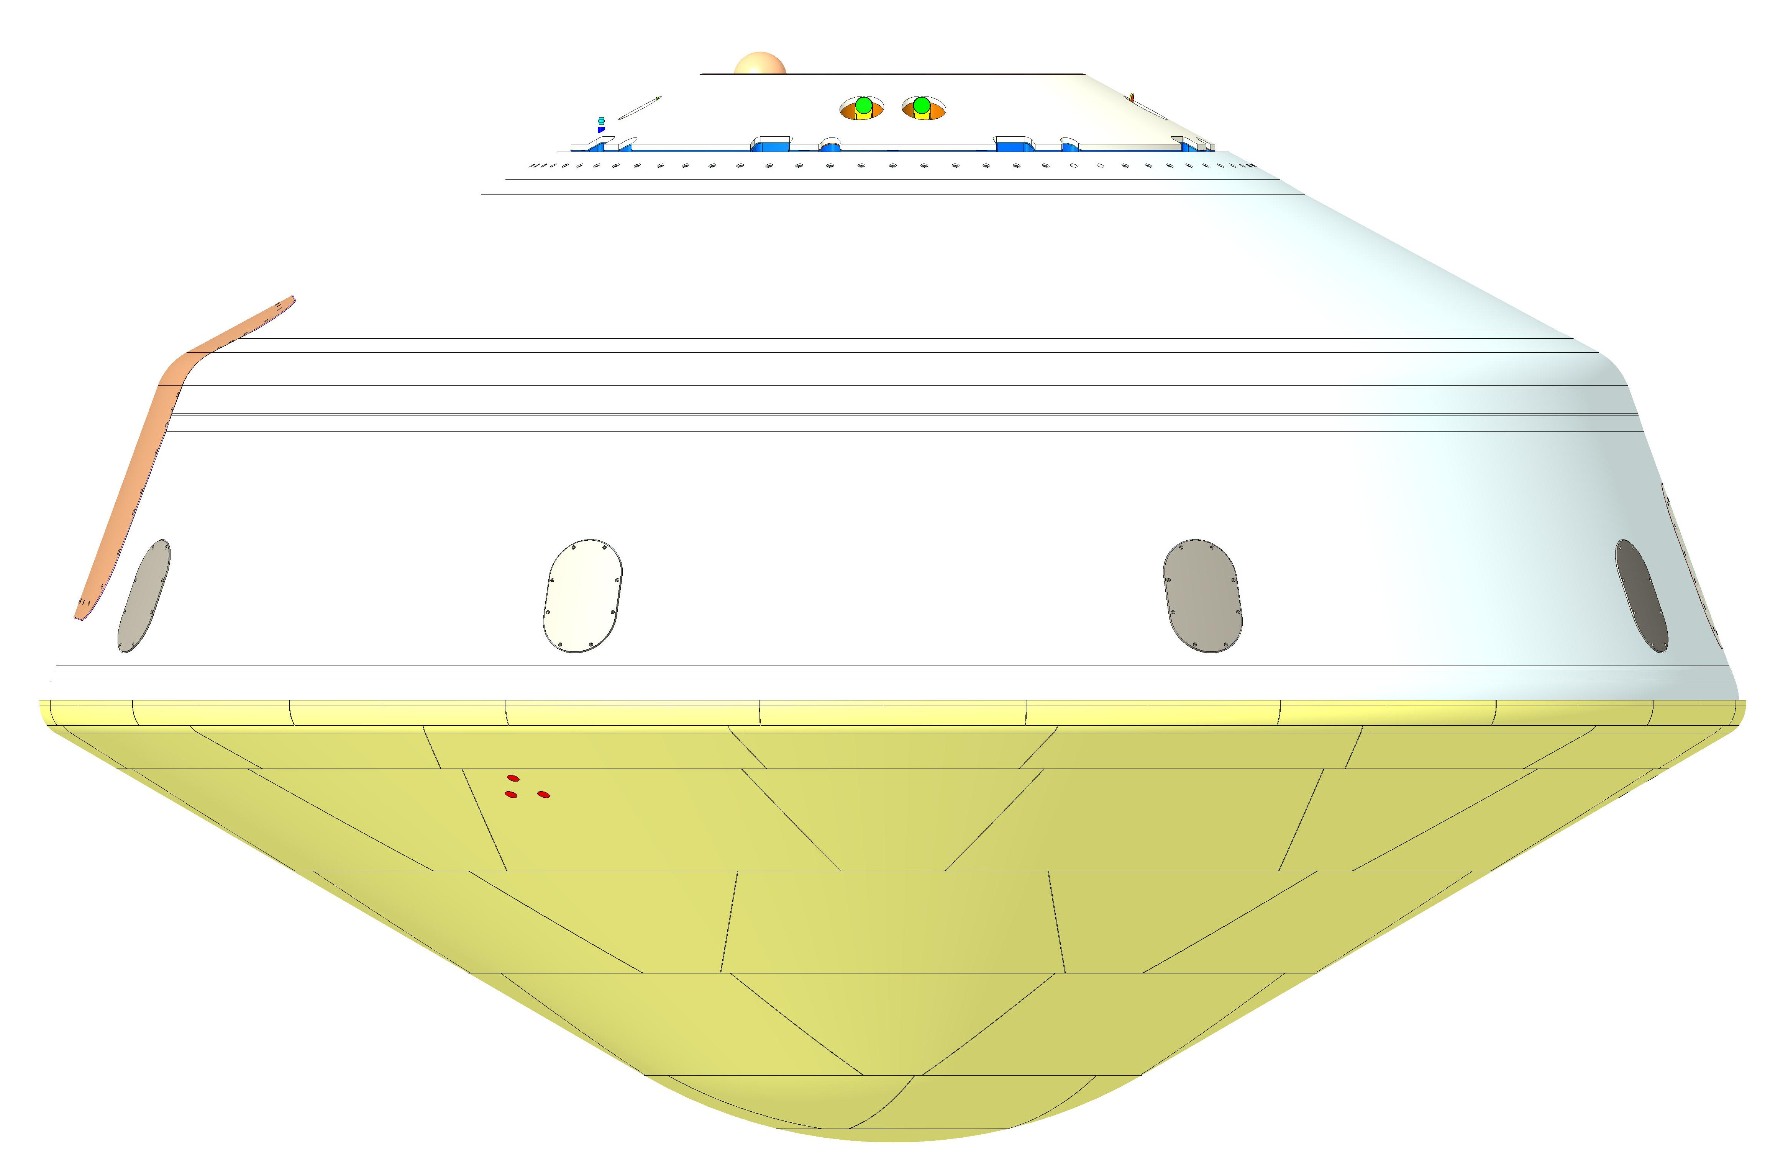
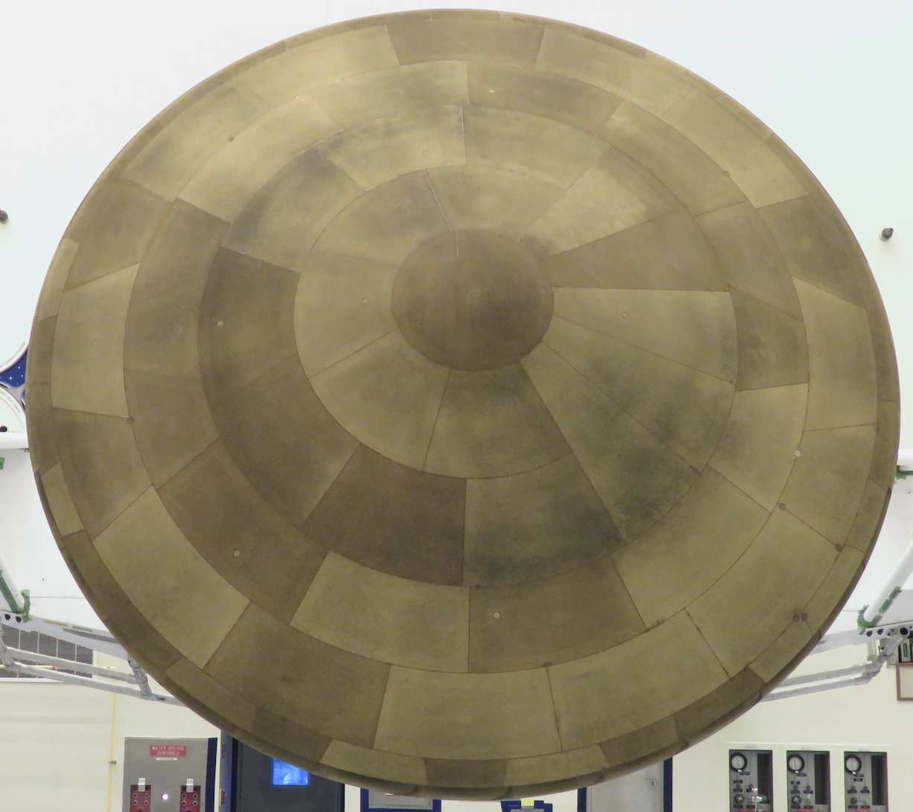
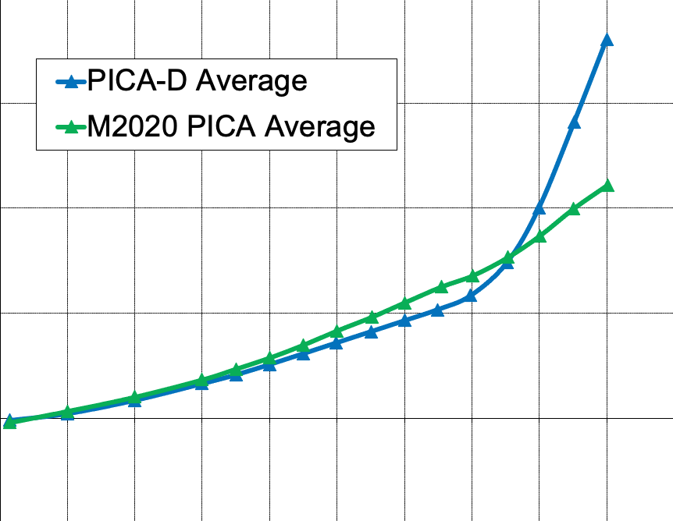
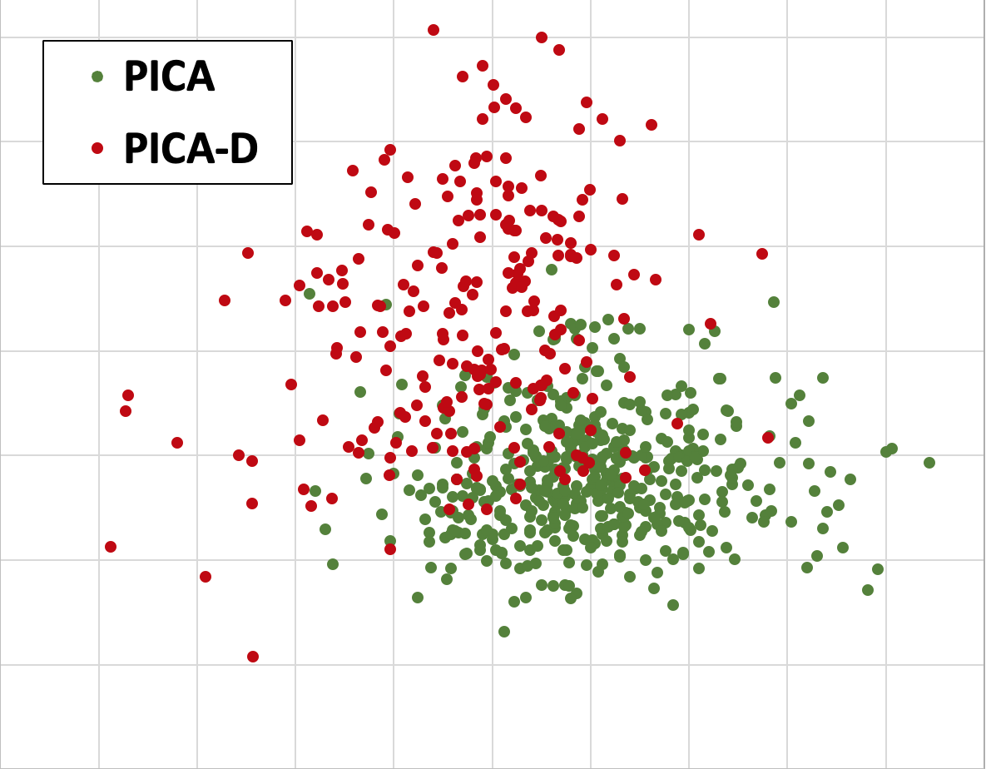
Introduction
Dragonfly Entry Vehicle
Mars2020 Tiled PICA Heatshield
PICA-D is the heatshield TPS material for NASA’s Dragonfly mission
  Domestic replacement for heritage PICA used on past NASA missions (Stardust, MSL, OSIRIS-Rex, M2020)
  Initial expectation was that PICA-D would behave similarly to PICA allowing the team to leverage testing by past programs
Subsequent data indicated a shift in some mechanical properties compared to PICA
  Higher in-plane tensile stiffness and thermal expansion
  Preliminary thermostructural analysis predicted thermally driven compressive failure of PICA-D
Thermostructural performance concerns spurred a significant verification program
  Analysis and test plans were presented at the 20th IPPW
  Collaboration with Mars Sample Retrieval Lander team
This talk provides an overview of testing and analysis efforts to verify PICA-D performance
PICA-D Tiles
& RTV Gap Filler
In-Plane Thermal Expansion
PICA-D vs PICA in IP Tension
IP Thermal Expansion (Char)
IP Tensile Strength
Temperature
Failure Strain

Slide 3
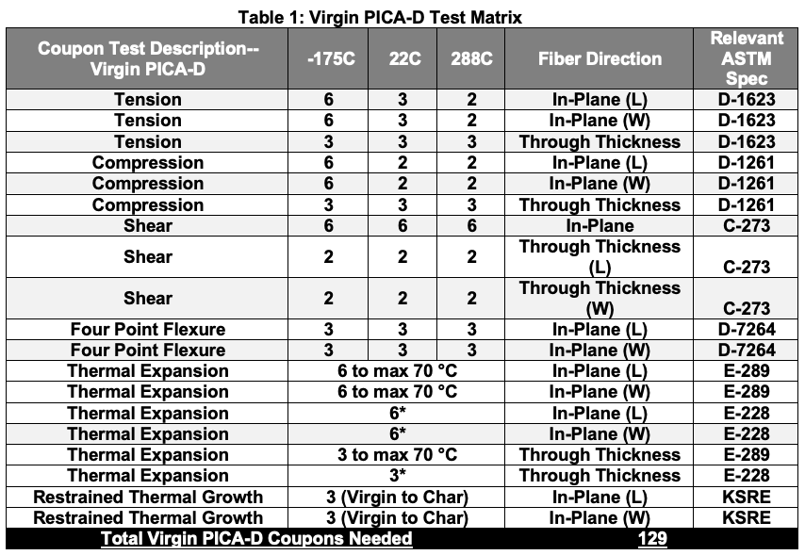
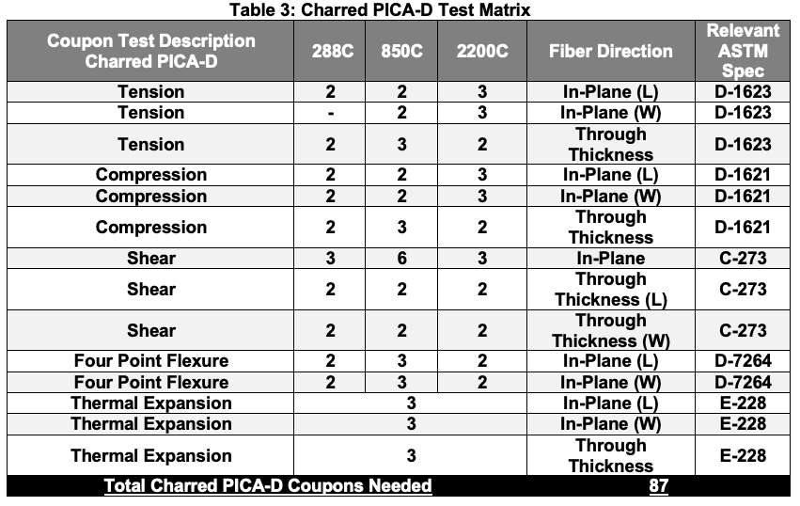
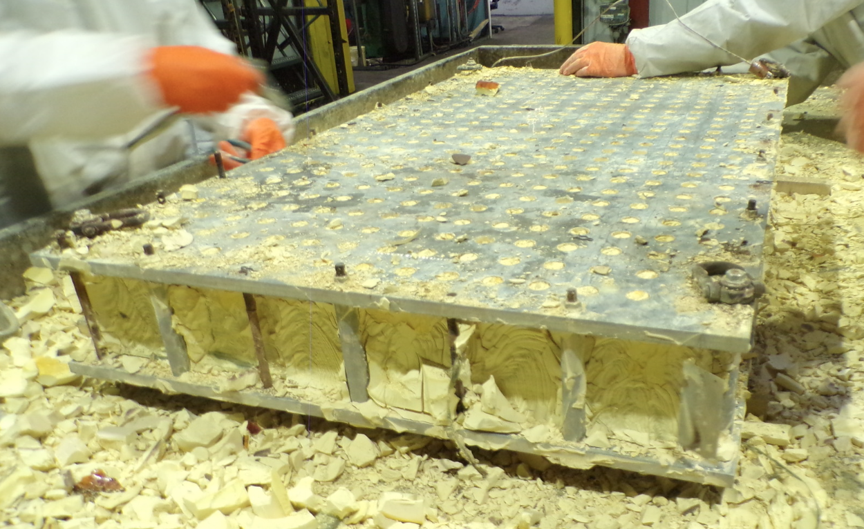
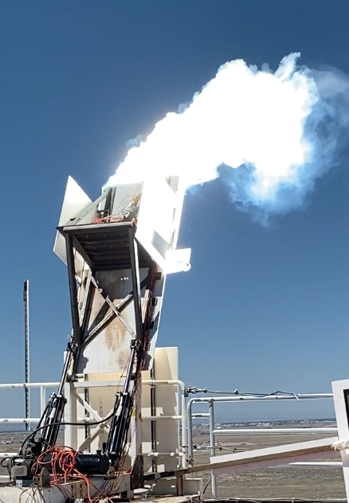
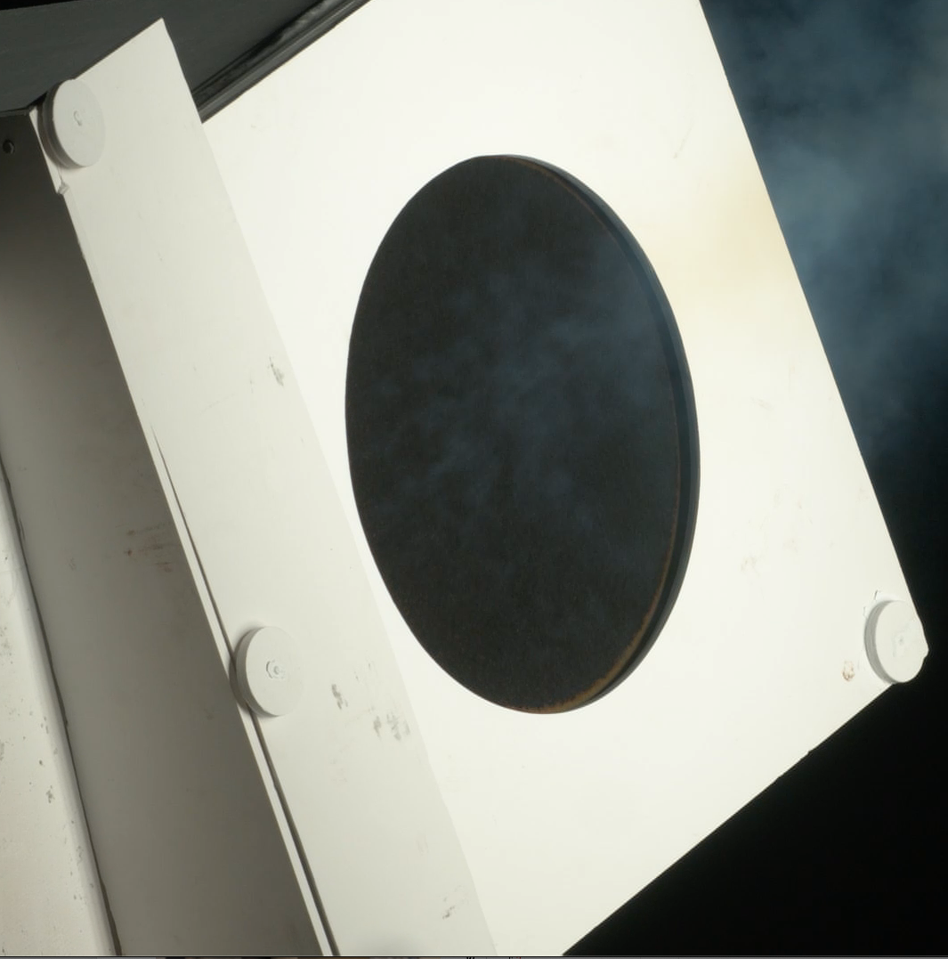
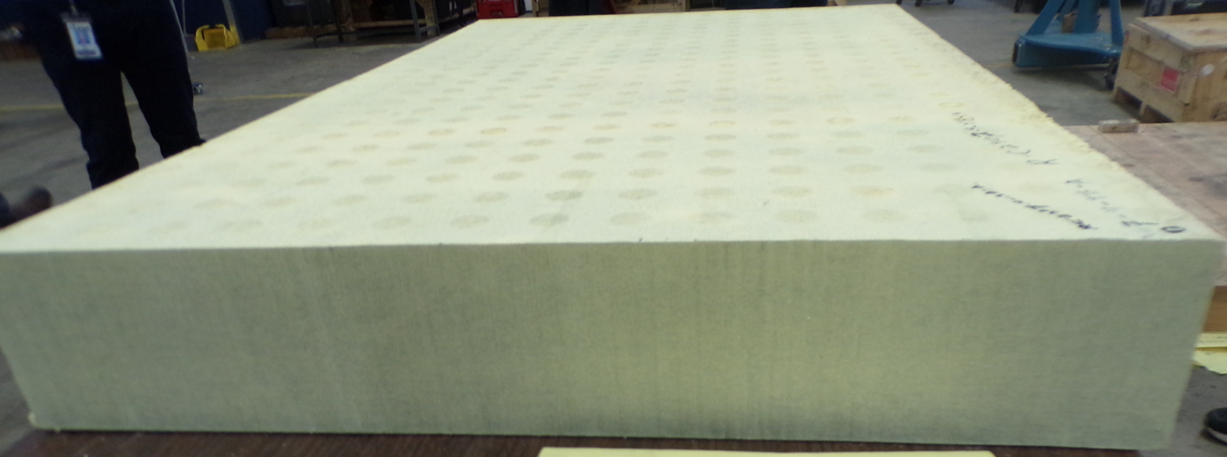
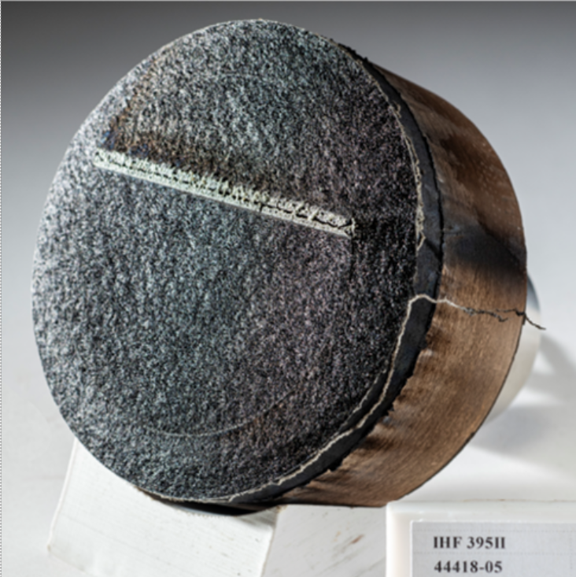
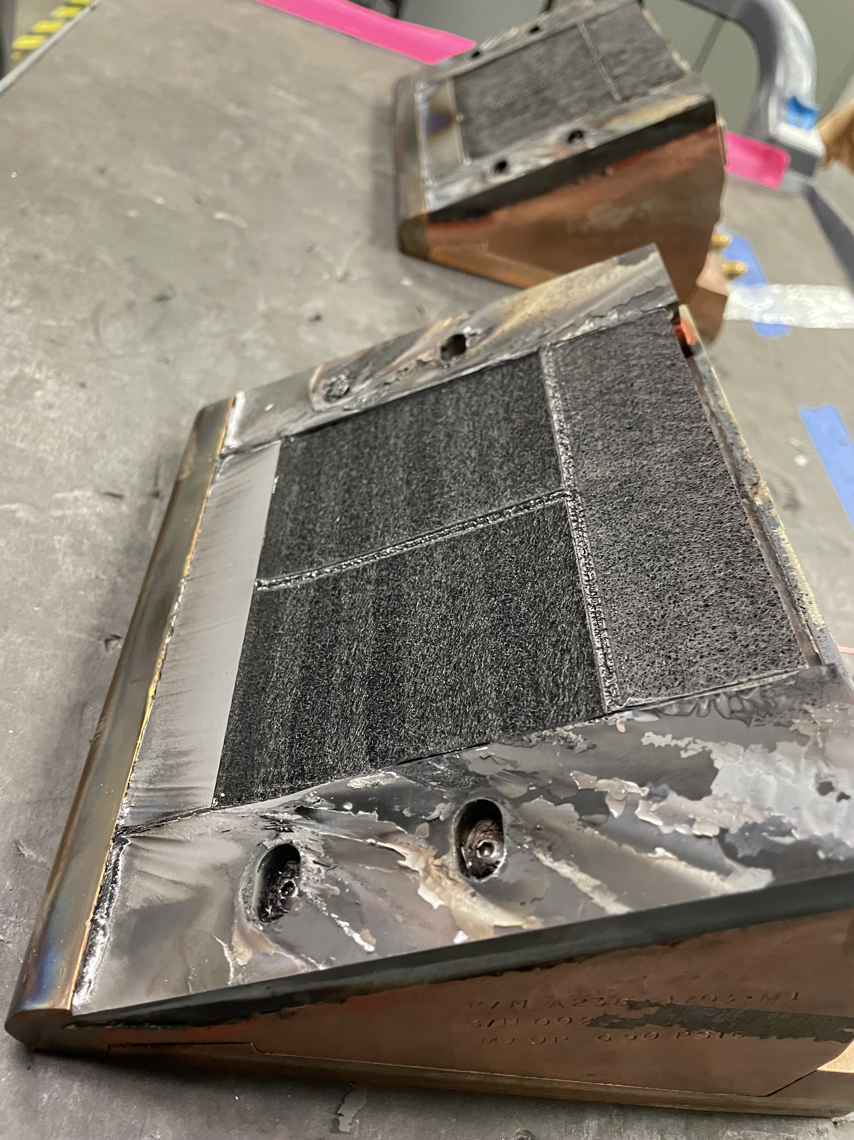
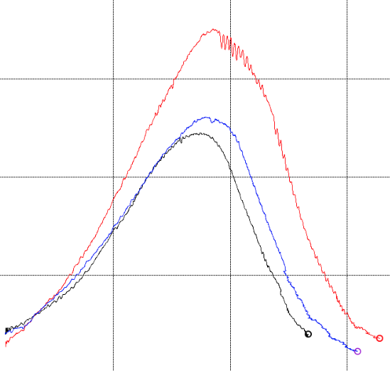
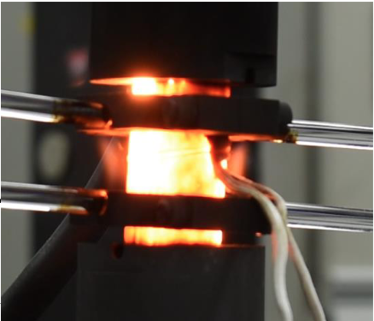
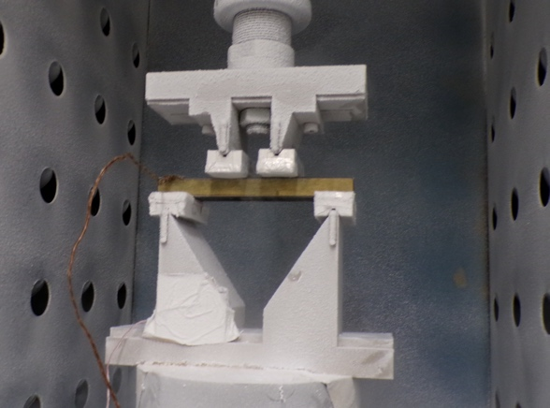
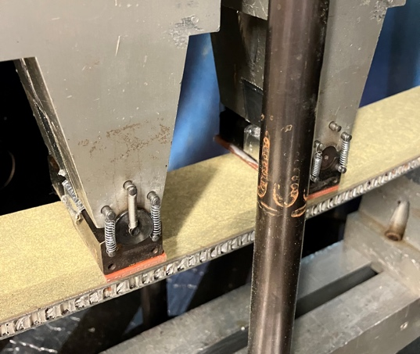
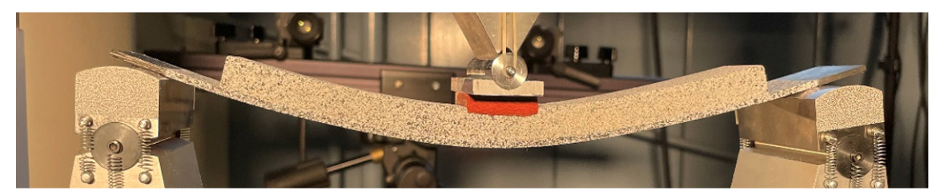
Overview Of Risk Mitigation Approach
Dragonfly and SRL adopted a four-pronged approach to address the PICA-D thermostructural risk and verify its performance
PICA-D Mechanical Property Testing
FEM Analysis
Informs flight margins, failure modes and test design
Thermostructural Verification Testing
Maturing and Testing Backup TPS – Conformal PICA*
Comprehensive Test Matrix Executed at Kratos
Acreage PICA-D
* Pursued only for SRL
Gap Filler, Flaws, Repairs
CPICA Infusion Demo at FMI
Peak Temperature Testing of
PICA-D at Solar Tower
Arcjet Test of CPICA
Restrained Thermal Growth Testing of Char PICA-D
IP Compressive Stress
Bonded PICA-D Mechanical Tests at Lockheed Martin
(cold, RT, hot)
Mechanical Test of CPICA
Softening
above PICA-D processing temp
Temperature

Slide 4
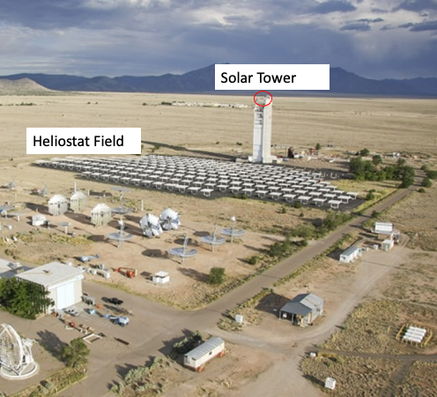
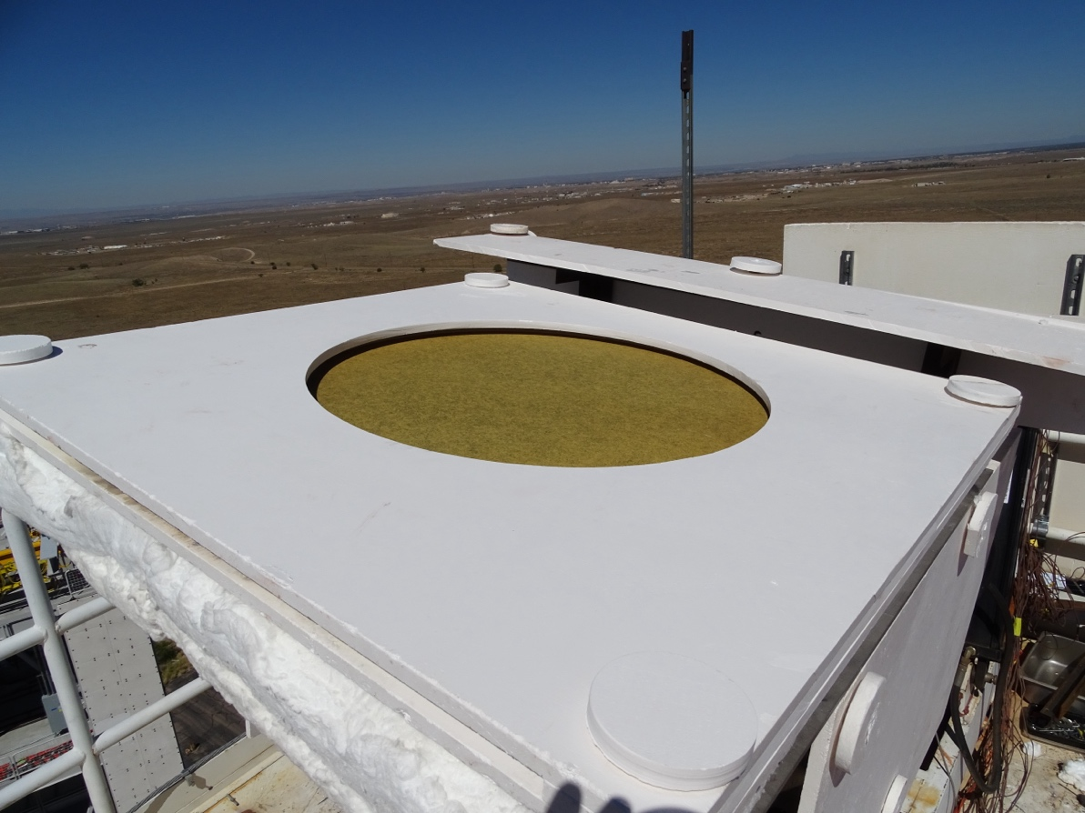
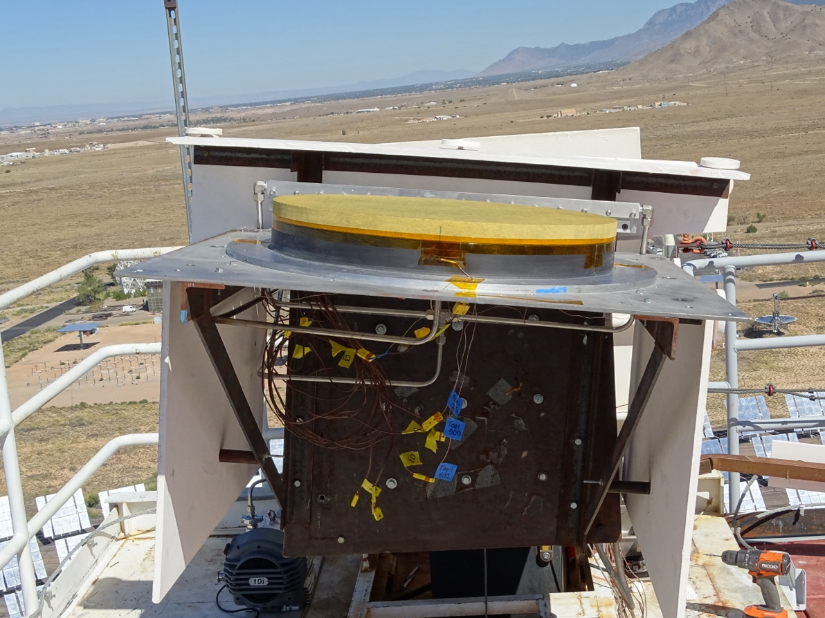
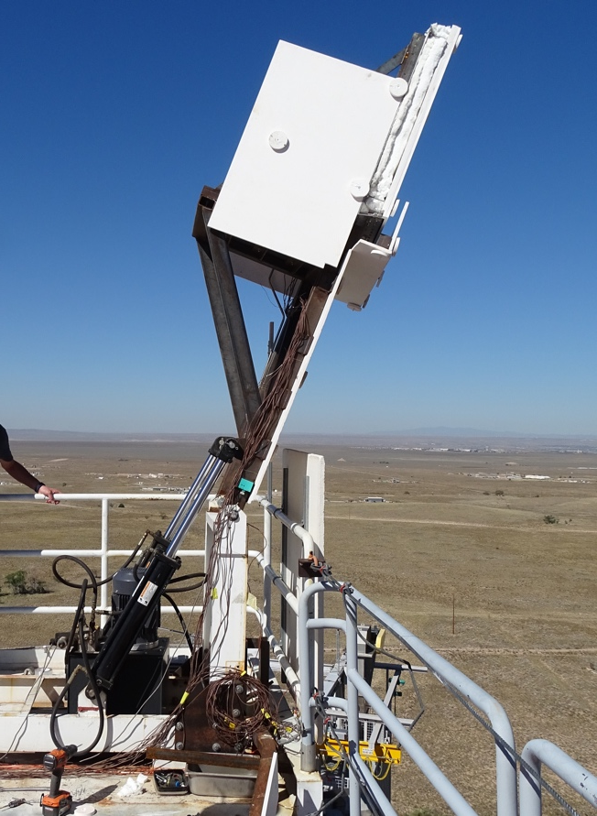
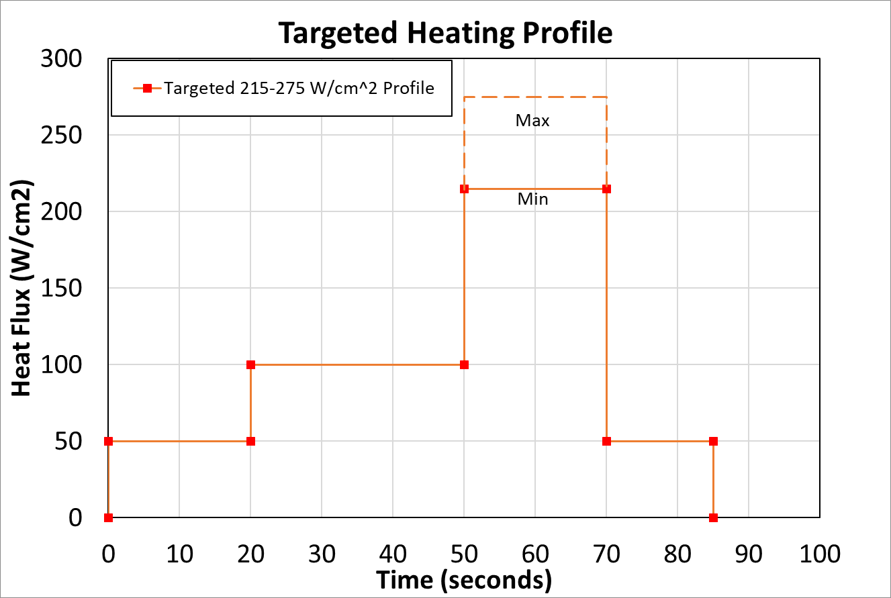
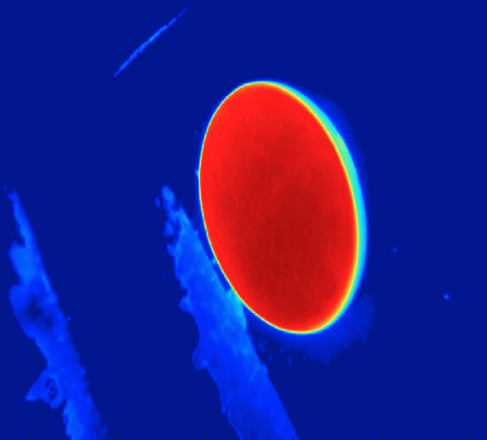
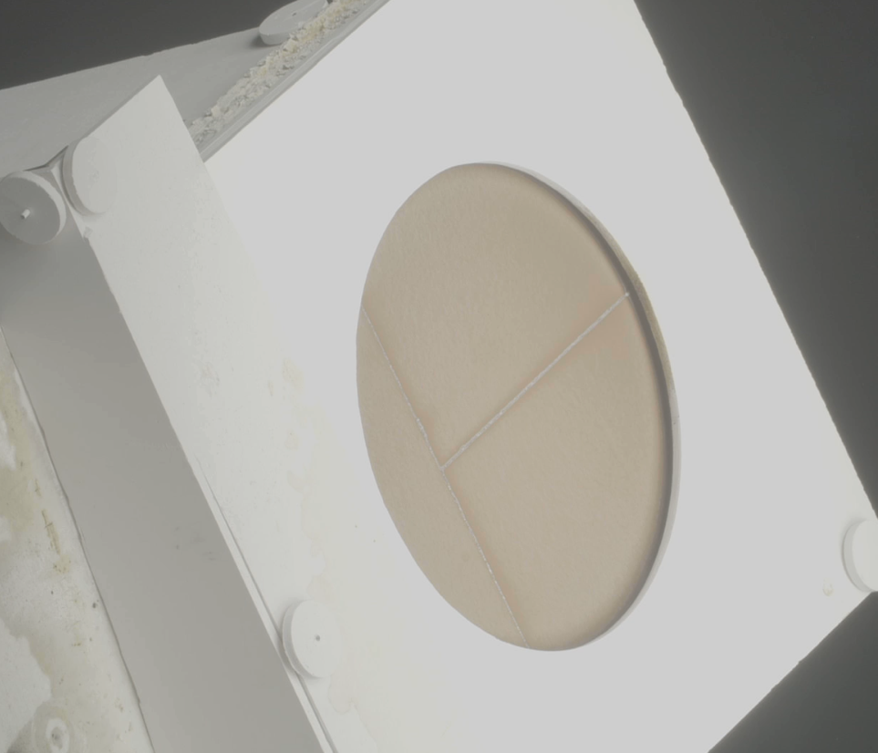
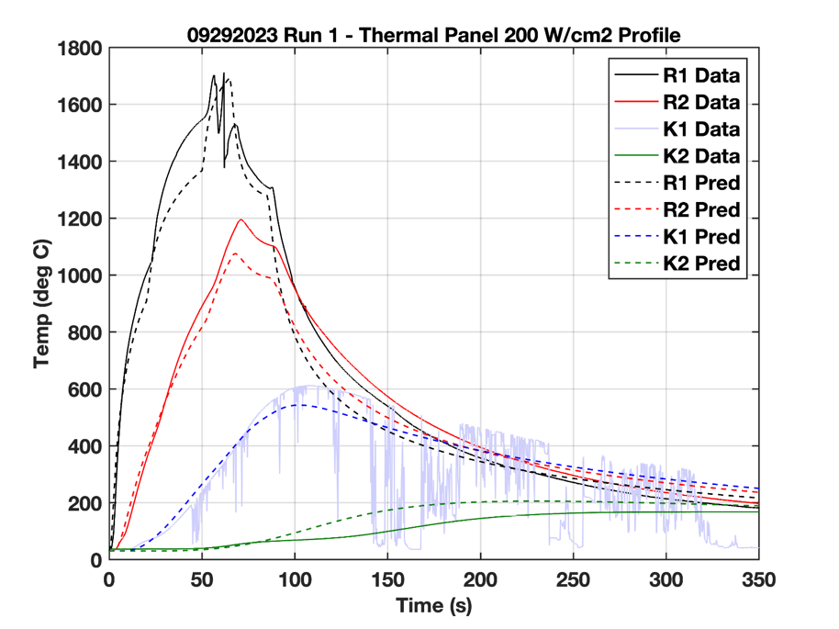
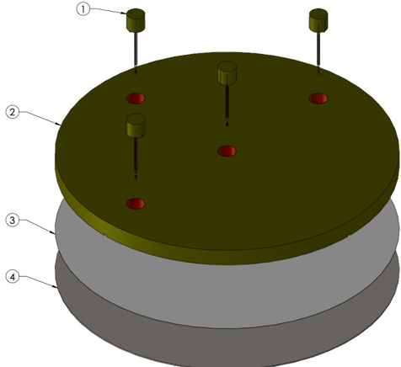
Solar Tower Test Overview
The team developed a novel test method at Sandia’s solar tower facility that enabled combined thermal and mechanical testing of PICA-D coupons at scales large enough to generate flight-like stresses
Insulation materials protect test fixture, exposing PICA-D coupon to intense solar radiation
N2 flow minimizes carbon combustion in presence of atmospheric oxygen
Heliostat field focuses Sun’s energy on a test stand at the top of tower
Test coupon faces the heliostat field
Vacuum chucks with different curvatures apply enforced deflection to 2-ft diameter PICA-D coupons generating mechanical stress
Heat profile designed to achieve flight-like temperature gradient and char depth
Infrared camera used to verify peak surface temperature
Filtered HD camera used to monitor coupon performance
Coupons with thermocouple plugs verified in-depth temperatures
Q3
Full field
Q2
TC Plug
Q1
Q4

Slide 5
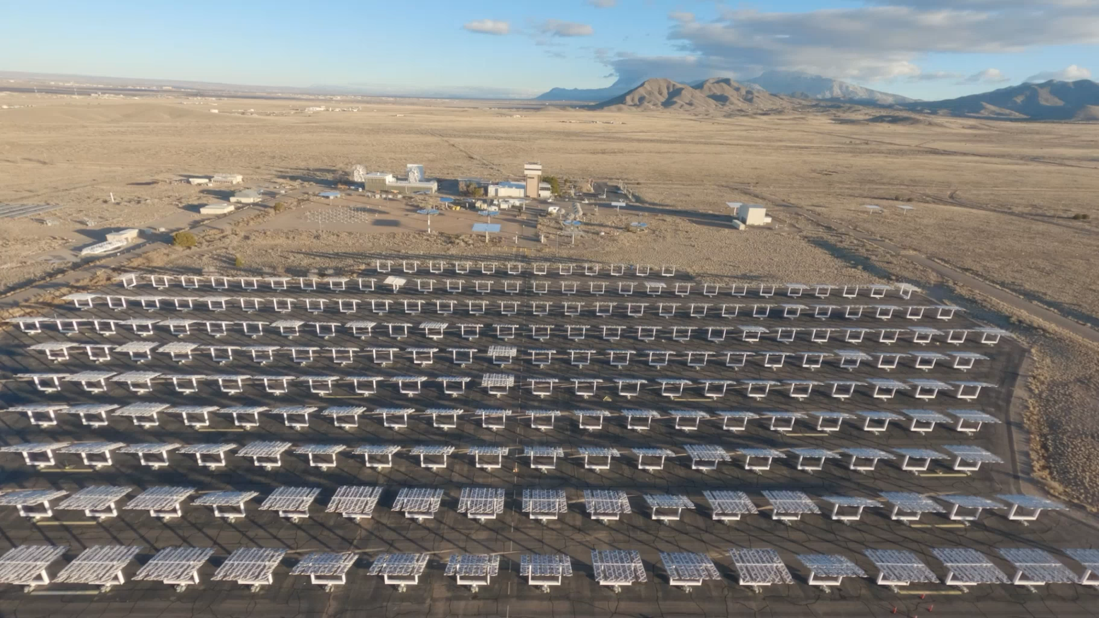
Test Video – Credit: Jenna Boss (JPL)

Slide 6
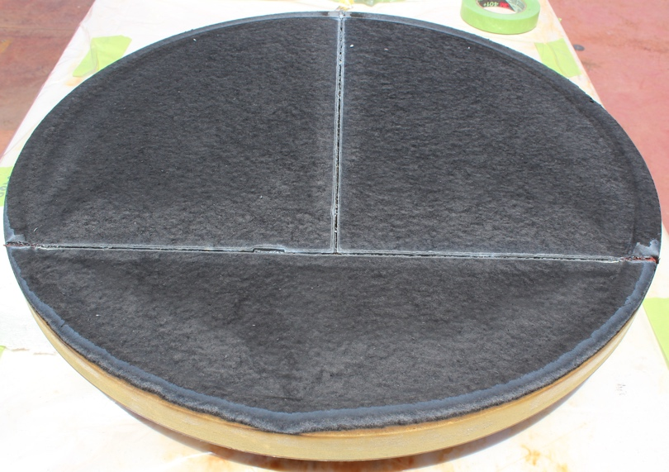
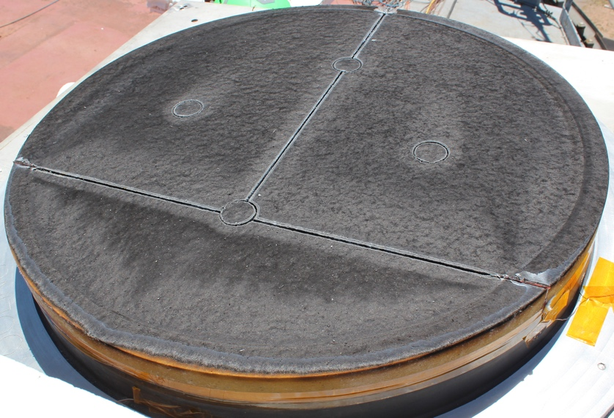
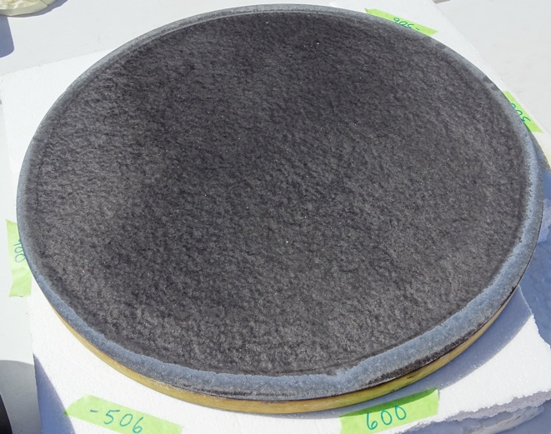
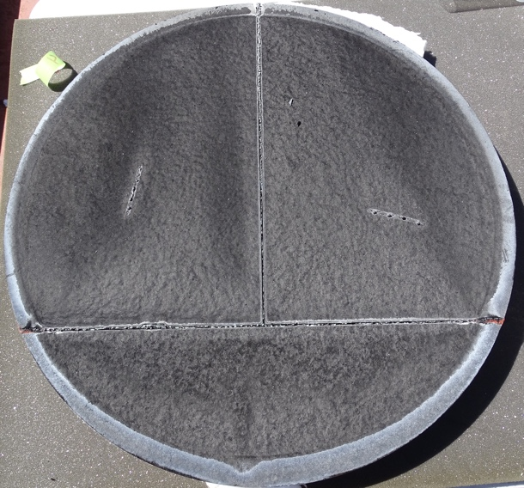
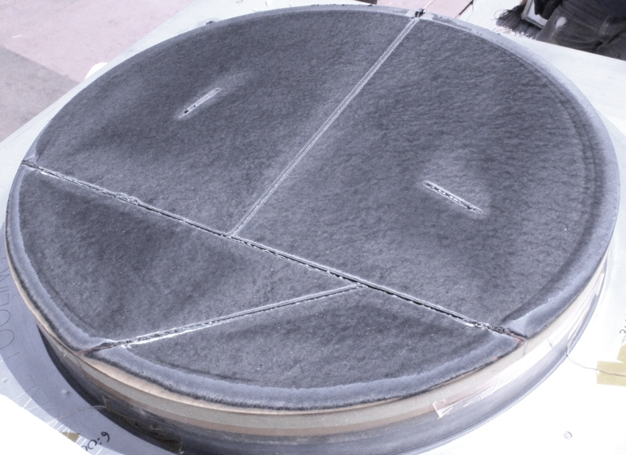
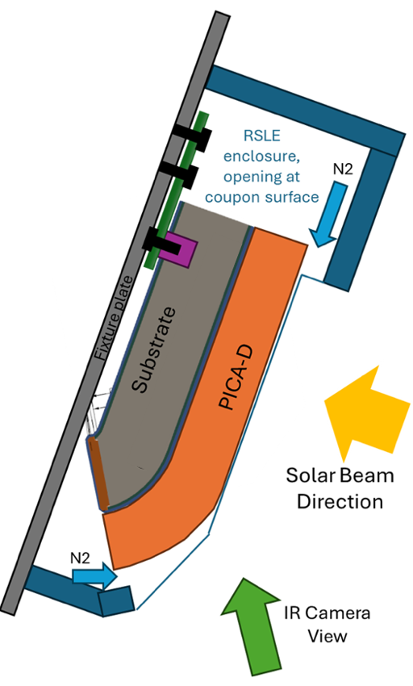
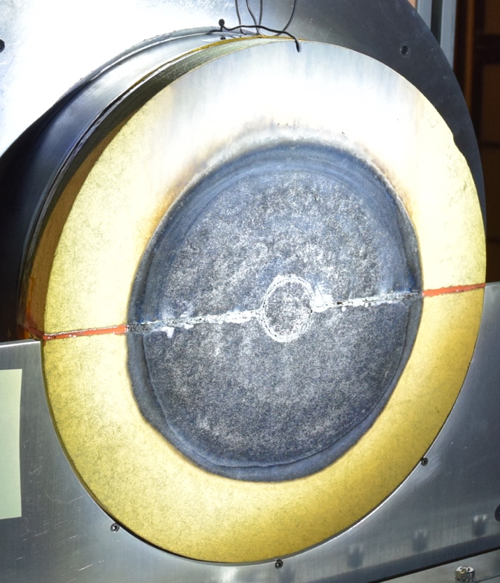
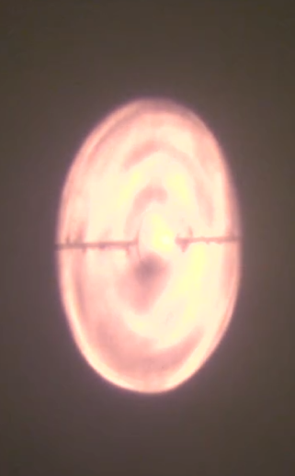
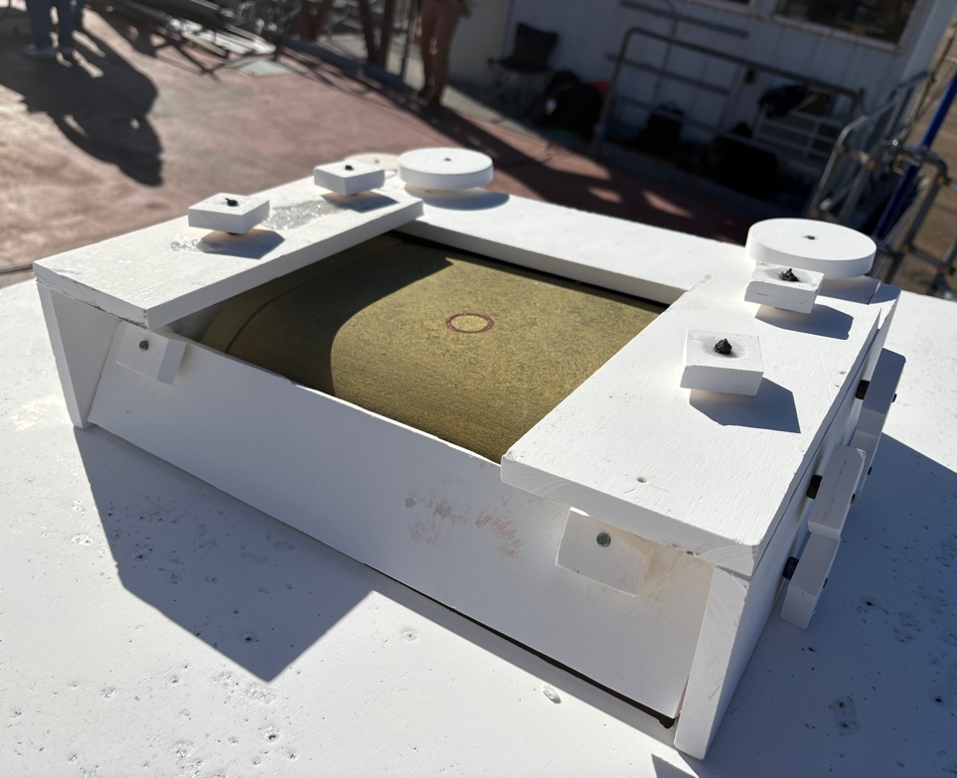
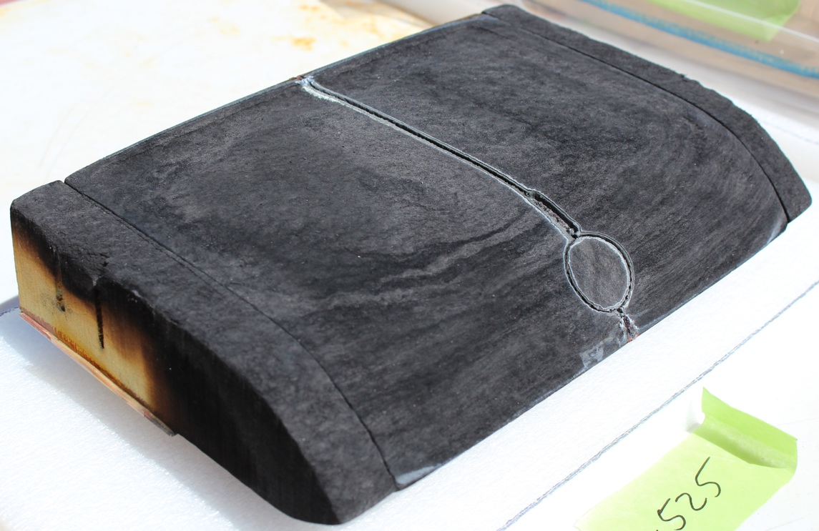
Thermostructural Test Entries
Test ID | Objective | Failure Modes | Date | Acreage Coupons | Feature Coupons
ST1 | Test Development & Risk Reduction | Biaxial IP Compression | 08/2023 | 2 | None
 |  |  | 09/2023 | 4 | None
 |  |  | 12/2023 | 2 | None
LHMEL | Alternate Facility Evaluation |  | 02/2024 | 2 | 2
ST2 | Flight Verification Acreage & Features |  | 09/2024 | 2 | 4
ST3 | Flight Verification Acreage & Features |  | 08/2025 | 1 2 shoulder | 5
ST4 | Flight Verification Shoulder & Features | TT Shear, TT Tension | 03/2026 | 2 | 4
Feature coupons containing gap fillers, flaws and repair methods tested in addition to acreage coupons
Solar tower selected for flight verification due to LHMEL’s smaller coupons and non-uniform laser heating pattern
New Test Fixture for Shoulder Coupons

Slide 7
Closing Thoughts
Thermotructural performance of the PICA-D bonded to the heatshield structure has been verified through a combination of analysis and coupon testing
  PICA-D mechanical material properties are better understood than heritage PICA
  Many advancements have been made in analysis and testing methods compared to previous programs including the development of a novel test technique and procedures at solar tower facility for flight verification testing
The PICA-D Heatshield TPS design, including features and flaws, has proven to be robust and capable of achieving the Dragonfly mission to Titan
  Held “PICA-D thermostructural peer review” on June 9, 2026 where we showed test/analysis results to project stakeholders and external SMEs and got concurrence that the PICA-D tiled heatshield design is good for flight!
In future material development efforts and early proposal stages, more focus on characterizing residual risks as opposed to justifying a TRL level will help with identifying risk mitigation steps early and alleviate the kind of schedule pressure that the Dragonfly and SRL teams faced

Slide 8
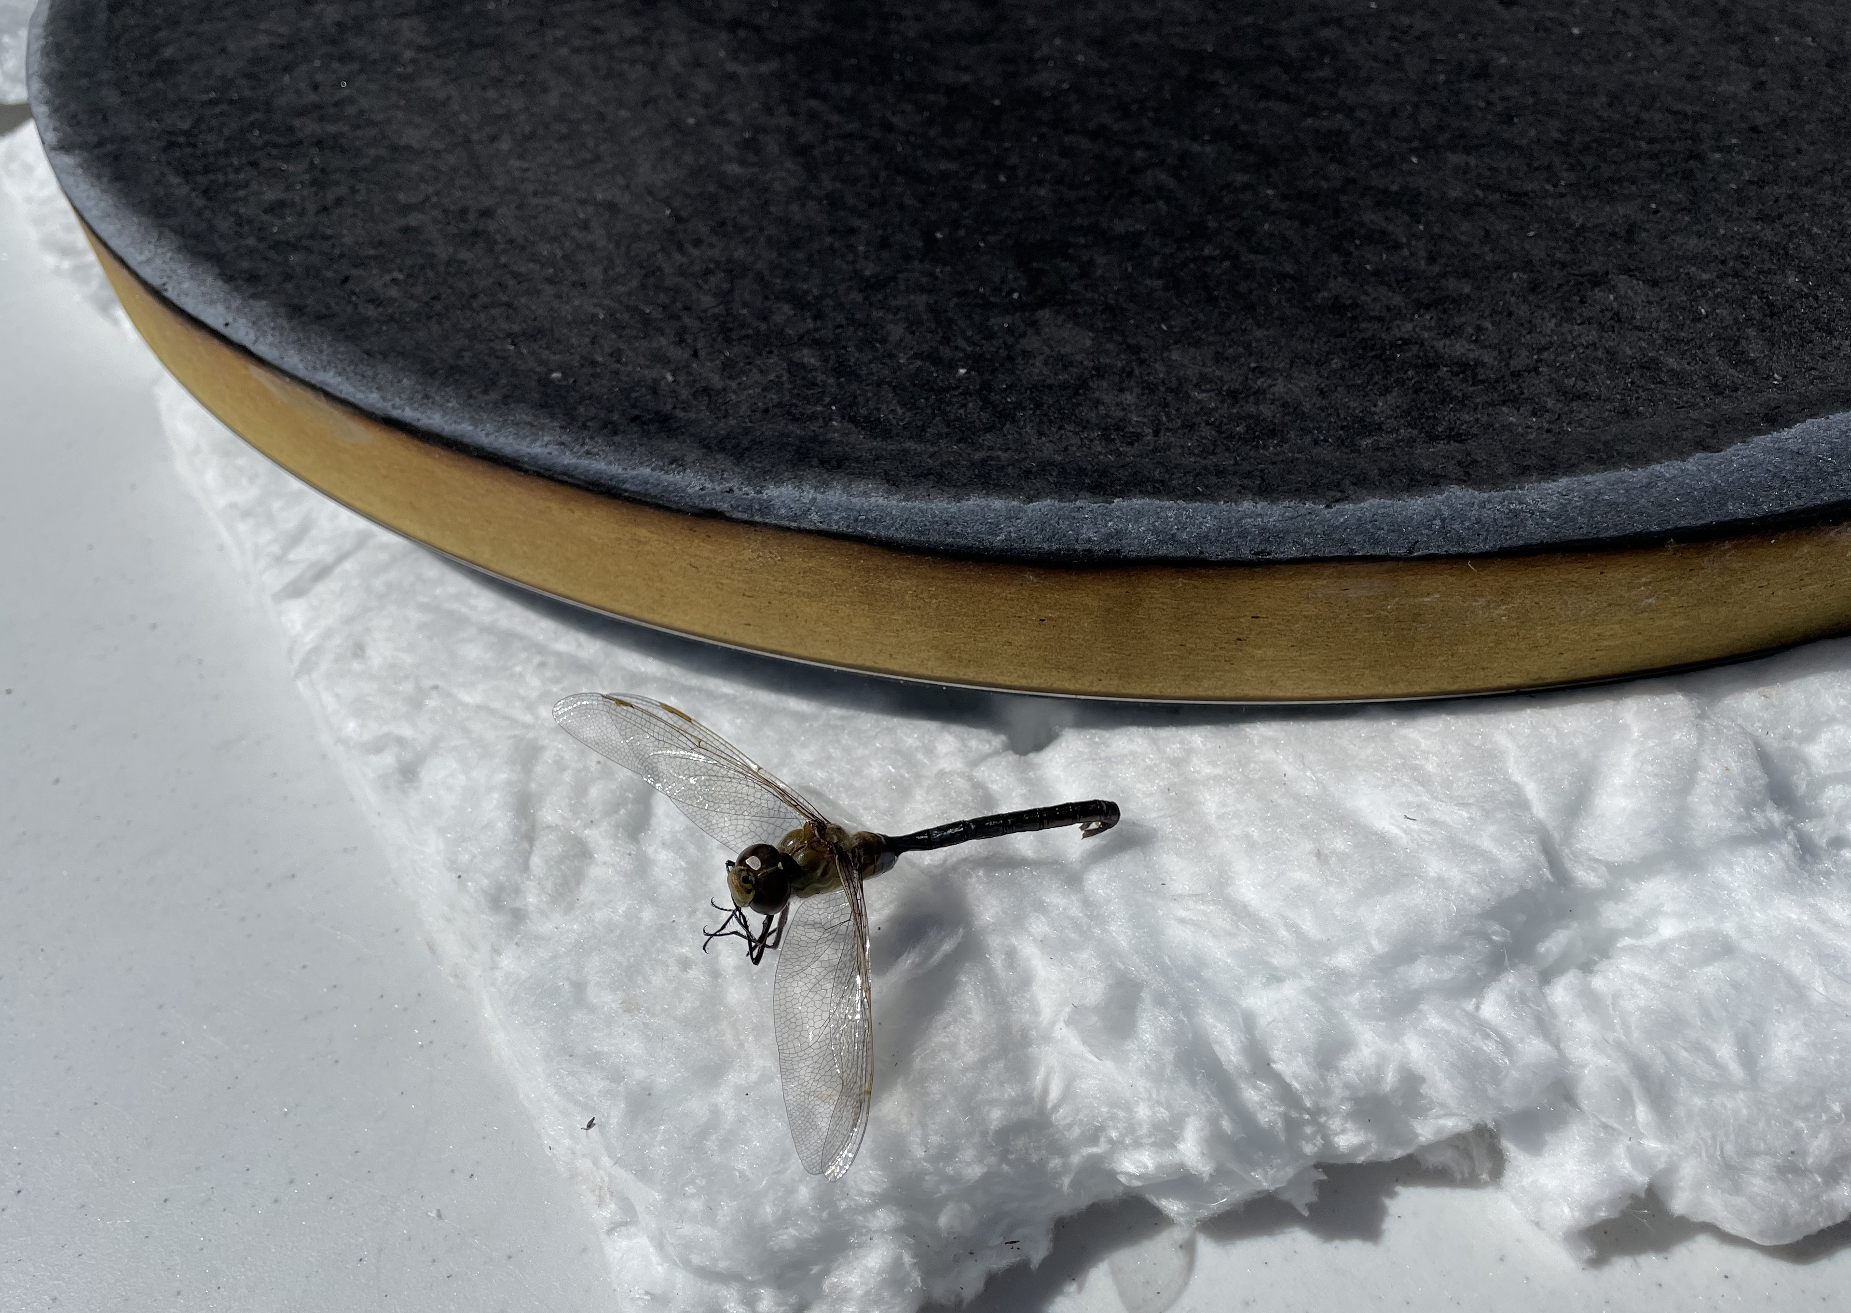
Acknowledgements
PICA-D thermostructural performance has been a key area of interest on both Dragonfly and SRL. Many engineers from NASA Ames, Lockheed Martin , APL, JPL, Sandia and Kratos have been involved in evaluating this issue and developing testing and mitigation strategies. The authors would like to acknowledge contributions/feedback/support from:
NASA Ames
Keith Peterson
Matt Gasch
Suman Muppidi
Owen Nishioka
Mike Wright
Helen Hwang
Jonathan Morgan
Josh Monk
Olivia Schroeder
Hannah Alpert
JHU APL
Karen Kirby
Wayne Dellinger
Ken Hibbard
Lockheed Martin
Derek Shannon
Jack Joyce
Nick Courtney
Sam Preece
Todd Arterburn
JPL MSR SRL
Charisse Chen
Brandon Smith
Ravi Prakash
Erich Brandeau
Dan Coatta
Jason Ginn
Marcus Lobbia
Steve Sell
Sandia
Ken Armijo
Aaron Overacker
Hayden Harper
Luis Garcia
Kratos
Bhavesh Patel
Kelly Mccullers
Rafael Gonzalez
Sacrifices were made!
Questions?

