Slide 1
ICES-2026-527
Space Suit Material Compatability with Space Vehicle Coolant PMS-1.5R
Linda Hewes, ILC Astrospace
Walter Fritz, ILC Astrospace
Michael Pedley, NASA Johnson Space Center
Trade names are used in this presentation for identification only. Their usage does not constitute an official endorsement, either expressed or implied, by the National Aeronautics and Space Administration.

Slide 2
Agenda
Coolant Leak Event Description
Characterizing EVA Risk
Test Objectives
Test Approach
Test Results
Vapor Pressures and Evaporation Rates
Conclusions

Slide 3
Coolant Leak Event
On February 11, 2023, a substance was detected on the Progress Vehicle leaking from the 82P external cooling loop.
The coolant, PMS-1.5R, is a high purity, isodecamethyltetrasiloxane and decamethyltetrasiloxane mixture
    Boiling of point of 194°C
    Vapor pressure of 0.975 mmHg at 95.5°C
    Density of 0.854 g/ml.
Due to these properties the coolant was expected to persist on surfaces. While the EVA translation path was not in the line-of-sight of the leak, near-by TQCM equipment from the SAGE-III experiment external payload (also not in the line-of-sight) detected contaminant deposition of approximately 27Å from the leaked coolant and showed no indication that the contaminant was reevaporating
Concern was that the silicone coolant would still be on ISS surfaces when the next EVA occurred and at the lower levels would not be visible to the crew. This could result in contamination of the EMU suit and potential degradation of the ISS Environmental Control and Life Support System (ECLSS) water separator by coolant brought inside the ISS pressurized volume.
Testing was deemed necessary to verify the effects of PMS-1.5R exposure and assess risk to the Space Suit Assembly (SSA) during EVA operations
Vapor Pressure and Evaporation Rates were also calculated and tested

Slide 4

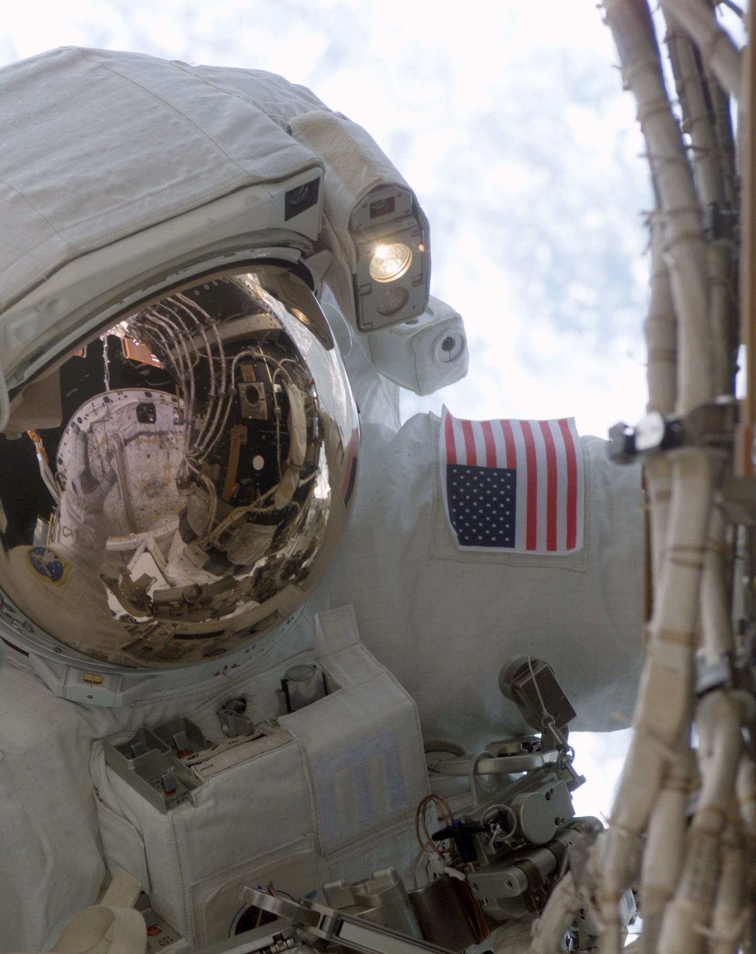
Characterizing EVA Risk
  Silicone materials are affected by the coolant. The exposed silicone materials are not structural but changes to the materials could impact EVA operations
    The glove palm material provides grip, thermal insulation and fabric structure standoff to sharp surface contact during grasping activities. Potential impacts to EVA operations include EVA translation difficulty (too slippery or too sticky), loss of the palm pads (both a glove thermal and grip concern), Silicone transfer to hardware (would be a contamination concern for optically sensitive surfaces) and change to glove fit, causing discomfort or fatigue
    The boot sole provides thermal isolation from the Articulated Portable Foot Restraint (APFR) and keeps crew indexed in the APFR. Swelling and/or tackiness could impact APFR ingress/egress
  Additionally, urethane bladder and coated polycarbonate visor materials were screened to verify no interaction with the coolant.
  The glove palm knit structure could allow for penetration. The bladder is critical and compromise could result in catastrophic failure of the air and pressure retention material.
  The hard coat used on the EVVA protective visor is siloxane based and contamination could be transferred to the EVVA protective visor from gloves. Distortion or haziness could impact crew visibility.

Slide 5
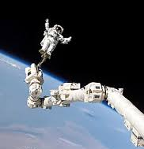
Test Objectives
Several objectives were identified for this testing and assessment. They include:
    Determine physical effects on silicone and siloxane based SSA materials
    Determine effects of EVA operations, environments and conditions (repeated exposure, long term exposure, and temperature) on reactivity/interaction of coolant with SSA material
    Determine the potential effects on EVA activity such as translation and APFR donning/doffing
    Determine if there are any visual indicators of contact or degradation that can be used for on orbit/EVA inspections and detection
    Assess cleaning procedures and efficacy.

Slide 6
Test Approach
Table I: Test Sample Description
Test Material | SSA Material Application
Molded Glove Palm with Pads | SSA Glove Palm
RTV Silicone Plates/Pads
Molded Silicone Boot Soles | SSA Boot Sole
Hard coated Polycarbonate Coupons | SSA EVVA Protective Visor
Hard coated Polycarbonate Visors
Ortho-Fabric Swatches | SSA TMG
Glove Bladder Urethane Film Test Plates | SSA Glove Bladder
Testing was performed on materials in Table I using decamethyltetrasiloxane (silicone oil) as a simulant for PMS-1.5R
Testing assumed 27Å coating on EVA surfaces
Testing included:
    Visual and Tactile Assessment
    Physical Property Testing
    EVA Environments Effects Assessment
    Cleaning Evaluations
  Exposure levels were varied
    Light (~0.1085 µm)
    Moderate (~79.5 µm)
    Heavy (~146 µm)
    Immersion

Slide 7
Test Approach (continued)
Visual and Tactile Assessment
    Consisted of applying oil to Ortho fabric, glove pads and visor polycarbonate to determine if contaminate was visible on surface and if oil interaction altered appearance. This assessment also established how long the oil remained visible
      Goal – Determine if crew can detect contamination visually and how long contamination is visible for to mitigate risk of bringing coolant into ISS and SSA useability
Physical Property Testing
    Consisted of applying oil to glove RTV, boot silicone sole, visor polycarbonate and glove bladder material to determine if material integrity would be impacted. This data was then used to assess mission safety and success
      Goal – Determine impact to material properties and use information in analysis to establish risk to EVA operations and safety
        Glove bladder integrity
        Grip
        Thermal performance
        APFR donning/doffing
        Visibility
        Durability of boot sole and glove pads

Slide 8
Test Approach (continued)
Assessing the Effects of EVA Environments
    Consisted of applying oil to glove pad material, subjecting to elevated temperature and performing blocking tests against aluminum sheet, Kapton film and ortho fabric (each representing a material typically contacted during EVA). Test parameters represented five 45 minute daylight cycles in an EVA at maximum T sink temperatures in hot thermal radiation environments for gloves at maximum grasp pressures
      Goal – Verify that the EVA environment did not cause additional degradation or more pronounced changes to glove RTV that would significantly reduce durability of pads
Cleaning Evaluations
    Consisted of applying oil to visor polycarbonate and Ortho fabric and, using materials available on orbit, develop a cleaning procedure and assess effectiveness. Testing assumed cleaning would not occur before the crew entered the airlock after a 7 hour EVA and that subsequent EVAs would occur no sooner than 6 days following the prior EVA
      Goal – Determine what material and cleaning method would reduce contamination to achieve acceptable visibility on the visor and for removing as much contamination from the SSA external fabric as possible to reduce the amount of coolant brought into the ISS. This testing also provided confidence in re-useability of the SSA

Slide 9
Test Matrix
Table II: Test Matrix

Slide 10
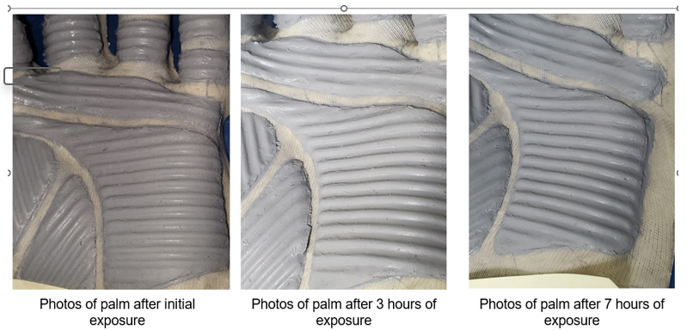
Test Results
Visual and Tactile Assessment
      Glove RTV pads immersed in silicone oil were gummy and showed significant distortion. However, after 2 weeks the sample reverted back to its original shape
      Application of the oil onto the glove palm RTV revealed it was barely visible initially but was undetectable within 30 minutes. There was no observable swelling and the RTV remained securely adhered to the glove materials.

Slide 11
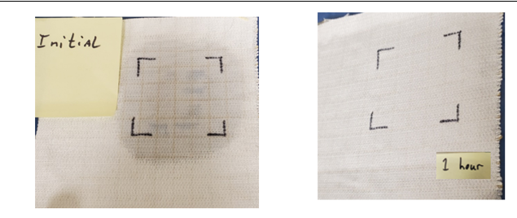
Test Results
Visual and Tactile Assessment (Cont)
        The silicone oil is visible when first applied but wicks, dispersing readily. After one-hour, visual detection was very difficult, and the oil was undetectable after 2 hours

Slide 12
Test Results
Physical Property Testing
      Immersed silicone samples showed significant changes in strength, elongation and/or hardness
        Up to 65% reduction in tensile and elongation for the glove RTV and a 24% reduction in boot sole hardness
      Testing of silicone samples with a light or moderate coating behaved better and material function is not expected to be compromised
        Up to 19% reduction in tensile strength and 13% reduction in elongation
        While the lighter coating appeared to experience a larger decrease over the moderate coating (6% reduction versus 19% reduction), the hardness testing shows no real change (44 Shore A versus 45 Shore A). The differences are most likely due to sample preparation and the presence of voids and inclusions. This is reflected in the high standard deviations.
      Physical property of moderately coated glove bladder material shows no change to physical properties
      The silicone oil can cause swelling in the silicone materials. This swelling is significant in immersed samples but is minimal in samples where the oil was applied by brush and allowed to sit
      Coefficient of friction (COF) increases can occur with limited exposure, and the boot is more susceptible than the glove RTV. The COF for the boot sole silicone increase with time as the oil is being absorbed, swells and softens the material. Conversely, the glove RTV readily absorbs the oil and therefore is less dependent on time. While the oil may act as a lubricant immediately on the silicone surfaces, this quickly changes to tackiness. Due to the amount of exposure expected during EVA (27 Å), changes to COF are expected to be minimal

Slide 13
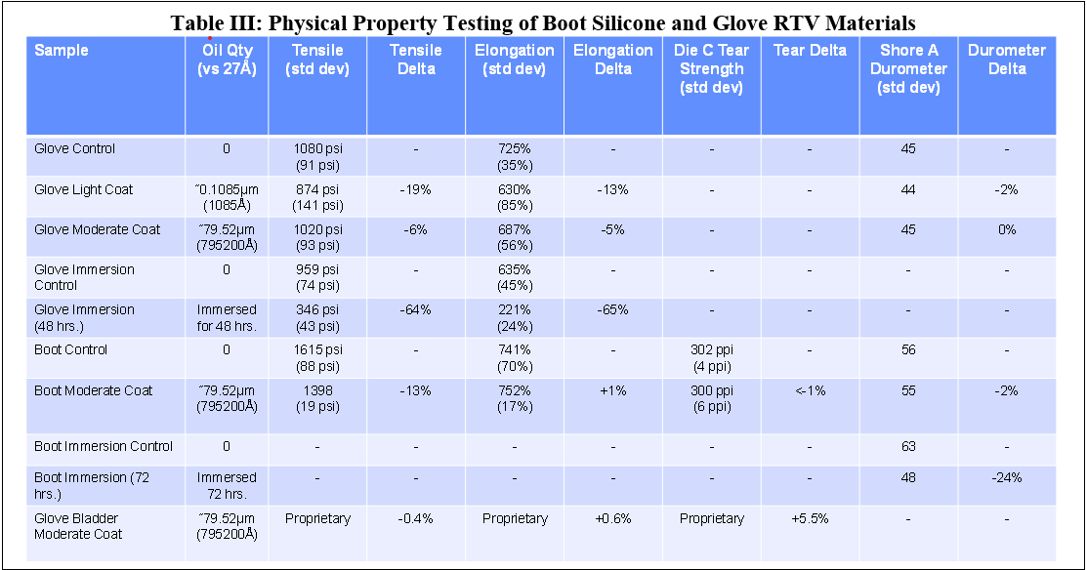
Test Results

Slide 14
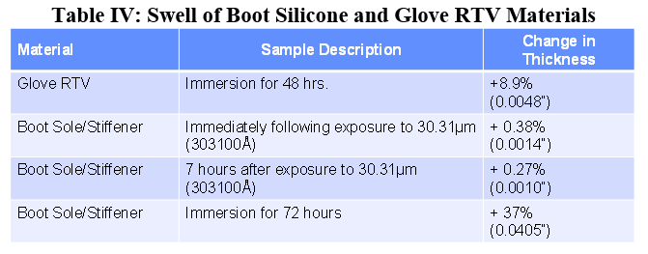
Test Results

Slide 15
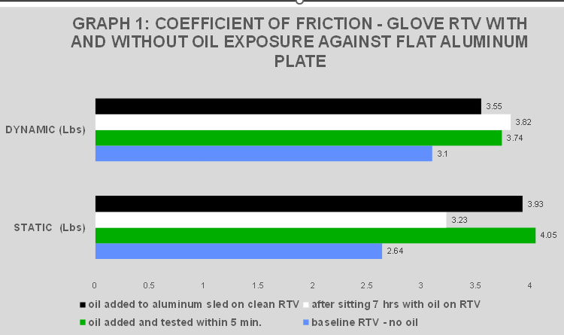
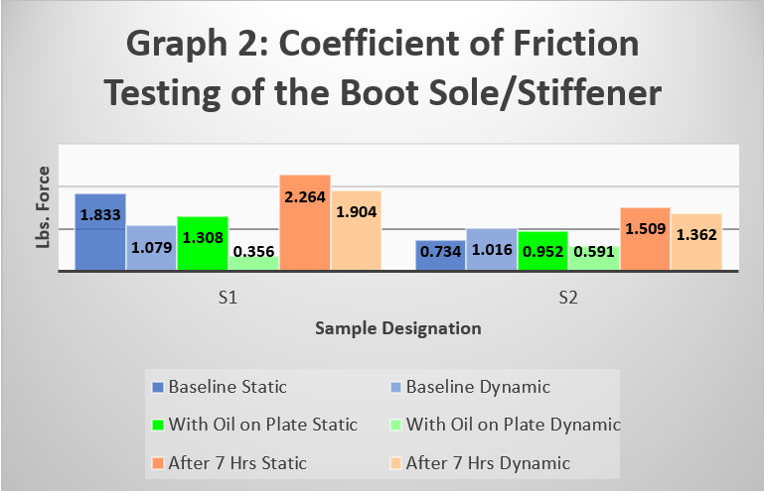
Test Results

Slide 16
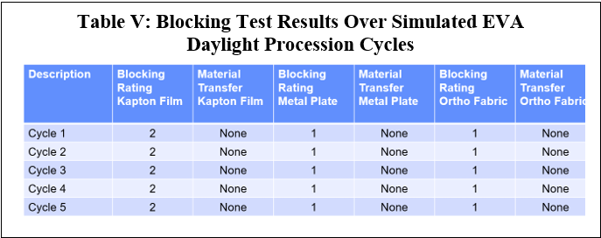
Test Results
Assessing the Effects of EVA Environment
      The blocking tests from this assessment showed that glove RTV material transfer did not occur under the maximum grasp pressure at the maximum sink temperature.
      The longer-term thermal cycling test with both single application (applied only before the first thermal cycle) and multiple applications (applied prior to each thermal cycle) showed negligible differences in COF for glove RTV, either as a result of time, temperature, or repeated exposure (ref. Graph 3).
      The slight blocking documented for the Kapton film challenge material is a function of the Kapton film properties and smoothness rather than Glove material silicone oil exposure effects

Slide 17
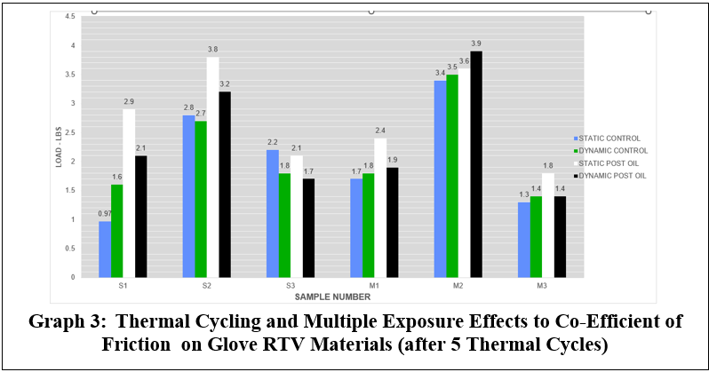
Test Results

Slide 18
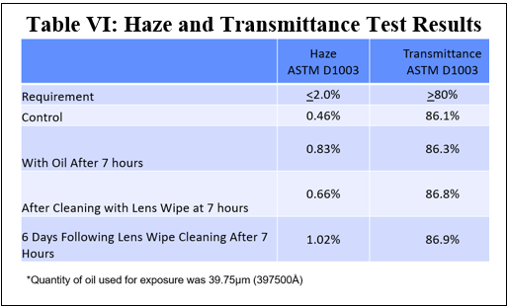
Test Results
Cleaning Evaluations
      The cleaning evaluations showed that wiping the Ortho-fabric surface did not remove any of the silicone oil. No evidence of oil was detected on a dry wipe used to wipe the Ortho-fabric swatch after a 7-hour period.
      The evaluation showed that the lens tissue was the most efficient material for cleaning the Protective Visor as the other cleaning mediums merely smeared the silicone oil around. In addition, although haze increased with time, haze and transmittance measurements remained within the requirement even without cleaning (Table VI). The larger impact on visibility was distortion occurring from silicone oil contamination

Slide 19

Vapor Pressures and Evaporation Rates
ISS environmental control systems degraded by siloxanes
  Testing had shown that bringing coolant into the ISS could not be mitigated effectively through detection and cleaning
MLM radiator leak in October 2023 significantly larger than 82P leak, with 72 liters of coolant leaking out in the direction of EVA translation paths for scheduled EVAs
  Greater concern about residual coolant brought inside ISS on EMU surfaces degrading the environmental control systems.
Studies conducted to establish how rapidly the coolant would reevaporate from ISS surfaces in translation paths at predicted minimum temperature of -40 °C
Clapeyron-Clausius equation used to relate vapor pressure and temperature
Where:
P1, P2 -- vapor pressures at two different temperatures
T1, T2 -- corresponding absolute temperatures in Kelvin
ΔH (joules/mole) -- molar enthalpy of vaporization (energy required for phase change from liquid to gas)

Slide 20
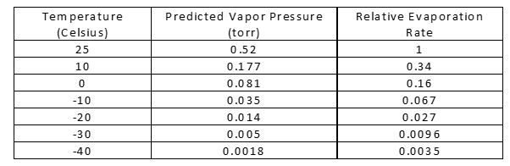
Vapor Pressures and Evaporation Rates
Predicted Vapor Pressures and Relative Evaporation Rates (Using 12.0 kcal/mol Heat of Vaporization)
Evaporation rate in vacuum proportional to the vapor pressure
  evaporation should occur about 300 times faster at ambient temperature than at -40 °C
Predicted Minimum Evaporation Rates

Slide 21
Conclusions
Testing showed that risk of material integrity impacts is very low.
    Materials that are susceptible to compatibility issues are not structural in nature.
    At levels far exceeding what is expected on orbit, materials are not likely to distort, swell or become so tacky or unstable unless immersed
    Material exposure during EVA operations will not result in loss of the material onto interfacing surfaces.
    Initial exposure effects are expected to be more pronounced but is temporary and that as the coolant dissipates, properties will rebound.
Testing also showed that risk to EVA operations, specifically translation and APFR ingress/egress was low.
    Risk from exposure to coolant making the handrails too slippery or transferring RTV material is very low.
    Tackiness may be increased for the boot sole. However, the amount of material the boot is expected to see, if any, is very low.
    Although immersion testing of the boot sole material showed significant swelling, there was little change in thickness at the lower exposure levels, which still far exceeded the amount of coolant exposure expected during an EVA.
Risk of impairment to crew visibility is low
    While coolant deposition on the protective visor could cause distortion, the haze and transmittance remain within specification.
    Cleaning evaluations showed that cleaning with a lens wipe upon re-entering the airlock would remove most of the coolant and any gross coolant contamination could be removed during EVA with and EVA wipe.

Slide 22
Conclusions
At the expected level of exposure (approximately 27Å), the crew is unlikely to be able to detect contact and that cleaning, other than the protective visor, would be ineffective. Therefore, concern of bringing coolant into the ISS could not be mitigated through detection and cleaning.
The SAGE-III payload TQCMs had identified permanent deposition that did not reevaporate.
    This deposition was low-level deposition from coolant vapor rather than from direct liquid coolant contact. Atomic oxygen and ultraviolet radiation are known to fix silicones as nonvolatile deposits, with atomic oxygen converting them to silica.
    The TQCM deposition was dependent on the atomic oxygen fluence with the greatest deposition on the ram-facing TQCM because it was getting the most atomic oxygen fluence.
    Some fixed deposits will have remained on ISS surfaces contacted directly by liquid coolant but would not be volatile and would not represent an EVA hazard.
Conclusion from predicted evaporation rates was that no significant unreacted coolant would be present on ISS surfaces in the translation path for next USOS EVA and no concern for contamination of EMU or degradation of ISS ECLSS water separator by coolant brought inside ISS.
    Unlikely that any ISS visiting vehicle will have an external coolant less volatile than MLM coolant, so this conclusion should apply to any future coolant leaks.
    If such a scenario did occur, approach of using Clapeyron-Clausius equation to predict vapor pressure as a function of temperature and WSTF testing to anchor the vacuum evaporation rate could be used again.

