Slide 1
A Simplified Model of VIPER Thermal Management System. Part II: Integrated Vehicle
Ezequiel F. Medici
S&K Global Solutions, Houston, TX, 77058
Jodi C. Turk, and Elijah R. Stewart
NASA Marshall Space Flight Center, Huntsville, AL, 35812
Tim Page
Amentum Space Exploration Division, Huntsville, AL, 35812
Zane W. Mittag, Juan M. Barragan, Angel Alvarez-Hernandez
NASA Johnson Space Center, Houston, TX, 77058

Slide 2
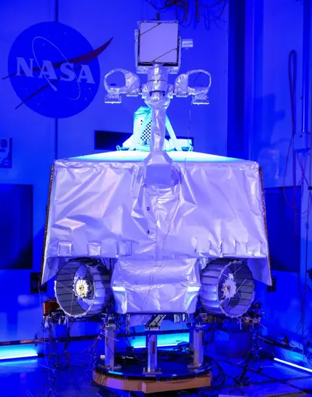
Background
VIPER Mission: Prospecting the south pole of the Moon, especially for water ice.
Payloads: TRIDENT, NSS, NIRVSS, and MSOLO.
General Mission Requirements and Goals:
  100 days mission.
  50 hours of hibernation.
  7.2 hour of lunar permanent shadow region.
  70 hours of payload instruments bakeout.
Thermal Management System:
  4 Heat spreaders (with embedded ammonia CCHPs), warmbox, to collect the electronic waste heat.
  4 Loop heat pipes, filled with propylene, to dissipate electronics waste heat into the sky.
  7 Ammonia heat pipes around the warmbox, balancing the thermal load and providing LHP redundancy.
  3 Ammonia heat pipes supporting the cooling of the MSOLO and NIRVSS payloads.
  4 Radiators.
  MLI and isolators.

Slide 3
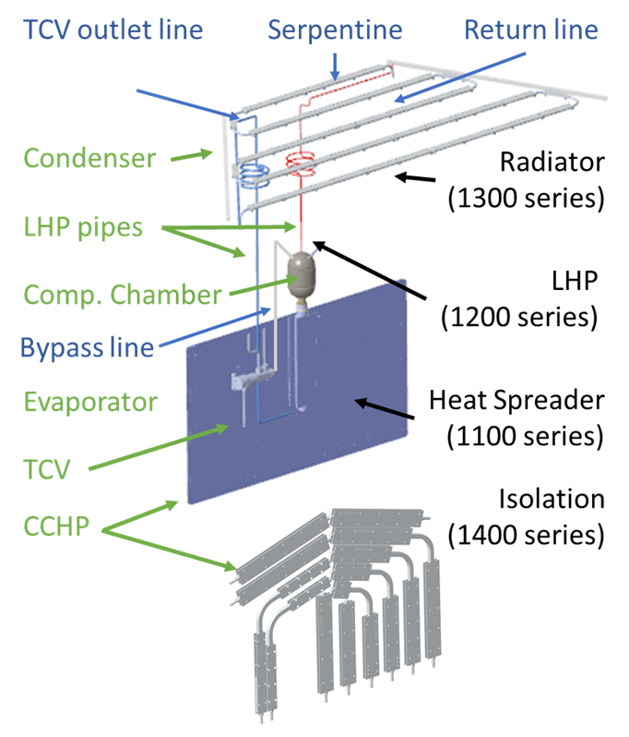
LHP Configuration
Components:
  1 Heat spreader with embedded ammonia CCHPs. 42.9g of ammonia.
  No mass simulators.
  1 Evaporator and compensation chamber. assembly. 209.4g of propylene.
  1 Aluminum phase sheet radiator.
  1 TCV, temperature set points [0°C to 20°C].
  Liquid and vapor lines.
Baseline configuration :
  Vertical heat spreader and LHP.

Slide 4
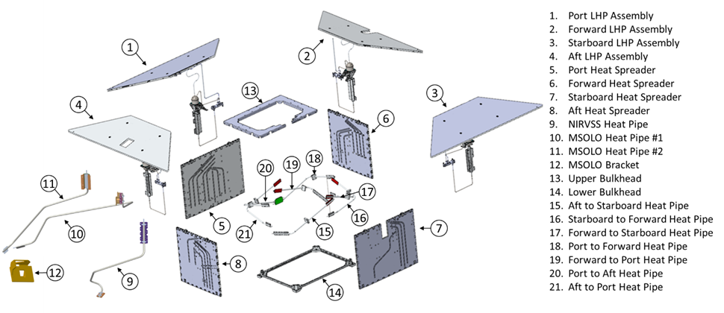
VIPER TMS Configuration

Slide 5
Model Objectives
Model Characteristics:
  Computational light.
  Capable of doing transient simulations.
  Easy to add ad-hoc logic to simulate LHP shutdown, LHP startup, and fault injections.
  Model will be used to:
  Provide quick performance assessments.
  Perform real time simulations, especially those dedicated to console operator training.
  Modeling Approach:
  Develop an in-house model of a single LHP using control volume approach. “A Simplified Model of VIPER Thermal Management System. Part I: Loop Heat Pipe”
  Complex geometry of the LHP, and the components attached to it, are reduced to thermal lump capacitances.
  Model correlated using thermal vacuum (TVAC) test data.

Slide 6
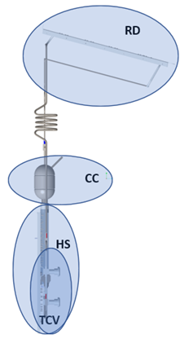
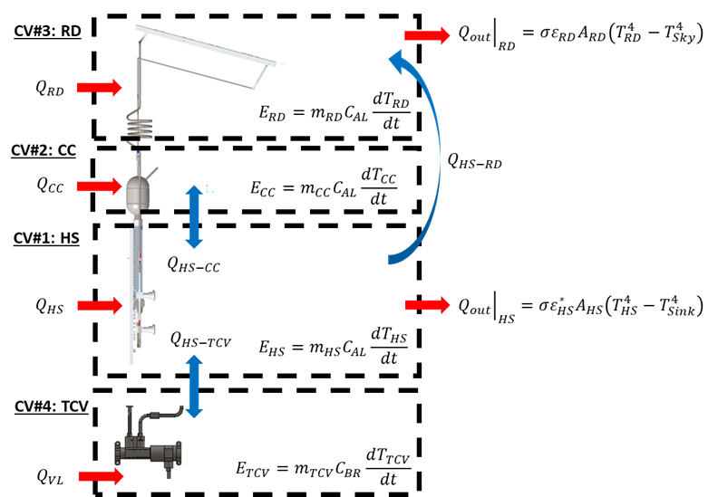
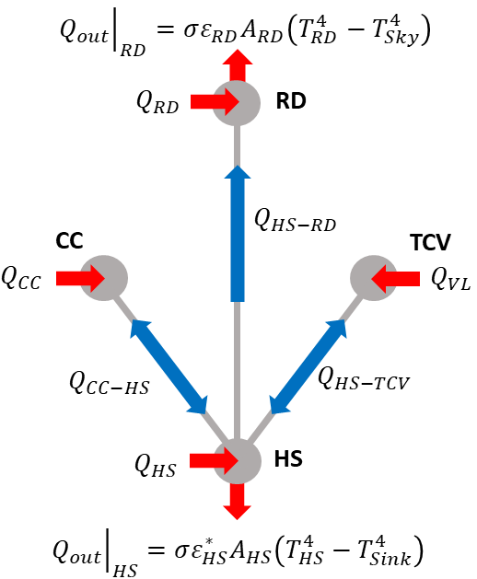

Modeling Approach: LHP
Control Volume Approach
Energy balance around the control volumes
4 Equations with 4 unknown: $T_{HS}$, $T_{CC}$, $T_{TCV}$, and $T_{RD}$

Slide 7
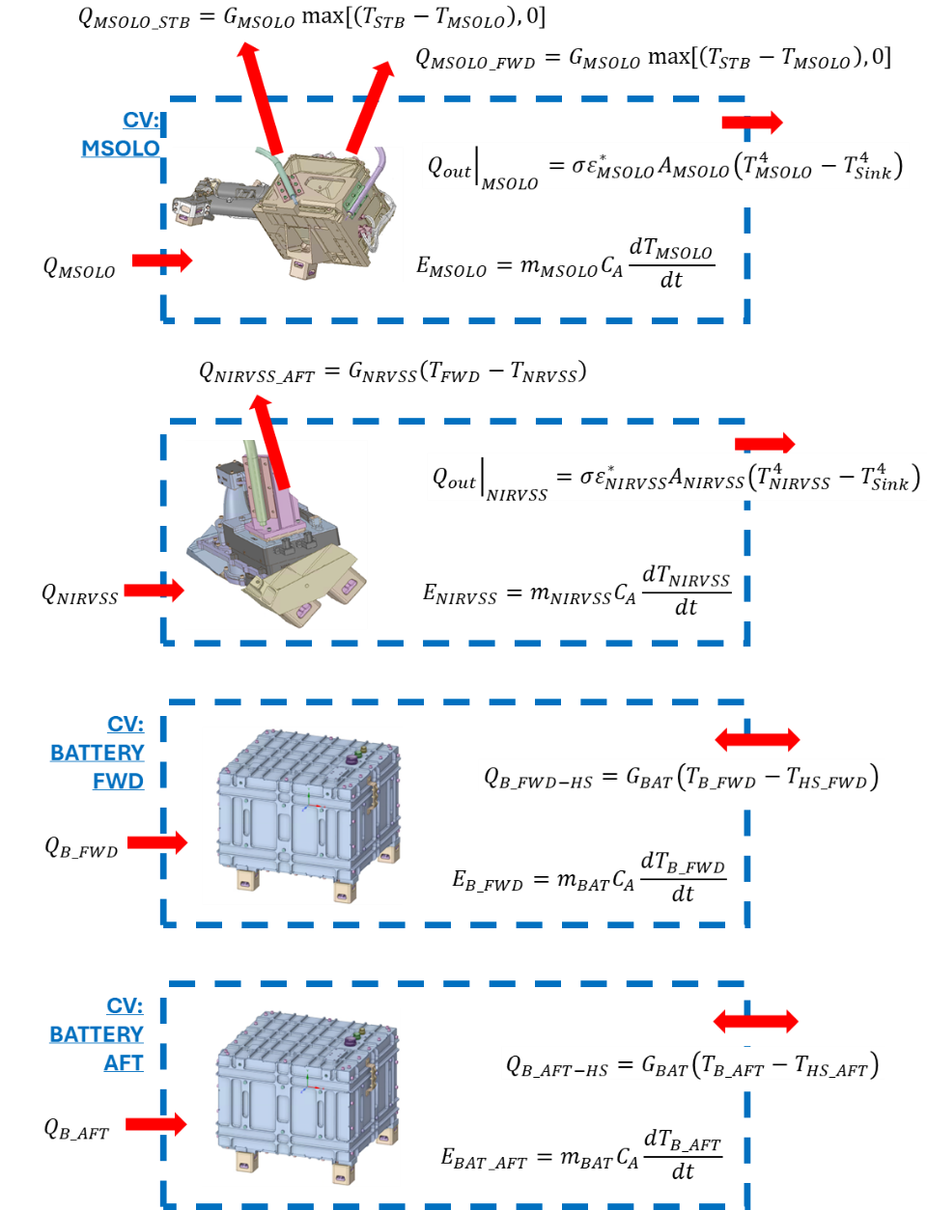

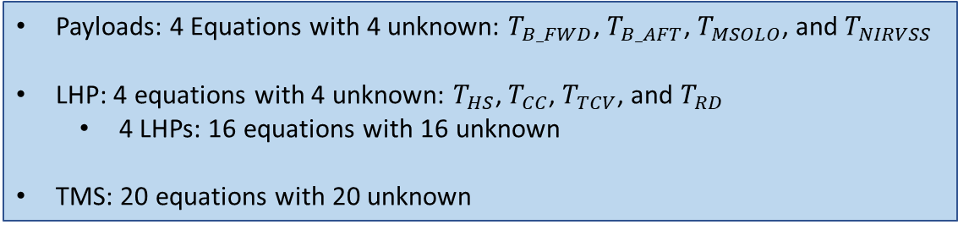
TMS, Payloads and Batteries Models
Energy Balance: ${\dot{E}}_{st}={\dot{E}}_{in}−{\dot{E}}_{out}$
Payloads: 4 Equations with 4 unknown: $T_{B_FWD}$, $T_{B_AFT}$, $T_{MSOLO}$, and $T_{NIRVSS}$
LHP: 4 equations with 4 unknown: $T_{HS}$, $T_{CC}$, $T_{TCV}$, and $T_{RD}$
  4 LHPs: 16 equations with 16 unknown
TMS: 20 equations with 20 unknown

Slide 8
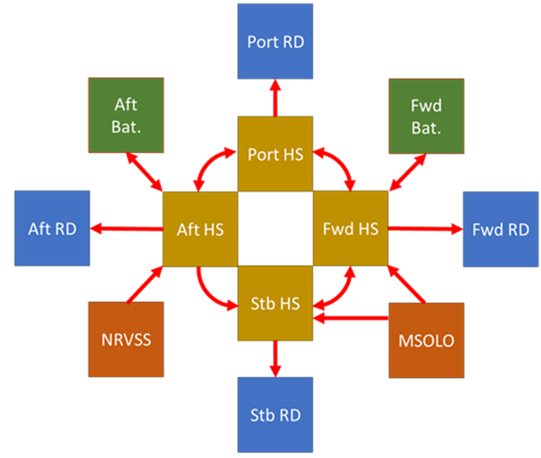
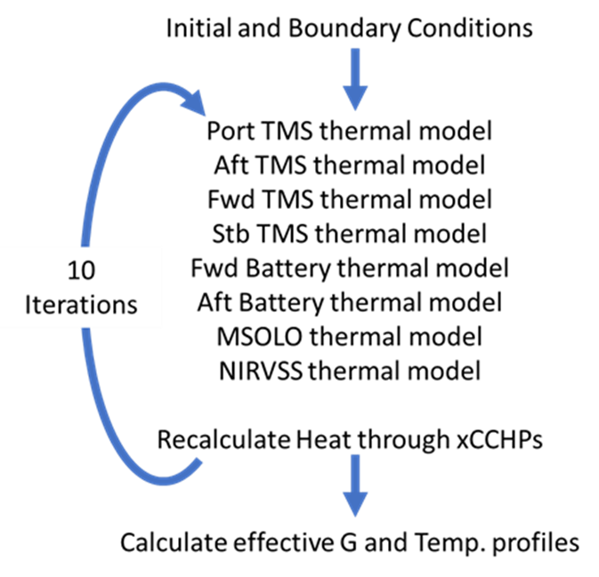
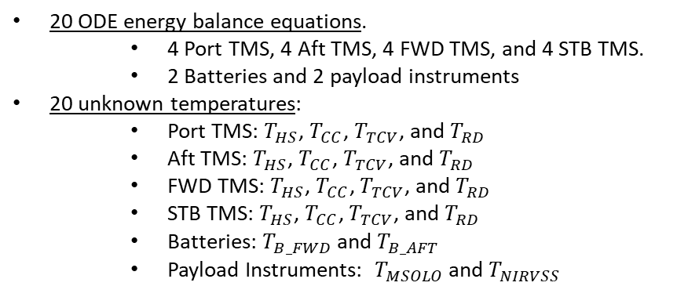
Integrated Vehicle TMS Model
20 ODE energy balance equations.
    4 Port TMS, 4 Aft TMS, 4 FWD TMS, and 4 STB TMS.
    2 Batteries and 2 payload instruments
20 unknown temperatures:
    Port TMS: $T_{HS}$, $T_{CC}$, $T_{TCV}$, and $T_{RD}$
    Aft TMS: $T_{HS}$, $T_{CC}$, $T_{TCV}$, and $T_{RD}$
    FWD TMS: $T_{HS}$, $T_{CC}$, $T_{TCV}$, and $T_{RD}$
    STB TMS: $T_{HS}$, $T_{CC}$, $T_{TCV}$, and $T_{RD}$
    Batteries: $T_{B_FWD}$and $T_{B_AFT}$
    Payload Instruments: $T_{MSOLO}$ and $T_{NIRVSS}$

Slide 9
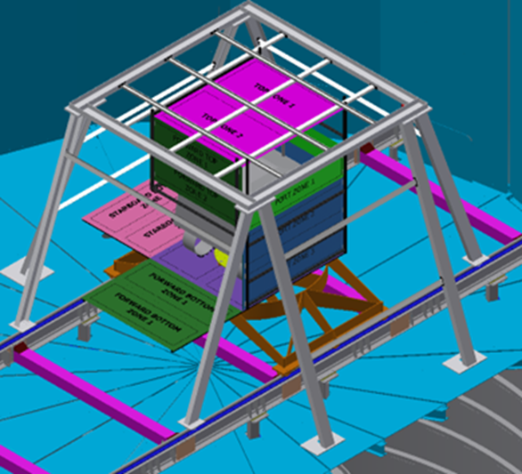
Integrated Vehicle TVAC Test
JSA Chamber A. LN2/He shroud.
Enclosure used to drive the thermal balances
Three relevant segments
  Hibernation
  Cold Thermal Balance
  Hot Thermal Balance

Slide 10
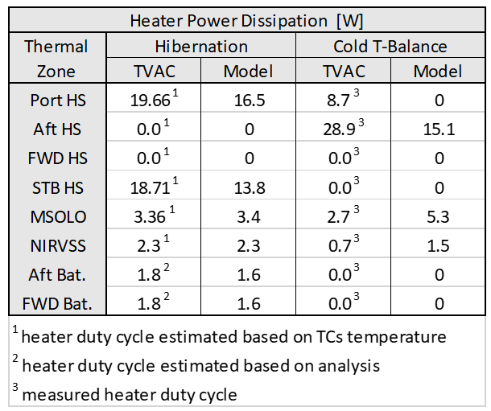
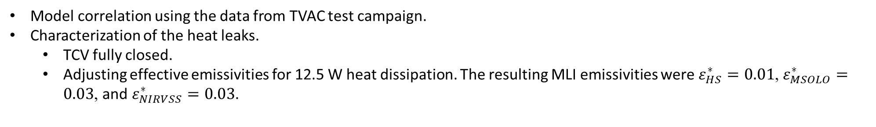
Model Correlation: Step #1, Hibernation
Model correlation using the data from TVAC test campaign.
Characterization of the heat leaks.
  TCV fully closed.
  Adjusting effective emissivities for 12.5 W heat dissipation. The resulting MLI emissivities were $ε_{HS}^{∗}=0.01$, $ε_{MSOLO}^{∗}=0.03$, and $ε_{NIRVSS}^{∗}=0.03$.

Slide 11

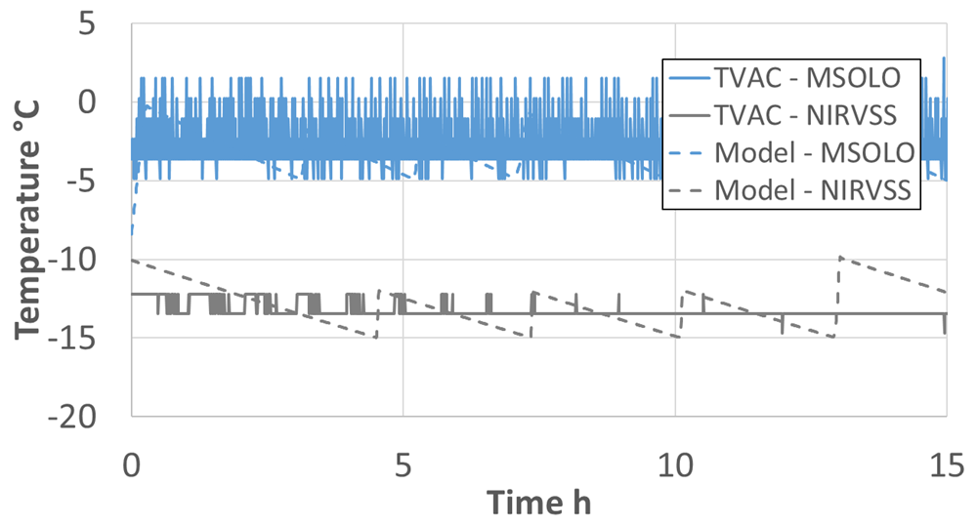
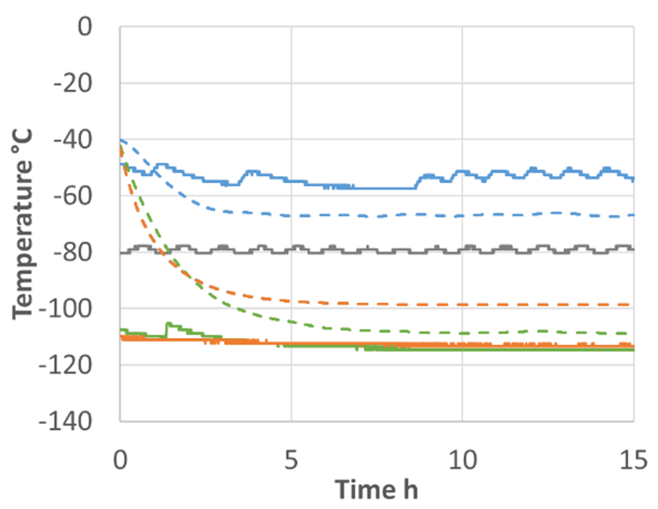
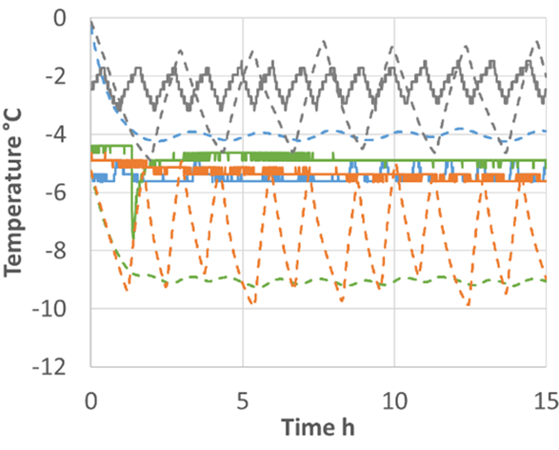
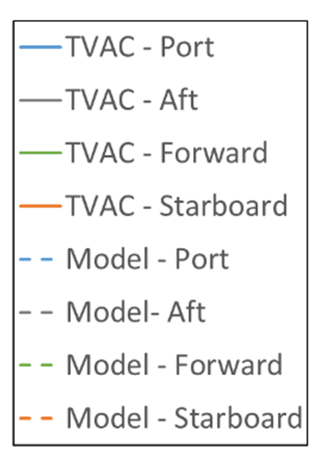
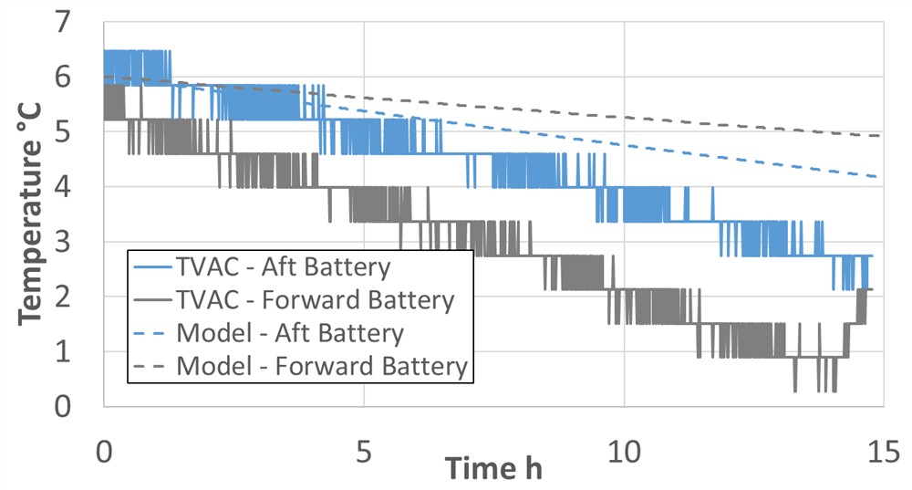
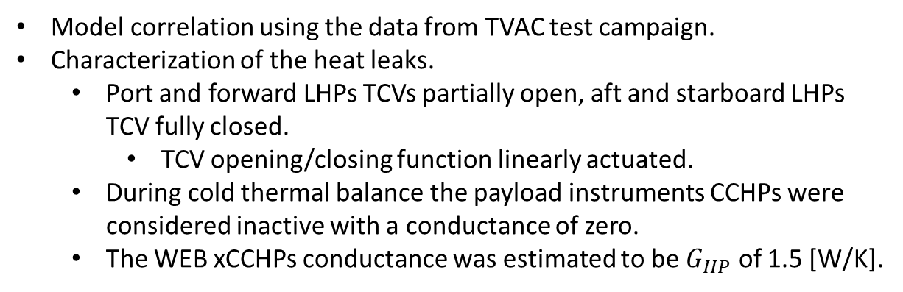
Model Correlation: Step #2 Cold Thermal Balance
Model correlation using the data from TVAC test campaign.
Characterization of the heat leaks.
  Port and forward LHPs TCVs partially open, aft and starboard LHPs TCV fully closed.
    TCV opening/closing function linearly actuated.
  During cold thermal balance the payload instruments CCHPs were considered inactive with a conductance of zero.
  The WEB xCCHPs conductance was estimated to be $G_{HP}$ of 1.5 [W/K].
Radiators
Evaporators

Slide 12
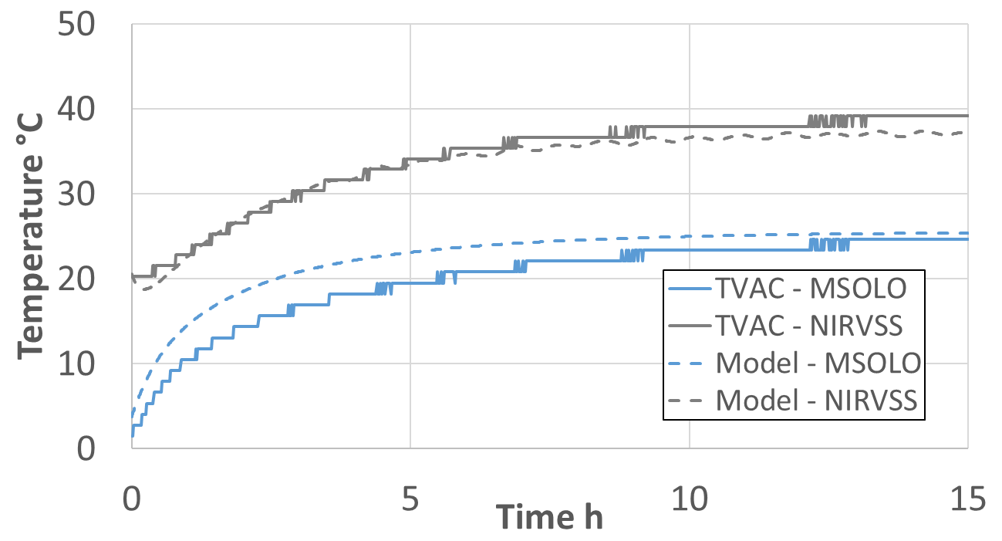
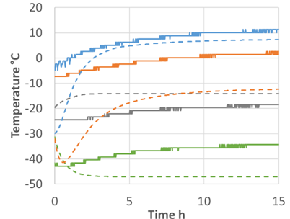
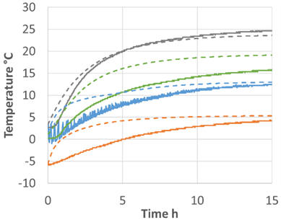
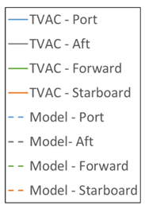
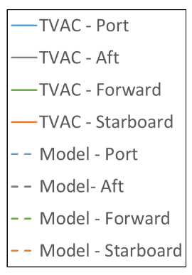
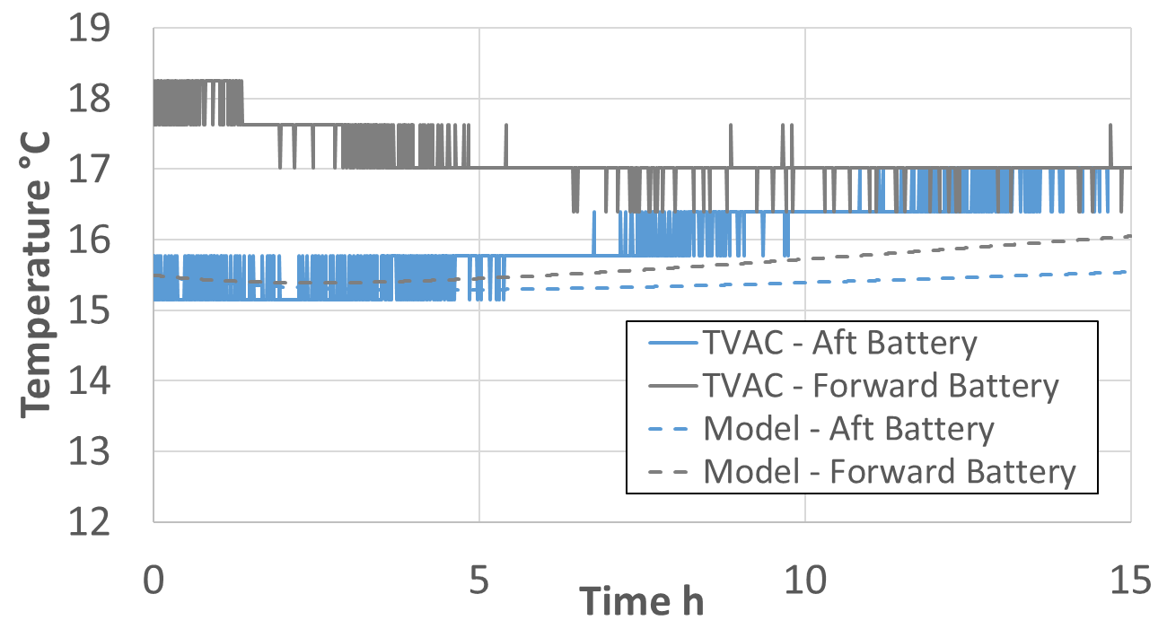
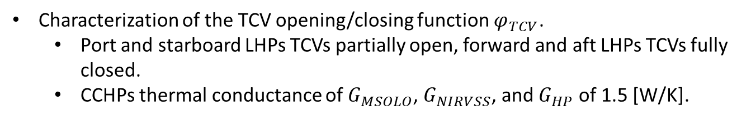
Model Correlation: Step #3, Hot Thermal Balance
Characterization of the TCV opening/closing function $φ_{TCV}$.
  Port and starboard LHPs TCVs partially open, forward and aft LHPs TCVs fully closed.
  CCHPs thermal conductance of $G_{MSOLO}$, $G_{NIRVSS}$, and $G_{HP}$ of 1.5 [W/K].

Slide 13
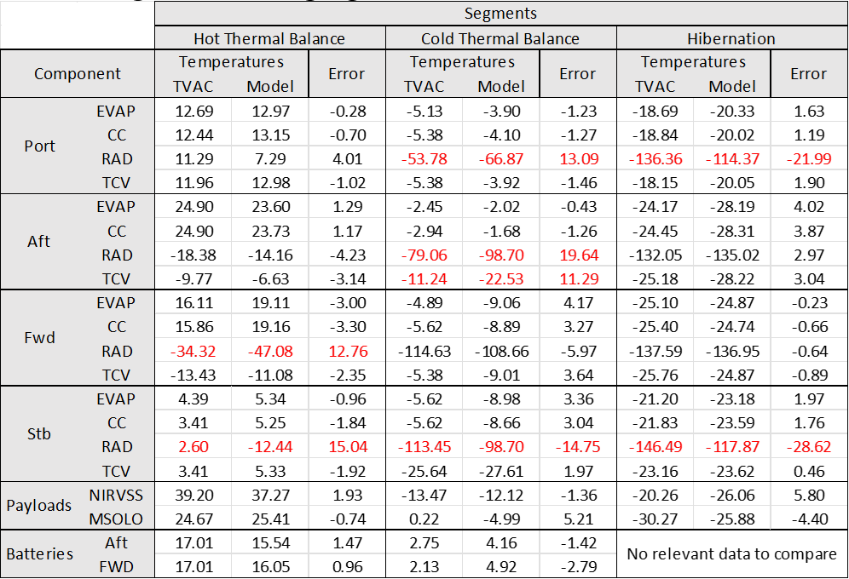
Model Correlation: Steady State Error Summary.
Model Correlation completed in three steps.
Error calculations at each control volumes for each test configuration.

Slide 14
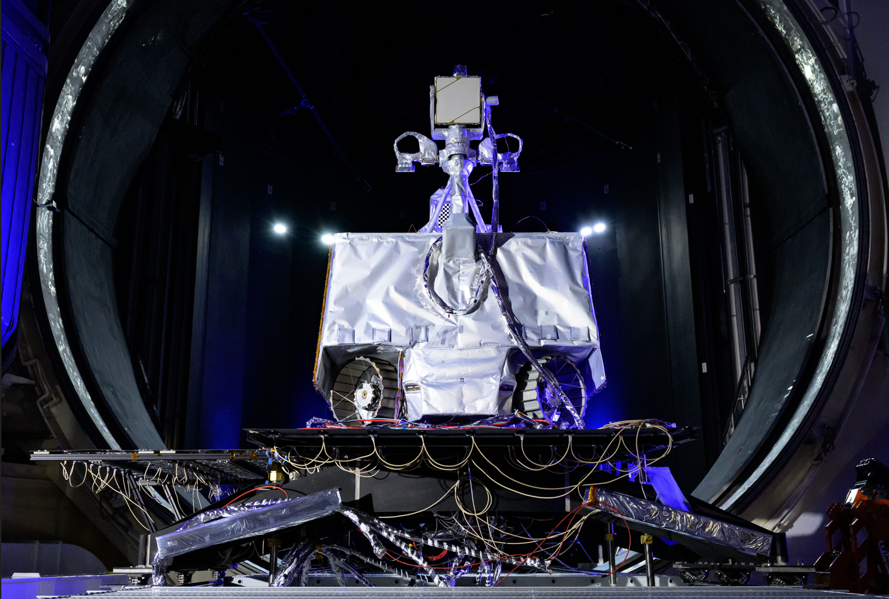
Summary
Control volume approach allowed simplification of the geometry of the TMS. This resulted in a 20-node network model which significantly reduced the computational effort.
This simplification allows quick performance assessments, and real time simulations, especially those dedicated to console operator training.
Simple correlation effort with only a few number of parameters. The model was correlated with the three most extreme conditions expected on vehicle.
The model captured the bulk transient and steady temperatures LHP response under a broad range of thermal load.
Disadvantage is the spatial (and not necessarily temporal) resolution of the model which is limited to only four lump capacitance nodes.

Slide 15
Questions?
Acknowledgments
The authors would also like to thank Dmitry Khrustalev whose support and contributions were crucial to the success of the test campaign and modeling efforts.

