Slide 1
The Roman Space Telescope Optical System:
Status, Test, and Verification Update
6 July 2026
SPIE Astronomical Telescopes and Instrumentation
14145-27
Matthew Bolcar¹ | Alice Liu¹ | John Crooke⁵ | Greg Wenzel⁸
John Hagopian³ | Tyler Groff¹ | Boris Glebov⁶ | Brian Kern²
Bente Eegholm¹ | Alden Jurling¹ | Joe Hayden⁷ | Mark Colavita²
Matthew Bergkoetter¹ | Joe Howard¹ | Samantha Herath⁸ | Gary Kuan²
Guangjun Gao¹ | Margaret Dominguez¹ | Mingjun Li⁵ | Kaitlyn Summey¹
Patricia Lyons⁴ | Catherine Marx¹ | Tim Reichard⁹ | Nick Collins⁷
Scott Rohrbach¹ | Olha Asmolova¹ | Drew Siedel⁵ | Nick Bond⁹
¹Goddard Space Flight Center, ²Jet Propulsion Laboratory, ³Lambda Consulting, ⁴Peraton, ⁵Microtel, ⁶Relative Dynamics, ⁷Columbus Technologies, ⁸KBR, ⁹Adnet Systems,

Slide 2
Optical System Overview

Slide 3
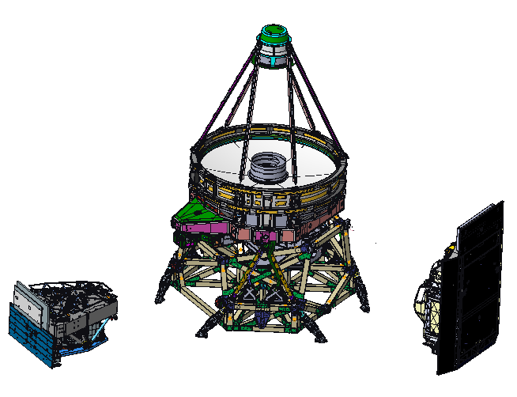
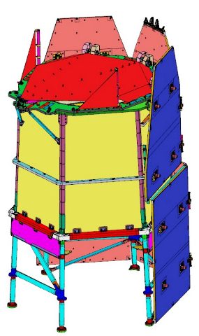
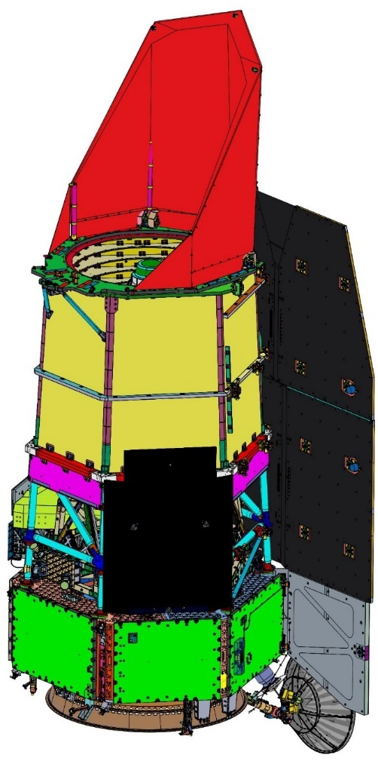
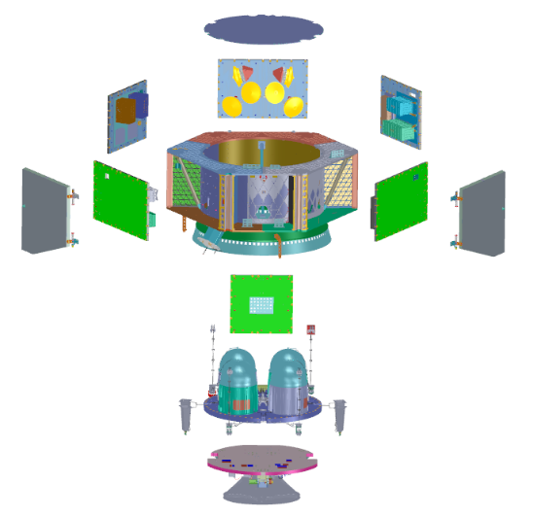
Observatory Expanded View
SCIPA = Spacecraft Bus + Integrated Payload Assembly
Observatory = SCIPA + OBA/SASS/DAC
Imaging Optics Assembly (IOA)
OSD (OBA/SASS/DAC)
Wide Field
Instrument (WFI) Cold Sensing Module
Integrated Payload
Assembly (IPA)
Deployable Aperture Cover (DAC)
Solar Array Sun Shield (SASS)
Coronagraph
Instrument (CGI)
(outer enclosure
not shown)
Outer Barrel
Assembly (OBA)
Instrument Carrier (IC)
Spacecraft Bus Avionics Panels
Propulsion Module
Spacecraft Bus
Communications
Module
SCIPA
Observatory

Slide 4
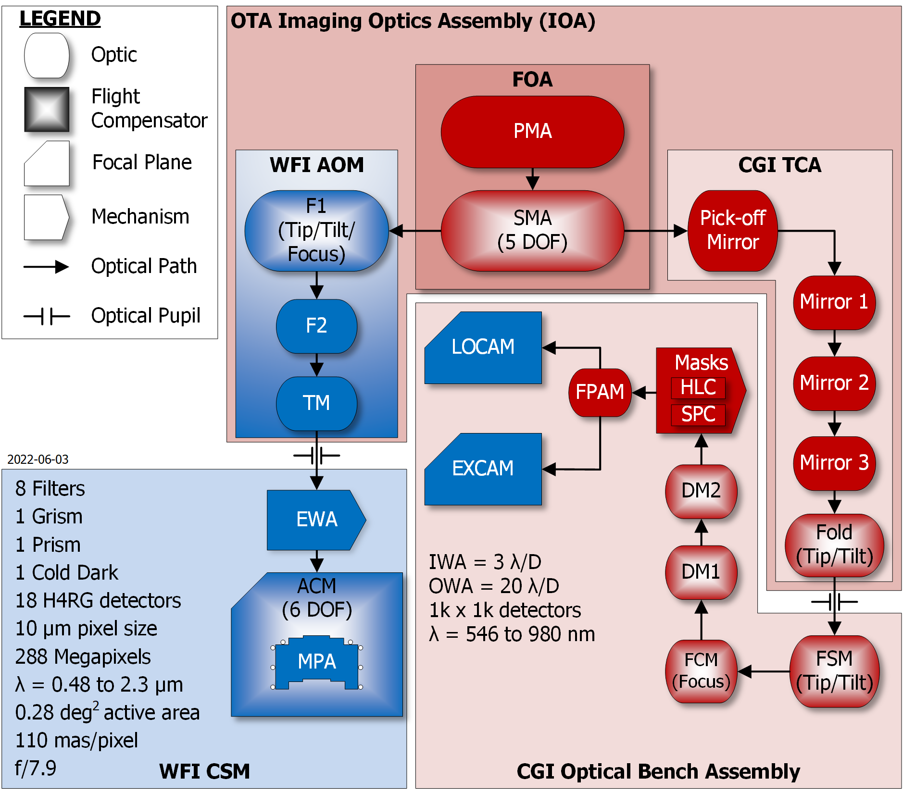
Optical Block Diagram
AOM = Aft Optics Module
ACM = Alignment Compensation Mechanism
CGI = Coronagraph Instrument
CSM = Cold Sensing Module
DM = Deformable Mirror
DOF = Degree of Freedom
EWA = Element Wheel Assembly
EXCAM = Exoplanet Camera
FCM = Focus Control Mechanism
F1/F2 = Fold Mirror 1/2
FOA = Forward Optics Assembly
FPAM = Focal Plane Alignment Mechanism
FSM = Fast Steering Mirror
HLC = Hybrid Lyot Coronagraph
IWA = Inner Working Angle
LOCAM = Low Order Wavefront Sensing Camera
MPA = Mosaic Plate Assembly
OTA = Optical Telescope Assembly
OWA = Outer Working Angle
PMA = Primary Mirror Assembly
RCS = Relative Calibration System
SMA = Secondary Mirror Assembly
SPC = Shaped Pupil Coronagraph
TCA = Tertiary Collimator Assembly
TM = Tertiary Mirror
WFI = Wide Field Instrument

Slide 5
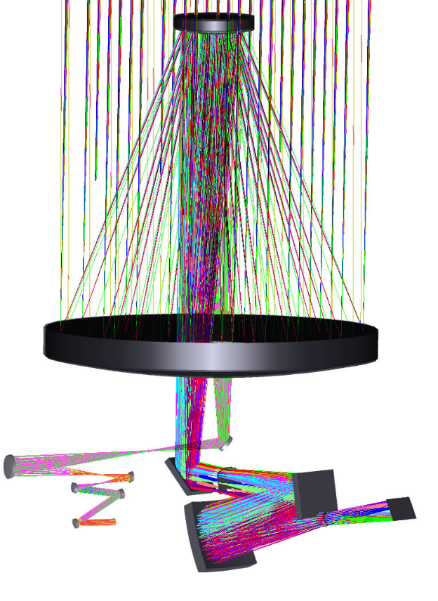
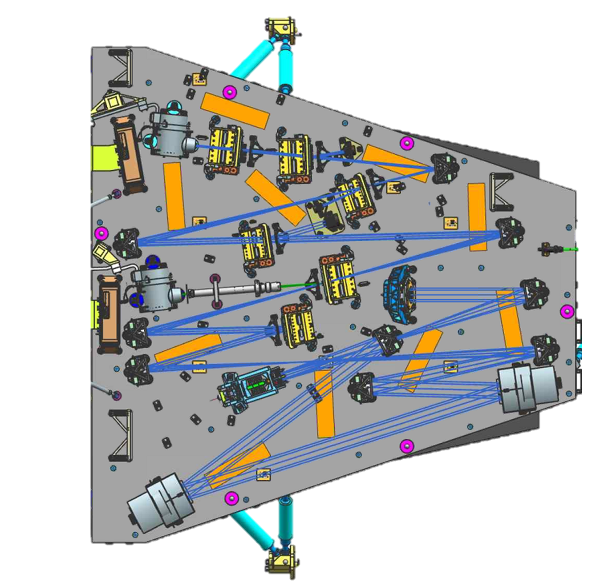

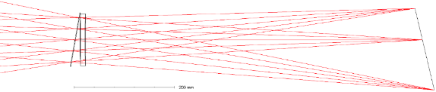


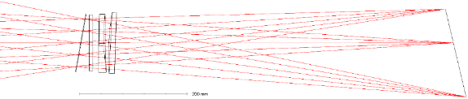

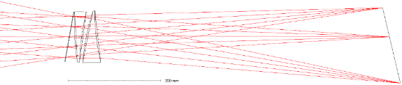
Optical Path
WIM: Filter (8x)
FPA
WSM: Grism
FPA
TCA
AOM
WSM: Prism
FPA
CGI
WFI

Slide 6
Flight Optical Compensators
Compensator | Optical Degree of Freedom
SM Focus Drives (FD)* | Defocus
SM Alignment Drives (AD)* | Decenter (x)
 | Decenter (y)
 | Defocus
 | Tip
 | Tilt
AOM Fold Mirror 1 (FM1) | Defocus
 | Tip
 | Tilt
WFI Alignment Compensation Mechanism (ACM)† | Defocus
 | Tip
 | Tilt
TCA Tip/Tilt Fold (TTF) | Tip
 | Tilt
*Heritage actuators from previous program
†Heritage JWST actuators
Compensate Wavefront Error (WFE)
Common to Each Channel
Compensate Focus WFI Channel
Compensate Pupil Shear in CGI Channel

Slide 7
Optical Verification Overview

Slide 8
Optical Alignment & Verification Summary
Component Level
CGH = Computer Generated Hologram
FDPR = Focus Diverse Phase Retrieval
FSA = Forward Structure Assembly
GSE = Ground Support Equipment
I/F = Interferometry
SAVI = System for Alignment and Vignetting Inspection
SHWFS = Shack-Hartmann Wavefront Sensing
Primary Mirror
Offner Null & Airbag in Ambient
Multipoint Support + CGH @ Amb. & 265K
Primary Mirror Assembly
Gravity Offloaded, CGH @265K
1g CGH @ 265K
0g cross-check horizontal multi-orientation @ Ambient
Element Level
IC Simulator given to WFI and CGI to place latches and check alignment
IOA Pre-vibe
Ambient soft-vac with gravity offload; I/F both channels
FDPR in WFI; SHWFS in CGI w/ and w/o gravity offload
Instrument Carrier
TVAC Photogrammetry Test
Instrument WFE & Alignment verification testing performed on GSE Interface
IOA Post-vibe
Ambient & cold hard-vac, 1g. FDPR in WFI; SHWFS in CGI.
Assembly Level
Integrated Payload Assembly (IPA)
Post-integration rigid-body metrology (IOA, CGI, WFI)
Ambient pupil alignment check with FSA fibers (CGI only)
Spacecraft Bus + IPA (SCIPA)
WFI pupil shear/clocking verification & vignetting check with LED system @TVAC
CGI pupil shear/clocking verification with FSA fibers @TVAC
WFI focal surface verification & wavefront x-check with sub-ap FDPR @TVAC
Observatory Level
Observatory
Pre-/Post-vibe ambient vignetting with SAVI
Analysis of 0g on-orbit performance
Instrument Carrier
IOA
Science Instruments
IPA / SCIPA
Observatory

Slide 9
I&T Flow with Metrology & Optical Test Activities
Optical Verification Testing
IC Available
Rigid-body Metrology
IPA
Pupil Alignment Check
SC / IPA
System for Alignment and Vignetting Inspection (SAVI)
OTA Delivered
OTA Checkout
Stray Light Inspection / Test
Observatory
WFI Delivered
WFI Checkout
Integrate IPA
Integrate IPA to SC Bus
SCIPA Checkout & Pre-Env Powered Tests
SCIPA EMI/EMC 1
SCIPA Powered Tests
SCIPA Vibe
SCIPA EMI/EMC 2
CGI Delivered
CGI Checkout
Post-Env Powered Tests
SCIPA TVAC
Final PM Inspection and Cleaning / SAVI Test
Configure SCIPA for Obs I&T
OSD to SCIPA
Integration
Pre-Env. Deployment Testing
OBS Pre-Env. Powered Testing
OBS Vibe, Acoustics, and Shock
SCIPA TVAC Pathfinder Test
We Are Here
Post-Env. Deployment
OBS Post-Env. Powered Testing
Stow / Final closeouts
SAVI Test
Prep for Shipment / Ship
Launch Site Processing
Launch!!

Slide 10
SCIPA TVAC Optical Test

Slide 11
Test Objectives
Verify CGI & WFI alignment to the OTA
  Verify instrument pupil alignment in shear and clocking degrees of freedom
  Verify WFI focal plane placement relative to the OTA focal surface
Demonstrate no vignetting in the WFI channel
Cross-check end-to-end system wavefront error in the WFI channel
Demonstrate wavefront sensing & control operations
Characterize wavefront error and alignment sensitivity to changes in Spacecraft temperature
Other tests of opportunity (test goals)
  Wavefront stability model validation test using Focus Diverse Phase Retrieval (FDPR)
  Secondary mirror kinematics calibration test
  Compare observed thermal background to model predictions
  Compare stray light measurements to model predictions

Slide 12
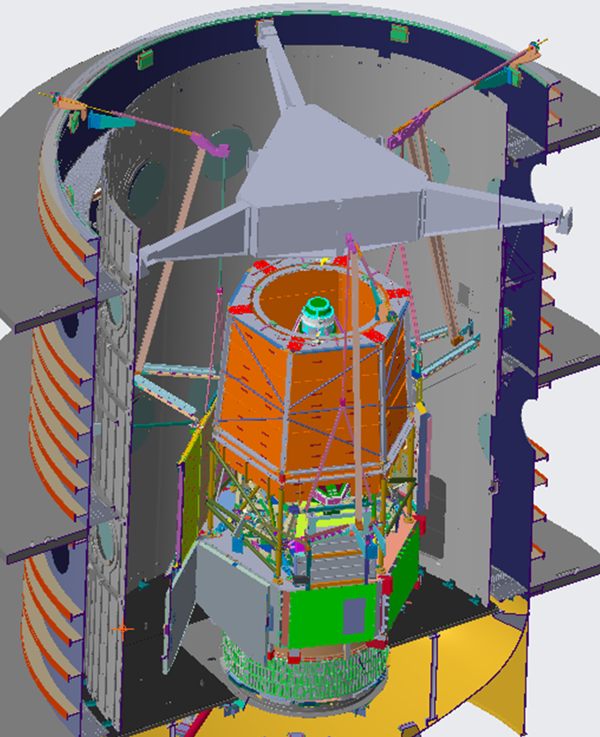
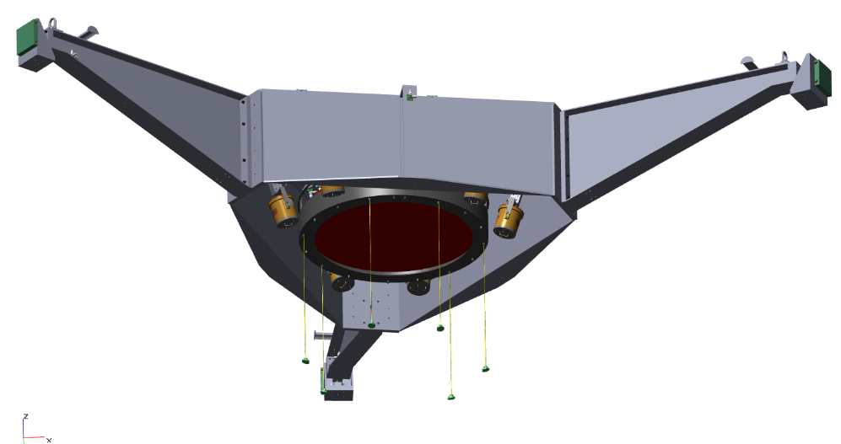
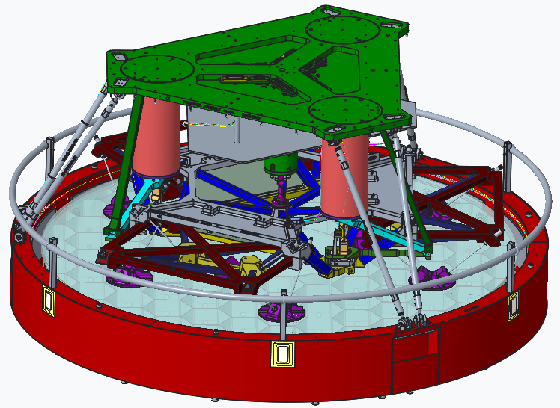
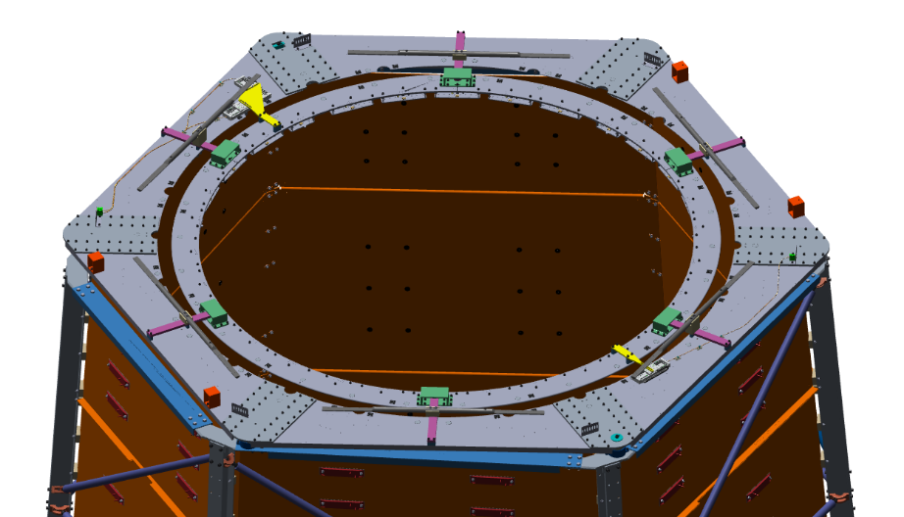
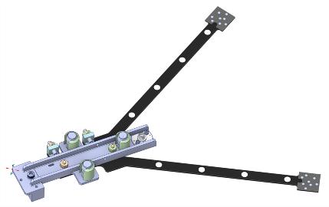
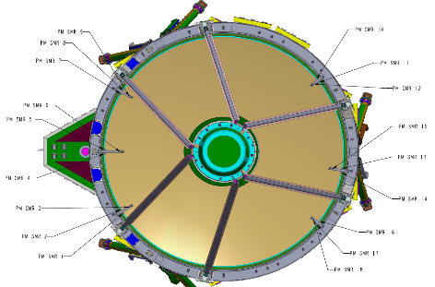
SCIPA TVAC – Optical Test Configuration
OLAFS (Optical Large Aperture Flat System) – 1.8 m mirror with Tip/Tilt actuators.
USF (Upper Support Frame) supporting OLAFS,
6x Photogrammetry (PG) cameras, PG “pogo stick” targets & vibration isolation system
6x Forward Structure Assembly (FSA) “Diving Boards” hold fiber sources above the primary mirror
Top Deck Assembly w/ LED System

Slide 13
As-Run Optical Tests
Dryout, HC1, CC1, HC2, CSB
PG System Alignment Measurement
Configure OTA at nom. alignment
CGI Pupil Alignment
CGI ExCam Gain
PG System Setpoint Check
OLAFS Checkout / PR-049
TPT IFE Part 1
OLAFS Checkout / PR-049 fixed
TPT IFE Part 2
LED Ring Alignment & PG Check
Ambient Temp/Press.
Configure OTA at nom. alignment
CGI Pupil Alignment
SM Offset for Gravity Sag
WFI Find Best Focus
CGI Pupil Alignment
ACM Compen-sation
WFI Find Best Focus / IFE Part 3
Cold Thermal Cycle 2
Analysis Hold
PG System Alignment Measurement
WFI Pupil
LED Test (24 prime LEDs)
WFI FDPR “Short”
WFI Pupil
LED Test (vignetting LEDs)
CGI Pupil Alignment (w/OLAFS move)
Other Tests (e.g., ACS Guide Star Phasing (SYS-40))
SM Kinematics Test
WFI-OLAFS-CGI Weak Lens Imaging
Thermal Cold Op. Tests
Set
Compen-sators
Cold Op Balance
PG System Alignment Measurement
WFI FDPR “Very Short”
CGI Pupil Alignment
Set
Compen-sators (Take 2)
WFI Pupil
LED Test
WFI FDPR “Very Short”
WFI FDPR “Long”
Transition Monitor
LED Ring Alignment & PG Check
WFI Pupil
LED Test
WFI FDPR “Short”
Cold Op Balance
COB→HOB
Hot Op Balance
CGI Pupil Alignment (w/LOCAM)
Thermal Hot Op. Tests & Functional
SM Kinematics Investigation
ACM ROM (includes CGI & WFI data collects)
(MRT-13d) Set
Compen-sators
TCS-17 (AMS Setpoint w/FD test)
PG System Alignment Measurement
CGI Pupil Alignment
Configure OTA at nom. alignment
CGI Pupil Alignment
Configure OTA to launch
Hot Op Balance
Ambient Temp/Vacuum
Notes:
65 days, 24/7 operations,

Slide 14
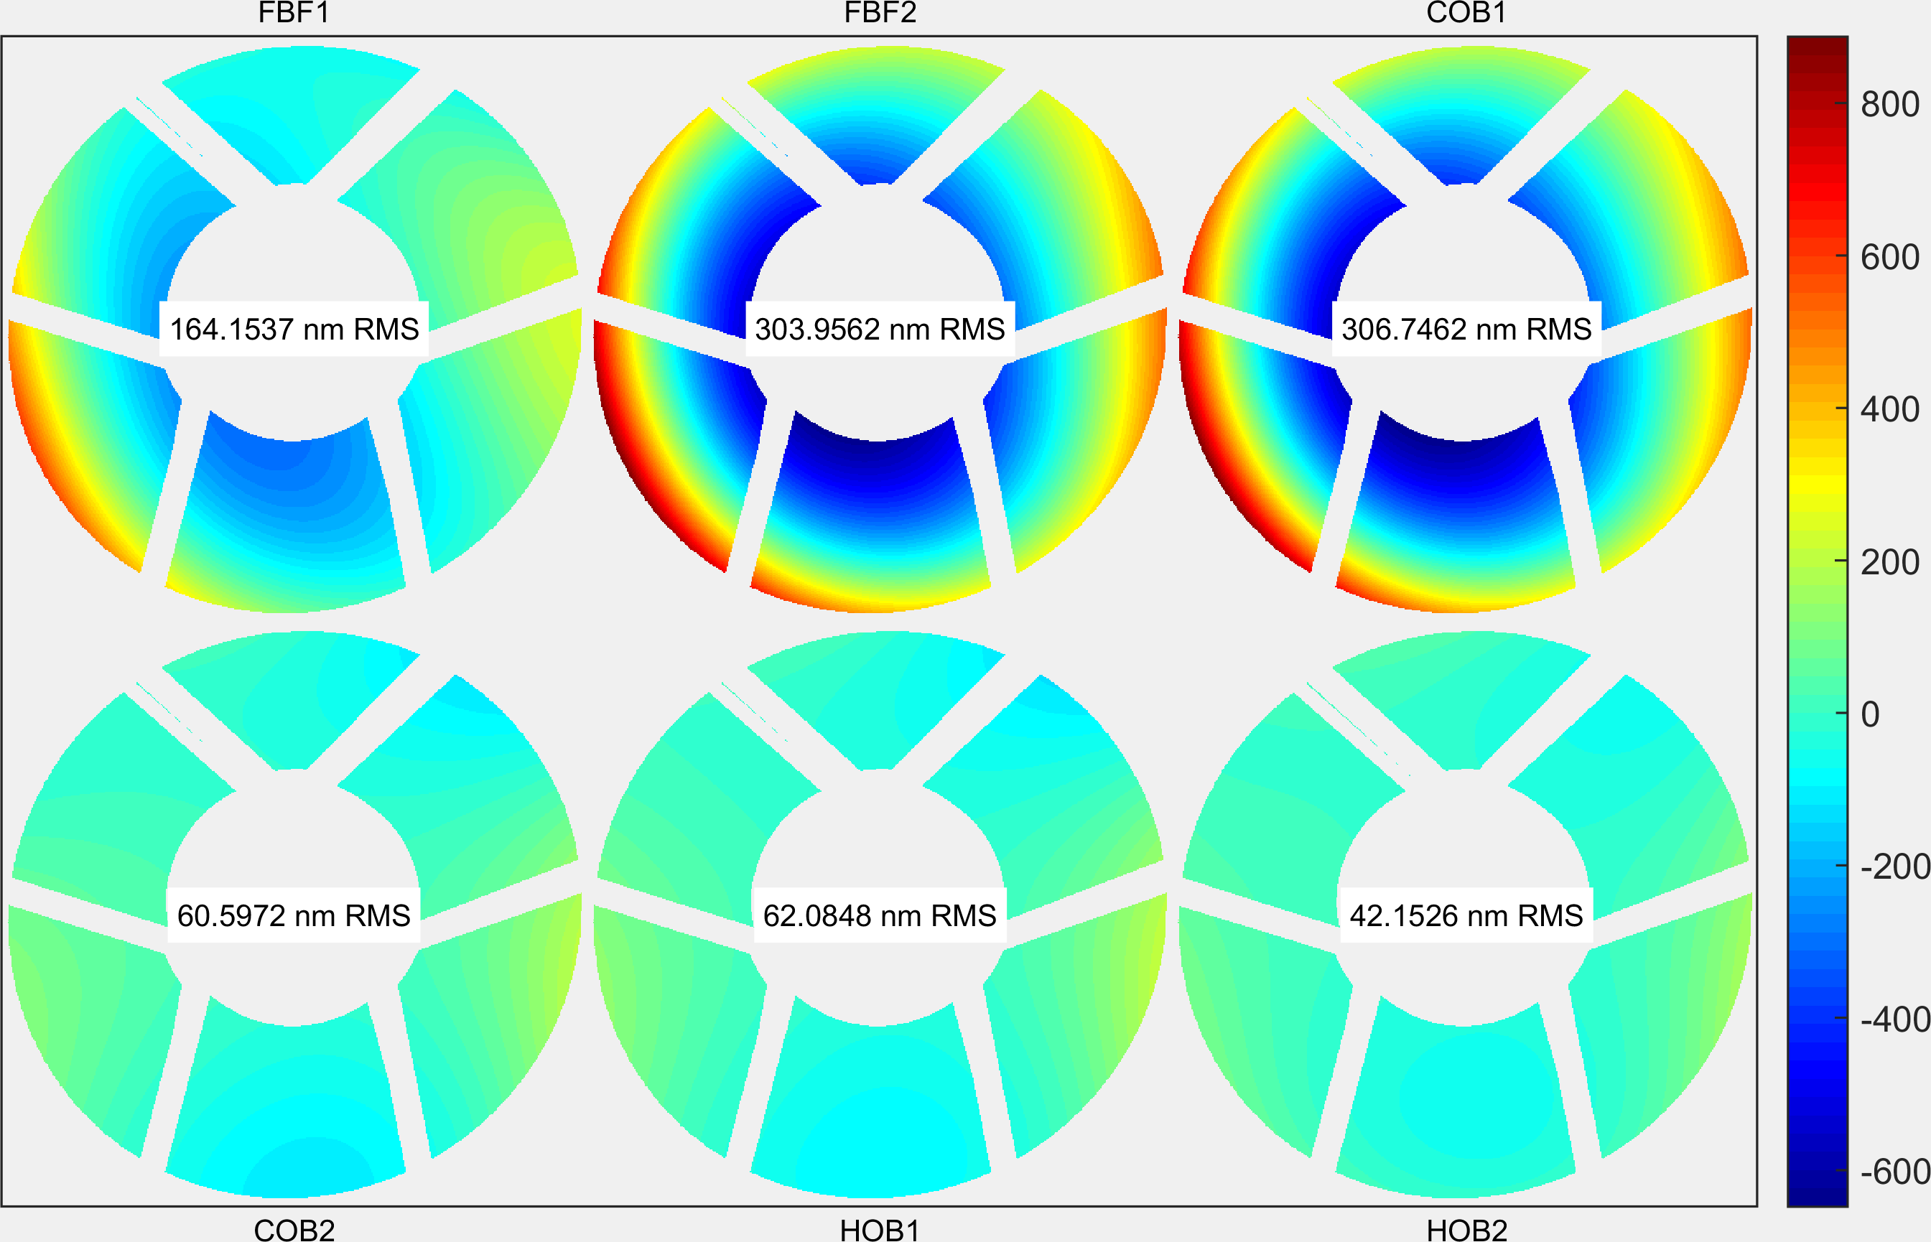
Example WFE Trending – Model-subtracted Residual
Initial compensation using ACM Dz based on Find Best Focus sweep to reduce overall defocus ahead of main test campaign
  Due to model errors at the time, our correction was wrong and system focus actually got worse
Second compensation following first ColdOp Balance used improved optical model and implemented with both SM & ACM
  System performance substantially improved
Final compensation exercised all degrees of freedom and targeted a joint filter and Prism optimal wavefront to demonstrate controllability and achieve final cross-check criteria
ACM Compensation
F6SCA17CE, Fiber 6, F158, 1550 nm
≤ 60 nm
Cross-check
Requirement
ACM & SM Compensation
ACM & SM Compensation

Slide 15
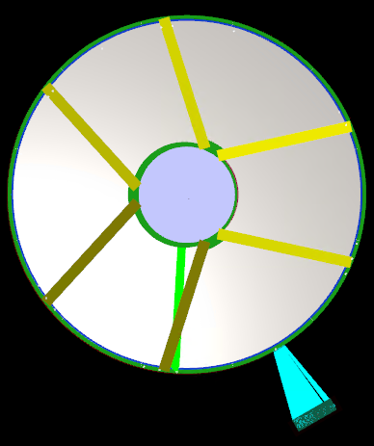
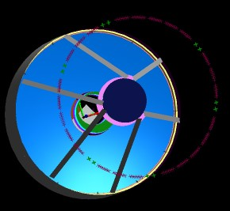
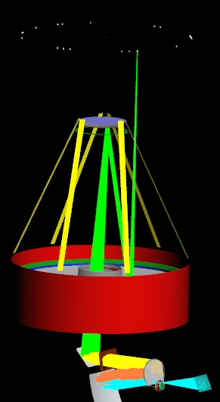
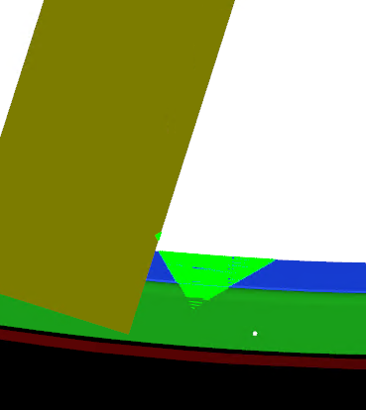
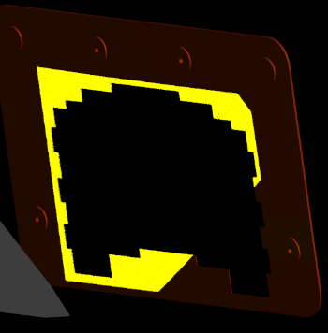
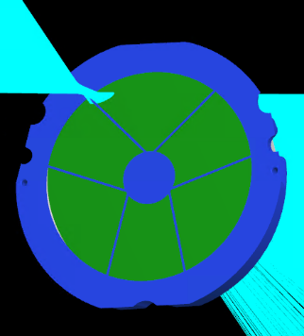
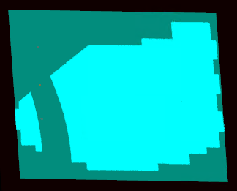
WFI Pupil Alignment – LED Test Description
1
LEDs
A ring of LEDs are position within the clear aperture:
LEDs are turned on individually. Each LED floods the WFI field.
OTA structure blocks part of the LED ray bundle
The entrance aperture plate further limits the field-of-view
In the WFI pupil, the same ray bundle can also be clipped by features in the pupil mask
The features in the OTA and the WFI pupil cast shadows that are imaged at the WFI detector
Positions of shadows on the WFI detector are related to the as built positions of the OTA and the WFI pupil mask to determine their relative alignment
1
2
OTA
2
3
4
5
3
4
5

Slide 16
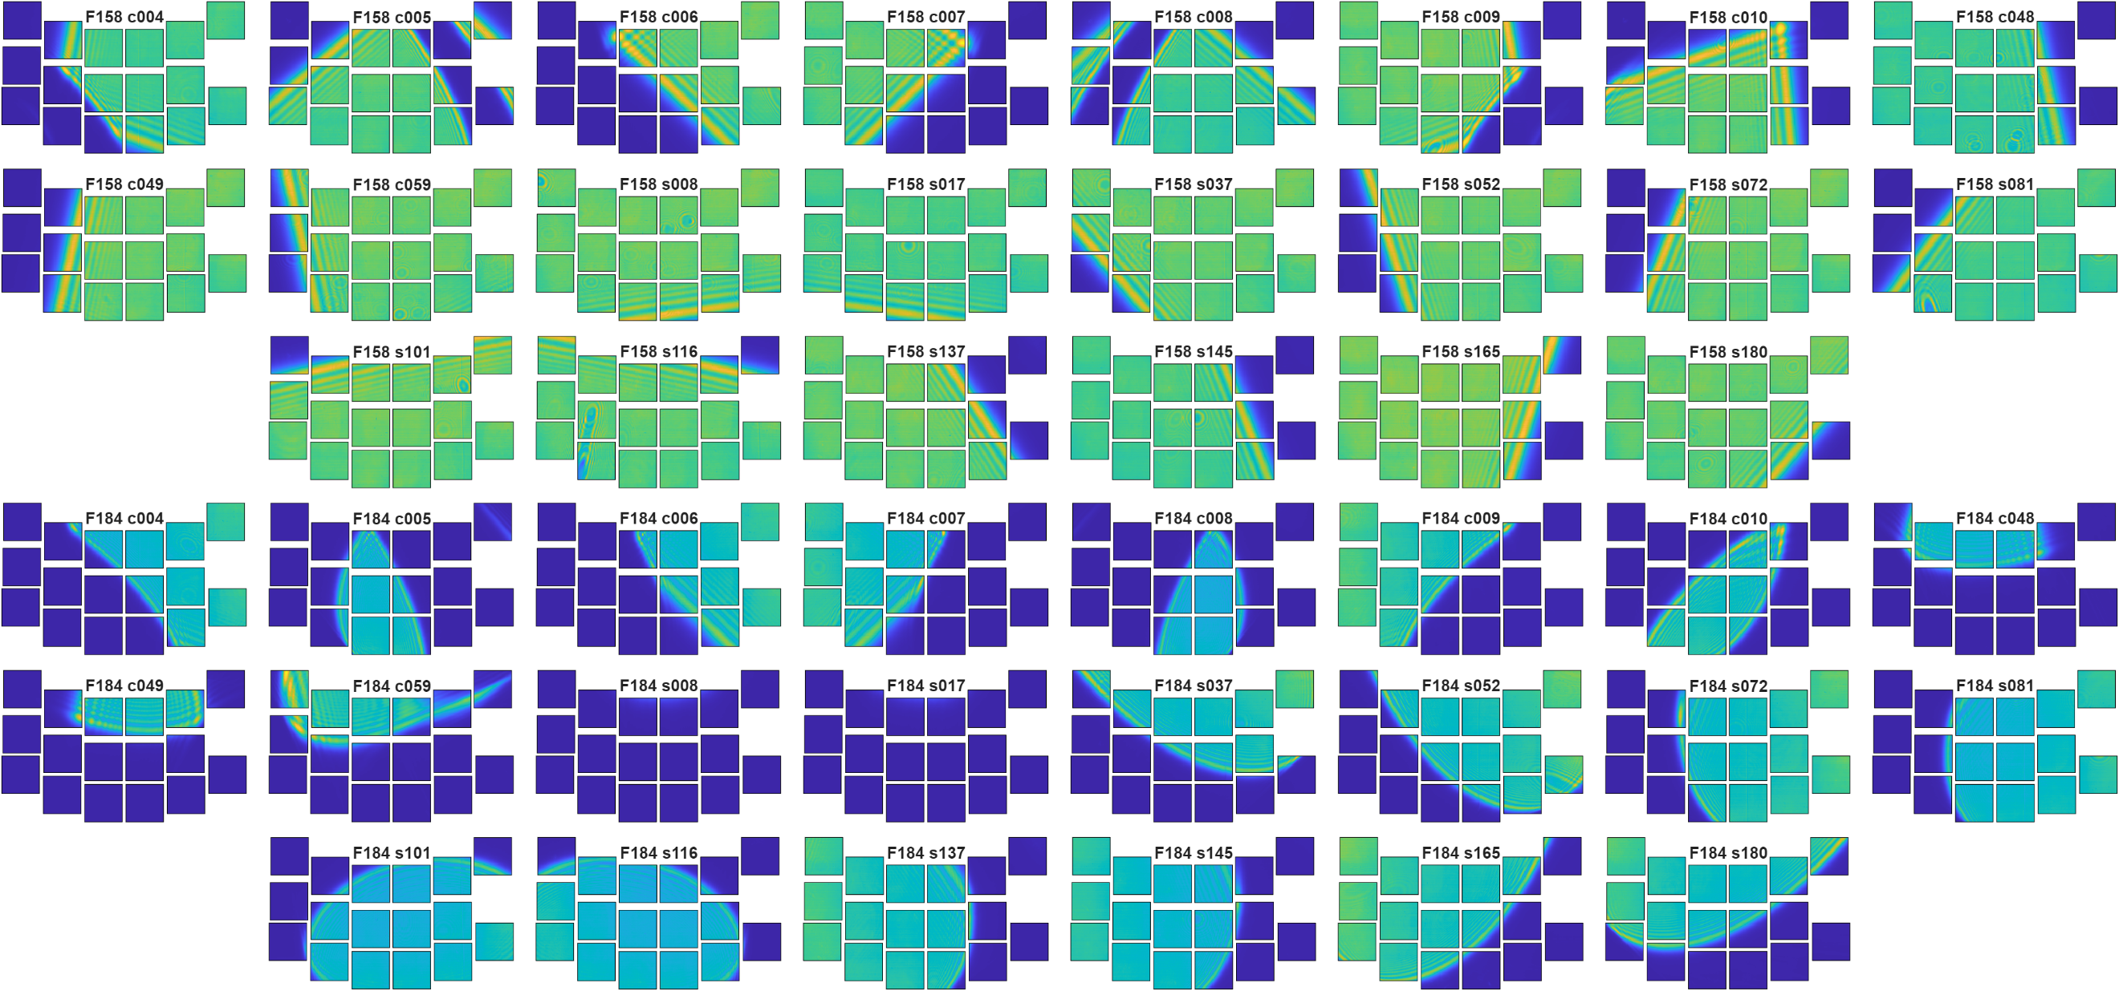
Example WFI Pupil Alignment Measurement
1
0
Note: Data from SCA8 missing due to temporary readout issue.
Test Measurements Match Predictions

Slide 17
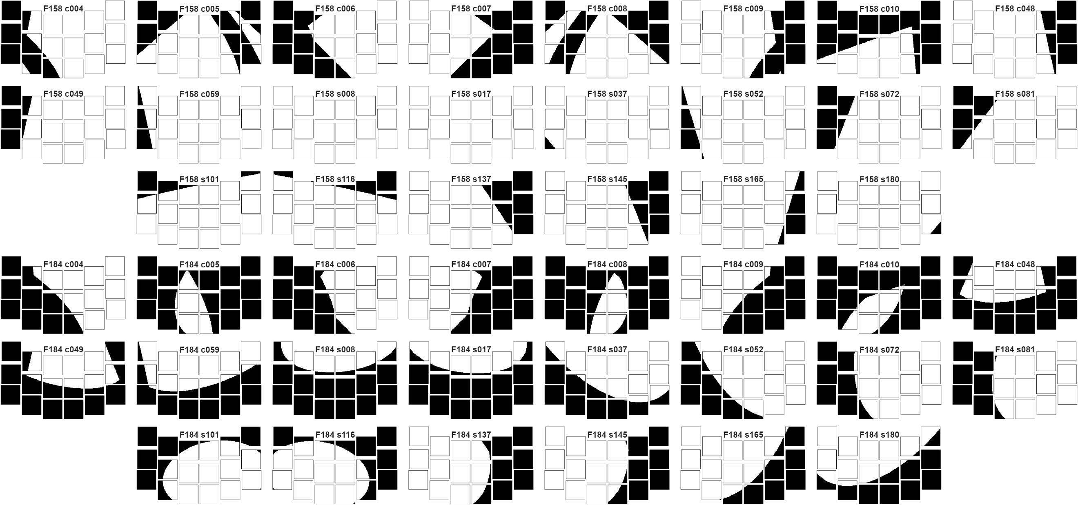
Example WFI Pupil Alignment Prediction
1
0
Test Measurements Match Predictions

Slide 18
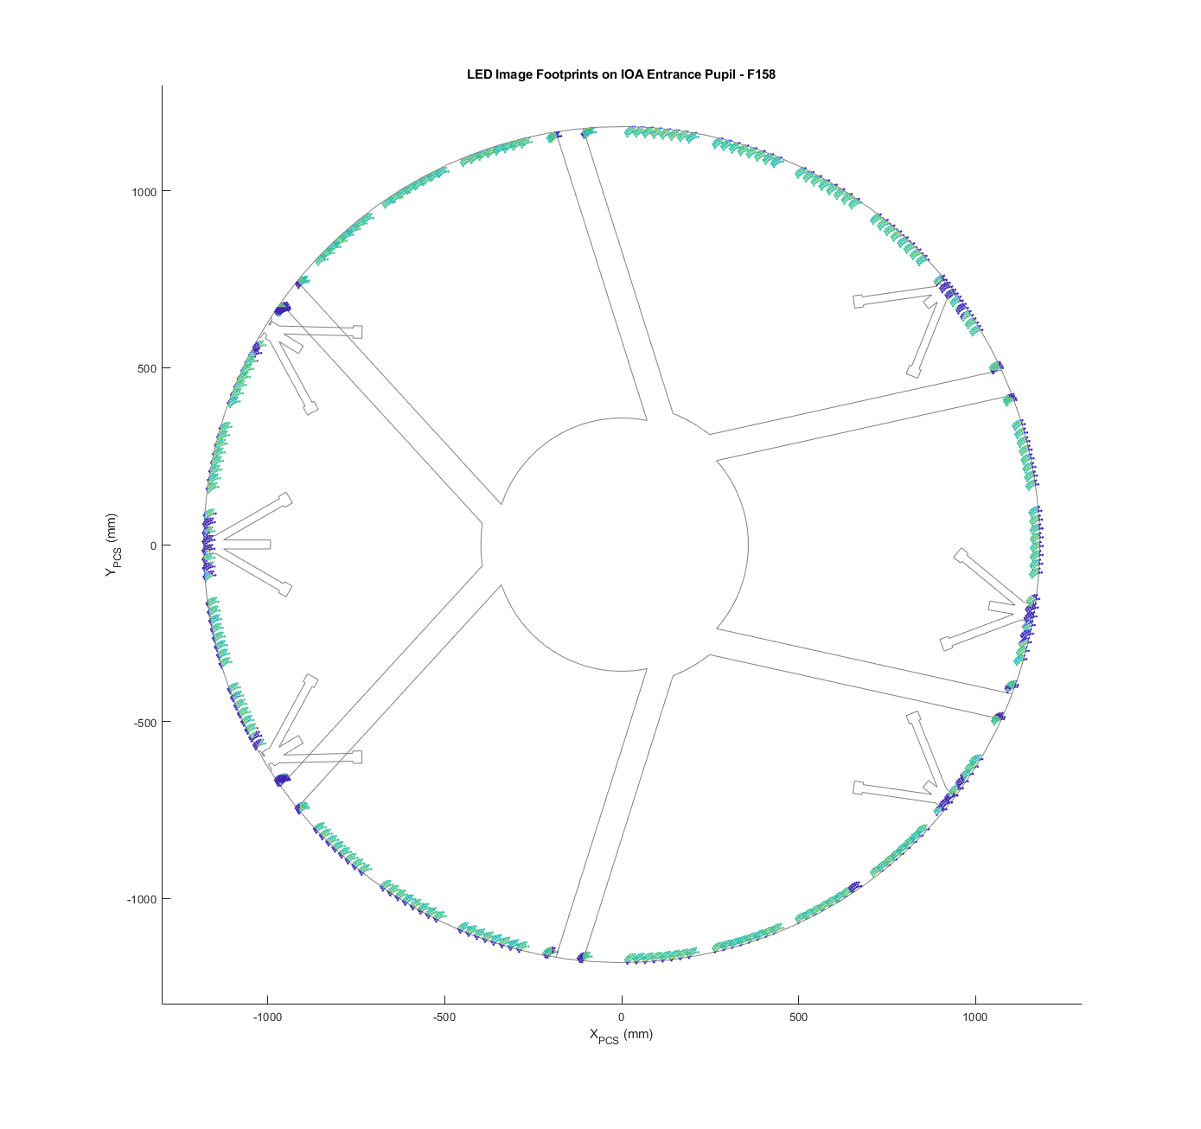
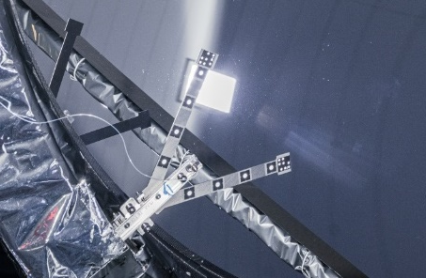
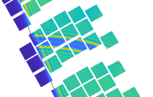
WFI Vignetting Test
Obstructions caused by FSA fibers observed at 4 of 6 FMS diving boards.
Projecting LED images onto IOA entrance pupil shows locations of fibers (left)
  Fibers observed in the same locations in inspection photos (right)
  Following slides show details of each fiber
Remaining 2 fibers likely pass through coverage gaps between LED modules

Slide 19
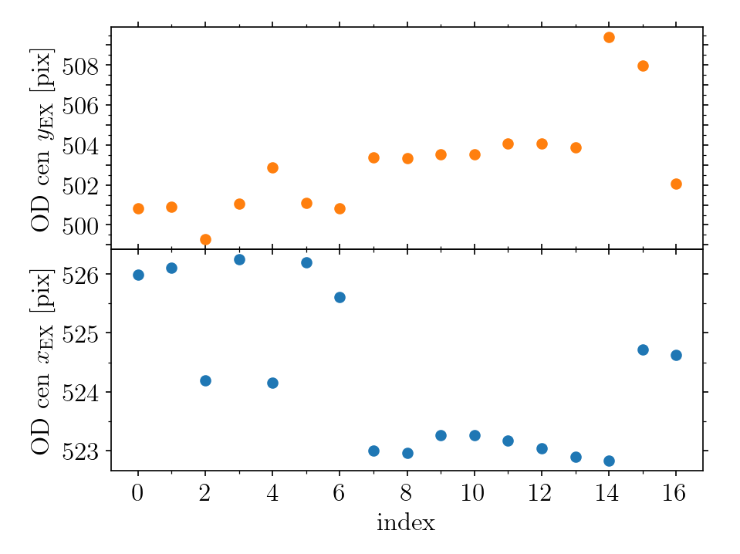
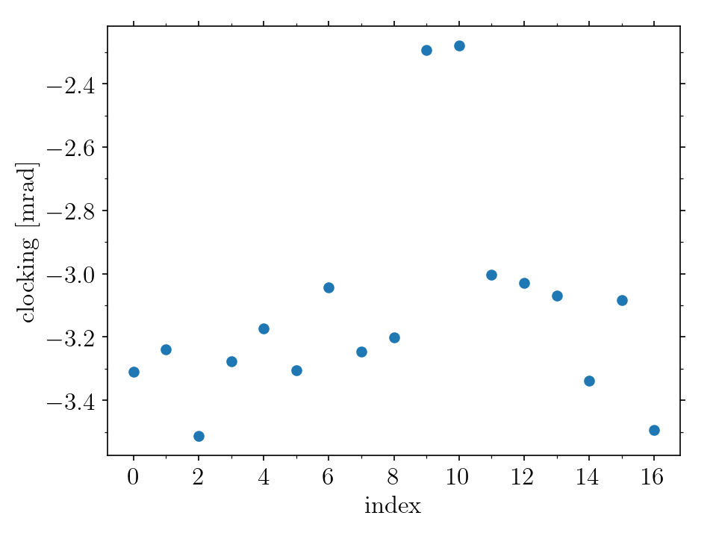
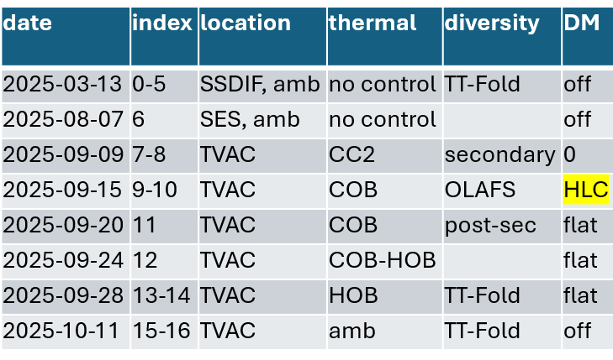
CGI Pupil Alignment Trending
CGI pupil alignment data shows expected behavior across multiple environments
  Early cleanroom measurements are consistent considering
  commanded tip/tilt fold mirror poses to test sensitivity
  TVAC data all very consistent across thermal plateaus
    Hot plateau shear outlier is because we commanded TTF to place the pupil at a specific ExCam location
    Cold plateau clocking outlier due to incorrect DM setting
SSDIF
TVAC
SES
SSDIF
TVAC
SES
X
Pupil Shear
(raw)
Clocking
Y

Slide 20
System for Alignment and Vignetting Inspection (SAVI)

Slide 21
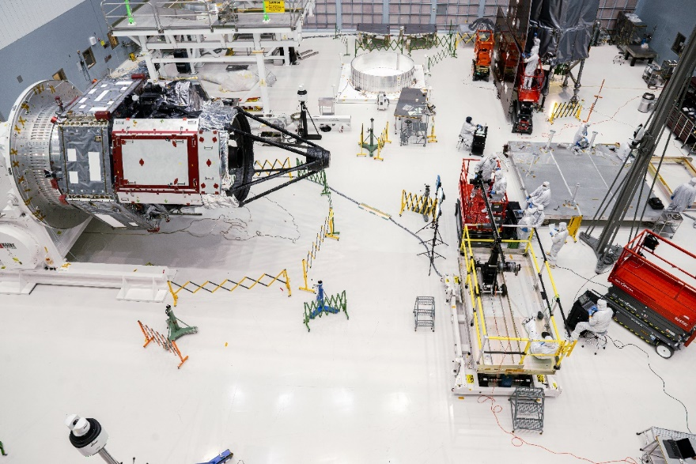
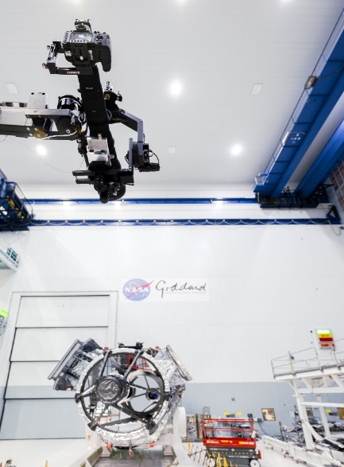
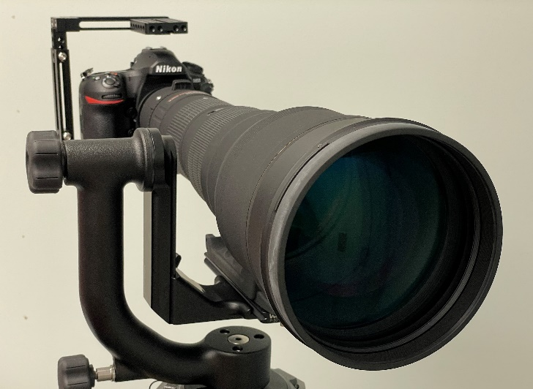
System for Alignment and Vignetting Inspection (SAVI)
SAVI is a test that was developed to address the lack of optical performance testing (aside from metrology) at the Observatory level
It is a low-budget, ambient test to cross-check the optical alignment and verify no vignetting of the optical path following Observatory environmental testing
  Bonus: the test could also inspect coating integrity of the PM and SM
The SAVI test uses a digital camera with a 300-800 mm zoom lens to “look back” through the optical path

Slide 22
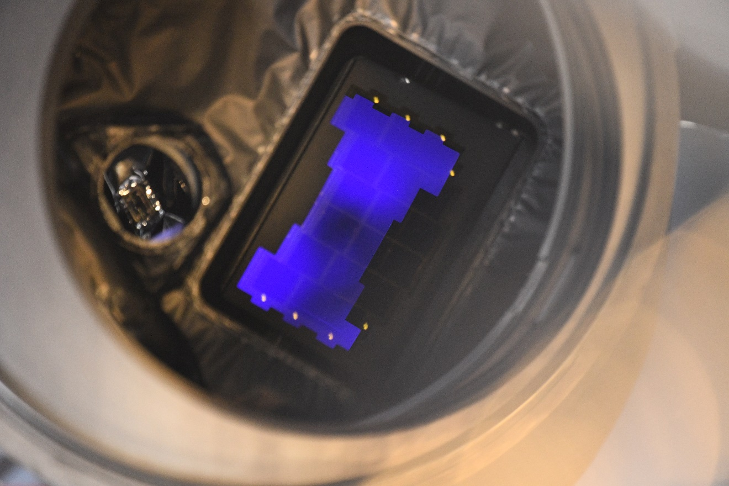
Example Details Seen with SAVI
WFI channel shown to the right
  Focusing on the entrance aperture plate with the blue reflection from the F062 filter
  Notice the individual SCA’s
  The reflection back from the fiber tips very easy to see
The CGI channel shown to the left
  We did not explicitly “look into” CGI for this test due to complexity of optical path and intervening masks

Slide 23
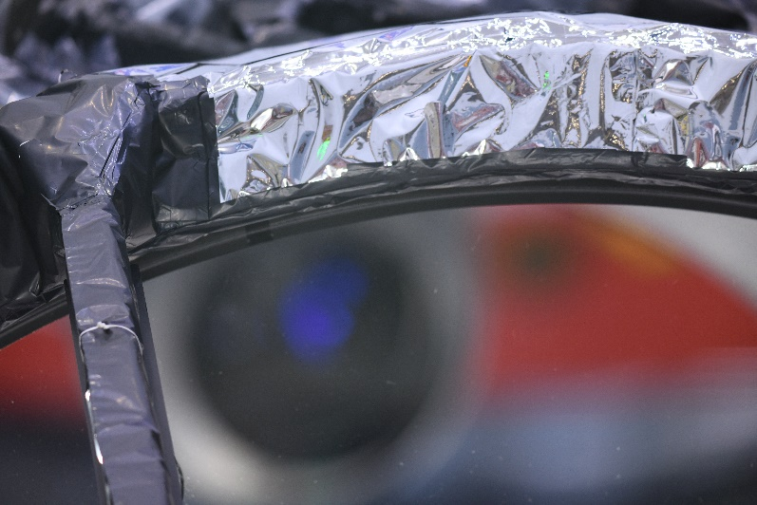
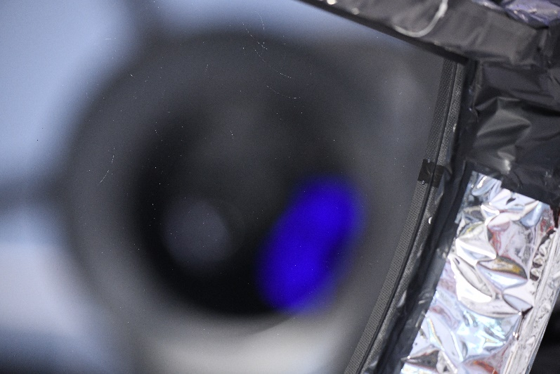
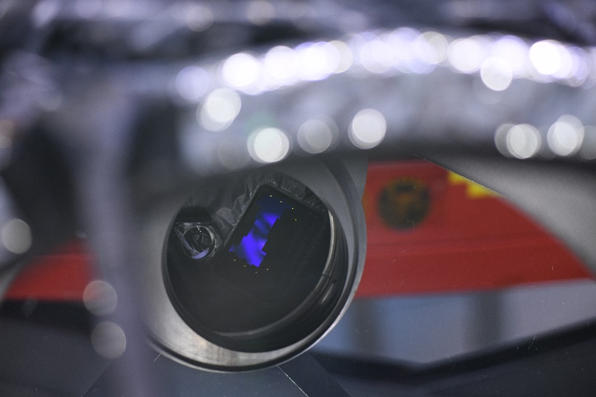
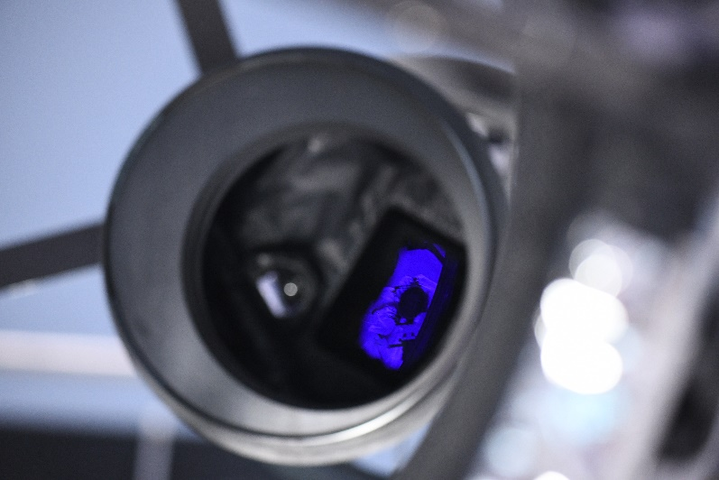
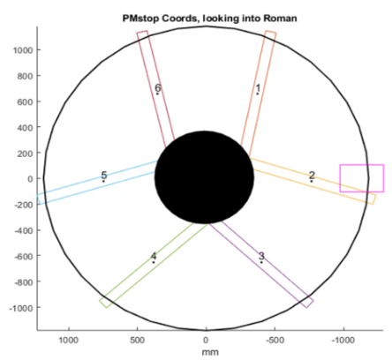
SAVI Vignetting Check
SAVI moved along the PM perimeter
Photos were acquired with the PM edge visible, focusing first on the edge, then at infinity (detector) from the same physical SAVI position
  Example images shown to the right.
None of the images indicated any vignetting
Positions of the selected image examples shown to the right
Top of PM:
Focusing on edge,
then on filter/detector
Right side of PM:
Focusing on edge,
then on filter/detector

Slide 24
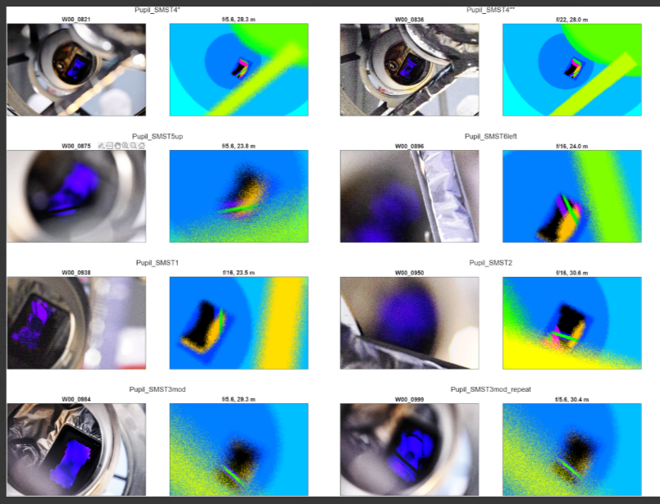
SAVI Pupil Alignment Check
For a given SAVI camera pose (as measured by external metrology):
  Image the SM support tube scraper
  Image the filter mask strut
  Compare the relative positions in the images to model predictions (see right)
Repeat process before and after Observatory environmental testing
  Look for changes in relative positions before and after vibe & acoustic testing
Measurement uncertainty on par with verification testing done during SCIPA TVAC
  Though SAVI is an ambient test and does not capture cooldown effects

Slide 25
Summary and Conclusion
The Roman Space Telescope optical system has completed a comprehensive test verification program
  Ambient rigid body metrology and stray light inspections throughout integration & test
  Thermal vacuum optical alignment and wavefront error performance verification
  Optical alignment and vignetting cross-checks through Observatory-level environmental testing
All optical performance requirements have been verified with significant margin
Roman is currently completing launch site processing and integration to the launch vehicle for an August 30 launch readiness date!

Slide 26
Backup

