Slide 1
Improvement in the Thermal-to-Structural Model Mapping Process for Integrated Modeling for the Roman Space Telescope
International Conference on Environmental Systems
July 12-16, 2026
Paper ICES-2026-588
Hume Peabody | NASA-GSFC
Carson McDonald | Vertex Aerospace
Kiet Vu | Aerodyne Industries
Trade names and trademarks are used in this paper for identification only. Their usage does not constitute an official endorsement, either expressed or implied, by the National Aeronautics and Space Administration.

Slide 2
Agenda
Introduction
Roman Space Telescope Overview
Integrated Modeling Process
ViewSave Tool
Mapping Tool
ViewGenerate Tool
Mapping Best Practices
Conclusions
Roman Space Telescope Project
2

Slide 3
Introduction
Integrated Modeling (IM) has been a key aspect of the Nancy Grace Roman Space Telescope (RST) project throughout its lifetime to verify requirements that are either impractical or impossible to verify through testing
One major step in IM that requires considerable effort is the mapping of thermal model predictions onto a structural Finite Element Model (FEM) and the verification of accurate mapping
This analysis has been performed many times throughout the project life cycle and as such, tools have been developed to automate the more laborious processes, including:
  ViewSave Tool: stores view information directly from AutoCAD
  Mapping Tool: uses the Interpolation Factors file to assign temperatures for many cases
  ViewGenerate Tool: uses the ViewSave information and Group names to auto generate images
Lastly, some Mapping Best Practices are further discussed

Slide 4
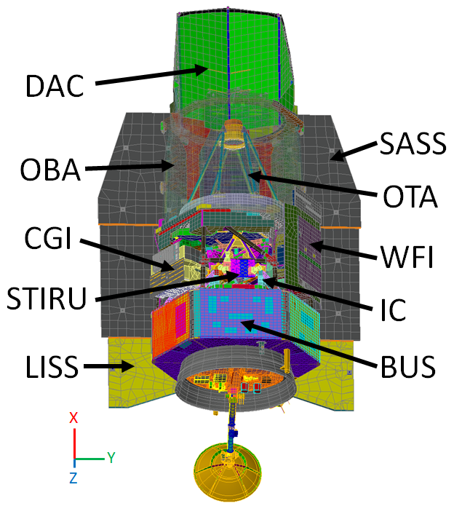
Roman Space Telescope Design
RST is the next great Astrophysics observatory, with a planned launch in late August 2026.
The observatory includes:
  6-sided spacecraft bus that handles the usual spacecraft needs (Comm, ACS, Power, etc)
  Lower Instrument Sun Shade: shadows the payload from the sun
  Star Tracker and Inertial Refence Unit: used for attitude control
  Instrument Carrier: Optical Structure that supports the Telescope,
  Instruments, and STIRU
  CoronaGraph Instrument: technology demonstration instrument
  Wide Field Instrument: main infrared imaging instrument
  Optical Telescope Assembly: main telescope optics
  Outer Barrel Assembly: provides stable thermal scene for OTA
  Solar Array SunShield: generates power/shades payload from the sun
  Deployable Aperture Cover: shadows inside of OBA from the sun
RST has a field of regard allowing
  ±15° Roll about X axis
  ±36° Pitch about the Y axis
  Full 360° Yaw about the Z axis

Slide 5
Integrated Modeling Process
The Thermal Desktop Post Processing Data Mapper has been used since the early days of RST
  It began with different FEMs for the major subsystems, but eventually settled to a single FEM for handling all the mapping, reducing the number of files to generate and track
  Group Associations are utilized to ensure that bleed-over from one group to another at interfaces is mapped properly
  Furthermore, Progressive Tolerancing is used to ensure the closest surface is selected
Based on the models themselves, it was entirely possible that some of the FEM gridpoints were beyond the largest acceptable tolerance and hence were not mapped
  For these cases, the FEM was conditioned to be able to execute a steady state thermal solution and unmapped gridpoint temperatures were assigned via that NASTRAN solution (in essence, it interpolates or extrapolates from known temperatures to “fill-in” the unmapped gridpoints)
Images were generated of the thermal contour and the mapped contour onto the FEM
  These images were placed side by side in a PowerPoint presentation
  After the “Fill-in” run was complete, a similar image was generated from the structural FEM software and replaced the mapped contour image
  Earlier on, these images were from similar, but not exact view positions, but eventually the view information was manually extracted from AutoCAD to allow these two image viewpoints to match exactly

Slide 6
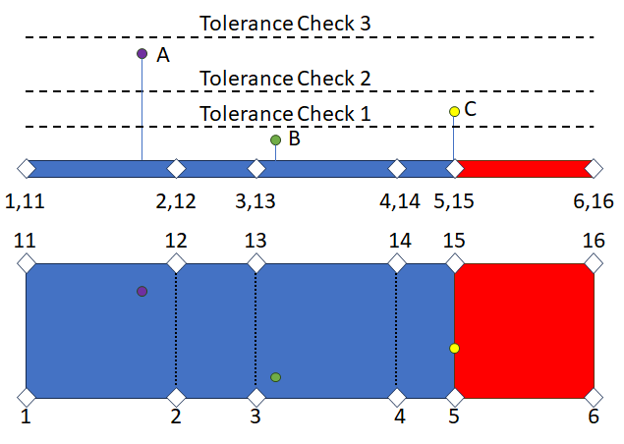
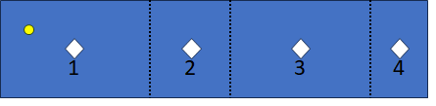
Integrated Modeling Process: Mapping
The Thermal Desktop mapping algorithm is as follows:
  A FEM GridPoint is projected onto candidate thermal surfaces
  If the projected point falls within the surface AND the distance between the GridPoint and the Projected point is below the tolerance…
  …Then shape functions are utilized to apportion contributions from the surrounding nodes towards the mapped temperature
  In the right image, Point B would be mapped first, with major contribution from node 3 and less from 13, 4, and 14
  Point C would be mapped next, with contributions from 5 and 15, and possibly 4, 14, 6, and 16
  Lastly, Point A would be mapped last with major contribution from 12 and less from 2, 11, and 1
  The weightings for each contribution generally add to unity
The above is true when there are four nodes surrounding the projected point, but it is possible that a one-dimensional centroid node approach could result in extrapolation
  In this case, the weightings would be from 1 and 2, and the weighting from 1 would be > 1 and 2 would be < 0, resulting in extrapolation. This may result in a mapped temperature higher than any of the predicted temperatures…

Slide 7
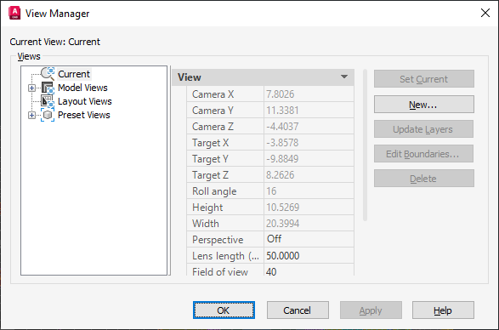
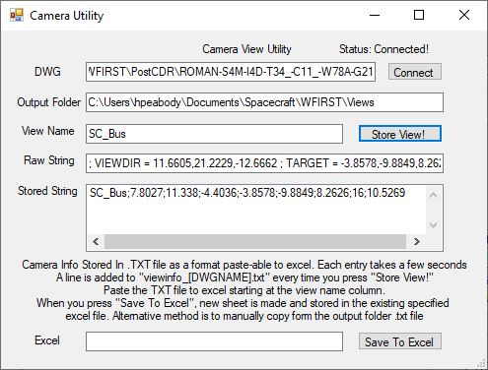
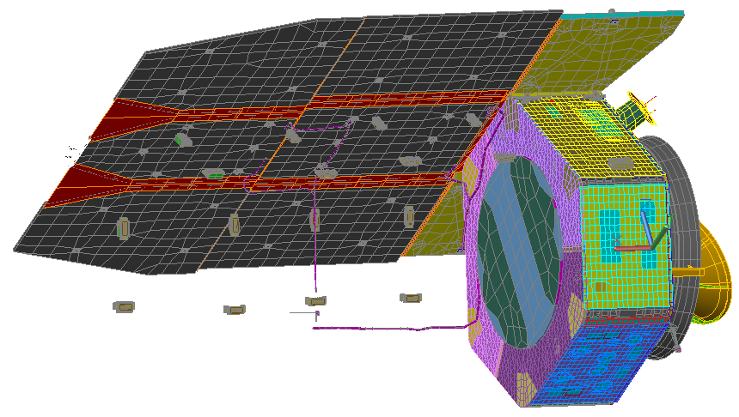
ViewSave Tool
The ViewSave tool was developed to capture the ViewFrom point, The ViewTo Point, the Camera Roll Angle, and the scale factor for zoom from AutoCAD variables and store the associated data along with the view name to a text file
The user than manipulates the model (Rotate, Pan, Zoom) to a new desired view for a new component and saves that view
Once all component views have been generated, the data can be saved to an Excel file
This data is later utilized by the ViewGenerate tool

Slide 8
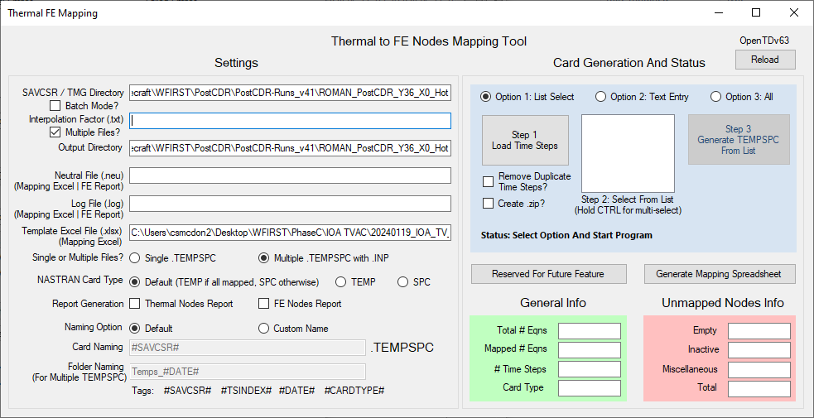
Mapping Tool
The Mapping tool is used to ensure that the exact same weighting factors are utilized with the model predicts across all cases
It was found that performing the exact same mapping multiple times could result in slightly different interpolation weighting factors being computed. This is hypothesized to happen when a projected gridpoint is exactly on the boundary between two surfaces or elements
To avoid any associated errors with this, once the mapping is performed, the Interpolation
Factors files are saved. Re-use of these files allows for consistent use of exactly the same factors with different output files from analysis cases
A number of other checks are also performed and additional options given for the NASTRAN inputs
This assembles a single NASTRAN file for delivery to the structures team

Slide 9
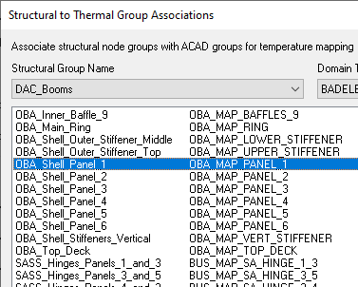
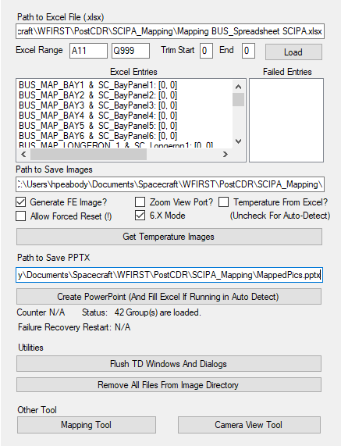
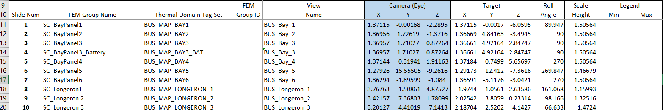
ViewGenerate Tool
Lastly, the ViewGenerate tool takes an input Excel sheet with data for the FEM group name, the Thermal Group Name (matching those found in the Structural to Thermal Group Associations form), and the View Information saved by the ViewGenerate tool
This information is then used to generate and save the contour plot images
A further option exists to import all those images and arrange them on PowerPoint slides along with the View name and notes with the view direction
This same data is also used with a companion tool to do the same actions in FEMAP to generate the post fill-in mapped structural image

Slide 10
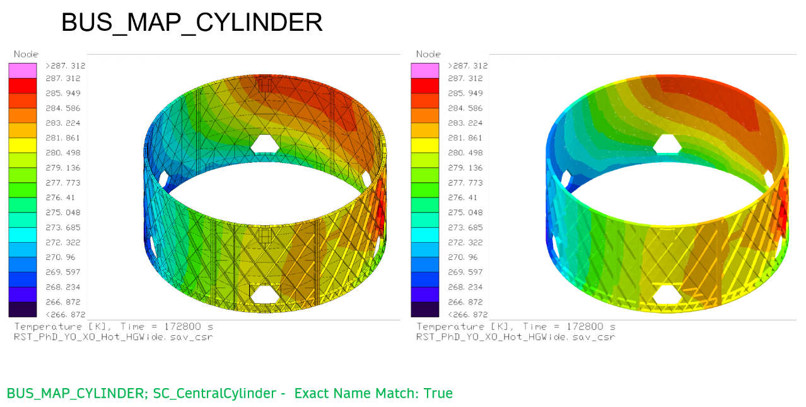
ViewGenerate Tool Output

Slide 11
Mapping Best Practices
Mapping best practices generally target two areas: accuracy and repeatability
RST did not try to enforce that all gridpoints needed to be mapped
  Differences in modeling techniques between thermal and structural analysts make this challenging
  This prevented all subsystems from having to ensure every gridpoint got mapped
  Unmapped gridpoints were assigned temperatures from a NASTRAN thermal solution that utilized the mapped temperatures as seed points, essentially interpolating or extrapolating to “fill in” the missing temperatures
After completion of the fill-in run, contour plots using the same scale, levels, and color indexes were generated from the thermal/structural models and placed sided by side for visual comparison
  For best comparison, the temperature range and number of nodes/elements should be minimized as much as practical
  Too wide a range and gradients might not be obvious
  Too many nodes/elements might mean that areas of interest are obscured by geometry in front
  Best to go to a piece-part level as much as possible (RST has > 400 group associations)
  Ensure that very lightweight components, such as MLI do not get mapped as they seldom contribute to distortion
Consider mapping temperature differences between two points in time (or two orientations). This tends to be a much smaller magnitude than bulk temperatures and with the reduced scale, may highlight problem areas
  Once Thermal Desktop has mapped temperatures, the weighting factors are saved internally. Therefore, new data sets may be displayed by recomputing, but not remapping. This could also apply to temperature difference user files…

Slide 12
Mapping Best Practices
For areas where the mapping is not acceptable
  More closely examine the two groups close up. What may appear to align well from a distance may not appear to align as well zoomed in closer, especially for optics and in particular if they have a sizable gradient
  Flexures are another area where thermal and structures may differ; structures often uses the midplane for the top and bottom flanges, whereas thermal often picks the closest flange surface to the blade (to not overestimate the distance). To address this, RST maps only the flanges and not the blades and allows the fill-in to populate the blade temperatures
A progressive tolerancing is used, starting from zero and slowly incrementing in a non-linear discretization up to 11 cm. If a point is 11 cm away from any thermal surface, it is considered too far to be mapped.
  The progressive tolerancing ensures that the gridpoint maps to the closest surface where it projects, since once a gridpoint is mapped, it is no longer considered in the mapping algorithm for higher tolerances
To improve repeatability, the exact same FEM is used for mapping, even though the thermal run may be different configurations (Stowed Arrays, HGA Dish pointing differently)
  This ensures that no errors are introduced by mapping to different FEM models representing different configurations, which would require checking maps for two different sets of models
  Since the mapping is just using the specified temperature set, it need not be a temperature set reflective of the mapped configuration (i.e. a stowed model could be used to map deployed temperature predictions)

Slide 13
Mapping Best Practices
RST did begin with multiple mappers (one for each subsystem)
Eventually, the project transitioned to a “One Mapper to Rule Them All” approach to minimize the number of files that had to be tracked and provided to the structures team
However, with the development of the Mapping Tool, the project has returned to multiple mappers and uses multiple Interpolation Factors files to assemble a single NASTRAN file for the structures team
  Furthermore, this means that when a single subsystem Mapper is updated, the new Interpolation Factors file can be used along with all the previously vetted ones for the other subsystems
  This also ensures that the exact same weighting factors will be used for all results sets, further ensuring consistency across analysis cases, rather than potentially introducing small differences when mapping each analysis case through Thermal Desktop
Lastly, RST has always employed a “pipe-cleaner” process before beginning the processing of many analysis cases
  This pipe cleaner focuses on detailed inspection of mapping from a preliminary run, being far more concerned with accurate mapping that the actual results and performance
  Once the mapping accuracy is completely vetted, then the pipeline is open and the numerous cases are processed to evaluate the system performance against requirements

Slide 14
Conclusions
RST has been continuously working to improve the speed and accuracy of temperature mapping for Integrated Modeling
Beginning with multiple mappers, similar but not identical viewpoints, and multiple files…
…To eventually a single mapper but with repeated executions of the mapping for different analysis cases, exact view points but still needing manual image generation…
To today, where the project
  Uses multiple mappers with Interpolation Factors files for each mapper
  Assembles a single file for delivery to the structures team
  Easily captures the desired viewpoint and scaling directly from the software
  Auto generates hundreds of images overnight with the push of a button
RST has successfully completed all testing and is currently preparing for a late August 2026 launch
Once through commissioning, Roman will follow in the footsteps of Hubble and James Webb to unlock the mysteries of the cosmos

