Slide 1
Use of Assistive Technology to Augment API Capabilities
International Conference on Environmental Systems
July 12-16, 2026
Paper ICES-2026-587
Hume Peabody | NASA-GSFC
Kiet Vu | Aerodyne Industries
Trade names and trademarks are used in this paper for identification only. Their usage does not constitute an official endorsement, either expressed or implied, by the National Aeronautics and Space Administration.

Slide 2
Agenda
Introduction
Motivation
Approach – Automation Elements
  Finding Elements in the GUI
  Interacting with GUI Elements
  Accessing Data in GUI Elements
  Finding Elements more Efficiently
Challenges
Conclusions
Roman Space Telescope Project
2

Slide 3
Introduction
Application Programming Interfaces (APIs) have in recent years been introduced and expanded to allow analysts to programmatically access capabilities and data in thermal models
But, the thermal analysis software was not developed from the start with API access in mind…
Therefore, the capabilities and data available in the API are typically a subset of those available through the software Graphical User Interface (GUI)
So, if a capability or data is not yet exposed to analysts through the API and the data is contained in a binary format, analysts are left with few options to access the needed data or capability
But, there is another way to potentially access data without the API…

Slide 4
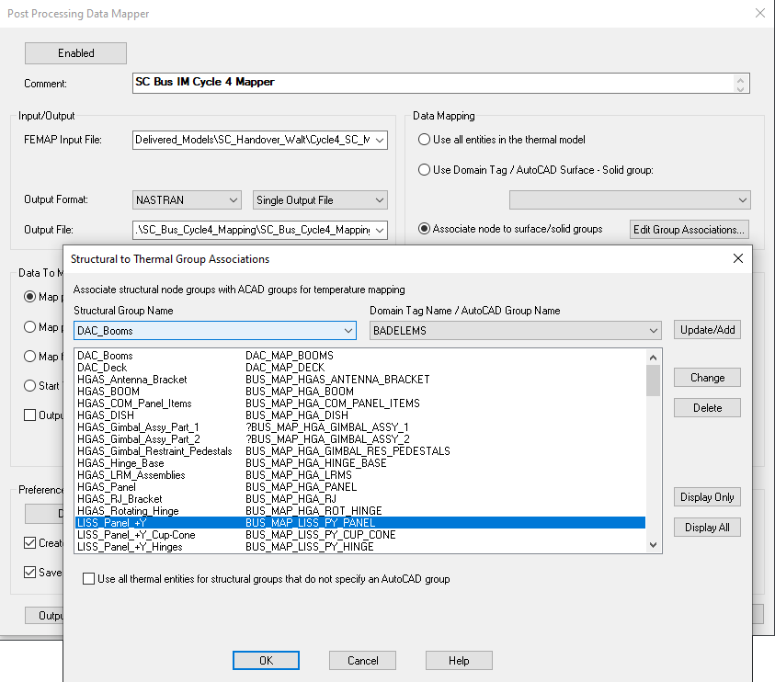
Motivation
For the Roman Space Telescope project, Integrated Modeling (in particular Structural-Thermal-Optical-Performance) has been a major analysis effort throughout the program
One of the most laborious parts of the process is verifying the accuracy of the mapping of thermal predictions to structural models for thermal distortion
A Post-Processing Data Mapper is used in Thermal Desktop® to perform the mapping, but the verification is a tedious comparison of thermal contour plots of the thermal model compared to mapped contour plots on the FEM
This is often done by associating selected groups of thermal objects mapped to selected groups of FEM grid points to minimize incorrect mapping at interfaces and can result in hundreds of images to manually generate and compare
Display of these associations is accomplished using the Display Only button capability in the GUI
Unfortunately, this capability is not currently exposed in the API…

Slide 5
Approach – AutomationElements
Fortunately, Assistive Technology allows programmers access to GUI elements in external programs and manipulate them or retrieve data
  This is notionally used to help disabled users to access programs more easily when they were not developed with a disabled user in mind
  For example, Assistive Technology could be used to extract text from a document and then process it to be read aloud for a blind user
This same technology could be used to access capabilities and data in a thermal analysis program and augment what can be accomplished programmatically via the APIs
The basis for this is called AutomationElements in the .NET framework and the process for utilizing it is as follows:
  Navigate the Visual Elements of the Windows environment to hierarchically find the AutomationElement representing the GUI control of interest
  Perform some action (Button Click, ListItem selection, retrieve TextBox text) using Control Patterns
Fortunately, tools like inspect.exe exist that allow users to uniquely identify the controls in the GUI for programmatic manipulation

Slide 6
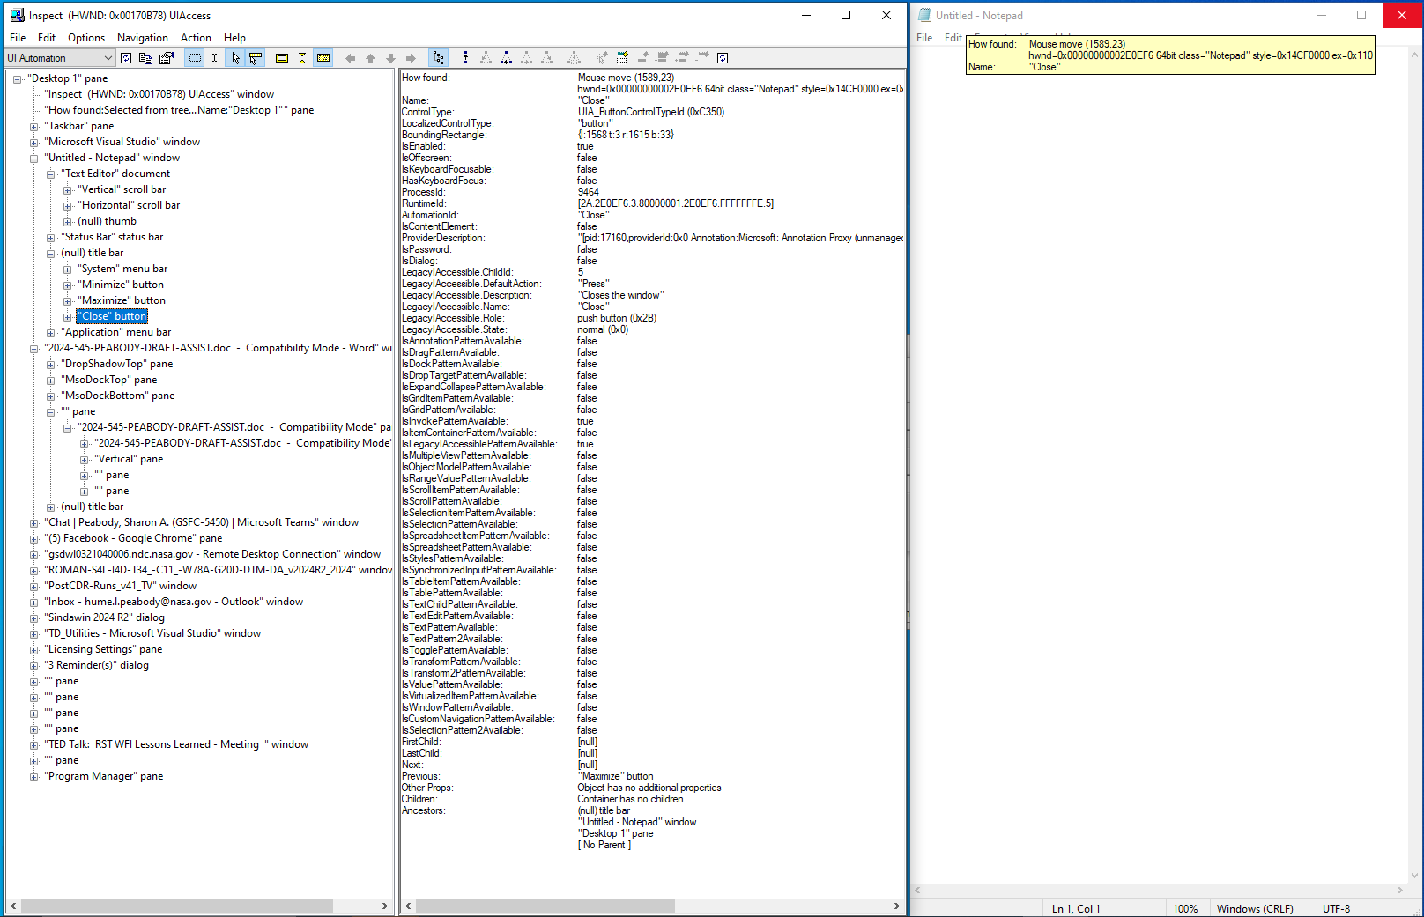
Finding Elements in the GUI
Tools like inspect.exe allow a user to select GUI elements in a program and display the relevant information, such as ControlType, Name, IsEnabled, etc
Navigation is hierarchical, beginning with the Windows Desktop (Desktop 1 Pane)
In this instance, Windows has GUI elements for Inspect, a ToolTip on How found, the TaskBar, Visual Studio, NotePad and other applications
Under Notepad is a TextEditor document, a Status Bar, a Title Bar, and a Menu Bar
Further navigating the Title Bar shows a Menu Bar and Minimize, Maximize and Close Buttons
Having hovered over the Close Button shows the Name for the control as well as the LocalizedControlType
This Name can be used by the AutomationElements to programmatically interact with this control in the Notepad application. (Note that the Name need not be unique)

Slide 7
Interacting with Elements in the GUI
This code snippet will navigate from the top Desktop window to find the Close button in an instance of Notepad and execute the Click to close the application
Start at the top:
Use the TreeWalker object to find the Notepad instance:
Find the Title Bar and then the Close Button:
Dim AEWindow as AutomationElement = AutomationElement.RootElement.FindFirst( TreeScope.Children,
New PropertyCondition(AutomationElement.LocalizedControlTypeProperty, "window")
) ‘// Find the first element in the Windows environment
Do While Not IsNothing(AEWindow)
If AEWindow.Current.Name.ToUpper.Contains(“NOTEPAD”) Then Exit do
AEWindow = TreeWalker.ControlViewWalker.GetNextSibling(AEWindow)
Loop ‘// Loop through all elements in the Windows environment until we find NOTEPAD in the name, then exit
Dim AETitle as AutomationElement = AEWindow.FindFirst(TreeScope.Children,
New PropertyCondition(AutomationElement.ControlTypeProperty, ControlType.TitleBar)
) ‘// From the NOTEPAD window we found earlier, find the TitleBar control
Dim AEClose as AutomationElement = AETitle.FindFirst(TreeScope.Children,
New PropertyCondition(AutomationElement.NameProperty, “Close”)
) ‘// From the NOTEPAD TitleBar control we found earlier, find the Close Button

Slide 8
Interacting with Elements in the GUI
Lastly, “Click” the Close to shut down the Notepad Application:
Being able to close an application via a program may seem trivial and unnecessary. But a tool was recently developed which allowed users to output the mass for selected Domain Tag Sets in Thermal Desktop
This tool called a method in the API which executed the command line function to calculate the mass for a given selection set and passed in the Domain Tag Set argument
At the conclusion of that command line function, an instance of Notepad was launched with the results
Repeating this for hundreds of Domain Tag Sets representing various constituent parts of the design would result in hundreds of Notepad instances also being opened which would be incredibly tedious to close manually
Fortunately, AutomationElements allowed each instance to be closed without the user needing to intervene
Dim IPClose As InvokePattern = AEClose.GetCurrentPattern(InvokePattern.Pattern)
IPClose.Invoke() ‘// From the Close Button of the TitleBar in NOTEPAD, execute a button click

Slide 9
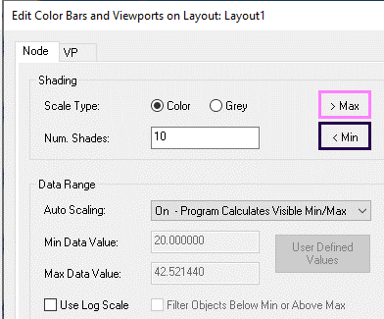
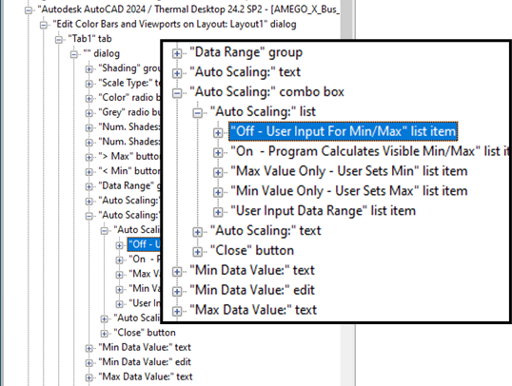
Accessing Data in the GUI Elements
The image on the right shows the Edit Color Bars from in the Thermal Desktop GUI along with the results from inspect.exe
Following a similar approach to earlier, the Min Data Value text can be found, but note that this control is currently disabled
To enable it, the AutoScaling listbox needs to be set to “User Input for Min/Max”
This requires navigating the hierarchy to find and invoke the Select Pattern on the list item
  Desktop → Autocad → ColorBarForm → ColorBarTab → ColorBarCombo →
  ColorBarComboList → ColorBarComboListItems
Dim AEColorBarComboListItems As AutomationElementCollection =
AEColorBarComboList.FindAll(TreeScope.Children,
New PropertyCondition(AutomationElement.LocalizedControlTypeProperty, "list item",
PropertyConditionFlags.IgnoreCase)
) ‘ // Get ColorBarComboListItems collection from ColorBarComboListBox
Dim SIPColorBarComboListItems As SelectionItemPattern =
AEColorBarComboListItems(0).GetCurrentPattern(SelectionItemPattern.Pattern
) ‘ // Set SelectedItem pattern for first ComboBox list item
SIPColorBarComboListItems.Select() ‘ // Invoke selection

Slide 10
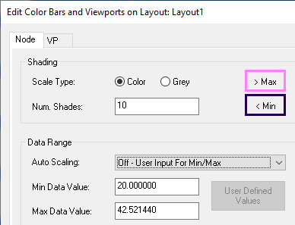
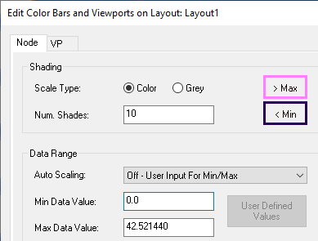
Accessing Data in the GUI Elements
The image on the right shows the Edit Color Bars from in the Thermal Desktop GUI at three stages
  Original
  After Selecting Off – User Input for Min/Max
  After Updating the Min Data Value text box
Following a similar approach to earlier, the AutomationElement for the Min Data Value text box (AEMinValue) can be found navigating the hierarchy
Using a TextPattern allows a programmer to access the data in the Text Box
Similarly, using a ValuePattern allows the programmer to set the data in the TextBox
  It is incumbent on the developer to ensure that controls are enabled and can accept data
The following code snippet retrieves the first 1000 characters in the text box and then sets the value to 0.0
Dim TPMinValue As TextPattern = AEMinValue.GetCurrentPattern(TextPattern.Pattern)
Dim StrMinValue as String = TPMinValue.DocumentRange.GetText(1000) ‘// Get the Min Data Value
Dim VPMinValue As ValuePattern = AEMinValue.GetCurrentPattern(ValuePattern.Pattern)
VPMinValue.SetValue(“0.0”) ‘ // Set the Min Data Value

Slide 11
Finding Elements more Efficiently
Code snippets so far have shown a methodical, step-by-step navigation of the hierarchy
But using a recursive argument (SubTree) instead of a next level down argument (Children) allows developers to find controls much faster by navigating the tree during the FindFirst method
However, this approach does assume that the first control with the specified name is the intended target. Recall, that Names not be unique…
Returning a Collection of all controls that meet the specified criteria using the FindAll method would return two elements: a text box (edit) and a label (text):
Dim AEColorBarComboListItem As AutomationElement = AEAcad.FindFirst(TreeScope.Children,
New PropertyCondition(AutomationElement.NameProperty, "Off – User Input For Min/Max")
) ‘ // Search next level down for elements with a name of Off – User Input for Min/Max
Dim AEColorBarComboListItem As AutomationElement = AEAcad.FindFirst(TreeScope.Subtree,
New PropertyCondition(AutomationElement.NameProperty, "Off – User Input For Min/Max")
) ‘ // Search hierarchy for elements with a name of Off – User Input for Min/Max
Dim MinValues As AutomationElementCollection = AEAcad.FindAll(TreeScope.Subtree,
New PropertyCondition(AutomationElement.NameProperty, "Min Data Value:")
) ‘ // Search hierarchy for elements with a name of Min Data Value:

Slide 12
Finding Elements more Efficiently
The specification of the desired element could also be further refined using an AndCondition
The code snippet above would return a collection of all Text Boxes (edit) that have a name of “Min Data Value:” from any hierarchy path starting from the AutoCAD window (which should just be a single element)
That said, the .Count property should always be checked for a Collection to ensure the code is working as intended
Dim MinValues As AutomationElementCollection = AEAcad.FindAll(TreeScope.Subtree,
New AndCondition(
New PropertyCondition(AutomationElement.NameProperty, "Min Data Value:"),
New PropertyCondition(AutomationElement.LocalizedControlTypeProperty, "edit")
)
) ‘ // Search hierarchy for elements with a name of Min Data value: that are also a TextBox

Slide 13
Challenges
Now for the bad news…This approach does have its share of caveats and pitfalls
  Since this approach is working with the GUI of external programs, a user moving focus to another application or control may cause disruption in the code execution. This approach is best left for fire-and-forget type applications that can be running undisturbed for their duration
  This approach does require robust error checking to ensure that control are enabled and able to be interacted with by the code. Furthermore, it does require very precise narrowing of the intended targets. It is quite possible to be operating on a wrong control in a second instance of an application that may also be open.
  Developers are not in control of an external program’s GUI. So, it is possible that forms may change, breaking the code. That said, major GUI changes in legacy programs are not all that common (developers are more often interested in adding to capabilities and not removing them…)
That said, these limitations are manageable with careful development and use by an analyst

Slide 14
Conclusions
APIs have expanded the abilities of analysts to further develop capabilities to interface with thermal analysis tools
However, if a particular capability is available in the GUI, but not exposed in the API, another approach must be used
AutomationElements allow users to programmatically interact with the GUI, giving analysts another tool in their toolbox for utility development
The process consists of:
  Navigating the GUI hierarchy to find the control of interest
  Executing some action (Click, Retrieve Text, Set Value, Select List Item, etc) on the control of interest
This approach was recently used on the Roman Space Telescope project to develop a utility that:
  Took an input file of Thermal Domain Tag Sets, Structural FEM group names, and View information
  Looped through and generated thermal model contour plots and FEM mapped contour plot images
  And pasted the images into an output PowerPoint file
This utility saved many hours of manual labor and turned the process into a turn-key, overnight effort

