Slide 1


Ceramic Matrix Composite (CMC) Thermal Protection Systems (TPS) and Hot Structures for Hypersonic Vehicles
Thermal Protection Systems for Space Applications American Ceramic Society Course
NASA Johnson Space Center
August 6, 2026
David E. Glass, Ph.D.
Senior Technologist, Advanced Structural / Thermal Systems
Applied Materials for Space & Hypersonics (AMSH)
NASA Langley Research Center, Hampton, VA 23681
Approved for Public Release
Additional details can be found in AIAA-2008-2682

Slide 2
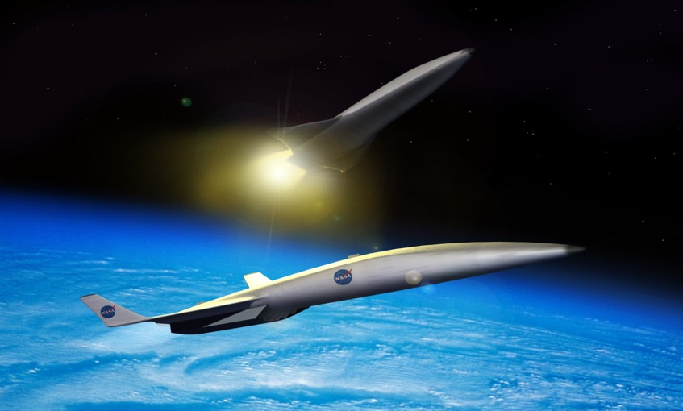
Outline
Introduction
  Ceramic matrix composites (CMCs)
  Aerothermodynamic heating
  Thermal management
  Thermal protection systems (TPS) for rocket-launched vehicles
  TPS and hot structures for hypersonic vehicles
TPS and Hot Structures Components
Key Technical Challenges
Concluding Remarks

Slide 3

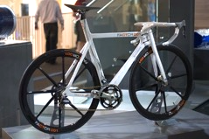
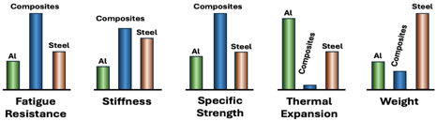

What are Composites?
Two or more constituents combined on macro scale
  Often comprises a matrix (binder) and reinforcement
Types of reinforcement
  Continuous or long fibers
    Unidirectional, woven, braided, or random architecture
  Random or short fibers
  Particulate, flakes, or fillers
Benefits
  Lightweight
  Tailorable to different applications
    Strength / stiffness
    Coefficient of thermal expansion (CTE)
    Hardness, fatigue life, damage tolerance
Common composite examples
  Reinforced concrete and masonry
  Composite wood such as plywood
  Polymer matrix composites (PMC)
  Ceramic matrix composites (CMC)
Boeing Dreamliner 787
PMC composite bicycle
Credit: “Composite Bike (3665606309)" by Paul Hudson licensed under CCA 2.0.
B787 PMC fuselage
Composite plywood
Credit: “N1015X Air Tahiti Nui Boeing 787-9 Dreamliner 26 " by New York-air licensed under CCA 4.0.
PMC versus metallic properties
Credit: “Spruce Plywood" by Bystander licensed under CCA 3.0.

Slide 4
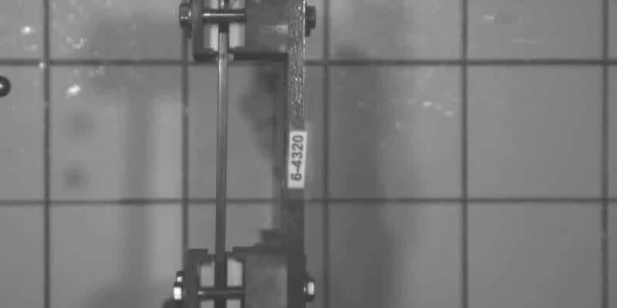
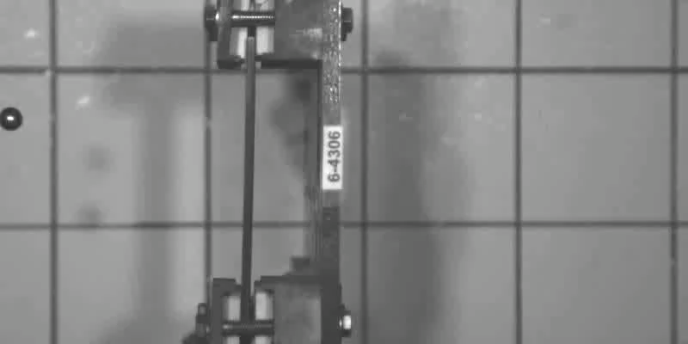
Ceramic Matrix Composites (CMCs)
CMC = Ceramic (or carbon) fiber in a ceramic matrix
  Material nomenclature is “fiber/matrix”
Common examples
  Oxides: Oxide/alumina-silicate, oxide/alumina-mullite
  Carbides: SiC/SiC, C/SiC, C/C-SiC
  Carbon/carbon: C/C
Characteristics
      Moderate density
      High use temperature
      Chemical resilience
      Excellent mechanical capability
“Game changer” for high-temperature applications
180 mph
(290 km/hr)
Environmental barrier coating (EBC) (possible)
Fiber: silicon carbide (SiC), carbon (C), oxide, etc.
Monolithic ceramic
Fiber-matrix interface coating (possible)
Monolithic ceramic panel
Unidirectional fibers shown
Matrix: SiC, C, oxide, etc.
180 mph
(290 km/hr)
CMC
CMC panel
Credit: GE Aerospace, used with permission

Slide 5
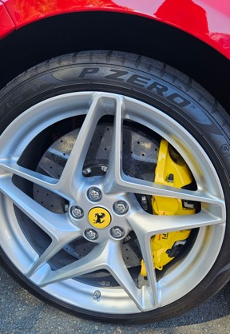
Perception of CMCs
Analogous to that of PMCs in the mid-1980s
Commonly viewed as promising, but…
  Too many problems, unknowns, and risks
  Immature manufacturing techniques
  Immature supply chain
  Exotic
  Complex to analyze and implement
  Too expensive and therefore unrealistic for “real-world structures”
Is this perception valid?
CMC brake discs, calipers, and pads are NOT complex, immature, or risky
Credit: J. Chenenko, used with permission

Slide 6
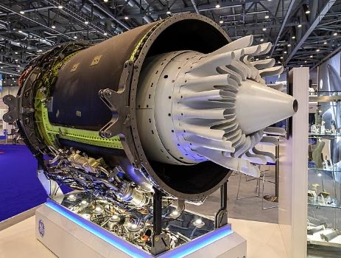
Reality of CMCs
Offer increased efficiency and decreased complexity for elevated-temperature applications
Have reached an inflection point in maturation
  Viable predictive and design capabilities
  Proof of profitability in multiple industries
  An actively developing supply chain
  Technological advances/improvements in manufacturing
    Can be tailored to application
    Decreased costs with increased quality and throughput
Passport engine oxide/oxide mixer and nozzle
Credit: "EBACE 2019, Le Grand-Saconnex (EB190671)" by Matti Blume licensed under CCA 4.0.
  Analogous to PMC composites in the mid-80s – CMCs are poised for explosive growth…

Slide 7
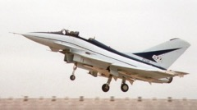

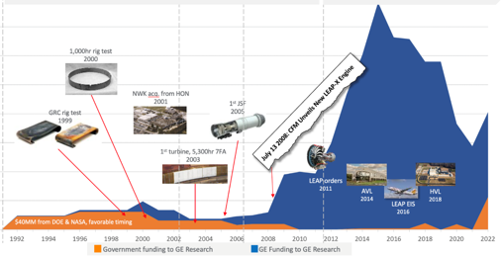
Cost Perceptions and Cost Realities of CMCs
CMCs have a reputation as too expensive
  Acquisition costs can cause hesitation in adoption of CMCs, even if life-cycle costs are reasonable
  Costs must be balanced against the drivers for CMCs
Investment in industrialization for high-pull business cases improves future business cases
PMC Business Case Evolution
1980’s to present
Sector Level of
Industrialization / Capitalization
Credit: “British Aerospace EAP at the Farnborough Air Show, 1986" by Mean as custard licensed under CCA 3.0.
Credit: “Tennis Racket and Balls" by Vladsinger licensed under CCA 3.0.
Low
High
Business case for CMCs in aviation drove GE investment
Demand / Pull for CMC Technology
Performance
Efficiency
Emissions
Environmental
Safety
Business case for industrialization
Cost often competitive
Used by permission of GE Aerospace: Approved for external publication (July 2024)
High
Funding
GE funding
Cost may not be competitive
Cost can be competitive
Low
S.J. Lewis, “The use of carbon fibre composites on military aircraft,” Composites Manufacturing, Vol. 5 No. 2, 1994.
2016
2022
$40M US government funding
> $1B GE funding

Slide 8
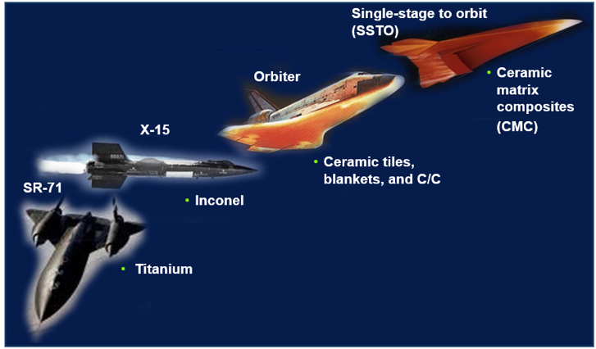
CMCs Are Both Enablers and Benefit-Multipliers
CMCs enable new technologies and products
  Spacecraft, aircraft, defense, nuclear, and other power generation components are some currently identified examples
CMC implementation results in system benefits
  CMC components enable a system with lower weight, higher performance, higher efficiency and improved safety while decreasing overall complexity – a benefit-multiplier
Aerospace: new materials enable new vehicles
Credit: NASA
Credit: NASA

Slide 9
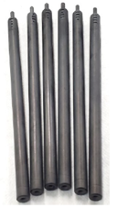
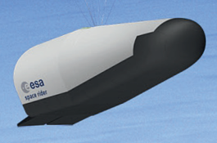
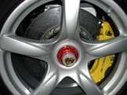
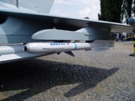
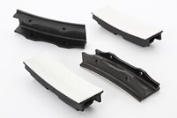
CMC Sectors
CMCs are currently making in-roads in multiple key industrial sectors
Automotive
Energy
Defense
Aviation
Space and Hypersonics
Brakes
Rocket control vanes
Aircraft engine shrouds
Credit: "PCCB Brake Carrera GT" by Nrbelex licensed under CCA 3.0.
ESA Space Rider
Nuclear fuel rods
Credit: “Space Rider mission” by ESA©ESA, ESA Standard License
Credit: General Atomics Electromagnetic Systems (GA-EMS), used with permission
Credit: "IRIS-T air-to-air-missile" by Owly K licensed under CCA 3.0.
Credit: “ORNL History (44684257470)" by ORNL History licensed under CCA 2.0.

Slide 10
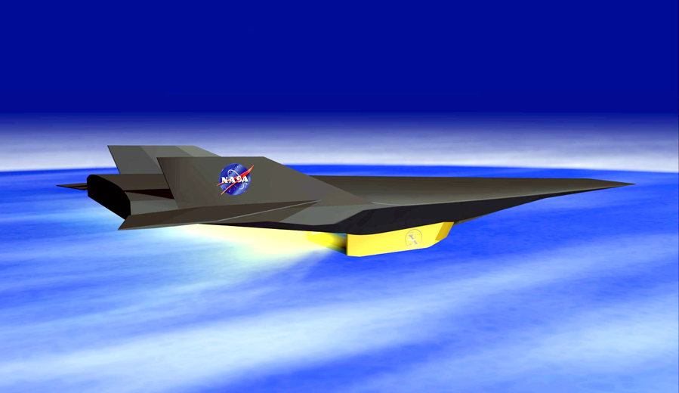
Outline
Introduction
  Ceramic matrix composites (CMCs)
  Aerothermodynamic heating
  Thermal management
  TPS for rocket-launched vehicles
  TPS and hot structures for hypersonic vehicles
TPS and Hot Structures Components
Key Technical Challenges
Concluding Remarks

Slide 11



Two Stage to Orbit (TSTO) Reference Vehicle
300
Rocket upper stage
1st stage return
to launch site
200
Dynamic pressure
100 psf
Altitude, kft
500 psf
2000 psf
Stage
separation
100
Increased heating, f (ρV³)
100 kft ~ 30 km
0
0
5
10
15
20
25
Mach Number
M ~ kft/sec

Slide 12
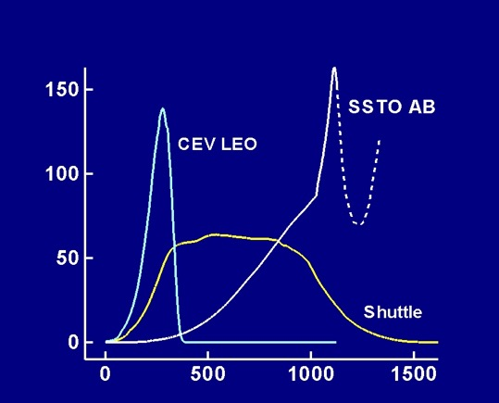
Heat Flux
∫
t_{final}
Heat Load = Heat flux dt
Heating ~ ρV³
t=0
Reference heating,
1-ft-diameter sphere
Heat flux, Btu/ft²-sec
Rocket boost
100 Btu/ft²-sec ~ 113 W/cm²
100 W/cm² ~ 88 Btu/ft²-sec
Crew Exploration Vehicle (CEV) Low Earth Orbit (LEO)
Single Stage to Orbit (SSTO) Airbreather (AB)
Time, sec

Slide 13

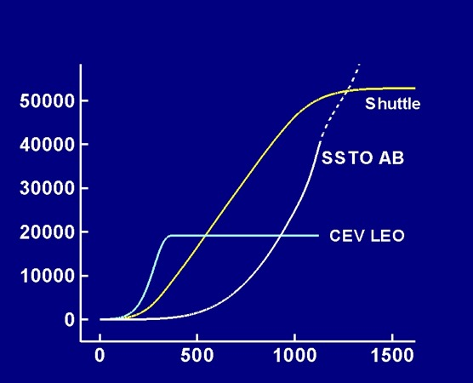
Heat Load
Heat load, Btu/ft²
Heat load, Btu/ft²
Reference heating,
1-ft-diameter sphere
Time, sec

Slide 14
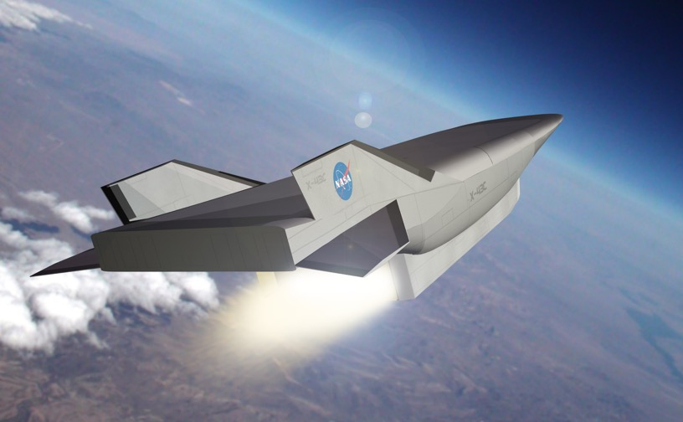
Outline
Introduction
  Ceramic matrix composites (CMCs)
  Aerothermodynamic heating
  Thermal management
  TPS for rocket-launched vehicles
  TPS and hot structures for hypersonic vehicles
TPS and Hot Structures Components
Key Technical Challenges
Concluding Remarks

Slide 15
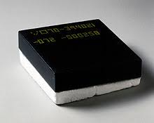
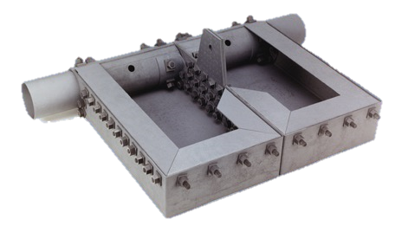
TPS & Hot Structures
In the US, the term “TPS” is usually used to include
  Acreage TPS such as tiles, blankets, and ablators (manage the heat)
    Insulation
  Hot structures such as control surfaces, leading edges, and nose caps
    Multi-functional structures that carry structural loads at operating temperatures (handle the heat)
Europe and most of the rest of the world use the terms TPS & hot structures separately
Tile TPS
Insulator / ablator
Aeroshells
Hot structures
TPS
Structure
C/C is used for the entire spectrum
Hot-structure control surface
TPS & hot structures can perform very different functions and should be referred to separately

Slide 16

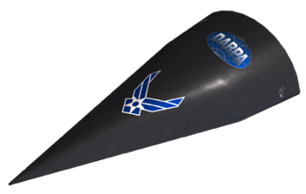
C/C as a TPS and/or a Hot Structure
C/C is used for the entire spectrum
Insulator / ablator
Aeroshells
Hot structures
TPS
Structure
Hot-structure
control surfaces
Genesis ablative TPS
Credit: DARPA
HTV: Hypersonic Technology Vehicle
Early building block metrics
Arc-jet test
Density
Early building block metrics
Mechanical properties at elevated temperature
HTV-2 ablative aeroshell hot-structure
Building block (and often the C/C) is component dependent

Slide 17






Flight Vehicle Thermal Management
5000
Apollo / CEV
Hot structure
Insulation
Active cooling
4000
Ablators
Mercury
3000
Insulation
Temp., °F
SSTO
2000
Shuttle Orbiter
Heat sink
1000
3000°F ~ 1650°C
Hot structure
X-15
SR-71
0
Time limited
1
Not time limited
2
Exposure Time, hr
Earl Thornton, “Thermal Structures for Aerospace Applications”, AIAA Press, 1996.

Slide 18
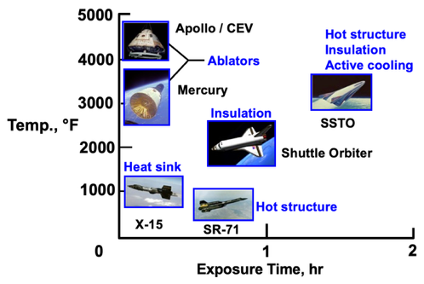
Passive: Insulated Structure
Use: Moderate heat flux, short times
High
Heat Flux
Moderate
Time limited
Time
Not time limited
Orbiter
Surface heating
Radiation
Heat radiated away
  Maximize surface emissivity
Minimal heat conducted inward
Structure remains cool
High emissivity surface
Conduction
Insulation
Structure

Slide 19
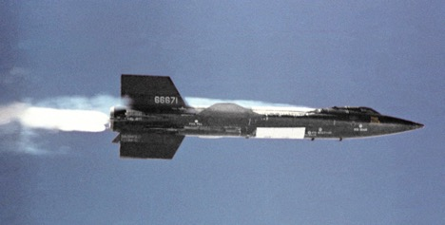
Passive: Heat-Sink Structure
High
Heat Flux
Moderate
X-15
Time limited
Time
Not time limited
Surface heating
Radiation
Heat radiated away
Heat absorbed by structure
Conduction
Structure

Slide 20
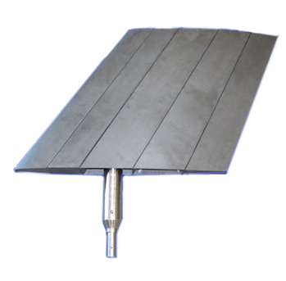
Passive: Hot Structure
High
Heat Flux
Moderate
Time
Control surface manufacturing demo
Time limited
Not time limited
Heat radiated away
Heat conducted inward
Structure operates hot
Surface heating
Radiation
Conduction
Structure

Slide 21
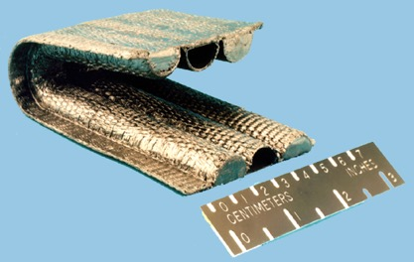
Semi-Passive: Heat Pipe
High
Notional leading edge
Heat Flux
Moderate
Time limited
Time
Not time limited
Surface heating
Radiation
Heat transferred by working fluid
Heat radiated away
Structure operates hot
Working
fluid
Structure

Slide 22
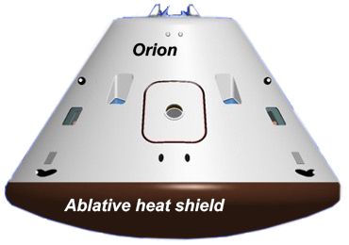
Semi-Passive: Ablation
High
Heat Flux
Moderate
Time limited
Time
Not time limited
Surface heating
Heat blocked by products of ablation (ablator consumed)
Heat absorbed by ablation
Structure remains cool
Air flow
Ablator
Structure

Slide 23
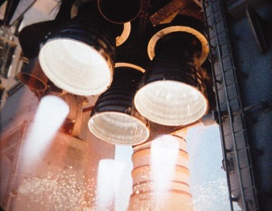
Active: Convective Cooling
High
Space shuttle main engine
Heat Flux
Moderate
Time limited
Time
Not time limited
Heat transferred into coolant
Coolant heats up and carries heat away
Structure operates hot
Surface heating
Radiation
Coolant flow
Structure

Slide 24
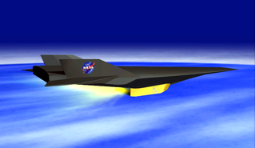
Active: Film Cooling
High
X-43
Heat Flux
Moderate
Time limited
Time
Not time limited
Surface heating
Coolant injected into flow (upstream)
Thin, cool, “insulating” blanket
Structure operates hot
Air flow
Coolant flow
Structure

Slide 25
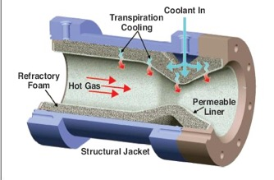
Active: Transpiration Cooling
High
Heat Flux
Moderate
Time limited
Time
Not time limited
Thrust chamber
Surface heating
Coolant injected into flow (porous structure)
Coolant decreases heat flux to structure
Structure operates hot
Air flow
Coolant flow

Slide 26
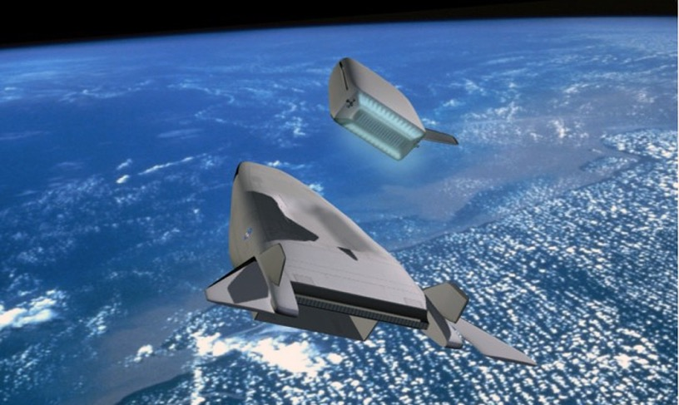
Outline
Introduction
  Ceramic matrix composites (CMCs)
  Aerothermodynamic heating
  Thermal management
  TPS for rocket-launched vehicles
  TPS and hot structures for hypersonic vehicles
TPS and Hot Structures Components
Key Technical Challenges
Concluding Remarks

Slide 27
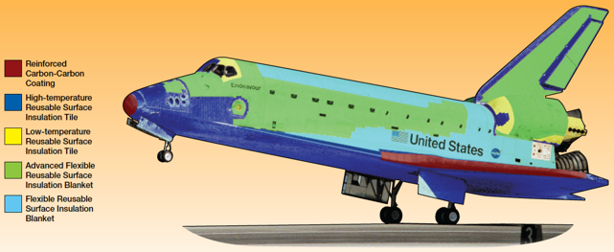
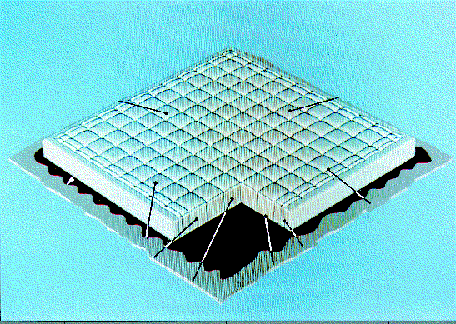
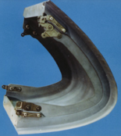
Space Shuttle Orbiter
Tile
Blanket
Conventional skin-stringer aluminum aircraft structure
Structural temperatures < 350°F (176°C)
Reusable surface insulation (RSI) tiles
Reusable blankets
Reinforced carbon/carbon (RCC) used for wing
leading edges and nose cap, T > 2300°F (1260°C)
RCC Leading Edge

Slide 28
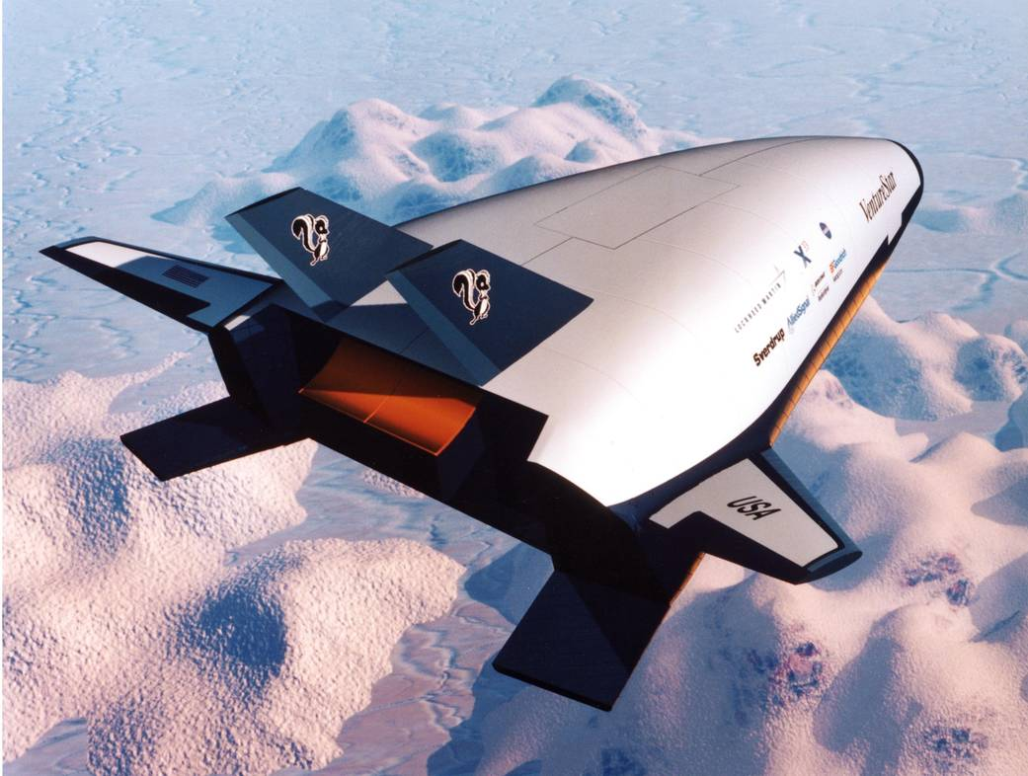
X-33 Thermal Protection System
Leeward aeroshell composite/blanket (17 panels)
Carbon/carbon (C/C)
nose cap, chin,
and skirt
Windward body -
Inco 617/MA754
metallic TPS (1333 panels)
C/C leading edge, fillet, and fin tip
Canted fin -
metallic (windward)
blanket (leeward)
Elevon - insulated with ceramic tile
Similar to Orbiter TPS except metallic TPS on windward surface

Slide 29
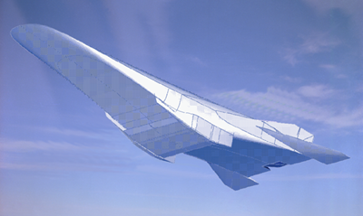
Outline
Introduction
  Ceramic matrix composites (CMCs)
  Aerothermodynamic heating
  Thermal management
  TPS for rocket-launched vehicles
  TPS and hot structures for hypersonic vehicles
TPS and Hot Structures Components
Key Technical Challenges
Concluding Remarks

Slide 30
Airbreathing Hypersonic Vehicles
Aerodynamics and Aerothermodynamics
Propulsion
TPS and Hot Structures
Vehicle propulsion, airframe, and aerothermodynamics are highly integrated

Slide 31

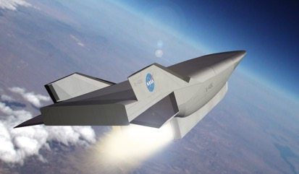
Rocket vs. Airbreather: Flight in Atmosphere
Rocket
Airbreather
  Accelerate and cruise in atmosphere
  Typically horizontal launch
  High dynamic pressure
  Accelerate only
  Usually vertical launch
  Get out quick
  Low dynamic pressure

Slide 32
Rocket vs. Airbreather: Drag
Airbreather
Rocket
  High drag not a problem on ascent
  Desirable on descent for deceleration
  Optimize for low drag
  Thin, slender body, low thickness-to-chord ratio

Slide 33
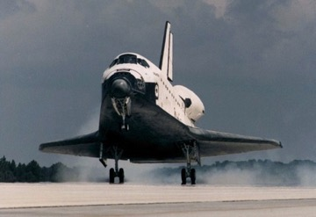
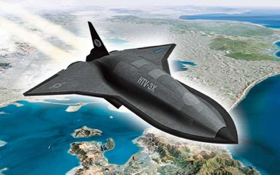
Key Point: Drag Reduction
Reentry vehicles (most of our prior experience) want drag to reduce velocity during reentry
Vehicles flying in the atmosphere must minimize drag during atmospheric flight
  Surface and cross-section
Hot structure is the preferred approach (rather than TPS over cold structure)
  Thin cross sections are required – hot structure is more volumetrically efficient
Credit: DARPA

Slide 34
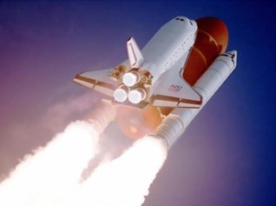
Rocket vs. Airbreather: Weight and Volume
Rocket
Airbreather
Weight Critical
  Structural mass fraction ~10% of gross take off weight (GTOW)
Volume Critical
  Volume impacts drag
  Structural mass fraction ~30% of GTOW

Slide 35


Rocket vs. Airbreather: TPS
Rocket
Airbreather
  Driven by descent
  Low ascent heat load due to short ascent time and trajectory
  Driven by ascent, descent, and cruise
  High heat load due to long ascent and cruise time

Slide 36
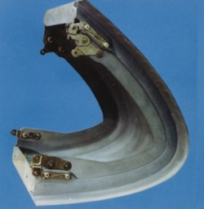
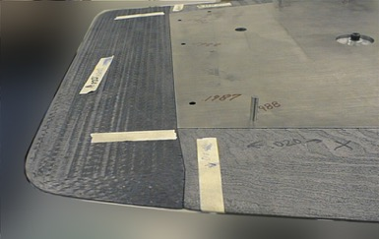
Rocket vs. Airbreather: Leading Edges
r = 0.030 in.
Rocket
Airbreather
r = 6 in. - 10 in.
  Blunt, due to desire for high descent drag and low heat flux
  Sharp, due to low drag, low thickness-to-chord ratio
  High heat flux

Slide 37
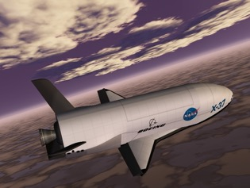
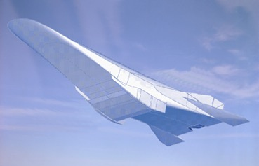
Rocket vs. Airbreather: Structures
Rocket
Airbreather
  Propulsion and airframe not highly integrated
  Propulsion and airframe highly integrated
  Hot wings and control surfaces due to thin cross sections and high heat flux and heat load

Slide 38
Thermal-Structural Challenges
Large thermal gradients
  Tank / outer surface
  Control surfaces / actuators
Thin cross sections at high mechanical loads
High mechanical loads at elevated temperatures
Stability of the outer mold line (OML) shape
  Performance
  Non-ablative leading edge
  Steps and gaps (sneak flow and heating)
Thermal expansion of the propulsion system
Long times, elevated temperatures, oxidizing environment

Slide 39
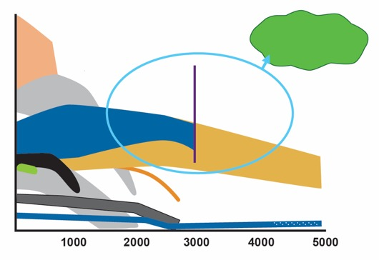
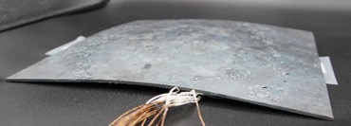
Why CMC Hot Structures?
MMC: Metal matrix composite
C/SiC: Carbon/silicon carbide
UHT: Ultra high temperature
Hot structures provide ~ 25% weight savings over insulated cold structure
High-performance vehicles utilize high specific strength/stiffness materials
  Aluminum (Al)
  Composites: carbon fiber reinforce polymers (CFRP)
  Titanium (Ti)
  Beyond Ti use temperatures (~Mach 5), often utilize superalloys, refractory metals, and active cooling – not high specific strength/stiffness
  Refractory-composite (C/C, C/SiC, SiC/SiC, etc.) hot structures extend high specific strength/stiffness structures to 3000°F (1650°C) and above
Reduced deflections
Goal: High specific strength & high temperature
CFRP
Specific
strength
(strength
/density)
MMC
Multi-Use
Single-Use /Ablator
C/SiC
Al
Ti
C/C
Superalloys
SiC/SiC
Ceramics
UHT Ceramics
Temperature, °F
Steel plate after 2200°F (1200°C) exposure
Note: 2200°F is above the normal use temperature of steel
> 0.5 in. (1.25 cm) residual deformation

Slide 40
Outline
Introduction
TPS and Hot Structures Components
  Leading edges
  Acreage TPS / aeroshell
  Control surfaces
Key Technical Challenges
Concluding Remarks

Slide 41
Typical Ascent Leading-Edge Heat Flux for SSTO
500 Btu/ft²-sec ~ 567 W/cm²
Wing ~ 500 Btu/ft²-sec
Nose ~ 5000 Btu/ft²-sec
Cowl ~ 50,000 Btu/ft²-sec
In comparison, Shuttle Orbiter leading edge ~ 70 Btu/ft²-sec, CEV ~ 700 Btu/ft²-sec

Slide 42
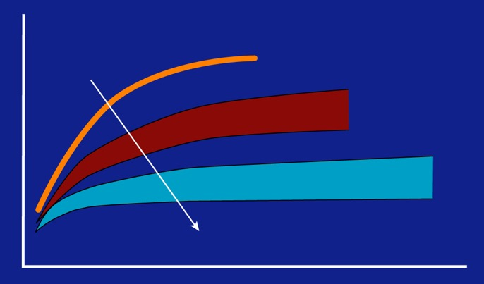
Leading-Edge Thermal Management Options
Passive
Ablator
Single use
Multi- use
Semi-passive (heat pipe)
Temp.
Active cooling
Increased cost, complexity, weight
Heat flux
There are multiple options to manage the intense heating on sharp leading edges

Slide 43
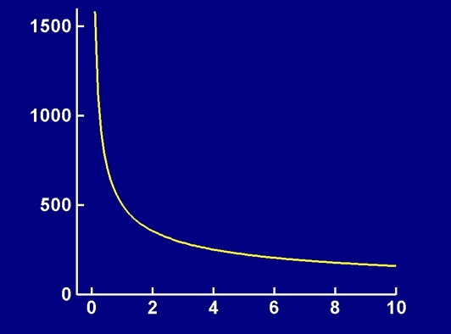
Leading-Edge Radius Effect on Heat Flux
Notional flight conditions
1
Heat flux ∝
radius
Heat flux, Btu/ft²-sec
1-in. radius, 500 Btu/ft²-sec
500 Btu/ft²-sec ~ 567 W/cm²
Radius, in.
10 in. = 25.4 cm

Slide 44
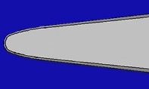
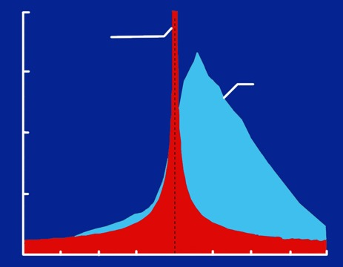
Leading-Edge Heating
Chordwise position
Leading edge
Sharp LE, hypersonic
vehicle
Shuttle
Orbiter
Heat
Flux
Upper
Surface
Lower
Surface
Chordwise position
Sharp leading edges produce intense, localized heating

Slide 45
Property: Emissivity (ε)
ε = 0.1
ε = 0.3
ε = 0.5
4000
ε = 0.8
3000°F ~ 1650°C
3000
ε = 1.0
High emissivity coatings
Radiation Equilibrium Temperature (T_{req}), °F
2000
4
1000
q_{conv,surf} = q_{rad,out} = ε σ T_{req}
0
20
40
60
80
100
q_{rad}, Btu/ft²-sec
100 Btu/ft²-sec ~ 113 W/cm²
100 W/cm² ~ 88 Btu/ft²-sec
High emissivity coatings are very important to keep temperatures survivable

Slide 46

Heat-Pipe-Cooled (Semi-Passive) Leading Edge
Heat pipes reduce leading-edge temperatures to reuse limits of materials
National Aerospace Plane (NASP)
Heat-pipe-cooled leading edge

Slide 47
Heat-Pipe Operation
Container
Wick
Working fluid
Vapor flow
Liquid flow
Heat input
Heat output
Evaporator
Condenser
Heat pipes transfer heat isothermally by the evaporation and condensation of a working fluid

Slide 48

Leading-Edge Heat-Pipe Operation
T_{s} = Surface temperature
T_{req} = Radiation equilibrium temperature

Slide 49


Leading-Edge-Shaped Heat Pipe
Heated region
Hastelloy-X container
Sodium (Na) working fluid
Heat pipe
Leading edge
Heat pipe results in an isothermal leading edge

Slide 50

Outline
Introduction
TPS and Hot Structures Components
  Leading edges
  Acreage TPS / aeroshell
  Control surfaces
Key Technical Challenges
Concluding Remarks

Slide 51

Recombination (Catalytic) Efficiency
Dissociated species in hypersonic flow
Recombination
  Includes flow and surface
  Can be exothermic
  Si_{(g)} + O SiO,
  ∆H = -605 Btu/mol (-638 kJ/mol)
NASA 1958 Technical Memorandum
https://ntrs.nasa.gov/api/citations/19930085278/downloads/19930085278.pdf)
40
Arc-jet test
Mach 4
ε = 0.84
30
Non-catalytic
q = 10.1 Btu/ft²-sec
Catalytic
q = 28.3 Btu/ft²-sec
Btu/ft²-sec
20
(kft/sec ~ Mach)
10
0
0.001
0.01
0.1
1
Recombination efficiency
Aerothermal heat flux calculations should assume partially-catalytic surface – higher heat flux is NOT always more conservative

Slide 52


Catalytic vs. Non-Catalytic Heat Flux
Uncoated C/C, γ ~ 1 (γ is catalycity)
2000K
~ 3150°F
Normalized heat flux
~1200°F (650K)
difference
(kft/sec ~ Mach)
Coated C/C, γ = very low
Non-catalytic wall (glass)
Oxides
Catalysts (metals)
SiC-coated surface is essentially non-catalytic
1350K
~ 1970°F
Krasnov, N. F. Aerodynamics. Translated by T. S. Patel. Edited by V. S. Kothekar. New Delhi: Amerind Publishing Co., 1978. Originally published 1971. Translated by NASA, open source.
https://archive.org/details/n.-f.-krasnov-aerodynamics-ntt-amerind-1978/page/665/mode/2up
Copyright and courtesy of ArianeGroup
Thierry Pichon, "IXV CMC Thermal Protection System: Post Flight Preliminary Analysis”, International Astronautical Congress, Guadalajara, Mexico, Sept. 25-30, 2016
Fully catalytic assumptions can excessively over-predict surface temperatures

Slide 53


Insulated Structure
Insulator attached directly to cold structure to form outer mold line (OML)
Transfer aerodynamic loads to structure
Strain isolation required
Segmented (~ 6 in. x 6 in. or ~ 15 cm x 15 cm)
Tile with high emissivity coating
Damaged tile post-flight
Space Transportation System (STS) - 114

Slide 54


CMC Standoff TPS on Intermediate eXperimental Vehicle (IXV)
Used by permission of ArianeGroup

Slide 55

Load-Bearing Aeroshell
DARPA/AF Falcon HTV-2
Carbon/Carbon Aeroshell
Aeroshell carries aero and vehicle axial loads
Insulation incorporated or separate
Potential for reduced weight

Slide 56
Outline
Introduction
TPS and Hot Structures Components
  Leading edges
  Acreage TPS / aeroshell
  Control surfaces
Key Technical Challenges
Concluding Remarks

Slide 57

Need for a Damage-Tolerance Approach (DTA)
Strength-based approach (SBA)
  Good for initial structural sizing
  Can provide inaccurate failure predictions from stress concentrations (cannot accurately predict)
  Cannot accurately predict crack advance: Manufactured parts containing cracks generally rejected
  Needs to be supplemented with a
  damage-tolerance approach
Damage-tolerance approach (DTA) (realistic goals)
  Apply at stress concentrations and manufacturing defects
  Accurately predict onset (stress concentrations) and growth (identified defects) of damage
  Utilize a no-growth philosophy for C/C and CMCs
  Inform part accept/repair/reject decisions
DTA can increase production yield, structural integrity, and vehicle life

Slide 58


Insulated Control Surface
Metal or polymer matrix composite (PMC)
Tile
Tiles on orbiter elevons
Disadvantages
  Heavy
  Little thermal margin
  Thick cross section
Advantages
  Suitable for very large structures
  Minimal thermal expansion issues
U. Trabandt, T. Schmid, and E. Werth, “CMC and Metallic Hot Structure Hybrid Components for RLV,” 54th International Astronautical Congress, Breman, Germany, 2003.

Slide 59



Hybrid (Material System) Control Surface
Advantages
  May not require TPS on upper surface
  More affordable manufacturing for large structures
  Replace CMC leading and trailing edges
  if damaged
Disadvantages
  Thermal growth mismatch between metal/PMC and CMC
  Weight increase 30% - 40% over all CMC
  Insulation of box structure leads to reduced thickness and small moment of inertia or a thicker cross section
X-43
C/C
Metal
or PMC
Haynes 230
CMC

Slide 60

CMC Hot-Structure Control Surface
Advantages
  Lowest weight and thin cross section
  Minimal thermal expansion mismatch problems
  Thermal margin
  CMC has sufficient strength, stiffness, and damage tolerance for torsional and bending loads
  No external insulation
Disadvantages
  High manufacturing/tooling costs for box structure
  Challenging for very large structures
  Limited repair capability
  Manufacturing risk in case of production damage
  Access for coating, inspection, and maintenance of internal areas
  Tolerance stack-up of fasteners
CMC
Key Point: Do not design (and build and fly) a structure that we cannot model
U. Trabandt, T. Schmid, and E. Werth, “CMC and Metallic Hot Structure Hybrid Components for RLV,”
54th International Astronautical Congress, Breman, Germany, 2003.

Slide 61

Outline
Introduction
TPS and Hot Structures Components
Key Technical Challenges
Concluding Remarks

Slide 62

Hypersonic Vehicles
CMCs are the family of materials that will enable hypersonic vehicles
For most hypersonic vehicles, there are two key materials and structures technical challenges
Leading edges
Acreage
Hot structures
Propulsion system

Slide 63

Key Technical Challenge: Environmental Durability
  Oxidation resistance (CMCs containing SiC)
    SiC works very well up to ~ 3000°F (1650°C), depending on temperature and pressure
    Is reusable, but number of cycles limited and must be verified
Passive oxidation (low temperature or high pressure)
    SiC_{(s)} + 2 O_{2(g)} SiO_{2(s)} + CO_{2(g)}
Active oxidation (high temperature or low pressure)
    SiC_{(s)} + 1.5 O_{2(g)} SiO_{(g)} + CO_{2(g)}
  Above ~ 3000°F (1650°C), but also function of pressure, no reusable solutions exist
  Challenges
Testing in relevant environments
Cycles under combined load
Multi-mechanism-driven failure
Accurate life prediction
Physics-based material limitations
Failed test article due to active oxidation
Multiple cycles and increased duration increase environmental durability challenges

Slide 64


Temperature Jump Observed in Multiple Arc Jets
Starfire SMP-10 (PCP) based CMC with boride and carbide fillers tested in NASA Langley HyMETS arc-jet
~700°F / 4 sec.
Arc-jet testing of UHTC for the SHARP-B1 flight test at NASA Ames
Si
Voltage
Temperature, °F
Current (Amps), Voltage (Volts)
Temperature
Current
Glass, Ref. 6
Kolodziej, Ref. 7
Infed, Ref. 1
Arc-jet testing of MT Aerospace C/SiC in the German PWK2 facility
Active
Passive
Comparison of active and passive oxidation of sintered SiC
250
500
750
1000
1250
1500
1750
Time, sec

Slide 65



Key Technical Challenge: Hot-Structure Manufacturing
A state-of-the-art material is not the same thing as a state-of-the-art structure – big difference
In almost every program in which I've been involved,
it is manufacturing that comes up and bites us
The manufacturing challenges (MRL) are often under-estimated due to a focus on demonstrating performance (TRL)
Adopting the suggested AMSH Gates for Transitioning CMCs (next chart) will significantly improve cost and schedule for transition to flight
Credit: David Glass
MRL = manufacturing readiness level
TRL = technology readiness level
AMSH = Applied Materials for Space and Hypersonics
If we can manufacture it (well) and analyze it (accurately), it will perform as expected

Slide 66



AMSH Gates for Transitioning CMCs
Gate1 (G1): Locked-down manufacturing process – requires iterative process with manufacturing and testing
G2: Material property database utilizing a locked-down manufacturing process
  After database is generated, equivalency testing can be used to gradually transition improved processes
G3: Complex-shaped structure, at appropriate scale, manufactured utilizing the locked-down manufacturing process
  Example manufacturing demonstration: C-channel, saddle, and I-beam
G4: Thermal-structural tests and corresponding analyses of complex structures validating manufacturing and material properties
Can extract sub-elements from these
Saddle
30 in. x 16 in. x 10 in.
Chemical vapor infiltration (CVI) C/SiC I-Beam
24 in. x 16 in. x 8 in.
May do some gates in parallel or different order
61 cm x 41 cm x 20 cm
I-beam
12 in. x 12 in. x 2 in.
C-channel
76 cm x 41 cm x 25 cm
30 cm x 30 cm x 5 cm
Demonstrated manufacturing capability (validated via test and analyses) at desired scale and complexity should be a required gate before consideration in a flight program

Slide 67


Manufacturing Challenges
Densification of thick parts: properties function of thickness
Complex curvature and closure
Large scale (equipment, power, uniformity, etc.)
Delamination, poor bonds, voids, and defects
Tooling
Machining
Assembly methods, joints, and attachments
Tolerances
Reproducibility / consistency
Fabrication modeling
Design of manufacturable structures
Nondestructive inspection
Repair
Affordable (cost and schedule) manufacturing techniques (often-overlooked and typically addressed late in the development cycle)
X-38 C/SiC body flaps
Manufacturing challenges are process-dependent
Credit: “CMC-X38-Bodyflaps” by MT Aerospace AG, Augsburg, Germany licensed under CCA 3.0.
Credit: C-CAT
Years of manufacturing experience and building-block testing are required before complex structures can be successfully manufactured at scale and flown
C/C closure

Slide 68






Successfully Transitioning Hot Structures to Flight Vehicles
G1: Locked-down process
G2: Material databases
G3: Fabrication of complex parts at scale
G4: Thermal-structural tests with model correlation
Iterative process
Caution: Jumping straight from a material to flight test can lead to over-estimation of MRL & TRL
Flight hardware
No flight requirements
Components
Subcomponents
Elements
Flight requirements
Coupons
May execute some gates in parallel or different order
Credit: “CMC-X38-Bodyflaps” by MT Aerospace AG, Augsburg, Germany licensed under CCA 3.0.
Transitioning hot structures to flight: Vehicle & flight requirements inform TRL/MRL advancements to fill gaps
Science & technology (S&T) “fill” the toolbox (independent of flight/vehicle requirements)
Toolbox

Slide 69



Manufacturing is the Biggest Challenge, Not Performance
Atmospheric reentry
Atmospheric flight
IXV post-flight
IXV body flap post-flight
Credit: David Glass
Credit: David Glass
HTV-3X
Credit: DARPA
Intermediate eXperimental Vehicle (IXV)
Body flaps for different applications are very relevant because manufacturing is the biggest challenge
If we can manufacture it (well) and model it (accurately), it will perform as expected

Slide 70

Will Hot Structures Meet Flight Requirements?
Operation has a significant impact on our ability to use these materials as structures on flight vehicles
  Thermal loads
  Thermal gradients
  Mechanical loads
  Acoustic and vibration loads
  Pressure (oxidation)
  Combined loads
  Number of cycles
Testing at NASA Armstrong Flight Research Center (AFRC)

Slide 71




Testing
How do we qualify the vehicle for flight?
We are unable to test many components in relevant, combined loads, environments (even small scale)
  Thermal, mechanical, plasma, shear, oxygen partial pressure, vibration and acoustic, etc.
  Apply appropriate boundary conditions over entire structure
  Thermal gradients (spatial and temporal) from boundary layer transition
Extensive testing is required
Performance testing and benchmarking for analyses
Building block approach
We cannot simulate this in ground tests
Component
test
Sub-element test
Arc-jet test of sharp leading edge
Testing at NASA AFRC
Material / coupon test
Test as much as you can, and still include adequate margins for uncertainties

Slide 72

Outline
Introduction
TPS and Hot Structures Components
Key Technical Challenges
Concluding Remarks

Slide 73

Concluding Remarks
Hypersonic vehicles will require us to move beyond an insulated aluminum “airplane” to a vehicle with multiple TPS and hot-structure approaches
Our ability to build and fly these vehicles successfully will depend on our ability to utilize multiple types of CMC structures, first having solved the environmental durability and manufacturing challenges
Additional details can be found in AIAA-2008-2682

