Slide 1
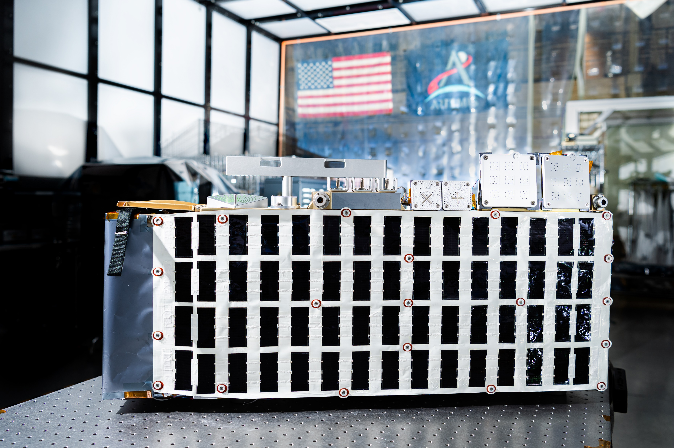
Simulating the Lunar Thermal Environment for the Surface Deployed LEMS Artemis III TVAC Test
55th International Conference on Environmental Systems
Juan Rodriguez-Ruiz, NASA GSFC
Ethan Burbridge, Vertex Aerospace
Dan Powers, NASA GSFC
ICES-2026-490
07/13/2026
Notes:
today we'll cover the thermal vacuum (TVAC) test plan and configuration developed to validate that the thermal control system can survive and operate through the lunar night.

Slide 2
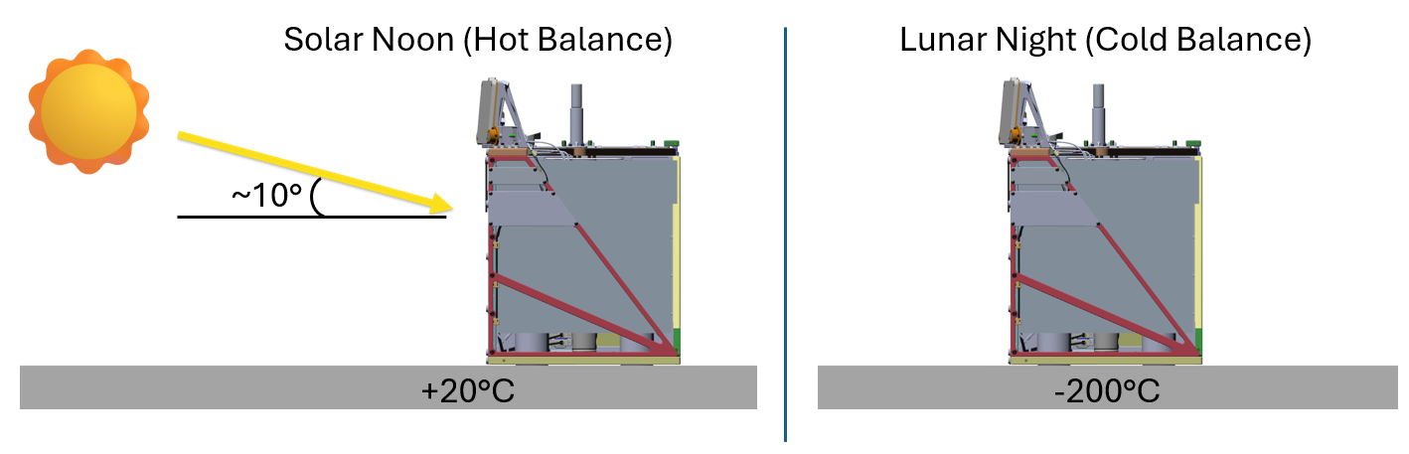
Mission Overview & The Lunar Night Challenge
LEMS: Autonomous seismic suite, surface-deployed by Artemis crew for a 2-year continuous mission.
Location: Lunar south pole (-83.6°to -88.2°latitude).
Extreme Thermal Environment: Surface temps range from +20°C (day) to -200°C (night).
Thermal and Power Constraint: Nighttime lasts ~15 Earth days. Must survive on battery power alone.
The seismometers operate buried in the regolith
Notes:
LEMS is an autonomous seismometer package. Because it goes to the lunar south pole, it faces a brutal thermal environment. The defining challenge of this mission is surviving a 15-day lunar night with no sun, plummeting to minus 200 degrees Celsius. The fact that it must operate continuously for two years—especially during the lunar night—is the driving force behind all the engineering challenges we will discuss today. With no way to generate power at night, LEMS must ride out ~15 Earth days on battery. The 2.5 W heat budget during the night is the driving constraint — every fraction of a watt of heat leak matters for survival.

Slide 3
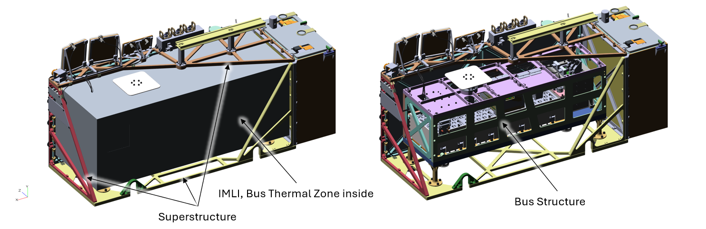
LEMS Thermal Architecture
Strict Energy Budget: The 1400 W-h battery accommodates an average 2.5 W power consumption between avionics, comms, seismometers, and heaters during the lunar night.
Novel Hibernation Mode: High-level functions are off >98% of the mission, while science runs continuously.
  C&DH processor wakes up for 20 mins daily for health checks; has a monthly 3-hr communications event.
Thermal Isolation: Bus structure (internal electronics & battery) is kept > -30C and is thermally isolated from the external superstructure (solar arrays, antennas) which is exposed to the extreme thermal environment.
Notes:
We have no nuclear heaters and no sun during the night, meaning we rely entirely on battery power. Generating heat drains the battery, so we are restricted to a tiny 2.5W heat budget. To survive this, the internal electronics bus is heavily isolated from the external structure using advanced IMLI and enters a deep Hibernation Mode. Because there is no solar power during the 15-day night, power conservation is everything. The system essentially sleeps to save energy, only waking up briefly to check health and occasionally phone home via the Deep Space Network.

Slide 4
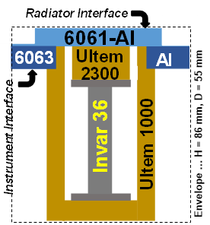
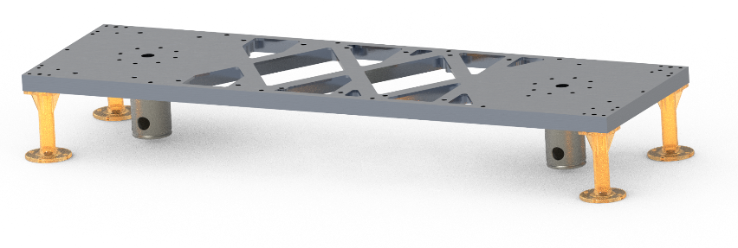
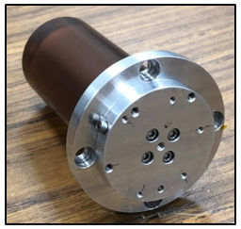
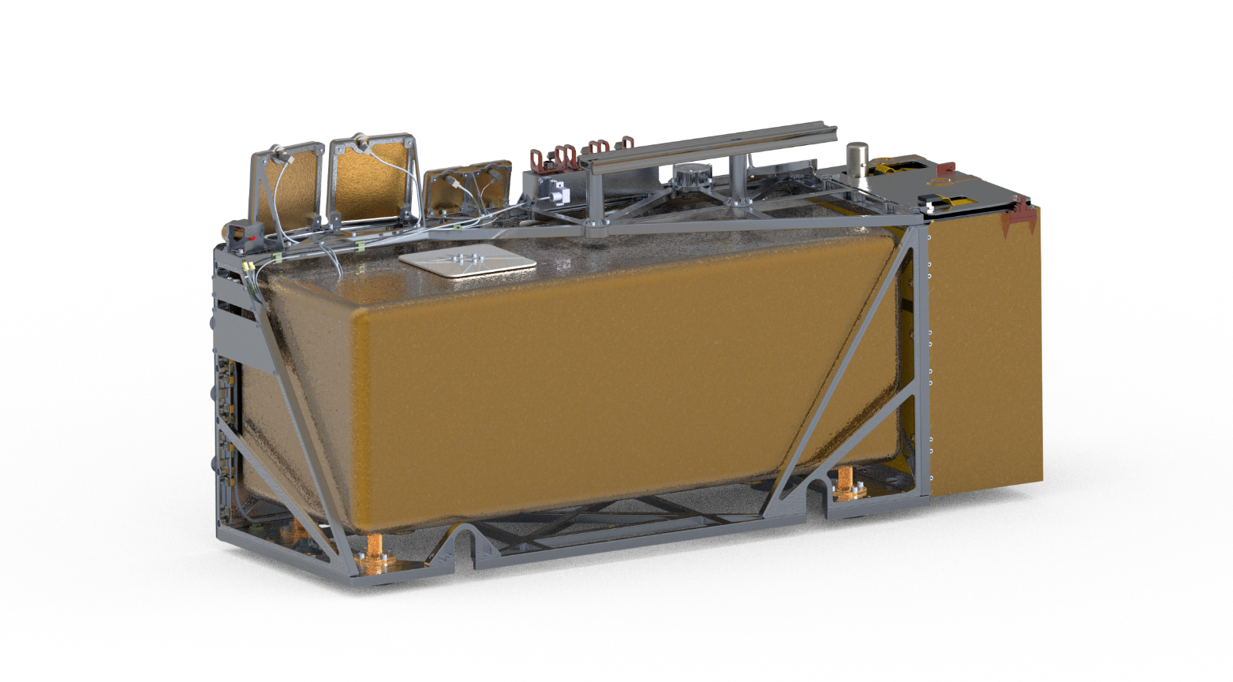
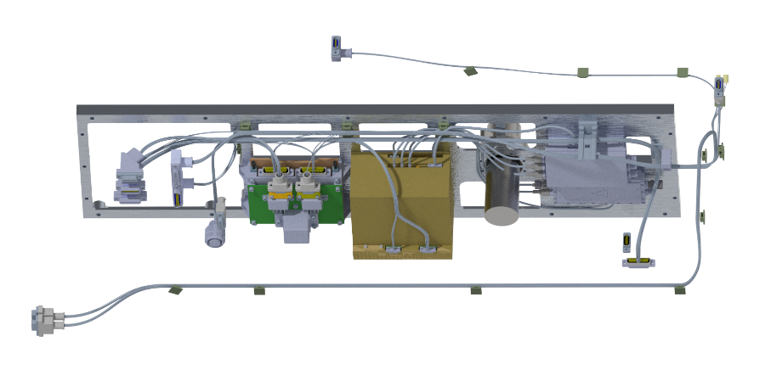
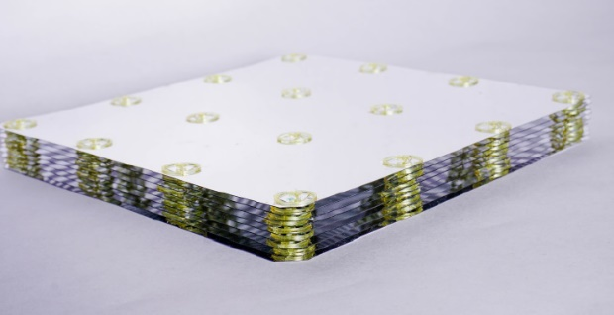
Surviving the Lunar Night
Minimizing heat leaks to the environment
Heat switch to de-couple from the radiator
G_on = 3.0 W/K
G_off = 0.002 W/K
Minimizing conductive and radiative coupling to the lunar surface
LL Mechanical Post qty. 2
(Ti6Al4V / Gold plated)
LL Thermal Leg qty. 4
(Ultem 1000 / VDA tape)
SAPP
IMLI
Minimizing wire heat leaks with use of low-k wire materials, Ultem clickbond standoffs, and SLI/MLI
Wrapped around the bus structure to minimize radiative heat leaks (e* < 0.003)
Notes:
With no RTGs (nuclear) and no sun, we are strictly on battery power. Generating heat costs precious battery life. We are restricted to just 2.5 Watts of heating, requiring an incredibly efficient insulation scheme.
These four key thermal design/technology areas help LEMS survive the lunar night
This isolation gives an extremely low heat-transfer-to-mass ratio — which is good for survival, but as we'll see, creates a challenge for testing. Note that the seismometers operate buried in the regolith.

Slide 5
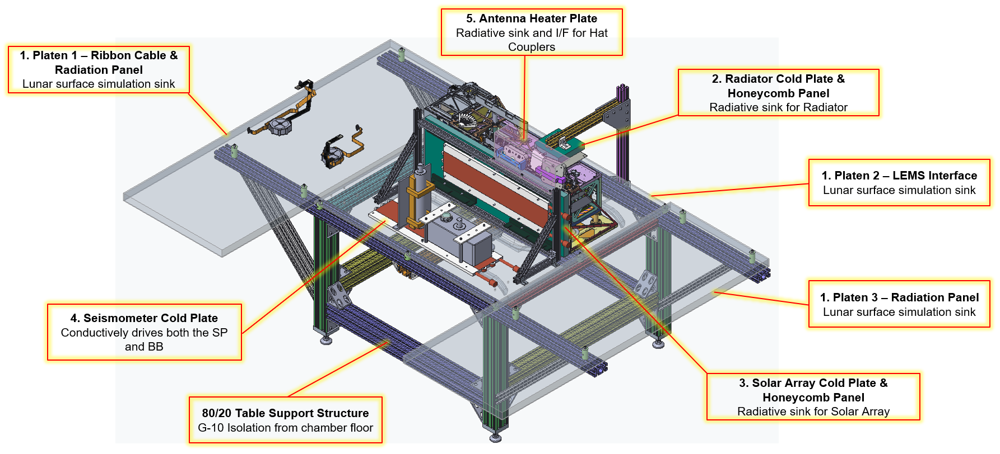
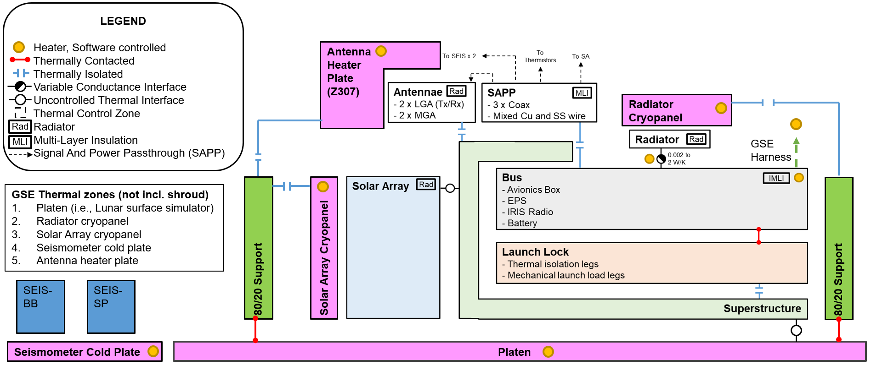
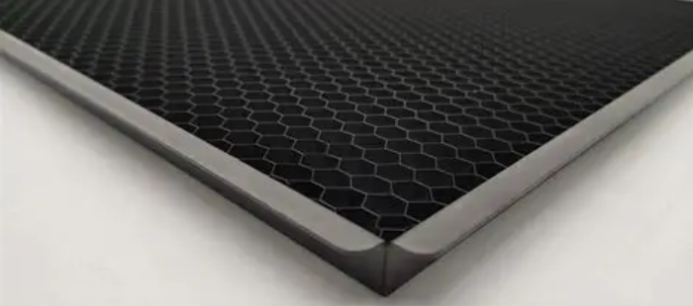
TVAC Test Configuration
System-level thermal vacuum test at NASA Goddard Space Flight Center to qualify for spaceflight
Lunar environment simulated with high emissivity panels cooled by GN2/LN2 flow, plus heaters for warm cases
Radiator/solar-array cryopanels use Z307 black-coated open-cell honeycomb (ε ≈ 0.98)
Notes:
Walk through the physical test setup. The goal is to recreate both the hot lunar day and cold lunar night radiative environments inside the chamber. Cooled high-emissivity honeycomb panels act as cold sinks, while heaters recreate warm conditions. Point to the CAD and photo to orient the audience, and use the block diagram to show how the simulated environment interfaces with each flight component.

Slide 6
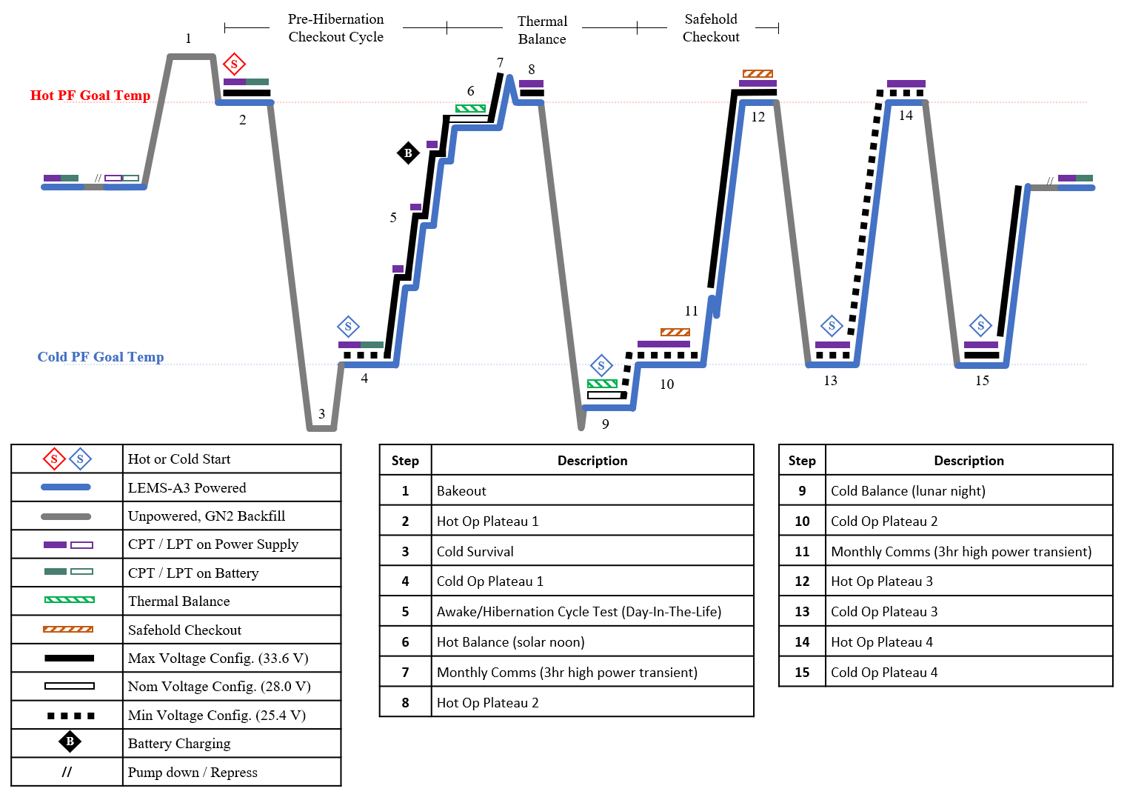
Test Profile and Objectives
Simulate flight-like hot balance and cold balance cases
  Cold balance is critical: verify survival for ≥15 Earth days of lunar night
Demonstrate hardware thermal capacitance absorbs the 3-hr comms power spike
Achieve protoflight temperatures for four cycles
Demonstrate bus survives cold non-op temperatures expected during HLS transit
Notes:
Summarize what the test must accomplish. Beyond the hot and cold balances, the profile verifies that thermal mass can absorb the transient heat spike during the 3-hour monthly communications session without overheating. Each plateau exercises components toward protoflight limits. The cold balance is the make-or-break objective for lunar-night survival.

Slide 7
GN2 Backfill to Accelerate Cooldowns
The Problem: Slow Cooldown in High Vacuum
  Bus is intentionally well-isolated
    Heat leak only ~1.5 W
  Very low heat-transfer-to-mass ratio
    Extremely slow cooling
  Cooling from +50°C to -30°C takes over a week in high vacuum
The Solution: Partial Cold GN2 Backfill
  Partially backfill chamber with cold GN2 to "short" the IMLI and add gas conduction
  Flight hardware powered off during transition to accelerate cooling and avoid corona/arcing risk
The Proof: Checkout Test with GSE and LEMS Test Unit
  Measured both heater power to hold temp and cooldown rate at various pressures
  Diminishing returns above 13 Pa (0.1 torr)
  Reduces cooldown from 1 week to 1 day
Notes:
Bus GSE heater over-drives transitions and catches hardware at low temp to shorten the balance asymptote
Here's the central testing challenge. The same isolation that lets LEMS survive the night makes it painfully slow to cool in vacuum — over a week for a single hot-to-cold transition. That's too expensive and slow given limited chamber time. This motivates the innovative technique on the next slide.
By introducing a controlled amount of cold nitrogen gas, we create conduction paths that bypass the insulation, dramatically speeding cooling. We power off the flight hardware to both accelerate cooling and avoid electrical arcing when passing through the corona pressure region. Protective heaters prevent overshooting cold limits. Then LEMS powers back up and PI-controlled heaters bring it to the balance setpoint. Bottom line: a week-long transition collapses to about a day.

Slide 8
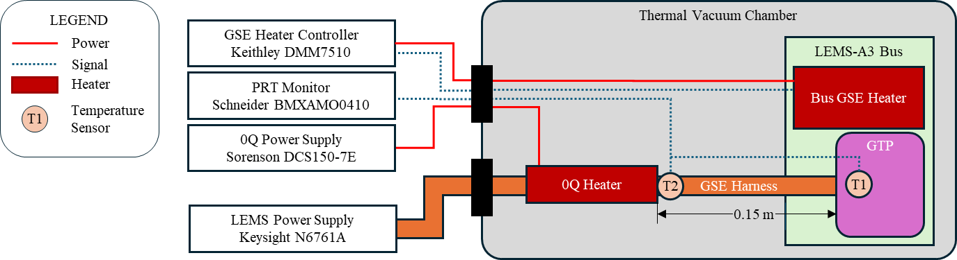
GSE for Thermal Stability Measurement
GSE designed to minimize heat losses and measure heater power for accurate nighttime energy prediction
Bus GSE heater:
  PI-controlled by Lakeshore 336 reading a calibrated DT-670 Silicon diode sensor to reduce signal noise.
  Power supplied by Keysight N6761A and monitored by Keithley DMM7510 for high accuracy capabilities.
  Flight Bus Op heater turned off during cold balance (lacks PI control) to rely on Bus GSE heater for accurate power determination
Ground Test Panel (GTP) Zero-Q (0Q) heater drives net heat flow from GSE harness to zero
Notes:
Detail how heat flows are measured. Because we're extrapolating from a short test to a 15-day night, measurement accuracy is paramount. The PI-controlled GSE heater minimizes noise; the 0Q heater zeroes out parasitic conduction through the ground interface. We deliberately use the well-instrumented GSE heater instead of the flight heater during cold balance so we can precisely determine the power needed to hold temperature.

Slide 9
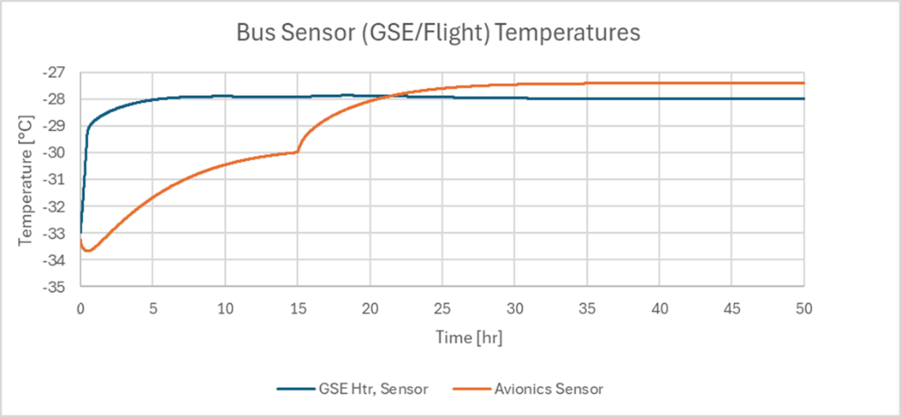
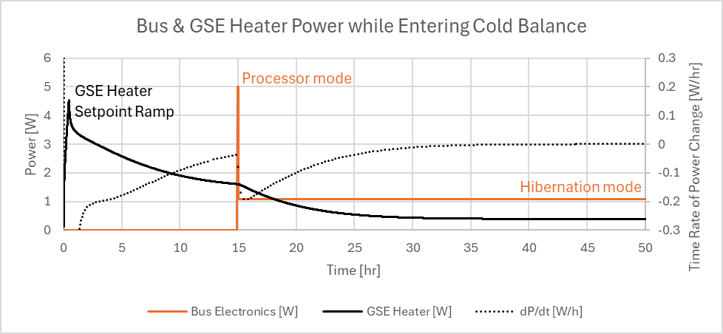
Entering Cold Thermal Balance
While LEMS is off, the Bus is cooled past the cold heater set point, then warmed with the Bus GSE heater
  Ensures bus thermal mass absorbs heat rather than releasing it as it approaches stability
Bus starts at -33°C; PI-controlled Bus GSE heater setpoint ramps to -28°C
Avionics enabled to processor awake mode for 5 min once temp sensor > -30°C, then switches to low-power hibernation mode
Notes:
Walk through how we drive the system into cold balance efficiently and accurately. The key trick: overshoot the cold setpoint, then gently warm back up with the GSE heater, so the thermal mass is soaking up heat during the measurement — this prevents the mass from bleeding stored heat and biasing the heat-loss reading. A PI controller regulates GSE heater power against the silicon diode temperature. Early iterations suffered from integral windup, which we solved with setpoint ramping at 5°C/hr and by capping the integral term. Figures 17 and 18 show the modeled power and temperature behavior; we'll also use early test time to fine-tune these gains against reality.

Slide 10
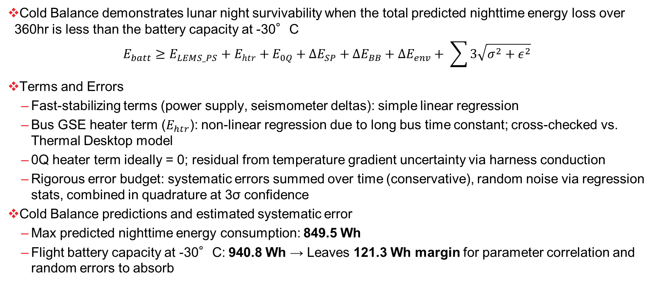
Thermal Balance Stability Criteria Methodology
Cold Balance demonstrates lunar night survivability when the total predicted nighttime energy loss over 360hr is less than the battery capacity at -30°C
  $$E_{batt}≥E_{LEMS_PS}+E_{htr}+E_{0Q}+{ΔE}_{SP}+{ΔE}_{BB}+{ΔE}_{env}+ \sum{3\sqrt{σ^{2}+ε^{2}}}$$
Terms and Errors
  Fast-stabilizing terms (power supply, seismometer deltas): simple linear regression
  Bus GSE heater term ($E_{htr}$): non-linear regression due to long bus time constant; cross-checked vs. Thermal Desktop model
  0Q heater term ideally = 0; residual from temperature gradient uncertainty via harness conduction
  Rigorous error budget: systematic errors summed over time (conservative), random noise via regression stats, combined in quadrature at 3σ confidence
Cold Balance predictions and estimated systematic error
  Max predicted nighttime energy consumption: 849.5 Wh
  Flight battery capacity at -30°C: 940.8 Wh → Leaves 121.3 Wh margin for parameter correlation and random errors to absorb
Notes:
This slide is the analytical heart of the talk. Equation (1) states our criterion plainly: add up every source of nighttime energy loss — the LEMS power supply, the GSE heater, the 0Q heater, the two seismometer flight-vs-RRU corrections, and the TVAC-to-flight environment delta — and require that the total stay below the battery's capacity at –30°C. Because we only have 48 hours of chamber time but the night lasts over 360 hours, we measure power for each term and extrapolate to energy. Terms that stabilize quickly use linear regression; the bus GSE heater term needs a non-linear fit because of the bus's long thermal time constant, and we validate it against our Thermal Desktop model. Every term carries an error budget — systematic errors summed conservatively, random noise propagated statistically, combined in quadrature — so the final prediction carries at least three-sigma confidence.

Slide 11
Conclusions
Presented the TVAC test profile and configuration to qualify LEMS for spaceflight
Test setup simulates both a hot solar noon case and a cold lunar night case
  Cold lunar night case is critical - verifies LEMS can survive the lunar night for at least 15 Earth days
Demonstrated a partial cold GN2 backfill technique to accelerate hot-to-cold transitions and enable achievement of cold balance
  Technique expected to reduce cooldown transitions from 1 week to 1 day
Developed a thermal stability methodology and criteria for cold thermal balance
  LEMS validated to survive & operate in the lunar night when extrapolated energy (systematic + random) stays below battery capacity of 940.8 Wh at -30°C
  Approach expected to retain adequate margin for lunar night survival

Slide 12
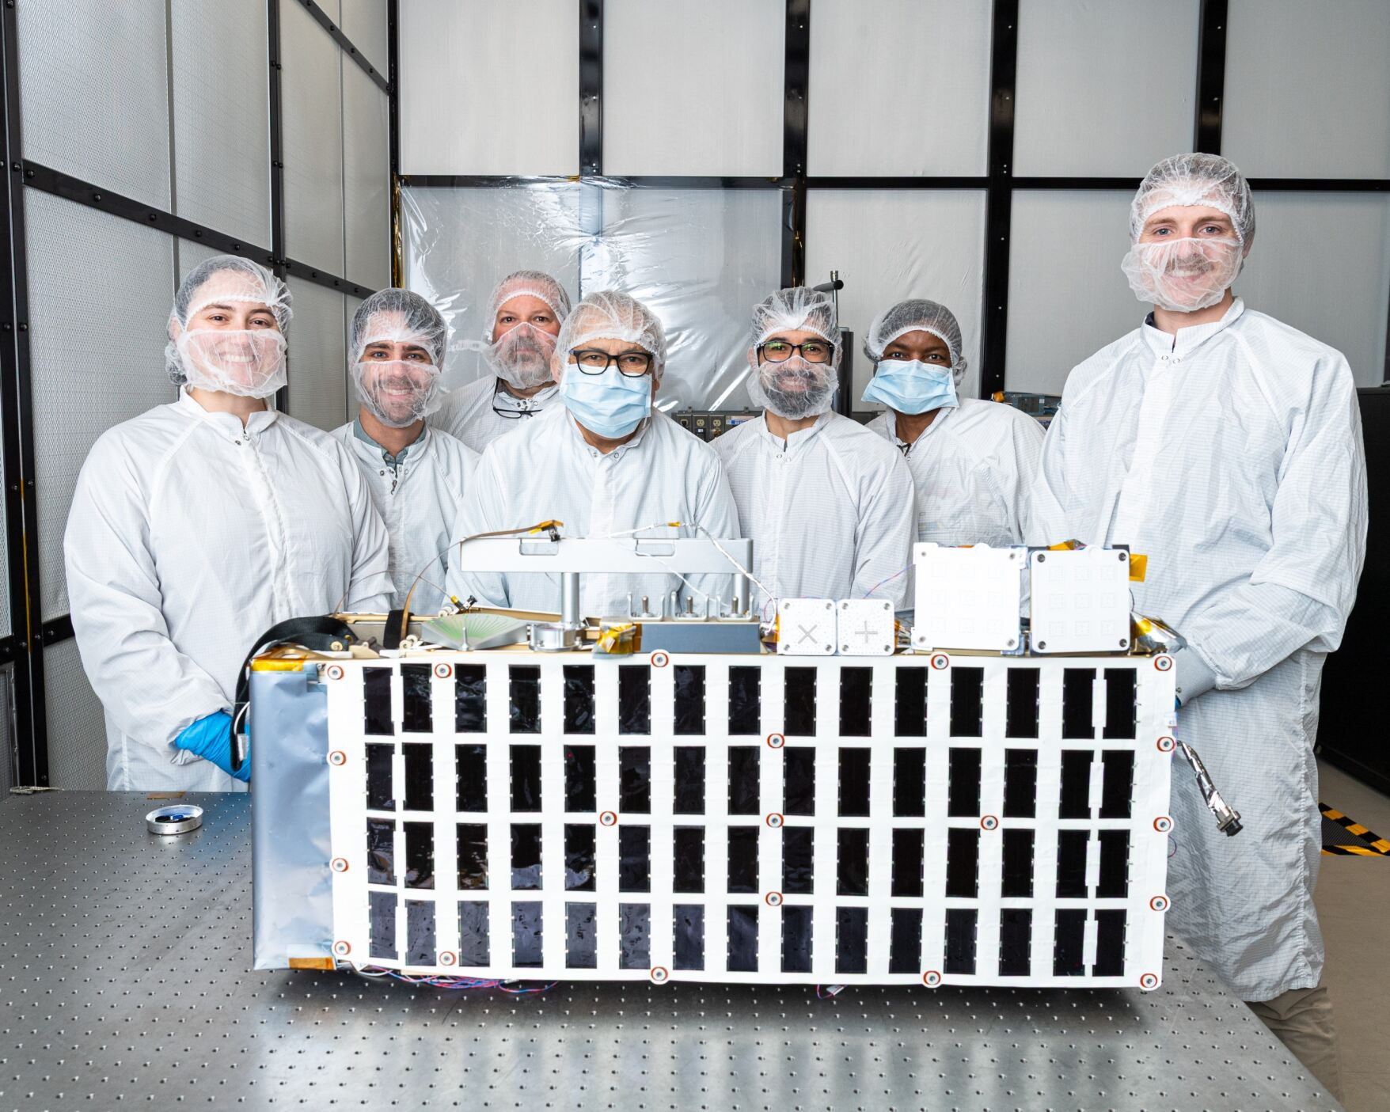
Questions?

Slide 14
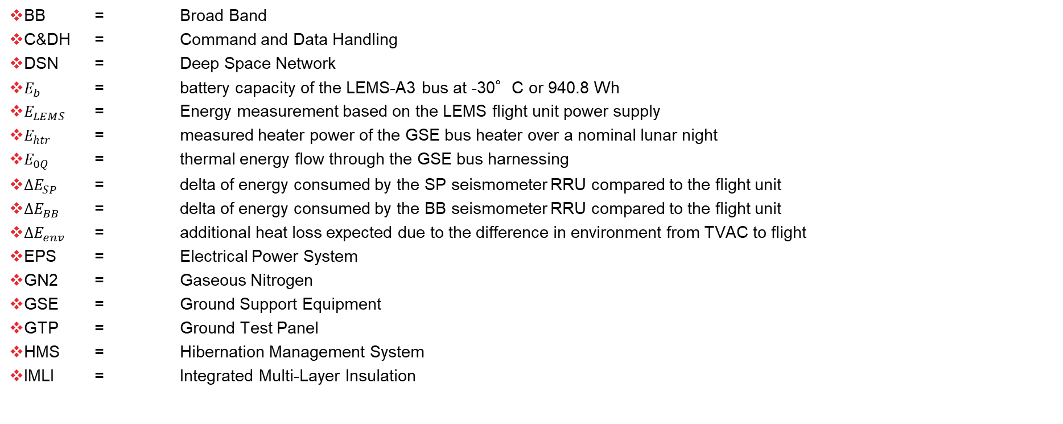
Acronyms and Nomenclature
BB = Broad Band
C&DH = Command and Data Handling
DSN = Deep Space Network
$E_{b}$ = battery capacity of the LEMS-A3 bus at -30°C or 940.8 Wh
$E_{LEMS}$ = Energy measurement based on the LEMS flight unit power supply
$E_{htr}$ = measured heater power of the GSE bus heater over a nominal lunar night
$E_{0Q}$ = thermal energy flow through the GSE bus harnessing
${ΔE}_{SP}$ = delta of energy consumed by the SP seismometer RRU compared to the flight unit
$ΔE_{BB}$ = delta of energy consumed by the BB seismometer RRU compared to the flight unit
${ΔE}_{env}$ = additional heat loss expected due to the difference in environment from TVAC to flight
EPS = Electrical Power System
GN2 = Gaseous Nitrogen
GSE = Ground Support Equipment
GTP = Ground Test Panel
HMS = Hibernation Management System
IMLI = Integrated Multi-Layer Insulation

Slide 15
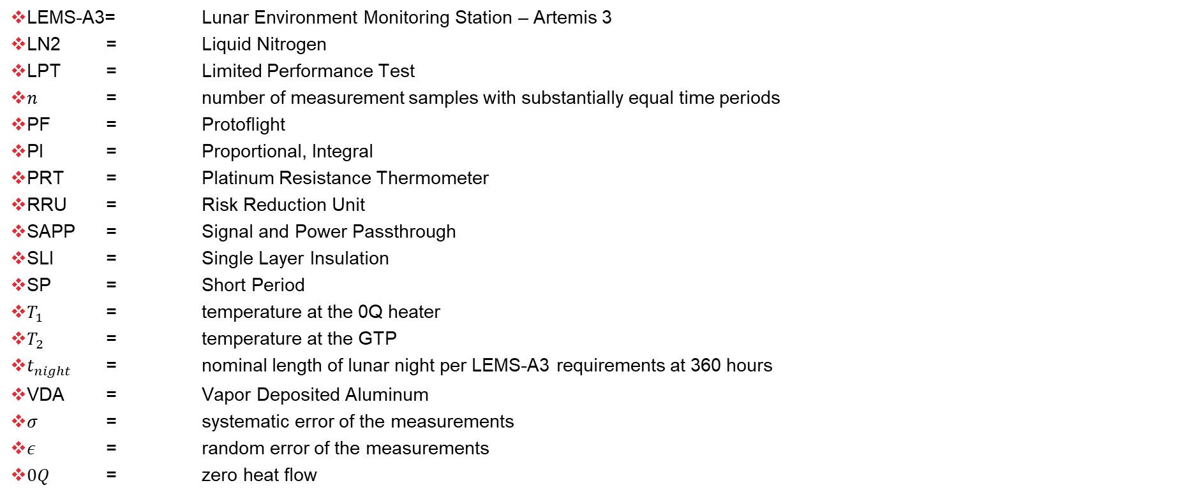
Acronyms and Nomenclature
LEMS-A3= Lunar Environment Monitoring Station – Artemis 3
LN2 = Liquid Nitrogen
LPT = Limited Performance Test
$n$ = number of measurement samples with substantially equal time periods
PF = Protoflight
PI = Proportional, Integral
PRT = Platinum Resistance Thermometer
RRU = Risk Reduction Unit
SAPP = Signal and Power Passthrough
SLI = Single Layer Insulation
SP = Short Period
$T_{1}$ = temperature at the 0Q heater
$T_{2}$ = temperature at the GTP
$t_{night}$ = nominal length of lunar night per LEMS-A3 requirements at 360 hours
VDA = Vapor Deposited Aluminum
$σ$ = systematic error of the measurements
$ε$ = random error of the measurements
$0Q$ = zero heat flow

Slide 16
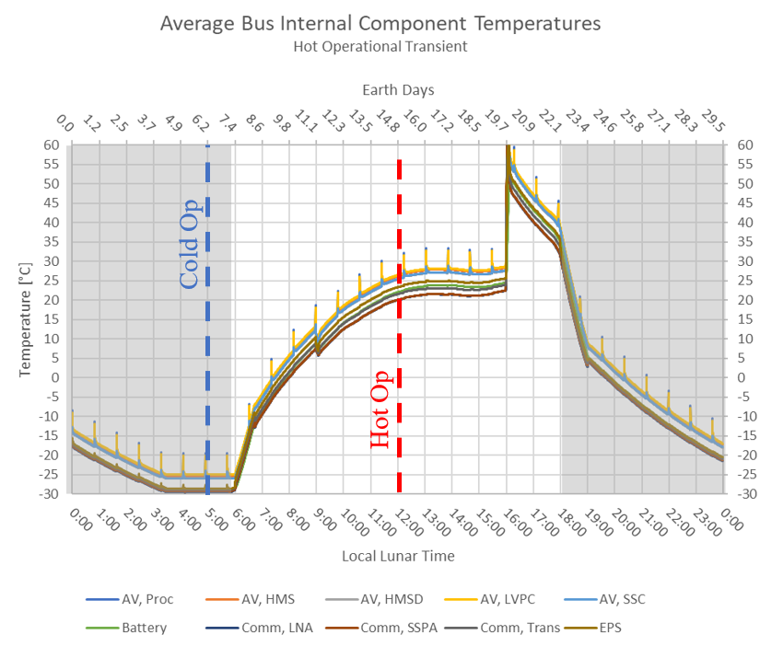
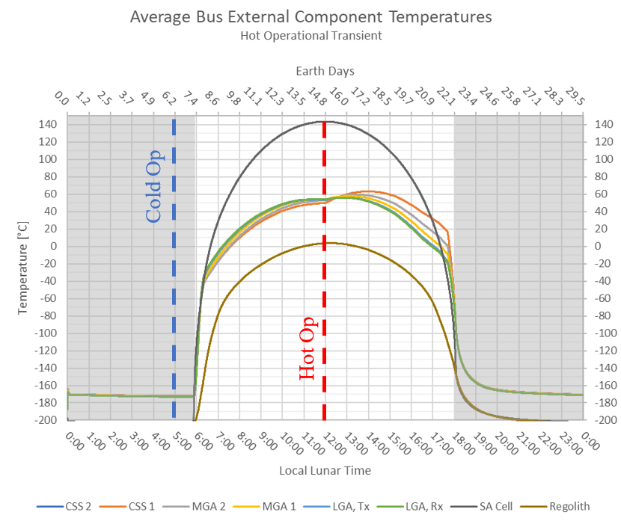
Hot and Cold Cases

