Slide 1
Analog Simulation Training and Research Outpost Utilizing Self-sustaining Architecture: A Testbed for Moon and Mars Technology at Purdue University
55th International Conference on Environmental Systems
ICES-2026-251
12–16 July 2026
Rio Grande, Puerto Rico
Purdue University: John M. Peters, Tayla C. Koenig, Ethan Williamson, Vijay Muthukumar, Adriana K. Sanchez, Chelsea Garcia, Quincy Bourell, Alexis Greenfield, Leesa Takara, Jason White, Keegan Breese, Melissa Cook, Swastik Patel, Sam Waymire, Shruti Subramaniyan, Henry Ewald, Myles Bryan, Brayden Quale, Heer Mehta, D. Marshall Porterfield, Robert M. Stwalley III, Dawn Whitaker, and Richard Barker
NASA: Luke Roberson
Artificial Intelligence (AI) Usage Disclosure This document was created with assistance from OpenAI’s ChatGPT for basic grammar and editorial assistance. The content has been reviewed and edited by John M. Peters. More information on the extent and nature of AI usage is included in the Methods or Acknowledgements sections of the document.

Slide 2
A proposed Earth-based analog habitat is intended to test future Moon base and Mars habitation technologies
The Analog Simulation Training and Research Outpost Utilizing Self-sustaining Architecture (ASTRO-USA) is a proposed Purdue-led Moon and Mars analog habitat concept project intended to test sustainable habitation technologies on Earth before future use in long-duration surface missions.
Development Phase | Purpose
Secondary Mini-Hab | Near-term subsystem testing for food production, sensors, controls, and biological water-processing research
Primary Habitat | Long-term high-fidelity analog target for closed-loop systems, controlled human factors, and Moon/Mars habitat design
ASTRO-USA may provide an Earth-based testbed for proving technologies needed for future Moon base and Mars habitat operations.

Slide 3
ASTRO-USA is proposed to address the need for an integrated closed-loop Moon and Mars analog habitat
Need | ASTRO-USA Response
Current analogs rarely integrate all major life-support systems | ASTRO-USA will combine waste, water, air, food, power, and human factors research
Closed-loop systems must be tested before deployment | The phased Secondary Mini-Hab and Primary Habitat will allow technologies to mature before full integration
The Moon base and future Mars habitats require sustainable long-term habitation systems. These technologies must be tested on Earth before future deployment.
ASTRO-USA is being designed as an analog habitat testbed to bridge the gap between current analog limitations and the integrated closed-loop systems needed for sustainable long-term Moon and Mars habitation.

Slide 4
Analog fidelity criteria were evaluated using enabling systems, habitat design, and human factors
Fidelity Category | High | Medium | Low
Enabling Systems | Supports TRL 6+ Technologies Food Production Closed-Loop Life Support Systems Pressurization | Supports TRL 5 Technologies Food Production | Supports TRL 4 and below Technologies
Habitat Design | Constructed using space-grade materials Structural design and layout is realistic for extraterrestrial habitation | Meets one of the two high-fidelity prerequisites | Meets none of the high-fidelity prerequisites
Human Factors | Full control of environmental conditions | Partial control of environmental conditions | No control of environmental conditions

Slide 5
No reviewed analog fully combines closed-loop systems, realistic habitat design, and controlled human factors
Category Analog | Enabling Systems | Habitat Design | Human Factors
CHAPEA | Low | Medium | High
HERA | Low | Medium | Medium
Aquarius | Low | Medium | Medium
NEK | Low | Medium | Medium
HI-SEAS | Low | Medium | High
ILMAH | Medium | Medium | Medium
Biosphere 2* | Medium | Low | Medium
SAM† | High | Medium | Medium
*Biosphere 2’s enabling system capability was high-fidelity in concept but medium in demonstrated operation because closure was not maintained. Its design flaws and failures bring the Habitat Design fidelity to low
† SAM is high in enabling system capability but remains limited by incomplete closure of waste, power, and air.

Slide 6
Current analog gaps define ASTRO-USA’s design targets
Current Analog Gaps | What This Means | ASTRO-USA Design Response
Non-flight-ready habitat structures | Many analogs use fixed buildings or layouts that do not reflect future Moon base or Mars habitat architecture. | Develop a modular habitat concept with off-world relevant design targets.
Incomplete closed-loop systems | Waste, water, food, air, and power systems are rarely integrated into one sustained habitat loop. | Connect waste, water, food, air, power, and controls into one phased testbed.
Limited food-production integration | Food production is often separate from life support and waste recovery. | Tie hydroponics and Mycoponics™ into future nutrient and waste recovery research.
Limited environmental and operational control | Many analogs simulate isolation but do not fully control habitat conditions or mission operations. | Support controlled human factors testing, mission timelines, EVA procedures, and fault response.
SAM was the strongest analog identified, but it still lacks a flight-ready structure and full closure of waste, power, and air constraints. ASTRO-USA is intended to address these gaps through phased Secondary Mini-Hab and Primary Habitat development.

Slide 7
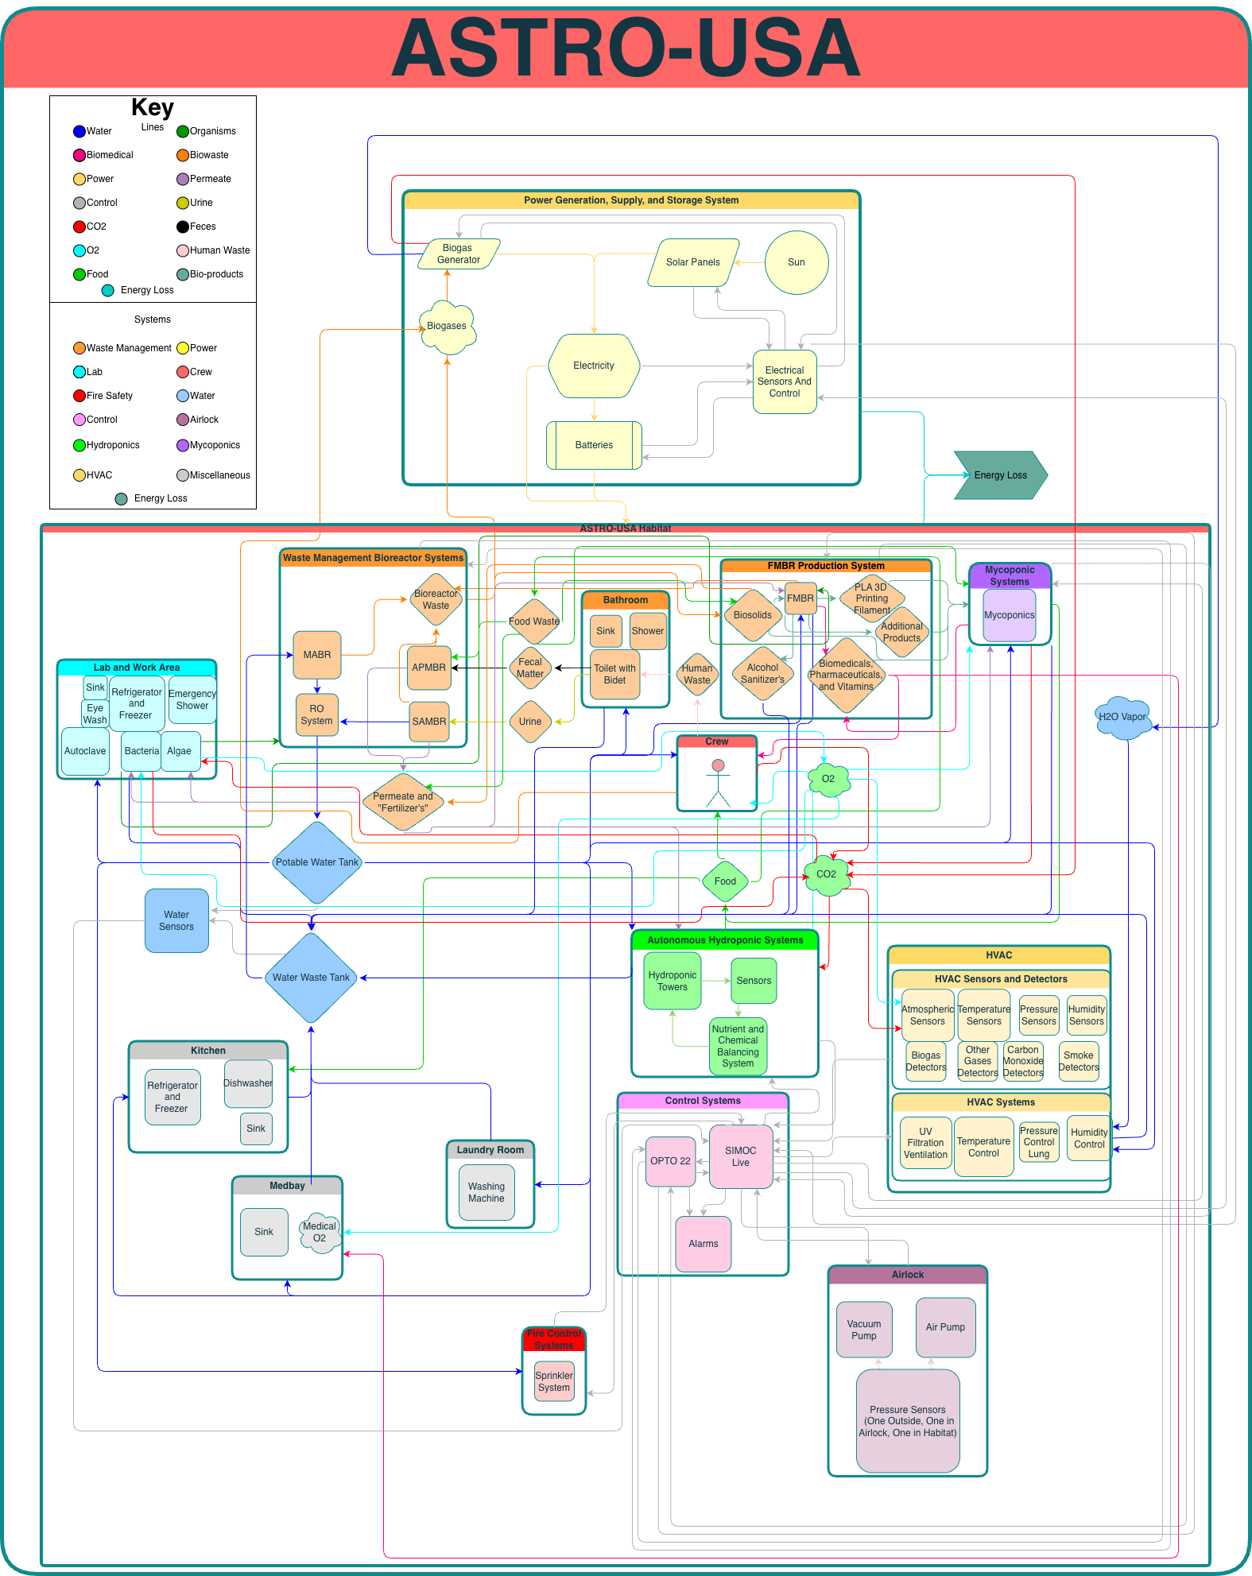
ASTRO-USA is designed to integrate closed-loop habitat systems
This flowchart shows the full ASTRO-USA concept as one integrated habitat system rather than separate standalone subsystems.
Connects waste, water, food, air, power, crew systems, and controls.
Routes human waste and graywater through bioreactors and reverse osmosis.
Produces potable water, fertilizer, biogas, and food-production inputs.
Uses Scalable, Interactive Model of an Off-World Community (SIMOC) Live and Opto 22 for monitoring, automation, and fault response.

Slide 8
Solar and biogas power support habitat energy needs

Slide 9
Waste, water, food, air, and control loops connect the full habitat system

Slide 10
The Secondary Mini-Hab provides near-term subsystem testing while the primary habitat is the high-fidelity target
Category | Secondary Mini-Hab | Primary Habitat
Purpose | Near-term prototype for phased system testing | Long-term high-fidelity Moon/Mars analog
Enabling Systems Fidelity | Medium | High
Habitat Design Fidelity | Low | High
Human Factors Fidelity | Medium | High
Focus | Food production, sensors, solar power, early human factors | Closed-loop waste, water, air, food, power, and crew systems
Mission Scale | Crew of 6 for two weeks | Sustained long-duration analog missions
Role in ASTRO-USA | Tests systems before full integration | Final integrated habitat testbed

Slide 11
Secondary Mini-Hab starts ASTRO-USA development with food production, sensors, power, and early human factors
Category | Mini-Hab Implementation
Main Purpose | Medium-fidelity prototype for testing ASTRO-USA subsystems before full habitat integration
First Module | Food Production Module
Mission Support Goal | Support a crew of 6 for a two-week mission
Core Systems | Hydroponics, Mycoponics™, sensors, solar power, and environmental monitoring
Research Focus | Plant growth, crop selection, food production, and early human factors research
Future Integration | Waste and nutrient recovery systems will connect into the food production loop
The Mini-Hab is the lower-cost first step toward ASTRO-USA. It does not replicate the final habitat structure, but it allows food production, sensors, power, and closed-loop subsystems to be tested before they are scaled into the primary habitat.

Slide 12
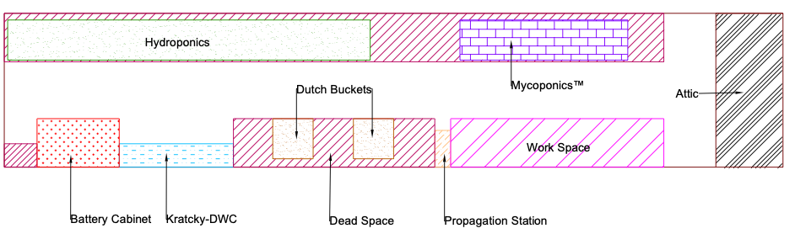
The Food Production Module organizes support systems, hydroponics, propagation, Mycoponics™, and workspaces
Hydroponics: primary crop-production area
Propagation: seedling growth and early plant development
Mycoponics™: fungal growth and biological research
Battery Cabinet: power storage and support infrastructure
This layout shows the functional organization of the Food Production Module, including hydroponics, Mycoponics™, propagation, Kratky-DWC, Dutch buckets, workspace, battery storage, and attic space.

Slide 13
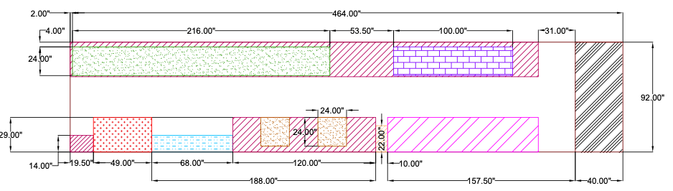
The Food Production Module layout defines the first physical Mini-Hab test space
464 in × 92 in module footprint
Hydroponics and Mycoponics™ zones
Workspace and support equipment
Battery and utility areas
The Food Production Module is the first physical Mini-Hab module. This dimensioned layout defines the usable footprint and shows how major food-production and support systems fit inside the container.

Slide 14
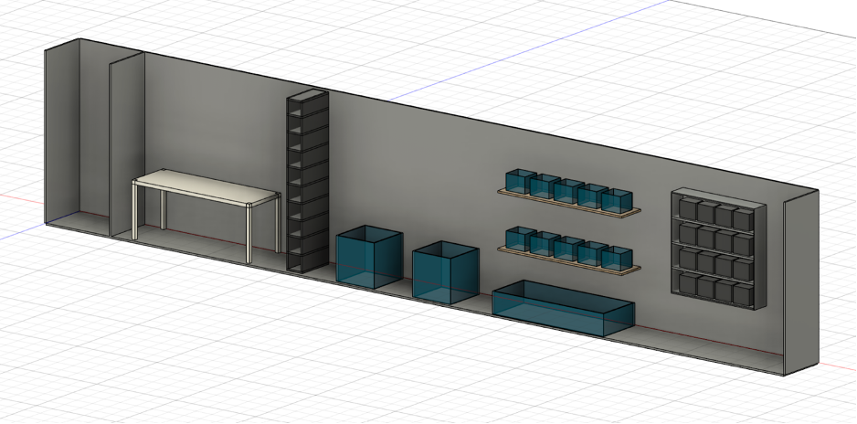
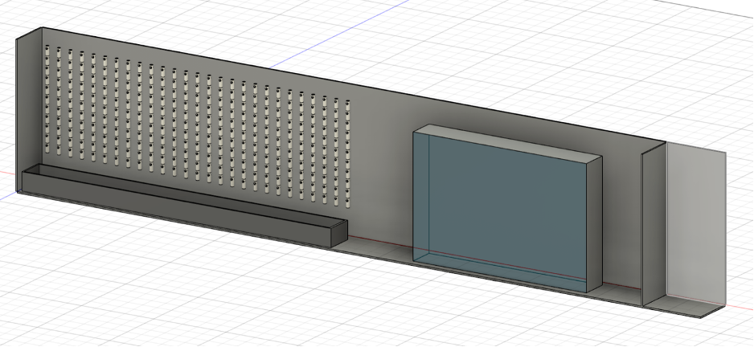
The container setup provides a practical testbed for early Mini-Hab subsystem development
Low-cost test environment
Builds early operational experience
Supports food-production research
Provides data for primary habitat design
The container setup represents the first implementation step for the Mini-Hab. Its purpose is not high-fidelity habitat structure, but practical subsystem testing for food production, sensors, power, and early closed-loop operations.

Slide 15
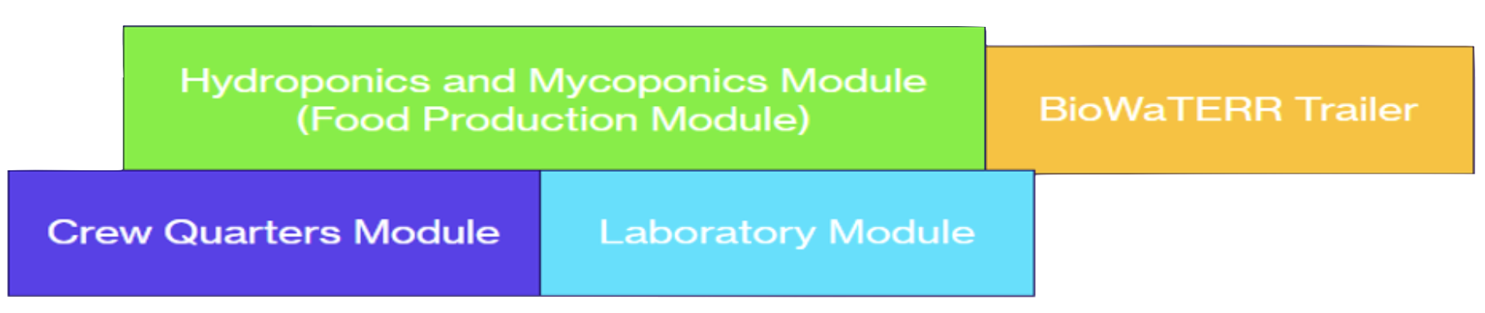
Future Mini-Hab development will expand toward laboratory, BioWaTERR, crew quarters, and missions
Food Production Module: hydroponics and Mycoponics™
Laboratory Module: bioreactor testing and BSL-2 research
BioWaTERR Trailer: potential wastewater and nutrient recovery integration
Crew Quarters Module: habitation required for first full Mini-Hab analog mission
Future Mini-Hab development will expand from the Food Production Module into a testbed with crew quarters, laboratory space, and the BioWaTERR trailer for waste, water, and nutrient-loop research.
BioWaTERR Reference: ICES-2026-290

Slide 16
The primary ASTRO-USA habitat is the long-term high-fidelity closed-loop analog target
Design Area | Primary Habitat Design Target
Enabling Systems | Integrated closed-loop waste, water, air, food, power, and crew-support systems
Habitat Design | Modular cylindrical and spherical habitat sections using off-world relevant structural materials
Human Factors | Fully controlled internal environment for lighting, atmosphere, temperature, noise, circadian studies, and mission scenarios
Controls and Monitoring | SIMOC Live and Opto 22 for real-time data, automation, alarms, and fault response
End Goal | High-fidelity Moon/Mars habitat analog for Moon base relevant technology maturation
The primary habitat is the long-term ASTRO-USA goal: a high-fidelity analog that is intended to integrate habitat design, human factors, and enabling systems into one closed-loop testbed.

Slide 17
ASTRO-USA may support Moon and Mars habitation objectives
Exploration Need | ASTRO-USA Contribution | Why It Matters
Sustainable lunar habitation | Intended to test closed-loop waste, water, food, air, and power systems | Reduces dependence on resupply for long-duration missions
Technology maturation | May provide an Earth-based testbed for integrated habitat subsystems | Allows systems to be tested before deployment to the Moon or Mars
Crew health and performance | Intended to enable controlled lighting, atmosphere, temperature, noise, and mission scenarios | Supports human factors research for future surface habitats
Modular habitat architecture | Intended to develop a scalable habitat concept with off-world relevant design targets | Supports future expansion of lunar and Martian base infrastructure
Phased development | Will use the Mini-Hab to test subsystems before primary habitat integration | Lowers risk before building the full high-fidelity analog
ASTRO-USA may support the Moon base and Mars habitat architecture by maturing sustainable habitation systems needed for long-term crewed operations on the Moon and Mars.

Slide 18
Future work moves from Mini-Hab operations to full primary habitat integration
Phase | Development Focus | Target Outcome
Year 1 | Complete Food Production Module | Hydroponics, sensors, solar power, and early environmental monitoring operations
Year 2 | Develop Laboratory Module | Begin bioreactor testing, waste processing, nutrient recovery, and Mycoponics™ integration
Year 3 | Develop Crew Quarters Module, fully integrate BioWaTERR, or a similar module, and operate full Mini-Hab | Conduct first full Mini-Hab analog mission and collect system performance data
Primary Habitat Phase 1 | Complete primary habitat structure | Build modular high-fidelity habitat shell for long-duration mission simulation
Primary Habitat Phase 2 | Integrate closed-loop systems and controls | Prepare primary ASTRO-USA for its first high-fidelity analog mission
Future work will use Mini-Hab mission data to improve closed-loop performance, human factors studies, EVA procedures, and the final primary ASTRO-USA habitat design.

Slide 19
ASTRO-USA is intended to provide a phased path toward a high-fidelity closed-loop habitat analog
Key Takeaways | Summary
Current analogs have full integrated capabilities limitations | Existing facilities provide useful research value, but none fully integrate high-fidelity habitat design, human factors, and enabling systems in one closed-loop architecture.
ASTRO-USA addresses this gap | ASTRO-USA is being designed as a modular, controlled, closed-loop habitat testbed for Moon and Mars technology development.
The Mini-Hab enables phased testing | The secondary Mini-Hab will allow food production, bioreactors, sensors, power, and crew operations to be tested before full primary habitat integration.
The primary habitat is the long-term target | The final ASTRO-USA habitat will provide a high-fidelity analog for long-duration mission research and technology maturation.
ASTRO-USA is intended to provide a phased path from near-term subsystem testing to a high-fidelity closed-loop analog habitat for future Moon and Mars missions.

Slide 20
Acknowledgements
The authors gratefully acknowledge funding support from Purdue University and the Indiana Space
Grant Consortium (INSGC), which is administered through Purdue University as part of NASA’s National Space Grant College and Fellowship Program.
The authors acknowledge the use of OpenAI’s ChatGPT for editorial assistance, including grammar, readability, and identification of minor writing issues. No NASA data was used through ChatGPT except NSA publicly available data (published papers and webpages). All technical content, analysis, interpretations, and final manuscript revisions were completed and approved by the authors.
The ASTRO-USA team would also like to acknowledge the student researchers and faculty advisors at Purdue University who have contributed to the design, development, and documentation of this project.
We would also like to thank our collaborators at NASA Kennedy Space Center and the University of Arizona for their guidance, technical input, and continued support in developing ASTRO-USA as a Moon and Mars analog habitat testbed.

