Slide 1

Predicting Operational Performance of xEMU Boot at Lunar South Pole Temperatures using Thermal Desktop®
Emma Quick, Amentum/JSC
Noah Andersen, HX5/JSC
TFAWS Interdisciplinary Paper Session
Presented By
Emma Quick
Thermal & Fluids Analysis Workshop
TFAWS 2026
August 31 – September 4, 2026
NASA Marshall Space Flight Center
Huntsville, AL
Trade names and trademarks are used in this report for identification only. Their usage does not constitute an official endorsement, either expressed or implied, by the National Aeronautics and Space Administration.

Slide 2
Agenda
Background and Objectives
Test Setup/Conditions/Instrumentation
MiniShroud Model Overview
MiniShroud Model Correlation
  Results, performance
Boot Model Overview
Boot Model Correlation
  Results, performance, RMSE
Lunar Operation
  Modeling, heat flux and temperature predictions
Conclusions

Slide 3
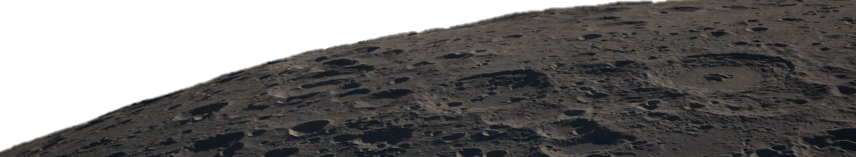
Background & Objectives
Upcoming Artemis missions will land astronauts on the moon at the south pole
  Temperatures here can be as low as ~50 K
Exploration Extravehicular Mobility Unit (xEMU) boots will need to withstand these temperatures throughout extravehicular activity (EVA)
  Comprehensive TVAC testing and thermal model correlation of the xEMU boot are essential to ensure crew safety
Test data was used to correlate the thermal model and subsequently predict lunar boot performance in permanently shadowed regions on the moon

Slide 4
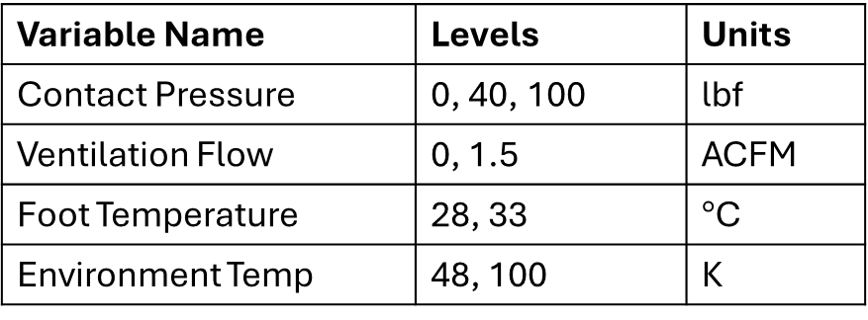
Test Setup, Instrumentation, and Conditions
CITADEL TVAC chamber at NASA JPL
Thermal manikin foot outfitted with xEMU boot
  Water lines running through the foot maintain a skin boundary temperature
  Thermocouples/RTDs on various layers of the foot+boot stack-up
    56 external and 16 internal TCs
  Ventilation flow of 12.4 SLPM (1.5 ACFM) between the sock and bladder layers
  Pressurization of boot to 4.3 psia
“MiniShroud” for environmental temperature control
  Aluminum stomp pad for boot to contact
  Six environment TC coupons
Boot mounted on actuated push-rod system to simulate IVA to EVA transition
Test Parameters:
Variable Name | Levels | Units
Contact Pressure | 0, 40, 100 | lbf
Ventilation Flow | 0, 1.5 | ACFM
Foot Temperature | 28, 33 | $°$C
Environment Temp | 48, 100 | K

Slide 5
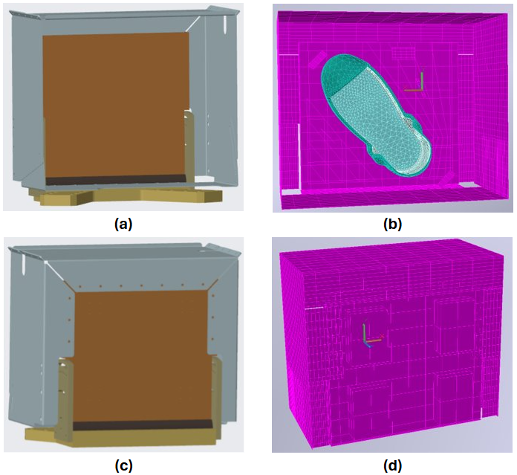
MiniShroud Model
It was necessary to build the MiniShroud model instead of using single external sink node for the boot
  In test, the MiniShroud did not provide a cold, isothermal environment
Model built from JPL CAD and includes stomp pad, top/side/bottom panels, copper bars, Teflon stomp pad coverings, and SLI curtain
External MiniShroud environment simulated with sink temperature nodes on each face
G10 spacers on bottom of MiniShroud were not explicitly modeled, but represented with a gap and low-conductance contactor
Mechanical joints (screws, panel overlaps, interfaces) were modeled with face/edge contactors
  Conduction coefficients calculated based on screw count, conductivity, and contact area
Comparison of CAD file (.stp) and Thermal Desktop (TD) geometry. (a) CAD interior, (b) TD interior, (c) back of CAD, (d) back of TD.

Slide 6
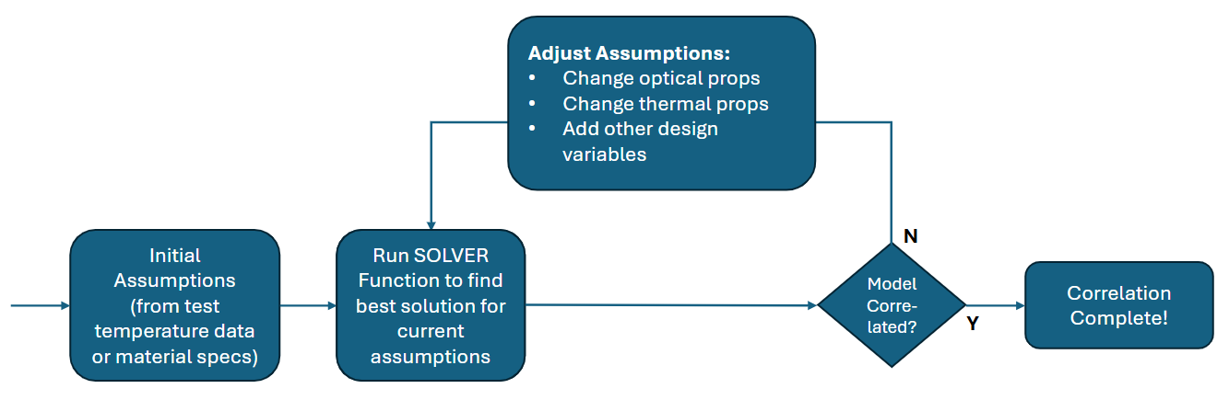
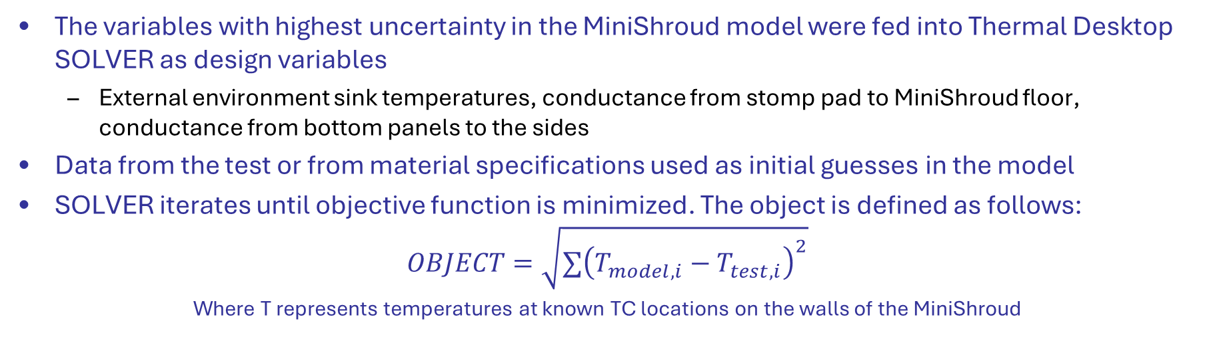
MiniShroud Model Correlation
The variables with highest uncertainty in the MiniShroud model were fed into Thermal Desktop SOLVER as design variables
  External environment sink temperatures, conductance from stomp pad to MiniShroud floor, conductance from bottom panels to the sides
Data from the test or from material specifications used as initial guesses in the model
SOLVER iterates until objective function is minimized. The object is defined as follows:
$$OBJECT=\sqrt{∑{\left(T_{model,i}−T_{test,i}\right)}^{2}}$$
Where T represents temperatures at known TC locations on the walls of the MiniShroud
Optical and thermal properties were adjusted manually between iterations
Model was correlated to 4 steady state radiation and contact test points separately since the temperature of the stomp pad affects the wall temperatures

Slide 7
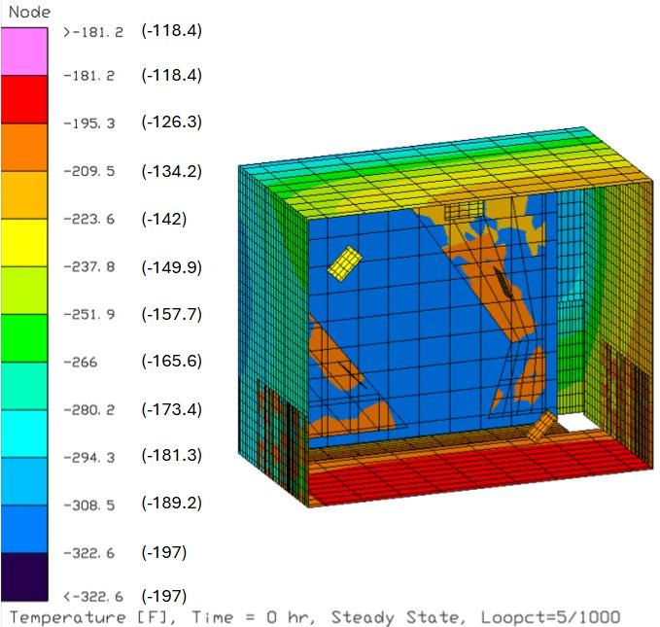
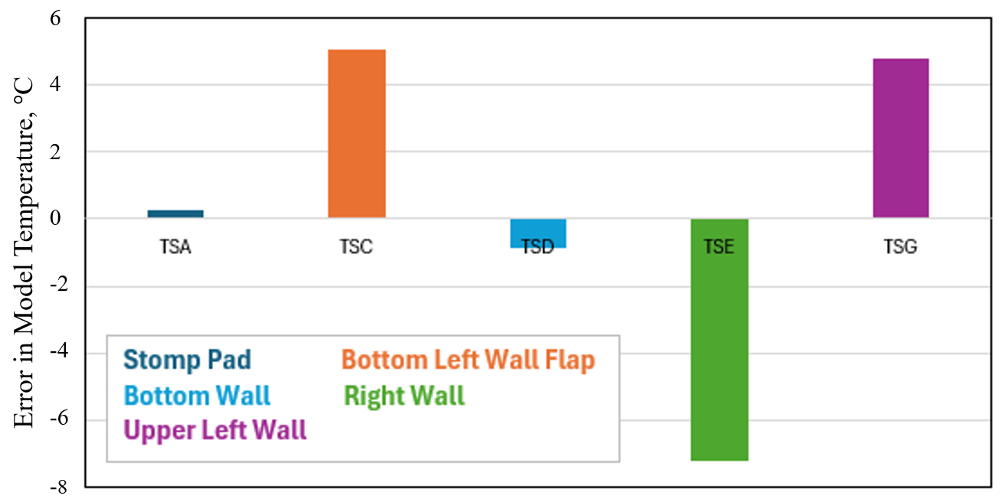
MiniShroud Model Correlation Results
Design Variable | All Radiation Test Points | Contact, 48-60 K setpoint | Contact, 100 K setpoint | Units
Tchambersink_floor | 255.8 | 272.0 | 264.2 | K
Tchambersink_left | 284.9 | 279.8 | 282.9 | K
Tchambersink_right | 255.4 | 255.4 | 255.4 | K
Tchambersink_top | 309.1 | 289.2 | 299.2 | K
Tload | 292.0 | 294.8 | 294.7 | K
StompPad2Bottom | 16.139 | 21.276 | 25.297 | W/K/m²
Flap2SideScrew | 0.100 | 0.129 | 0.100 | W/K

Slide 8
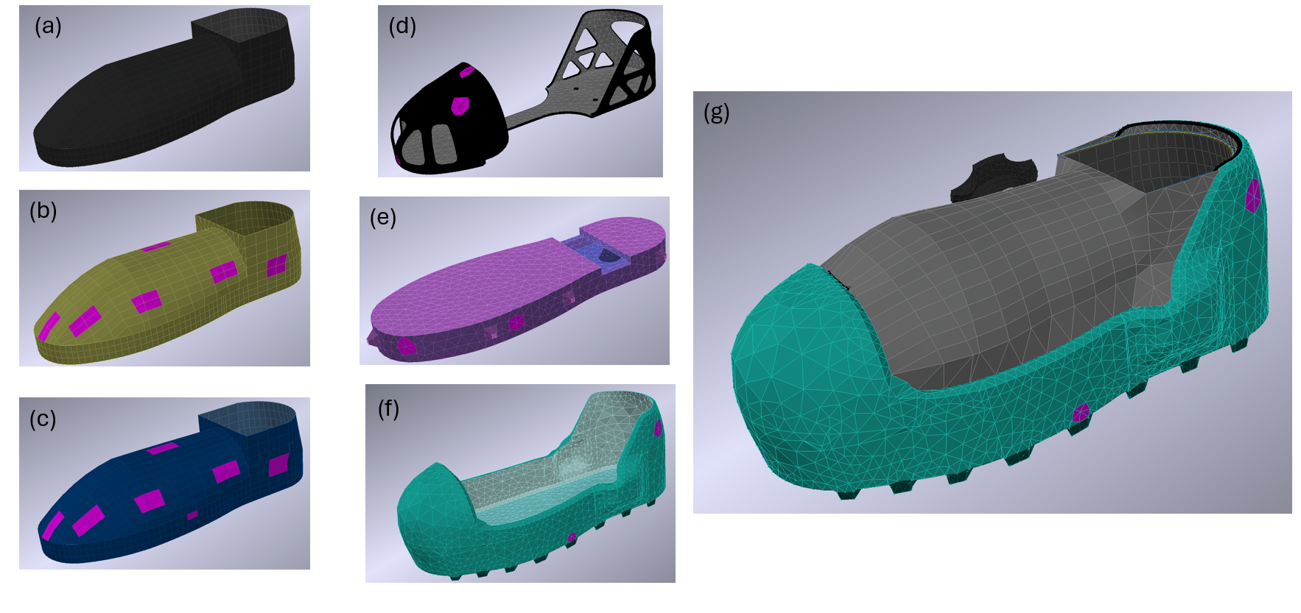
Boot Model
Built from CAD of xEMU boot model
Layer material properties such as conductivity, specific heat, and optical characteristics match actual hardware
Foot is represented with boundary nodes to match manikin’s isothermal behavior
  Full human foot model not available
Linear conductors and contacts capture internal heat transfer paths
External heat transfer paths include radiation and outsole conduction
EPG regions had adjustable effective emissivity for tuning purposes
Thermal Desktop Boot Model: (a) sock, (b) pressure bladder, (c) restraint layer, (d) frame, (e) thermal insert, (f) outsole, and (g) full assembly. Magenta regions represent TC locations.
Stomp contact could be modeled with just the tread tops (hard flat surface) or the entire outsole (granular regolith)

Slide 9
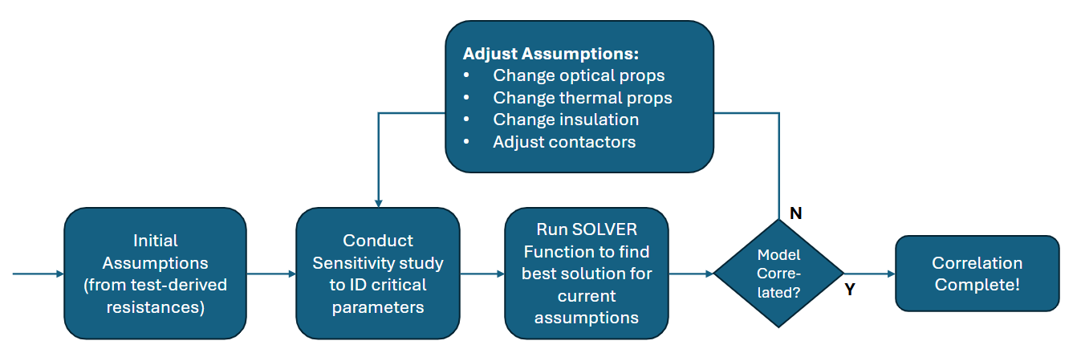
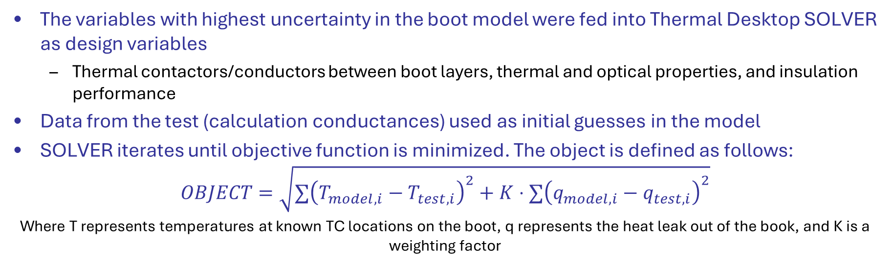
Boot Model Correlation
The variables with highest uncertainty in the boot model were fed into Thermal Desktop SOLVER as design variables
  Thermal contactors/conductors between boot layers, thermal and optical properties, and insulation performance
Data from the test (calculation conductances) used as initial guesses in the model
SOLVER iterates until objective function is minimized. The object is defined as follows:
$$OBJECT=\sqrt{∑{\left(T_{model,i}−T_{test,i}\right)}^{2}+K⋅∑{\left(q_{model,i}−q_{test,i}\right)}^{2}}$$
Where T represents temperatures at known TC locations on the boot, q represents the heat leak out of the book, and K is a weighting factor
Optical and thermal properties were adjusted manually between iterations
Model was correlated to radiation and contact test points separately

Slide 10
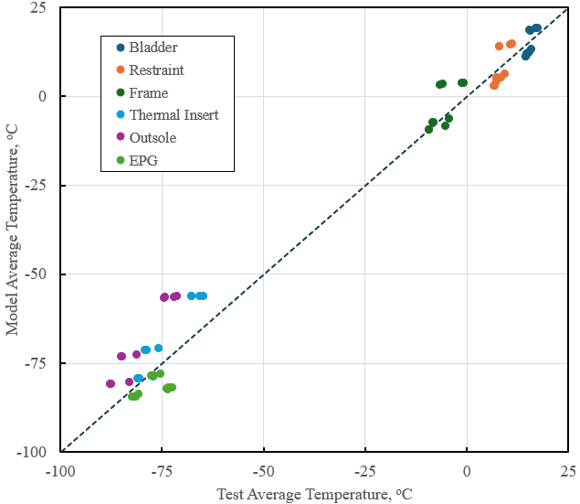
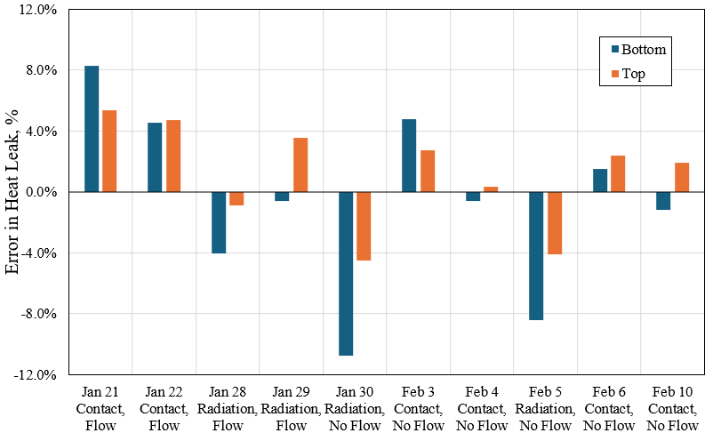
Boot Model Correlation Results
In general, the model is slightly conservative for contact cases (overpredicting heat leak) and slightly non-conservative for radiation-only test points.
Above line means model is warmer; inner layers are more well correlated

Slide 11
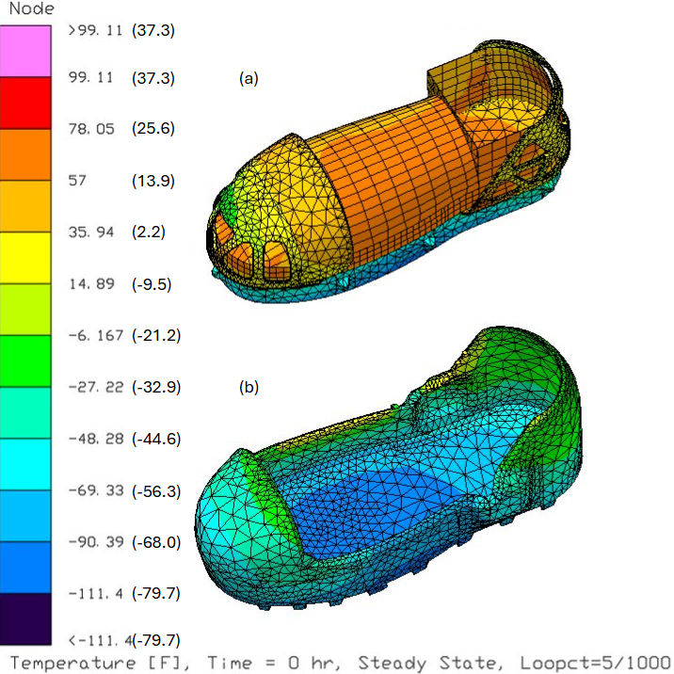
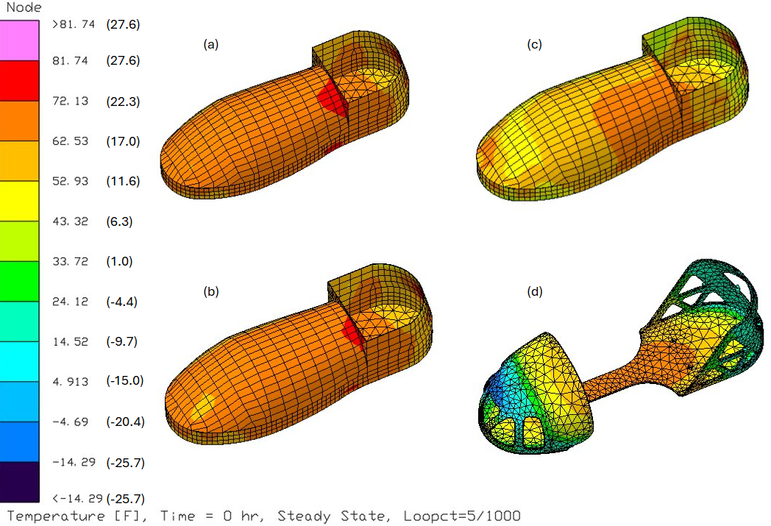
Boot Model Thermal Performance
Radiation case temperature gradients throughout individual layers of the boot. (a) sock, (b) pressure bladder, (c) restraint, (d) frame. Temperature in Celsius are provided in parentheses.
Radiation case temperature gradients between layers of the boot. (a) restraint, frame, and thermal insert; (b) outsole. Temperatures in Celsius are provided in parentheses.

Slide 12
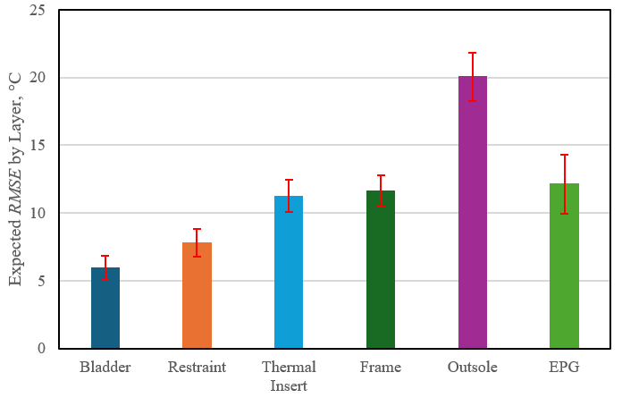
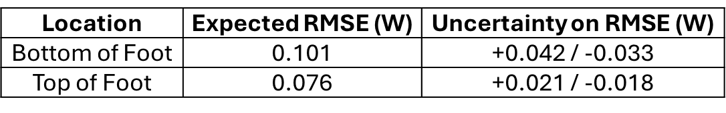
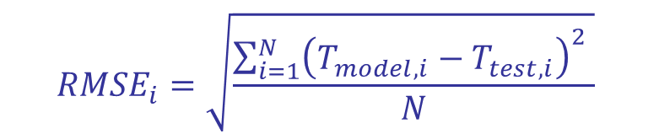
Boot Model Predictions (RMSE)
$$RMSE_{i}=\sqrt{\frac{\sum_{i=1}^{N}{{\left(T_{model,i}−T_{test,i}\right)}^{2} }}{N}}$$
Sensors closest to the foot exhibit the lowest error, while sensors near the outsole and EPG have higher variability due to large thermal gradients and positional uncertainty.
Location | Expected $\text{RMSE}$ (W) | Uncertainty on $\text{RMSE}$ (W)
Bottom of Foot | 0.101 | +0.042 / -0.033
Top of Foot | 0.076 | +0.021 / -0.018
Heat leak predictions were highly accurate
(low RMSE)

Slide 13
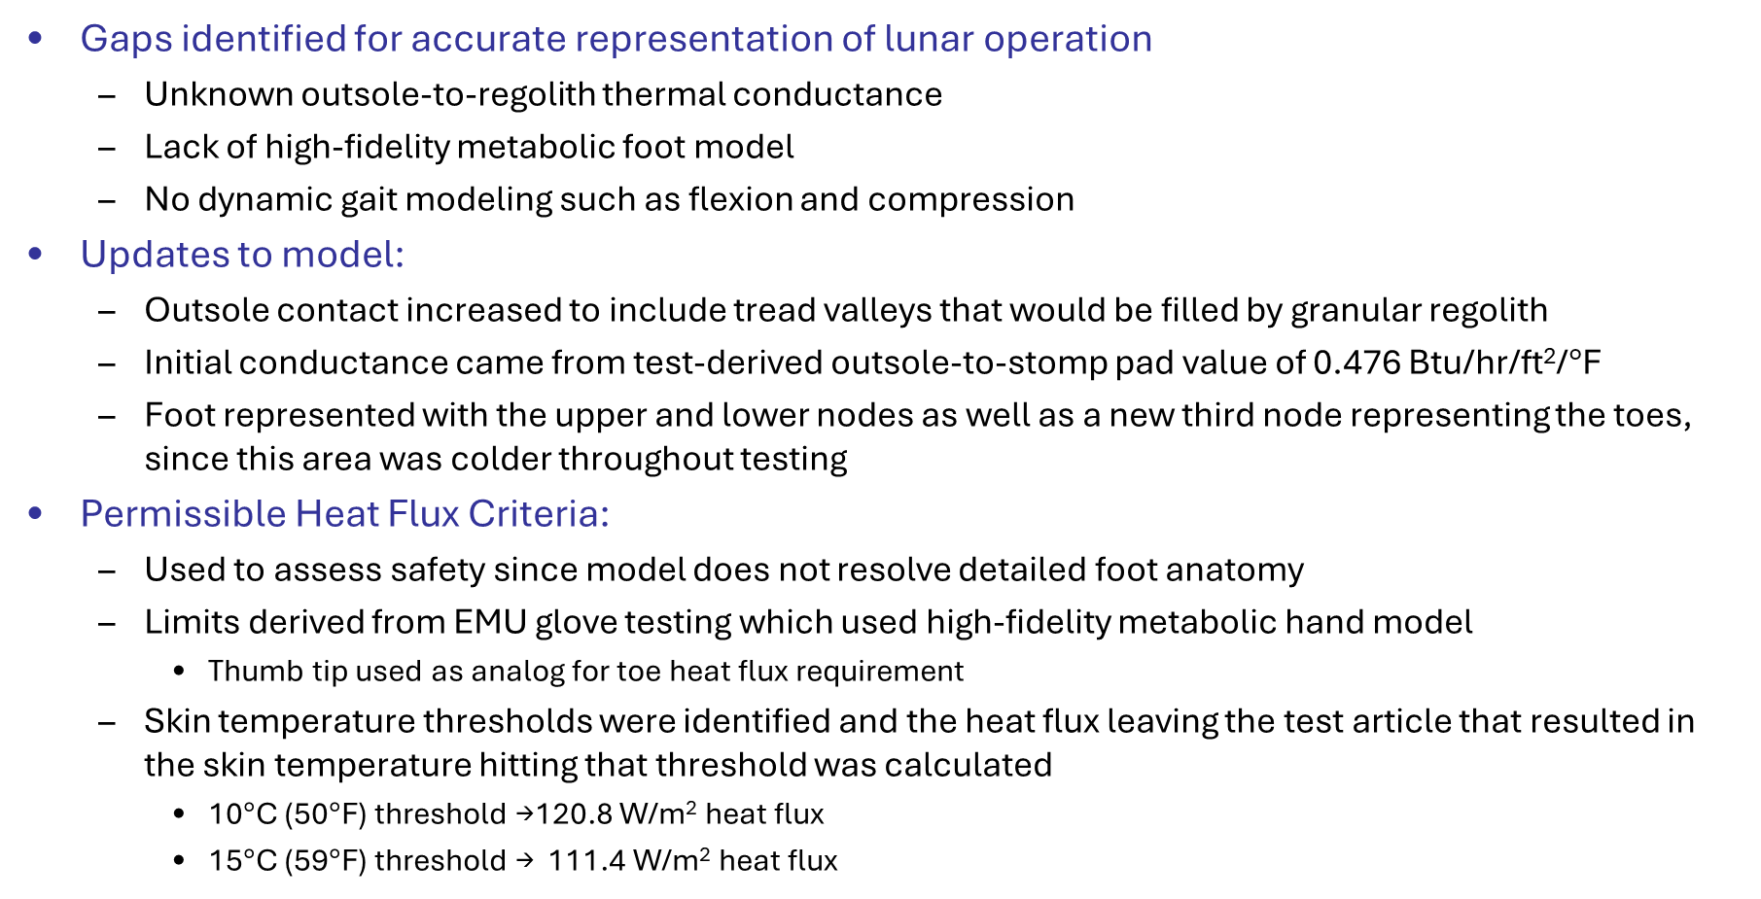
Lunar Operation Modeling
Gaps identified for accurate representation of lunar operation
  Unknown outsole-to-regolith thermal conductance
  Lack of high-fidelity metabolic foot model
  No dynamic gait modeling such as flexion and compression
Updates to model:
  Outsole contact increased to include tread valleys that would be filled by granular regolith
  Initial conductance came from test-derived outsole-to-stomp pad value of 0.476 Btu/hr/ft²/$°$F
  Foot represented with the upper and lower nodes as well as a new third node representing the toes, since this area was colder throughout testing
Permissible Heat Flux Criteria:
  Used to assess safety since model does not resolve detailed foot anatomy
  Limits derived from EMU glove testing which used high-fidelity metabolic hand model
    Thumb tip used as analog for toe heat flux requirement
  Skin temperature thresholds were identified and the heat flux leaving the test article that resulted in the skin temperature hitting that threshold was calculated
    10$°$C (50$°$F) threshold →120.8 W/m² heat flux
    15$°$C (59$°$F) threshold → 111.4 W/m² heat flux

Slide 14
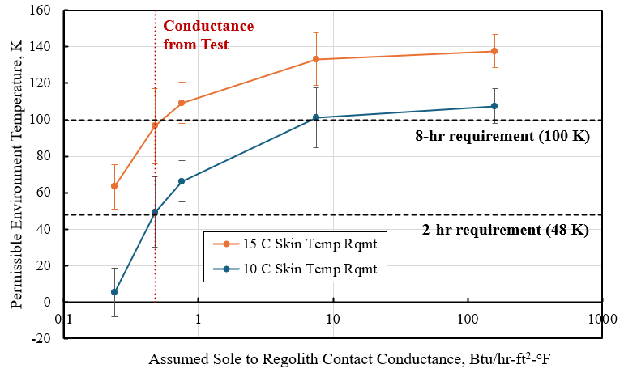
Lunar Operation Heat Flux Predictions
Error bars represent the standard error for the model, as computer using a Monte Carlo Simulation.

Slide 15
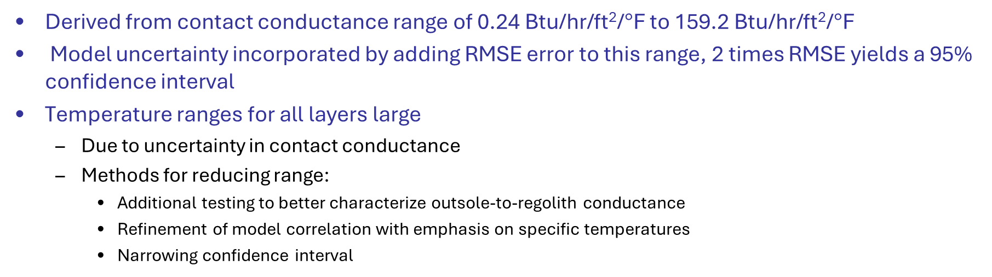
Lunar Operation Temperature Predictions
Assumes a constant foot temperature of 10 °C
Addresses outsole-to-regolith contact conductance uncertainty and inherent model uncertainty
Layer | Minimum Permissible Temperature | Minimum Expected Temperature at 48 K (with 95% confidence) | Minimum Expected Temperature at 100 K (with 95% confidence)
Bladder | -34.4 °C | -37.2 to -5.0 °C | -34.0 to -3.3 °C
Upper Frame | N/A | -109.0 to -37.0 °C | -96.6 to -30.2 °C
Outsole | N/A | -225.2 to -157.7 °C | -173.2 to -126.4 °C
Derived from contact conductance range of 0.24 Btu/hr/ft²/$°$F to 159.2 Btu/hr/ft²/$°$F
Model uncertainty incorporated by adding RMSE error to this range, 2 times RMSE yields a 95% confidence interval
Temperature ranges for all layers large
  Due to uncertainty in contact conductance
  Methods for reducing range:
    Additional testing to better characterize outsole-to-regolith conductance
    Refinement of model correlation with emphasis on specific temperatures
    Narrowing confidence interval

Slide 16
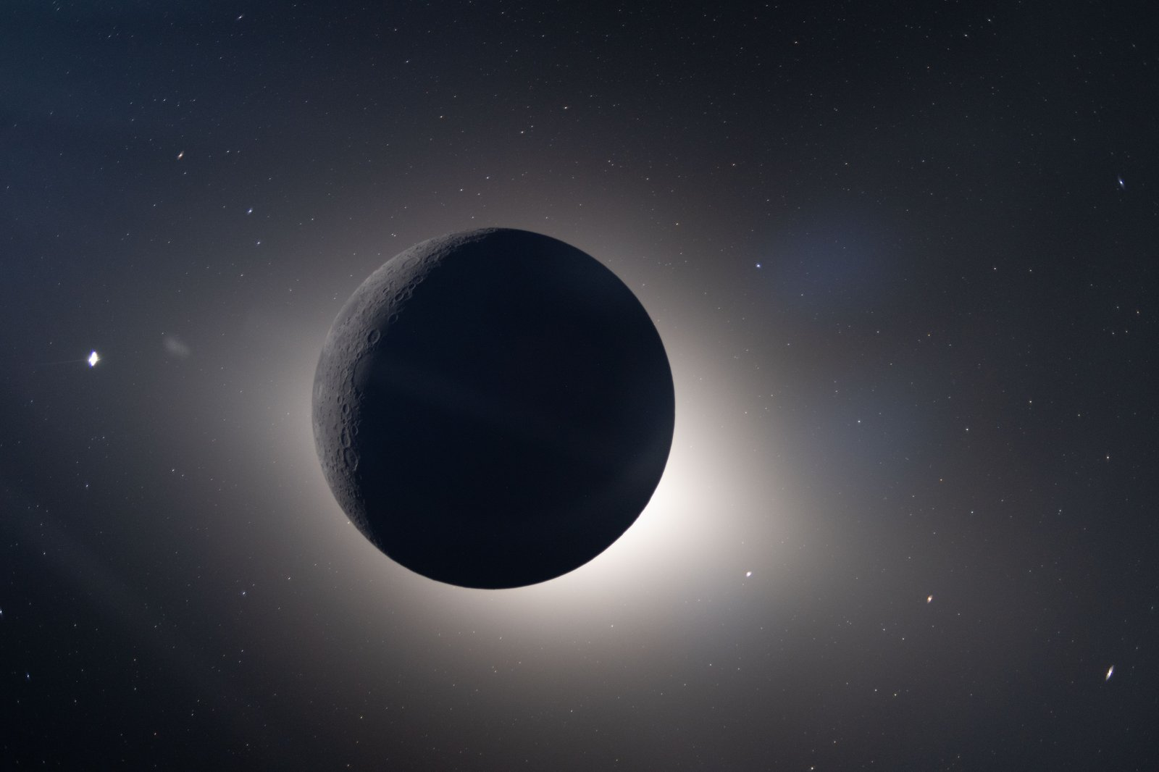
Conclusions
Successfully correlated lunar boot thermal model using extensive, repeatable steady-state data obtained across 10 test points including contact and radiation cases
  Achieved heat leak accuracy within 0.1 W
Used bootstrapping and Monte Carlo methods to quantify model uncertainty for both test and operational conditions
Outsole-to-regolith contact conductance identified as the dominant driver of heat flux and temperature variability
  Bounded its impact and defined permissible environmental temperatures with parametric studies
Future improvements needed in regolith contact fidelity, colder/more uniform radiation environments, and human in the loop testing to validate a high-fidelity metabolic, transient, foot model

Slide 17
References
[1] | E. Quick, “Model Correlation and Thermal Analysis of xEMU Boot at Lunar South Pole Temperatures,” in International Conference of Environmental Systems, Rio Grande, Puerto Rico, 2026.
[2] | B. Swartout, "xEMU Spacesuit Boot Lunar South Pole Thermal Vacuum Testing," in International Conference of Environmental Systems, Rio Grande, Puerto Rico, 2026.
[3] | B. Swartout, "Exploration Extravehicular Mobility Unit (xEMU) Lunar Boot Chamber B Thermal Vacuum Testing Results," in International Conference on Environmental Systems, Louisville, 2024.
[4] | B. C. Conger, "Thermal Analysis of the EMU Boot with Foam Insert Removed," CTSD 1404, 1992.
[5] | T. Durrant, "Orlan Spacesuit Boot Thermal Model," HDID-2G41-1132, 1999.
[6] | J. V. Iovine, "EMU Boot Thermal Analysis for ISS EVA," HDID-2G41-954, 1998.
[7] | J. V. Iovine, "Thermal Analysis of the EMU Boot Pressure Bladder," CTSD862, 1990.
[8] | W. Lee, "Thermal Analysis Results of Stand-Alone Shuttle Boot Model for the Thermal Vacuum Chamber B Test for STS-37 Mission Hardware," CTSD454, 1989.
[9] | T. Nguyen, "The Thermal Effect of a Newly Designed Aluminum Piece Attached to the Heel of the EMU Boot," 20977, 1984.
[10] | D. Ochoa, "Thermal Design and Analysis of Constellation Space Suit System Boot Options for Lunar Missions," ESCG-4470-09-TEAN-DOC-0110, 2009.
[11] | D. G. Gilmore, Spacecraft Thermal Control Handbook: Volume 1: Fundamental Technologies, The Aerospace Press, 2002.
[12] | "fitgeotrans," Mathworks, [Online]. Available: https://www.mathworks.com/help/images/ref/fitgeotrans.html.
[13] | "imwarp," Mathworks, [Online]. Available: https://www.mathworks.com/help/images/ref/imwarp.html.
[14] | Z. Fester, S. McFarland, N. Andersen, E. Quick, D. Green, T. Jaimes and D. Morris, "xEMU Boot TVAC Final Report," NASA, CTSD-ADV-2272.
[15] | N. L. Langston and V. Margiott, "EMU Phase VI Glove Thermal Vacuum Test and Analysis Final Report," CTSD-SS-1621, 1998.
[16] | M. B. Abney, R. J. Jones, S. R. Wilson, T. K. Brady and N. L. Andersen, "Lunar Glove Thermal and Durability Analysis, Test, and Failure Mitigation," NESC-RP-21-01722, 2024.
[17] | NASA, "NASA Spaceflight Human-System Standard Volume 1, Crew Health," 2023.

Slide 18
Acknowledgements / Questions
The authors would like to acknowledge the CITADEL test team at JPL for their hard work conducting test points and compiling data files.
Thank you!
Questions?
Further inquiries may be sent to the following:
Emma Quick: emma.j.quick@nasa.gov
Noah Andersen: noah.l.andersen@nasa.gov

