Slide 1
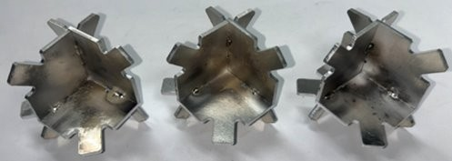
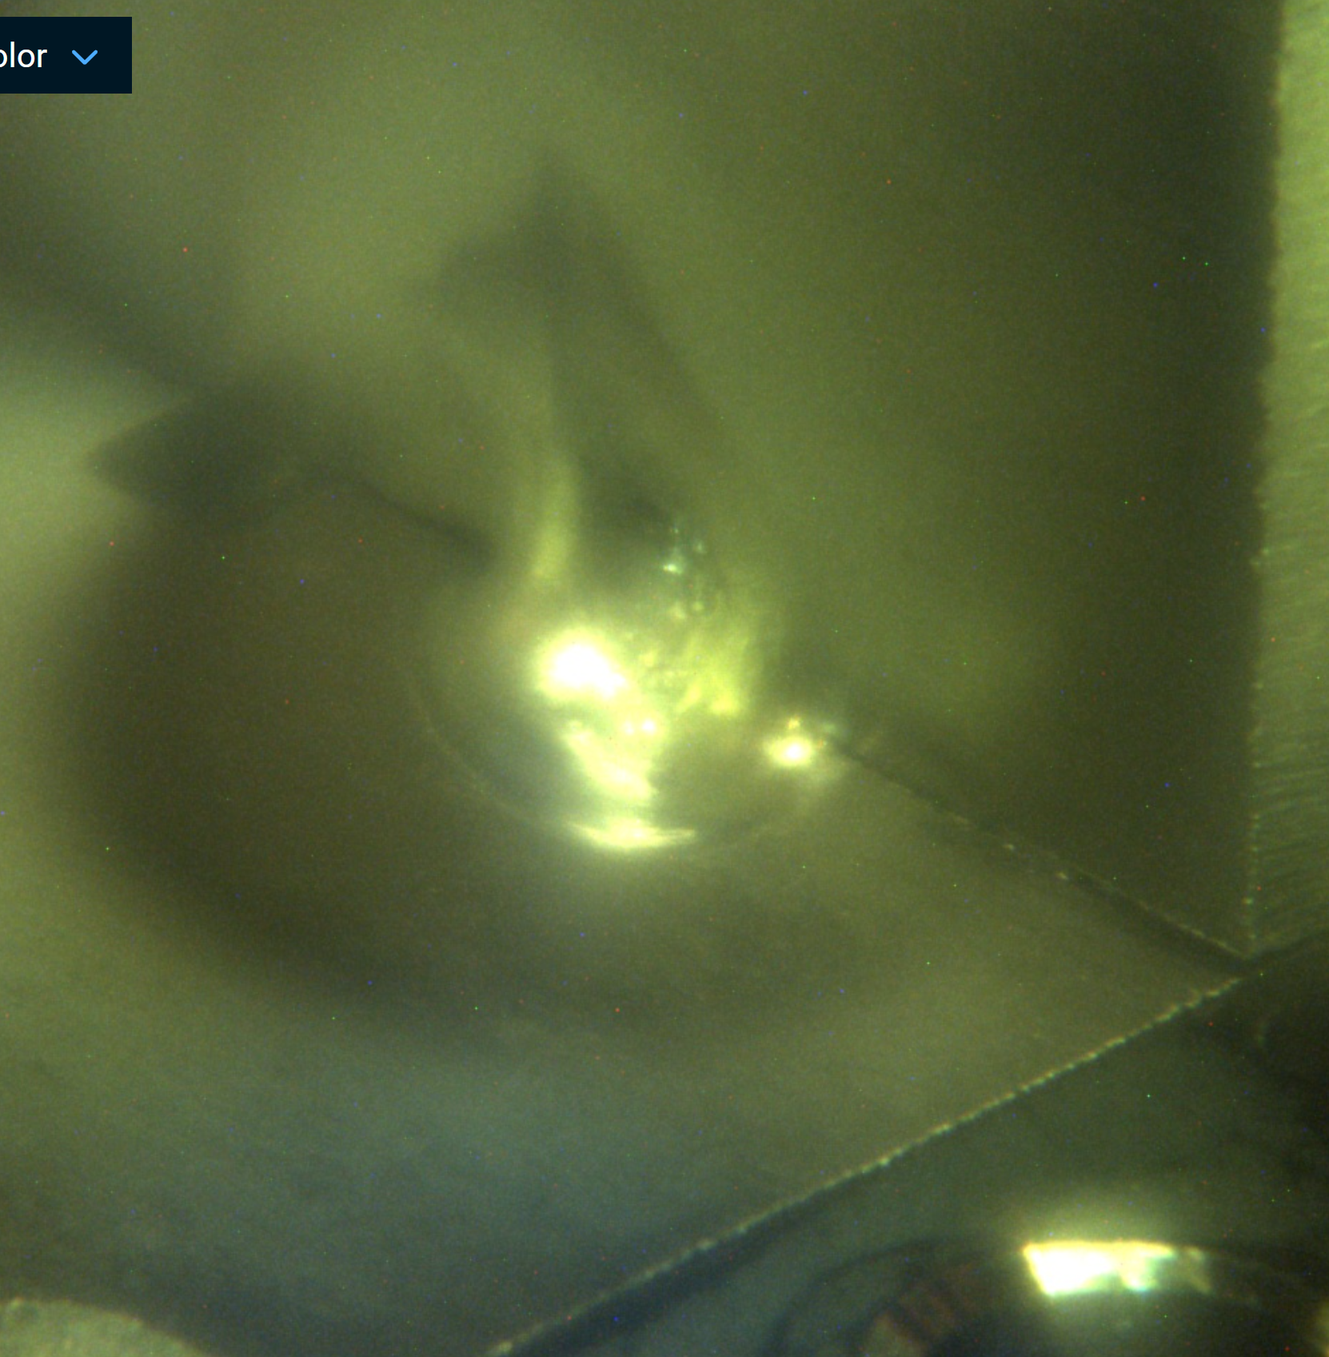
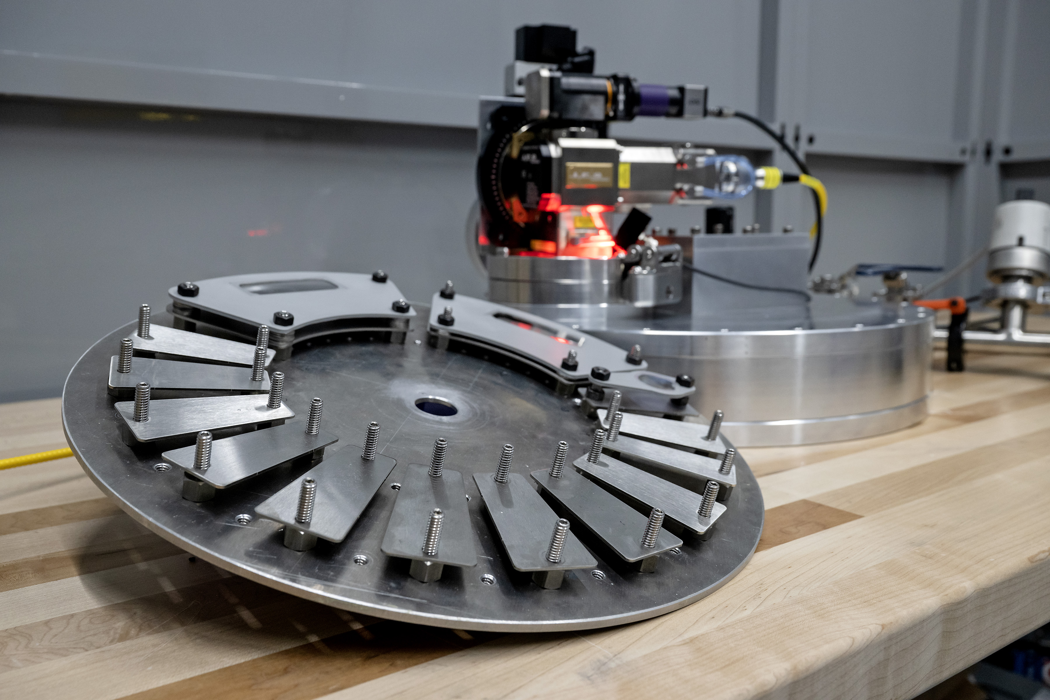
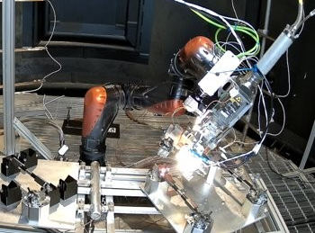

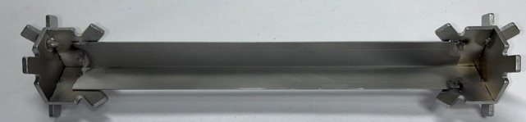
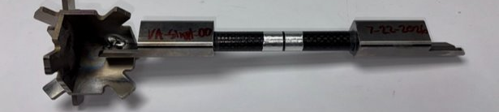
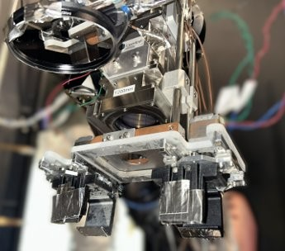
Laser Beam Welding Advancements for In-Space Servicing, Assembly, and Manufacturing
Keanu Brayman
Marshall Space Flight Center
Flat Floor Robotics Laboratory (FFRL)
Pathways Intern
Astronaut Scholar Technical Conference
August 15th, 2026

Slide 2
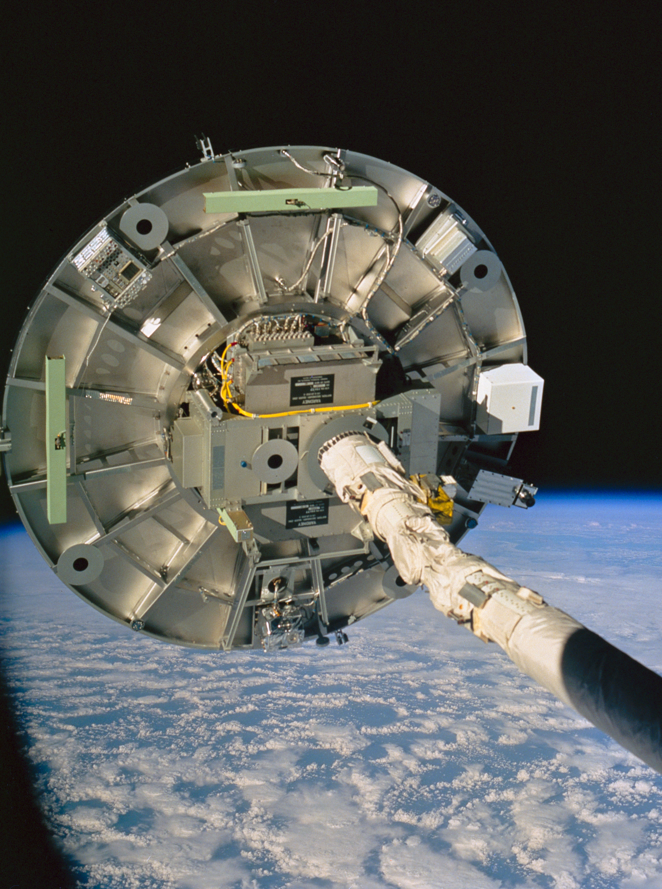
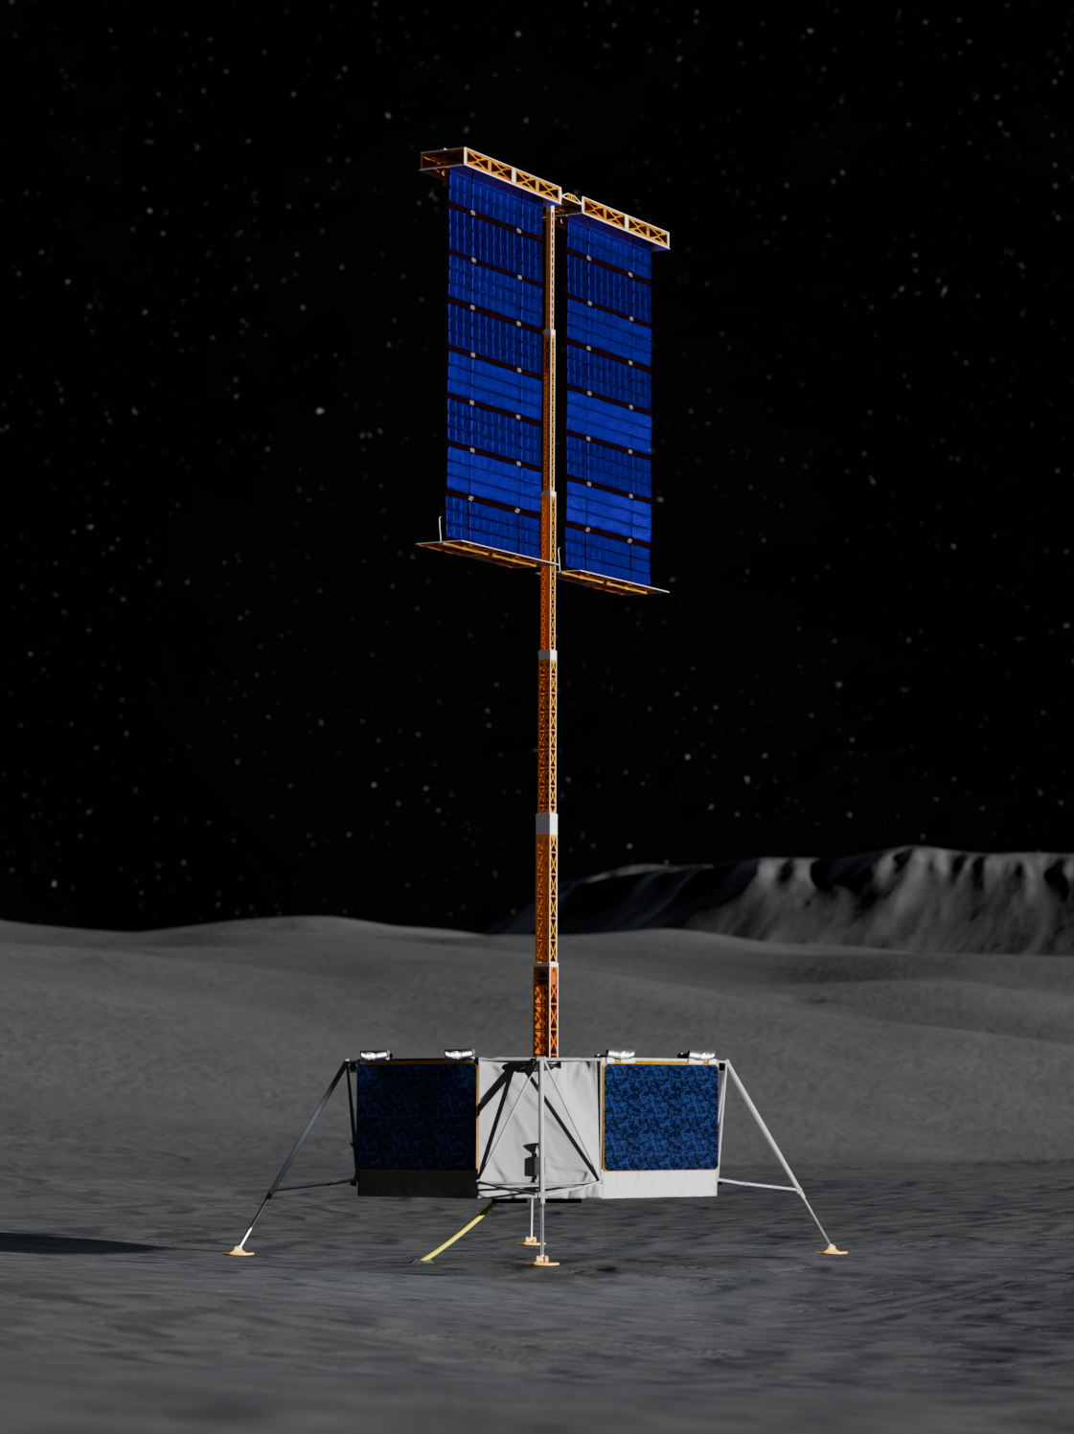
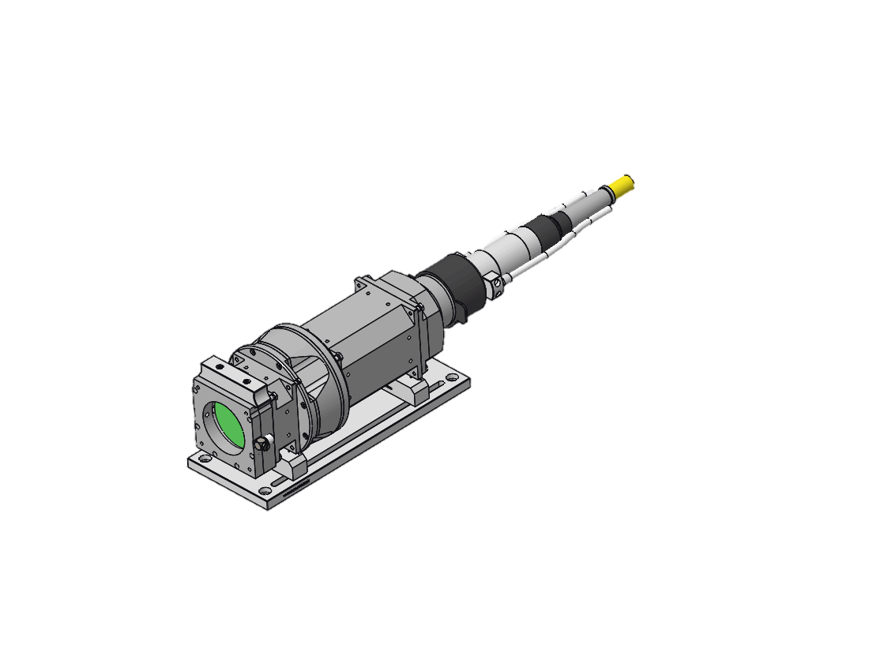
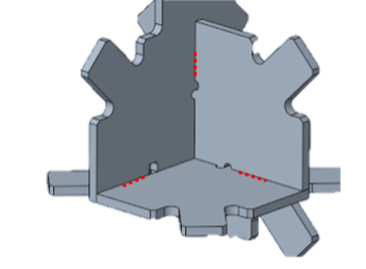
Background
Laser Welding
In-Space Manufacturing
Space Infrastructure
Laser beam welding uses concentrated heat from a laser to join two pieces of metal
The future of space exploration will require many resources to be produced off-world
To build a moon base, large structures will need to be manufactured robotically

Slide 3
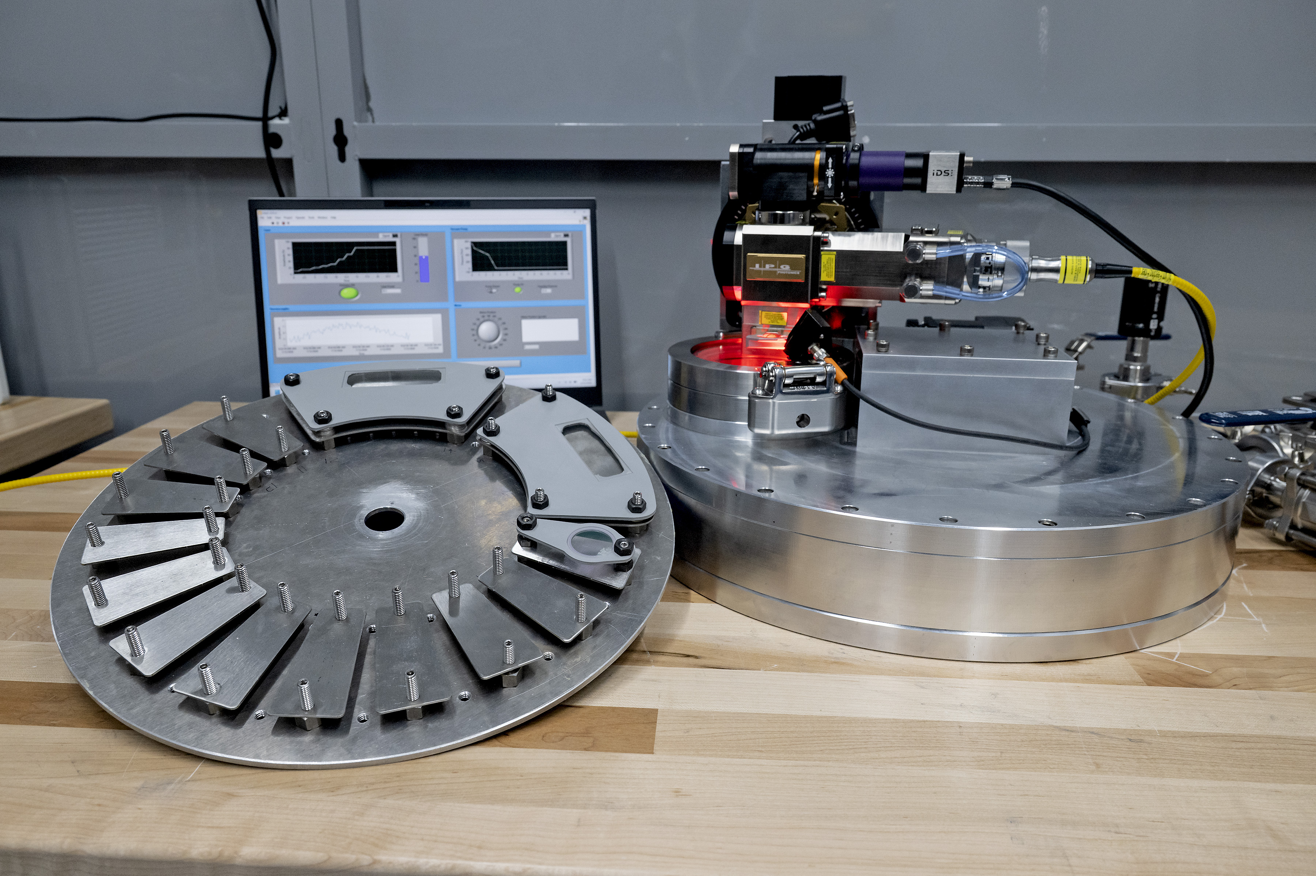
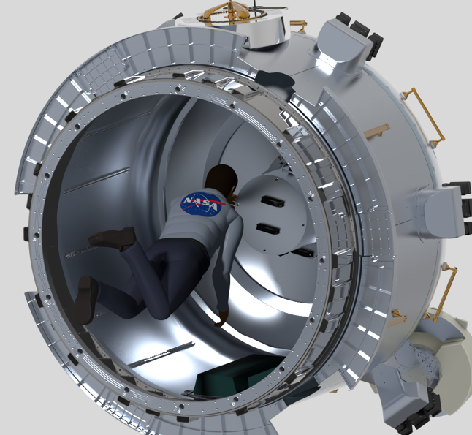
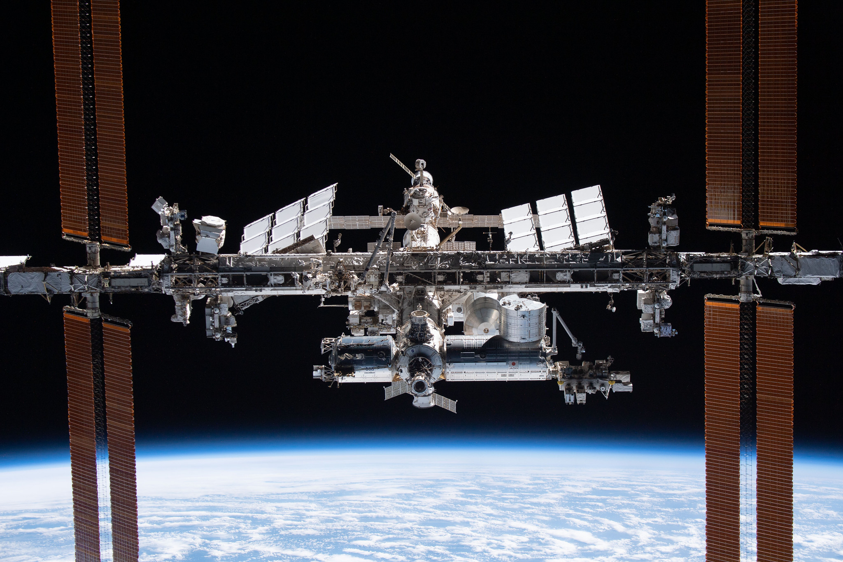
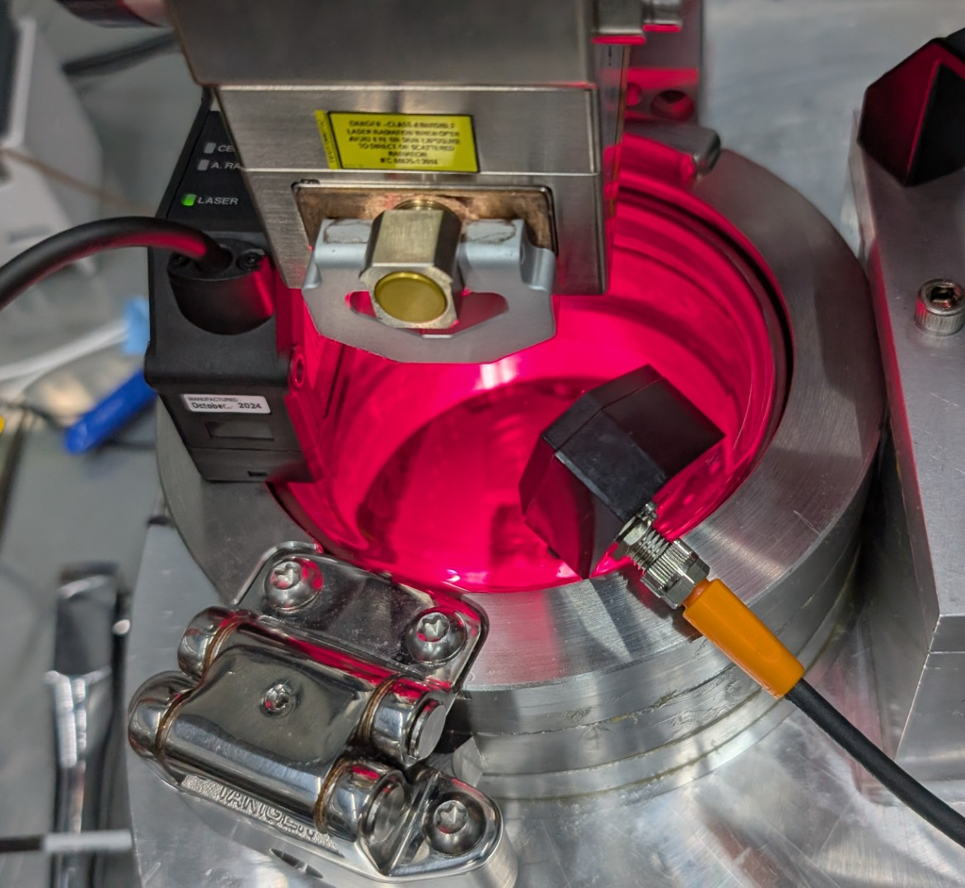
Laser Process Development in Microgravity
Payload:
DIsk-Shaped Configurable and Modular vAcuum uNit (DISCMAN)
Mission:
Laser process development for in-space laser welding under sustained microgravity
Launch:
Est. 2029 to the Bishop Airlock abord the International Space Station

Slide 4
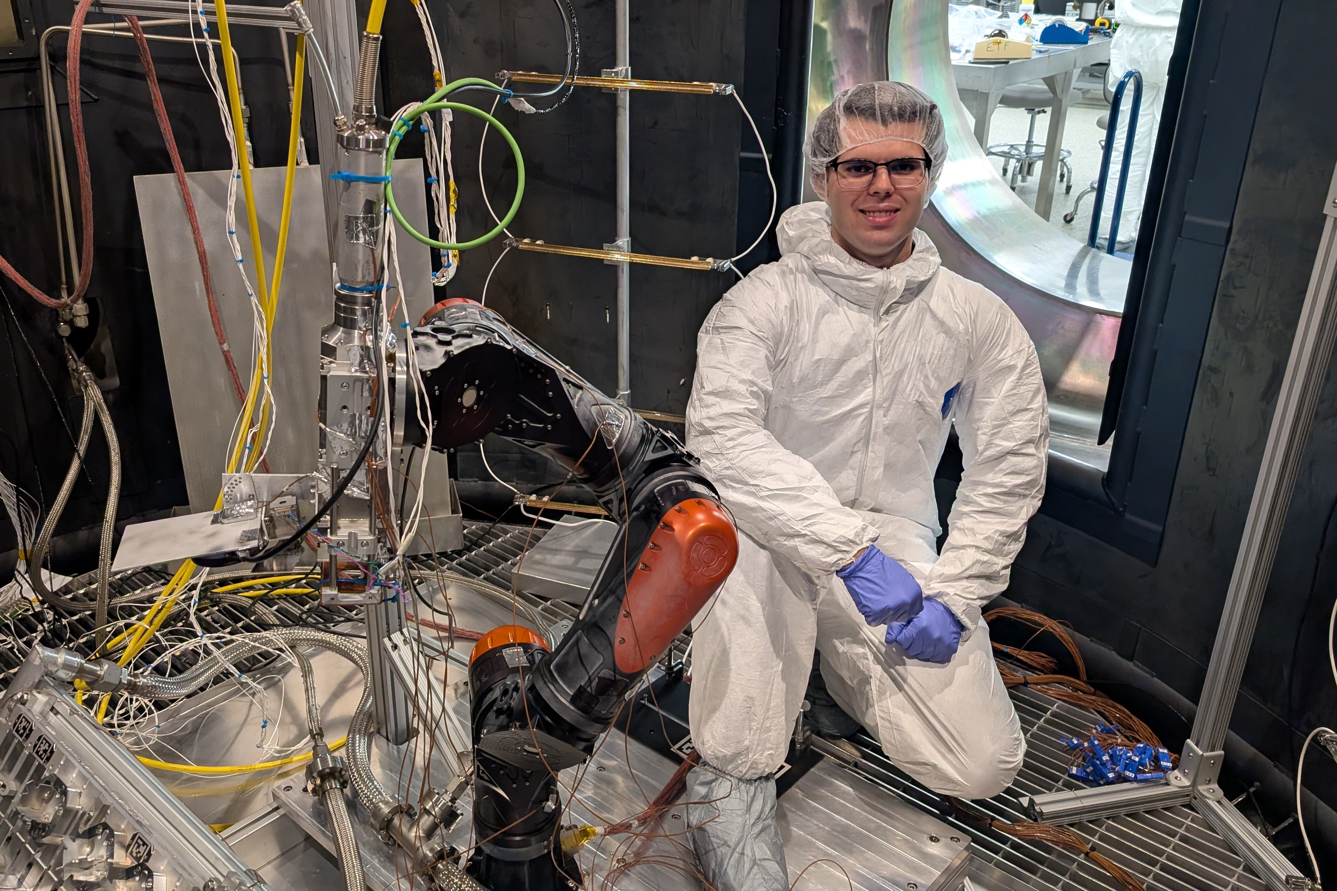
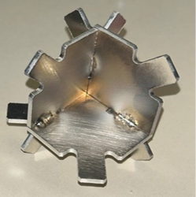
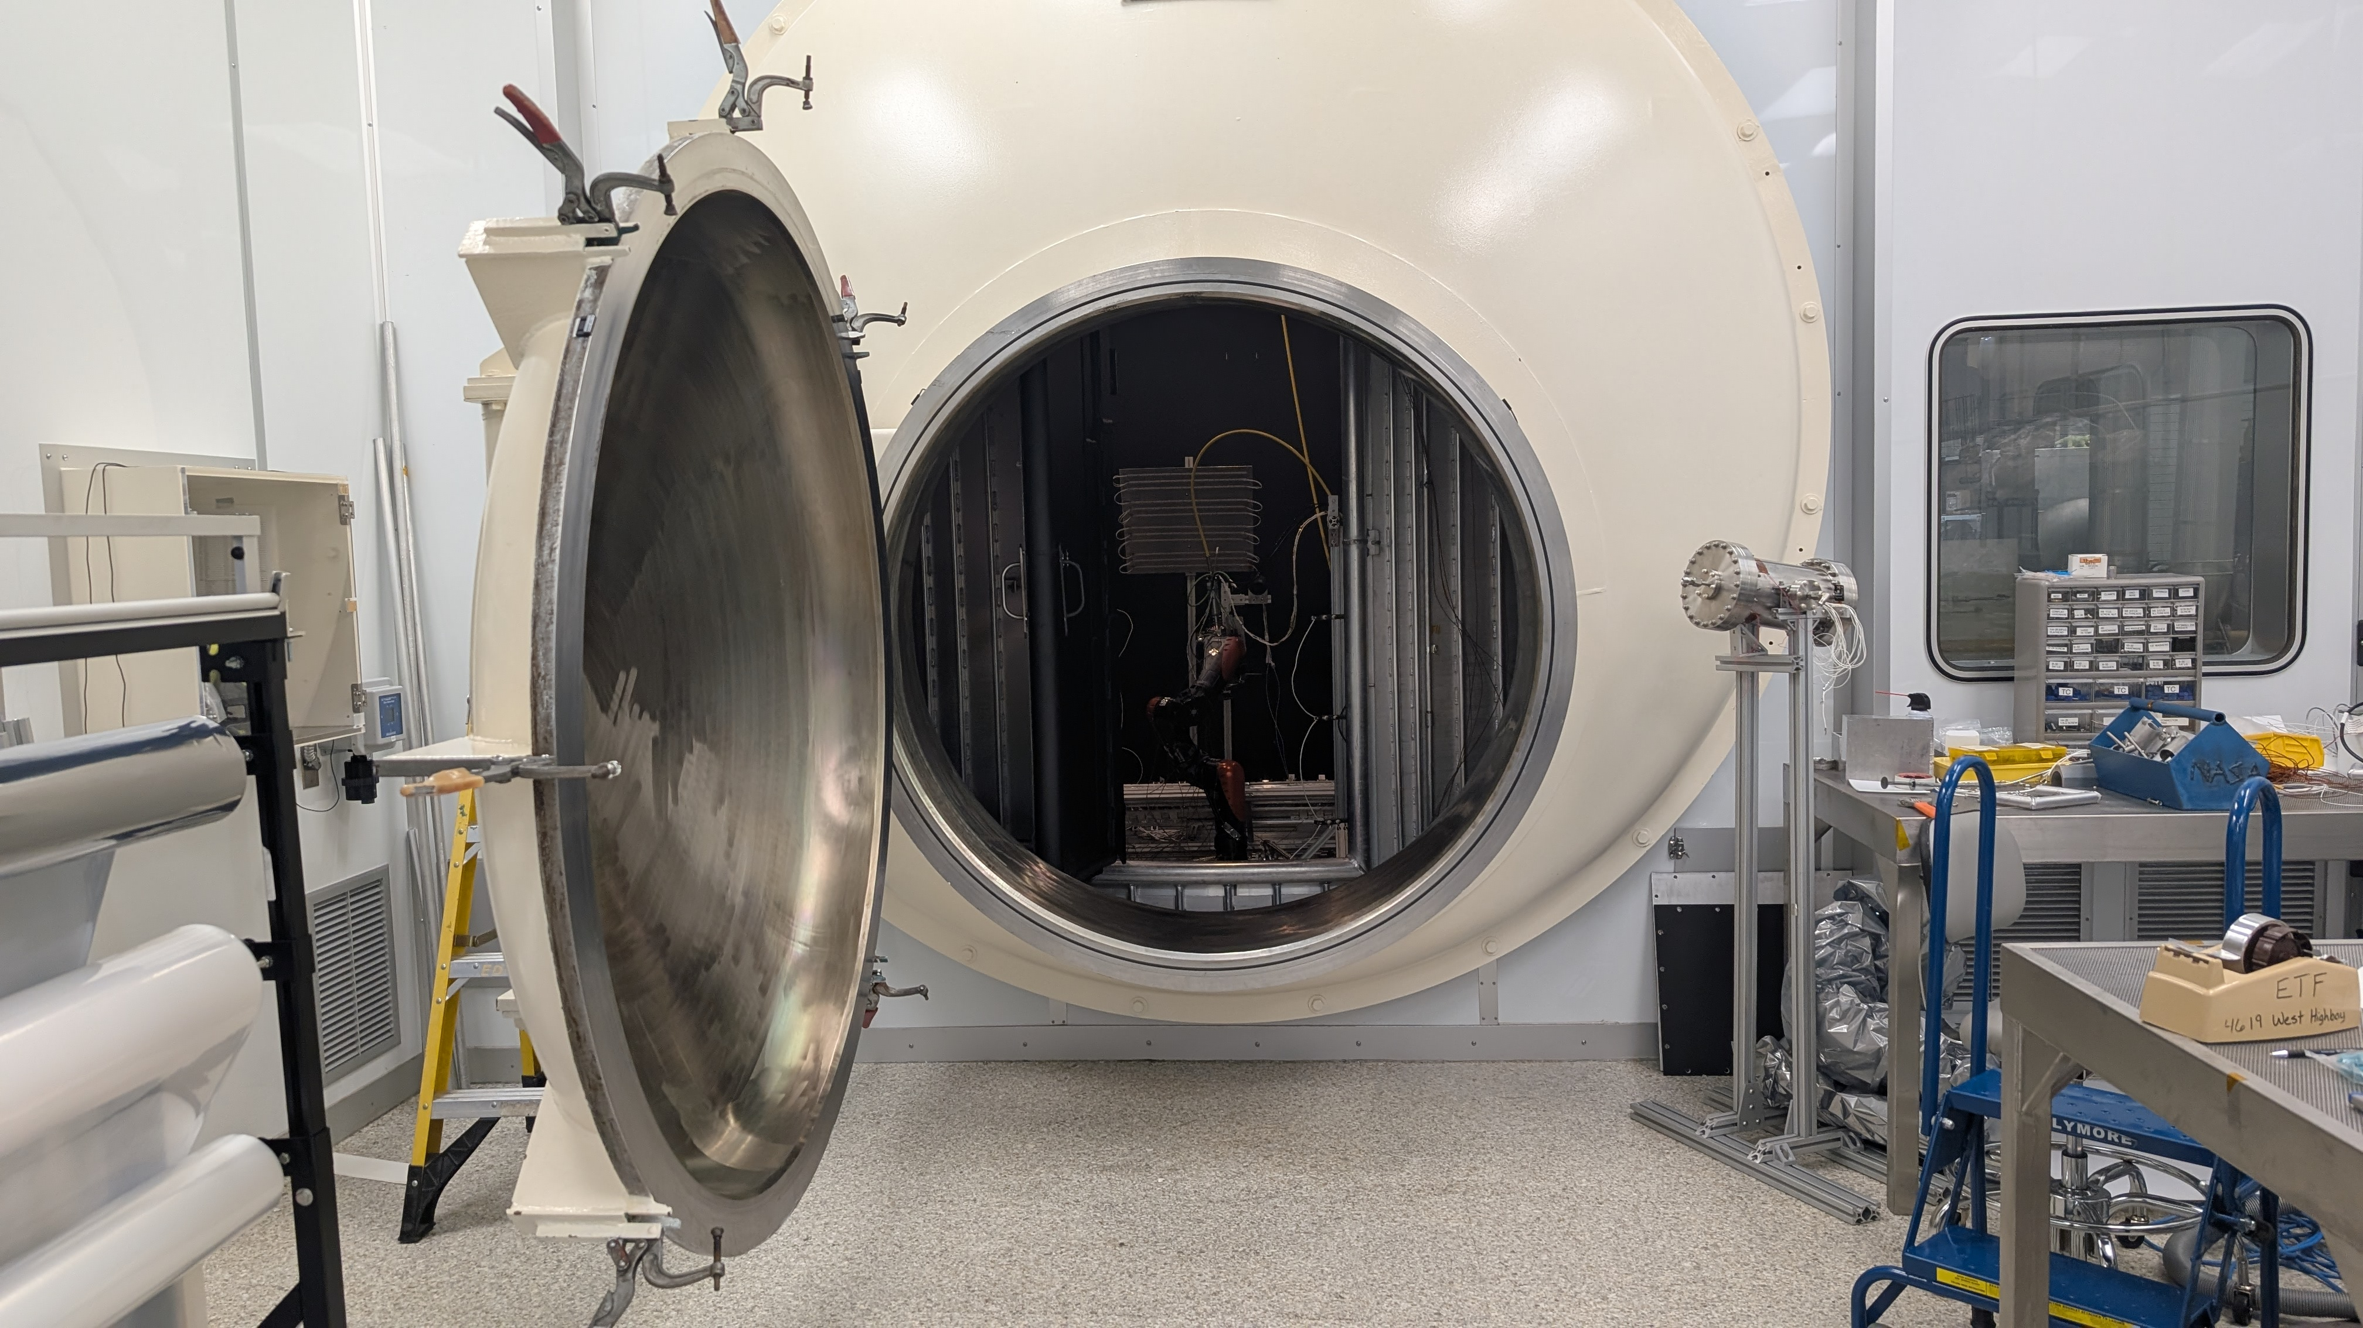
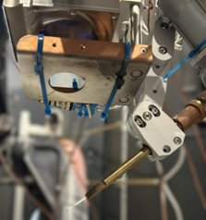
Robotic Welding in Thermal Vacuum
Project:
Lunar Assembly and Servicing by Autonomous Robotics (LASAR)
Goal:
Demonstrate the ability to perform welds autonomously under hot and cold vacuum
Testing:
Three test campaigns featuring novel laser welding, structures, and robotics technologies

Slide 5
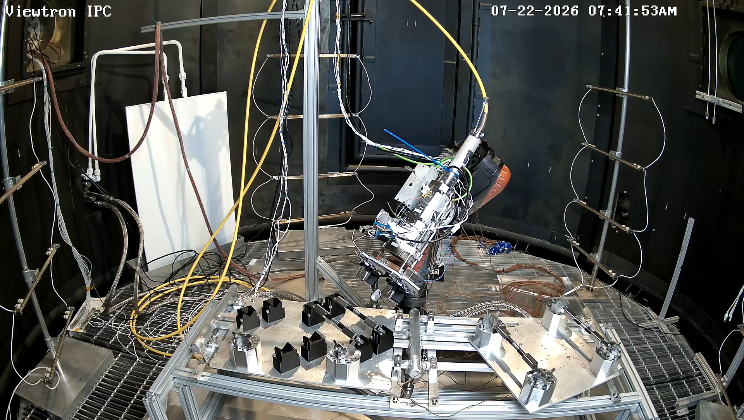
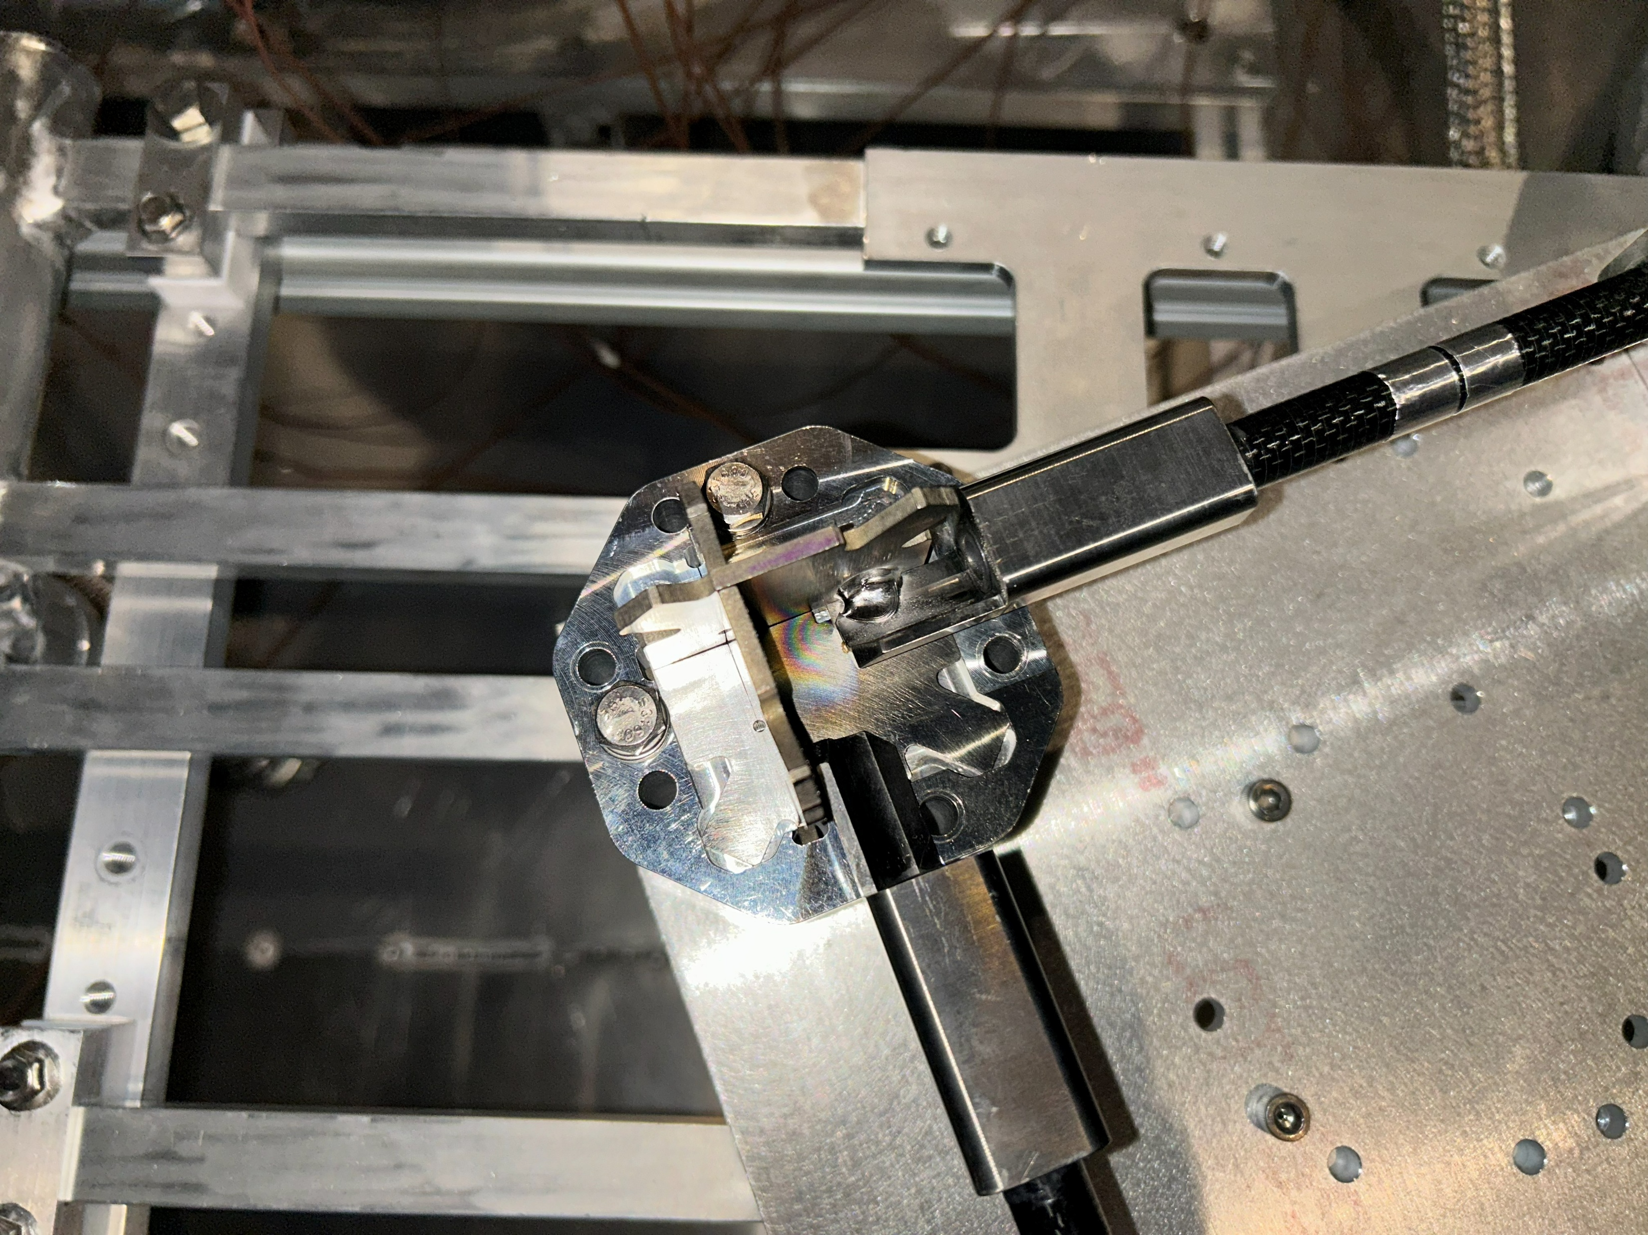
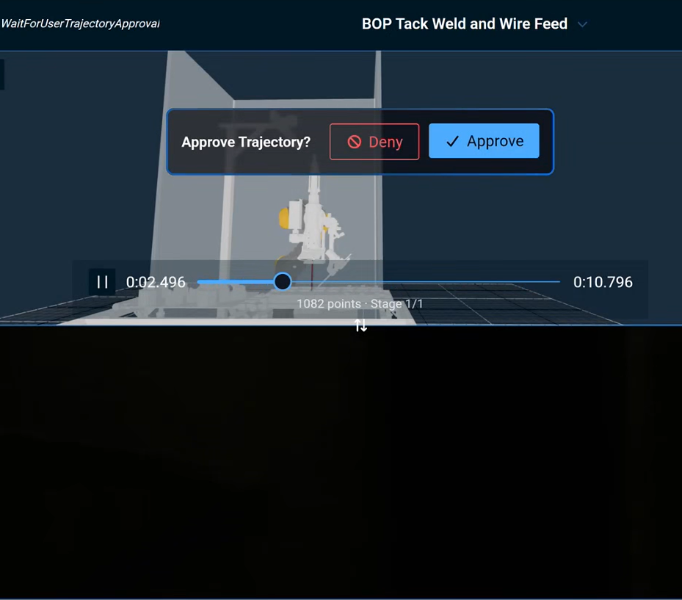
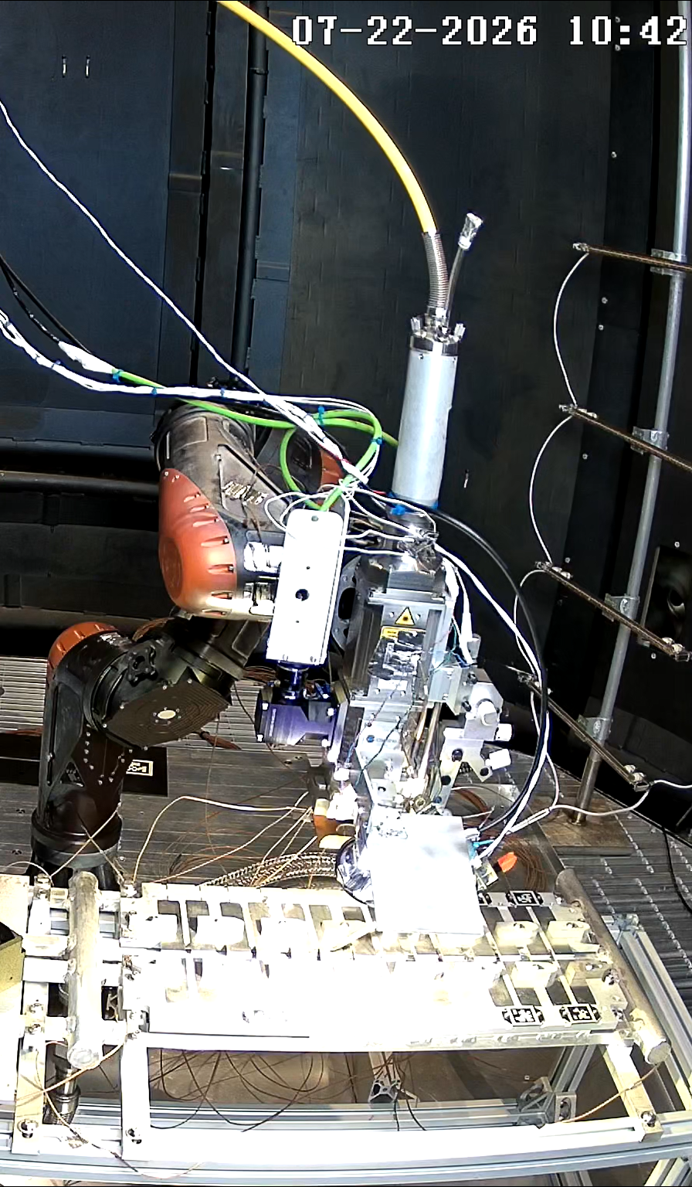
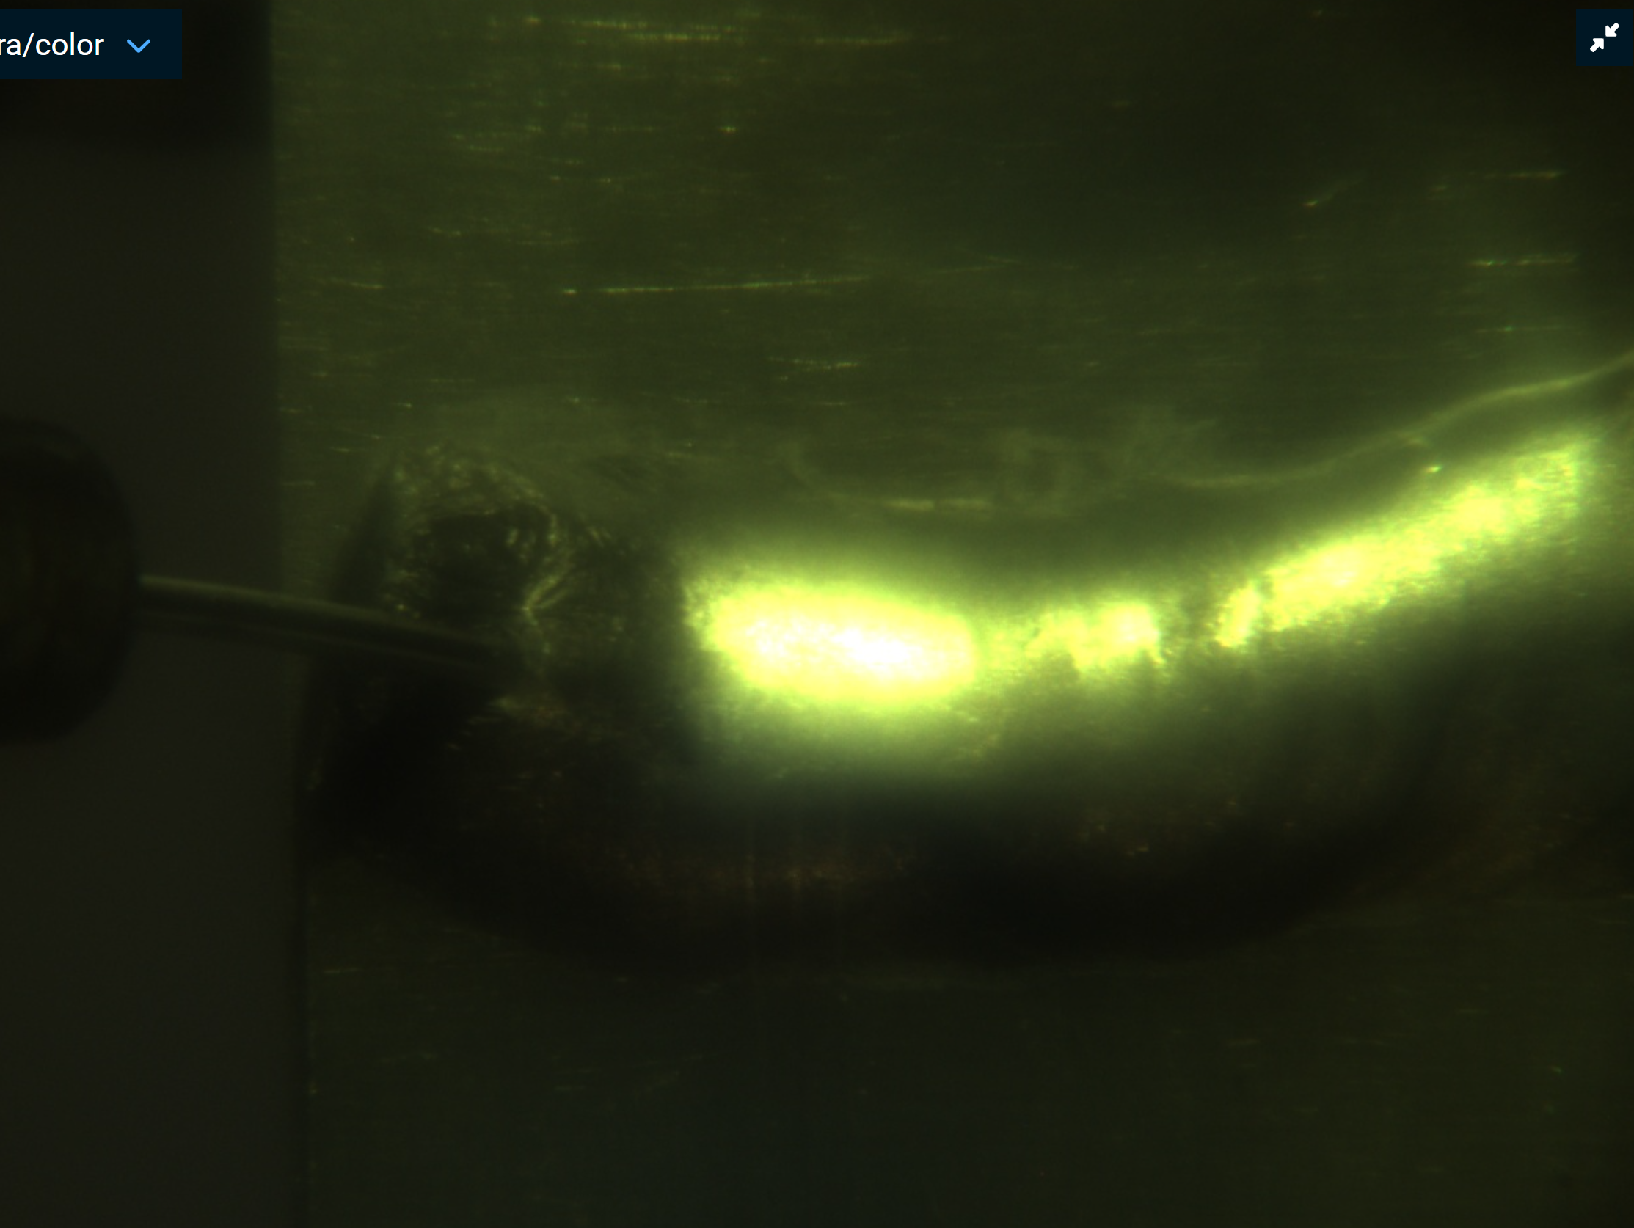
Assembly and Additive Manufacturing
Strut Manipulation and Welding:
Used a gripper to pick up, move, place, and weld a titanium strut
Laser Wire Directed Energy Deposition:
First known demonstration of laser wire additive manufacturing under vacuum

Slide 6
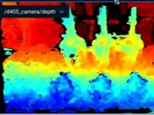
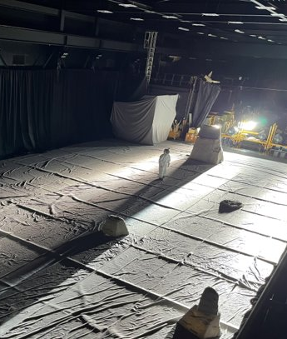
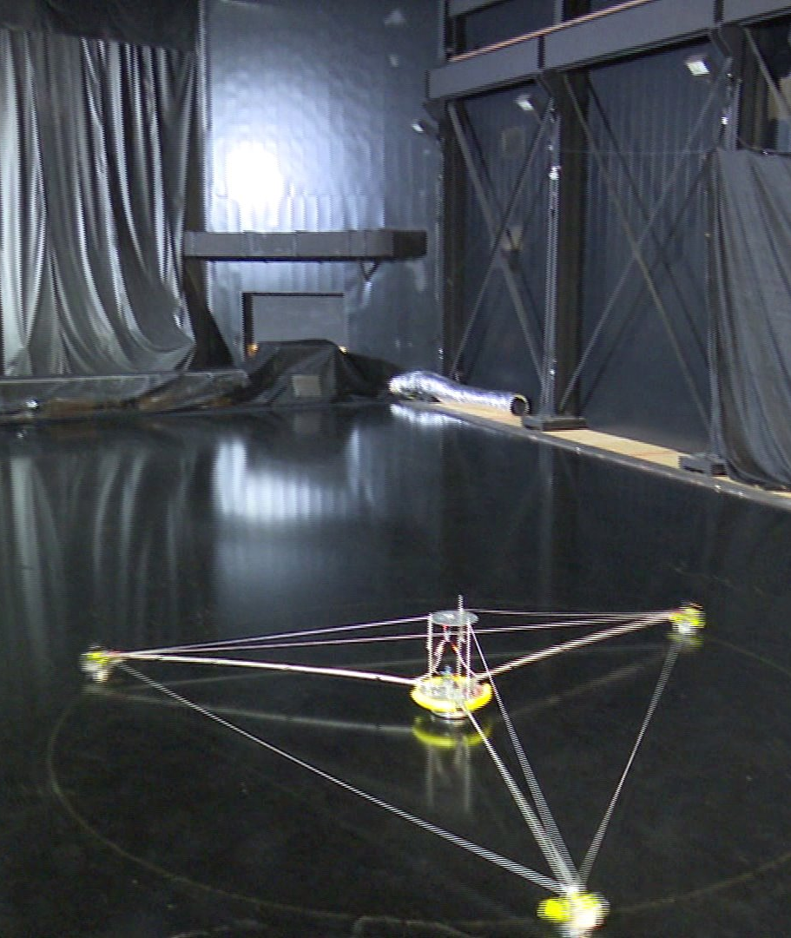
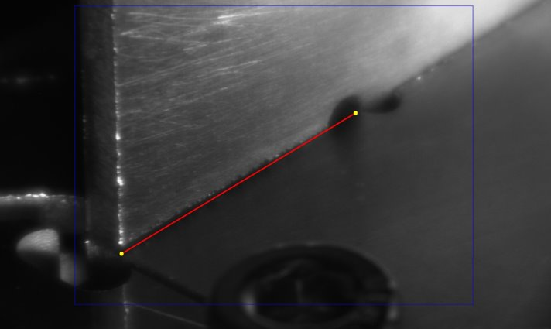
Current and Future Work
Robotic Perception
Lunar Lighting
Flat Floor
Advance positioning and alignment for welds using seam tracking, points clouds, etc.
Simulate welding on the lunar south pole using bright film lights and terrain mockups
Perform robotic welds in simulated microgravity with air bearings on a low friction epoxy floor

Slide 7
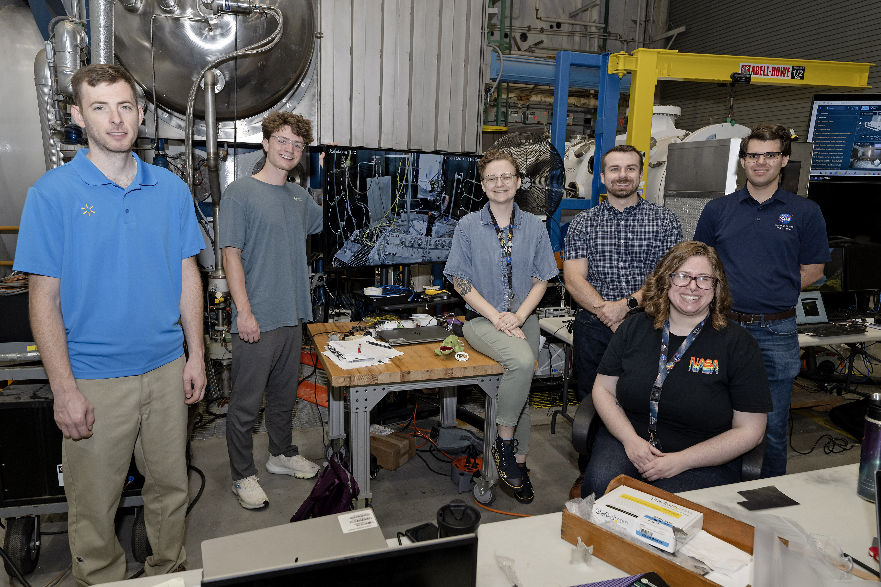
Acknowledgements
Emma Jaynes (Mentor, MSFC)
Andrew O’Conner (PI, MSFC)
Joel Amert (Team Lead, MSFC)
Matt McSavaney (Branch Chief, MSFC)
Parker Shake (Materials, MSFC)
Tucker Trivette (Intern, MSFC)
Alex Sowell (Robotics, JSC)
Emily Sheetz (Robotics, JSC)
Maxwell Rosales (Intern, JSC)
Derrick Seubert (Structures, LaRC)
Brace White (Structures, LaRC)
Marshall Space Flight Center
NASA Pathways Program
Thank you, Astronaut Scholarship Foundation!

Slide 8
Questions?

