Slide 1

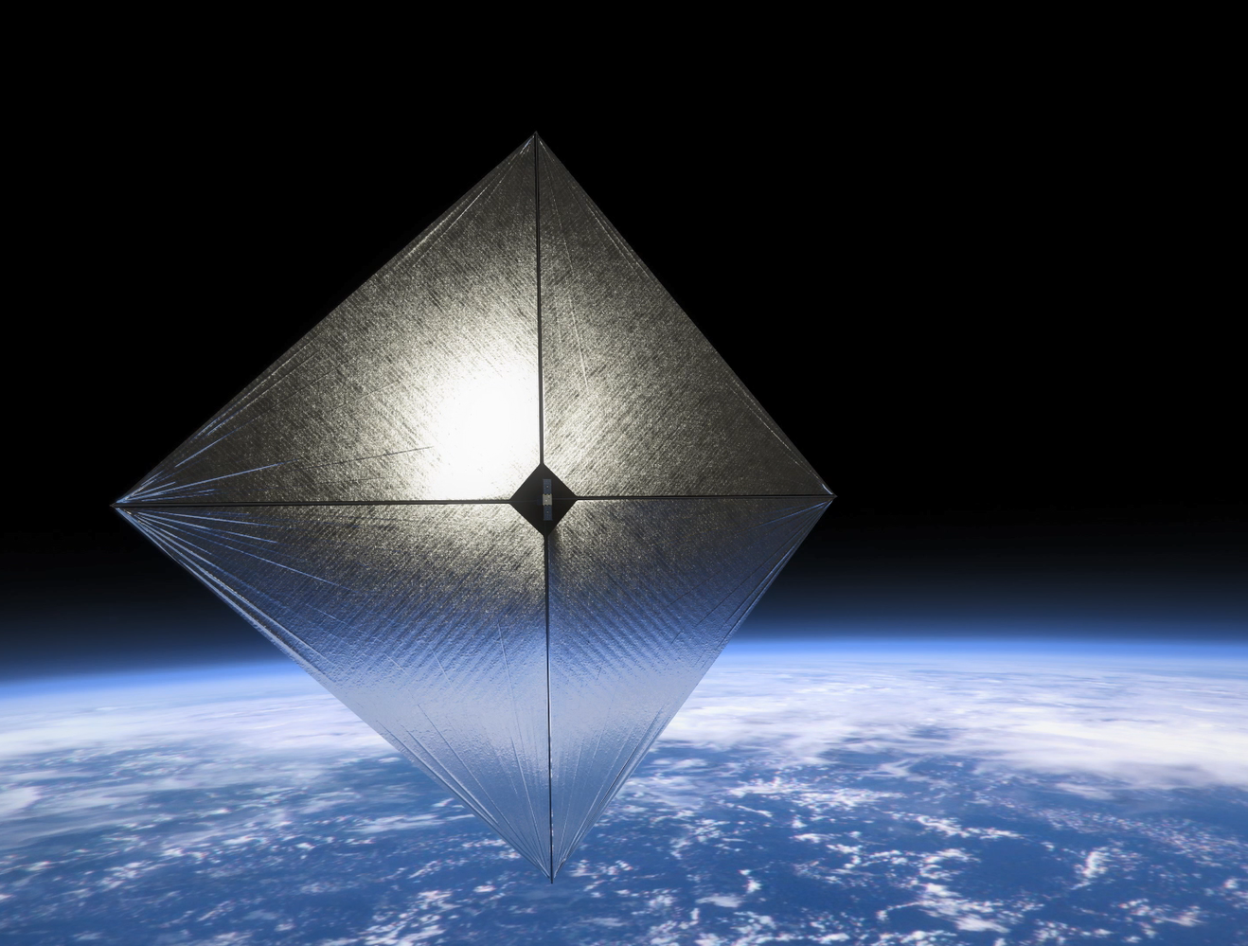
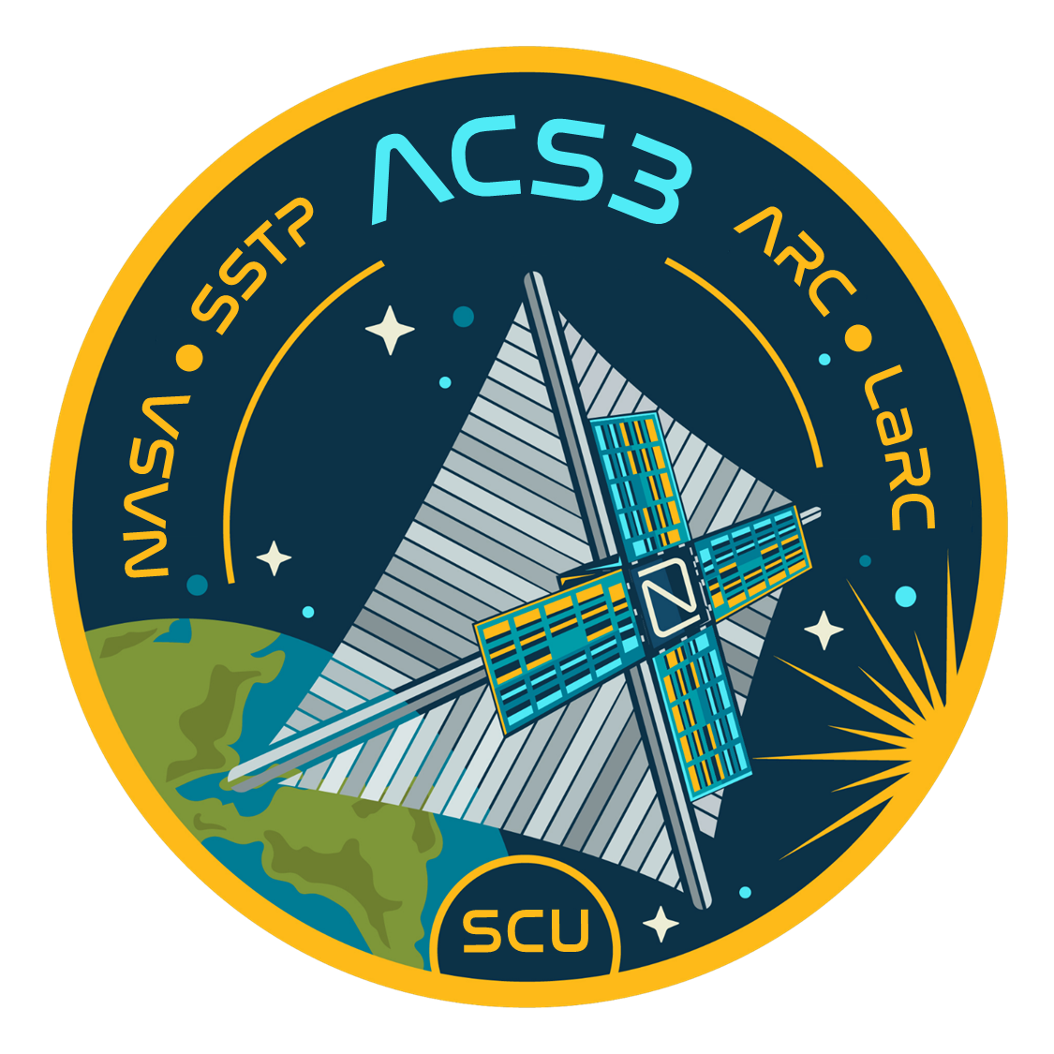
Advanced Composite Solar Sail System (ACS3) Results and Lessons Learned
Philip Shih (NASA Ames Research Centers)
Olive Stohlman (NASA Langley Research Center)
Ivan Bertaska (NASA Marshall Space Flight Center)
Andres Dono Perez (Astrion/NASA Ames Research Center)
24 August 2026
Small Satellite Conference 2026
National Aeronautics and Space Administration
www.nasa.gov

Slide 2
Agenda
ACS3 Mission Overview
Challenges encountered during mission operations
Lessons learned for Solar Sail missions

Slide 3
ACS3 Mission
ACS3 Project - Low Earth Orbit (LEO) flight demonstration of a composite-based small-sat solar sail system.
Objectives:
  Primary: On-orbit deployment and characterization of a smallsat class composite solar sail system
  Secondary: Demonstrate controlled solar sailing in LEO (e.g. pointing, SMA-raising/lowering); characterize deployed structural dynamics
Sponsors:
  NASA STMD Small Spacecraft and Distributed System (SSDS) Program
  Composite Technology: STMD Game Changing Development (GCD) Program, Deployable Booms Project (DCB)

Slide 4
ACS3 Mission Team
Partner Roles and Responsibilities During Mission Operations:
NASA Ames Research Center (ARC) – Project Management, payload control avionics (AS) and camera system for sail deployment capture, AS Flight Software (FSW), and Mission Operation Planning
NASA Langley Research Center (LaRC) – Principal Investigator, ACS3 Sail Boom Subsystem (SBS)
NASA Marshall Space Flight Center (MSFC) – Attitude Determination and Control System (ADCS)
Santa Clara University Robotic System Lab (SCU RSL) – ACS3 Mission Operations Ground Station
Kongsberg NanoAvionics – Spacecraft Bus
ExoLaunch - Dispenser
Rocket Lab – Launch Provider
* ARC and LaRC shared the flight director responsibilities

Slide 5
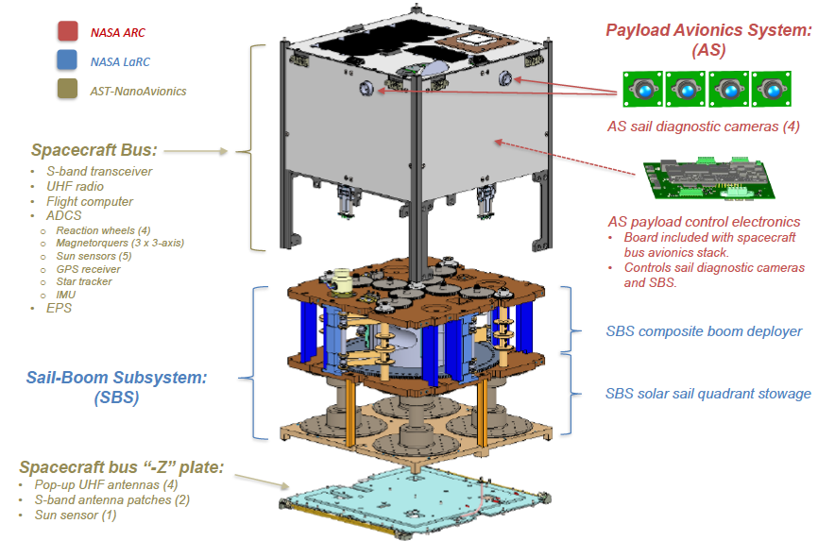
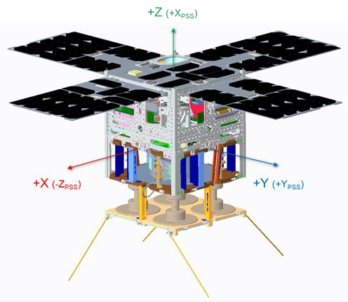
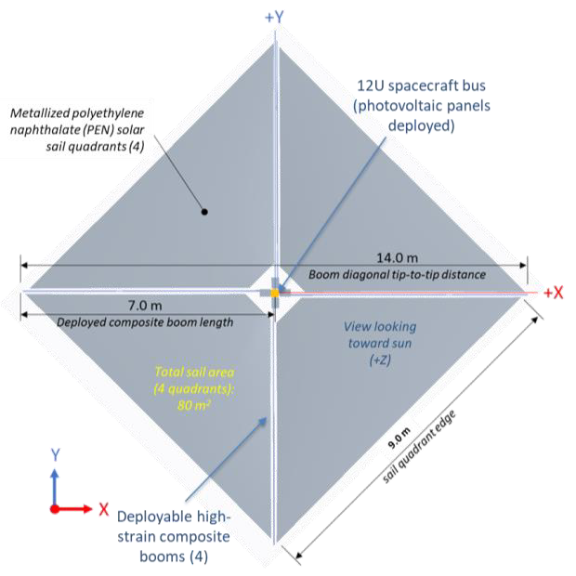
ACS3 12U Spacecraft Subsystems
ACS3 12U Spacecraft with Solar Array Deployed

Slide 6
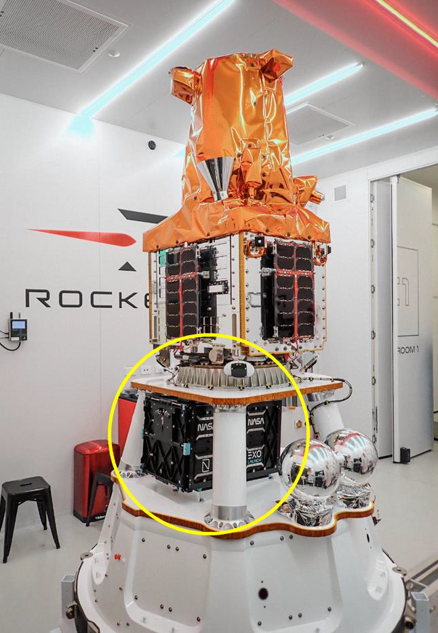
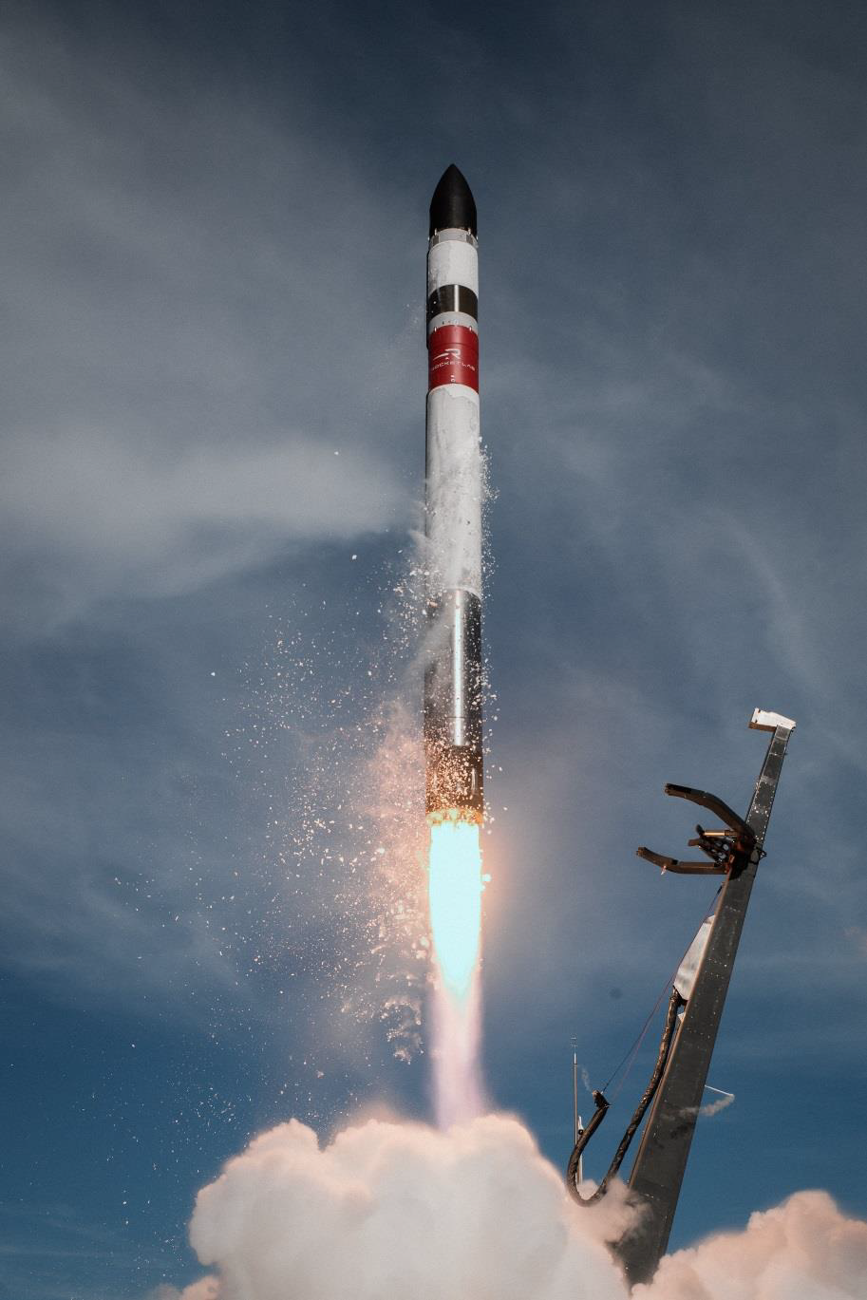
Mission Overview
ACS3 was launched on 24 April 2024
  Rocket Lab Electron launch vehicle
  Launch Complex 1, Mahia, NZ
Spacecraft successfully deployed to target orbit:
  992 x 1024 km, 97.4º
  Near SSO; 1100 LTDN
Solar Sail deployed on 28 Aug 2024 – primary objectives achieved!!
Spacecraft Decommissioned on 27 Mar 2026
ACS3 spacecraft in the launch vehicle
Rocket Lab Electron

Slide 7
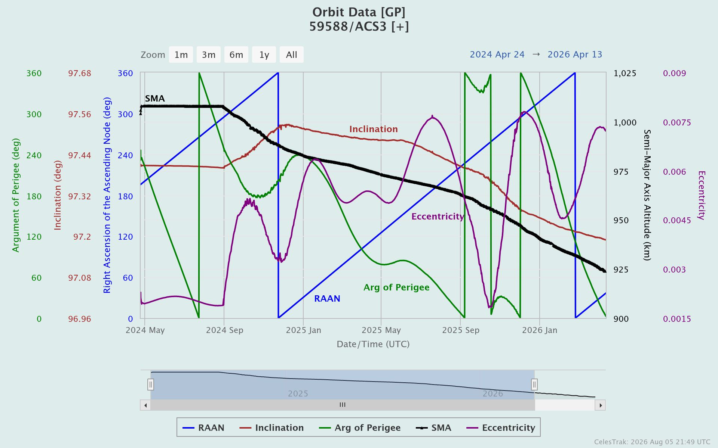
Key Events Timeline
Spacecraft Successfully Deployed to Orbit – Apr 24, 2024: The mission commenced as the spacecraft was launched and entered its designated orbit.
Sail Deployment – Aug 28, 2024: The solar sail was deployed, a key milestone in the operational timeline.
Attitude Anomaly onset – Sep 20, 2024: An unexpected anomaly occurred causing spacecraft inverted and enter a low power state.
Power Restored & Comm Reestablished – Oct 13, 2024: Power levels stabilized, S-band comm. was restored and active detumbling operations resumed.
2
3
1
4
5
6
7
8
9
ACS3 Orbit data of the whole mission - courtesy Celestrak

Slide 8
Key Events Timeline (cont’d)
Seasonal Low Power & Hibernation – Feb 04, 2025: Due to seasonal variation in earth’s albedo; spacecraft experienced low power and was placed into hibernation mode.
Contact resumed & Battery Recharged – April – May 2025: Communication with the spacecraft was re-established, battery recharged to non-critical level, and detumbling operations resumes.
Z-Axis Detumbling Attempts – July – Dec 2025: Detumbling was focused on z-axis in attempt to flip the spacecraft and restore its correct orientation.
Slow Battery Charging – Dec 2025: Low battery temperature led to slower charging rates and limiting detumbling operations.
Spacecraft Decommissioned – Mar 27, 2026: The mission concluded with formal decommissioning of the spacecraft.
2
1
3
4
5
6
7
8
9
After resumed contact with the spacecraft in May 2025, detumble operations continued until before decommission

Slide 9
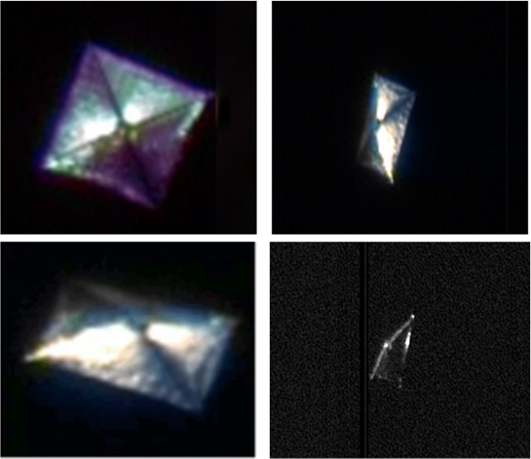
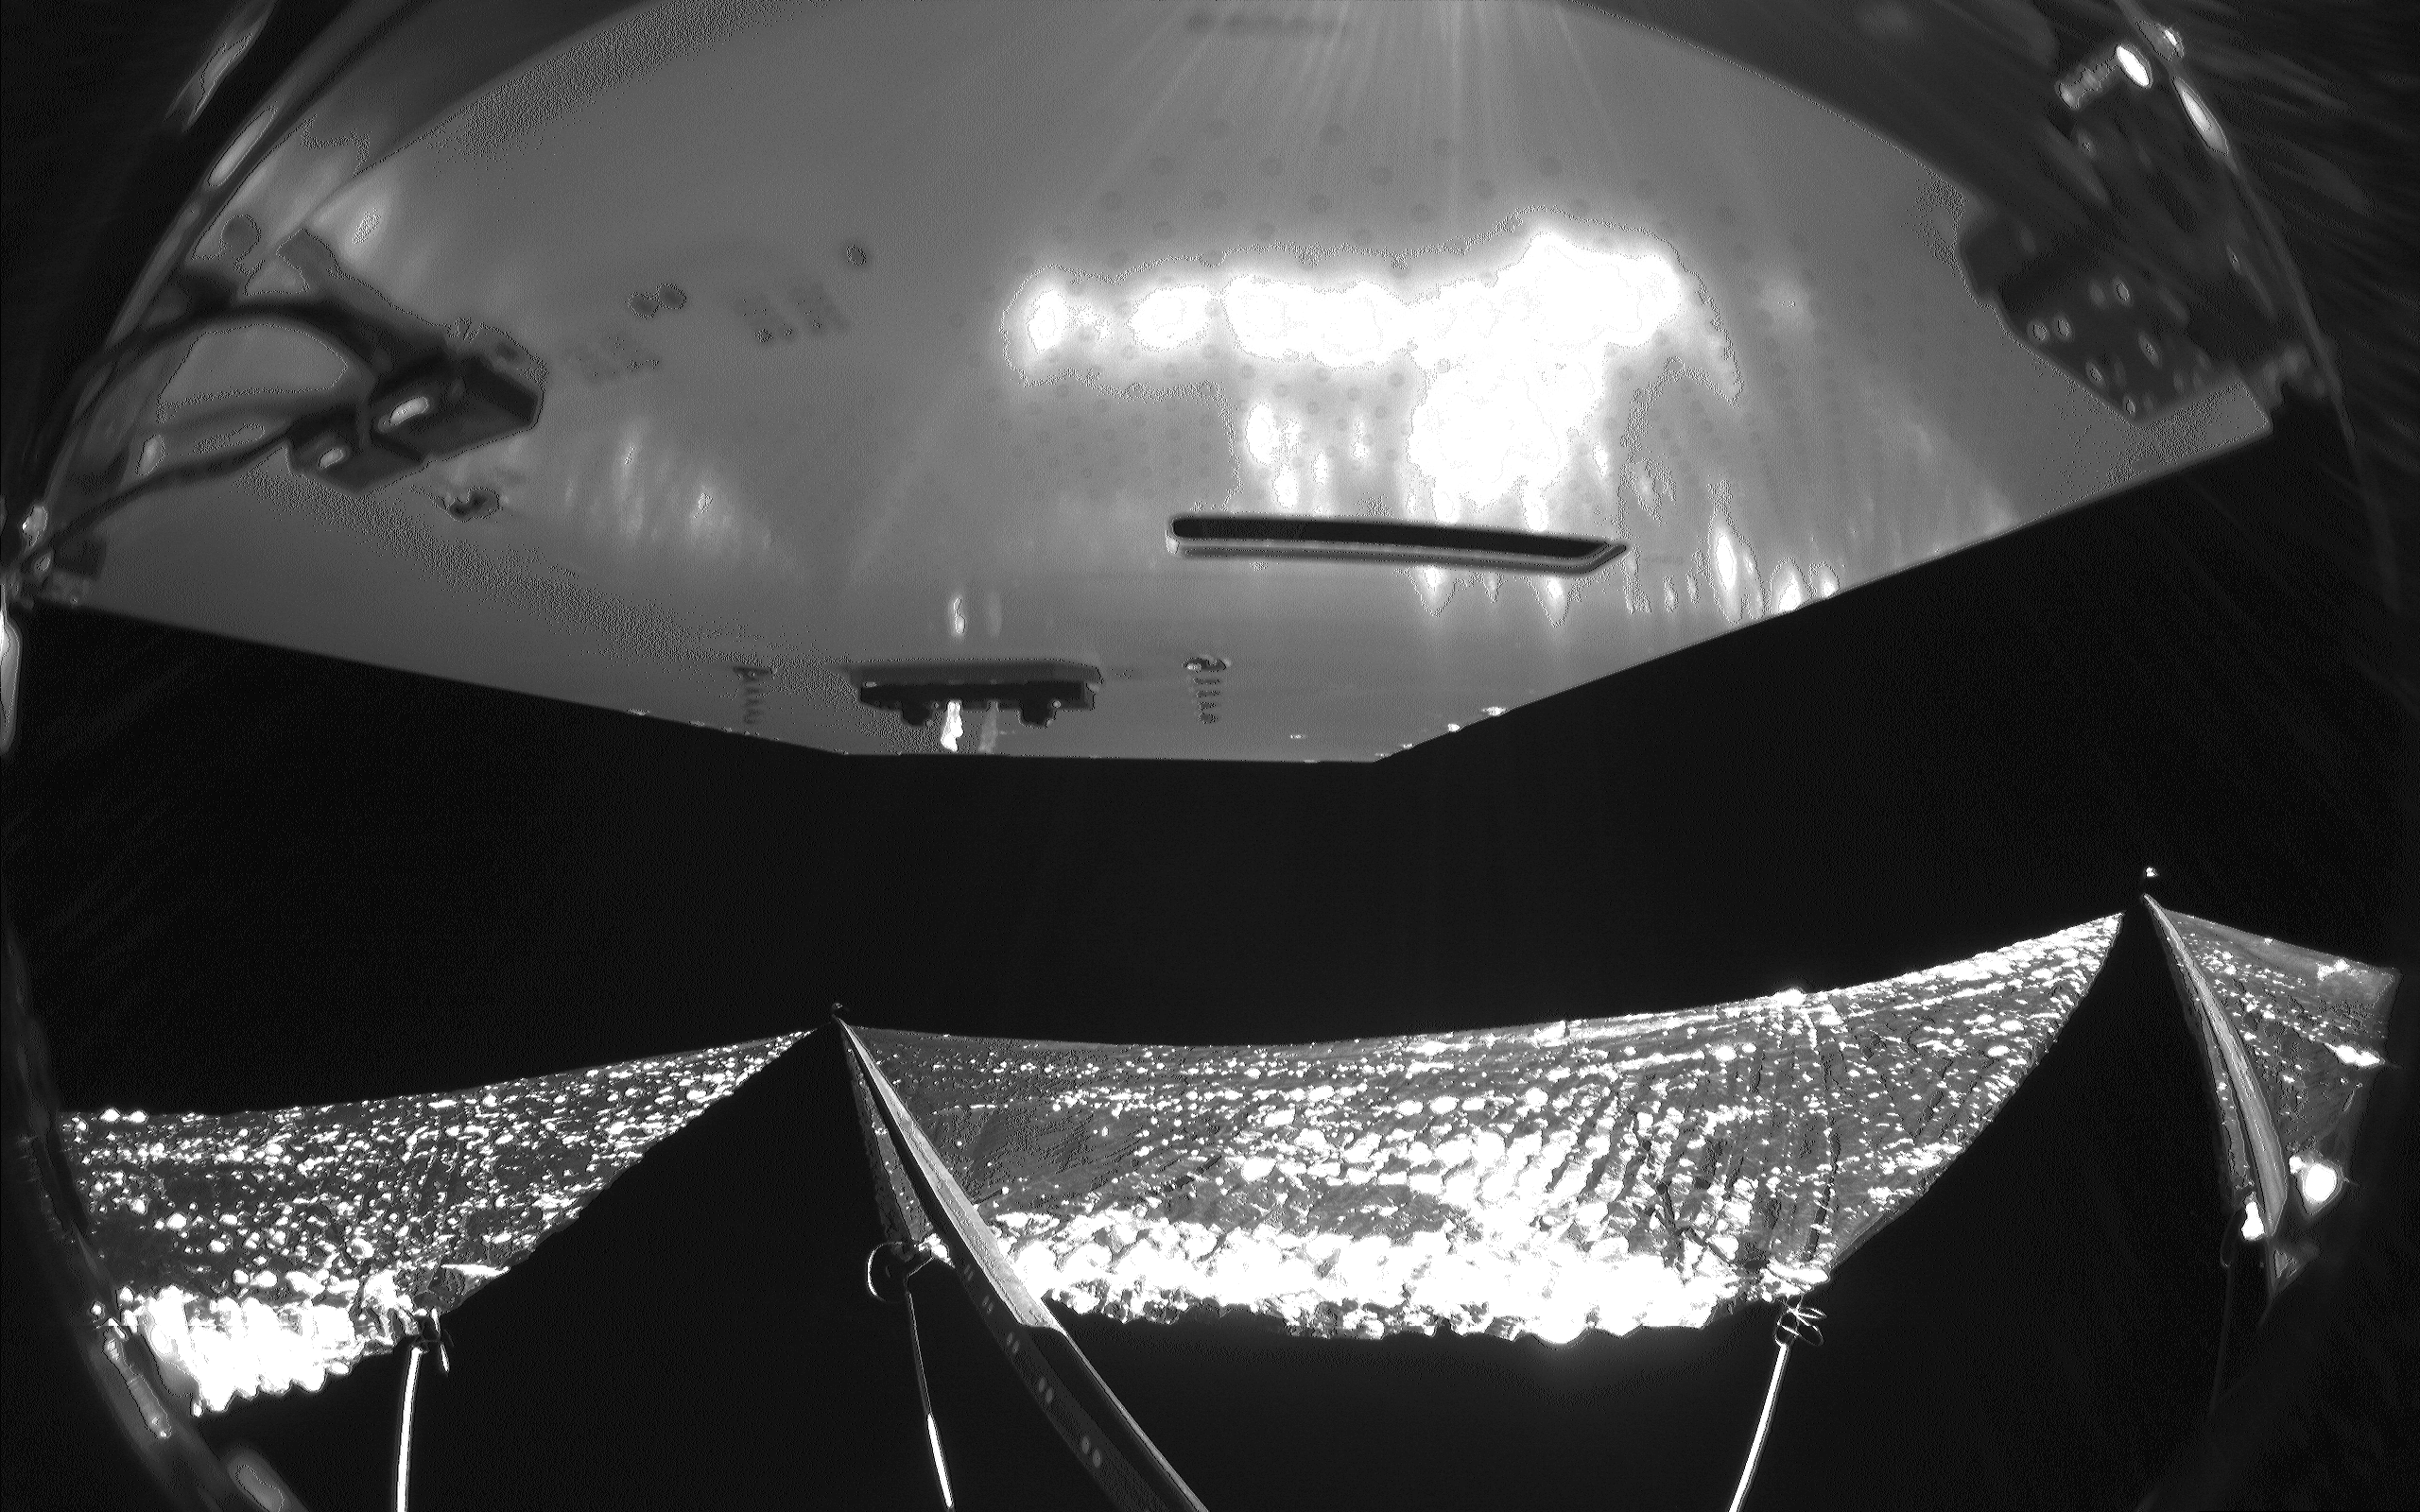
Key Results - Sail Deployment and Sail Shape Analysis
Full deployment was evident in the acquired images
Detailed analysis found a bend and rotation near the root of one of the booms
The booms were clocked by about 45º and swept aft by 1 to 2 meters => more pyramidal and less planar.
Worldview-2 images of ACS3 spacecraft taken on 11 Sep 2024 – Courtesy Vantor
Deployment video from camera A show boom collapses at the end of deployment

Slide 10
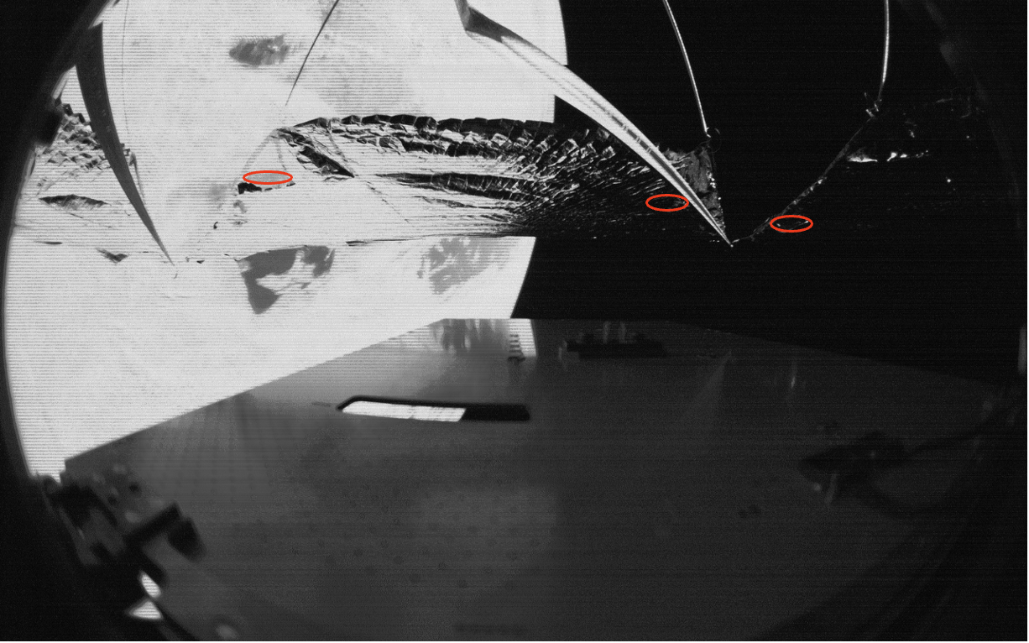
Sail Observations
Sail Degradation: Key Findings
  Anticipated Wear: Continuous exposure to UV and thermal cycling was expected to cause holes and tears in the sail material over time.
  Early Observations: Small holes appeared within four months of deployment, consistent with predicted degradation.
  Long-Term Integrity: The sail remains structurally sound after two years in orbit. No signs of structural deterioration and the initial holes have shown no visible changes.
Tears and holes on the sail (circled in red) – from quadrant camera full resolution image

Slide 11
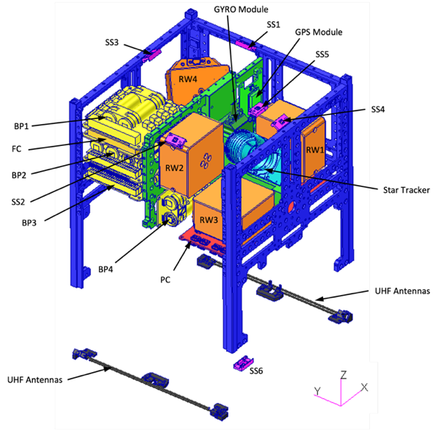
ADCS Challenges
ADCS Sensors Overview: Standard sets of ADCS sensors typical of CubeSat missions, presenting no unique risks.
  6 Sun Sensors
  4 Reaction Wheels
  3 Magnetorquers (X, Y, Z axis)
  4 Magnetometers
  Multi-axis Gyroscope Sensors
  Star Tracker
Spacecraft Components Location
SSn: Sun Sensors 1-6
RWn: Reaction Wheel 1 – 4
BPn: Battery Pack 1 – 4
FC: Flight Computer

Slide 12
ADCS Challenges (cont’d)
ACS3 Mission ADCS Challenges:
  Star Tracker Malfunction: The star tracker failed, limiting attitude determination to coarse estimates.
  Solar Sail Deployment Issues: Solar sail deployed off-nominally, causing higher-than-expected Solar Radiation Pressure (SRP) torques
  Reaction Wheels Saturation: Reaction wheels saturated during a controlled pointing experiment
    Gyroscopic Spin: Spacecraft entered a gyroscopic, semi-stable spin in the z-axis
    Solar Array Orientation: The solar arrays pointed away from the sun – relying on Earth’s albedo and reducing detumble controller effectiveness.
    Orbital Frame Lock: ACS3 attitude remained “locked” to the orbital frame and precessed with the orbit.
The spacecraft was in gyroscopic stabilization and locked to the orbital frame kept the solar arrays pointed away from the sun. The spacecraft relied only on Earth’s albedo for power.

Slide 13
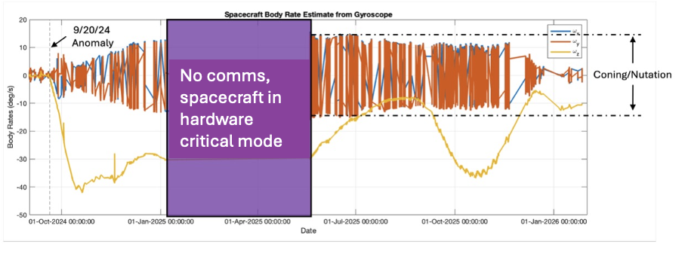
ADCS Challenges (cont’d)
    Torque Effects: Gravity gradient and gyroscopic torques led to the spacecraft spin axis of inertia was perpendicular to the orbital plane.
    Attitude Precession: As the SSO precessed 180º, the spacecraft attitude rotated along with it, keeping solar panels away from the sun.
Following the attitude anomaly, ACS3 detumble mode remained engaged throughout the mission. However, despite continuous effort, the system was unable to achieve the necessary threshold for stable, controlled pointing or enable other maneuvers
The spacecraft was unable to reduce the spin rate to the required threshold as detumble operations were limited by the power availability.

Slide 14
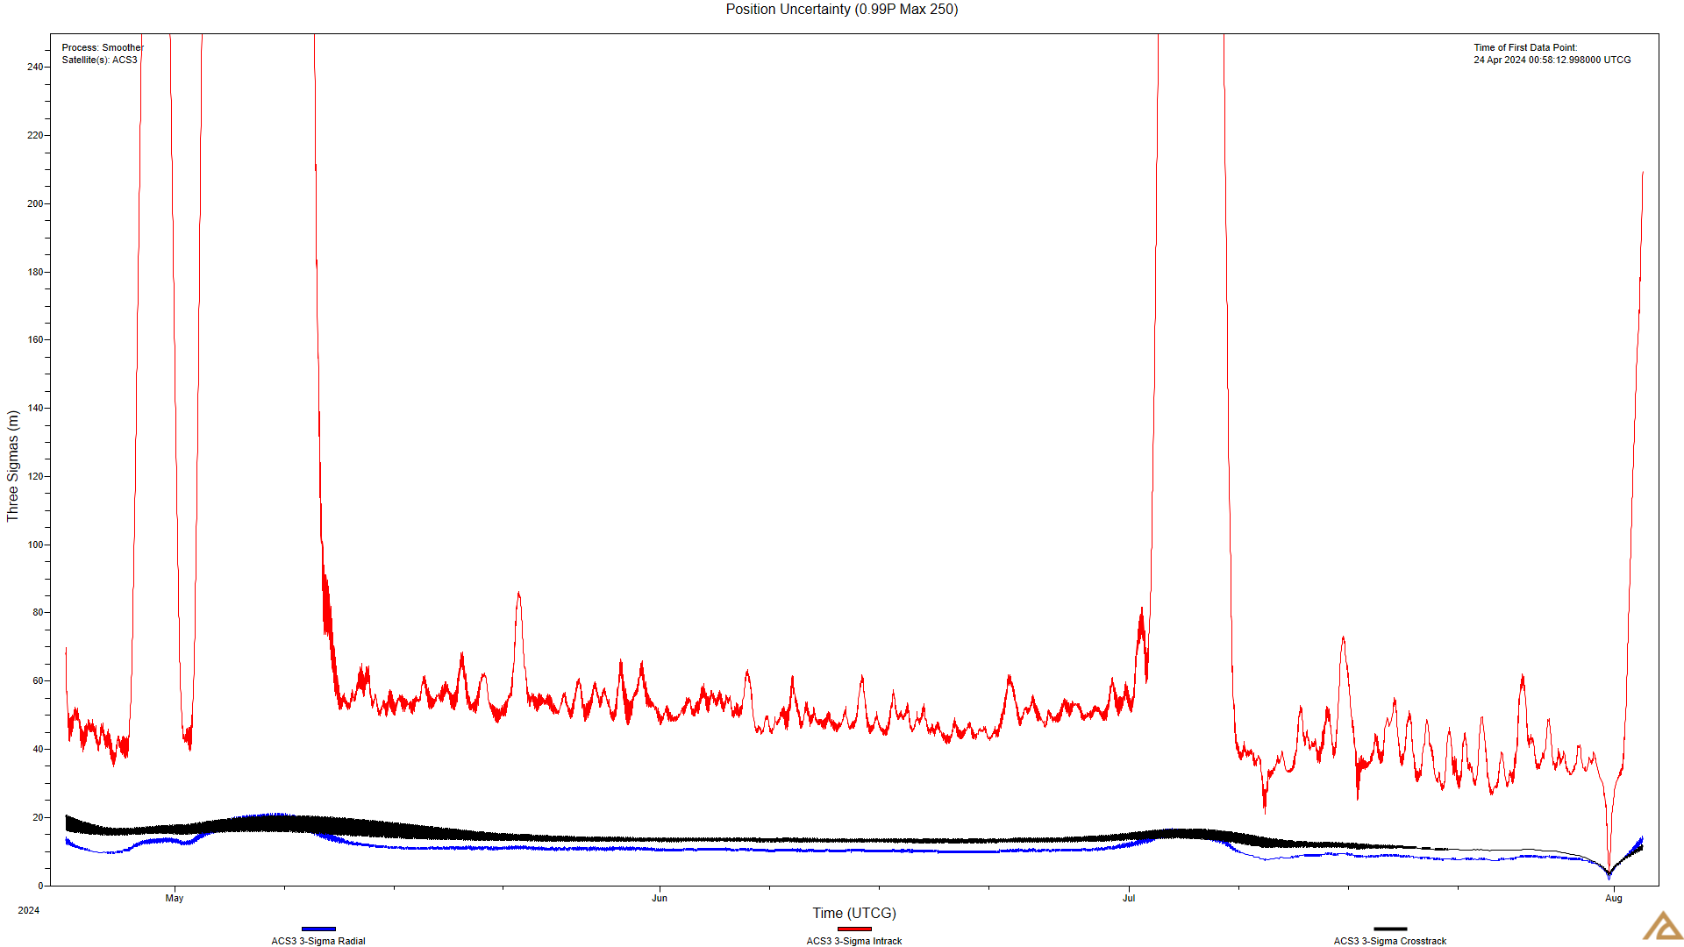
Trajectory Prediction Challenges
Before Sail Deployment:
GPS Data Acquisition: The GPS Receiver struggle to acquire consistent data - Although some valid data of sufficient quality to generate ephemeris files, overall reliability was limited.
Data Quality: The available data were too noisy for high fidelity attitude determination and reconstruction
Position Uncertainty with observed GPS data from commissioning until sail deployment

Slide 15
Trajectory Prediction Challenges (cont’d)
After Sail Deployment:
GPS Receiver Outage: Not able to receive GPS data due to issues in the power system
Orbit Monitoring: To compensate, orbit propagation was monitored by analyzing Vector Covariance Message provided by NASA CARA team
Propagator Limitations: A high-fidelity propagator only good for a short time span
Impact of Solar Radiation Pressure (SRP): SRP-induced eccentricity changes proved difficult to predict over long durations, further impacting the accuracy of orbital predictions.
Long-term Prediction Challenges: The methods used were not suitable for long-term propagation and lifetime predictions
Key Takeway: High-fidelity orbital prediction of ACS3 spacecraft proved challenging due to (i) GPS Receiver unavailable in most of the mission operations, (ii) SRP-induced eccentricity impacting long-term orbital propagation

Slide 16
Lessons Learned
Solar Sail Deployment and Diagnostics – Key Considerations in Testing and Analysis
High-Fidelity Deployment Testing: It is essential to conduct a full deployment test to evaluate the solar sail and its control system’s performance and reliability
Partial Deployment Testing: Utilize a gravity offloader that allows unrestricted 3D motion for partial deployment tests. This approach bridges the gap between the earth-based development environment and operational performance in space.
Sail Shape Analysis Challenge: Determine the full sail shape through analysis alone is complex due to challenge in capturing complete sail images onboard, limiting the assessment accuracy.
Onboard Diagnostic Cameras Design: High-fidelity diagnostic cameras system onboard and its placement is crucial for monitoring deployment and identifying potential issues in real-time.
Scaling Challenges: As the sail area increases, the complexity and difficulty of addressing deployment and diagnostic challenges also grow, requiring enhanced testing and monitoring strategies.

Slide 17
Lessons Learned (cont’d)
Attitude Determination and Control System (ADCS)
Onboard Camera System: Provide invaluable insights for identifying and characterizing off-nominal deployments, enabling update to dynamic models for more accurate system response.
Flexible-body attenuation filters: Roll-off frequencies designed prior to the first fundamental structure mode suppress higher frequencies response, improving stability and control.
Hardware-in-the-loop Star Tracker Testing: Utilize emulated star fields at the subsystem level whenever feasible to ensure accurate response under real-world conditions.
Long-Term Simulations: Integrate the interaction of environmental and dissipative effects in long-term that are often overlooked, providing more accurate understanding of system behavior over time.
Early Off-nominal Simulation: Conduct off-nominal scenarios simulation early in the project lifecycle to proactively identify and address risks.

Slide 18
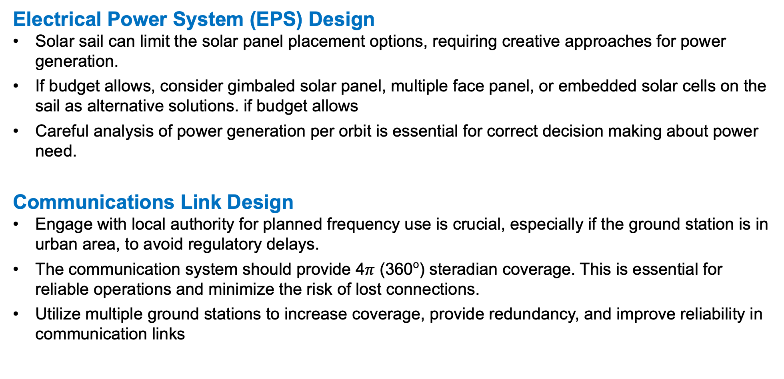
Lessons Learned (cont’d)
Electrical Power System (EPS) Design
Solar sail can limit the solar panel placement options, requiring creative approaches for power generation.
If budget allows, consider gimbaled solar panel, multiple face panel, or embedded solar cells on the sail as alternative solutions. if budget allows
Careful analysis of power generation per orbit is essential for correct decision making about power need.
Communications Link Design
Engage with local authority for planned frequency use is crucial, especially if the ground station is in urban area, to avoid regulatory delays.
The communication system should provide 4$π$ (360º) steradian coverage. This is essential for reliable operations and minimize the risk of lost connections.
Utilize multiple ground stations to increase coverage, provide redundancy, and improve reliability in communication links

Slide 19
Lesson Learned (cont’d)
Complexity Does not Scale
  Smaller spacecraft impose constraint on the sail deployer and avionics subsystem design. Plan for the volume constraints early to avoid unexpected challenges during development and testing.
  Conduct a thorough form factor trade analysis in early stage of the project. Early evaluation supports better design decisions and help balance performance with practical constraints.

Slide 20
Conclusion and Acknowledgment
Primary Objectives Accomplished: Successfully deployed the solar sail using a composite deployer within a 12U spacecraft, achieving all primary objectives.
Collaboration Across Sectors: ACS3 was a collaborative effort involving multiple NASA centers, government agencies, industry partners and academic institutions.
Advancing Space Technology: Demonstrate the value of cross-organizational collaboration to drive innovation for future missions.
Thank You!: Deep appreciation for the dedication, contributions, and support from:
  ACS3 team members, whose commitment made the mission a success.
  Leadership at SSDS, RTMD, Ames Research Center, Langley Research Center, and Marshall Space Flight Center.
Looking Ahead: The lessons learned from this mission will inform and inspire future advancements in solar sail missions.

