Slide 1

CFD-assisted nodal modeling of sloshing in a cryogenic propellant tank
Alok Majumdar, Andre LeClair,
NASA Marshall Space Center, Huntsville, AL 35812
Ramon Lopez Otero
CFD Research Corporation, Huntsville, AL 35806
Jacob Brodnik
NASA Marshall Space Center, Huntsville, AL 35812
TFAWS Cryothermal Paper Session
Presented By
Alok Majumdar
Thermal & Fluids Analysis Workshop
TFAWS 2026
August 31 – September 4, 2026
NASA Marshall Space Flight Center
Huntsville, AL

Slide 2
Introduction
Motivation
  Simulation of thermodynamic impact of Sloshing in a Cryogenic Propellant Tank is of interest to Space Propulsion.
  Traditionally, Sloshing is modeled by high fidelity CFD computation, but this can be time-consuming.
  Development of Slosh Modeling Capability using a fast Nodal Code will benefit industries during initial design phase.
What happens during sloshing?
  During autogenous pressurization, tank sloshing causes a significant increase in pressurant consumption to maintain constant ullage pressure during draining of the tank.
  This increase in pressurant consumption is caused by a significant increase in condensation at the liquid-vapor interface.
  Sloshing strongly affects the liquid side heat transfer coefficient and thereby the condensation rate.

Slide 3
Modeling Methodology
Traditionally, sloshing is modeled by CFD code using the VOF (Volume of Fluid) method to track the liquid vapor interface during sloshing. CFD calculations require a very fine grid to accurately compute the heat and mass transfer at the interface.
Therefore, computations are time consuming and prohibit performing many parametric studies often needed during the design of a new system.
This presentation describes an alternative approach by developing a CFD-assisted nodal model to predict system parameters more economically with reasonable accuracy.
In this approach, a multi-node model of tank pressurization was developed and verified by comparing with test data using GFSSP.
The model computes heat and mass transfer at the interface to calculate the condensation rate.

Slide 4
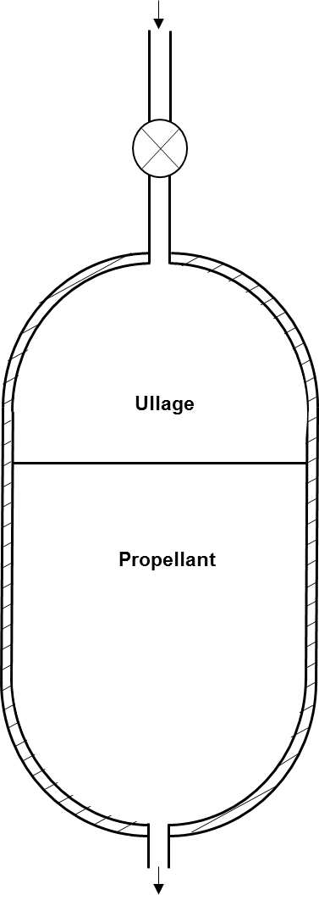
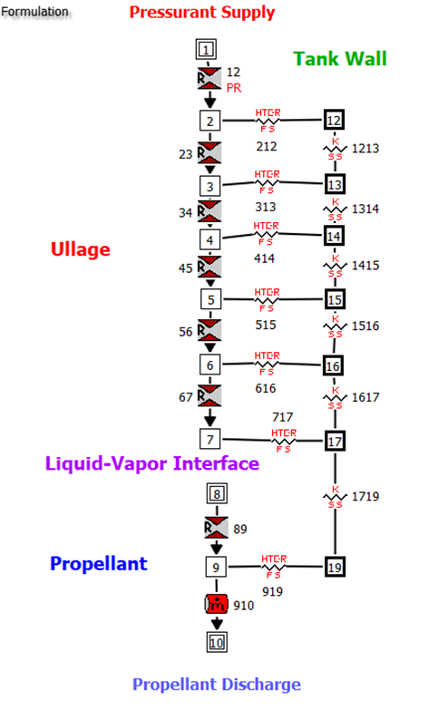
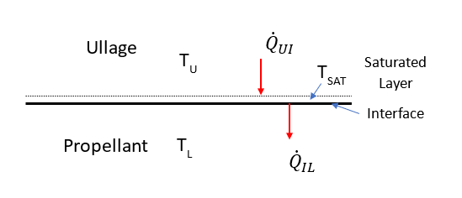



GFSSP Model of Tank Pressurization
$${\dot{Q}}_{IL}=H_{FL}\left(T_{saturated}−T_{liquid}\right)$$
$${\dot{Q}}_{UI}=H_{FU}\left(T_{ullage}−T_{saturated}\right)$$
Multi-node model allows stratification and improves the accuracy of condensation calculation
The consumption of gaseous methane compares within 6% (MAPE) with K-site Test Data [1,2].

Slide 5
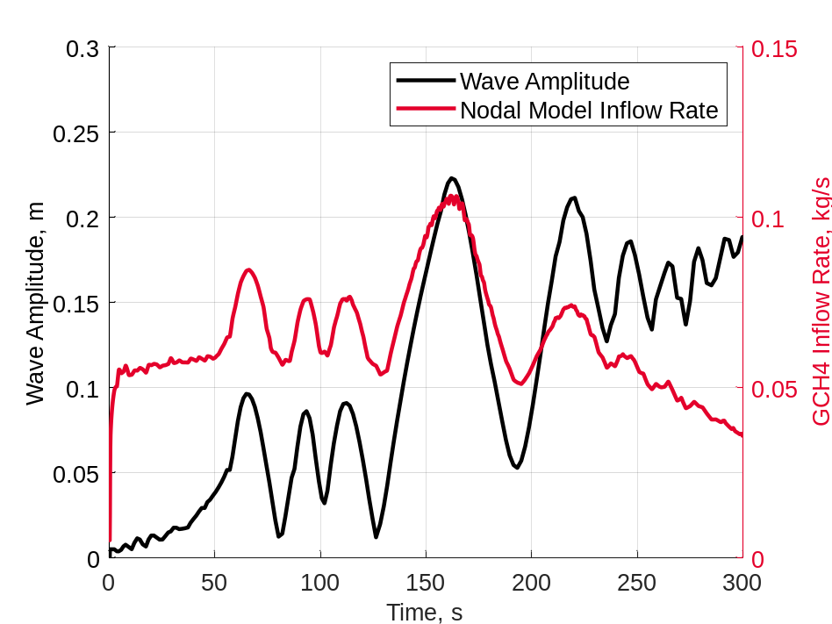

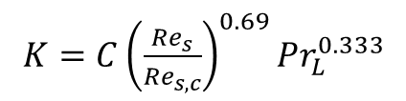


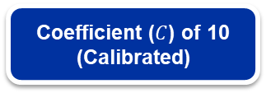


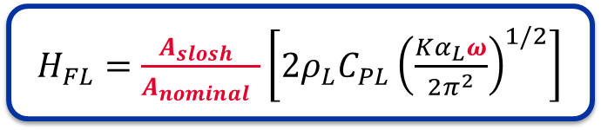


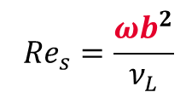
Interface Heat & Mass Transfer Model During Sloshing
Phase Change
Heat Transfer Model [3]
Thermal Diffusivity Enhancement
$${\dot{Q}}_{UI}−{\dot{Q}}_{IL}=\dot{m}L_{v}$$
$H_{FL}=\frac{A_{slosh} }{A_{nominal} }\left[2ρ_{L}C_{PL}{\left(\frac{Kα_{L}ω}{2π^{2}}\right)}^{1/2}\right]$
$K=C{\left(\frac{{Re}_{s}}{{Re}_{s,c}}\right)}^{0.69}{Pr}_{L}^{0.333}$
$${\dot{Q}}_{IL}=H_{FL}\left(T_{saturated}−T_{liquid}\right)$$
$${Re}_{s}=\frac{ωb^{2}}{ν_{L}}$$
Coefficient ($C$) of 10 (Calibrated)
$$T_{ullage}$$
$${\dot{Q}}_{UI}$$
$$T_{saturated}$$
$$T_{liquid}$$
$${\dot{Q}}_{IL}$$
Variable Provided by CFD

Slide 6
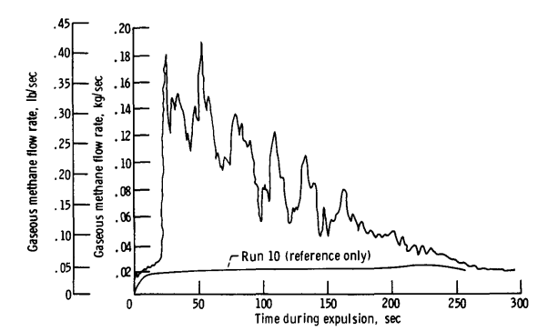
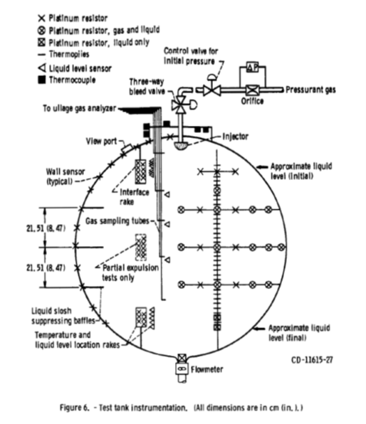
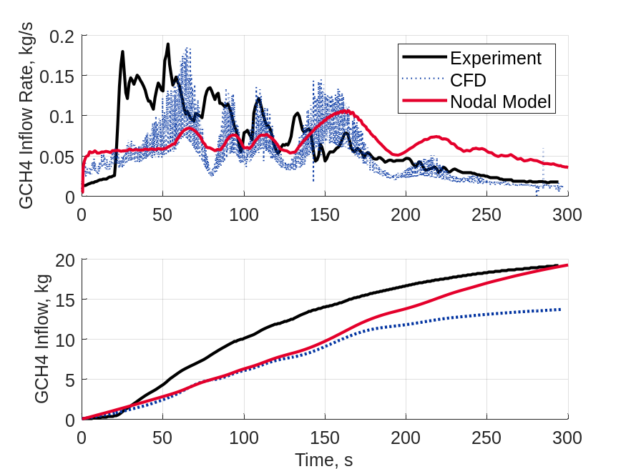
K-Site Slosh and Drain - Run 29 [1,4,6]
Parameter | Value
Fluid | LCH4 / GCH4
Inlet Temperature (K) | 349
 | 3.34
Tank Pressure (bar)
Expulsion Time (s) | 296.3
Total GCH4 Added (kg) | 19.082

Slide 7
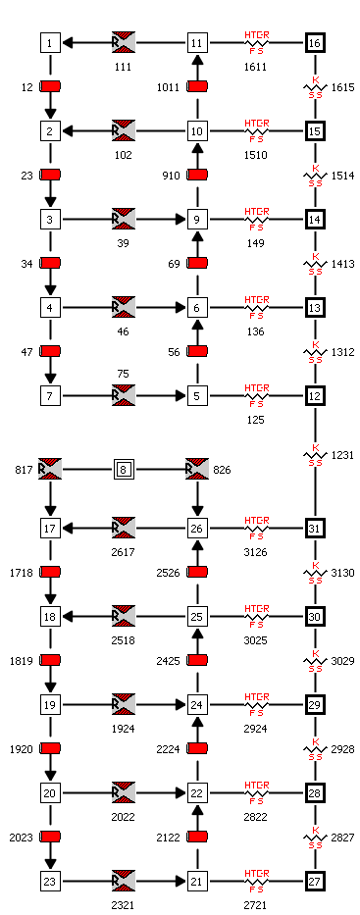
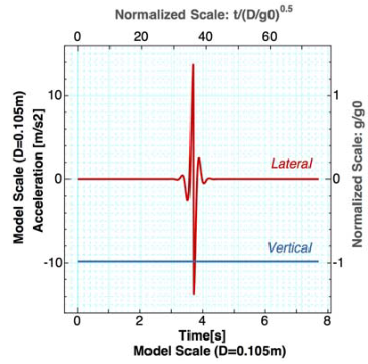
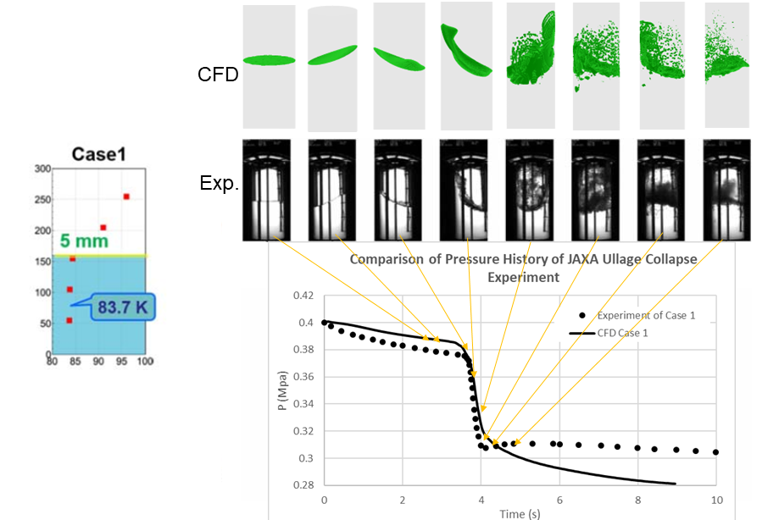
JAXA Cryostat Case 1 [5]
Parameter | Value
Fluid | LN2 / GN2
Initial Temperature (K) | 83.7 / 94
 | 4
Initial Tank Pressure (bar)
Initial Thermal Stratification (mm) | 5
Ullage
Tank Wall
Liquid
Validation of Loci/STREAM-VoF [6]

Slide 8
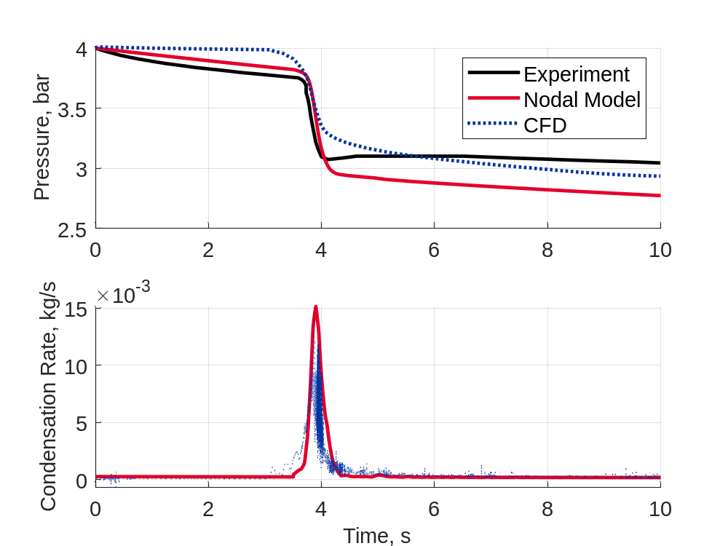
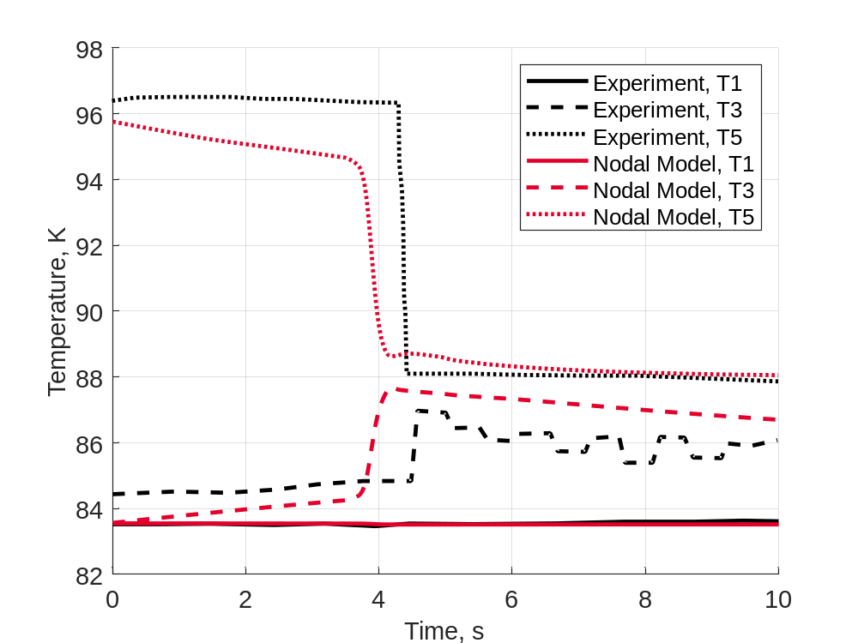
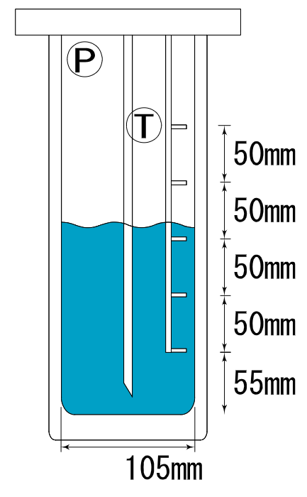



JAXA Cryostat Case 1
$$T5$$
$$T3$$
$$T1$$
Pressure results within 10% of experiment (4.4% mean absolute percentage error)
Good agreement with temperature sensor data

Slide 9
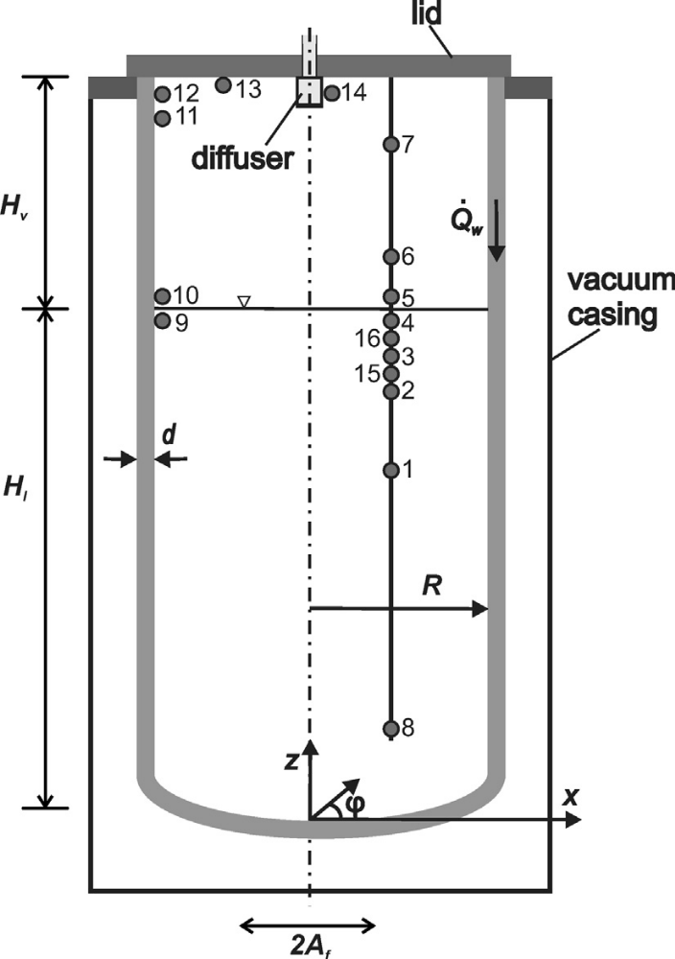
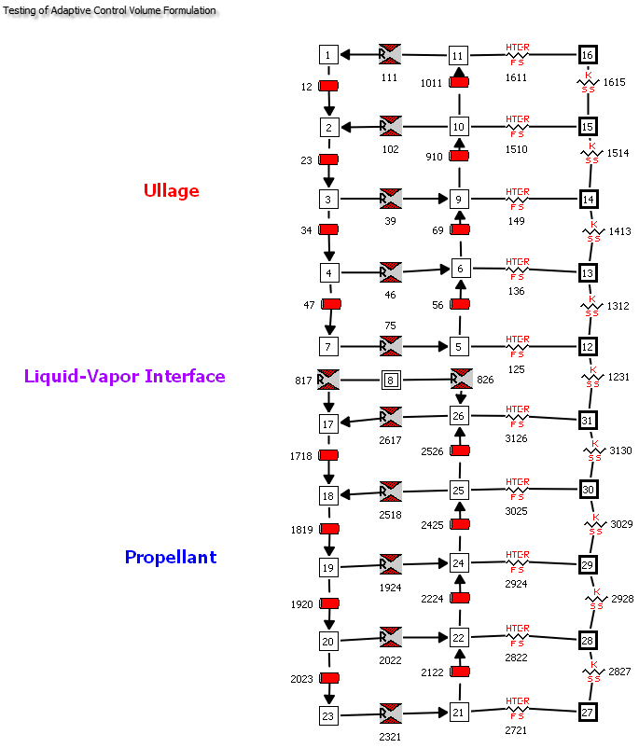
Modeling Ludwig’s Experiment [7]
Ludwig et al. conducted a test program where tank was first pressurized, held steady, and then subjected to oscillation.
Ludwig et al. also developed an interface heat transfer model using an empirical correlation to estimate effective diffusivity in terms of slosh dynamics parameters.
Present model only considered sloshing operation and used Ludwig’s model of interface heat and mass transfer

Slide 10
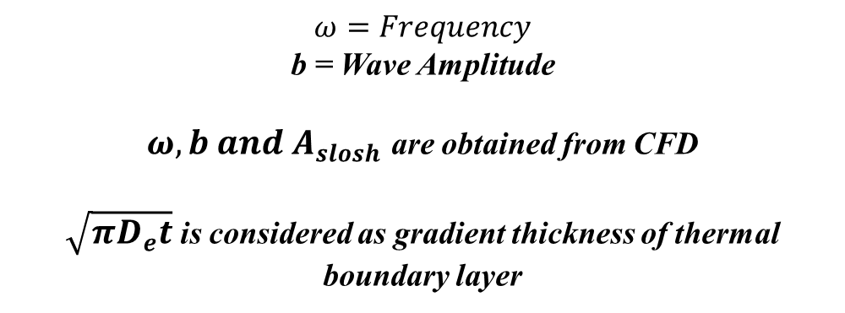
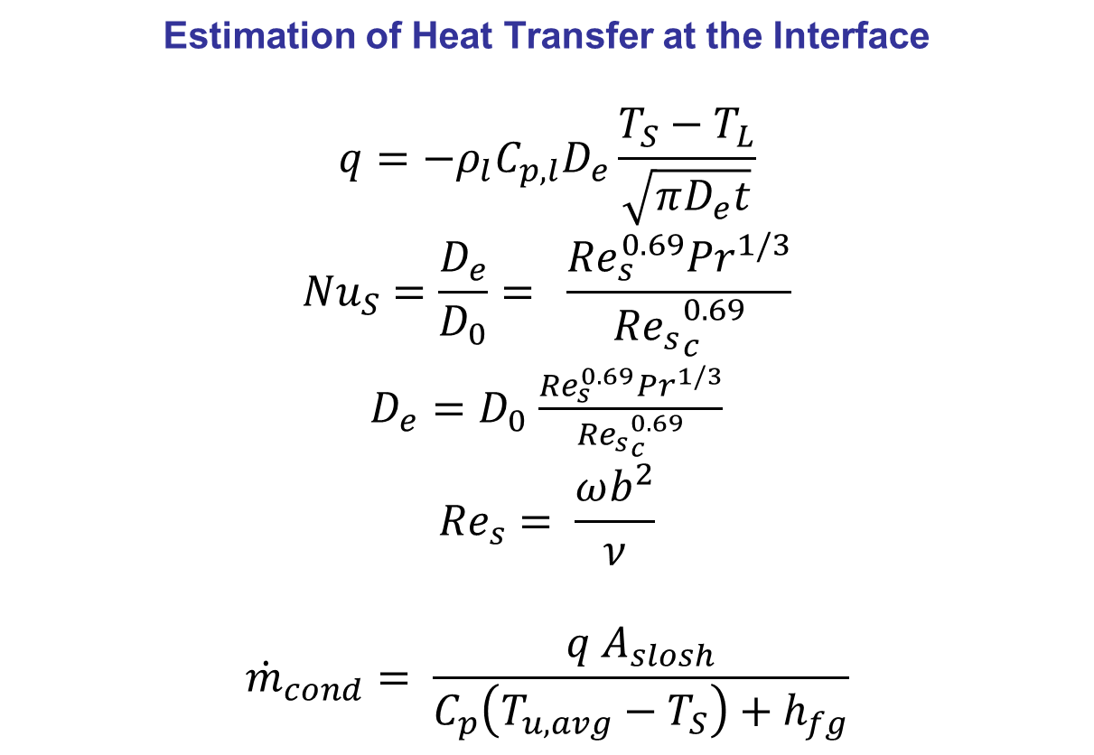
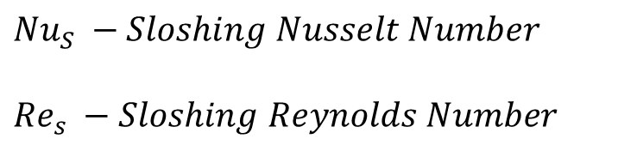
Ludwig Correlation used for estimation of condensation during sloshing
Estimation of Heat Transfer at the Interface
$$q=−ρ_{l}C_{p,l}D_{e}\frac{T_{S}−T_{L}}{\sqrt{πD_{e}t}}$$
$${Nu}_{S}=\frac{D_{e}}{D_{0}}= \frac{{Re}_{s}^{0.69}{Pr}^{1/3}}{{{Re}_{s}}_{c}^{0.69}}$$
$D_{e}=D_{0}$ $\frac{{Re}_{s}^{0.69}{Pr}^{1/3}}{{{Re}_{s}}_{c}^{0.69}}$
$${Re}_{s}= \frac{ωb^{2}}{ν}$$
$${\dot{m}}_{cond}= \frac{q A_{slosh}}{C_{p}\left(T_{u,avg}−T_{S}\right)+h_{fg}}$$
$$ω=Frequency$$
b = Wave Amplitude
$ω, b and$ $A_{slosh}$ are obtained from CFD
$\sqrt{πD_{e}t}$is considered as gradient thickness of thermal boundary layer
$${Nu}_{S} −Sloshing Nusselt Number$$
$${Re}_{s} −Sloshing Reynolds Number$$

Slide 11
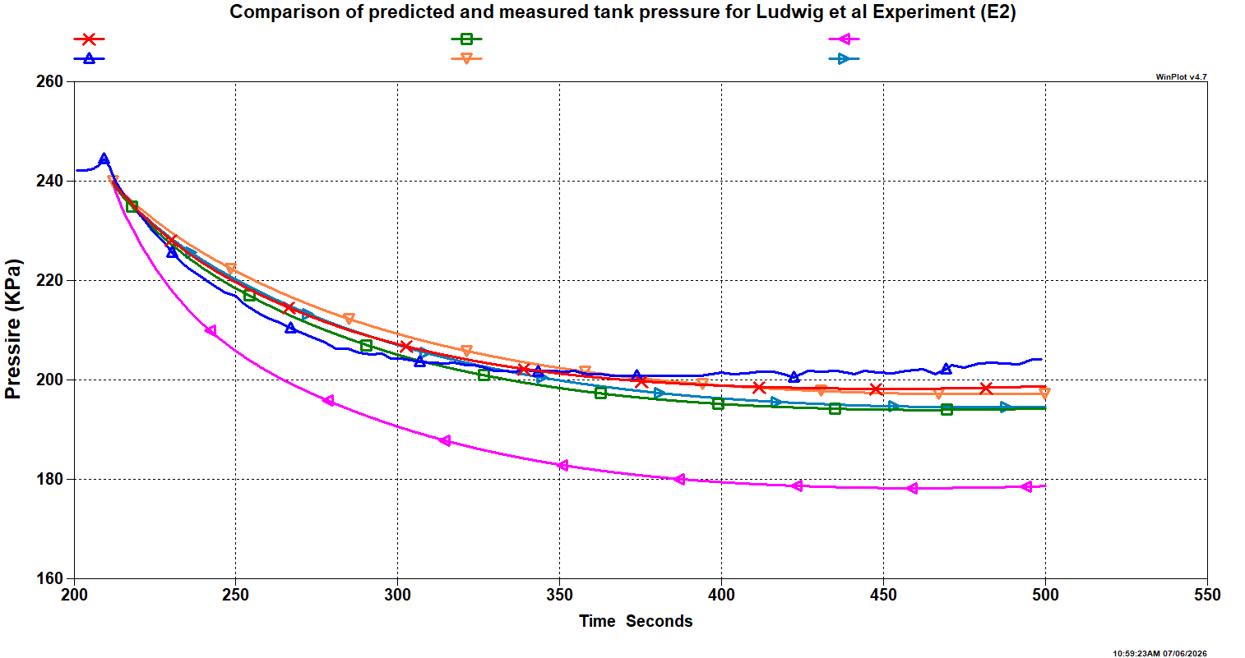
Study of Radial Grid Distribution
Measured
BL with finer grid
BL with course grid
No Boundary Layer

Slide 12
Results of Axial Grid Sensitivity Study on Pressure Calculation
Run Number | Description | Grid Resolution | MAPE (%)
1 | No Boundary Layer | Each layer is 11.38 cm depth | 8.13
2 | 1 node BL (Course) | 1 node in BL of 1 mm and 3 nodes of 15.13 cm depth | 1.86
3 | 2 node BL (Course) | 2 node in BL of 1 mm & 2 mm and 2 nodes of 22.6 cm depth | 1.67
4 | 1 node BL (Fine) | 1 node in BL of 0.5 mm and 3 nodes of 15.15 cm depth | 1.92
5 | 2 node BL (Fine) | 2 node in BL of 0.5 mm & 1 mm and 2 nodes of 22.68 cm depth | 1.16

Slide 13
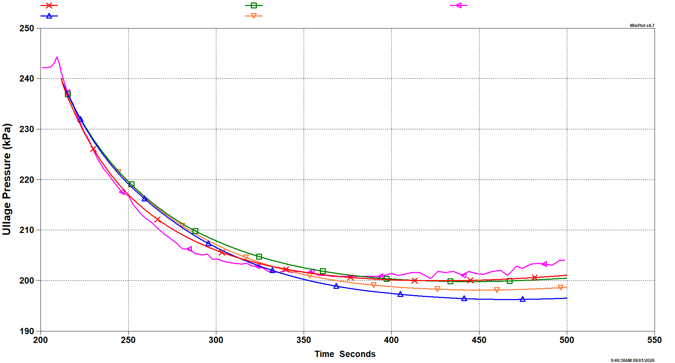
Results of Radial Grid Sensitivity Study on Pressure Calculation
Core – 50% ; Annulus – 50%
Core – 80% ; Annulus –20%
Test Data
Core – 95% ; Annulus –5%
Core – 90% ; Annulus –10%

Slide 14
Results of Radial Grid Sensitivity Study on Pressure Calculation
Run Number | Description | Grid Resolution | MAPE (%)
5.1 | 2 node BL (Fine)** | Core – 90% ; Annulus – 10% | 1.16
5.2 | 2 node BL (Fine) | Core – 95% ; Annulus – 5% | 1.45
5.3 | 2 node BL (Fine) | Core – 85% ; Annulus – 15% | 1.0
5.4 | 2 node BL (Fine) | Core – 80% ; Annulus – 20% | 1.05
5.5 | 2 node BL (Fine) | Core – 50% ; Annulus – 50% | 0.55
** Run 5 of previous slide

Slide 15
Summary
This presentation describes the progress made to model the sloshing of a cryogenic tank using a nodal code using inputs from a CFD code.
The main emphasis is to predict interface heat and mass transfer during sloshing which is believed to be the cause of observed ullage collapse.
During sloshing, the interface heat transfer is increased due to the increase of effective diffusivity at the interface. The effective diffusivity has been expressed as a function of frequency and amplitude of fluid oscillation.
Two different heat transfer models that account for increased heat transfer were investigated to analyze sloshing in three different experimental situations.
The heat transfer model proposed by Ludwig et al. appears to be the more promising candidate for further research.
The model needs further validation with test data and extended for moving interface observed during draining of the tank.

Slide 16
Acknowledgement
The work has been performed under Cryogenic Fluid Management Portfolio Project (CFMPP).
The authors would like to acknowledge Bryan Hoffman, Chintan Patel, and H.Q. Yang for many useful technical discussions during the course of this investigation.

Slide 17
References
R.L. DeWitt and T.O. McIntire, "Pressurant Requirements for Discharge of Liquid Methane from a 1.52-meter-(5-ft-) Diameter Spherical Tank Under Both Static and Slosh Conditions" NASA-TN-D-7638. 1974.
Andre C. LeClair and Alok K. Majumdar, “Nodal Modeling of Tank Pressurization and Draining using a Multi-Node-Ullage Approach”, AIAA SciTech Forum, 6-10 January 2025, Orlando, FL, Paper No. 2025-0358.
S.M. Ghiaasiaan and P. Mehdizad, “Nodal Modeling for Cryogenic Fluid Management,” JPID-FY25-000095, Georgia Institute of Technology, Submitted to Structures, Design, and Thermal Analysis Propulsion Systems at NASA Marshall Space Flight Center, October 25, 2024.
Bryan Hoffman ,Alok Majumdar, Andre Leclair, Jacob Brodnick, S. Mostafa Ghiaasiaan, “Nodal modeling of sloshing in a cryogenic propellant tank using a multi-node approach” Space Cryogenics Workshop, May 2025, Lake Tahoe, CA.
T. Himeno et al., “Investigation on Phase Change and Pressure Drop Enhanced by Violent Sloshing of Cryogenic Fluid,” AIAA Propulsion and Energy Forum, July 2018, Cincinnati, OH, AIAA 2024-0548.
H.Q. Yang, C. Patel, and B. Williams, “Validation of Cryogenic Propellant Tank SelfPressurization”, AIAA SciTech 2023 Forum, 23-27 January 2023, National Harbor, MD, AIAA 2023-1411.
C. Ludwig, M.E.Dreyer, and E.J. Hopfinger, “Pressure variations in a cryogenic liquid storage tank subjected to periodic excitations”, International Journal of Heat and Mass Transfer, Vol 66, 2013, pp 223-234.

