Slide 1


A Case Study of AI-assisted Creation of a Thermodynamics Model of Precipitation Formation During Rapid Depressurization of a Vented Container
TFAWS Interdisciplinary Paper Session
Jedediah M. Storey, Ph.D.
Thermal/Fluid Discipline Expert
NASA KSC Launch Services Program
Environments and Nuclear Launch Approval Branch
Artificial Intelligence (AI) Usage Disclosure
The model and code described in this document were created with assistance from ChatGSFC. The content has been reviewed by Jedediah Storey. More information on the extent of AI usage is included in the AI Case Study section. The document itself was not created with AI assistance.
Thermal & Fluids Analysis Workshop
TFAWS 2026
August 31 – September 4, 2026
NASA Marshall Space Flight Center
Huntsville, AL

Slide 2
Before we begin…
AI was used in the development of the model but not to write this presentation or the accompanying paper.
All opinions stated in this work are personal and are not the official position of NASA.

Slide 3
Introduction
Precipitation may form in humid containers undergoing rapid depressurization
  Liquid (fog) if dewpoint > freezing
  Ice (snow) if dewpoint < freezing
Recent need to model this for a rapidly ascending vented container
  Potentially relevant to vented containers/compartments in aircraft, spacecraft, and launch vehicles, as well as rapidly depressurizing vacuum chambers
Anything that adds water vapor to container will enhance precipitation. Ex:
  Water pool
    Need to model convection, evaporation, boiling, freezing, sublimation, structure heat transfer, freezing while evaporating, and triple point boiling & freezing of the water pool
    Transitions between regimes, e.g. L→B
  Vapor sources such as foam or MLI

Slide 4
Objectives
Primary objective: to rapidly develop a thermodynamics model in python useful to engineers wishing to simulate rapidly depressurizing humid containers
Secondary objective: to use an AI LLM to assist in its creation
“Assist” = selection and development of physics models, code acceleration
Model execution speed > maximum accuracy
Objectives were met
Math is in the paper
Model built in python, ~10000 lines
Will show a validation case and an example
Will discuss experience using AI for this
No novel modeling or thermodynamics methods
Notes:
This work does not present any novel modeling or thermodynamics. The new part is the use of AI to not only code it, but to select and implement the relevant thermodynamics.

Slide 5























Model
$${\dot{m}}_{a,dry}$$
Air
Air
$${\dot{m}}_{i,vent}$$
V, $T_{a}$, $P_{a}$,
$m_{v}$, $m_{cond}$,
$$m_{i,a}$$
$${\dot{m}}_{v,inj}$$
$${\dot{m}}_{a,dry}$$
V, $T_{a}$, $P_{a}$,
$m_{v}$, $m_{cond}$,
$$m_{i,a}$$
$${\dot{m}}_{i,vent}$$
$${\dot{m}}_{v,inj}$$
$${\dot{m}}_{v,vent}$$
$${\dot{m}}_{v,vent}$$
Container
Water vapor source
g
$${\dot{Q}}_{S,a}$$
$${\dot{m}}_{pool_to_vapor}$$
$${\dot{Q}}_{S,a}$$
$${\dot{m}}_{pool_to_vapor}$$
$$T_{film}$$
$${\dot{Q}}_{i,S}$$
Ice
Structure in contact with water pool
$$T_{film}$$
$m_{i}$, $T_{i}$,
$A_{s}$, $D_{i}$, $A_{W,i}$
$${\dot{Q}}_{L,S}$$
Liquid
Vent
Water pool
Structure
$${\dot{Q}}_{W,L}$$
$m_{L}$, $T_{L}$, $A_{s}$,
$D_{L}$, $A_{W}$
$m_{W}$, $T_{W}$
$${\dot{Q}}_{W,i}$$
$${\dot{m}}_{freeze}$$
$${\dot{Q}}_{L,i}$$
$$T_{freeze}$$
Structure
Liquid
Water pool
$m_{W}$, $T_{W}$
$${\dot{Q}}_{W,L}$$
$m_{L}$, $T_{L}$,
$D_{L}$, $A_{W,L}$
Physical
Nodal
Water pool
Notional physical representation and two nodal representations, one for a liquid pool, and one for a partially frozen pool.
Notes:
Explain physical model
Explain liquid nodal model. States, heat flow paths, mass flow paths
Explain liquid+ice nodal model differences
Pool = liquid and ice

Slide 6
Physics
Container total air pressure prescribed. Container air temperature from polytropic expansion.
Water vapor in the container air can condense/precipitate out as either liquid or ice. Excess water vapor is shunted to precipitate in each time step.
Vented air is the composition of the container air: mix of air, water vapor, ice
Optional Water Pool
  Variable depth, area, volume pool
  Convection: natural convection flat plate heat transfer correlations. Horizontal for interfaces, vertical for structure-pool heat transfer
  Evaporation mass transfer from pool to air: Chilton-Colburn analogy
  Low pressure (Kn<0.1) mass transfer: Hertz-Knudsen with user sublimation coefficient
  Volumetric boiling only, no surface boiling. Calculated from heat balance
  Boiling splash model
  Freezing begins with a surface layer and progresses down
Fluid properties from CoolProp and curve fits
Some assumptions:
  Perfectly mixed container air
  Volume of container large enough that changes to the optional water pool volume don’t affect container volume
  Container walls have enough thermal mass to stay above dewpoint
  Structure in contact with the pool has infinite thermal conductivity. A contact conductance is assumed.
Notes:
High level overview of the physics.

Slide 7
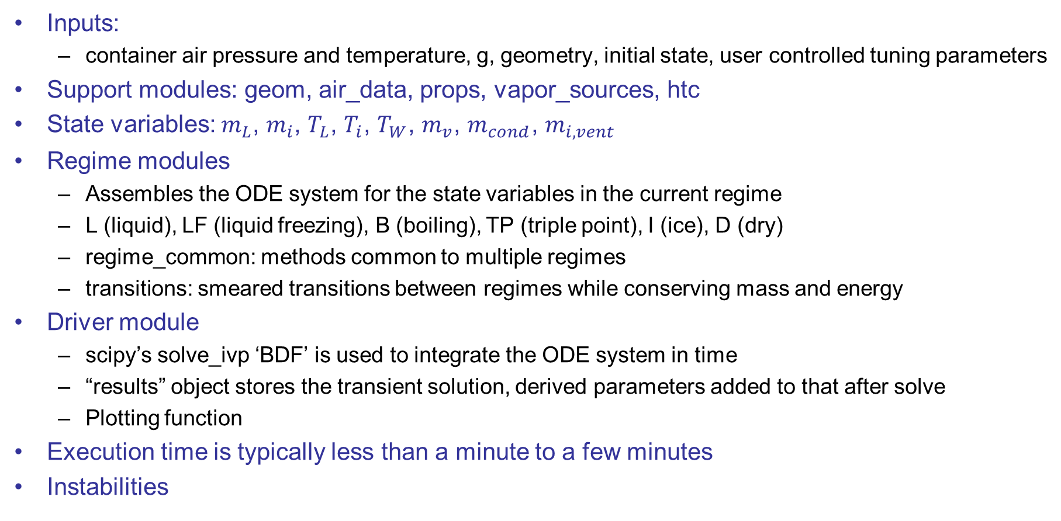
Code Structure
Inputs:
  container air pressure and temperature, g, geometry, initial state, user controlled tuning parameters
Support modules: geom, air_data, props, vapor_sources, htc
State variables: $m_{L}$, $m_{i}$, $T_{L}$, $T_{i}$, $T_{W}$, $m_{v}$, $m_{cond}$, $m_{i,vent}$
Regime modules
  Assembles the ODE system for the state variables in the current regime
  L (liquid), LF (liquid freezing), B (boiling), TP (triple point), I (ice), D (dry)
  regime_common: methods common to multiple regimes
  transitions: smeared transitions between regimes while conserving mass and energy
Driver module
  scipy’s solve_ivp ‘BDF’ is used to integrate the ODE system in time
  “results” object stores the transient solution, derived parameters added to that after solve
  Plotting function
Execution time is typically less than a minute to a few minutes
Instabilities
Notes:
Instability: Solver instabilities were encountered during the development process, and these are discussed in the Opus subsection of the AI Case Study section. Some extreme cases still exhibit solver stability problems. For example, the RH may spike above 100% when the air in the container has mostly vented, resulting in extremely low vapor holding capacity, and the pool starts drying out or is nearly frozen. These instabilities cease when the water pool fully dries or freezes. More rarely, certain combinations of conditions can cause instabilities during startup (see Figure 3 RH) or transitions. Usually, decreasing time step will resolve these stability problems.

Slide 8
Validation Case
https://www.youtube.com/watch?v=8SOCni8JfiU
Standard 100 mL beaker with ~22 mL of water in it placed in a bell jar with attached evacuated chamber and large vacuum pump
Valve is opened, near instant drop in pressure to ~60 kPa, then rapid drop to liquid saturation pressure in ~7.7 s, pool rigorously boils and some water splashes out, pressure continues to drop, surface starts freezing, then water completely freezes.
Extracted estimates of everything needed to model this from video
  Two video cuts, so took the “Water to ice in 90 seconds” in title literally
Validation criteria:
  Time boiling began (~7.7 s)
  Most of time spent at triple point like in video?
  Remaining ice mass (8 mm, ~13.3 g)

Slide 9
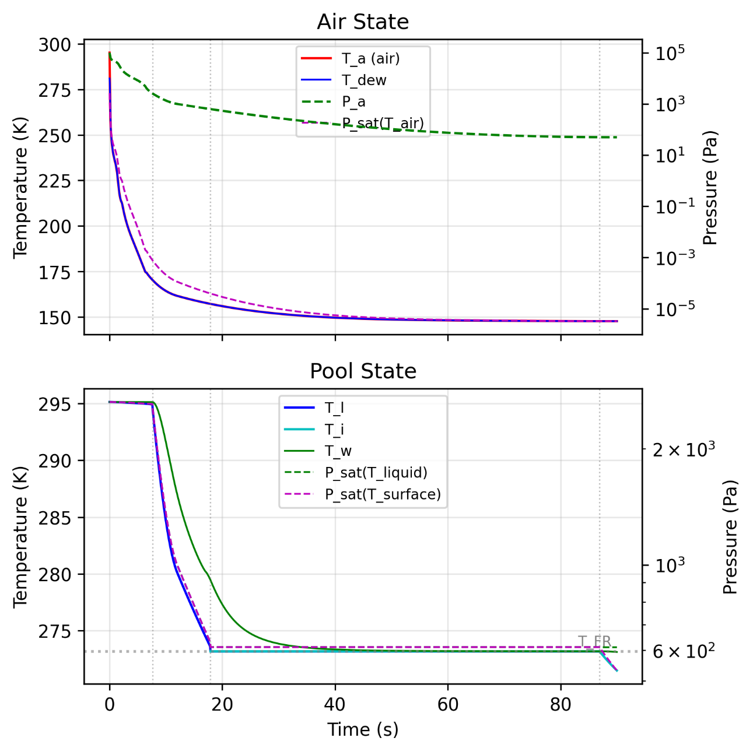
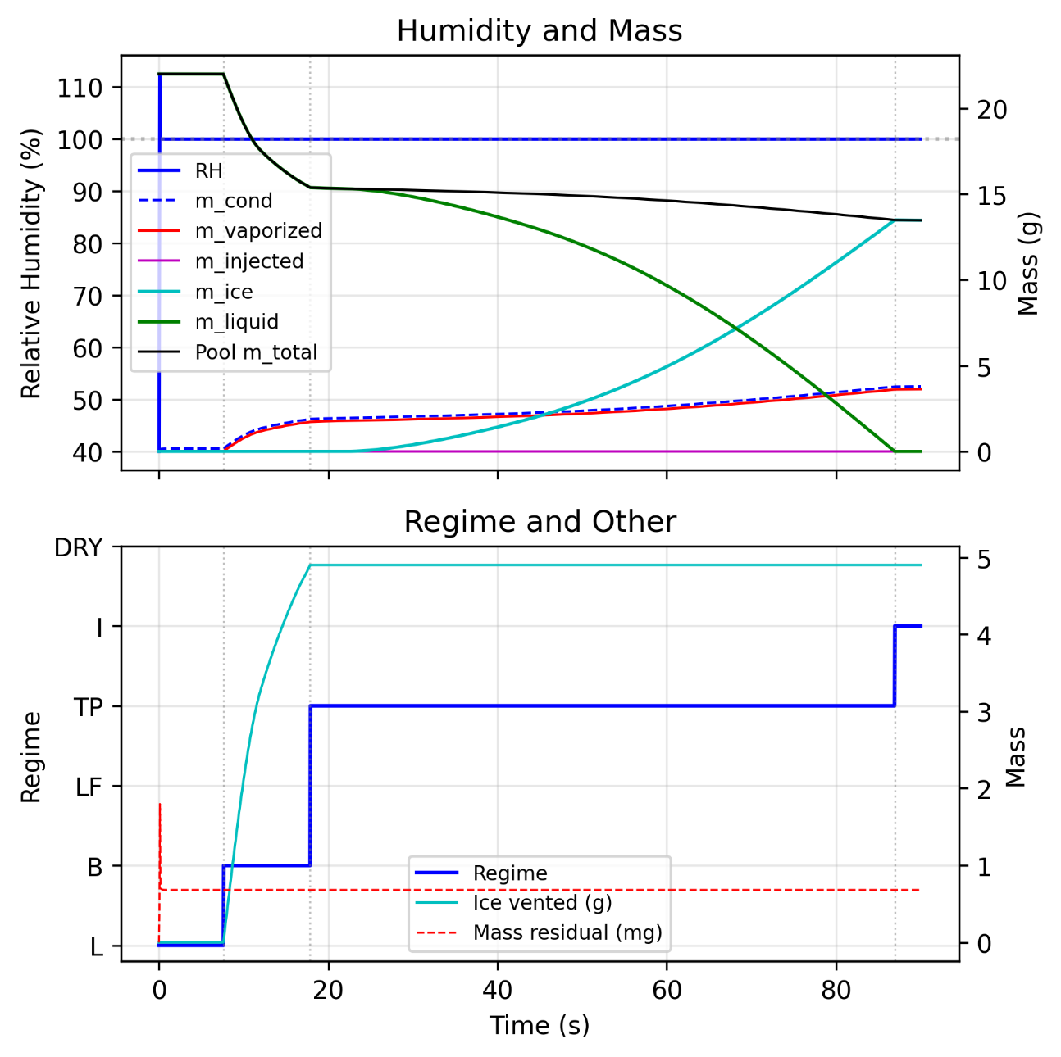
Validation Case: Simulation Results
Notes:
Explain all plots
Boiling time: ~8 s
Spent most of time in TP regime
Final ice mass: 13.4 g
Very little tuning needed to achieve this. Tuned the polytropic expansion coefficient to keep temperature above extreme cryo temps while preserving the near-adiabatic first drop. The splash coefficient, which is a multiplier on boiled off mass, was increased to 6. It was clear in the video that a few mL splashed out of the beaker during rigorous boiling, so this seems reasonable.
The agreement between the test and simulation for boiling onset timing and final ice mass provides a validation point for most of the water pool physics. Although this was considered sufficient for the intended use of the model, I acknowledge that additional validation would be beneficial.

Slide 10
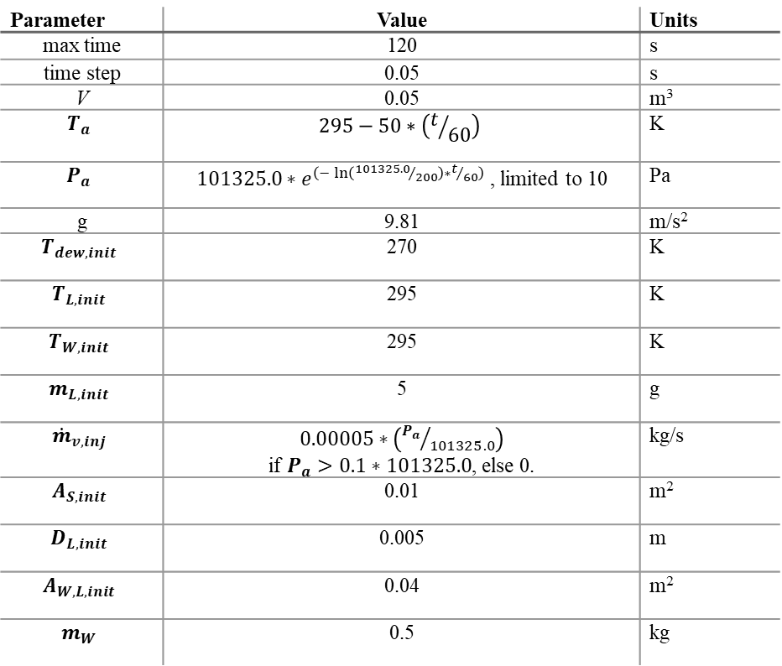
Example Case 1
Regimes: L→B→TP→I→D
Inputs somewhat contrived to achieve desired regime changes.
Rapid air pressure decay, linear temperature drop
Pool is 1cm x 1cm x 0.5cm
Includes a small water vapor injection source that shuts off at low pressure
Parameter | Value | Units
max time | 120 | s
time step | 0.05 | s
V | 0.05 | m³
$$T_{a}$$ | $$295−50∗\left(t/{60}\right)$$ | K
$$P_{a}$$ | $101325.0∗e^{\left(−\ln\left({101325.0}/{200}\right)∗t/{60}\right)}$, limited to 10 | Pa
g | 9.81 | m/s²
$$T_{dew,init}$$ | 270 | K
$$T_{L,init}$$ | 295 | K
$$T_{W,init}$$ | 295 | K
$$m_{L,init}$$ | 5 | g
$${\dot{m}}_{v,inj}$$ | $0.00005∗\left({P_{a}}/{101325.0}\right)$ if $P_{a}>0.1∗101325.0$, else 0. | kg/s
$$A_{S, init}$$ | 0.01 | m²
$$D_{L,init}$$ | 0.005 | m
$$A_{W,L,init}$$ | 0.04 | m²
$$m_{W}$$ | 0.5 | kg

Slide 11
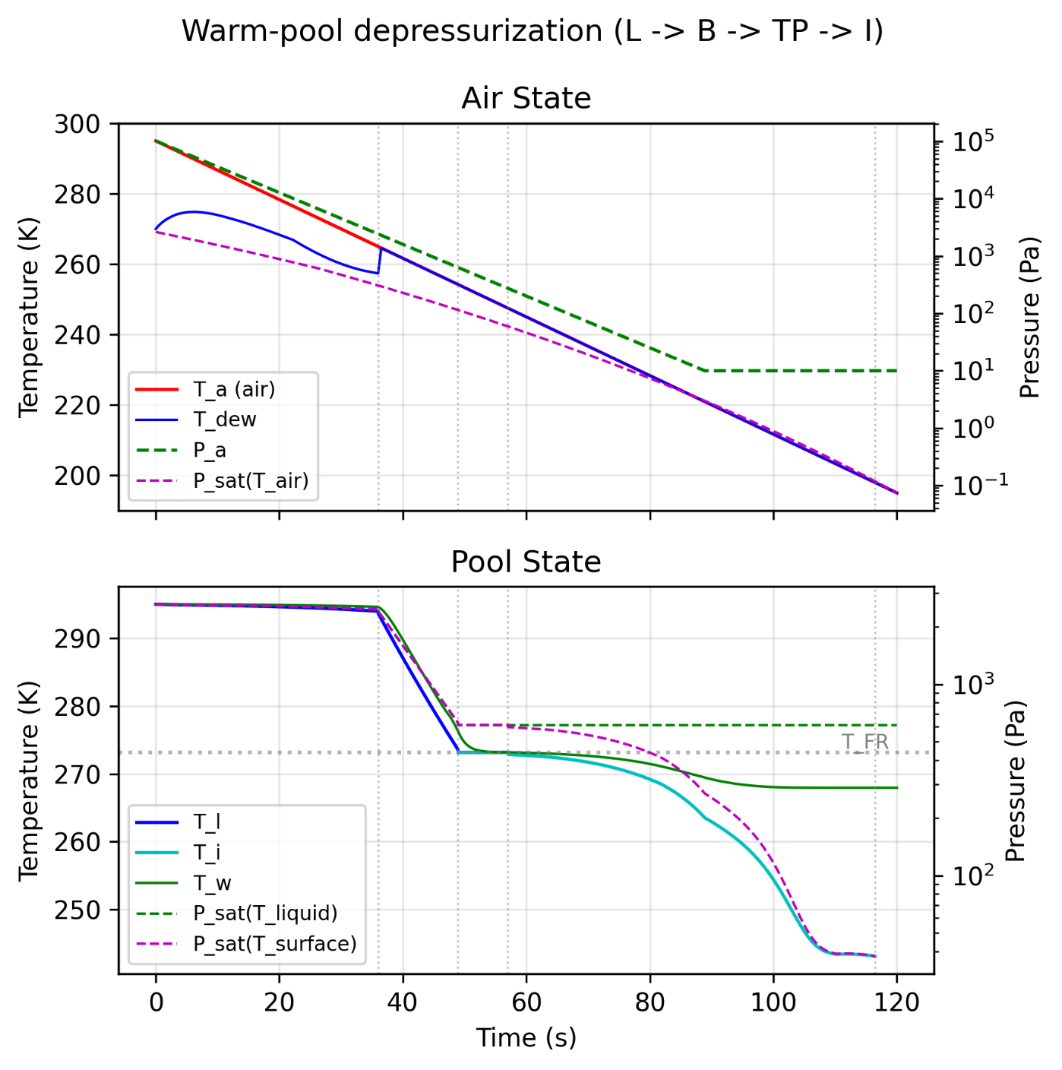
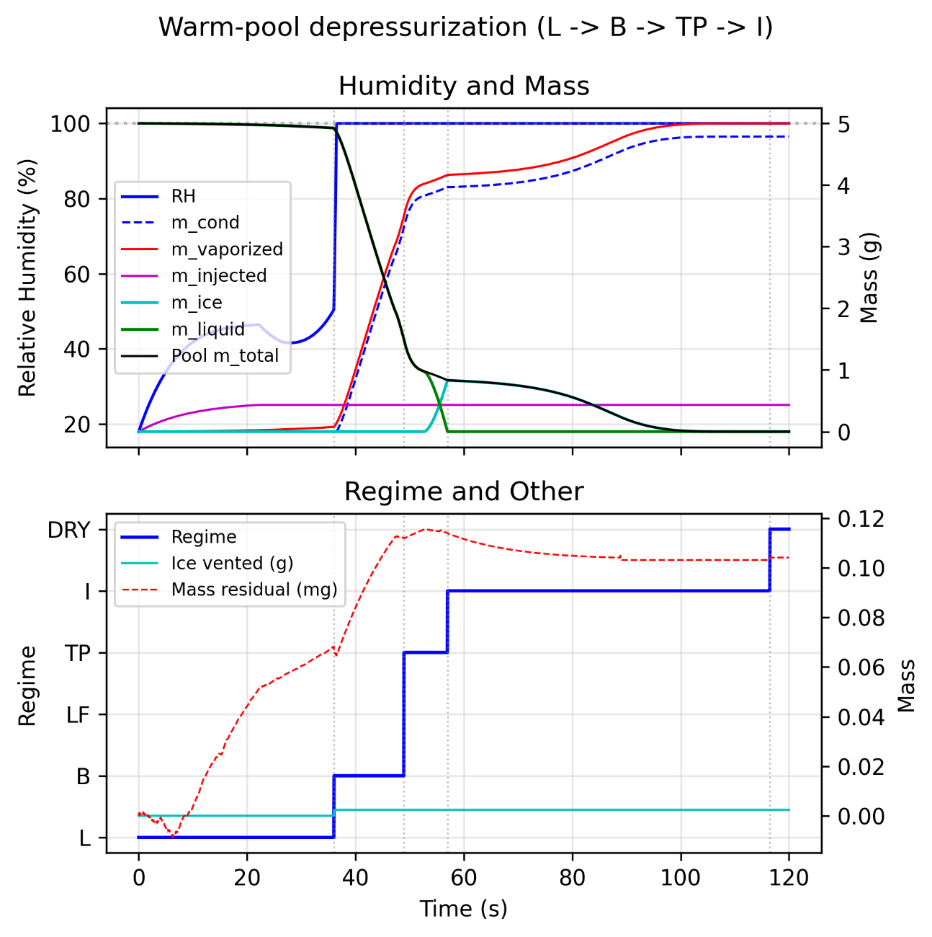
Example Case 1
Notes:
The initial rise in RH is primarily driven by the vapor injection. When that levels off, RH actually drops slightly before rapidly rising to 100% when the pool begins boiling. A small amount of $m_{L}$ evaporates during the L regime. $m_{i}$ is 0 until ice formation beings in the TP regime; it rises to the $m_{total}$ line indicating that the entire pool is frozen. Ice sublimation drives more vapor into the air and subsequent $m_{cond}$ (precipitation - snow). Eventually the remaining ice reaches the minimum threshold around 116 s, at which point the transition to the dry regime occurs.
There’s another example case in the paper.

Slide 12
AI Case Study

Slide 13
AI Overview
ChatGSFC: Anthropic Claude Haiku 4.5 and Opus 4.7
AI accelerated coding
Wanted the AI to select correct physics and equations
Tried Haiku first, then Opus
Will discuss:
  Strengths and weaknesses
  Estimates of performance, time, and cost
  Tips
Notes:
I have some experience coding, though no formal software development training. I’d used AI to accelerate coding for ~6 months before beginning this project.

Slide 14
Haiku
Gradually added modeling complexity while providing code and physics descriptions.
Asked the AI to defend its choices.
AI could explain some physics correctly, such as the pressure differences between evaporation and volumetric boiling, but most of the physical insight came from me
Misplaced constants inside the ODE loop, forgot wall heat transfer repeatedly, and repeatedly ignored instructions to use CoolProp when it was valid (Opus too…)
AI sometimes gave partial modification instructions instead of directly modifying the code, and at one point forgot how to handle flash boiling despite having previously suggested the relevant formula
Required user-guided debugging, AI self-debugging was ineffective
Stability problems at regime transitions led to repeated troubleshooting loops
AI was often confidently incorrect. It defended numerical artifacts as physical behavior, hallucinated sources, blamed already reverted changes, and messed up units math
Later attempts using new chat windows, enthalpy-based reformulation, and a staged context-building approach produced some correct thermodynamic descriptions and equations and a partially functional code, but had the same stability problems and failed troubleshooting loops
Notes:
I believe providing a complete description in the first prompt would have failed spectacularly.
The compliments were incredibly annoying.

Slide 15
Opus
Suspected some issues with Haiku were due to it being a less capable LLM
I prompted Opus with a description of the desired model and thermodynamics (without equations), asked for a detailed thermodynamics and heat-transfer description with equations, and explicitly told it not to write code yet
  Despite requiring multiple “continue thinking” prompts due to ChatGSFC response context limitations, Opus produced a thorough and mostly correct response. Obviously superior to Haiku for this.
Opus asked relevant clarification questions without being prompted
Opus suggested laying out all possible regime transitions and associated state-variable mappings, then iterated on it and found additional edge cases without my input.
When it felt like it had a complete-enough model description, it, unprompted, proposed a logical multi-module code structure
We worked on one file at a time. Opus (unprompted) added unit tests to each file, which helped immensely with debugging, which it could usually do itself given the error output.
Still had issues: it missed some loose solver tolerances, reverted to polynomial property fits instead of using CoolProp for some properties, made code changes that failed to produce desired demo-case modifications, and my idea is ultimately what fixed most of the stability issues.

Slide 16
Case Study Assessment
Haiku:
  Partial success, code partially worked.
  Total time: ~30 hours
  Total token cost: ~$4
  I could have written something more functional in less time without it
Opus:
  Success. Met objectives of the project.
  Total time: ~30 hours
  Total token cost: ~$221, over 50x Haiku’s, but still small compared to what my time costs
  Wrote a better code than I could have in the same amount of time
Notes:
I could have written something that would have been useful for the original application in about the same amount of time if I had handled the model and physics, and only used the AI to accelerate writing portions of the code and looking for errors. However, the code would not have been organized or commented as well, nor be as adaptable

Slide 17
Tips for Using LLMs to Develop Complex Physical Models
Opus integrated into an IDE with the ability to run the code itself would be able to diagnose and fix errors. NASA has IDE AI tools available. NMC AI Hub (internal NASA Link)
  This would also avoid the context limitations of ChatGSFC, which definitely hurt performance
It is “lazy” and “forgetful”.
It will lie to you.
It will be extremely confidently wrong. “Incredibly knowledgeable idiot”
Save versions of the code (use version control) so changes can be reverted easily if the AI breaks something or implements something that doesn’t work.
It is useful for accelerating the writing of code.
It can save time, but using it still requires a lot of time.
Token costs are likely small compared to what the user’s time costs.
It is good at formulating steps for “textbook” problem solutions.
It has no comprehension of the physical world. The user needs to understand the physics.
It is not creative. The user must supply the creative piece.
Notes:
It is “lazy” and “forgetful”. Unless explicitly told otherwise, it will tell the user how to modify/fix code instead of doing it itself. It will sometimes do/implement whatever is the least effort, even if it or the user identified a better way. (Meanwhile, it will write a whole essay in a code comment)

Slide 18
Summary and Future Work
A functional thermodynamics model and corresponding python code useful to simulate rapidly depressurizing humid containers has been developed with the assistance of an AI LLM
Flagship AI LLMs, such as Opus, may be useful when creating thermodynamics models, especially for accelerating the code development aspect. Cheaper LLMs are unlikely to be useful for tasks like this.
Future model improvements:
  Calculate the container air pressure given vent area, discharge coefficient, and transient external pressure for ascending containers, or alternatively, vacuum chamber/pump specifications. Then the container air temperature include heat transfer from the container walls and be treated as a state variable with an equation in the ODE system.
  Several fluid properties are prescribed constants or use curve fits that could be partially replaced with CoolProp calls for improved accuracy.
  More advanced boiling splash and convection enhancement models
  Changing the heat transfer mechanism between the structure and pool as the pool becomes shallow would improve accuracy.

Slide 19
Questions?
The author would like to thank the NASA ChatGSFC team for their efforts developing a simple-to-use LLM interface.

