Slide 1

In-Situ Heat Rejection to the Martian Atmosphere
R. Gregory Schunk
Thermal Analysis and Control Branch
NASA/MSFC/Amentum/ESSCA
TFAWS Active Thermal Paper Session
Presented By
Greg Schunk
Thermal & Fluids Analysis Workshop
TFAWS 2026
August 31 – September 4, 2026
NASA Marshall Space Flight Center
Huntsville, AL

Slide 2
Introduction
In order to provide in-situ heat rejection to the thin Martian atmosphere, two approaches relying on forced convection and buoyancy flow are conceptualized.
A convective radiator concept utilizing a fan to draw local atmosphere through an expanded metal foam heat exchanger panel is developed. Pumped fluid loop flow tubes are embedded in the heat exchanger panel and heat is transferred from the tubes to the foam via conduction and subsequently via convection to the environment.
To forgo the use of a specialized high throughput fan, a concept utilizing a buoyant chimney tower to draw atmospheric flow through a low pressure drop heat exchanger is also considered.
Results from models developed in Microsoft Excel™/VBA to size and optimize in-situ convective and chimney heat rejection technologies for Mars applications is presented.
Sought to utilize more formulaic approaches for efficient computation to allow for greater parameterization of the heat exchanger and chimney geometry.
This effort was supported by the NASA Space Technology Mission Directorate (STMD) in 2026 as part of the Advanced Thermal Technologies for Exploration Study.

Slide 3
Convective Radiator Concept
Exhaust
Coolant Outlet
Manifold
A convective radiator concept for Mars utilizing a fan to draw local atmosphere (primarily CO2) through an expanded metal foam heat exchanger panel is shown.
  Flow tubes are embedded in the panel and heat is transferred from the tubes to the foam via conduction and subsequently convectively to the environment.
  A sunshade/dust shield is included on the front with enough clearance to not affect fan delta pressure.
  The porous media could be expanded metal foam, honeycomb or other.
An expected areal density for the heat exchanger foam of 10-20 in²/in³ would result in an internal surface area of 25m² for a panel 1m² by 1”.
A conservative heat transfer coefficient of kgas/D is assumed where kgas is the thermal conductivity of the atmosphere and D is the pore size of the expanded foam (1/10”-1/40” typical).
To minimize pressure drop, an effective density of 8% is chosen for the foam. A screen may be needed to filter the Martian atmosphere (1 to 3-micron particles).
The fan is based on terrestrial low mass exhaust fan options but the impeller may be a significant technology development for Mars application.
Atmosphere
Flow
Sun/Dust
Shield
Fan
Filter/Screen
Expanded
Metal Foam
Coolant Inlet
Manifold
Exhaust

Slide 4
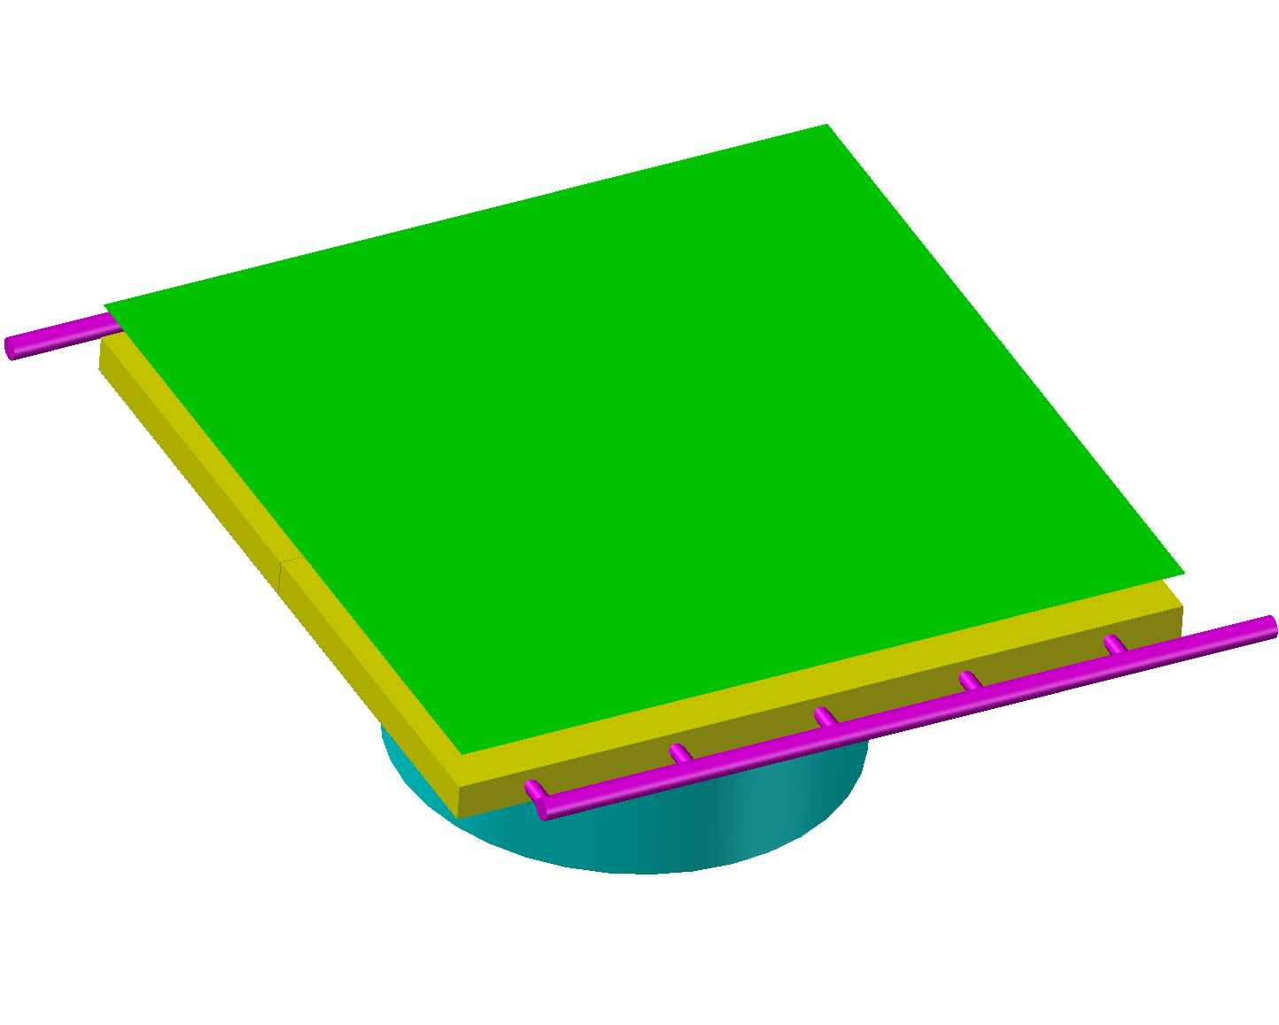
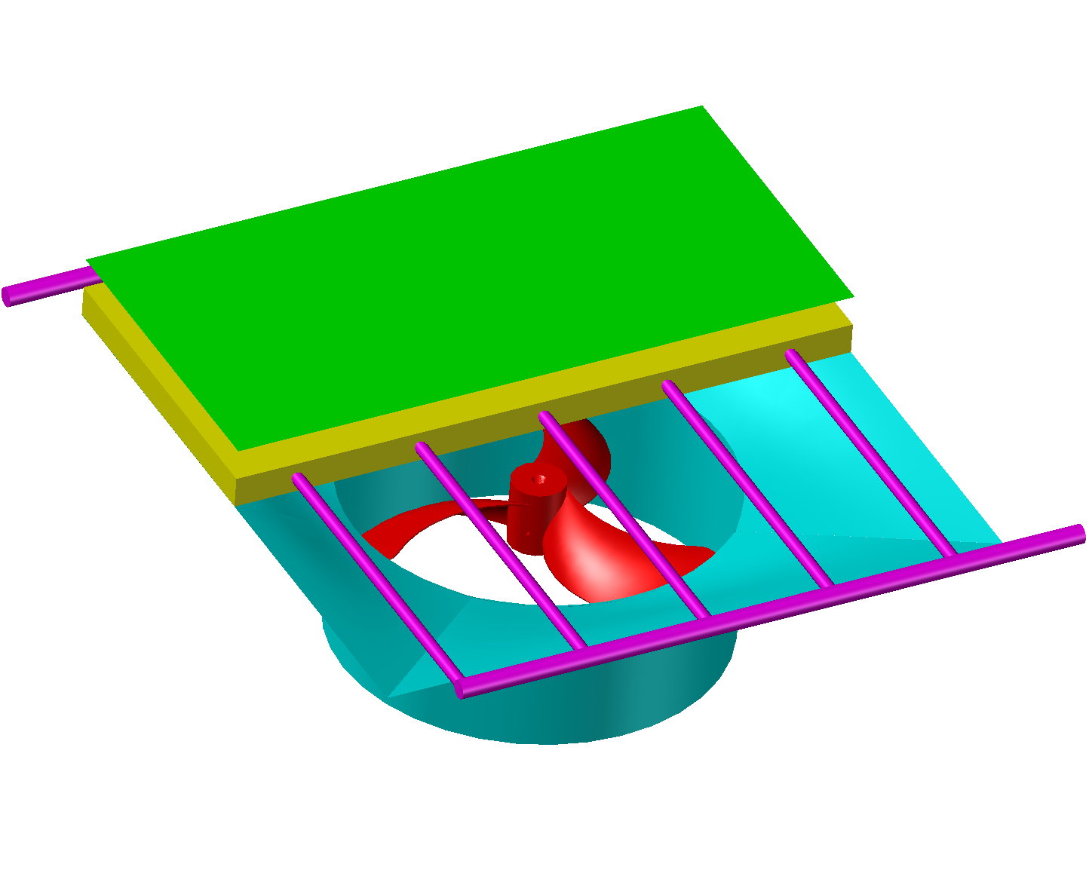
Forced Convection Heat Rejection Concept
Cross Flow Heat Exchanger
Cut-Away View
Sun Shade/
Dust Shield
Exhaust
Exhaust
Coolant
In
Fan
Coolant
Out
Expanded
Metal Foam
Embedded
Coolant Tubes
Manifold
Shroud
Atmosphere Flow

Slide 5







Heat Exchanger Model Coordinate System and Variables
Assumption is that the foam temperature varies in the x and y directions (between and along the length of the coolant channels).
But the foam is isothermal in the z direction due to the thermal conductivity of the foam and the relative heat capacities of the foam and the gas and the gas is assumed to exit at the foam temperature.
The minimum thickness of the foam, w, to achieve this is given by (derivation in the backup slides):
$$θ_{out}=\left({T_{r,o}−T}_{∞}\right)$$
Tr,o
Coolant Passage
Tr,o
$$θ=\left({T_{foam}−T}_{∞}\right)$$
Y
w
Z
Gas Flow thru Foam
Expanded
Metal Foam
S
Tr,i
X
$$w=−\frac{ρuc_{p}}{hα}ln\left(δ\right)$$
$${T=T}_{∞}$$
$${T=T}_{Foam}\left(x,y\right)$$
$$δ=\frac{T_{gas,out}−T_{foam}}{T_{gas,in}−T_{foam}}=\frac{θ_{out}}{θ_{in}}$$
$$θ_{in}=\left({T_{r,i}−T}_{∞}\right)$$
Tr,i

Slide 6
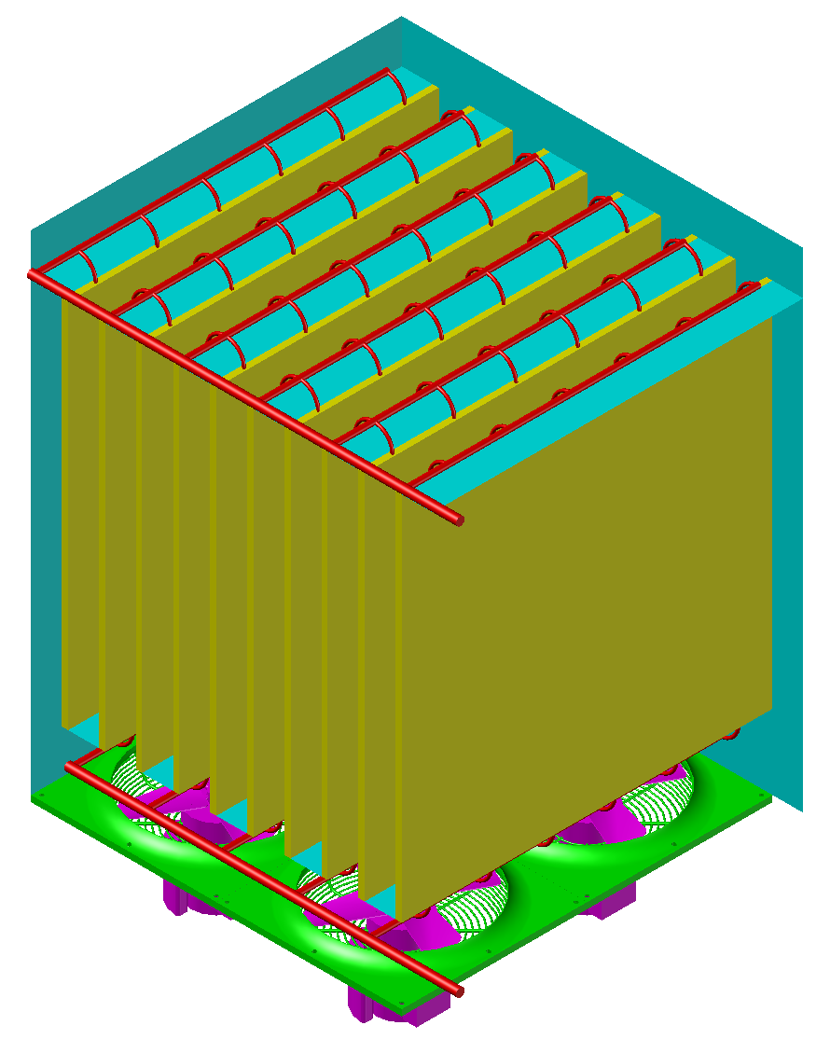
High Capacity Forced Convection Heat Rejection Concept
Cut-Away View
Low ΔP Cross Flow Heat Exchanger
Exhaust
Coolant Supply/Return
Manifold
Cover (Possibly Pressure Actuated)
Expanded Metal Foam
(with embedded
cooling tubes)
Expanded
Metal Foam
Insulation
Coolant
In
Manifold
Atmosphere Flow
Atmosphere Flow
Screen/Filter
Fan
Coolant
Out

Slide 7
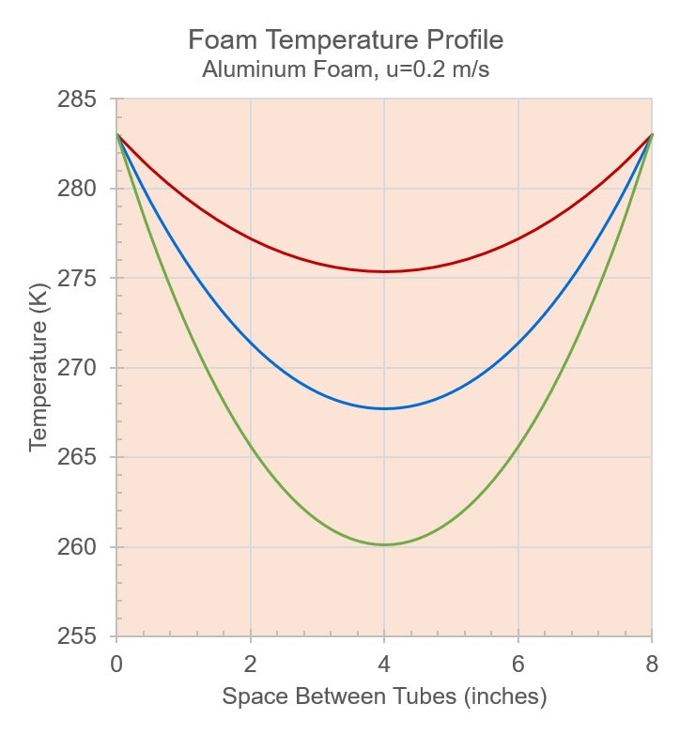



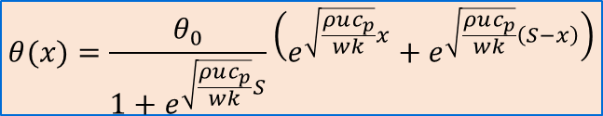




Expanded Metal Foam Heat Exchanger Energy Balance
Supply
x
y
H
dy
T₀
Return
S
Conduction
$$T_{∞}=253K$$
$$ρuc_{p}dxH\left(T_{∞}−T\right)$$
Conduction
$$Q_{x}=−kwH\frac{dT_{x}}{dx}$$
$$Q_{x+∆x}=−kwH\frac{dT_{x+∆x}}{dx}$$
z
dx
w
$$T_{∞}=223K$$
S
x
T_{0 ,} θ₀
Mars
Atmosphere
$$T_{∞}$$
$$T_{∞}=193K$$
$$θ(x)=\frac{θ_{0}}{1+e^{\sqrt{\frac{ρuc_{p}}{wk}}S}}\left(e^{\sqrt{\frac{ρuc_{p}}{wk}}x}+e^{\sqrt{\frac{ρuc_{p}}{wk}}\left(S−x\right)}\right)$$
For an incremental slice in the y direction, the metal foam temperature is a function of x (T=T(x)) and assumed isothermal in the z direction due to the reduced thickness and thermal conductivity of the foam. Derivation for the temperature profile solution is included in the backup slides.
The foam is sized thick enough for the thin Martian atmosphere to reach the equilibrium temperature at or before exit.

Slide 8
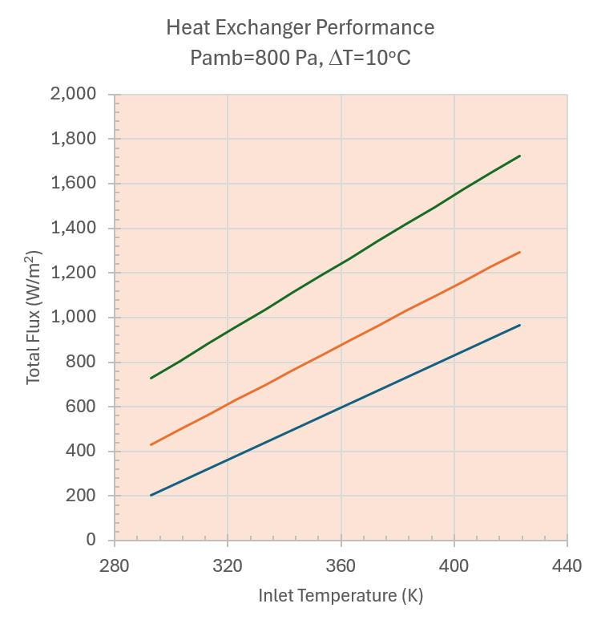


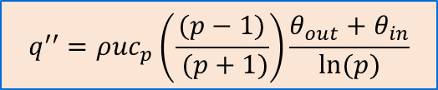

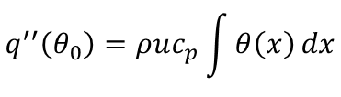
Metal Foam Heat Exchanger Performance
Supply
x
y
H
dy
$$T_{∞}=193K$$
Return
S
$$T_{∞}=223K$$
Define:
$$m=\sqrt{\frac{ρuc_{p}}{wk}}$$
$$p=exp\left(mS\right)$$
$$T_{∞}=253K$$
$$q^{′′}\left(θ_{0}\right)=ρuc_{p}\int{θ\left(x\right)}dx$$
$$q^{′′}=ρuc_{p}\left(\frac{(p−1)}{ (p+1)}\right)\frac{θ_{out}+θ_{in}}{ln⁡(p)}$$
The overall heat rejection through the heat exchanger panel is obtained by first integrating across the span between tubes (x: 0 to S) then along the length of the heat exchanger (y direction).
A simplified expression in terms of the inlet and outlet temperature differences (θ_{in} and θ_{out}), a dimensionless parameter (p) and the inlet mass flux and specific heat is shown. See the background slides for a derivation.

Slide 9
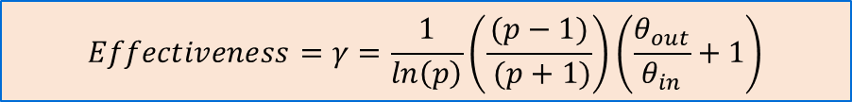
Metal Foam Heat Exchanger Effectiveness
Supply
x
y
H
dy
Return
S
$$q^{′′}=γρuc_{p}θ_{in}$$
$$Effectiveness=γ=\frac{1}{ln\left(p\right)}\left(\frac{(p−1)}{ (p+1)}\right)\left(\frac{θ_{out}}{θ_{in}}+1\right)$$
The heat flux equation is conveniently rearranged as a function of θ_{in} and the inlet thermal mass flow (CO₂) to derive a heat exchanger effectiveness.
Results are shown in the plot for various panel thicknesses against tube spacing for p=5.
As expected, the heat exchanger effectiveness is greatly influenced by the geometry.
Foam Thickness (in)

Slide 10

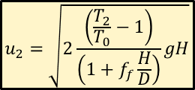
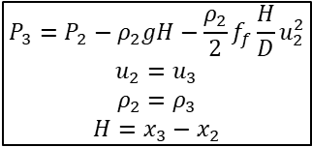






Chimney Cooling Tower Concept for Mars
P_{o}-ρ_{o}gH
Exit Boundary Condition
Derivation of the governing equation, based on a modified version of Bernoulli’s equation, for the chimney cooling tower is shown.
Frictional losses are included in the chimney tube pressure drop formulation.
The flow through the heat exchanger is not strictly incompressible; the density may decrease by 10%-50% depending upon the heat load and mass flow rate (i.e. temperature rise).
However, at peak velocities (<10 m/s), the change in kinetic energy is less than 0.1% of the total heat addition so essentially all of the added heat results in a temperature increase of the fluid.
Constant Area
3
Conservation of Mass
$$P_{0}−ρ_{0}gH=P_{2}−ρ_{2}gH−\frac{ρ_{2}}{2}f_{f}\frac{H}{D}u_{2}^{2}$$
Chimney:
Bernoulli (incompressible*)
$$P_{3}=P_{2}−ρ_{2}gH−\frac{ρ_{2}}{2}f_{f}\frac{H}{D}u_{2}^{2}$$
$$u_{2}=u_{3}$$
$$ρ_{2}=ρ_{3}$$
$${H=x}_{3}−x_{2}$$
$$P_{0}−P_{2}=ρ_{0}gH−ρ_{2}gH−f_{f}\frac{H}{D}\frac{ρ_{2}}{2}u_{2}^{2}$$
H
$$\left(1+f_{f}\frac{H}{D}\right)\frac{ρ_{2}}{2}u_{2}^{2}=ρ_{0}gH−ρ_{2}gH$$
Heat Exchanger:
Conservation of Momentum and Energy
(incompressible* and negligible change in height)
$$\dot{m}=ρ_{2}u_{2}A$$
$$u_{2}^{2}=\frac{2\left(ρ_{0}−ρ_{2}\right)}{\left(1+f_{f}\frac{H}{D}\right)ρ_{2}}gH$$
2
Q
h << H
1
$$\left(P_{0}−P_{2}\right) ={\frac{ρ_{2}}{2}u}_{2}^{2}$$
$$u_{2}=\sqrt{2\frac{\left(\frac{T_{2}}{T_{0}}−1\right)}{\left(1+f_{f}\frac{H}{D}\right)}gH}$$
$$\frac{ρ_{0}}{ρ_{2}}\sim \frac{T_{2}}{T_{0}}$$
x
P_{o}, T_{o}
Inlet Pressure Drop (Bernoulli)

Slide 11
Low Pressure Drop Cooling Tower Heat Exchanger Concept
Truncated Cooling
Tower
The Chimney cooling tower heat exchanger is designed to transfer heat to a buoyant flow of Mars atmosphere (primarily CO₂) at the lowest pressure drop possible.
Metal foam heat exchangers with embedded coolant flow tubes are arranged in parallel to the buoyant flow to induce a cross-flow through the foam.
The cross-sectional surface area exposed to the flow through the heat exchanger would be nearly 30x that of the cooling tower.
With a resultant >30x reduction in velocity the pressure drop through the heat exchanger is expected to be negligible to that of the cooling tower.
~1.25m
Expanded Metal Foam
(with embedded
cooling tubes)
Coolant Supply/Return
Manifold
Insulation
~1.5m
Screen/Filter
Buoyant Atmosphere Flow

Slide 12
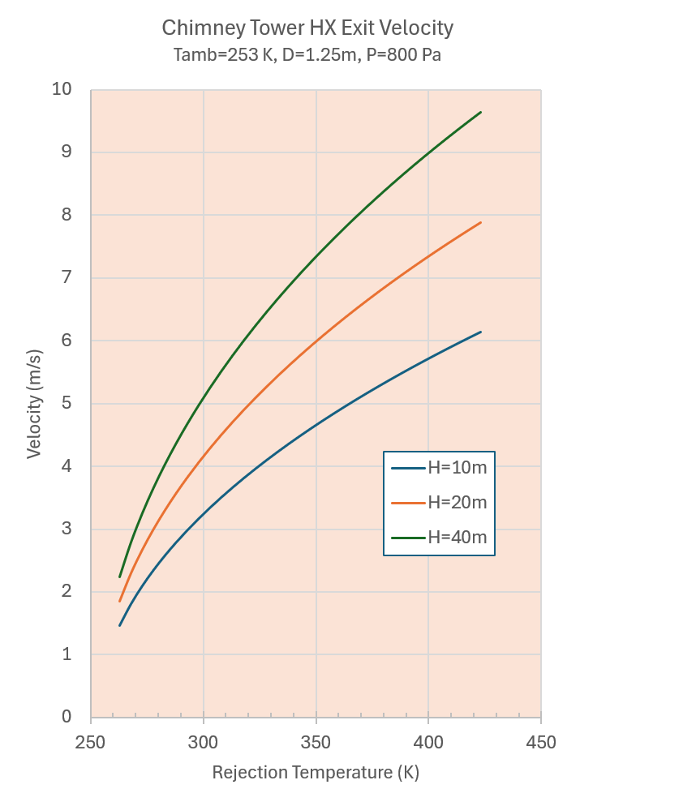
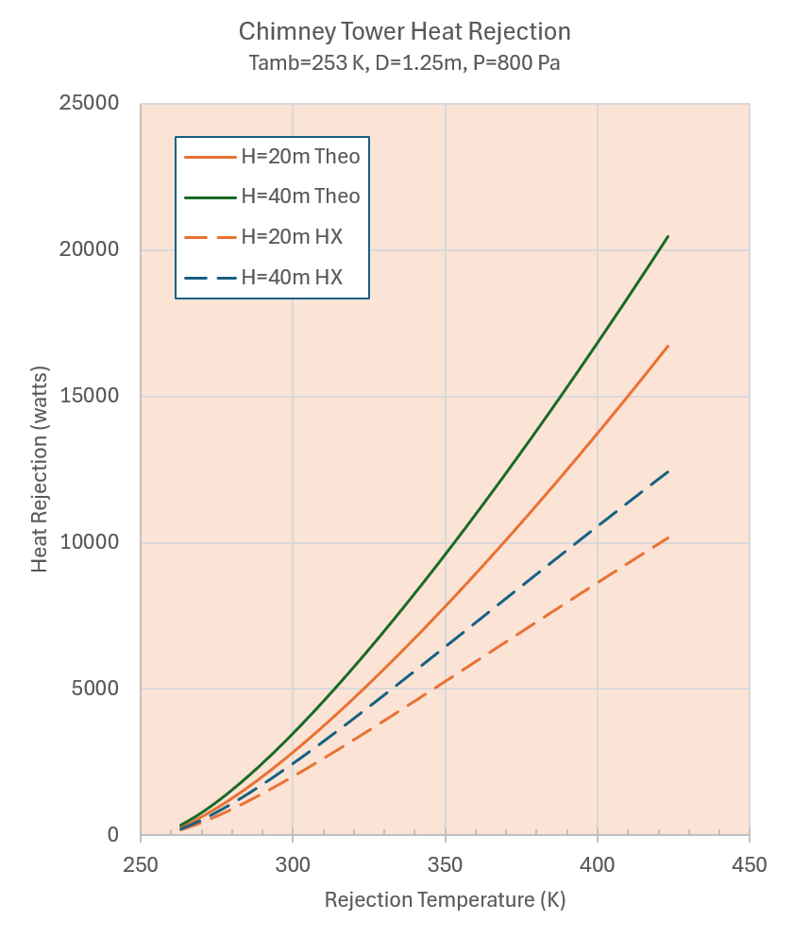
Chimney Performance
Chimney performance is shown in terms of induced velocity and overall heat rejection.
The heat rejection is expressed in terms of theoretical performance (based only upon the buoyancy of the chimney draft) and including the heat exchanger effectiveness which can significantly affect performance.

Slide 13
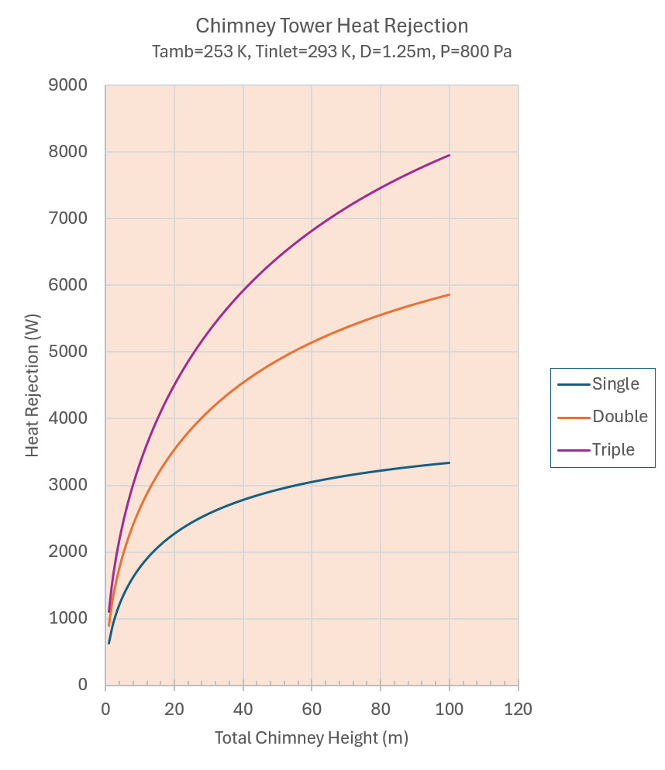
Chimney Optimization
A potential optimization for the chimney is to divide a single tower into 2 or more shorter chimneys.
A single chimney may approach an asymptotic limit due to increased velocity and resulting frictional losses within the chimney.
With lower velocities, shorter chimneys delay the onset of a frictional constraint while providing the needed volumetric flow.
However, care must be taken to preserve enough driving potential (through buoyancy) to maintain the draft through the chimney and heat exchanger.
Heat exchanger velocities are sized to limit the pressure drop to < 1% of the available buoyancy pressure head.

Slide 14
Summary and Acknowledgements
Both Mars in-situ heat rejection concepts may best align with moderate- to high-temperature heat loads that provide a significant delta temperature relative to the ambient atmosphere temperature.
While eliminating dust accumulation on radiator surfaces, some type of serviceable filtration or screening may be required to prevent accumulation of dust inside the expanded metal foam heat exchanger for both concepts.
Dividing a single large chimney into several smaller chimneys may optimize for heat rejection as well as be more manageable for construction and transport. Care must be taken to ensure that the smaller chimneys have sufficient height to overcome heat exchanger pressure drop.
Fan development for throughput (as opposed to lift) in the Martian environment is a critical technology for the convective heat exchanger option.
Special thanks to the NASA Space Technology Mission Directorate (STMD) and the Advanced Thermal Technologies for Exploration study team as well as numerous co-workers and colleagues who have supported this effort.

Slide 15
Back-up

Slide 16

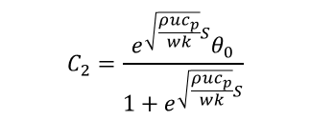






Expanded Metal Foam Heat Exchanger Energy Balance
Supply
x
y
H
T₀
Return
S
$$T_{∞}=253K$$
Conduction
$$ρuc_{p}dxH\left(T_{∞}−T\right)$$
Conduction
$$Q_{x}=−kwH\frac{dT_{x}}{dx}$$
$$Q_{x+∆x}=−kwH\frac{dT_{x+∆x}}{dx}$$
$$T_{∞}=223K$$
z
dx
w
S
x
T_{0 ,} θ₀
$$T_{∞}=193K$$
Mars
Atmosphere
$$T_{∞}$$
$${\left(−kHw\frac{dT}{dx}\right)}_{x}−{\left(−kHw\frac{dT}{dx}\right)}_{x+∆x}+ρuc_{p}dxH\left(T_{∞}−T\right)=0$$
$$k\frac{d^{2}T}{dx^{2}}+\frac{ρuc_{p}}{w}\left(T_{∞}−T\right)=0$$
$$θ=\left({T−T}_{∞}\right)$$
$$\frac{d^{2}θ}{dx^{2}}−\frac{ρuc_{p}}{wk}θ=0$$
The metal foam temperature is a function of x (T=T(x)) and is assumed isothermal in the z direction due to the reduced thickness and thermal conductivity of the foam.
The foam is sized thick enough for the thin Martian atmosphere to reach the foam temperature at or before exit.
$$C_{2}=\frac{e^{\sqrt{\frac{ρuc_{p}}{wk}}S}θ_{0}}{1+e^{\sqrt{\frac{ρuc_{p}}{wk}}S}}$$
$$θ={C_{1}e}^{\sqrt{\frac{ρuc_{p}}{wk}}x}+{C_{2}e}^{−\sqrt{\frac{ρuc_{p}}{wk}}x}$$
$$@x=0,S T=T_{0}$$
$$@x=\frac{S}{2} \frac{dT}{dx}=0$$
$$C_{1}=\frac{θ_{0}}{1+e^{\sqrt{\frac{ρuc_{p}}{wk}}S}}$$

Slide 17





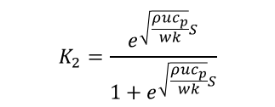


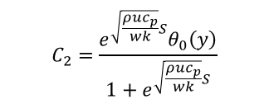

Metal Foam Heat Exchanger Performance
Supply
x
y
H
dy
Return
S
$$T_{∞}=193K$$
$$C_{2}=\frac{e^{\sqrt{\frac{ρuc_{p}}{wk}}S}θ_{0}\left(y\right)}{1+e^{\sqrt{\frac{ρuc_{p}}{wk}}S}}$$
$$θ\left(x\right)={C_{1}e}^{\sqrt{\frac{ρuc_{p}}{wk}}x}+{C_{2}e}^{−\sqrt{\frac{ρuc_{p}}{wk}}x}$$
$$C_{1}=\frac{θ_{0}\left(y\right)}{1+e^{\sqrt{\frac{ρuc_{p}}{wk}}S}}$$
$$T_{∞}=223K$$
$$K_{2}=\frac{e^{\sqrt{\frac{ρuc_{p}}{wk}}S}}{1+e^{\sqrt{\frac{ρuc_{p}}{wk}}S}}$$
Define:
$$K_{1}=\frac{1}{1+e^{\sqrt{\frac{ρuc_{p}}{wk}}S}}$$
$$m=\sqrt{\frac{ρuc_{p}}{wk}}$$
$$p=exp\left(\sqrt{\frac{ρuc_{p}}{wk}}S\right)$$
$$T_{∞}=253K$$
$$q^{′′}\left(θ_{0}\right)=ρuc_{p}\int{θ\left(x\right)}dx$$
$$q^{′′}\left(θ_{0}\right)=ρuc_{p}θ_{0}\int_{0}^{S}{\left({C_{1}e}^{\sqrt{\frac{ρuc_{p}}{wk}}x}+{C_{2}e}^{−\sqrt{\frac{ρuc_{p}}{wk}}x}\right)dx=ρuc_{p}θ_{0}\left(\frac{K_{1}}{mS}\left(e^{mS}−1\right)−\frac{K_{2}}{mS}\left(e^{−mS}−1\right)\right)}$$
$$q^{′′}=\frac{\int_{θ_{in}}^{θ_{out}}{q^{′′}\left(θ_{0}\right)dθ_{0}}}{θ_{out}−θ_{in}}=ρuc_{p}\left(\frac{K_{1}}{mS}\left(e^{mS}−1\right)−\frac{K_{2}}{mS}\left(e^{−mS}−1\right)\right)\frac{θ_{out}^{2}−θ_{in}^{2}}{2\left(θ_{out}−θ_{in}\right)}$$
$$q^{′′}=ρuc_{p}\left(\frac{K_{1}}{mS}\left(e^{mS}−1\right)−\frac{K_{2}}{mS}\left(e^{−mS}−1\right)\right)\frac{θ_{out}+θ_{in}}{2}$$

Slide 18
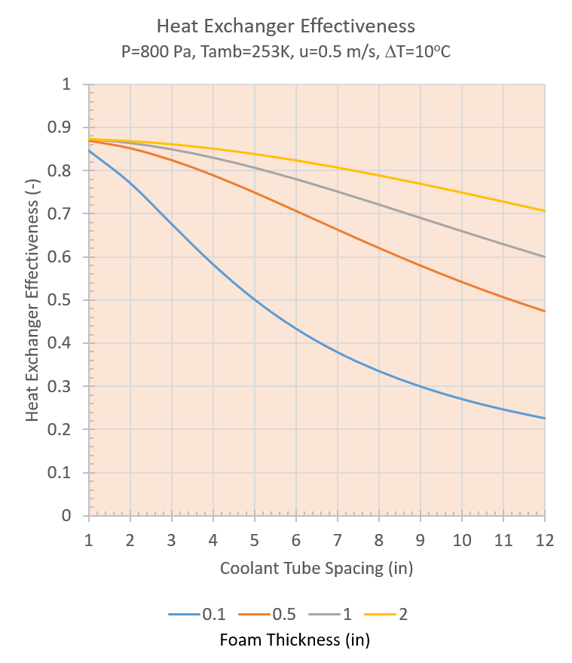




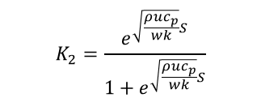
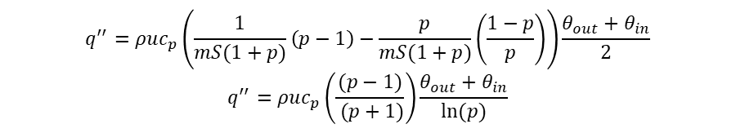
Metal Foam Heat Exchanger Effectiveness
Supply
x
y
H
dy
Return
S
$$K_{2}=\frac{e^{\sqrt{\frac{ρuc_{p}}{wk}}S}}{1+e^{\sqrt{\frac{ρuc_{p}}{wk}}S}}$$
Define:
$$K_{1}=\frac{1}{1+e^{\sqrt{\frac{ρuc_{p}}{wk}}S}}$$
$$m=\sqrt{\frac{ρuc_{p}}{wk}}$$
$$p=exp\left(\sqrt{\frac{ρuc_{p}}{wk}}S\right)$$
$$q^{′′}=ρuc_{p}\left(\frac{K_{1}}{mS}\left(e^{mS}−1\right)−\frac{K_{2}}{mS}\left(e^{−mS}−1\right)\right)\frac{θ_{out}+θ_{in}}{2}$$
$$q^{′′}=ρuc_{p}\left(\frac{1}{mS(1+p)}\left(p−1\right)−\frac{p}{mS(1+p)}\left(\frac{1−p}{p}\right)\right)\frac{θ_{out}+θ_{in}}{2}$$
$$q^{′′}=ρuc_{p}\left(\frac{(p−1)}{ (p+1)}\right)\frac{θ_{out}+θ_{in}}{ln⁡(p)}$$
$$Efficiency=γ=\frac{1}{ln\left(p\right)}\left(\frac{(p−1)}{ (p+1)}\right)\left(\frac{θ_{out}}{θ_{in}}+1\right)$$
$$q^{′′}=γρuc_{p}θ_{in}$$

Slide 19








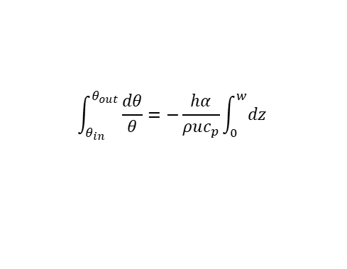


Gas Temperature in Metal Foam
Minium Thickness Required
$$T_{gas,out}$$
dz
z
$$T_{foam}$$
w
S
x
T_{0 ,} θ₀
Mars
Atmosphere
$$T_{gas,in}$$
$$ρuc_{p}HSdT_{gas}+hdzHSα\left(T_{gas}−T_{foam}\right)=0$$
$$ρuc_{p}\frac{dT_{gas}}{dz}+hα\left(T_{gas}−T_{foam}\right)=0$$
α | Internal surface area of the foam per unit volume. Typically, 10-20 in²/in³.
h | Heat transfer coefficient between gas and foam. Estimated as k/d where k is the thermal conductivity of the gas and d is the pore size.
$$\frac{dT_{gas}}{dz}+\frac{hα}{ρuc_{p}}\left(T_{gas}−T_{foam}\right)=0$$
$$θ=\left({T_{gas}−T}_{foam}\right)$$
$$\frac{dθ}{dz}+\frac{hα}{ρuc_{p}}θ=0$$
$$\int_{θ_{in}}^{θ_{out}}{\frac{dθ}{θ}}=−\frac{hα}{ρuc_{p}}\int_{0}^{w}{dz}$$
$$δ=\frac{T_{gas,out}−T_{foam}}{T_{gas,in}−T_{foam}}=\frac{θ_{out}}{θ_{in}}$$
$$ln\left(δ\right)=−\frac{hαw}{ρuc_{p}}$$
$$w=−\frac{ρuc_{p}}{hα}ln\left(δ\right)$$
Foam Pore Size

