Slide 1
GeoStorm Beacon Design Reference Mission (DRM) and Technology Drivers
John W. Dankanich
In-Space Transportation Capability lead
NASA Advanced Research and Technology Division / GO Domain
Research and Technology Mission Directorate (RTMD)

Slide 2
The Team
COMPASS Team from NASA GRC
- Steve Oleson, COMPASS Team Lead
- Betsy Turnbull, Systems Lead
- Laura Burke, Mission Design
- Brent Faller and Ben Wozniak, ACS
- Lucas Shalkhauser, C&DH
- Matthew Hilts and Prash Choksi, Comms
- Nick Uguccini and Aaron Fernandes, EPS
- Tony Colozza, Thermal
- Jim Fittje, Propulsion
- John Gyekenyesi, Mechanical
- Tom Packard, Configuration
- Cassandra Change and Amelia Marino, Costs
NOAA
- Pat Mulligan, Science Lead
Marshall Space Flight Center
- Darren Boyd, Solar Sail System
- Aaron Houin, Sail Trajectory
- Roman Bassett, Momentum Control

Slide 3
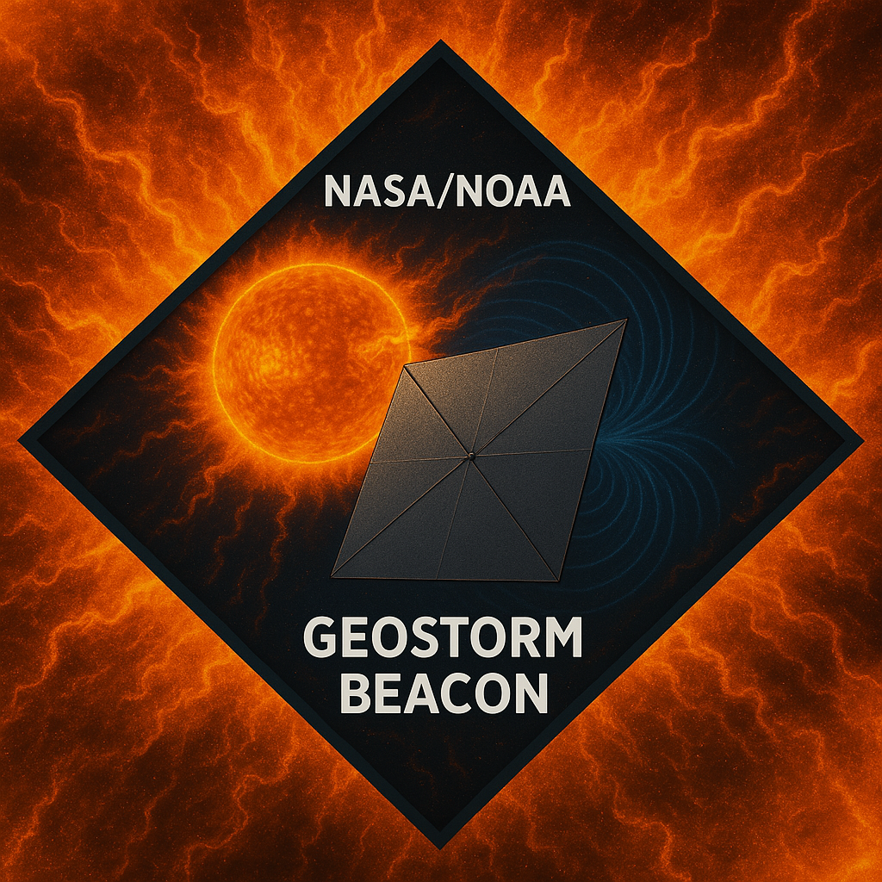
DRM Objectives, Assumptions and Requirements
Produce a Design Reference Mission for a NOAA Space Weather monitoring platform that provides warning times
>20 minutes with a 10-year lifetime.
Determine technology drivers and capability gaps
Assess extensibility of subscale demonstration technologies
  Determine required A_{c} for the spacecraft
  Trade the mass of the systems vs the size of the sail to provide the required A_{c}
    Which current boom technologies are extensible to that needed for the DRM A_{c}?
  Average Distance from the Earth = 0.02AU
  Maximum 2600km/s ejecta velocity = 2600 km/s
  Maintain an angular distance between 4° to 13° off the earth-sun line
  - 4° to avoid sun interference with communications
  - 13° to capture earth bound plasmas
  Host both a magnetometer and a plasma sensor
  Class C Mission, though mostly zero fault tolerant
FOMs: Mass, warning time, cost

Slide 4
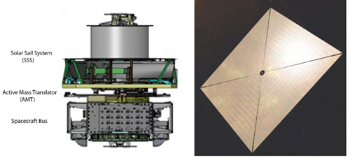
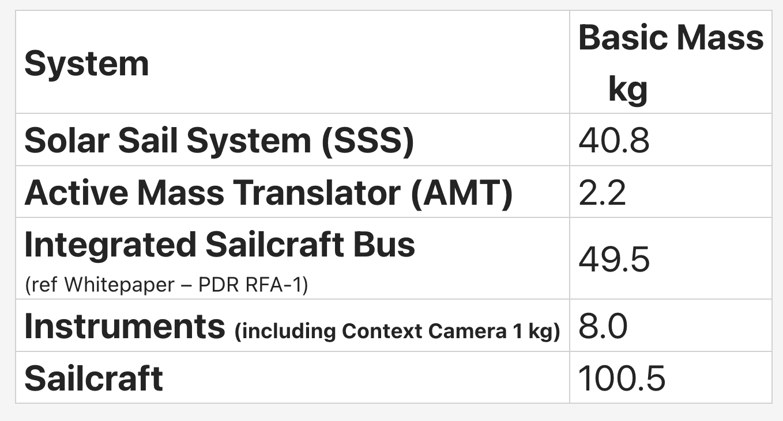
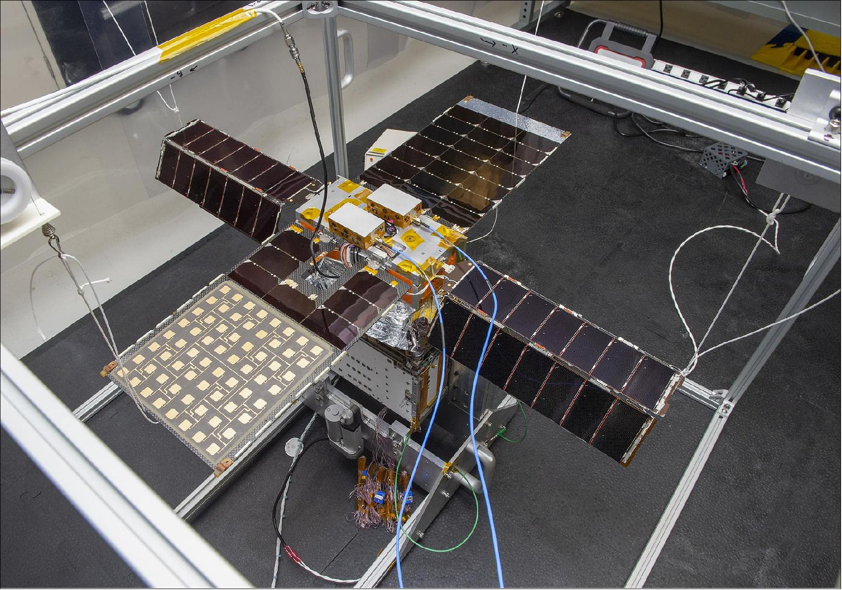
Point of Departure – Leveraged Design Details
The DRM Leverages Previous Design and Scaling Data from Solar Cruiser and NEAScout.
Solar Cruiser was a proposed NASA mission to test a large solar sail at an artificial orbit between the Earth and Sun.
Solar Cruiser’s sail would have been the largest ever tested in space, covering an area of more than six tennis courts.
NASA canceled the mission in 2022
NEAScout was delivered and launched as Artemis 1 Rideshare
Notes:
NEAScout was 86m2, Solar Cruiser is 1650m2

Slide 5
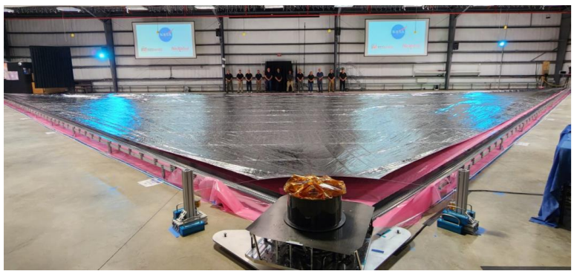
Deployment Demonstration
Generation-1 full scale quadrant deployment demonstrated in 2022.

Slide 6
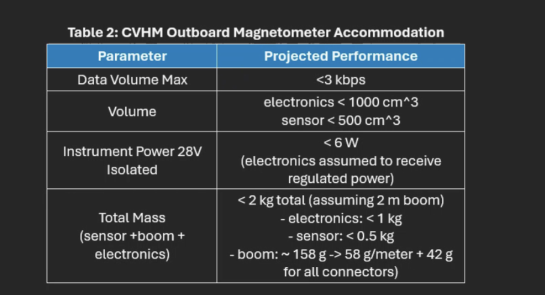
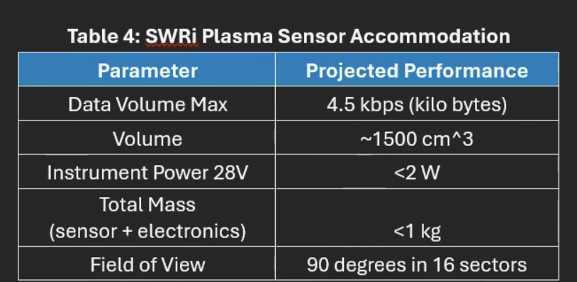
Science Package
Solar Sail Technology & Science Payload
  No current on-orbit solar sail missions with a science payload (particle detector & magnetometer).
  Key mission challenge: Potential interaction between sail materials and sensors.
  Mass constraints are critical due to photon pressure-based navigation.
Magnetometer (Reference)
  CVHM Outboard Magnetometer
Plasma Sensor (Reference)
  SWRi Plasma Sensor
Estimated telemetry:
    Magnetometer: 3.0 kbps
    Plasma sensor: 4.5 kbps nominal (throttled to 3 kbps to meet current comm estimates)
Question: How will the S/C or big metalized sail adversely impact the science (magnetometer) reading
*Custom boom designed
Demonstration Mission to Validate Sail Induced Environment on the Magnetometer
Notes:
CVHM (Compact Vector-Helium Magnetometer). CVHM is a JPL/UCLA instrument of extensive magnetometer

Slide 7
Instrument Interactions
Solar Sail Interference Considerations
  Deployed sail unlikely to significantly disturb solar wind plasma measurements.
  Ion gyroradius at L1 (~100 km) >> sail size (e.g., 40x40m for Solar Cruiser).
  Interplanetary Magnetic Field (IMF) variations unaffected (Alfvén wavelengths ~30–100×10⁶ m).
  Need for further study on:
    Magnetic interference from sail boom.
    Eddy currents affecting instruments.
Magnetic Cleanliness & Calibration
  Robust magnetic cleanliness program planned.
  Experienced personnel from NASA-NOAA GOES-R & SWFO missions for calibration.
  The Magic/SWAN accommodation study on Solar Cruiser estimated that 5 nT absolute accuracy could be achieved with a 3.5m boom.
Demonstration Mission to Validate Sail Induced Environment on the Magnetometer

Slide 8
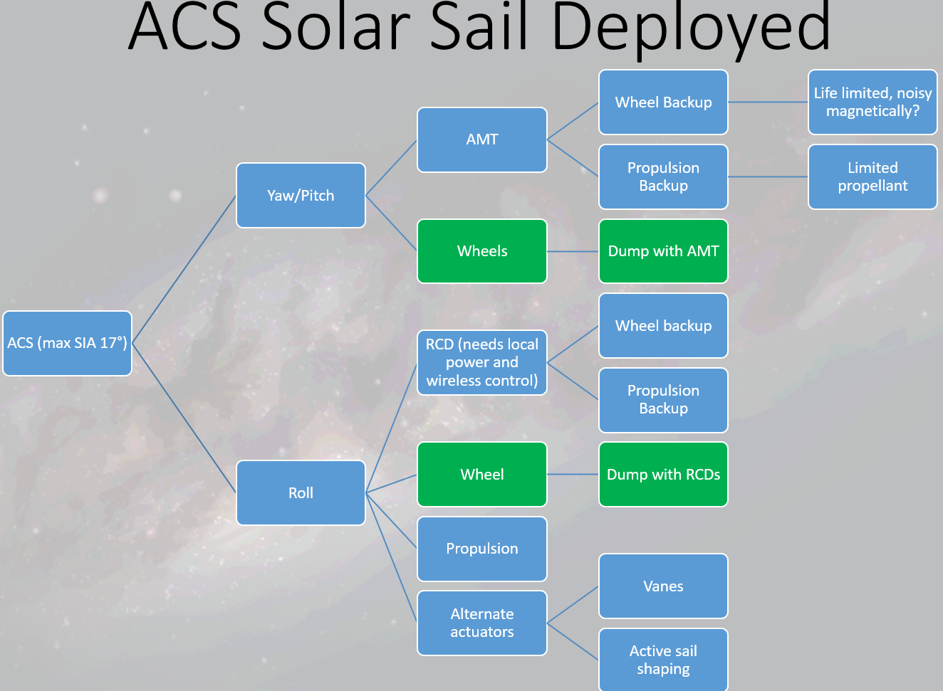
Trade Studies
Growth and Margins: OTS equipment less growth than new equipment
Single fault vs zero fault (option for a second, identical S/C )
Science
  magnetometers, plasma detector, and witness camera
TRL
  Except for solar sail make everything OTS as much as possible - OR lower TRL to save mass…
Comm link
  DSN
  NOAA antennas
  NOAA comm assets could be used
  Relay with another L1 Assets
  LiDIA or equivalent antenna phased array X-Band
    Fixed
    Deployable
    Integrate into Solar sail
    Could be electronically beamed steered
C&DH: Cubesat or smallsat? (>1yr, 3 mos ), do we need separate data storage (no)
Spacecraft Bus
  OTS
  Generic
Jettison unused systems once on station?
Two spacecraft which separate (Solar sail beaconcraft (1) and deployer (2))
Propulsion systems (no translational ∆V – just RCS, tip off with wheels)
  Cold gas or electric
  Can we live w/o propulsion with wheels: not pursued
ACS Ideas
  (sun pointing safe mode), AMT actuator
  Wheels (impact on magnetometer, life of S/C)
  Reflective control devices: powered locally, controlled wirelessly (RF or light)
  Tip vanes (shape changing alloys?), warp the boom
  IMUs, Star trackers, sun sensors
  Wheels vs transit bang-bang
  AMT provides yaw/pitch (no wheels?). RCDs provide roll control? RCS propulsion for backup
Power
  Rigid or flexible solar arrays (LISA-T?), 28VDC, batteries
    put PVs on solar sail? (can’t use until sail deployed) Not pursued
  Beamed power
Comms:
  Put MGA on the back of the solar sail (TT&C through LGA for transit out to station) Not pursued
Mechanical:
  Composite bus/parts
  Boomless, ‘spun’ solar sail: Post session trade
Thermal
  No body MLI

Slide 9
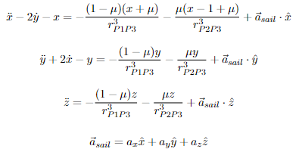
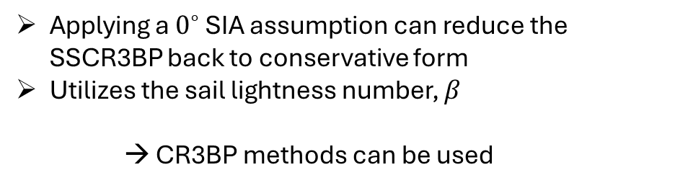
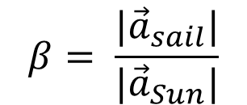
Trajectory Design
Solar Sail CR3BP (SSCR3BP)
Introducing a sail makes conventional, semi-analytic methods not possible
$$β= \frac{|{\vec{a}}_{sail}|}{|{\vec{a}}_{Sun}|}$$
Continuous, nonconservative force
Applying a $0^{∘}$ SIA assumption can reduce the SSCR3BP back to conservative form
Utilizes the sail lightness number, $β$
→ CR3BP methods can be used

Slide 10
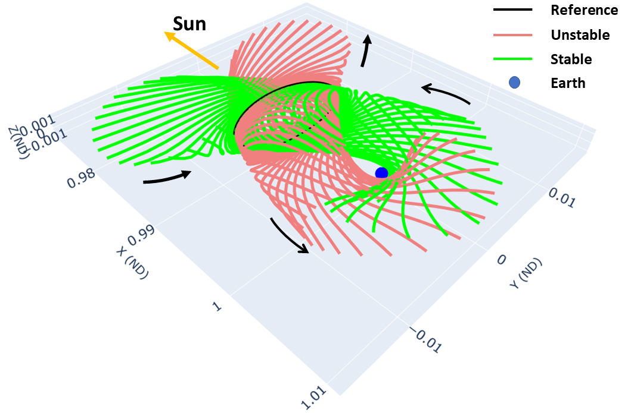
Trajectory Design
Demonstration Mission to Validate Navigation and Control Performance

Slide 11
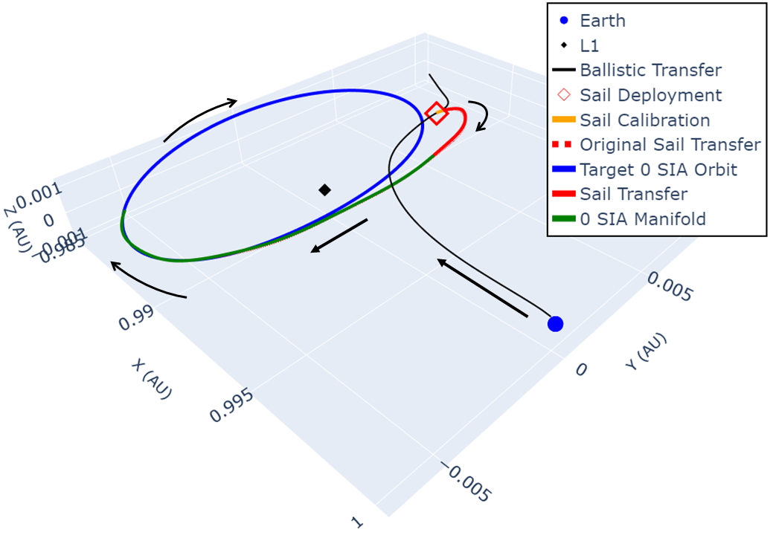
Trajectory Design

Slide 12
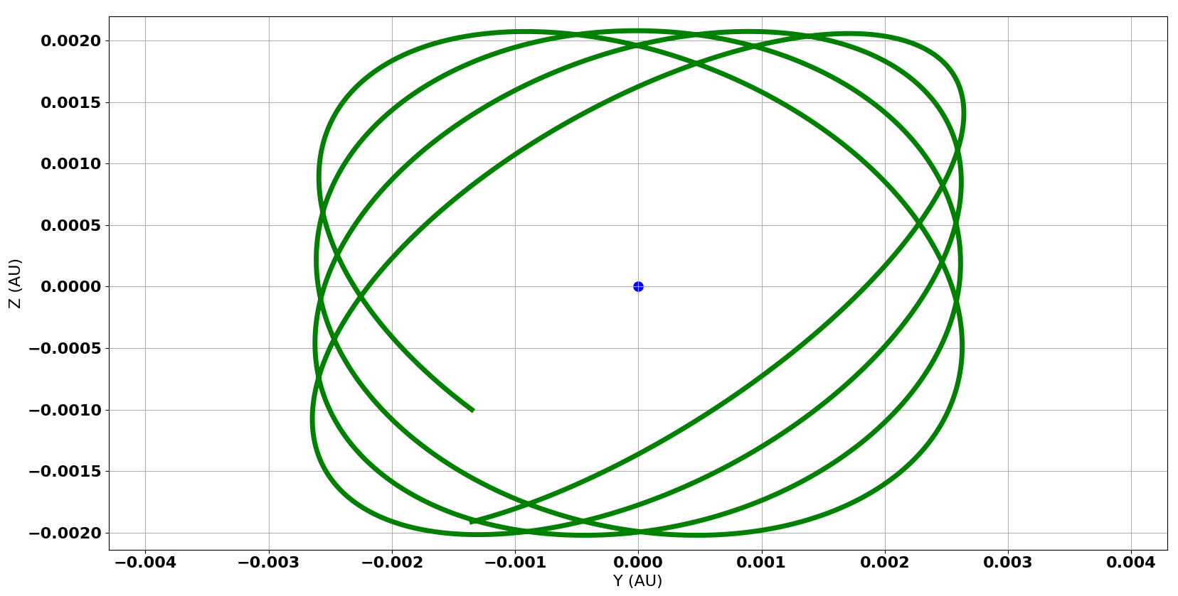
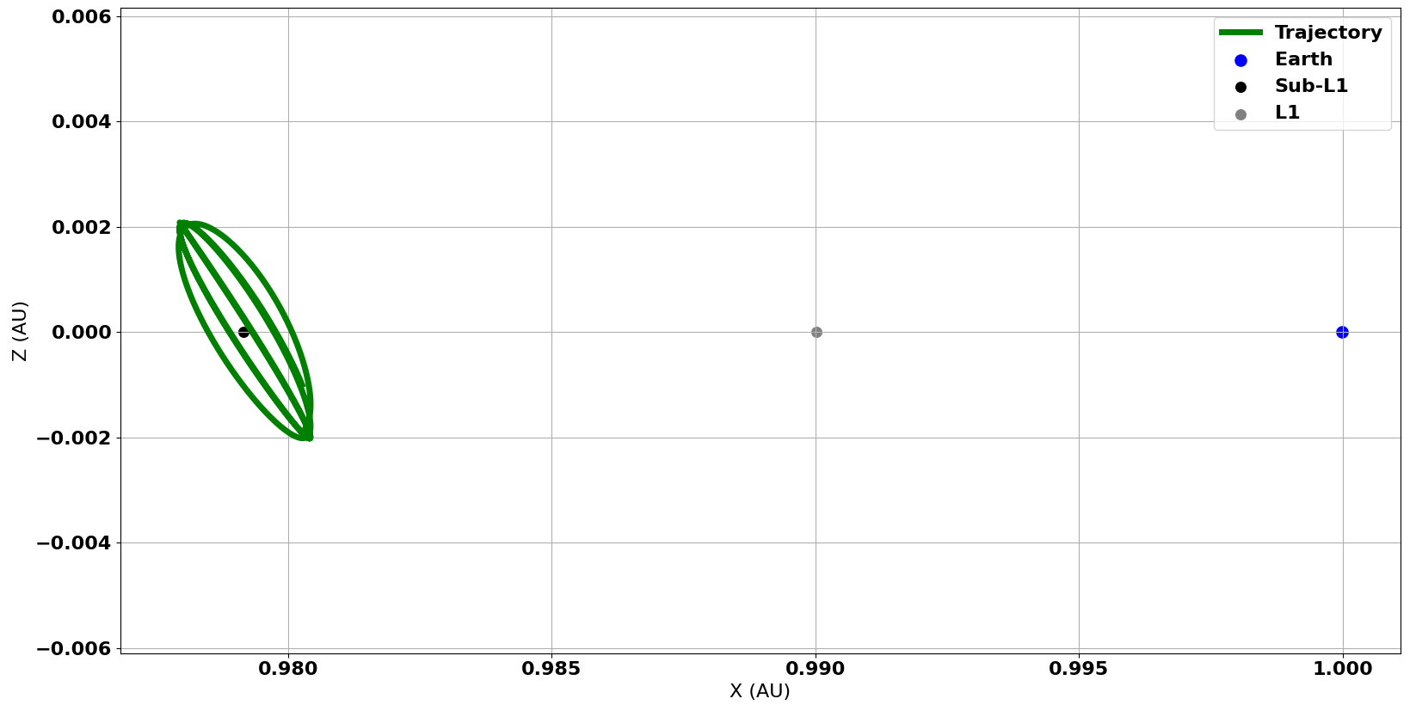
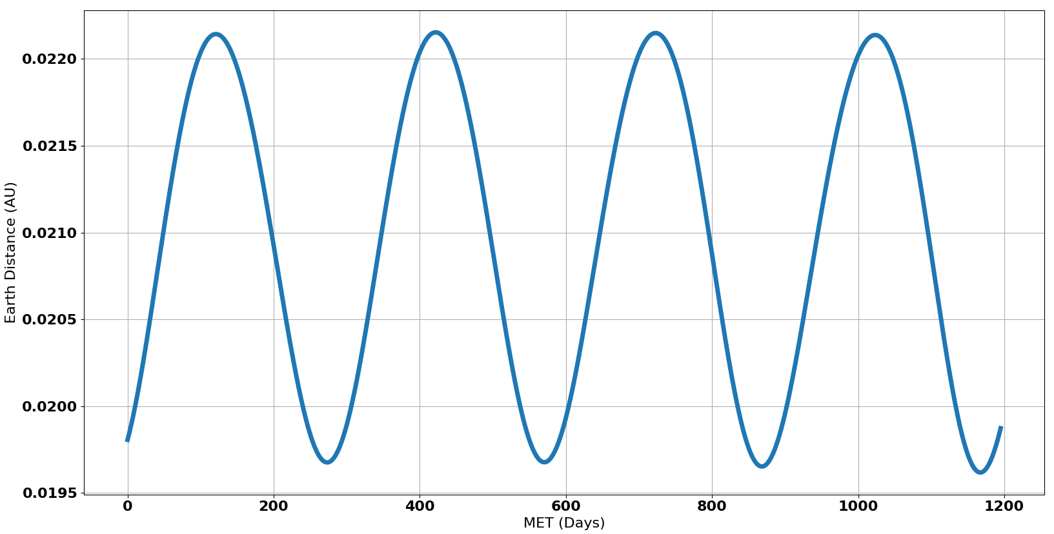
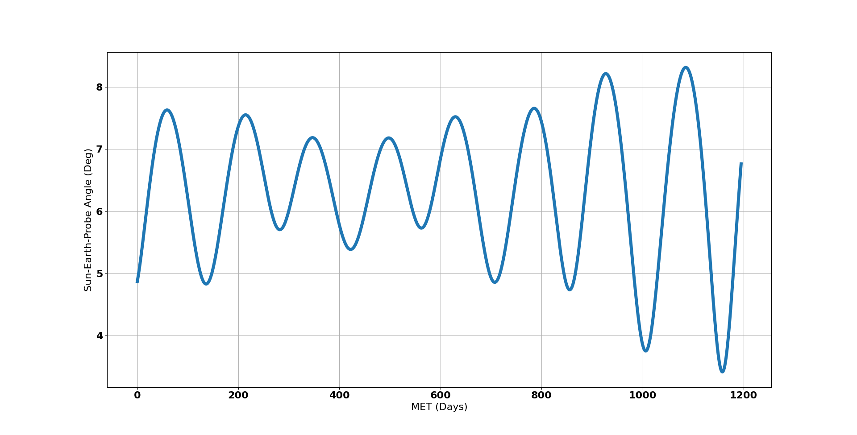
Trajectory Design – Reference Orbit Performance
Sail Performance Requirement: A_{c} ≥ 0.32 mm/s²

Slide 13
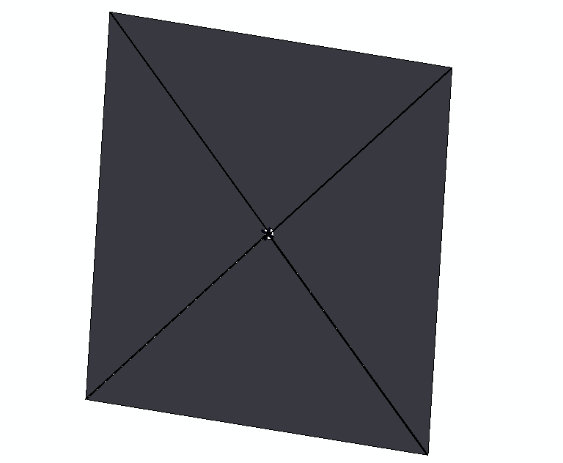
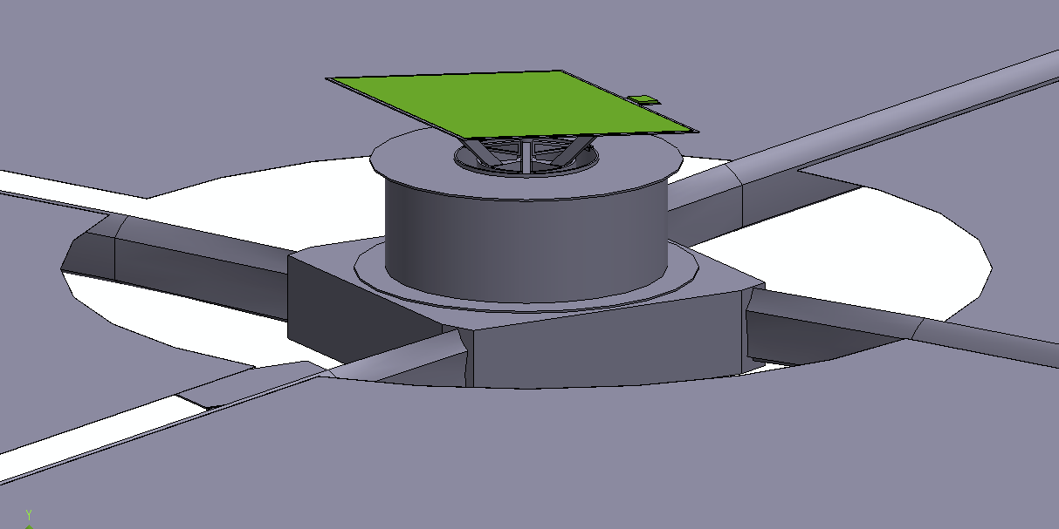
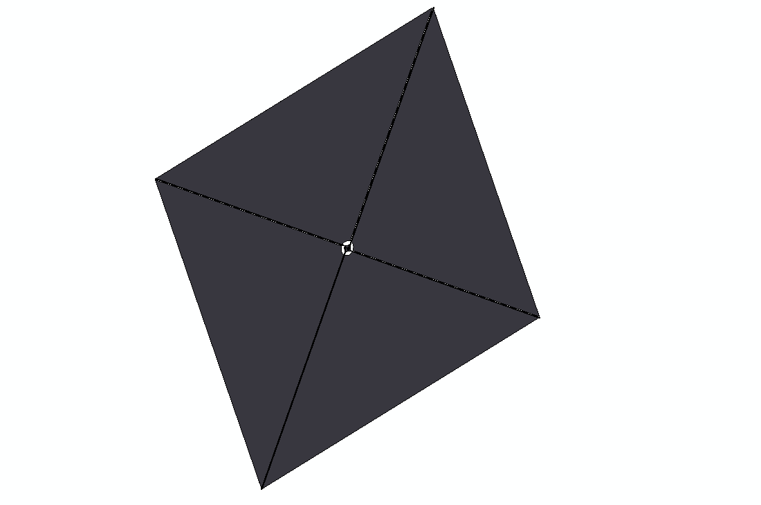
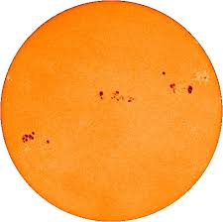
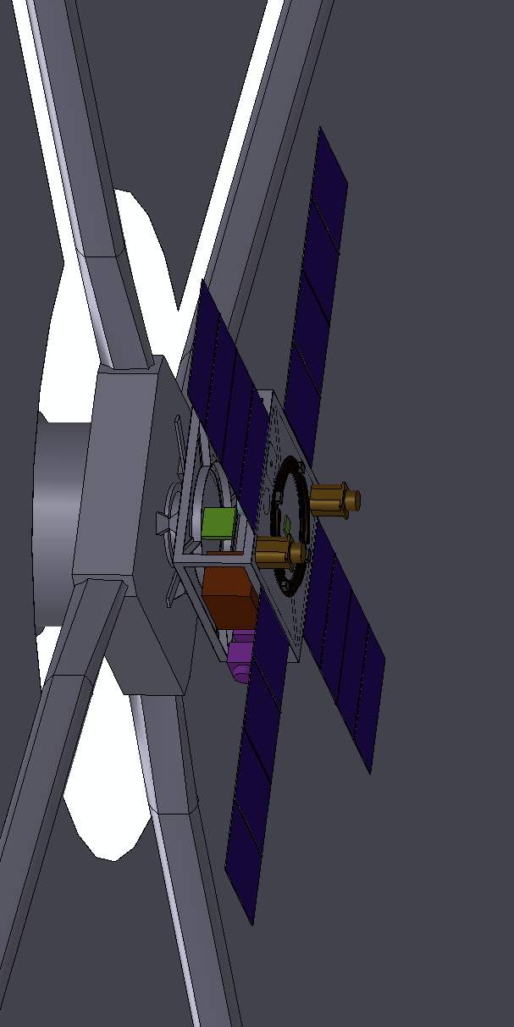
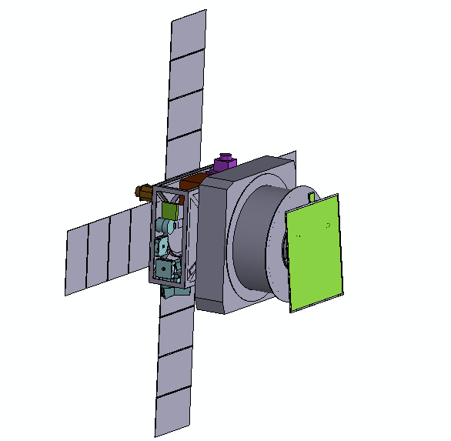
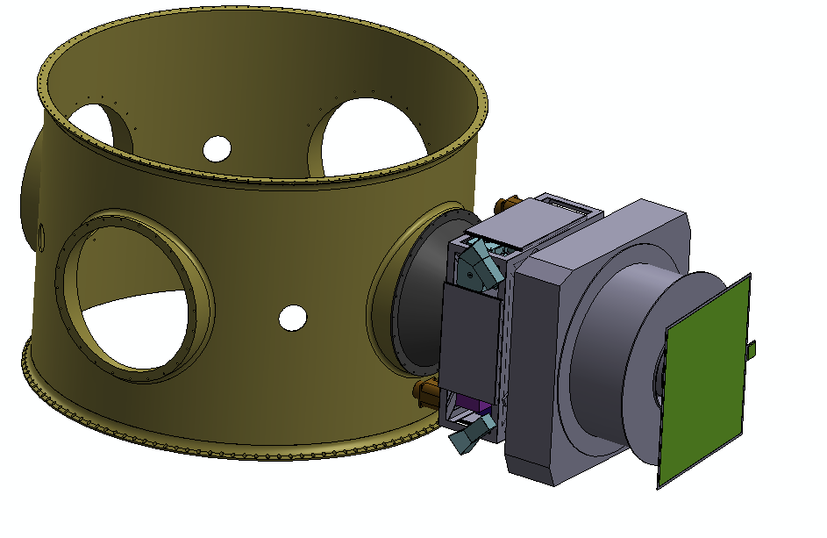
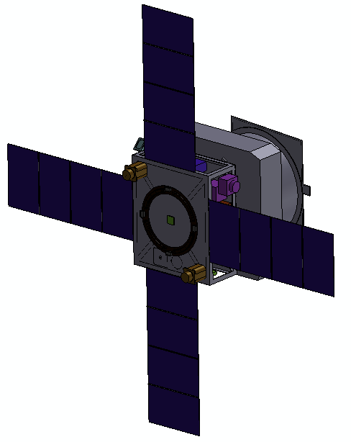
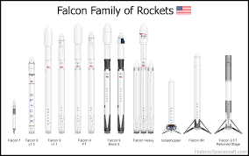
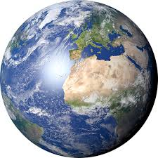
Concept of Operations (ConOps)
DRM Conops
Phased Array antenna on top of Sail deployer (anti-sun)
5200 m² Sail,
four 52m booms
X-band Comms with 16m NOAA antennas, ~ 10 kbps
Cruise to Manifold Insertion, 180 days
Deploy and commissioning
Fly to Lissajous Beacon orbit ~ 3 million km from Earth: average >20min warning time
L1
Launch as secondary to L1 on ESPA Grande
Deploy Solar Sail (~ 5 days)
Sun side of bus

Slide 14
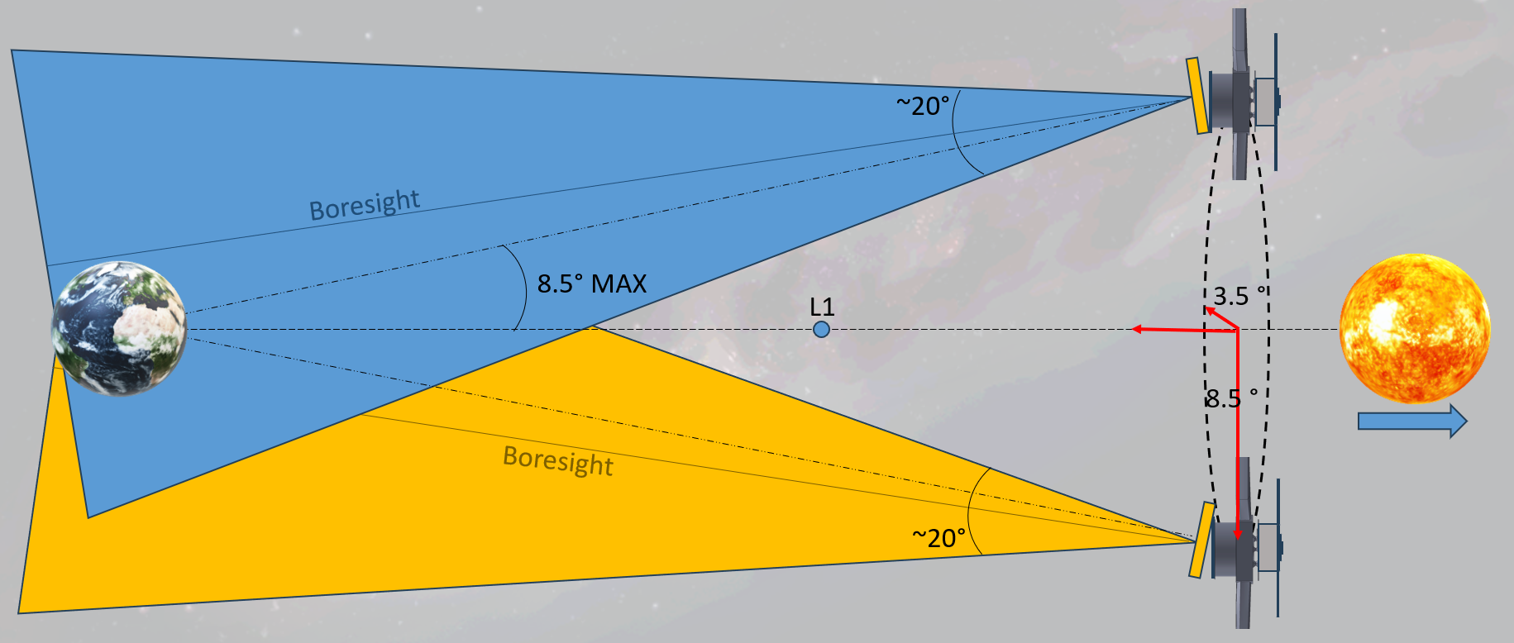
Concept of Operations (ConOps) - Pointing
DRM Conops
Craft oscillates between 8.5° and 3.5°from the Earth-Sun line. LiDIA expected to have 10° width. We will need to angle LiDIA and turn SC to get best coverage.

Slide 15
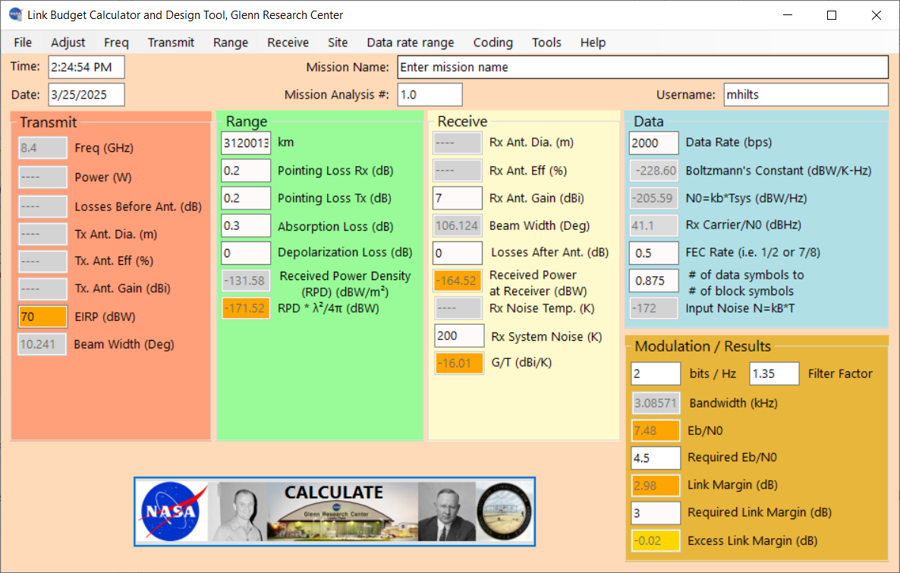

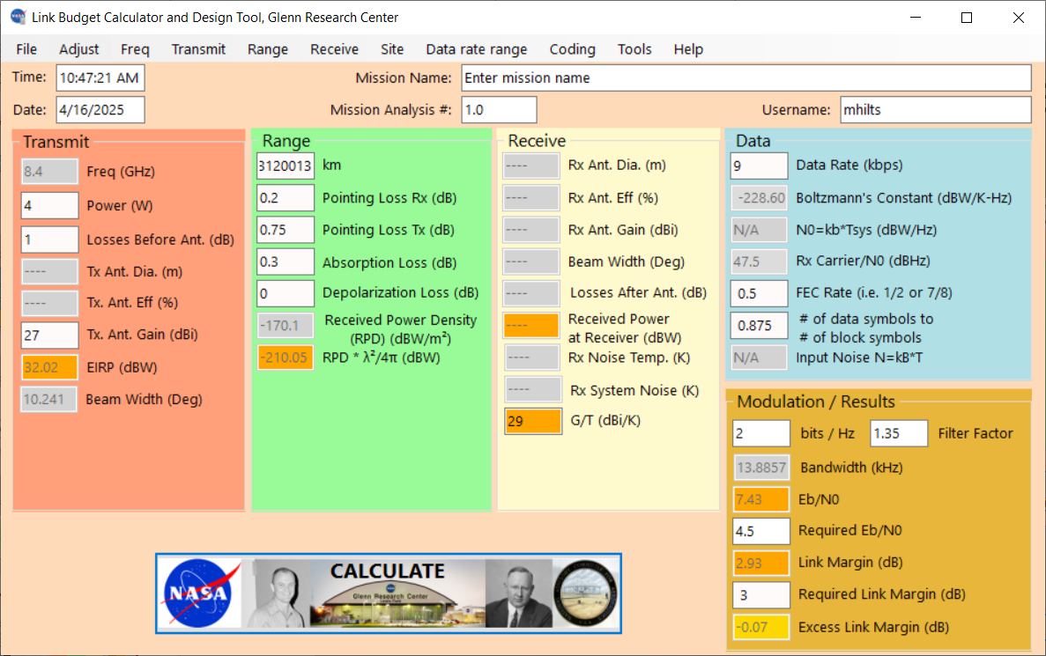
Communications
DRM Conops
Uplink: X-Band, NOAA ground station with 70 dBW EIRP, X-band patch antenna 7 dBi gain.
2 kbps achievable
Downlink: X-Band, NOAA ground station with 29 dBi/K G/T, X-band Patch antenna 7 dBi gain.
100 bps achievable
SC Antenna: LiDIA (X-Band, 27dBi, 10º beamwidth)
Ground station: GOES (X-band, 30 dB/K)
9 kbps achievable
Using IRIS (4W TX) and NOAA Ground Stations

Slide 16
Momentum Management
Dominant environmental torque encountered in mission is Solar Radiation Pressure (SRP). No appreciable gravity gradient or aero drag torques expected
SRP torque magnitude depends on the offset between the CM and the CP (projected onto a plane perpendicular to the incoming solar photons)
This design utilizes SRP as an attitude control torque via the AMT and the RCD patches
y
RCD Principle
y
AMT Principle
Bus
x
x
CM
Results in a torque about z axis (sail normal)
CP
Results in a torque about y axis
DRAFT- Pre-Decisional

Slide 17
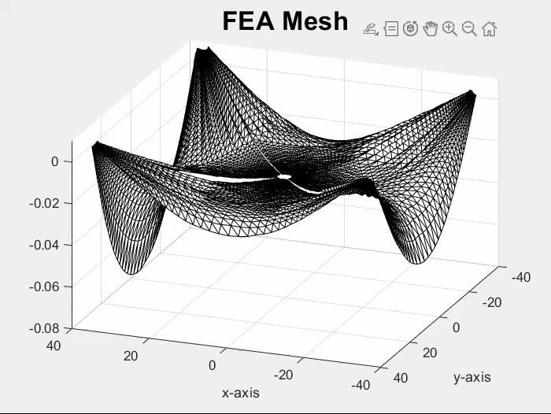
Momentum Management
Disturbance torques arise from SRP
  Pitch & yaw torque come primarily from sail geometric center not aligning with center of mass (COM)
    Correctable by moving AMT to realign COM
  Roll torque comes primarily from sail non-flatness
    AMT trimming tends to reduce this non-flatness torque in asymmetric sail shapes
  Roll torque also arises from non-aligned COM at high SIA
    AMT trimming reduces roll torque from this source
  Even after AMT correction, residual roll torque generally remains, and cannot be managed by AMT use alone
Estimating roll torque allows for sizing of RCS
  Reaction wheel max speeds & torque outputs
  RCS thruster size & propellant loads
  Optical patch size
S5 sail mesh generated by FEA at Opterus, scaled to GeoStorm proportions

Slide 18
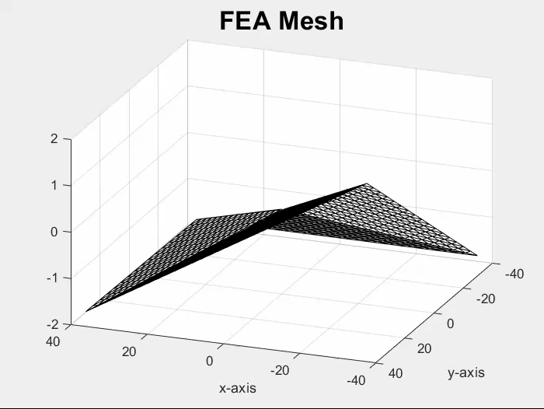
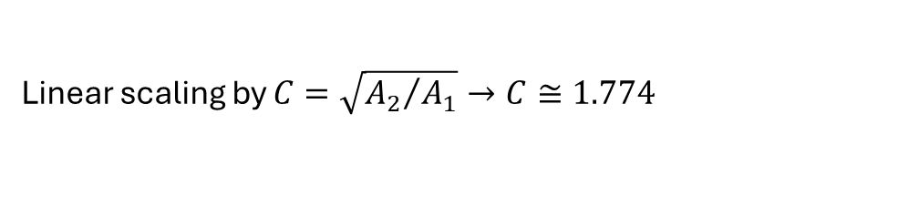
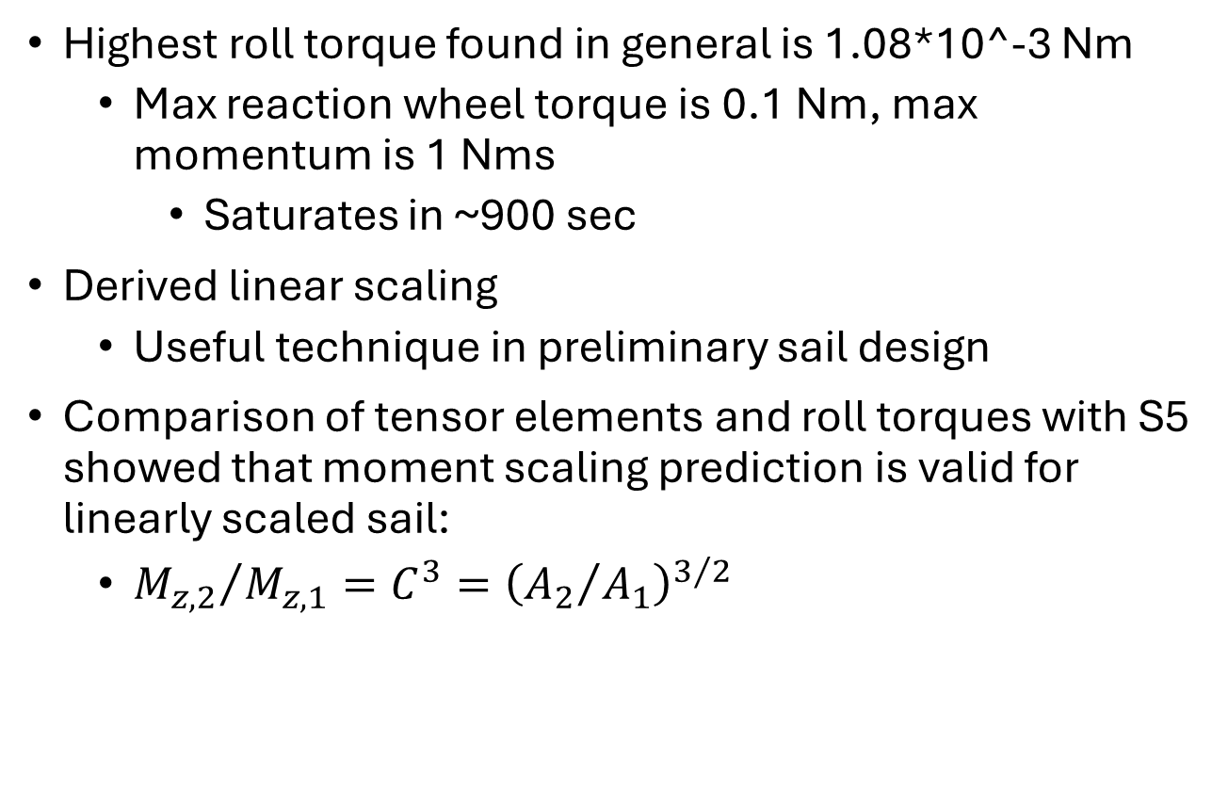
Momentum Management
Highest roll torque found in general is 1.08*10^-3 Nm
  Max reaction wheel torque is 0.1 Nm, max momentum is 1 Nms
    Saturates in ~900 sec
Derived linear scaling
  Useful technique in preliminary sail design
Comparison of tensor elements and roll torques with S5 showed that moment scaling prediction is valid for linearly scaled sail:
  ${M_{z,2}}/{M_{z,1}}=C^{3}={\left({A_{2}}/{A_{1}}\right)}^{3/2}$
 | Largest roll torque by SIA (Nm)
SIA | AMT off | AMT on
0° | 4.8218*10^-5 | 6.9629*10^-5
5° | 3.7717*10^-4 | 8.2838*10^-5
10° | 7.4184*10^-4 | 1.1347*10^-4
15° | 1.0840*10^-3 | 1.7229*10^-4
Linear scaling by $C=\sqrt{{A_{2}}/{A_{1}}}→C≅1.774$

Slide 19
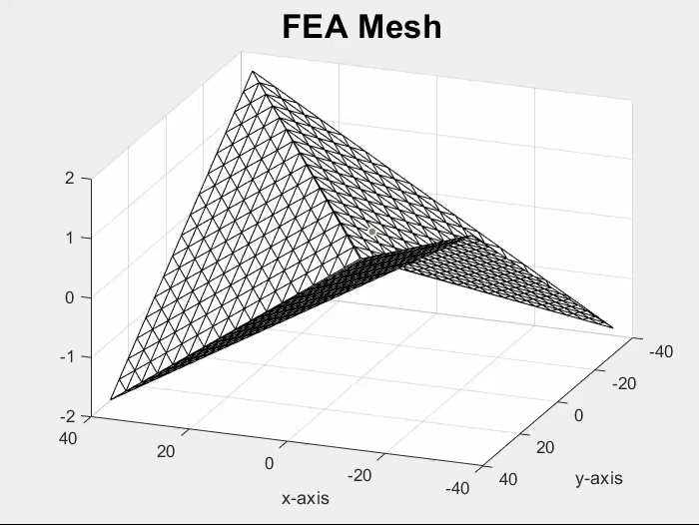
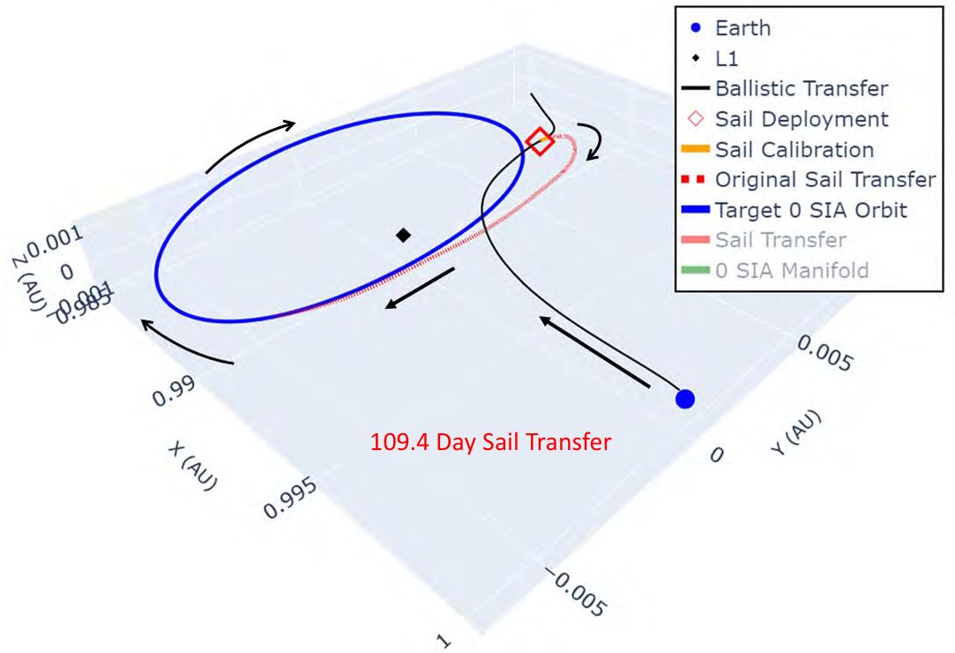
Reaction Control Propellant w/o Propellant Roll Control
Total mission length: 10 years @ 0.98 AU from Sun
  100-day transfer: assumed average sun incidence angle (SIA) = 17°
  Stationkeeping at sub-L1: assumed average SIA = 5°
Parametric study generated sail shape mesh by permuting boomtips through most extreme deflections in- and out-of-plane, drawing triangular quadrants between [2]
  M_{roll} = 8.39*10^-5 Nm, sun incidence angle (SIA) = 5° (sub-L1)
  M_{roll} = 2.20*10^-4 Nm, SIA = 17° (100-day transfer)
Assume propellant consumption doesn’t affect sail orbit
AMT trims out pitch/yaw torque (tends to reduce roll torque)
0.461m moment-arm
  From bus center to bus corner (roughly where thrusters are mounted)
Example sail shapes from parametric study
Thruster type vs propellant mass requirement
Thruster | Isp | Transfer | Stationkeeping | Total prop mass
Cold gas (Vacco) [3] | 40 s | 10.6 kg | 14.6 kg/yr | 153 kg
Cold gas (Moog) [4] | 65 s | 6.54 kg | 9.01 kg/yr | 94.1 kg
Monoprop [5] | 200 s | 2.13 kg | 2.93 kg/yr | 30.6 kg
Electric [6] | 1300 s | 0.327 kg | 0.45 kg/yr | 4.71 kg
GeoStorm Beacon orbit

Slide 20
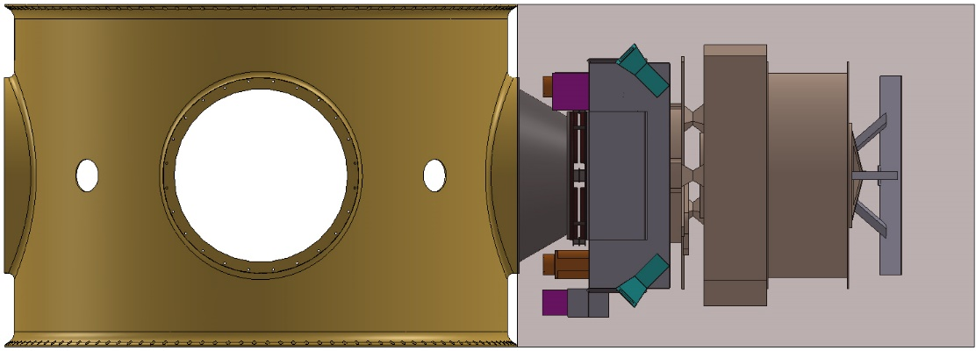
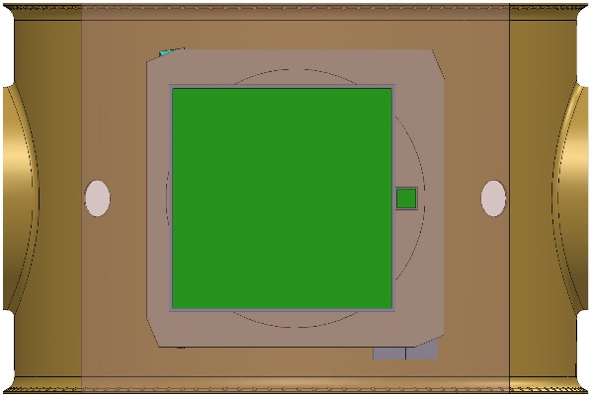
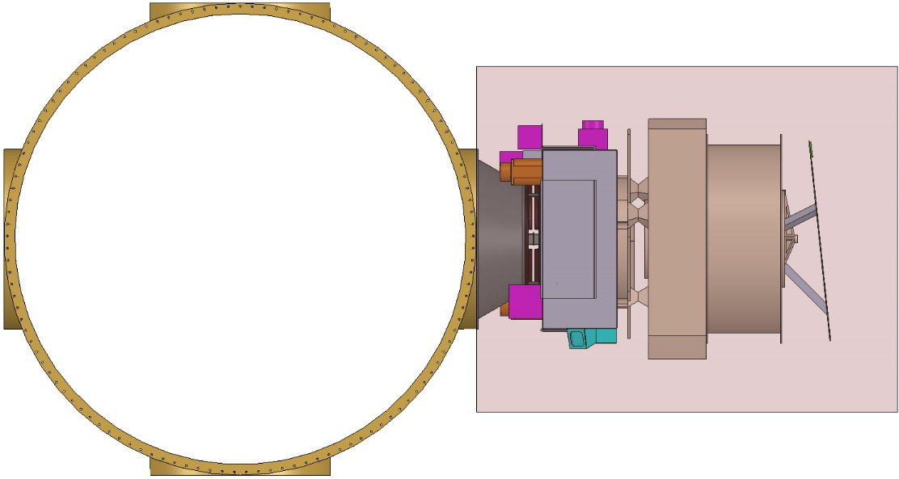
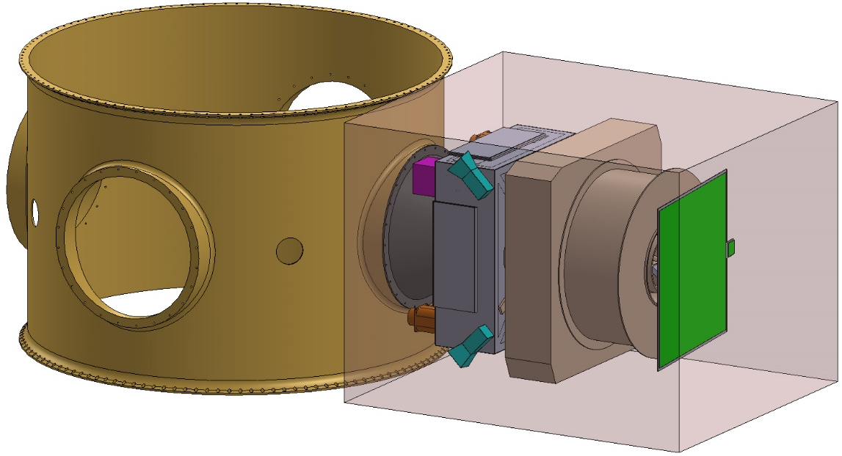
Spacecraft Configuration – ESPA Grande Rideshare
142.24 cm (56 in)
106.68 cm (42 in)
ESPA Grande Payload Envelope
116.84 cm (46 in)

Slide 21
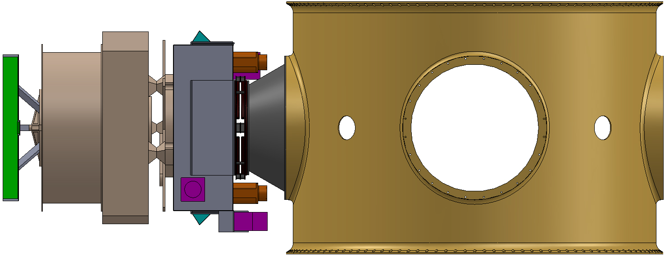
Spacecraft Configuration – Launch Configuration
Bus Interface Plate
Active Mass Translator (AMT)
Bus Antenna and Antenna Mounting Structure
Solar Sail Deployer (Sail Spool and Boom Spool)
Conical Adaptor Between 15-inch Lightband and 24-inch ESPA Port
Spacecraft Bus
15-inch Lightband
ESPA Grande

Slide 22
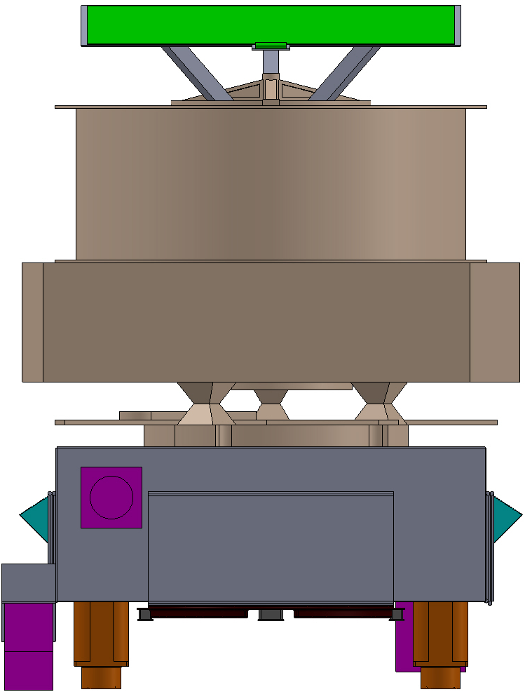
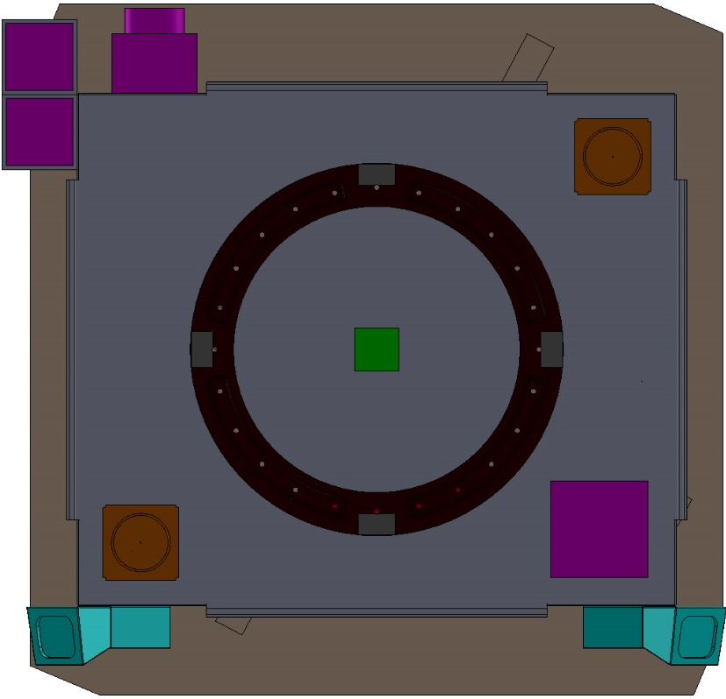
Spacecraft Configuration – Stowed Dimensions
72.06 cm
81.28 cm
111.74 cm
85.02 cm
Bus Frame Structure is: 70 X 60 X 25 cm

Slide 23
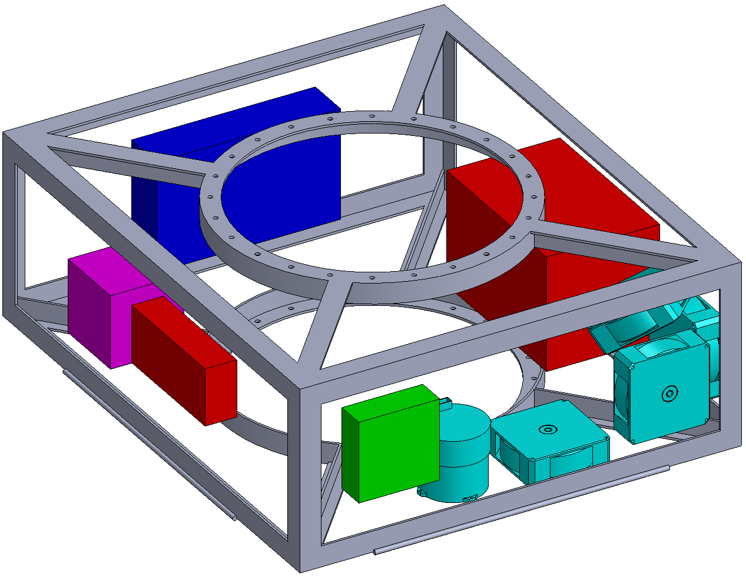
Spacecraft Configuration - Internal Components
Subsystems:
Science: Magnetometer Electronics
Attitude Determination and Control: 4 Reaction Wheels, IMU
Command and Data Handling: FleXbus Avionics Computer and Box
Communications: Communications Electronics Enclosure
Electrical Power: Power Electronics Box, Lithium-Ion Battery
Structures: Spacecraft Bus Frame
NOTE: All internal components are mounted to the bus closeout panels (not shown)

Slide 24
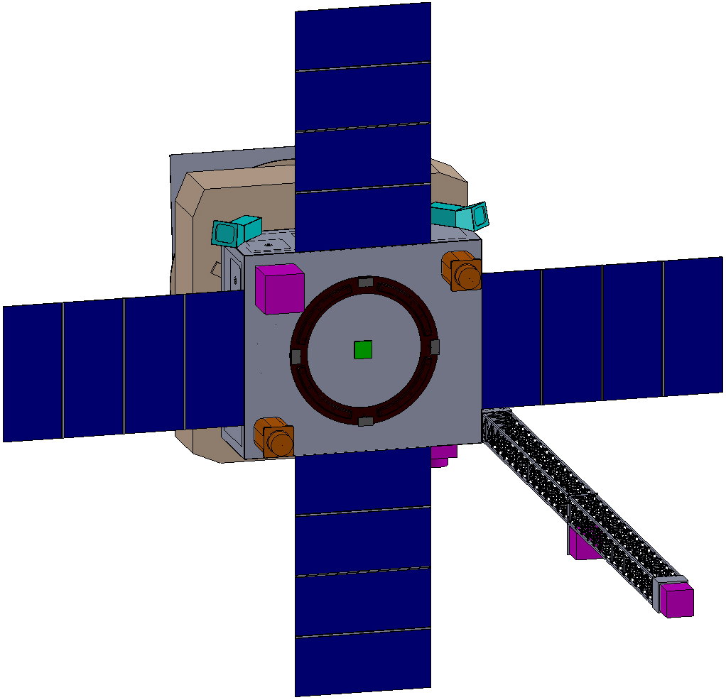
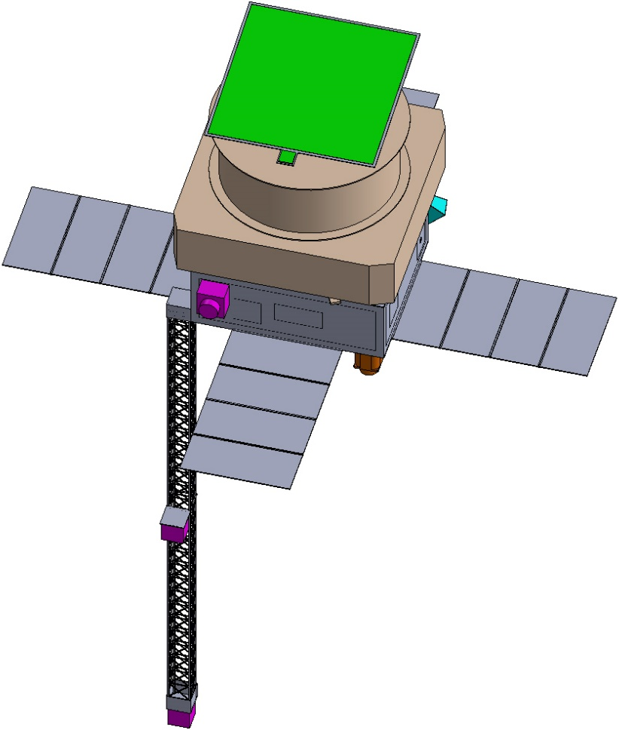
Spacecraft Configuration – External Components
Solar Sail Boom Deployer/Spool
LiDIA and X-band Patch Antenna Mounting Structure
Solar Array Wing
LiDIA Antenna
Star Tracker
CHIPS Propulsion Module
X-band Patch Antenna
Star Tracker
Plasma Sensor
X-band Patch Antenna
Solar Array Wing
Solar Array Wing
Solar Sail Spool
15-inch Lightband (Passive Side)
Magnetometer Boom
CHIPS Propulsion Module
Context Camera
Magnetometer
Solar Array Wing
Magnetometer

Slide 25
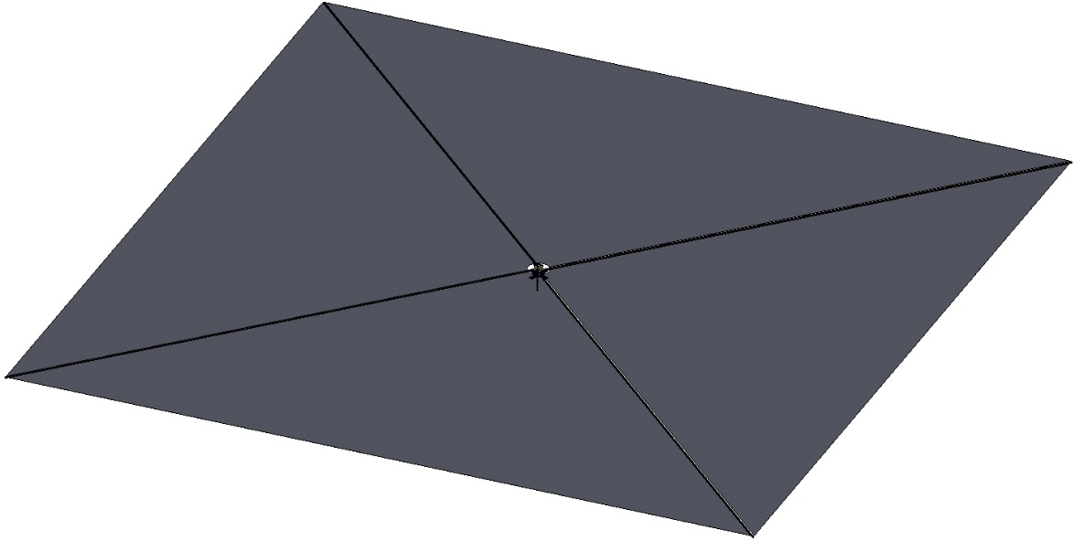
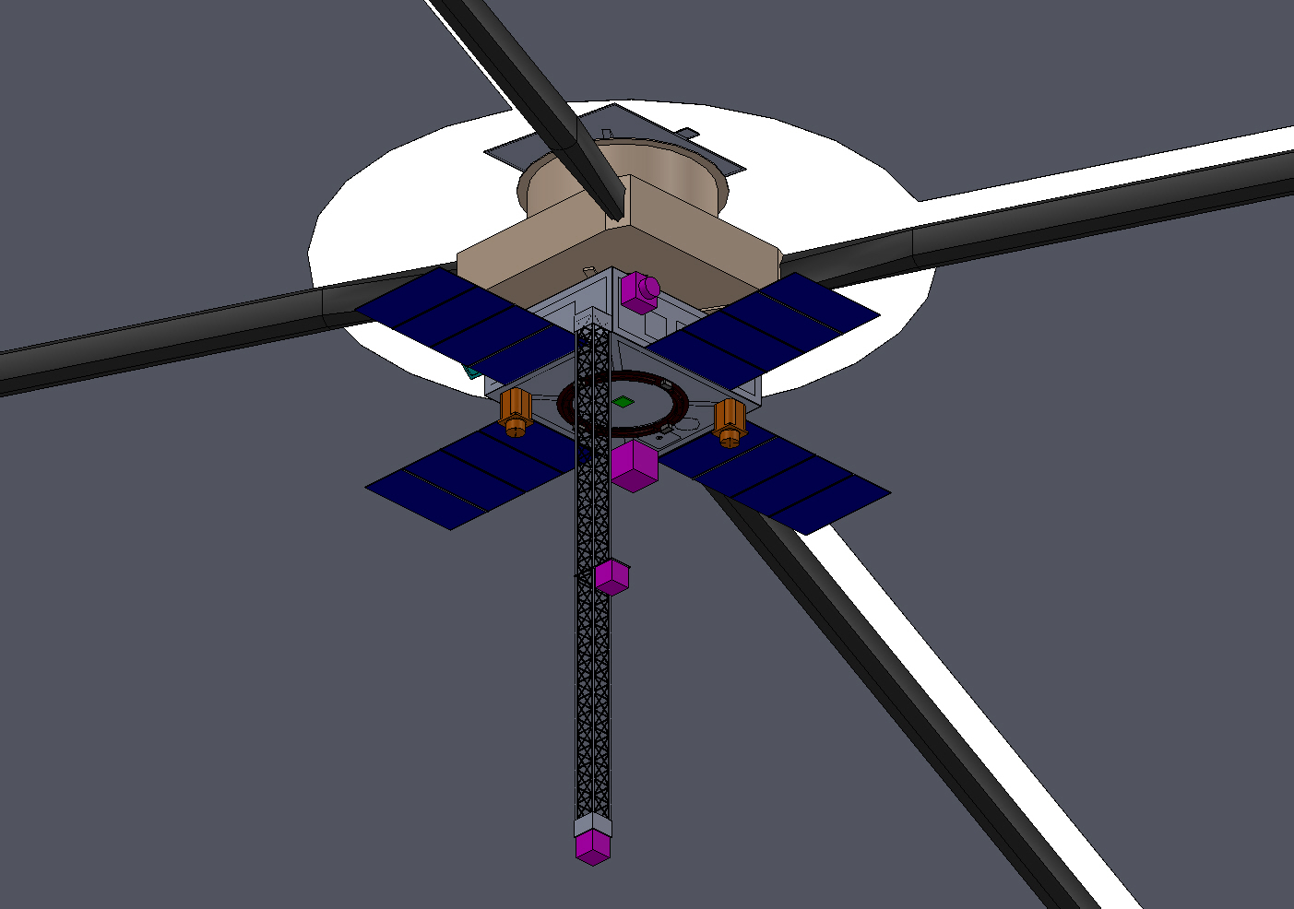
Spacecraft Configuration – Deployed Configuration
2.1-m Diameter
5200 sq-m Total Sail Area

Slide 26
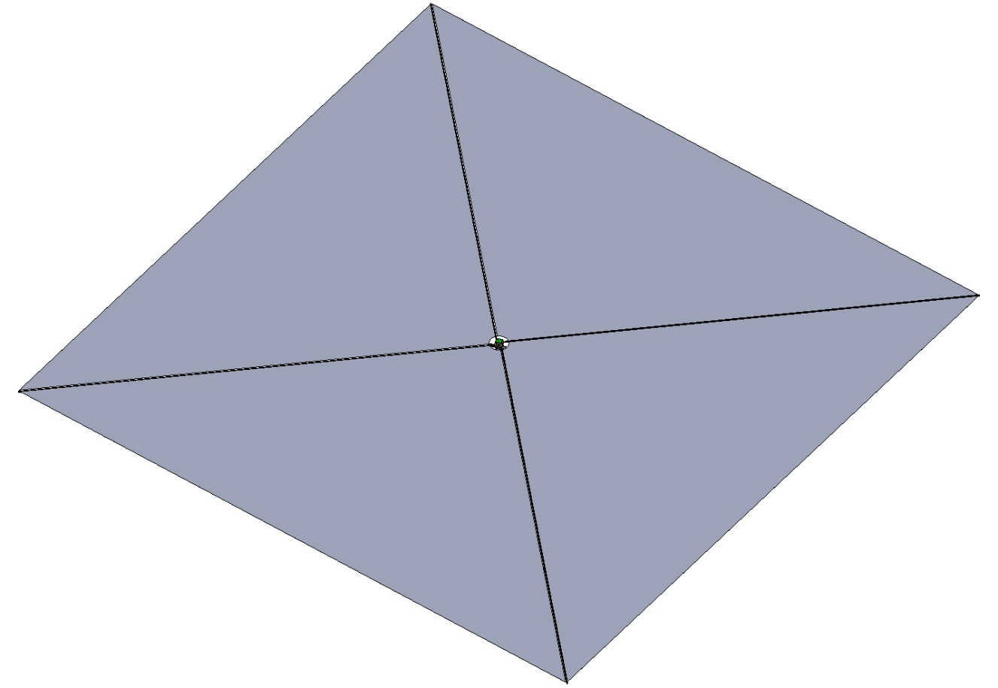
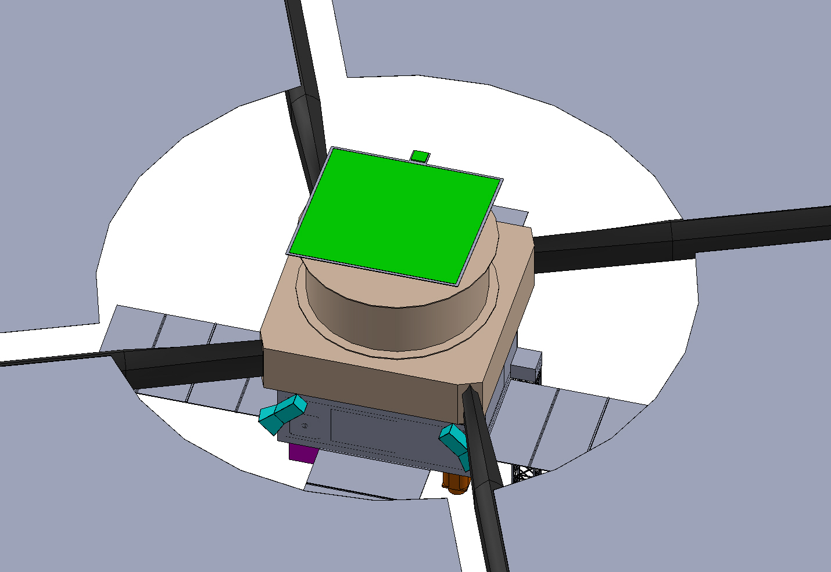
Spacecraft Configuration – Deployed Configuration
2.1-m Diameter
5200 sq-m Total Sail Area

Slide 27


Spacecraft Configuration – Deployed Bus
NOTE: Sail and Sail Booms Not Shown

Slide 28


Spacecraft Configuration – Deployed Bus w/ Dimensions
Bus Frame Structure is: 70 X 60 X 25 cm
111.56 cm
202.45 cm
299.54 cm
202.01 cm
212.48 cm

Slide 29


Spacecraft Configuration – Transparent Views
NOTE: Sail and Sail Booms Not Shown

Slide 30



MEL and PEL

Slide 31




Cost Estimates
Notes:
commercial tool TruePlanning, from Unison Global. Mission costs were estimated using in-house developed cost estimating relationships (CERs) based on NASA earth-orbiting and planetary missions. The heritage assumptions for each subsystem are shown in Table 3, with “New” corresponding to TRL 6, where the exact component has not flown before, and “Off the Shelf” corresponding to TRL 9, where the exact component has flown before.

Slide 32
Summary – Design Reference Mission
A design reference mission for a solar storm warning system has a proof-of-concept design
  Completed a range of trade studies (subsystems during the DRM development)*
    * Evaluated alternative architectures prior to DRM Development (e.g. EP and Small Sat Constellation).
20-minute warning times require a sail space spacecraft performance Ac ≥ 0.32 mm/s2
Roll control is manageable for short duration missions with propellant based propulsion, but propellentless approaches are enhancing and likely enabling for long duration missions
Developing sizing tools for Solar Sail Systems 100m² – 6000m² (Validated up to 1600m²)
A generation-2 solar sail spacecraft is cost viable for a NASA Astrophysics MIDEX AO
The community is lacking a validated sail shape model, drives uncertainty
The community is lacking a validated model for magnetic cleanliness, drives system viability risk
The sail system scales by ~40m² per kg of vehicle mass

Slide 33
Summary – Technology Drivers / Demonstration Mission
A Generation-1 solar sail can mitigate technology risks for a Generation-2 mission if subsystem technologies are extensible
  The composite boom technology must be extensible to 50m class booms
  The membrane fabrication and folding approach must be extensible to 5,000m² class sails
Mass reduction activities have a very high Return-on-Investment
A flight demonstration mission should prioritize:
Sail shape model validation
Characterization of sail induced environmental relative to instrument requirements
Propellantless roll-control solution

Slide 34
GeoStorm Beacon Design Reference Mission (DRM) and Technology Drivers
John W. Dankanich
NASA
John.Dankanich@nasa.gov

