Slide 1

SR-1 Freedom Thermal Architecture Challenges
TFAWS Passive Thermal Paper Session
Scott Thomas | NASA/MSFC
Jared Berg | NASA/GRC
Thermal & Fluids Analysis Workshop
TFAWS 2026
August 31 – September 4, 2026
NASA Marshall Space Flight Center
Huntsville, AL

Slide 2
Agenda
What is SR-1 Freedom?
Thermal Architecture Overview
Integrated Thermal Analysis Approach
Nuclear Power Module (NPM)
Heat Rejection System (HRS)
Thermal system challenges

Slide 3
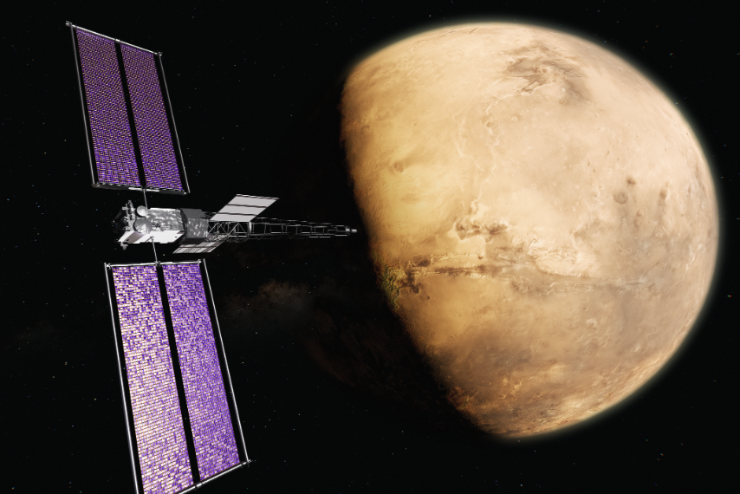
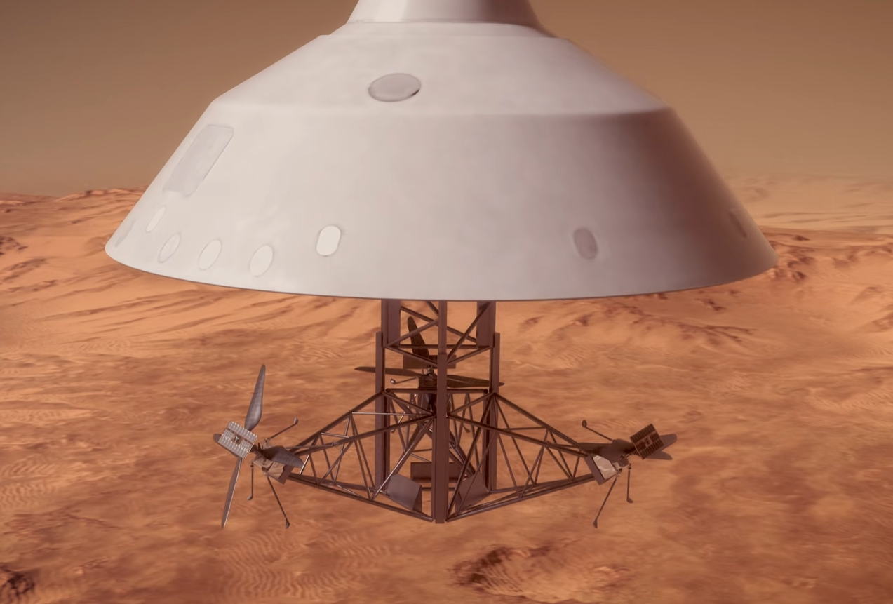
What is SR-1 Freedom
SR-1 Freedom seeks to advance U.S. space fission system technologies that will enable power generation capabilities in-space, on the Moon and Mars.
Goals and Objectives:
  Operate a nuclear-electric propulsion system in space
  Launch on Earth escape trajectory
  Utilize the 2028 Mars launch period
  Leverage existing technology and flight hardware to the maximum extent possible
  Deliver Skyfall to Mars Intercept
  Reactor Extended Performance
  Fly by Mars with imagery return
Re-purposes the Power and Propulsion Element (PPE), previously developed for Gateway
Target Launch Date: December 2028
Credit: NASA
Credit: NASA/JPL-Caltech

Slide 4


SR-1 Thermal Architecture
80kW
Primary Heat Rejection to Space
2 Wings of 3 Radiator Panel Arrays
7m² per panel side → 84m² total area
Average T_{rad} ≈ 400K (260F)
2 pumped fluid loops – 1 per wing
ROSA
Excess Power Converted to Heat and Rejected to Space
20kW
HRS
2 Wings
PPE Heat Rejection
PLR
Heat Loss to BOOM
PPE Radiators
Heat Loss to Space
PPE
Brayton
120kW
SKYFALL
BOOM
Reactor Total Thermal Load
20kWe Power Delivered to PPE
100kW
Heat Transferred to Brayton Engine
Heat values shown are notional/approx.
Skyfall Heat Rejection

Slide 5
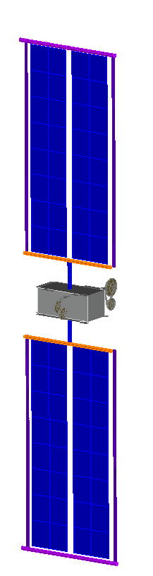
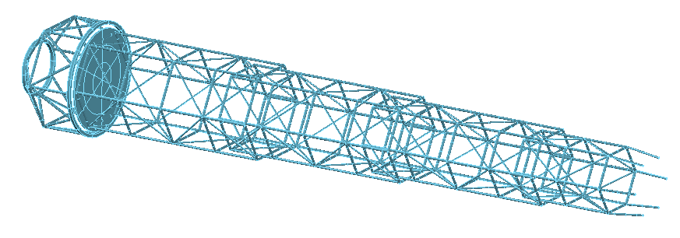
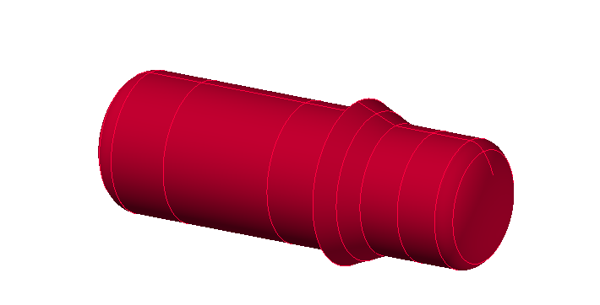
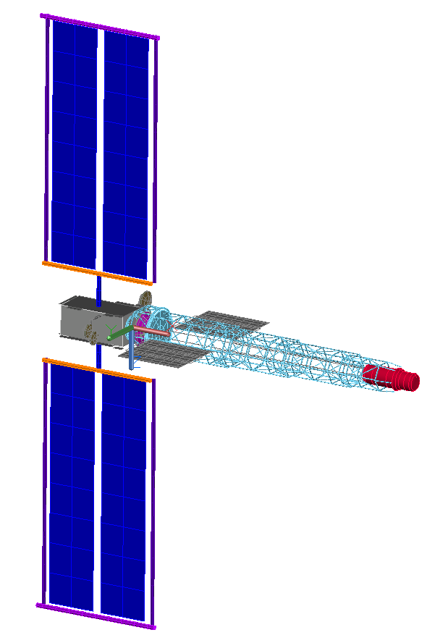
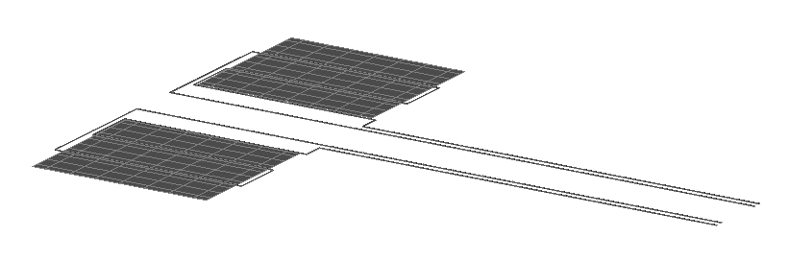
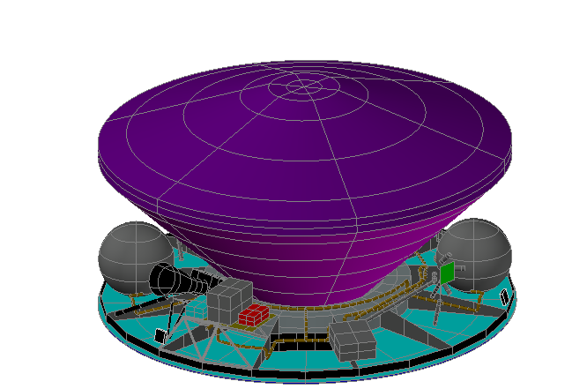
Integrated Thermal Analysis Approach
Integrated Thermal Analysis centers around developing and maintaining the SR-1 Integrated Thermal model (ITM), consisting of Reduced Thermal Models (RTMs) for all Spacecraft Elements
  The ITM is used by other Spacecraft Elements for their detailed thermal analysis (similar process used for Gateway)
Due to project schedule constraints and spacecraft size, only limited integrated TVAC testing is possible
  Verification relies heavily on the ITM, coordinated element‑level testing, targeted interface tests, and increased model fidelity and margins where interface testing cannot occur
Reduced Thermal Models (RTMs)
Inputs from other Disciplines
PPE
Boom
Environments
DSNE
Launch Vehicle
Induced (Plume)
Mission Design
DRMs
Con-Ops
Pointing constraints
Hardware Ops and RQMTs
Power & Dissipation
Thermal Interface Rqmts
Reactor & PCS
NPM
SR-1 ITM
HRS
Definition of Thermal Interfaces and Induced Environments
Thermal Data Book
ITM for Element’s detailed analysis
Mission thermal performance
Skyfall

Slide 6
Nuclear Power Module
New (and old) systems that have never operated in space
High-Assay Low-Enriched Uranium Fission Reactor
  Based on VALKRE design from Idaho National Lab
  < 20% enriched UO₂
  Core cooled by sodium heat pipes
    Operates at ~1000 K
Closed Cycle Brayton Power Conversion System
  He-Xe working fluid turbomachinery
  Heat pipe–gas “hot” side heat exchanger
  Gas-liquid “cold side” heat exchanger interface to heat rejection system radiators
  Parasitic Load Radiator resistors regulate turbine speed (~800 K operating temperature)
  ~20% thermodynamic efficiency
Turbine
PLR
Reactor Core
Radiator
Cold
HX
Alternator
Hot
HX
Sodium heat pipes
Compressor

Slide 7
Heat Rejection System
Radiators are critical to any Nuclear Electric Propulsion architecture
  T_{hot} (reactor) and T_{cold} (radiators) determine system efficiency
  …but T⁴ performance of radiators and mass minimization push you to higher T_{cold}
  Materials limit max temperature
  Must consider reactor fluence (neutrons and gamma) on materials
Design point ~500 K
  Titanium-water heat pipe / polymer matrix composite baseline design
  Considerable IR backload on surrounding hardware
  Pumped fluid trunkline interfaces with PCS HX
  Implies high heater power usage during cold mission phases
Two deployed “wings” flown edge-to-sun
  Independent flow loops
Pump
Wing 1
Pump
PCS
HX
Wing 2

Slide 8
SR-1 Thermal Challenges
Extremely aggressive launch schedule constrained by Mars launch window
  Severely limits level of thermal testing we can accomplish
Reactor core ~1000 K, must attach to boom structure that can also react launch loads
  Significant mass limitations drove design to a shorten static Boom, led to reactor being much closer to rest of spacecraft
PLR must reject 20 kW at peak, extreme source of IR backload and mounting challenge
Skyfall was designed as free-flyer and spin stabilized
  SR-1 architecture houses Skyfall within a partial enclosure, yet must allow Skyfall adequate ability to radiate to space

Slide 9
Questions?

