Slide 1
Thermal Modulation Test (TMT)
Tomasz Lis | MSFC
David Smith | MSFC
H. Phil Stahl | MSFC
Joshua Hopson | MSFC
Thermal modulation test (TMT) and preliminary test results

Slide 2
TMT - Goal & Objectives
Primary Goal:
Develop/Demonstrate method to measure thermal response of mirrors with picometer sensitivity using existing hardware and facilities.
Core Objectives:
Continue developing/refining Thermal Modulation Test Method for future use to evaluate HWO mirror technology and acceptance test HWO flight mirrors.
Use TMT method to test community provided and NASA owned mirrors.
How large can the TMT thermal modulation be while still providing deterministic extrapolation to the pico-meter level wavefront disturbances relevant to HWO.”
Characterize mirror system response parameters needed to enable specification of active thermal control of flight mirror segments.

Slide 3
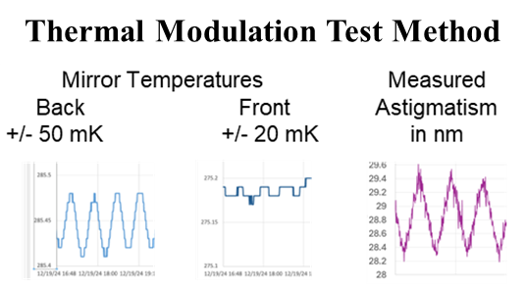
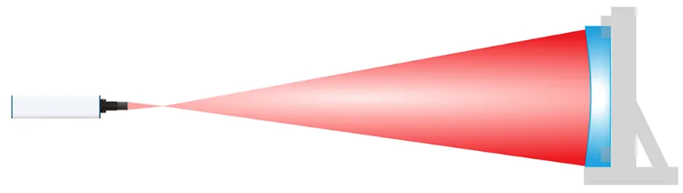
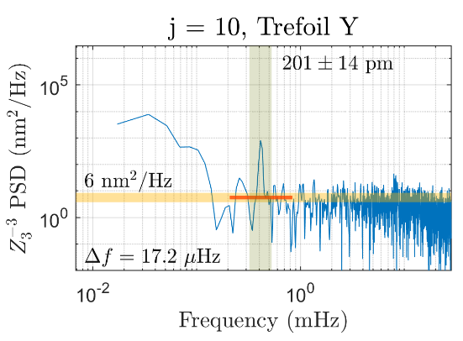
What is a mK Thermal Modulation Test (TMT)?
Center of curvature mirror test with interferometer
Mirror is located inside cold-biased vacuum chamber
Mirror is under positive thermal control using a heater behind the mirror.
Heaters are sinusoidally modulated about a given setpoint temp with a period of 20-40 minutes (< mHz).
  Slow thermal modulation causes the mirror figure to change as a function of its CTE and heat transmission.
Wavefronts are measured about one frame per 7 secs for dozens of thermal cycles, 10-20 hours or more.
Measured wavefronts are decomposed into Zernike functions, which also exhibit sinusoidal variations.
These time series are Fourier transformed into frequency space, equivalent to heterodyne detection.
Because thousands of measurements are processed, we can detect the change in wavefront Zernikes to picometer levels in the frequency domain.
Chamber Cryogenic Shroud
Frequency Domain Analysis
Phase Cam 6110
Interferometer
Mirror
Thermal
Control
Chamber
Window
Mirror under test
1 m Thermal Vacuum Chamber

Slide 4
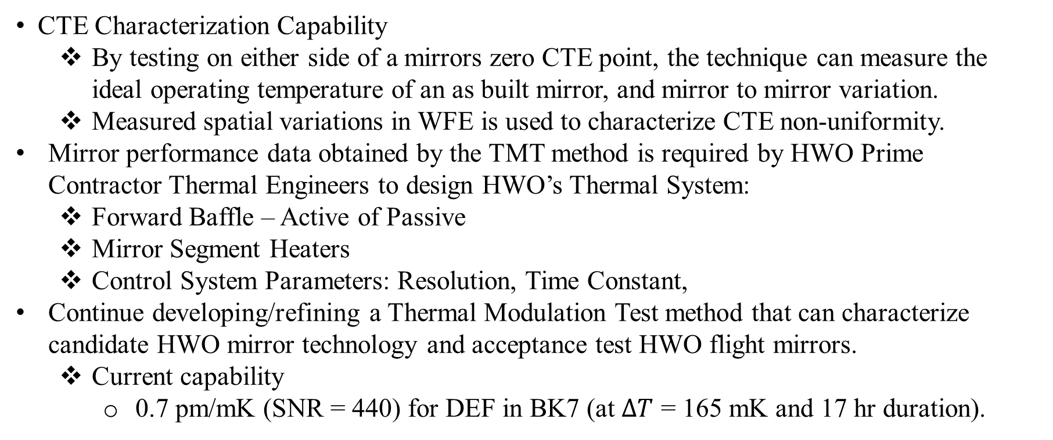
TMT - Significance
CTE Characterization Capability
  By testing on either side of a mirrors zero CTE point, the technique can measure the ideal operating temperature of an as built mirror, and mirror to mirror variation.
  Measured spatial variations in WFE is used to characterize CTE non-uniformity.
Mirror performance data obtained by the TMT method is required by HWO Prime Contractor Thermal Engineers to design HWO’s Thermal System:
  Forward Baffle – Active of Passive
  Mirror Segment Heaters
  Control System Parameters: Resolution, Time Constant,
Continue developing/refining a Thermal Modulation Test method that can characterize candidate HWO mirror technology and acceptance test HWO flight mirrors.
  Current capability
    0.7 pm/mK (SNR = 440) for DEF in BK7 (at $ΔT$ = 165 mK and 17 hr duration).

Slide 5
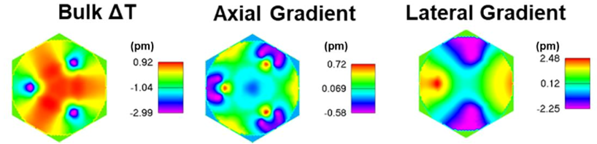
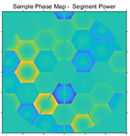
Relevance to HWO
Coronagraphic Error Budget Modeling (HWO Straylight Suppression Team) demonstrated that HWO requires ultra-stable mirrors to the following:
  Wavefront stable to ~ 1.5 pm rms for slow temporal instability (<0.001 Hz)
  Wavefront stable to ~ 10 pm rms for fast temporal instability (0.001 Hz to 10+ Hz).
All current HWO thermal modeling assumes uniform-CTE substrates, therefore all current HWO thermal modeling is invalid.
(HWO Systems Modeling Team) Modeling of HWO EAC (Exploratory Analytical Concept) shows that thermal instability is the most important performance risk.
Because these models assume uniform CTE, mount interface induced errors are dominating. Adding substrate CTE adds Defocus
5
Notes:
When you go from a bulk to lightweighted geometry (I’m sure this list is not complete):
The zero-expansion null temp of the mirror could differ from that of the bulk
The coefficients of the nonlinear function that describes the expansion vs temp could be different (slope of CTE near the zero crossing and higher orders too).
Certain regions of the mirror could be weighted more important than others
Different spatial modes could have different nulls, dependencies on temp.

Slide 6
Relevance to HWO
HWO requires MSFC’s Thermal Modulation Test Method to:
Validate Thermal Models
Separate Thermal Performance effects of Mirror Substrate CTE from Mount Interface.
Answer compelling thermal modeling questions such as ‘how large can the TMT thermal modulation be while still providing deterministic extrapolation to the pico-meter level wavefront disturbances relevant to HWO.”
Characterize mirror system response parameters needed to enable specification of active thermal control of flight mirror segments.
Evaluate HWO mirror technology and acceptance test HWO flight mirrors.

Slide 7
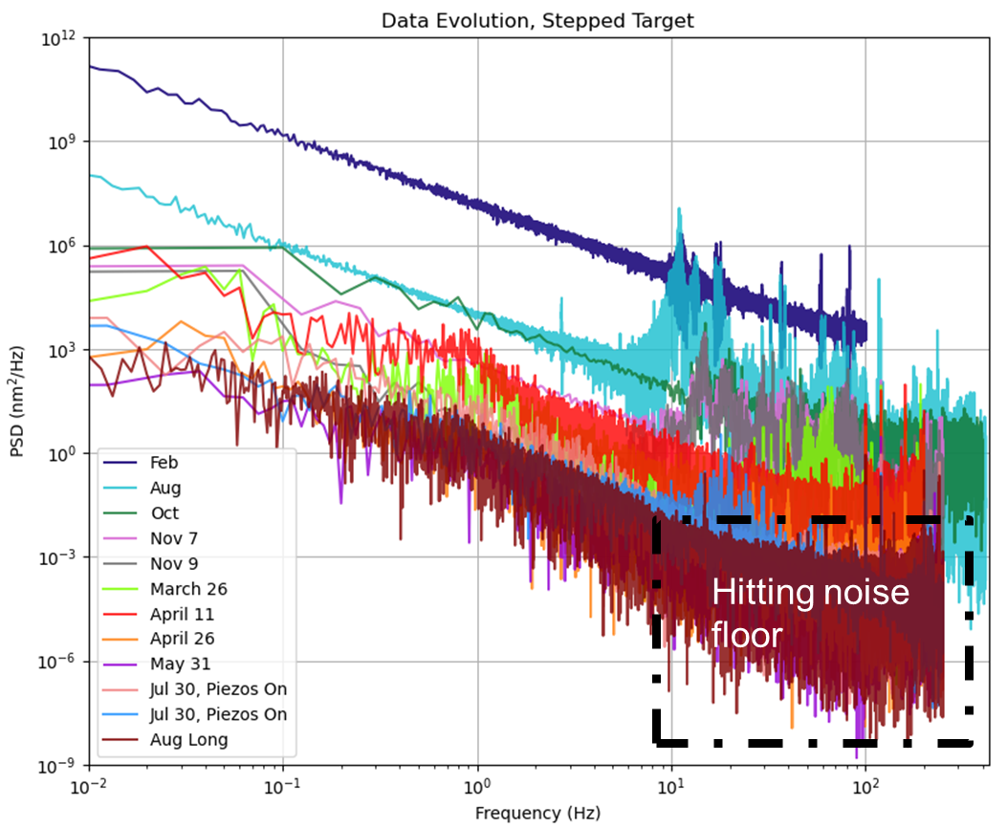
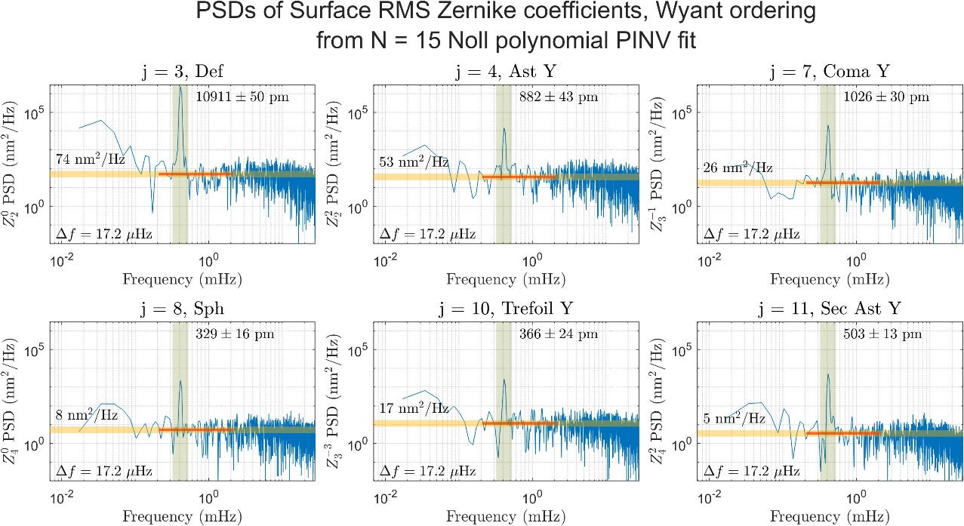
Complementarity
MSFC’s Thermal Modulation Test Method, the Team that performs the Method and the Facilities that employ the Method do not duplicate and capability at another Center and synergistically compliments GSFC Ultra-Stable Structure Lab (USS).
GSFC’s USSL is achieving picometer-level measurements on 15 cm mirror when stacking data sets at frequencies > ~ 0.1 Hz.
Breann Sitarski, Towards picometer-level metrology with the GSFC Ultra-Stable Structures Laboratory (USSL), Mirror Tech Days, 2024
MSFC’s TMT is achieving picometer-level measurements on 25 cm mirror for temporal frequencies from 1E-4 to 0.02 Hz.

Slide 8
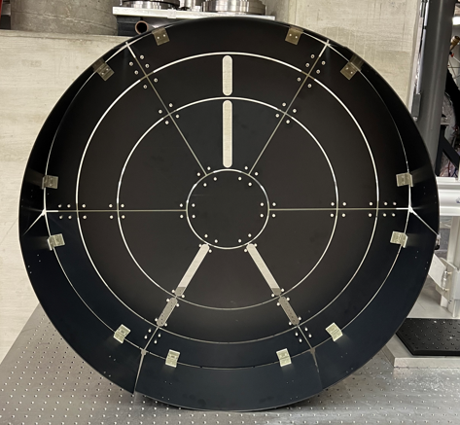
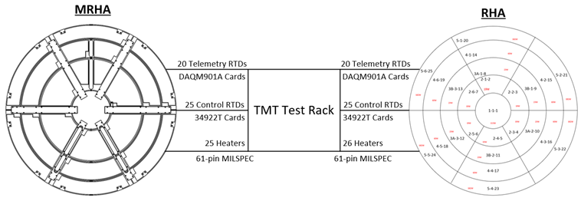
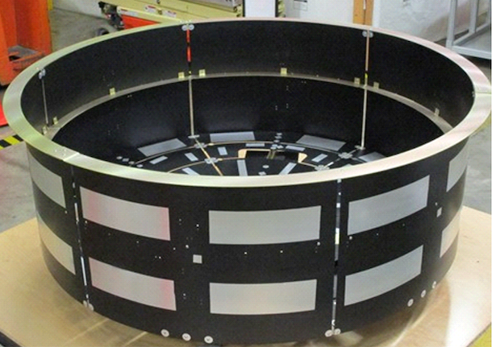
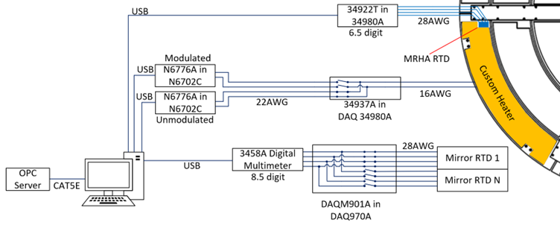
Precision Thermal Control (PTC) Test Beds
TMT Method can be performed in two Precision Thermal Control Test Beds with 25-zones of active thermal control: 1.5-m PTC and 0.8-m min-PTC
Both Test Beds share the same Sensing and Control Electronics.
Upgraded Electronics improves Performance:
  Thermal Sensing = < 0.5 mK
  Thermal Control = < 50 mK
  Thermal Stability = < 2 mK rms
0.8-m mini-RHA
Common Electronics
1.5-m Rear Heater Assembly

Slide 9
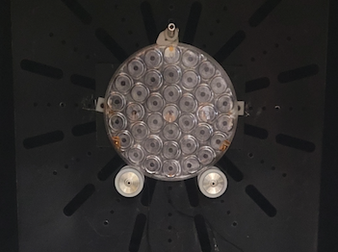
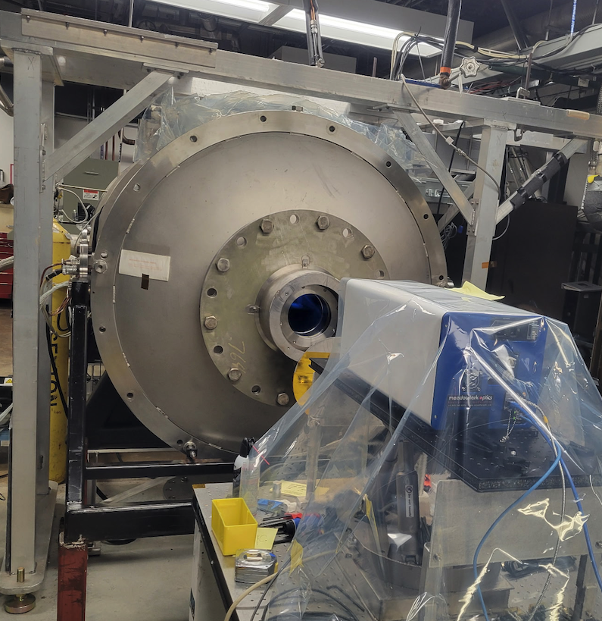
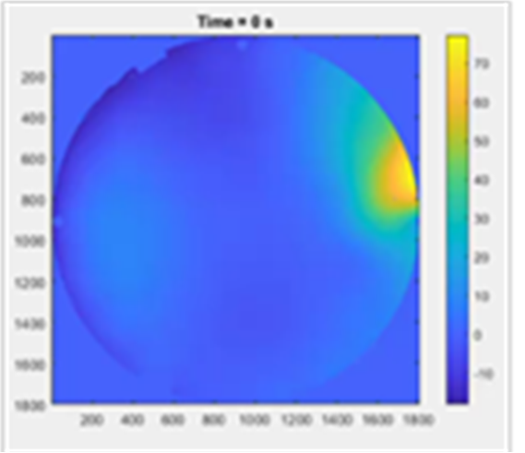
TMT Demonstration
Ran thermal modulation tests on a 250 mm Hextek Bk7 mirror in our 1-m chamber.
Mirror modulated by heater located behind and to the side.
  Off-axis heating produces modes decoupled from rigid body motions
  Diodes measure temps of shroud, heater plate, mirror back and front.
  Mirror supported by two beams with Teflon sleeves for thermal isolation.
  Chamber cooled to 270° K. Heater plate held at 305° K. Rear of mirror reached 285° K, front settled to 275° K.
  Heater plate P/V modulations between 80 mK and 1200 mK. Mirror mods between ~10 mK and 380 mK P/V.
  Chamber shroud stability ~10 mK RMS, ~50 mK P/V.
  While this mirror is NOT ultra-stable or HWO suited, it proved to be good for initial test development.
  This enabled us to demonstrate the process and develop modeling tools in preparation for large mirror testing in XRCF.
250 mm
Mirror
1 m chamber test config.
Measured
Thermal
Signal

Slide 10
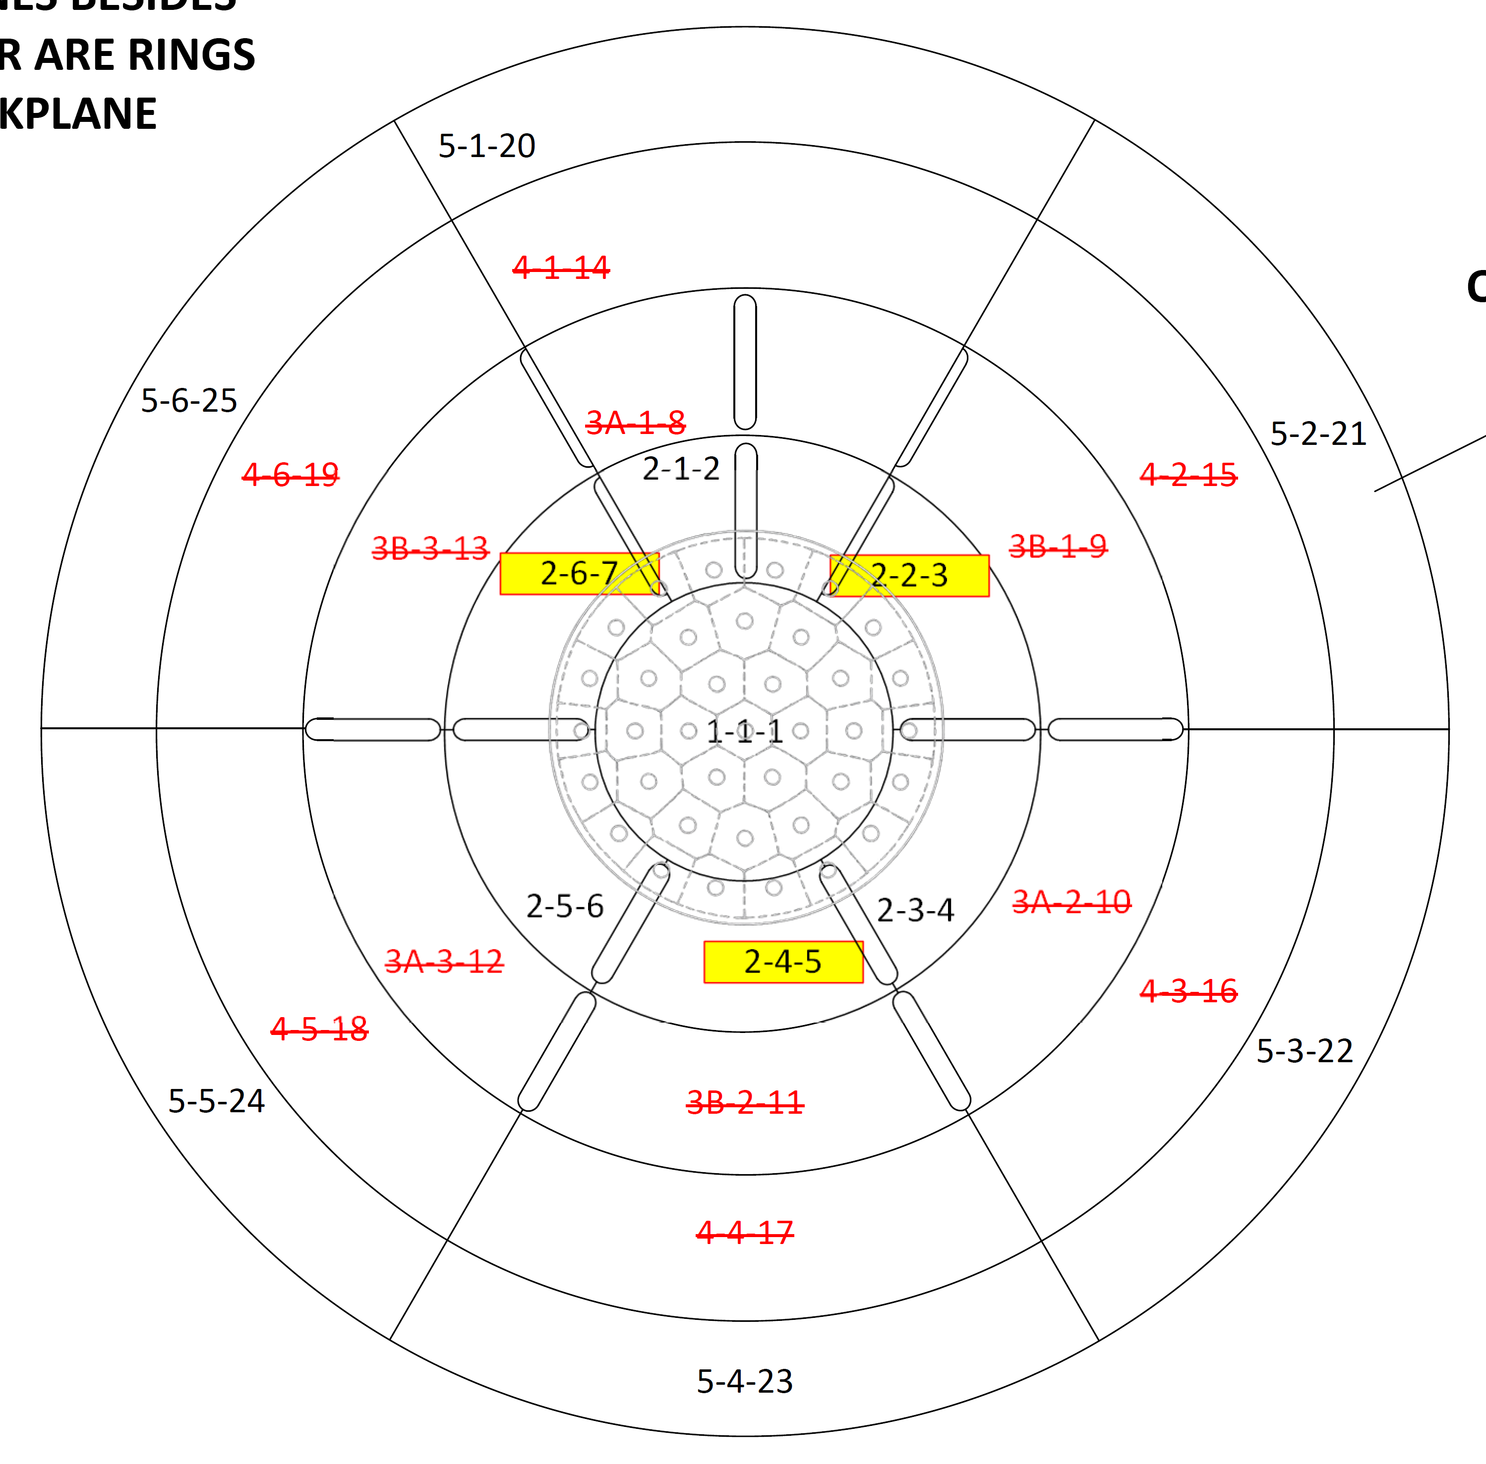
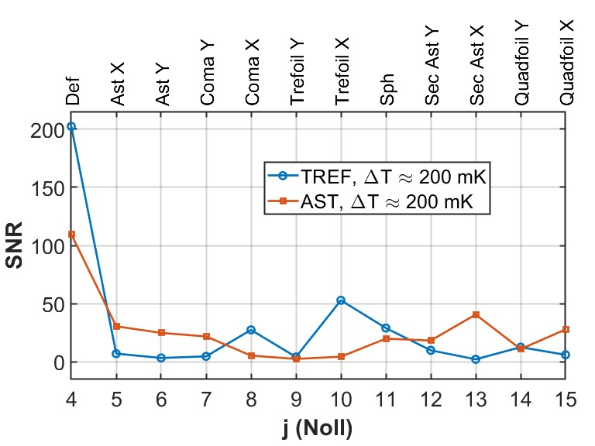
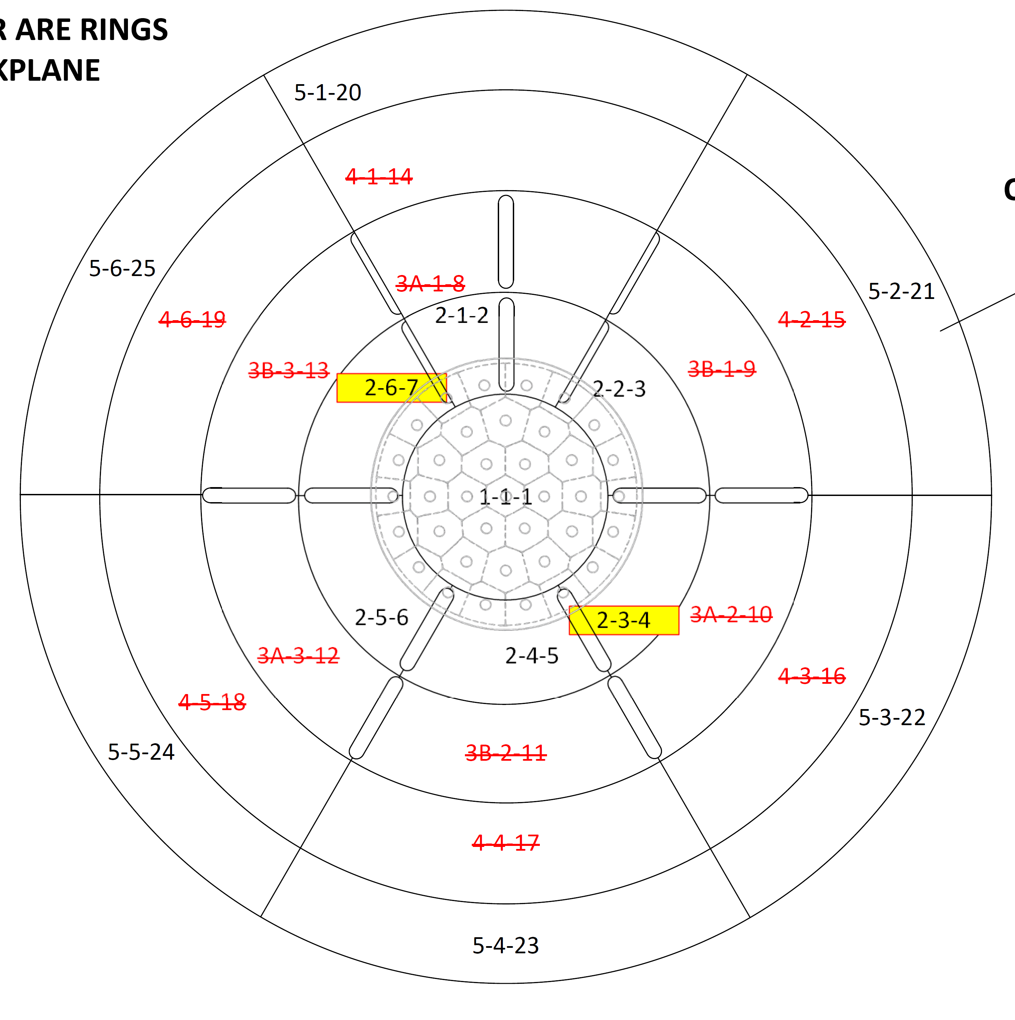
Mini-PTC Results: 25-cm BK-7 mirror
Heating Patterns:
Results:
WFE SNR vs. Zernike Mode Index
TREFOIL
All Zones other than outer cylinder are rings in the backplane
modulation period = 20 min
Modulated Zones
Outer Cylinder
ASTIGMATISM
WFE signal improved for excited Zernike modes. The spatial distribution of the thermal excitation is an extrinsic tuning knob for TMT SNR.

Slide 11
Linearity

Slide 12
Spatio-Temporal Thermal Transfer Function
(developed by Univ. of Arizona)
Process Flow
Motivation: coronagraph dark-hole degradation is driven by dynamic speckle, whereas static speckle is correctable via deformable mirrors.
Physics:
Mirror spatial frequencies (Fourier modes) map directly to speckle at known angles (via Rayleigh-Rice theory).
Temporal modulation of a spatial mode (as in TMT test) causes corresponding speckle to vary in intensity.
Idea: decompose surface into spatial Fourier modes rather than Zernikes (which mix spatial frequencies) before temporal PSD.
Temporal PSD then relates directly to speckle contrast - stability PSD.
TMT transfer function depends on both temporal and spatial frequencies – informs how stable the environment needs to be at a particular temporal frequency to meet contrast requirement at a particular spatial frequency.
Generate Surface Maps
2D Spatial FFT (Amp & Phase)
Bin in k-space
Temporal FFT each binned k

Slide 13
Mirror Testing lineup
MSFC will continue developing/refining Thermal Modulation Test Method for future use to evaluate HWO mirror technology and acceptance test HWO flight mirrors.
Additionally, MSFC takes advantage of available schedule time in the XRCF to use the TMT method to test NASA owned, other Agency owned and community provided mirrors.
  Owner Description Availability
  NASA 60-cm ULE mirror FY26
  NASA AMTD 1.5-m ULE Mirror FY27
  EvolvOptic SBIR 0.4-m ClearCeram Mirror (Open/Closed Back) FY27
  EvolvOptic 76-cm ClearCERAM mirror FY28
  NASA 76-cm D19 ULE mirrors FY28
Testing these mirrors ensures that TMT is fully developed and characterized before HWO.

Slide 14
In-Process and Future
Implement active thermal control on small chamber:
  Built 80-cm mini-PTC testbed with 25-zones of active thermal control.
  Improved thermal control and monitoring with platinum RTDs instead of diode-based sensors.
New Methodologies:
  Stability PSD: Decomposition into Fourier modes and plot Instability vs Spatial Frequency.
  Broadband TMT: Broadband thermal excitation enables measurement of impulse response in a single shot, capturing the full temporal response and all relevant thermal time constants.
Characterize Noise Floor in XRCF:
  Expect noise reduced to seismic regime.
  Interferometer and optics on common bench inside chamber.

Slide 15
Conclusion
TMT is Proven, Versatile, and Scalable
  There is nothing magic about the Thermal Modulation Test (TMT)—it is fundamentally based on mathematics and can be applied to any test setup.
  Initial tests on a 25-cm mirror successfully demonstrated the process, confirming the assumption of linearity at small temperature changes (ΔT).
Crucial Enabler for HWO Success
  Current HWO models falsely assume uniform CTE; TMT enables accurate thermal model validation and separates mirror substrate CTE effects from mount interface errors.
  TMT is essential for the Habitable Worlds Observatory (HWO) to meet ultra-stable wavefront requirements (1.5 pm rms for slow drift, 10 pm rms for fast instability).
Enables Advanced Mirror Characterization
  Allows for the calculation of the Spatio-Temporal Thermal Transfer Function.
  Broadband thermal excitation will enable measuring the full temporal response and thermal time constants in a single shot.
Future Pathway at MSFC
  MSFC will continue refining the TMT method for future HWO mirror technology evaluation and flight acceptance testing.

