Slide 1

Navigating your own stressful-strain curve
Mechanics of Materials
Austin Smith M.S.
Materials Research Scientist
NASA Langley Research Center [LaRC]

Slide 2

Examples of Mechanics of Materials
showing up in NASA projects

Slide 3
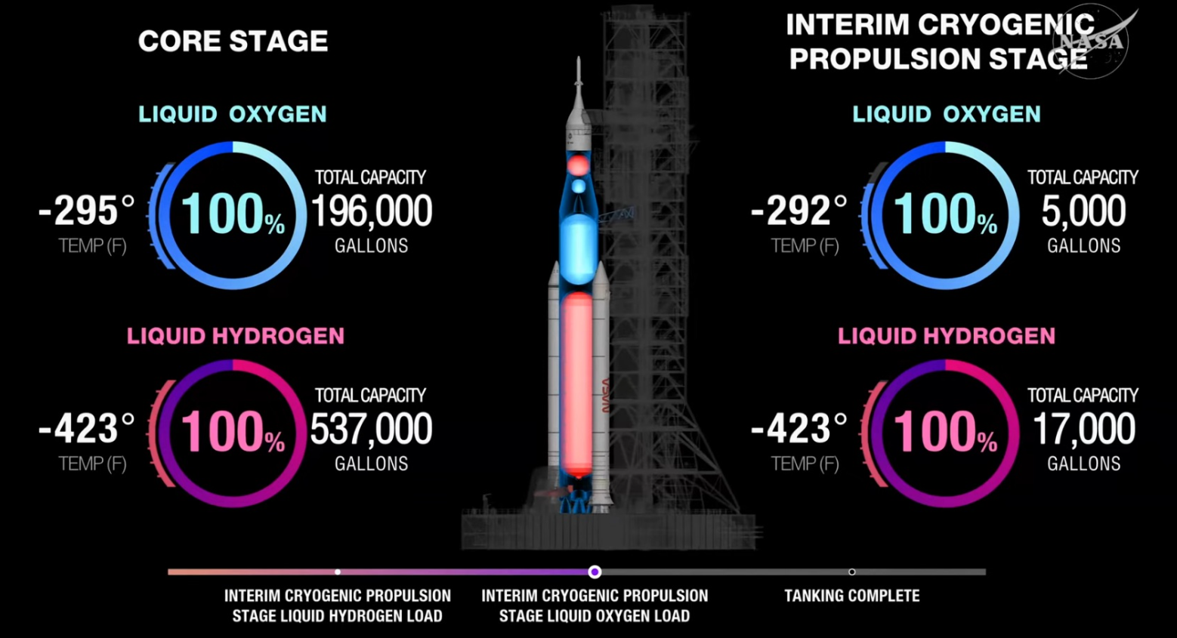

Case Study 1 – Artemis Cryogenic Tanks
Thin-Walled Pressure Vessels at -423°F
The System
  Liquid Hydrogen (LH₂)
  Liquid Oxygen (LOX)
The Math: solving biaxial stresses on light-weight metallic walls
$$σ_{hoop}=\frac{pr}{t}$$
$$σ_{axial}=\frac{pr}{2t}$$
The Trade-off: Thinning walls reduces launch weight but increases buckling risk

Slide 4
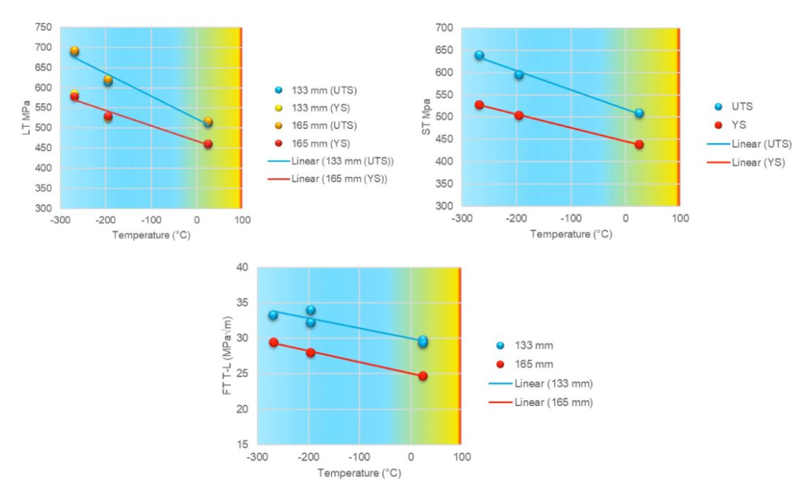
Cryogenic Stress/Strain Behavior
Material Phase Shifts in Deep Space Environments
The Shifts: Extreme cold increases ultimate tensile strength in AL alloys but decreases ductility
The Threat: Risk of brittle fracture (catastrophic) rapidly escalates when propellant is rapidly cooled
The Alloys: Aluminum-Lithium 2195 and 2050 were engineered specifically for high fracture toughness at cryogenic temperatures

Slide 5
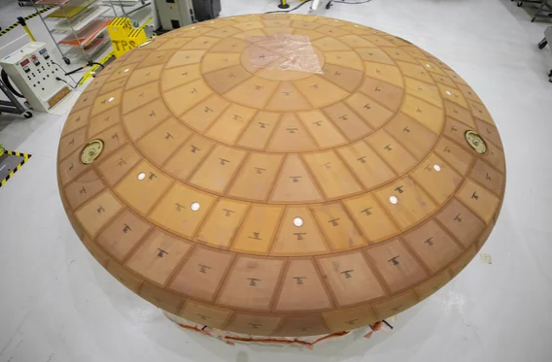
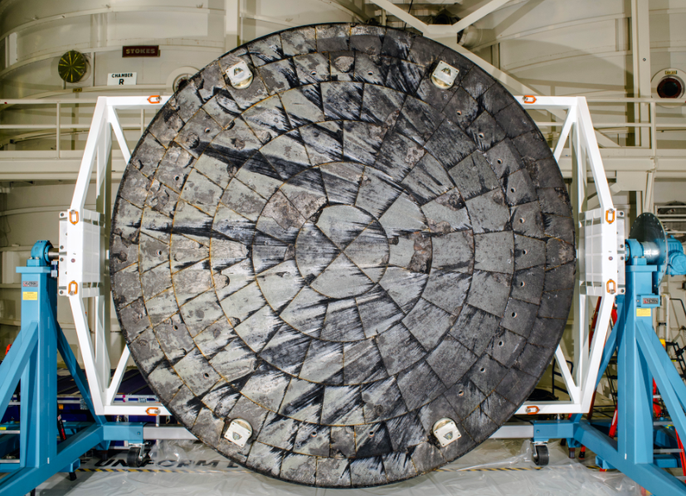
Case Study 1B – Orion Reentry Heat Shield
Pyrolysis, Permeability, and Internal Pressure Failures
The Mission Atmosphere: Returning from the Moon requires hitting Earth’s atmosphere at 24,000 mph, generating friction temperatures nearing 5000-7000˚F
The Ablative Mechanism: The shield uses Avcoat (an epoxy resin tile system) designed to chemically decompose, char, and slowly flake off to carry intense thermal energy away from the capsule.
The Artemis I Engineering Anomaly: Post-flight inspection revealed unexpected “spallation” – large chunks of Avcoat pop off and create deep cavities rather than eroding smoothly
Photo Credit: NASA
Reentry Plasma Flow (5000°F)
Char Layer
Trapped Gas (Crack Formation)
Avcoat Material
Internal Titanium Structure
Orion heat shield
Orion heat shield after Artemis I reentry

Slide 6
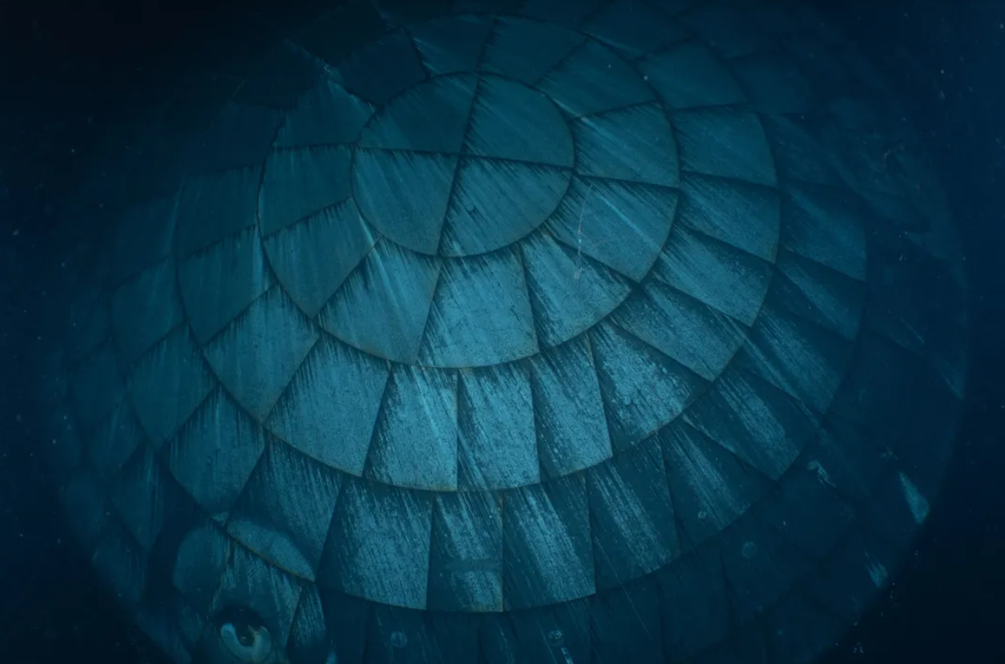
Case Study 1B – Orion Reentry Heat Shield
Pyrolysis, Permeability, and Internal Pressure Failures
The Mechanical Root Cause:
  Pyrolysis: Extreme heat caused internal chemical layers to outgas
  Impermeability: the outer char layer hardened too rapidly and became non-porous
  Internal Stress: Trapped gases couldn’t vent, spiking localized internal pressure until it violently fractured the material
The Resolution Strategy: Engineers resolved the issue for subsequent flights by adjusting the chemical formula to increase material permeability and modifying reentry flight paths to carefully manage the rate of peak thermal stress accumulation.
Photo Credit: NASA
Reentry Plasma Flow (5000°F)
Char Layer
Trapped Gas (Crack Formation)
Virigin Avcoat Material
Internal Titanium Structure
Orion heat shield
Orion heat shield after Artemis I reentry
Orion heat shield after Artemis II reentry

Slide 7
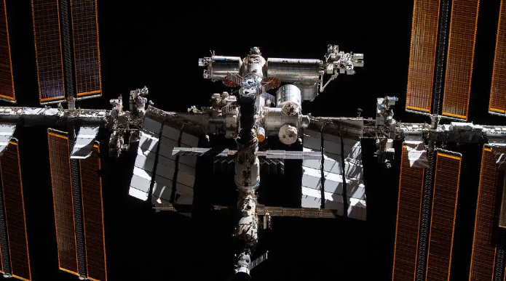
Case Study 1C – PrK Russian Module on ISS
PRK – Prichal – Russian portion of ISS module – LEAKING AIR
The problem: When the air pressure in the PrK consistently dropped, microcracks were discovered.
The band-aid: attempts to fix cracks with welding did not resolve leaking
The threat: Engineers flagged it due to the potential for "catastrophic failure"—specifically, a rapid mode-I fracture that could lead to explosive depressurization.
The complexity: no single root cause could be identified (no reliable fix)
The only choice: PrK remains unpressurized and the hatch to the PrK remains closed at all times, except for brief, strictly monitored unmanned supply transfers from Progress cargo ships.
PrK
Internation Space Station
Photo Credit: NASA

Slide 8
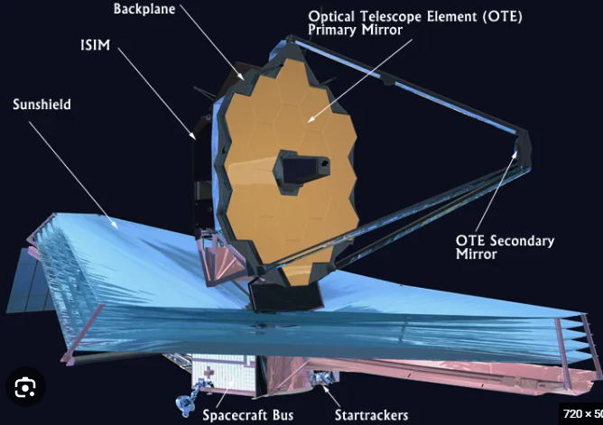
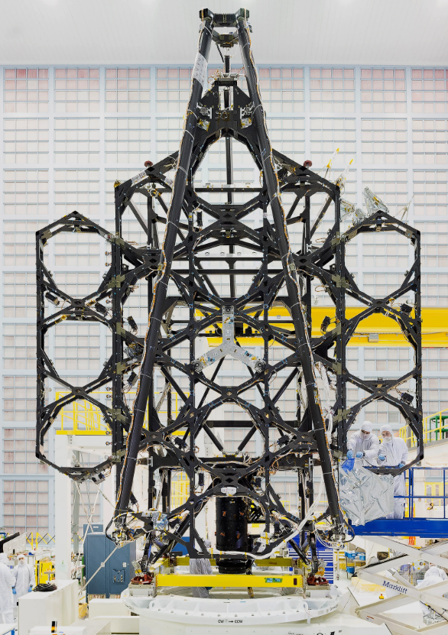
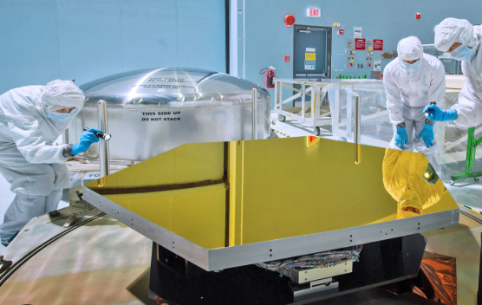


Case Study 2 – James Webb Mirror Support
Mitigating Structural-Thermal-Optical Performance (STOP) Distortion
The Target: Maintaining optical alignment down to a freezing 40 Kelvin (-388°F)
Thermal Strain: Dimensional contraction dictated by material coefficients:
$$ε_{th}=α∙∆T$$
James Webb Space Telescope (JWST)
The Solution: Carbon fiber composite trusses engineered for near-zero expansion/contraction ($α ≈0$)
JWST optical mirror
JWST mirror support trusses
Photo Credit: NASA

Slide 9
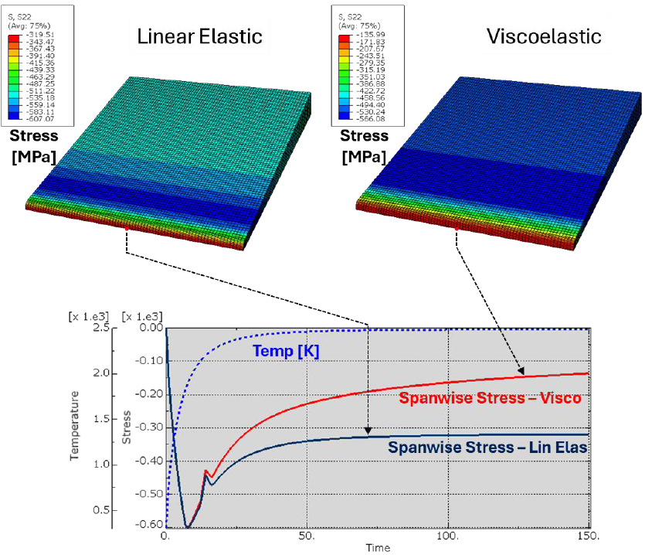

The Math Behind Finite Element Analysis
Breaking Complex Continuums into Managable Matrix Grids
The System Equation: Solving structural loading across thousands of connected points/nodes:
$$\left[K\right]\left\{u\right\}=\{F\}$$
Stiffness Matrix ($\left[K\right]$): Blends exact component geometry with material properties
Displacement Vector ($\left.\{u\}\right.$): Solved locally to map precise, localized strain gradients

Slide 10

The Danger of “Color Plot Syndrome”
Why Beautiful Computer Models Can Induce Catastrophic Failures
The Trap: Software will generate beautiful plots regardless of bad inputs
Mesh Distortion: Bad element aspect ratios (long and thin) artificially stiffen virtual parts
Boundary Illusions: Misrepresenting boundary conditions (i.e., a flexible bolted joint or clamp as a perfectly rigid)
Word to the wise: If your hand-drawn free-body diagram disagrees, trust the hand sketch.

Slide 11
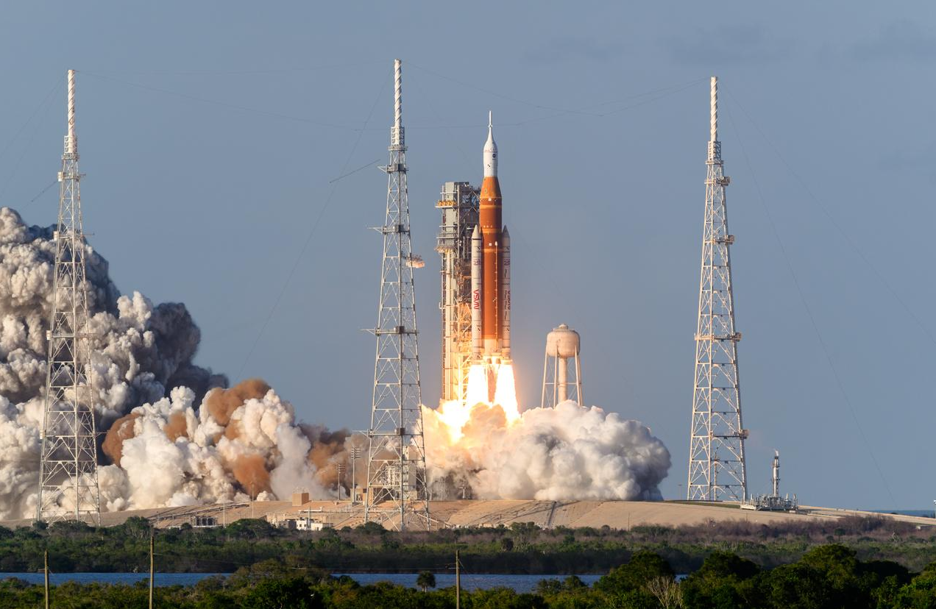
Fatigue and Acoustic Flight Vibration
Structural Fatigue Damage from Violent Launch Decibels
The Assault: Rocket engines generate intense sound pressure levels at liftoff
Cyclic Loading: Structures endure millions of microscopic stress micro-cycles.
S-N Curves: Mapping safe fatigue life limits to prevent unexpected structural tearing.
Artemis II launch
Photo Credit: NASA

Slide 12


Fracture Mechanics and Stress Concentration
The Catastrophic Propagation of Sub-Critical Internal Flaws
Geometry Spikes: Notches, ports, and sharp corners amplify basic nominal stress:
$$σ_{max}=K_{t}∙σ_{nom}$$
Fracture Limit: cracks grow unstable when the stress intensity hits structural limits:
$$K=Y ∙σ∙\sqrt{π∙a}≥K_{IC}$$
Linear elastic analysis predicts triple the stress at hole edge
S
Stress
hole
r
Distance from crack tip
$Stress ∝ \frac{1}{\sqrt{radius}}$

Slide 13
Fracture Mechanics and Stress Concentration
The Catastrophic Propagation of Sub-Critical Internal Flaws
Geometry Spikes: Notches, ports, and sharp corners amplify basic nominal stress:
$$σ_{max}=K_{t}∙σ_{nom}$$
Fracture Limit: cracks grow unstable when the stress intensity hits structural limits:
$$K=Y ∙σ∙\sqrt{π∙a}≥K_{IC}$$
Stress increases as radius decreases
S
Stress
hole
r
Distance from crack tip
$Stress ∝ \frac{1}{\sqrt{radius}}$

Slide 14
Fracture Mechanics and Stress Concentration
The Catastrophic Propagation of Sub-Critical Internal Flaws
Geometry Spikes: Notches, ports, and sharp corners amplify basic nominal stress:
$$σ_{max}=K_{t}∙σ_{nom}$$
Fracture Limit: cracks grow unstable when the stress intensity hits structural limits:
$$K=Y ∙σ∙\sqrt{π∙a}≥K_{IC}$$
If radius approaches zero (i.e., crack tip) stress spikes to infinity
S
Stress
crack
Distance from crack tip
$Stress ∝ \frac{1}{\sqrt{radius}}$

Slide 15
Internships with NASA
Requirements
U.S. Citizenship
3.0 GPA
Age 16+
More info and
application instructions
intern.nasa.gov
OSTEM Internships (short term)
For Undergrad and Graduate Students
Summer – 10 weeks
Fall/Spring – 15 weeks
PATHWAYS Internships (long term)
Leading to a job at NASA upon graduation

Slide 16
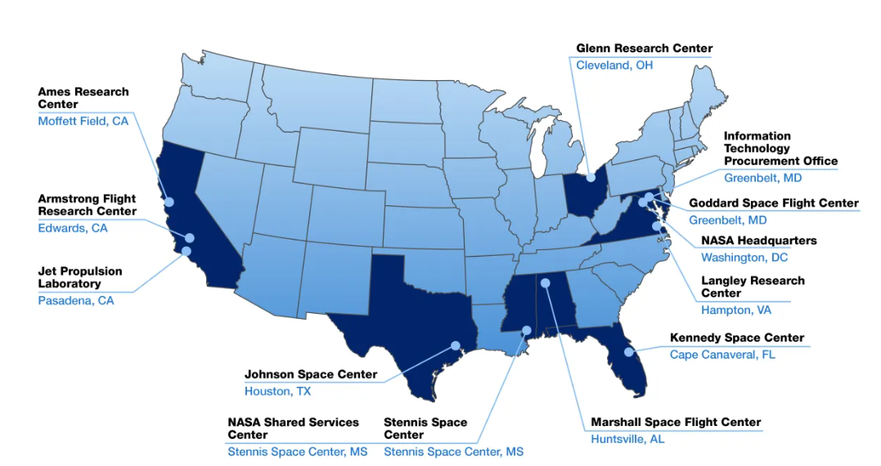
Internships with NASA

