Slide 1
Investigations in the
Low Density Shock Tube (LDST)
Brett A. Cruden¹, Andrea Fagnani²
¹AMA Inc., ²ORAU at NASA Ames
Radiation in High Temperature Gases Workshop
Bari, Italy
Sep. 23, 2026

Slide 2
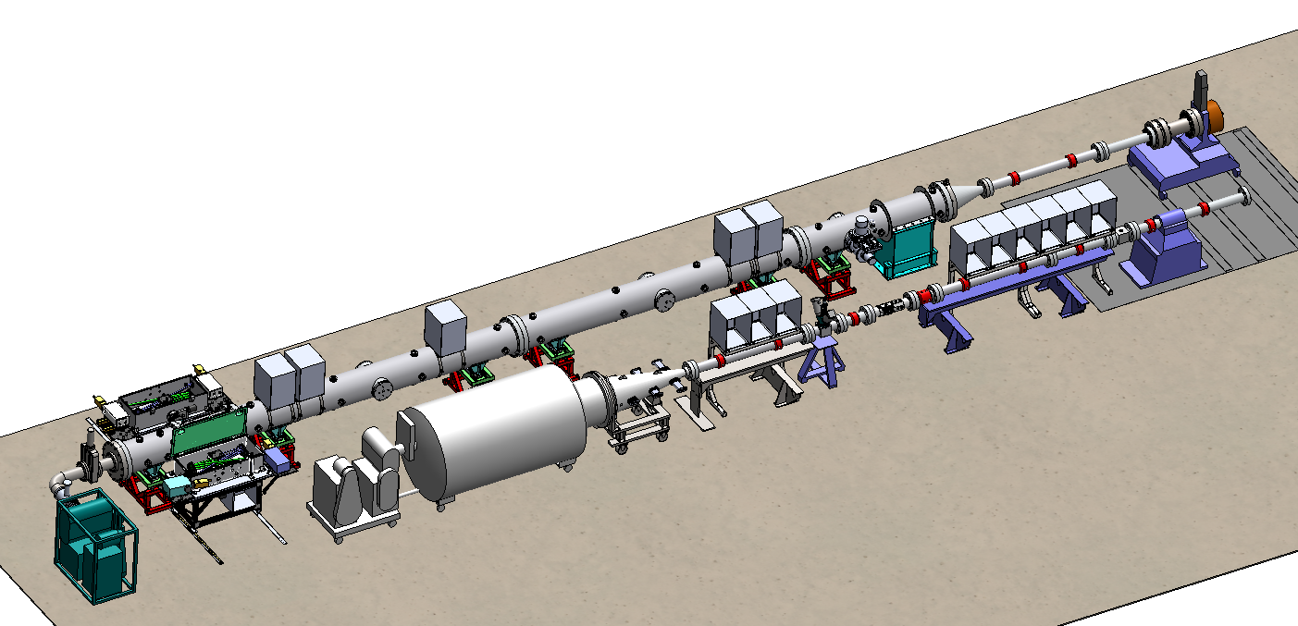
Electric Arc Shock Tube (EAST)
The Electric Arc Shock Tube (EAST) is capable of simulating high speed flows relevant to entry problems
Two shock tubes share the same driver:
  High Velocity Shock Tube (HVST) – 10 cm (4”) Aluminum Tube – test section at 7.9 m (L/D=79)
  Low Density Shock Tube (LDST) – 54.3 cm (21.4”) Stainless Steel Tube – test section at 20.7 m (L/D=39)
NEW!

Slide 3
Low Density Testing
In 2024, we installed the Low Density Shock Tube (LDST) in the EAST Facility
LDST diameter is 5.4x larger than EAST High Velocity Tube
Increased diameter
  Increases test time as PD² (Roshko/Mirels)
    Enables testing at low density, useful for high mass
    Mars landers
  Increases S/N of optical measurements
  Reduces boundary layer/core flow ratio
    Reduced deceleration
Test Series:
  Test 65B (2024-25): Dragonfly (Titan) high altitude
  Test 68 (2026-27): Air entries, overlap conditions

Slide 4
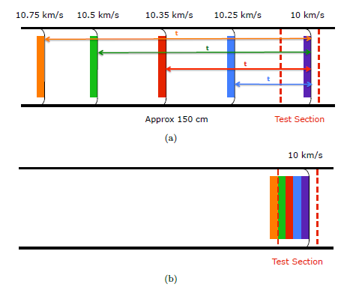
Shock Velocity Profiles
Compression Ratio @ 10 cm
Shock deceleration impacts the enthalpy profile of test gas in the test section
Shown are three tests at 5.2 km/s in HVST (Tests 61,65A) and LDST (65B)
  Noise in test section is due to proximity of sensors: average value reported
  LDST shows less deceleration than Test 65A, but similar to Test 61

Slide 5
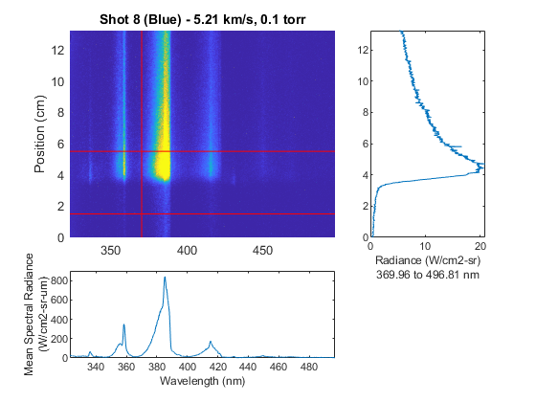
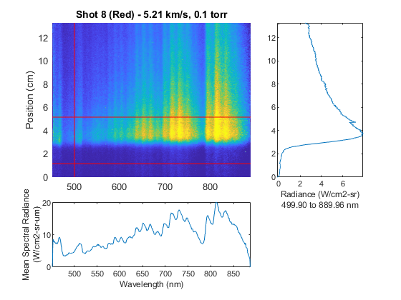
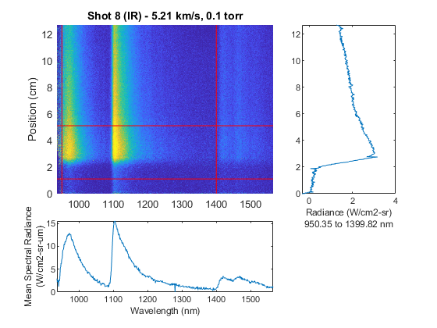
Sample Data – 5.2 km/s
Spectral and spatial radiance data collected on 4 spectrometers (UV not shown)
Spectral features
  CN Red
  CN Violet
No test gas contamination
  Long test times realized
Significant signal ahead of shock
  Believed to be due to reflections from tube wall

Slide 6
Spectral Comparison – LDST to HVST
65A/5 - 5.21 km/s
Mean spectral radiance within +/-0.5 cm of peak, normalized by Tube Diameter
UV/Visible (330-490 nm)
  Variation within test 15%, tube-to-tube comparisons overlap
Visible (480-890 nm)
  Variation within test series from 1-10%, mean values agree within 5%
Infrared (950-1400 nm)
  5-13% variation within tests, Test 65B averages 12% higher than 65A
Test 61 (2017, not shown) is in general agreement with these data
65A/4 - 5.18 km/s
65B/7 - 5.16 km/s
65B/8 - 5.21 km/s

Slide 7
HVST/LDST Comparison vs Time
Necessary to convert x-axis to particle time to compare
Quantitative agreement obtained between LDST/HVST
  Shot 65A/4 (greater deceleration) is somewhat an outlier
DPLR/NEQAIR Comparisons:
  Underpredicts peak radiance, except in IR
  Decay rate slower in EAST than prediction
  Cause of offset in shock location not yet determined
  These inconsistencies are known from previous shock tube testing
  Data will be used to improve modeling practices
Notes:
Note density

Slide 8
Scattered Signal
Shot 8 – 5.21 km/s
Shot 9 – 4.53 km/s
All signals are normalized to maximum
Raw signal shown as dotted lines
Pre-shock signal can be due to dark charge or scattered light: Solid lines are corrected signal
Shot 9 had early trigger : shows 10-15% of peak signal after subtraction
Indicates pre-shock signal may be real – suggests scattering in the tube

Slide 9
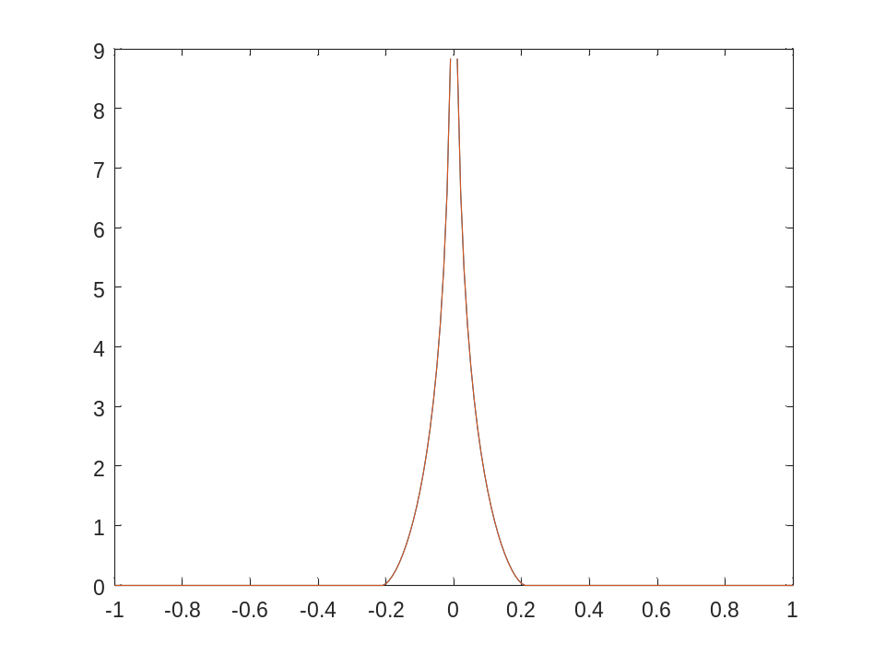
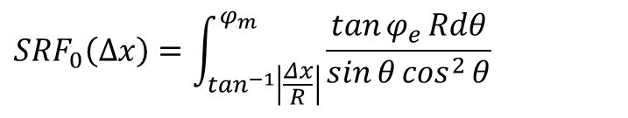
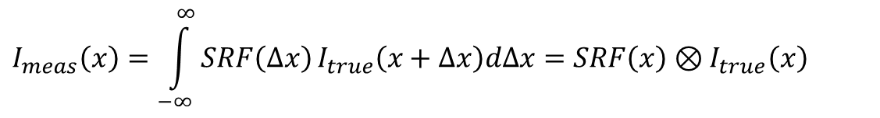
Specular reflectance
Radiance Measured is a convolution of the actual radiance with a spatial resolution function (SRF):
The optics subtend a biconic volume, which produces the optical portion of the SRF (Cruden, 2014):
$$I_{meas}\left(x\right)=\int_{−∞}^{∞}{SRF\left(Δx\right)}I_{true}\left(x+Δx\right)dΔx=SRF\left(x\right)⊗I_{true}\left(x\right)$$
$${SRF}_{0}\left(Δx\right)=\int_{\tan^{−1}\left|\frac{Δx}{R}\right|}^{φ_{m}}{\frac{\tan{φ_{e}}Rdθ}{\sin{θ}\cos^{2}{θ}}}$$

Slide 10
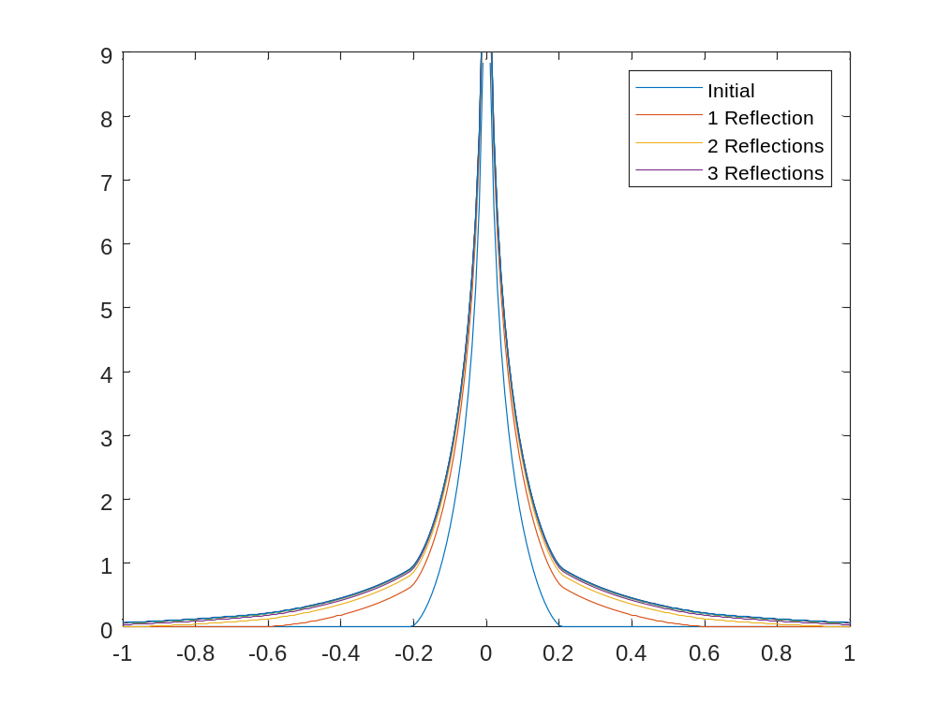



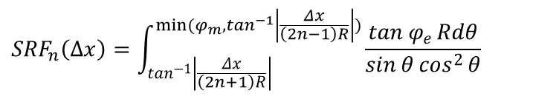
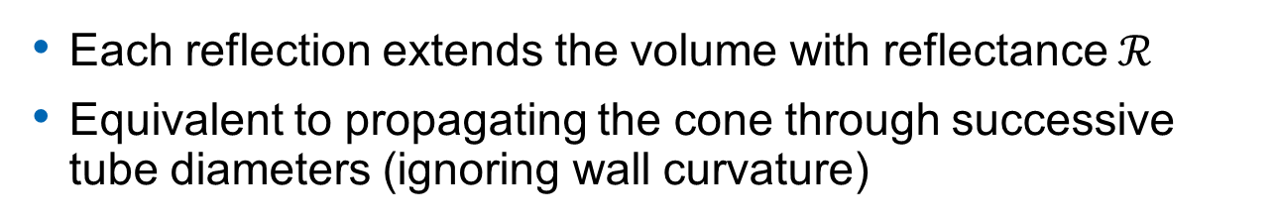

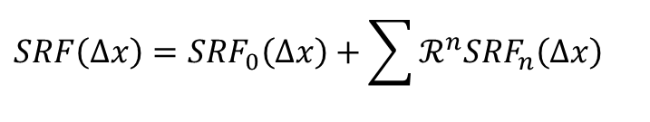





Specular reflectance
Each reflection extends the volume with reflectance $ℛ$
Equivalent to propagating the cone through successive tube diameters (ignoring wall curvature)
$ℛ$⁵
$ℛ$³
$$ℛ$$
$$SRF\left(Δx\right)={SRF}_{0}\left(Δx\right)+\sum{ℛ^{n}{SRF}_{n}\left(Δx\right)}$$
$ℛ$⁴
$ℛ$²
$${SRF}_{n}\left(Δx\right)=\int_{\tan^{−1}\left|\frac{Δx}{\left(2n+1\right)R}\right|}^{min⁡(φ_{m},\tan^{−1}\left|\frac{Δx}{\left(2n−1\right)R}\right|)}{\frac{\tan{φ_{e}}Rdθ}{\sin{θ}\cos^{2}{θ}}}$$
$$ℛ$$
$$ℛ=0.5$$
$ℛ$²
$ℛ$³

Slide 11
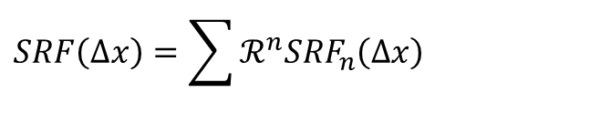
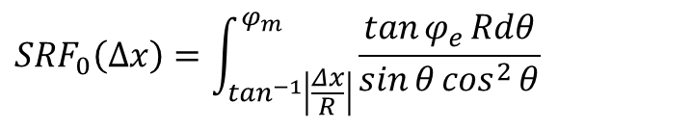
Diffuse Reflectance
SRF₀
$$SRF\left(Δx\right)=\sum{ℛ^{n}{SRF}_{n}\left(Δx\right)}$$
For diffusely reflecting wall:
0 reflections: bi-conic SRF₀ as given previously
$${SRF}_{0}\left(Δx\right)=\int_{\tan^{−1}\left|\frac{Δx}{R}\right|}^{φ_{m}}{\frac{\tan{φ_{e}}Rdθ}{\sin{θ}\cos^{2}{θ}}}$$

Slide 12
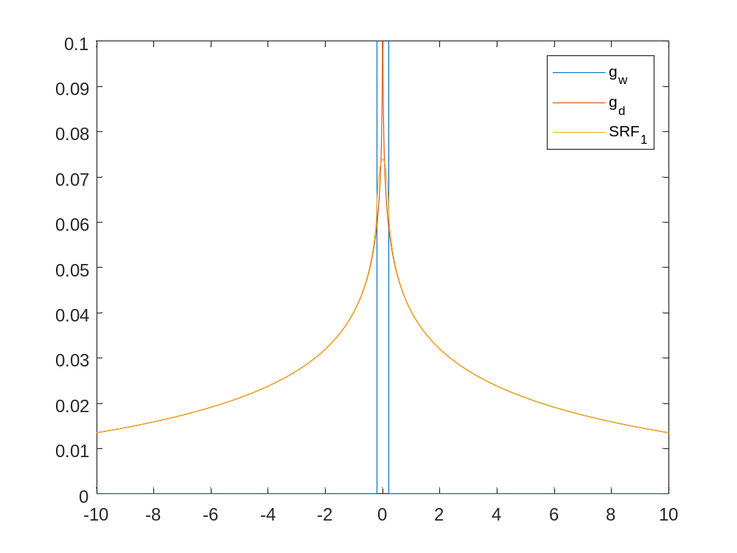
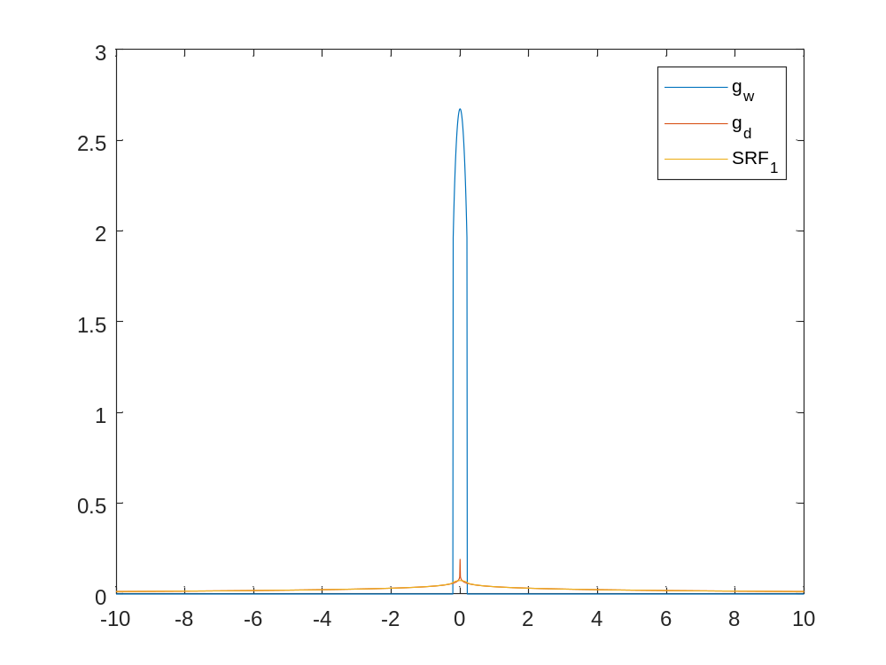
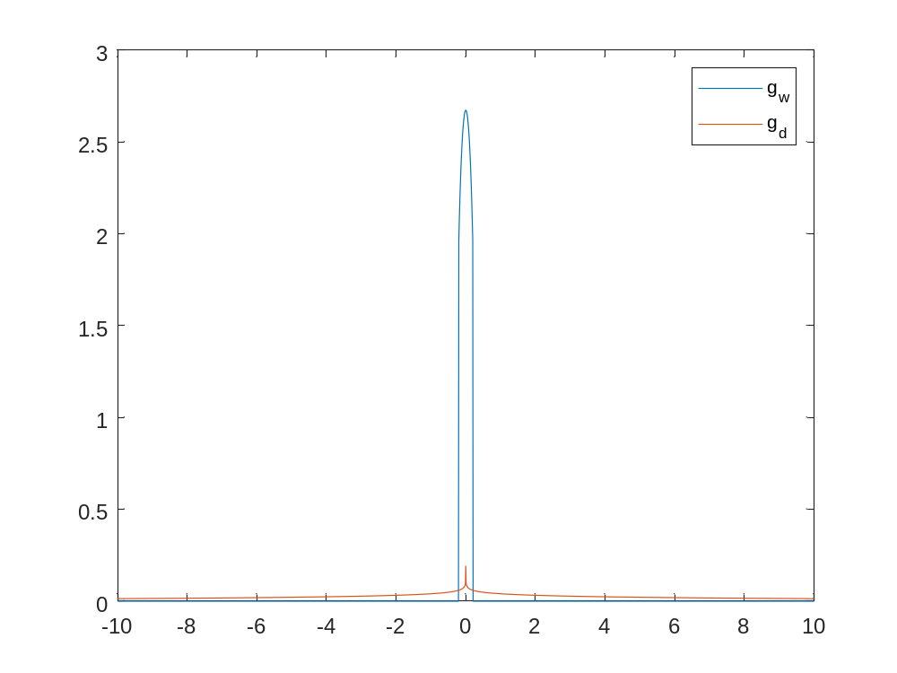
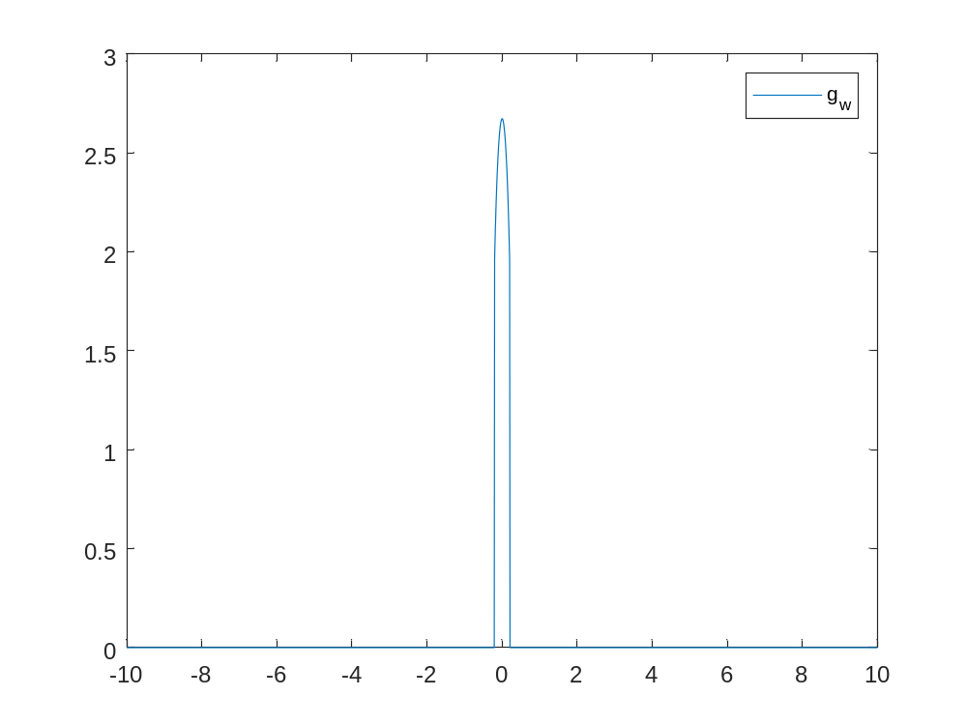


Diffuse Reflectance
$$SRF\left(Δx\right)=\sum{ℛ^{n}{SRF}_{n}\left(Δx\right)}$$
For diffusely reflecting wall:
0 reflections: bi-conic SRF₀ as given previously
1 reflection: Conical wall transfer function:
Diffuse transfer through medium to wall:
Convolve:
$$g_{w}\left(Δx\right)=\left(R^{2}+Δx^{2}\right)\ln\left(\frac{1+\sin{φ_{e}}}{1−\sin{φ_{e}}}\right)$$
g_{diff}
g_{wall}
$$g_{d}\left(Δx\right)=\frac{1}{2πR}\int_{\tan^{−1}\left|\frac{Δx}{2R}\right|}^{\frac{π}{2}}{\int_{0}^{φ_{max}\left(θ,Δx\right)}{\frac{\cos{θ}}{\cos{φ}}dφ}dθ}$$
$${SRF}_{1}\left(Δx\right)=g_{w}\left(Δx\right)⨂g_{d}\left(Δx\right)$$

Slide 13
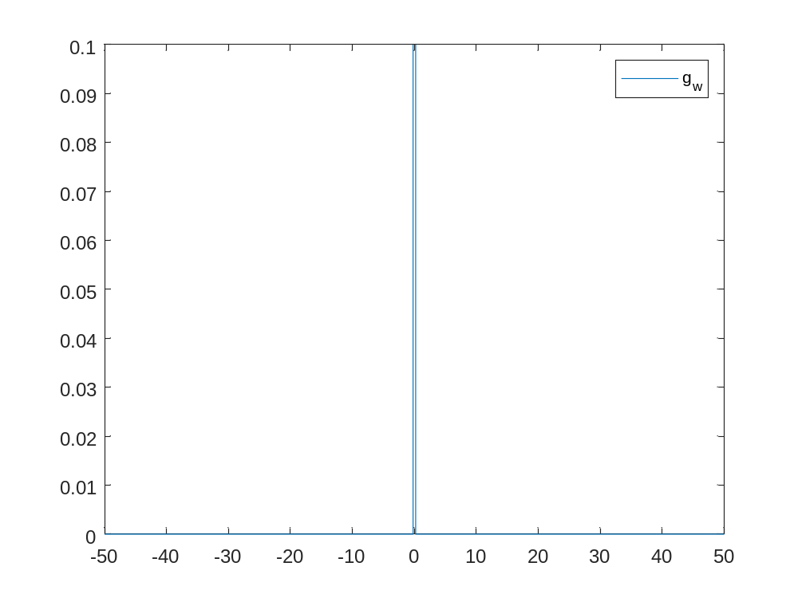
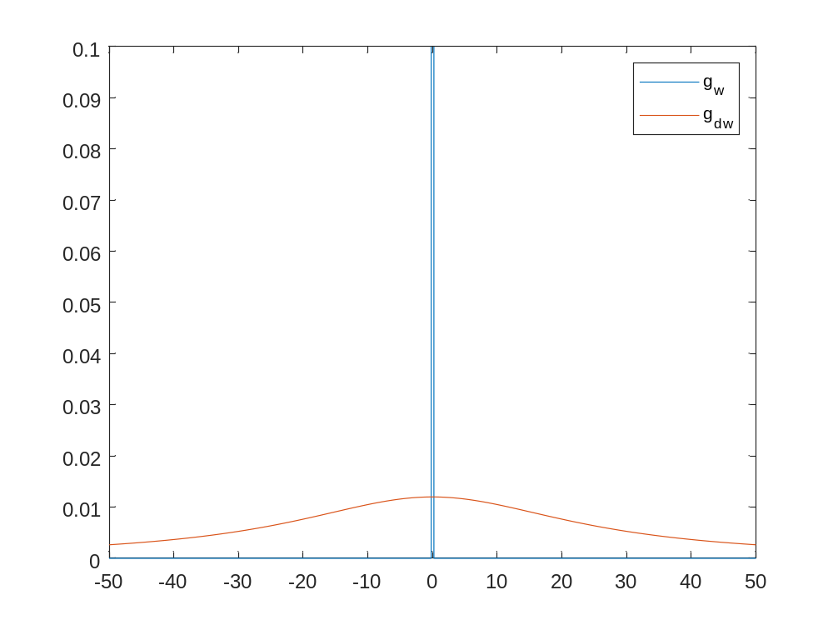
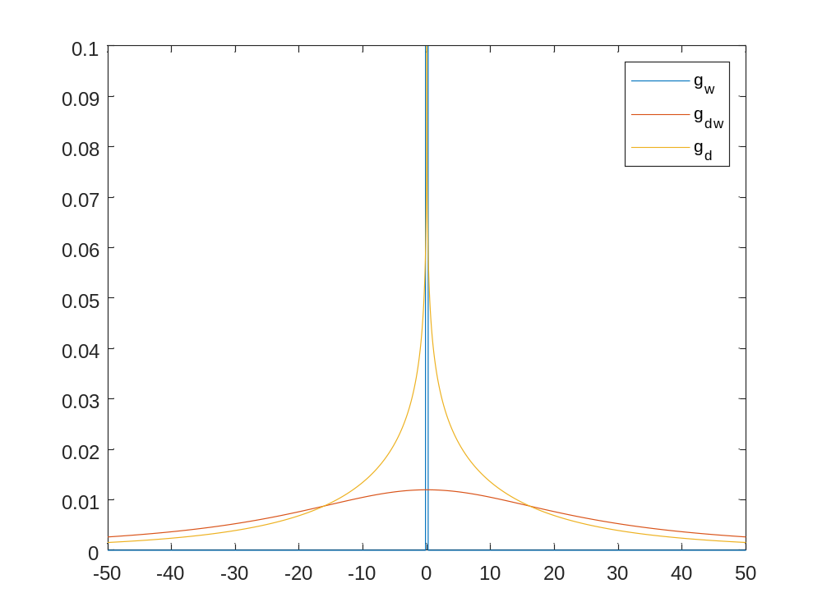
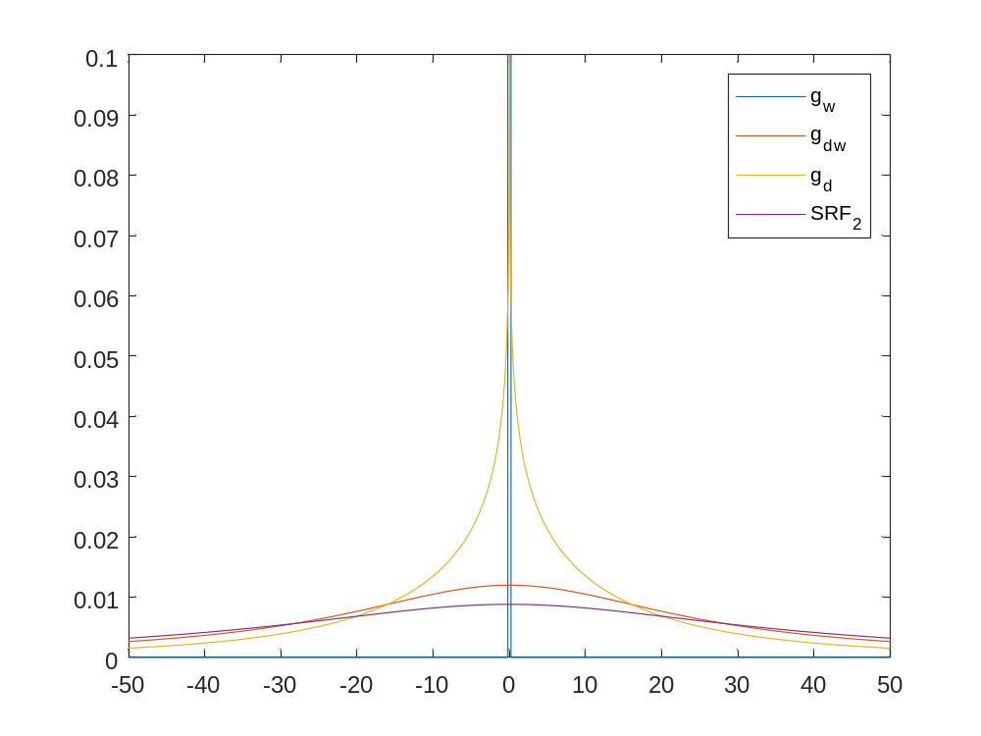



Diffuse Reflectance
$$SRF\left(Δx\right)=\sum{ℛ^{n}{SRF}_{n}\left(Δx\right)}$$
For diffusely reflecting wall:
0 reflections: bi-conic SRF₀ as given previously
1 reflection: Conical wall transfer function, convolved with diffuse collection through the medium
2 reflections: Conical wall transfer function:
Diffuse wall transfer function:
Collection through the medium:
Convolve:
g_{diff}
g_{dw}
$${SRF}_{1}\left(Δx\right)=g_{w}\left(Δx\right)⨂g_{d}\left(Δx\right)$$
g_{wall}
$$g_{w}\left(Δx\right)$$
$$g_{dw}\left(Δx\right)=\frac{1}{πR}{\left[{\left(\frac{Δx}{R}\right)}^{2}+1\right]}^{−1}$$
$$g_{d}\left(Δx\right)$$
${SRF}_{2}\left(Δx\right)=g_{w}\left(Δx\right)⨂g_{dw}\left(Δx\right)⨂g_{d}\left(Δx\right)$= ${SRF}_{1}\left(Δx\right)⨂g_{dw}\left(Δx\right)$

Slide 14
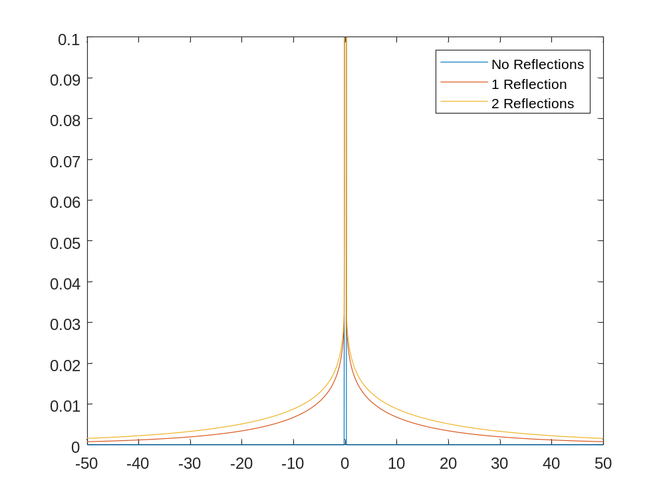


Diffuse Reflectance
$$SRF\left(Δx\right)=\sum{ℛ^{n}{SRF}_{n}\left(Δx\right)}$$
For diffusely reflecting wall:
0 reflections: bi-conic SRF₀ as given previously
1 reflection:
2 reflection:
N reflections:
Conical wall transfer function
N diffuse wall transfer functions
Collection through the medium
g_{diff}
$${SRF}_{1}\left(Δx\right)=g_{w}\left(Δx\right)⨂g_{d}\left(Δx\right)$$
g_{dw}
${SRF}_{2}\left(Δx\right)=$ ${SRF}_{1}\left(Δx\right)⨂g_{dw}\left(Δx\right)$
g_{wall}
$$ℛ=0.5$$
$${SRF}_{N}\left(Δx\right)=g_{w}\left(Δx\right)⨂g_{dw}\left(Δx\right)⋯⨂g_{dw}\left(Δx\right)⨂g_{d}\left(Δx\right)$$
$$={SRF}_{N−1}\left(Δx\right)⨂g_{dw}\left(Δx\right)$$

Slide 15
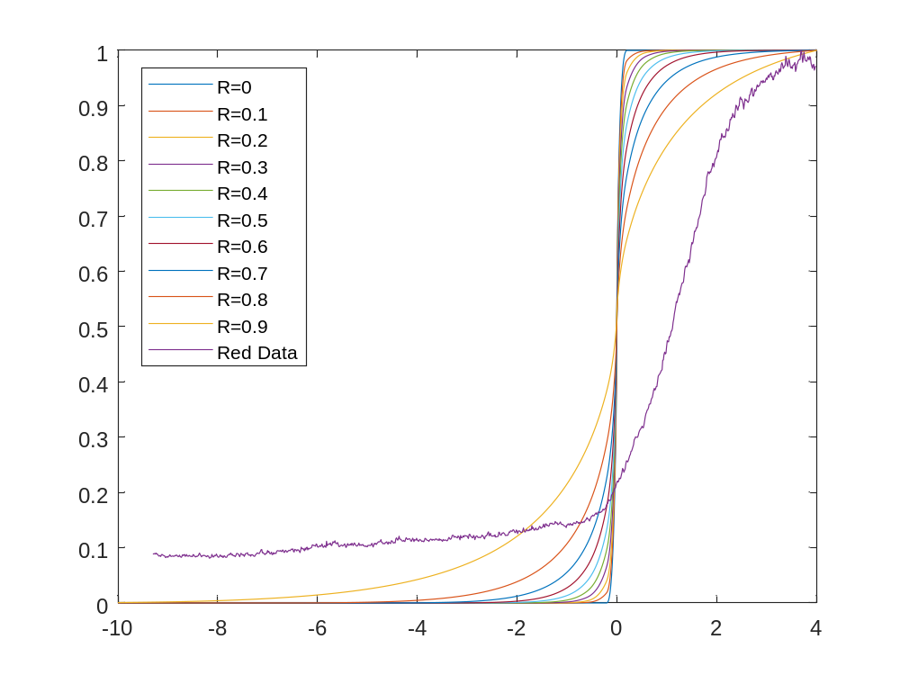
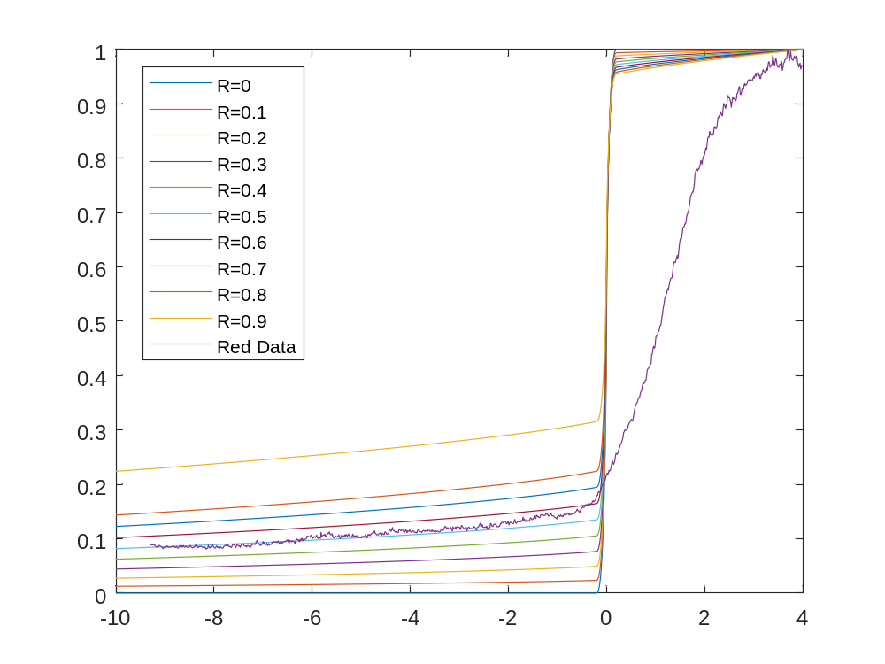
Compare SRFs on Step (Heaviside) Function
Specular
Diffuse
Examine impact of SRFs on shock as a step function, compare to Shot 9
Specular reflections do not capture the shape of the data
Diffuse reflections with reflectivity near 0.5 in reasonable agreement with shape
Diffuse reflections span multiple tube diameters (100s of cm)

Slide 16
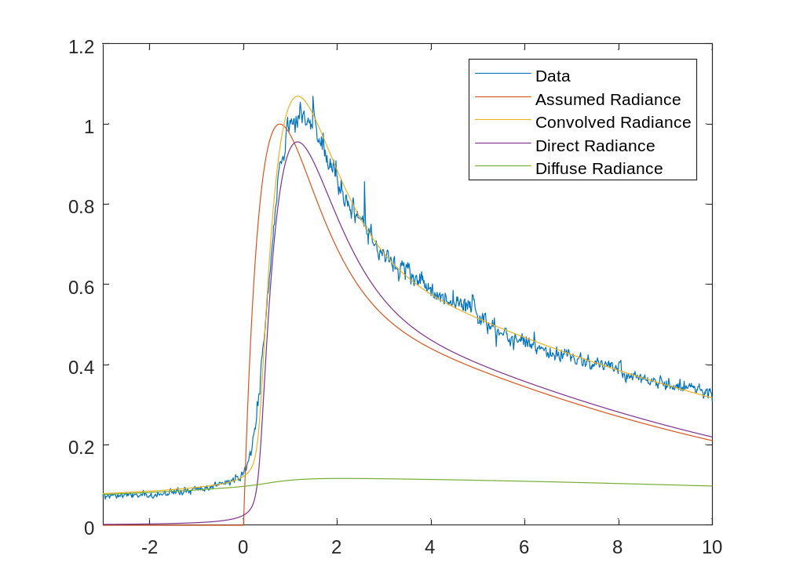
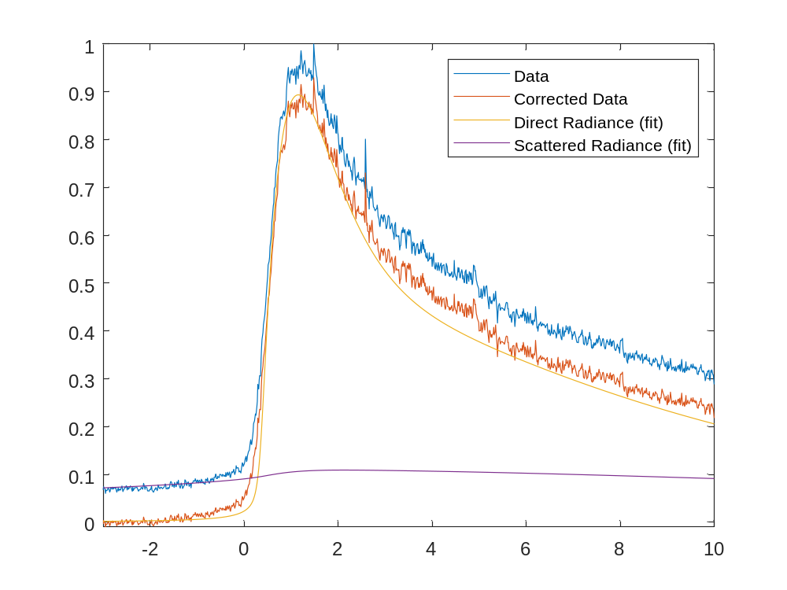
Reflectance Correction
Subtract
Pre-shock
Assume radiance rises and falls exponentially and convolve with camera and diffuse SRF
Multi-parameter fit to data returns reflectance and functional parameters
Correcting data by subtracting the pre-shock reduces scattered contribution from 11% to 4%
Error in the peak signal ~4%, error at edge of domain ~10%

Slide 17
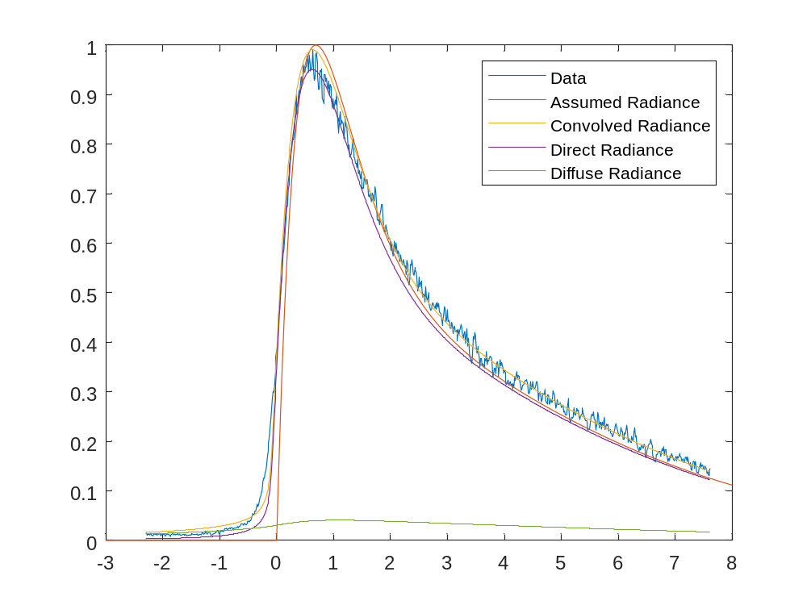
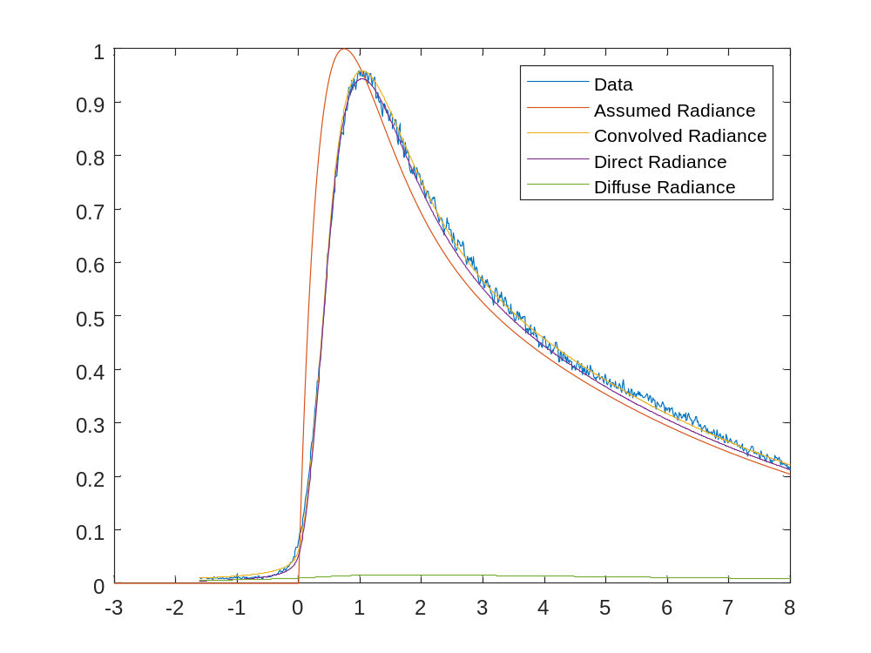
Comparsion to HVST (10 cm tube)
UV/Vis
Vis/NIR
Reflection contribution much smaller in HVST
More attenuation at smaller radius
Lower Reflectance from HVST walls

Slide 18
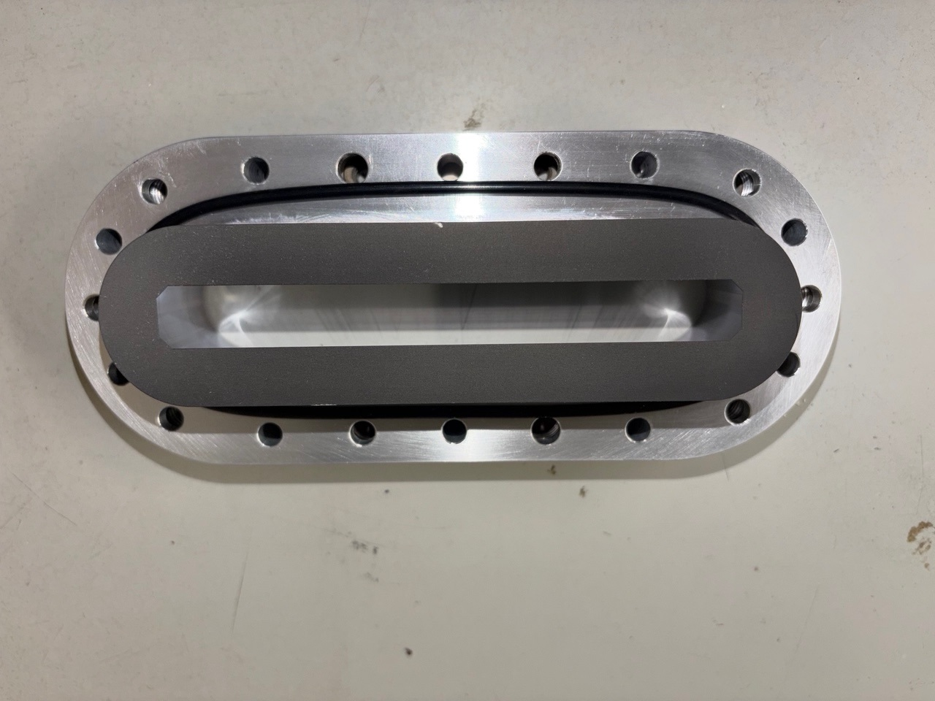
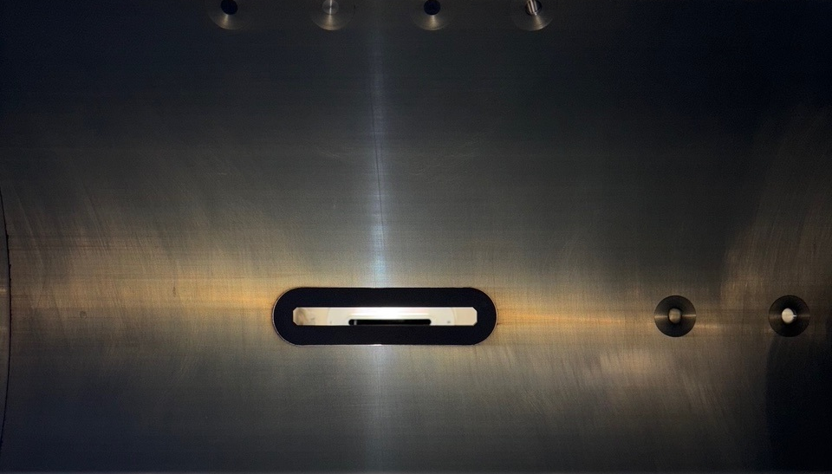
Non-reflective Coating
w/o coating (5.7 km/s)
w/coating (6 km/s)
Adding non-reflective strip to opposite wall reduces pre-shock signal substantially
A non-outgassing black coating was applied to inserts on the opposite wall
Will be deployed in next test series

Slide 19
Conclusion
Low Density Shock Tube (LDST) in EAST is operational
Initial series performed for Dragonfly (Titan) entry conditions
LDST shows much longer test times, lower deceleration
Initial data shows quantitative agreement to data collected in High Velocity Shock Tube (HVST)
  Spatial axis must be converted to Lagrangian (Time of Flight) basis
Issues identified and being addressed
  Pre-shock signal caused by diffuse reflections mitigated by non-reflective coating
  Non-planarity with Helium/Argon mixtures addressed through driver loading panel
Presently starting repeat of air testing studied in HVST
Low density Mars/Venus testing next year

Slide 20
Contributors
EAST Facility Staff
Ramon Martinez
Rick Ryzinga
Alex Contreras
Ryan Chung
LDST Design
Daniel Schickele
Trent Hughes
Daniel Philippidis
Frank Lesperance
Research Staff
David Bogdanoff
Andrea Fagnani

Slide 21
Backup

Slide 22
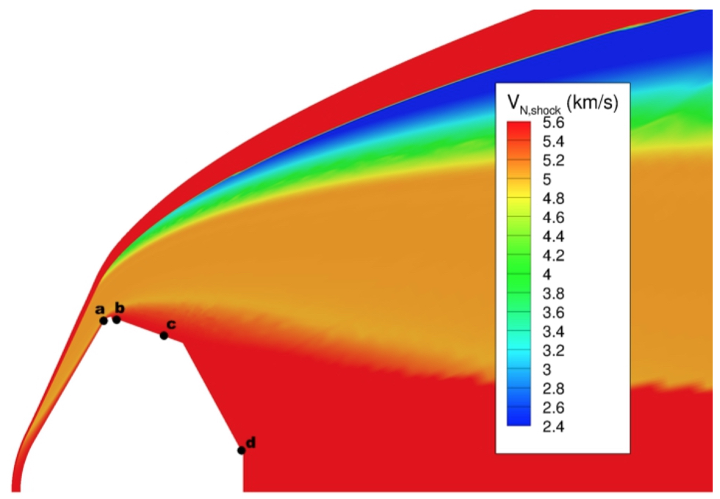

First Test Series in LDST (Test 65B, Dragonfly/Titan)
Shocks from 3-8 km/s in Titan simulant (2.2% CH₄ in N₂) are performed for Dragonfly Mission
The “Shock Tube Informed Bias” Approach is used to compare to radiative heating on vehicle backshell¹
  These will be compared to radiometers installed on the vehicle backshell (Dragonfly Entry Aerothermal Measurement – DrEAM)
Test 65A was conducted in HVST in 2021 at (mostly) 0.2 Torr and Above²
Test 65B includes 0.09 and 0.03 Torr conditions for early trajectory points³
  Includes overlap to Test 65A
v_{eff} $cosθ$
d_{eff}
¹Johnston, C.O. “Evaluating Shock-Tube Informed Biases for Shock-Layer Radiative Heating Simulations," JTHT 2021.
²Tibère-Inglesse, A. C., Johnston, C. O., Brandis, A. M., and Cruden, B. A. "Backshell radiation measurements in the EAST facility for Titan entry," AIAA AVIATION 2023 Forum, 2023.
³Fagnani, A., Brandis, A. M., and Cruden, B. A. "Characterization of Titan Entry Radiative Heating in the Low Density Electric Arc Shock Tube," AIAA SCITECH 2025.
⁴Fagnani, A., et al. "Assessment of CN non-Boltzmann kinetics against Low Density Shock Tube data," AIAA SCITECH 2026.

Slide 23
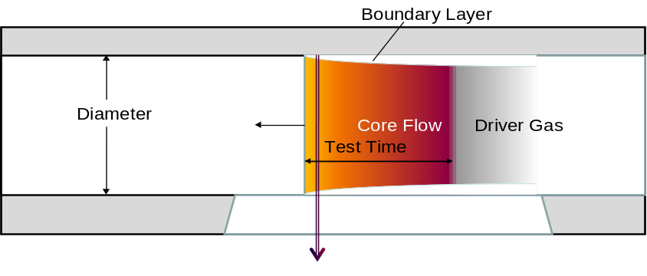
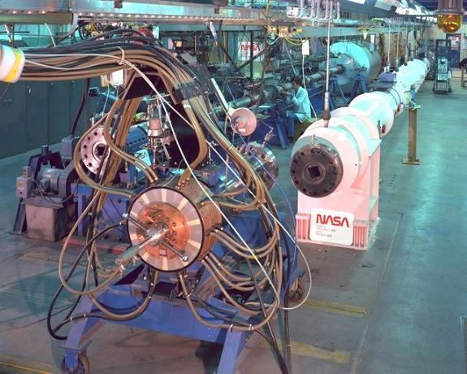
Testing at low density
Around 2011, HEDL project expressed interest in low density testing for high mass mars landers, e.g. HIAD, ADEPT
Difficulty achieving sufficient test time, signal in HVST at these conditions
The LDST should achieve longer test times based on Mirels (Roshko) Theory (1963)
  τ ~ PD²
    At 6x diameter, possible 36x increase in test time
    Actual gain is less than this due to length scaling
A series of tests were performed in the 24” Low Density Shock Tube (LDST) from 2012-15
  Quality of shots was generally poor
  Attributed to quality of fabrication of tube
  It was decided to construct a replacement for LDST
Fabrication of new LDST started ~2020
New LDST became operational in late 2024
Radiation Observed
Integrated over tube diameter
And through the boundary layer
4” HVST
Old 24” LDST

Slide 24
Spatial Comparison – LDST to HVST
Radiance vs distance from shock front
Comparing 2 Shots from each tube
Nominally 5.2 km/s and 0.1 Torr
Normalized by Tube Diameter
  65A – HVST (10.16 cm)
  65B – LDST (54.31 cm)
Intensity at peak generally agrees between tubes

Slide 25
Spatial Comparison – LDST to HVST
Comparing radiance vs distance from shock
Results diverge ~4 cm from shock
DPLR/NEQAIR
  Peak is generally delayed relative to camera alignment
  CN Violet peak is lower, trends between LDST and HVST
  CN Red peak is later, trends with LDST data

Slide 26
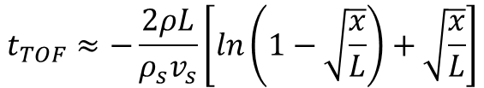
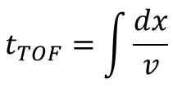
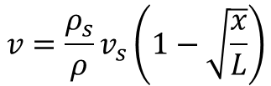
Spatial Comparison –Time of Flight
Shock frame of reference
Clarke, et al. (2023), recognized spatial transform required
This is due to the deceleration of gas from the shock front to the contact front
Time spent in the flow is the integral of velocity:
Data can be compared on a Lagrangian, or time-of-flight, basis:
v=0
v=0
ρ∞, T∞
v∞ = v_{s}
v<<v_{s}
Test Gas
Driver Gas
$$v=\frac{ρ_{s}}{ρ}v_{s}\left(1−\sqrt{\frac{x}{L}}\right)$$
L
x
$$t_{TOF}=\int{\frac{dx}{v}}$$
$$t_{TOF}≈−\frac{2ρL}{ρ_{s}v_{s}}\left[ln\left(1−\sqrt{\frac{x}{L}}\right)+\sqrt{\frac{x}{L}}\right]$$
Notes:
Use density based on CFD simulation

Slide 27
Time of Flight HVST vs LDST
HVST
LDST has 5.4x diameter
Maximum slug length is 28x larger than in HVST
Actual slug length (at test section) is 10x larger
v > 0 at end of slug
  Contact front continues moving backward with particle
For measurement at a particular time/location
  TOF calculation should use maximum slug length
  Data not obtained beyond the actual slug length
The time of flight on HVST is longer than on LDST
Max Slug
LDST
Actual Slug
v>0
0g
HVST
LDST

Slide 28
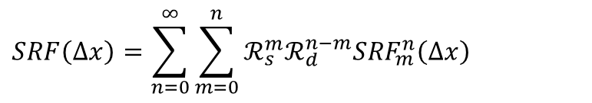
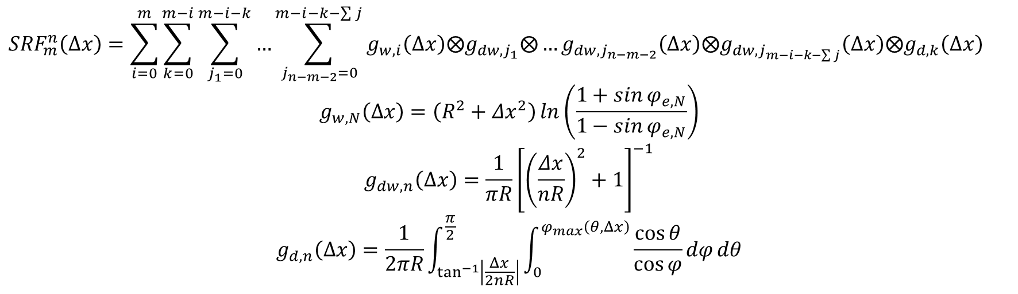
Combined Diffuse + Reflective
Consider n total reflections, with m specular
Relationships get complicated, embedded sums:
A recursive algorithm is written to compute the combinatorics
$$SRF\left(Δx\right)=\sum_{n=0}^{∞}{\sum_{m=0}^{n}{ℛ_{s}^{m}ℛ_{d}^{n−m}{SRF}_{m}^{n}\left(Δx\right)}}$$
$${SRF}_{m}^{n}\left(Δx\right)=\sum_{i=0}^{m}{\sum_{k=0}^{m−i}{\sum_{j_{1}=0}^{m−i−k}{…\sum_{\begin{aligned}j_{n−m−2}=0\end{aligned}}^{m−i−k−\sum{j}}{g_{w,i}\left(Δx\right)⨂g_{dw,j_{1}}{⨂…g}_{dw,j_{n−m−2}}\left(Δx\right){⨂g}_{dw,j_{m−i−k−\sum{j}}}\left(Δx\right)⨂g_{d,k}\left(Δx\right)}}}}$$
$$g_{w,N}\left(Δx\right)=\left(R^{2}+Δx^{2}\right)\ln\left(\frac{1+\sin{φ_{e,N}}}{1−\sin{φ_{e,N}}}\right)$$
$$g_{dw,n}\left(Δx\right)=\frac{1}{πR}{\left[{\left(\frac{Δx}{nR}\right)}^{2}+1\right]}^{−1}$$
$$g_{d,n}\left(Δx\right)=\frac{1}{2πR}\int_{\tan^{−1}\left|\frac{Δx}{2nR}\right|}^{\frac{π}{2}}{\int_{0}^{φ_{max}\left(θ,Δx\right)}{\frac{\cos{θ}}{\cos{φ}}dφ}dθ}$$

Slide 29
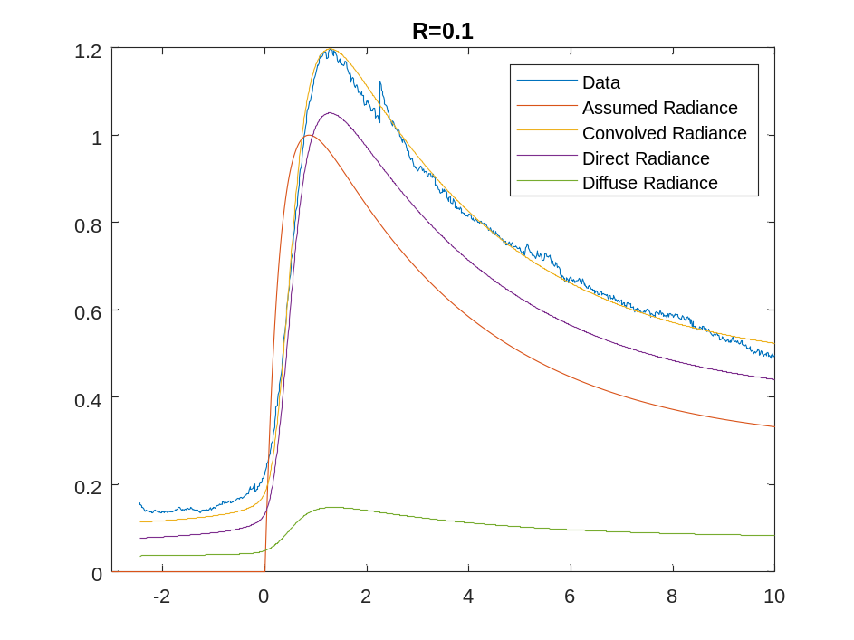
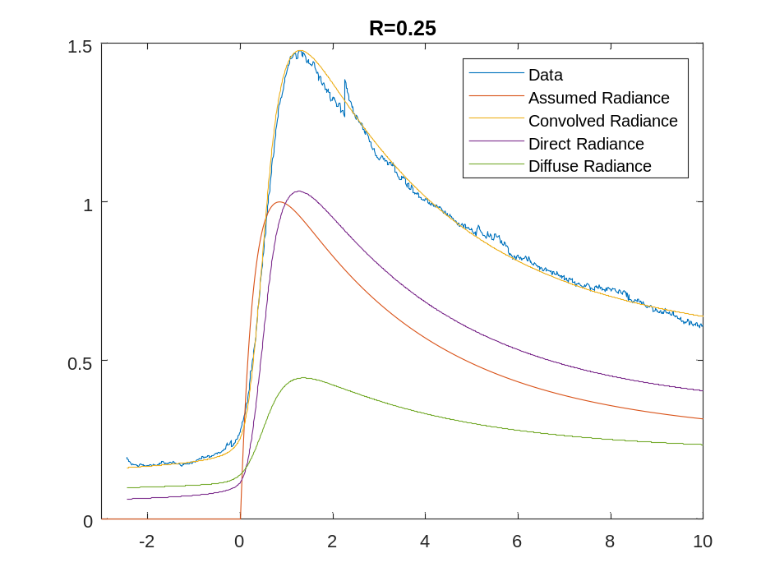
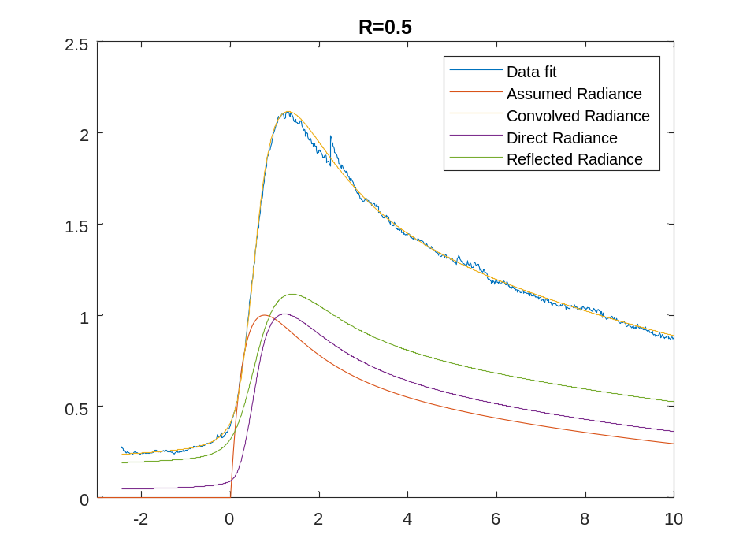
Combined Specular+Diffuse vs Data
Fix diffusive reflectance at 0.5, vary specular reflectance
Fit is not unique, but R>0.1 seems necessary
Specular reflectance leads to potentially significant overestimates of radiance

Slide 30
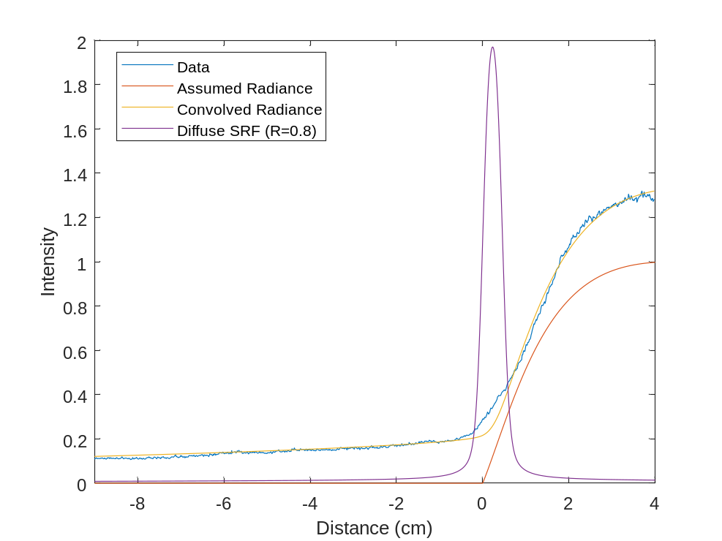
Pre-shock signal – Scattered Light
4.53 km/s, 0.09 Torr
Pre-shock signal persists for several cm in front of shock arrival
A scattering function is analytically derived which acts as a convolution on the unscattered signal
Influence of scattered radiation spans multiple tube diameters (100’s cm), depends on signal measured outside of spectrometer image

Slide 31
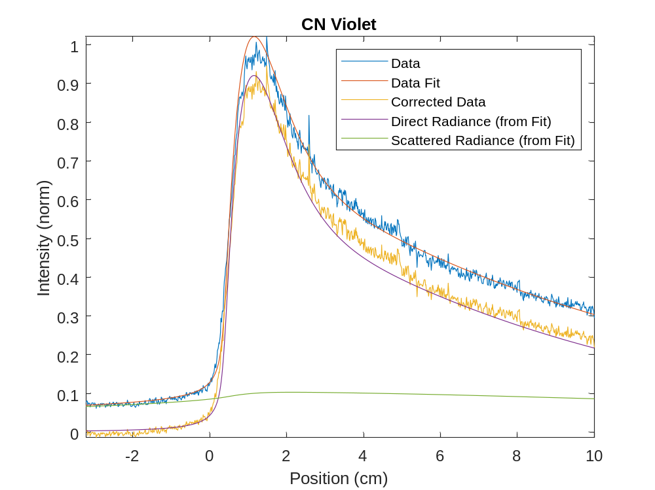
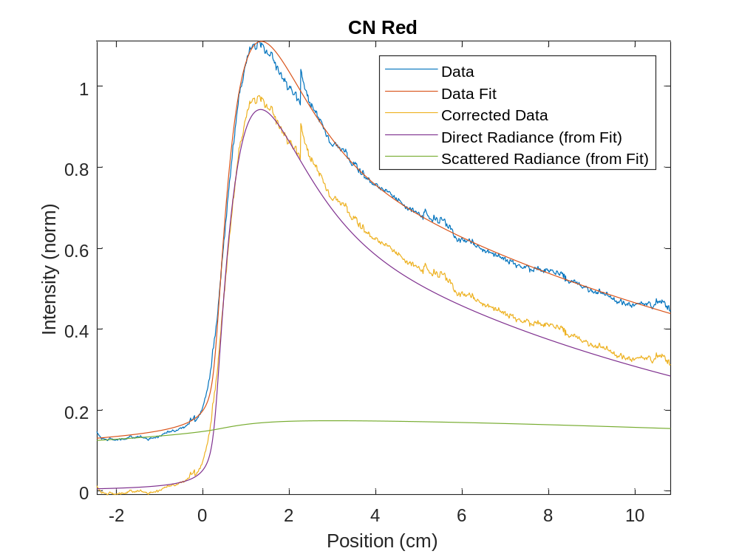
Scattered Light Correction
Scattered signal is about 10% of the peak signal, but ~30% of signal at camera edge
Scattering model shows scattered signal before shock is smaller than post-shock signal
Subtracting the pre-shock signal leaves <6% error in post-shock signal

Slide 32
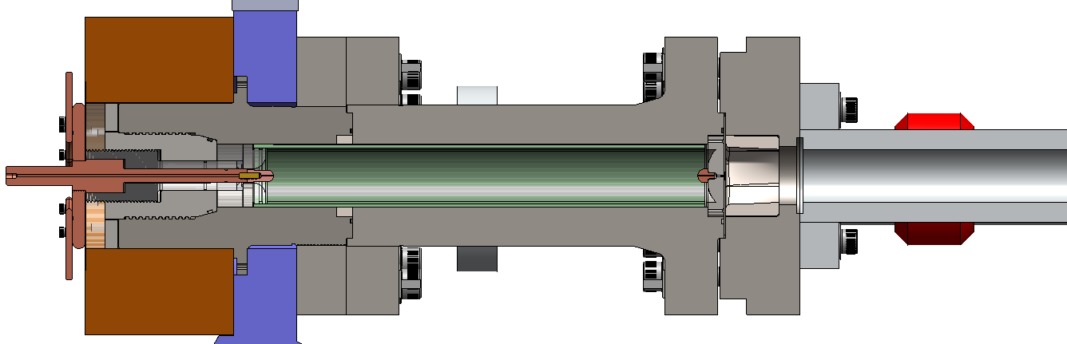
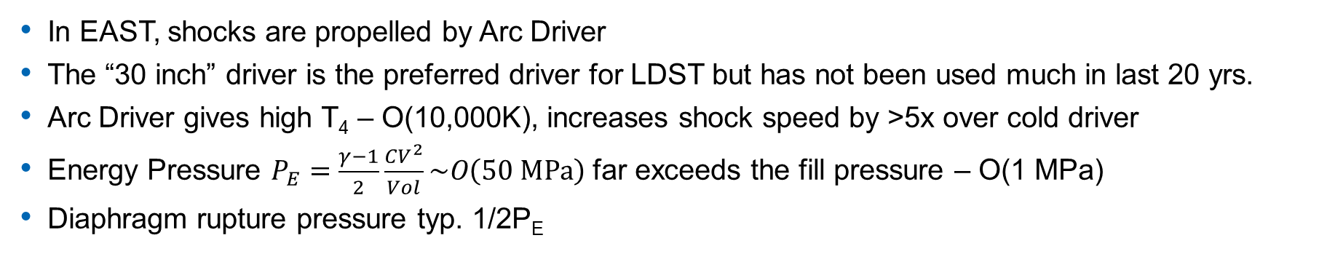
The Arc Driver
0 kV
0 kJ
Up to 40 kV
1.3 MJ
In EAST, shocks are propelled by Arc Driver
The “30 inch” driver is the preferred driver for LDST but has not been used much in last 20 yrs.
Arc Driver gives high T₄ – O(10,000K), increases shock speed by >5x over cold driver
Energy Pressure $P_{E}=\frac{γ−1}{2}\frac{CV^{2}}{Vol}\sim O\left(50 MPa\right)$ far exceeds the fill pressure – O(1 MPa)
Diaphragm rupture pressure typ. 1/2P_{E}

Slide 33
Driver Optimization
0 kV
0 kJ
15 kV
170 kJ
4 kV
12 kJ
Poorly chosen driver conditions may not fully discharge the capacitor bank
Reflected shock return causes secondary discharge which damages the driver
Necessary to reduce pressure, add Argon and/or increase Voltage to reduce “Arc-out”
Increasing voltage raises shock speed – Add Argon to tune the velocity

Slide 34
Driver Mixing/Planarity
Gas Load
Observed a loss of planarity when Helium % exceeds ~60% (v > 6 km/s)
For 0.7 MPa initial pressure, the Ar-He diffusion length is ~5 cm in 5 min
Increasing settling time to ~40 minutes improved planarity
Future plan to load gases simultaneously to improve mixing

Slide 35
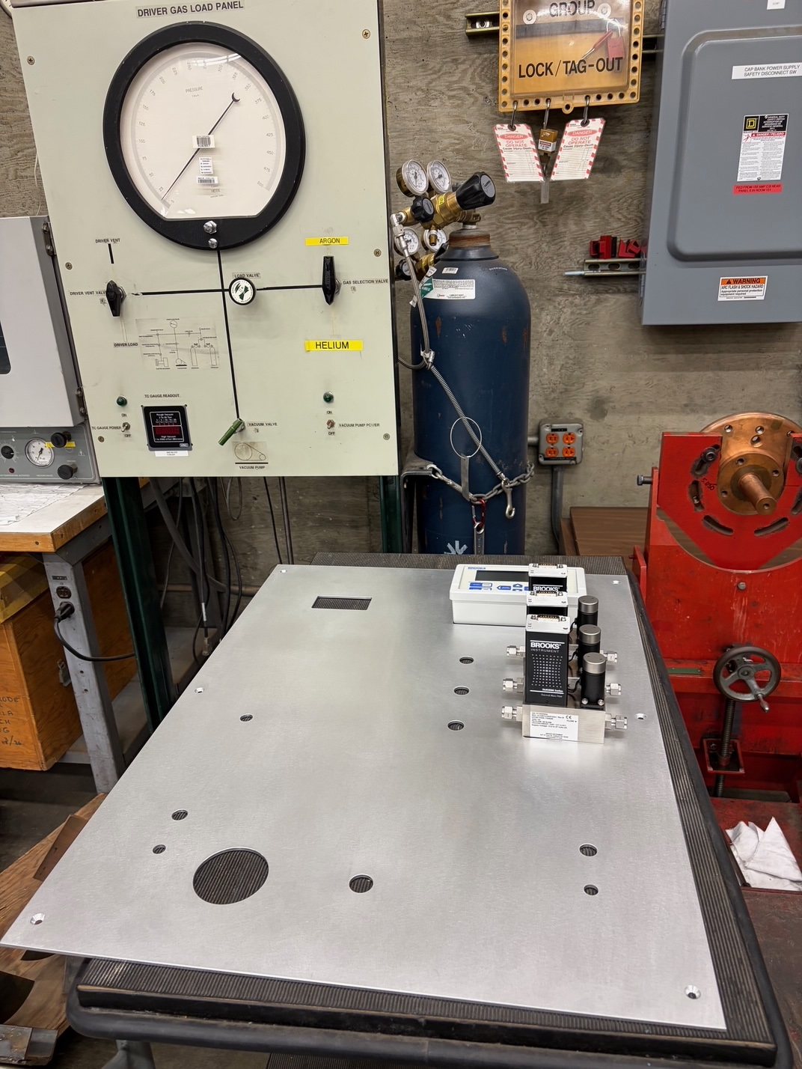
Mixed Gas Loading
Old Panel
New Panel
A gas loading panel for the driver was designed
Gas loading panel delivers Ar and He in controlled ratio simultaneously, eliminating Ar/He stratification

