Slide 1
NASA
Artemis Plan
NASA JSC/Brian O’Hagan
GCRI Summit
Oct 8, 2026

Slide 2
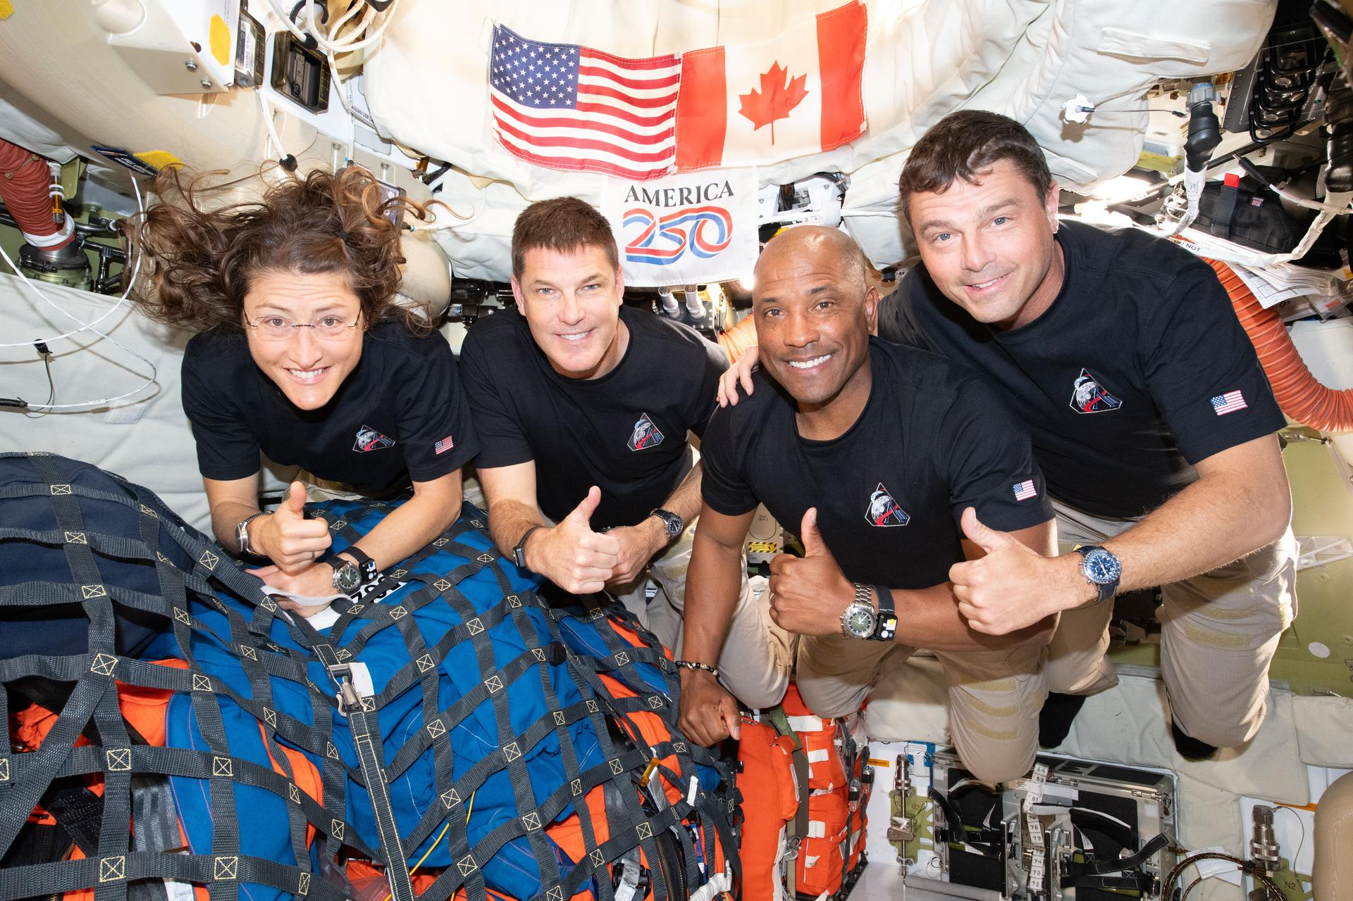
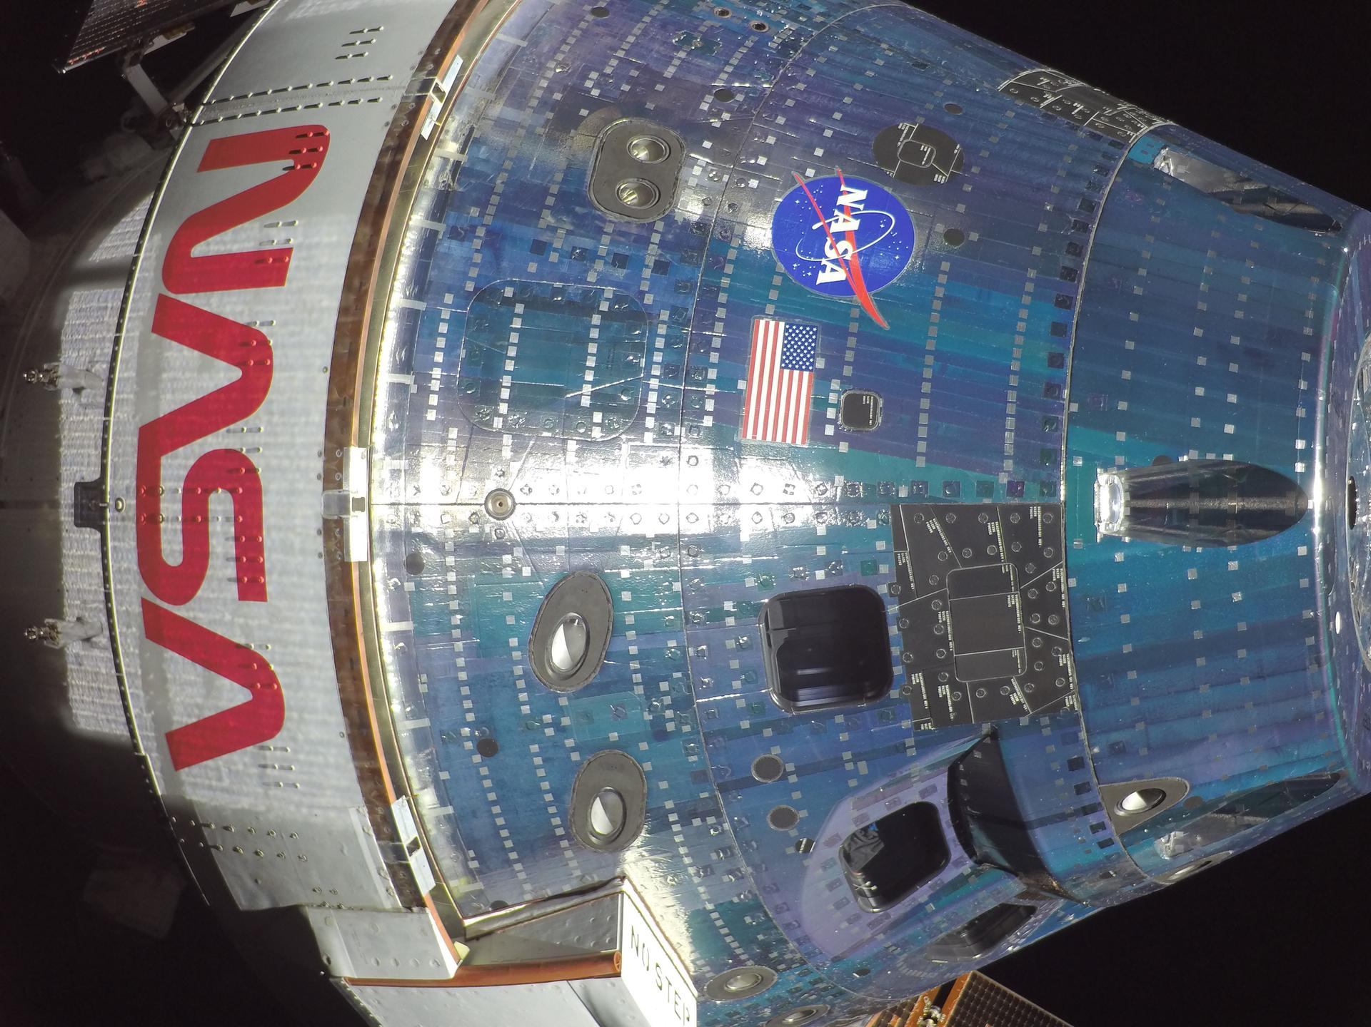
Agenda
NASA Organization
  Org charts
  Artemis Program Overview
  NASA cybersecurity domains
Artemis & Moonbase
  Lunar Command & Control Interoperability (LuCCI) team and results
  How does the Artemis needs differ from Low Earth Orbit cybersecurity and spacecraft protection
See https://www.nasa.gov/ for Artemis II imagery
Inspiration and crew post-lunar flyby

Slide 3
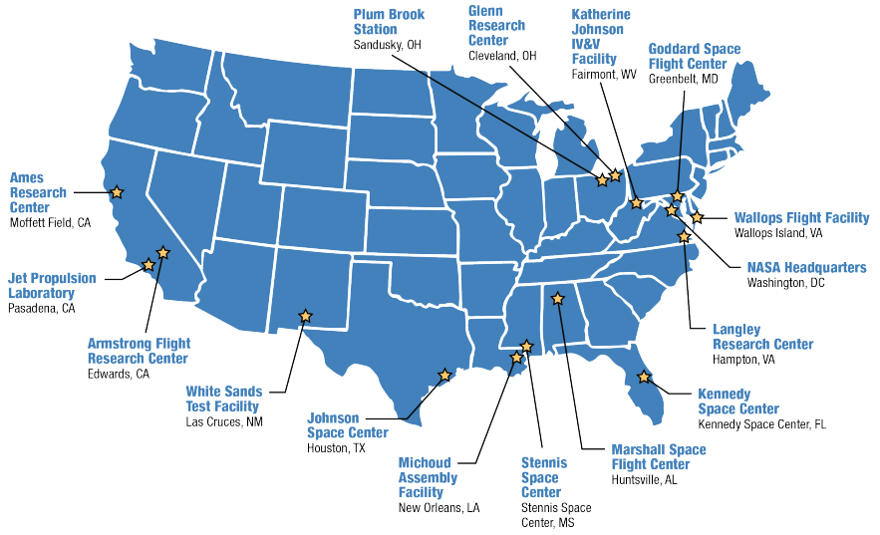
NASA Centers and General Responsibilities
HQ
Human Spaceflight Centers
  KSC
  MSFC
  JSC
  SSC
Earth Science Spaceflight Center
  GSFC
Planetary Spaceflight Centers
  ARC
  JPL
Aeronautics Research Centers
  AFRC
  GRC
  LaRC
Support Facilities
  IV&V, MAF, PBS, WFF, WSTF

Slide 4
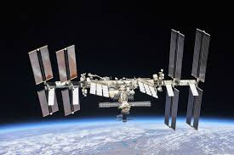
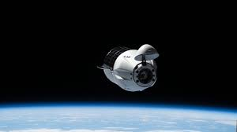
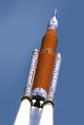
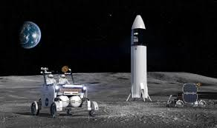
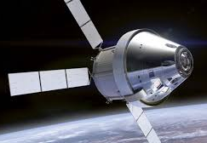


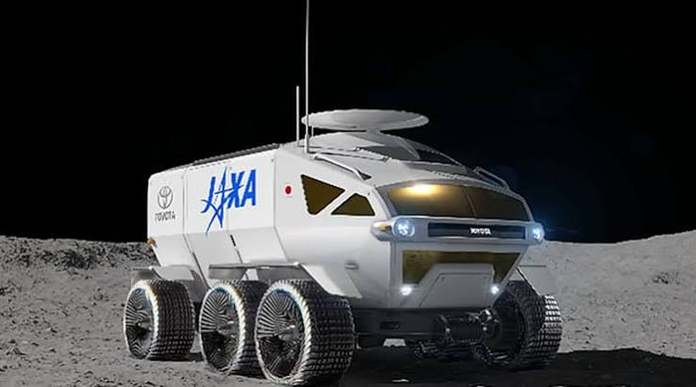
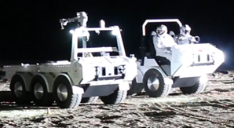
Human Spaceflight Mission Directorate Overview
Low Earth Orbit (LEO) Program
  International Space Station (ISS)
  Commercial Crew Office (CCO)
  Cargo Transportation Office (CTO)
  Commercial Destinations Office (CDO)
Artemis Program
  Space Launch System (SLS)
  Orion
  Human Landing System
  Extravehicular Activity (EVA) suits
Moon Base Program
  Lunar Terrain Vehicle
  Pressurized Rover
  Lunar Utility Vehicle
Commercial Access to Space Program

Slide 5
Artemis Flights
New plan rolled out the NASA Administrator on March 24th. See https://www.nasa.gov/ignition/.
Updated Plan — announced Feb 2026
  Artemis I: Uncrewed test flight — 2022 (completed)
  Artemis II: Crewed lunar flyby — 2026 (completed)
  Artemis III: Human landing system & EVA suit test mission in Earth orbit — June 2027
  Artemis IV: Astronauts return to the lunar surface — June 2028
  Artemis V: Additional astronaut landing — targeting late 2028
Challenges:
  Key take-away is the architecture is getting much bigger and much sooner.
  There is a need for collaboration across agencies both domestic and international.

Slide 6
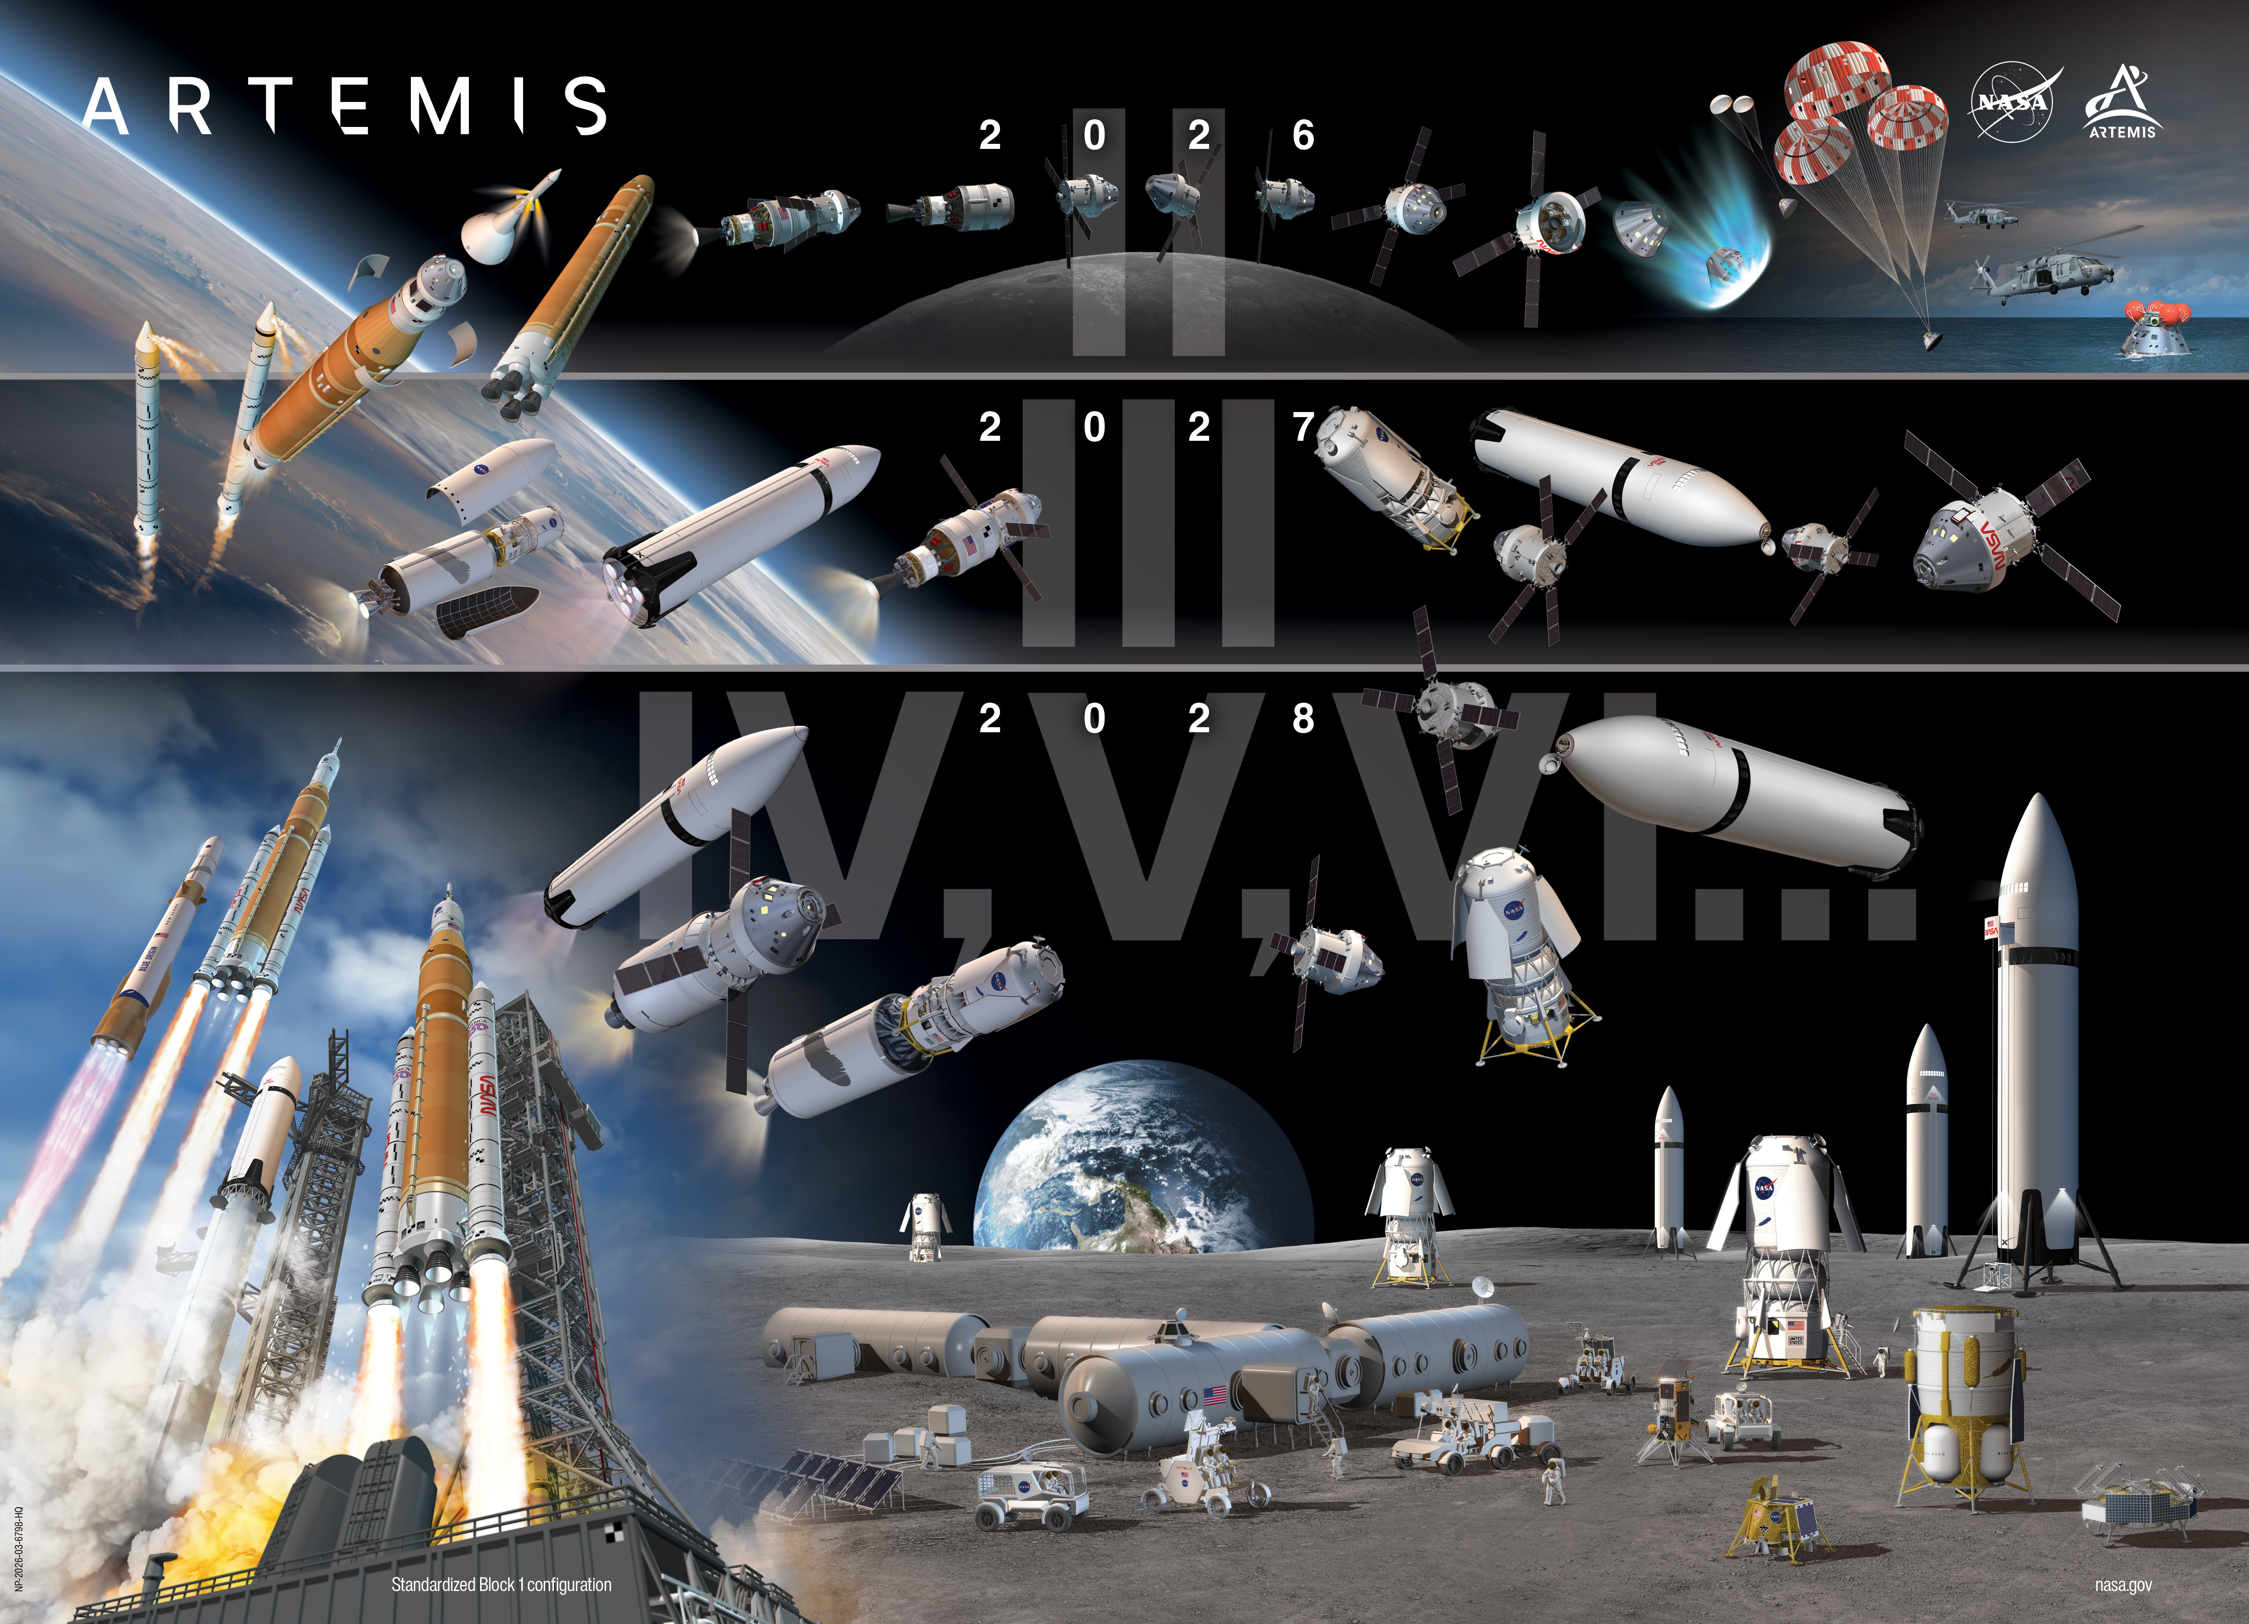

Slide 7
Ignition Plan
Phase 1: Secure reliable access to the surface and experiment Starts now | Phase 2: Establish the initial Moon Base operating capability Starts 2029 | Phase 3: Achieve semi-permanent crew presence Starts 2032

Slide 8
Ignition Plan Recap
Phase 1 (Now–2029): Experiment, Learn NASA is kicking off with a rapid series of robotic and early uncrewed missions to scout, experiment, and prepare for surface operations ahead of the astronaut missions in 2028.
  A dramatic increase in lunar activity: Up to 25 missions, including 21 landings
  Crewed and autonomous rovers for basic mobility and surface improvement demonstrations, hopper drones called MoonFall, and communications relay and observation satellites to bring the world along as the Moon Base is constructed.
  Early power, navigation, communication, and nuclear RHU demonstrations to ensure systems can survive the lunar night.
  All the scientific payloads that can be incorporated on every lander and rover.
  The first real "footprint" of the Moon Base effort: four tons of payload delivered to test what works on the surface.
Phase 2 (2029–2032): Early Habitation By 2029, NASA will transition to assembling semi-permanent infrastructure and begin early habitation and logistics operations.
  Rolling out improved solar and initial nuclear-based power stations (potentially including both fission reactor and RTGs), upgraded rovers, advanced MoonFall drones, and habitation.
  Enhancing surface-to-orbit communications stations to ensure reliable, high-quality connectivity across the lunar South Pole.
  Delivering up to 60 tons of cargo during this phase through up to 24 landings with low, medium and heavy cargo-class landers, providing the mass needed to start shaping a functioning base.
Phase 3 (2032 and beyond): Sustained Human Presence This phase will scale up to achieve a true enduring presence as crew rotations become routine. This is the era when living and working on the Moon becomes a reality.
  Establishing semi-permanent habitation modules with spacious interior volume for crew living and operations.
  An operational fission surface power station with sufficient power to provide steady, reliable energy through the long lunar nights, leveraging in situ resource manufacturing.
  Operating pressurized rovers that enable long distance exploration and surface travel.
  Building out advanced logistics networks, leveraging a fleet of crewed and autonomous rovers, to keep the lunar base supplied and functioning continuously.
  Delivering up to 38 tons of cargo per year, enough to support habitats, logistics, power stations, and major science outposts, taking advantage of low cost, reusable heavy lift capabilities.

Slide 9
NASA Cybersecurity Domains
Domains
  Enterprise IT
    General to all agencies.
  Ground stations, ground networks, Mission Control Center (MCC), Launch Control Center (LCC), etc.
    These are the immediate threat areas since easiest to access.
  Low Earth Orbit (LEO)
    Area of interest today, with ISS and commercial crew and cargo vehicles.
    Growing concern for commercial space stations via Commercial LEO Destinations contract.
  Earth-Lunar Orbit Transit, Lunar Orbit
    Area between Earth and Moon will become more important as traffic increases.
    This includes LunaNet (lunar equivalent of GPS and TDRSS) which is built and operated by commercial companies.
      NASA portion is Lunar Communication Relay and Navigation System (LCRNS)
      Also includes (Moonlight (ESA) and Lunar Navigation Satellite System (JAXA) contributions.
  Lunar Surface
    Area of major concern since we will have a lot of infrastructure and we won’t be alone.
    Includes vehicles, habitats, infrastructure, etc. provided by NASA, commercial, and international partners.
  Beyond Earth Orbit
    Starting to become an area of interest, especially related to Mars.
    Space Reactor-1 (SR-1) Freedom: Nuclear Electric Propulsion to Mars, December 2028.
  Test and verification in labs
    Another area of potential collaboration since we need to “test like we fly and fly like we test”.

Slide 10
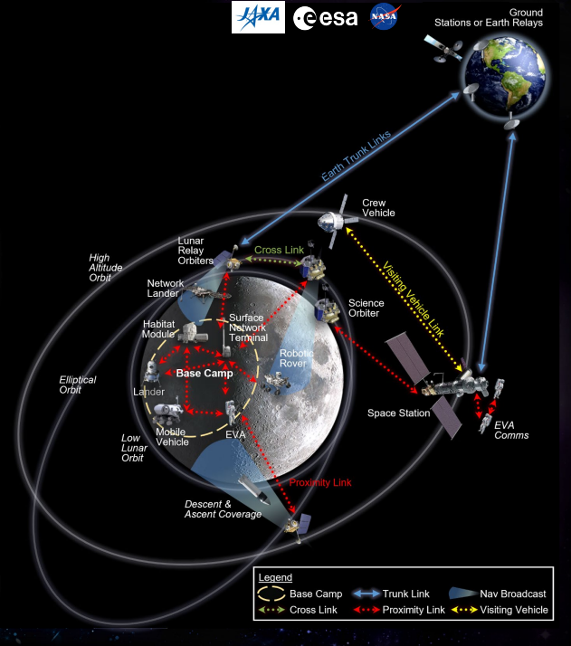
Lunar Communications, Position, Navigation, Timing (CPNT)
Phase 1
Orbital comm & PNT relay
• Deploy initial 5-satellite constellation
• Add second provider constellation
Add observation capability Data and standards
• Mature interoperability specification baseline across all users and infrastructure - LunaNET
Phase 2
Surface communications
• Permanent surface "cell towers"
• Simultaneous support for multiple users via integrated surface network terminals
Navigation infrastructure
• Clock technology demonstration
Phase 3
Surface communications
• Coordinated communication across all assets in support of Moon Base
• Scaled network deployment across regions
Navigation infrastructure
• Clock ensembles – persistent time broadcast

Slide 11
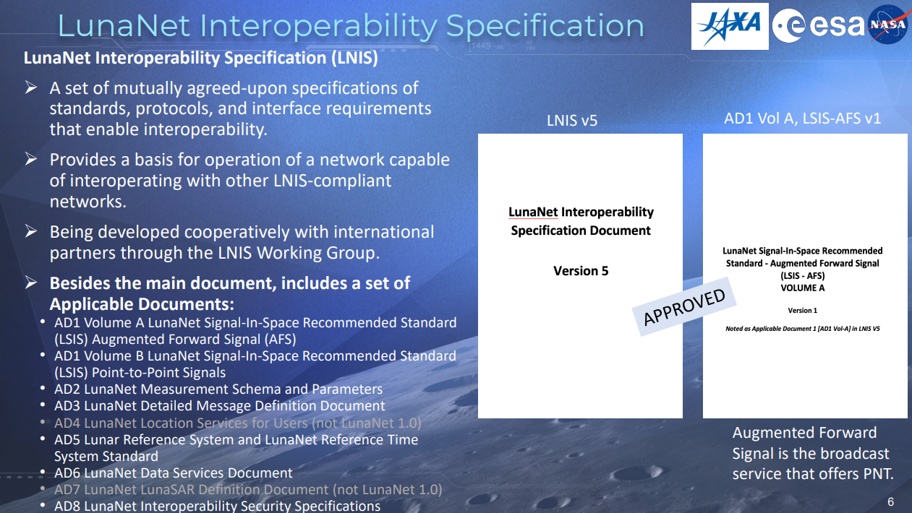
LunaNet Interoperability

Slide 12
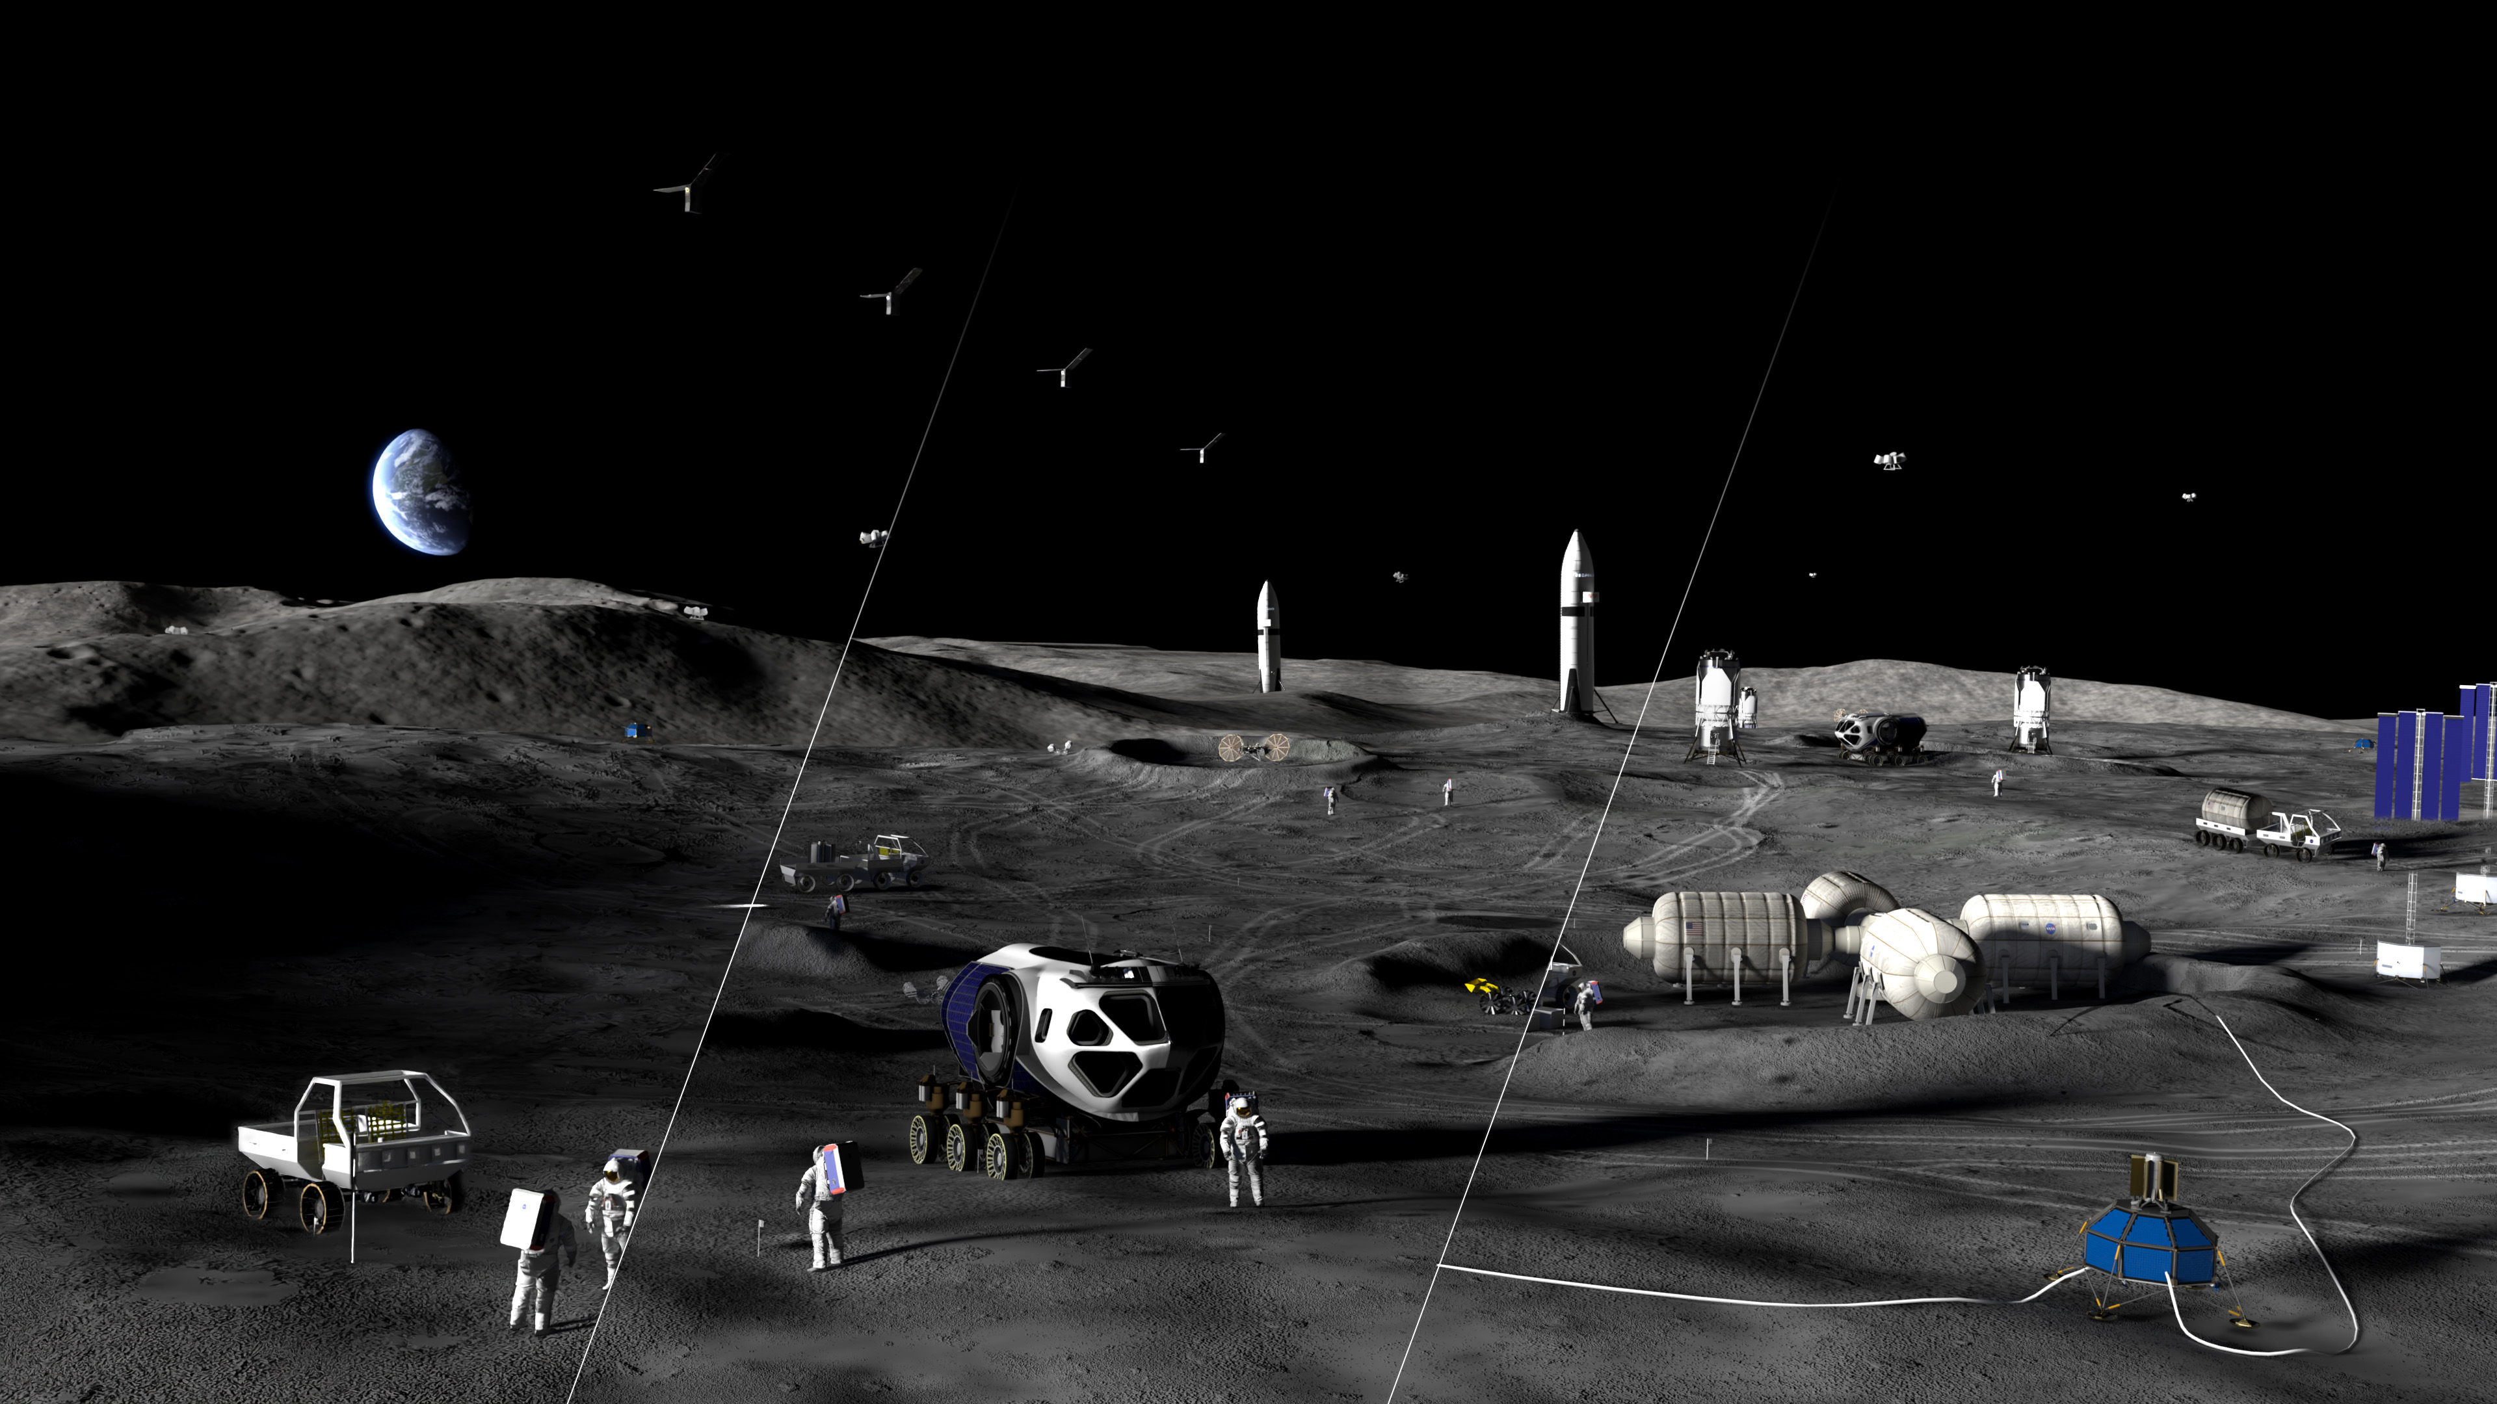


Moon Base Comm & Data Architecture
Notional Diagram
Phase 2:
Establish the initial Moon Base operating capability
Starts 2029
Phase 3:
Achieve semi-permanent crew presence
Starts 2032
Phase 1:
Secure reliable access to the surface and experiment
Starts now
LunaNet
Comm Relay
CLPS Landers
Human Landing System
(HLS and HDL)
Science Sites
HLS
Phase 1
Phase 2
Phase 3
Rover
Lunar Utility Rover (LUV)
Surface Power
Mini Pressurized Habitat (MPH)
Pressurized Rover (PR)
Lunar Terrain Vehicle (LTV)
EVA Suits
Fission Surface Reactor (FSP)
2026

Slide 13
Data Architecture
NASA was directed by the White House to develop a lunar time standard.
  Lunar Time Coordinated (LTC) is similar to Universal Time Coordinated (UTC) but adjusted to the Moon’s gravity.
    This leads to faster clock rates by 58.7 microseconds per day.
  Also, the Moon doesn’t have an even distribution of material, measuring time is not uniform across the surface and at varying elevations.
    This leads to an uneven measurement of time depending on the surface location.
  Work is ongoing at GSFC
Interoperability Standards
  LunaNet is working on Communication, Position, Navigation, and Timing (CPNT) standards.
  Next level is data standards for networking and data communications. This is the equivalent of the lunar Internet.
Encryption Standards
  Interoperability will be dependent of common, standardized secure communications.
  Transition from Advanced Encryption Standard (AES) algorithms to Post-Quantum Cryptography (PQC) algorithms.
  Need to build into architecture, since retrofitting is more difficult.

